Slide 1
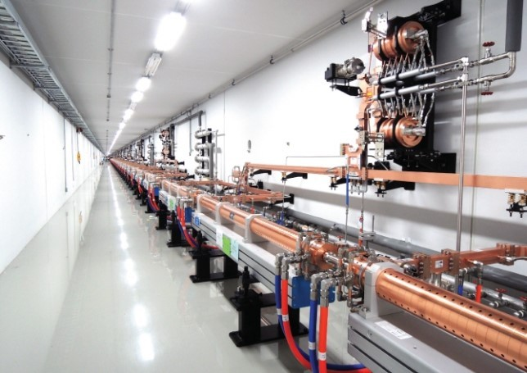
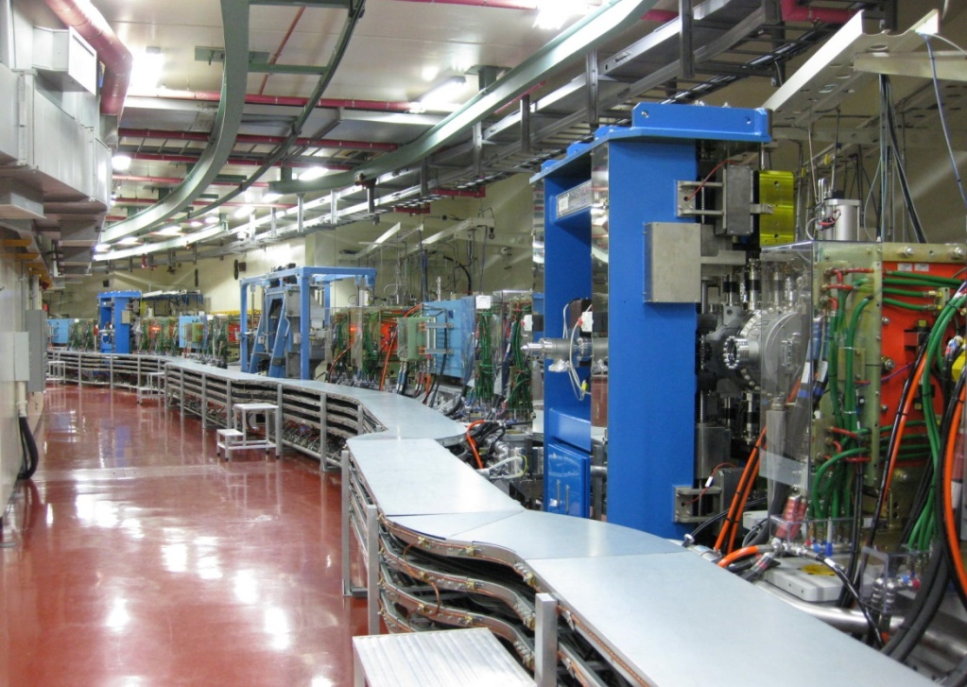
EIC Accelerator Partnership Workshop (2021. 10. 28)
Design and hardware for handling SR in light sources
Seunghwan Shin (PAL) on behalf of PLS-II accelerator division
October 28, 2021

Slide 2
EIC Accelerator Partnership Workshop (2021. 10. 28)
Contents
Introduction
Handling SR
Damage protection
BPM position stabilization.
2

Slide 3
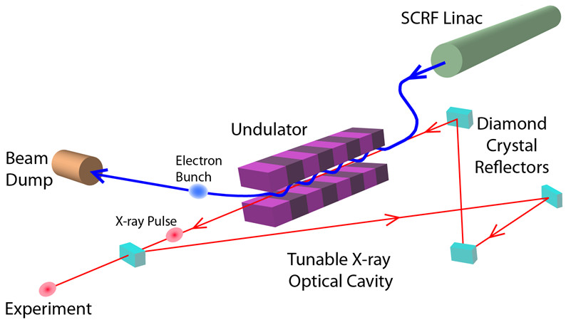
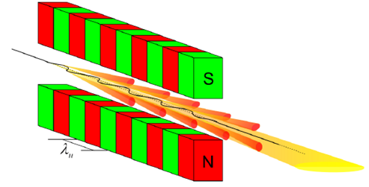
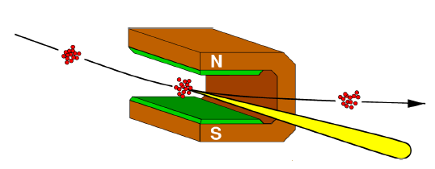
EIC Accelerator Partnership Workshop (2021. 10. 28)
The progression of x-ray source
10²⁸
XFEL-O
10²⁶
10²⁴
XFEL-SASE
10²²
4th GSR
10²⁰
3rd GSR
10¹⁸
Average brightness (photons / sec / mm² / mrad² / 0.1 % bandwidth)
10¹⁶
2nd GSR
4th GSR ALSU
10¹⁴
10¹²
1st GSR
10¹⁰
10⁸
3rd GSR ALS
10⁶
Sun
Candle
3

Slide 4
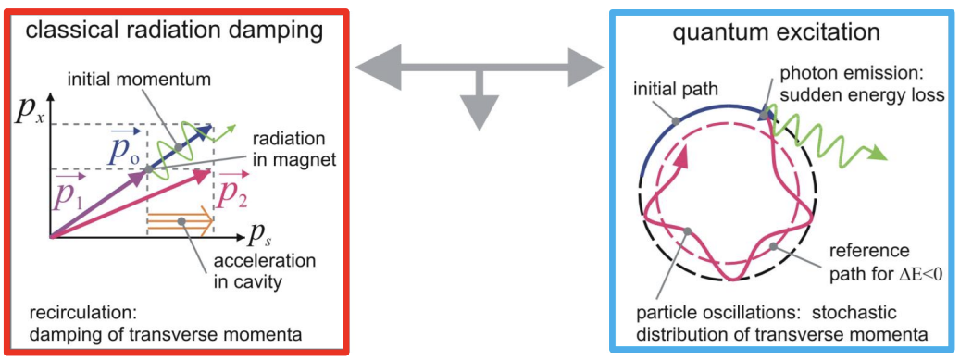
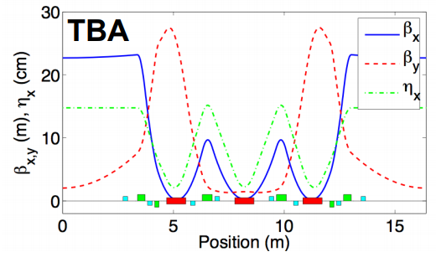
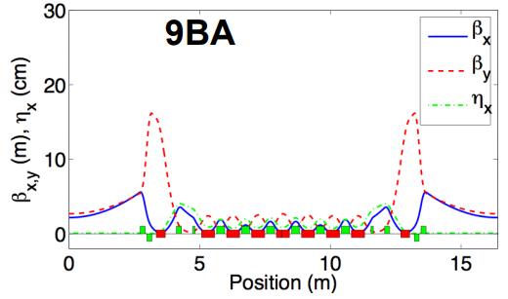
EIC Accelerator Partnership Workshop (2021. 10. 28)
Smaller emittance and MBA
A. Streun (PSI)
Equilibrium
emittance
in storage ring
Maximum radiation damping
Minimum quantum excitation
- High field bending magnets? => increase of quantum excitation too - Damping wiggler in small dispersion => requires much space
- Minimize dispersion at radiation locations => many short bends to limit dispersion => highest radiation at lowest dispersion (longitudinal gradient bend for this)
D. Robin (ALS)
4

Slide 5
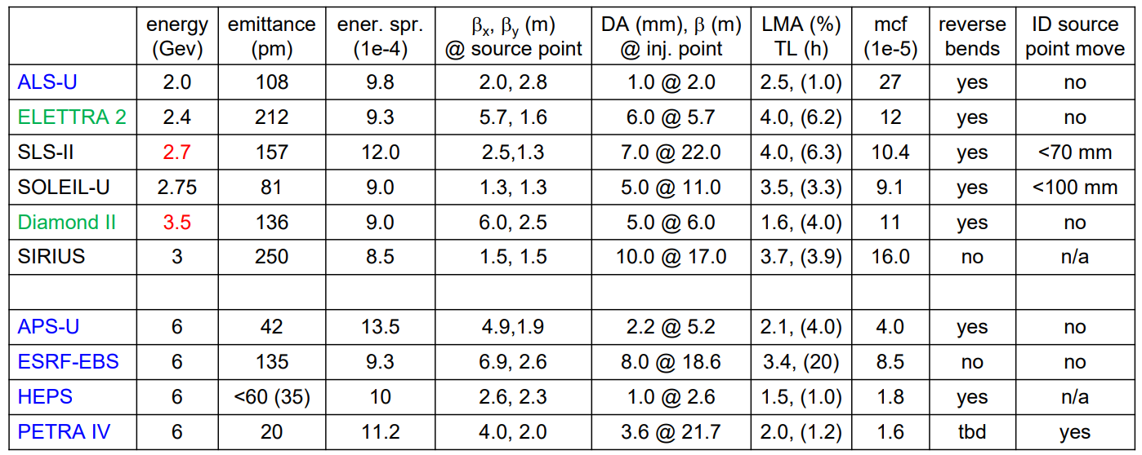
EIC Accelerator Partnership Workshop (2021. 10. 28)
Ongoing 4GSR projects
R. Bartolini (PETRA-IV) @ 7th DLSR workshop
Classical MBA, HMBA, Variations
5

Slide 6
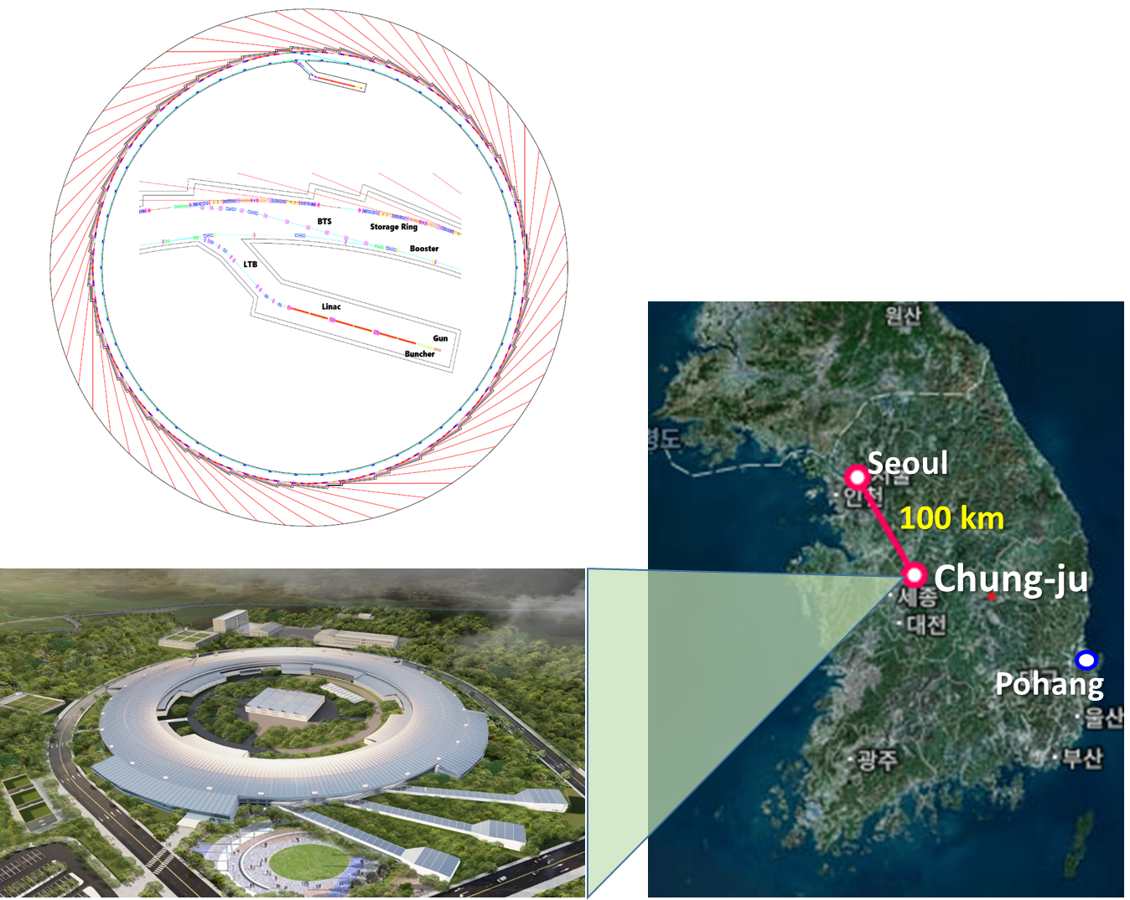
EIC Accelerator Partnership Workshop (2021. 10. 28)
Korea-4GSR project
Korea-4GSR - Preliminary study by PAL: 2017 ~ 2019. - CDR project: 2020. - Project stat: 2021. 7 ~ - Budget: 1 B $
Parameter | Units | PLS-II | Korean 4GSR
Electron energy | GeV | 3 | 4
Horiz. Emittance | pm | 5800 | 58 (RB: 39 )
Vert. Emittance | pm | ~ 58 | ~ 5.8 (RB: 39 )
Bunch length (rms) | ps | 20 | 13 (50 with HC)
Circumference | m | 280 | 800
Harmonic # |  | 470 | 1332
RF frequency | MHz | 500 | 500
Beam stability @ ID (x/y) | $μm$ | < 4 / 2 | < 2.5 / 0.45
Injection mode |  | Top-up | Top-up
6

Slide 7
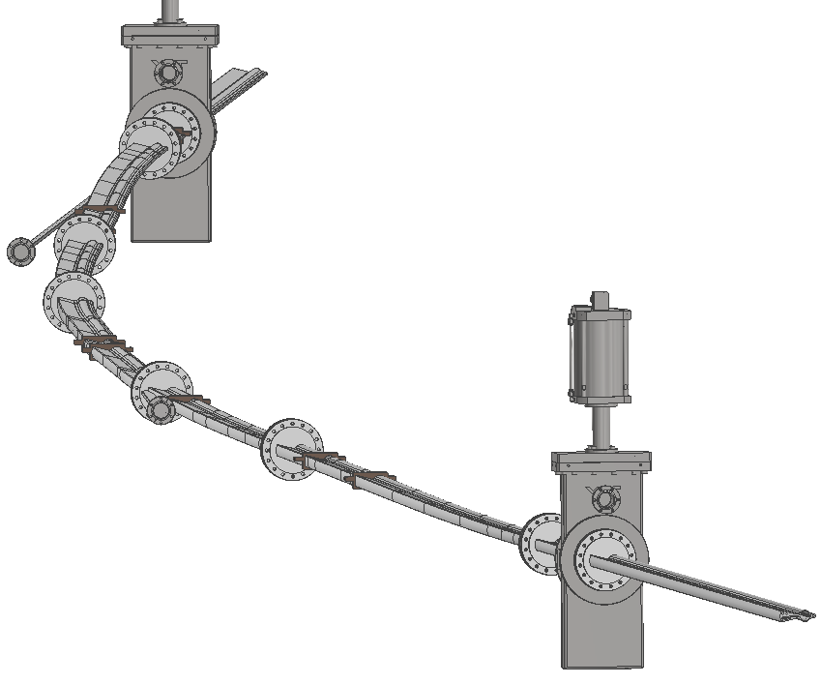
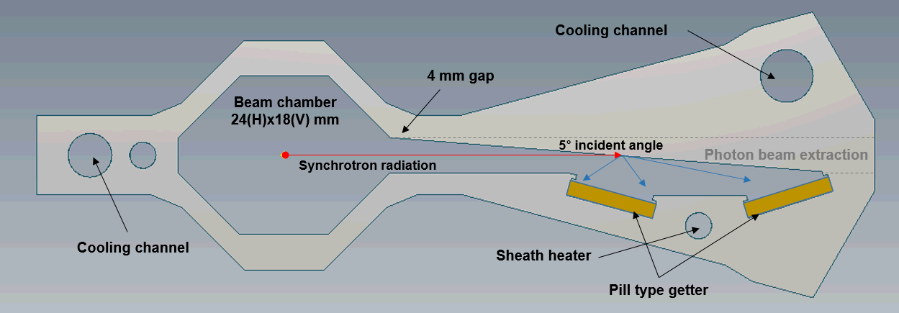
EIC Accelerator Partnership Workshop (2021. 10. 28)
Vacuum chambers of an arc-section
Vacuum system in Korea-4GSR
Characteristics - Required average vacuum pressure is low 10⁻⁹ mbar (CO equivalent). - PSD gas is pumped by distributed pill-type NEGs and lumped sputter ion pumps. - 5° inclined side chamber wall absorbs SR photon beams. - Thermo-mechanical analysis results show that both aluminum and copper alloy are suitable for the SR vacuum chamber material. - Booster ring vacuum chambers are made of 1 mm-thick stainless steel and pumped with lumped sputter ion pumps.
ID beam port
Bending magnet beam port
Cross section of the SR vacuum chamber
BPM
Layout of an arc section
Lumped vacuum pumps (SIP)
RF-bellows
7

Slide 8
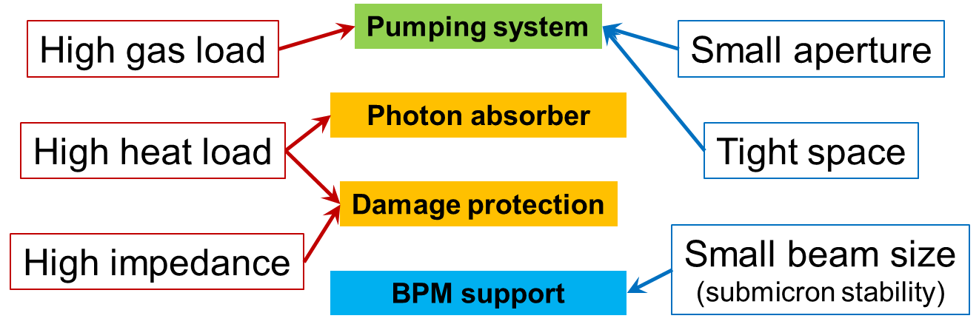
EIC Accelerator Partnership Workshop (2021. 10. 28)
Overview of SR issues
T. Ha (PAL) @ HBSLS workshop
New generation light source: “High current & low emittance”
Vacuum system should accommodate:
8

Slide 9
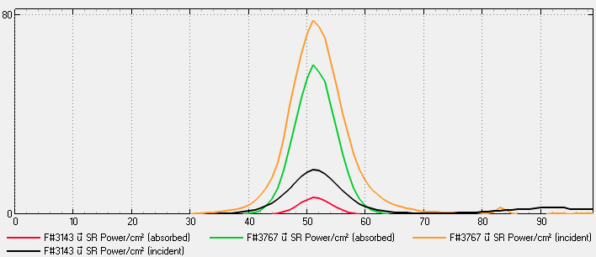
EIC Accelerator Partnership Workshop (2021. 10. 28)
SR heat load (Synrad+)
Aluminum chamber
SR power
- from C-bend (line AA): ― incident, ―absorbed
- from LGB2 (line BB): ― incident, ―absorbed
0.6 W/mm² (center bend)
→ T_{max} = 62℃
A
A
B
0.07 W/mm² (LGB2)
→ T_{max} = 30℃
B
[Power (W/cm²)]
e⁻
9

Slide 10
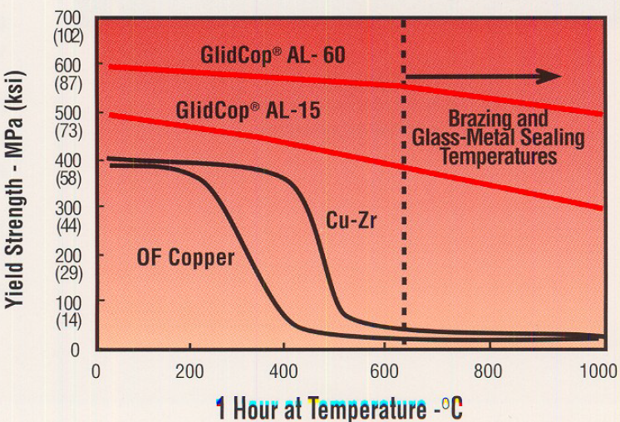
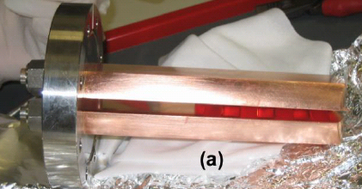
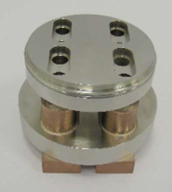
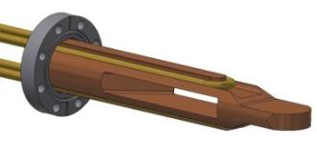
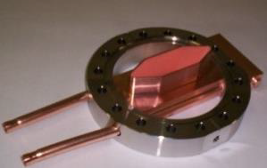
EIC Accelerator Partnership Workshop (2021. 10. 28)
Handle higher SR power (1)
T. Ha (PAL) @ HBSLS workshop
OFHC Copper - Commonly used for photon absorption (easily available). - Excellent thermal conductivity. - Very low outgassing rate. - Need bi-metal joint with stainless steel flange (brazing, EBW, …) - Softened after exposure to high temperature for brazing.
Glidcop - Good thermal conductivity & high strength. - Resistance to thermal softening. - UHV compatible. - Widely used for high-heat-load vacuum components. - Difficult to optimize brazing condition. - Limited supplier (cost, delivery)
B
B
“Glidcop absorbers at ALBA”
“Glidcop absorbers at NSLS-II”
10

Slide 11
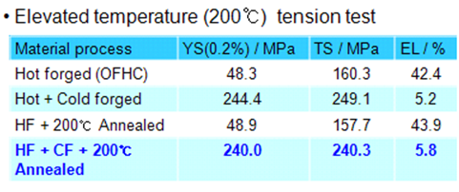
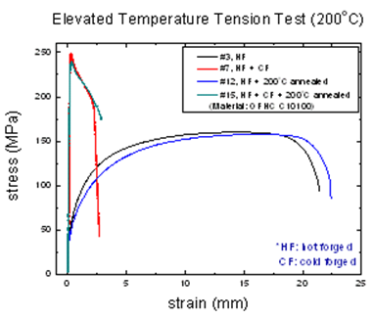
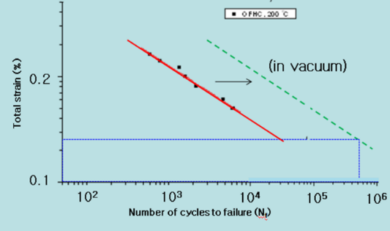
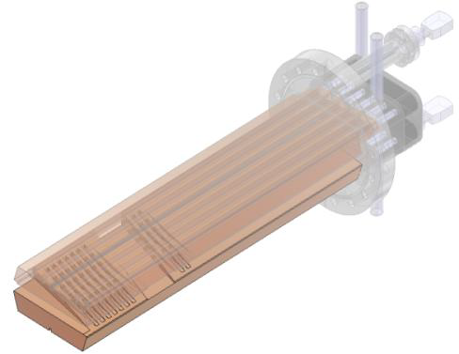
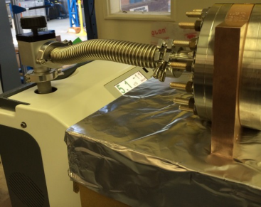
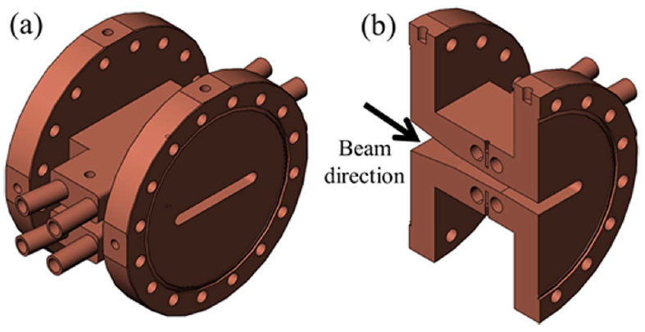
EIC Accelerator Partnership Workshop (2021. 10. 28)
Handle higher SR power (2)
T. Ha (PAL) @ HBSLS workshop
Cold forged OFHC Copper - Excellent thermal conductivity. - Easily available. - E-beam weld to prevent softening from brazing. (shorter exposure to high temperature than brazing)
CuCrZr - Good thermal conductivity. - UHV compatible. - Conflat flange integrated to absorber. - Widely available.
B
B
EBW (Cu-SST)
EBW (Cu-Cu)
“Cold forged OFHC
absorber at PLS-II”
“CuCrZr flange at NSLS-II”
“CuCrZr absorber at TPS”
11

Slide 12
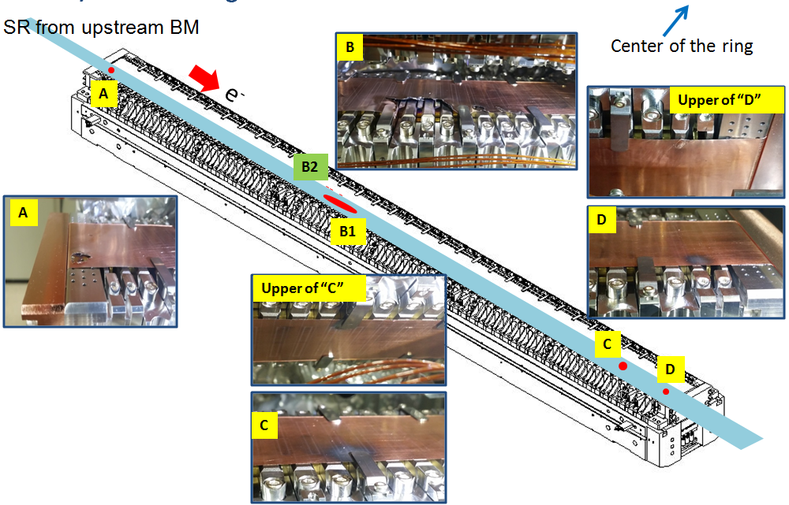
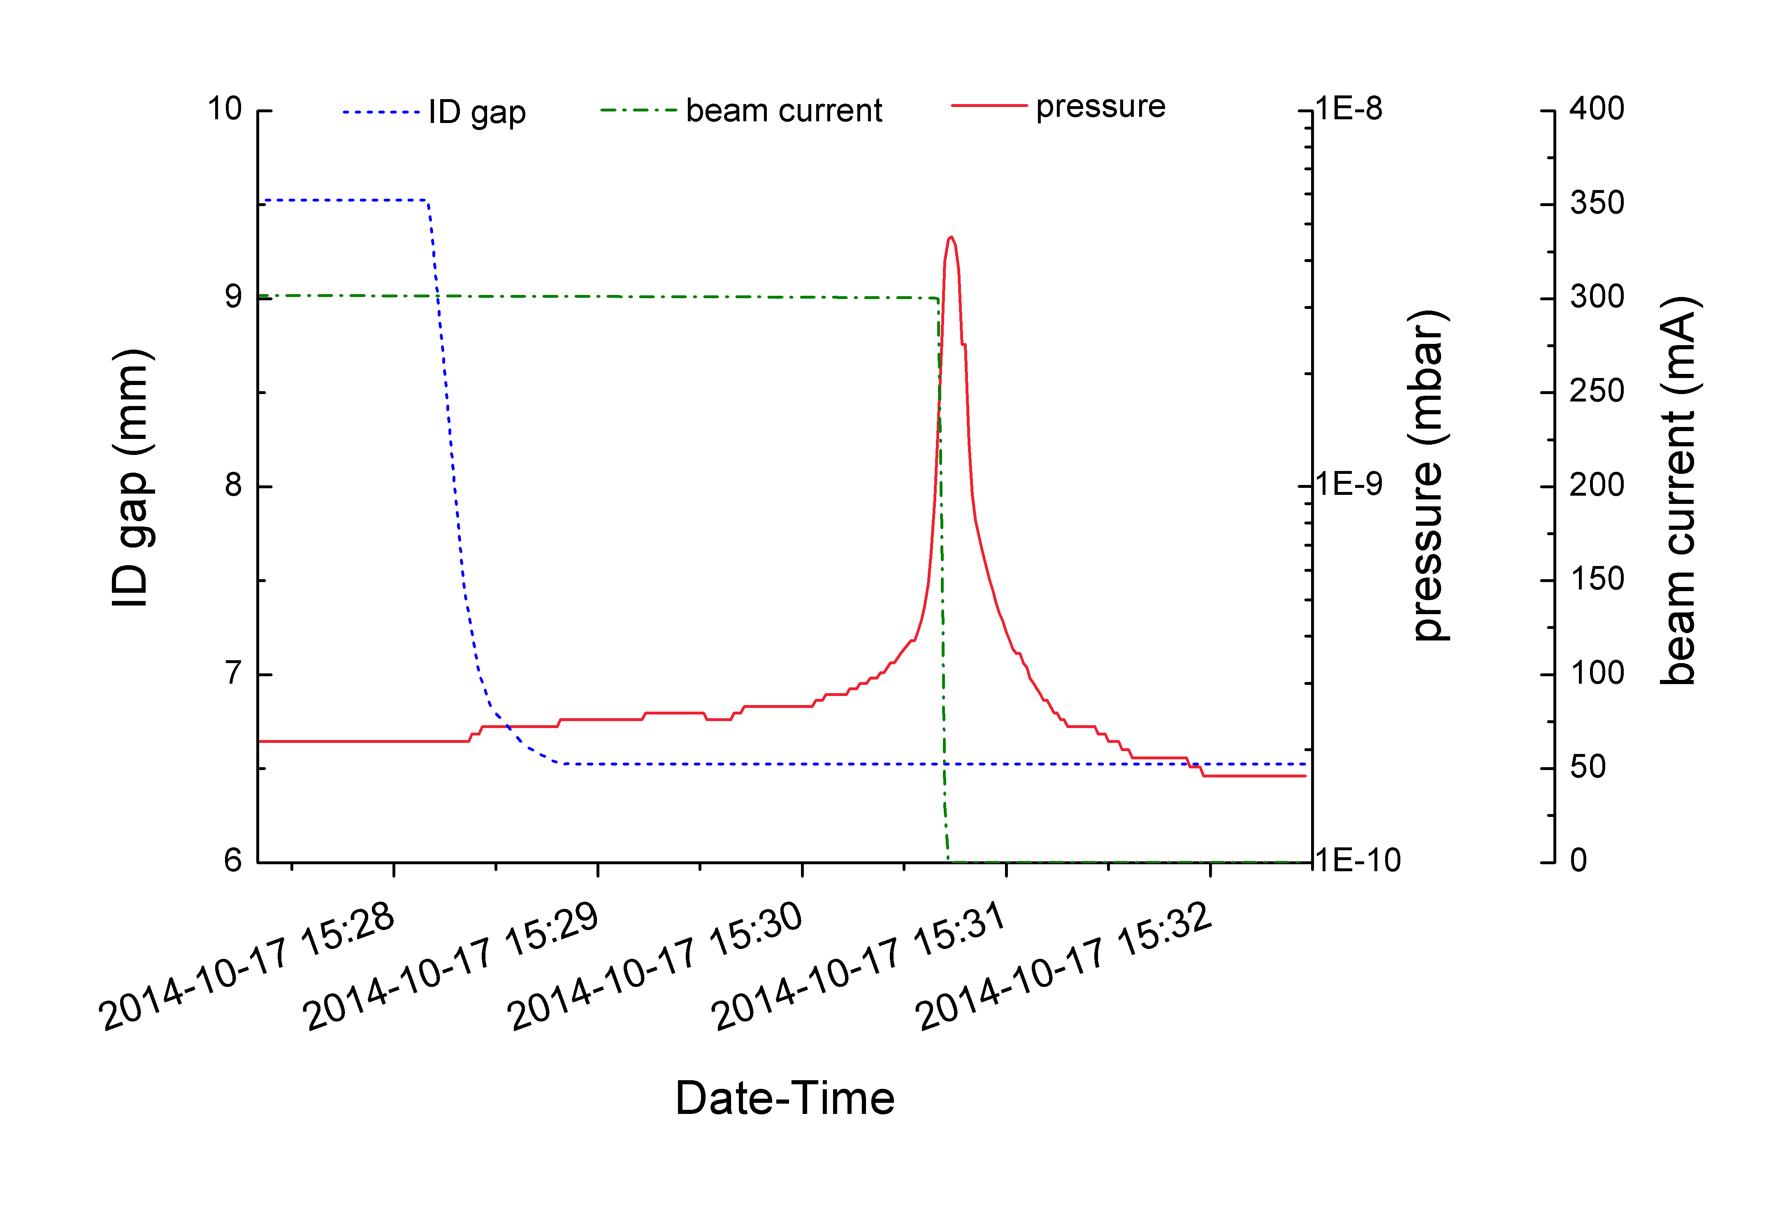
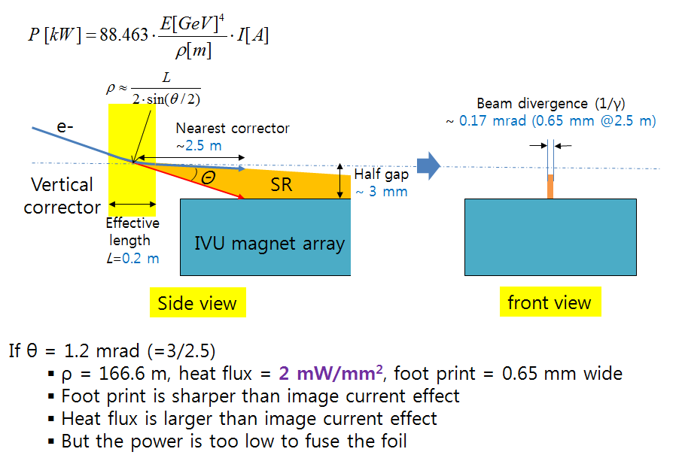
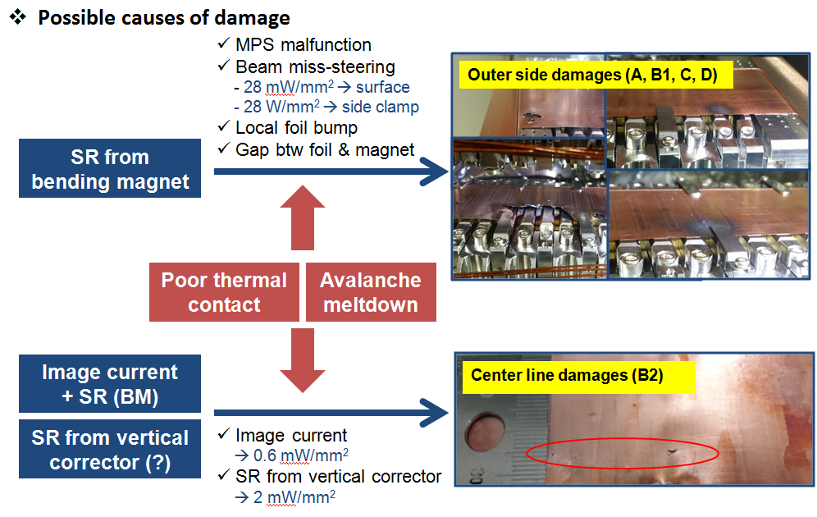
EIC Accelerator Partnership Workshop (2021. 10. 28)
Foil damage in IVUs at PLS-II
Abnormal pressure change before beam dump
B
B
12

Slide 13
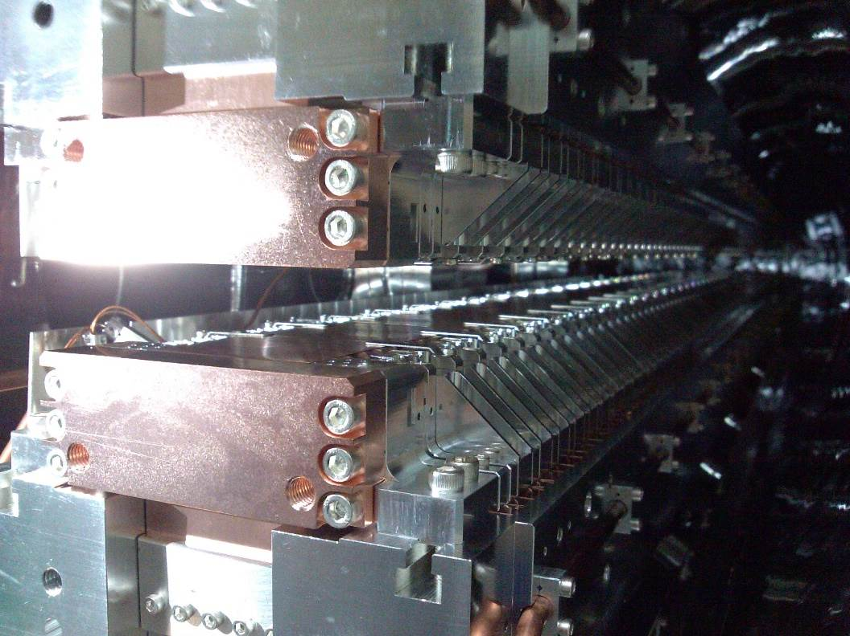
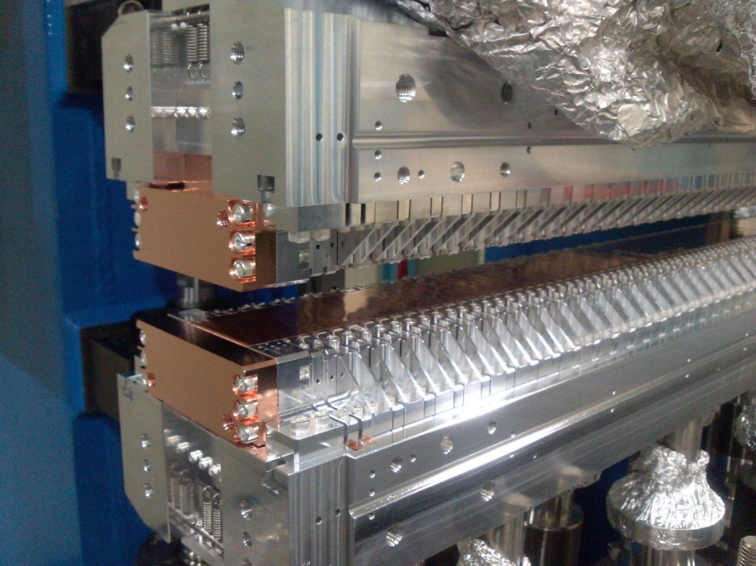
EIC Accelerator Partnership Workshop (2021. 10. 28)
Improvements of IVU
Hardware - Removed all side clamps - Increased the thickness of the Cu/Ni foil from 50/20 μm to 50/50 μm.
Orbit control - Apply a fast beam orbit interlock: 200 ms => 1 ms.
Heat load reduction: Bunch length increase - RF gap voltage reduction by Ext. Q adjustment. - 3rd harmonic cavity discussion but not applied. - Bunch pattern: 400 -> 430 (temporary) but 300 + 1 (12 mA) confirmed later.
B
B
13

Slide 14
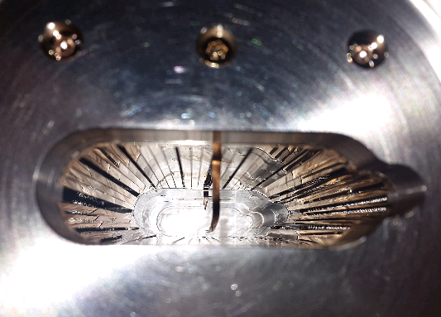
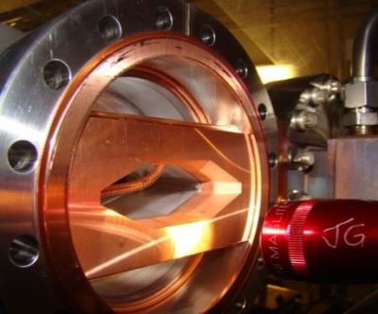
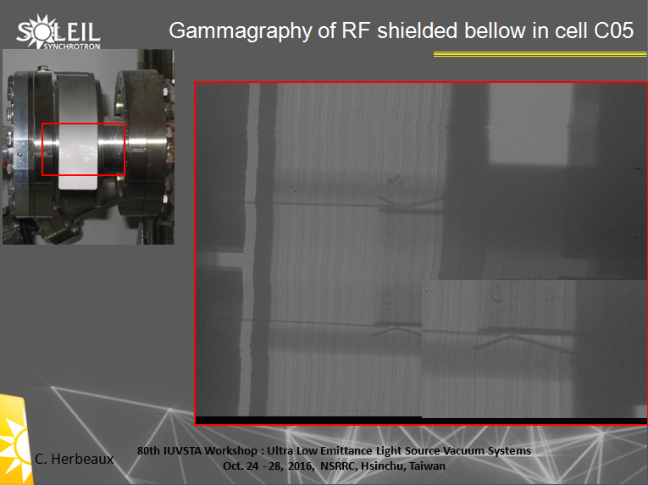
EIC Accelerator Partnership Workshop (2021. 10. 28)
RF-shielding failures
PEP-II
B
B
PLS-II
NSLS-II
SOLEIL
14

Slide 15
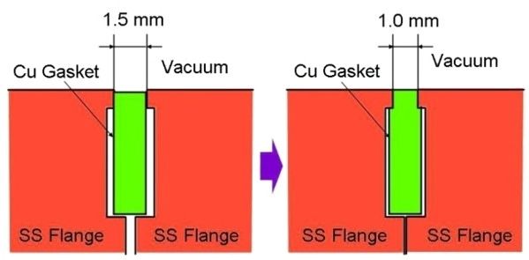
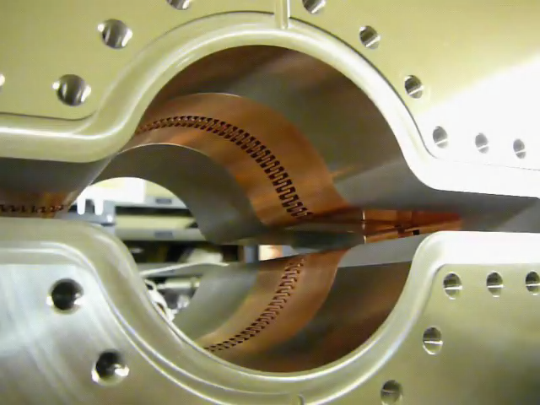
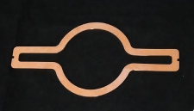
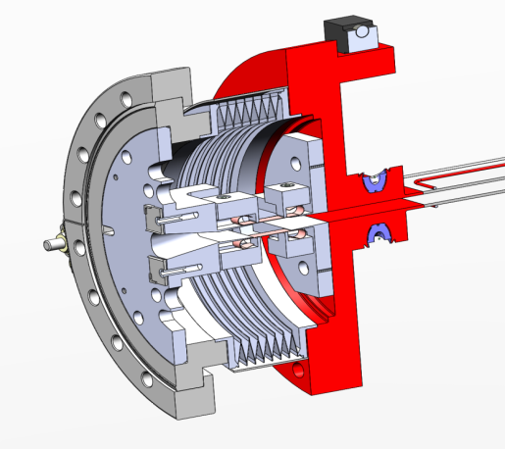
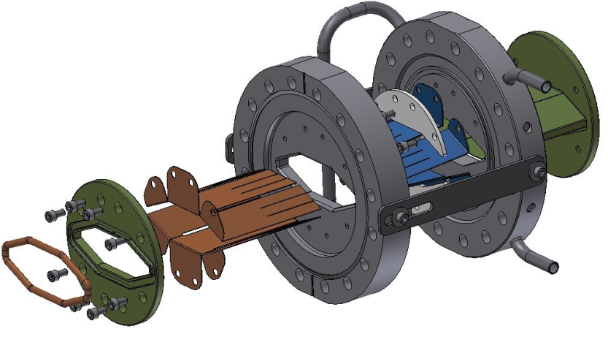
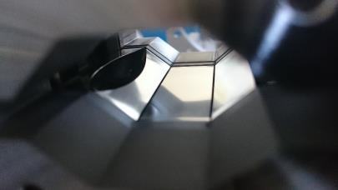
EIC Accelerator Partnership Workshop (2021. 10. 28)
Designs for robust RF-shielding
SuperKEK
Mo-type flange
NSLS-II
Comb type
RF-shielding
ESRF EBS
Wide thick fingers
Sliding fingers
Gate valve with wide fingers
15

Slide 16
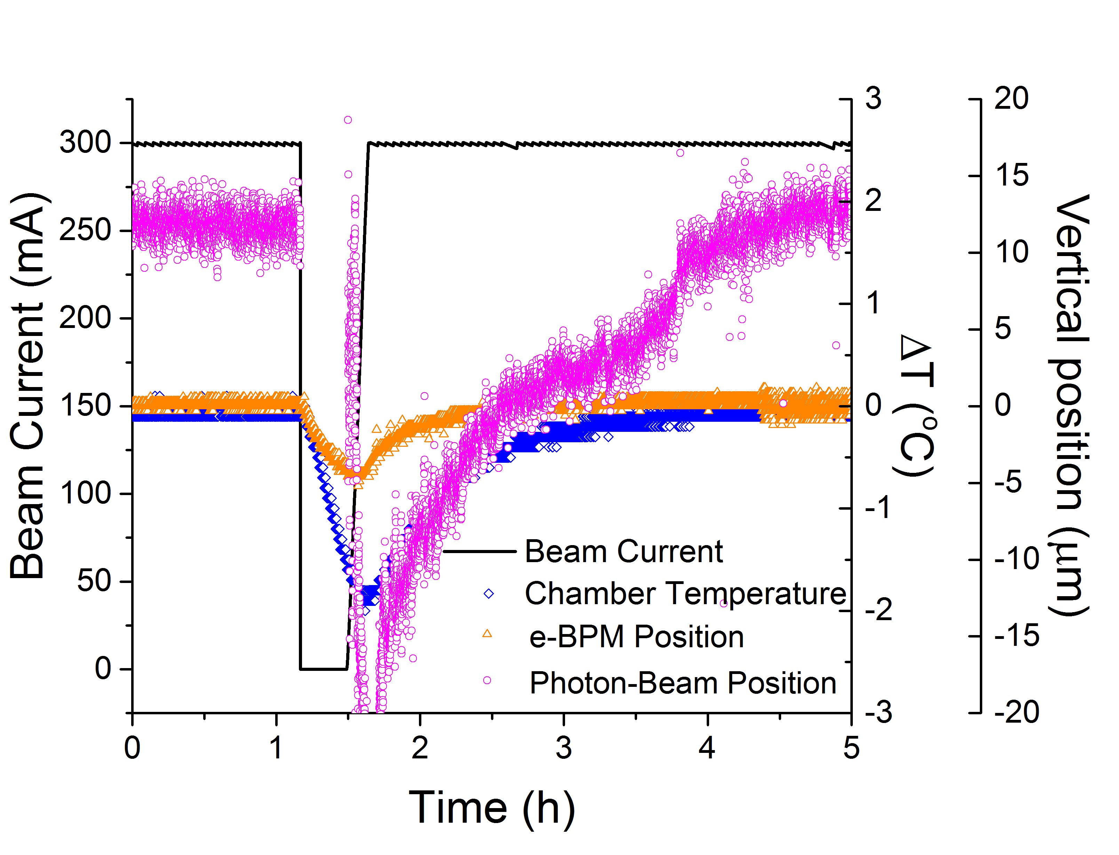
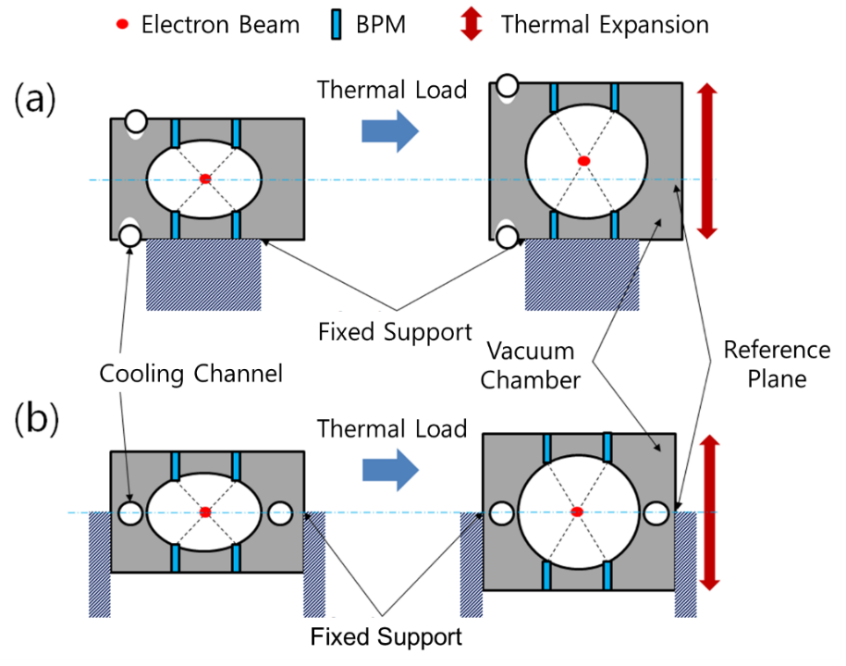
EIC Accelerator Partnership Workshop (2021. 10. 28)
BPM position stability
Effect of BPM displacement to photon beam stability - Orbit feedback system intends that the electron beam pass through the center of the BPMs - Position of BPM could be changed by ground motion, thermal load change, etc., then the electron beam orbit can be changed. - Beam dump → Δtemperature → Δe-BPM position → Δphoton beam position.
New design of BPM chamber & support - Balance in thermal expansion. - Enhanced cooling.
B
B
Existing
design
Improved
design
16

Slide 17
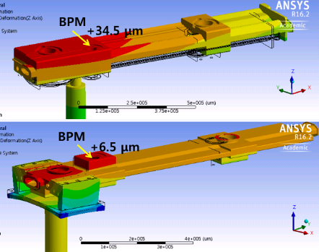
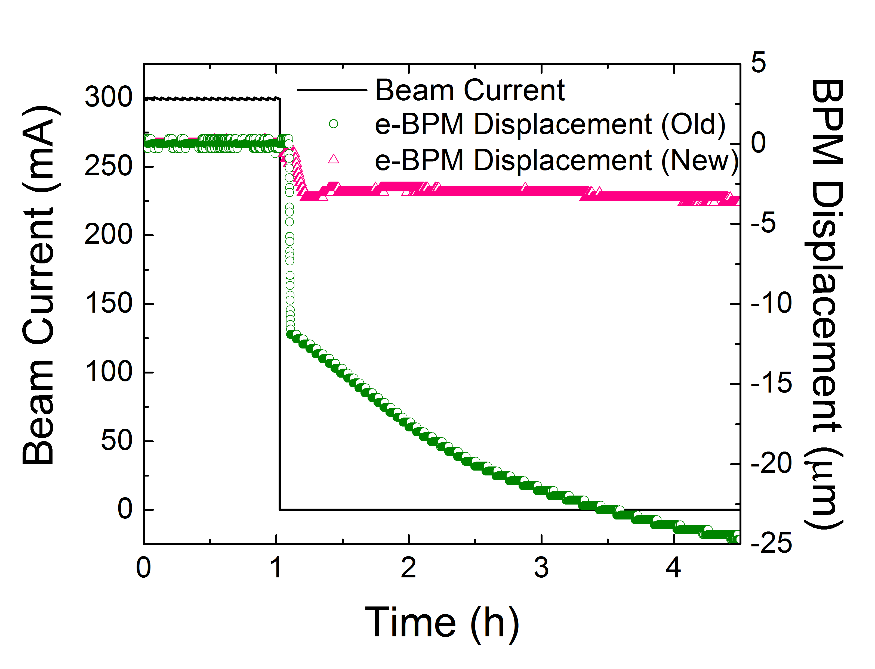
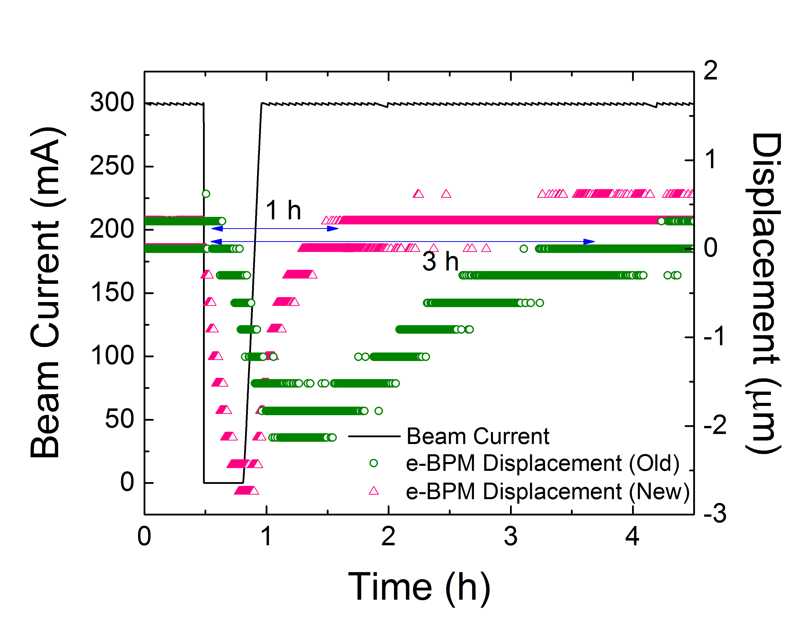
EIC Accelerator Partnership Workshop (2021. 10. 28)
Improvement of Δ BPM position
Improvement of new BPM chamber & support - (a) Reduction of BPM displacement: 25 μm -> 5 μm. - (b) Fast recovery after beam abort & restoration: 3 h -> 1 h.
(a)
(b)
B
B
17

Slide 18
EIC Accelerator Partnership Workshop (2021. 10. 28)
Summary
Introduction - New era of synchrotron radiation: fourth-generation storage ring. - Should handle SR heat load, protect damage from SR, and realize BPM position stabilization.
Handling SR - More options in material choice rather than Glidcop.
Damage protection - Need fast orbit interlock (< 1 ms) to prevent damage in IVU. - Various shielding mechanisms are studied.
Need high mechanical stability (1 μm) - Water cooling is very effective. - Need careful design of BPM support.
18

Slide 19
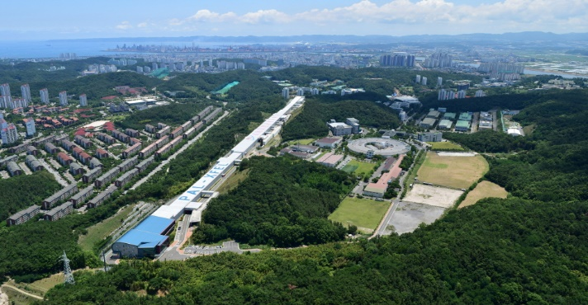
EIC Accelerator Partnership Workshop (2021. 10. 28)
We sincerely thank all those who joined in this presentation.

