Slide 1
EIC second IR – assumptions and timeline
Andrei Seryi
Associate Director for Accelerator Systems and International Partnership
EIC 2021 Accelerator Partnership Workshop
26-29 October 2021

Slide 2


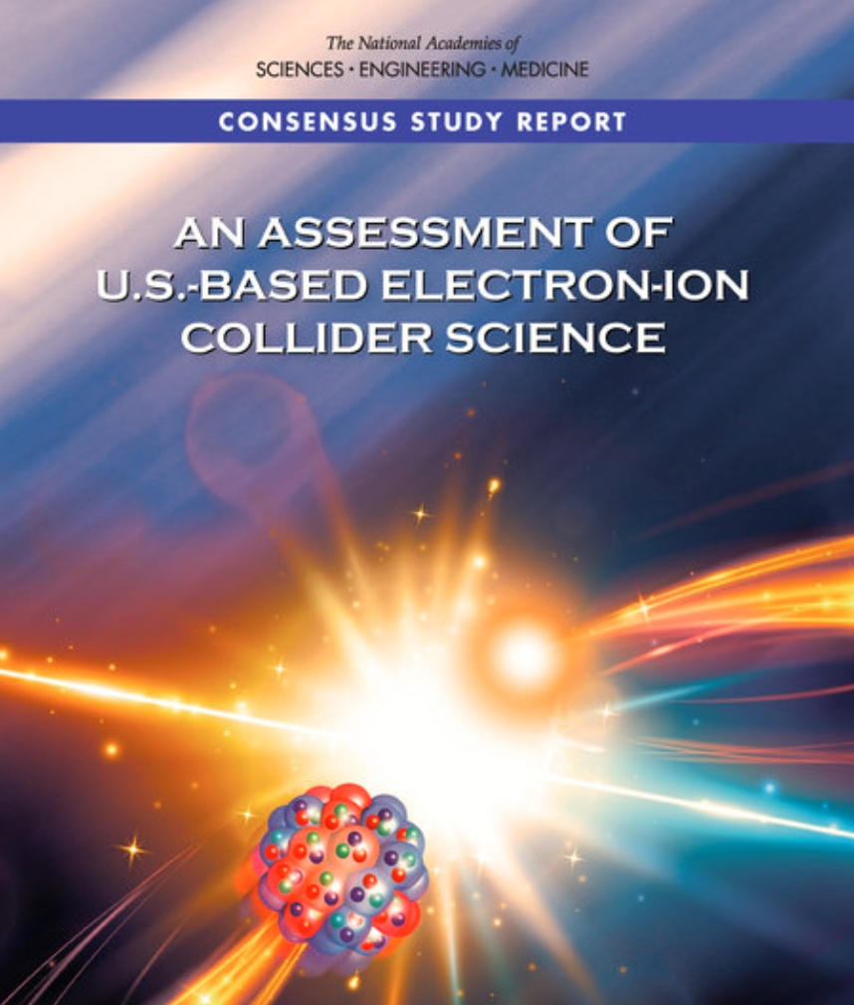
Project Requirements
Project Design Goals
High Luminosity: L= 10³³ – 10³⁴cm⁻²sec⁻¹, 10 – 100 fb⁻¹/year
Highly Polarized Beams: 70%
Large Center of Mass Energy Range: E_{cm} = 20 – 140 GeV
Large Ion Species Range: protons – Uranium
Large Detector Acceptance and Good Background Conditions
Accommodate a Second Interaction Region (IR)
Conceptual design scope and expected performance meets or exceed NSAC Long Range Plan (2015) and the EIC White Paper requirements endorsed by NAS (2018)

Slide 3
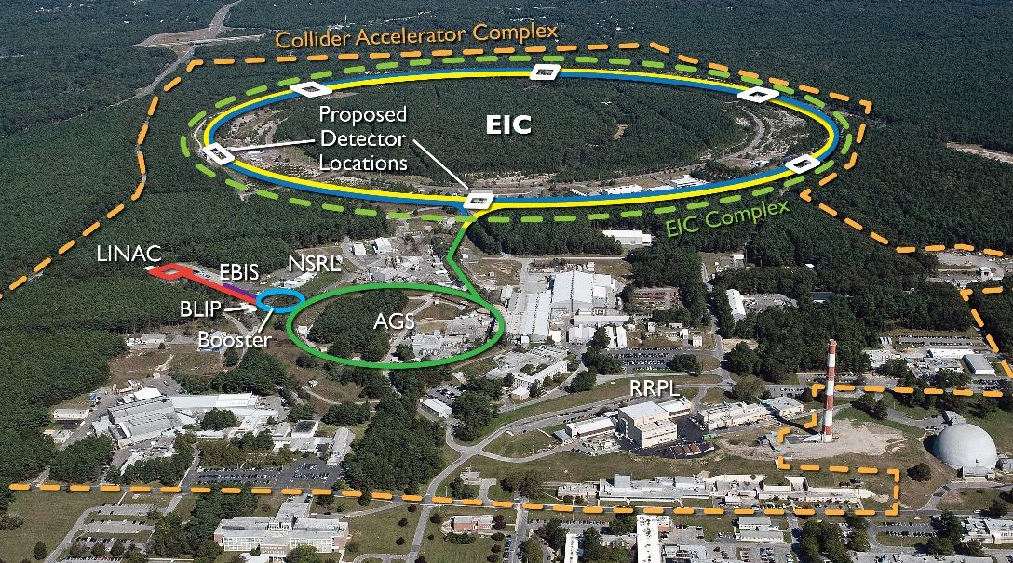
EIC Design Overview
EIC benefits from $B class investments at BNL and the highly successful RHIC program.
EIC CDR: https://www.bnl.gov/ec/files/EIC_CDR_Final.pdf

Slide 4
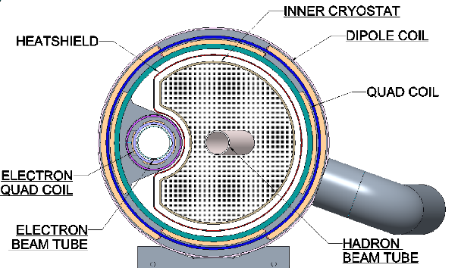
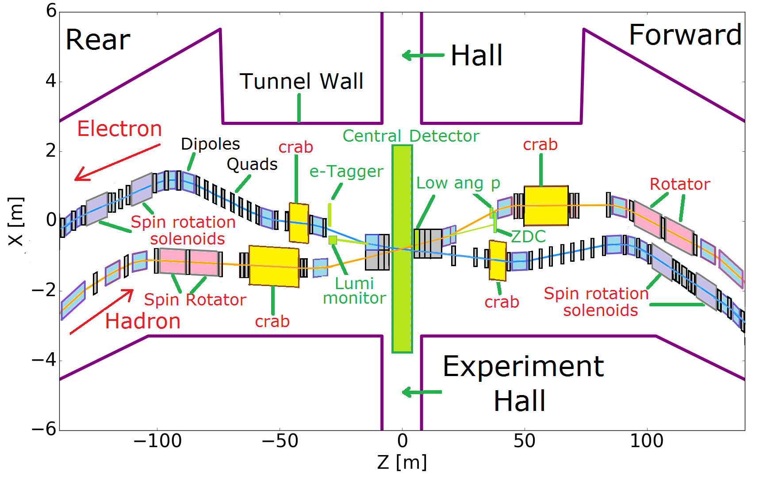
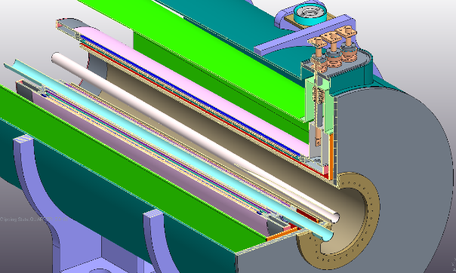
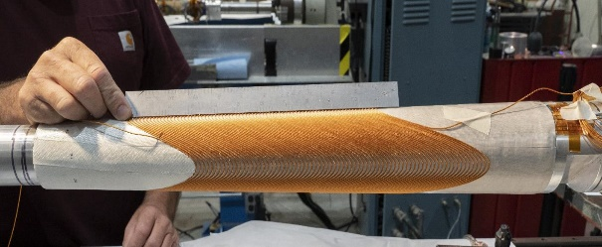
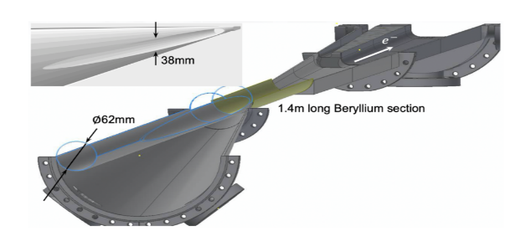
Interaction Region (@IR6)
Beam focused to β_{y} ≤ 5 cm @ σ_{y}= 5 μm, => L=10³⁴ cm⁻² s⁻¹
Manageable IR chromaticity and sufficient DA
Full acceptance for the colliding beam detector
Accommodates crab cavities and spin rotators
Synchrotron radiation and impedance manageable
Conventional NbTi SC magnets, collared & direct wind

Slide 5
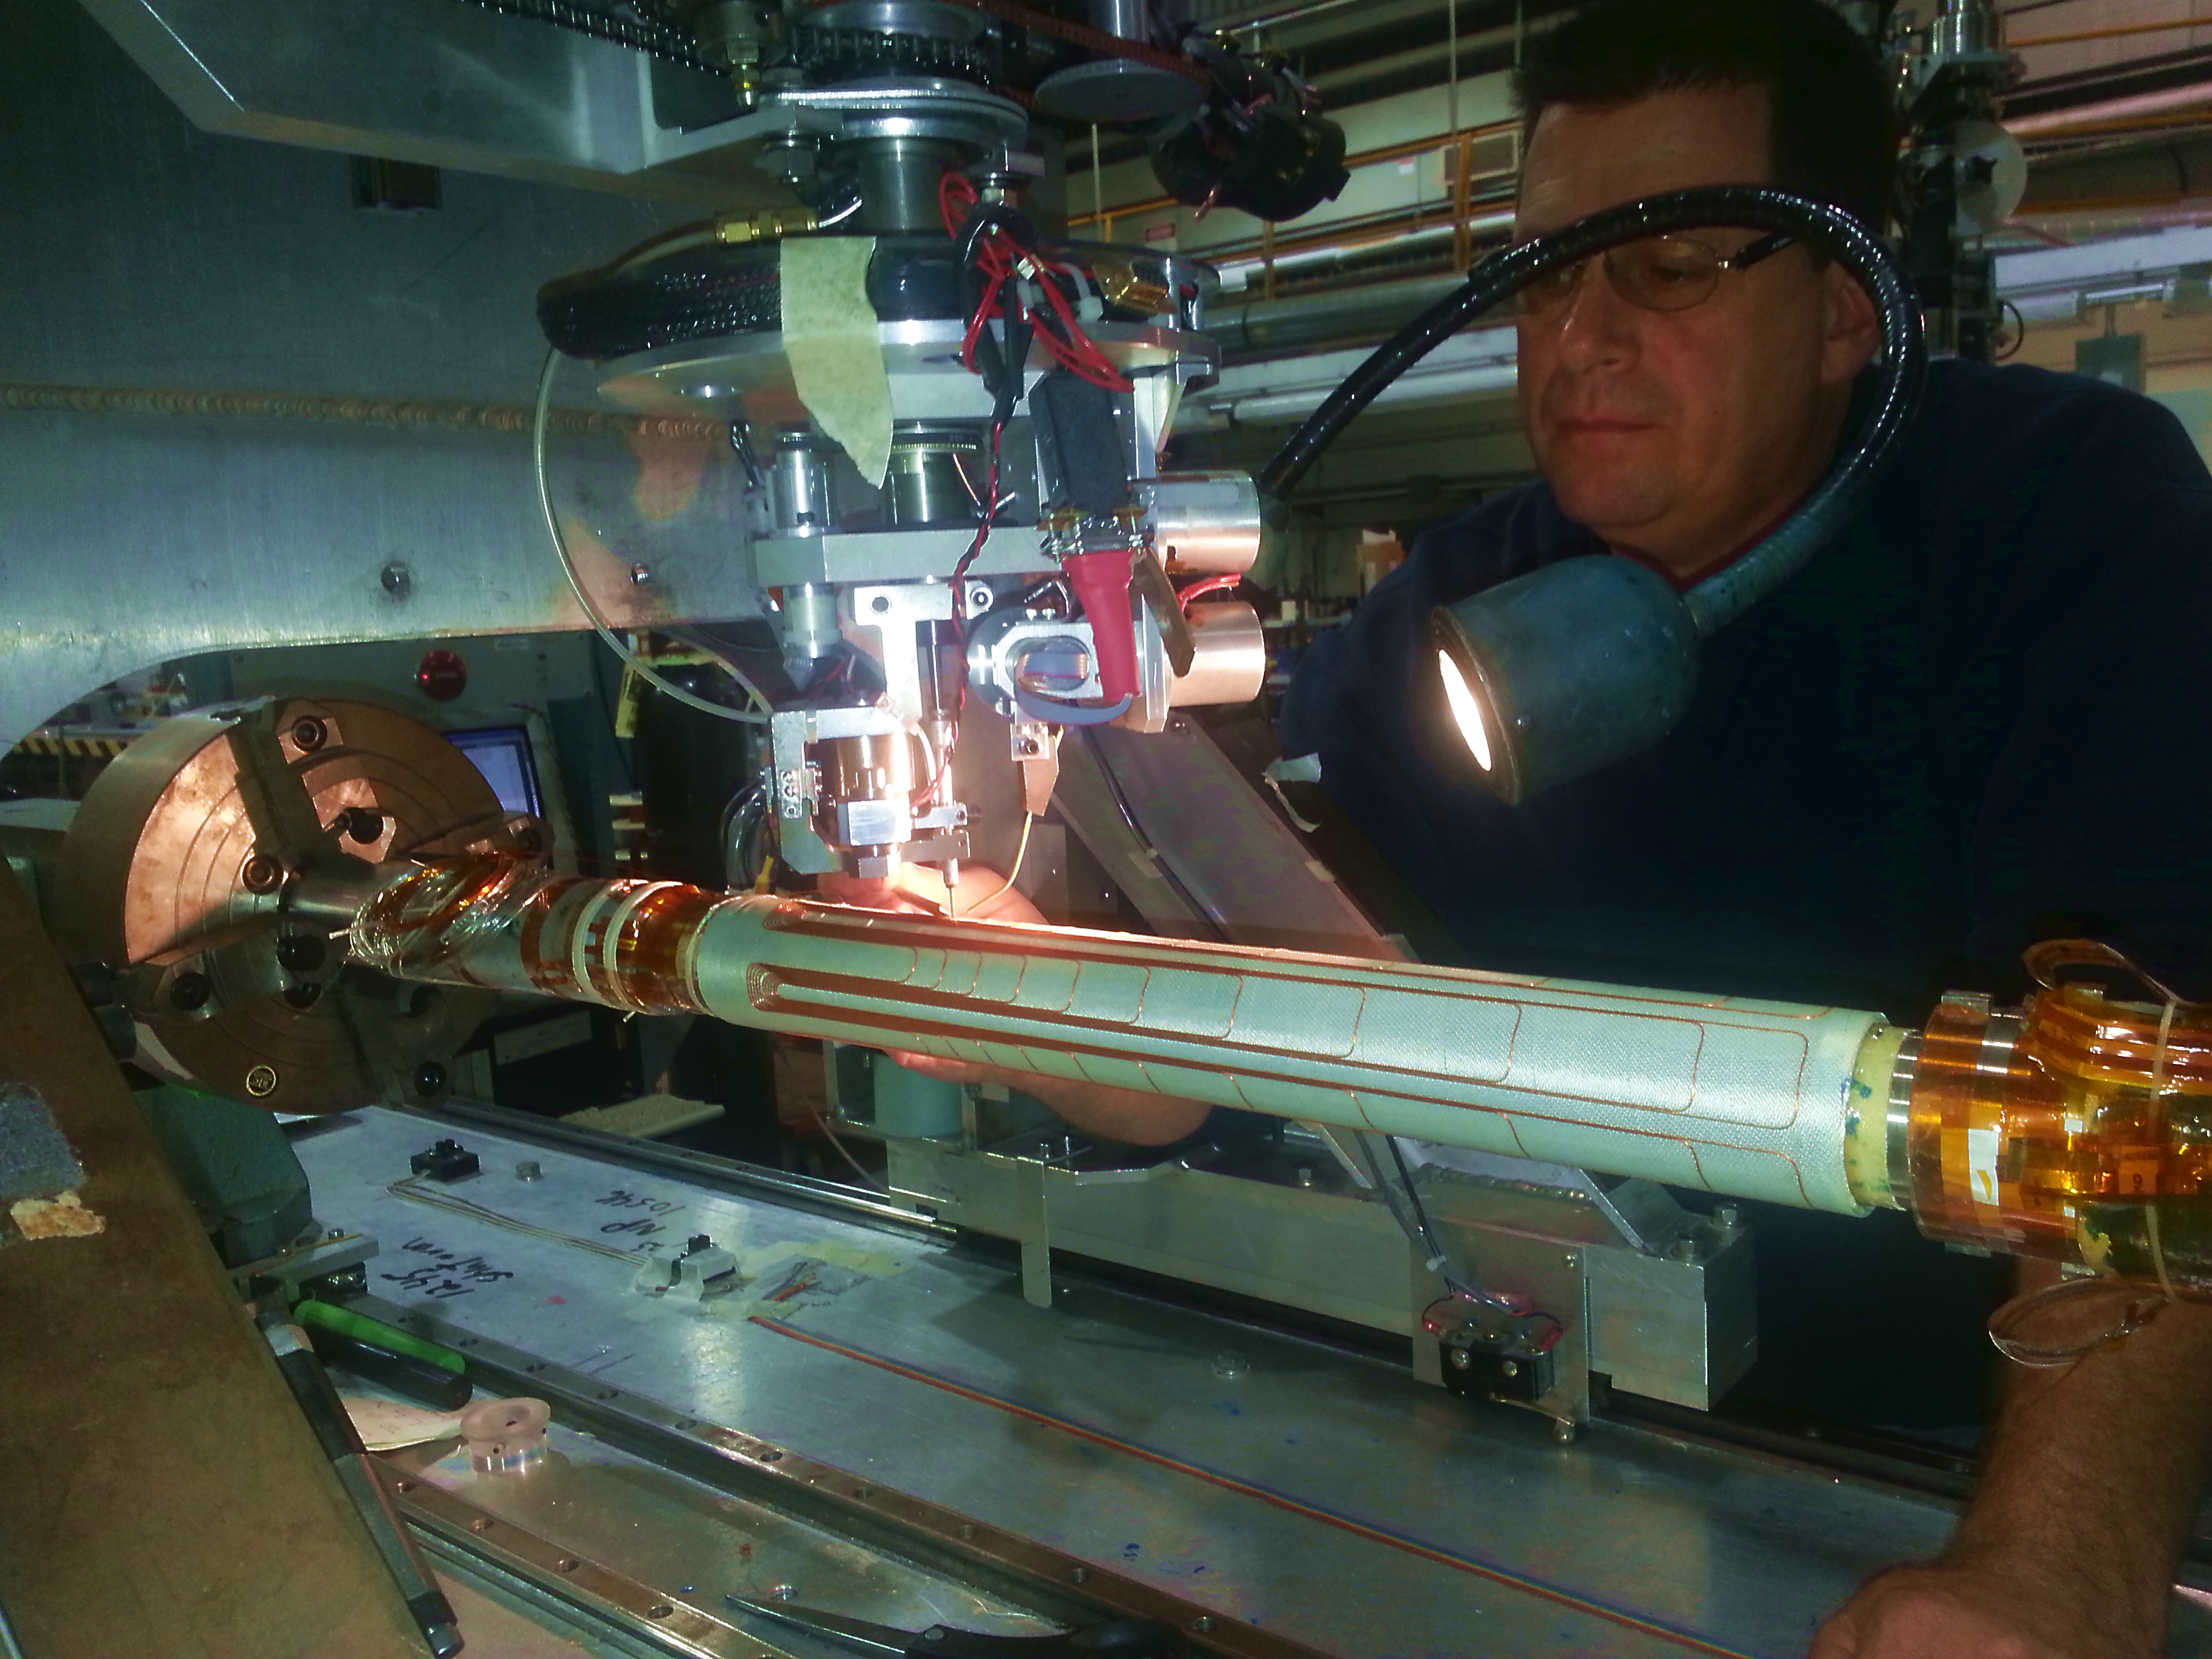
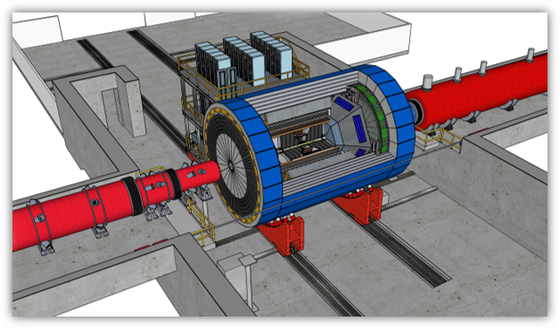
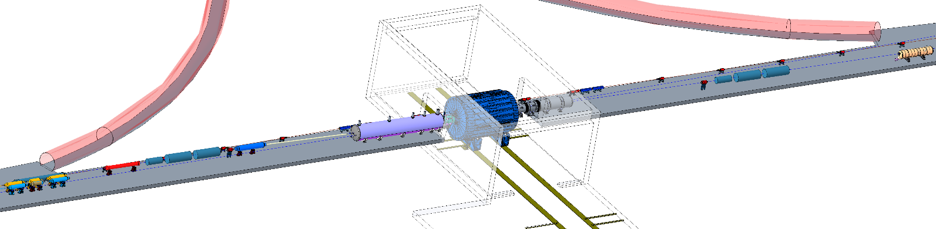
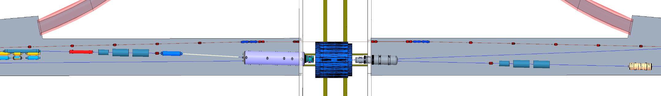
Interaction Region (@IR6)
Direct wind s.c. coil production in progress

Slide 6
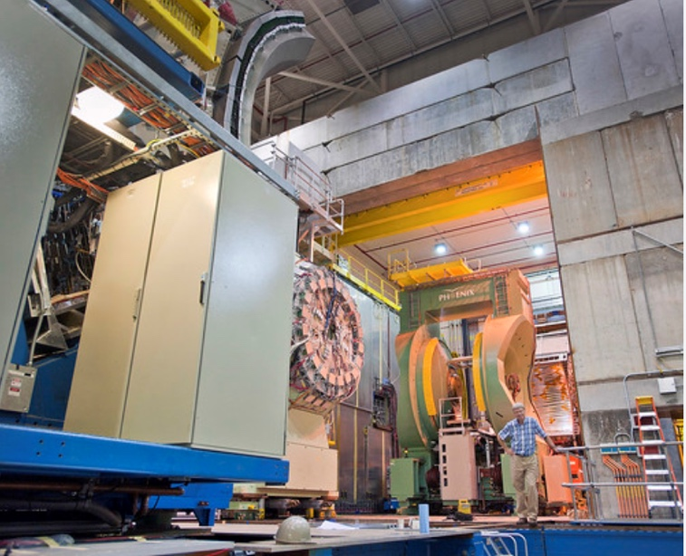
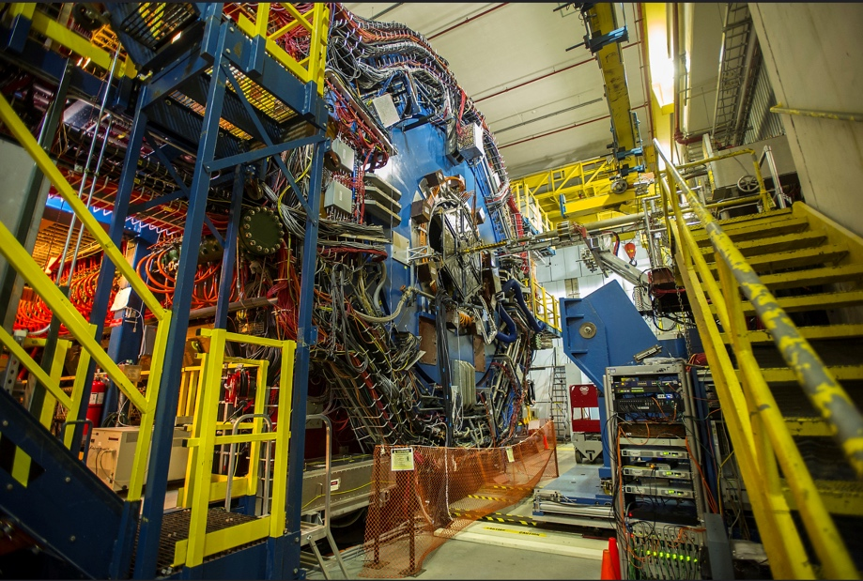
The EIC will benefit from two large existing detector halls in IR 6 and IR 8
Both halls are large and fully equipped with infrastructure such as power, water, overhead crane, ….
6
6
IR 8 detector hall with PHENIX detector (transitioning to sPHENIX)
IR 6 detector hall with STAR detector
Both IRs can be implemented simultaneously in the EIC lattice and be accommodated within beam dynamics envelope
2 IR’s: laid out similarly or optimized for maximum luminosity at different E_{CM}

Slide 7
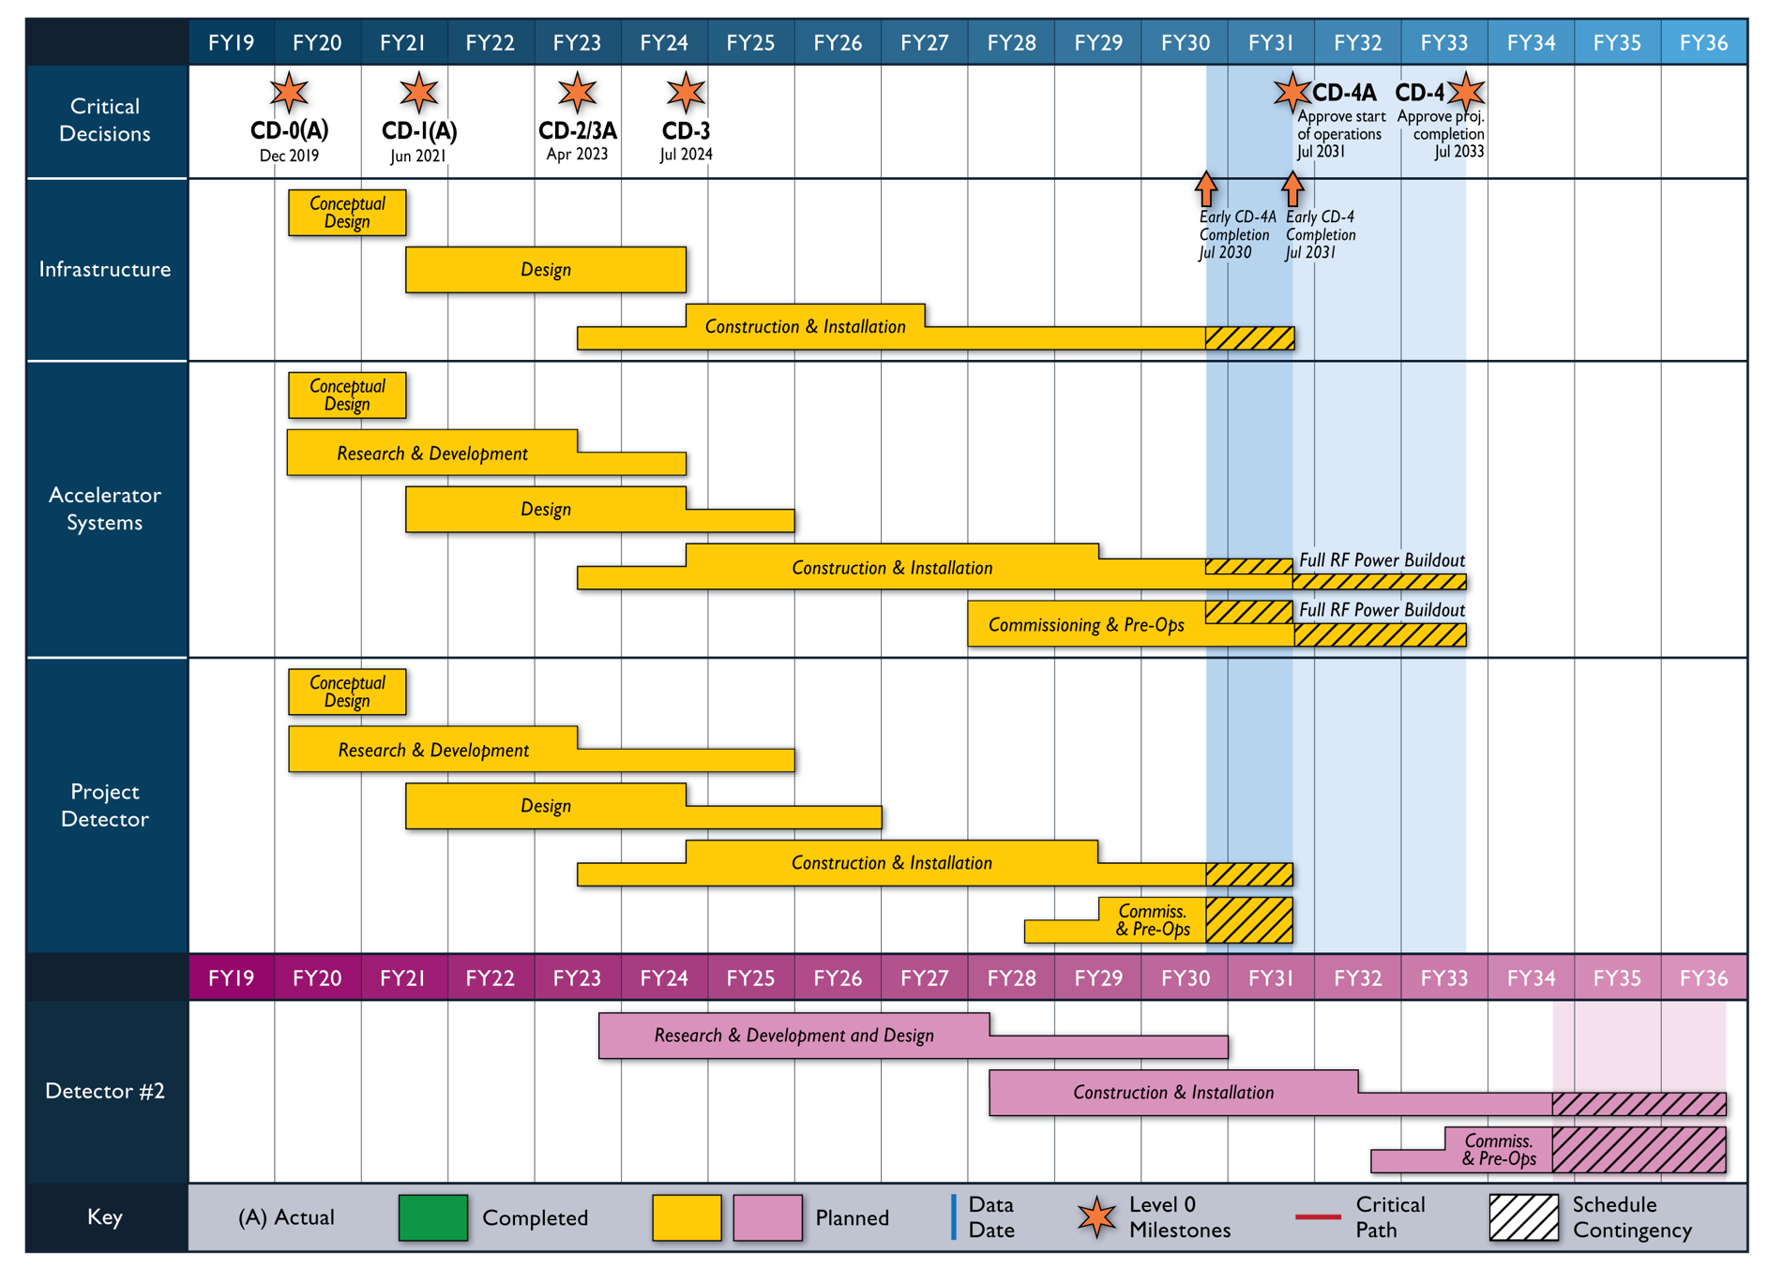
Reference Schedule
Notional Schedule
2nd IR and

Slide 8
2nd IR @IR8 assumptions & Nb3Sn
The first IR in the project scope
  Based on SC NbTi technology
The second detector and IR in reference schedule follow the first with delta of about 3-5 years. Questions:
  Can this timeline be compatible with development of Nb3Sn magnets for the 2nd IR?
  Should this be the same technology as used in HL-LHC or further technology advances can/should be included?
  What R&D and prototypes are needed for Nb3Sn 2nd IR?
Two 2nd IR Nb3Sn sessions in this workshop
  Tentative 2nd IR Nb3Sn optics provided to magnet experts ~2 weeks before the workshop, and pre-meeting held on Oct 18
Looking for fruitful discussion today, and will arrange follow-up meetings on 2nd IR after the workshop as well

