Slide 1
Ultrafast Ferroelectric Based Tuning for EIC Applications
Presenter: Chunguang Jing, on behalf of team members:
Alexei Kanareykin, Sergey Kuzikov, Yubin Zhao, Pavel Avrakhov, Yu Xiao
Euclid Techlabs, LLC
10/28/2021
EIC Workshop

Slide 2

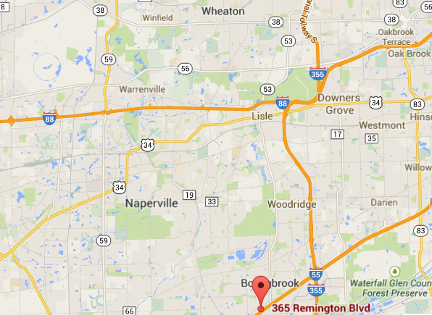
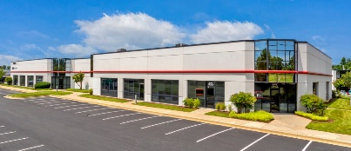
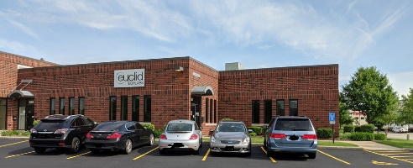
Euclid Techlabs LLC
Euclid Techlabs, LLC is a research and development company specializing in linear particle accelerators, ultrafast electron microscopy, and advanced material technologies for energy, defense, and medical applications. The company was formed in 2003. Euclid has developed expertise and products in several innovative technologies: time-resolved ultra-fast electron microscopy; ultra-compact linear accelerators; electron guns with thermionic, field emission or photo-emission cathodes; fast tuners for SRF cavities; advanced dielectric materials; HPHT and CVD diamond growth and applications; thin-film applications in accelerator technologies; and beam physics. Merging these technologies allows Euclid to create cost-effective, compact and reliable solutions, which provide potential access to a wide variety of markets.
32 employees, 15 PhD, particle physicists, material scientists, as well as electrical and mechanical engineers
2 Lab/offices: Bolingbrook, IL and Washington DC.
Tight collaborations with National Labs and Institutes: FNAL, ANL, BNL, LBL, SLAC, LANL, Jlab, NIST, NIU, IIT, etc.
DOE
BNL
30 min
flight
NIST
Fermilab
Washington
Jlab
2.5 hour
drive
ANL
Euclid Techlabs
www.euclidtechlabs.com

Slide 3
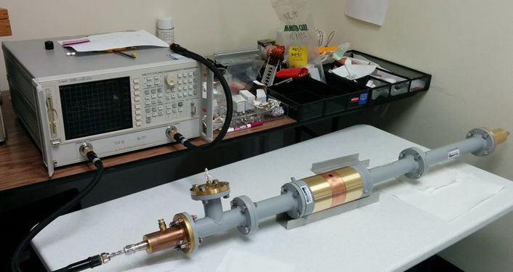


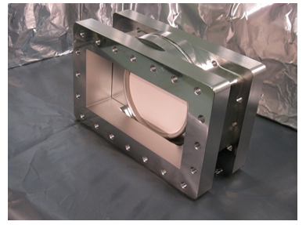
Key Euclid Technologies
Ferroelectric based fast tuner
Accelerator components (RF windows, couplers…)
Ultra-compact MeV energy range accelerators
Electron guns for accelerators: Photo-, thermo-, field emission (FE)- and SRF guns. Photocathodes.
SRF cavities, conduction cooled cryomodules
Stroboscopic pulser for Transmission Electron Microscope
Other high power microwave/RF components and beam physics instrumentation
Fast ferroelectric 400 MHz tuner successfully tested at CERN
L-band RF window for AWA ANL
UFPTM for TEM
www.euclidtechlabs.com

Slide 4
Low Loss “Smart” Ceramic for RF
With the talk, we present recent developments on fast active ferroelectric tuner designed based on the recently developed and demonstrated “smart” low loss tunable ceramic materials especially engineered for high power accelerator applications.
The Fast Ferroelectric Tuner with the tuning ceramic element made of the composite low loss ferroelectric, which dielectric constant can be altered with temperature (slow tuning,) and DC voltage (fast tuning). As long as the DC voltage changes the dielectric constant at 10-100 ns time range, it opens possibility for the development of the fastest ever tuning high power components.

Slide 5
Motivation – Fast Ferroelectric Tuner
A fast controllable phase shifter would allow microphonics compensation for the SRF accelerator (application of transient beamloading detuning is under consideration)
Nonlinear ferroelectric microwave components can control the tuning or the input power coupling for rf cavities. Applying a bias voltage across a nonlinear ferroelectric changes its permittivity. This effect is used to cause a phase change of a propagating rf signal or change the resonant frequency of a cavity. The key was the development of a low loss but still tunable ferroelectric material. The parameters have to be :
Dielectric constant has to be low (~ 100-150)
Loss factor has to be low ~ 10⁻³ at 1 GHz and 3×10⁻⁴ at 100 MHz
Tuning range has to be high ~ 6-8% at ~15 kV/cm
Can be done with (Ba, Sr)TiO₄+Mg based oxides
Courtesy of N.Shipman, CERN
*Ferroelectric tuning for SRF cavity was proposed by I. Ben-Zvi

Slide 6
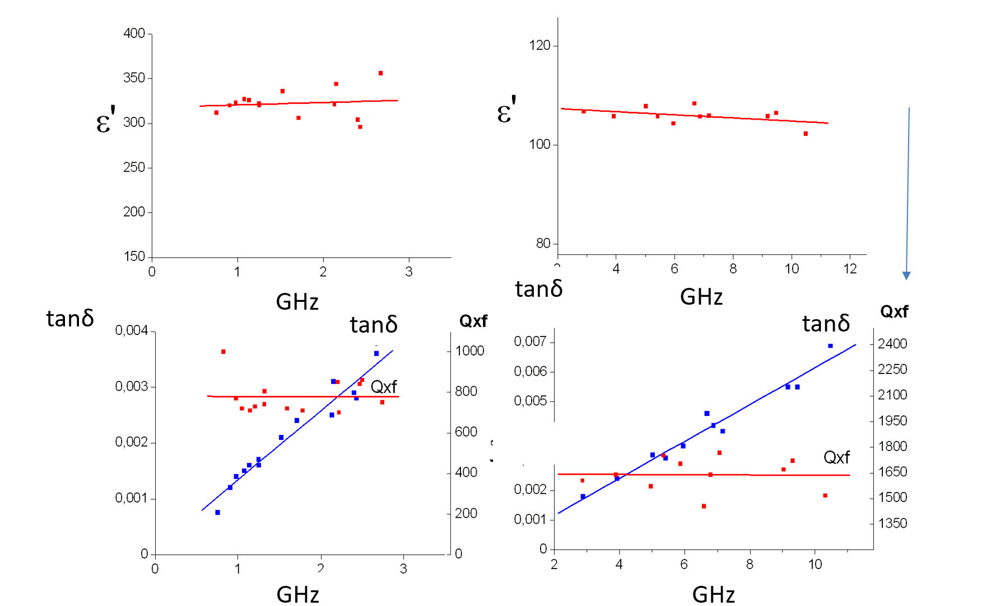
Frequency dependence of ε and tanδ for the ferroelectrics with low permittivity at ~GHz range
Q×f – FoM, GHz
Q×f=f (GHz)/tanδ
Q×f ~ const. at
50 MHz – 100 GHz
BST(M) is microwave ceramic – it means that its permittivity
does not depend on frequency.
Same time, loss factor tan δ of microwave ceramic linearly increases with frequency.
tanδ= 2.8×10⁻⁴ (80 MHz), =4.8×10⁻⁴ (400 MHz),

Slide 7
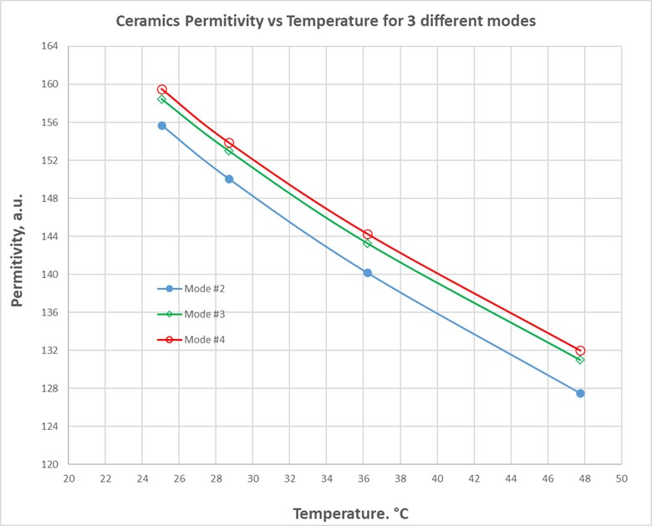
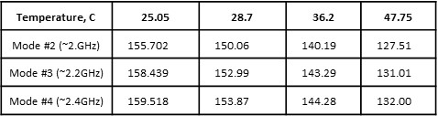

Ferroelectric ceramic properties, temperature
C, pF
BST ferroelectric
~ε
20000
BST with Mg oxide increasing content
15000
10000
(3)
(2)
(1)
5000
0
100
150
200
250
300
T, K
Temperature dependence of the BST(M) material permittivity in the 25C-50C temp. range.
Curie temperature shift from 250K to 170K with increase of Mg-based oxides in BST-Mg oxide solution.
Dielectric constant of BST based ferroelectrics strongly is dependent on temperature. With the low linear ceramic content in BST, Curie temperature is ~250K shifting to the ~170K range with linear ceramic content increase. For the BST(M) material with its dielectric constant ~150 at room temperature, Δε(T)/ε~1%/⁰K or Δε/T=1.2/⁰K. Optimal operations for BST (M) has to be in the 10⁰C-50⁰C temperature range.

Slide 8
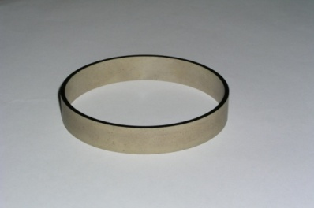
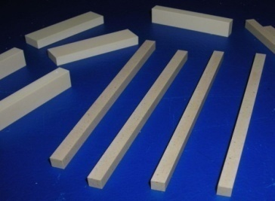
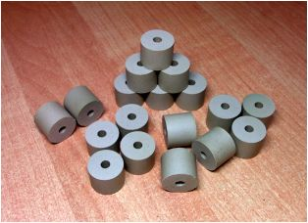
Progress on BST(M) Material Development
(Ba,Sr)TiO₄+Mg oxides in various proportionsat room temperature
Q*f
tanδ=4×10⁻⁴ 400 MHz
K_{dc} =ε(V=0)/ε(V₀)
tunability
Q×f – FoM, GHz
Q×f=f (GHz)/tanδ
Q×f ~ const. at
50 MHz – 100 GHz
8% at 15kV/cm
BST(M), ε~50-150
record low values of dielectric constant and loss tangent at relatively high tunability level required for high power bulk tuner operating in air (< 30 kV/cm) and in vacuum ( up to 80 kV/cm).

Slide 9
Ferroelectric ceramic properties
Parameters | Value
dielectric constant, ε | ~150
tunability, Δε/ε | ~10% at 15kV⋅cm⁻¹ of the bias field
response time | 10 - 100 ns
tanδ at 1 GHz and 400 MHz | ~1×10⁻³ and ~4×10⁻⁴ correspondingly
breakdown limit | 200 kV/cm
thermal conductivity, K | 7.02 W/m-K
specific heat, C | 0.605 kJ/kg-K
density, ρ | 4.86 g/cm³
coefficient of thermal expansion | 10.1×10⁻⁶ K⁻¹
temperature tolerance, ∂ε⁄∂T | (1-2) K⁻¹

Slide 10
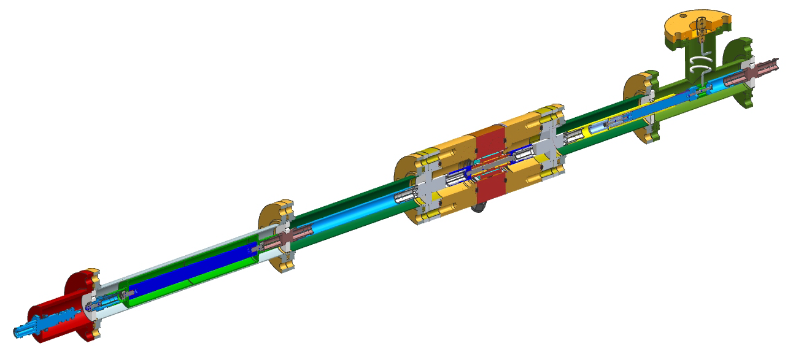
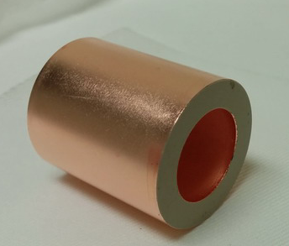
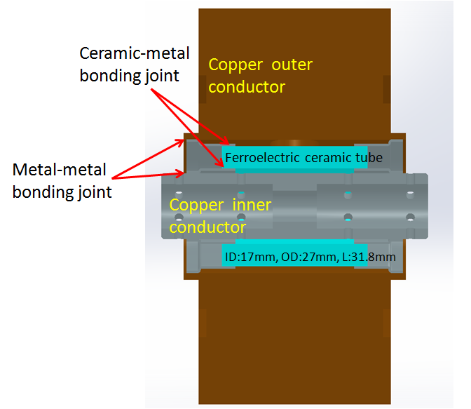
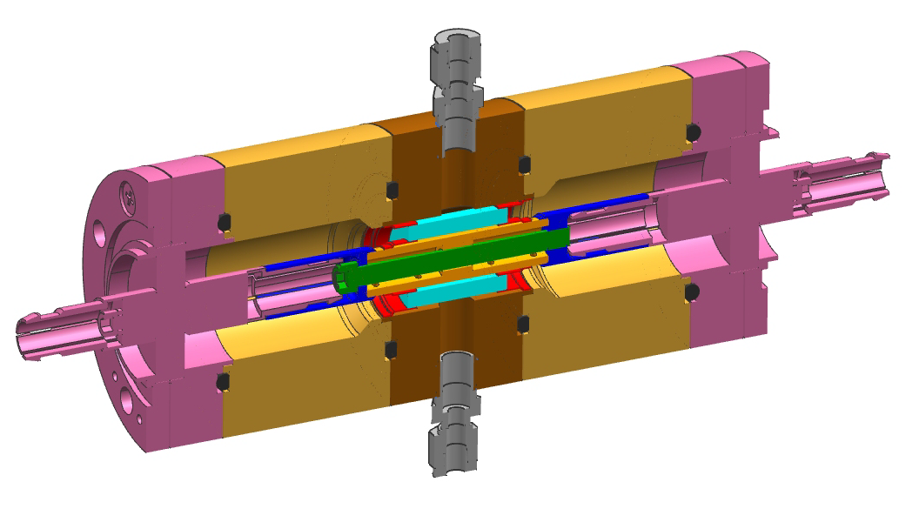
BST Based Tuner Design (assembly)
design of S. Kazakov and V. Yakovlev

Slide 11
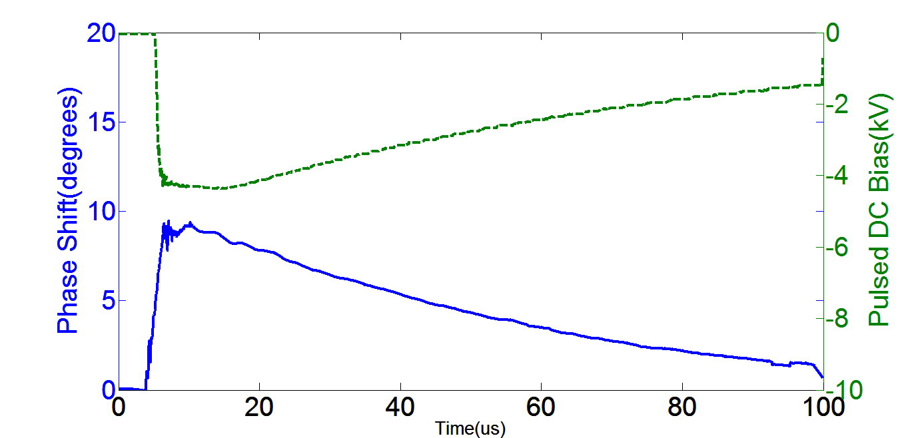
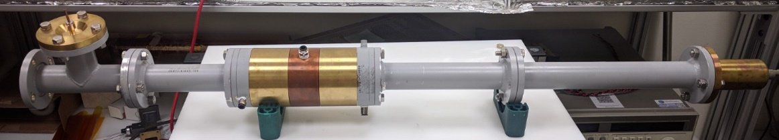
Ferroelectric Based High Power Tuner for SRF Cavities
Ferroelectric Fast Reactive Tuner (FE-FRT) for SRF accelerator operations
  Ultrafast tuner: 100 ns range
In collaboration with CERN
  Case study: LHeC application
Offers potential for significant reduction in RF power consumption
N. Shipman, et al., ERL’19, TUCOZBS02

Slide 12

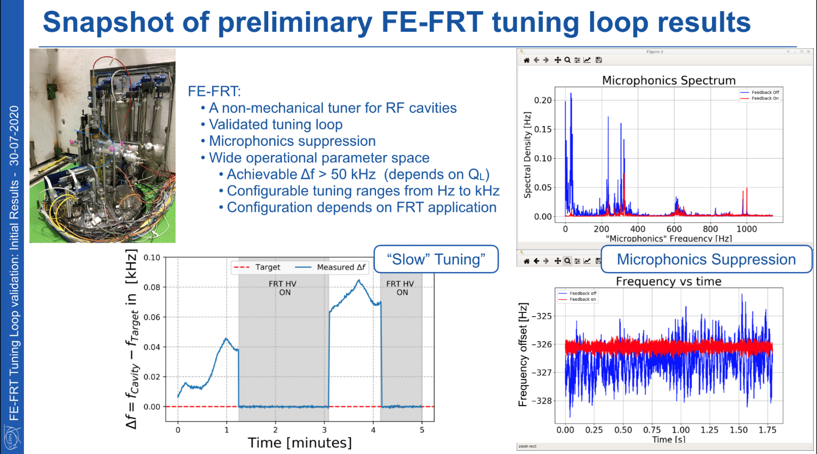
Preliminary Test Results, CERN, 2020
First ever Ferroelectric Fast Reactive Tuner (FE-FRT) test with a superconducting cavity
Courtesy of A.Macpherson and N.Shipman, CERN

Slide 13
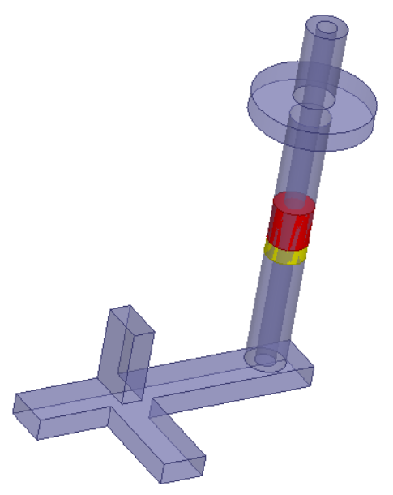
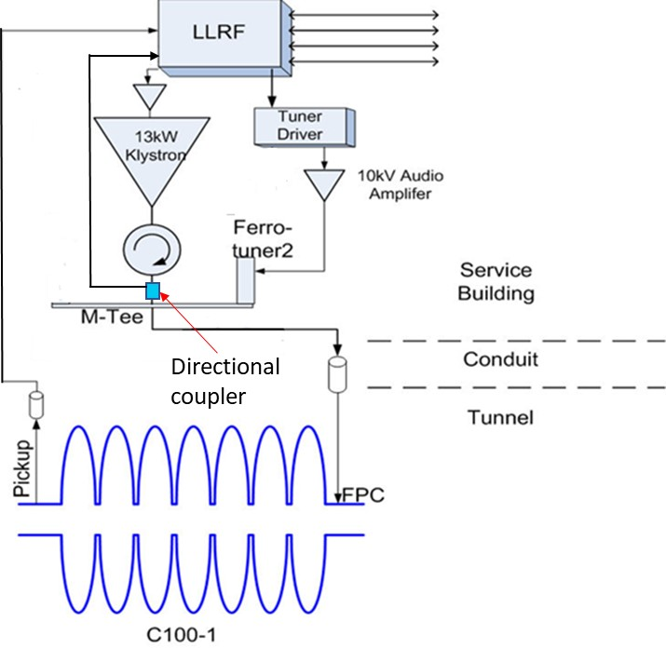
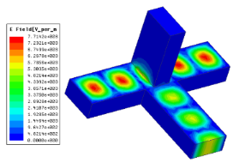
FRT for 1.5 GHz Single Port Cavity
Ferroelectric tuning element (red) with alumina matching section (yellow)
C100 cavity, and C100 cryomodule with FPCs in CEBAF section SL25, Jlab.
Ferroelectric tuner and MT (upper corner) in the LLRF schematic of C100
Euclid Techlabs is developing the first fast ferroelectric tuner for a SRF accelerator that is currently in operation – CEBAF at JLAB. In comparison with our first tuner prototype, it requires a new configuration, with a single RF power port for both the klystron and the tuner. This is the only option for the current C100 cryomodules at CEBAF, and many other projects.

Slide 14
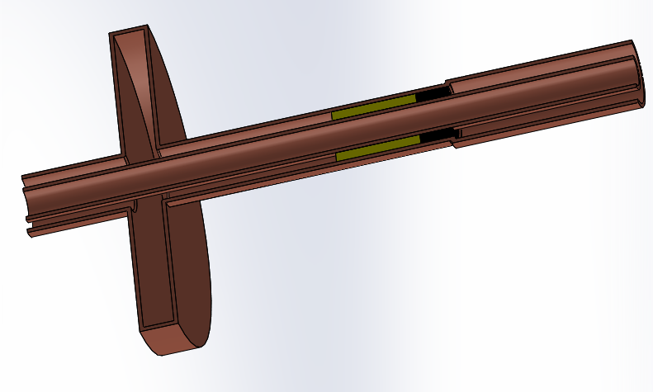
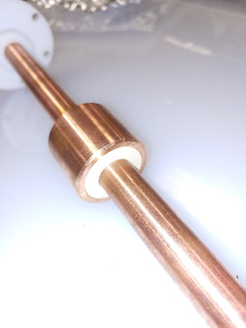
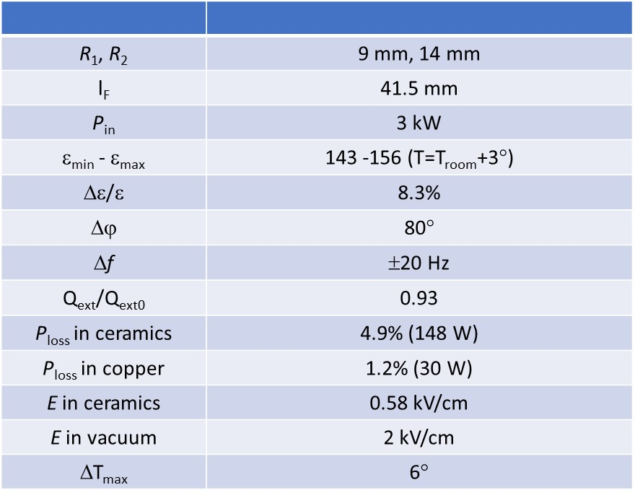
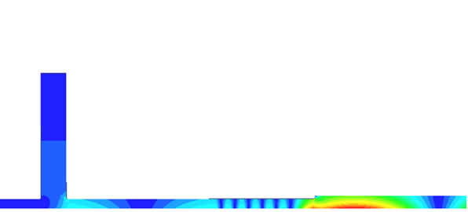
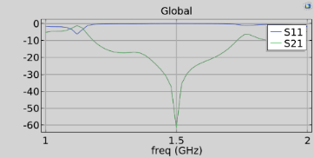
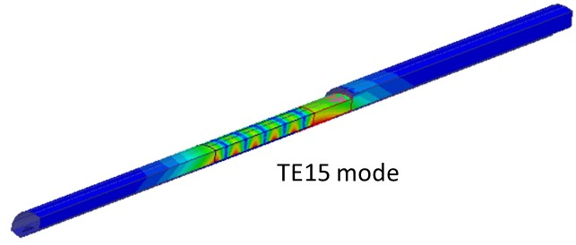
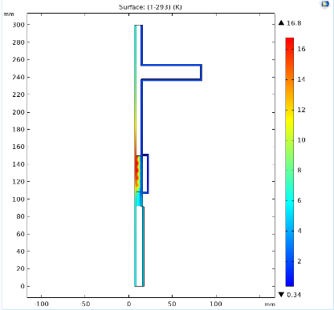
Current Status of the 1.5 GHz FRT
HOM analysis
3 kW of CW power causes 17° temperature rise with water cooling outside and cooled air inside.
Euclid has carried out thermal and RF measurements of improved ferroelectric ceramic, completed the tuner RF and thermomechanical design, and is currently finishing the mechanical engineering design for fabrication. HOM analysis is complete too.

Slide 15
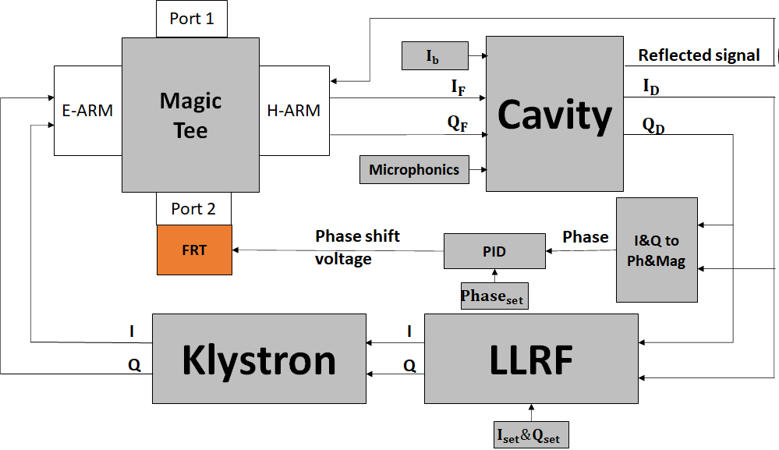
Simulink modeling of the FRT microphonics compensation via the single FPC
Although it is non-ideal to use FRT through FPC, it is possible to maintain Qext and compensate the microphonics simultaneously.
Simulink modeling shows the klystron power demanding can be reduced by ~25% in the case of Jlab C100 cavities.
~25% reduction
Klystron power as needed to compensate the microphonics
FRT OFF
FRT ON
Cavity voltage
FRT with 10% loss
Cavity Phase
Emulated microphonics signal

Slide 16
New Research Directions
MVAR level of FRT concept
I. Ben-Zvi, etc, arXiv:2109.06806
N. Shipman, et al, CERN

Slide 17
Summary
  BST (M) ceramic was developed with dielectric constant ~150, loss factor ~ 5×10⁻⁴ at 400 MHz and tunable ~ 8% at 15 kV/cm at 10-100 ns pulse range
  The fast 400 MHz BST(M) ferroelectric tuner was designed, fabricated and cold tested at Euclid. Validation test at CERN of the 400 MHz tuner with SRF cavity demonstrated successful microphonics compensation at up to 1 kHz frequency range.
  1.5 GHz MT single port tuner configuration is currently under development for the Jlab’s C100 cavity for CEBAF.
  New FRT applications are on the horizon.

Slide 18
Acknowledgements
DOE, Office of Science Nuclear Physics
  M. Shinn, M. Farkhondeh
Our collaborators
  BNL, I. Ben-Zvi
  CERN: N. Shipman, A. Macpherson, F. Gerigk, E. Jensen,
  JLab: R. Rimmer, T. Powers, C. Hovater, T. Plawski
  Fermilab: V. Yakovlev, S. Kazakov,
  Ceramic Ltd: E. Nenasheva

