Slide 1
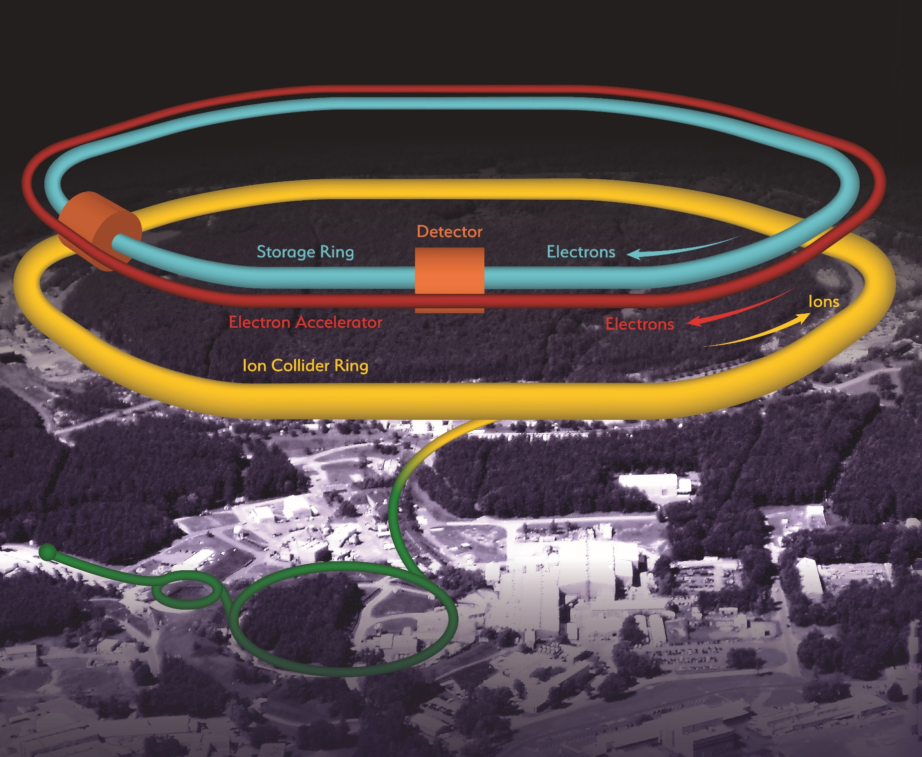
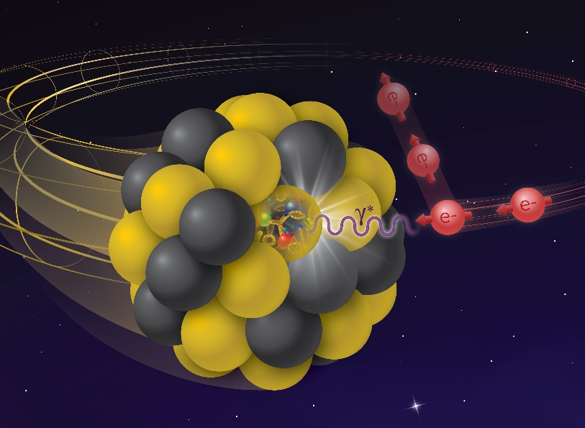
Impressions from the 2021 EIC Accelerator Partnership Workshop
Oliver Kester
Associate Laboratory Director – Accelerators
TRIUMF, Canada

Slide 2
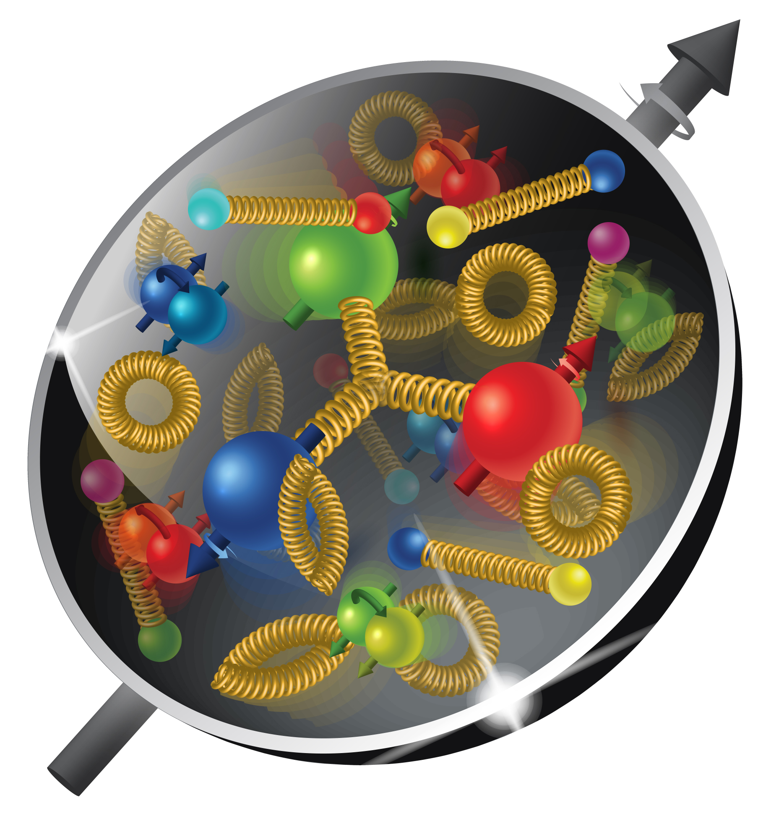
The Electron Ion Collider – leading edge of Accelerator Technology
EIC is a very complex machine and requires a collaborative approach to identify and overcome the technical challenges
BNL and JLab seek engagement of international and domestic partners in these efforts → this workshop!
Challenges:
High Luminosity: L= 10³³ – 10³⁴cm⁻²sec⁻¹ over large energy range → Many bunches, large beam currents, small emittance
Highly Polarized Beams: 70%
Large Center of Mass Energy Range: E_{cm} = 20 – 140 GeV
Large Ion Species Range: protons – Uranium
Large Detector Acceptance and Good Background Conditions
Accommodate a Second Interaction Region → Collaboration investigates an IR based on Nb₃Sn

Slide 3
2021 EIC Accelerator Partnership Workshop participation
The workshop saw 284 registered participants from 23 countries Between 60 and 100 participants in each session
Topics we explored (contribution from):
IR SC magnets and spin rotators (BNL, KEK, Jlab, INFN, CERN)
Second IR based on Nb₃Sn option (Jlab, CERN, FNAL, LBNL)
HSR and ESR vacuum system (BNL, CERN, INFN, KEK, ANL, MAX-IV,CNPEM)
Lessons from SuperKEKB (KEK and U of Hawaii)
Crab Cavities (Jlab, ODU, TRIUMF, BNL, CERN, STFC, U of Uppsala, FNAL)
ESR high current elements (CERN, BNL, ESRF)
ESR SRF and CM (BNL, SLAC, Stanford U, CERN, ESS, Euclid Techlabs)
Machine Detector Interface (MDI), First and Second IR (BNL, Jlab, U of Hawaii, PAL, LBNL)

Slide 4
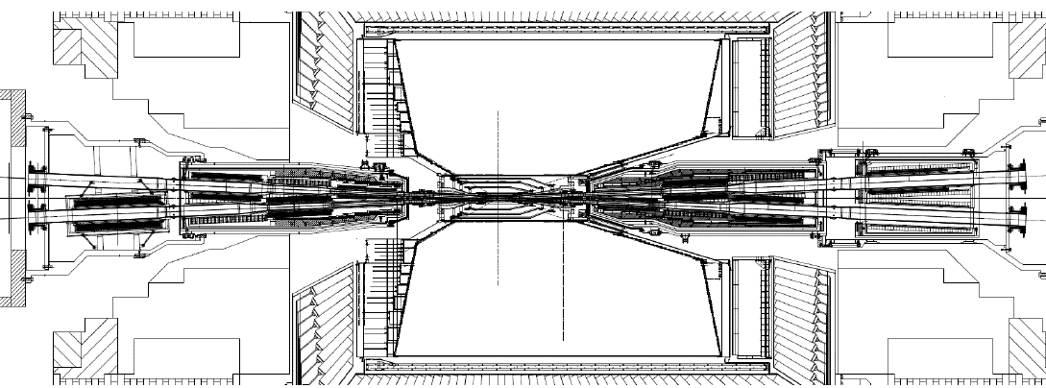
Impressions from the sessions: IR SC magnets
IR1 has challenging geometric constraints – SC IR magnets and spin rotator solenoids all magnets in NbTi, forward direction 2K, rear direction 4K
Beams share magnet aperture → combined function magnets, large aperture → space constraints require 2K
CCT (Canted Cosine Theta) winding pattern resolves several issues → reduced conductor stress, excellent field quality need to be proven mechanically (quit some experience at LBNL)
IR2 – Nb₃Sn magnets, which allow higher gradients, shorter L*, higher luminosity – compact IR → driving development of Nb₃Sn magnets and lessons learned from the US program on Nb₃Sn magnets
Just to visualize the complexity of an IR → SuperKEKB

Slide 5
Impressions from the sessions: HSR and ESR vacuum systems and high current systems
Electron cloud and vacuum stability (e- ionize residual gas and are a second source of ion flux to the wall - desorption
Electron and photo stimulated desorption – lower on porous substrate → C-coating in cold sections, significant coating experience at CERN → investigation of resistive wall impedance
Dealing with synchrotron radiation (9 MW)
High intensity, short bunches and short bunch spacing – large resistive wall heating Vacuum upgrade of the hadron ring
Impedance modeling is essential, important lessons from synchrotron light sources (ESRF, MAX-IV,…) → impedance minimization in close collaboration with mechanical engineers essential
Careful design beam screens with minimal impact on the apertures – combined with cryosorbers or NEG in warm sections
Interesting the contribution from SLAC about the pre-injector (high achievable gradients, distributed coupling structure and enhancement of rf-parameters for cryogenics temperatures)

Slide 6
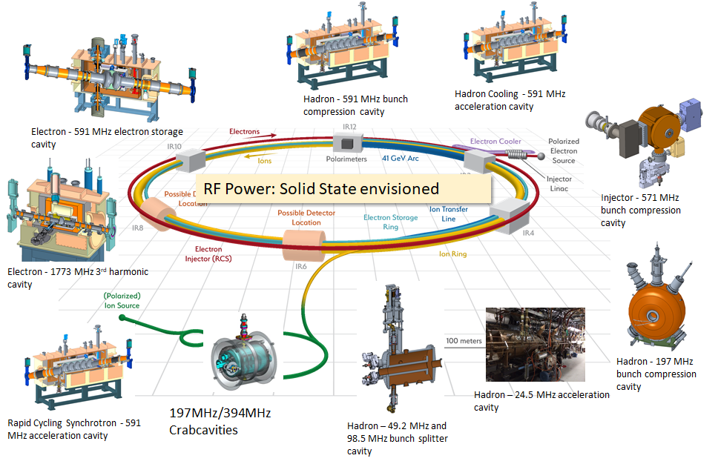
The EIC rf-systems
Significant portfolio of different systems
Normal and super-conducting

Slide 7
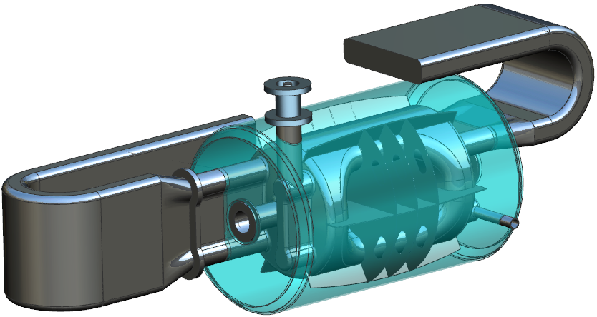
Impressions from the sessions: EIC crab cavities
The Crab Cavity performance is critical to the success of the EIC
Large crossing angle
Luminosity impact ~ order of magnitude
The requirements are challenging
Significant deflecting voltage ~34 MV
Tight impedance budgets
RF control requirements are beyond anything done - Phase noise should be 2 orders of magnitude lower than that of LHC.
Hi-Lumi provides a good example of how to engage the international community in a challenging Crab cavity project
Jacketed 197 MHz Crab Cavity Variant
394 MHz Crab Cavity

Slide 8
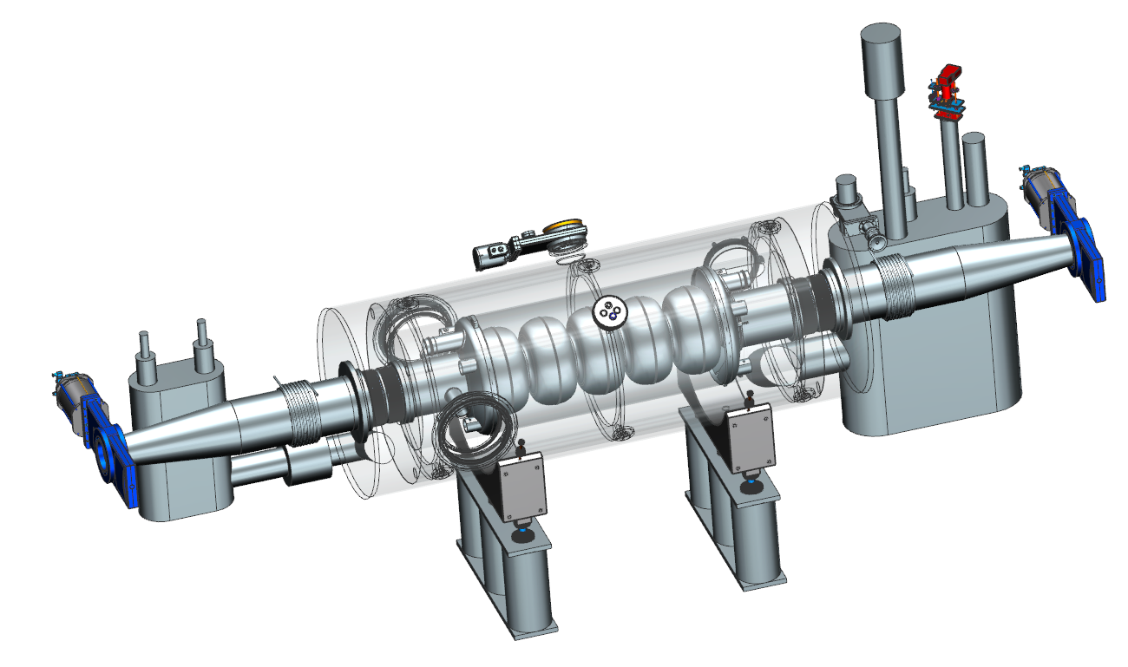
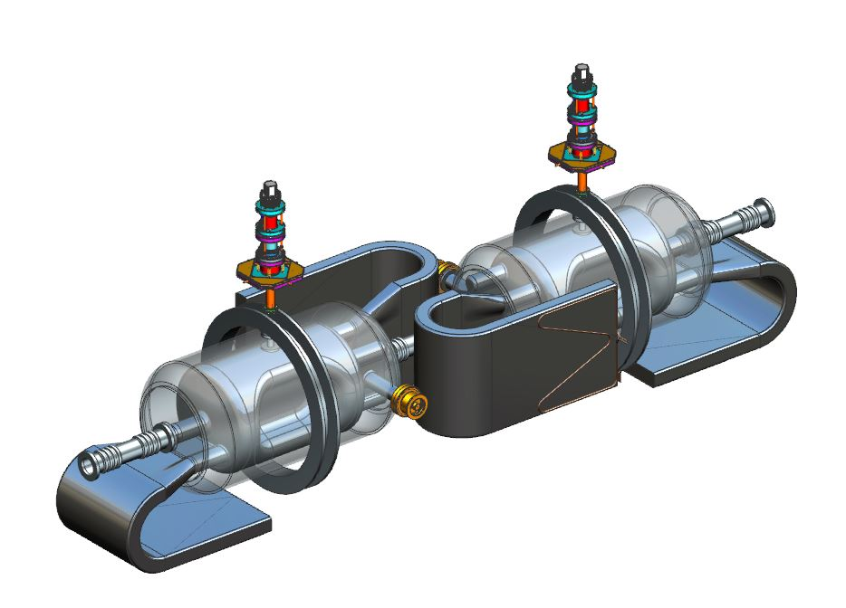
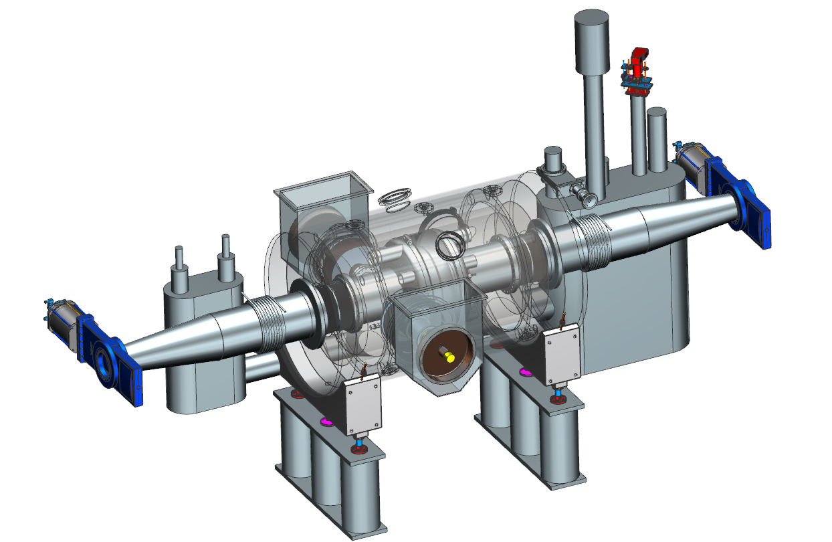
Impressions from the sessions: SRF and cryomodules
EIC requires multiple new SRF systems (cavity, power, and control). Many opportunities for new and exciting work.
Goal of early work based at BNL and JLab is to develop understanding of systems and reduce risk.
Requirements and designs are mature but not final. The beam and machine physics are still being optimized. SRF systems may need to be updated as the design is finalized.
Need to leverage common designs where possible.
Challenges in cryomodule footprint, High power rf, Fundamental power couplers, LLRF and HOM dampers
HSR - 591 MHz 5-Cell Cavity
Bunch Compression
SHC- 591 MHz 5-Cell and
1773 MHz 5-Cell ERL Cavities
RCS - 591 MHz 5-Cell Cavity
Acceleration Cavity
Crab Cavities – HSR & ESR
591 MHz ESR 1-Cell Cavity

Slide 9
Impressions from the sessions: Machine Detector Interface
The EIC will feature powerful beams: 10x the stored energy of RHIC, 2x SuperKEKB target stored energy with 1/2 the bunches
Collimators are even more critical - accomplish 2 main missions: a) Beam cleaning to reduce radiation & backgrounds form lost particles and b) machine protection from accidental beam loses (CCs, kickers, instabilities, …)
Synchrotron Radiation management - Heat extraction (ANSYS simulation)
5-7 collimators in both rings + absorbers and masks Simulation studies with FLUKA and tracking codes

Slide 10
Lot’s of lessons from SuperKEKB (to learn!)
Collimator beam power and damages Narrow aperture to reduce beam background at detector, but limit on max. bunch current
Beam-beam blow-up chromatic coupling, multi bunch effects, head-tail? I wonder why are the long range beam-beam wire correctors explored at CERN not in discussion for EIC?
Quality and amount of beam injected from the linac (quite common) strict on parameter fluctuation of beam from the linac (energy spread, pointing stability, beam current …)
Feedback gain of bunch feedback system – can inject noise and might cause dipole motion of the beam
Beam background at the detector Belle II Movable collimators – cut beam tails, tungsten shielding to stop showers from the final focus quads
Beam losses (or aborts) by pressure bursts – dynamic vacuum effects, collision of the circulating beam with dust particles, etc.
And more ….

Slide 11
My overall impression
The selected focused areas are all very important for the EIC project and the project team is really benefitting from presentation from experts from other labs.
A follow up on collaboration on these topic will be very useful and timely for CD2.
I’m fascinated by the advances in the different areas, the community is not afraid to explore new ideas!
Yes, there are a lot of challenges, but there are many labs working on solutions to overcome these challenges and support the EIC project.
I want to congratulate BNL and Jlab for the significant advances and the strong collaboration that has been established to realize this outstanding nuclear physics facility.

Slide 12
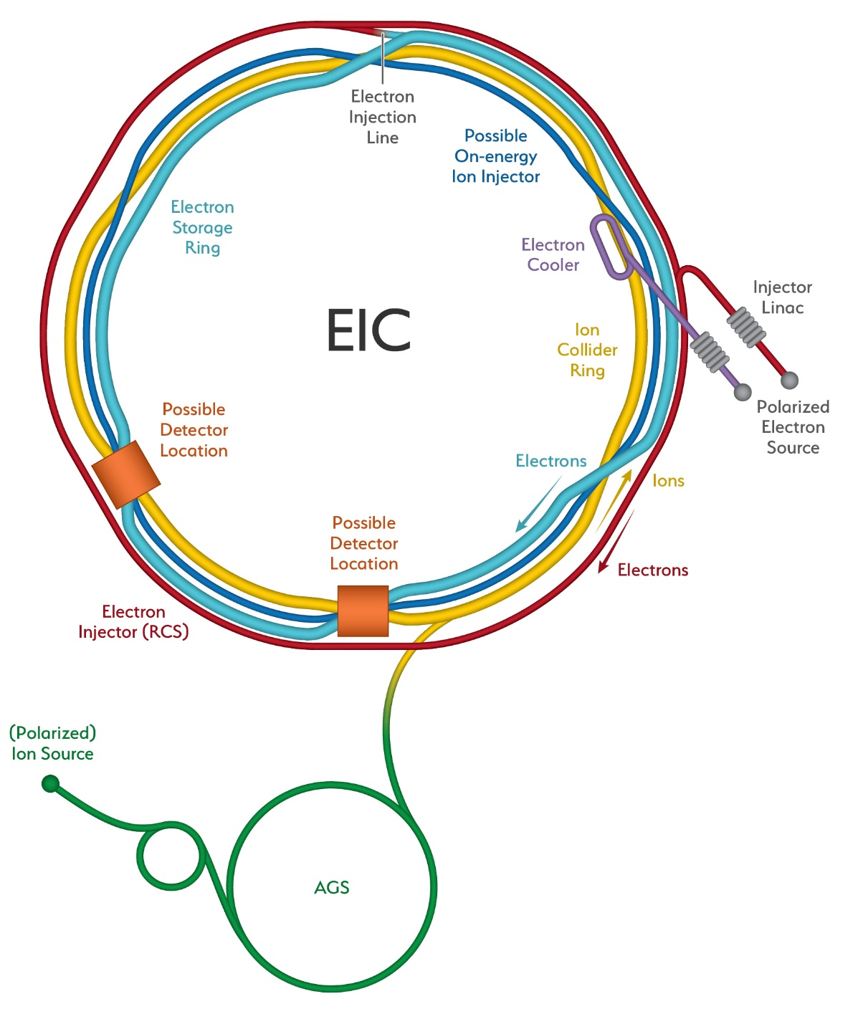
Thank you! Merci!
TRIUMF 2021 EIC Accelerator Partnership Workshop

