Slide 1
EIC Collaboration Path Forward
Jim Yeck, EIC Project Director
EIC Accelerator Partnership Workshop
October 28, 2021

Slide 2
Outline
Schedule
Organization and Partnership
Cooperation and Collaboration
Next Steps

Slide 3
DOE Project Planning Process*
EIC
*
Operating* Funds
PED
Funds
Construction & PED
Funds
Operating Funds
Initiation
Definition
Execution
Closeout
Conceptual Design
Preliminary Design
Final Design
Construction
Critical
Decisions
CD-0
Approve Mission Need
CD-1
Approve Alternative Selection
and Cost
Range
CD-2
Approve Performance Baseline (PB)
CD-3
Approve Start of Construction or Execution
CD-4
Approve
Start of Operations or Project Completion
EIC Critical Decision Plan
CD-2/3a April 2023
CD-3 July 2024
CD-4a early finish July 2030
CD-4a July 2031
CD-4 early finish July 2031
CD-4 July 2033
Assumption:
3 Months Continuing Resolution (CR)
Project typically receives 1/12 per month during CR
Request
PED Funds
Receive/Spend
PED Funds
* Example
Calendar Year
2019
2020
2021
2022
2023
2024
2025
2026

Slide 4
EIC Recent History and Plans
Event | Date
Mission Need Statement Approved | January 22, 2019
CD-0, Mission Need Approved | December 19, 2019
DOE Site Selection Announced | January 9, 2020
FY2020 Budget Includes EIC TEC and OPC Funding | 1st Quarter FY2020
BNL - TJNAF Partnership Agreement Approved | May 2020
Conceptual Design Review | November 2020
DOE Independent Cost Review (ICR) | Jan. 4 – Feb. 4, 2021
DOE CD-1 Review Date | January 26-29, 2021
CD-1, Alternative Selection and Cost Range, Approved | June 29, 2021
DOE OPA Review and ICR | January 2023
CD-2/3A, Performance Baseline/Long Lead Procurement | April 2023

Slide 5
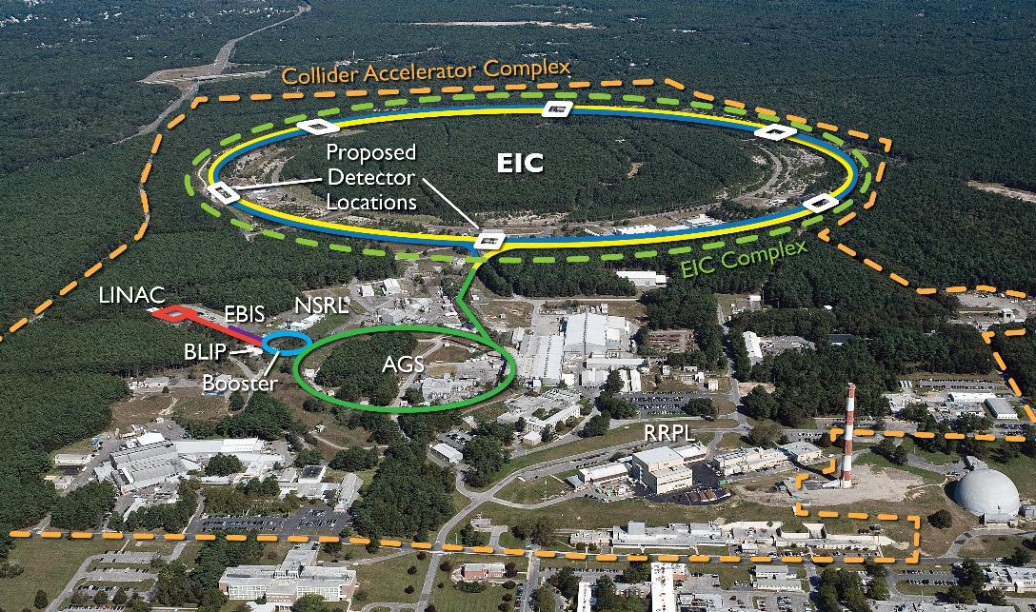
EIC benefits from $B class investments at BNL and the highly successful RHIC program.
RHIC will conclude operations in 2025. EIC installation will begin after RHIC ops concludes.

Slide 6
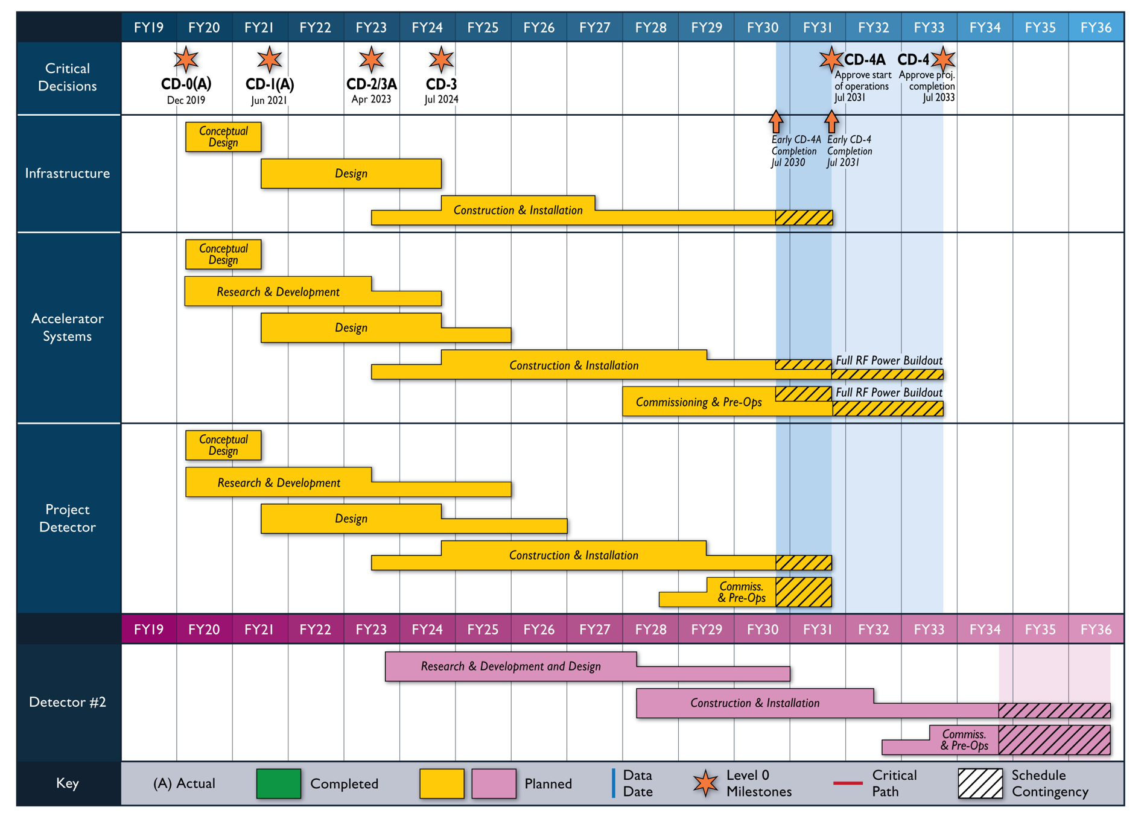
Reference Schedule
Notional Schedule
2nd IR and
Schedule
Generic Detector R&D

Slide 7
CD-2/3A Preparation
Assumptions
DOE FY2022 funding is $70 million (possibilities range from $30M to $806M!)
CD-2/3A approval in April 2023
Schedule
DOE Status Review (confirm CD-2/3A goals) October 19-21, 2021
DOE Status Review (confirm OPA/ICR review plans) April (TBD) 2022
Preliminary Design Complete November 2022
Final Design/Maturity Readiness for CD-3A Items November 2022
Preliminary Design Review November 2022
Director’s Review December 2022
DOE OPA Review and ICR January 2023
$$√$$

Slide 8
DOE Review Recommendations
Evaluate the lessons learned from each CeC Pop run, including the role of the EIC project input to the experiment, and develop an EIC project path forward that includes a timely PoP demonstration of SHC. This should be presented at the next OPA review.
Assess the requirements for pre-cooling at a lower energy both to complement SHC and to offer contingency in case the SHC performance falls below expectation; report by the next OPA review.
Pursue commitments on accelerator in-kind contributions before CD-2/CD-3A. (Accelerator SC)
Develop a mitigation plan - with cost and schedule - to support Rutherford cable production in house by CD2-CD3A.
Pursue formal commitments for in kind contributions before CD-2. (Detector SC)
By the end of January 2022 to support the start of preliminary design, validate the scope of CD-3a to ensure it includes the long lead electrical procurements (LLP), electrical overhead line and electrical substation installation.
Award the A/E design contract by end of January 2022.
Complete evaluation of the impacts of revised escalation rates and provide an update at the April 2022 status review.
By the CD-2 review, develop and present a technical maturation plan which highlights technical status at each critical decision, the residual risks after the Critical Decisions, and supports why those risks are manageable. It would be advisable to present progress on this at the next IPR.
At the next review, present the expectations for status of international agreements (binding and planning documents) at the time of CD-2. (PM Subcomittee)

Slide 9
BNL/TJNAF Special Partnership
BNL/JLab partnership established in early 2020
Serve together as hosts for the EIC experimental program
Integrated project scope responsibilities recently defined

Slide 10
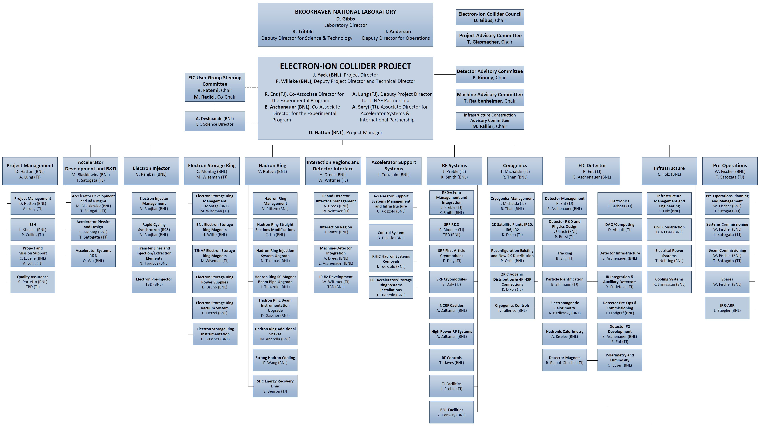
TJNAF Roles and Responsibilities
Responsibilities tied to expertise

Slide 11
EIC Partnerships
International and Domestic Partners
International and domestic partners are being pursued. Bi-lateral meetings with potential partners are underway to discuss opportunities in the accelerator and experimental areas.
Accelerator Partnership (Assuming ~5% In-kind, pursuing 10% goal).
In-kind contributions to the accelerator design and hardware are being pursued and were discussed at the “EIC Accelerator Partnership Workshop” this week
BNL and TJNAF will also engage U.S. domestic partners
Experimental Program Partnership Activities (Assuming ~30% In-kind)
Expressions of Interest (EoI) submitted in 2020
Call for Collaboration Proposals for Detector(s) - March 2021
Collaboration Proposals Due – December 2021
EIC Project Detector Defined – March 2022

Slide 12
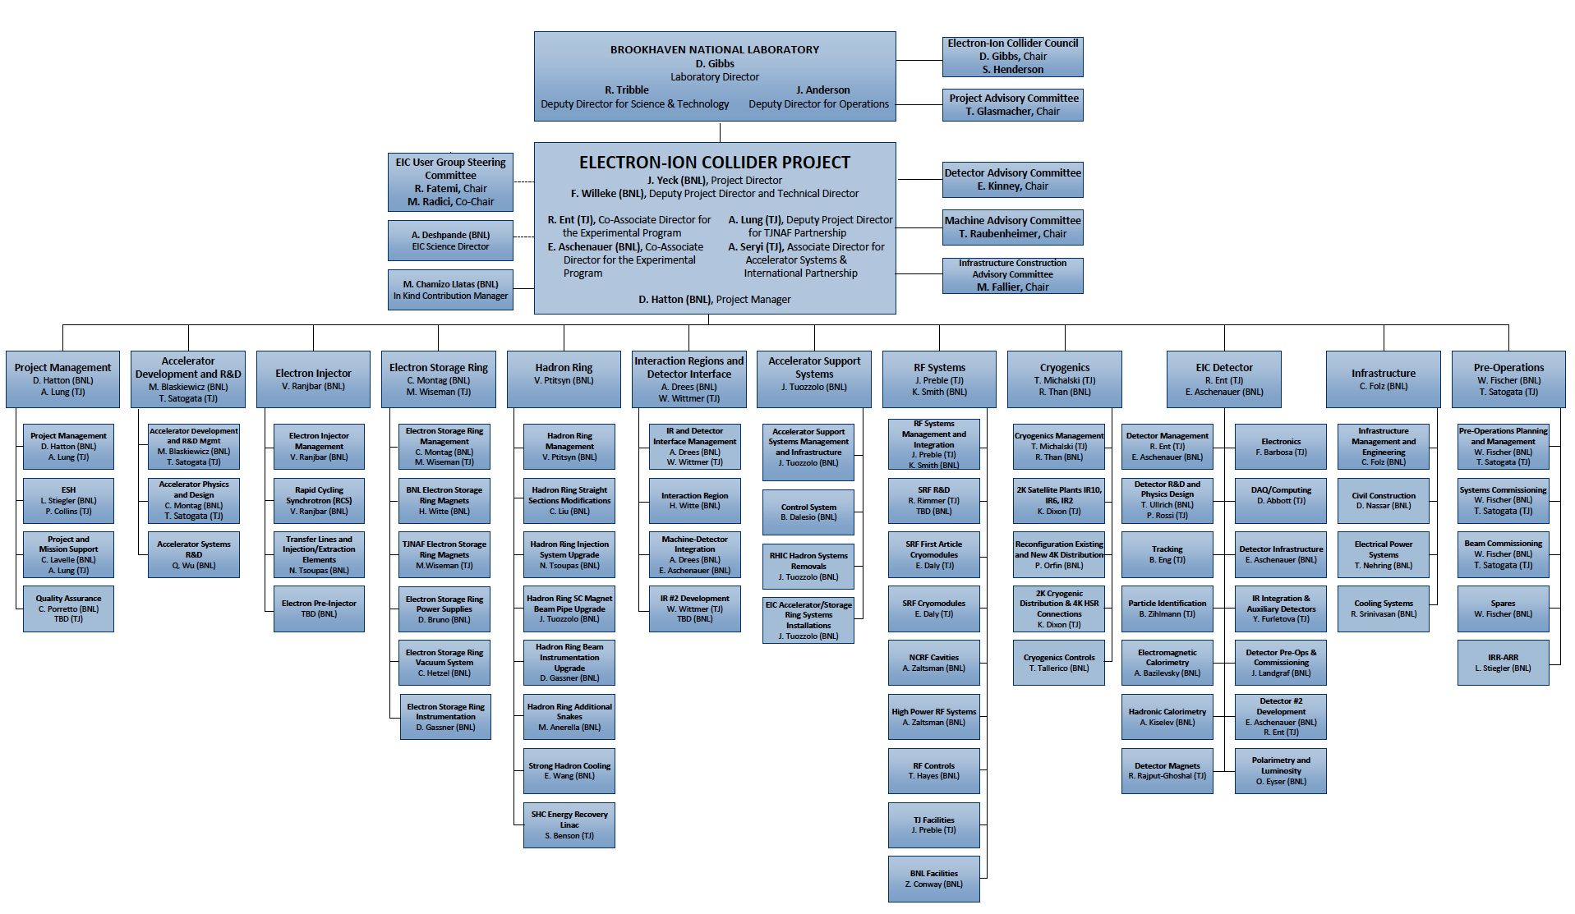
EIC Project Organization

Slide 13
EIC Governance
EIC is a DOE project, with traditional DOE accountability structure
The DOE and BNL/JLab vision is a facility for the world and fully international in character
DOE continues meetings and discussion with international funding agencies on cooperation and collaboration and is pursuing government to government agreements
BNL established an EIC Council (BNL and JLab Directors as founding members) and ready to include potential partners
The governance of the experimental program requires input from the EIC Users Group, detector collaborations, host labs, and funding agencies. There are many benefits to the CERN RRB model.
We hope to establish the governance model in the next year.

Slide 14
EIC Council
Name | Affiliation
Doon Gibbs | Brookhaven National Laboratory
Stuart Henderson | Thomas Jefferson National Accelerator Facility
The purpose of the EIC Council is to address issues affecting scope and/or resource allocation for the EIC project at BNL and at Partner institutions. The EIC Council advises the BNL Director on areas such as organization, scope, schedule, collaboration, and international engagement.
EIC Council meets nominally twice per year
Meetings: 26 April 2021, 1 December 2020, 25 June 2020

Slide 15
Next Steps
Continued development of the EIC accelerator collaboration to promote a coordinated effort to design and build the EIC. This approach is a strength of the accelerator science and technology community.
Increased technical exchanges among EIC accelerator collaborators to ensure that EIC benefits from the world-wide interest and expertise
Lab to Lab visits (in person, virtual as needed) to discuss specifics on potential in-kind contributions.
Transparency on potential possibilities for EIC in-kind and on progress. We need an existence proof.
EIC Accelerator Collaboration and Partnership Workshop in one year, ~October 2022.
Thank you for joining the effort to design and build the EIC!

