Slide 1
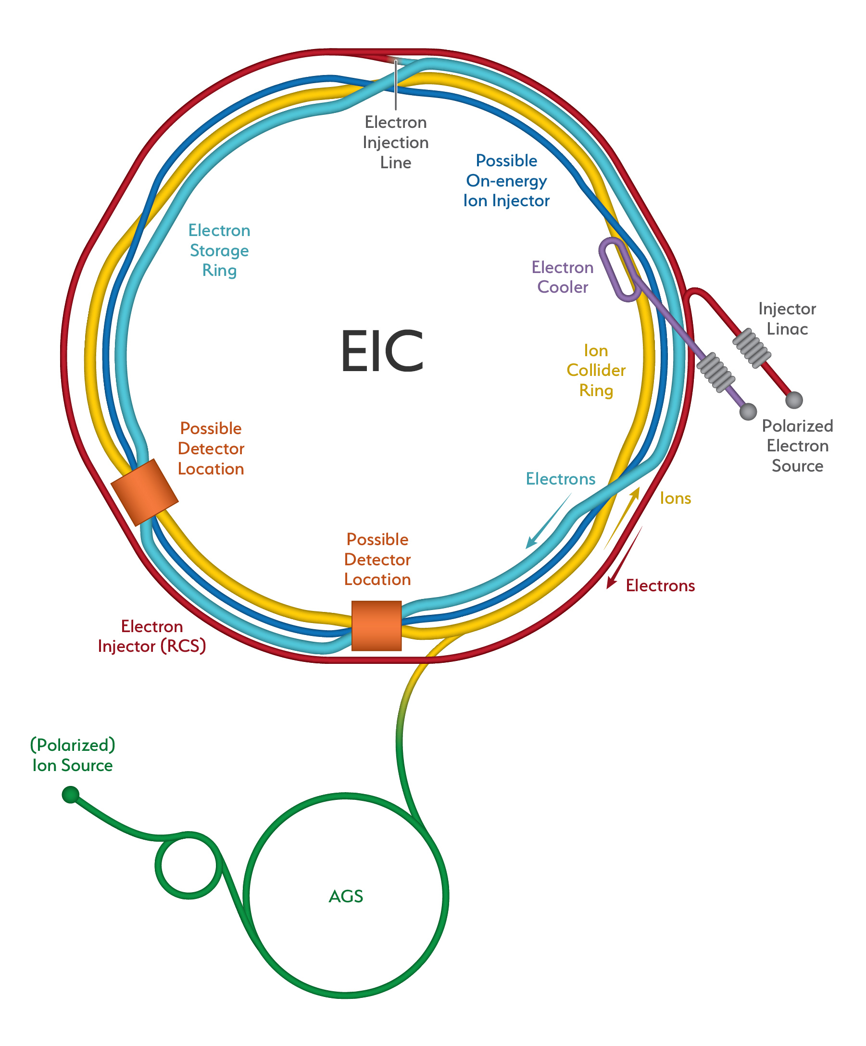
EIC Workshop 2021 – Closing Remarks
Oliver Kester
Associate Laboratory Director – Accelerators
TRIUMF, Canada

Slide 2
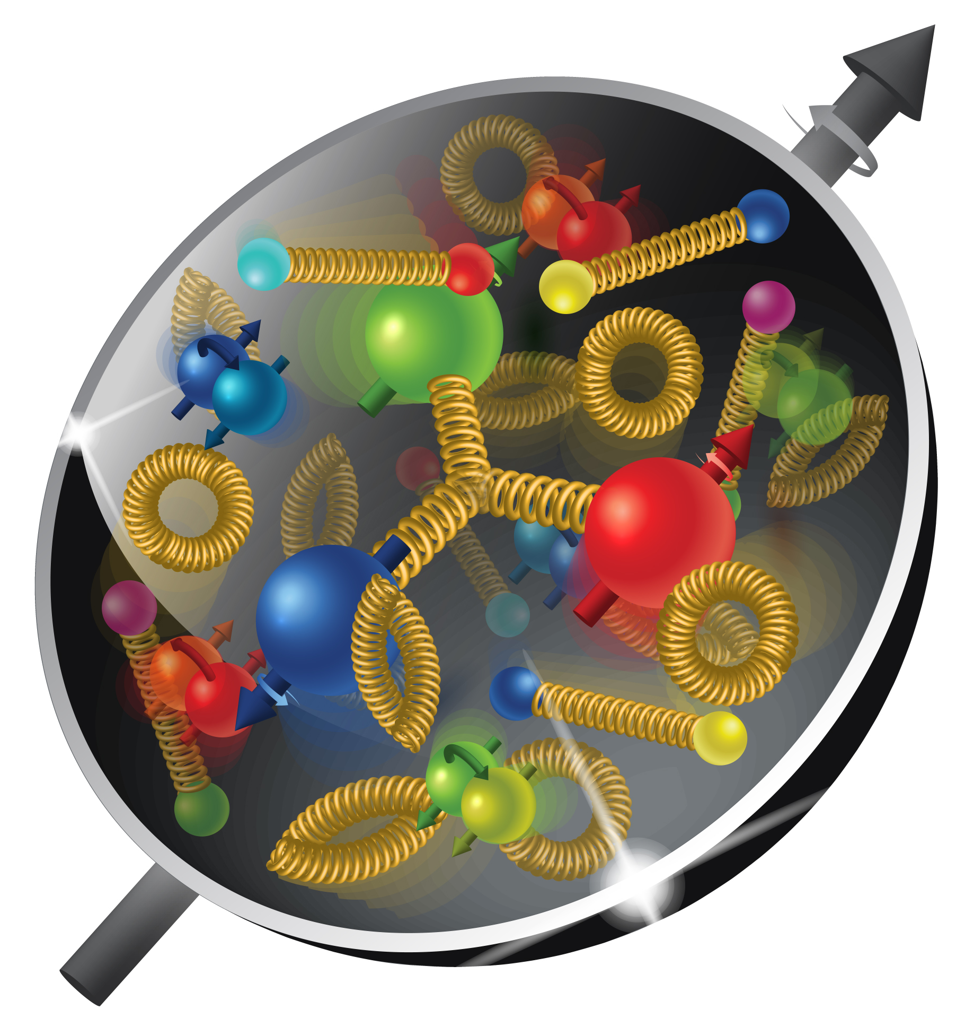
TRIUMF 2021 EIC Accelerator Partnership Workshop
The EIC Accelerator Partnership Workshop 2021 was (like in 2020) a global event with 284 registered participant from 23 countries
The workshop does Promote Collaboration on the Electron-Ion Collider at the leading edge of Accelerator Science and Technology.
Thanks to the speakers for the well prepared and exciting presentations and to the participants for the good and interesting discussions.
I want to recall what Tim Hallman said in the opening session: With the EIC project moving towards CD2 in early 2023 its time to define ‘who will do what’ and we need to work with our funding agencies to be part of this challenging project.
The workshop showed the status and demonstrated the required development and new ideas for IR SC magnets, MDI, SC cavities, vacuum systems (impedance issues, electron clouds,…), dealing with high beam currents etc.

Slide 3
Thanks to the LOC members
Silke Bergelt-Brückner (TRIUMF) – ACC Division Assistant
Andrei Seryi (Jlab) – EIC Associate Director for Accelerator Systems & International Partnership, Co-Chair
Bob Laxdal (TRIUMF) - Deputy ALD Accelerator Division
Ferdinand Willeke (BNL) – EIC Deputy Project Director and Technical Director

Slide 4
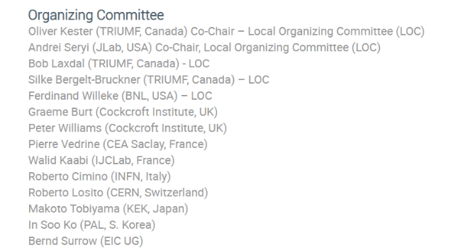
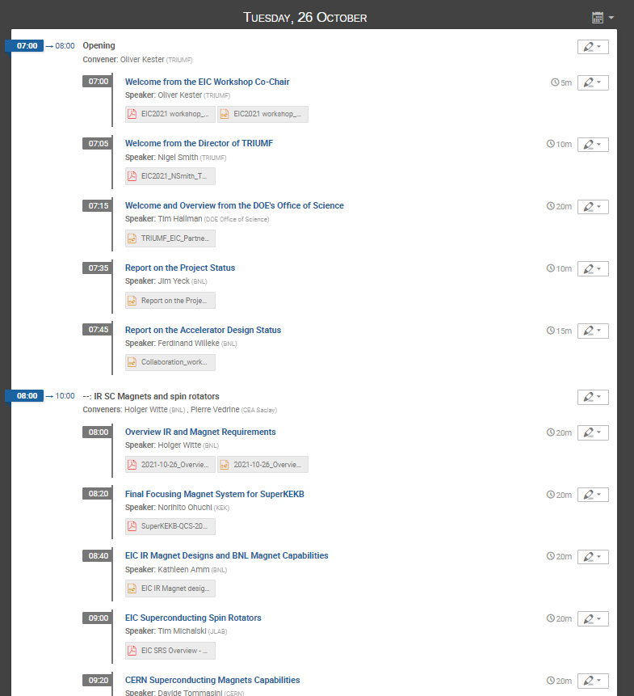
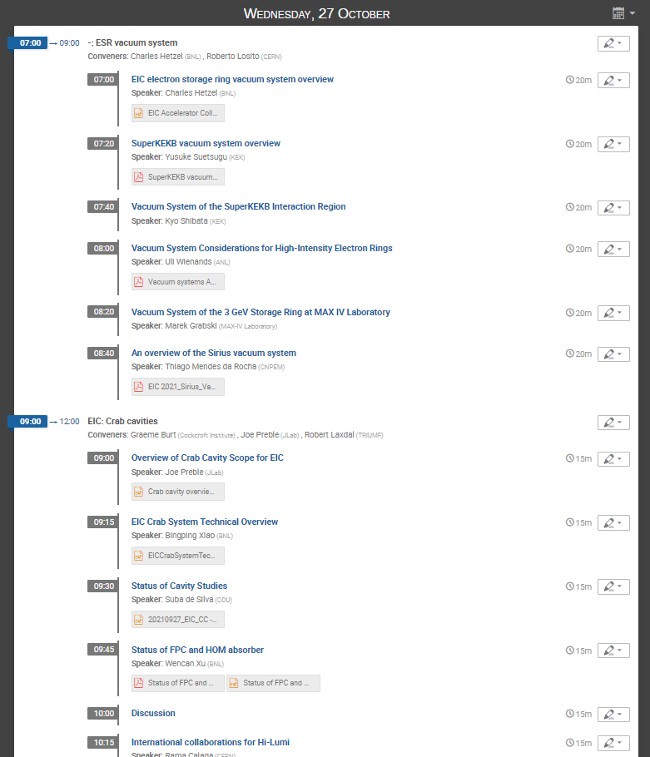
2021 EIC Accelerator Partnership Workshop program
Thanks to the members of the Organizing Committee for assembling a rich program of Accelerator Science and Technology topics.
Thanks to the session chairs for keeping the time and guiding discussions.

Slide 5
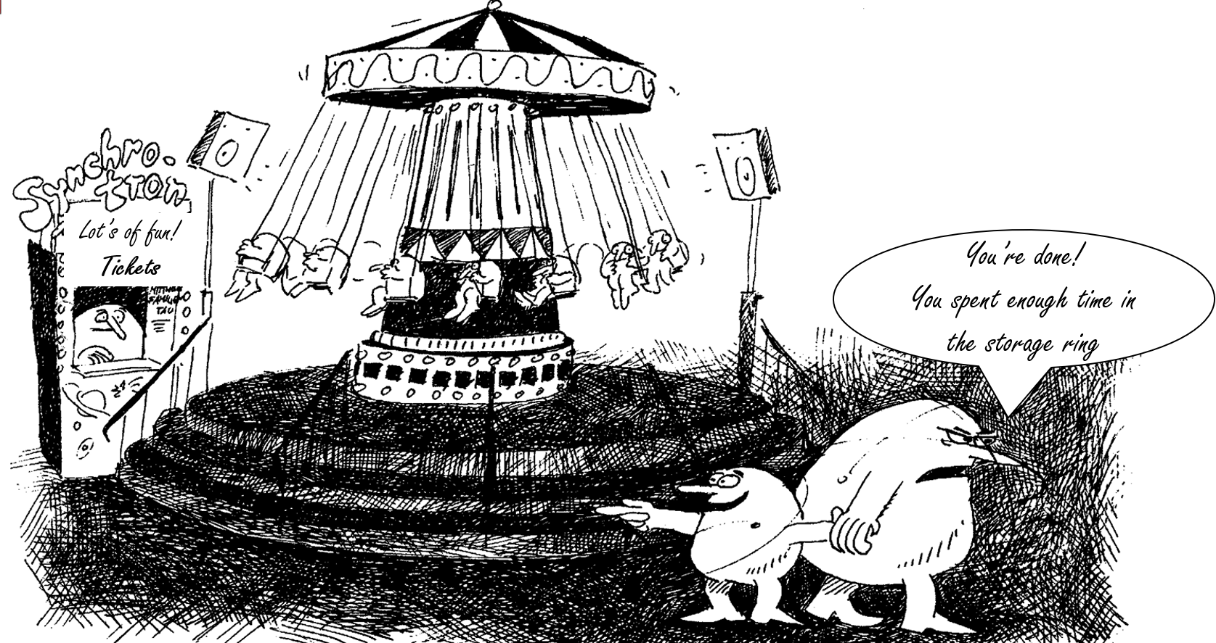
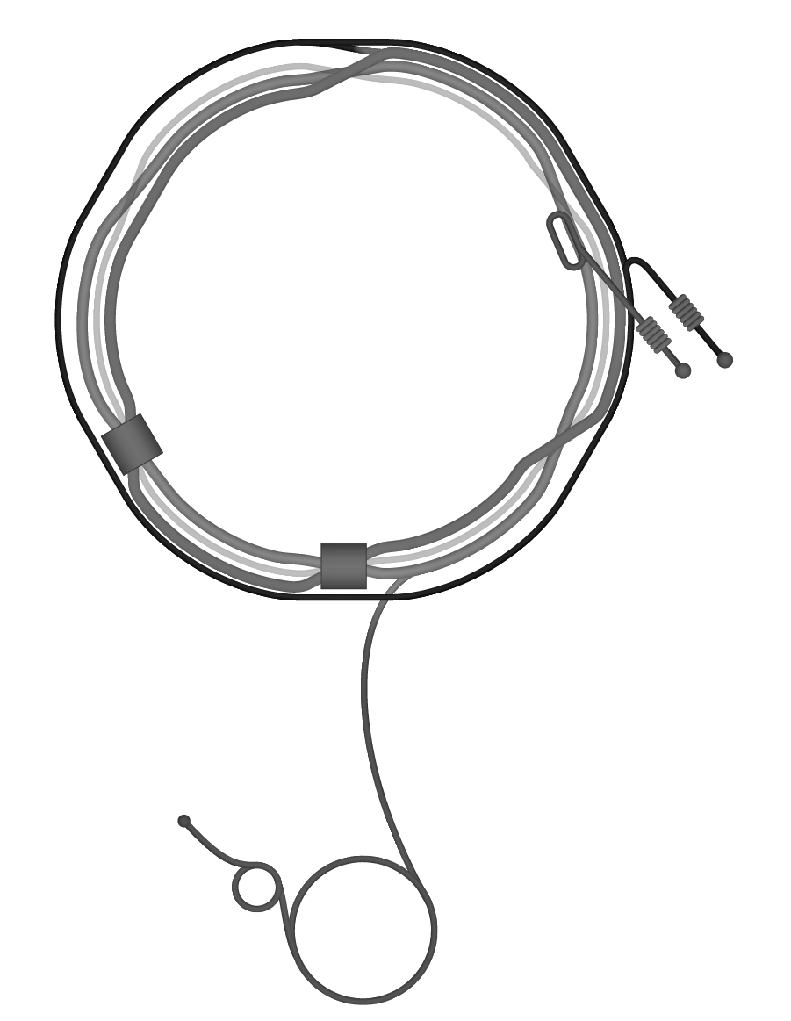
EIC

Slide 6
Thank you! Merci!
TRIUMF 2021 EIC Accelerator Partnership Workshop

