Slide 1
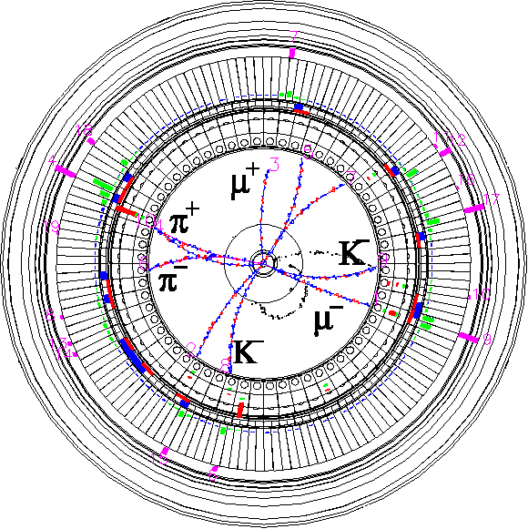


Vacuum system of
SuperKEKB interaction region
Kyo Shibata
(on behalf of SuperKEK Vacuum Group)
2021.10.27
TRIUMF 2021 EIC Accelerator Partnership Workshop
ESR vacuum system session
Inter-University Research Institute Corporation High Energy Accelerator Research Organization (KEK)
大学共同利用機関法人 高エネルギー加速器研究機構 (KEK)

Slide 2
Contents
Overview
IP pipe
QCS pipes
RVC
Summary
IP: interaction point
QCS : final focusing superconducting magnets system
RVC : remote vacuum connection
Almost all presentation materials were provided by
K. Kanazawa(SuperKEKB), S. Tanaka(Belle) and K. Gadow(DESY).

Slide 3
1. Overview

Slide 4
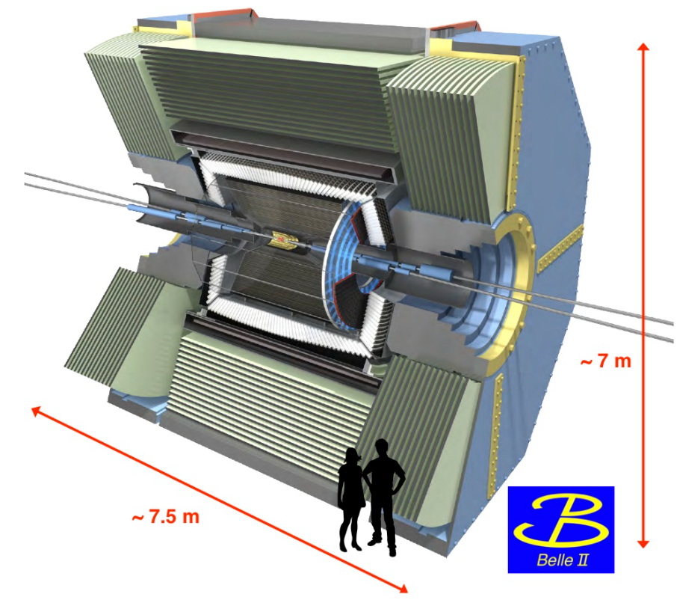
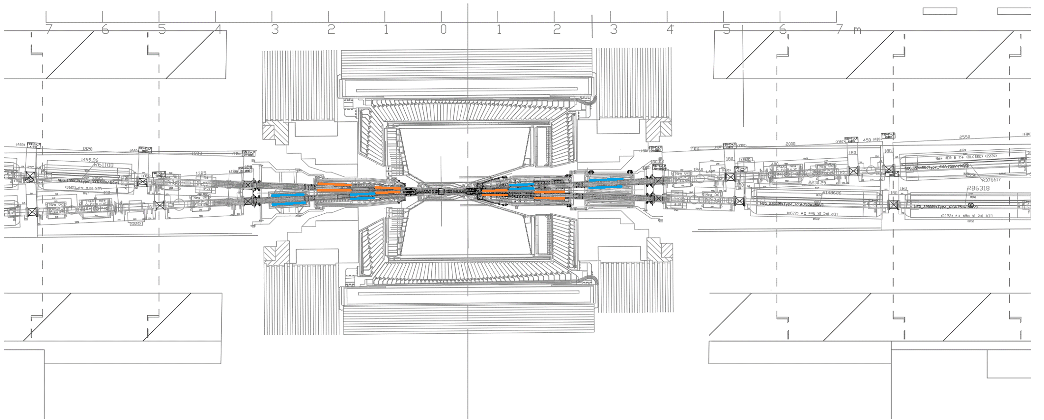
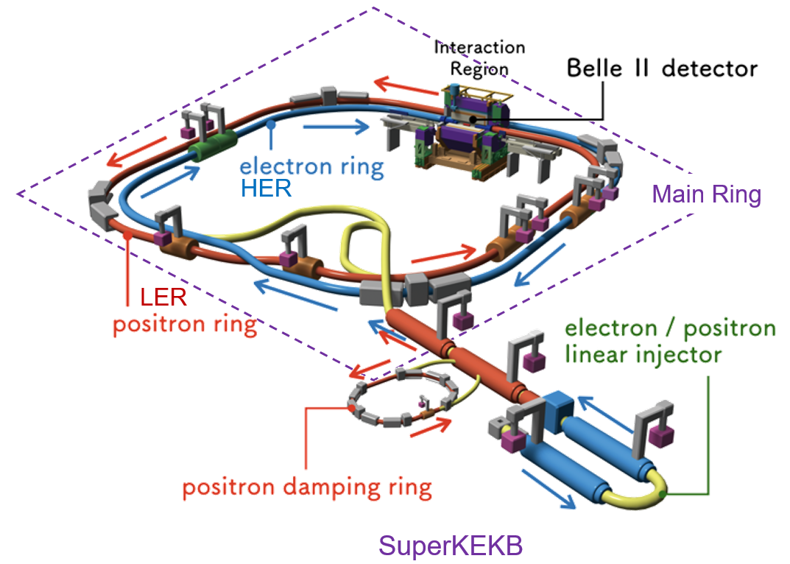
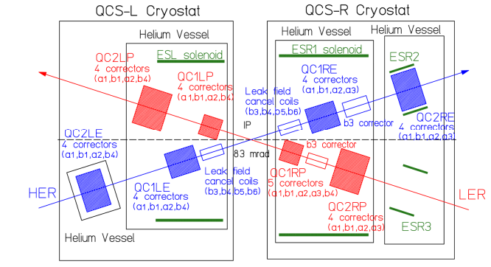
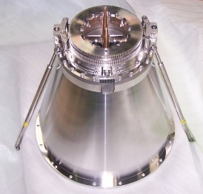
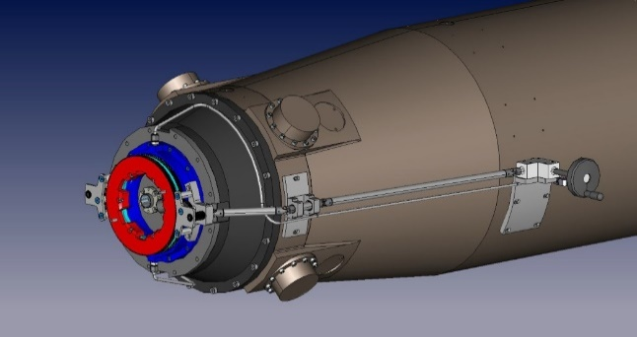
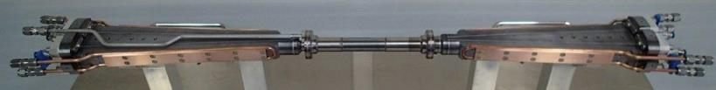
SuperKEKB interaction region
SuperKEKB Interaction Region (IR)
Belle II detector
IP pipe (Be)
Positron beam (4 GeV)
Electron beam (7 GeV)
Electron beam (7 GeV)
Positron beam (4 GeV)
QCS-L
QCS-R
(Final focusing superconducting magnets in the left system to IP)
(Final focusing superconducting magnets in the right system to IP)
RVC
RVC
Remote vacuum connection
SuperKEKB
QCS cryostat
Photo by DESY
QCS
Final focusing superconducting magnet system
IP pipe

Slide 5
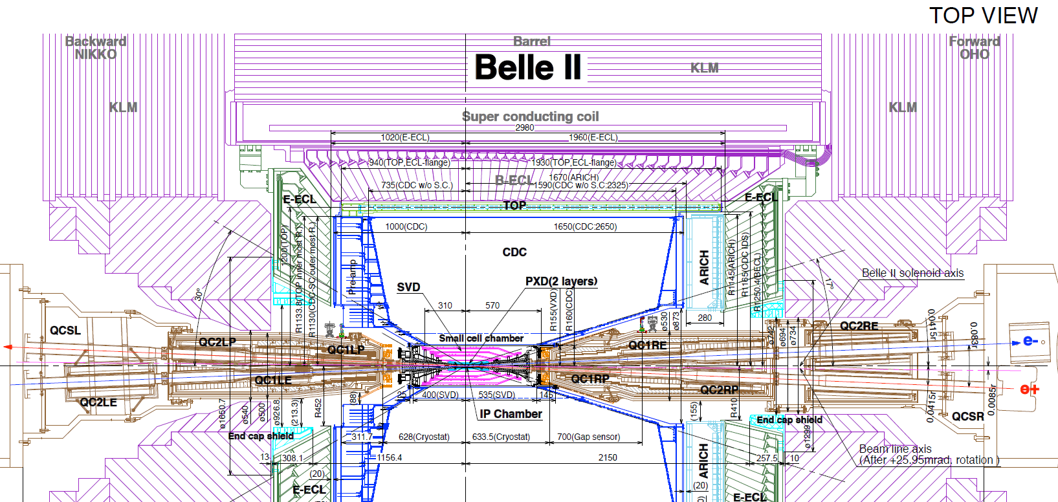
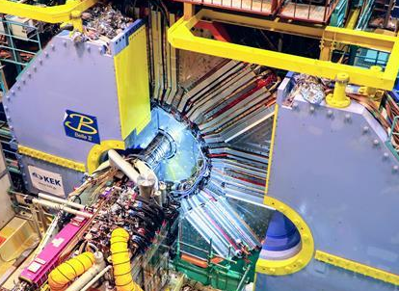
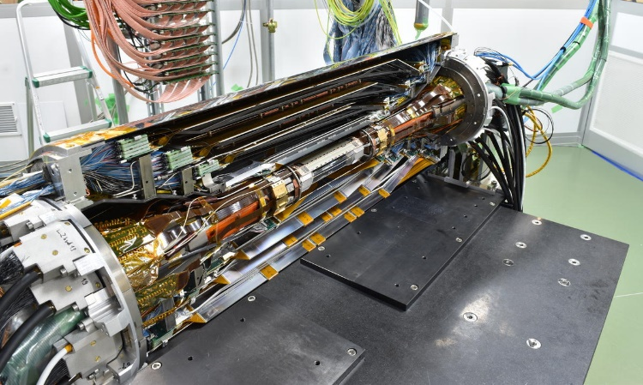
Configuration inside Belle II detector
VXD
QCS-L cryostat
IP pipe
RVC
RVC
QCS-R cryostat
BPM-bellows chamber
IP pipe assembled with VerteX Detector (VXD)

Slide 6
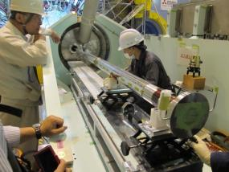
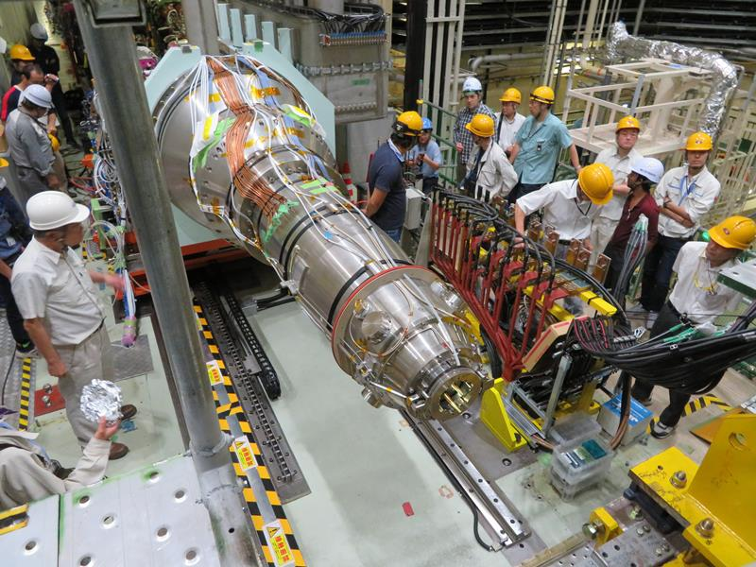
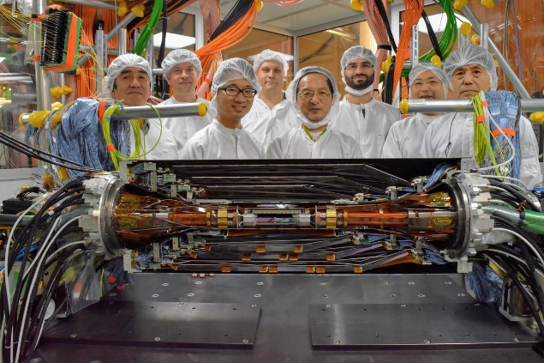
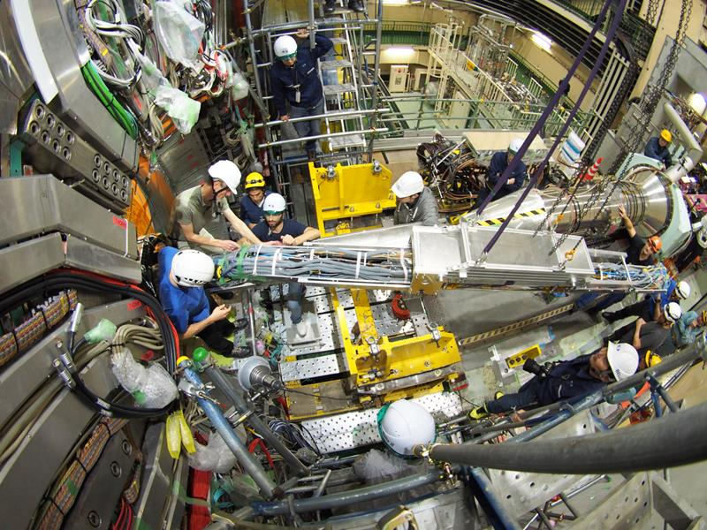
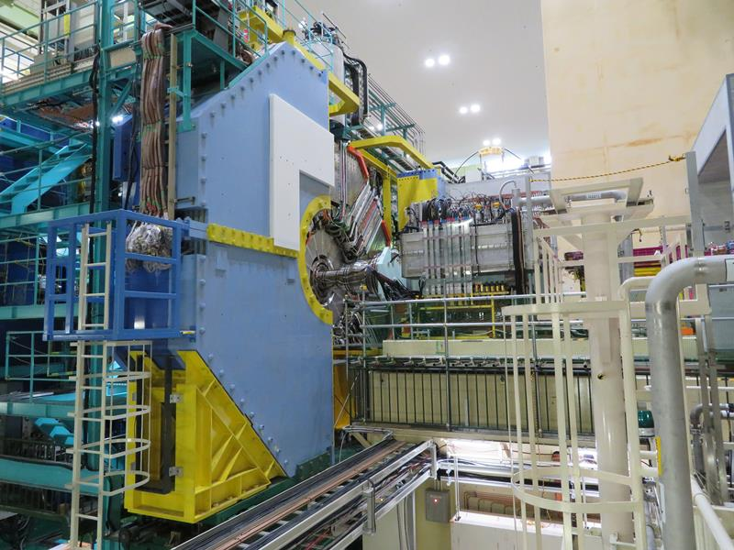
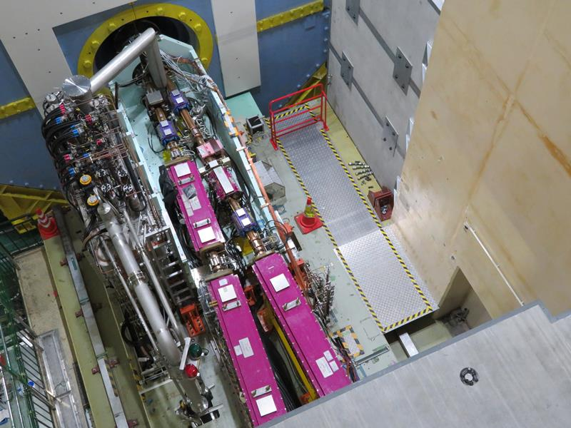
Installation procedure of IR beam pipes
1.1 Assembling IP pipe and VXD
1.2 Installing BPM-bellows chambers into both sides
of IP pipe
1.3 Installing IP pipe assembled with VXD into Belle II
2.1 Installing QCS beam pipes into QCS cryostat
2.2 Inserting QCS on movable platform into Belle II
3.1 Connecting IP pipe and QCS pipes by RVC
3.2 Installing magnets and beam pipes outside
movable platform

Slide 7
2. IP pipe

Slide 8
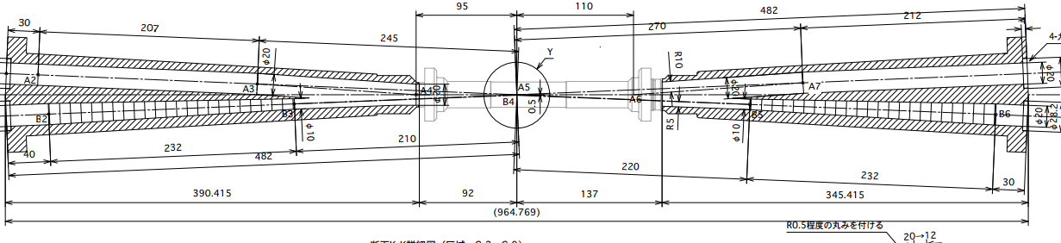
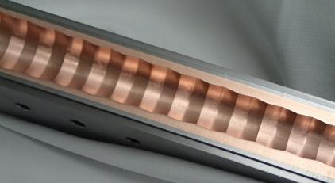
IP pipe
IP part
Crotch part
Taper/Ridge
Taper/Ridge
Electron beam
Positron beam
Ta
Ti
Be
Ti
Ta
Cu plated (∼10 μm)
Au plated (∼10 μm)
Cu plated (∼10 μm)
Water cooled
Paraffin cooled
Water cooled
Central IP part is made of Be and crotch parts are made of Ta.
Ti is used to connect Be and Ta.
Only taper parts are exposed to direct SR from last bend.
Ridge

Slide 9
Synchrotron radiation and Trapped mode
Electro-magnetic field (HOM) due to the crotch :
∼300 W
Au coat (10∼20 μm)
∼300 W
Be
φ10
No trapped mode at the central part
Positron beam
Electron beam
Taper/Ridge
HOM due to the taper and the ridge :
∼100 W
φ20
∼50 W
Taper : to reduce the number of photons entering into the central part
Ridges : to keep the direction of scattered photons away from Be pipe
Ridges are omitted to avoid complex machining.
This part is slightly bent downward (in this drawing) to avoid direct SR hit on Be pipe.

Slide 10
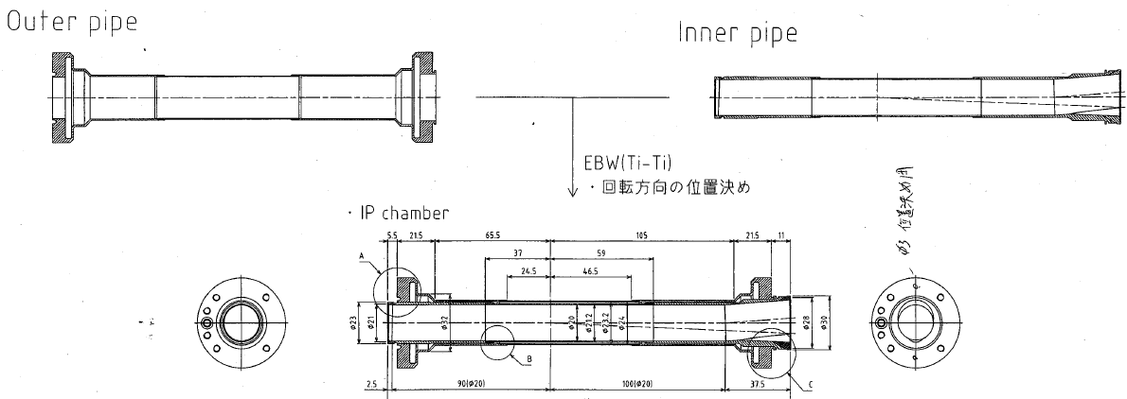
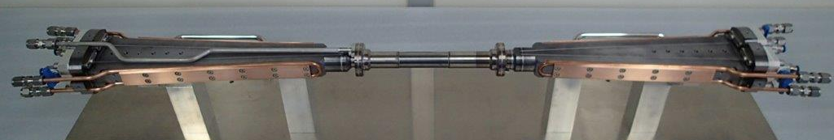
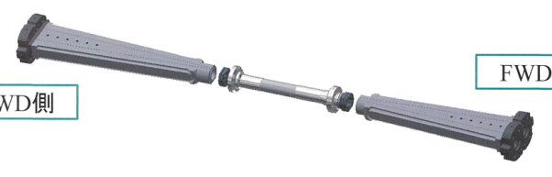
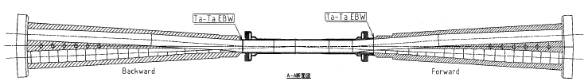
Central part of IP pipe
Be-Ti Brazing
Inner tube
Be-Ti Brazing
Ta-Ti by HIP
Outer tube
Ta-Ti by HIP
(HIP : Hot Isostatic Pressing)
Ti
Be
Ti
Ta
Ti
Be
Ti
Ta
Outer Be : 0.4 mm thick
Inner Be : 0.6 mm thick
Gap : 1 mm
Ti-Ti EBW
Ti-Ti EBW
The central straight part consists of inner and outer tubes.
Paraffin runs between tubes for cooling.
Connection between tubes is done by Ti-Ti EBW.
Connection between IP part and crotch part is done by Ta-Ta EBW.
Ta-Ta EBW
Ta-Ta EBW

Slide 11
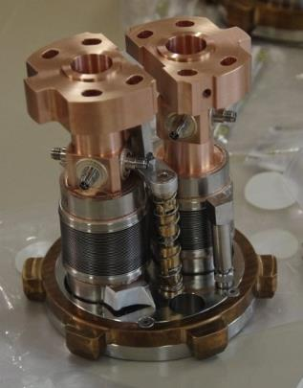

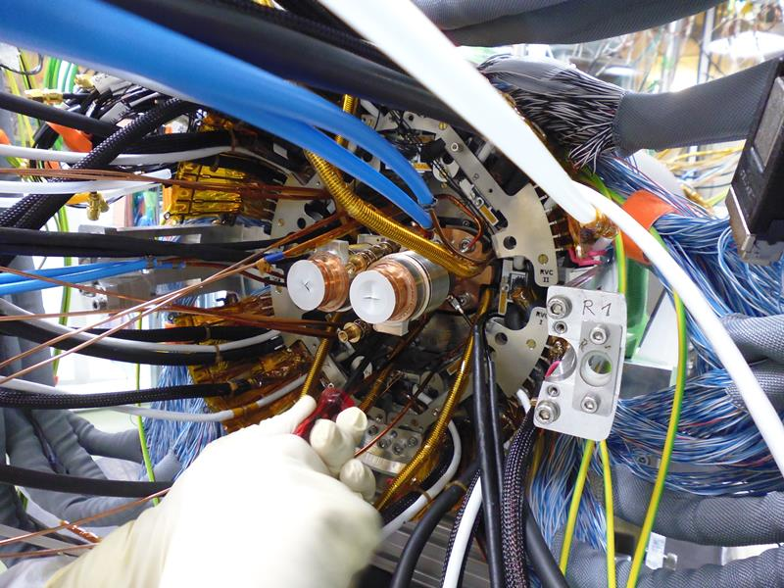
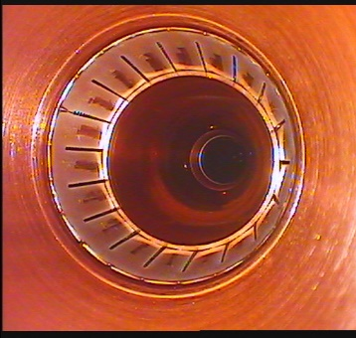
Installation of IP pipe into Belle II
1.1 Assembling IP pipe and VXD
1.2 Installing BPM-bellows chambers into both sides of IP pipe
1.3 Installing IP pipe into Belle II
BPM
Bellows with finger-type RF shield

Slide 12
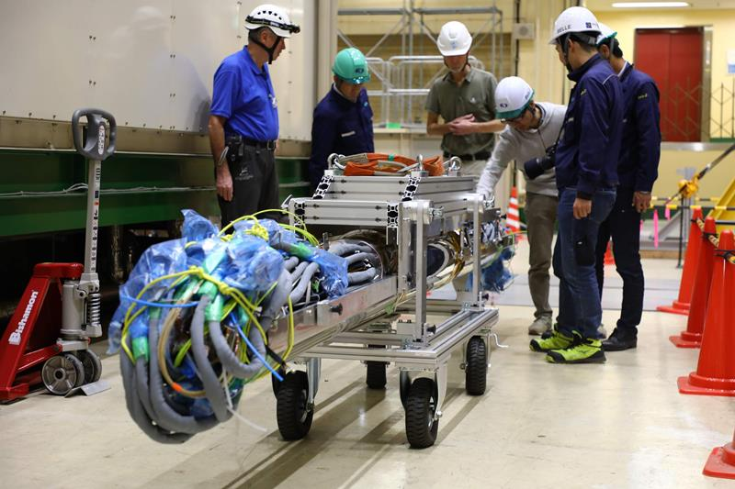
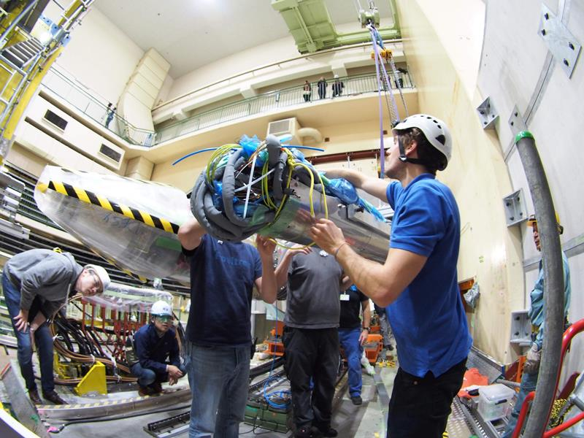
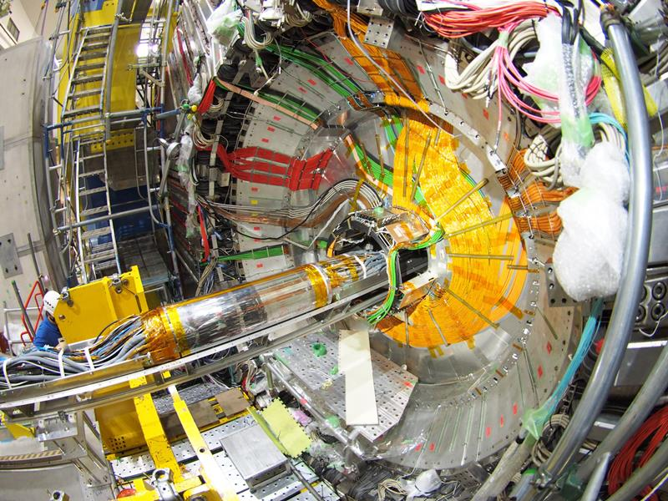
Installation of IP pipe into Belle II
1.1 Assembling IP pipe and VXD
1.2 Installing BPM-bellows chambers into both sides of IP pipe
1.3 Installing IP pipe into Belle II

Slide 13
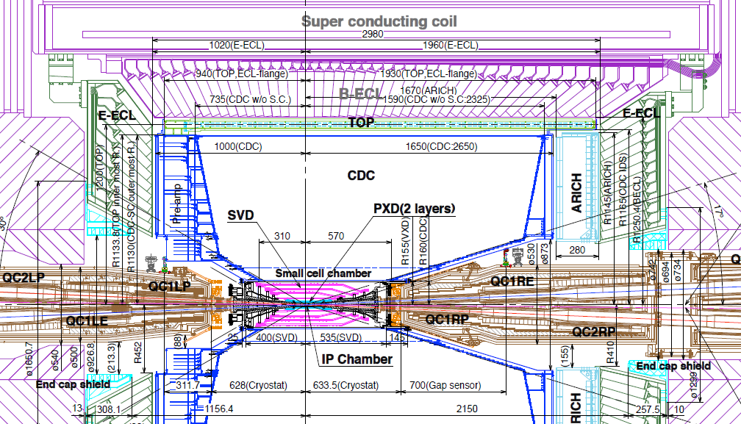
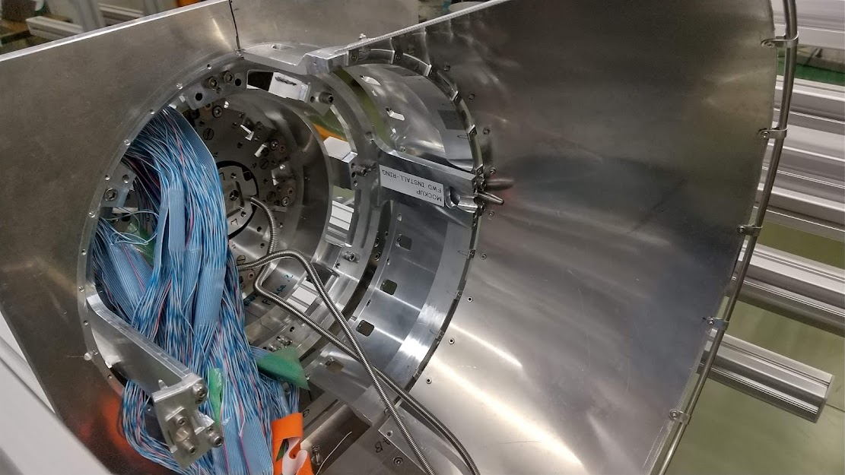
Installation of IP pipe into Belle II
1.1 Assembling IP pipe and VXD
1.2 Installing BPM-bellows chambers into both sides of IP pipe
1.3 Installing IP pipe into Belle II
IP pipe alignment
  IP-pipe_VXD assembly is mounted on CDC.
  Location of IP-pipe_VXD assembly is determined by CDC positioning pins.
  Position of CDC positioning pips are measured by laser tracker before installation of IP-pipe_VXD assembly.
  Pin holes of IP-pipe_VXD assembly are positioned so that the IP pipe can be installed in the proper position for the accelerator.
  Position of VXD is estimated from particle track data.
IP-pipe_VXD assembly installed into CDC (mock-up)

Slide 14
3. QCS pipes

Slide 15
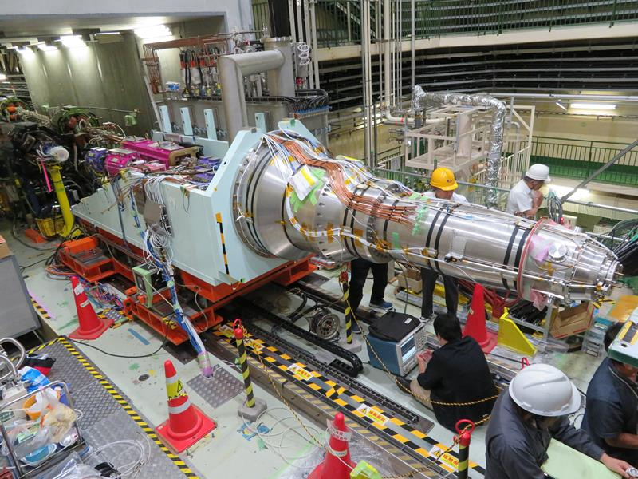
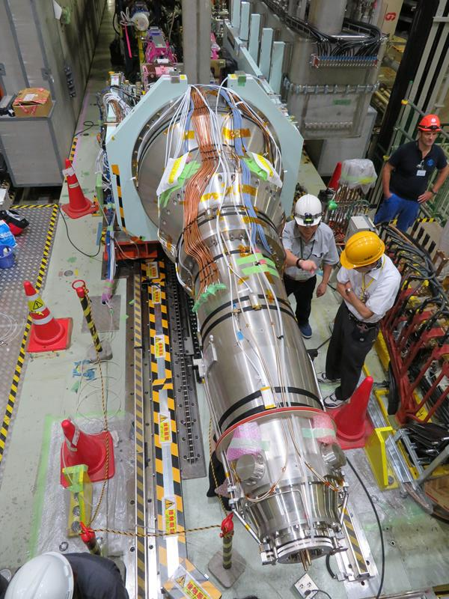
Beam pipes for QCS
Beam pipes are fixed to QCS cryostat.
They are made of stainless steel with a 4 mm thick wall.
They have water cooling channels on both sides.
Inner surface is coated with Cu (+ TiN only for positron ring).
Movable platform
Helium vessel
QC1LP
QC2LP
QC1LE
QC2LE
BPM
Bellows with O-ring seal
O-ring seal between beam pipes and cryostat
Beam pipe
QCS-L cryostat

Slide 16
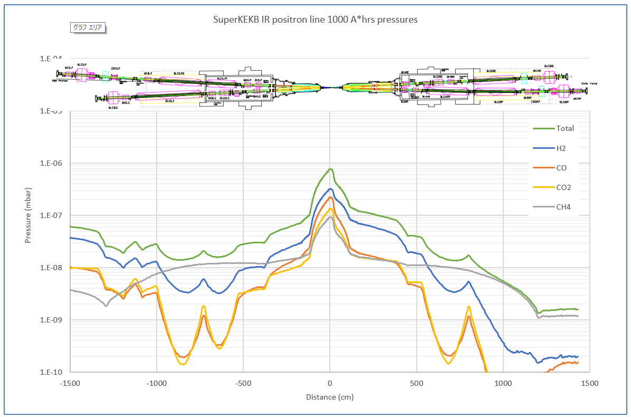
IR pressure distribution
IP pipe and QCS beam pipes have no pump.
Pressure at IP is estimated to be about one order higher than that at the end of the cryostat.
Thanks to J. Carter (ANL), M. Ady, R. Kersevan, and P. Chiggiato (CERN)
No vacuum pumps in this region.

Slide 17
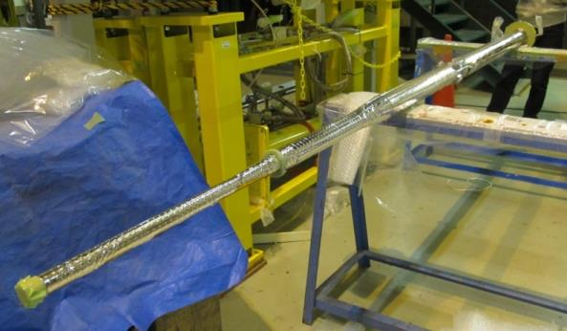

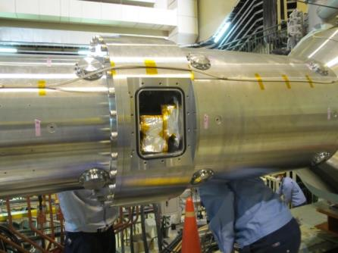
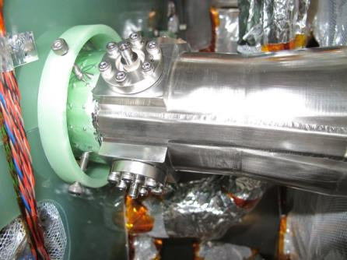
QCSR beam pipe installation
Installation procedure :
  Set beam pipe
  Attach BPM and leak check
  Connect BPM cable
  Leak check of the cryostat
super insulator
Fiberglass (G10) spacer
QCS beam pipe
Beam pipe is inserted using a special tool.
Service window on QCSR cryostat is used to manually guide the beam pipe and to attach BPM.
Service window
BPM
Photo by Y. Arimoto

Slide 18
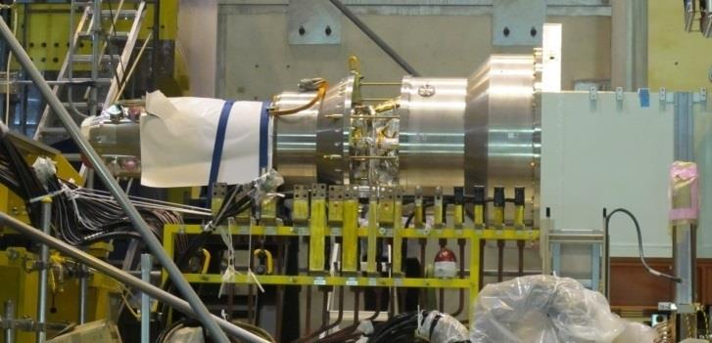
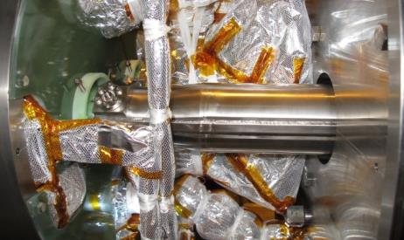
QCSL beam pipe installation
BPM
Photo by Y. Arimoto
Since QCSL cryostat has no service windows, the cryostat is disassembled for beam pipe installation.

Slide 19
4. RVC

Slide 20
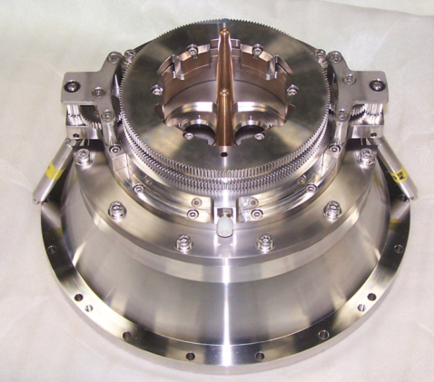
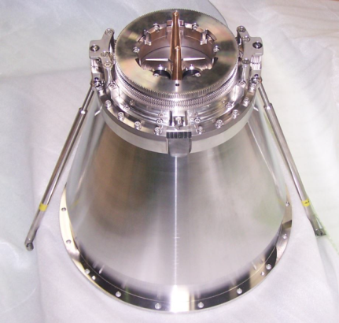
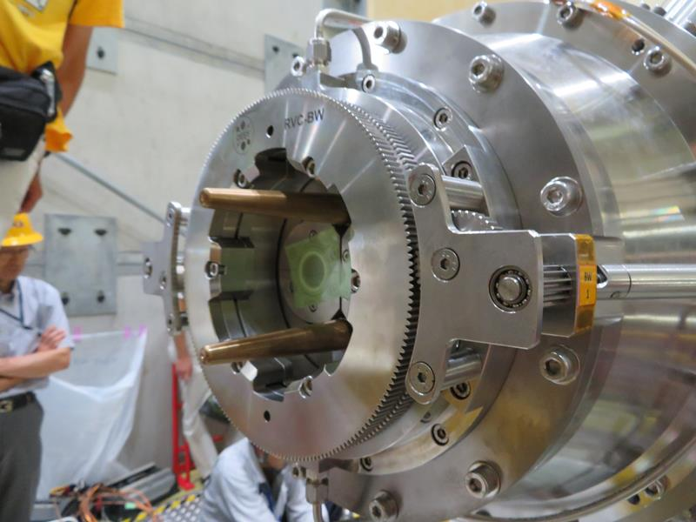

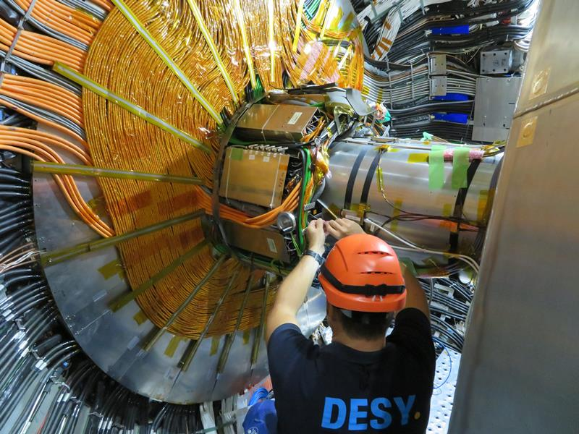
Remote vacuum connection (RVC)
Photo by DESY
QCS is inserted into Belle II by movable platform and connected to IP pipe.
There is no space for vacuum sealing work by hands.
RVC is a mechanism introduced by Belle group to connect QCS beam pipes to IP pipe (BPM-bellows chambers) by a remote manipulation.
RVC was designed and produced by DESY.
RVC on QCSL head
RVC on QCSR head
Remote manipulation wheel

Slide 21
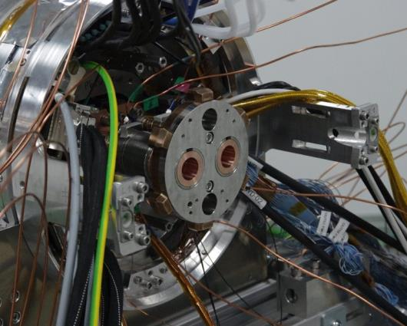
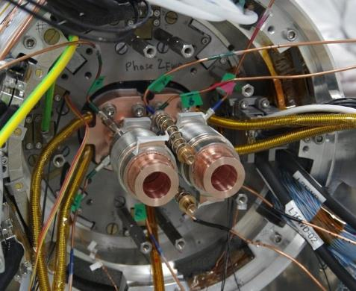
How RVC works
Drawing by K. Gadow
BPM-bellows w/ lock flange
QCS is inserted into Belle II.
Single lock flange with a retainer is attached to two bellows units.
BPM-bellows w/o lock flange

Slide 22
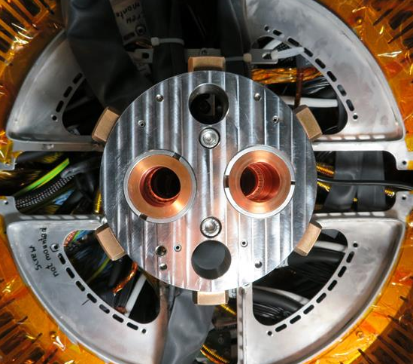
How RVC works
Drawing by K. Gadow
Protruding claws of the lock flange are caught by RVC.
These components (red+blue) rotate to catch the lock flange.

Slide 23
How RVC works
Drawing by K. Gadow
Cylinder for dry N₂ (about 50 bar)
High pressure N₂ gas is introduced into this volume.
As a result, vacuum sealing between IP pipe (BPM bellows chamber) and QCS pipe is completed.
These parts are connected to the piston in the cylinder, and shift to press the bellows flange to the cryostat.

Slide 24
How RVC works
Drawing by K. Gadow
This large light blue screw nut turns to lock the mechanism.
Completed!!

Slide 25
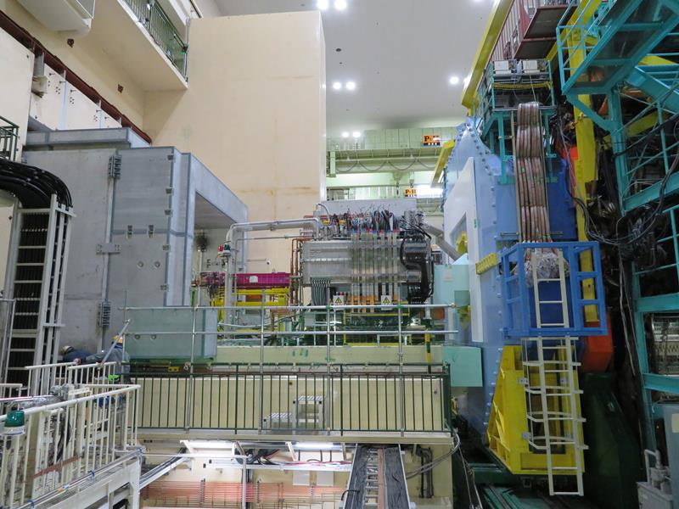
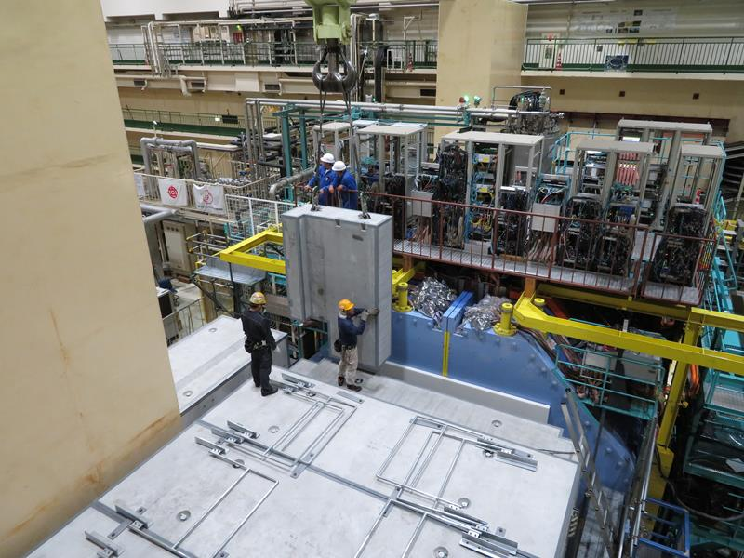
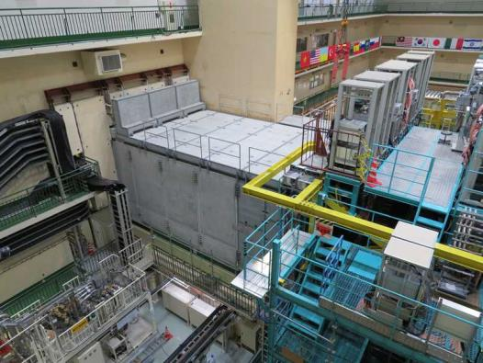
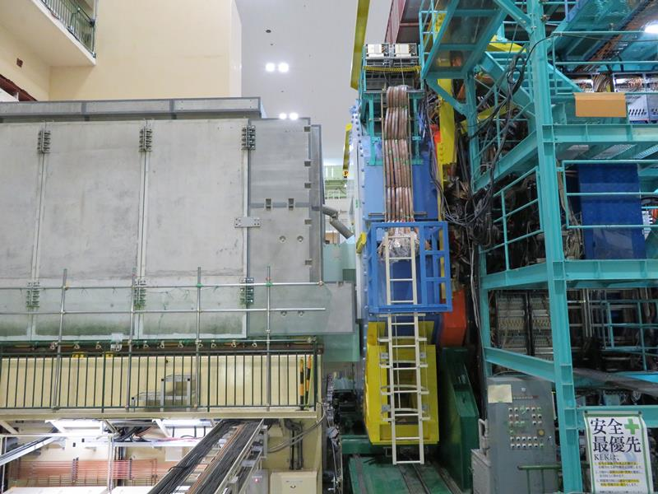


IR exterior appearance
Finally concreate radiation shields cover accelerator components.

Slide 26
5. Summary

Slide 27
Summary
IP pipe;
  IP pipe consists of Be (center), Ti and Ta (crotch) parts.
  Central Be pipe is not exposed to direct SR.
  Crotch part has taper and ridge structures to reduce the number of photons entering into the central part.
  IP pipe is assembled with VXD and installed into Belle II.
QCS pipes;
  SUS pipes are fixed to QCS cryostat and inserted into Belle II by QCS movable platform.
  QCS pipes have no pump
  Pressure at IP is estimated to be about one order higher than that at the end of the cryostat.
RVC;
  RVC is a mechanism introduced by Belle group to connect QCS pipes to IP pipe by a remote manipulation.
  RVC was designed and produced by DESY.

Slide 28
Fin.
Thank you for your attention.
Inter-University Research Institute Corporation High Energy Accelerator Research Organization (KEK)
大学共同利用機関法人 高エネルギー加速器研究機構 (KEK)

Slide 29
Backup

