Slide 1
The Canadian Light Source Project Process
Mark Silzer
Senior Project Advisor

Slide 2
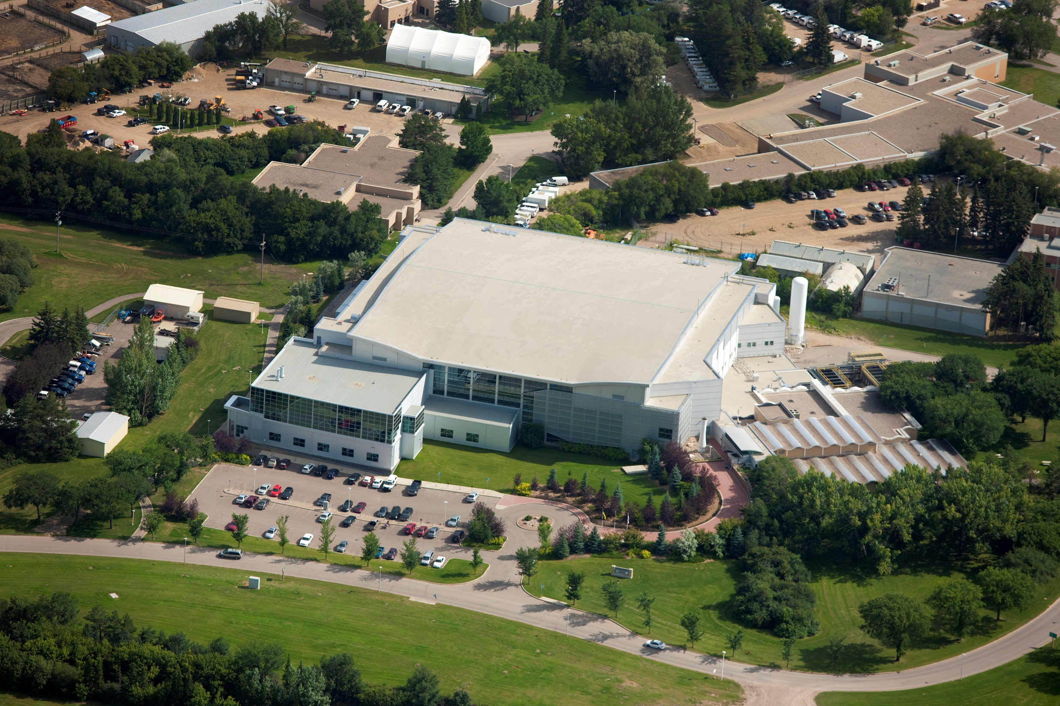

Slide 3
The Canadian Light Source
Located on the University of Saskatchewan in Saskatoon.
A synchrotron can be used to probe matter and analyze many physical, chemical, geological, and biological processes.
More than 1,000 academic, government, and industry scientists from around the world use the CLS every year.
We have roughly 250 Staff members.
Have roughly 20 beamlines for doing around-the-clock research for roughly 10 months a year.

Slide 4
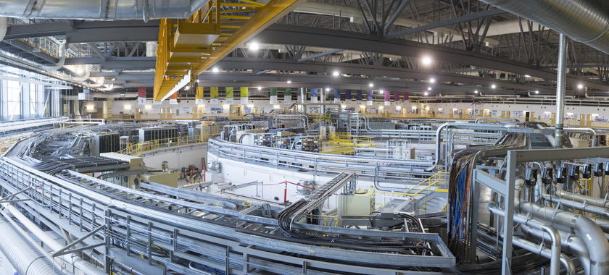

Slide 5


Slide 6


Slide 7
CLS Project Process Overview
Up until this year, the project process was only mandated for projects that required significant resources from the Machine division (Engineering, Accelerator Operations, Technical Services, Controls). This generally covered major machine upgrades, larger beamline upgrades, and infrastructure upgrades.
Suggested by the CLS Board of Governors and an external review: The Project Process has been mandated facility wide, including all projects. This will now include many more small science projects and System Technology projects etc.

Slide 8
Canadian Light Source Project Process
Based on a “waterfall” process, finish one stage completely before the next stage can commence.
Opportunity
Planning
Commission
Initiation
Execution
Closeout
Can and/or should CLS consider doing this?
Resource Request form
Define the project
Assign PM
Project Charter
Conceptual Design
Cost Estimate
Should CLS progress to Planning?
Create Work Packages
Build Plan
Develop Schedule
Preliminary Design
Budget Verification
Project Baseline
Should CLS proceed to Execution?
Final Design
Verification
Procure
Fabricate
Build
Program
Install
Test
Validation
Commissioning report
As-built drawings
Summary reports
Final cost report
Lessons learned

Slide 9
CLS Project Group (The PMO)
CLS Projects Group is located in the Executive Support Office
Supports the entire facility
Has the main functions of:
Governance over the project process
Mentoring project managers in the facility
Supplying Project Managers for selected large projects
Reporting project status to the Executive
Major Outage planning (maintenance and project work)

Slide 10
Who is the CLS project group?
Very limited resources in the group (Under the General Manager: 1 Senior Project Advisor + 3 Senior Project Managers)
Most project managers are supplied from other groups (Engineering, Accelerator Operations, Science, IT etc.)
Project management office (PMO) participates in the decision making for the projects. Major decisions require a larger group that has representation from Science, Executive support, Machine division managers, Finance, Project Sponsor, or others as required.

Slide 11
Key points to our process
Potential Projects are identified at the Opportunity Phase
Charter and Cost estimate work sheet to define the Initiation Phase
Planning phase sets baseline Scope, Cost, and Schedule. No purchases are allowed at the Planning Phase.
Budget is set going into Execution and Commissioning. Contingency (this is a sticky point at the CLS) is set into the budget based on project risks.
Closeout of projects must have a Lessons-Learned document that will be included in our database.
Deviation from the process (often to attempt to accelerate the process) require Director level approval and an acknowledgement of added risk of rework and increased cost.

Slide 12
CLS has developed a detailed swim diagram to help guide project managers, managers, and others as to their roles in the process.

Slide 13
Project Decisions
Jira system is used to display active and potential projects in their subsequent stages
Jira is used for all toll-gate decisions and project change request approvals. This includes such things as:
Should we spend resources to put together a Charter and Cost estimate for the potential project (Opportunity to Initiation Phase)
Should we authorize additional resources to Plan the Project (Initiation to Planning).
Should we reject, shelve or Execute the project (Planning to Execution)
All major changes to the project Scope, Schedule, or Budget must be authorized using out change request process.
Any “over-rides” to the process are approved in Jira.

Slide 14
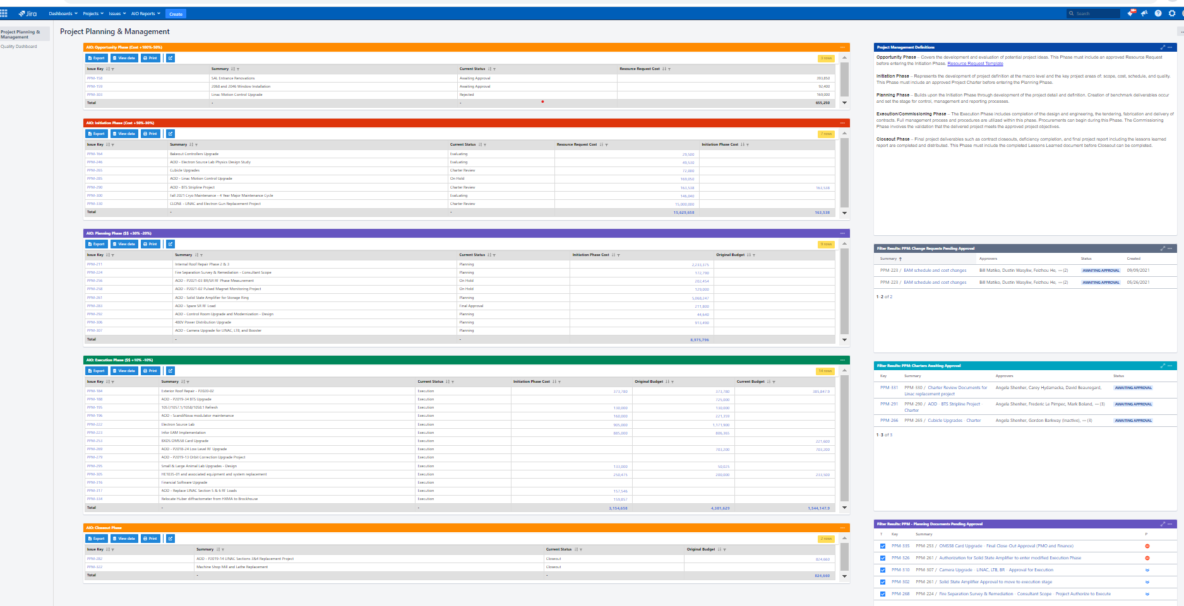
Our Jira Dashboard

Slide 15

Checks and Balances
Try to incorporate procedural checks into our system
Purchases must route through the PM for approval
Change requests must route through the project sponsor
The General Manager, Senior Project Advisor and Budget and Planning Manager are used strategically in many approvals to ensure proper procedures are followed.

Slide 16
A Graded Approach
The larger the project the more control is required
Some small projects can be handled using our Engineering Change Requests system.
Small projects require only a timeline and costing information.
Large projects require:
A Project Management Plan, outlining how major PM areas will be governed (Schedule, Cost, Resources, Communication, Risks etc.)
A detailed schedule, detailed costing, and a detailed work breakdown.
Other documents may be required.

Slide 17
Regular Reporting: Monthly Reports
Monthly Reports are required by all project managers to communicate:
PMs assessment of projects health wrt Scope, Schedule, and Cost
Upcoming milestones (what needs to be done in what outage)
What was accomplished in the previous month?
What is planned for the upcoming month(s)?
Technical Issues?
Project Management issues (egs. Human resource issues)?

Slide 18

Monthly Meetings
(now virtual)
Monthly meetings are used to enhance communication between PMs and resource managers.
The meetings are used to report resources used for all higher priority projects and compare this to the current CLS priority list. Are we using resources on the projects that the CLS deems as highest priority?
Resource Managers are there to address resourcing issues.
PMs give brief project updates, upcoming change requests are identified, and project health is discussed.

Slide 19
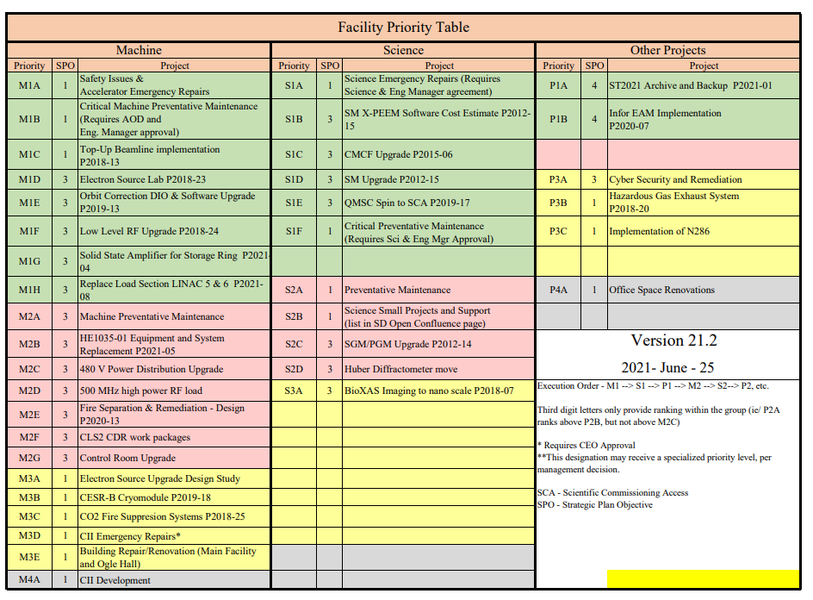

Slide 20
Establishing a culture to improve.
The Project Process is designed to allow for continual improvement.
Lessons-learned documents are required at the end of every project.
Lessons-learned database is being established to allow for future projects to more easily use this data early in the project process.
Templates are used extensively to help guide the process. These are continually being refined and updated.
Projects are set up to track resources for smaller sub-projects so that we can learn for future projects.
Vendor reports etc. are used to identify good or problem vendors.

Slide 21

The tough road to change
Shifting of a culture is hard. Initial buy-in is definitely not automatic
Invest in training people with PMBOK based project management. This could be anything form a few day to courses lasting many weeks.
Some of the “trained” people will become champions for the cause.
Don’t try and implement too much, too soon.
Make it as easy as possible. Automate, and use templates to fight the “there is too much paper work” belief.
Continue to adapt. “The first pancake is always lumpy”.

Slide 22

A look to the future.
Reopening the process to build on the recent training that others have received.
There is a move to adding some Agile that is being considered.
Likely Agile sub-tasks in a waterfall framework.
New Priority chart with built in Project reporting….
Now at the brainstorming phase.

