Slide 1
Microelectronic Simulations of the Proton in Silicon using Geant4 for Beam Lifetime 3 Experiment
JABIA MOAZAM
University of Manitoba

Slide 2
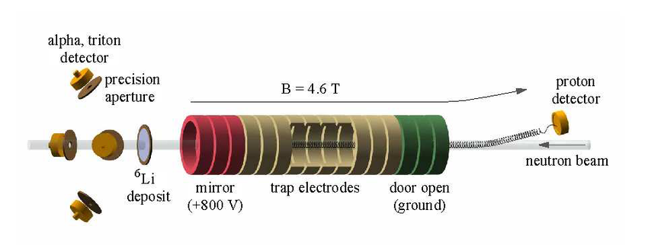
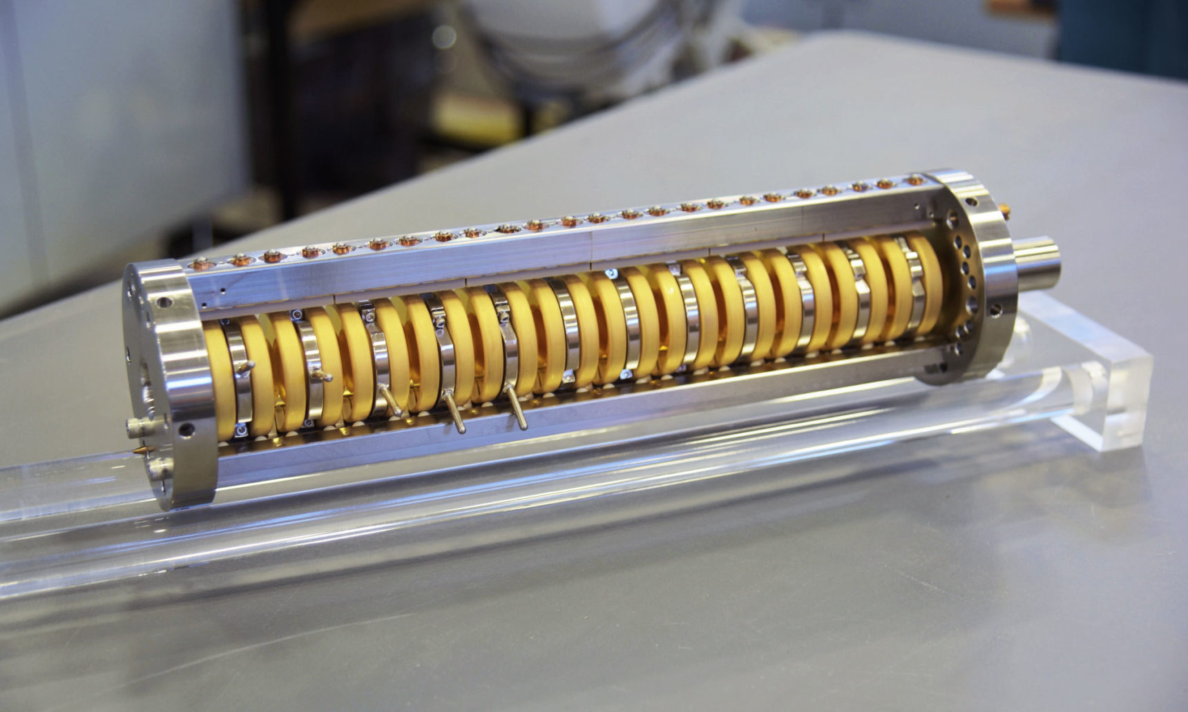
Beam Lifetime 3 Experiment
The Proton Detector at the National Institute of Standards and Technology used in the “Beam Method.”[1]
An illustration of the method of measuring the lifetime with a cold neutron beam.[2]
[1] https://www.quantamagazine.org/neutron-lifetime-puzzle-deepens-but-no-dark-matter-seen-20180213/
[2] Determination of free neutron lifetime 20 October 2014.

Slide 3
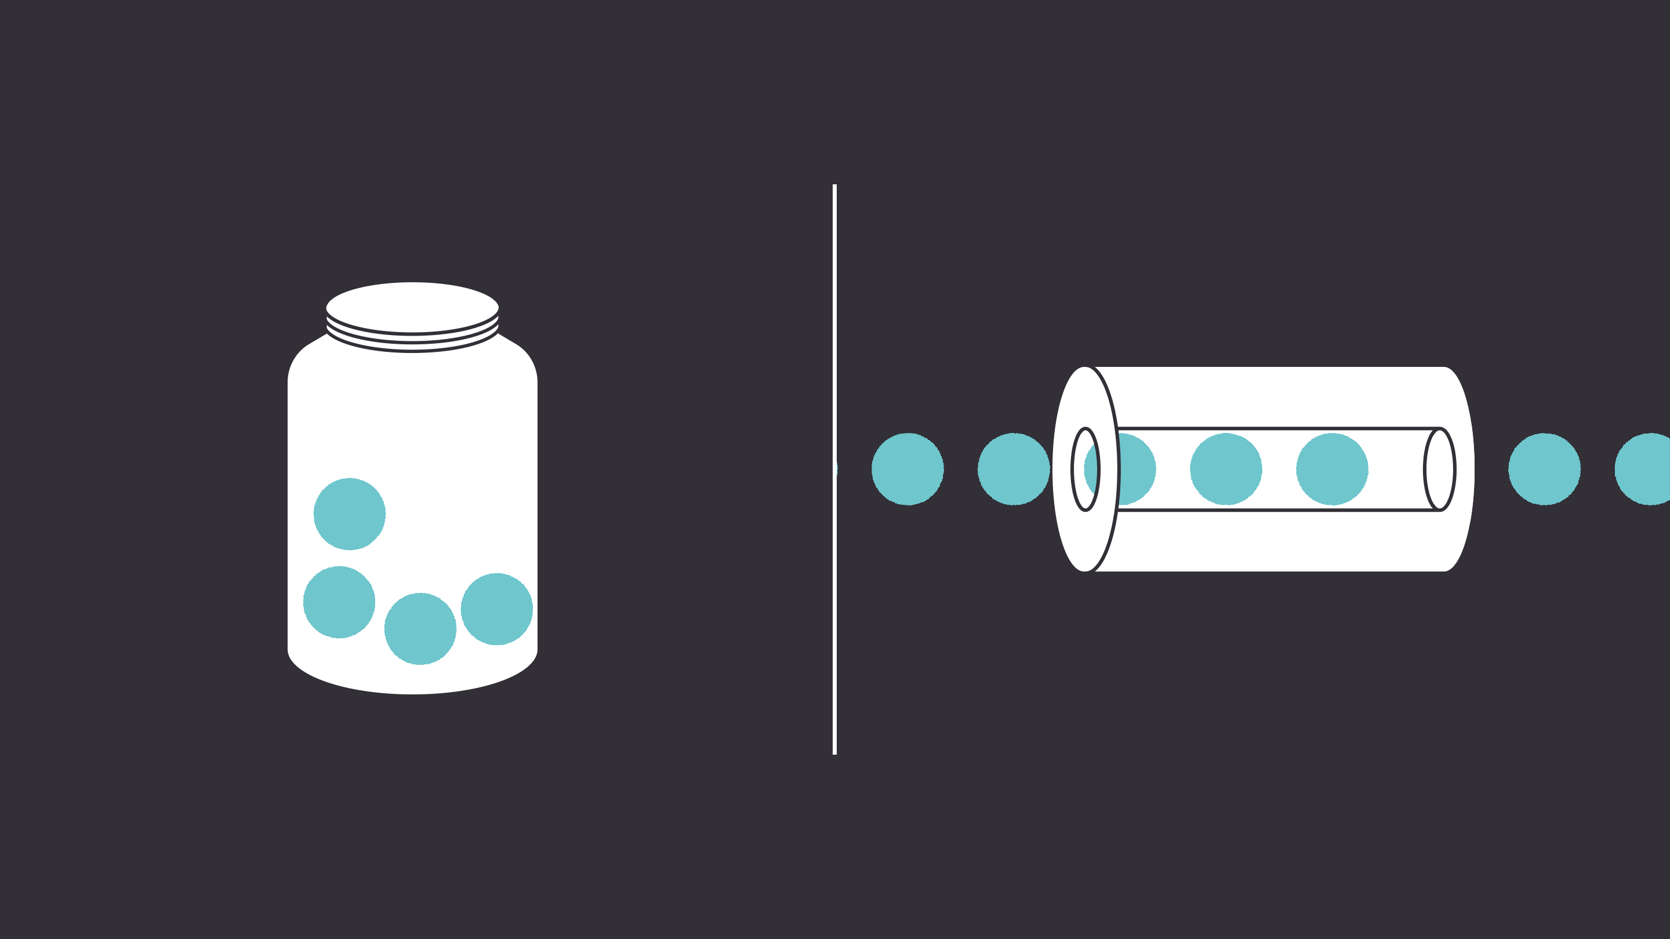
Techniques to Measure Neutron Lifetime
Bottle method: Free neutrons are trapped in a magnetized bottle where they begin to decay into protons.
Beam method: A beam of neutrons decays into protons, and the protons are counted.
Bottle Method [3]
[3] https://www.quantamagazine.org/neutron-lifetime-puzzle-deepens-but-no-dark-matter-seen-20180213/

Slide 4
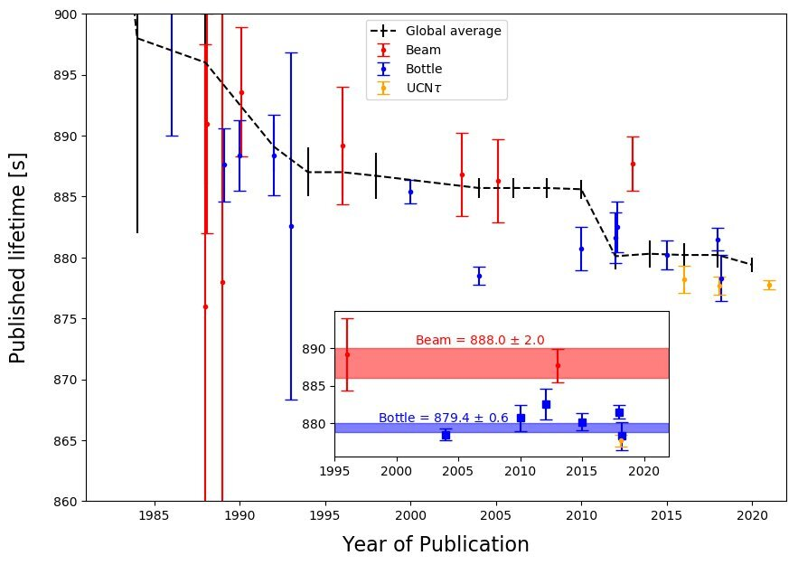
Neutron Lifetime Discrepancy
The lifetime of the neutron is about 15minutes
Physicists have spent decades measuring the precise lifetime of the neutron
Results differ by multiple standard deviations in the uncertainty
The latest experiment is the UCNtau experiment
The bottle and beam mystery is still there.
[4] https://phys.org/news/2021-10-physicists-world-precise-neutron-lifetime.html
A comparison of neutron lifetime results from several experiments performed since the early 1980s [4].

Slide 5
Significance of Neutron
Neutrons are hard to detect
We use a Silicon detector to detect protons
35 keV protons on 500 nm silicon detectors
It is dense material with many scattering processes
Backscattering under large angles
It is not thin foil, it depends on the thickness of the dead layer.
Depends on the metallization layer

Slide 6
Simulation Tools
1) SRIM (Stopping and Range of Ions in the matter):
Energy deposition, dead layer effects, and charge sharing.
2) TRIM (Transport of Ions in Matter):
It accepts complex targets made of compound materials, ion’s energy loss, target damage, and ionization.
3) Geant4 (Base Simulation):
It is a platform for the simulation of the passage of particles through matter.

Slide 7
Screened Nuclear Recoil
A process that manipulates screened coulomb collisions between nuclei.
Multiple scattering processes for protons and ions are substituted by a single scattering process.
Geant4 covers all relevant physics processes.
It is used to produce statistical distributions of particles.
Used different screening functions, the default functions are:
ZBL(Ziegler-Biersack-Littmark): used for Soft Scattering
LJ (Lennard-Jones): used for Backscattering
Mol: used for Moliere Potential

Slide 8
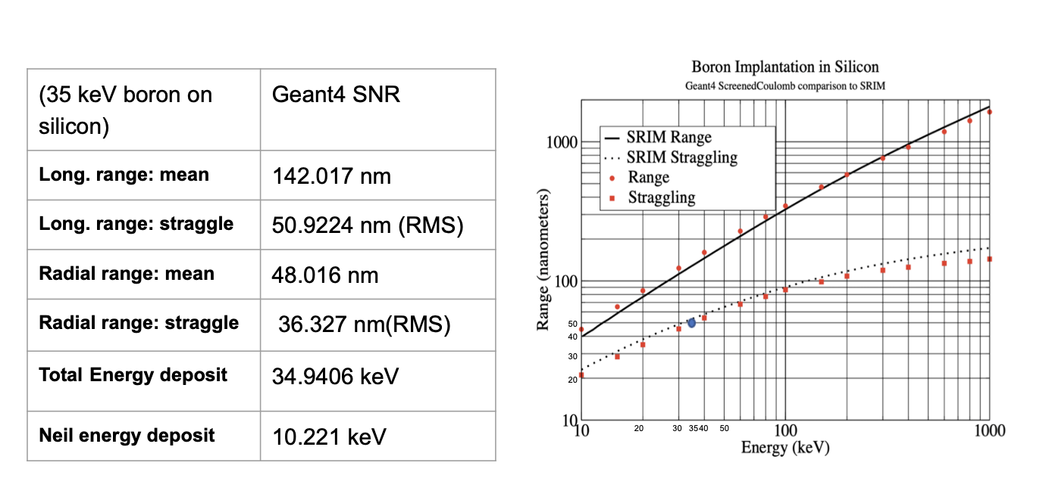
Boron Implantation in Silicon
[5] An algorithm for computing screen coulomb scattering in GEANT4 Marcus H. Mendenhall, Robert A. Weller, October 2018

Slide 9
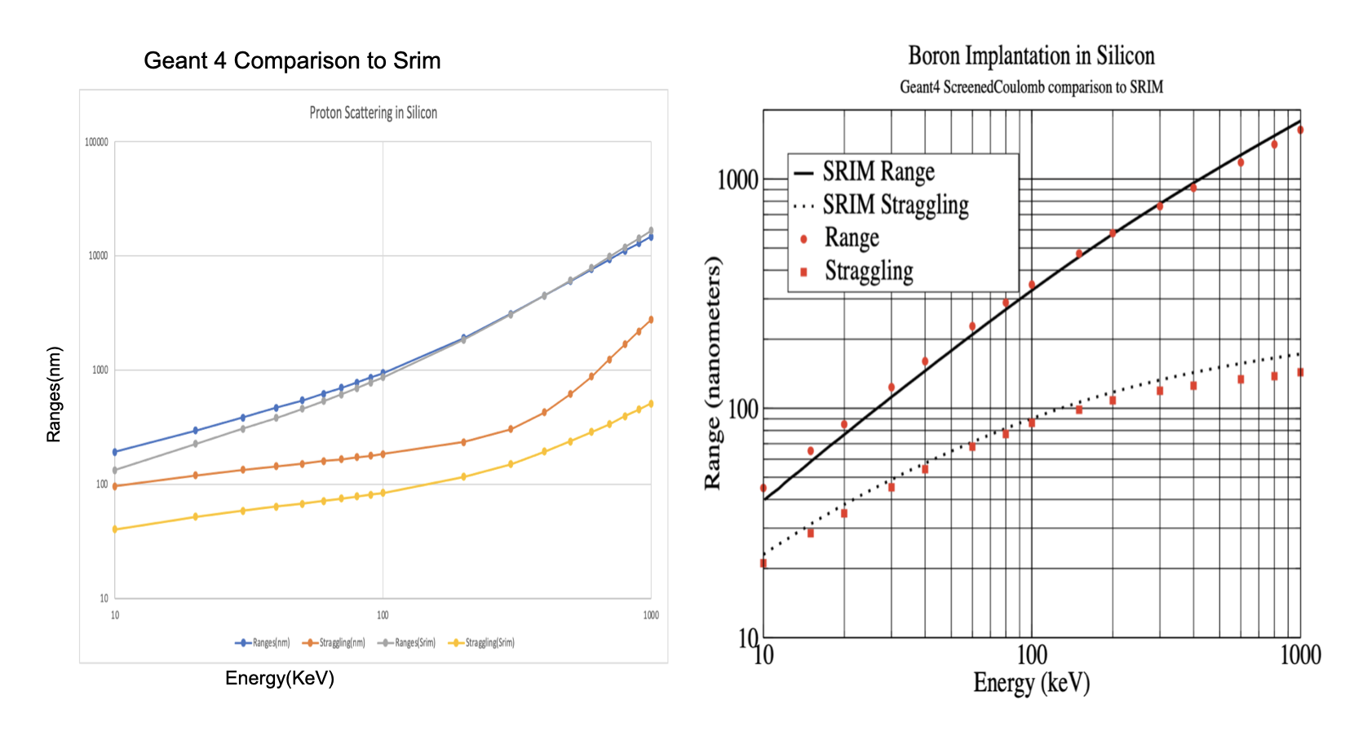
Geant4 Comparison to SRIM (50um Si) with Boron Implantation in Silicon

Slide 10
Simulation of Proton
Able to use Geant4 with SNR (Screen Nuclear Recoil)
Comparable to SRIM
Low energy protons on silicon scattering
Backscattering of protons

Slide 11
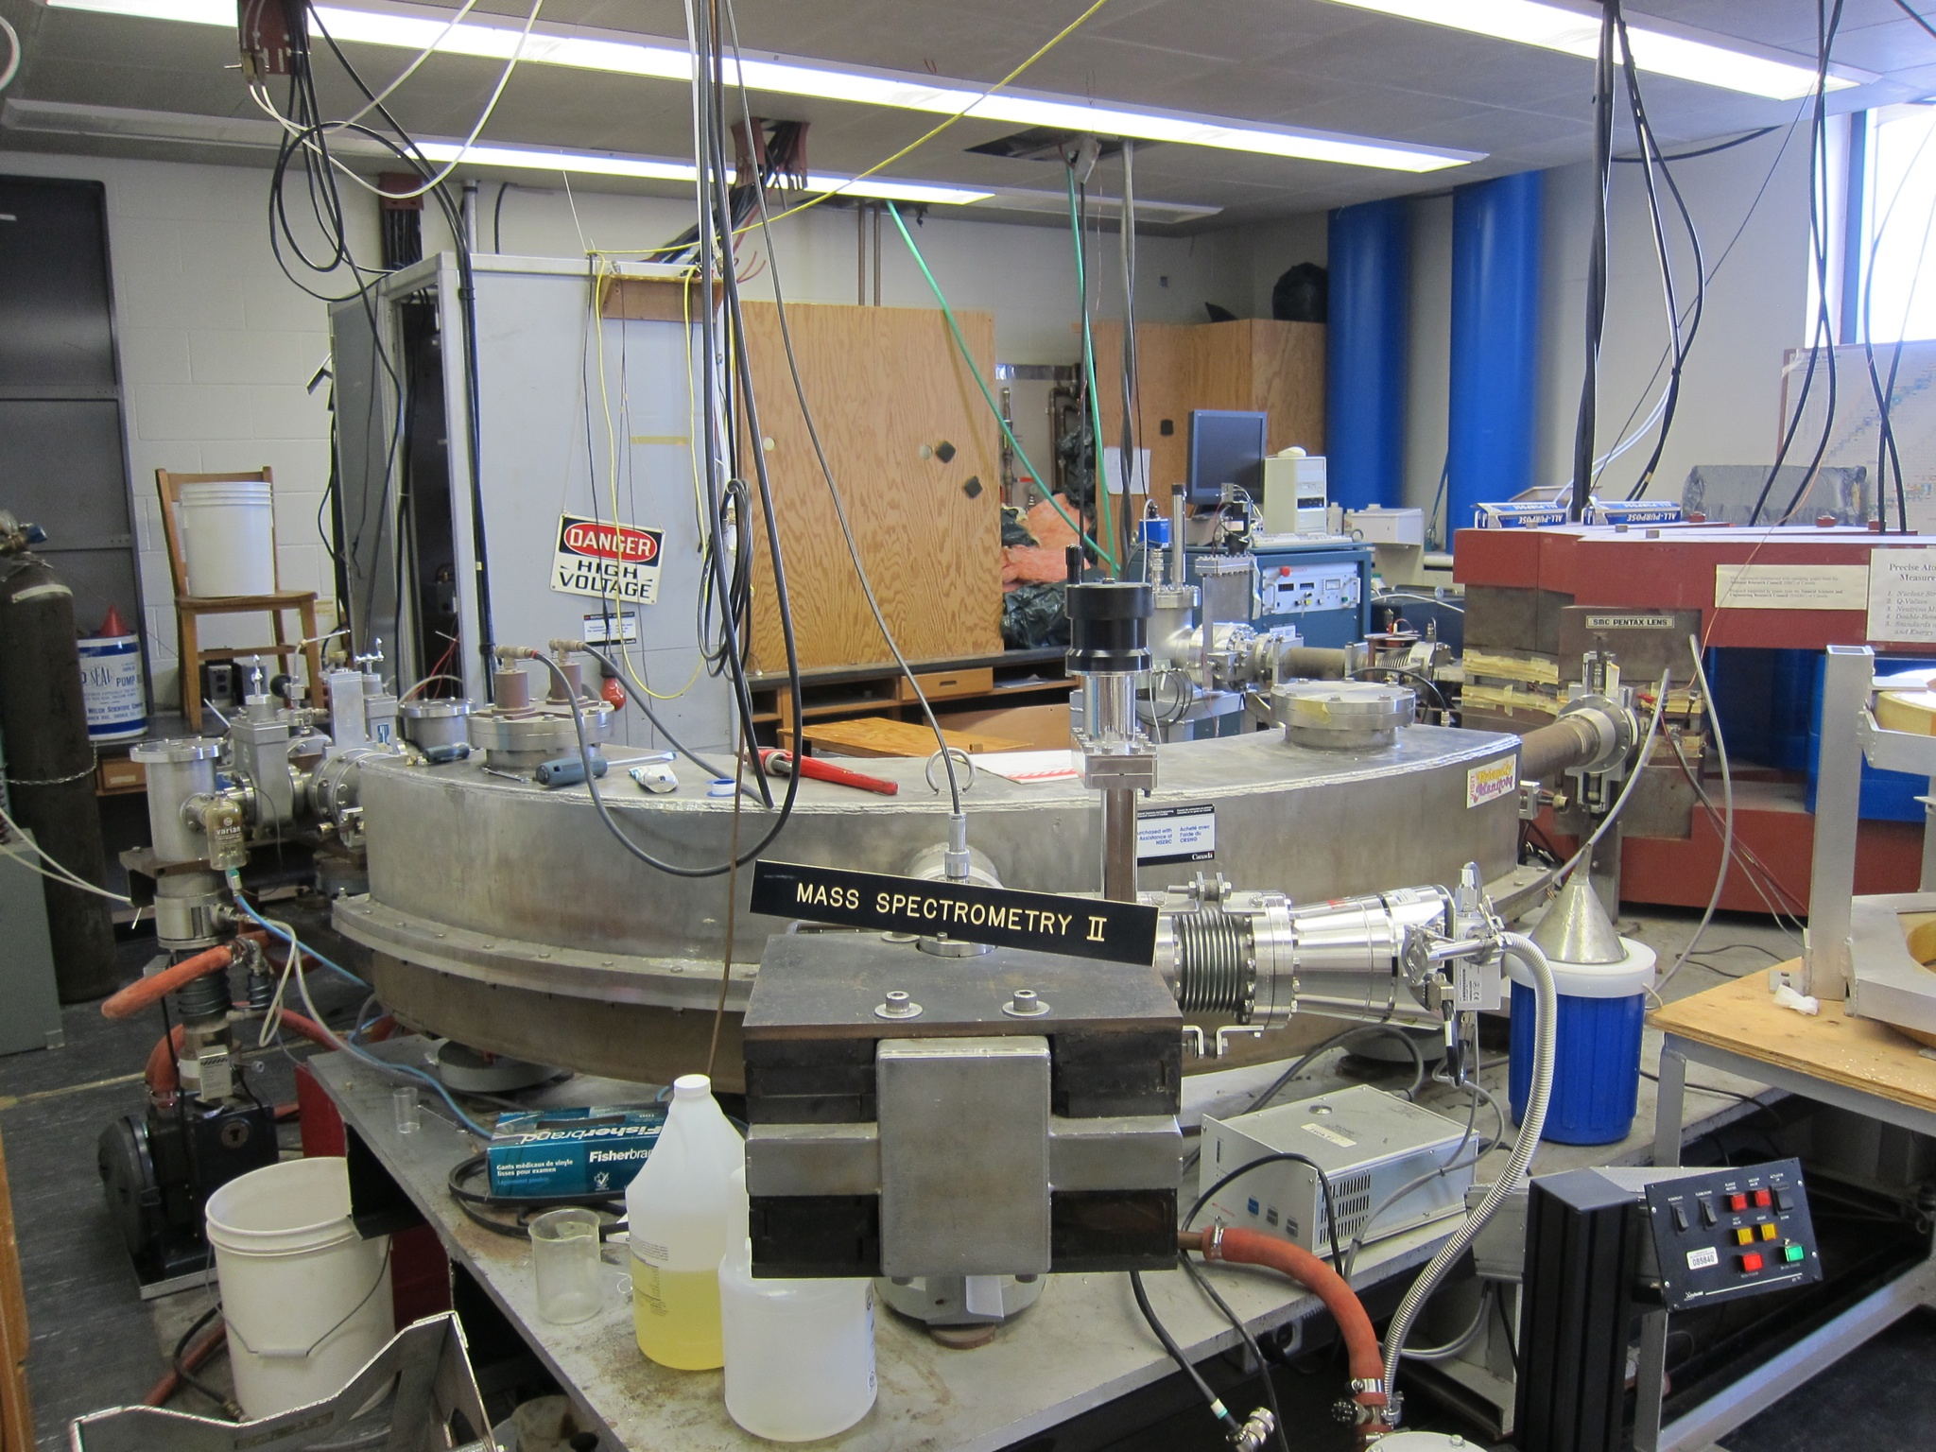
Future Work
Continue with simulations work.
Comparing results to data that will be collected with the University of Manitoba 35keV mass spectrometer in future.
Use silicon in the accelerator and look for the backscattered events at specific angles.
Determine the energy deposition by applying different layers on silicon.
The Manitoba II , Physics Department, University of Manitoba
[6]https://ingeniumcanada.org/channel/articles/field-notes-mass-spectrometry-at-the-university-of-Manitoba

Slide 12
THANK YOU

