Slide 1
Machine Learning for Noise Removal in NEWS-G
Noah Rowe
February 15 2022
Presented on behalf of the NEWS-G collaboration

Slide 2
Presentation Outline
NEWS-G Background
Problem Definition
Methods
Results
Conclusion

Slide 3
NEWS-G
Signal Generation:
Primary ionization
Electron drift
Townsend avalanche
Positive ion drift
Analysis data taken from LSM detector in France

Slide 4
Problem Definition
Goals:
Utilize machine learning methods to remove noise from recorded detector signals
Model implementation should aid in measuring important signal characteristics, such as amplitude and rise-features
Mark Anderson has designed and trained such a model for a Germanium P-Type Point Contact Detector (Submitting for publication this month)

Slide 5
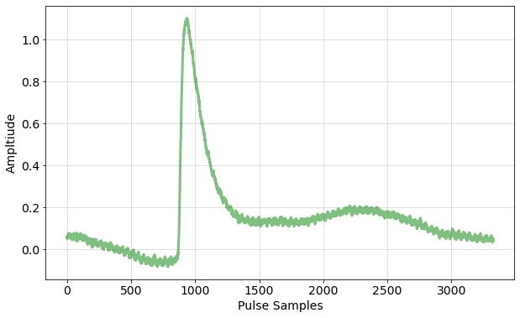
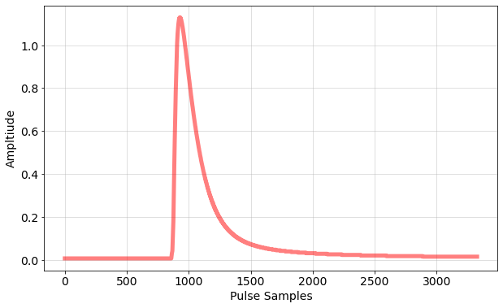
Methods – Model Architecture

Slide 6
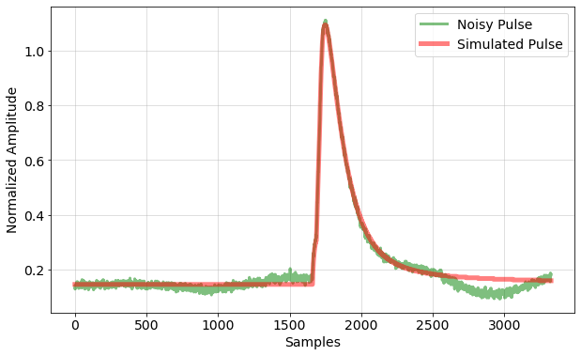
Methods – Model Training
Trained on a simulation-based dataset modeled after our real detector
Model input (X): simulated pulses with real detector noise added
Model target (Y): simulated pulses
Trained to reduce MSE between prediction and underlying simulated pulse

Slide 7
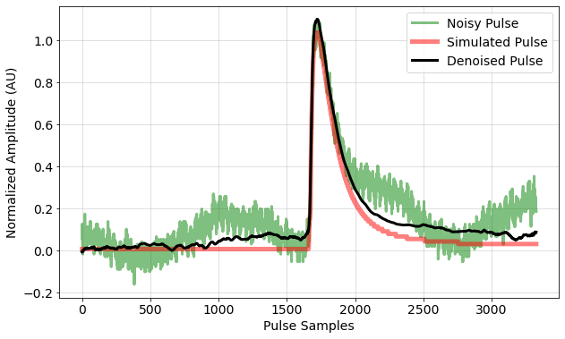
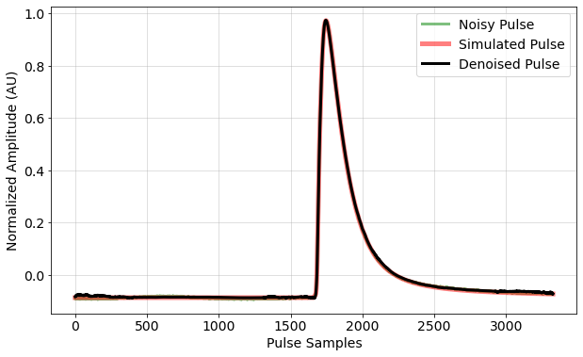
Example Pulses
Energy: ~170eV
Energy: ~1370eV

Slide 8
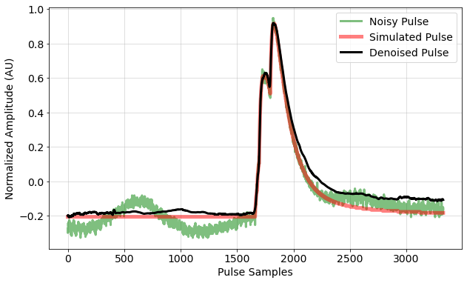
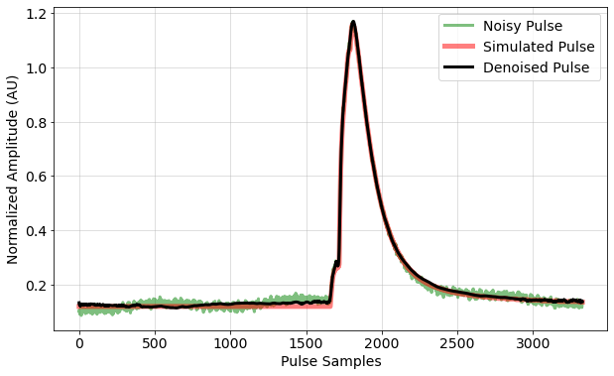
Example Pulses
Energy: ~380eV
Energy: ~540eV

Slide 9
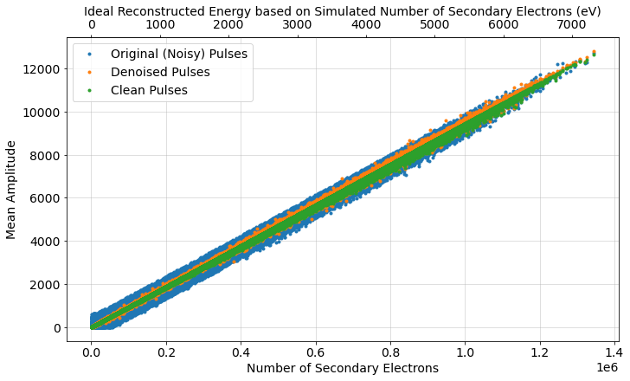
Results: Energy Resolution

Slide 10
Results: Energy Resolution

Slide 11
Results: Primary Electron Counting
Looked at our ability to determine the number of primary electrons for an event
Analyzed a simulated dataset of 100000 single-electron events and used existing methods to count primary electrons
Signal Type | Accuracy (%)
Raw (Noisy) | 36.5
Denoised | 63.9
Clean | 71.9

Slide 12
Conclusion
Trained a denoising neural network on simulated data with real detector noise
Shown to improve energy resolution measurements and primary electron identification
Procedure can be extended to other signal analysis applications
Single parameter prediction
Pulse classification

Slide 13
Questions?

Slide 14
Results: Primary Electron Counting
Dataset | Accuracy (%)
Clean | 71.89
Raw | 36.50
Denoised | 63.87

Slide 15
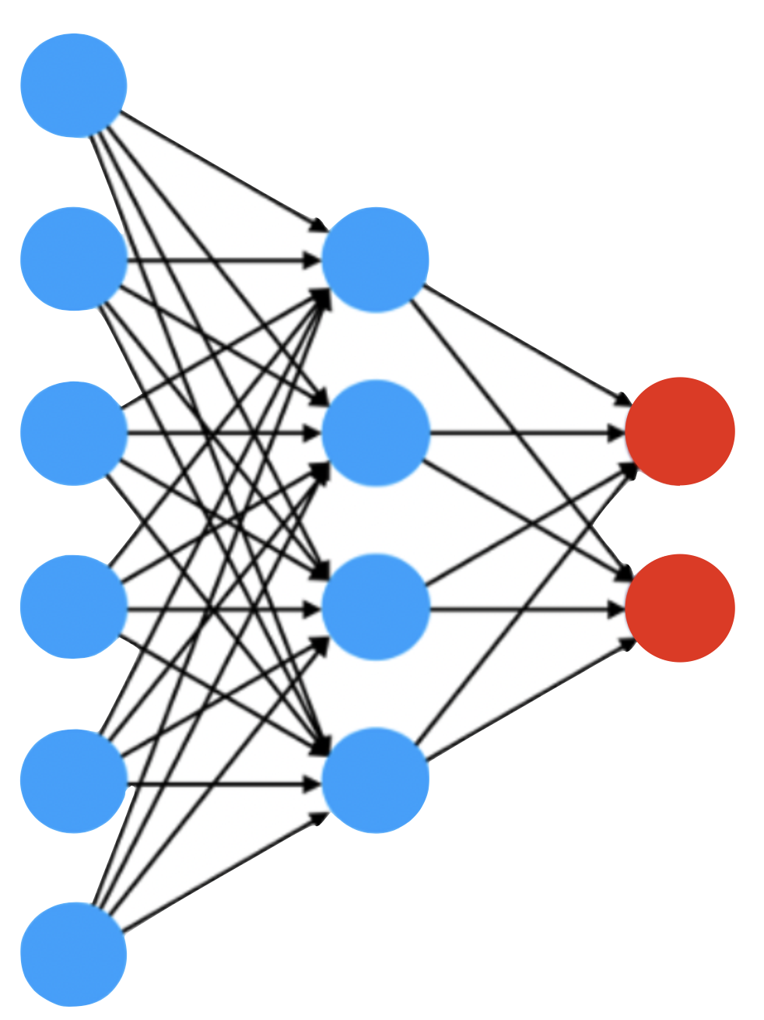
EXTRA SLIDES: Other Applications
Avalanche Signal Recovery
Anomaly Signal Detection
Signal Parameter Identification

