Slide 1

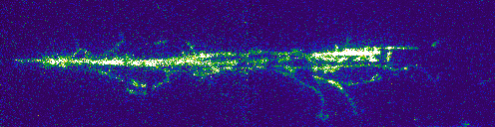


ARIADNE: A novel optical 1-ton dual-phase LArTPC
Adam Roberts (On behalf of the ARIADNE team)
aroberts@hep.ph.liv.ac.uk
hep.ph.liv.ac.uk/ariadne

Slide 2

Outline
Introduction to ARIADNE
Optical readout
Beamline characterisation of optical readout at CERN
Future directions of optical readout with fast timing information
1

Slide 3
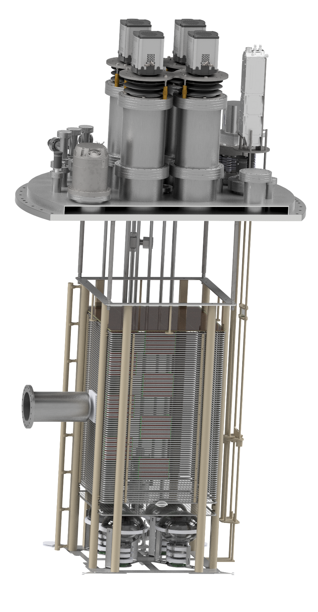
ARIADNE is a 1 ton two phase liquid argon TPC designed for R&D into optical readout
Experiment goals:
Characterise camera readout in a mixed charged particle beam (T9 at CERN)
Demonstrate the scalability of optical readout to larger scale TPCs
Pion cross section in LAr measurement
Track reconstruction studies
2

Slide 4
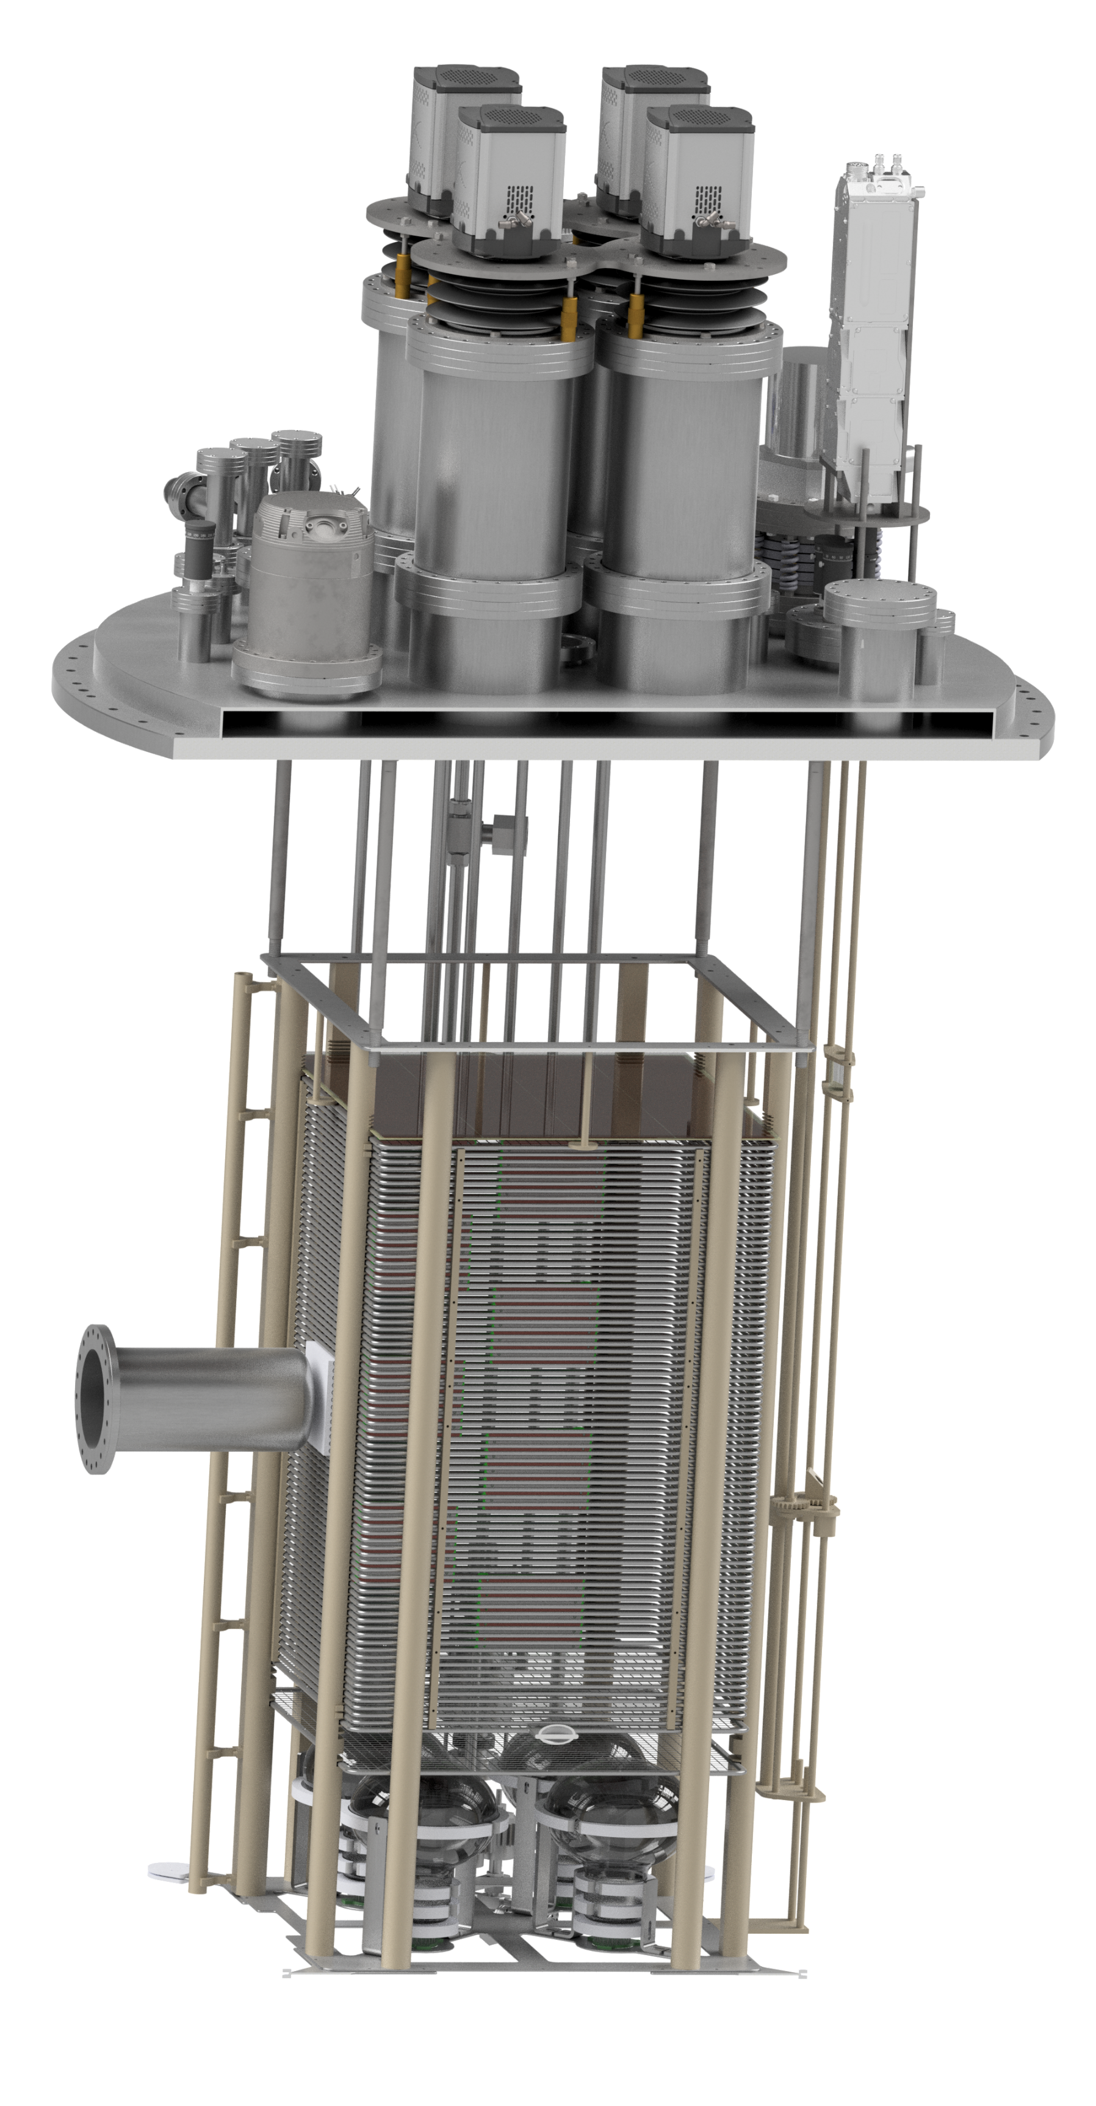
54cm
x 54cm
x 80cm active
volume
Beam window and plug for beamline operation
3

Slide 5
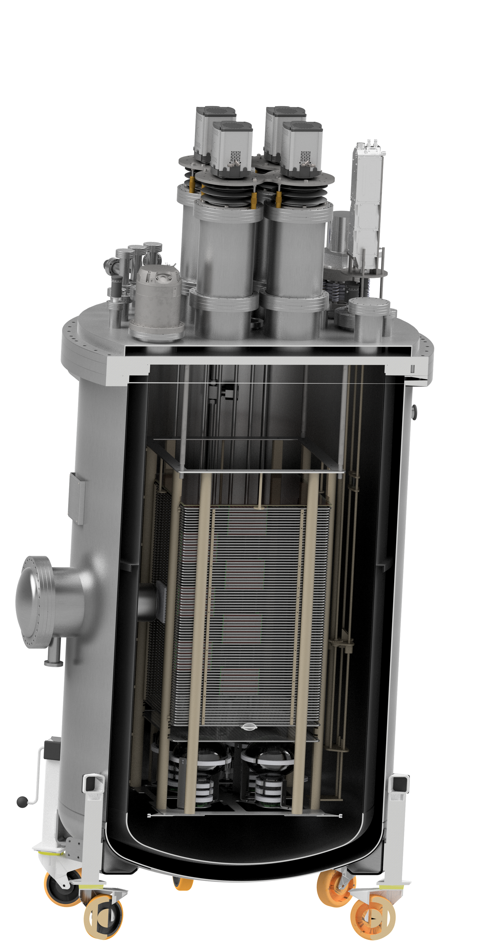
54cm
x 54cm
x 80cm active
volume
Beam window and plug for beamline operation
4

Slide 6
54cm
x 54cm
x 80cm active
volume
Beam window and plug for beamline operation
PMTs for detector triggering
5

Slide 7
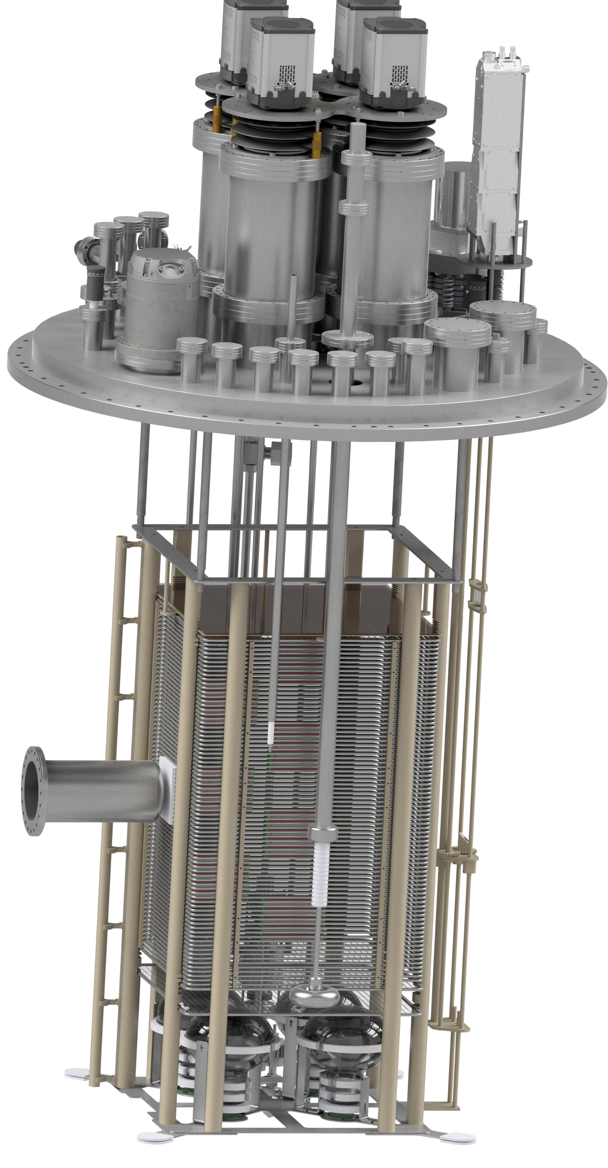
54cm
x 54cm
x 80cm active
volume
Beam window and plug for beamline operation
Cryofitted 100kV cathode feedthrough
PMTs for detector triggering
6

Slide 8
Nd:Yag laser calibration system
54cm
x 54cm
x 80cm active
volume
Beam window and plug for beamline operation
Cryofitted 100kV cathode feedthrough
PMTs for detector triggering
7

Slide 9
16 pad segmented THGEM
Nd:Yag laser calibration system
54cm
x 54cm
x 80cm active
volume
Beam window and plug for beamline operation
Cryofitted 100kV cathode feedthrough
PMTs for detector triggering
8

Slide 10
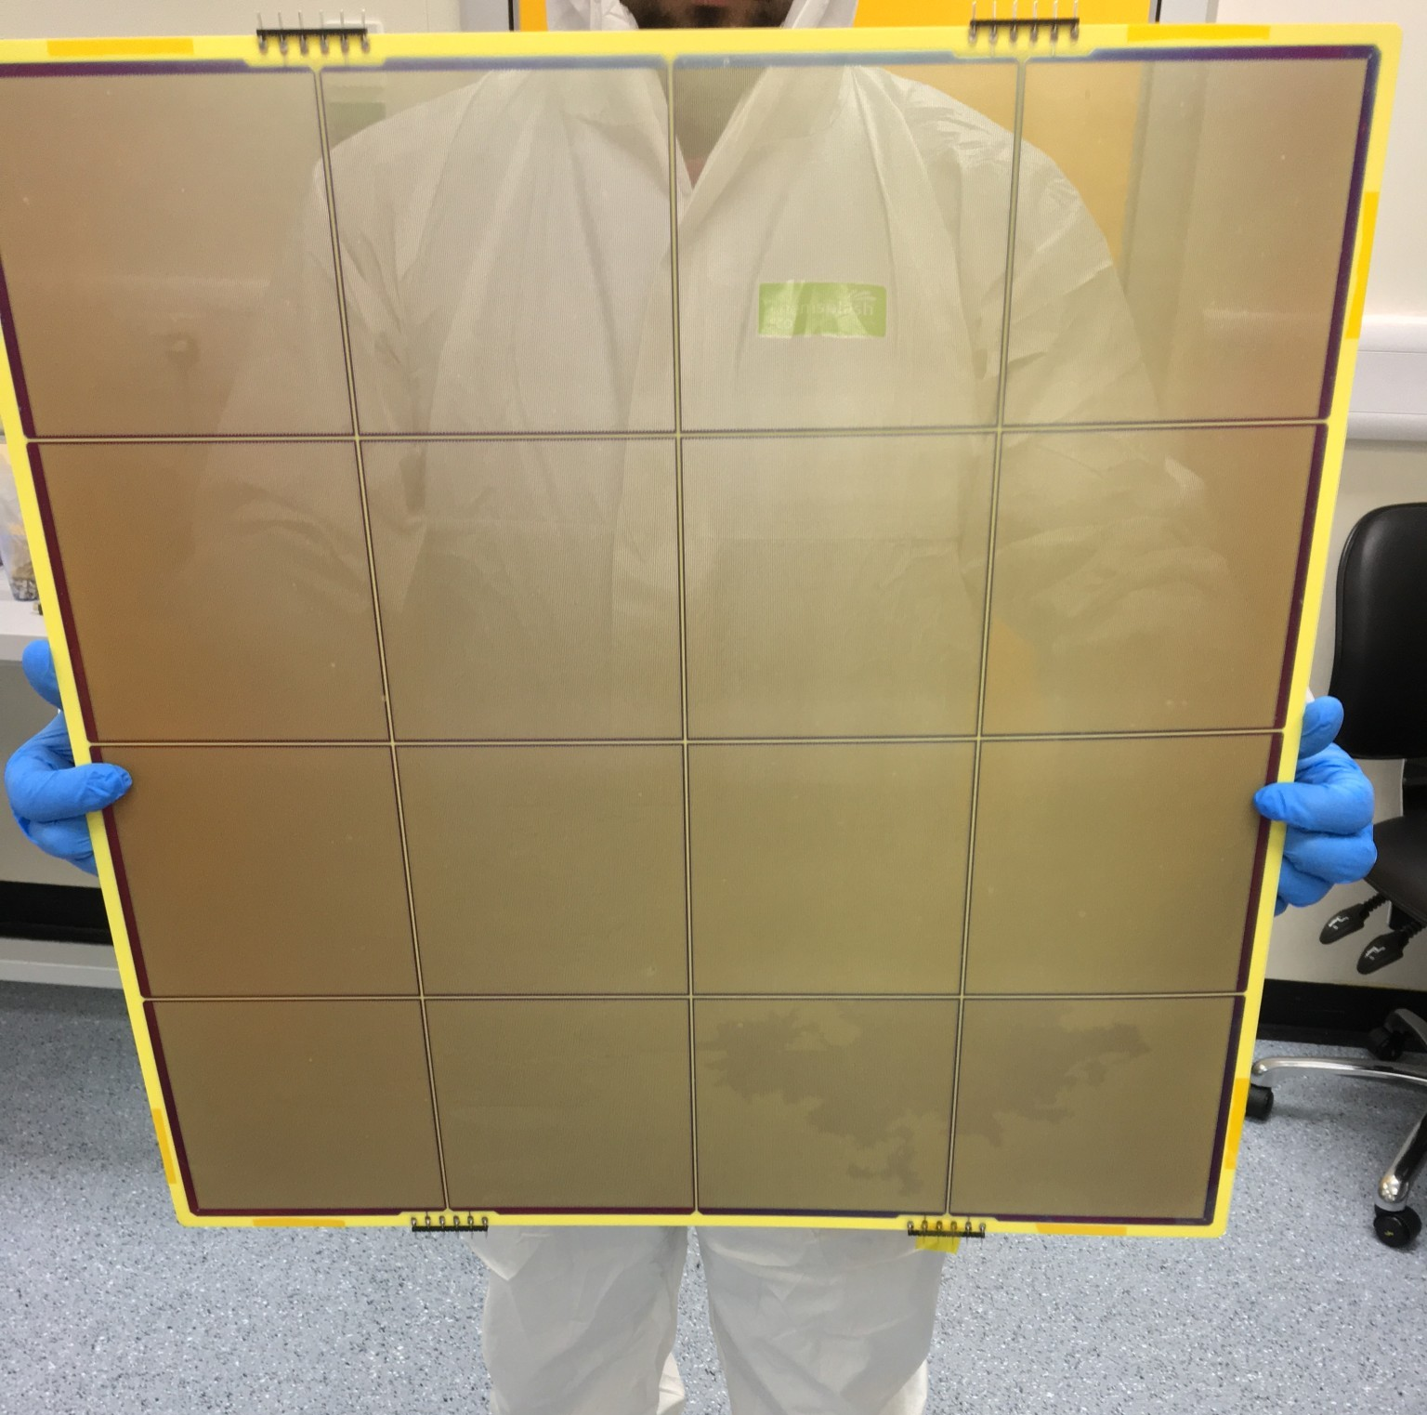

16 pad segmented THGEM
Nd:Yag laser calibration system
54cm
x 54cm
x 80cm active
volume
Beam window and plug for beamline operation
1mm thick, 500µm ID holes, 800µm pitch
Cryofitted 100kV cathode feedthrough
PMTs for detector triggering
9

Slide 11
Operating principle
Ionising particle passes through detector volume
10

Slide 12
Operating principle
Ionising particle passes through detector volume
Electric field drifts electrons to the THGEM
Townsend discharge in the THGEM multiplies electrons and also produces S2 light
11

Slide 13
Operating principle
Ionising particle passes through detector volume
Electric field drifts electrons to the THGEM
Townsend discharge in the THGEM multiplies electrons and also produces S2 light
Traditionally the charge is collected using an anode with many strips or pads
12

Slide 14
Operating principle
Ionising particle passes through detector volume
Electric field drifts electrons to the THGEM
Optical readout captures the light produced instead of charge
Townsend discharge in the THGEM multiplies electrons and also produces S2 light
TPB coated glass sheet placed above THGEM converts VUV S2 light to 430nm
Traditionally the charge is collected using an anode with many strips or pads
13

Slide 15

Optical readout captures the light produced instead of charge
Highly sensitive EMCCD cameras look down towards the THGEM through optical viewports, capturing light from the THGEM with high x, y resolution (1 pixel maps to 1mm x 1mm on the THGEM with 4x4 binning)
Benefits over charge readout:
Low noise – camera readout noise is decoupled from TPC noise sources
Ease of access – external cameras can be easily repaired and upgraded
Cost effective – Readout channels are integrated into camera ASIC
0.4 m
14

Slide 16
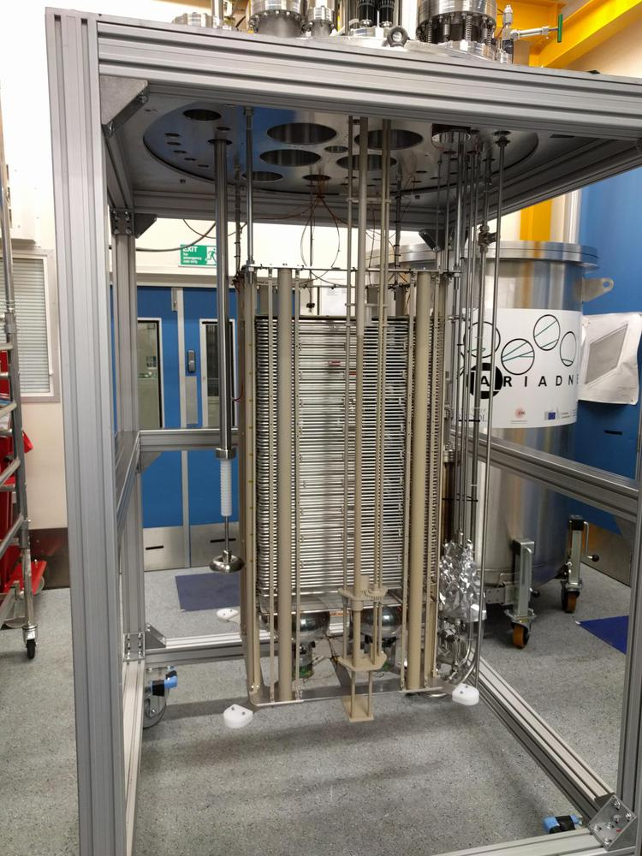
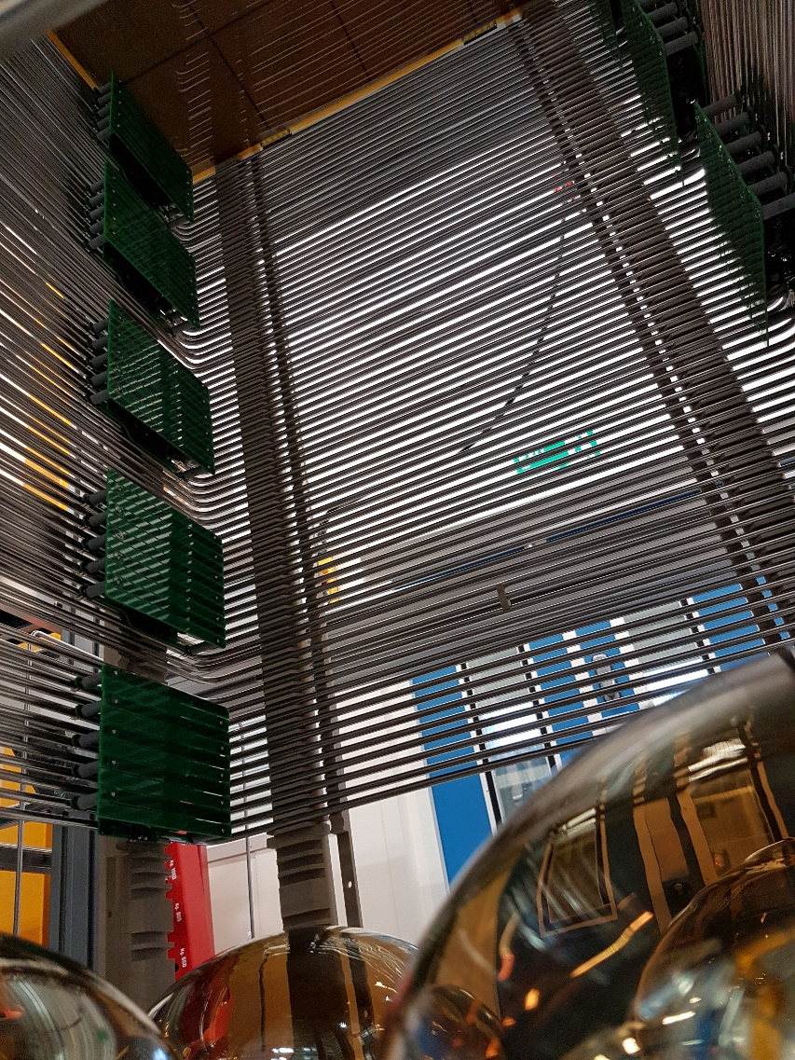
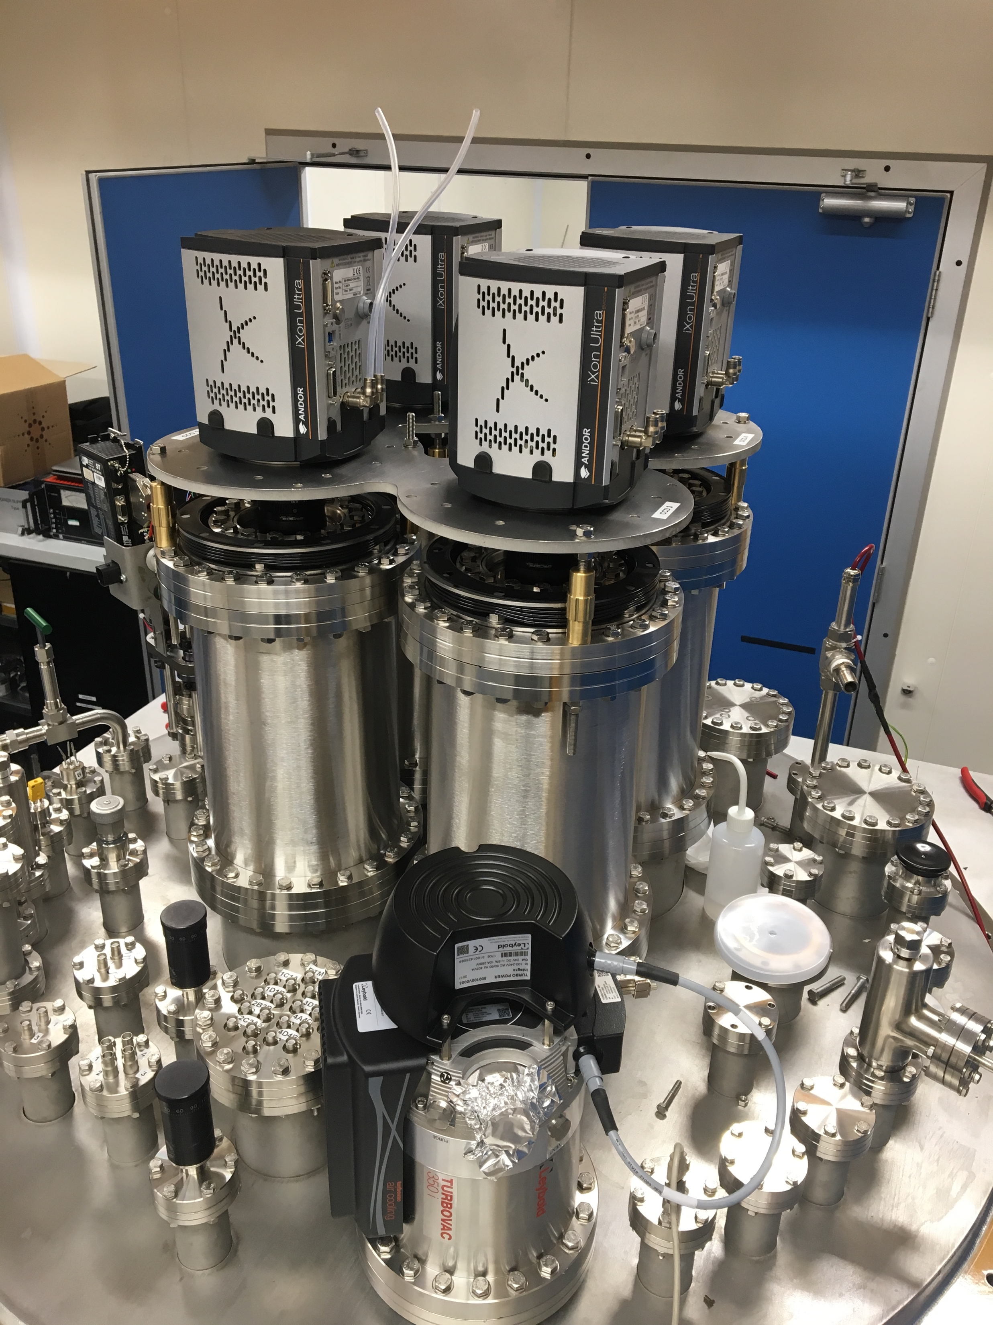
Construction at Liverpool
EMCCDs on flange
TPC Assembly
TPC inside
15

Slide 17
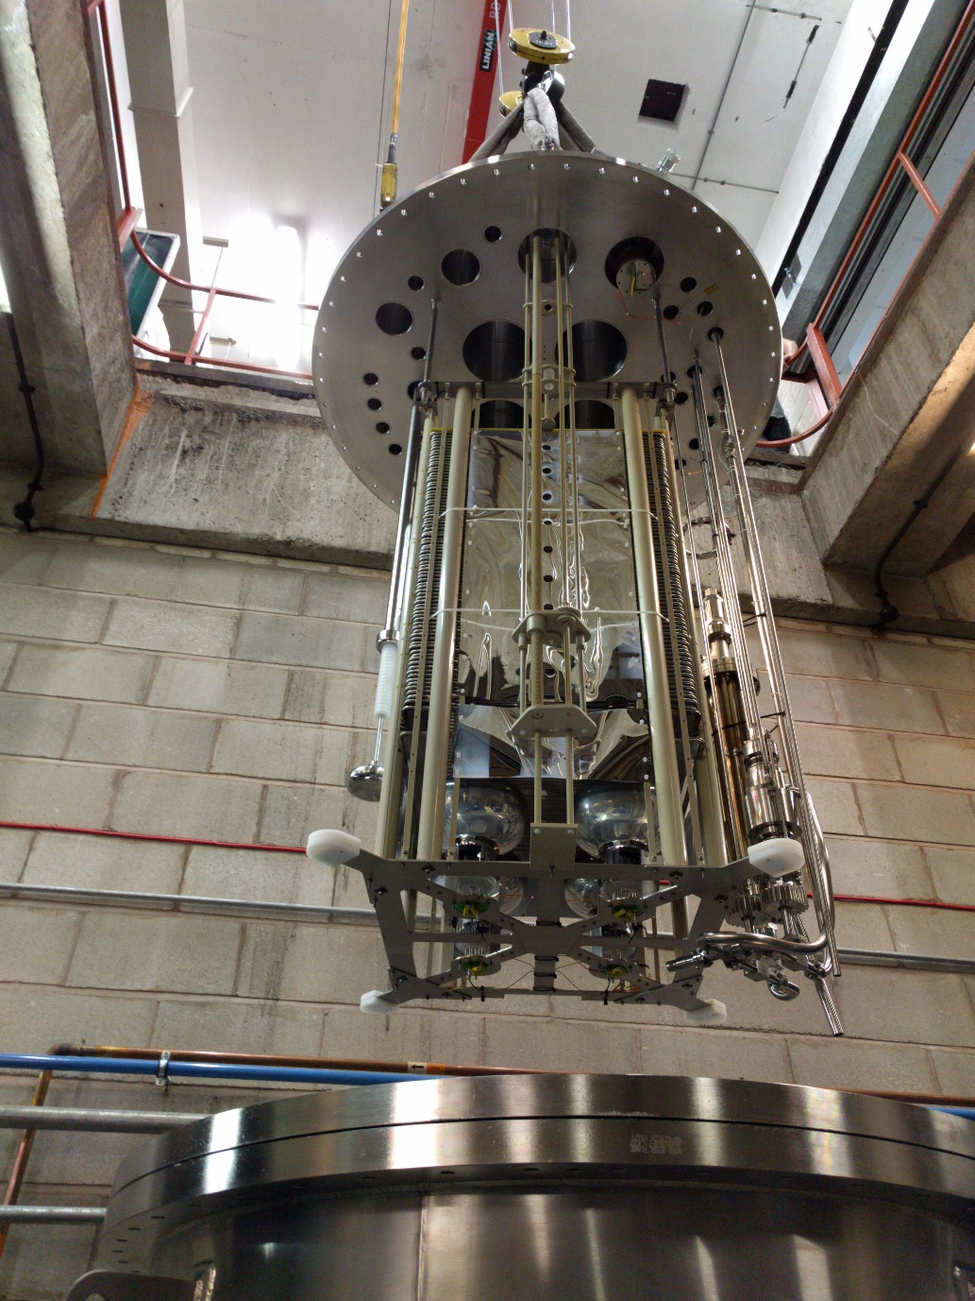
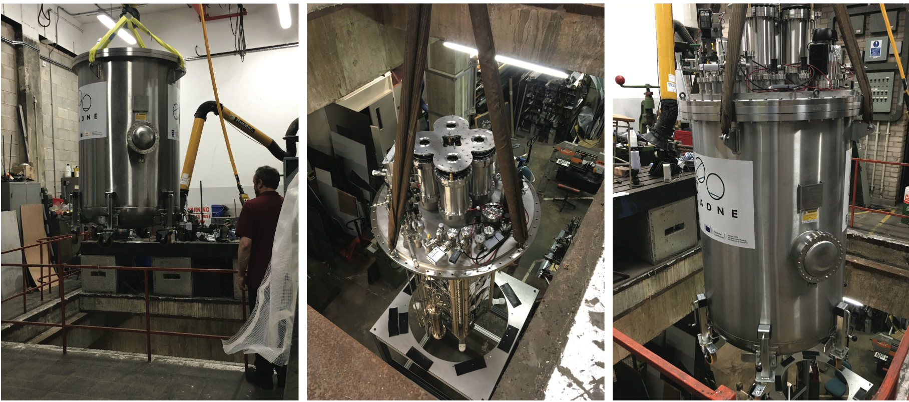
Construction at Liverpool
2017 was a busy year constructing ARIADNE.
By the end of 2017 we were ready for our first run at Liverpool…
16

Slide 18
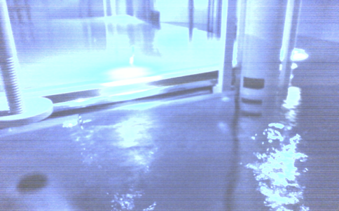
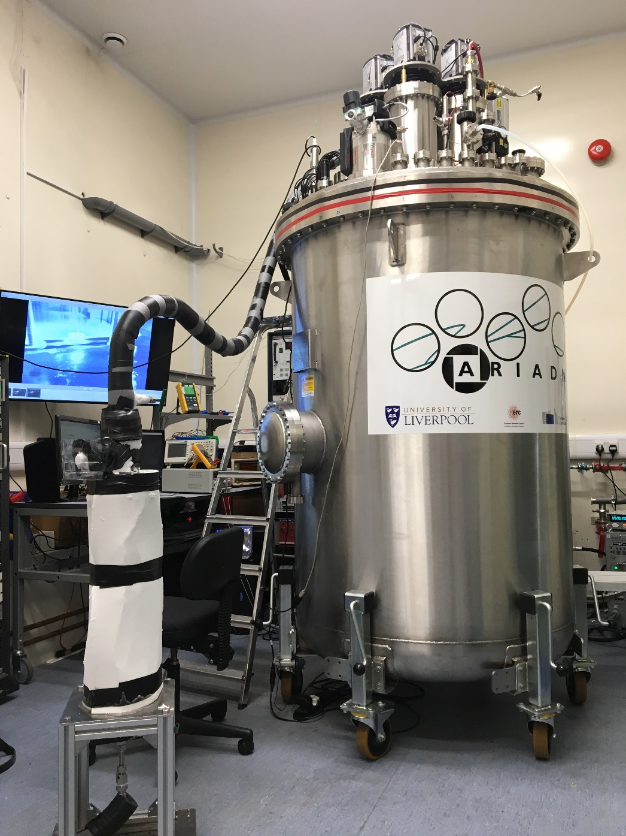
First run in Liverpool (December 2017)
Tested slow control / DAQ etc
We were ready to ship to CERN for T9
17

Slide 19
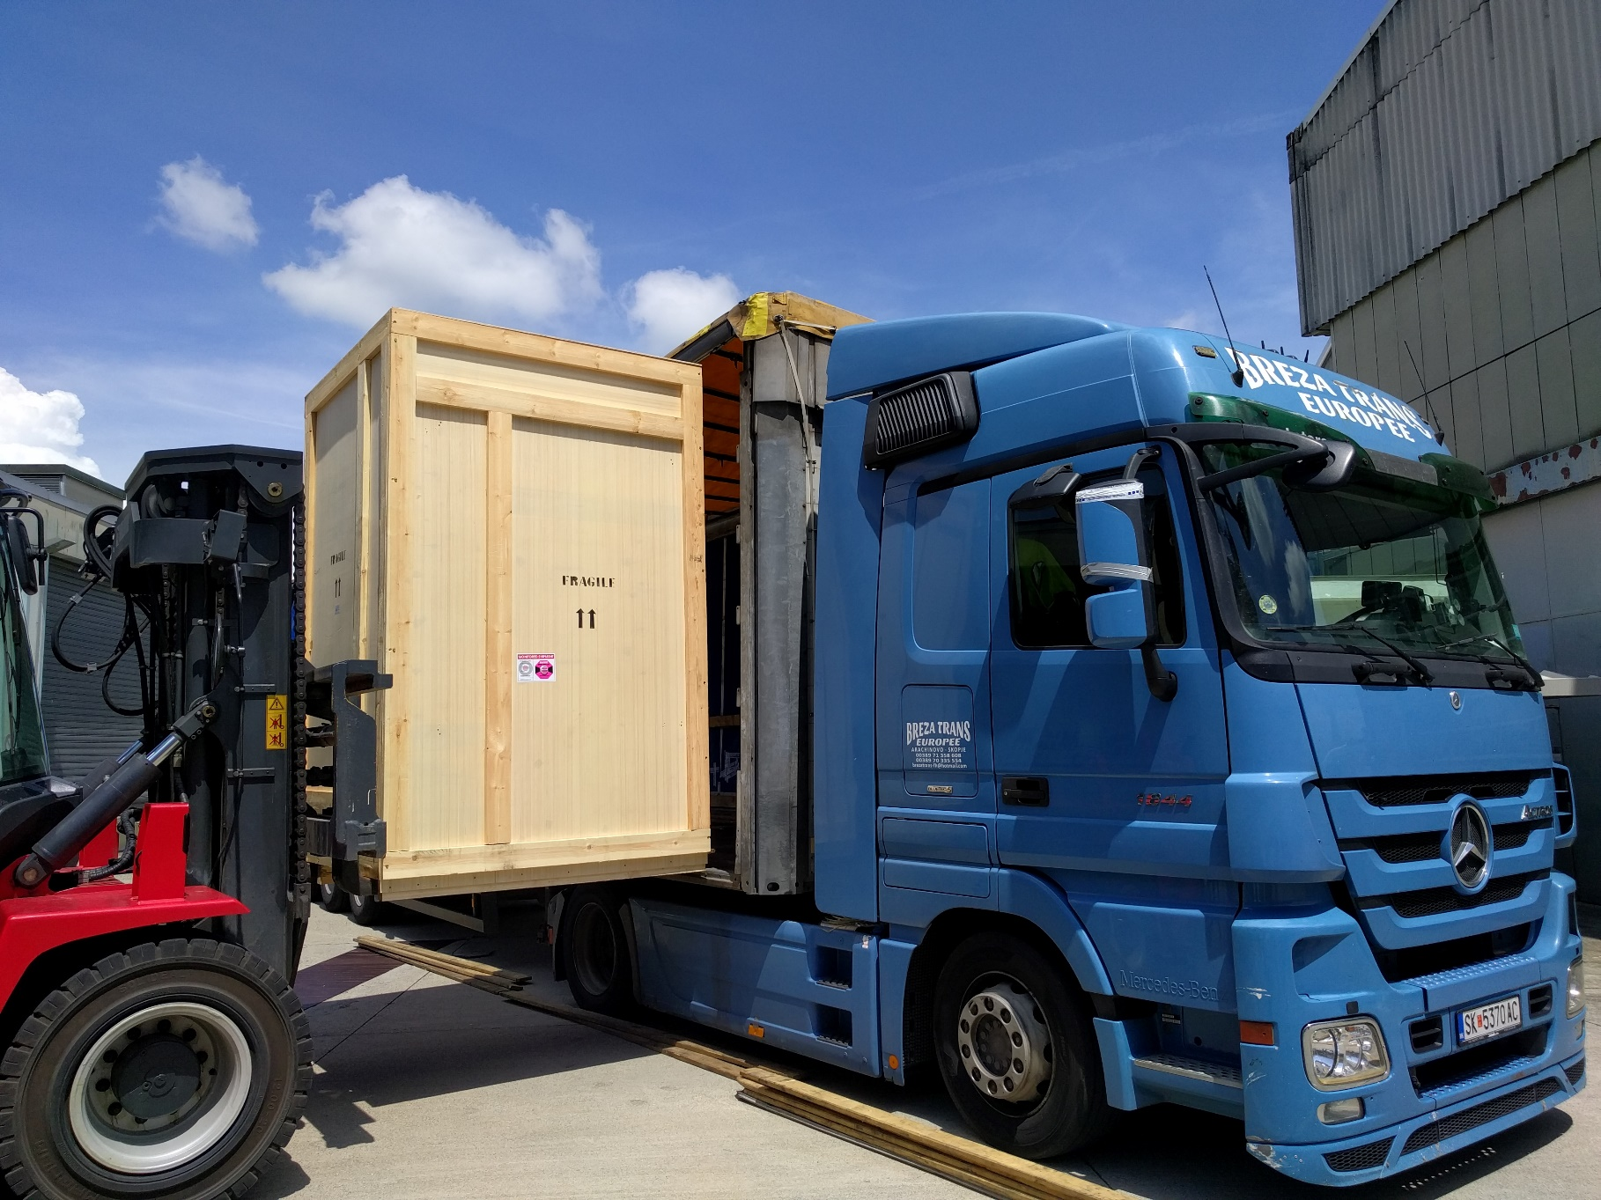
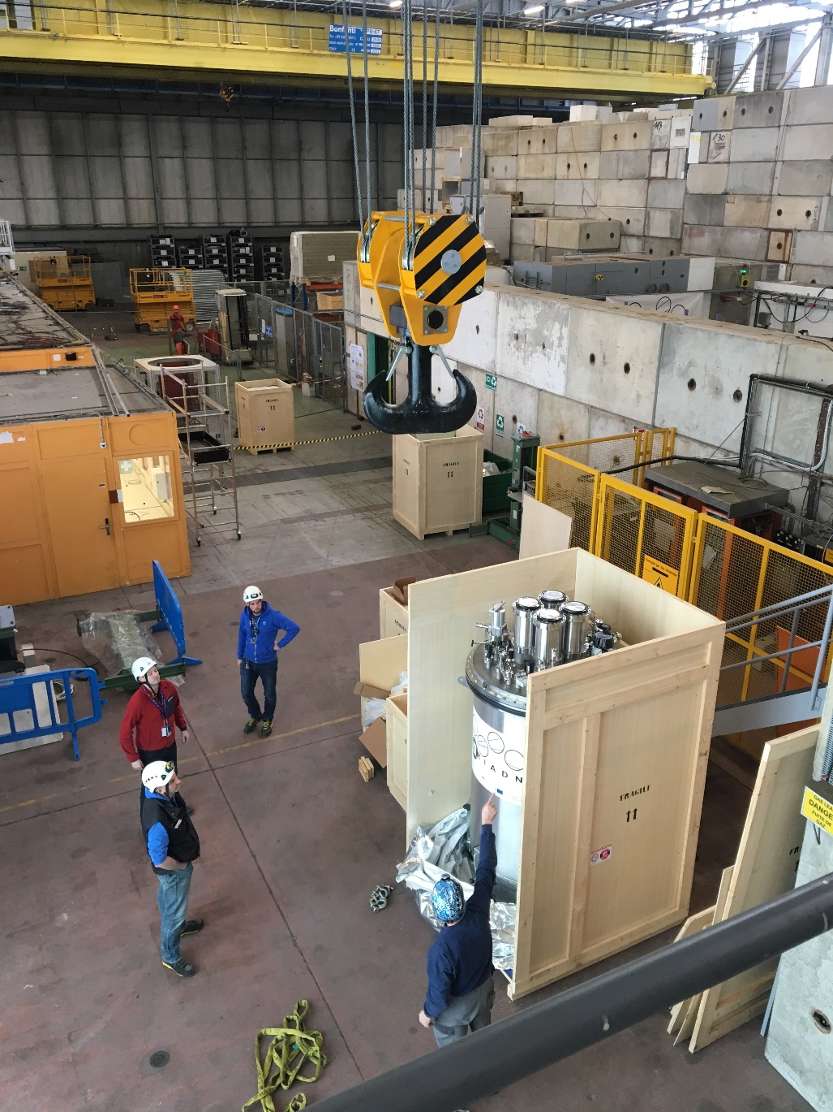
ARIADNE arrives at CERN
18

Slide 20
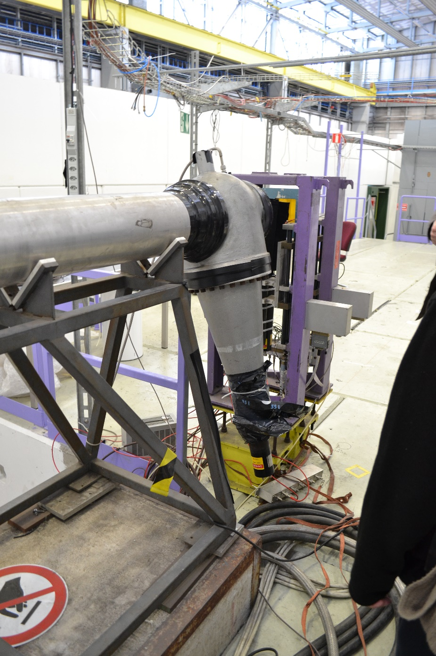
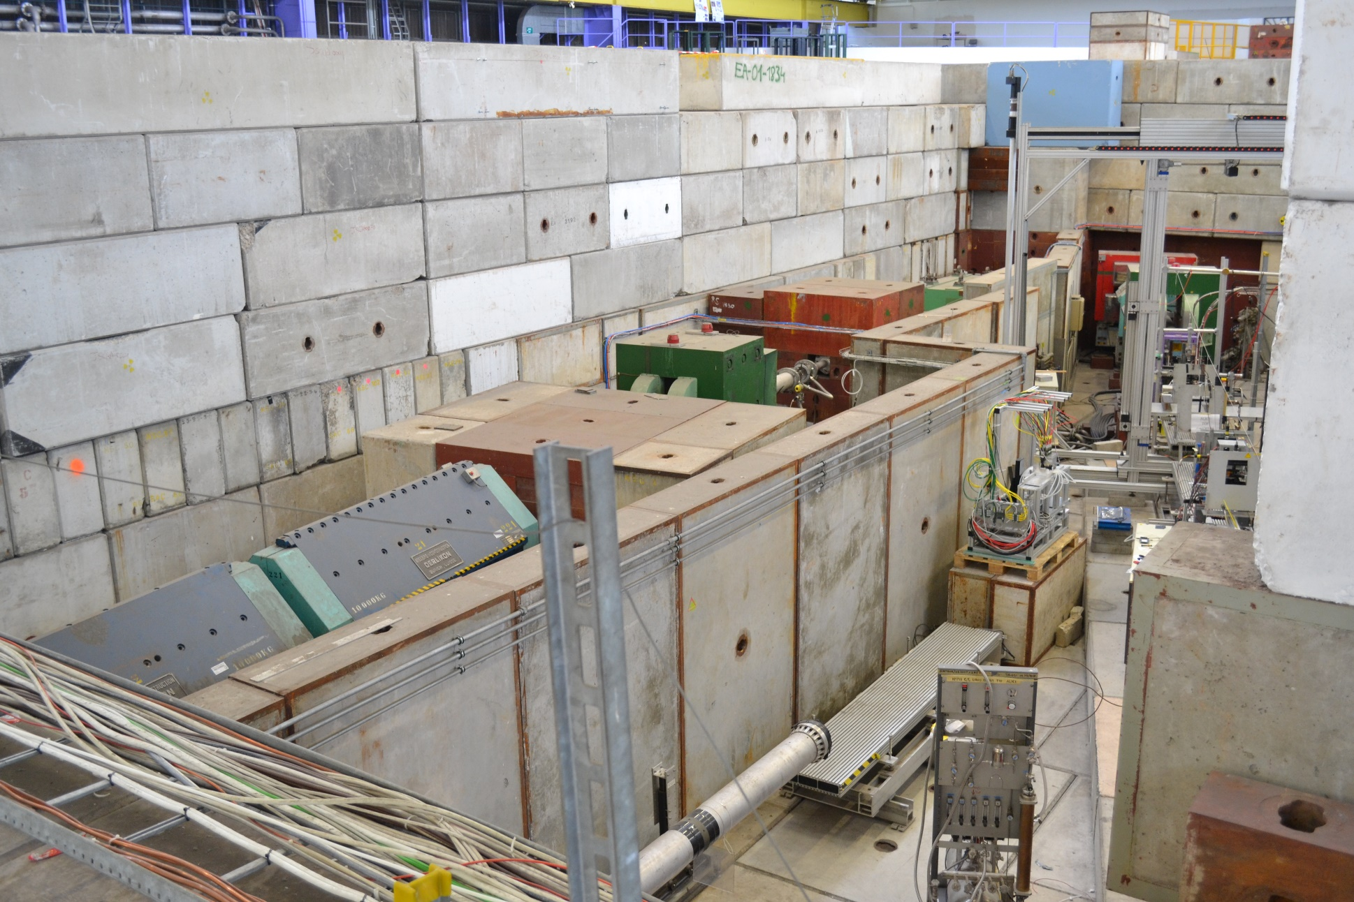
T9 Beamline
Label Cherenkov and time of flight
Gas Cherenkov
ToF
19

Slide 21
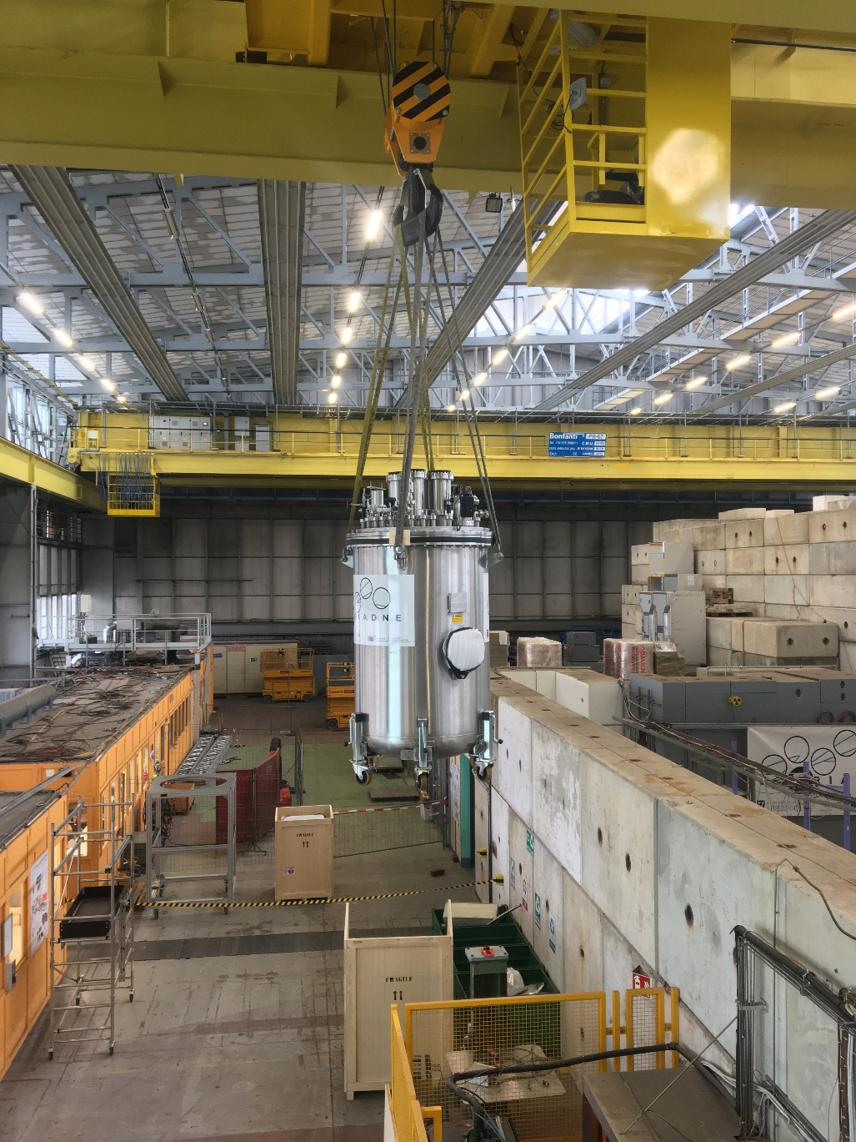
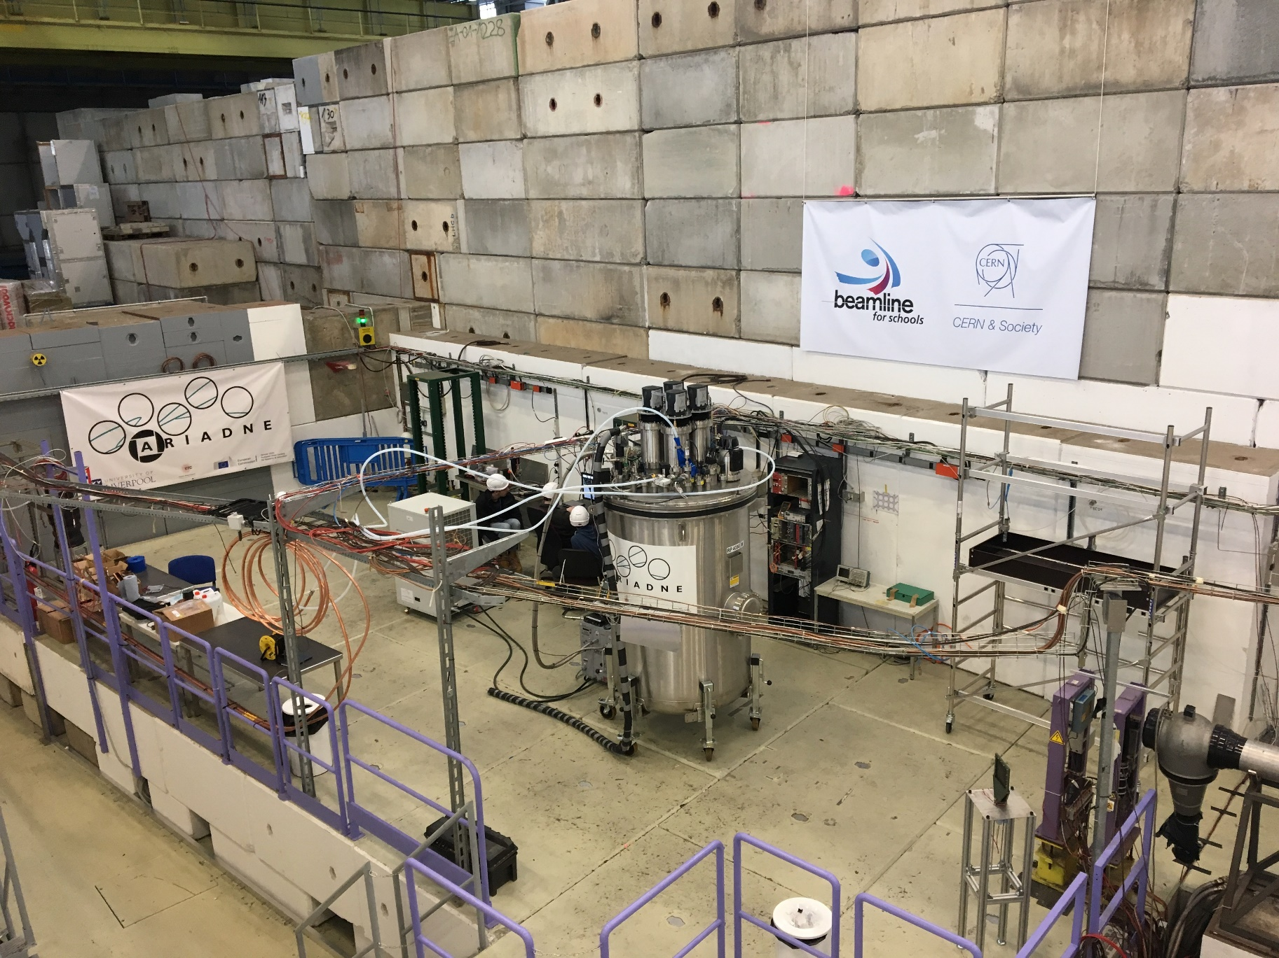
Installing ARIADNE to T9
20

Slide 22
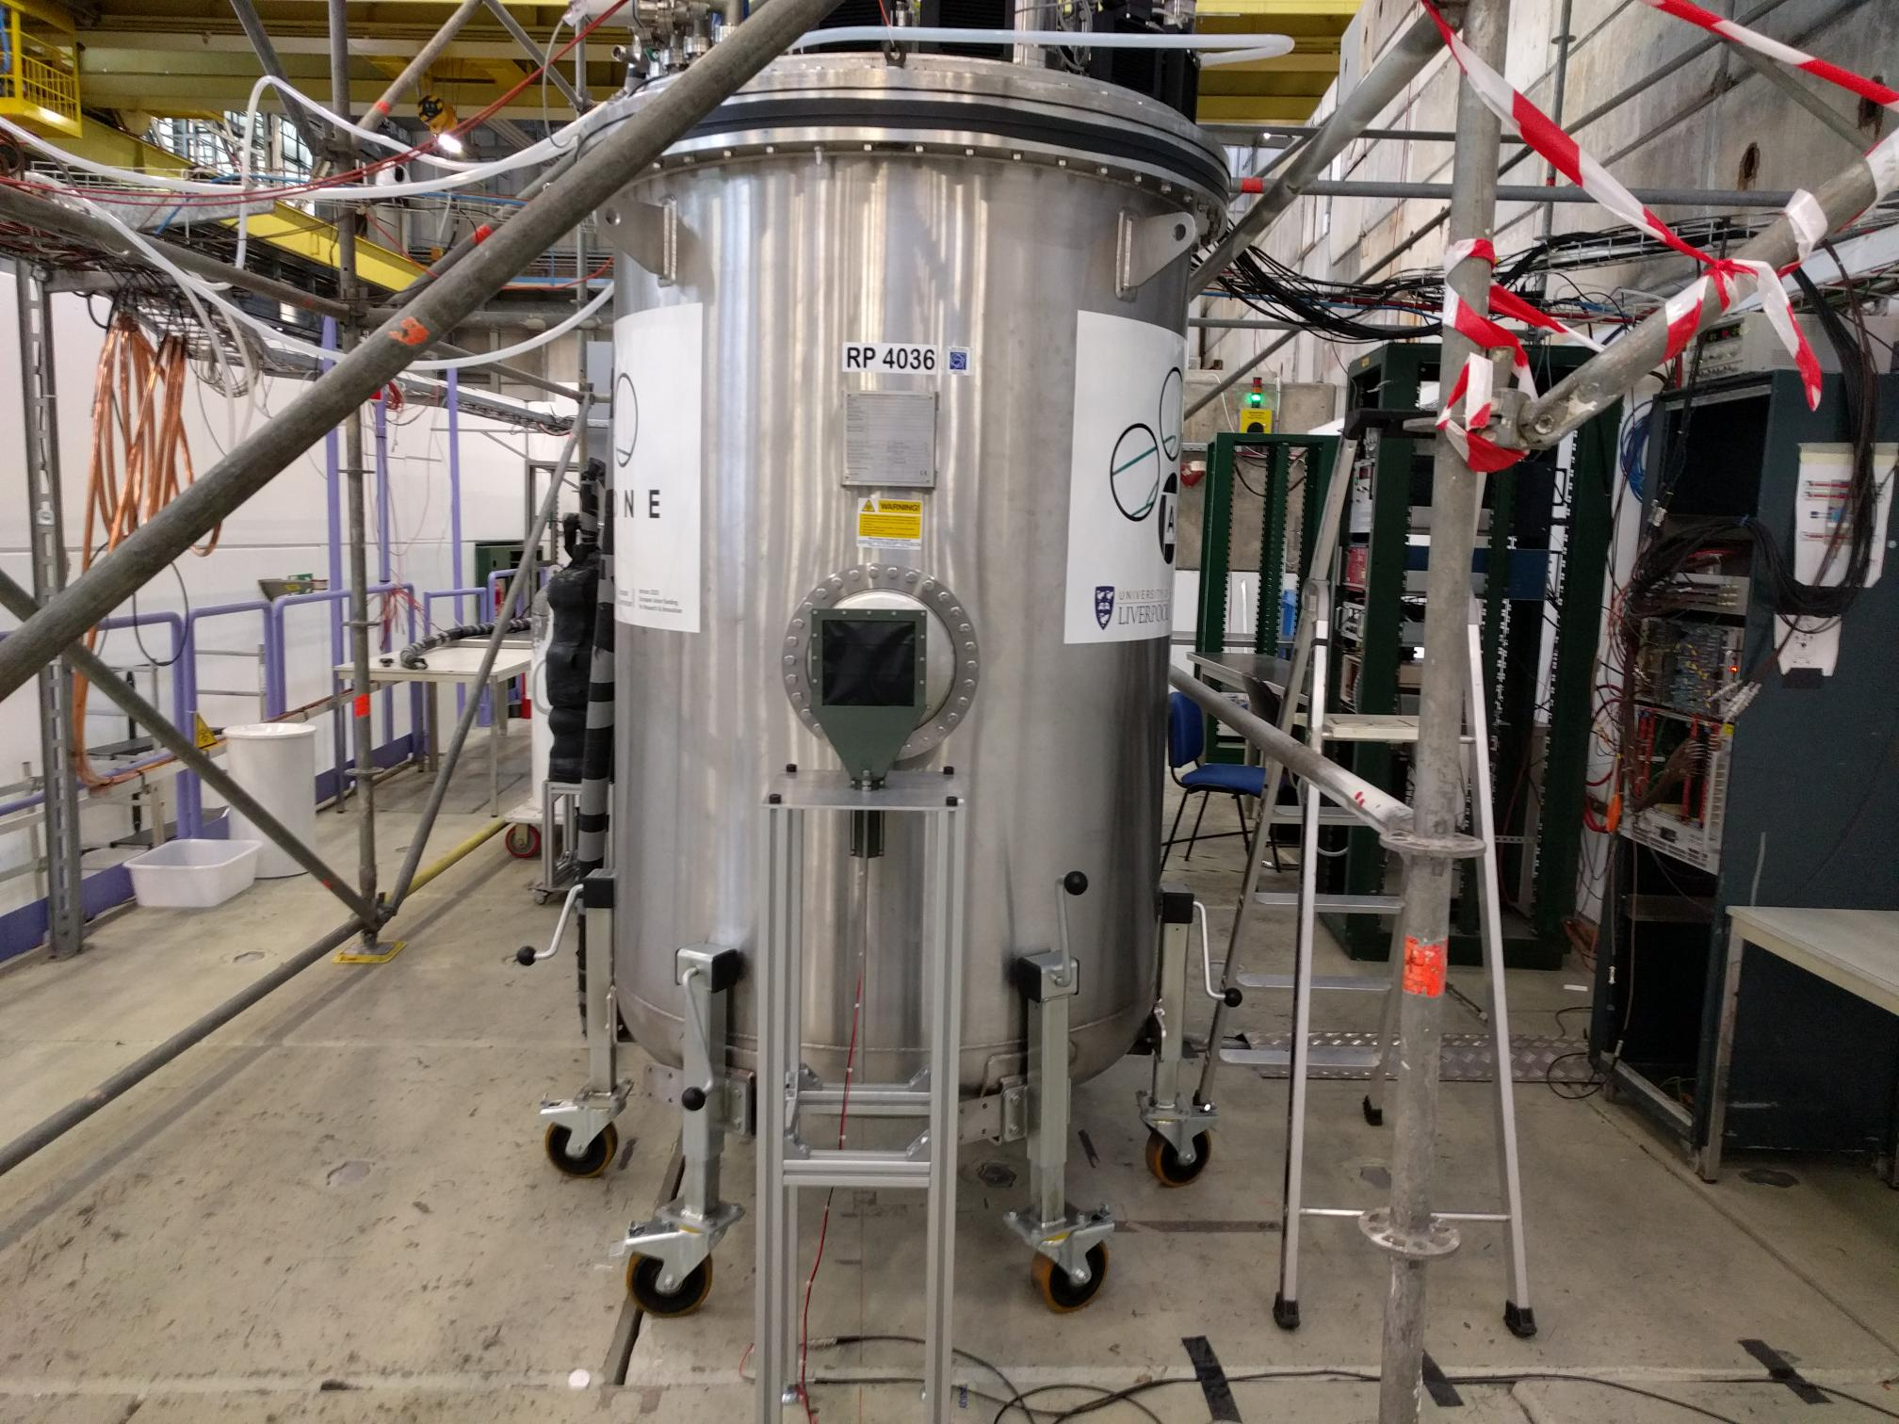
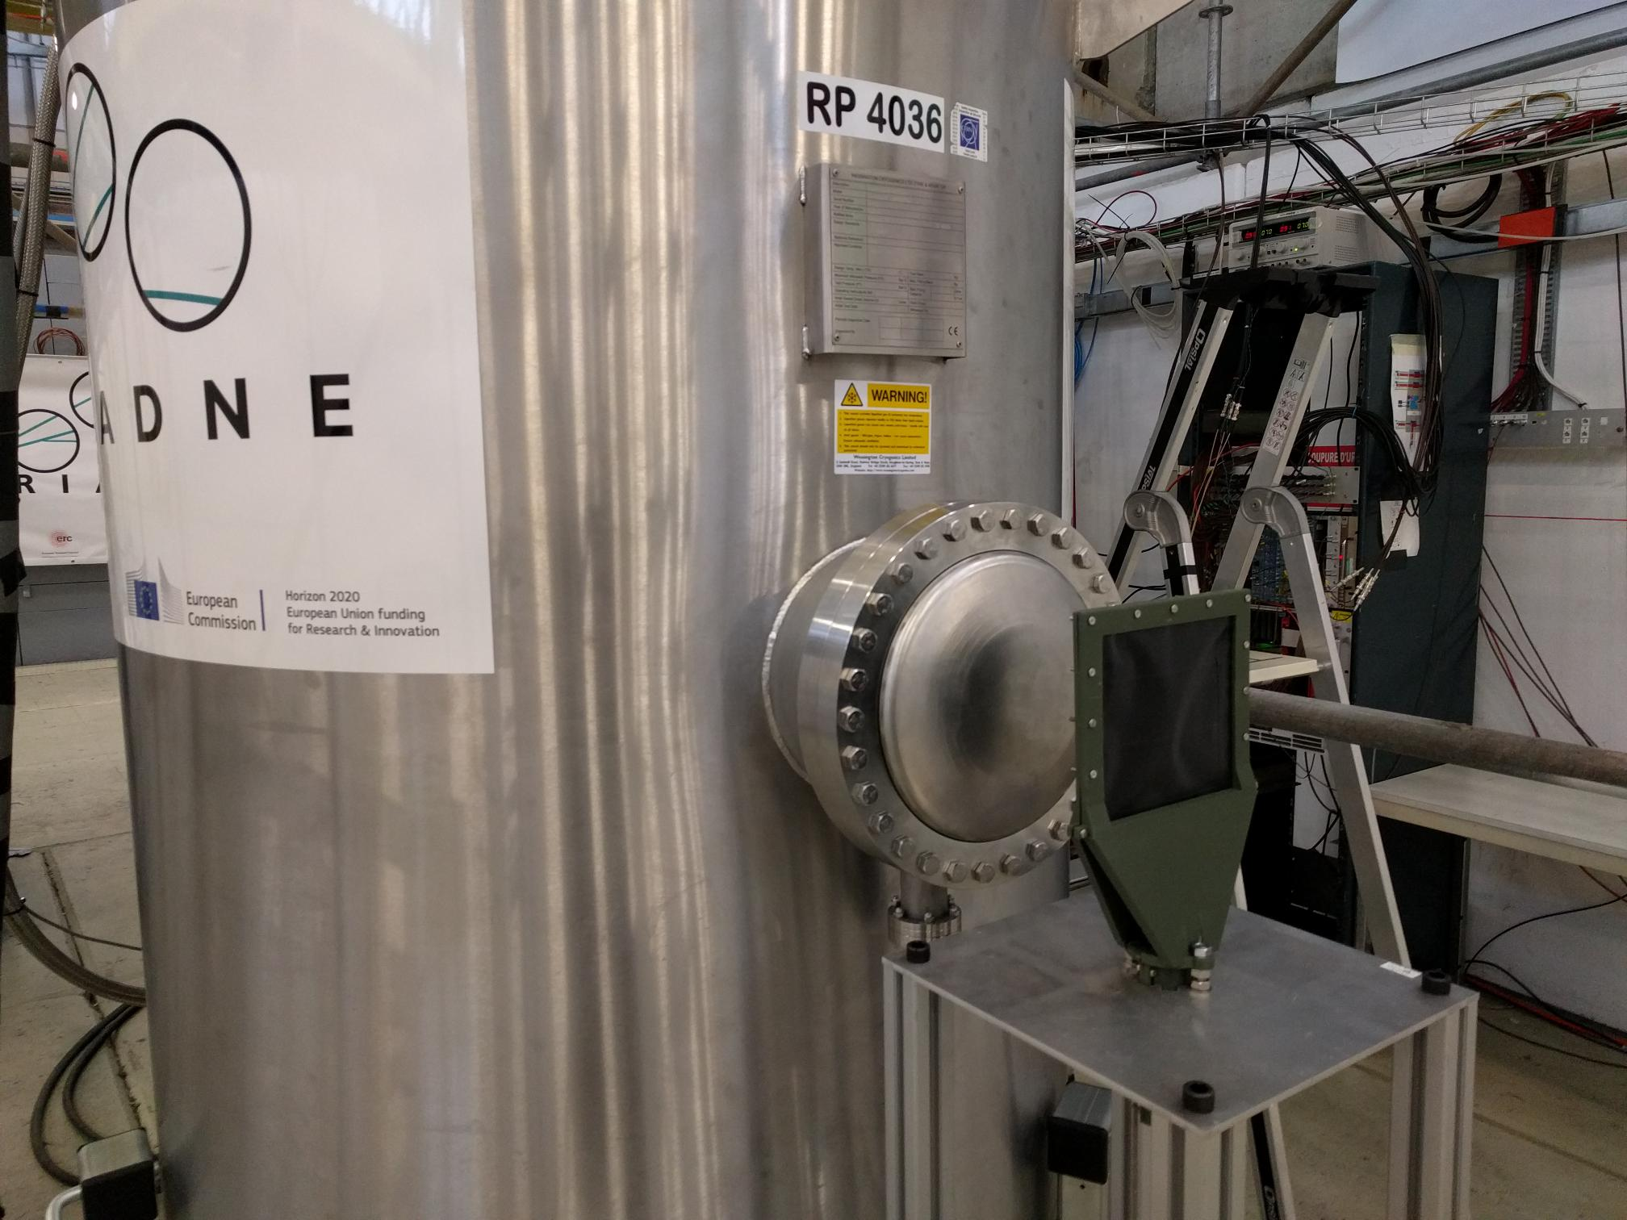
ARIADNE at CERN T9 beamline March/April 2018
Data collected: 0.5 GeV – 8 GeV:
400,000 events Negative Polarity
400,000 events Positive Polarity
Mix of e±, µ±, 𝜋±, p±
ToF paddle
0.4 m
21

Slide 23
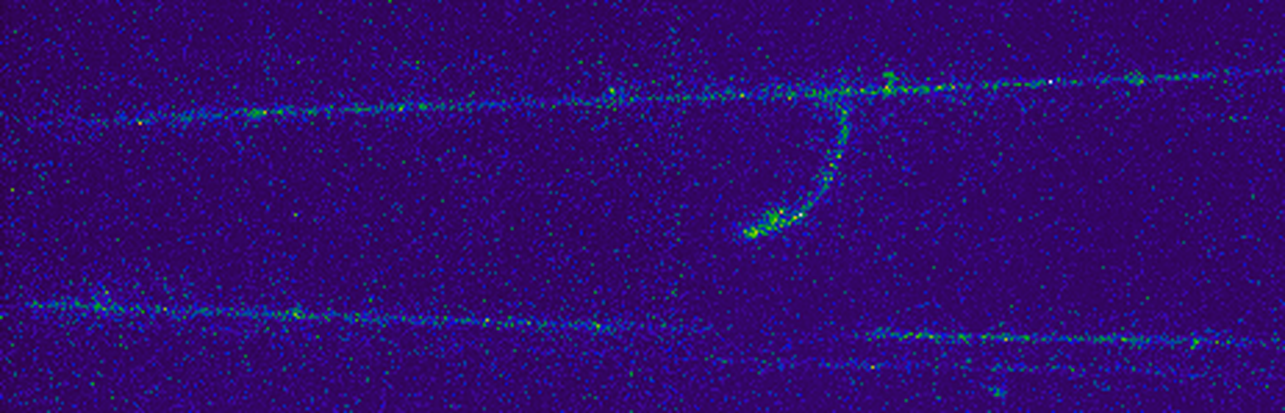
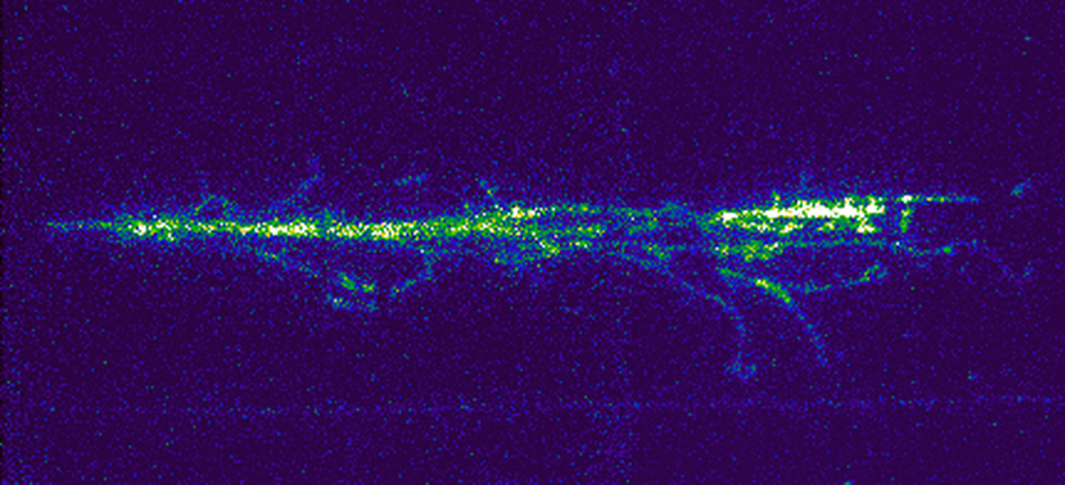
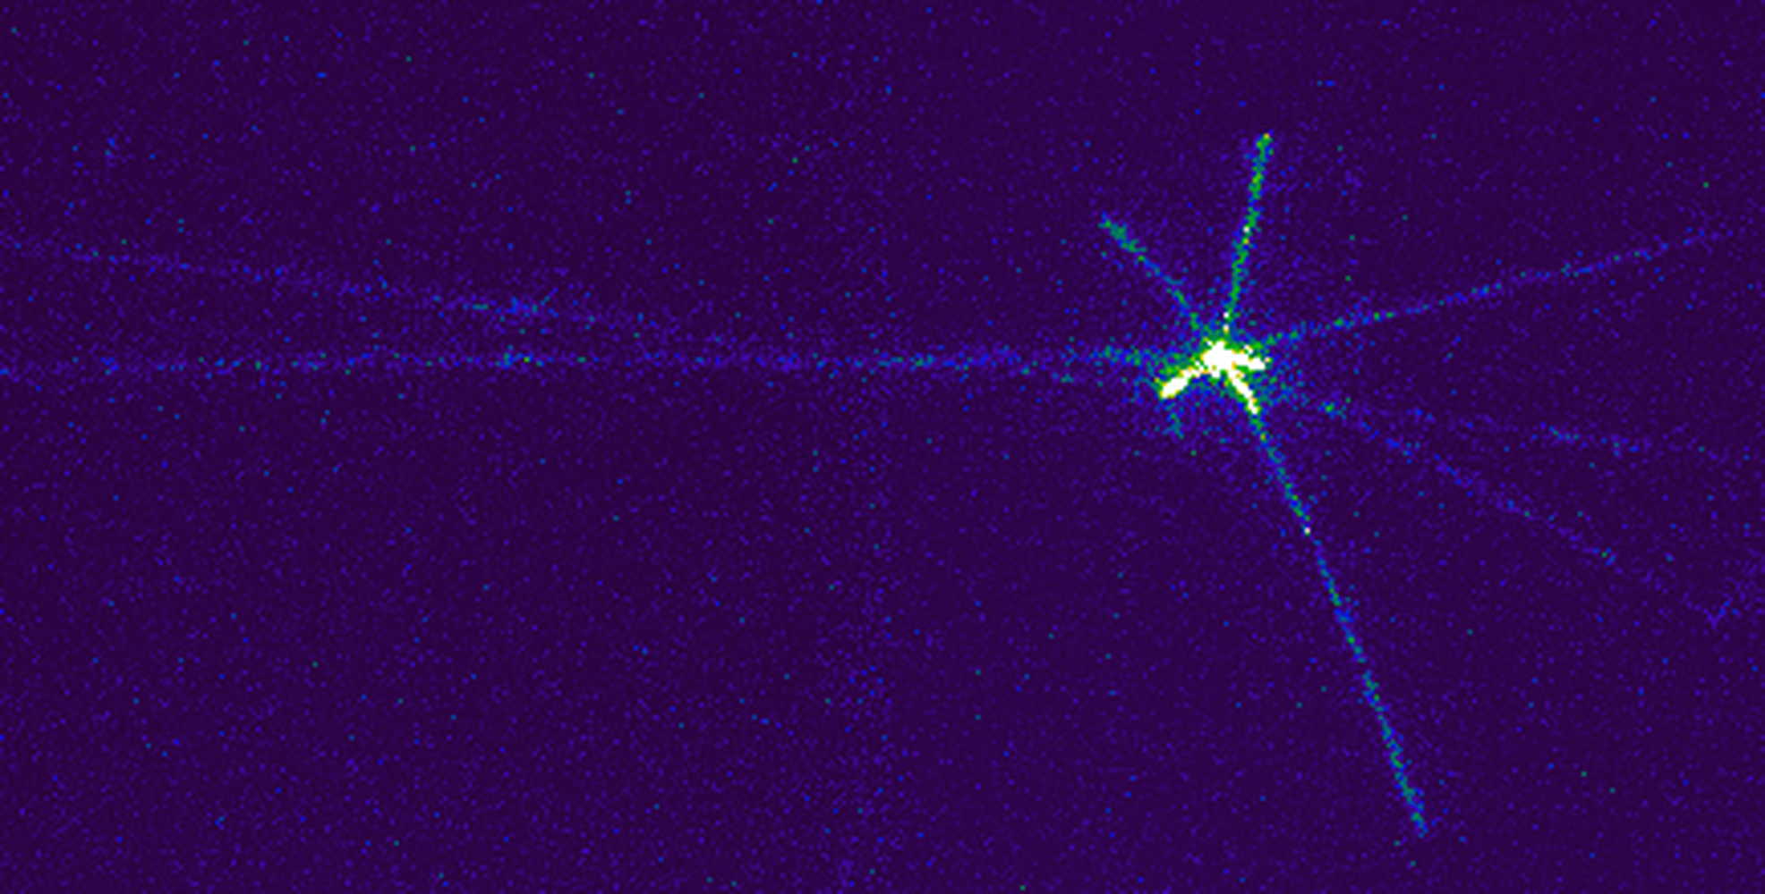
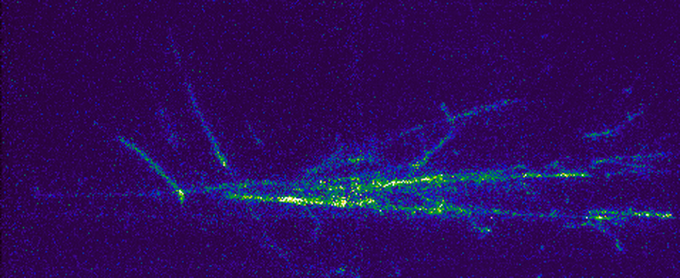
First demonstration of optical imaging beamline interactions in a two phase LArTPC
0.4 m
LHC ring
0.4 m
22

Slide 24
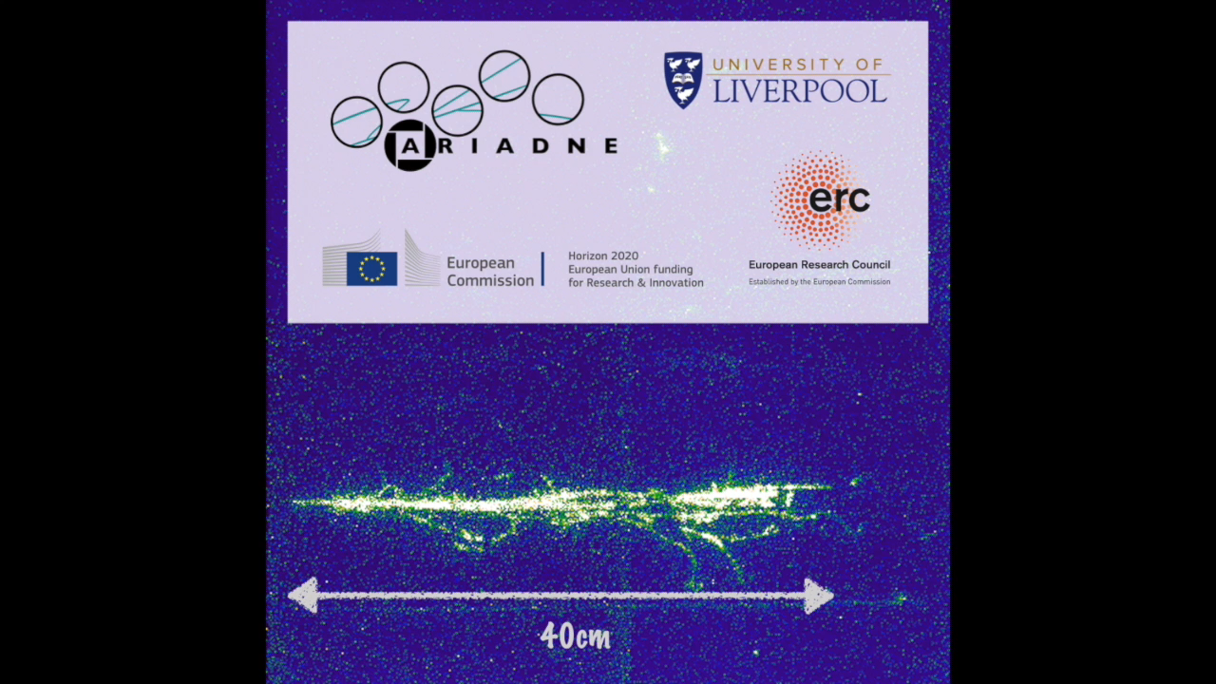
23

Slide 25
Future direction
z position information still relies on charge / PMT information when using EMCCDs
What if we could find a camera with timing resolution fast enough to resolve track information from within the drift velocity of the TPC? (LAr ≈ 2mm/µs)
Moving towards cameras with fast timing resolution…
24

Slide 26
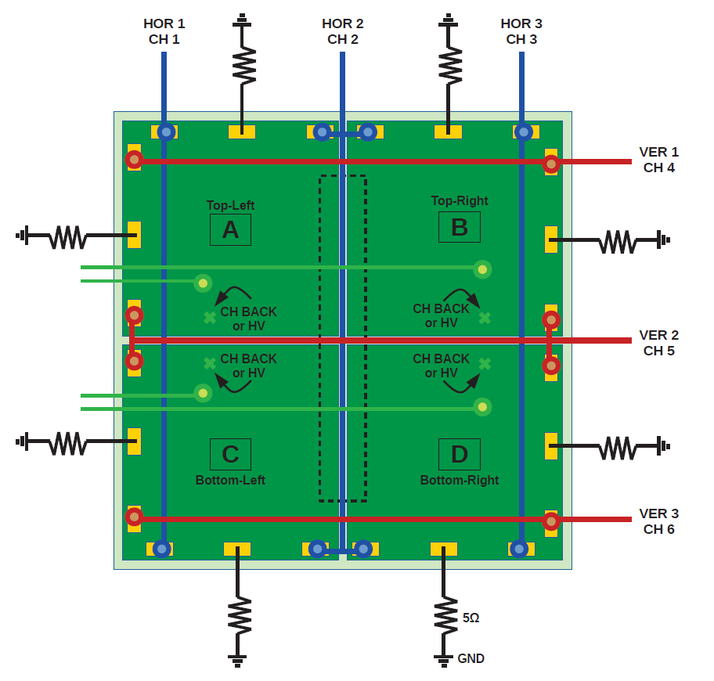
Linear Graded (LG)-SiPM based camera
Ongoing collaboration with FBK-IRST (Italy)
  Raw SiPMs currently used, i.e. medical imaging
  ARIADNE: first time with SiPM/lens combination
  Paper in progress
17 x 17mm total active area
3 horizontal + 3 vertical readout channels
Position reconstruction = weighted average of relative channel integrals
Results also to be presented at NSS2018 https://www.eventclass.org/contxt_ieee2018/online-program/session?s=N-28#e317
Gola A. et al., IEEE NSS/MIC (2013)
25

Slide 27
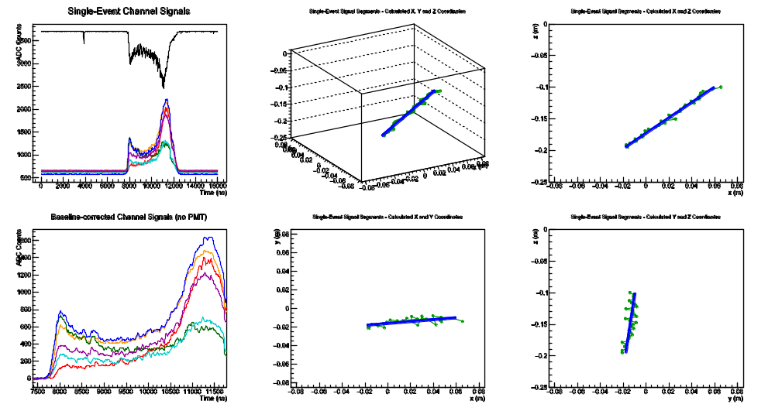


Linear Graded (LG)-SiPM based camera
S₁ peak
(Primary)
S₂ peak
(Track)
Difference $\sim$ $v_{d}$
Bragg Peak
Strip based readout can have ambiguities if there is pileup
Exciting future developments are expected
26

Slide 28
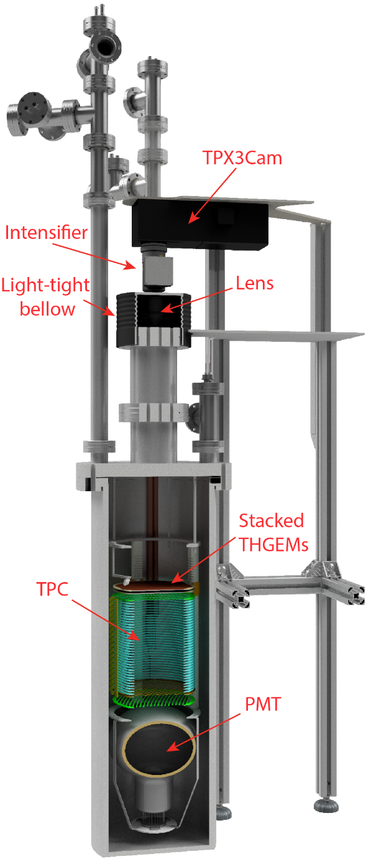
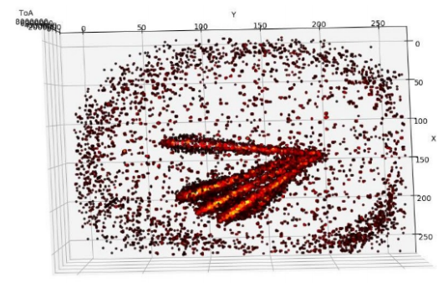
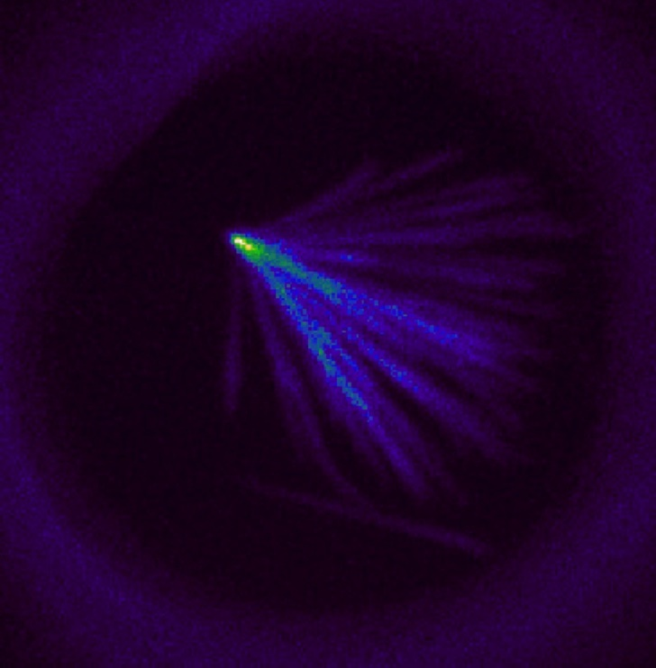
First demonstration of 3D optical readout of a TPC using a single photon sensitive Timepix3 based camera (https://arxiv.org/abs/1810.09955)
Compare to 2D EMCCD:
ToA information gives z coordinate. Simultaneous ToT gives intensity and enables calorimetry
27
No complicated reconstruction required to build events in 3D.

Slide 29
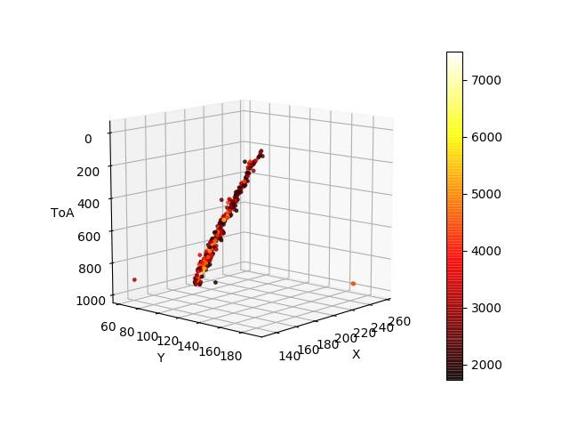
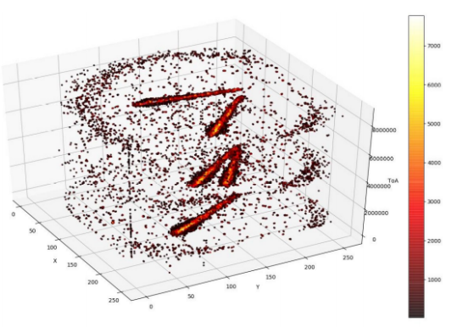
First demonstration of 3D optical readout of a TPC using a single photon sensitive Timepix3 based camera (https://arxiv.org/abs/1810.09955)
The camera has been demonstrated in 100mb CF4 with two THGEMs imaging an Am-241 alpha source.
Visible Bragg peak!
Light sensitivity comparable to EMCCDs
28

Slide 30
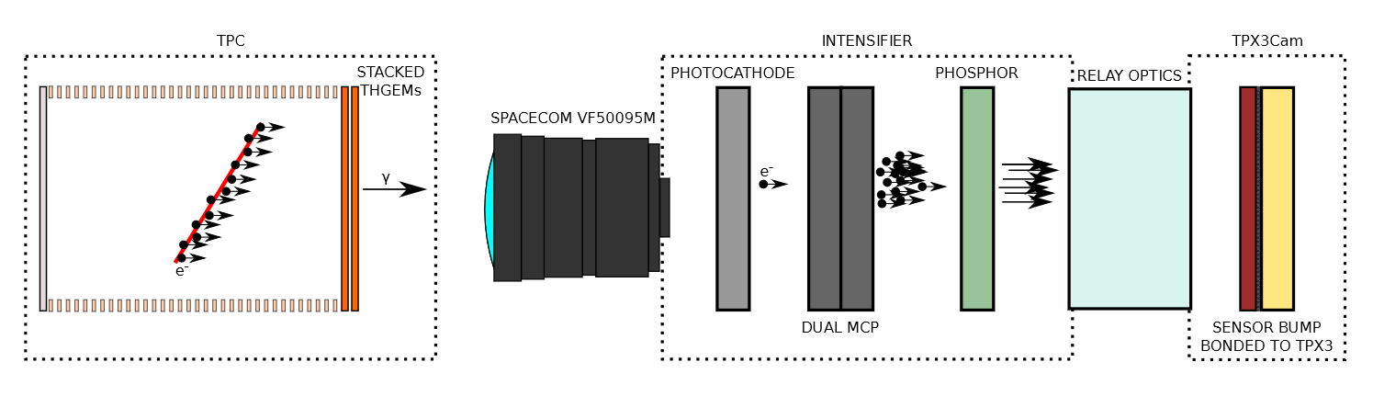
First demonstration of 3D optical readout of a TPC using a single photon sensitive Timepix3 based camera (https://arxiv.org/abs/1810.09955)
Advantages:
Low detection thresholds (single photon sensitivity)
Fast readout rates are possible (Up to 80 Mhits/s per camera)
Low cost – A single camera can cover 30cm x 30cm with ≈ 1mm x, y resolution
External camera readout allows for easy maintenance and upgrades
Natural experiment upgrade path as TPX4, TPX5, SiPM, etc technologies develop
28
All the benefits of pixel readout while eliminating most/all? of the drawbacks

Slide 31
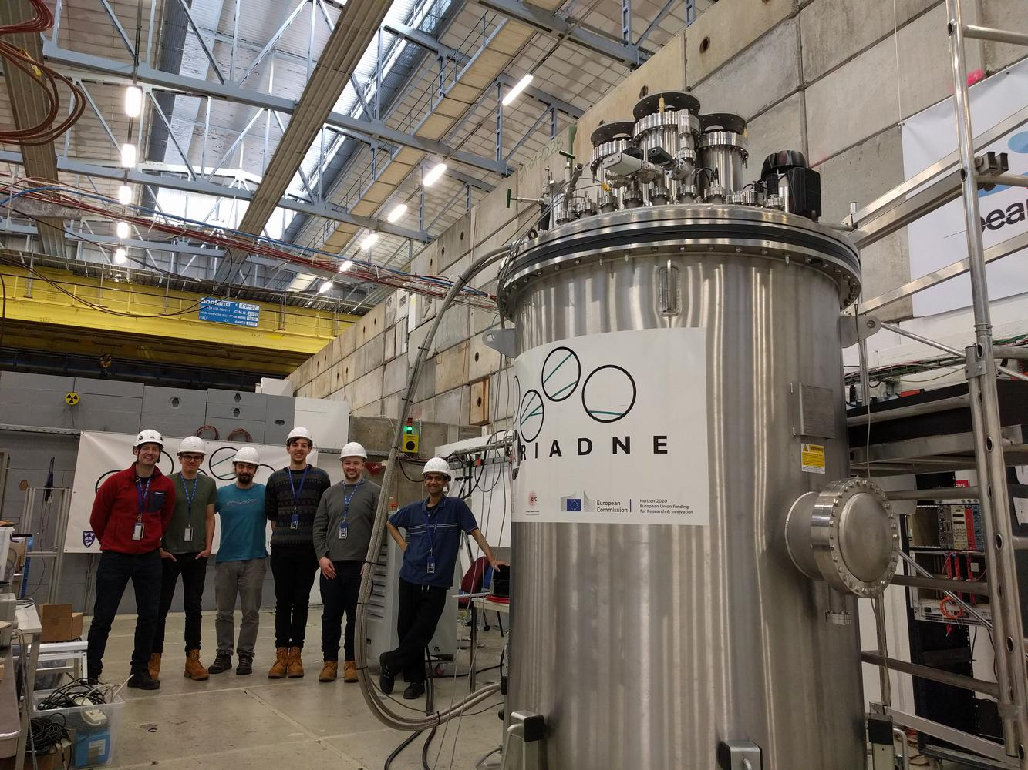
ARIADNE outlook
Characterise full optical 3D tracking with ‘fast’ cameras in LAr! Demonstrate calorimetry/track reconstruction
Return to a test beam to further solidify 3D cameras with mixed particle species
Open to collaboration for the development of future camera technology with fast timing resolution
29

Slide 32
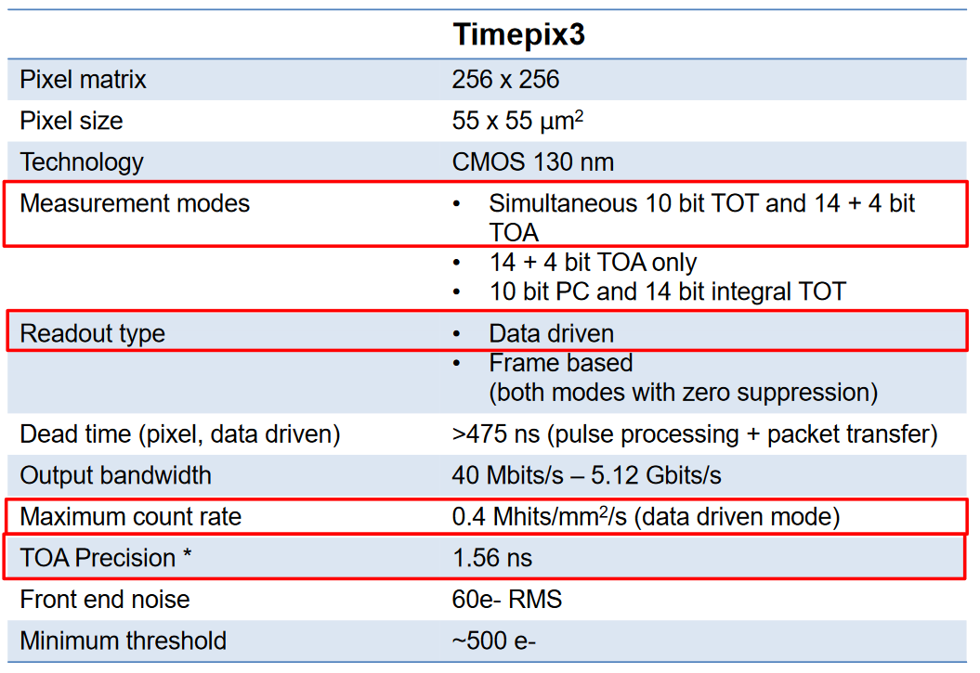
Backup – TPX3 Specifications
≈ 1mm in LAr

Slide 33
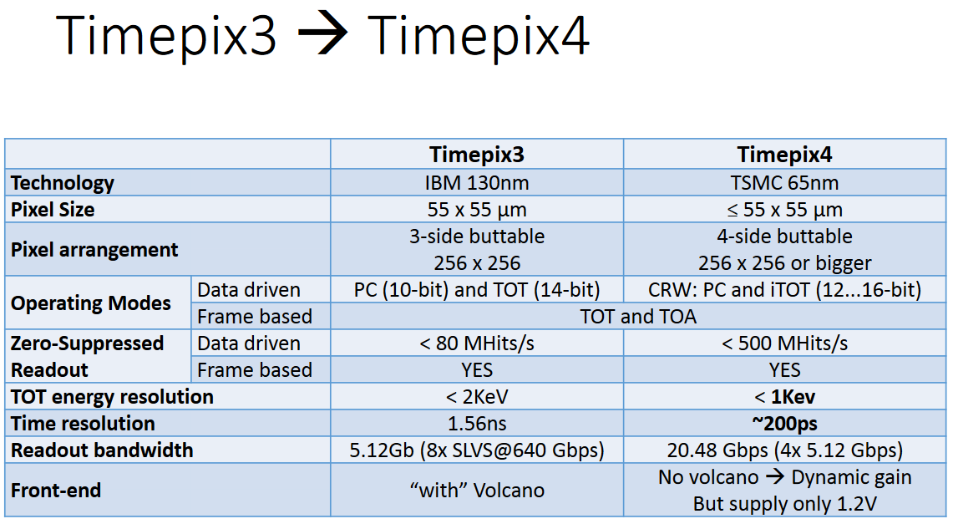
Backup – Experiment upgrade path
Higher x,y resolution
Faster readout rates
Improved calorimetry

Slide 34
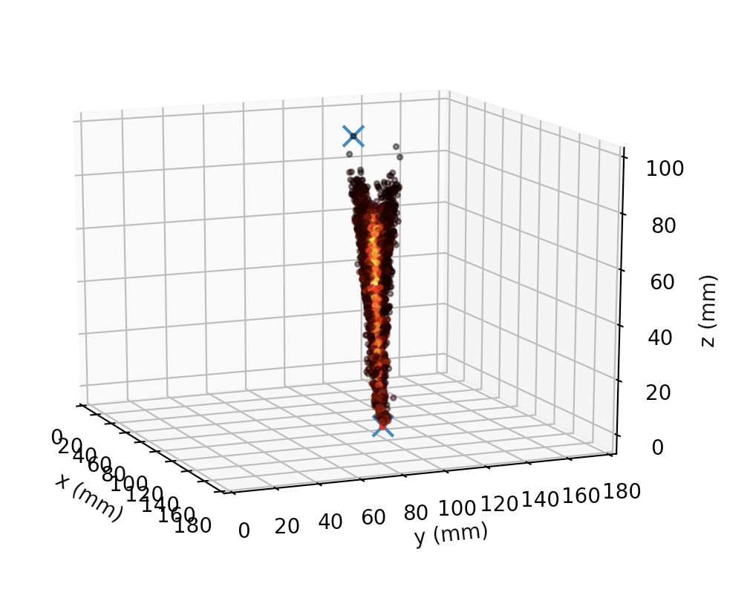
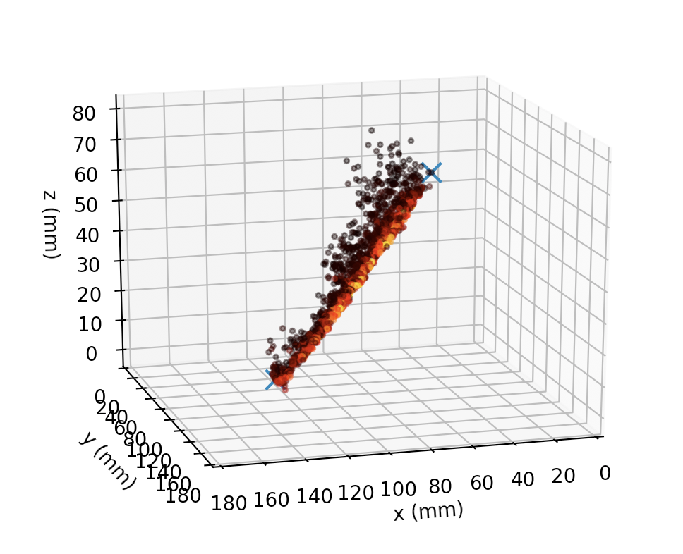
Backup – time walk

Slide 35
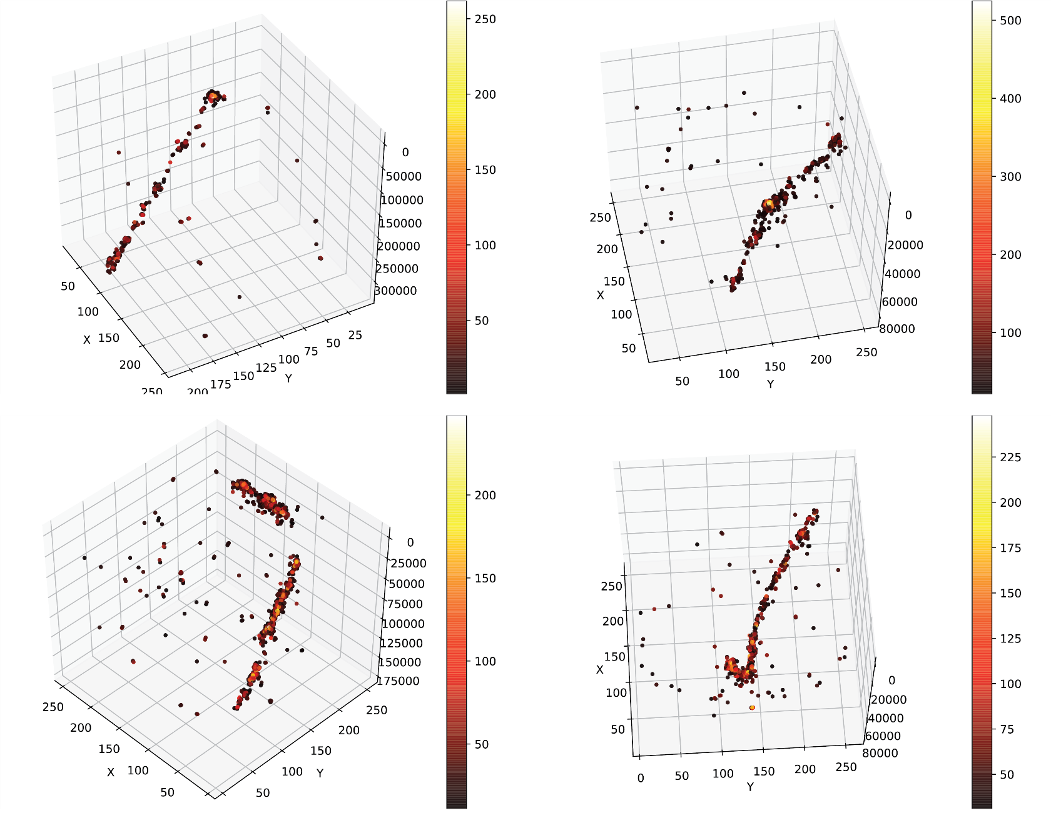
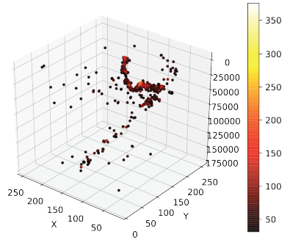
Backup – cosmics

