Slide 1

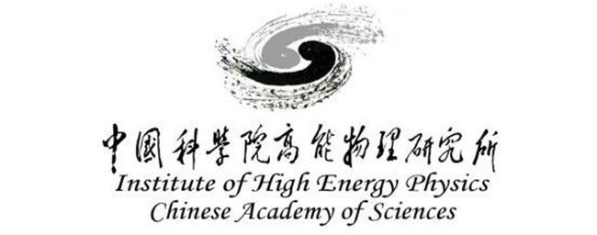
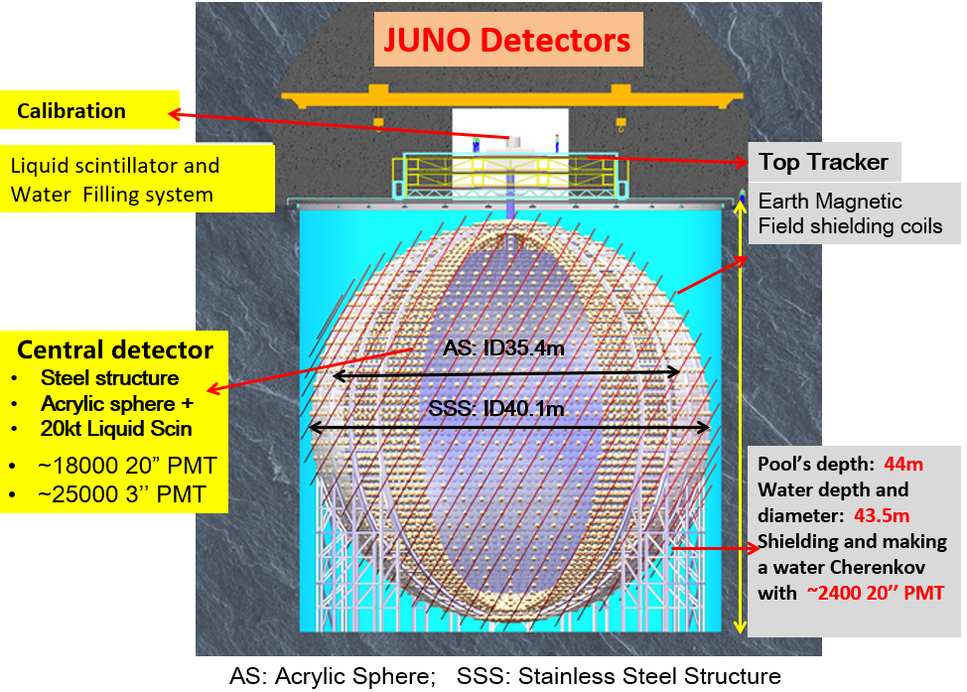
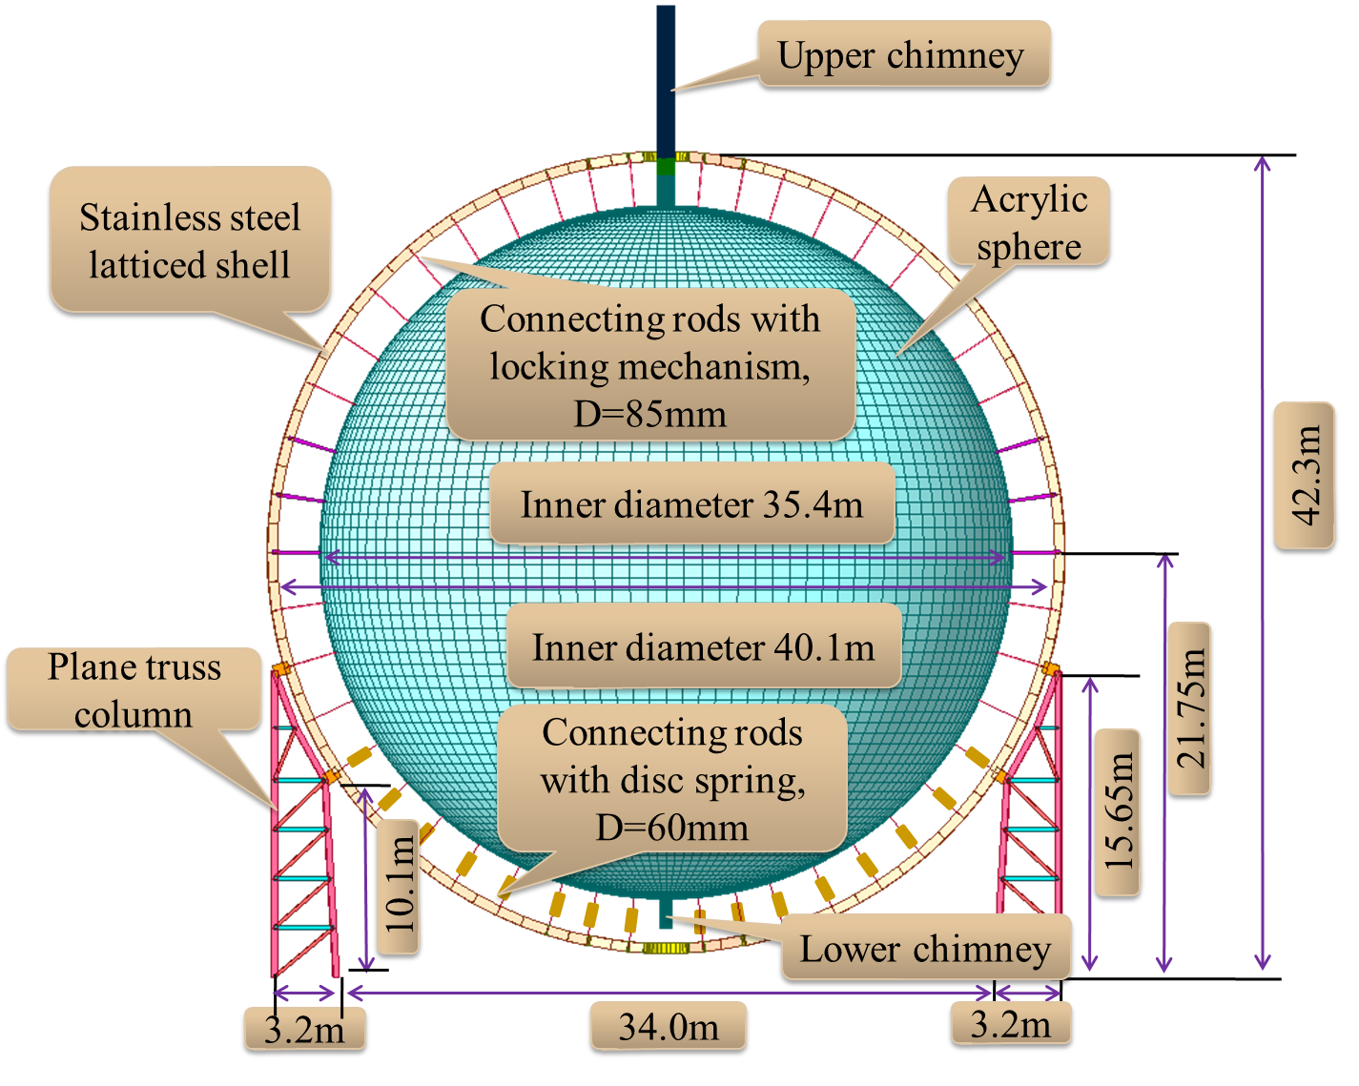
The Central Detector of JUNO
Pei Yatian (IHEP)
On behalf of the JUNO Central Detector group
Central Detector (CD)
  Photocathode coverage: ~ 75%,
  PMT photon detection eff.:~27%
  Divided into 30 longitudes and 23
  latitude layers
Our aim: Determine MH with Reactors

Slide 2

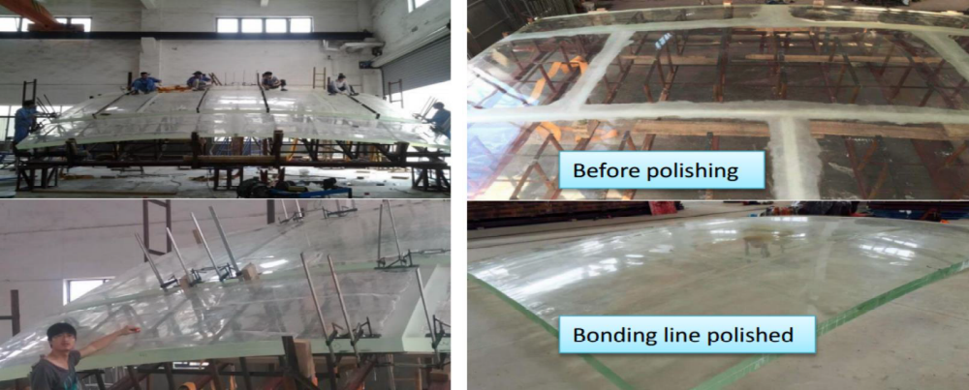
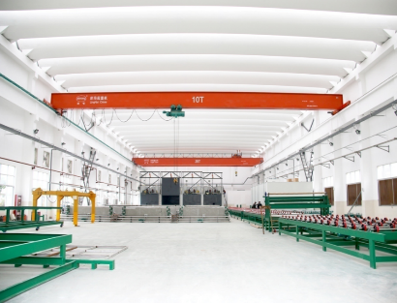
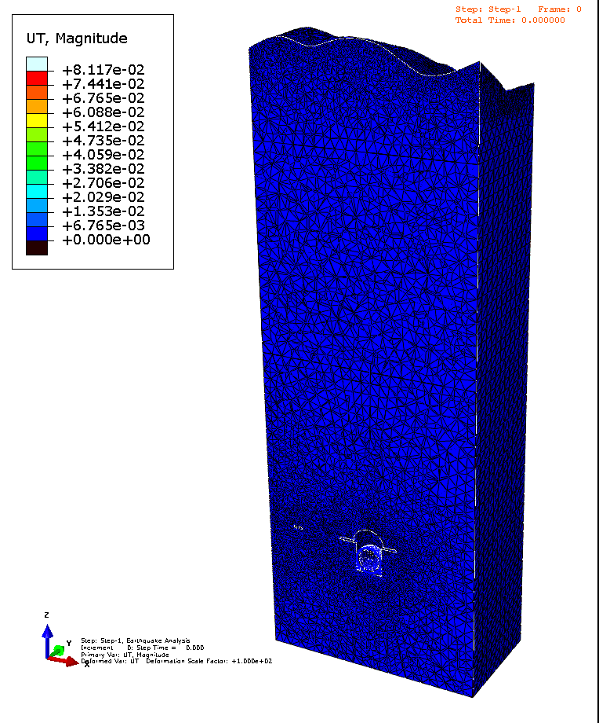
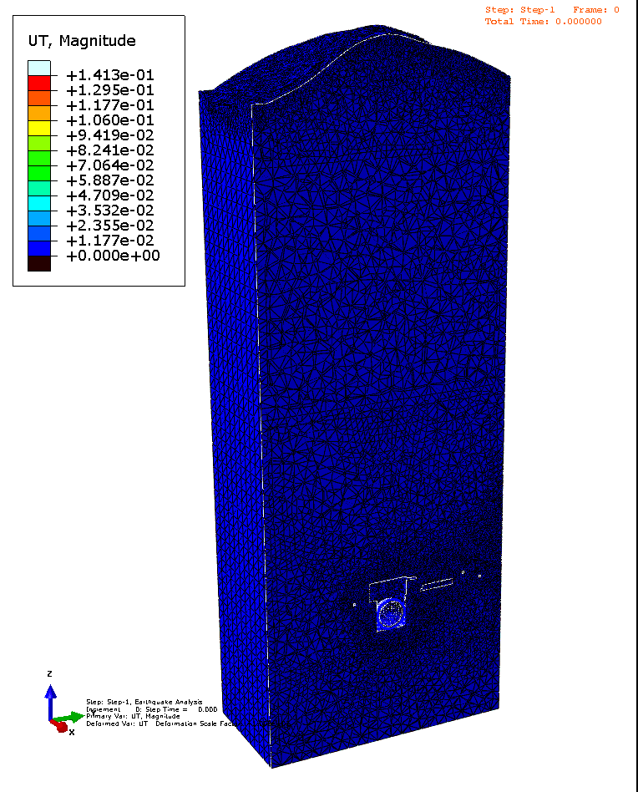
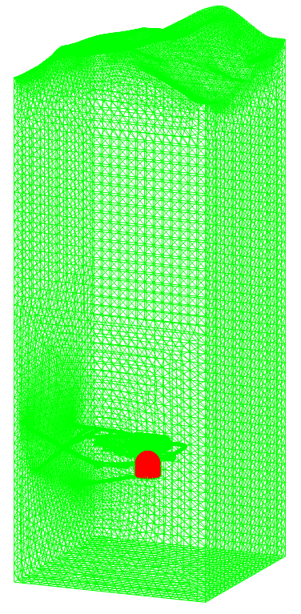
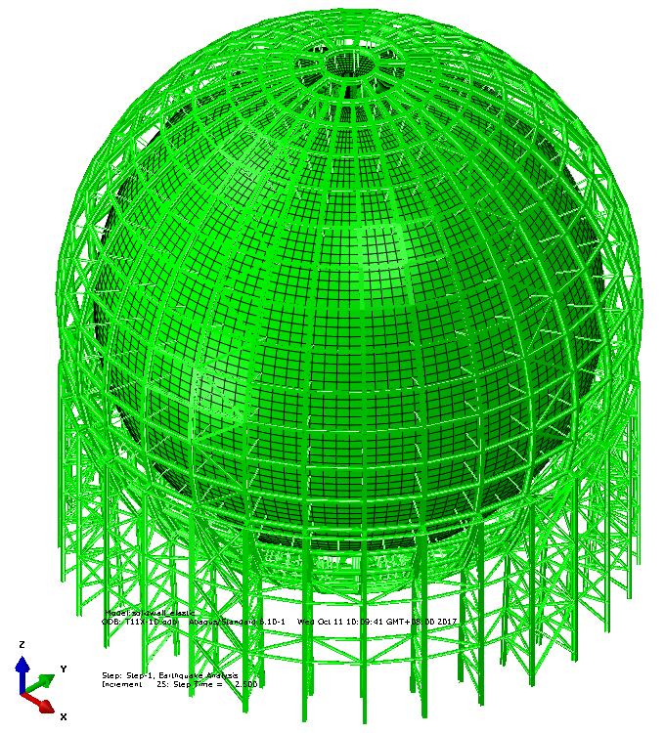
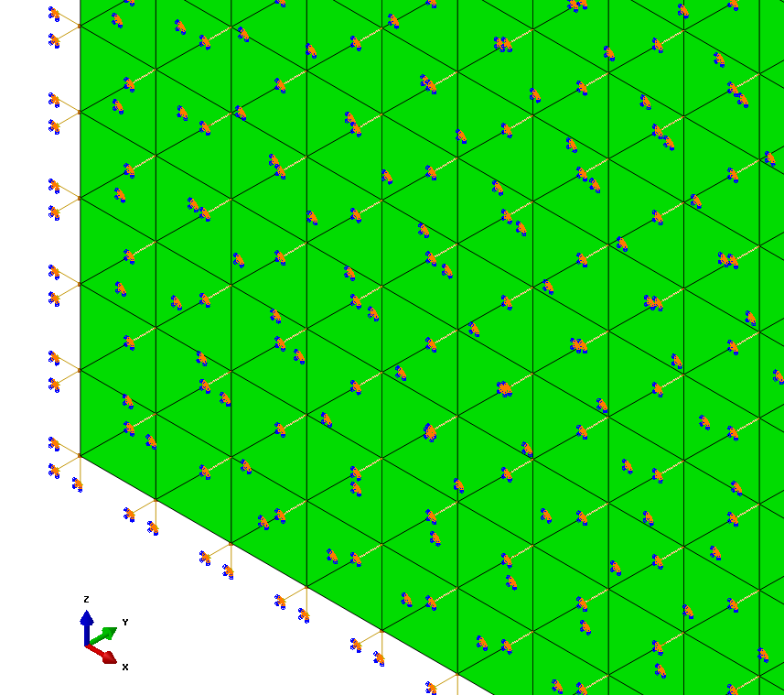
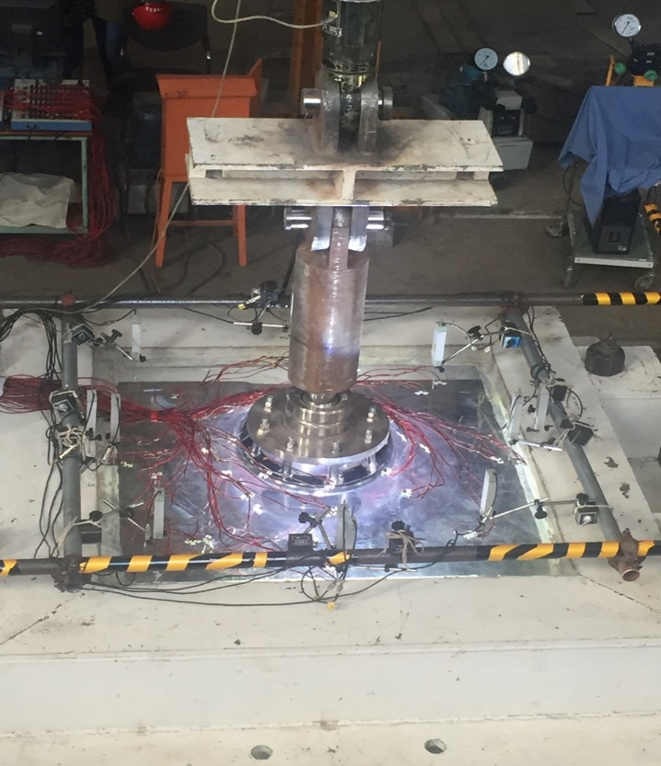
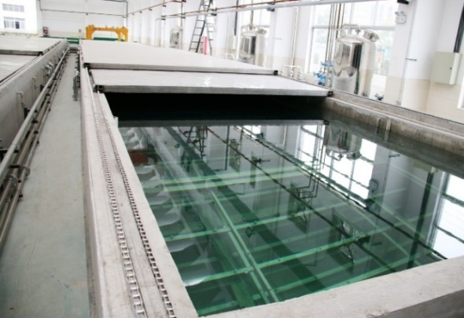
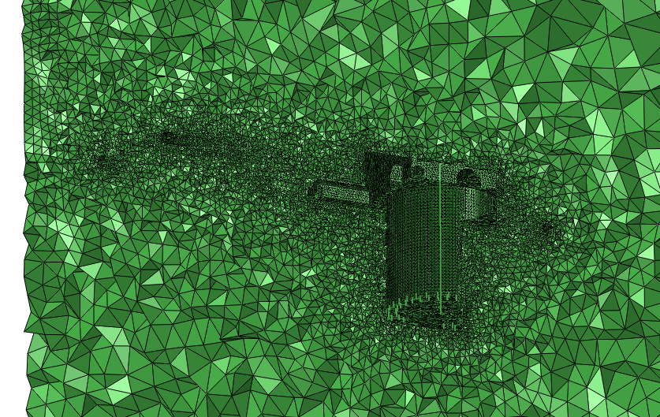
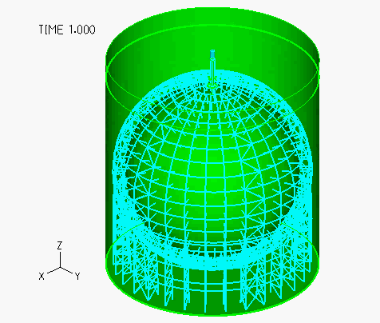
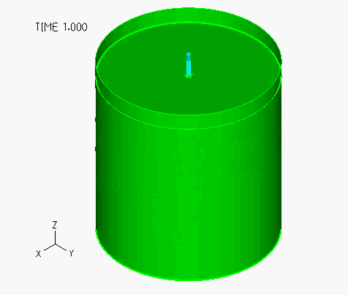
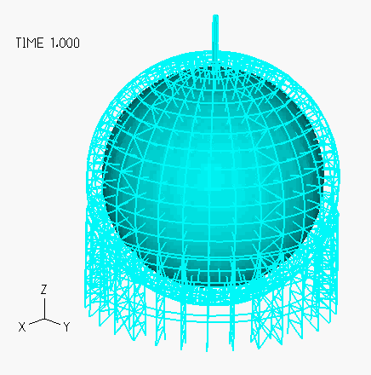
Progress 1: General R&D
Progress 2: Acrylic sphere（AS）
Static analysis and seismic analysis of CD main structure have been finished
R&D
Production
Test for bulk-polymerization
Near-field seismic response analysis model
Load test of node: break at 100 tons
Achieved goals:
-Max pulling load of node: ~ 8 tons
-Break at load of node: ~100 tons
-max stress on acrylic ≤ 3.5MPa
-Creep: over 100 years
Other questions:
- radiation back- ground
- Light transmittance
(Thermoforming, polymerization)
-A new production lines
special for JUNO are
finished
-A constant temperature
workshop is being made
for acrylic panels
machining and pre-
assembly
Integrated model
Pure water
SS structure
Fluid-structure interaction seismic analysis

Slide 3
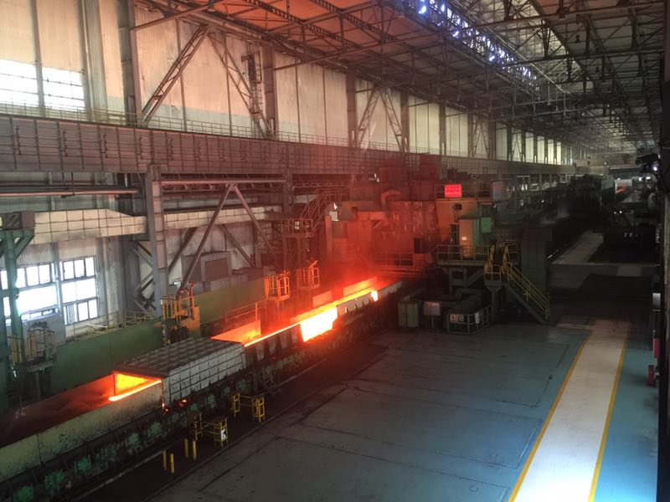
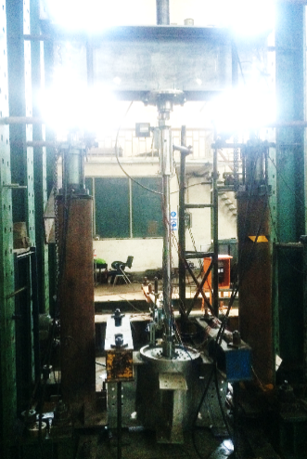
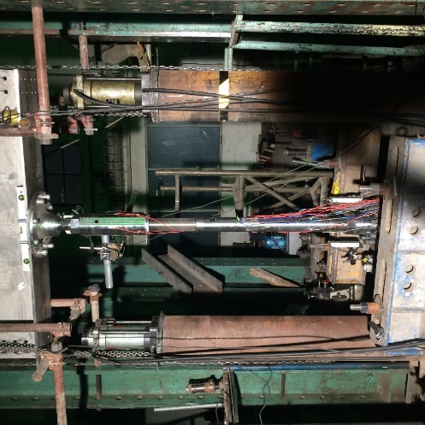
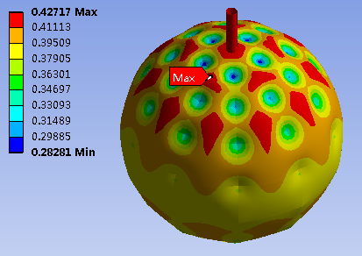
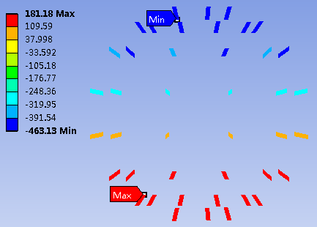
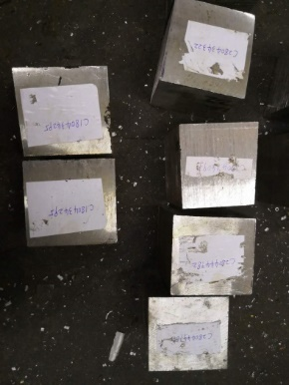
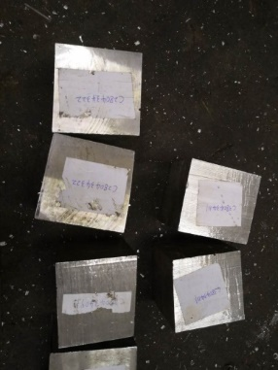
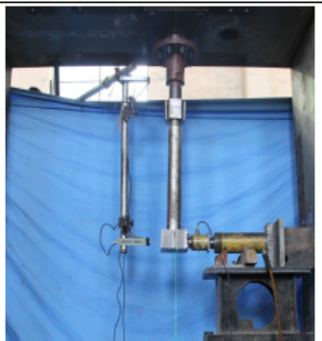
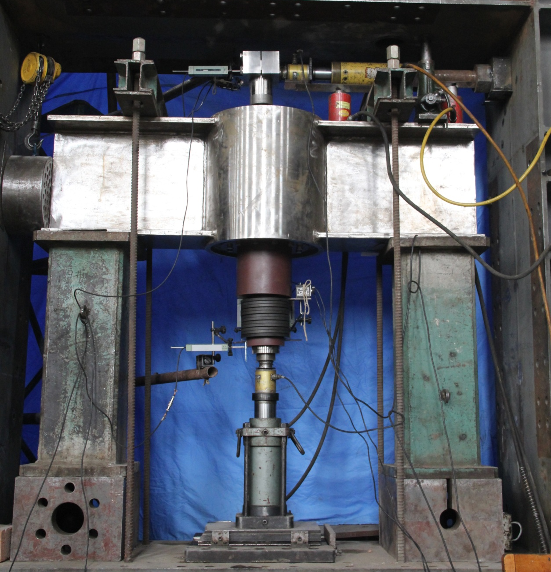
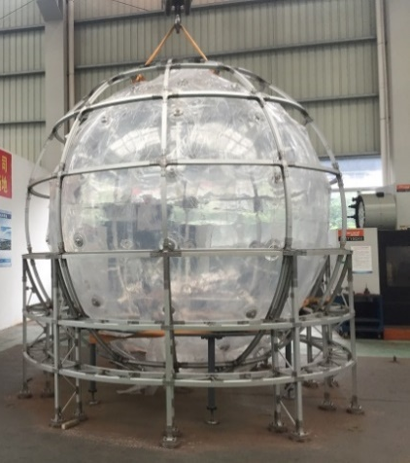
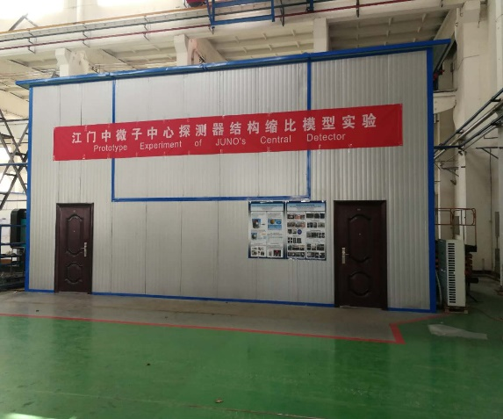
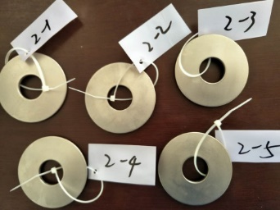
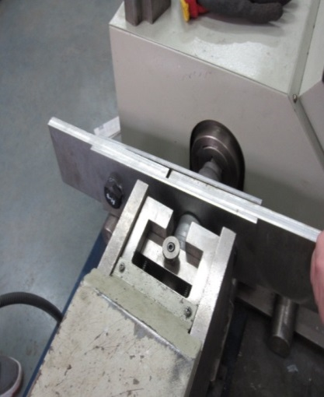
Progress 3: Stainless steel structure（SSS）
Progress 4: 1/12 scaling CD prototype
R&D
Production
Prototype has finished
The laboratory has been set up
-First batch of stainless steel with low background met our requirement
-Techniques and Production Readiness Review of SSS of CD has been held on 2018.10.12
Verify the FEM calculation; Check the spring effects; Check the temperature load;;Test the monitor system; Test the filling/overflow system
Mechanical test; Corrosion test; Slip coefficient test and so on
Thank you for your attention （ID:62）

