Slide 1

Performance of Large Area Picosecond Photo-Detectors (LAPPDTM)
Lyashenko
Incom Inc.

Slide 2
LAPPD development group:
A. V. Lyashenko (alyashenko@incomusa.com), B. W. Adams, M. Aviles, T. Cremer, C. D. Ertley, M. R. Foley, C. J. Hamel, M. J. Minot, M. A. Popecki, M. E. Stochaj, W. A. Worstell, Incom Inc, Charlton, MA
A. U. Mane, J. W. Elam, Argonne National Laboratory
O. H. W. Siegmund, University of California, Berkeley
Prof. H. J. Frisch’s group (E. Angelico, A. Elagin, E. Spieglan), University of Chicago
Prof. M. Wetstein’s group, Iowa State University

Slide 3
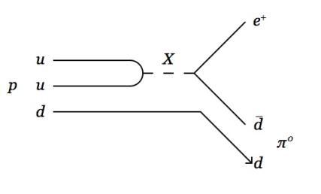
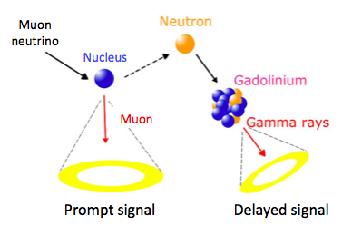
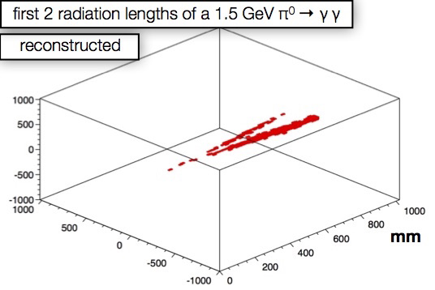
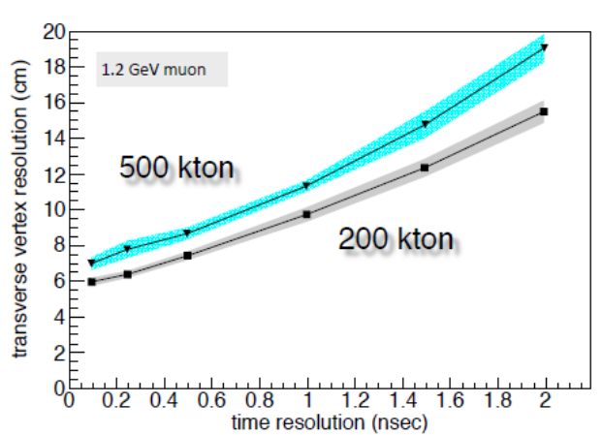
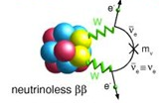
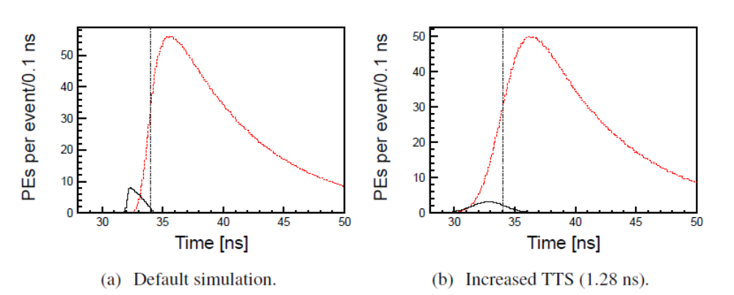
Benefits of fast timing
More efficient background rejection
M. Sanchez, NUFACT2015
M. Sanchez, NUFACT2015
Precise track reconstruction
High vertex resolution in large scale experiments
https://people.nscl.msu.edu/~witek/Classes/PHY802/betadecay2017a.pdf
TTS 0.1nS
TTS 1.28nS
Directionality
information
C. Aberle et al., JINST 9 (2014), arXiv:1307.5813

Slide 4
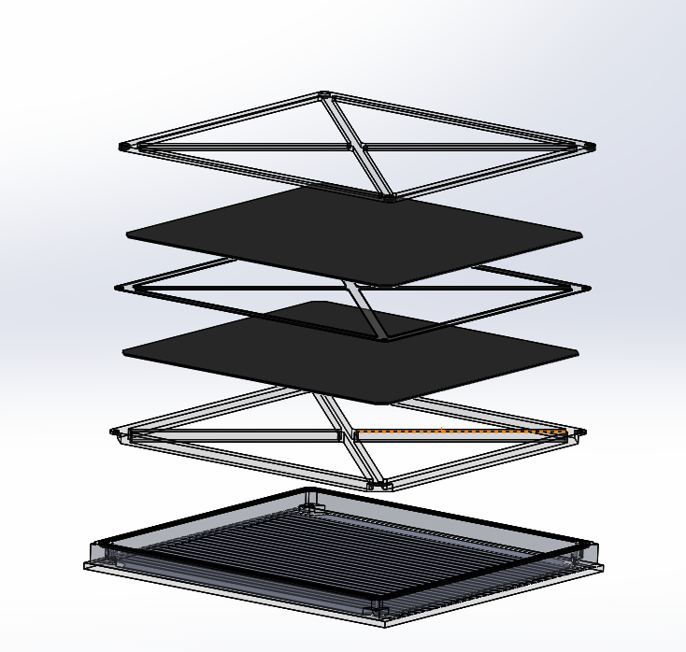
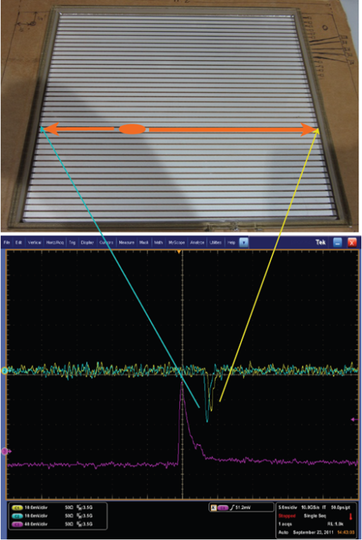
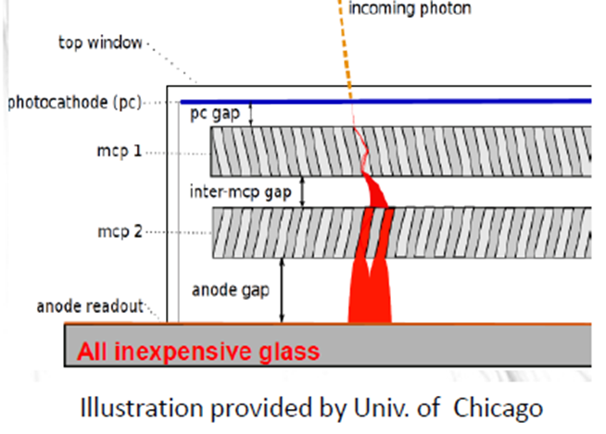
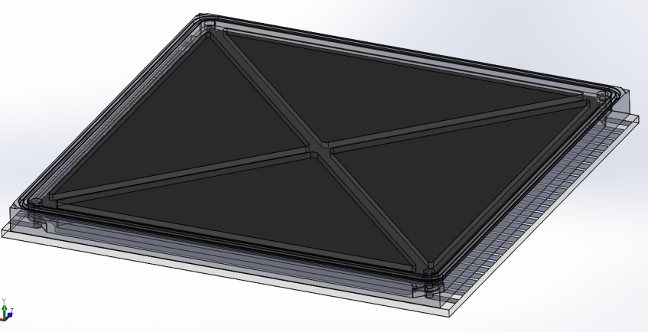
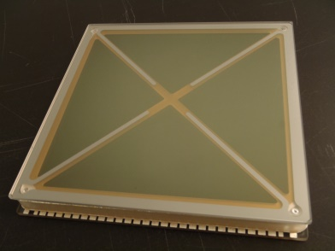
LAPPD features
50Ω impedance
Incom
MCPs
Glass/ceramic body
Large Active Area: 195 x 195 mm²
Picosecond timing resolution
mm spatial resolution
QE >20% w/bi-alkali photocathode
Fused Silica/Borosilicate window
Flat square geometry, high filling factor
Lower Cost per Unit Area
21mm
Active area 92%
220mm
229mm

Slide 5
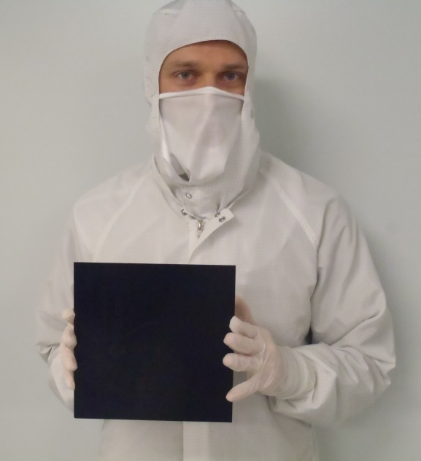
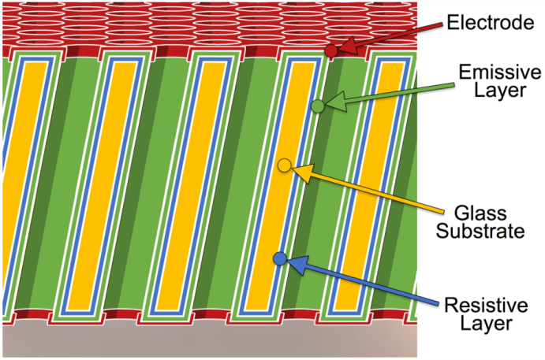
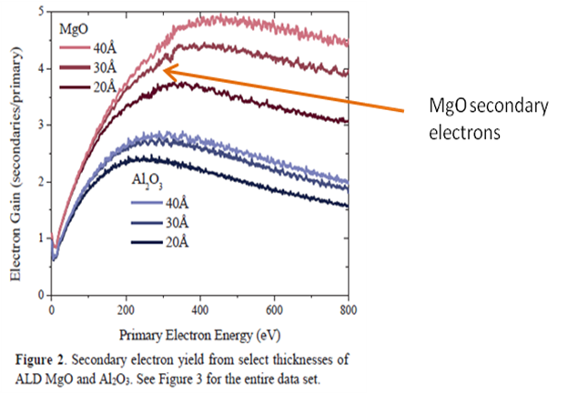
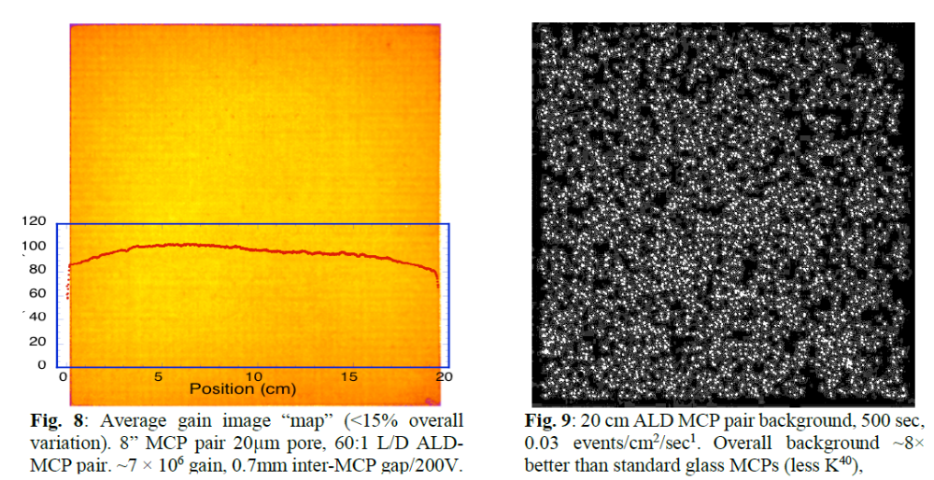
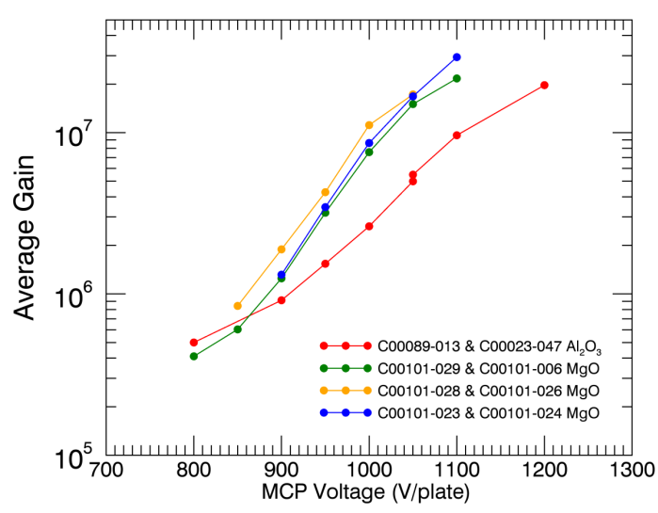
Incom MCPs
Glass capillary arrays functionalized in-house with ALD
Gain Uniformity in 203mm X 203mm MCP
Gain >10⁷
MgO
Al₂O₃
Dark count rate
0.03 Hz/cm²
MCPs are a separate product line.
Standard dimensions DIA33mm, SQ53mm, SQ60mm, SQ127mm, SQ200mm. Curved MCPs.

Slide 6
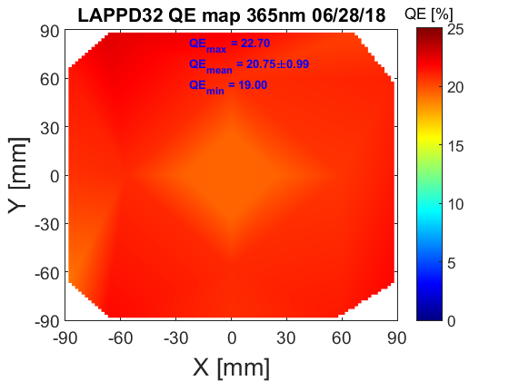
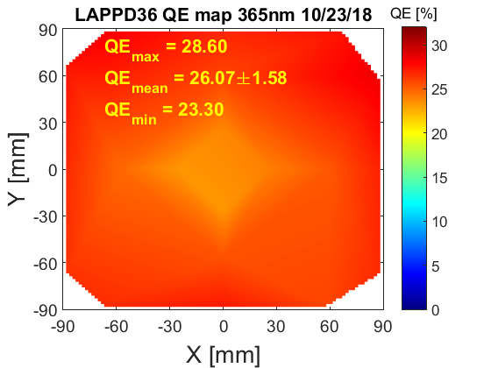
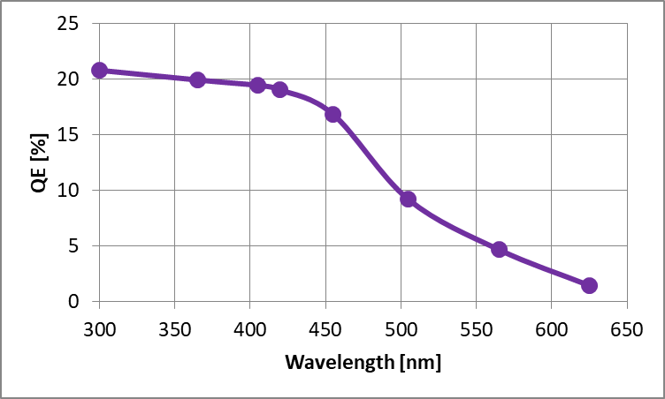
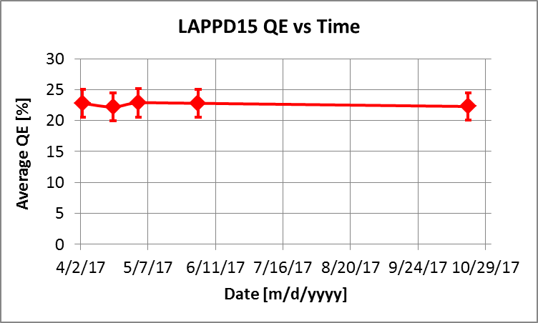
Photocathode
± standard deviation
Bi-alkali: Na₂KSb
QE measured at 365 nm
Highest avg. is 26%
LAPPD 15 photocathode stable for > 6+ months and counting.
Large Area Photocathode production process is established
QE >20% demonstrated in sealed LAPPDs
LAPPD S/N | Maximum % | Average % | Minimum %
LAPPD #13: | 23.5 | 18.6±3.3 | 13.5
LAPPD #15: | 25.8 | 22.3±3.0 | 15.7
LAPPD #22: | 14.7 | 10.6 | 7.0
LAPPD #25: | 10 | 7.1 | 5.0
LAPPD #29: | 19.6 | 13.0±6.0 | 3
LAPPD #30: | 22.9 | 17.2±2.5 | 13
LAPPD #31: | 19.6 | 16.0±1.9 | 12.1
LAPPD #32: | 22.7 | 20.8±1.0 | 19.0
LAPPD #36: | 28.6 | 26.1±1.6 | 23.3

Slide 7
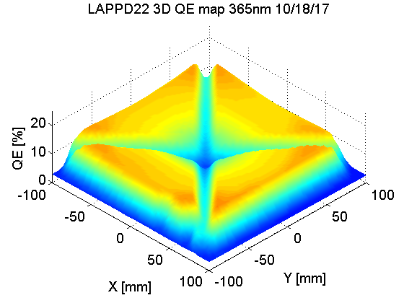
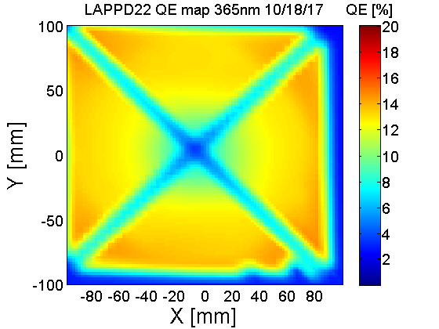
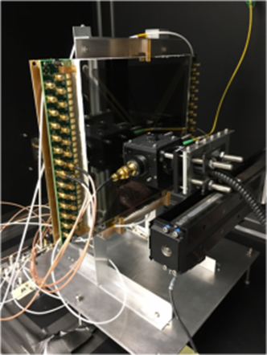
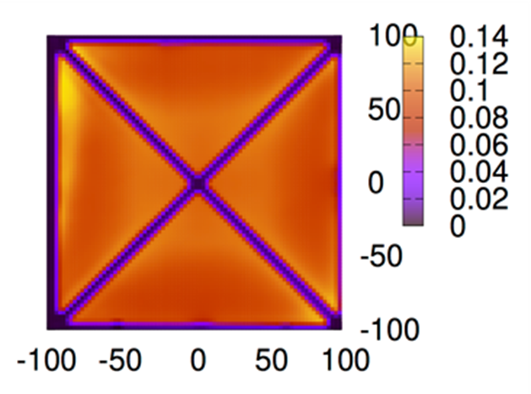
QE scanner
X-Y motorized stage with LED

Slide 8
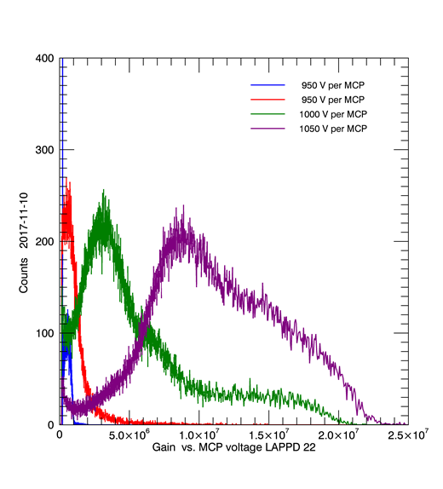
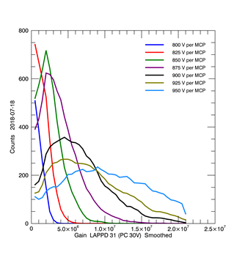
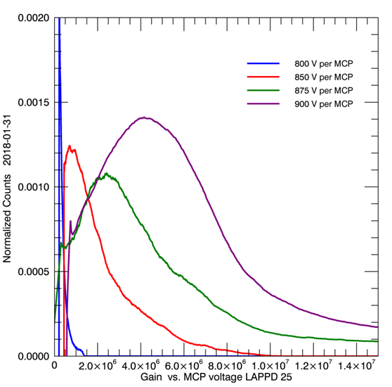
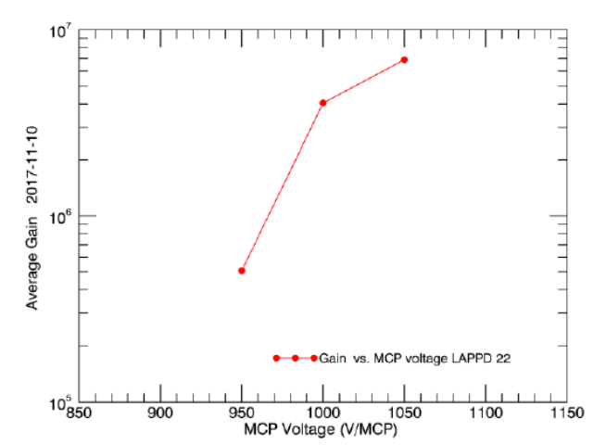
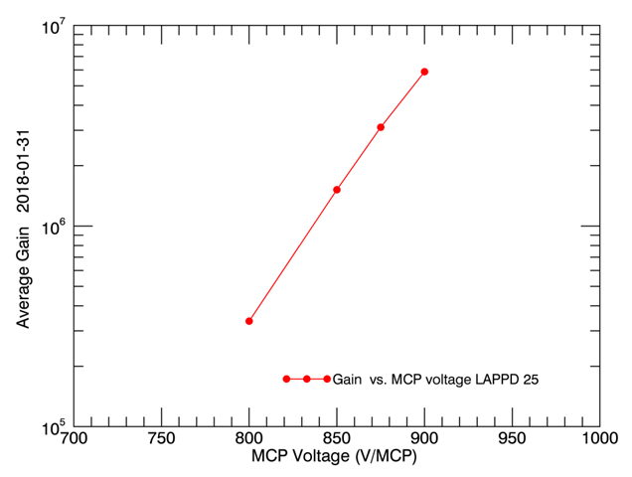
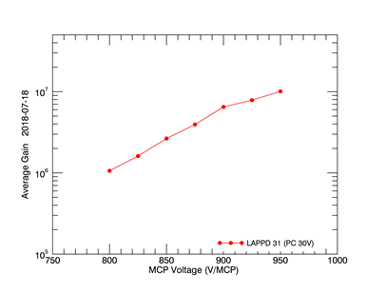
LAPPD Gain
LAPPD 22
LAPPD 25
LAPPD 31
7*10⁶
6*10⁶
10⁷
    Read out with DRS4 eval. or CAEN waveform digitizers
Gain >5*10⁶

Slide 9
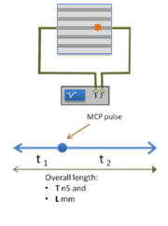
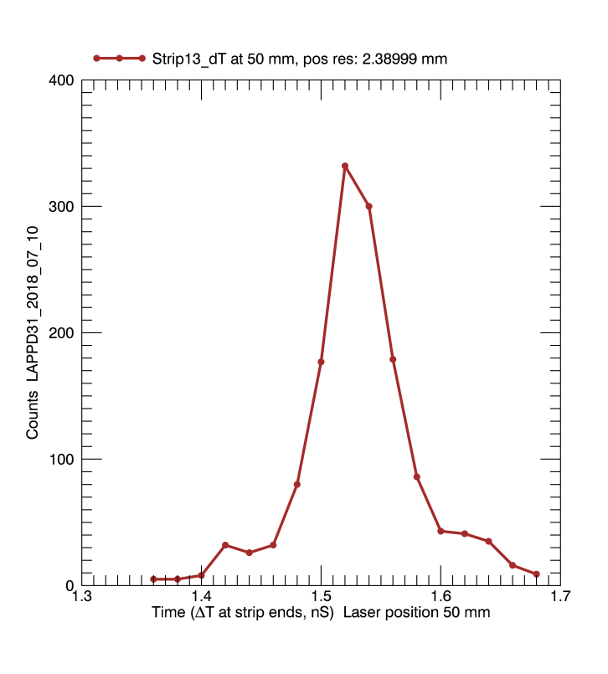
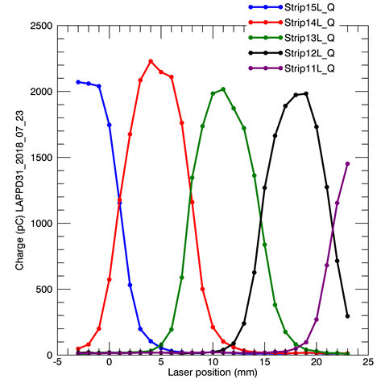
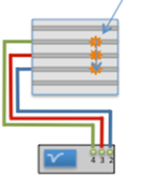
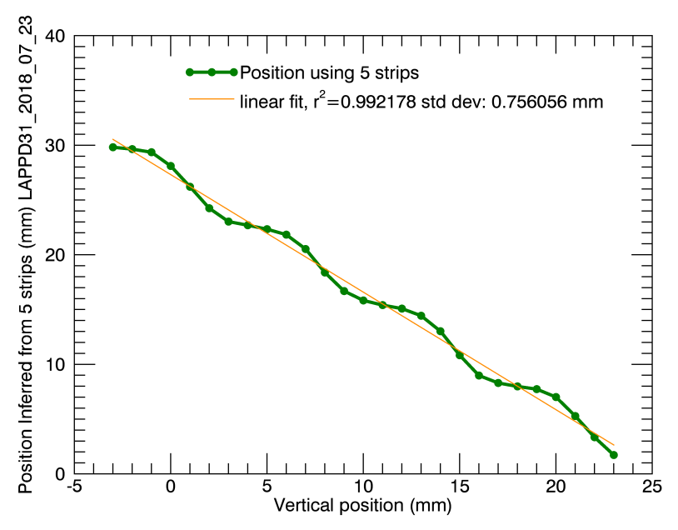
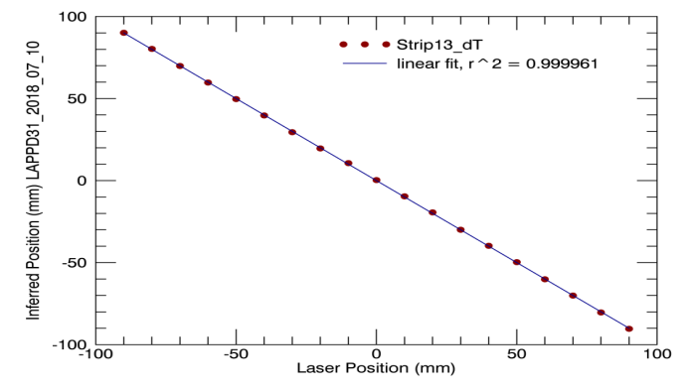
Spatial Resolution
Along a Strip
Across Strips
Jitter in Δt for a fixed laser position
Center of Mass of five adjacent strip signals
FWHM
2.4mm
    DRS4 waveform samplers
Pulses observed at both ends of a strip.
St. dev. from linear fit 0.75mm
Reconstructed position
vs laser position
Notes:
From Andrey: I would make relative time plot from slide 13 bigger and focus on that. Perhaps 12-14 can be combined in a single slide with focus on transverse and longitudinal resolution numbers (less so about how those numbers were extracted).
Pulse selection requirements:
Both ends of the central strip must exceed a threshold of 10mV.
Maximum amplitude must be on the central strip, rather than adjacent strips
At each laser position along a strip:
Use a peak fit to each pulse to calculate relative arrival times, and pulse amplitudes
Form a distribution of arrival times
Fit the distribution of relative arrival times

Slide 10
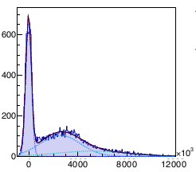
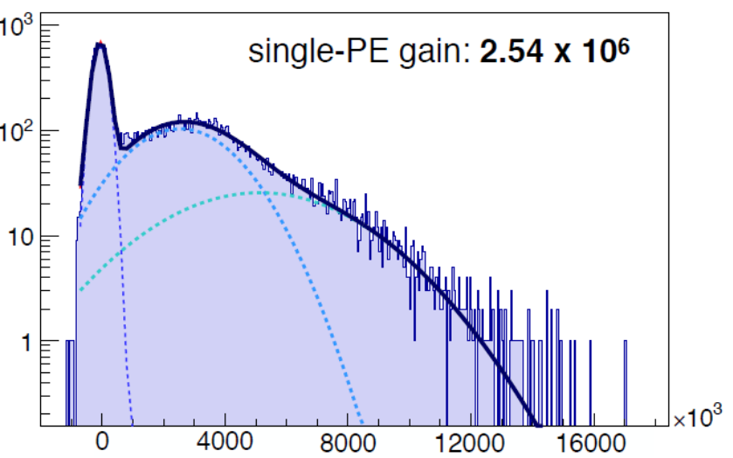
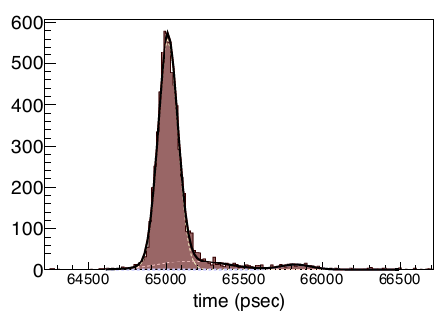
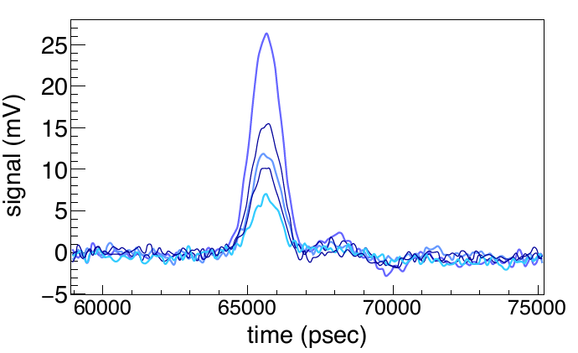
Time Resolution
Testing at Iowa State University, Matt Wetstein, ANNIE Program for more details see talk by Dr. Vincent Fischer on Saturday
Peak Gain >> 10⁶
@ low voltages
Transit Time Spread
64 psec
electronics limited (with 40pS FWHM laser pulses)
Typical Single PE Pulses
FWHM: 1.1 nsec
Rise time: 850 psec
Notes:
TOP LEFT: Random pulses, approx every tenth trace sampling
TOP Right: Amplitude very clean distinct single-PE separation, ≥5 MV, Low noise
Bottom Left : Peak gains well above 10^6 even at low voltage (850 & 950 V)
Bottom Right: better than 70 psec time resolution with very little effort
• We turned it on and it worked well.
• More details to follow, including spatial scans
• This tile solidly meets ANNIE specifications

Slide 11
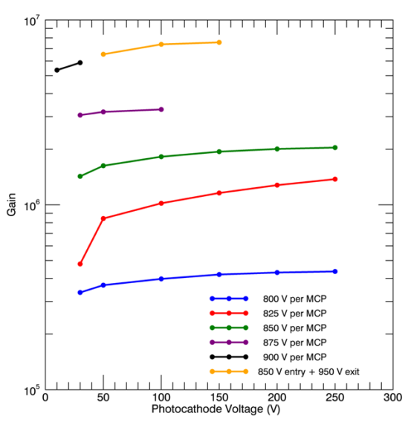
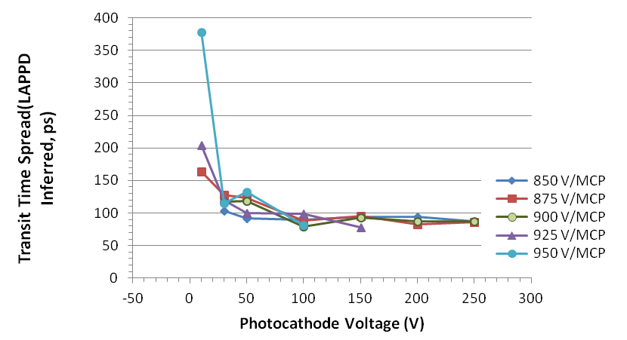
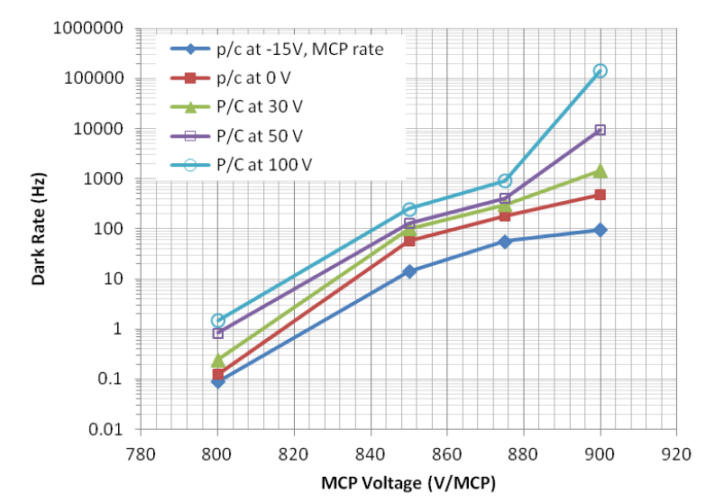
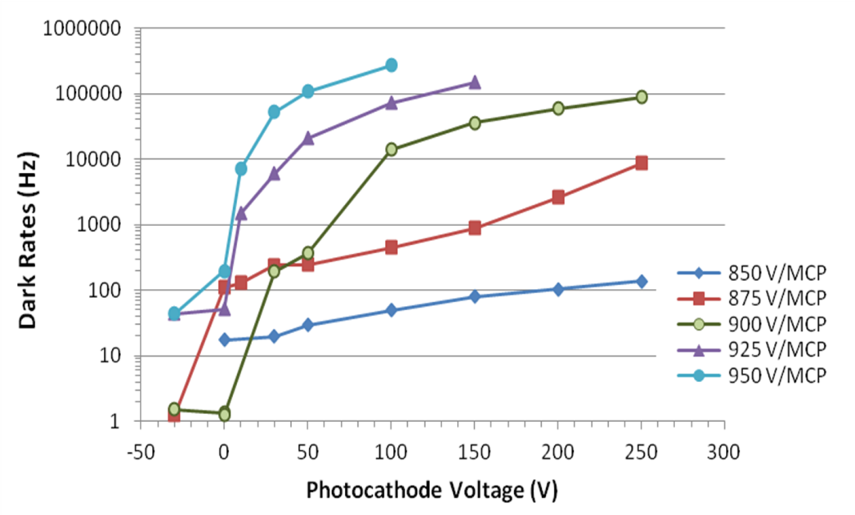
Dark Count Rate
Dark count rates per 13.5cm² strip
At optimal operation conditions @ 50V extraction voltage, 875V-900V MCP voltage with
Dark count rate 30-60 Hz/cm²

Slide 12
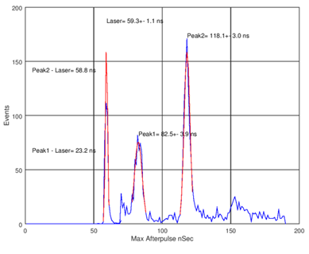
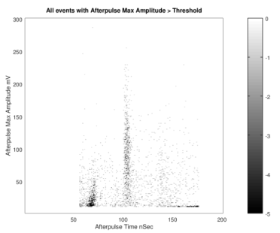
Afterpulses
Laser-induced pulse
  Laser pulse downscaled to fit on histogram
  3.5% afterpulse ratio
Pulse Amplitude (mV)

Slide 13
LAPPD Pilot Production Timeline
DOE Funding to create infrastructure and demonstrate a pathway toward pilot production (April 2014)
Facility operational (November 2015)
LAPPD Commissioning trials initiated (December 2015)
  #9 – 9/14/2016, First Sealed Tile – Aluminum Photocathode
  #15 – 03/31/2017, Photocathode QE Optimization
  #22 – 10/10/2017, Mean QE: High Gain MCPs, Peaked SPE PHD,
  #31 – 5/25/2018 Functional Tiles with “Personality”
  #36 - 10/16/2018 – First GEN II, Ceramic Body LAPPD
Exploitation (2018)
  Currently Producing prototypes for early adopters
  Process Optimization

Slide 14
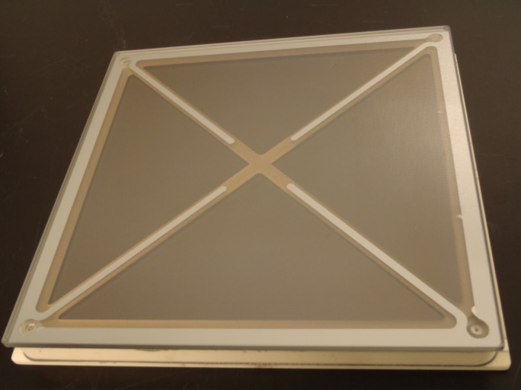

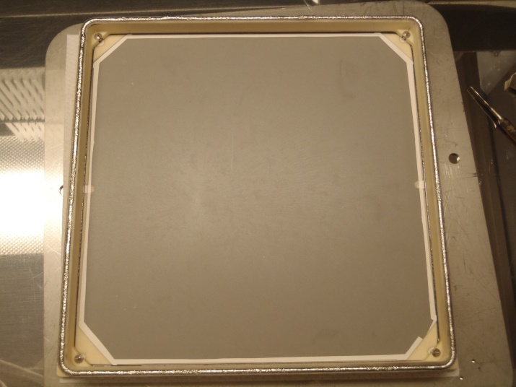
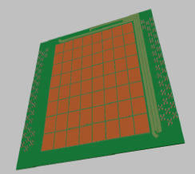
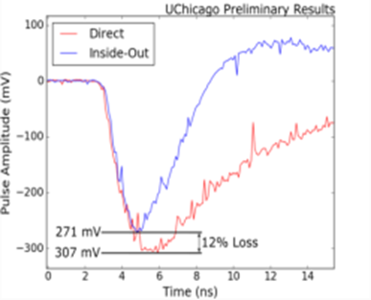
GEN II LAPPD
A robust ceramic body
Capacitive signal coupling: to an external PCB anode
Pixelated anodes: to enable high fluence applications
Sealed Ceramic LAPPD
Only 12% loss in signal amplitude due to capacitive coupling
Capacitively Coupled Readout
Board
Resistive Anode

Slide 15
Early Adopters
Opinion leaders able to influence the adoption of LAPPD for established or future technical programs.
Collaborators that have access to special facilities: magnetic fields, neutron beam, Cherenkov light, Fermi Lab Particle Beams, Neutrino-less Double-Beta Decay, life testing, etc.
Incom works with early adopters to insure that LAPPD are available to be evaluated for appropriate applications.
  Measurement & Test Workshop
  Discounted pricing to Early Adopters with DOE funded programs.
  Swaps & Warranty
  Options for Short term loan of LAPPD
Discussions underway to explore joining end user programs as a collaborator or sub-contractor rather than just a vendor.
Notes:
In experimental methodology, a round robin test is an interlaboratory test(measurement, analysis, or experiment) performed independently several times. This can involve multiple independent scientists performing the test with the use of the same method in different equipment, or a variety of methods and equipment

Slide 16
Incom Measurement & Test Workshops http://www.incomusa.com/mcp-and-lappd-documents/
Workshop #5, February 11 – 13th, 2019 Participants: Coming up | Workshop #4, October 9 – 11th, 2018 Participants: Mitaire Ojaruega (NGA-DOD) Kevin Richard Jackman (NGA-DOD) Varghese Anto Chirayath, (Physics, UTA) | Workshop #3, May 15-17th, 2018 Participants: Junqi Xie (ANL) Mickey Chiu, (BNL) Carl Zorn, (Jefferson Lab) Wenze Xi, (Jefferson Lab) Camden Ertley(UC B, now Incom Inc.)
Workshop #2, January 24-26, 2018 Participants: Matthew Malek (The University of Sheffield) Matt Wetstein (ISU – ANNIE Program) Lindley Winslow, Julieta Gruszko (MIT, NuDot) Albert Stebbins (Fermilab, Cosmology Group) Andrew Brandt, Varghese Chirayath (UTA) Klaus Attenkofer – BNL |  | Workshop #1, November 13 – 16th, 2018 Participants: Kurtis Nishimura (U of Hawaii / Sandia) Josh Brown (Sandia) Julieta Gruszko (MIT)

Slide 17
LAPPDTM Early Adopter Programs
PI & SPONSOR | PROGRAM TITLE
Mayly Sanchez and Matthew Wetstein, Iowa State | ANNIE - Atmospheric Neutrino Neutron Interaction Experiment
Erik Brubaker, Sandia National Lab/CA | Neutron Imaging Camera
Graham Smith, Klaus Attenkofer (BNL) | Gamma & Neutron Detectors
Henry Frisch (U of Chicago) , Dmitri Denisov (Fermilab) | Precision Time-of-Flight with Commercial Photodetectors at the Fermilab Testbeam Facility
Matthew Malek,(u of Sheffield) | WATCHMAN, UK STFC
Josh Klein, U of Penn | Spectrally Sorting of Photons, using Dichroic Films and Winston Cones, WATCHMAN, THEIA
Gabrial D. Orebi Gann ( UC Berkeley) | WATCHMAN, THEIA
Zein-eddine Meziani | High Rate Trials at Jefferson Labs, EIC
Andrey Elagin (U of Chicago) | Neutrino-less Double-Beta Decay
Mickey Chiu (BNL) - | Phenix Project - “eIC Fast TOF”
John Learned, U. of Hawaii, and Virginia Tech | Short Baseline Neutrino (NuLat)
Lindley Winslow (MIT) | Neutrino-less Double-Beta Decay (NuDot) Using Fast Timing Detectors
Andrew Brandt, (UT Arlington) | Life Testing of LAPPD

Slide 18
Summary & Conclusions
GEN I - Incom LAPPD Pilot Production is now underway
  GEN I LAPPD - Available Today!
      Artifacts to be resolved as production volume and experience increases.
      Providing early adopters a means to explore potential of PSEC timing.
  “Typical” performances meet early adopter needs:
      Gain > 7X10⁶, or higher
      Max PC QE (#36) ~ 27.7%, Mean ~ 25.8%
      Time Resolution < 70 Picoseconds, and mm Spatial Resolution
GEN II - Capacitive coupling works, ceramic package demonstrated.
A good candidate for the use in neutrino and rare decay experiments
We will work with you to make LAPPD available for test & evaluation.

Slide 19
Current Funding & Personnel Acknowledgements
DOE, DE­-SC0015267, NP Phase II – “Development of Gen-II LAPPDTM Systems For Nuclear Physics Experiments”
DOE DE-SC0018445 NP Phase I “Magnetic Field Tolerant Large Area Picosecond Photon Detectors for Particle Identification”
DOE, DE-SC0011262 Phase IIA - “Further Development of Large-Area Micro-channel Plates for a Broad Range of Commercial Applications”
DOE DE-SC0017929, Phase II– “High Gain MCP ALD Film” (Alternative SEE Materials)
NIH 1R43CA213581-01A Phase I – “Time-of-Flight Proton Radiography for Proton Therapy”
DOE DE-SC0018778 Phase I “ALD-GCA-MCPs with Low Thermal Coefficient of Resistance”
NASA 2018-I SBIR Proposal: S1.06-1093 Phase 1 “Curved Microchannel Plates and Collimators for Spaceflight Mass Spectrometers”
DOE (HEP, NP, NNSA) Personnel: Dr. Alan L. Stone, Dr. Helmut Marsiske,, Carl C. Hebron, Dr. Kenneth R. Marken Jr, Dr. Michelle Shinn, Dr. Elizabeth Bartosz, Dr. Gulshan Rai, Dr. Manouchehr Farkhondeh, Dr. Donald Hornback, Dr. Manny Oliver.
Notes:
NASA: NNX15CG22P Curved Microchannel Plates for Space Flight Mass Spectrometers

Slide 20

Thank you!
For more information
Alexey Lyashenko
Sr. Photodetector Research Scientist, Incom Inc.
alyashenko@incomusa.com
Office: 508-909-2226
Michael J. Minot
Director R&D, Incom Inc.
mjm@incomusa.com
Office: 508-909-2369
Cell: 978-852-4942

Slide 21
Selected LAPPD References & Links
http://www.incomusa.com/mcp-and-lappd-documents/
Craven, Christopher A. et al - “Recent Advances in Large Area Micro-Channel Plates and LAPPD™” TIPP’17 International Conference on Technology and Instrumentation in Particle Physics, Beijing, People’s Republic of China, May 22-26, 2017
Lyashenko, Alexey et al “Further progress in pilot production of Large Area Picosecond Photo-Detectors (LAPPDTM)” New Technologies for Discovery III: The 2017 CPAD Instrumentation Frontier Workshop, University of New Mexico, Albuquerque, NM October 12-14, 2017
Angelico, E. et al, “Capacitively coupled pickup in MCP-based photodetectors using a conductive metallic anode”, Nuclear Instruments and Methods in Physics Research A 846 (2017) 75–80
Ertley, Camden et al, “Microchannel Plate Imaging Detectors for High Dynamic Range Applications”, IEEE Transactions on Nuclear Science, 2017.
Siegmund, Oswald et al, “Microchannel plate detector technology potential for LUVOIR and HabEx”, Proceedings of the SPIE, Volume 10397, id. 1039711 14 pp. (2017)
Siegmund, Oswald et al, “Single Photon Counting Large Format Imaging Sensors with High Spatial and Temporal Resolution”, Proceedings of the Advanced Maui Optical and Space Surveillance (AMOS) Technologies Conference, 2017.
Michael J. Minot, et. al., “Pilot production and advanced development of large-area picosecond photodetectors” SPIE 9968, Hard X-Ray, Gamma-Ray, and Neutron Detector Physics XVIII, 99680X (30 September 2016); doi: 10.1117/12.2237331
Adams, B.W et al. “A Brief Technical History of the large-Area Picosecond Photodetector (LAPPD) Collaboration” - Submitted to: JINST arXiv:1603.01843 [physics.ins-det] FERMILAB-PUB-16-142-PPD, March, 2016
M.J. Minot, et al., Pilot production & commercialization of LAPPD™, Nuclear Instruments and Methods in Physics Research A 787 (2015) 78–84

Slide 22




LAPPD & Small Format Tile Magnetic Field Testing
ANL 6cm Small Format Tile - 10 & 20 µ MCPs
LAPPD #15
LAPPD 15
B field limit
Gain decreased with increasing field
Max with field aligned with MCP pore
~0.7 T with 20 microns
  ~1.3 T with 10 microns
J. Xie et al., ICHEP 2018, S. Korea

Slide 23
LAPPD Price Projections
Current costs are driven by overhead rates, non-reimbursed R&D Costs, and low volume
Costs drop rapidly, as demand and volume increases.
Incom projects price to drop from current levels as follows:
Timing | Cmrcl Price | DOE Price | Cum Vol. | Annual Capacity
Current | $ 75,000 | $ 50,000 | 48 | 48
1 | $ 56,250 | $ 37,688 | 58 | 82
2 | $ 45,000 | $ 30,150 | 144 | 120
3 | $ 36,900 | $ 24,723 | 268 | 204
4 | $ 31,365 | $ 21,015 | 502 | 264
5 | $ 30,032 | $ 20,121 | 1,000 | 278
With full scale production, and cumulative volumes of product produced approaching 10,000 units, a price of $10,000 or less, for a full size LAPPD, is entirely plausible.

