Slide 1
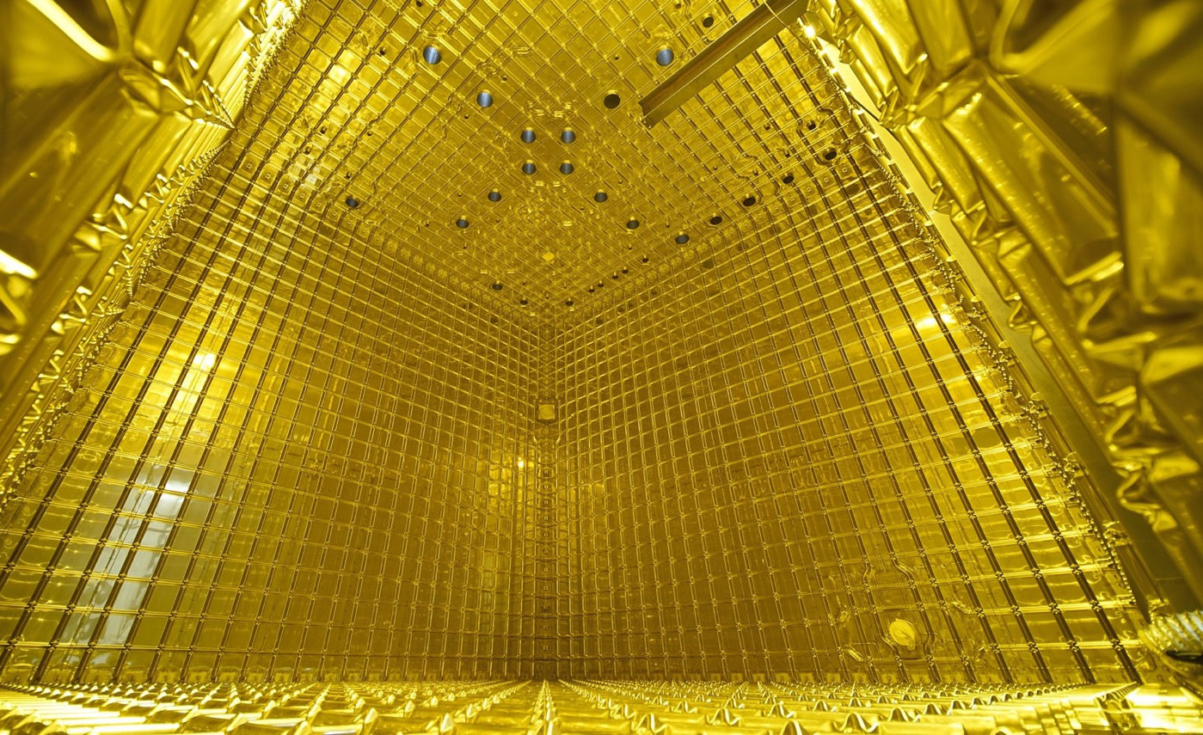
ProtoDUNE SP
A scalable Liquid Argon Time Projection Chamber for DUNE
Francesca Stocker on behalf of the DUNE Collaboration
NNN18, Vancouver
02. November 2018

Slide 2
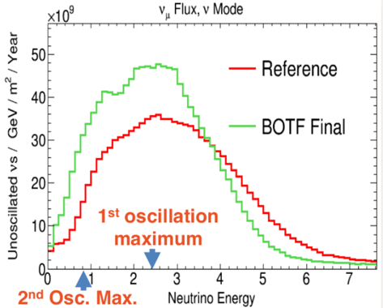
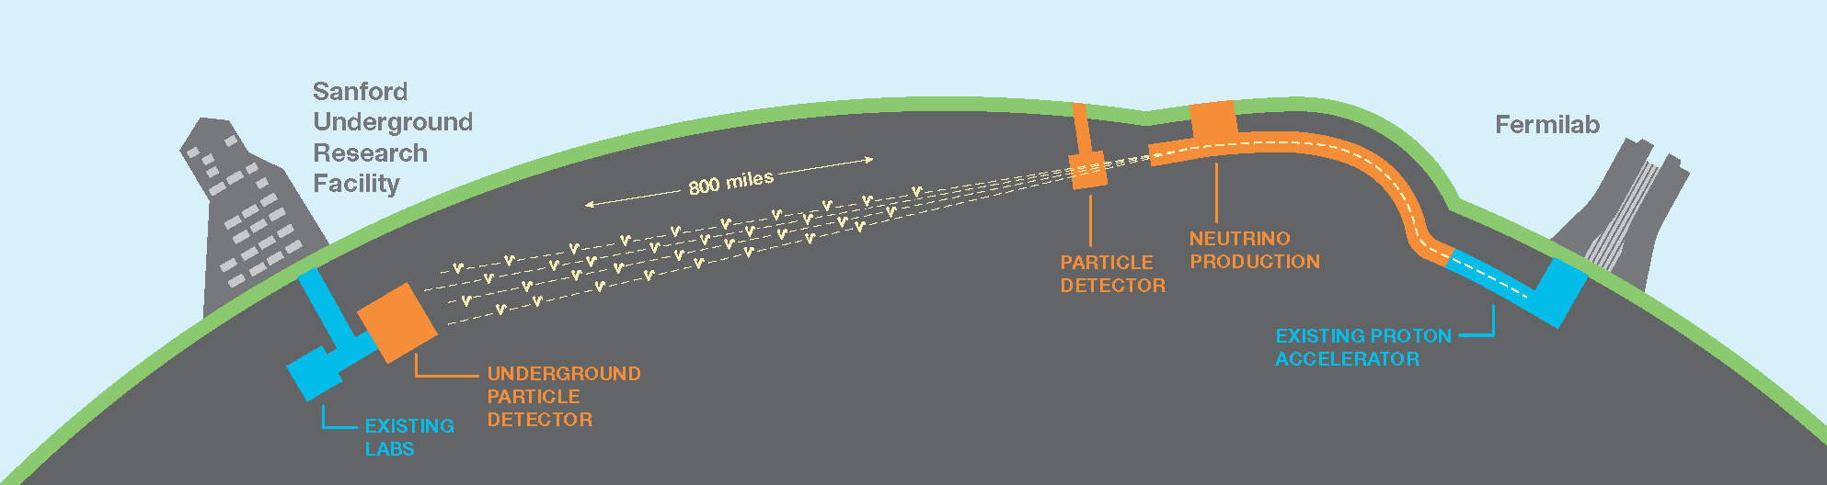
DUNE
Physics
Precise measurement of neutrino oscillations parameters, particularly δ_{CP} violation phase and determination of mass hierarchy
Detection of galactic-core supernovae neutrinos
Nucleon decay
Search for NSI (Non Standard Interactions)
wide band 𝝂_{𝜇} & 𝝂_{𝜇} – beam
Far Detector (FD)
Hosted at SURF, South Dakota
4 LAr TPCs, 10kt each act. vol.
First module operational in 2024
1.5km underground
[GeV]
Near Detector (ND)
Hosted at Fermilab
(1300 kilometers)

Slide 3
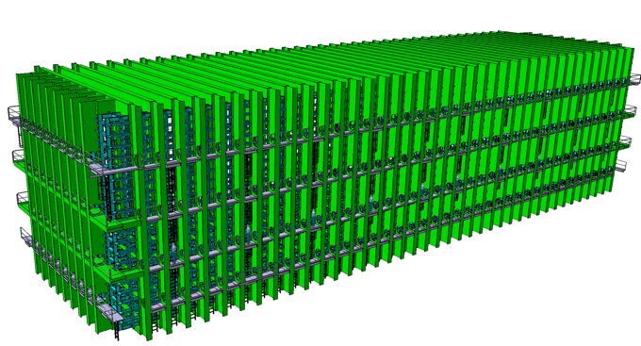
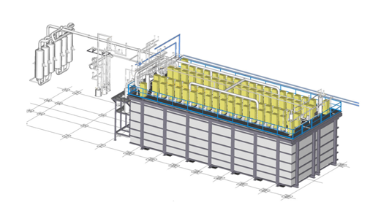
DUNE Challenges
So far largest LAr TPC operated ICARUS 2 x 235t (active) → 1 DUNE FD module will be ~10kt
Several new challenges to scale to DUNE. Need prototypes to develop solutions scalable for DUNE:
ICARUS
1 DUNE FD module
18m
4m
66m
20m
9m
19m

Slide 4
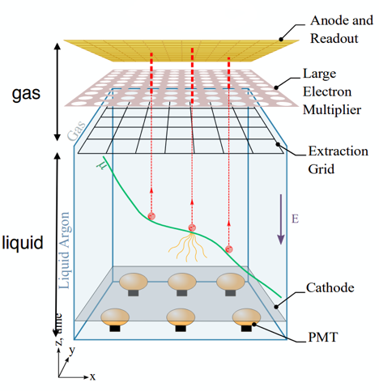
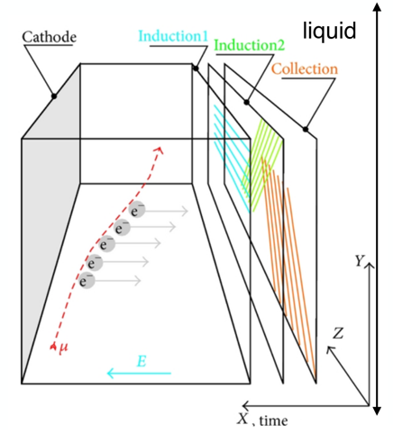
Working principle of LAr TPC
Single phase (SP), only LAr
Dual phase (DP), Gar AND LAr
Cryostat, high voltage (HV), LAr purity, electronic R/O
system issues: grounding, noise

Slide 5
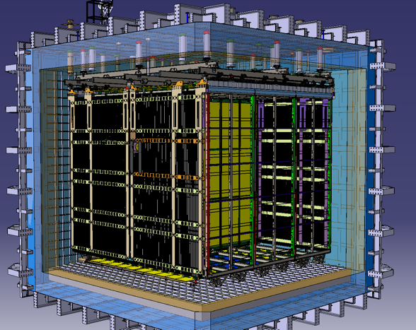
DUNE Challenges
Critical aspects to be addressed in the prototypes
Engineering aspects
  Test full scale detector elements used in DUNE, for SP
  Installation sequence and test procedures
  Long term operation stability
Physics aspects
  Benchmark reconstruction performance
  dQ/dx recombination
  calibration techniques
  Characterise hadron – argon interactions
3D model of ProtoDUNE SP

Slide 6
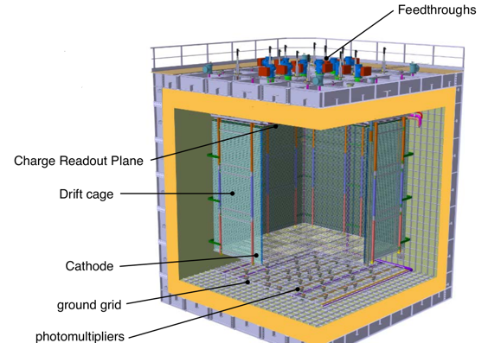
ProtoDUNE(s)
The biggest small prototype (1/20 of one DUNE module)
2 11x11x11 m³ cryostats
2 LAr TPC technologies, SP and DP
750t of LAr → 420t active TPC
SP: charged particle beam p, pi, K, mu, e ~ 0.5 GeV/c → 7 GeV/c
SP built and operational in < 2 years at CERN Neutrino Platform
DP being commissioned in early 2019
Inside SP
3D model of DP

Slide 7
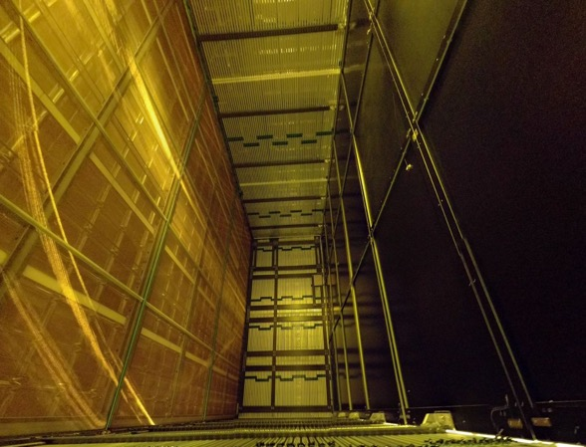
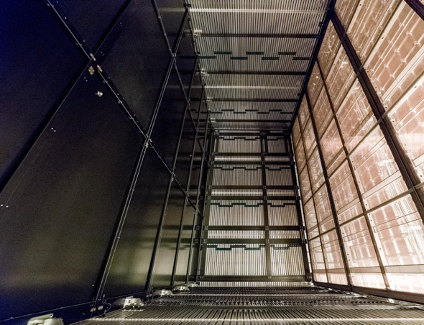
ProtoDUNE SP
2 TPCs 6 m high, 7 m wide, 3.6 m deep, common cathode
dimensions, assembly & installing procedures as in DUNE
6 x Anode Plane Assembly
4 wire planes 2.3m, electronics in LAr (preamp. & digitisation)
4.5mm wire pitch (2560 ch/APA)
Cathode Plane Assembly
180kV nominal for 500V/cm drift field, resistive kapton
Photon Detection
Light bars with SiPMs inside APA , 3 versions tested for DUNE
APA
APA
CPA
Drift Volume 1
Drift Volume 2
K. Wood

Slide 8
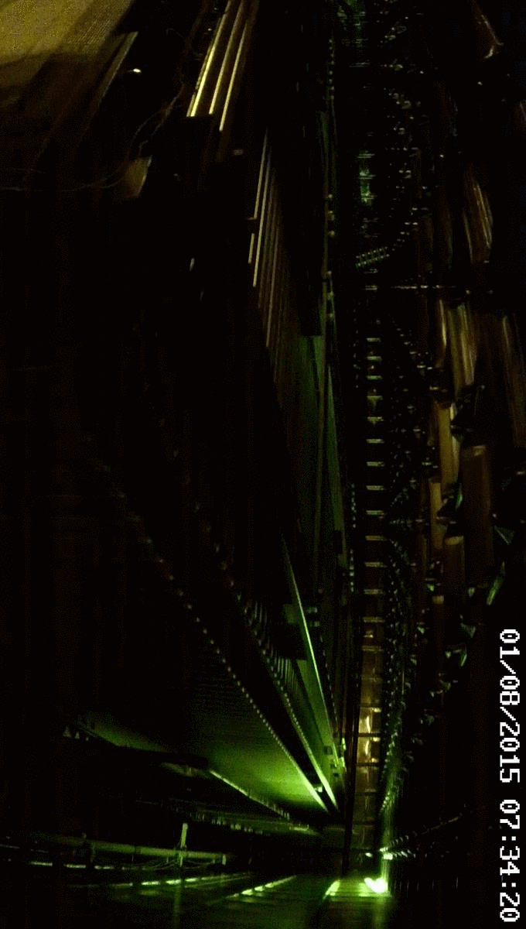
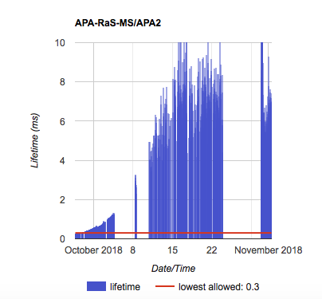
ProtoDUNE commissioning
Filling phase August 8th to September 13th
Purification start September 18th , 4.5 days for full volume recirculation
By now: Achieved ~ 8ms max. free electron life time compared to 2.25ms max. drift time
Decrease in purity as pumps were turned off for a duration of 22h. Increasing again now
From K. Wood
Inside SP
View: bottom edge of field cage, outside TPC

Slide 9
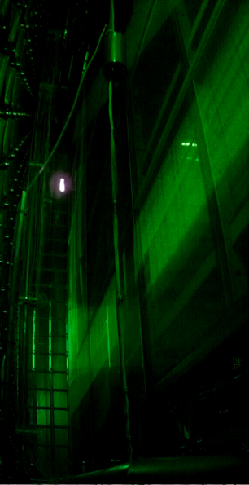
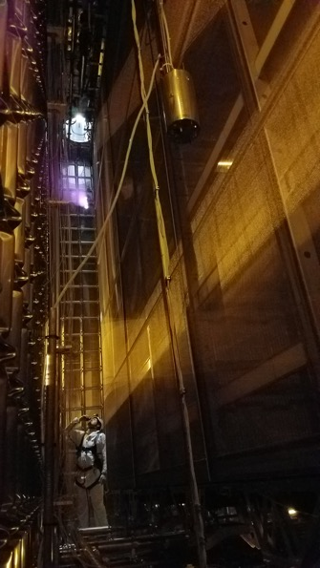
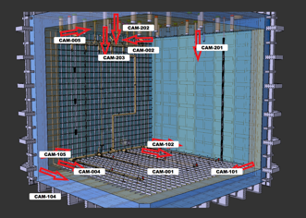
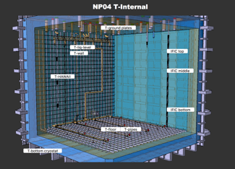
ProtoDUNE Instrumentation
92 high precision temperature sensors for detailed temperature maps
12 cameras, to monitor the state of the apparatus and localize any sparking that may occur
Purity monitors to measure the drift electron lifetime regularly, at 1.8m, 3.7m, 5.6m from floor
“Last days working in the cryostat”
A few days ago, from cameras inside. TPC full of LAr

Slide 10
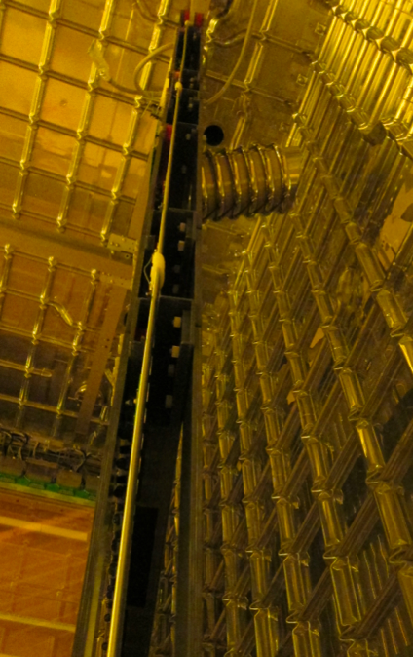
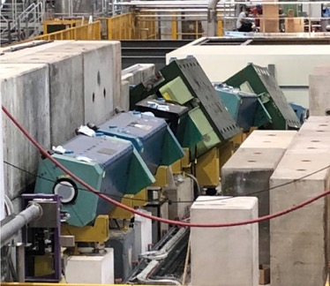
ProtoDUNE Test Beam
Beamline
400 GeV/c p beam from SPS ➜ 80 GeV/c secondary 𝜋⁺
➜ 0.5 – 7 GeV/c tertiary e⁻, p, 𝜇⁺, 𝜋⁺
TPC 2
TPC 1
Beam plug = END of beamline to get electron showers inside TPC, filled with N2
PHYS. REV. ACCEL. BEAMS 20, 111001 (2017)
EHN1 extension, H4 beamline

Slide 11
ProtoDUNE Data
  Electronics performance (reliability and SNR)
  Free electron lifetime
  dE/dx of 𝜋, p, K, e
  Energy and momentum resolution
  Provide 3D map of detector response for space charge and E field distortion studies
  Perform cross section measurements of hadrons on Argon
    knowledge of π-Ar interactions
  Reconstruction algorithm performances on data
    e-γ separation
    Energy scale for EM and hadron showers
  Test charge recombination models at different E-fields

Slide 12
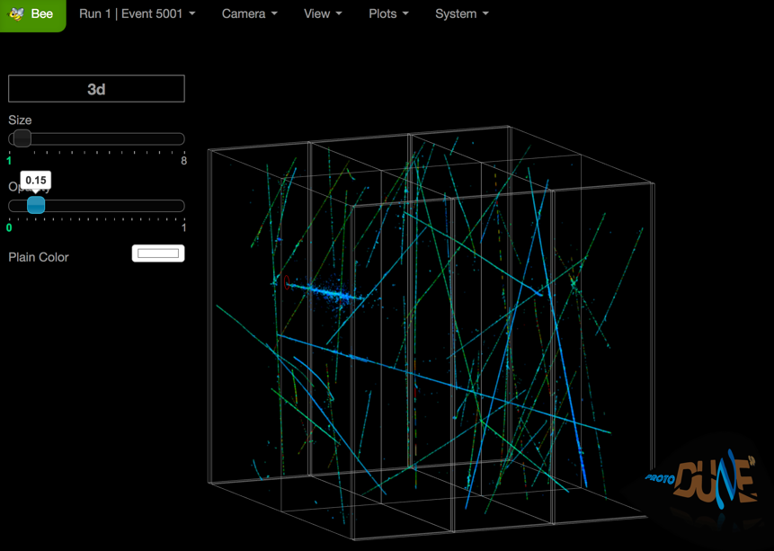
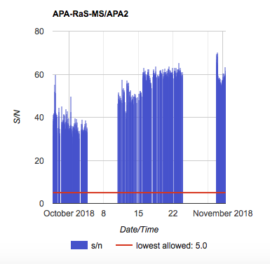
Some Events
3D reconstruction quality is achieved thanks to SNR ~ 50

Slide 13
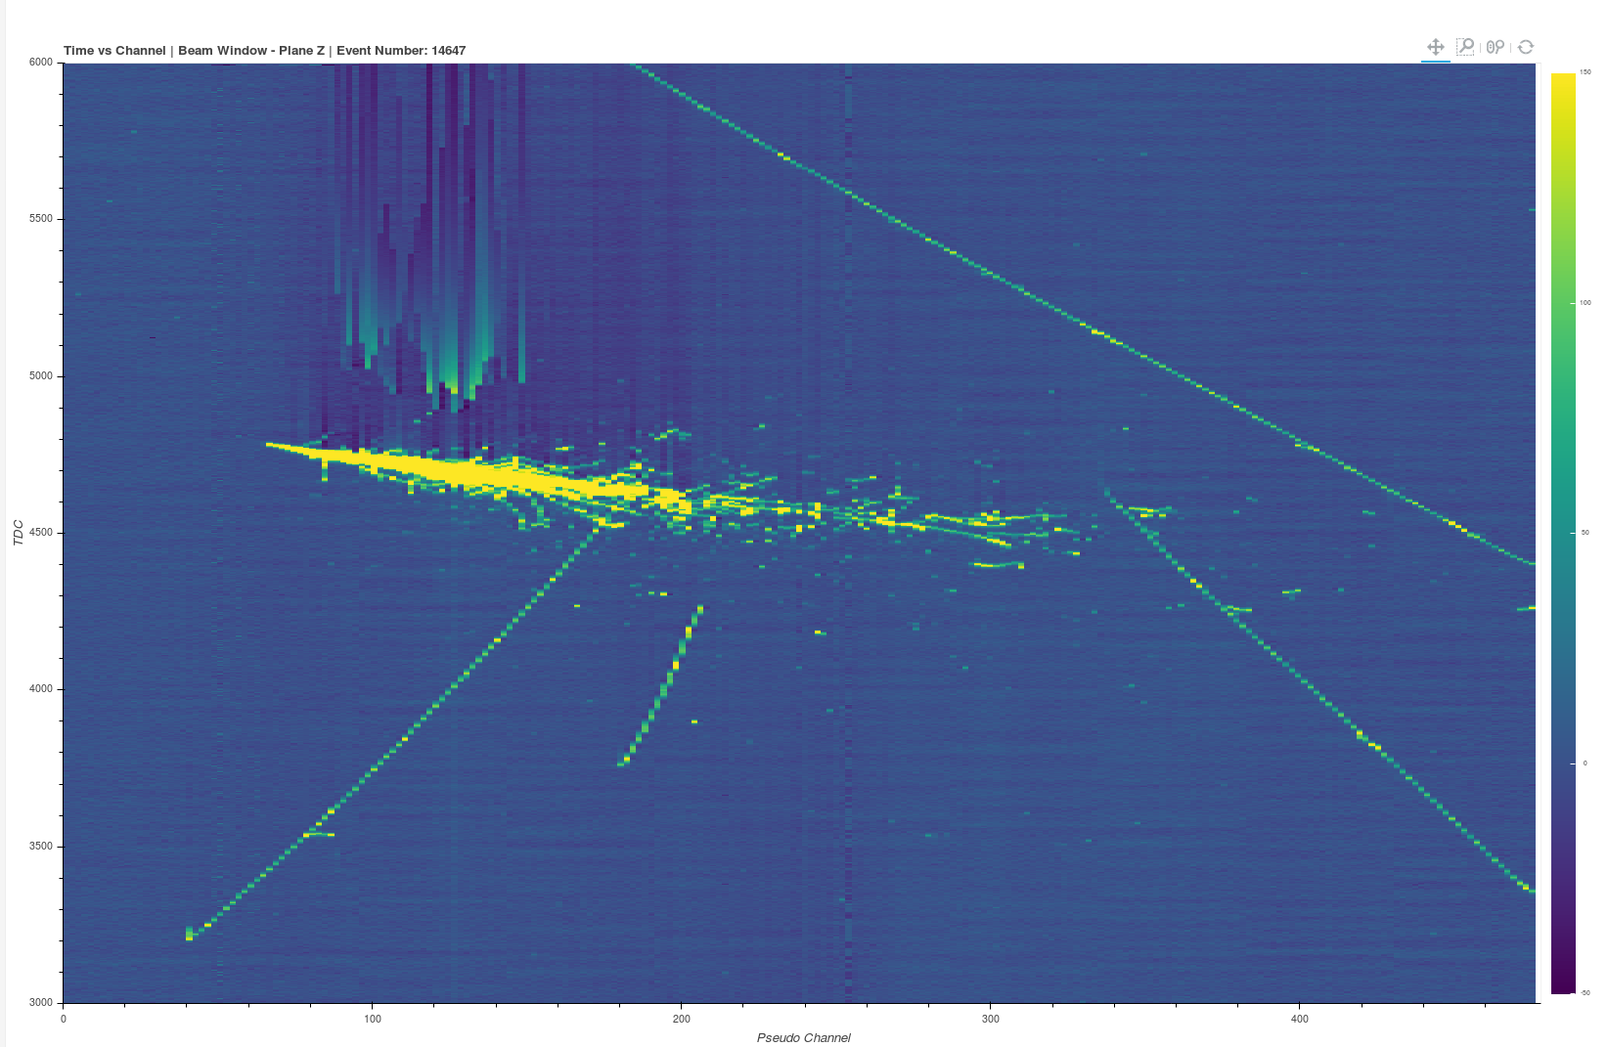

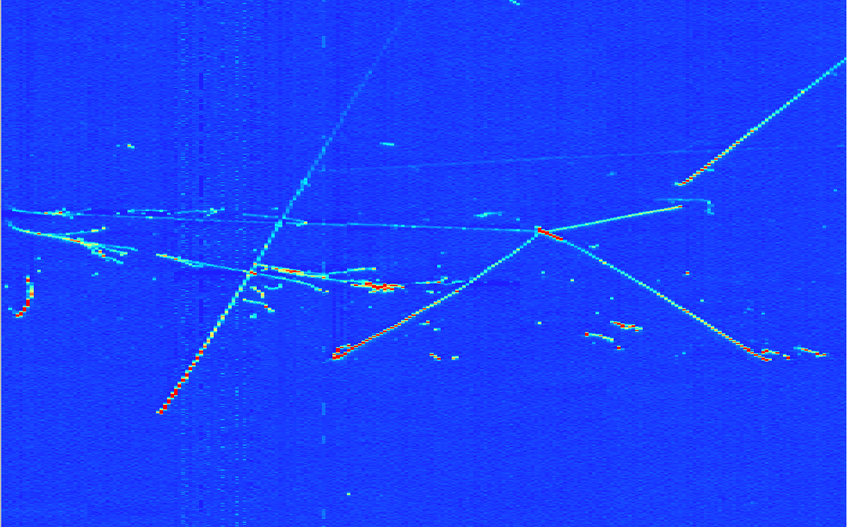
Some Events
EM showers and a pion interaction with 4 outcoming particles
Run 4696, Ev 103
EM shower from beam, raw collection view, electronics over shoot above

Slide 14
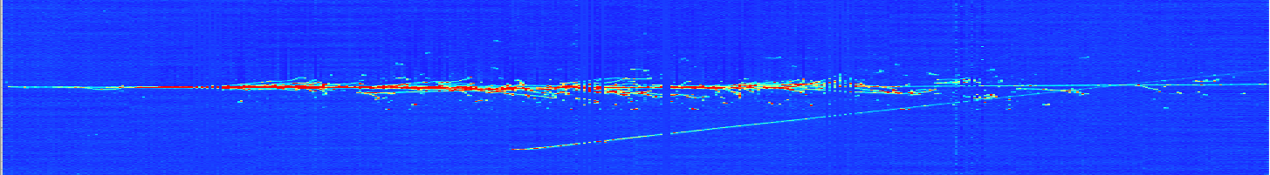
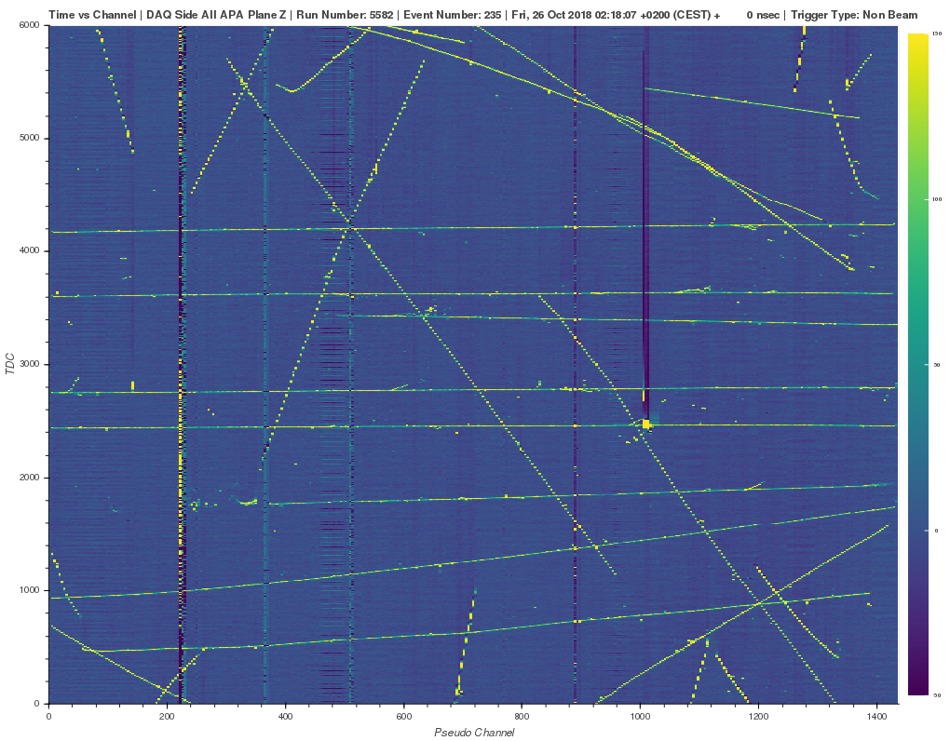
Some Events
Beam halo (high energy) muon with bremsstrahlung initiaded EM shower

Slide 15

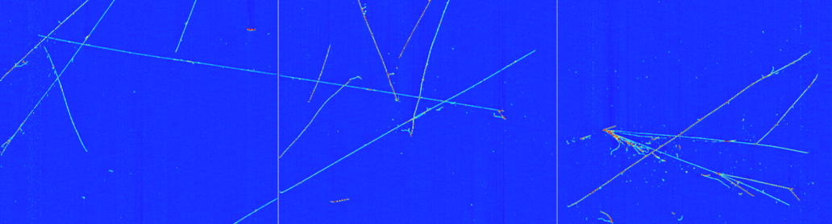

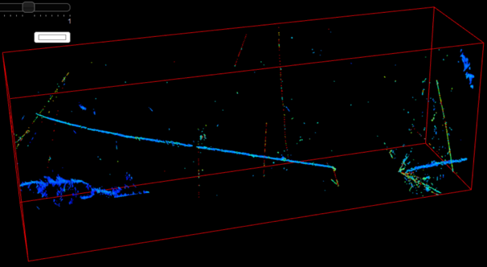
Some Events
2D view
7 GeV/c beam event
3D view
APA3
APA2
APA1
Interesting event
Notes:
2 hadronic interactions (1m in between ~interaction length) neutral particle in between maybe neutron or k0

Slide 16
ProtoDUNE SP summary
Stable operation of cryogenics
Operating the TPC at nominal field of 500 V/cm
Drift electron lifetime of 8 ms and still improving
Taking Data right now at 4 and 6 GeV
3D reconstruction and analysis on real data ongoing
Proposals under discussion for operation of ProtoDUNE SP & DP during and after LS2

Slide 17
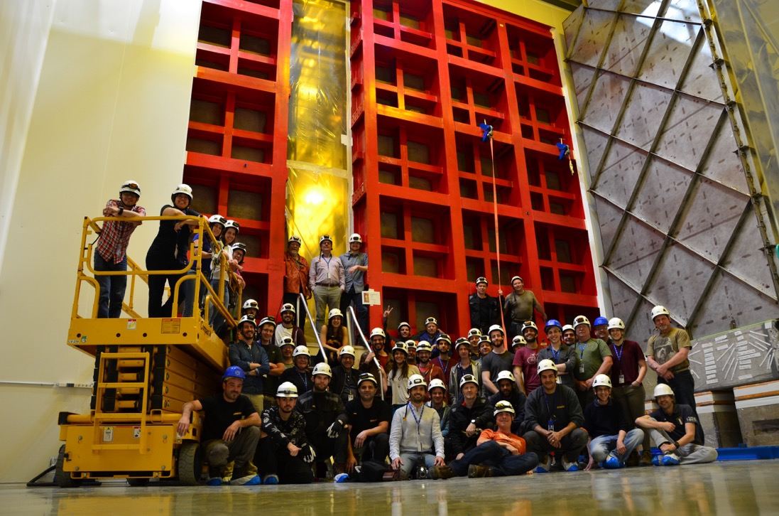
Thank you!

Slide 18
Back up Slides

Slide 19
EHN1 Detector Hall

Slide 20
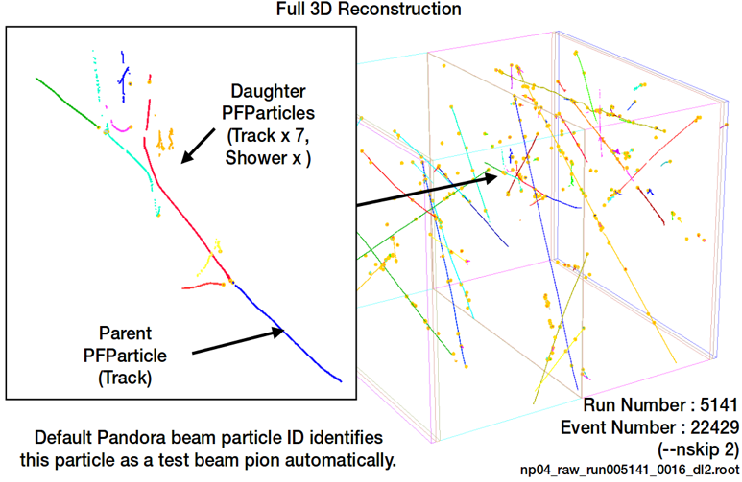
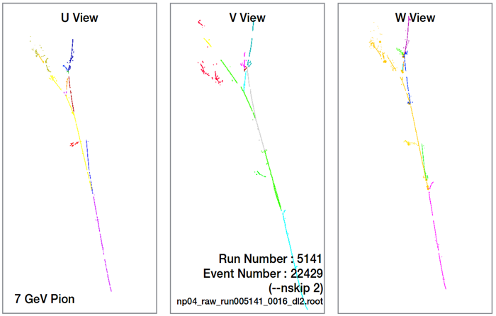
ProtoDUNE Beam Data
  7 GeV Pion from beam reconstructed with Pandora algorithm in 2D and 3D
I1 plane
I2 plane
C plane
  The algorithm correctly distinguishes parent from daughter particle and identifies it as a beam event

Slide 21
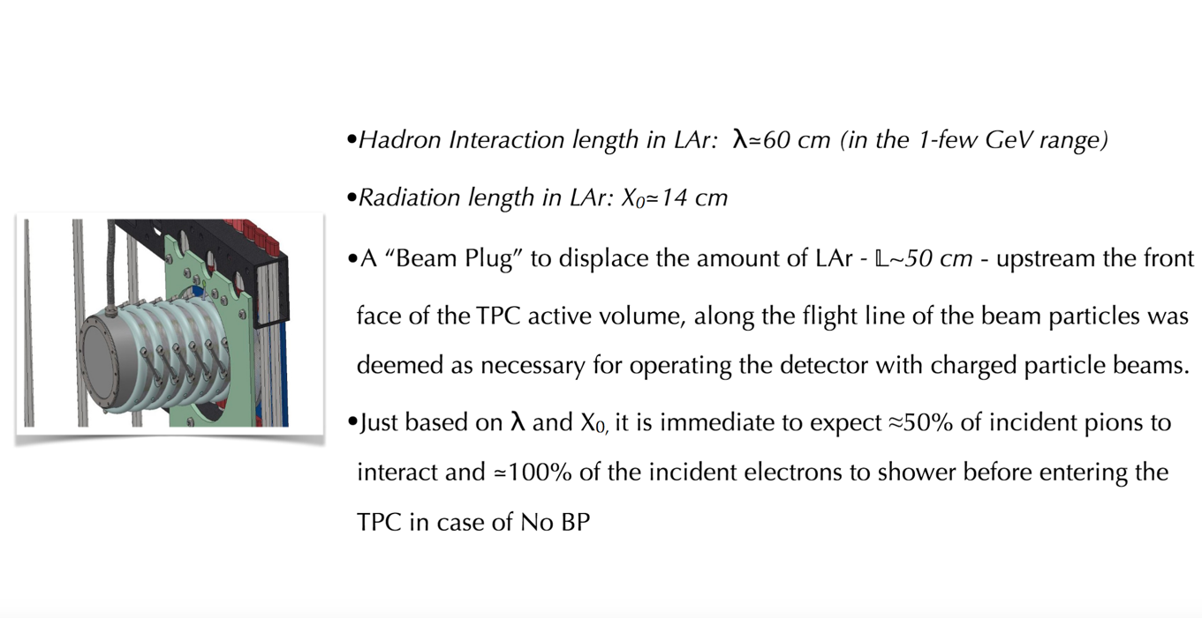
Beam Plug
  Flavio Cavanna, https://indico.fnal.gov/event/16522/contribution/1/material/slides/0.pdf

Slide 22
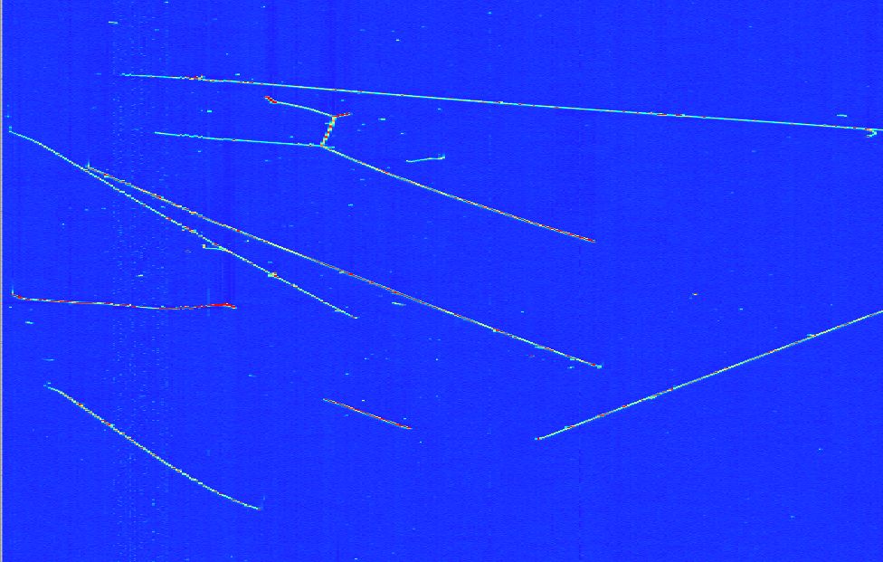
Wierd Event

