Slide 1
Applications of FairRoot
Thorsten Kollegger
Data Science and Quantum Computing Workshop
TRIUMF, 28. June 2018

Slide 2
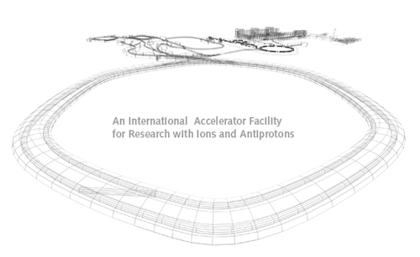
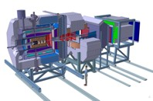
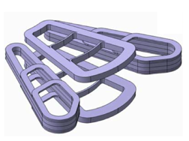
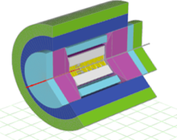
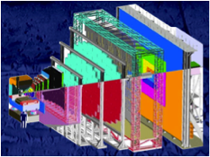
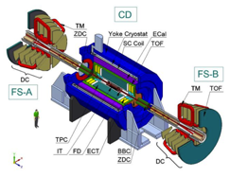
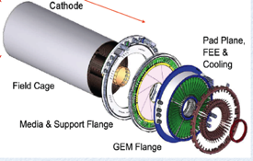
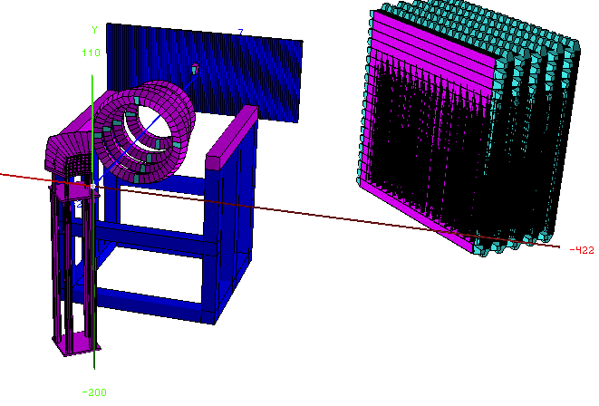
FairRoot
FairRoot

Slide 3


FairRoot
FairRoot
FAIR
Facility for Antiproton- and Ion Research: new International Research Facility under construction in Germany
ROOT
A modular scientific software framework for big data processing, statistical analysis, visualisation and storage

Slide 4
FairRoot
FairRoot
Modular Framework (& software stack)
to support the data processing,
analysis and simulation of
(nuclear) physics experiments
(not only at FAIR)
  https://github.com/FairRootGroup/FairRoot

Slide 5
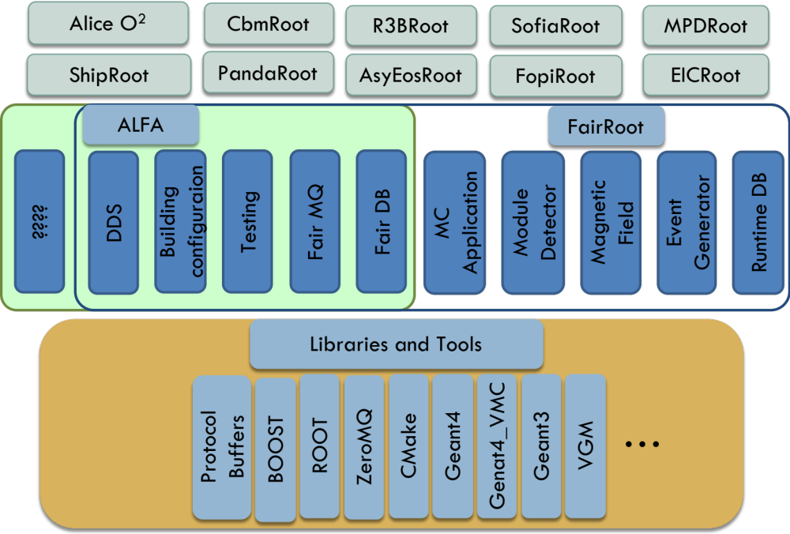
FairRoot
Experiment
specific
implementations
FairRoot
(Nuclear) physics
specific processing
framework
Build on foundation of
other frameworks, libraries and tools for data processing, simulation and analysis

Slide 6
FairRoot
Experiment
Specific
Implementations
FairRoot Software Stack
FairRoot
(Nuclear) physics
specific processing
framework
Build on foundation of
other frameworks, libraries and tools for data processing, simulation and analysis

Slide 7
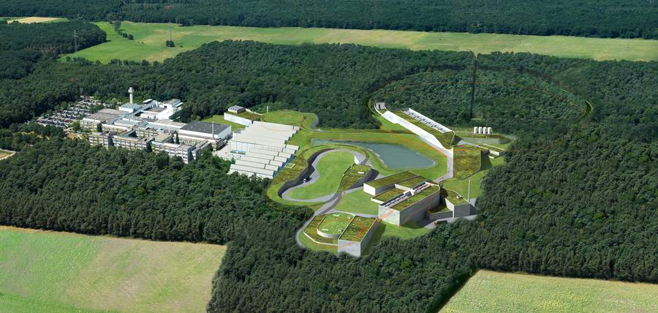
FAIR Project
New International Accelerator Facility in Darmstadt, Germany
Budget: 1.3 Billion Euros (2005)
Upgraded accelerators from GSI as injectors
9 Member States + worldwide Partners

Slide 8
FAIR Project
New International Accelerator Facility in Darmstadt, Germany
Budget: 1.3 Billion Euros (2005)
Upgraded accelerators from GSI as injectors
9 Member States + worldwide Partners

Slide 9
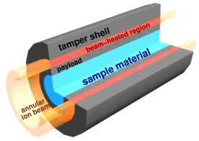
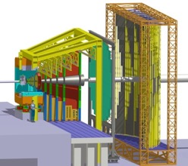
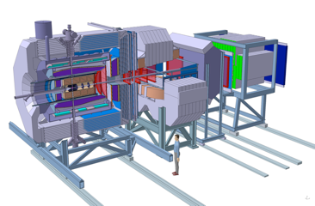
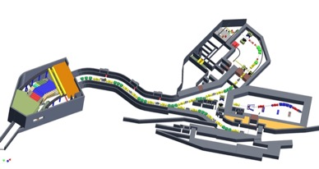
FAIR Scientific Pillars
APPA
CBM
Atomic, Plasma Physics
and Applications
Compressed Baryonic Matter
PANDA
NUSTAR
Nuclear Structure, Astrophysics
and Reactions
Hadron Structure Physics

Slide 10
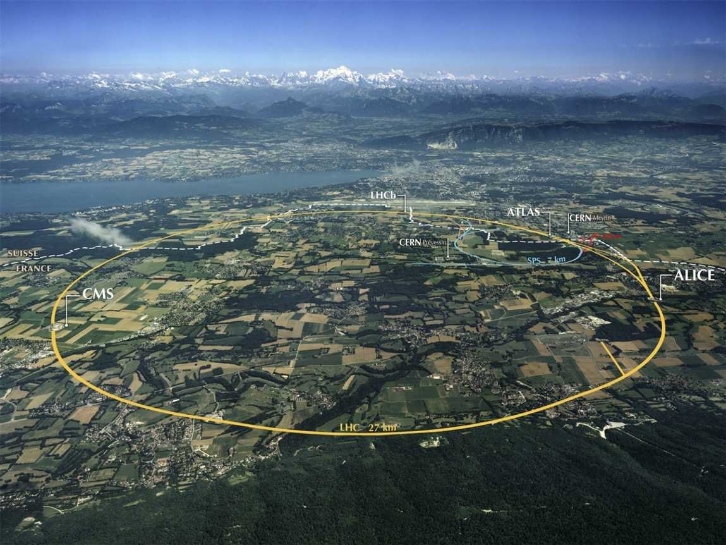
CERN

Slide 11


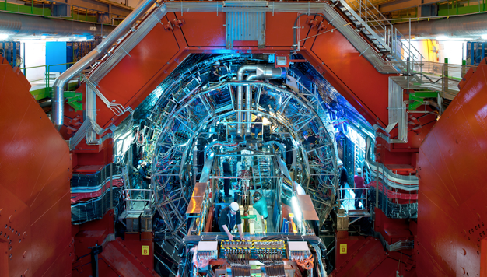
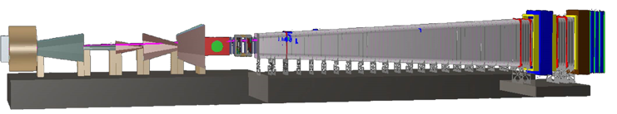
CERN

Slide 12
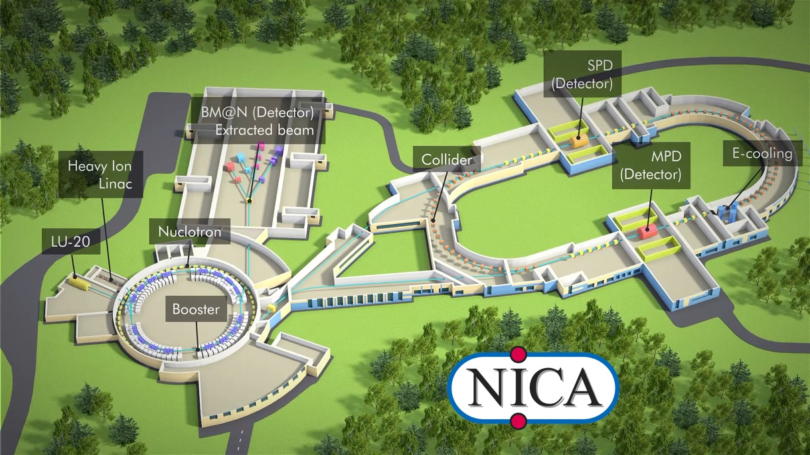
NICA
NICA (Nuclotron-based Ion Collider fAсility) is a new accelerator complex
designed at the Joint Institute for Nuclear Research (Dubna, Russia)

Slide 13
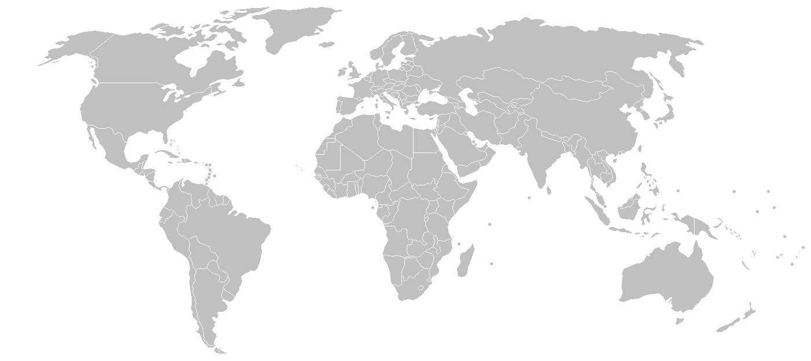
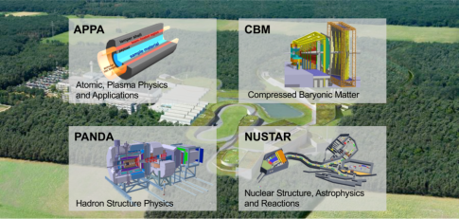
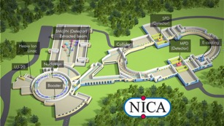
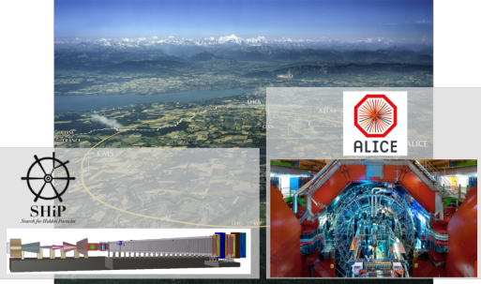
FairRoot
Also used/explored
by others:
EIC (US)
J-PARC HI (Japan)
…
FairRoot: Framework (& software stack)
to support the data processing,
analysis and simulation of
(nuclear) physics experiments

Slide 14
FairRoot
The common challenges:
Big Data and High Data Rates
Modern Computing Technologies
Ease of Algorithm Development
Also used/explored
by others:
EIC (US)
J-PARC HI (Japan)
…
FairRoot: Framework (& software stack)
to support the data processing,
analysis and simulation of
(nuclear) physics experiments

Slide 15
Computing at FAIR: Big Data
High Velocity: ~1 TByte/s into Online Farms
High Variety: from Structured Data to Images
High Volume: ~35 PByte/Year on Disk
High Computational Capacity: ~300.000 Cores
High Value: Scientific Output

Slide 16
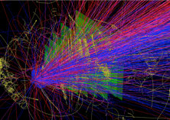
Computing at FAIR
„Data is inherently dumb.
Algorithms are where the real values lies“
Peter Sondergaard, Gartner, 2015
1
1
1
0
0
1
0
More complex algorithms necessary
to exploit the full scientific potential
of the instrumentation
(i.e. accelerators, detectors)
0
1
0
1
0
1
1
1
1
0
0
0
1
0
1
0
0
0
1
1
1
0
0
0
0
0
1
Fundamental change in detector design
From custom electronic to commodity
computing systems (“triggerless”)
Software defined -> Agility
Huge data rates into (quasi-)real time analysis
FAIR, LHC upgrades, Nuclear Physics …

Slide 17
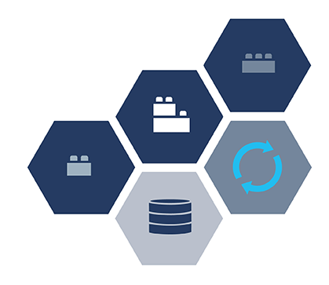
FairMQ
Looking at the IT landscape: shift towards
Microservices
  Unbundled, decentralized modules
  Organized around specific capability
Containers
Algorithm Economy
These are at the heart of the
„cloud/app“ business model/economy
driven by scalability and reliability demands
based on multi-process and message exchange
development cost advantage
FairMQ uses many of these technologies under the hood;
replacing custom code (e.g. ALICE HLT framework)

Slide 18
FairMQ
The Data Processing Component of ALFA
Multi-process concept (specialized devices)
Data-flow model: Message queues for data exchange,
technology agnostic
sampler
processor
sink
Push
Push
sampler
processor
Proxy
Proxy
sink
sampler
processor
sink
sampler
processor
Design Goals
Scalability, Maintainability, Reliability
  efficient use of multi-core architectures
Reusable with common data processing components
  Reduce cost of new developments, agile development

Slide 19
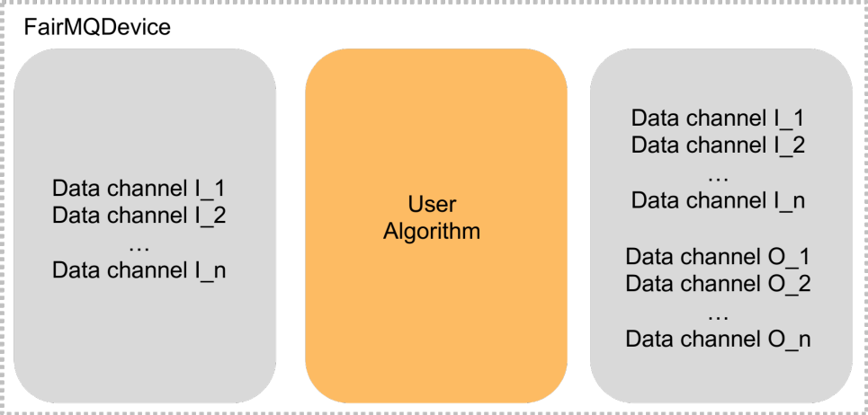
FairMQ Devices
Input and Output designed
as Message Queues
Device takes/passes ownership of data,
no central data management unit

Slide 20
FairMQ Devices
Several message transports
and serialization protocols
supported
0MQ, nanomsg,
shared memory, RDMA
ROOT, protobuf, boost, …
Input and Output designed
as Message Queues
Device takes/passes ownership of data,
no central data management unit

Slide 21
FairMQ Devices
User Algorithm executed when
necessary input data
from all channels available
Several message transports
and serialization protocols
supported
0MQ, nanomsg,
shared memory, RDMA
ROOT, protobuf, boost, …
Input and Output designed
as Message Queues
Device takes/passes ownership of data,
no central data management unit

Slide 22
FairMQ Devices
User Algorithm executed when
necessary input data
from all channels available
Each ”Device" is a separate process, which:
Can be multithreaded, SIMDized, …
Runs on different hardware (CPU, GPU, …)
Be written in an any supported language
Several message transports
and serialization protocols
supported
0MQ, nanomsg,
shared memory, RDMA
ROOT, protobuf, boost, …
Input and Output designed
as Message Queues
Device takes/passes ownership of data,
no central data management unit

Slide 23
FairMQ Devices
User Algorithm executed when
necessary input data
from all channels available
Each ”Device" is a separate process, which:
Can be multithreaded, SIMDized, …
Runs on different hardware (CPU, GPU, …)
Be written in an any supported language
All the framework user sees:
Callback to his algorithm
Several message transports
and serialization protocols
supported
0MQ, nanomsg,
shared memory, RDMA
ROOT, protobuf, boost, …
Input and Output designed
as Message Queues
Device takes/passes ownership of data,
no central data management unit

Slide 24
FairRoot
Experiment
specific
implementations
FairRoot
(Nuclear) physics
specific processing
framework
Build on foundation of
other frameworks, libraries and tools for data processing, simulation and analysis

Slide 25
FairRoot
Also used/explored
by others:
EIC (US)
J-PARC HI (Japan)
…
FairRoot: Framework (& software stack)
to support the data processing,
analysis and simulation of
(nuclear) physics experiments

