Slide 1


Slide 2
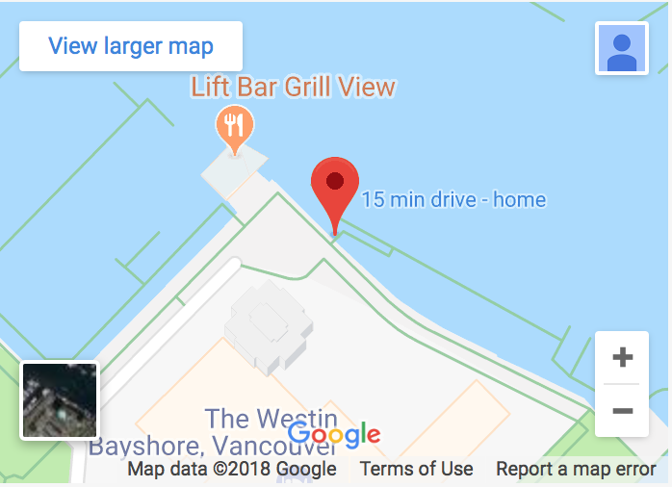
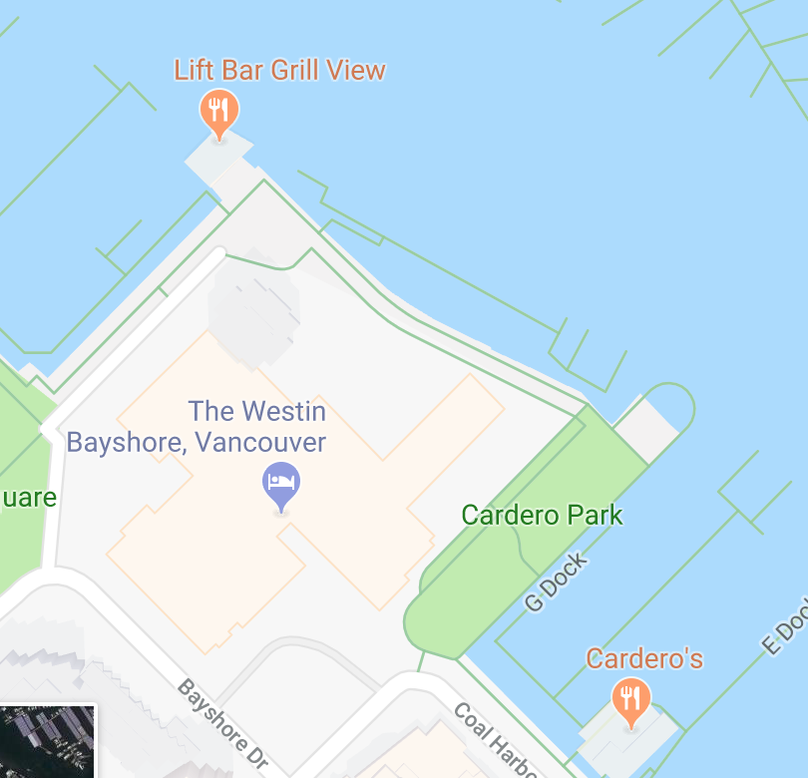
Dinner Cruise
Tonight:
  Bus leaves 5 pm at front door
  Right after session
  Workshop Picture at 6:00 pm
  Boat leaves 6:30 pm The Marina, 1601 Bayshore Drive

Slide 3
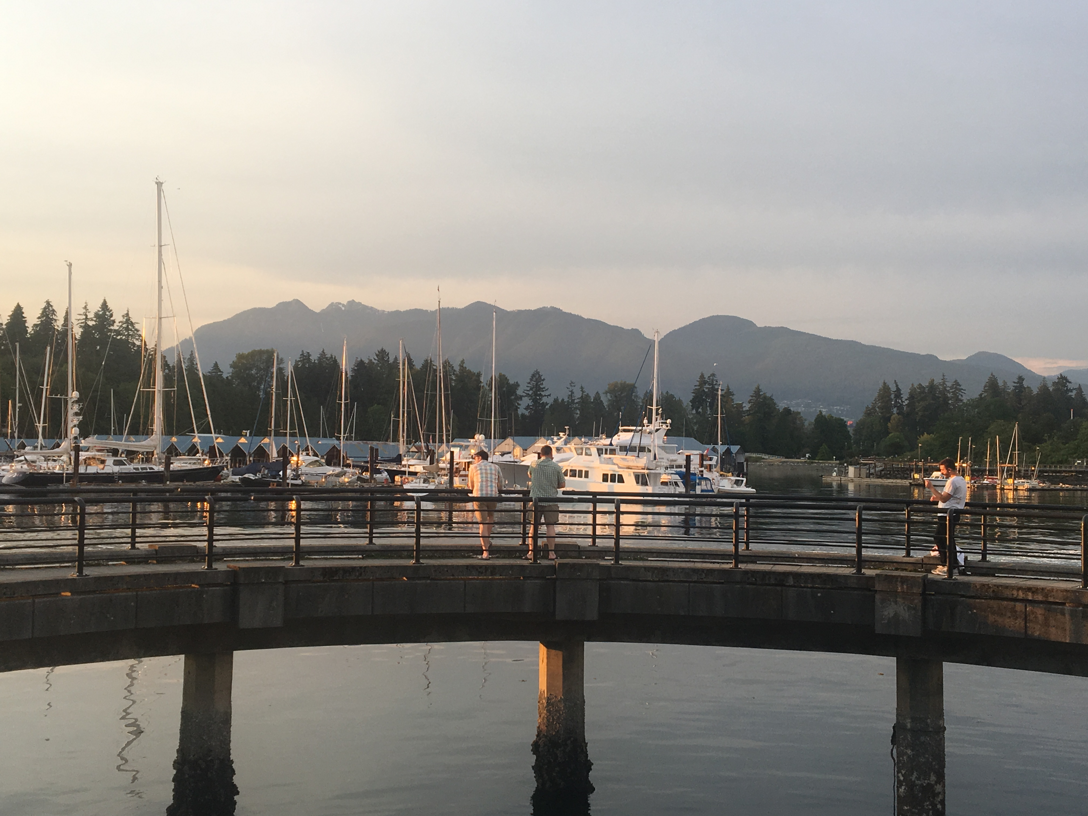
Dinner Cruise
Tonight:
  Bus leaves 5pm at front door
  right after session
  Workshop Picture at 6:00 pm
  Boat leaves 6:30 pm The Marina, 1601 Bayshore Drive

Slide 4
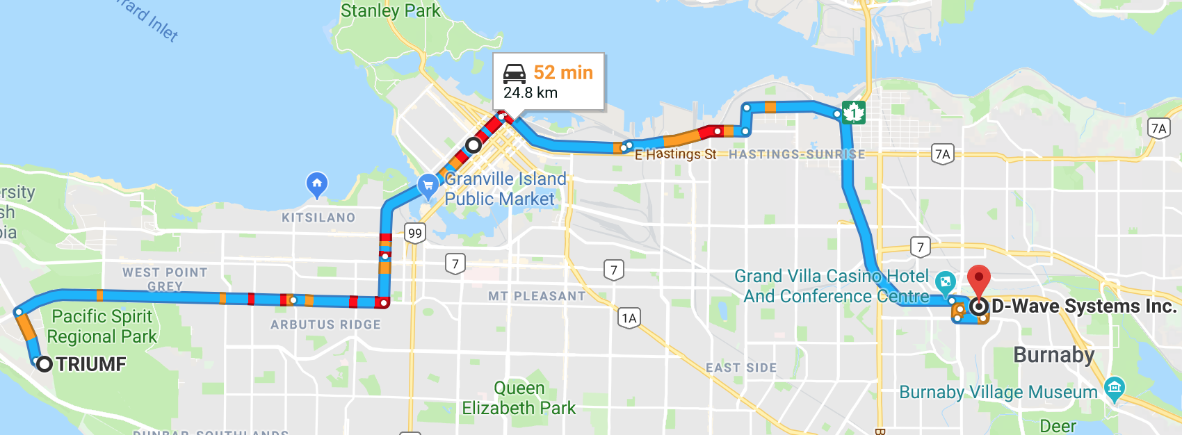
DWAVE Visit
Tomorrow:
  Bus (Perimeter) leaves 8:45 am at front door
  Stop at Hyatt at 9:15 am
  Visit from 10 am - 11:45 am
  Back at TRIUMF around 12:45

Slide 5
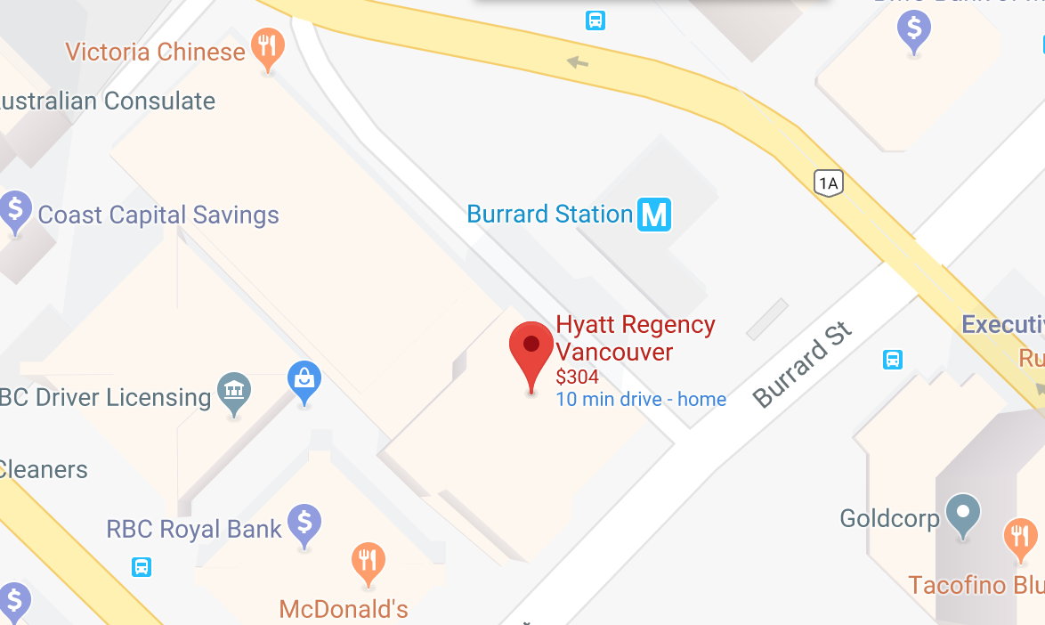
DWAVE Visit
Tomorrow:
  Bus leaves 8:45 am at front door
  Stop at Hyatt at 9:15 am
  Visit from 10 am - 11:45 am
  Back at TRIUMF around 12:45
Burrard/Melville

Slide 6
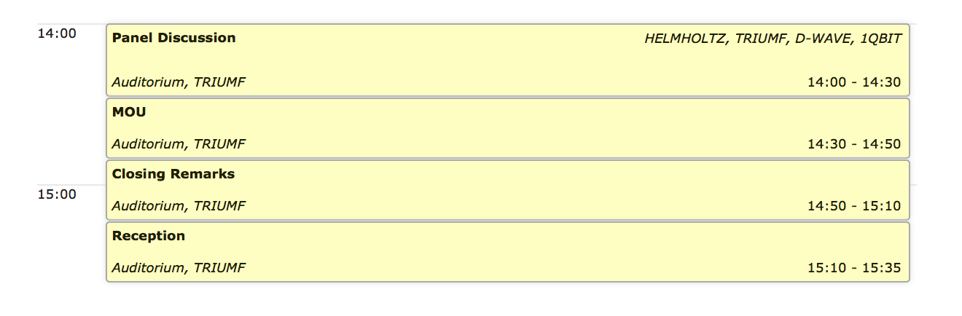
Closing Session
Tomorrow

