Slide 1
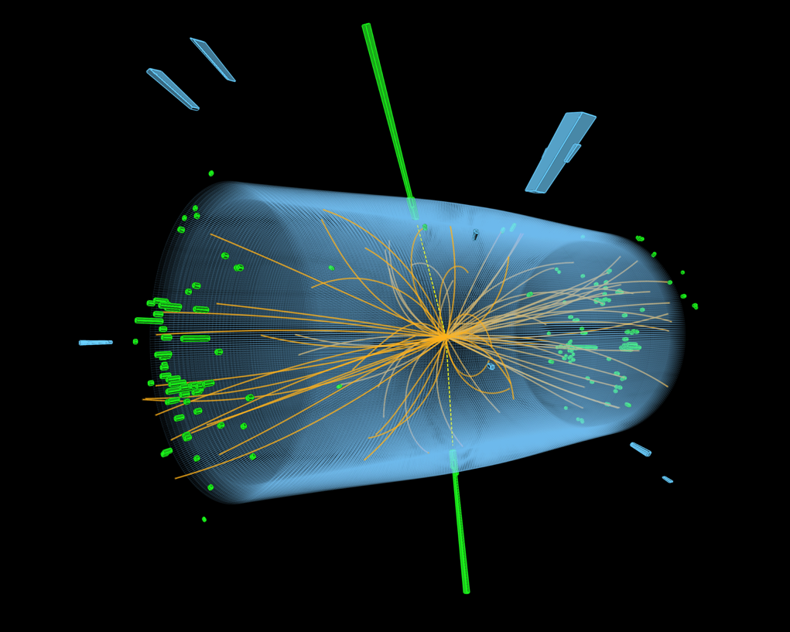
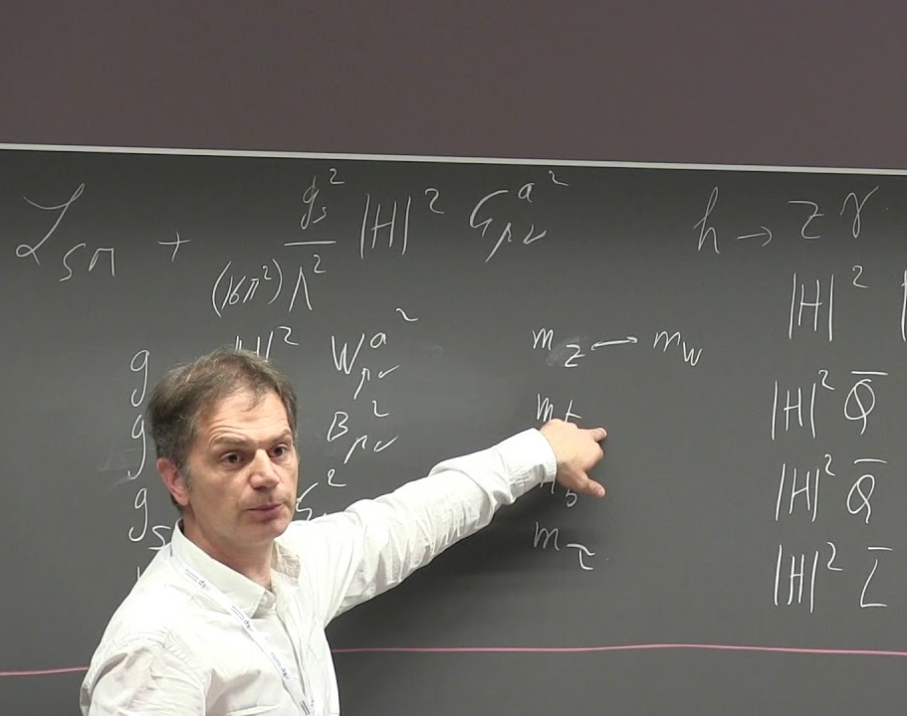
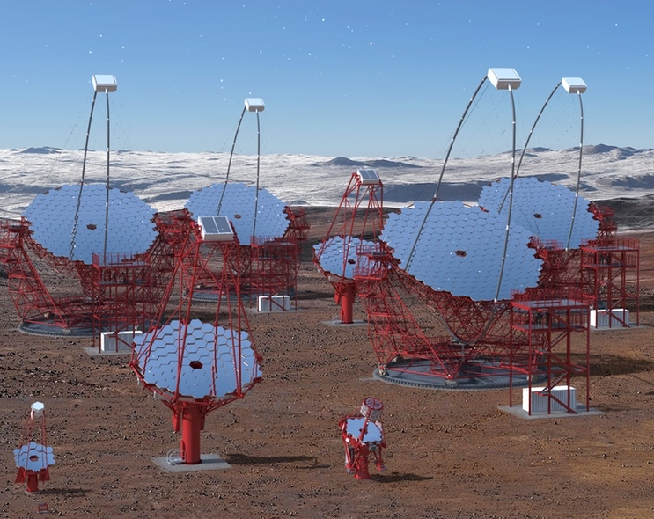

Introduction to Helmholtz
Mission,
Structure,
Centres
Joachim Mnich
TRIUMF Workshop on “Data Science and Quantum Computing”
TRIUMF, Vancouver, 27-29 June 2018
Notes:
Titel hier ‘rausschmeissen???

Slide 2
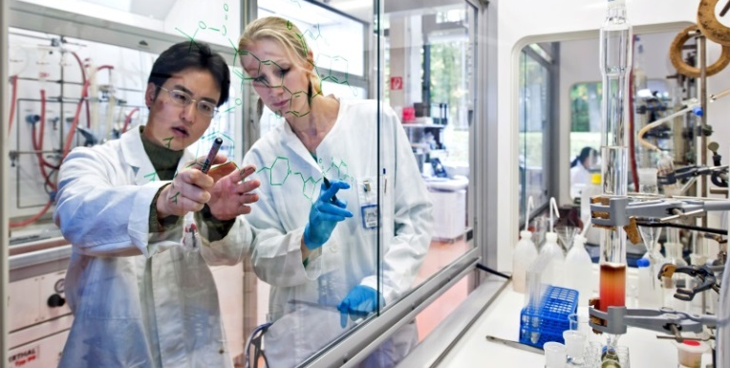
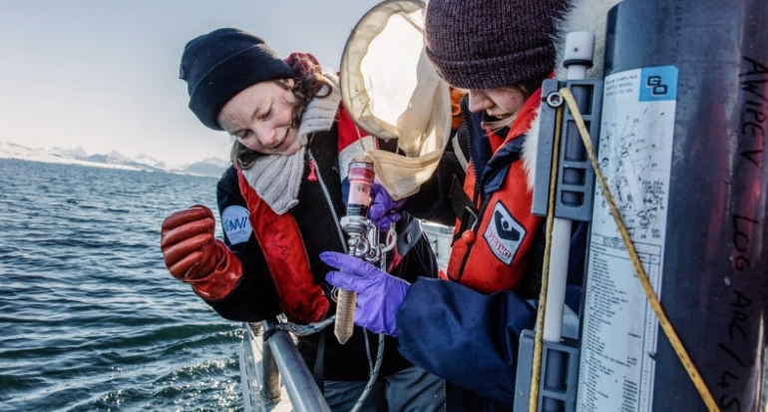
Helmholtz Research
Mission and strategy
Systems solutions for grand challenges based on:
  Scientific excellence
  Interdisciplinarity and critical mass
  Long-term research programs
Helmholtz provides a highly attractive environment for talents and brilliant scientists
Profound expertise in large scale research infrastructure
Helmholtz as a prime strategic partner
at the local, national and international level
Transfer of knowledge into economy and society

Slide 3
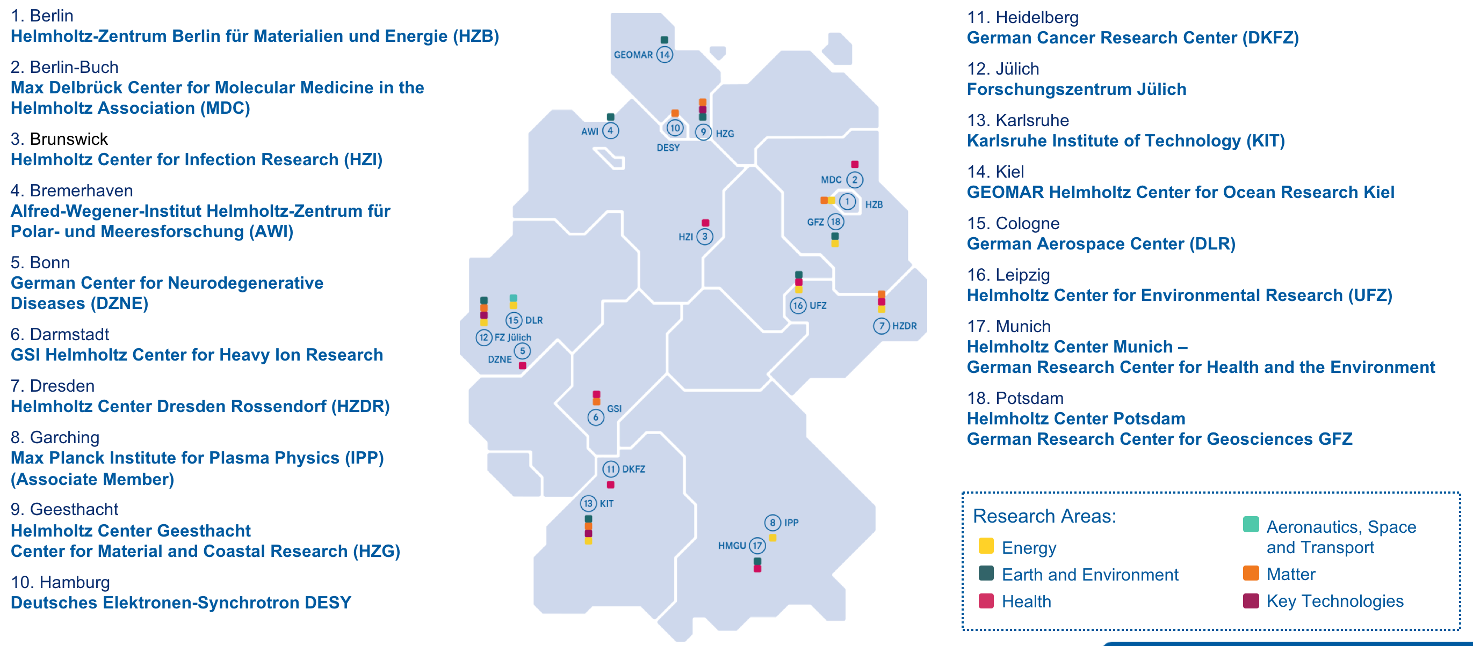
Helmholtz Research
Helmholtz centres

Slide 4
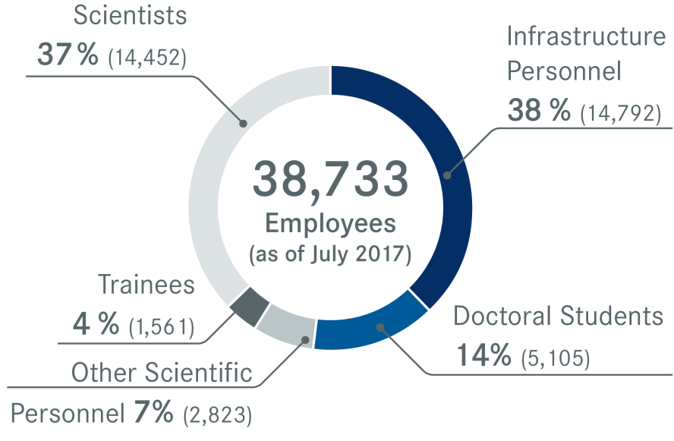
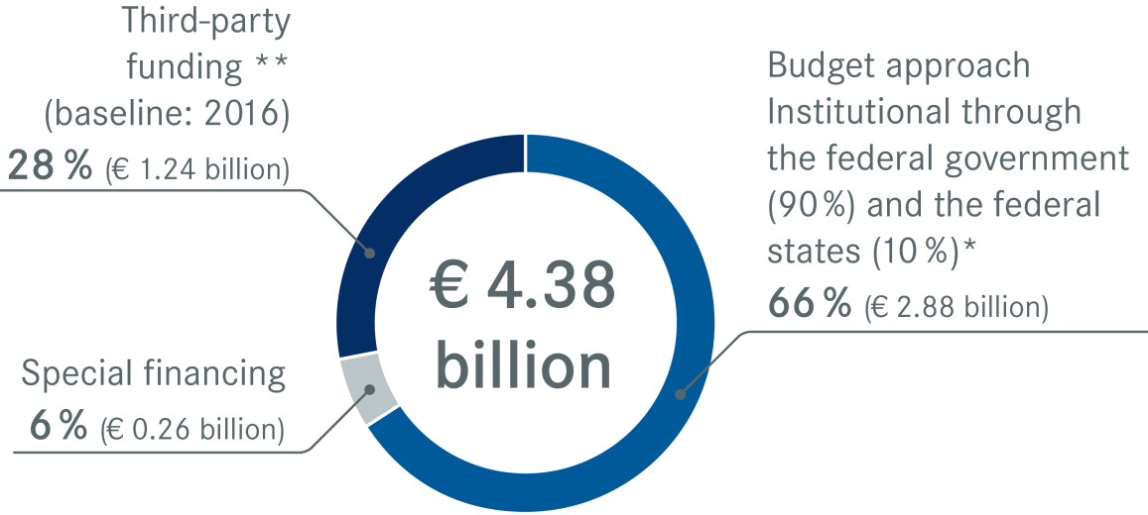
Helmholtz Research
Personnel and budget 2017
* As of 2016, the German federal government alone is financing the pact increase so that the federal government's share is over 90%.
** Including project sponsorships

Slide 5
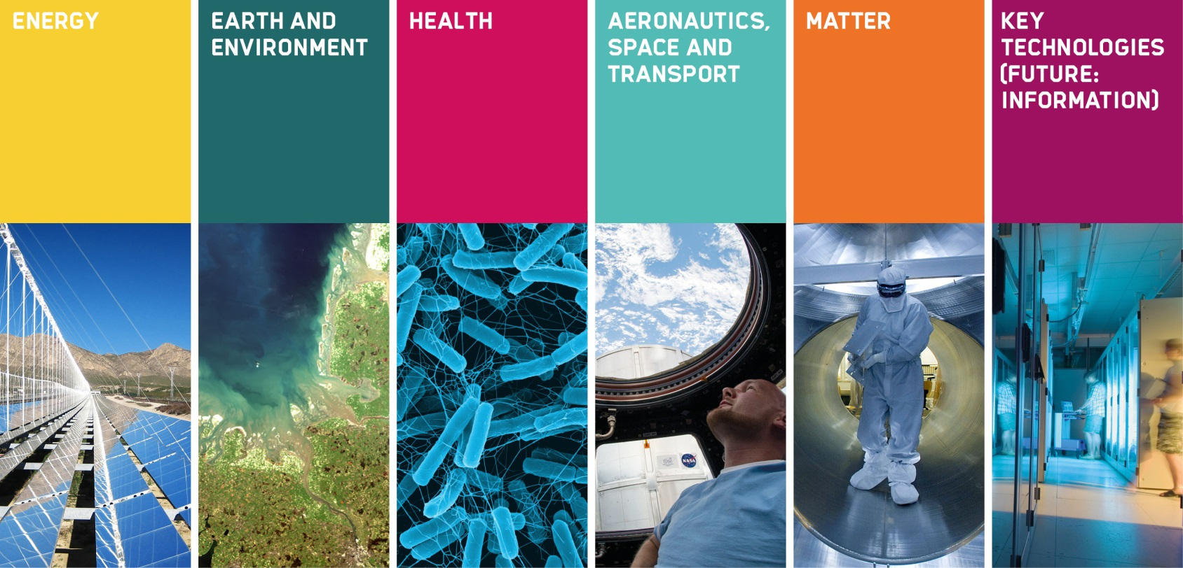
The Six Research Fields
Of the Helmholtz Association

Slide 6
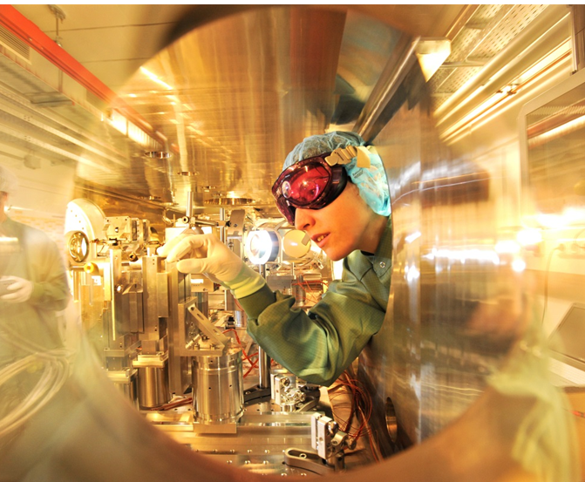
The Future Agenda of the Association
Challenges for the research fields
Energy systems of the future
(Materials & Storage, NUSAFE)
Individualized and data-based medicine (eHealth, proof of concept); mental disorders
Integrated exploration of the Earth System
Development of new mobility concepts
Compact accelerator systems
Information and data science

Slide 7

Information and Data Science
At Helmholtz
Information & Data Science strategy for all research centers and research areas
(Earth system modelling; digital earth)
New research area: Information
New Helmholtz Center on Cyber Security (CISPA)
Helmholtz incubator as interactive platform
Helmholtz Information & Data Science
Junior Academy
Helmholtz Data Federation

Slide 8
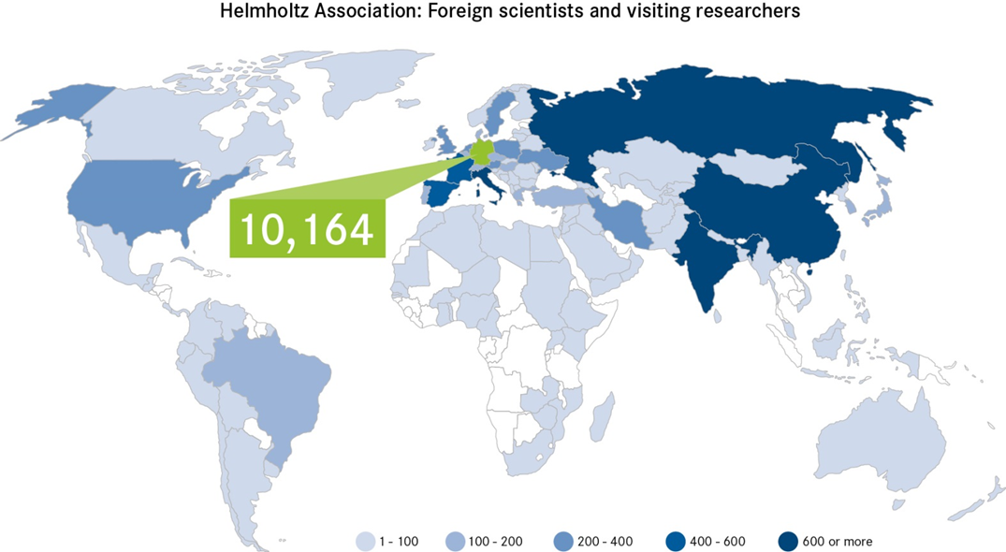
Helmholtz Internationalisation Strategy
Helmholtz as strong partner nationally and internationally
Bilateral partnerships around the world
Liaison offices in Brussels, Moscow, Beijing
7,500 foreign scientists at Helmholtz Centers
Bi-national programs
International Helmholtz laboratories
International Helmholtz research schools
European Partnering Initiative
World class large-scale facilities (XFEL, FAIR, W-7-X, Polarstern, Neumayer station, HALO, TERENO)
Strategic cooperations with outstanding partners in USA, Israel, France, UK, Canada, China, Russia,
As of 2016
Notes:
10164 ist die Zahl der “foreign scientists and visiting researchers” der HGF in 2016.

Slide 9
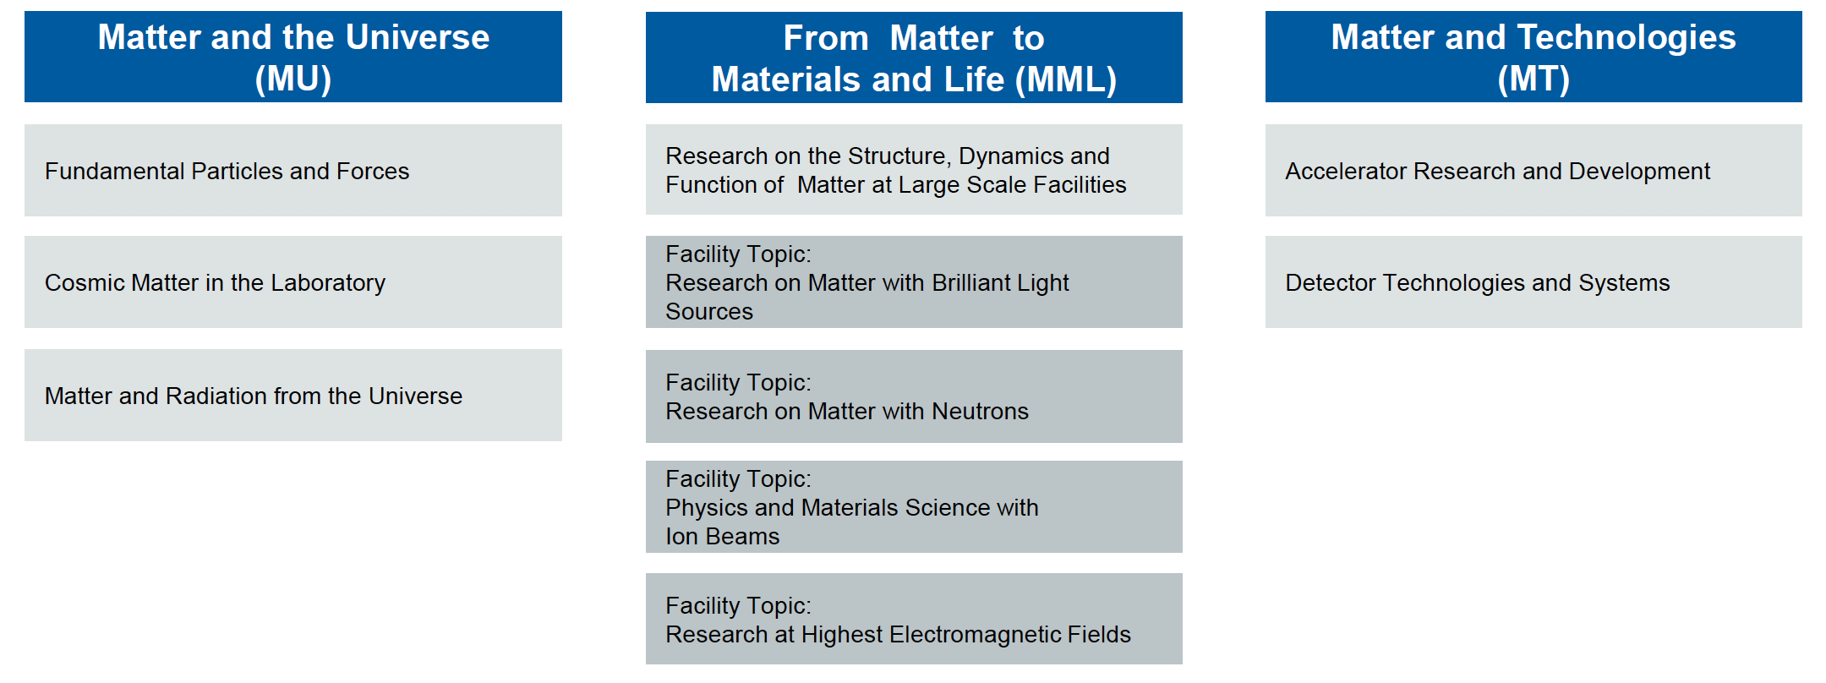
The Research Field Matter
Of the Helmholtz Association
Data Management and Analysis

Slide 10
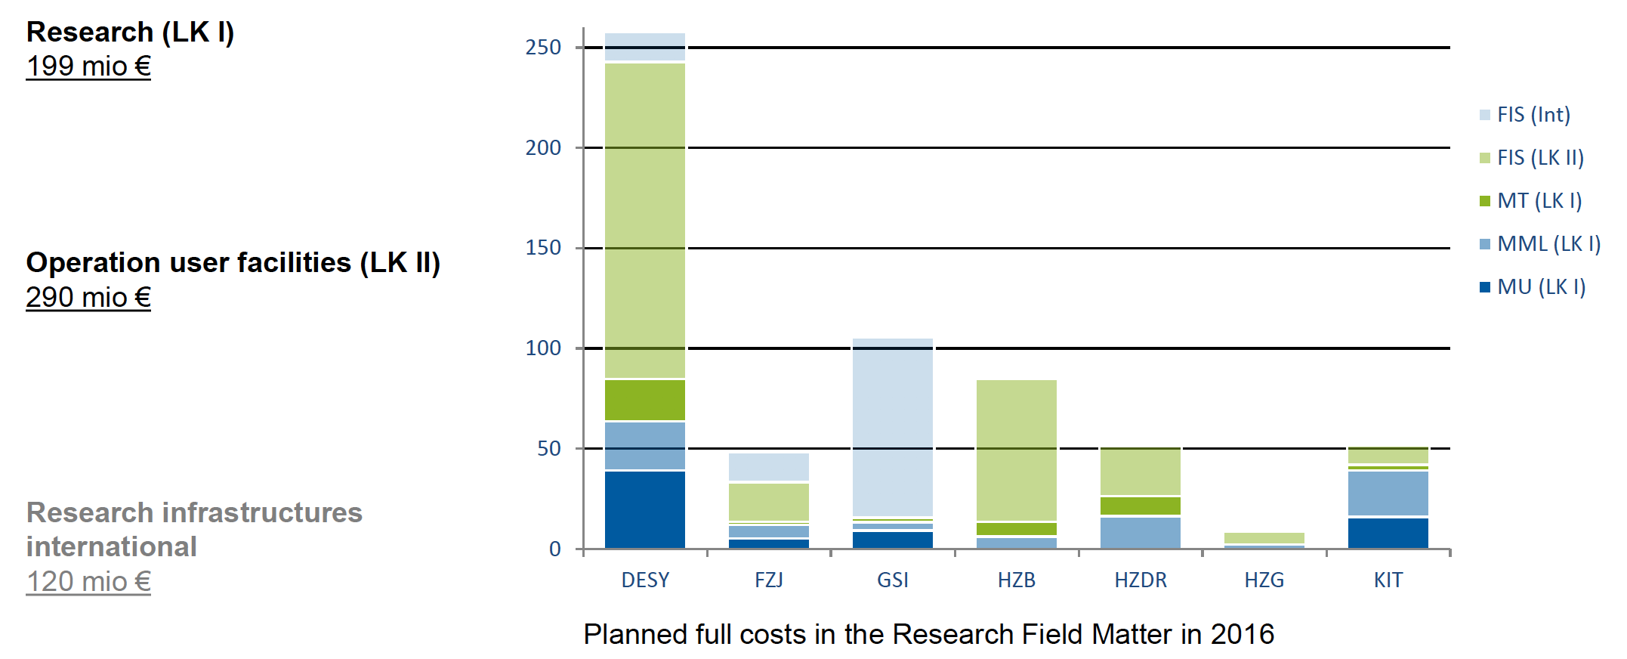
The Research Field Matter
Program participation

Slide 11
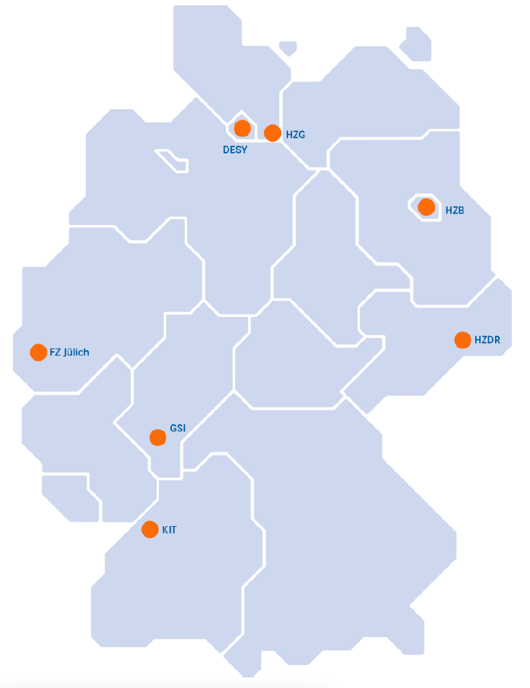
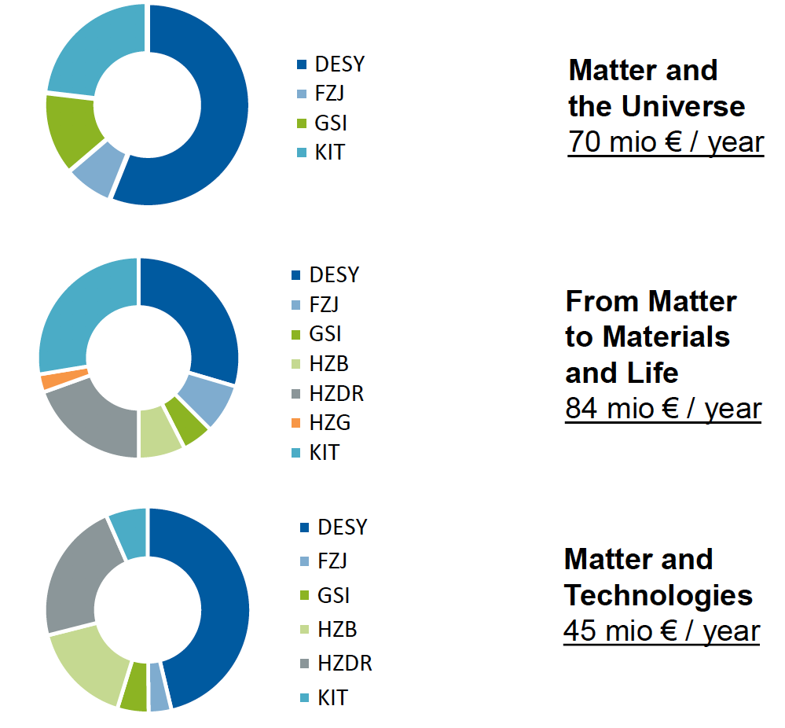

The Research Field Matter
Program participation

Slide 12
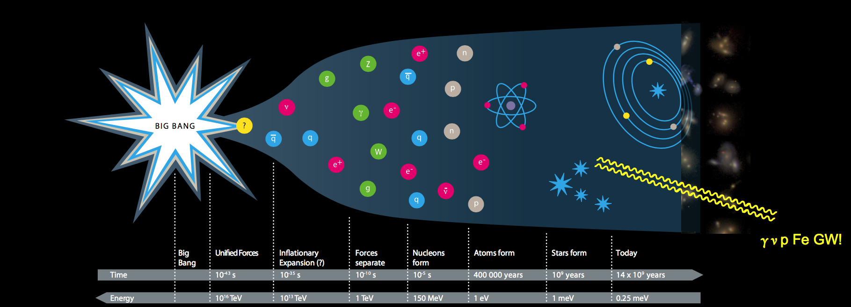
The Mission of Matter and the Universe
… and our “science drivers”
Understanding the most elementary building blocks of matter, their interactions, and their influence on the development of the universe.
Our current picture is incomplete and partly inconsistent, and the entire effort in particle physics is dedicated to solving the related scientific challenges.

Slide 13
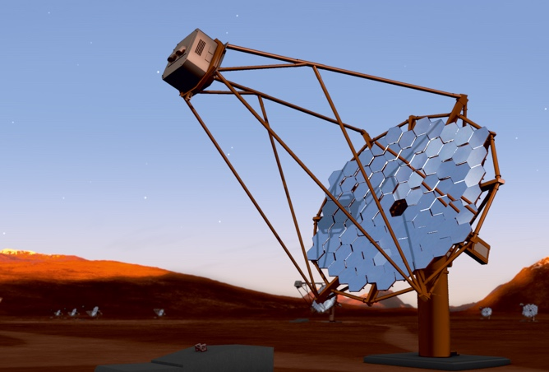
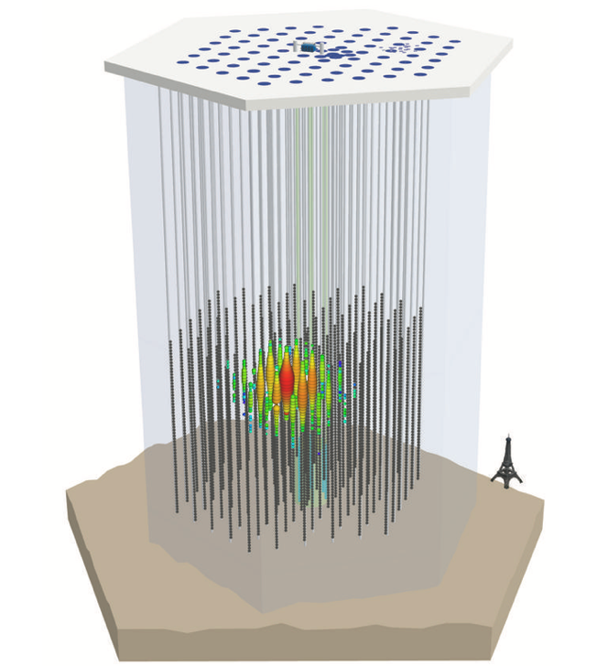
Science Drivers
Structure of the vacuum
Big open questions
Nature of the Higgs boson
Theory beyond SM
Dark matter
ATLAS
CMS
(Anti)Matter asymmetry
CTA
Neutrino properties
Cosmic accelerators
IceCube
Theory
Belle II

Slide 14
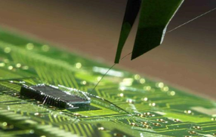
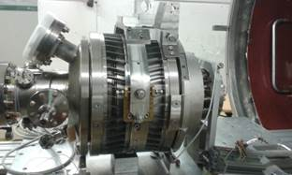
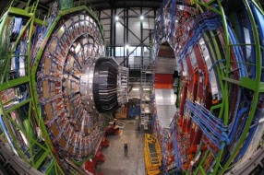
The Mission of Matter and Technologies
Develop enabling technologies
MT
Technologies, R&D
Develop fundamental technologies
Give the freedom to try new things
Give the freedom to try risky things
We are science-driven
Prototyping, R&D
Building
MU
MML
Operation
We develop today the technologies for tomorrow
driven by the scientific questions in our fields

Slide 15
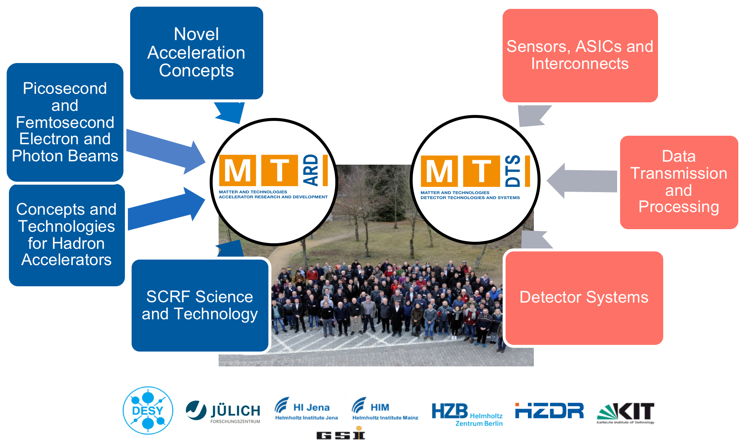
Organisation of Matter and Technologies
Develop enabling technologies

Slide 16

Hot from the Press
Research area Information and MT topic Data Management and Analysis (DMA)
Matter and Technologies
(MT)
Accelerator Research and Development (ARD)
Detector Technologies and Systems (DTS)
Data Management and Analysis

Slide 17

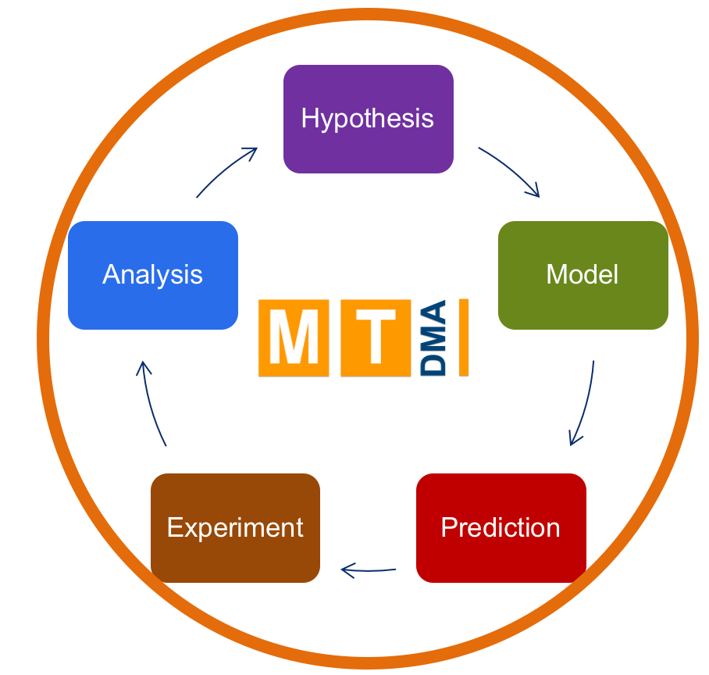
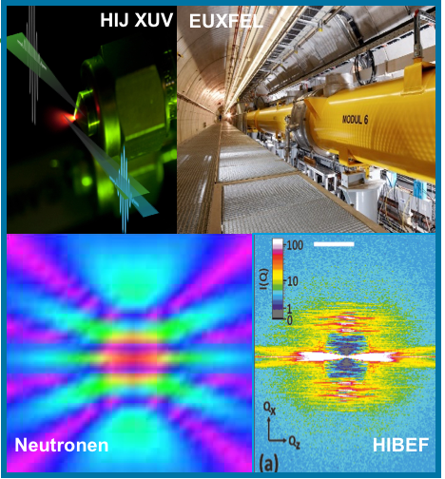
The Challenge for DMA
Improve the full data lifecycle
Challenges that DMA addresses:
Volume: individual scientists need to analyse PB of complex data that can‘t be transferred to their home institutions and that have limited lifetime
Rate: Detectors record ever large amounts of data.
Complexity: Scientific and technological progress increase complexity of single measurements
Example: High-rate 3D image processing with machine learning and strat-to-end simulations (compression, reconstruction, extraction)

Slide 18
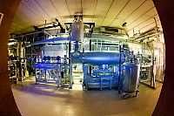
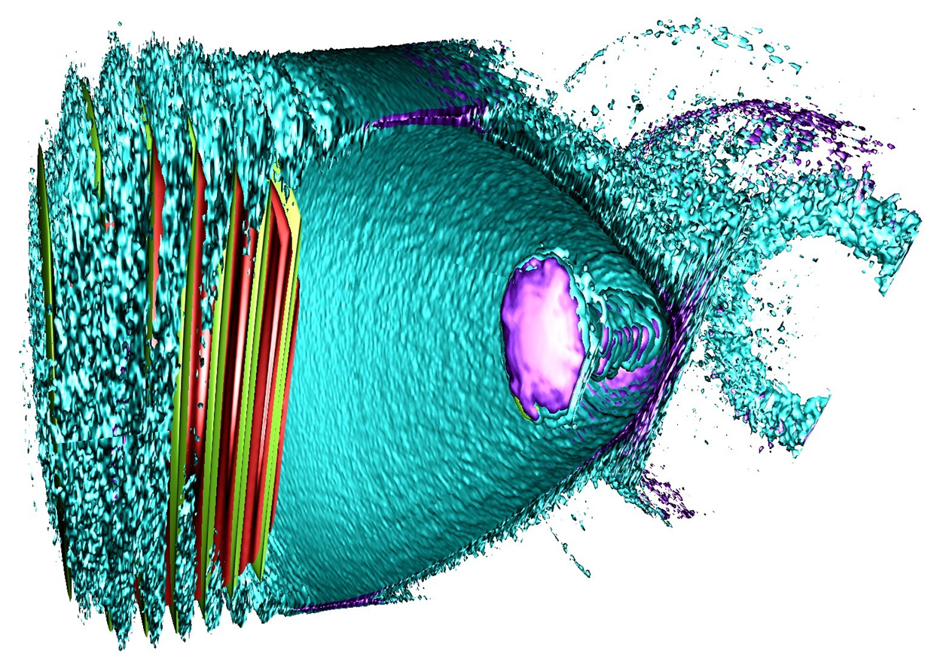
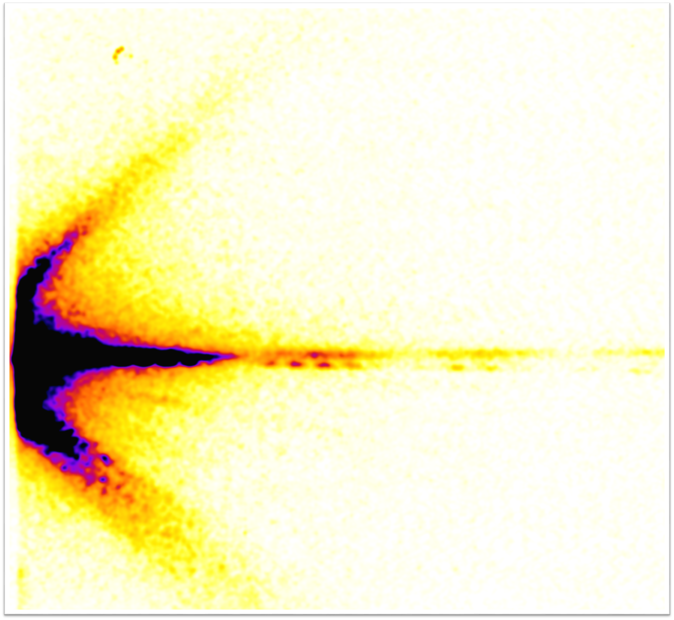
Structure and Tasks of DMA
Three subtopics
ST1: The Matter Information Fabric
  IT Solutions (Hard+Software) for Large Facilities
  Automated Data Lifecycle Management (LK II)
  Solution for Community Specific Demands
ST2: The Digital Scientific Method
  Method Research in Data Analysis & Simulation
  Machine Learning, Visual Analytics, Scientific Workflows
  Heterogeneous HPC, HTC, I/O
  New technologies, e.g. Quantum Computing
ST3: The Digital Experiment and Machine
  Start-to-End Simulations (Machine/Physics/Detector)
  Fast Feedback („Human in the Loop“)
  Determination of Data Quality, Handling of Metadata
  Control Systems

Slide 19
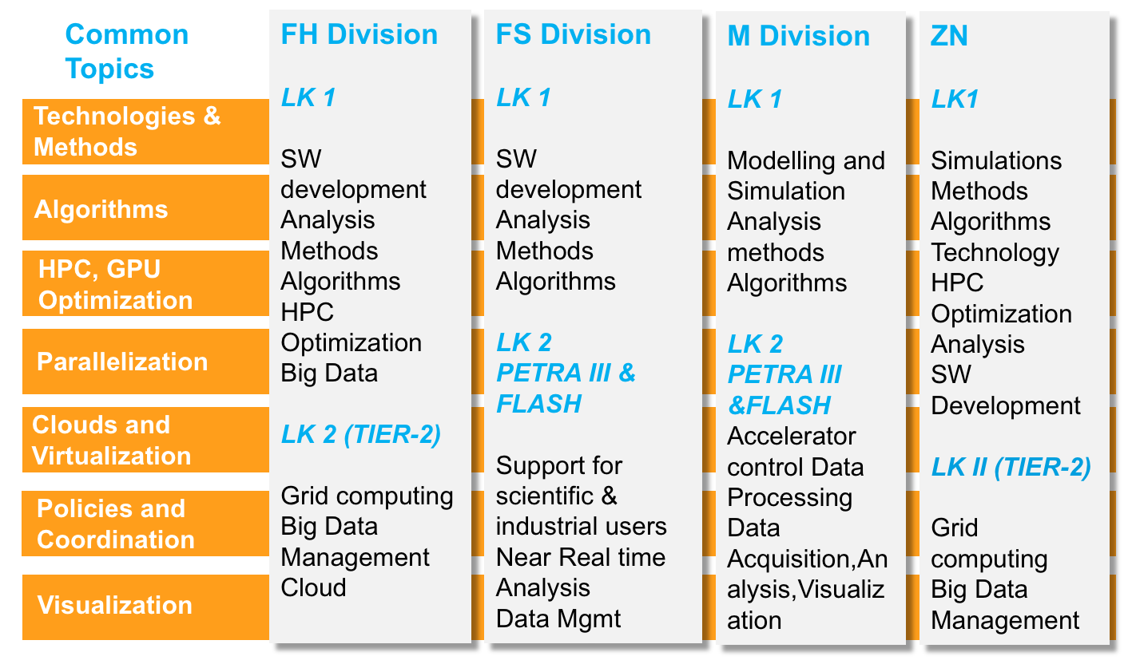
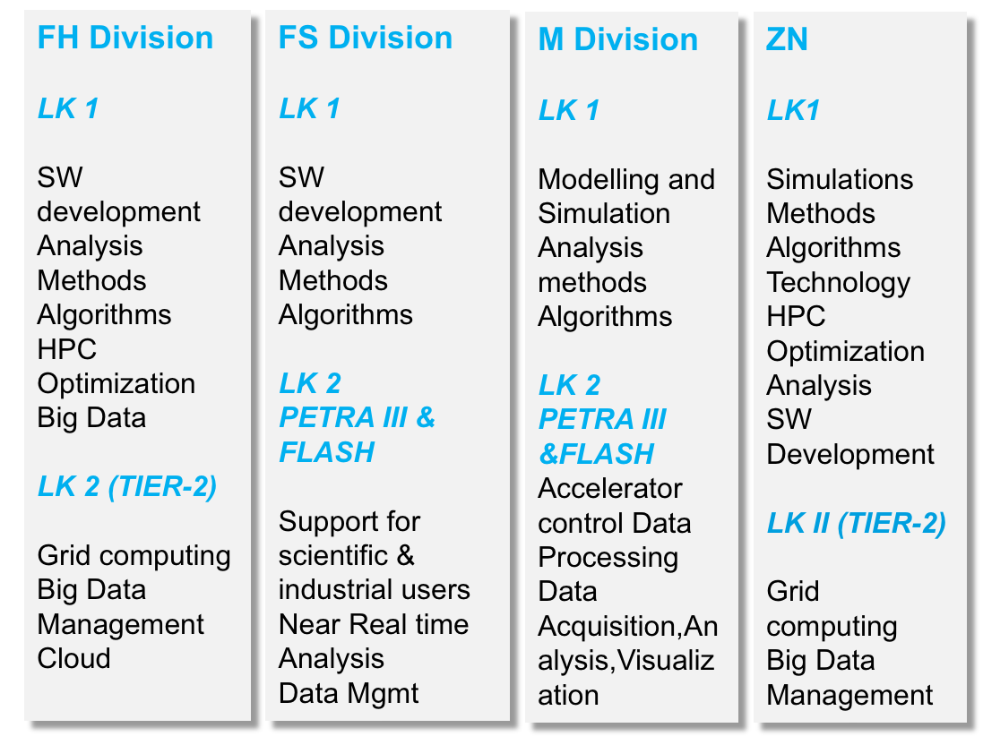
E.g. DMA at DESY
Virtual group across disciplines
Virtual group „Scientific Computing“
spanning the DESY divisions

Slide 20







E.g.: DMA at DESY
DMA accompanied by in-house fundamental research and excellent infrastructures
Centre for Data and Computing Science (CDCS):
  Interdisciplinary cooperation across universities
  with computing science / applied math departments
    Create and strenghten necessary new competences
  Establish a Data Science Graduate School
    Focus on knowledge+education („brainware“)
  Interdisciplinary R&D center for applied information and data science
    Focus on research for use cases / applications out of the domain „Science“
  Support for designing efficient IT infrastructure
  (but not the operation of IT Infrastructure
The Interdisciplinary Analysis Facility (IDAF):
„LK II“ large-scale facility for external users
Services e.g. for LHC, Belle, astroparticle
physics, photon science
DMA
CDCS
IDAF

Slide 21
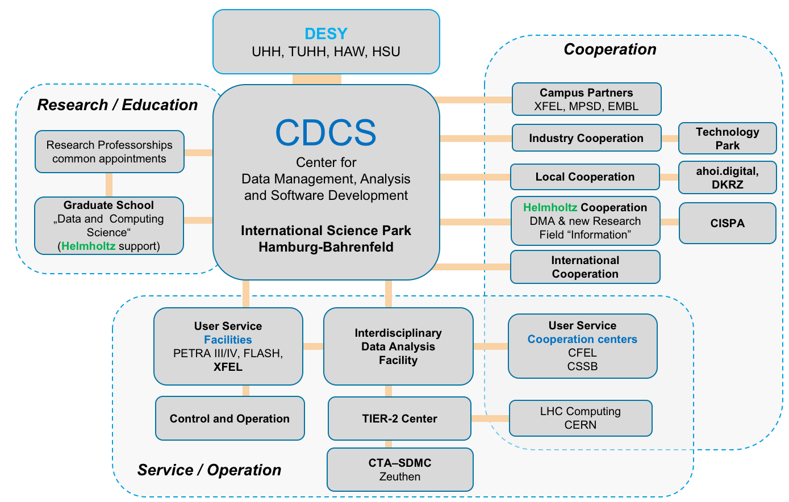
E.g.: DMA at DESY
DMA accompanied by in-house fundamental research and excellent infrastructures

Slide 22
Research Area Information
A new research area in Helmholtz
Research area (RA) Information researches and develops basic methods and concepts for the recoding, storage, digestion, transmission and usage of information in an integrative way in natural, technical and cognitive systems.
The RA develops information-oriented technologies and research infrastructures, makes them available to third parties, demonstrates their added value and analyses their impact on society.
RA Information understands itself as method- and technology-oriented facilitator and shaper
(„enabler“) of a digitial future in Helmholtz and beyond, in science, economy and society.

Slide 23
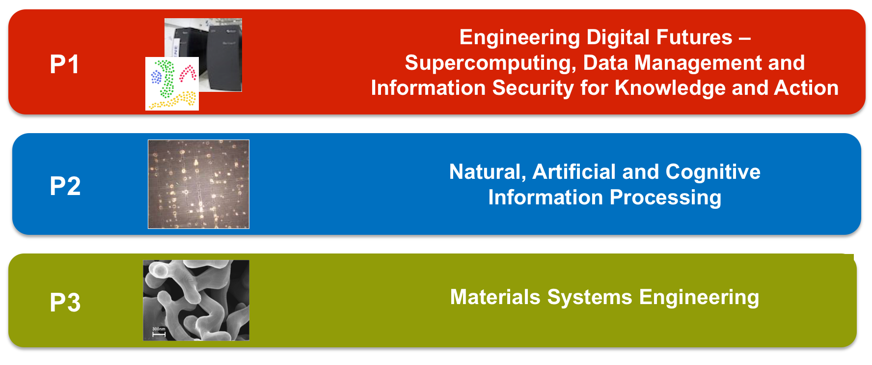
Research Area Information
Programs and joint labs
Joint labs

Slide 24
DMA in Matter and in Helmholtz
Matter
MU
MML
MT
DMA
INFORMATION
P1: From data to knowledge and action
DMA communicates solutions and results from Matter that can be generalised
DMA supports applications and specialisations of solutions and results
Bundles resarch, competences, resources in „Scientific & Data-intensive Computing“ in Matter
Increases networking in Matter with the aim of developing, distributing and supporting common solutions
Supports large topical diversity, international impact and visibility
HELMHOLTZ
INCUBATOR
DMA as central hub for method researchers in the Incubator for applications in Matter
Helmholtz Introduction | TRIUMF Workshop 27-29 June 2018 | J. Mnich

Slide 25
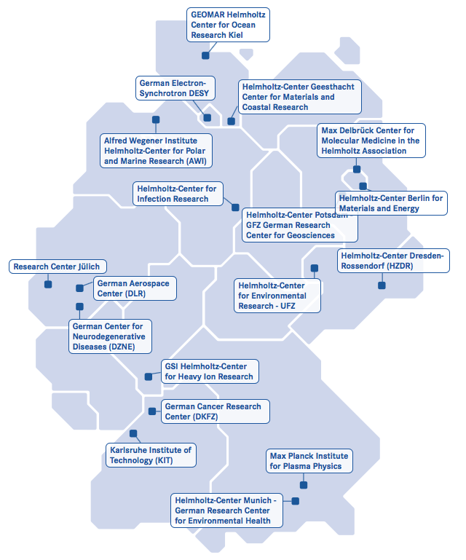
Conclusions
Helmholtz: a major player in science
„Leading research for grand challenges“
Six research areas, e.g. Matter
Provider of large-scale infrastructures
Information, computing and data science as important future topics
New research area Information
New research topic in Matter: Data Management and Analysis (DMA)
At DESY: New Centre for Data and Computing Science (CDCS) and new virtual „Scientific Computing“ group
We are looking forward to fruitful collaboration.

Slide 26
Backup

Slide 27
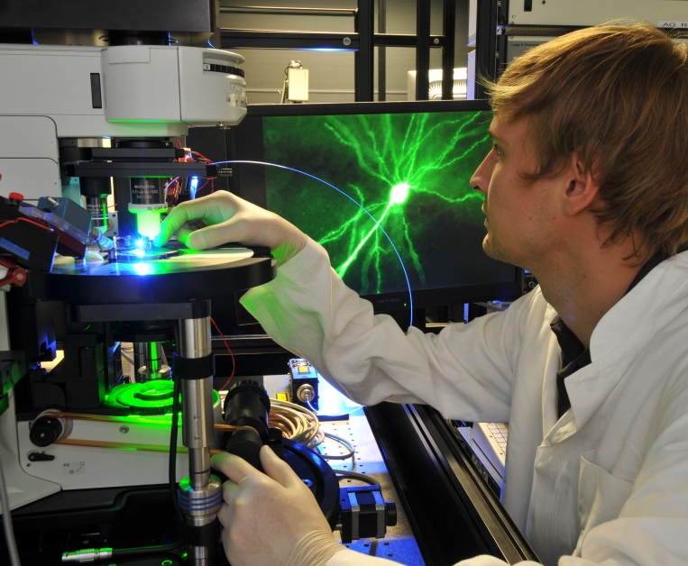
Strategic Partnerships
Helmholtz as strong partner nationally and internationally
644 joint W2 and W3 professorial appointments
Long-term cooperations :
  15 Helmholtz Institutes
  20 Helmholtz Alliances
  110 Virtual Institutes
  225 Helmholtz Young Investigator Groups
Karlsruhe Institute of Technology
Jülich-Aachen Research Alliance
Excellence strategy with Universities
German Centers for Health Research
R&D partnerships with companies

Slide 28
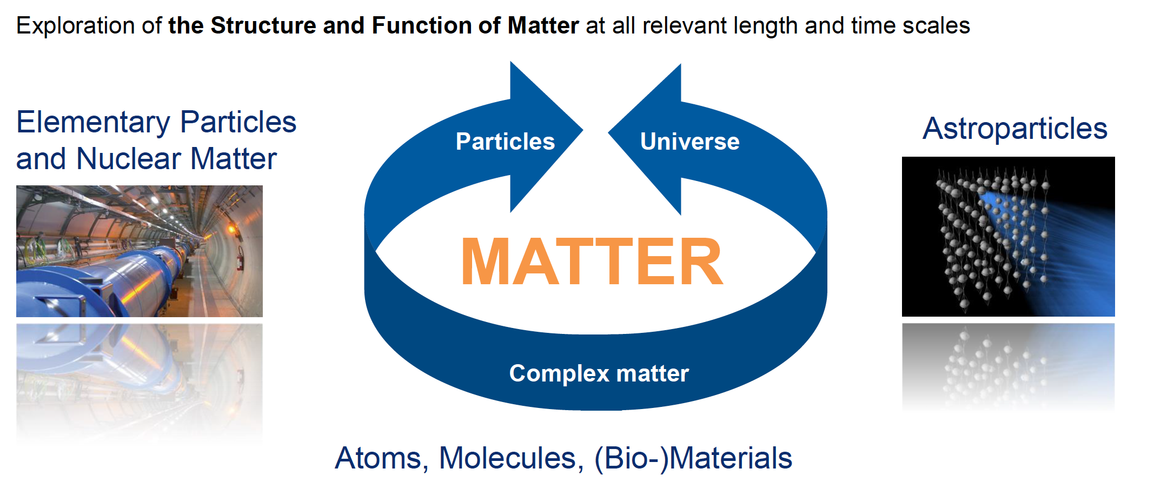
The Research Field Matter
Mission

Slide 29
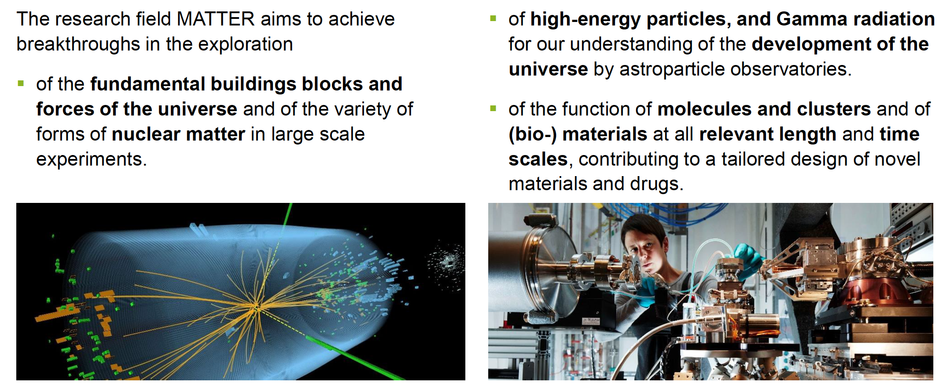
The Research Field Matter
Mission

