Slide 1
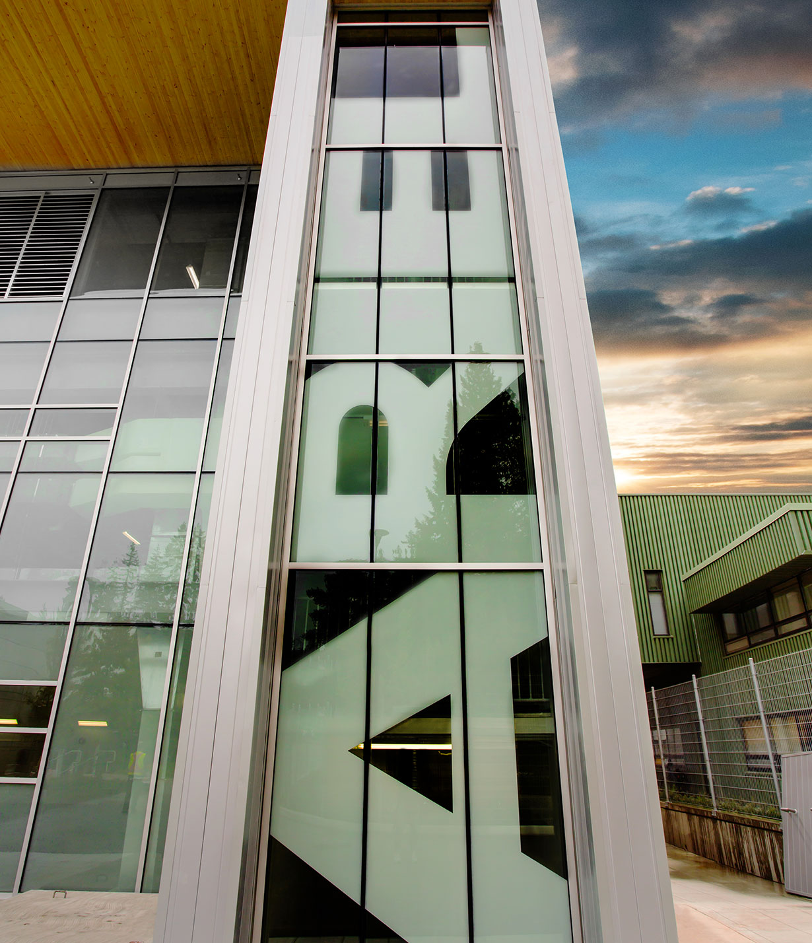
Introduction to TRIUMF
Data Science and Quantum Computing Workshop
June 27, 2018
Jonathan Bagger
Director

Slide 2


Slide 3
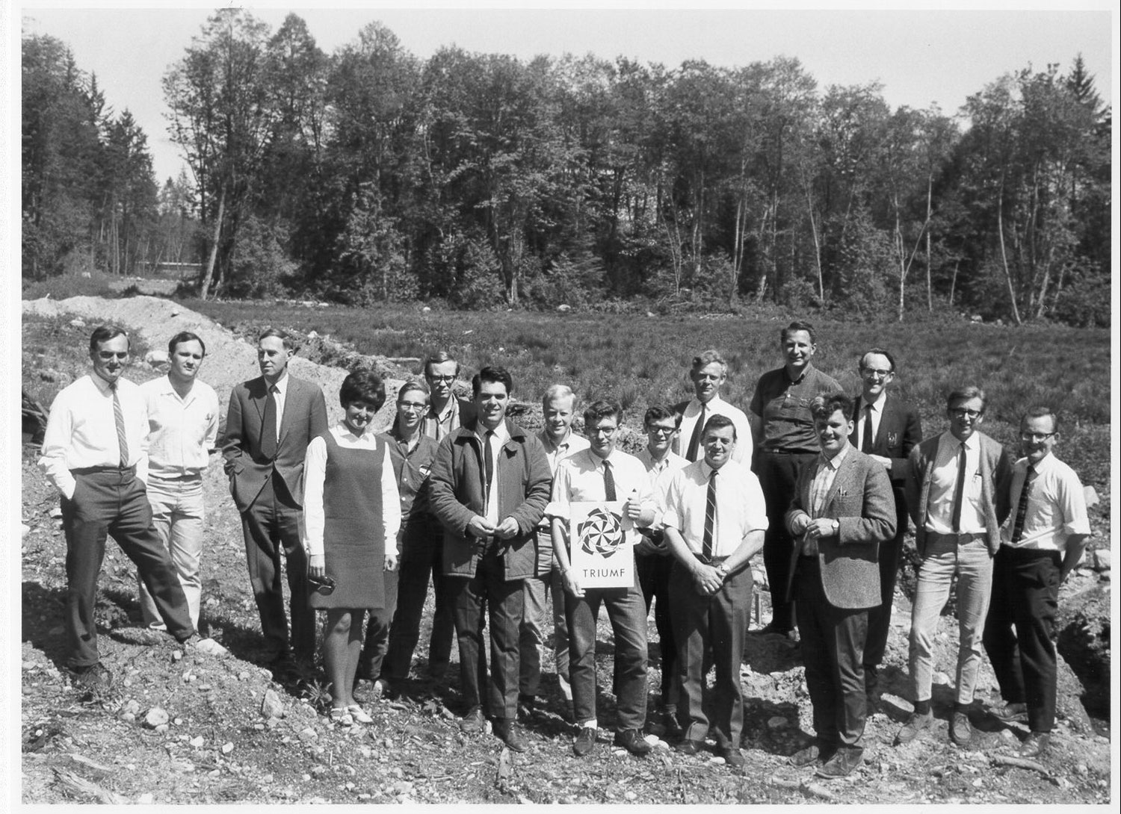

Slide 4
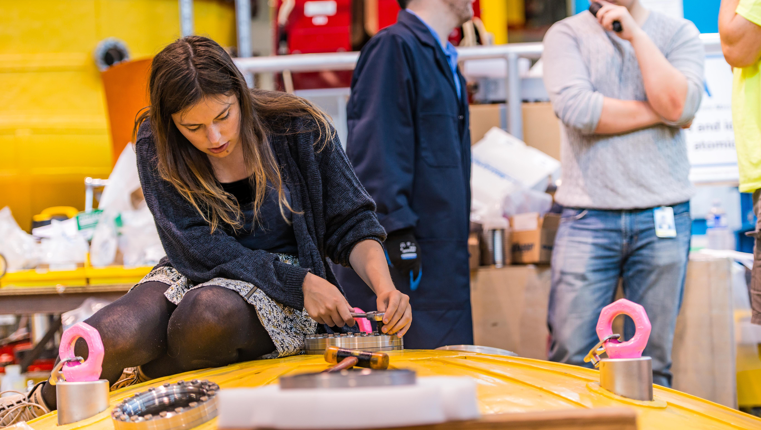
  TRIUMF is Canada's
  particle accelerator centre

Slide 5
What is TRIUMF? A World-Class Laboratory
TRIUMF is a place where teams of researchers collaborate on projects that are too large and too complex for any single institution
  TRIUMF is home to a billion-dollar multidisciplinary research infrastructure
  TRIUMF enables the Canadian S&T community to carry out internationally recognized cutting-edge research

Slide 7
Revenue Sources (2015-2020)
Large-Scale
!
FY17/18:
$95.2M Total Funding
535 Employees

Slide 8
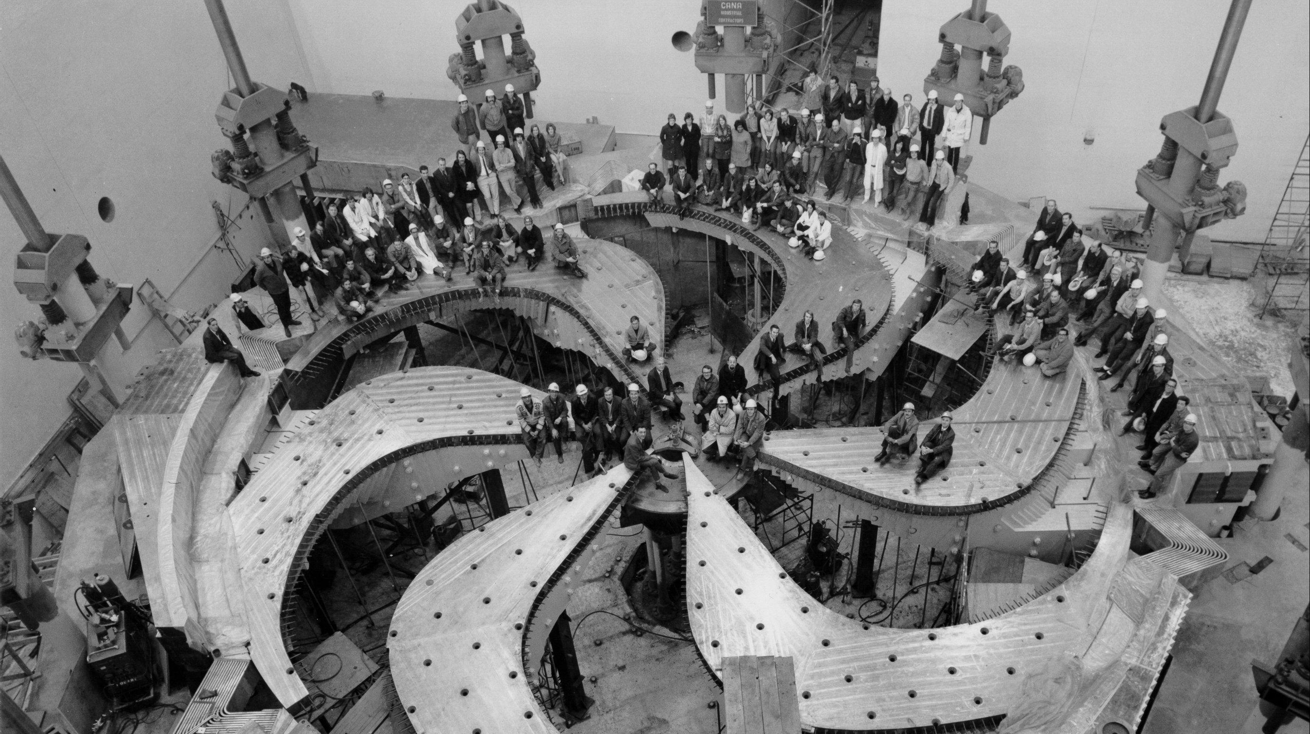
World’s Largest Cyclotron

Slide 9
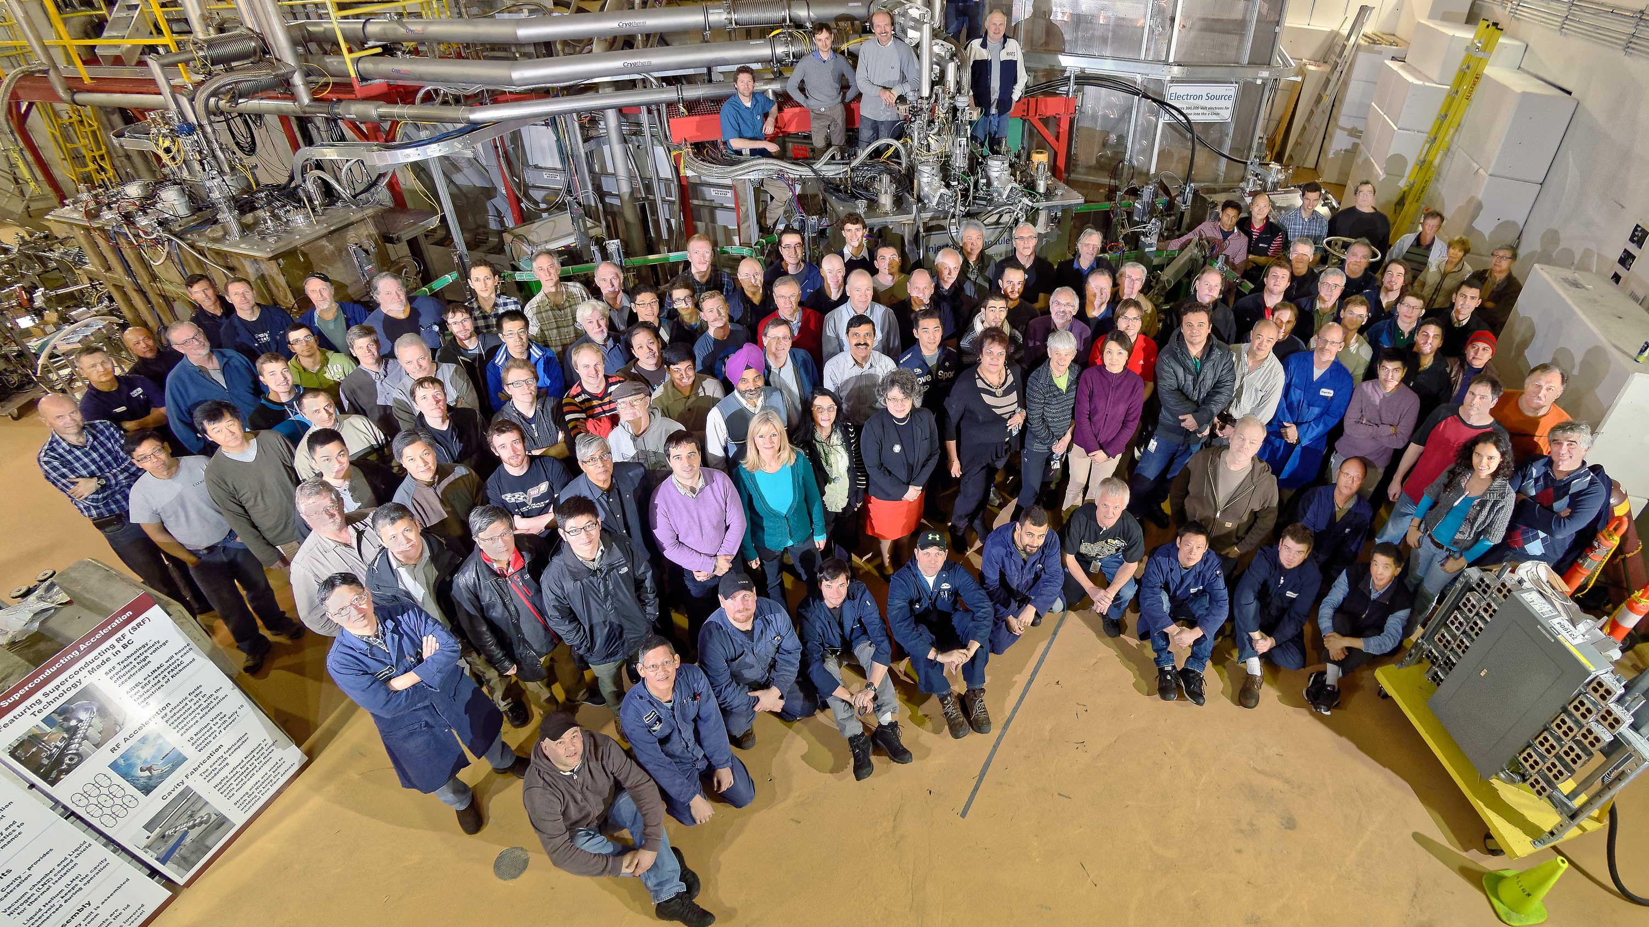
World’s Highest Current Superconducting Electron Linac

Slide 10
What is TRIUMF? A Network Hub
TRIUMF links leading universities across Canada with each other and with national and international facilities around the world
  TRIUMF is a magnet for people and ideas – for attracting, training, and retaining talent for Canada
  TRIUMF allows Canadians to compete at scale in the global scientific enterprise

Slide 11

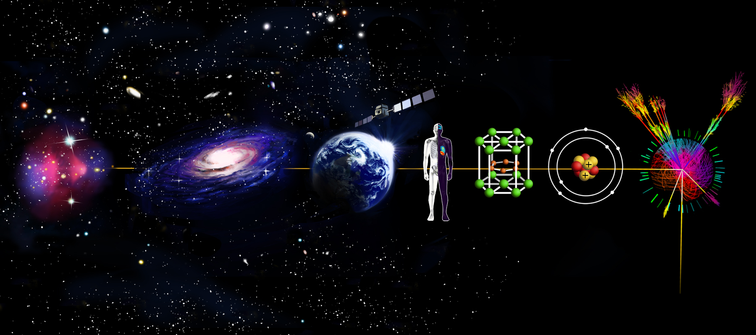
Dark Matter
& Cosmology
Electronics
Radiation Testing
Molecular &
Materials Science
Particle
Physics
Nuclear
Astrophysics
Nuclear
Medicine
Nuclear
Physics
Data Science

Slide 12
Scientific Users and Visitors by Field (FY17/18)
Multidisciplinary
!
!
FY17/18:
875 Scientific Users and Visitors
Irradiation Services

Slide 13
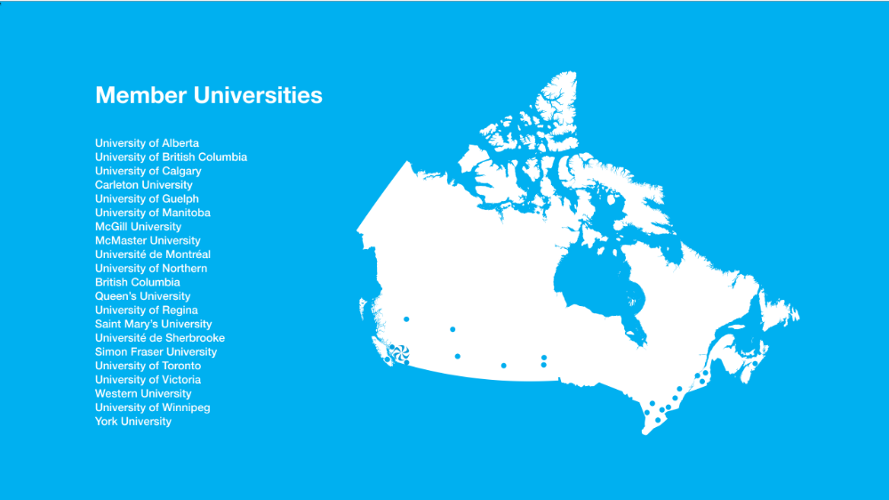
20

Slide 14
Scientific Users and Visitors by Region (FY17/18)
Global Destination
FY17/18:
875 Scientific Users and Visitors

Slide 15
What is TRIUMF? A Global Brand
TRIUMF is unique in Canada, and known world-wide as a Canadian centre of excellence
  TRIUMF serves as a scientific ambassador, advancing Canada’s interests at home and around the world
  TRIUMF is a model for engagement with the commercial sector

Slide 16
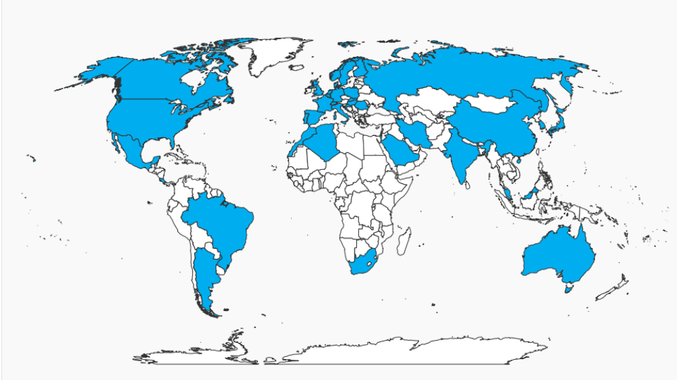
TRIUMF Users
39 Countries

Slide 17





Helmholtz Association
Centres
Germany
50+
CERN
Europe
international
agreements
KEK / J-PARC
Japan
VECC
India
Department of Energy
Laboratories
USA

Slide 18
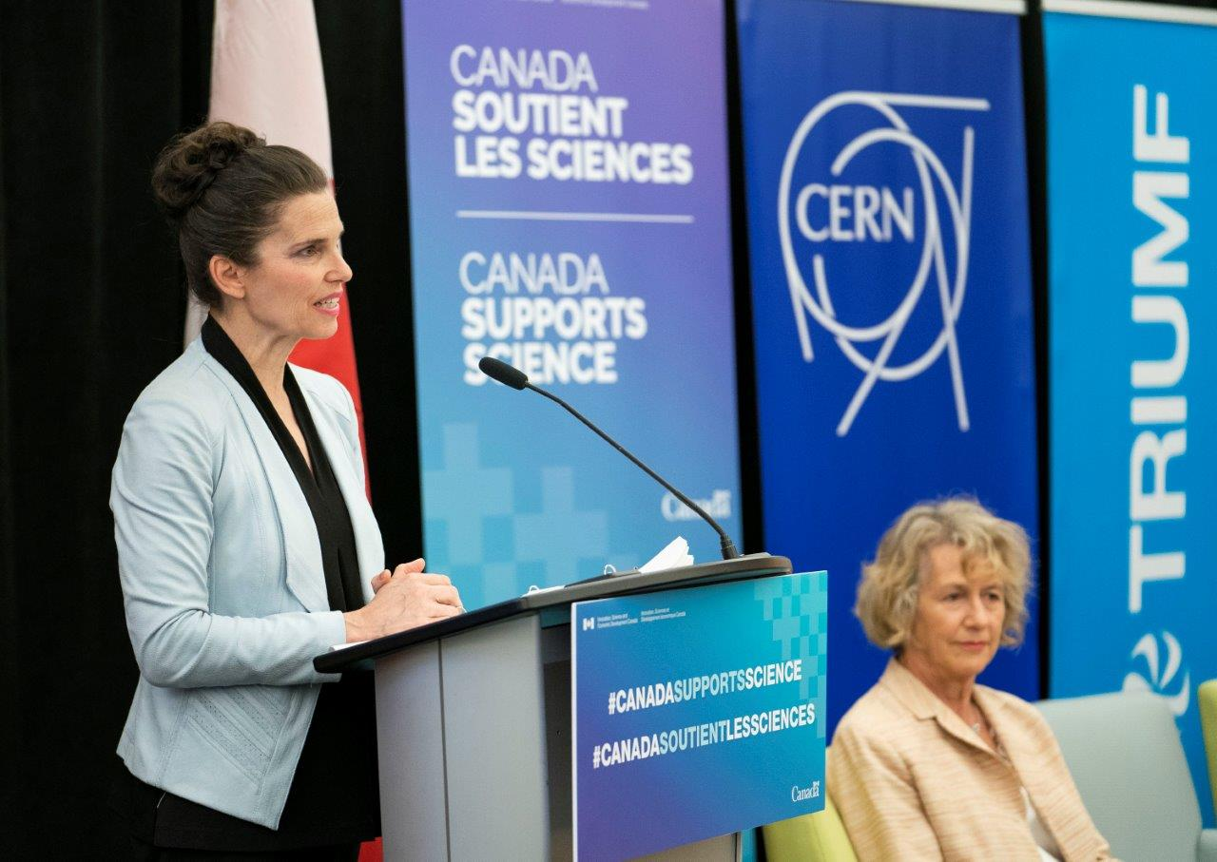
The Honourable Kirsty Duncan, Minister of Science and Minister of Sport and Persons with Disabilities

Slide 19
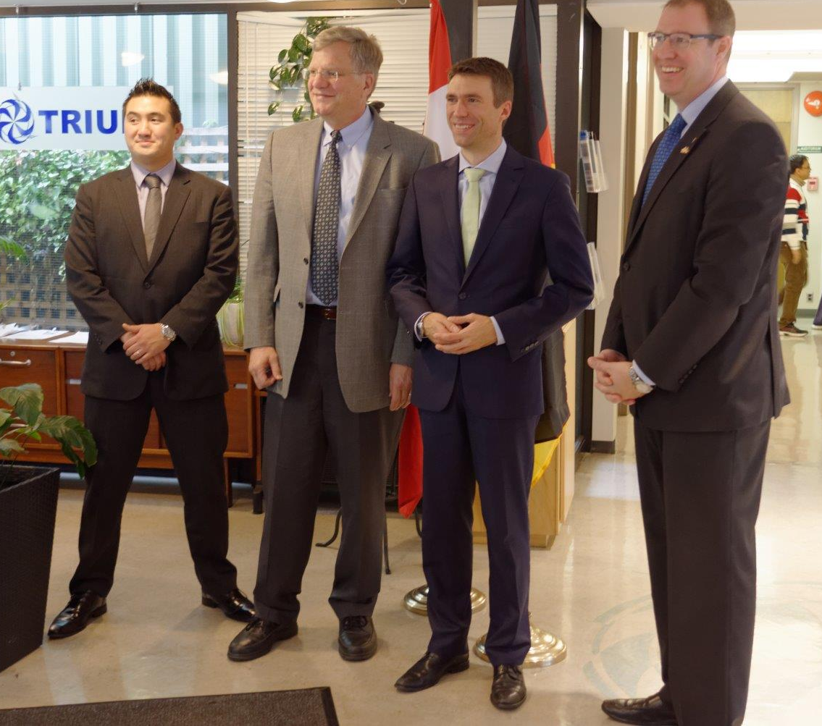
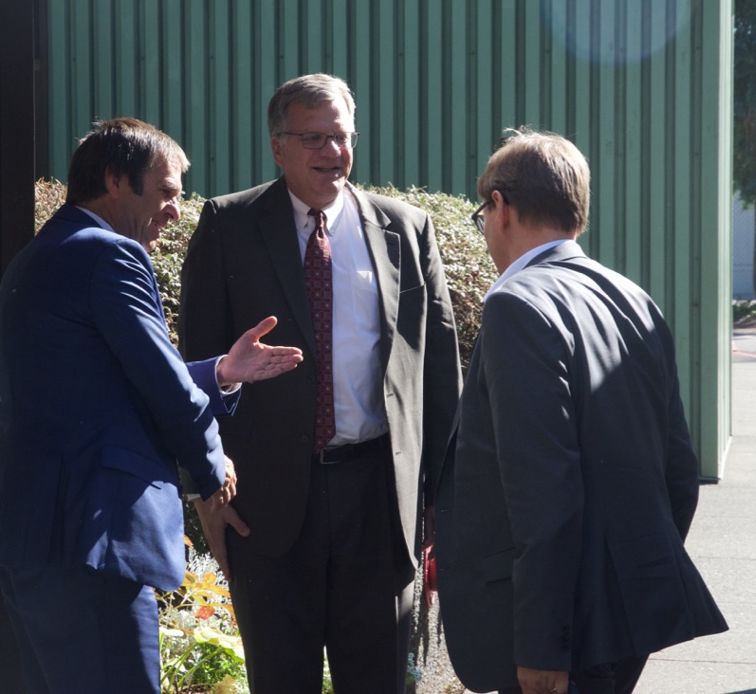
Mr. Stefan Müller, Parliamentary State Secretary to the Federal Minister of Education and Research
Dr. Otmar Wiestler, President of the Helmholtz Association

Slide 20










Commercial Partners

Slide 21

Industry
Academia
Government
TRIUMF plays a critical role in the Canadian innovation ecosystem

Slide 22
TRIUMF delivers value to Canada across three critical dimensions
Science and Technology
People and Skills
Innovation and Collaboration

Slide 23
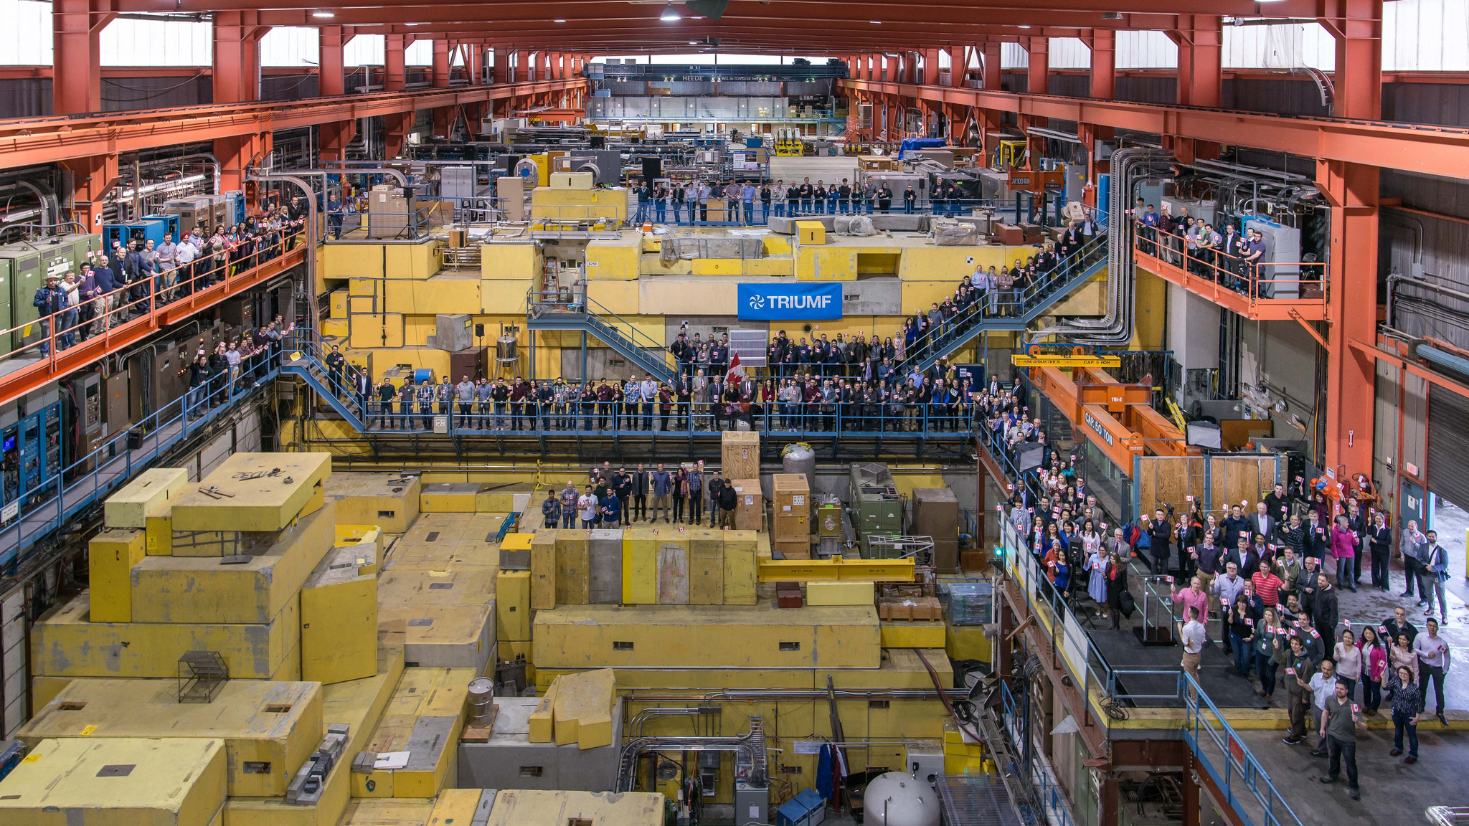
Governor General Julie Payette
“It matters, what I have just seen in a very few minutes here at TRIUMF. I knew about TRIUMF and it still amazes me seeing you today, that you are at the very forefront of the frontier of knowledge and yet you are very practical. You are so important to help people every day and for this I hope you are very proud.” March 22, 2018

Slide 24
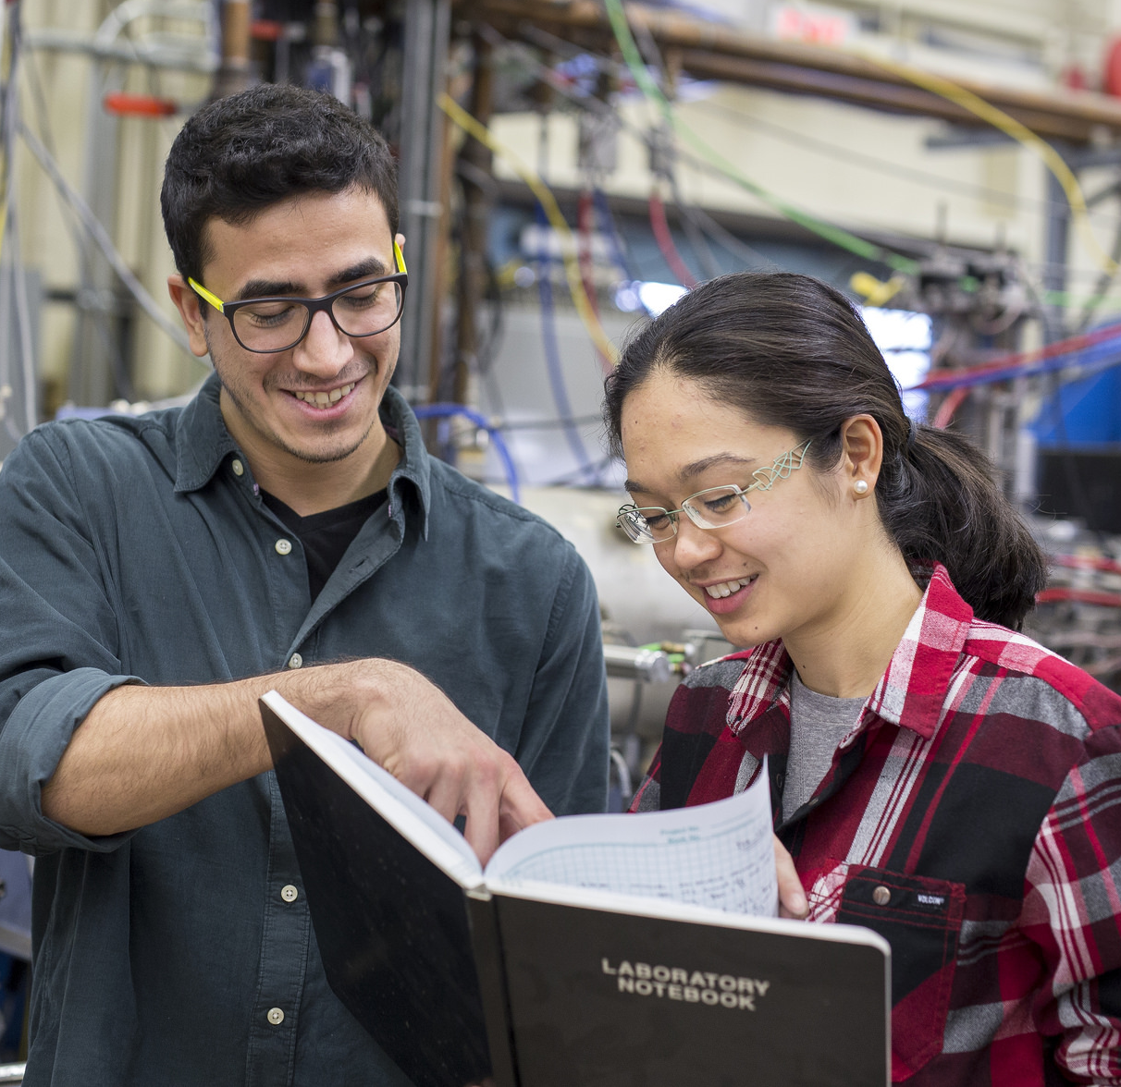




Thank you
Merci
Danke
www.triumf.ca
Follow us @TRIUMFLab

