Slide 1
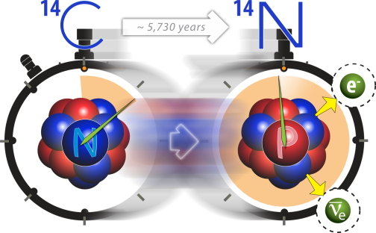
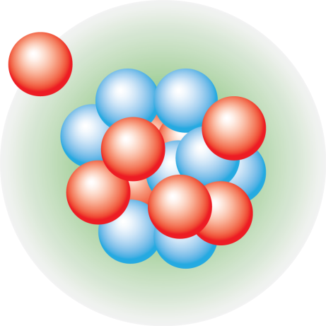




Quantum computation of
the deuteron
Titus Morris
Data Science and Quantum Computing Workshop, TRIUMF
June 28th , 2018

Slide 2

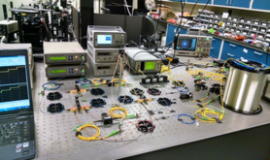
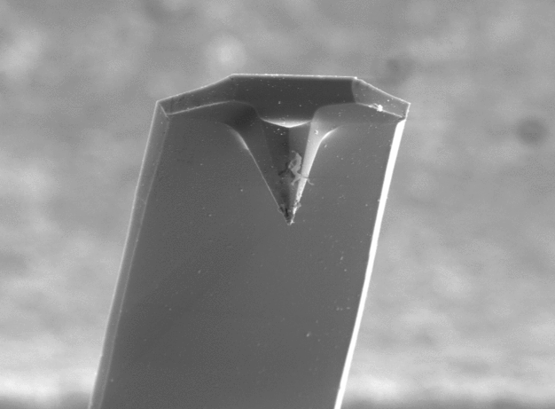
The Quantum Information Science Group supports research and development in a variety of quantum technologies
Sub-radiant
Super-radiant
Optical Pumping
Quantum Sensing
Quantum Computing
Quantum Communication
Compressive Quantum Imaging
Quantum Plasmonic Sensors
Ultra-sensitive MEMS Displacement
Standoff Spectroscopy
Opto-mechanical Force Microscopy
Circuit Model Simulations
Analog Digital Quantum Simulations
Physical Qubits Modeling
Quantum Characterization, Verification and Validation
Quantum Networks
Quantum Key Distribution
Quantum Secret Sharing
Quantum Random Number Generators
More information:
https://www.ornl.gov/division/csed/quantum-information
Contact: gricew@ornl.gov
Pathfinder Testbed FY 2016-2018 (PI – R. Pooser)
Quantum Algorithms FY 2016-2018 ( PI - P. Lougovski)
Kickoff Meeting October 2017

Slide 3
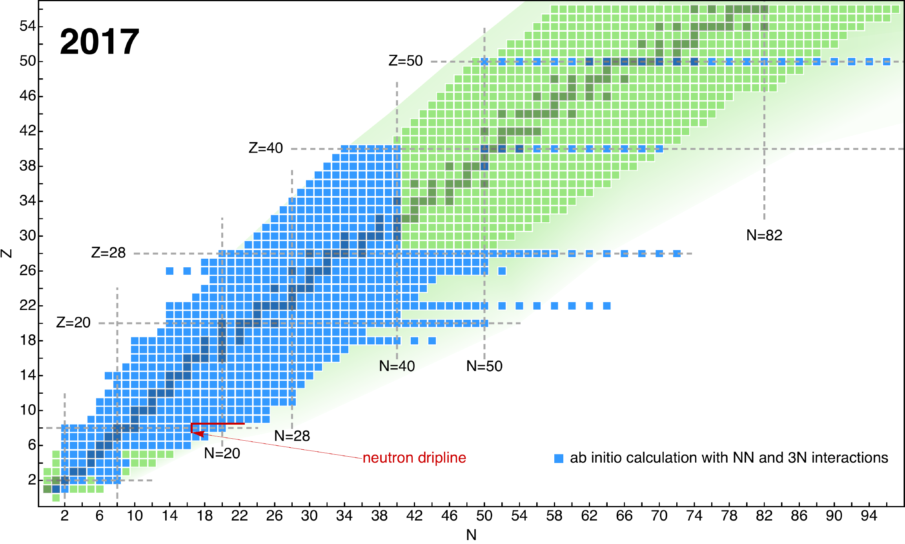
Nuclear Structure Theory at ORNL
Simplest nuclei we can calculate!
Notes:
3

Slide 4
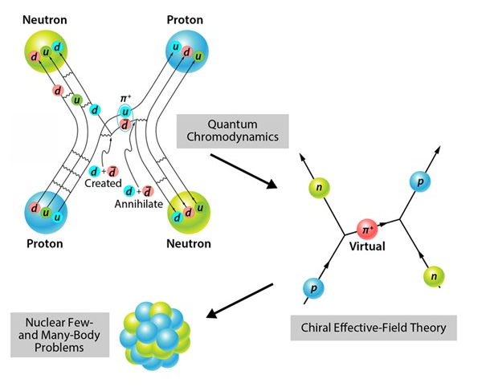
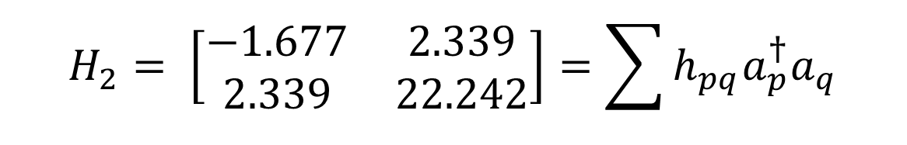
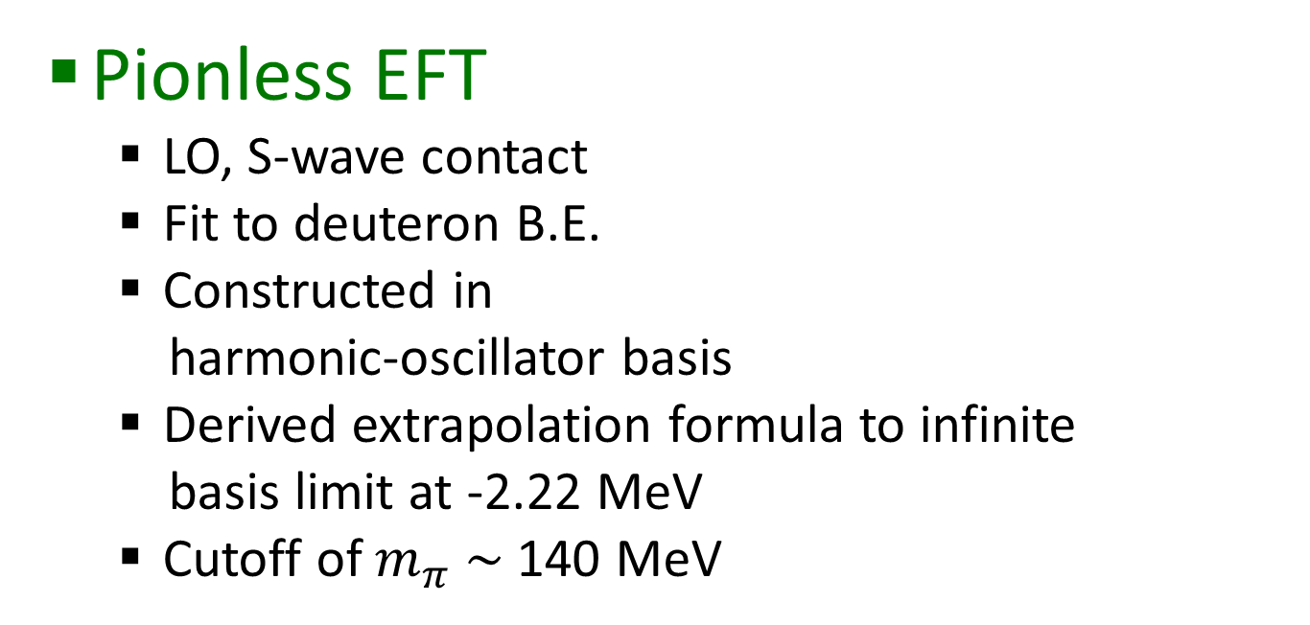
Deuteron (the H₂ NP)
Chiral EFT
Pionless EFT
  LO, S-wave contact
  Fit to deuteron B.E.
  Constructed in
  harmonic-oscillator basis
  Derived extrapolation formula to infinite
  basis limit at -2.22 MeV
  Cutoff of $m_{π} \sim$140 MeV
V
APS/Alan Stonebraker
$$H_{2}= \left[\begin{matrix}−1.677 & 2.339 \\ 2.339 & 22.242\end{matrix}\right]=\sum{h_{pq}a_{p}^{†}a_{q}}$$
arXiv:1712.10246
Notes:
Log(ft) of all known nuclei (histogram). Sn100 has the smallest log(ft) value and the largest GT matrix element (inversely proportional to E1A^2).
The Gamow–Teller strength is inversely proportional to ft and thus is greatest for the 100Sn decay establishing the robustness of N 5 Z 5 50 shell closures
Sb – Antimony
Te – Tellurium
In – Indium
The Sn-Sb-Te cycle prevents the synthesis of elements heavier than Te and has important
consequences for x-ray burst profiles,

Slide 5
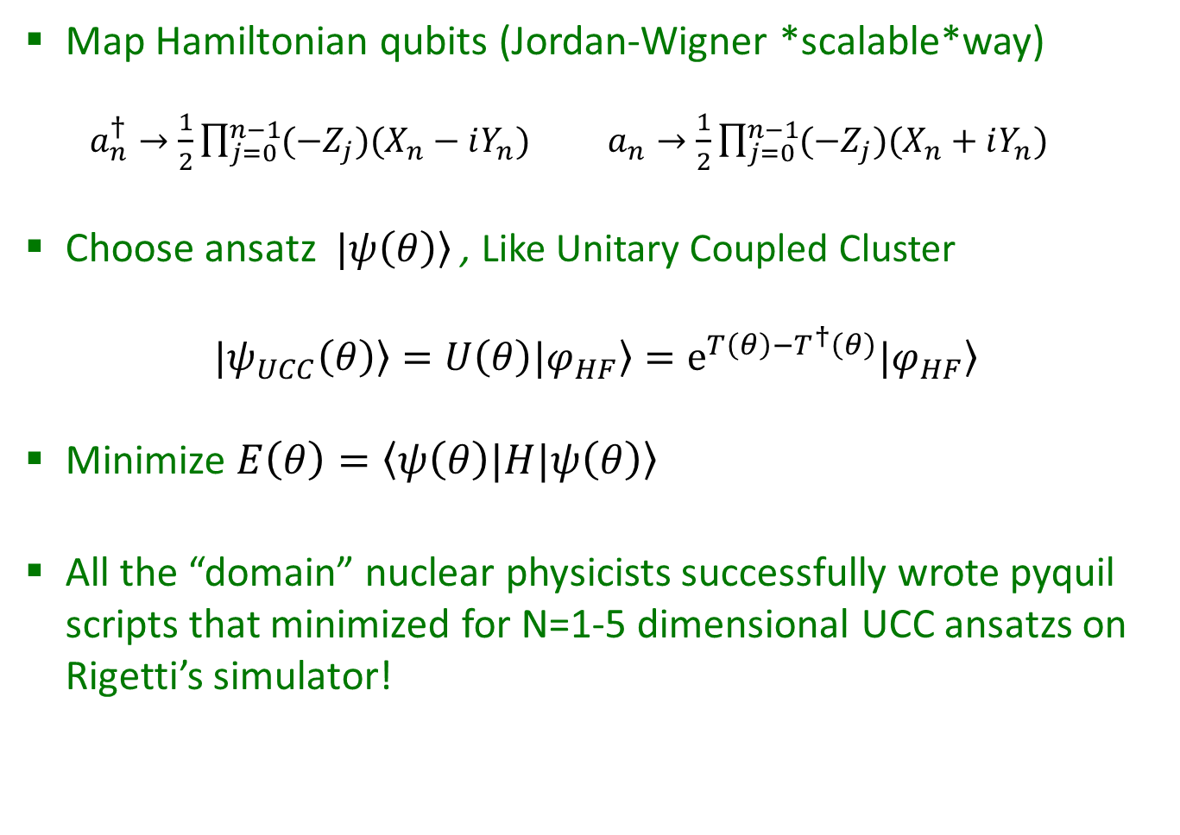
Variational Quantum Eigensolver
Map Hamiltonian qubits (Jordan-Wigner *scalable*way)
  $a_{n}^{†}→\frac{1}{2}\prod_{j=0}^{n−1}{(−Z_{j})(X_{n}−iY_{n})}$ $a_{n}→\frac{1}{2}\prod_{j=0}^{n−1}{(−Z_{j})(X_{n}+iY_{n})}$
Choose ansatz $\left.|ψ\left(θ\right)\right\rangle$ , Like Unitary Coupled Cluster
$$\left.|ψ_{UCC}\left(θ\right)\right\rangle =U\left(θ\right)\left.|φ_{HF}\right\rangle =e^{T\left(θ\right)−T^{†}\left(θ\right)}\left.|φ_{HF}\right\rangle$$
Minimize $\left.E\left(θ\right)=\left\langle ψ\left(θ\right)|\right.H|ψ\left(θ\right)\right\rangle$
All the “domain” nuclear physicists successfully wrote pyquil scripts that minimized for N=1-5 dimensional UCC ansatzs on Rigetti’s simulator!
Notes:
Log(ft) of all known nuclei (histogram). Sn100 has the smallest log(ft) value and the largest GT matrix element (inversely proportional to E1A^2).
The Gamow–Teller strength is inversely proportional to ft and thus is greatest for the 100Sn decay establishing the robustness of N 5 Z 5 50 shell closures
Sb – Antimony
Te – Tellurium
In – Indium
The Sn-Sb-Te cycle prevents the synthesis of elements heavier than Te and has important
consequences for x-ray burst profiles,

Slide 6
The Quantum Information Science Group supports research and development in a variety of quantum technologies
Sub-radiant
Super-radiant
Optical Pumping
Quantum Sensing
Quantum Computing
Quantum Communication
Compressive Quantum Imaging
Quantum Plasmonic Sensors
Ultra-sensitive MEMS Displacement
Standoff Spectroscopy
Opto-mechanical Force Microscopy
Circuit Model Simulations
Analog Digital Quantum Simulations
Physical Qubits Modeling
Quantum Characterization, Verification and Validation
Quantum Networks
Quantum Key Distribution
Quantum Secret Sharing
Quantum Random Number Generators
More information:
https://www.ornl.gov/division/csed/quantum-information
Contact: gricew@ornl.gov
Pathfinder Testbed FY 2016-2018 (PI – R. Pooser)
Quantum Algorithms FY 2016-2018 ( PI - P. Lougovski)
+A.J. McCaskey + E.D. Dumitrescu
Kickoff Meeting October 2017

Slide 7
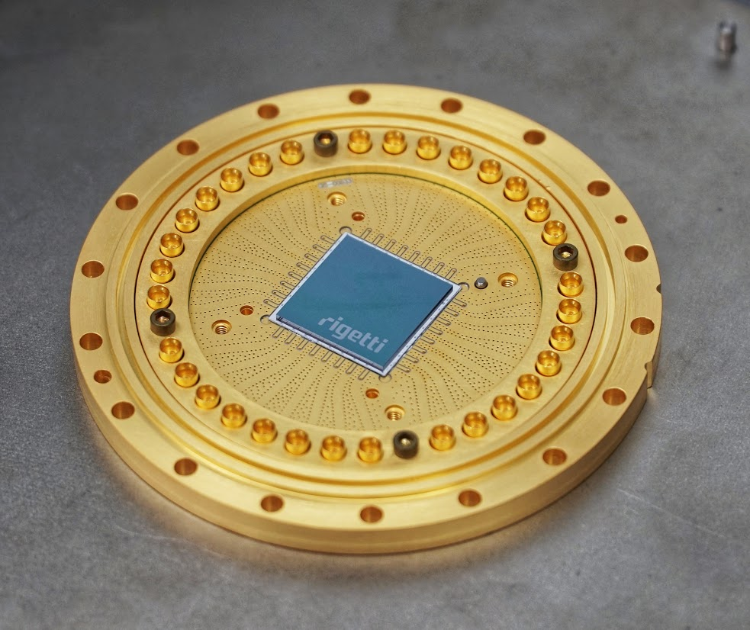
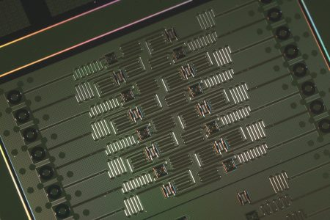
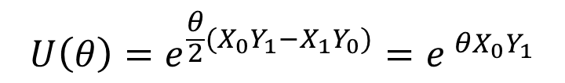
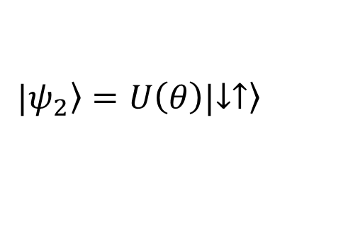
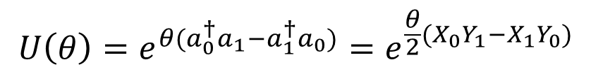
VQE Deuteron
IBM QX5, and Rigetti Q19 via cloud access
Unitary coupled cluster ansatz 2x2
  few percent error ~ 8000 shots
With some manipulation, we can show
$$U\left(θ\right)=e^{θ(a_{0}^{†}a_{1}−a_{1}^{†}a_{0})}=e^{\frac{θ}{2}(X_{0}Y_{1}−X_{1}Y_{0})}$$
$$|\left.ψ_{2}\right\rangle =U\left(θ\right)|\left.↓↑\right\rangle$$
$$U\left(θ\right)=e^{\frac{θ}{2}(X_{0}Y_{1}−X_{1}Y_{0})}=e^{ θX_{0}Y_{1}}$$
10.1103/PhysRevLett.120.210501
Notes:
Log(ft) of all known nuclei (histogram). Sn100 has the smallest log(ft) value and the largest GT matrix element (inversely proportional to E1A^2).
The Gamow–Teller strength is inversely proportional to ft and thus is greatest for the 100Sn decay establishing the robustness of N 5 Z 5 50 shell closures
Sb – Antimony
Te – Tellurium
In – Indium
The Sn-Sb-Te cycle prevents the synthesis of elements heavier than Te and has important
consequences for x-ray burst profiles,

Slide 8
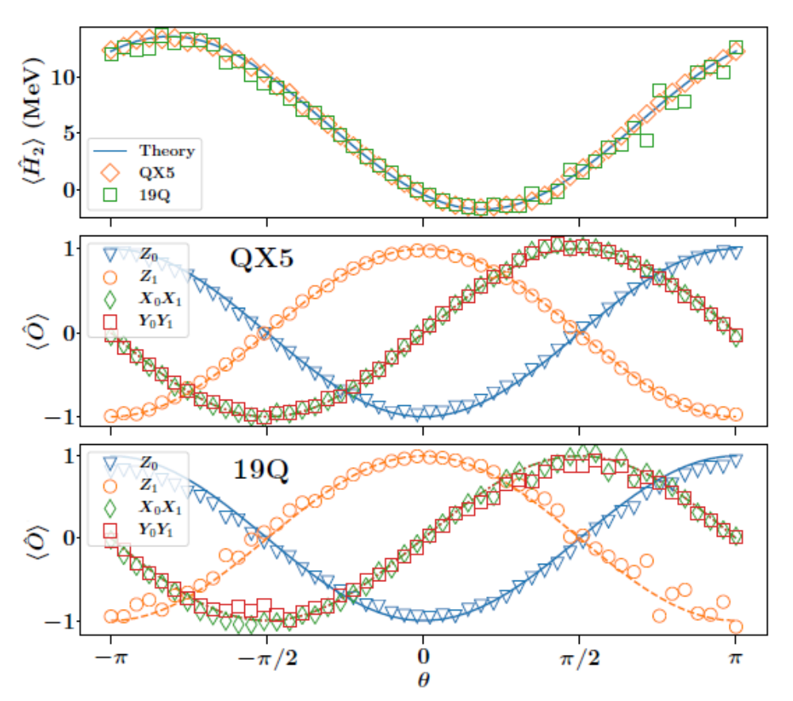
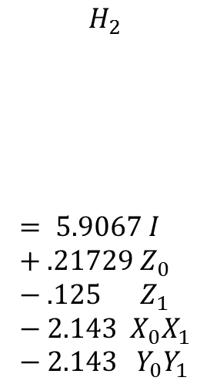
VQE Deuteron
$$H_{2}$$
$$= 5.9067 I+.21729{ Z}_{0}−.125{ Z}_{1}−2.143{ X}_{0}X_{1}−2.143 Y_{0}Y_{1}$$
10.1103/PhysRevLett.120.210501
Notes:
Log(ft) of all known nuclei (histogram). Sn100 has the smallest log(ft) value and the largest GT matrix element (inversely proportional to E1A^2).
The Gamow–Teller strength is inversely proportional to ft and thus is greatest for the 100Sn decay establishing the robustness of N 5 Z 5 50 shell closures
Sb – Antimony
Te – Tellurium
In – Indium
The Sn-Sb-Te cycle prevents the synthesis of elements heavier than Te and has important
consequences for x-ray burst profiles,

Slide 9
VQE Deuteron 3x3
CNOT minimized unitary coupled cluster ansatz 3x3
  40 percent error, -1.2 vs -2.046 MeV
Too many noise inducing CNOT gates
Must practice error mitigation
  Use a two-qubit gate “white noise” model
  Ling (2017) doi.org/10.1103/PhysRevX.7.021050
  Error scales linearly in number of CNOT gates, “boost” error by adding noisy identities (CNOT twice)
10.1103/PhysRevLett.120.210501
Notes:
Log(ft) of all known nuclei (histogram). Sn100 has the smallest log(ft) value and the largest GT matrix element (inversely proportional to E1A^2).
The Gamow–Teller strength is inversely proportional to ft and thus is greatest for the 100Sn decay establishing the robustness of N 5 Z 5 50 shell closures
Sb – Antimony
Te – Tellurium
In – Indium
The Sn-Sb-Te cycle prevents the synthesis of elements heavier than Te and has important
consequences for x-ray burst profiles,

Slide 10
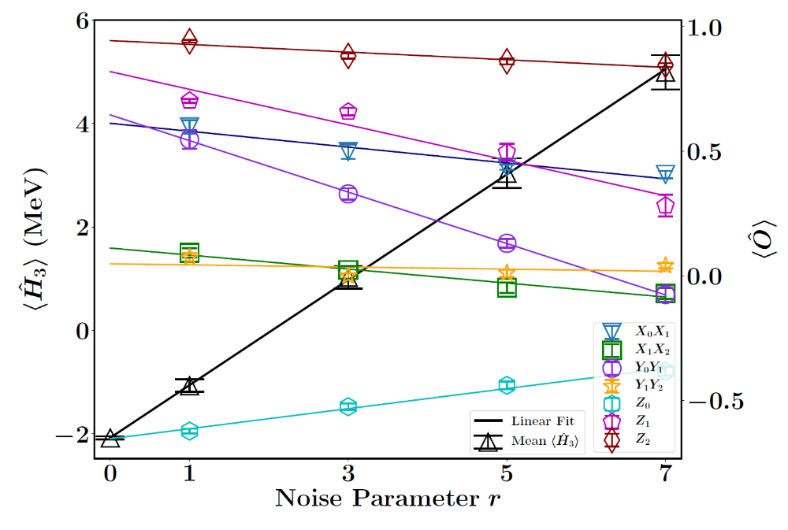
Error Mitigation
10.1103/PhysRevLett.120.210501
Notes:
Log(ft) of all known nuclei (histogram). Sn100 has the smallest log(ft) value and the largest GT matrix element (inversely proportional to E1A^2).
The Gamow–Teller strength is inversely proportional to ft and thus is greatest for the 100Sn decay establishing the robustness of N 5 Z 5 50 shell closures
Sb – Antimony
Te – Tellurium
In – Indium
The Sn-Sb-Te cycle prevents the synthesis of elements heavier than Te and has important
consequences for x-ray burst profiles,

Slide 11
Basis Extrapolation
Exact infinite limit -2.22 MeV
10.1103/PhysRevLett.120.210501
Notes:
Log(ft) of all known nuclei (histogram). Sn100 has the smallest log(ft) value and the largest GT matrix element (inversely proportional to E1A^2).
The Gamow–Teller strength is inversely proportional to ft and thus is greatest for the 100Sn decay establishing the robustness of N 5 Z 5 50 shell closures
Sb – Antimony
Te – Tellurium
In – Indium
The Sn-Sb-Te cycle prevents the synthesis of elements heavier than Te and has important
consequences for x-ray burst profiles,

Slide 12
Summary/Outlook
Simplified deuteron treated in *scalable* way
  Gate depth
  Error Mitigation
  Acceptable Error
  ORNL QIS group was invaluable
Treating ⁴He, ³He, ³H
  Using same pionless EFT, much larger dimension
  Currently simulating on analogue machine
  New algorithm allows optimization of ~70 parameters in ~40 function evaluations
⁴He, ⁸He in second quantized fashion
Notes:
Log(ft) of all known nuclei (histogram). Sn100 has the smallest log(ft) value and the largest GT matrix element (inversely proportional to E1A^2).
The Gamow–Teller strength is inversely proportional to ft and thus is greatest for the 100Sn decay establishing the robustness of N 5 Z 5 50 shell closures
Sb – Antimony
Te – Tellurium
In – Indium
The Sn-Sb-Te cycle prevents the synthesis of elements heavier than Te and has important
consequences for x-ray burst profiles,

Slide 13
Collaborators
Oak Ridge/UTK
  Gaute Hagen
  Thomas Papenbrock
  Gustav Jansen
  David Dean
  Pavel Lougovski
  Eugene Dumitrescu
  Alex McCaskey
  Raphael Pooser
Notes:
13

Slide 14

Questions?

