Slide 1
TRIUMF e-Linac RF Issues ERW2022
Yanyun Ma

Slide 2
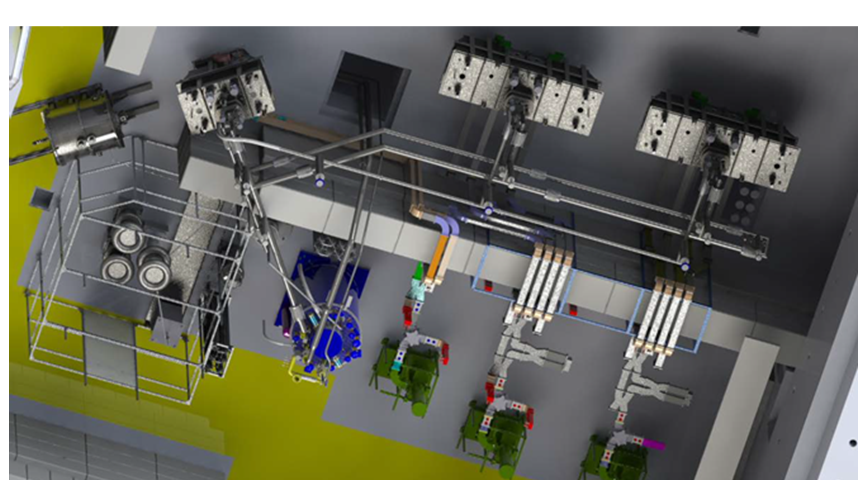
Outline
300kV RF modulated thermionic Gun
650MHz
SRF cryomodules performance
Field emission
RF stability
High power RF system
Klystron and Waveguide system
KPS
Discussion
In future

Slide 3
Outline
300kV RF modulated thermionic Gun
650MHz
SRF cryomodules performance
Field emission
RF stability
High power RF system
Klystron and Waveguide system
KPS
Discussion
In future

Slide 4
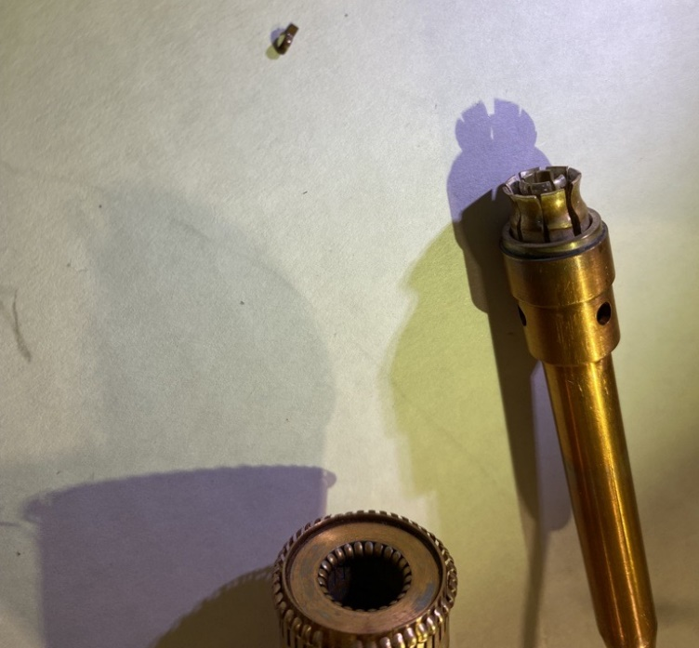
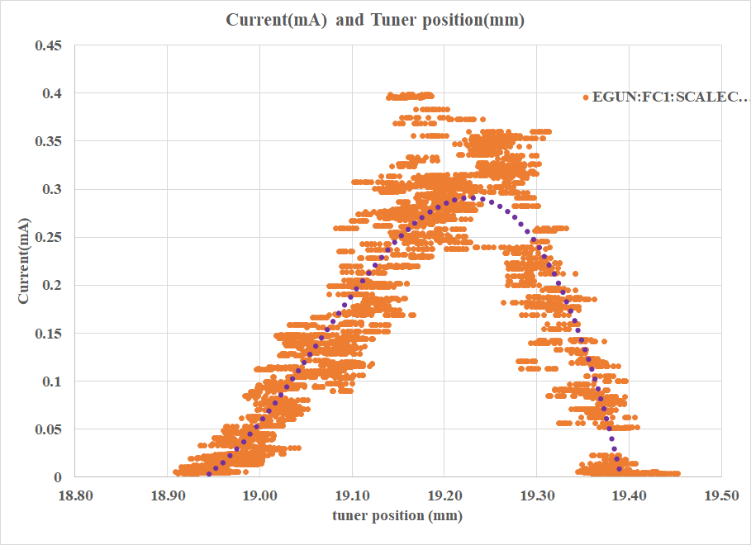
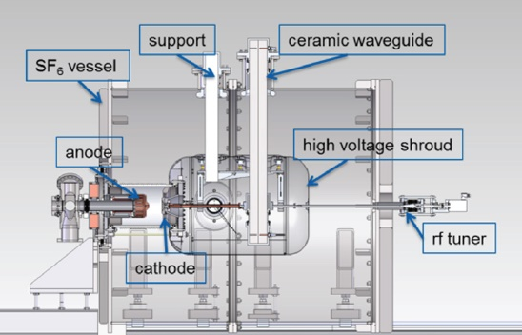
E-Gun
650MHz RF modulation bunches the beam at the grid
RF tuned by matching circuit
No feedback for RF regulation
The tuner works for pre-tuning only
Matching circuit
Position sensitivity is too high
Drive the tuner through 1m rod
The beam tuning range is only about 0.4mm
Beam current is too sensitive to position
Movable RF contact (fingerstock)
fragile
Notes:
TEL2341

Slide 5
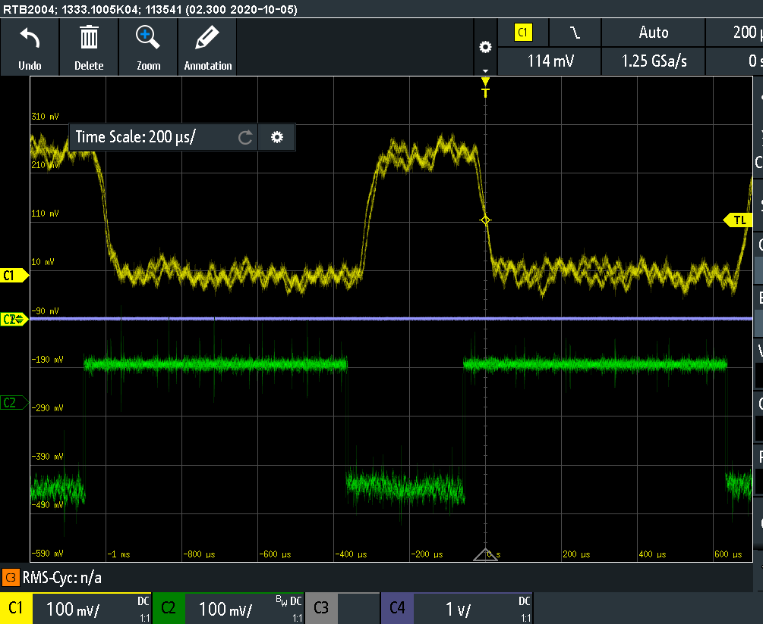
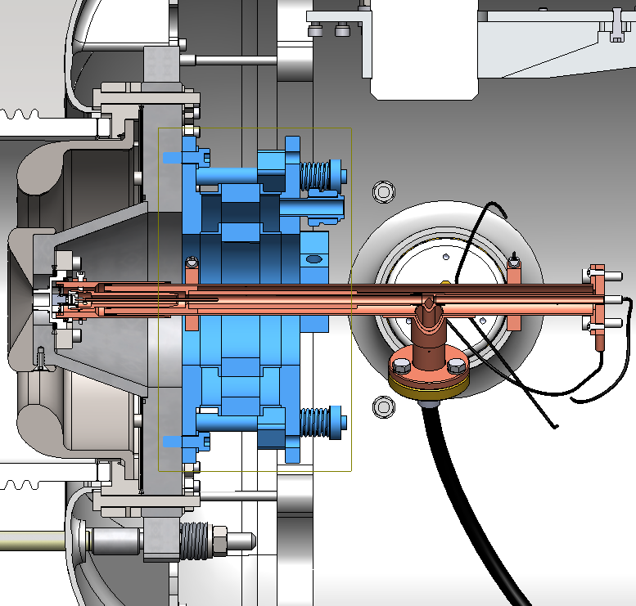
Proposal for e-gun tuner control
Proposal for e-gun tuner
DCCT
ACCT
A pneumatic tuner mechanism is proposed to improve tuning control.
The ACCT is just after E-gun.
The ACCT signal could be used for feedback control.

Slide 6
Outline
300kV RF modulated thermionic Gun
650MHz
SRF cryomodules performance
Field emission
RF stability
High power RF system
Klystron and Waveguide system
KPS
Discussion
In future

Slide 7
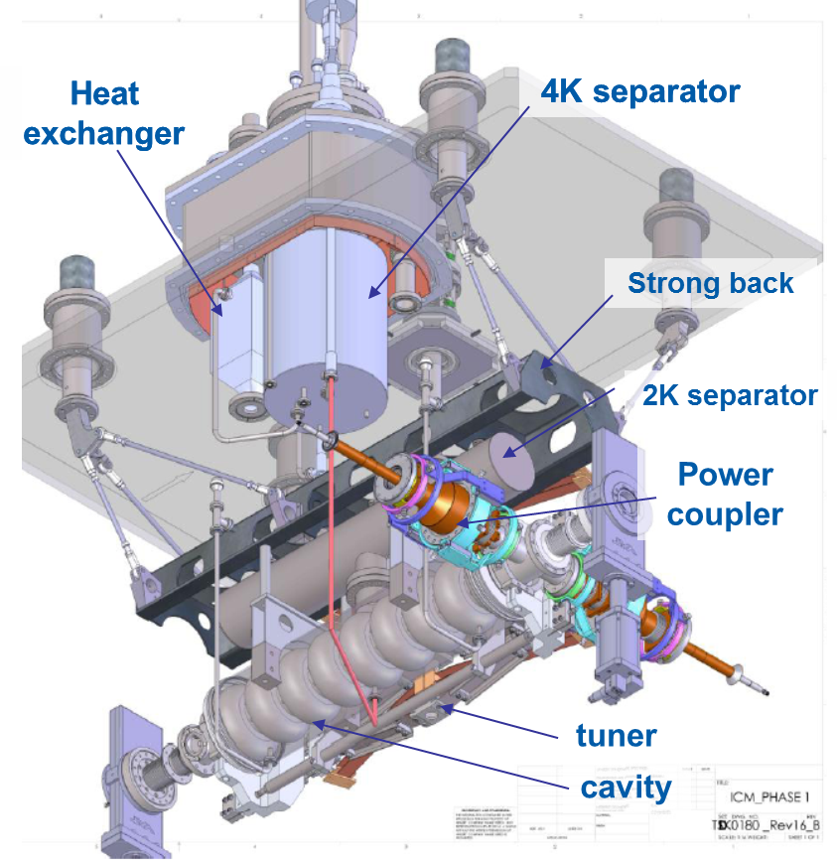
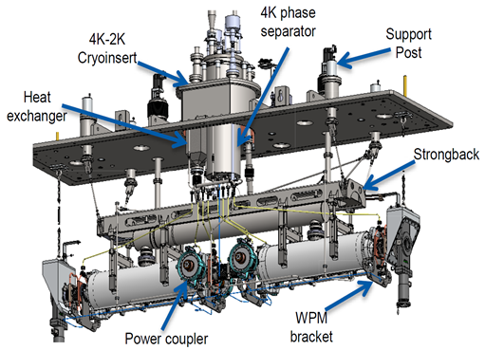
Cryomodules
Box cryomodule with a top-loading cold mass;
One/two nine-cell 1.3GHz cavity
Two/four 50kW power couplers
HOM coaxial dampers
4K/2K heat exchanger unit with JT valve on board;
Scissor tuner with warm motor;
LN₂ cooled thermal shield;
4K intercepts cooled by syphon circuit from 4K tank;
2 layers mu-metal shield
WPM alignment system
ICM 2K static load is 5.0W
ACM1 2K static load is 10.9W

Slide 8
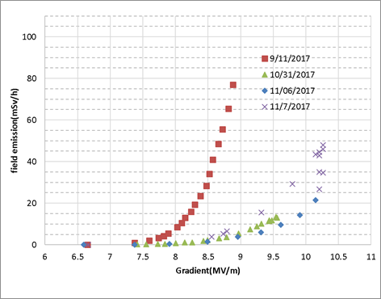
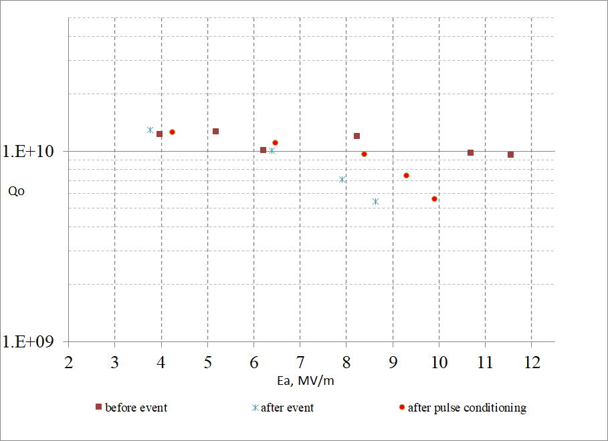
EINJ field emission and pulse conditioning
Could not run @ 10MV/m
Could run @ 10MV/m with strong x-ray after pulse conditioning
EINJ Q₀ deterioration due to operational mistake during venting and pumping
Vented EINJ RF space in 15 minutes in 2016.
10 Torr pressure step during pumping in 2017
a pressure step between 716Torr to 708Torr (cavity was lower side).
Notes:
We have to move einj offline for Vecc cryomodule(ICM2) commissioning

Slide 9
EINJ field emission and pulse conditioning
Continue pulse conditioning
During pulse conditioning, we use a beam loss monitor to measure the x-ray
Run CW after pulse conditioning to check the progress
Moderate pulse conditioning
11MV/m~ 13MV/m 15ms~20ms LLRF self-excited pulse, 1~10Hz
High gradient pulse conditioning
Signal generator, 3ms, up to 16~16.3MV/m
sometimes it becomes worse
Moderate pulse conditioning is more efficient
10MV/m
Stuck and hard to improve
Notes:
Continue pulse conditioning

Slide 10
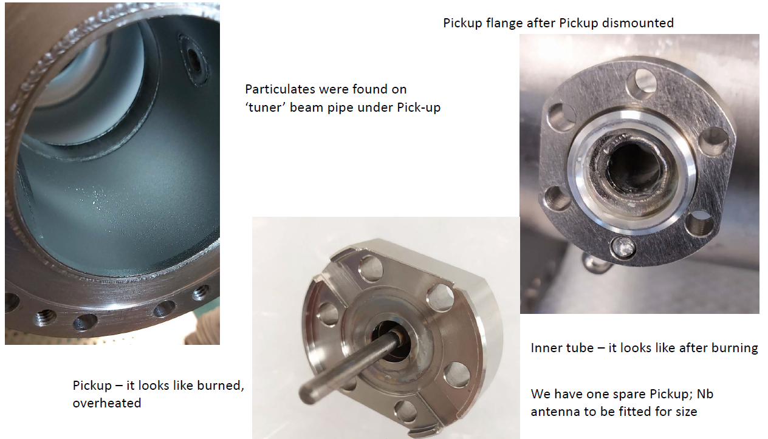
Refurbish EINJ during 2020-2021 shutdown
Field emission controlled by high power pulse conditioning
Improved after conditioning
Strong field emission at 10MV/m
Refurbished the EINJ cavity in clean room and restored the performance
We found the pickup antenna and flange burned
Might be burned by field emission electrons

Slide 11
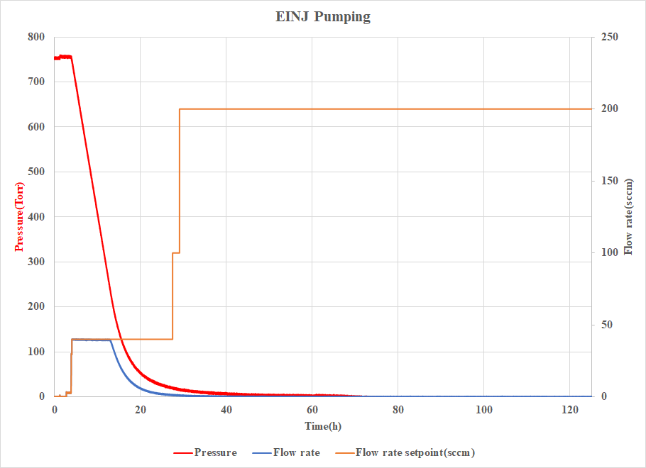
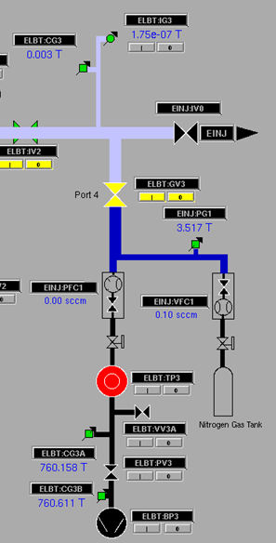
Slow venting and Pumping
During the 2020-2021 shutdown, we installed a venting/pumping system on CMs
control pressure changing rate through MFC(mass flow controller);
A new PG has been installed to monitor the pressure.
Venting takes 7 hours for EINJ
With Max. 120 sccm(standard cubic centimeter per minute) flow rate
Slow pumped EINJ 5 days(3 days+ weekends) – too slow
Need a bigger MFC for pumping line or a bypass pumping line

Slide 12
EACA 1st cavity Q₀ deterioration during warming up /cooldown
After 2018 cooldown, 1st CAV Q₀ was about 6e9@10MV/m
Moderate pulse conditioning, push Q₀ to 9.4e9@10MV/m
After 2020 cooldown, 1st CAV Q₀ was 4e9@10MV/m
was pushed to 8.6e9@10MV/m and 7.27e9@11MV/m.
Quench at 14.57MV/m with 3ms pulse and Q₀ drop to 5.2e9@10MV/m
After moderate pulse conditioning and CW operation, Q₀ recovered to 8e9@10MV/m
During day-to-day 20MV CW operation, EACA vacuum kept improving from 1e-9Torr to 5e-10Torr
Notes:
20200824data

Slide 13
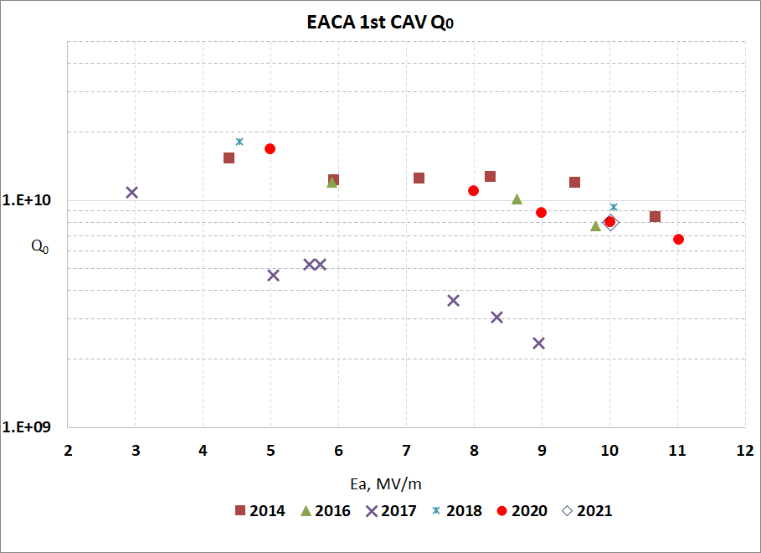
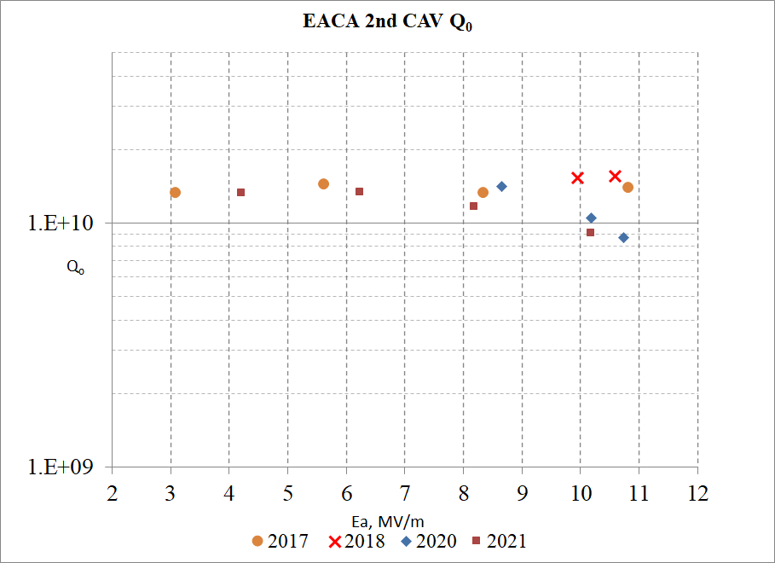
EACA Cavities performance by year
Reprocessed EACA in 2018
Both of EACA cavities show Q₀ deterioration with time
extra cryogenic load and x-ray limit the gradient

Slide 14
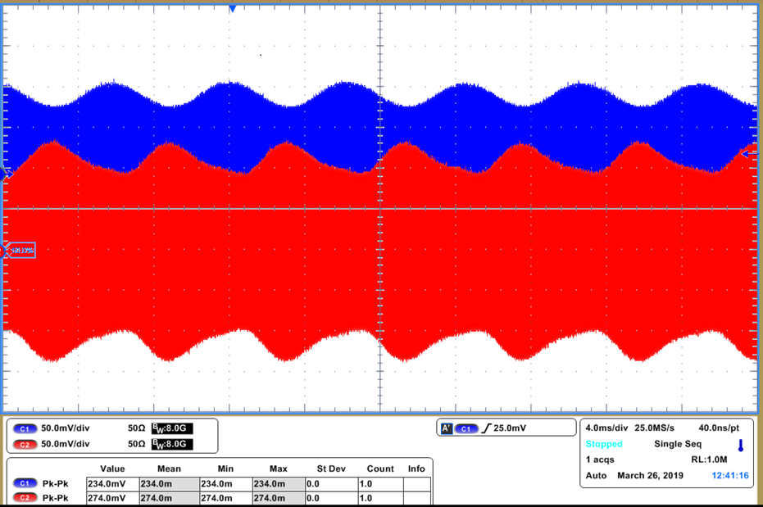
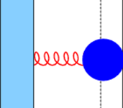
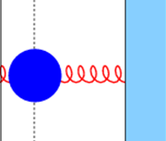
EACA RF Stability
EACA cavities are driven by a single klystron in Vector Sum
Under certain conditions, individual cavity voltages can oscillate in counterphase causing an instability in the beam energy
The instability is driven by coupling between cavity mechanical vibrations and `the Lorentz force
Mitigation: 1. reduce microphonics 2. appropriate choice of detuning parameters
Cavity 1
Cavity 2
Tuner Loop 1
ϕ_{C1}~0
ϕ_{C2}~0
Tuner Loop 2
Power Divider
Amp
ϕ_{A}
Att
V1
Vector Sum
V_{sum}
V2
V₁
V₂
LLRF compensation and mitigation of two cavity instability. Ramona LEEWE ,TTC2019,Vancouver

Slide 15
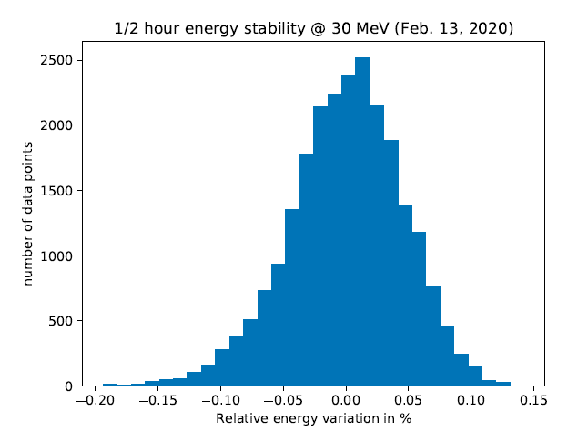
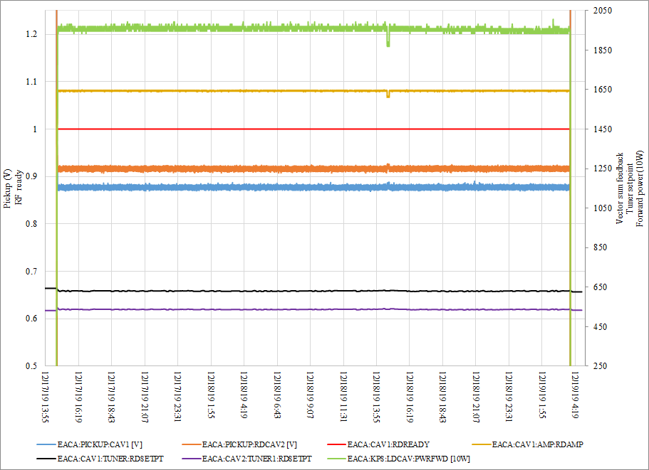
Beam energy Stability without beam loading
RF stability demonstration
After Microphonics suppression, Piezo installation and LLRF watchdog upgrade, we could run EACA smoothly
Relative fluctuation of the beam energy measured at a dispersive location over a period of time of > 30 min. FWHM= 0.09%.
37 hours of uninterrupted operation of EACA at 20MV vector sum

Slide 16
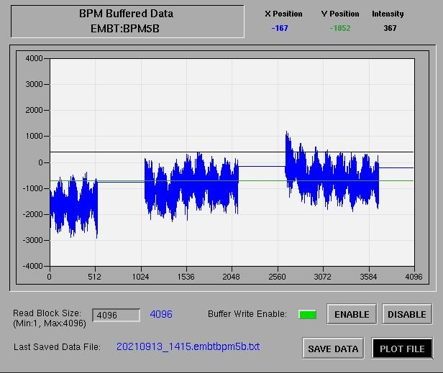
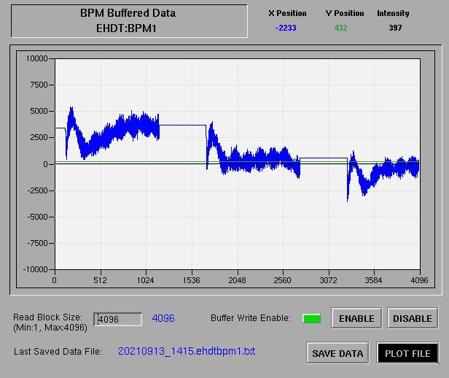
30MeV/ 10kW
Pulse profile after EINJ
Pulse profile on EHD dump
Adaptive feed-forward (ILC-- Iterative Learning Feedforward Controller) compensation when running in pulsed mode
There are energy fluctuations in a single pulse (microphonics?) and between pulses (current stability?)
The beam energy stability is 0.4%

Slide 17
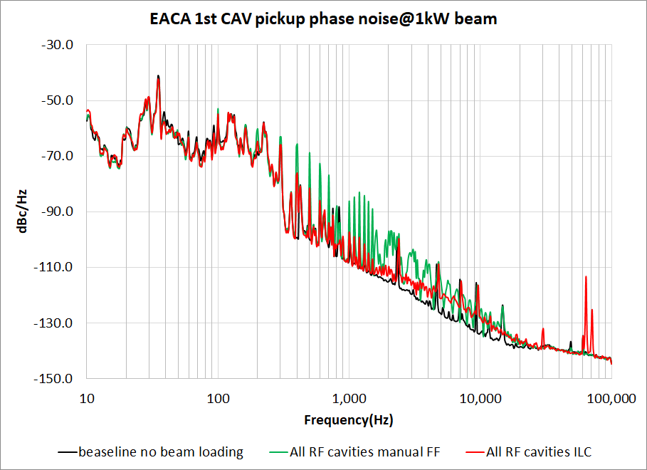
EACA 20MV vector sum
100Hz harmonics
Manual FF has stronger harmonics
ILC could suppress the harmonics
Need to study the correlation between the beam loading and feed forward compensation
Notes:
20210120 data

Slide 18
Outline
300kV RF modulated thermionic Gun
650MHz
SRF cryomodules performance
Field emission
RF stability
High power RF system
Klystron and Waveguide system
KPS
Discussion
In future

Slide 19
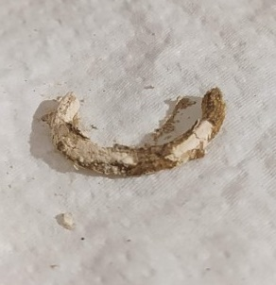
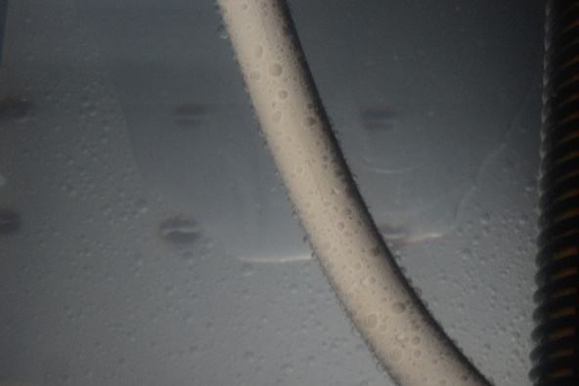
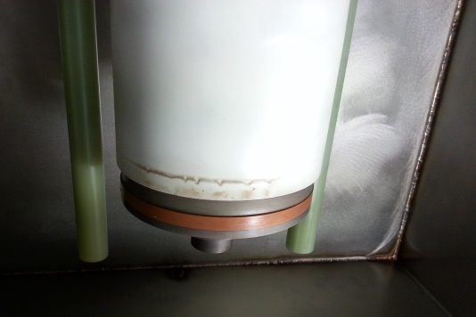
Klystron
Klystron and waveguide distribution system
CPI VKL 7967A
1.3 GHz, 300 kW, CW Klystron with 58% efficiency, 6 MHz bandwidth.
During operation, we had few water related problem
Flow meter failure
Klystron RF window cooling channel clogged
The channel section is 1mm*1inch
Found some rubber seal materials
Water contaminated the high voltage isolation oil
Huge Water leak in collector cooling circuit (INLET) of Klystron 1; rubber gasket is broken due to high pressure of hot water from pump.
The water went to oil tank through the gaps
The Klystron isolation ceramic burn during HV test
Replaced the oil, seal the gaps and protect klystron with plastic film

Slide 20
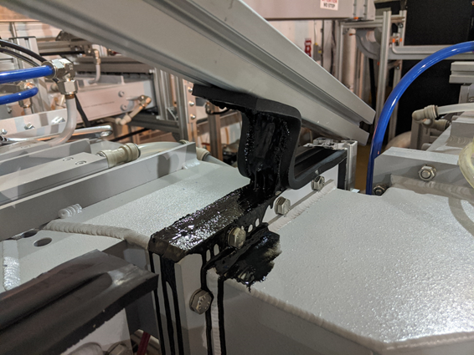
Waveguide distribution system
Waveguide Damper material melt (Polyurethane)
Applied too much stress on waveguides during damper installation;
The alignment changed, and there was an RF leak on the power divider flange
The temperature was up to 100C with about 19kW RF power
The damper melted and went into the waveguide
removed the damper and cleaned the flanges.
Re-aligned the waveguides.
Few water leaks event for phase shifter, power divider
Klystron Power Supply (KPS )
3/96 high voltage modules failure
two of them broken during a campus power bump
Maintenance on filament power supply, magnet power supply, flow meter, fan controller, etc.,
Connect 12.5kV AC to KPS causes a power fluctuation (Electromagnetic Compatibility)
It happens at ‘standby’ stage, the high voltage is still off
Trip Cyclotron magnet power supplies
Contactor failure on high voltage modules
Upgrade the module FPGA code

Slide 21
Discussion
A new E-gun RF matching circuit tuner is under development and we plan to add feedback control with an ACCT signal.
SRF cryomodules had been refurbished in the last few years.
The cavities show Q0 deterioration with time
Causes extra cryogenic load and x-ray.
Slow venting and pumping system has been implanted.
We use 11~13MV/m moderate pulse conditioning to reduce field emission.
Periodic Helium conditioning might be helpful( procedure? And parameters?)
The beam energy stability in pulsed mode is 0.4%
This should improve after better beam intensity control

Slide 23
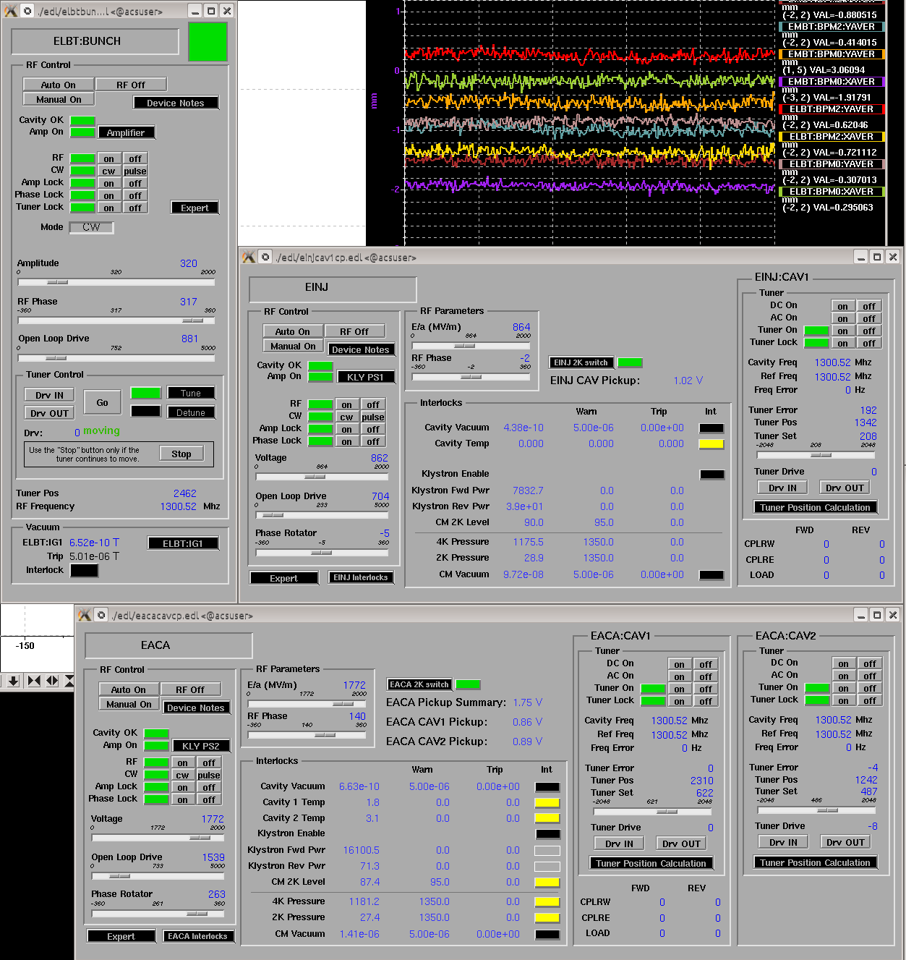
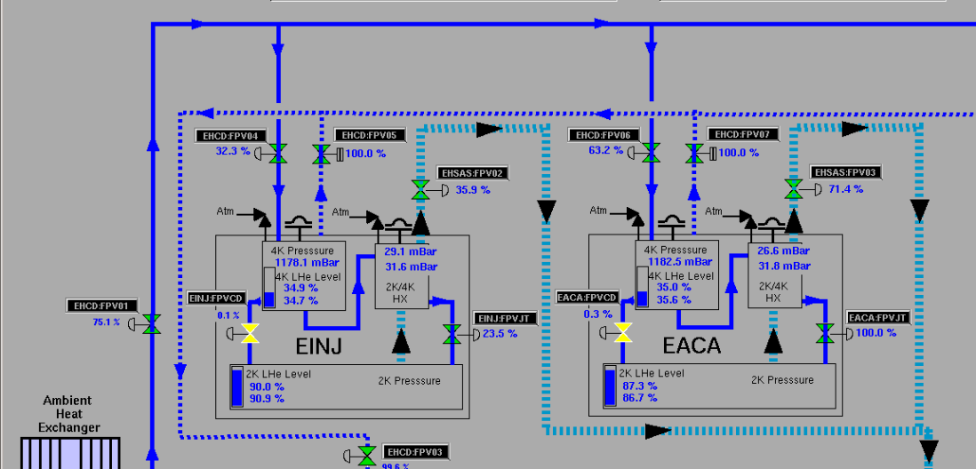
31MeV Beam to EHD
EINJ--- was 8.5MeV(after refurbish EINJ could output 10MeV beam)
EACA---22.5MeV
EINJ was limited by strong x-ray and EACA JT valve fully open

Slide 24
Pulse conditioning for VECC cryomodule
During ICM2 commissioning, we used 11~12MV/m, 5~15ms, 1~10Hz pulse conditioned cavity
1-week moderate pulse conditioning
VECC cryomodule is a twin sister of EINJ

