Slide 1
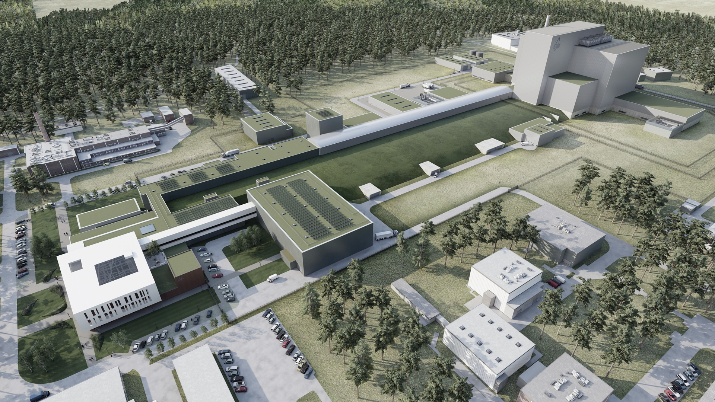

MYRRHA
Accelerator Driven Systems; the path towards sustainable Nuclear Energy
Hamid AÏT ABDERRAHIM
DDG SCK CEN, Director of MYRRHA
SCK CEN, Boeretang 200, B-2400 Mol, Belgium
haitabde@sckcen.be or myrrha@sckcen.be
TRIUMF Science Week 2022, July 18-22, 2022, Vancouver (BC), Canada

Slide 2
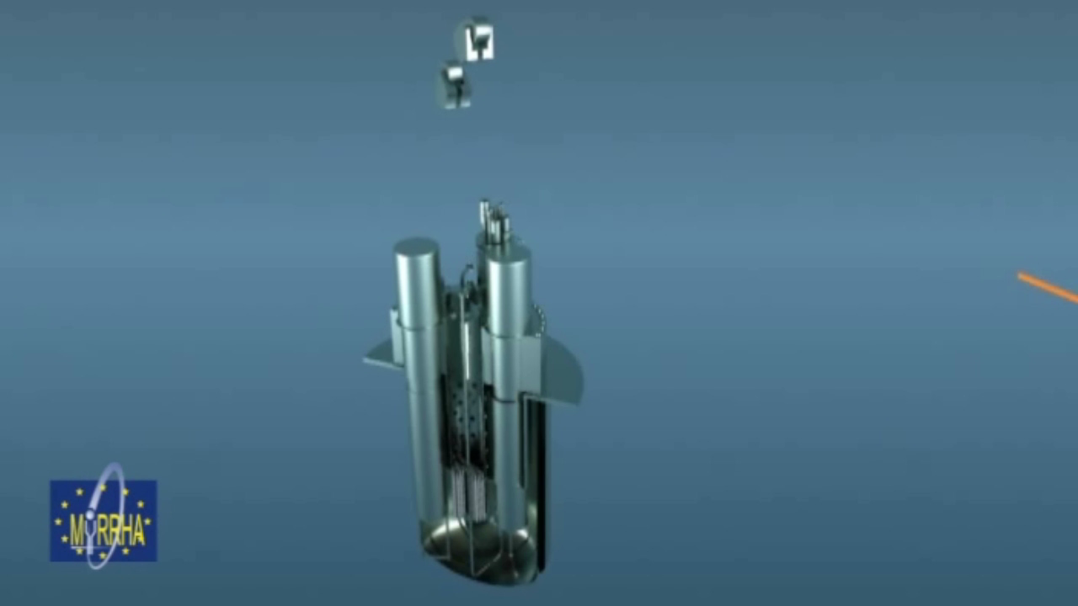
Accelerator Driven System: intrinsic safety
To keep the reactor operating we need CW proton beam with very high reliability
Notes:
video vertragen

Slide 3
Fission generates high level radioactive waste
Fuel
^{FP}
U²³⁵
U²³⁵
n
Minor Actinides
Actinides
n
Uranium
Fission
n
U²³⁸
Pu
Np
Am
Cm
Neutron
U²³⁸
n
^{Plutonium}
^{Neptunium}
^{Americium}
^{Curium}
^{FP}
1 ton of nuclear fuel used 4,5 year in commercial PWR reactor produces electricity for 100,000 Belgian families per year (3500 kWh/y per family)
After 4,5 years the spent nuclear fuel contains:
  94,7% of resources we can recycle (U+Pu)
  5,1% of nuclear waste with low radiotoxicity (FP’s)
  0,2% of high radiotoxicity nuclear waste
➔
Source: SCK•CEN MYRRHA Project Team

Slide 4
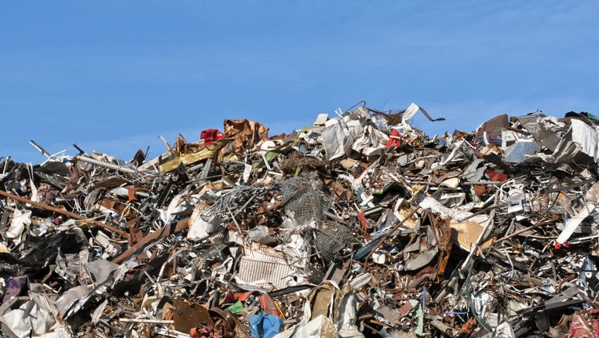
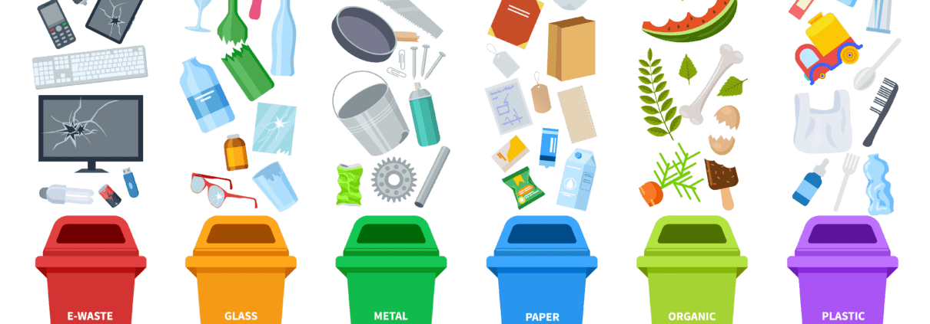
Partitioning & Transmutation
vs
Just like for classical household waste we need sorting and then valorizing through recycling
Partitioning
  Separate the ingredients of the spent fuel in “similar” categories we can treat in a similar way
Transmutation
  Use intense neutron field to transmute isotopes into others, less “nasty” and producing energy (circular economy)

Slide 5
Possible Fuel Cycles for High Level Waste treatment
1- Once Through
No Reprocessing
1 ton UO₂ used fuel (50 GWd/t)
93,5 % U
1,2 % Pu
0,2 % MAs
Vitrified with FPs
(in 2)
Transmuted is ADS
(in 3)
~5,1 % FPs
Spent fuel considered as HLW to go in Geological Disposal
Presently adopted in USA, SE, FIN
Decision for industrial Geol. Disp. construction taken in SE & FIN not yet in USA
Radiotoxicity of HLW for more than 300,000 y
Industrial scale

Slide 6
Possible Fuel Cycles for High Level Waste treatment
1- Once Through
No Reprocessing
2- Todays Recycling
PUREX
1 ton UO₂ used fuel (50 GWd/t)
93,5 % U
1,2 % Pu
0,2 % MAs
Vitrified with FPs
(in 2)
~5,1 % FPs
All 1 ton spent fuel considered as HLW to go in Geological Disposal
Presently adopted in USA, SE, FIN
Decision for industrial Geol. Disp. construction taken in SE & FIN not yet in USA
Burden of HLW for more than 300,000 y
U + Pu recycled in PWRs or BWRs
No recycling of MOX fuels
FPs + MAs vitrified and to go to Geolo. Disp.
Presently adopted in FR, JP, …
No formal decision for industrial Geol. Disp. yet
Radiotoxicity of HLW for more than 10,000 y
Industrial scale
Industrial scale

Slide 7
Possible Fuel Cycles for High Level Waste treatment
1- Once Through
No Reprocessing
2- Todays Recycling
PUREX
3- Advanced Recycling (P&T)
1 ton UO₂ used fuel (50 GWd/t)
93,5 % U
1,2 % Pu
0,2 % MAs
Vitrified with FPs
(in 2)
Transmuted is ADS
(in 3)
~5,1 % FPs
All 1 ton spent fuel considered as HLW to go in Geological Disposal
Presently adopted in USA, SE, FIN
Decision for industrial Geol. Disp. construction taken in SE & FIN not yet in USA
Burden of HLW for more than 300,000 y
U + Pu recycled in PWRs or BWRs
No recycling of MOX fuels
FPs + MAs vitrified and to go to Geolo. Disp.
Presently adopted in FR, JP, …
No formal decision for industrial Geol. Disp. yet
Burden of HLW for more than 10,000 y
U + Pu recycled in PWR or FR
MAs in ADS
MA are turned in FPs to go to Geolo. Disp. In specific packaging
Presently R&D programme (FR, JP, BE, DE, EU, CN, ROK, USA)
Radiotoxicity of HLW for ~300 y
Industrial scale
Industrial scale
R&D level

Slide 8
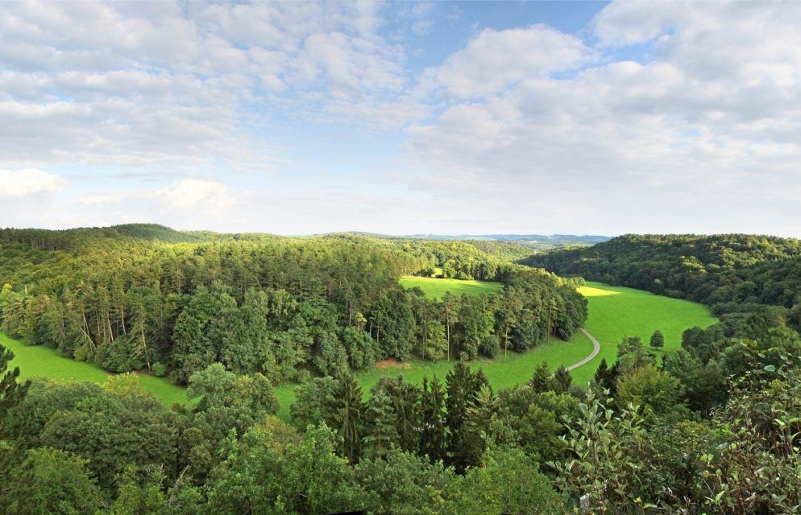


Advance Recycling (P&T)
Todays Recycling
PUREX
Once through
no reprocessing
Spent
Nuclear
Fuel
1000
Radiotoxicity
300 years
+10,000 years
+300,000 years
Natural Uranium
1

Slide 9

European Strategy for P&T (2005) with objective of possible industrialisation from 2040
EU P&T Strategy 2005: “The implementation of P&T of a large part of the high-level nuclear wastes in Europe needs the demonstration of its feasibility at an “engineering” level. The respective R&D activities could be arranged in four “building blocks”:
P&T building blocks |  | Description | Name & Location
 | Partitioning | Demonstrate capability to process a sizable amount of spent fuel from commercial Light Water Reactors to separate plutonium, uranium and minor actinides | Atalante (FR)
 | Fuel production | Demonstrate the capability to fabricate at a semi-industrial level the dedicated fuel needed to load in a dedicated transmuter | JRC-ITU (EU)
 | Transmutation | Design and construct one or more dedicated transmuters | MYRRHA (BE) ASTRID (FR)
 | MA Fuel Partitioning | Specific installation to process fuel unloaded from transmuter Not necessarily the same as type to process original spent fuel unloaded from commercial power plants
1
2
3
4
The European Commission contributes to the 4 building blocks and fosters the national programmes towards this strategy for demonstration at engineering level.
Source: European Commission Strategy Paper on Partitioning & Transmutation (2005)

Slide 10
Technology Readiness Level (TRL)
Advanced partitioning = “sorting of the waste” beyond classical PUREX
  TRL = 7 ~ 8
Fabrication of dedicated transmutation fuel (loaded with Minor Actinides)
  TRL = 3 ~ 4
Pre-Industrial sized transmuter demonstration (MYRRHA)
  TRL (FR = 9, ADS = 4 ~ 5 after building MYRRHA ➔ 9)
Advanced reprocessing of transmuter fuel (≠ from 1, Pyroreprocessing as the most promising)
TRL = 3
Advanced fuel technological aspects: transportation, cooling, and handling
TRL = 3 ~ 4
NSC Task Force on Demonstration of Fuel Cycle Closure including Partitioning and Transmutation (P&T) for Industrial Readiness by 2050 (TF-FCPT) with experts from Belgium, France, Japan, Russia, UK, US and EC

Slide 11
Three options for Minor Actinide (MA) transmutation
FR
heterogeneous
FR homogeneous
ADS
Driver fuel
Blanket with MA
Fuel with MA
Blanket
Fuel with MA
Core safety parameters limit the amount of MA that can be loaded in the critical core for transmutation, leading to transmutation rates of:
  FR = 2 to 4 kg/TWh
  ADS = 35 kg/TWh (based on a 400 MW_{th} EFIT design)
→ ADS performs the best

Slide 12
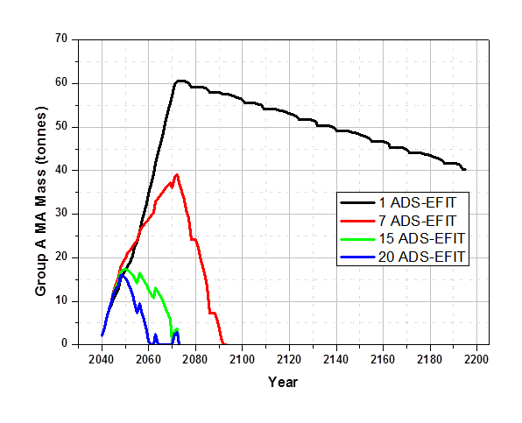
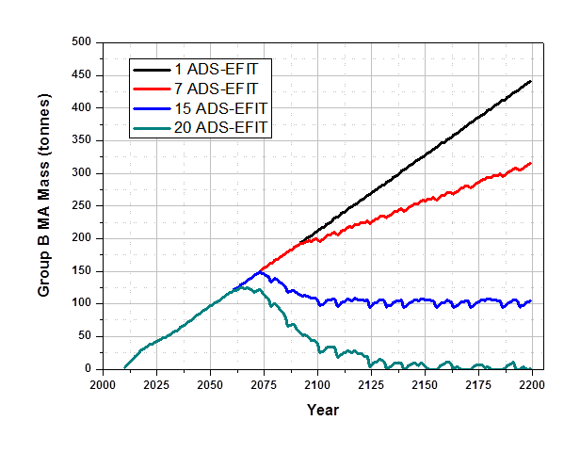
Shared & efficient solution for Minor Actinides management
EU case with 144 power reactors using EFIT 400 MWth
Europe should go for a regional approach (see PATEROS, ARCAS)
Countries with different nuclear energy policies to collaborate together
  Countries willing to continue Nuclear Energy
  Countries willing to develop fast reactor systems
  Countries in nuclear phase out, interested in Partitioning &Transmutation (P&T)
15 EFIT * 400 MWth = 6000 MWth
For all EU HLW treatment
Doel (BE) = 9000 MWth
Tihange (BE) = 9000 MWth
Gravelines (FR) = 17118 MWth
Zaporizhzhya (UA) = 18000 MWth
Bruce (CND) = 18702 MWth
Kashiwazaki-Kariwa = 23895 MWth
Source: [TBD]

Slide 13
Transport issues of MA-Fuels FR vs ADS
Transmutation in Fast Reactors
Large number of FRs needed
Many transport of MA-Fuels on the roads
Transmutation in ADS
Small units in small number ➔ Single site
Few or no transport of MA Fuel on the roads
FR
FR
FR
FR
FR
ADS
Reprocessing &
Fuel Fabrication
ADS
Reprocessing &
Fuel Fabrication
ADS
FR
ADS
FR
FR
no or limited “on-the-road” transport
FR

Slide 14
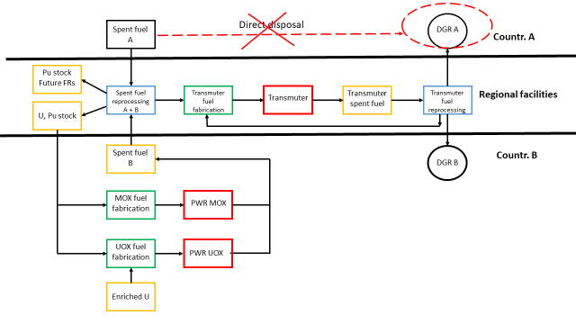
Even with completely different national NE policies
European solution for HLW works with ADS
Advantages for A
ADS shared with B
ADS burn A’s Pu& MA
Smaller Fu-Cycle units & shared
Advantages for B
ADS shared with B
ADS burn B’s MA
A’s uses B’s Pu (part) as resource in FR
FR fleet not contam with MA’s
Smaller Fu-Cycle units & shared
FP6 PATEROS project: Scenario 1 objective: elimination of A’s spent fuel by 2100
A = Countries Phasing Out, B = Countries Continuing

Slide 15

National context evolution (3)
2015 -> Today (National Program on waste management)
In 2014 the national policy for the management of spent fuel from commercial nuclear power plants is the safe storage of spent fuel followed by its reprocessing & disposal or direct disposal
2017: Prospective study on the strategies for the management of Belgian nuclear spent fuel
6 different strategies are assessed:
    Direct disposal
    Classical reprocessing of full inventory & disposal
    Partial reprocessing
    Advanced separation (P&C)
    Partitioning & Transmutation (P&T)
    Additional research

Slide 16
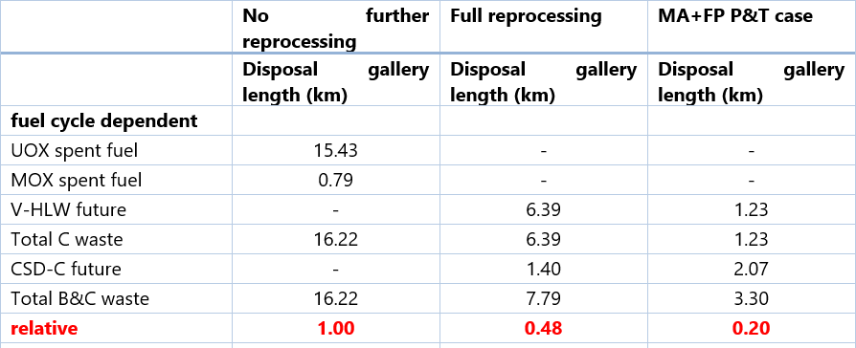
Belgian geological repository: impact on gallery length (km)

Slide 17
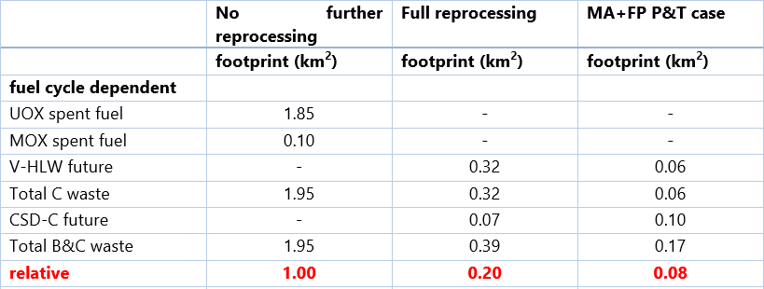
Belgian geological repository: impact on footprint (km²)

Slide 18
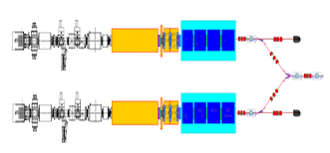
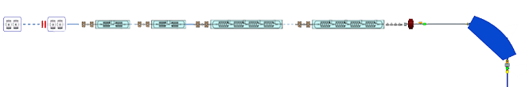
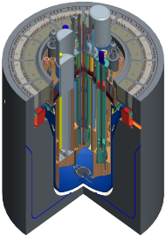
MYRRHA: Accelerator Driven System
Phase 1
Linear accelerator
Phase 2
100 MeV
600 MeV
✓ Transmutation demonstration
✓ ADS at pre-industrial scale
✓ Flexible irradiation facility
Phase 3
Sub-Critical Reactor
Pb-Bi Cooled
Notes:
What is MYRRHA
What offers

Slide 19





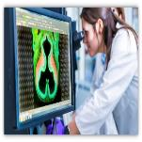
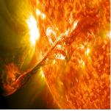
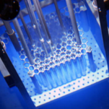
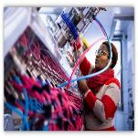
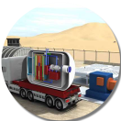
MYRRHA’s Application Portfolio
SNF*/ Waste
Multipurpose
hYbrid
Research
Reactor for
High-tech
Applications
Radio-isotopes
Fusion
Mat.& Fuel GEN IV
Fundamental research
*SNF = Spent Nuclear Fuel
Support to
SMR LFR
Notes:
What is MYRRHA
What offers

Slide 20
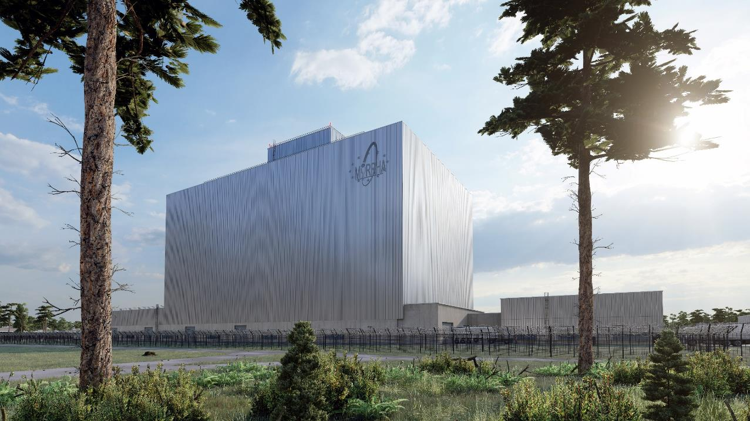
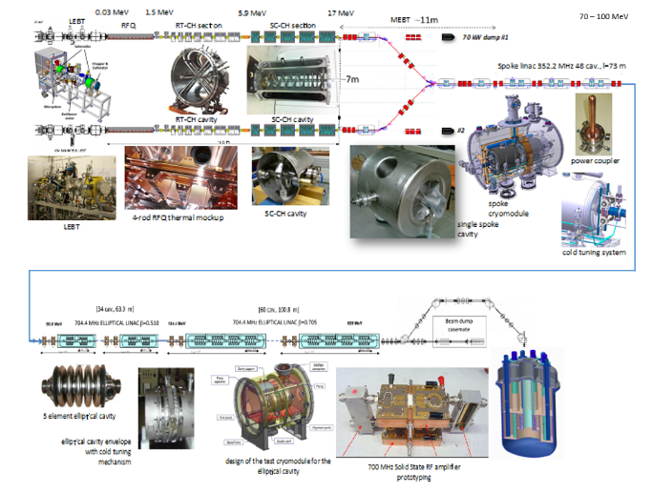

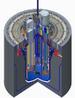
MYRRHA’s phased implementation strategy
Phase 1 – 100 MeV
+ Proton Target Facility
UNDER CONSTRUCTION
MYRRHA phase 1 = MINERVA
(see next presentation by Adrian FABICH
Phase 2 – 600 MeV
Phase 3 – Reactor
Source: SCK CEN MYRRHA Project Team
Notes:
OK

Slide 21
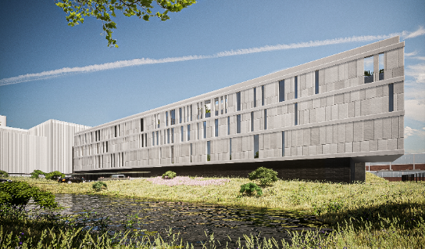
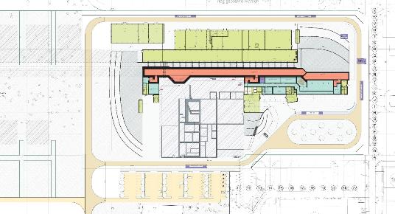
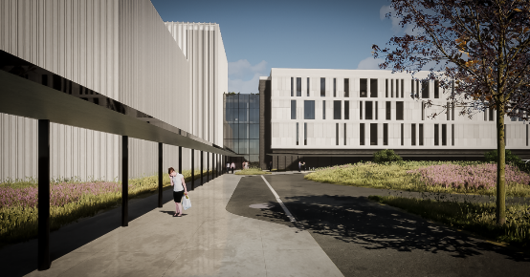
MINERVA implementation by 2026
Overall architecture frozen, main internal floor plan decisions taken
PTF design close to level of ACC, FPF catching up

Slide 22
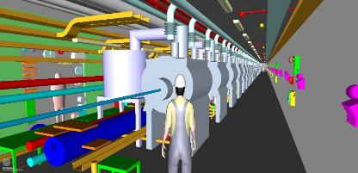
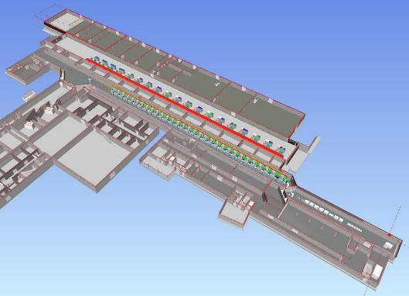
NF ACC
Outline Basic Design phase
  3D data model
    determines minimum level of detail (LOD 100) of all SSC
    links ‘all’ information
    tool for integration of SSC

Slide 23
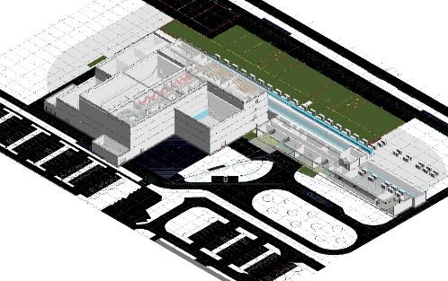
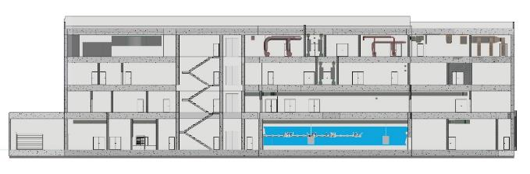
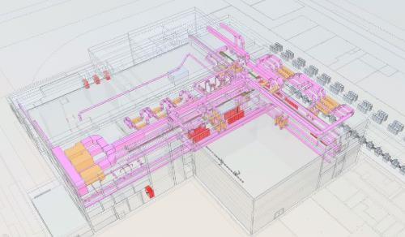
NF PTF
Conceptual Design phase
  3D data model
    minimum LOD 100, higher level reached
    primary systems included
Strong & Fruitful collaboration between TRIUMF and SCK CEN for the development of ARIEL and ISOL@MYRRHA

Slide 24
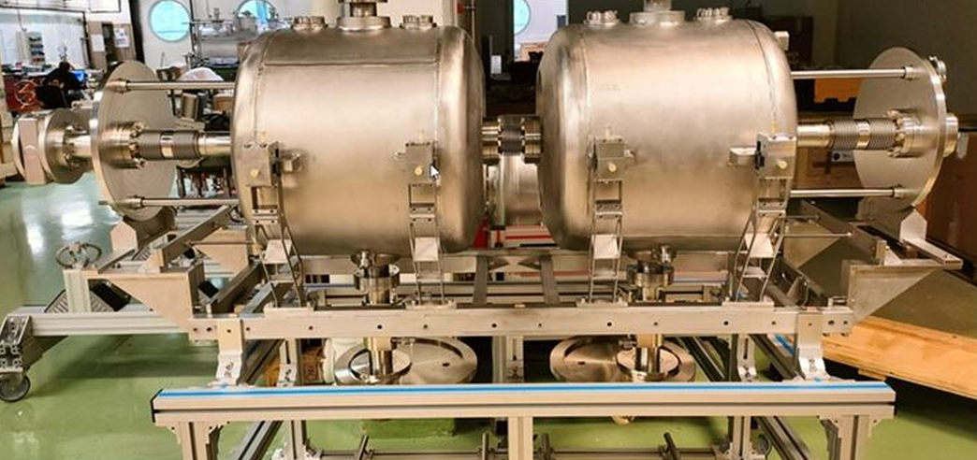
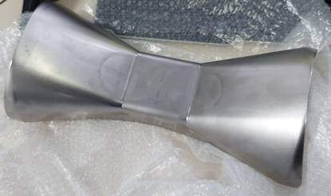
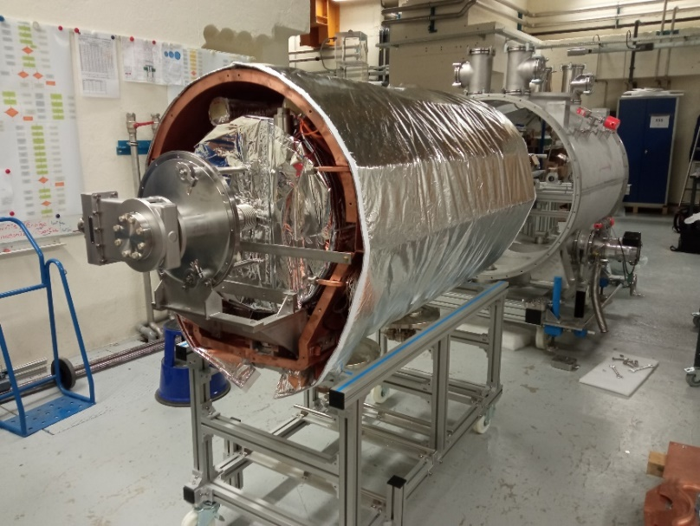
SC single spoke cavities & cryo module
Production of pre-series single spoke cavity parts
is ongoing at RI (DE)
Prototyping progressing at collaboration partner IJCLab (FR)

Slide 25
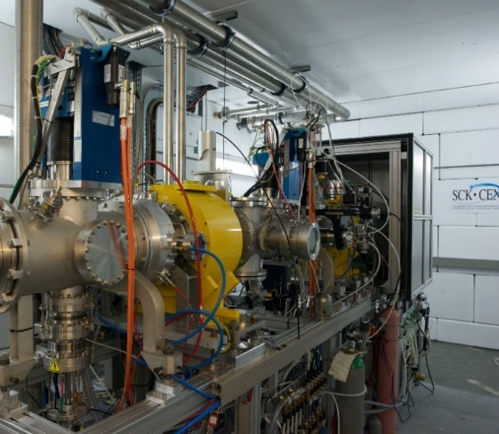
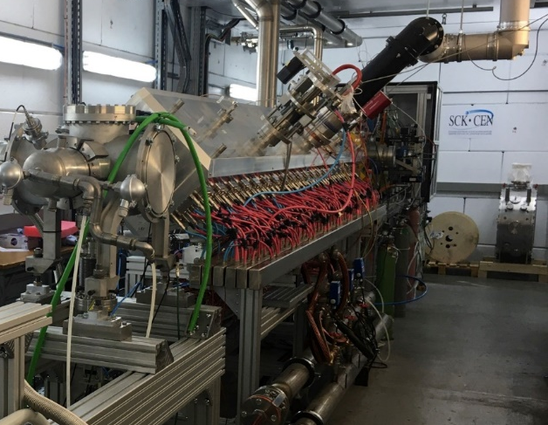
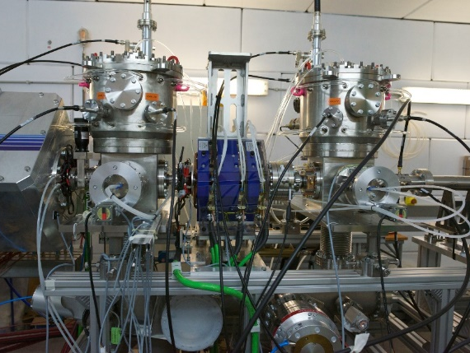
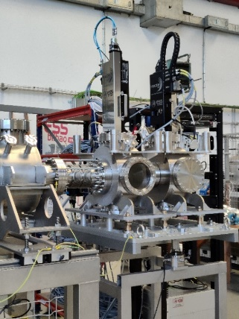
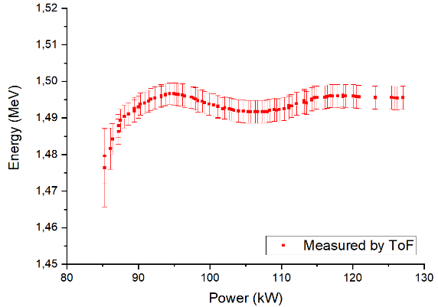
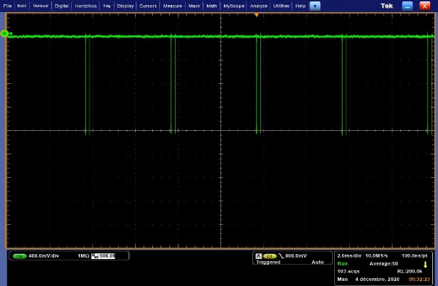
Injector test stand established at CRC (LLN-BE)
SCK CEN operates an injector test-stand consisting of:
ECR ion source
LEBT
  2 solenoids
  Alison scanner, Faraday cup,…
  Fast beam chopper
RFQ
  4 rod design
  Powered by up to 160 kW RF solid state amplifiers
  176.1 MHz
2 quarter wave rebunching RF-cavities
In fall, a emittance meter and a bunch shape monitor will be added
Target beam current/cycling achieved
RFQ commissioned with >95% transmission
Beam energy confirmed after the RFQ by ToF

Slide 26
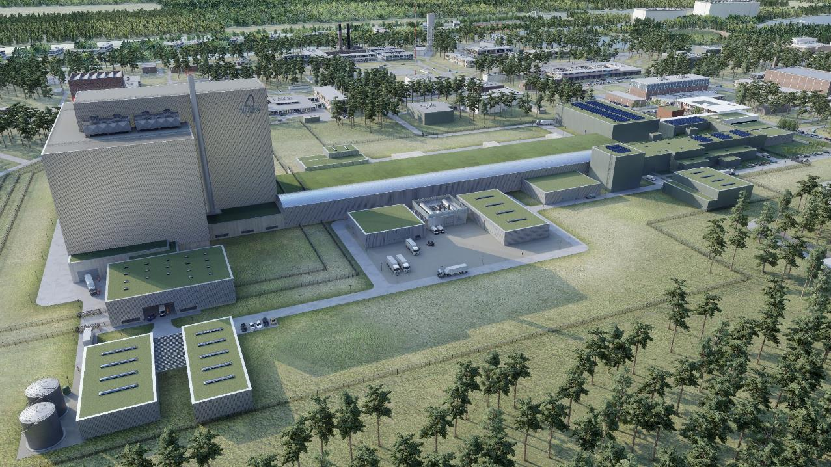
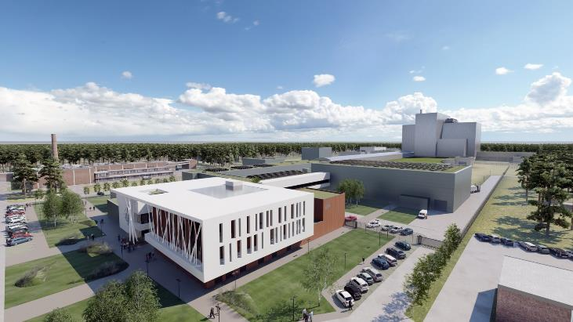
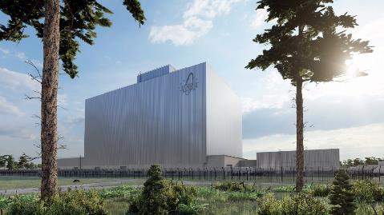
MYRRHA Reactor: implementation in 2036
Objectives = transmutation + radioisotopes + fusion material r&d + Fission technology platform

Slide 27

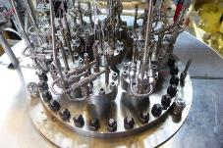
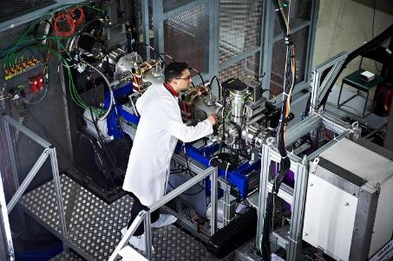
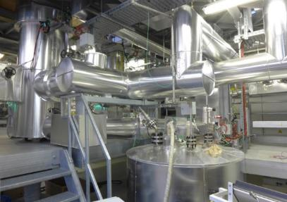
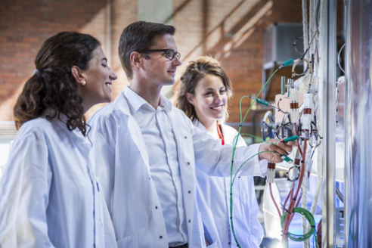
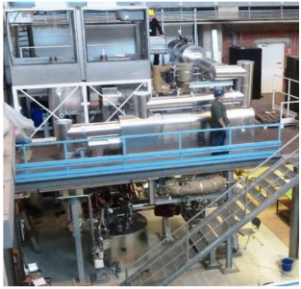
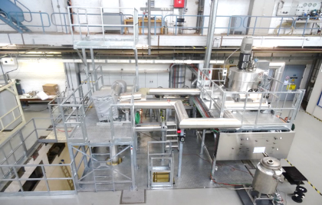
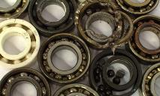
MYRRHA reactor Highlights

Slide 28
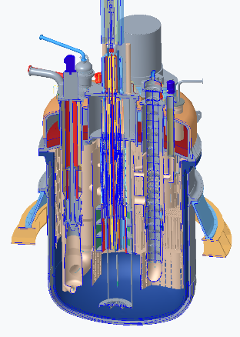
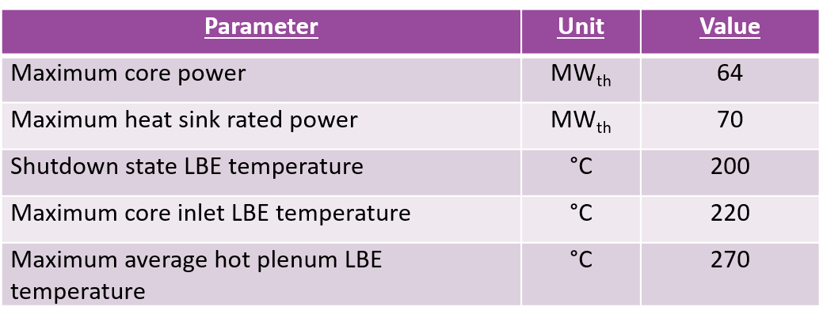
MYRRHA reactor primary design Rev. 1.8, frozen end 2020
Integrated Pool-type concept with LBE coolant
Fuel assemblies: hexagonal bundles of cylindrical wire-spaced fuel pins (MOX fuel 30wt.% Pu)
4x heat exchangers: double-walled with leak detection; water/steam on secondary side
2x primary pumps: vertical shaft mixed-flow design
Bottom core loading: single in-vessel fuel handling machine (IVFHM)
Safety vessel integrated into the primary vessel

Slide 29





MYRRHA Core design for multipurpose R&D : Subcritical core layout
control rods (3)
fuel assembly (78)
reflector (42)
beam tube + spallation target
thermal islands (3)
experiments (6)
Source: L. Fiorito, 2019
Notes:
This is the layout selected for the subcritical core revision 1.8
It contains 78 hexagonal FAs (in white) with 30% MOX fuel
6 experiments for material irradiation are loaded close to the spallation target in correspondence of the multifunctional channels where the neutron flues are the highest
3 thermal islands for Mo-99 production, farther from the center to not disrupt the flux, but close enough to have enough neutrons

Slide 30


MYRRHA: World Class Technology complex to serve HLM SMR development
LiLiPuTTeR-II
HELIOS 3
HLM Lab
MEXICO
CRAFT
LIMETS 3
RHAPTER
COMPLOT
ESCAPE
Ultrasonic Lab
GUINEVERE
Lead-Bismuth Chemistry & Conditioning
Material development
& testing
Component testing & Thermal Hydraulics
Instrumentation & Visualisation
Lead Zero Power Reactor

Slide 31




Belgian Government decision of 7 September 2018
Confirmed on 23 July 2021 (+ creation of MYRRHA NPO)
Decision to build MYRRHA as large new research infrastructure in Mol, Belgium
Belgium allocates € 558 m for 2019-2038
  2019-2026: construction of MINERVA (linac 100 MeV + PTF & FTS)
  2019-2026: design, R&D and licensing for Phases 2 (extended linac 600 MeV) & 3 (reactor)
  2027-2038: MINERVA operations (linac 100 MeV)
Establishment of international non-profit organisation
MYRRHA AISBL/IVZW
Decided 23.07.2021
Created 17.09.2021
Government support for establishing MYRRHA partnerships
  Belgium appoints tutorship ministers to promote and negotiate international partnerships
Source: Belgian minister of Energy, Environment & Sustainable Development

Slide 32
How to participate in MYRRHA

Slide 33

MYRRHA AISBL/IVZW official from 16 December 2021

Slide 34


MYRRHA AISBL: separate legal entity needed to find external partners/investors
Responsability:
  SCK CEN
  Design & build MINERVA
  Conduct R&D for phases 2 ACC-600 & 3 MYRRHA Reactor
  Obtain licenses for Phase 1 and later on for Phases 2 & 3
  Being the nuclear operator of MYRRHA/MINERVA
  MYRRHA AISBL
  Establish the MYRRHA International Consortium
  Guarding the overall scope of MYRRHA programme
ANS
MDB
MYRRHA
International nonprofit
organisation
MYRRHA
Notes:
Spreker: Hamid Aït Abderrahim
En nog een organisatiewijziging: MYRRHA
Aparte rechtsstructuur: ‘internationale vereniging zonder winstoogmerk’
Blijvende ondersteuning van SCK CEN
de belangstelling van buitenlandse partners voor een instap in het project stimuleren / internationale investeerders samenbrengen

Slide 35
MYRRHA AISBL/IVZW:
Membership
Member categories :
  Founding members : Belgian State and SCK CEN
  Contributing members open for :
    Countries
    National Research Organisations, industries of a country
    International Institutions or Associations
Rights & Obligations
  Contribution in-cash or in-kind to become contributing member
  from 40 M€ contribution :
    1 Director in the Board of Directors (overall maximum of 4)
    1 Voting right in the General Assembly per 40 M€ contribution
  Annual membership fee <100 k€ on proposal of BoD (right of nomination of a representative in the International Scientific and Technical Advisory Board (ISTAB)

Slide 36










Conclusions
Belgium sends a strong signal about its ambitions:
Maintaining a high level of know-how in the nuclear field
Becoming an international pole of attraction for young talents in nuclear applications
Convert innovations into solutions for societal challenges (nuclear waste, nuclear medicine, sustainability)
Encourage and welcome international cooperation and partnership
2018
Positive decision
Ground breaking
Q2-2023

Slide 37
Copyright © 2022 – SCK CEN
PLEASE NOTE!
This presentation contains data, information and formats for dedicated use ONLY and may not be copied, distributed or cited without the explicit permission of the SCK CEN.
If this has been obtained, please reference it as a “personal communication. By courtesy of SCK CEN”.
SCK CEN
Belgian Nuclear Research Centre
Stichting van Openbaar Nut
Fondation d'Utilité Publique
Foundation of Public Utility
Registered Office: Avenue Herrmann-Debrouxlaan 40 – B-1160 BRUSSELS
Operational Office: Boeretang 200 – B-2400 MOL

