Slide 1


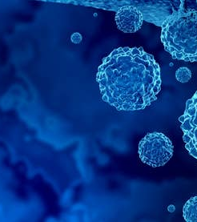
Raymond M. Reilly, Ph.D.
Professor and
Director, Centre for Pharnaceutical Oncology
Email: raymond.reilly@utoronto.ca
Theranostics for Cancer Imaging and Therapy

Slide 2


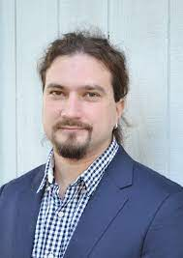
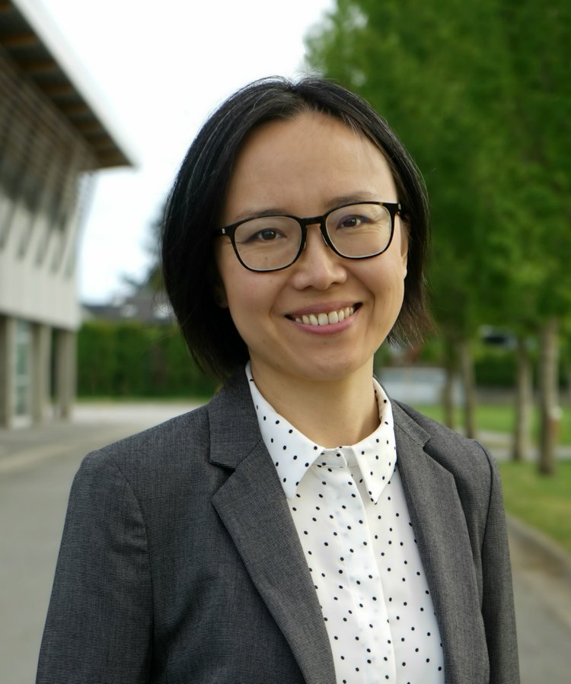
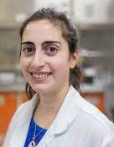
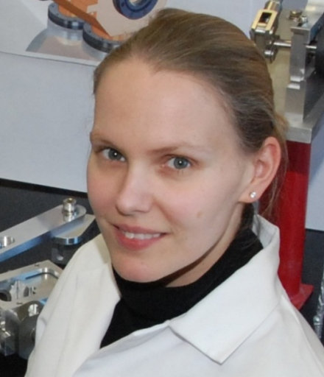
Disclosures
I have no conflicts-of-interest to declare.
I am collaborating with scientists at TRIUMF on development of novel theranostic agents for imaging and treatment of cancer, especially using novel Auger electron-emitting radionuclides.
Valerie Radchenko
Hua Yang
Caterina Ramogida
Cornelia Hoehr

Slide 3
Theranostics Concept
Theranostics (sometimes termed “theragnostics”) combine a therapeutic agent with a diagnostic imaging agent for cancer.
Radiopharmaceuticals offer the opportunity to construct a theranostic using the same molecule labeled with a radionuclide for treatment and another radionuclide for diagnostic imaging.
In some cases, the same radionuclide may be used by administering a low dose for imaging and a high dose for treatment of cancer.

Slide 4
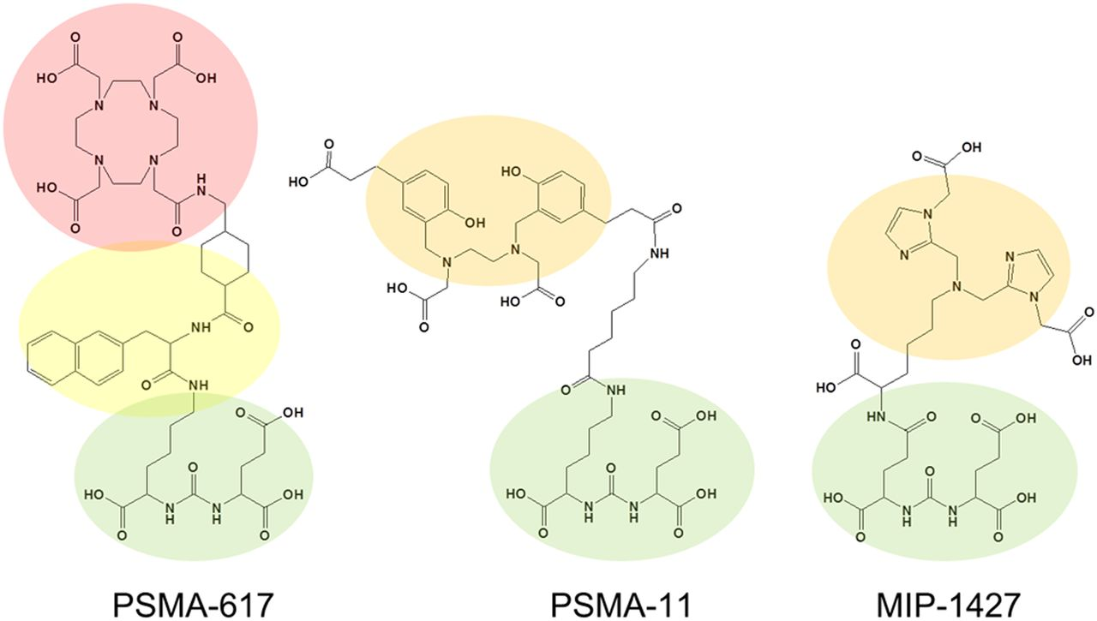
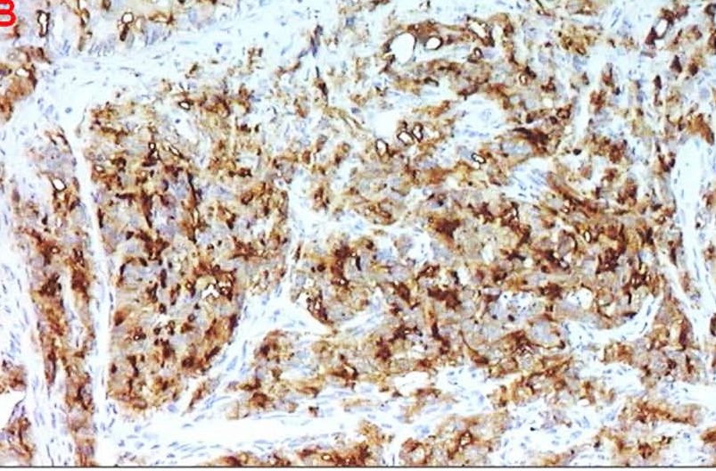
Prostate-Specific Membrane Antigen (PSMA) Theranostics
¹⁷⁷Lu
²²⁵Ac
⁶⁸Ga
DOTA
HBED-CC
PSMA-11
PSMA Expression
Glu-Urea
Glu-Urea
PSMA-617

Slide 5
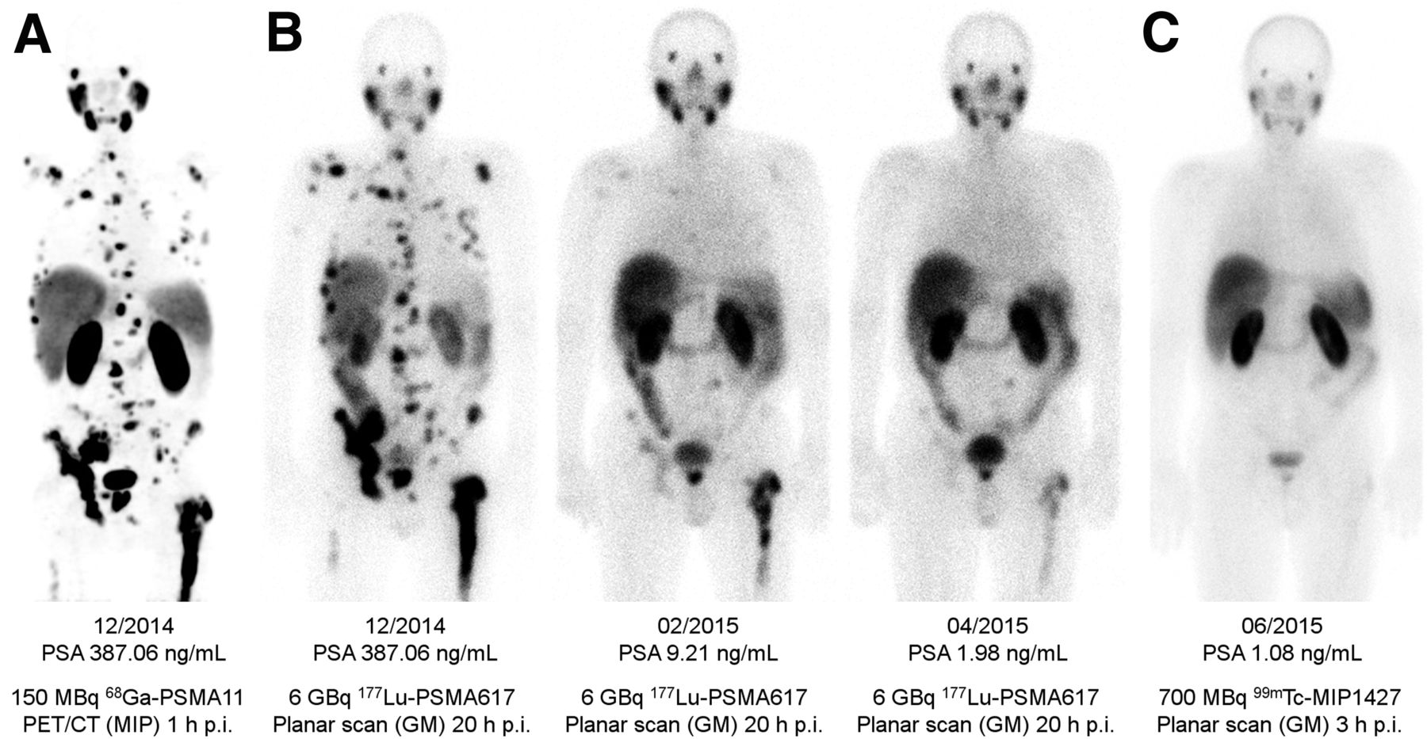
Imaging and Treatment of Prostate Cancer
Imaging of metastases and evaluation of treatment response by PET using ⁶⁸Ga-PSMA-11
Treatment of metastatic prostate cancer with ¹⁷⁷Lu-PSMA-617 (6,000 MBq/dose)
PSA:
387 ng/mL
387 ng/mL
9.2 ng/mL
2.0 ng/mL
1.1 ng/mL
Pre-Treatment
Dose 1
Dose 2
Dose 3
Post-Treatment
Very successful theranostic example!
Kratochwil C. et al. J Nucl Med 2016; 57: 1170-1176

Slide 6
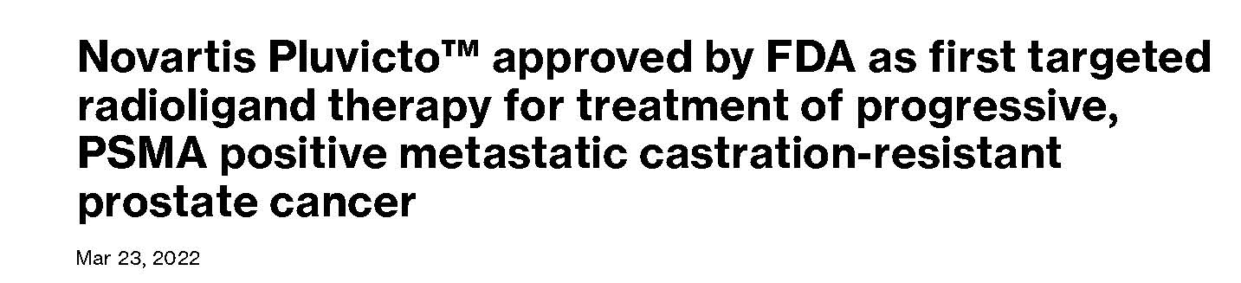
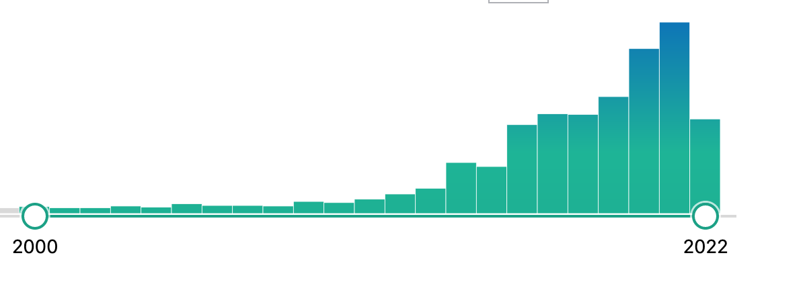


Growth in Interest in Theranostics
154
PUBMED: Theranostics + Radiopharmaceuticals
3
Global radiopharmaceutical market is expected to grow to >$11 billion from 2019-2023. High fraction of this market is for cancer imaging and treatment.
2000
2022

Slide 7
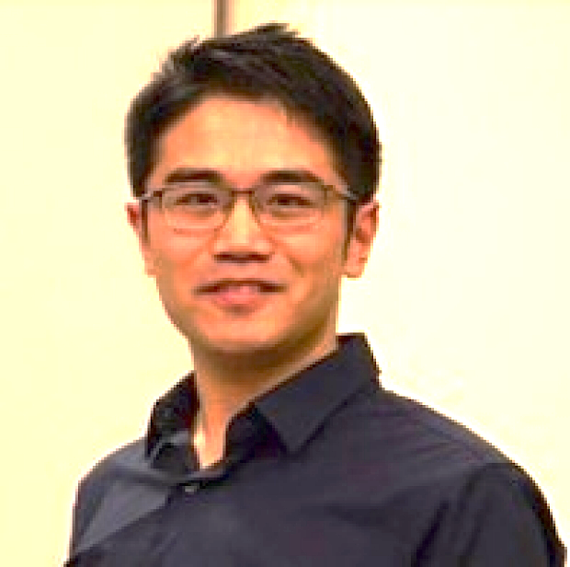

Two Theranostic Examples from My Team’s Research
Anthony Ku
Imaging and radioimmunotherapy (RIT) of head and neck cancer (HNSCC)
Valerie Facca
Imaging and RIT of triple-negative breast cancer (TNBC)

Slide 8
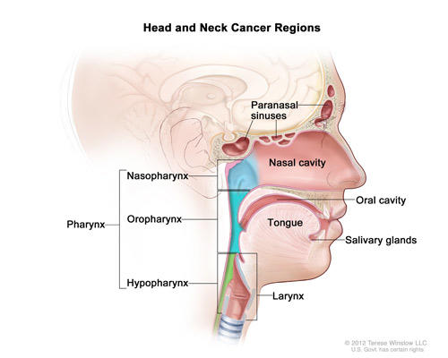
Head and Neck Cancer (HNSCC)
7,500 cases and 2,100 deaths per year in Canada. Long-term outcome is variable.
EGFR overexpression is present on 38-47% of tumours and is targeted by cetuximab therapy but is a poor prognostic marker
Recurrence and metastatic progression are major challenges after treatment by surgery, radiation, anti-EGFR cetuximab and chemotherapy.
Pharynx

Slide 9
Hypotheses
HNSCC tumours in mice could be imaged by PET/CT using ⁶⁴Cu-labeled anti-EGFR panitumumab F(ab’)₂ fragments
PET could be extended to radioimmunotherapy (RIT) in a theranostic approach using ¹⁷⁷Lu-panitumumab F(ab’)₂
PET with ⁶⁴Cu-panitumumab F(ab’)₂ would predict the radiation absorbed doses to the tumour and normal organs from RIT with ¹⁷⁷Lu-panitumumab F(ab’)₂

Slide 10
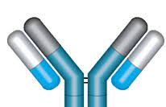
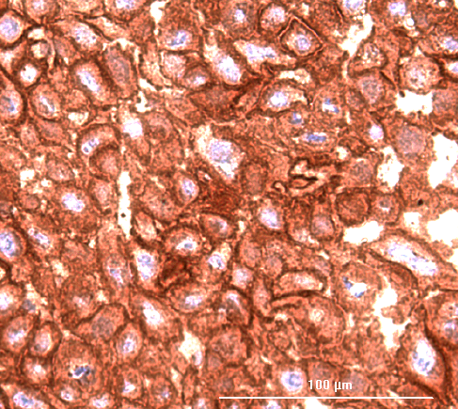
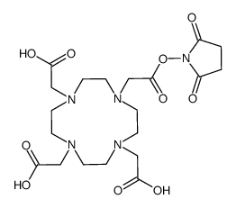
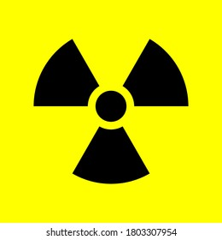
⁶⁴Cu/¹⁷⁷Lu-DOTA-Panitumumab F(ab’)₂
EGFR Positive HNSCC
HN
H
⁶⁴Cu : PET (β⁺)
¹⁷⁷Lu: RIT (β⁻), SPECT (γ)
F(ab)₂ fragments were used to achieve high tumour uptake and rapid elimination from the blood for PET with ⁶⁴Cu (t_{1/2} = 12.7 h)
DOTA
K_{d} = 2.9 ± 0.7 x 10⁻⁹ M

Slide 11
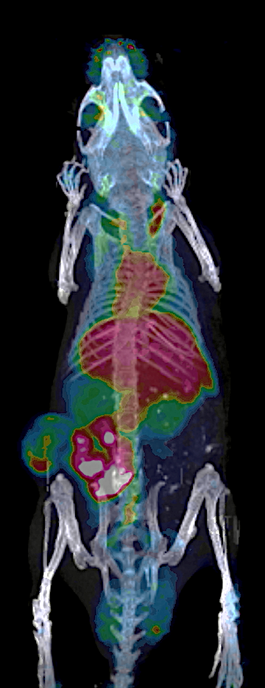
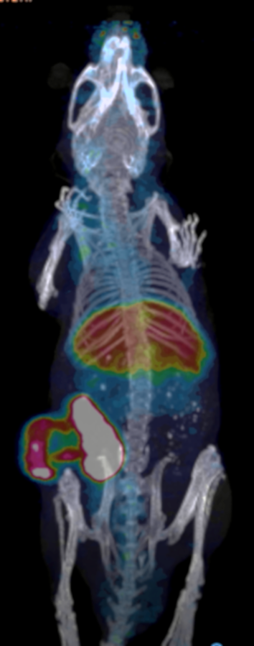
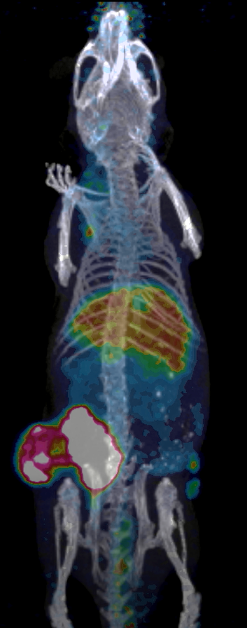
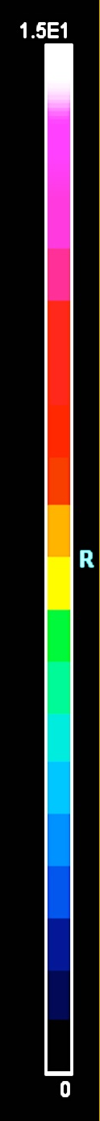
PET/CT Imaging with ⁶⁴Cu-DOTA-Panitumumab F(ab’)₂
a
b
c
NRG mice with s.c. patient-derived HNSCC xenografts imaged at selected times post-i.v. injection of ⁶⁴Cu-panitumumab F(ab’)₂ fragments. Normal liver uptake.
L
L
L
T
T
T
6 h
24 h
48 h
Ku, A et al. EJNMMI Radiopharmacy and Chemistry 2021 Aug 12;6(1):25.

Slide 12
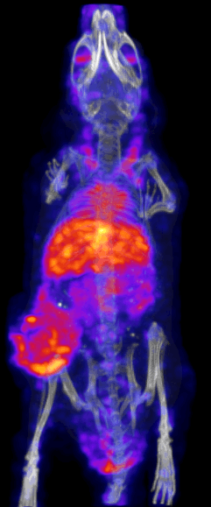
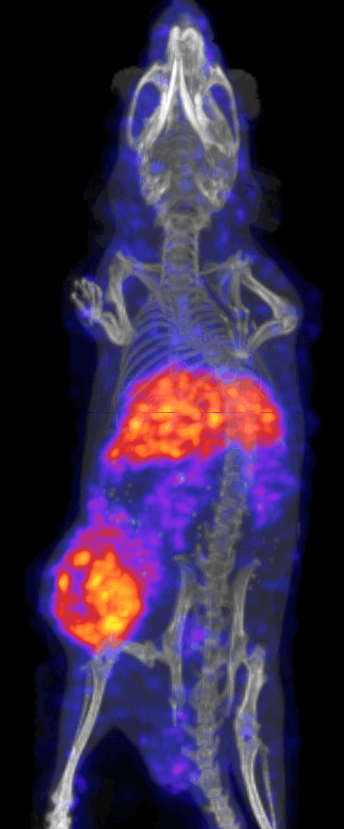
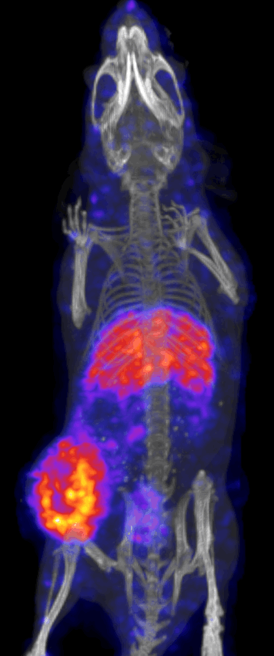
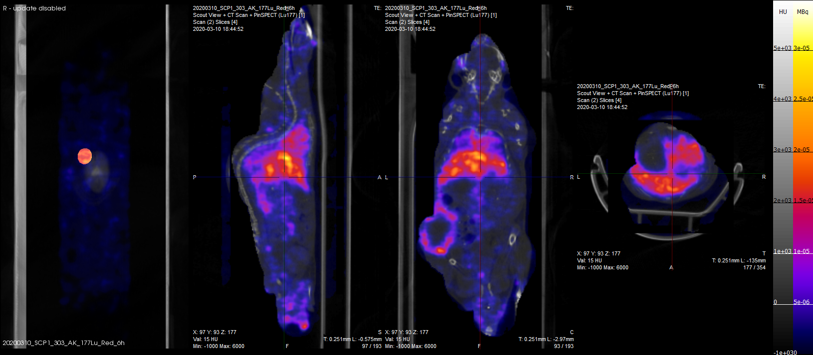
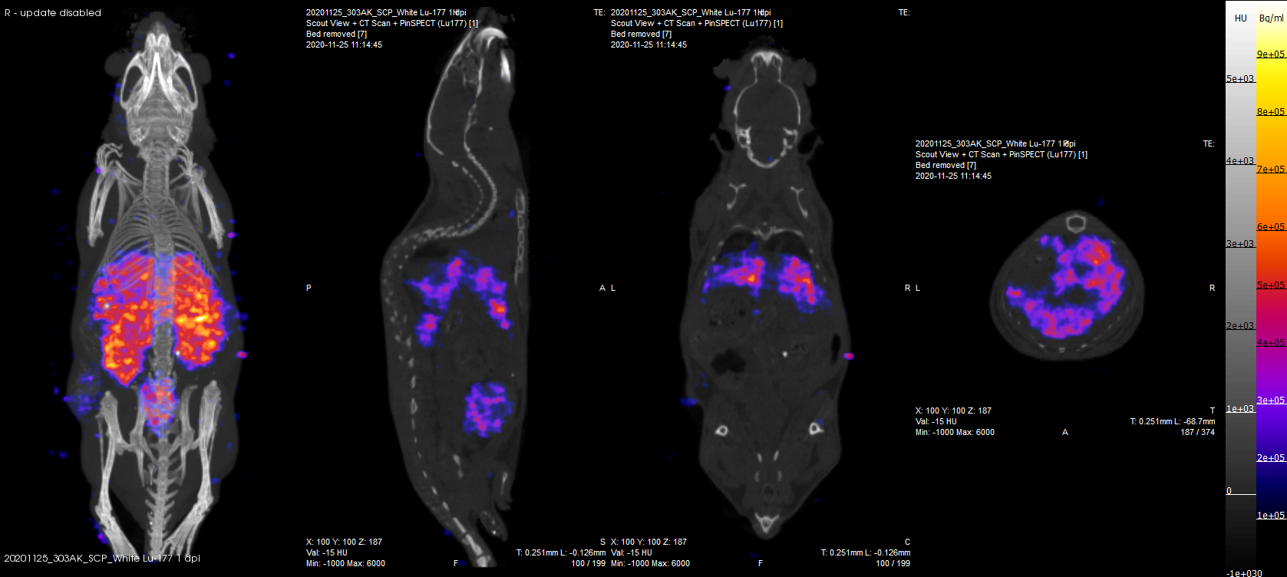
SPECT/CT Imaging with ¹⁷⁷Lu-DOTA-Panitumumab F(ab’)₂
a
b
c
d
NRG mice with s.c. patient-derived HNSCC xenografts imaged at selected times post-i.v. injection of ¹⁷⁷Lu-panitumumab F(ab’)₂ fragments.
L
L
T
L
L
T
T
T
6 h
24 h
48 h
24 h
¹⁷⁷Lu-DOTA-panitumumab F(ab’)₂
¹⁷⁷Lu-DOTA-trastuzumab F(ab’)₂
Anti-HER2

Slide 13
Comparison of Biodistribution
No significant differences at 24 h post-injection but small differences were found at 6 or 48 h in intestine, liver, blood, muscle, but not in the tumour
24 h p.i.

Slide 14
PET with ⁶⁴Cu Predicts the Dosimetry of ¹⁷⁷Lu
Organ | Radiation Equivalent Dose (Gy/MBq)
 | Predicted Based on ⁶⁴Cu | Estimated Based on ¹⁷⁷Lu
Heart | 0.35 ± 0.06 | 0.32 + 0.13
Lungs | 0.51 ± 0.05 | 0.38 ± 0.04
Liver | 1.22 ± 0.13 | 1.82 ± 0.14
Spleen | 0.71 ± 0.20 | 0.66 ± 0.18
Pancreas | 0.26 ± 0.08 | 0.16 ± 0.04
Stomach | 0.33 ± 0.03 | 0.27 ± 0.04
Intestines | 0.31 ± 0.05 | 0.21 ± 0.05
Kidneys | 0.63 ± 0.09 | 0.75 ± 0.08
Tumour | 2.00 ± 0.60 | 2.50 ± 0.80
Whole Body | 0.26 ± 0.02 | 0.34 ± 0.02
MIRD Equation:
D = Ã_{s} × S × W_{R}
⁶⁴Cu
¹⁷⁷Lu
No significant differences
Surrogate for ¹⁷⁷Lu

Slide 15
Toxicity of ¹⁷⁷Lu-DOTA-Panitumumab F(ab’)₂
Parameter | Normal Saline | ¹⁷⁷Lu-DOTA-Panitumumab F(ab’)₂
WBC (x 10⁹/L) | 1.4 ± 0.4 | 1.0 ± 0.3
RBC (x 10¹²/L) | 9.0 ± 0.2 | 8.7 ± 0.2
PLT (x 10⁹/L) | 527.3 ± 66.9 | 413.0 ± 15.3
Hb (g/L) | 14.5 ± 0.6 | 13.4 ± 0.3
Hct (%) | 39.9 ± 0.8 | 39.4 ± 0.7
ALT (U/L) | 41.0 ± 13.1 | 31.5 ± 9.3
Cr (μmole/L) | 18.0 ± 0.0 | 21.0 ± 2.1
Injected dose = 6 MBq (50 μg)
Deliver a tumour absorbed dose of 12-15 Gy based on 2.0-2.5 Gy/MBq
No significant differences

Slide 16
RIT of HNSCC Tumours with ¹⁷⁷Lu-DOTA-Panitumumab F(ab’)₂
A
B
Tumour Growth Index
Body Weight Index

Slide 17
Conclusions and Implications
HNSCC was imaged by PET with ⁶⁴Cu-DOTA-Panitumumab F(ab’)₂. PET predicted the radiation absorbed doses from RIT with ¹⁷⁷Lu-panitumumab F(ab’)₂
¹⁷⁷Lu-DOTA-panitumumab F(ab’)₂ was safe and effective for RIT of HNSCC tumours in NRG mice.
A theranostic approach combining ⁶⁴Cu- and ¹⁷⁷Lu-DOTA-panitumumab F(ab’)₂ is promising for imaging and treatment of HNSCC

Slide 18
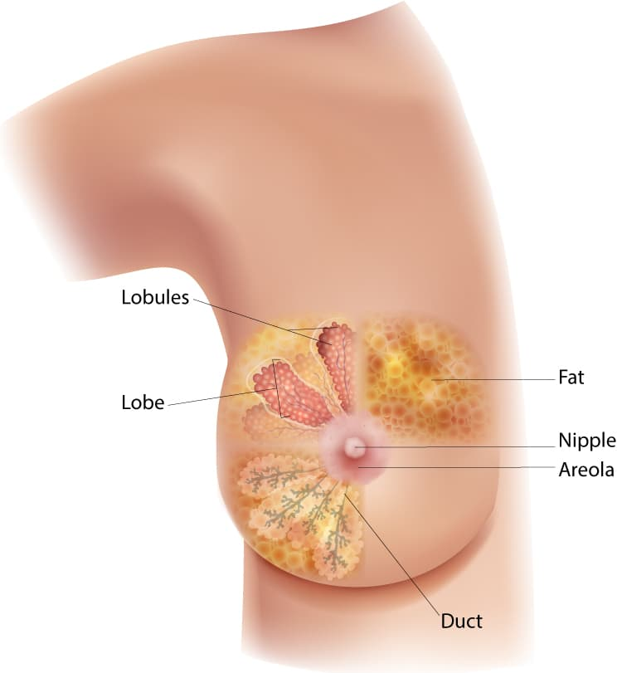
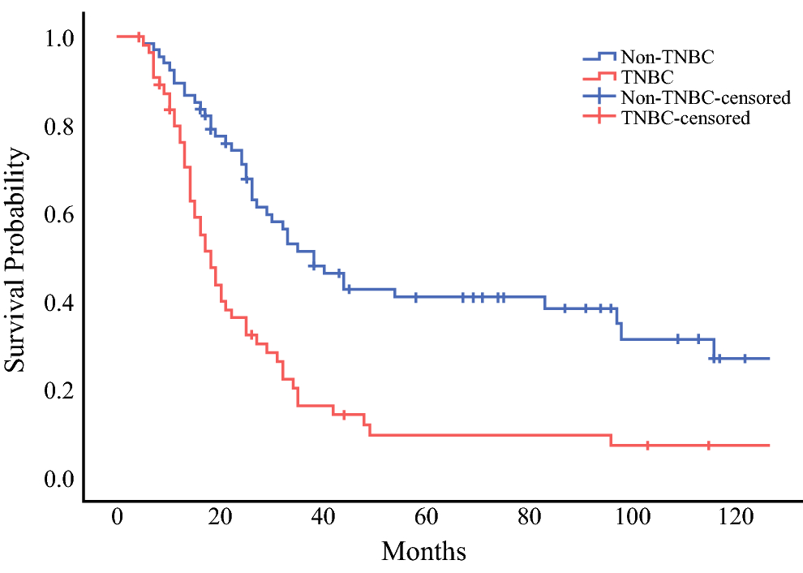
Triple-Negative Breast Cancer (TNBC)
28,900 cases and 5,500 deaths from breast cancer each year in Canada. TNBC accounts for 10-15% of cases but has a higher risk for progression and poor outcome.
TNBC is defined as breast cancer that does not express estrogen or progesterone receptors or HER2.
EGFR overexpression is present on 50-90% of tumours and is a poor prognostic marker but a good target.
Non-TNBC
Survival Probability
TNBC
Months
Hamy A-S, et al. (2020) PLoS ONE 15(6): e0234191.

Slide 19
Hypotheses
TNBC tumours in NRG mice could be imaged by SPECT/CT using ¹¹¹In-panitumumab intact IgG.
SPECT/CT could be extended to RIT in a theranostic approach by exploiting the Auger electron (AE) emissions of ¹¹¹In.
RIT with ¹¹¹In-panitumumab IgG would be safe and effective for treatment of primary and metastatic TNBC tumours in NRG mice.

Slide 20
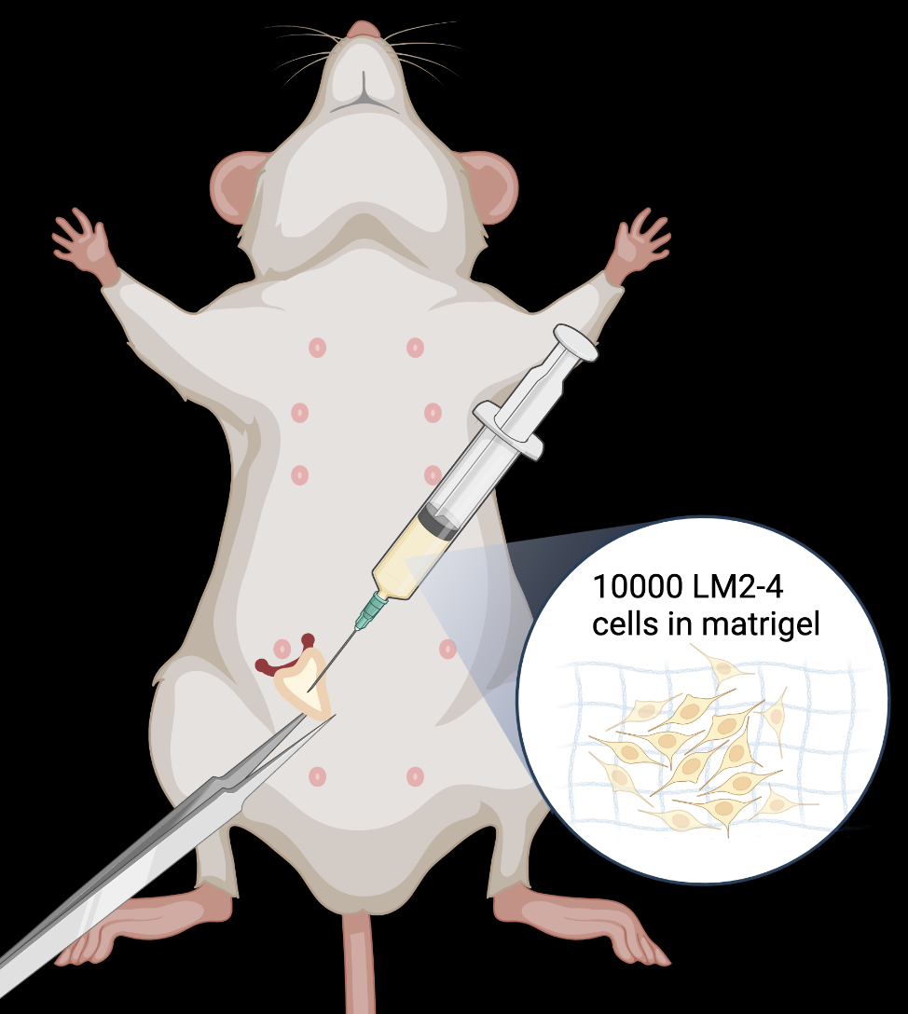
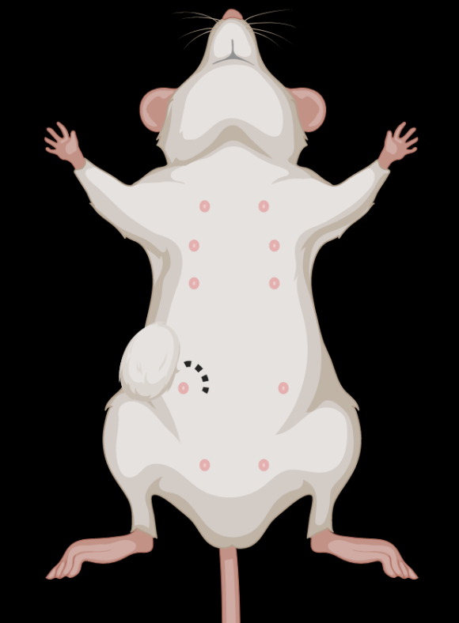
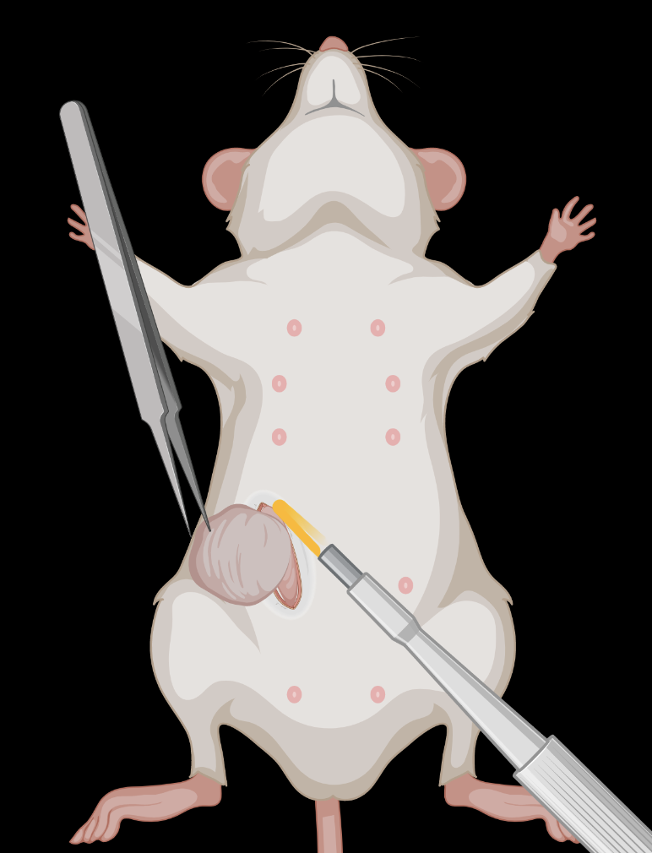
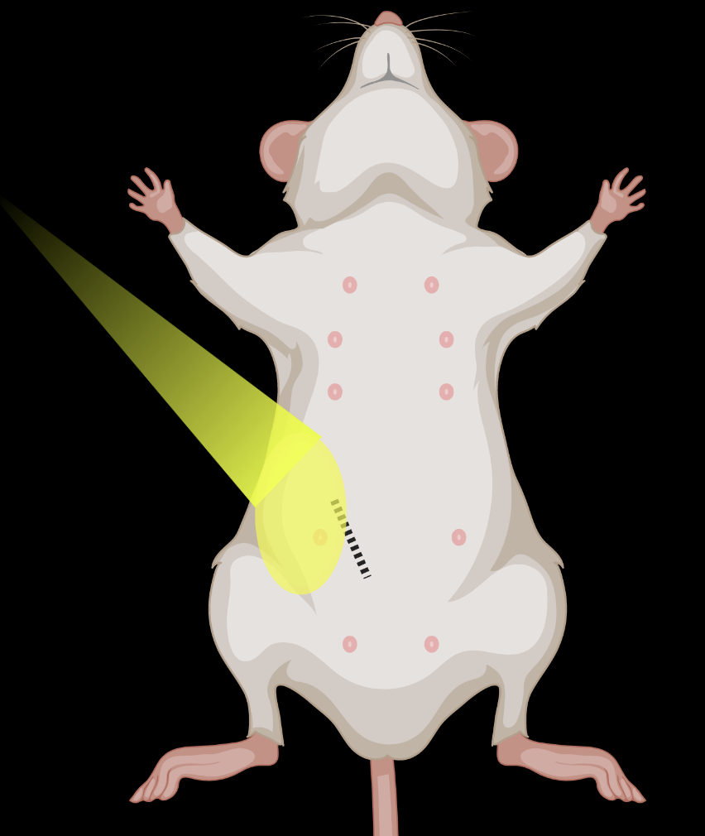
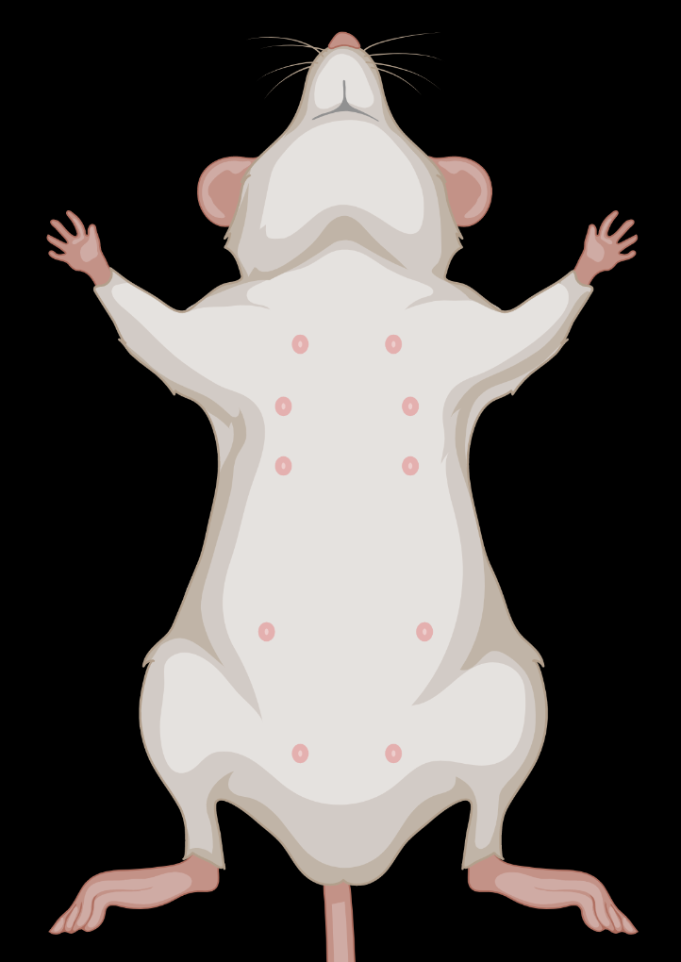
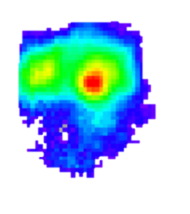
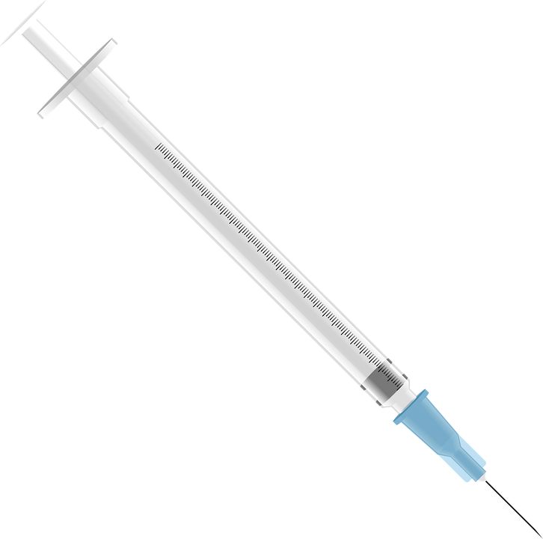
TNBC Tumour Xenograft Models
21 days
Inoculate LM2-4/Luc Cells into the MFP of NRG mice
1-2 weeks
5 x 6 Gy
Surgical Excision
Local XRT
RIT
BLI

Slide 21
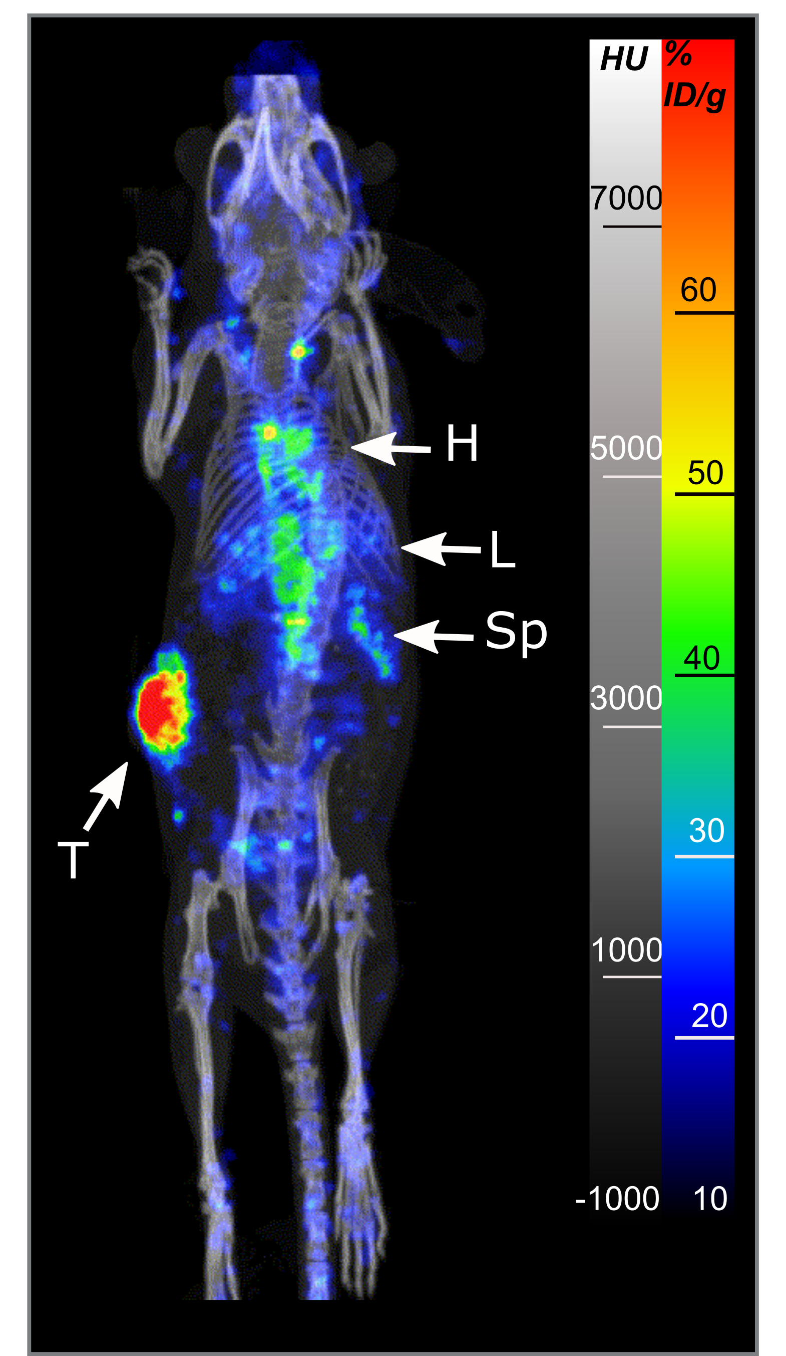
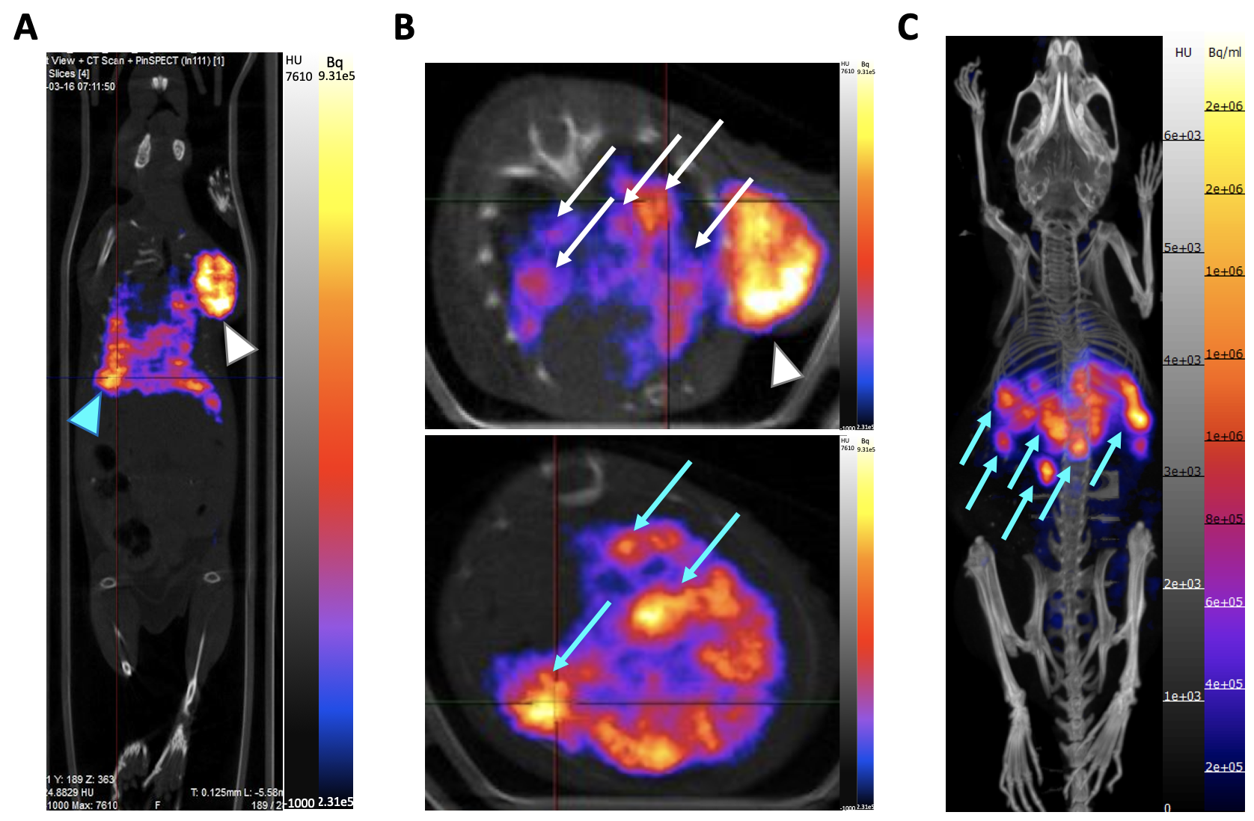
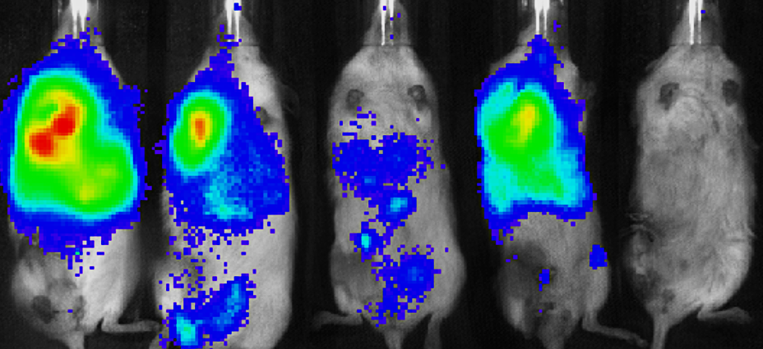
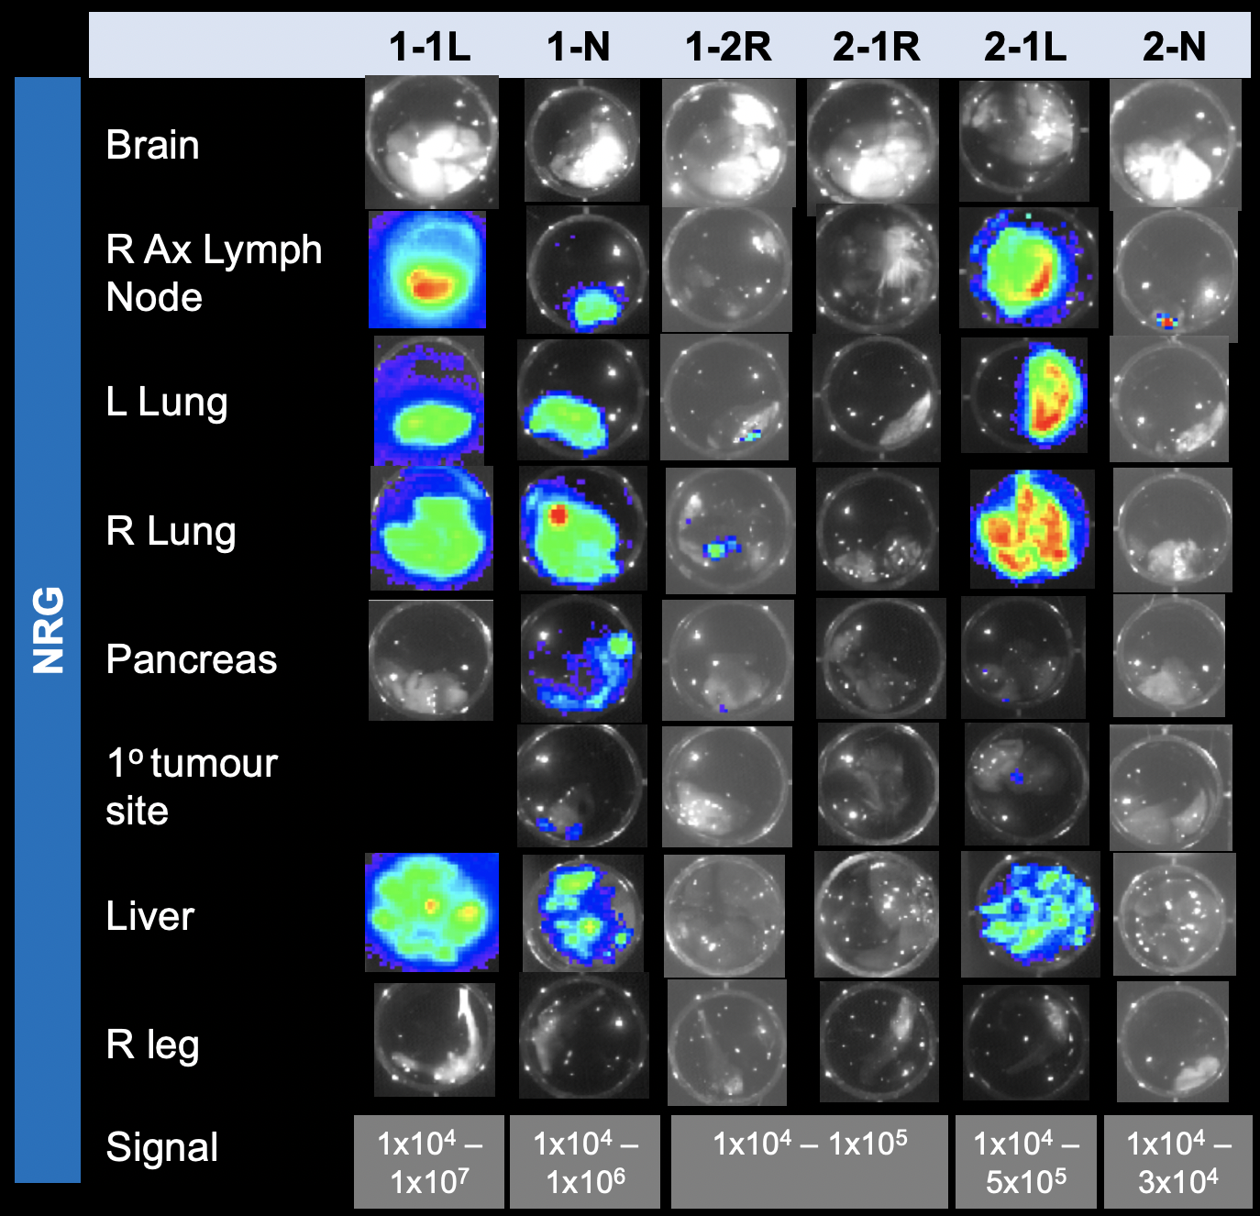
SPECT/CT Imaging with ¹¹¹In-DOTA-Panitumumab IgG
(48 h post-injection)
Transaxial
Lungs
Transaxial
T
Liver
Primary Tumour
Metastases
BLI

Slide 22
Toxicity of ¹¹¹In-DOTA-Panitumumab IgG
Parameter | Normal Saline | ¹¹¹In-DOTA-Panitumumab IgG
WBC (x 10⁹/L) | 0.9 ± 0.2 | 0.5 ± 0.1
RBC (x 10¹²/L) | 9.4 ± 0.2 | 8.5 ± 0.2
PLT (x 10⁹/L) | 497.5 ± 46.2 | 254.0 ± 62.6 *
Hb (g/L) | 14.2 ± 0.3 | 13.0 ± 0.3
Hct (%) | 41.2 ± 0.9 | 38.3 ± 1.1
ALT (U/L) | 40.9 ± 7.6 | 47.3 ± 11.8
BUN (μmole/L) | 7.9± 0.4 | 8.5 ± 0.4
Injected dose = 24 MBq (15 μg)
Selected in a dose-escalation study.
* Significant difference

Slide 23
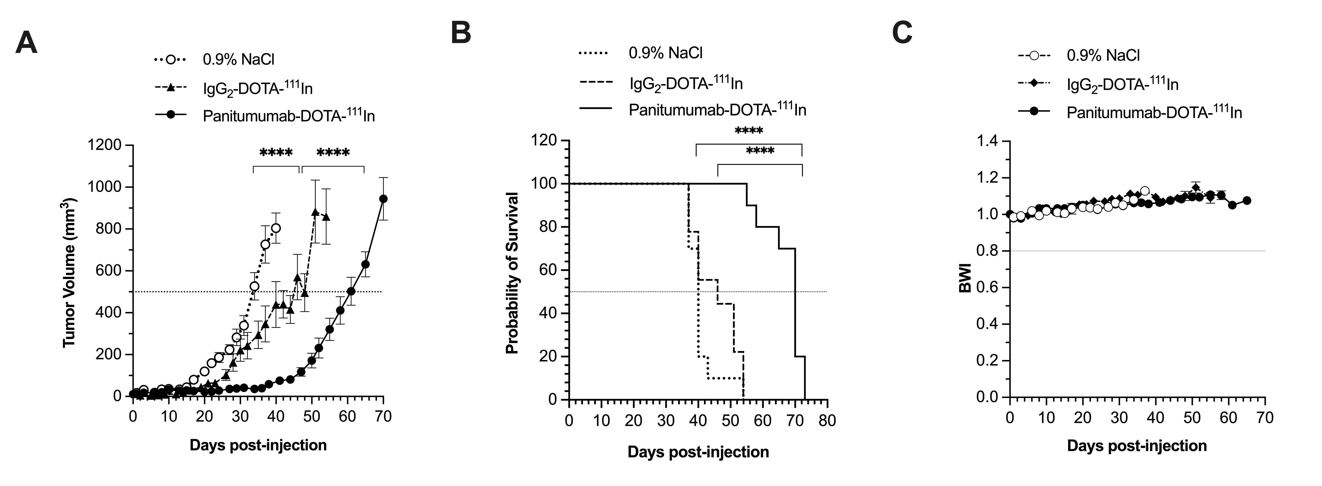
RIT of Primary TNBC Tumours in the MFP with ¹¹¹In-DOTA-Panitumumab IgG
Tumour Growth
Survival
Body Weight
Facca, V et al. Mol. Pharm. 2022 (in revision).

Slide 24
RIT of Metastatic TNBC Tumours with ¹¹¹In-DOTA-Panitumumab IgG
RIT improves survival in mice with metastatic TNBC, when combined with other treatments including surgery and local radiation of the primary tumour

Slide 25
Conclusions and Implications
EGFR-positive primary and metastatic TNBC tumours in NRG mice were imaged with ¹¹¹In-DOTA-Panitumumab IgG
RIT with ¹¹¹In-DOTA-Panitumumab exploiting the AE emissions delayed tumour growth and improved survival of mice with primary or metastatic TNBC tumours
A theranostic approach with ¹¹¹In-DOTA-Panitumumab IgG is promising for imaging and RIT of TNBC and may improve patient outcomes

Slide 26
Alternative Auger Electron-Emitters
Radionuclide | T1/2 (days) | AEs/decay | Total Energy (keV) | Other Emissions/AEs | Production
¹⁹⁷Hg | 2.7 | ~30 | 13.4 | 10:1 | ¹⁹⁷Au(p,n)¹⁹⁷Hg
¹¹⁹Sb | 1.6 | 24 | 26.0 | 0.9:1 | ¹¹⁹Sn(p,n)¹¹⁹Sb
¹¹¹In | 2.8 | 14.5 | 7.0 | 62:1 | ¹¹¹Cd(p,n)¹¹¹In
Novel chelators are needed to complex ¹⁹⁷Hg to panitumumab
(collaboration with Dr. Caterina Ramogida, SFU)

Slide 27



Acknowledgments
Thank you for the invitation to speak at the TRIUMF Science Week!

