Slide 1
Progress towards a measurement of the neutron electric dipole moment using a world-leading ultracold-neutron source at TRIUMF
Wolfgang Schreyer on behalf of the TUCAN collaboration
TRIUMF Science Week 2022

Slide 2
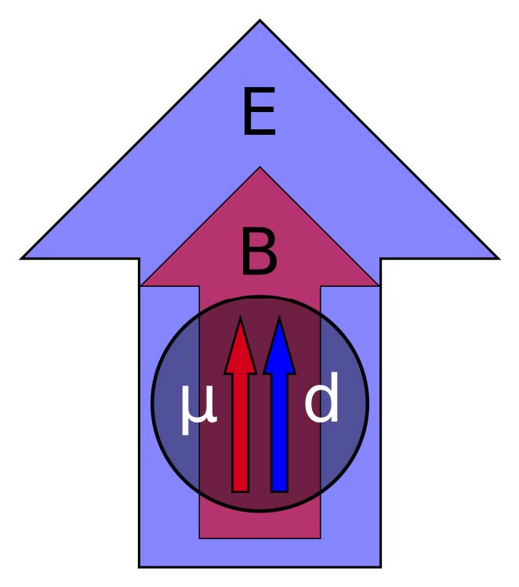
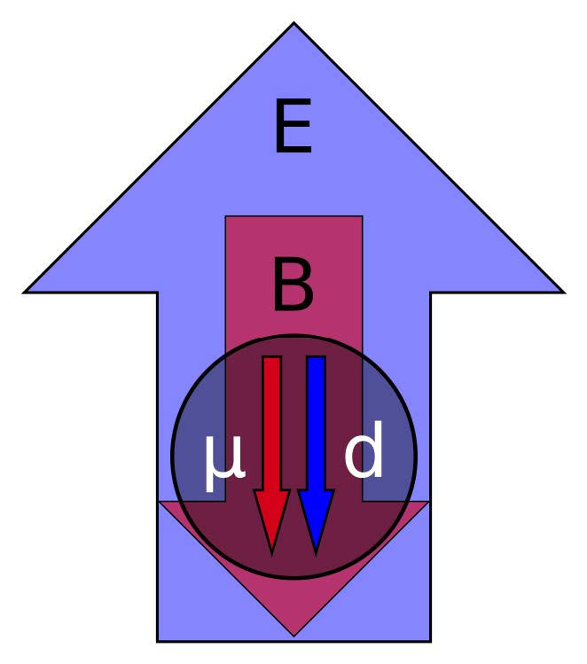
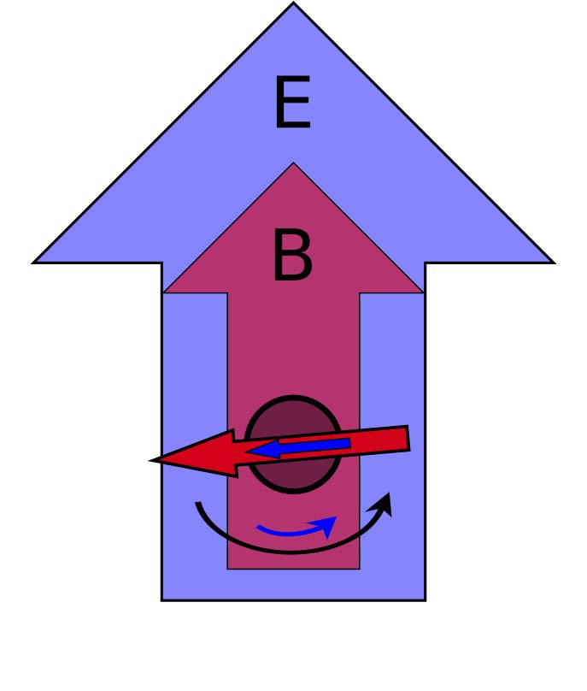
Neutron Electric Dipole Moment violates CP symmetry
Violates T & CP symmetry
➔ may explain matter-antimatter asymmetry
Test of beyond-Standard Model theories
Can be detected by measuring precession frequency in electric + magnetic field
T
$$H= −μ\frac{\overset{⃑}{σ}}{\left|\overset{⃑}{σ}\right|}∙\overset{⃑}{B}−d\frac{\overset{⃑}{σ}}{\left|\overset{⃑}{σ}\right|}∙\overset{⃑}{E} ≠ −μ\frac{\overset{⃑}{σ}}{\left|\overset{⃑}{σ}\right|}∙\left(−\overset{⃑}{B}\right)−d\frac{\overset{⃑}{σ}}{\left|\overset{⃑}{σ}\right|}∙\overset{⃑}{E}$$
Figures by D. Ries
https://www.youtube.com/watch?v=QBKPQFUdDB0

Slide 3
Ramsey’s method
“Separated oscillatory fields”
Figures by D. Ries
https://www.youtube.com/watch?v=QBKPQFUdDB0

Slide 4

Ultracold neutrons are the ideal tool for nEDM searches
Convert cold neutrons to ultracold through phonon-scattering
1 meV → 100 neV
$σ_{d}=\frac{ℏ}{2αET\sqrt{N}}$
$T≈200 \text{s}$ ☺
$α≈0.7$ ☺
$N≈{10}^{4} \text{per} \text{cycle}$ ☹
$E≈10 \text{kV}\text{/}\text{cm}$
Influenced by
gravity (103 neV/m)
Totally reflected by many materials
(Fe: 209 neV, Ni: 245 neV)
Interact with magnetic
field (60.3 neV/T)

Slide 5
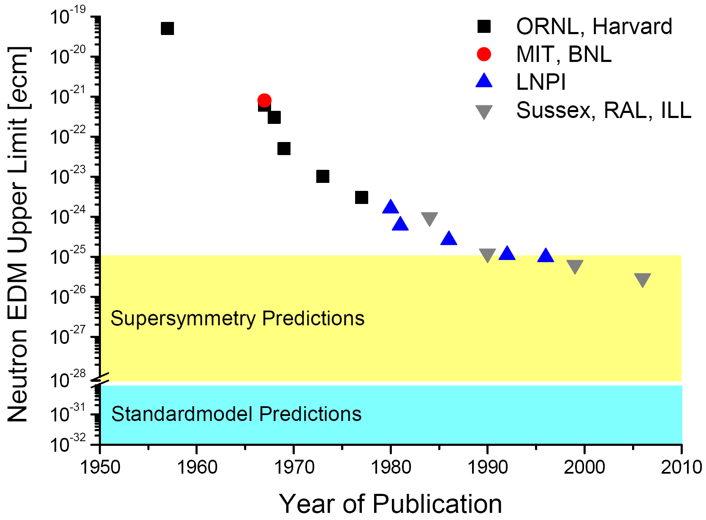
A great way to annoy theorists
d_{n} < 1.8 x 10⁻²⁶ ecm (90% C.L.)
C. Abel et al., Phys. Rev. Lett. 124, 081803 (2020)
Many groups pursuing ~ 10⁻²⁷ ecm measurement as next step
PSI
New UCN source
technology
TUCAN, others
SNS
2020
2030
Adapted from https://en.wikipedia.org/wiki/Neutron_electric_dipole_moment

Slide 6
Goals of the TUCAN collaboration
Search for nEDM at 10⁻²⁷ ecm sensitivity
Build the world’s strongest UCN source
Provide a second UCN delivery port as a user facility

Slide 7
A unique spallation-driven UCN source using superfluid helium
UCN-production cross section
in superfluid helium
phonon
(neV)
He-II
(1.1 K)
Cold
neutron
(meV)
(20 K)
tungsten
(MeV)
(300 K)
(480 MeV cyclotron)

Slide 8
Neutron spallation source
Fast kicker magnet to share proton beam with CMMS
10.1016/j.nima.2019.01.074
10.1103/PhysRevAccelBeams.22.102401

Slide 9
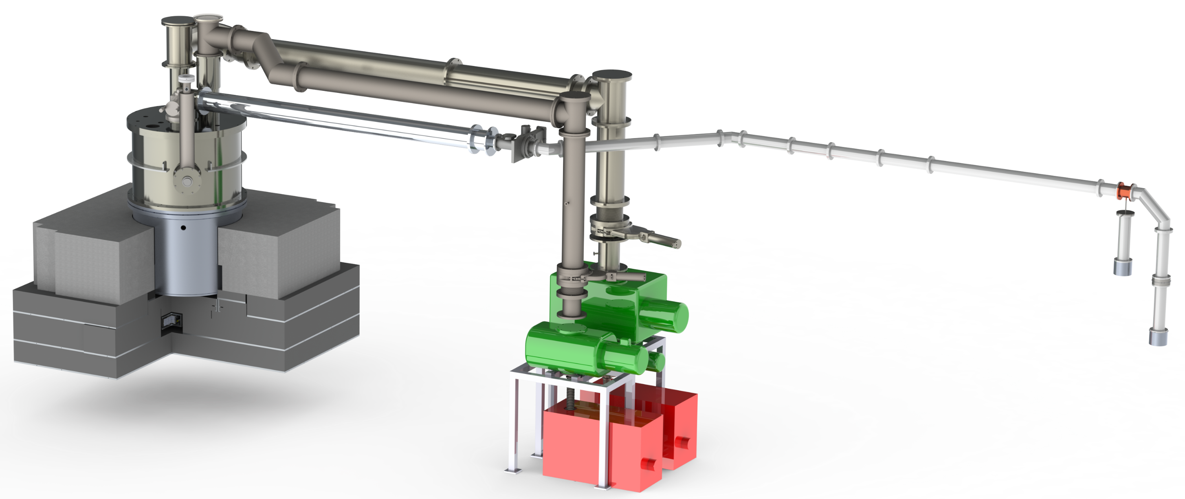
Prototype source (decommissioned 2020)
Pumping ducts
³He Cryostat
D₂O (20 K)
⁴He (0.9 K)
UCN guides
UCN valve
Pumps
UCN detectors
0
1
Spallation target
m
Helped us learn a lot during three runs (2017 – 2019):
Potential performance bottlenecks, clogging issues
Tested UCN guides (polishing, NiP coatings), valves, polarizers & detectors
S. Ahmed et al., Phys. Rev. C 99, 025503 (2019)

Slide 10
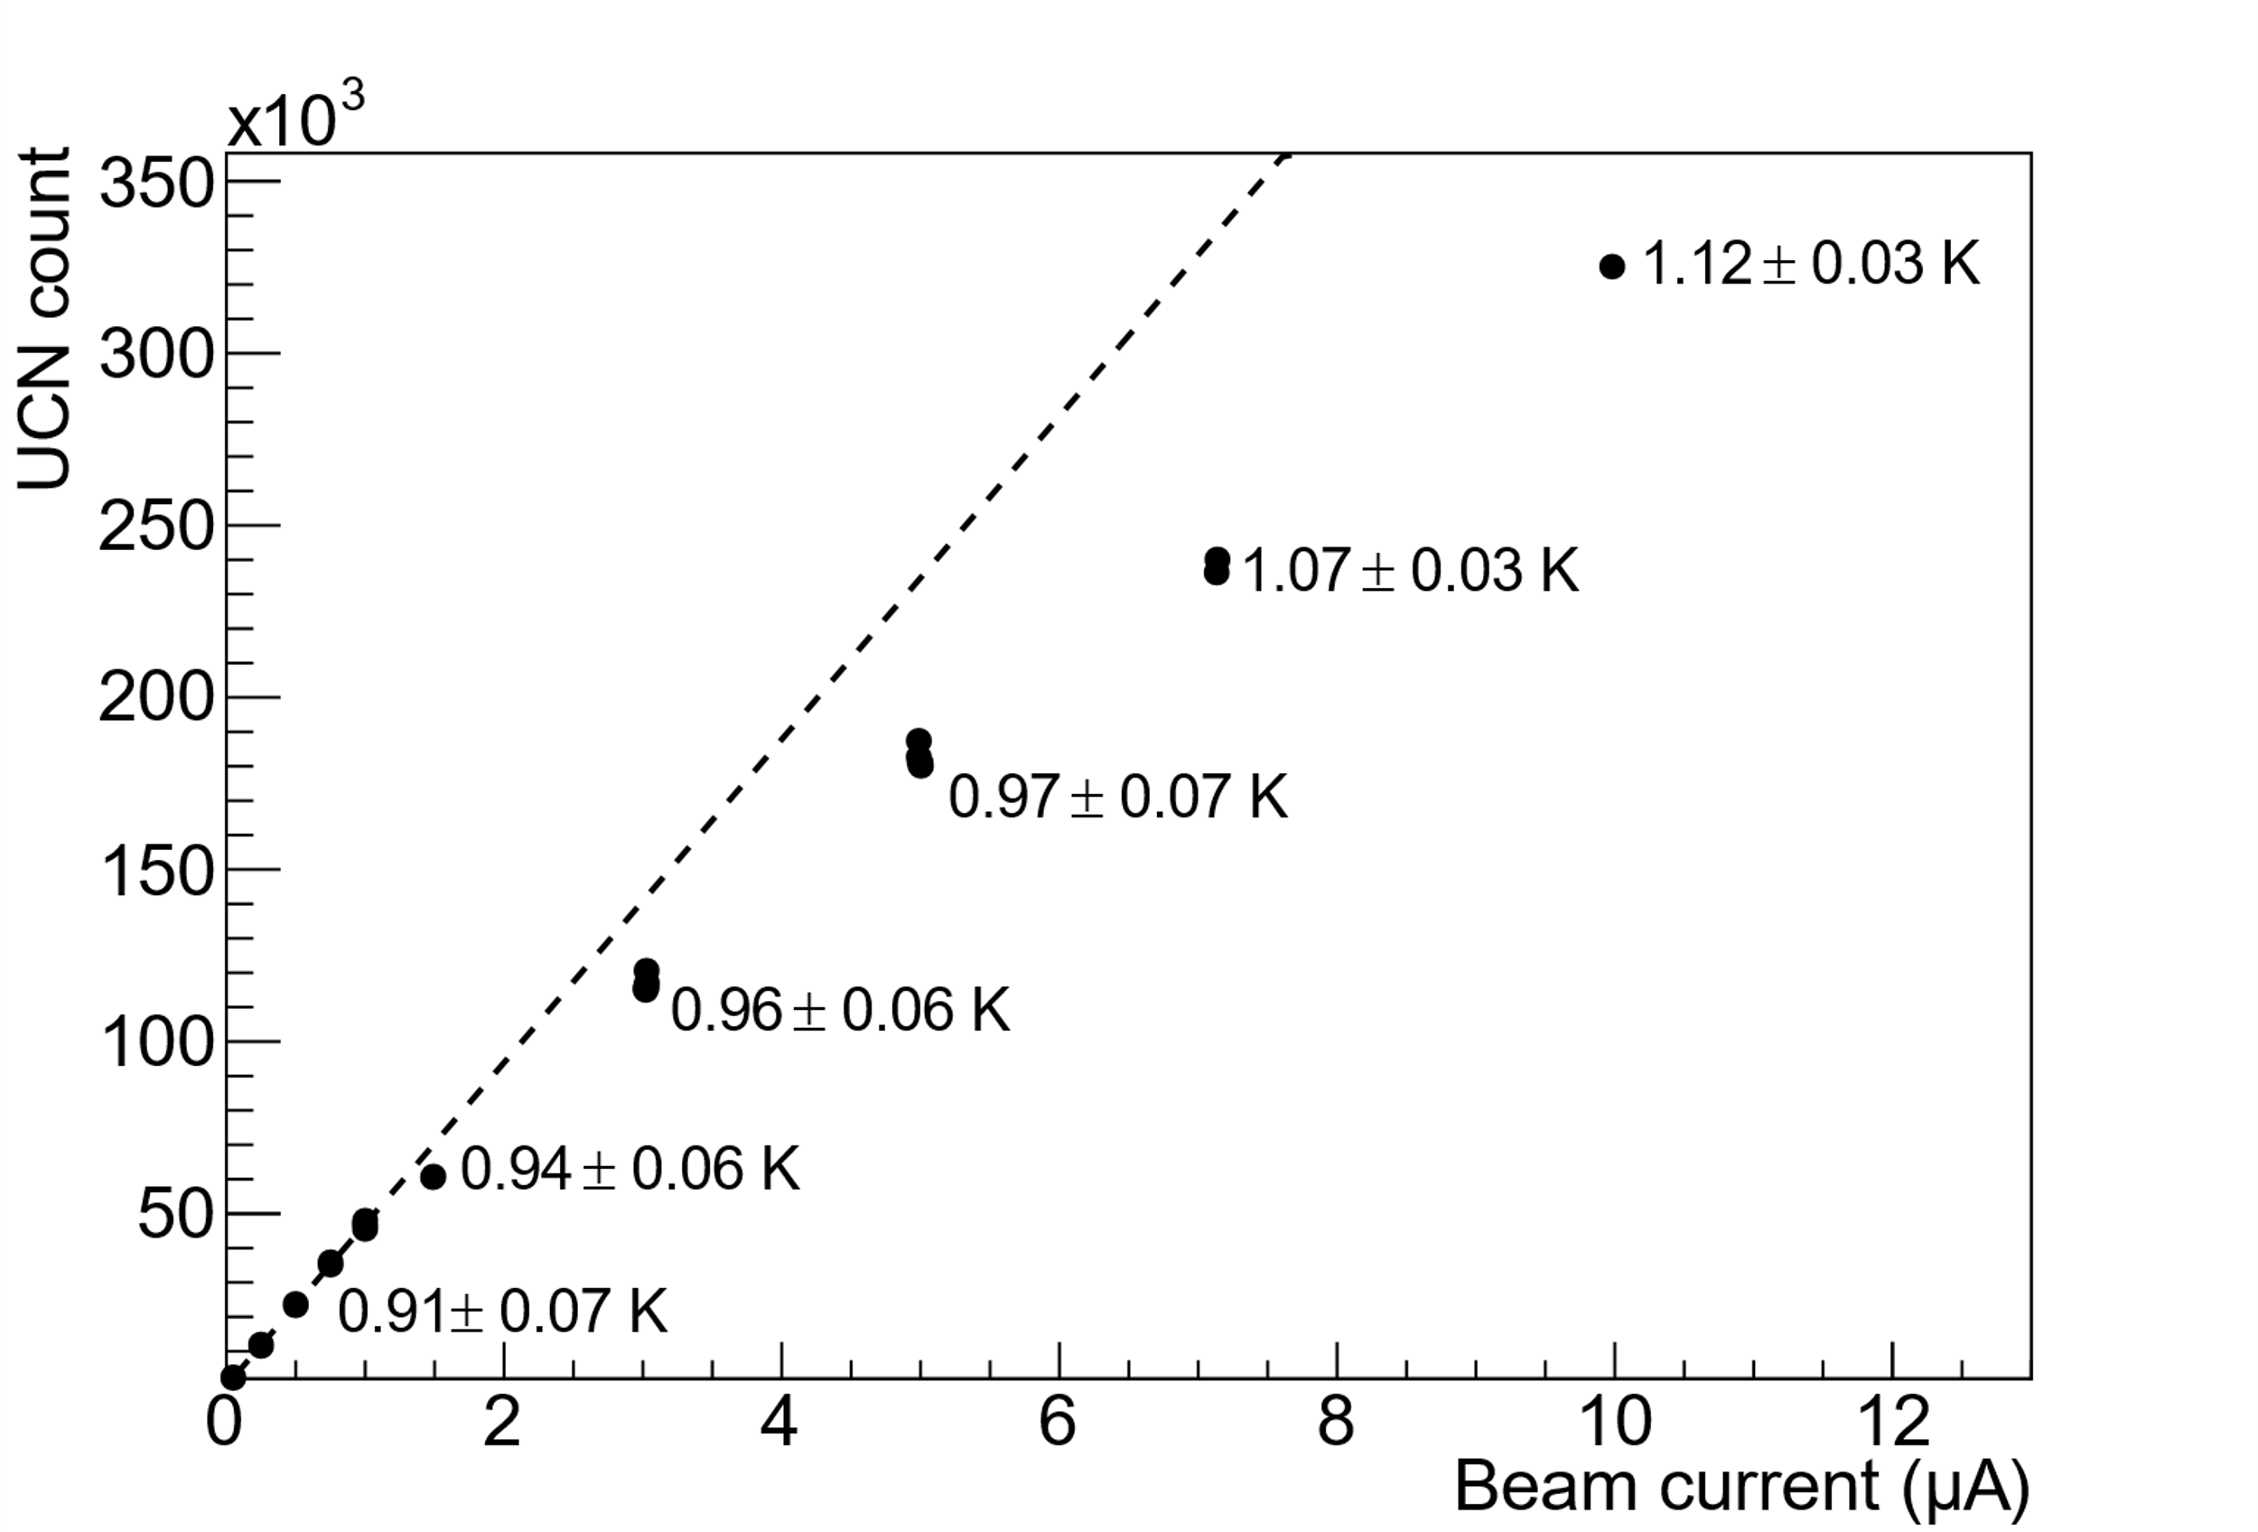
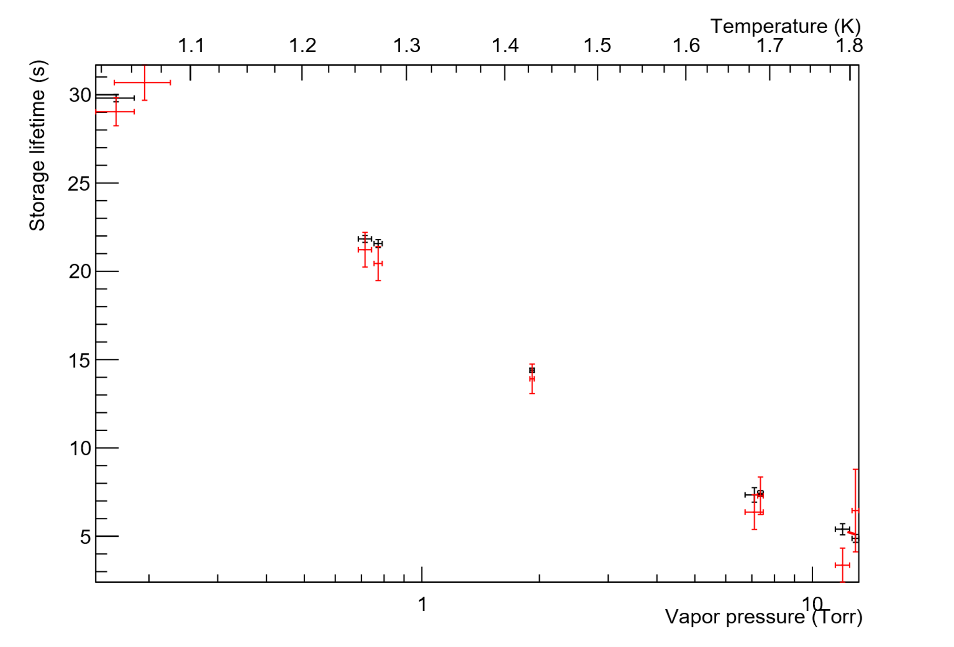
Performance of prototype source
PRELIMINARY
UCN lifetime in He-II strongly dependent on temperature ➔ need low temperature, high cooling power
S. Ahmed et al., Phys. Rev. C 99, 025503 (2019)

Slide 11
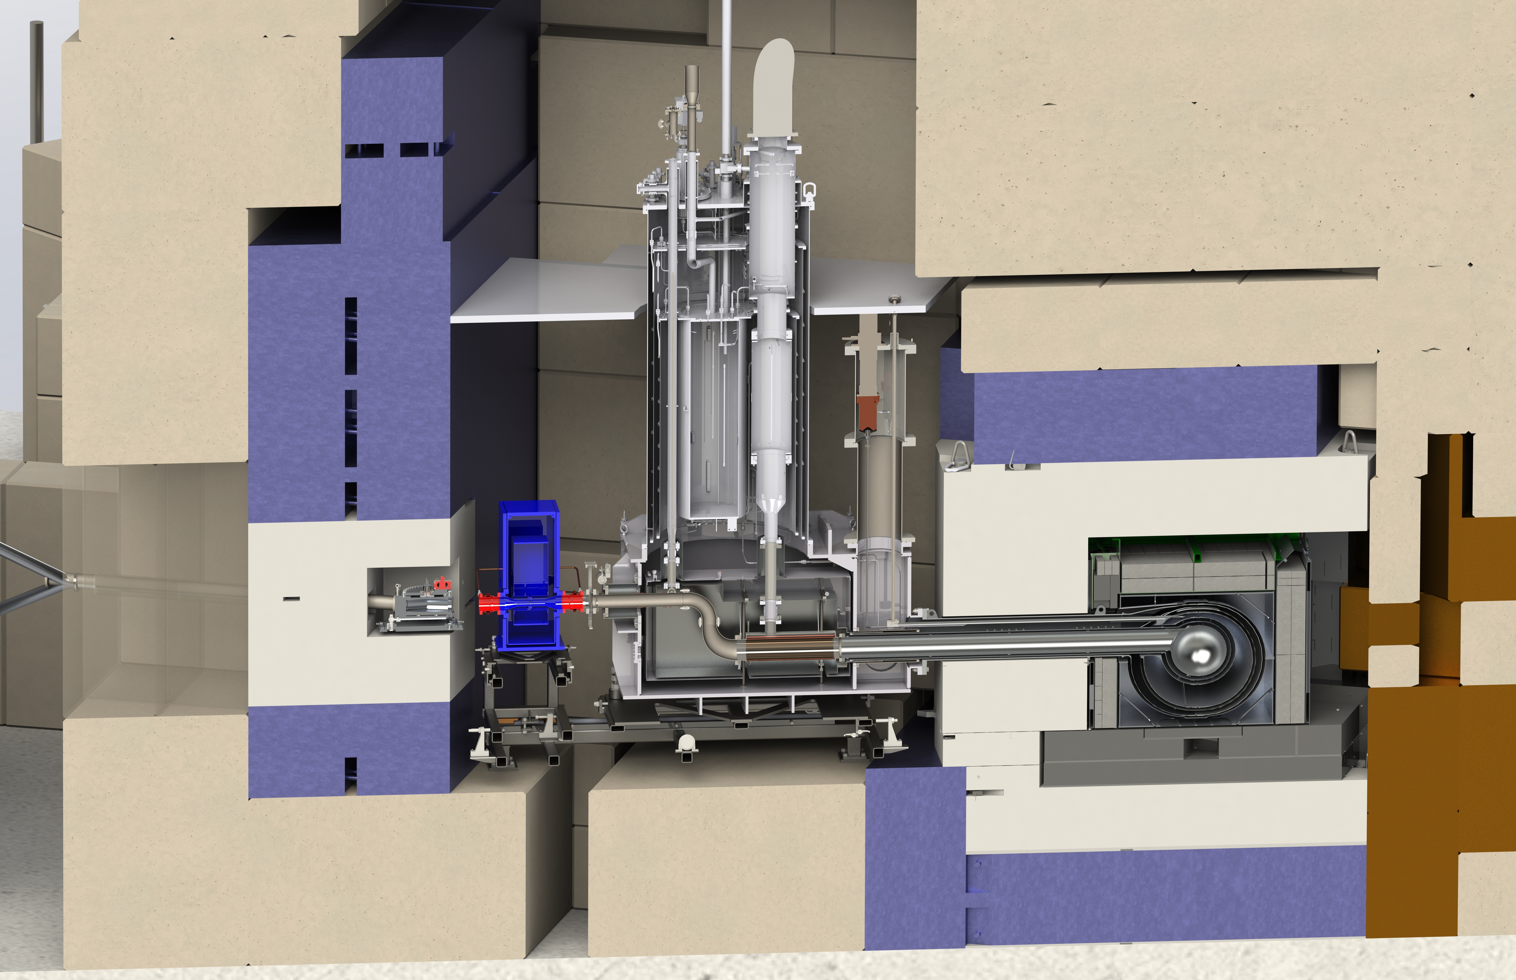
TUCAN source
40x proton-beam current
Optimized moderator geometry
Liquid deuterium moderator
4x He-II production volume
40x cooling power (10 W @ 1.1 K)
800x UCN-production rate (1.5x10⁷)
W. Schreyer et al, Nucl. Instrum. Meth. Phys. Res. A 927, 101-108 (2019)
³He cryostat
LD₂ cryostat
Concrete
shielding
Concrete shielding
To nEDM
Steel shielding
B₄C-filled panels
Graphite
D₂O
LD₂
He-II
Target
Steel
shielding
To 2nd
port
³He-⁴He heat
exchanger
0
1
Supercond.
polarizer
m

Slide 12
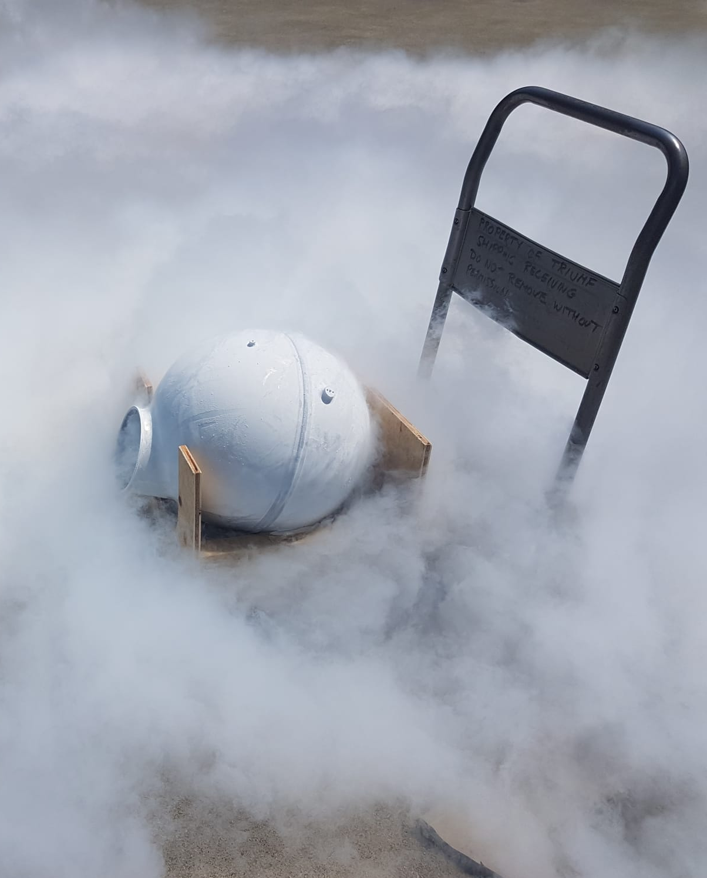
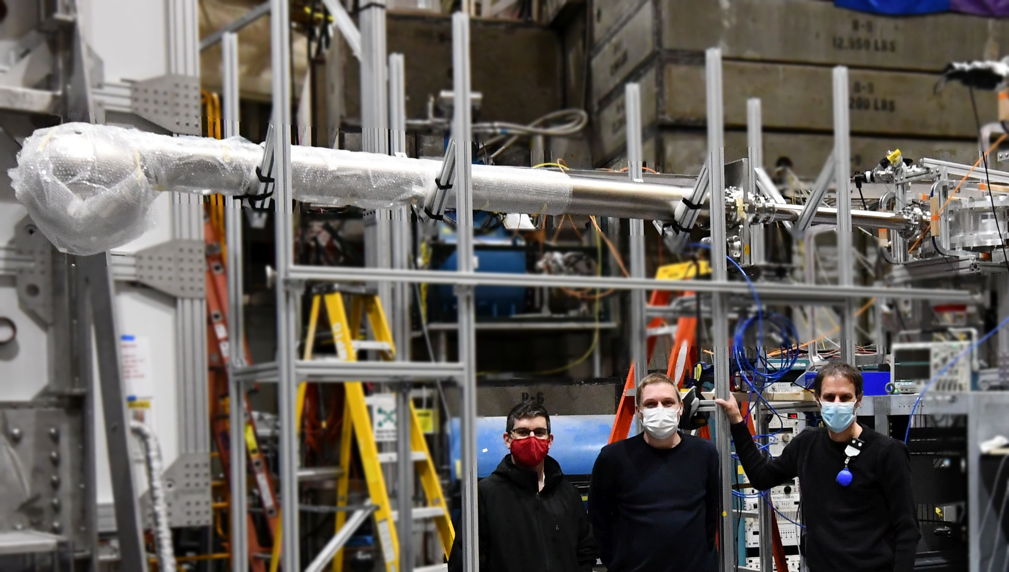
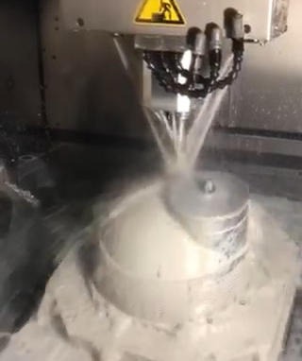
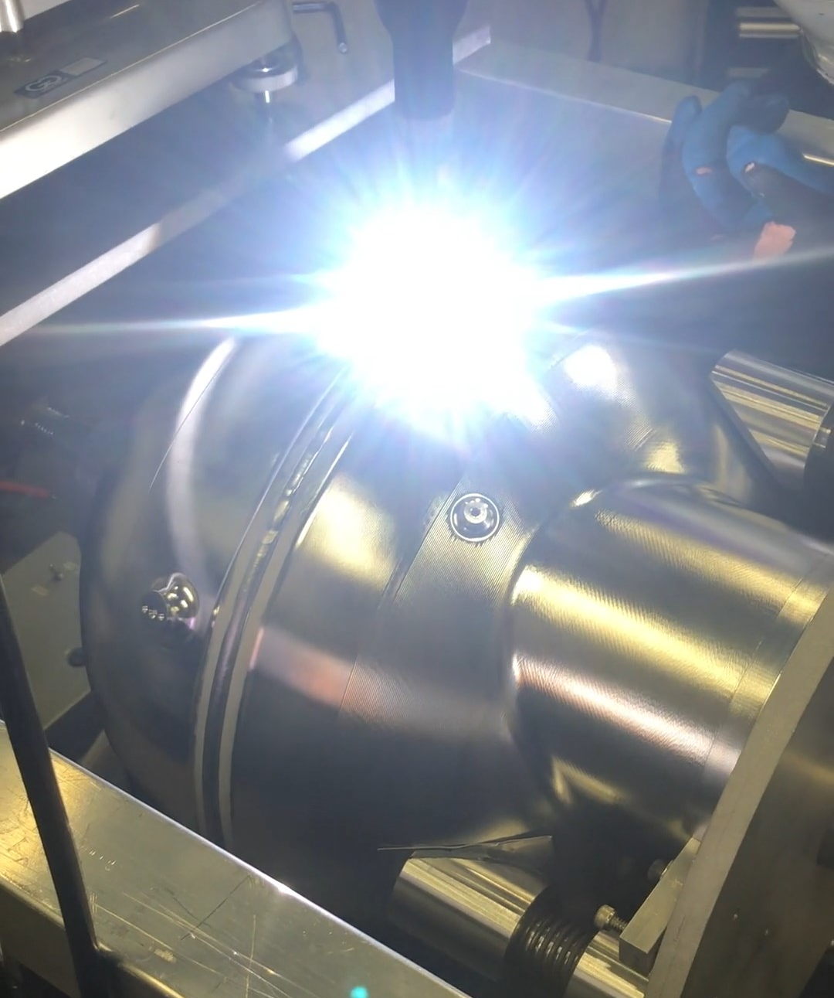
Superfluid-helium converter vessel
LANL UCN
source
He-II vessel
UCN valve
Machined, thin-walled Al domes to minimize neutron absorption and heat load
UCN-reflective NiP coating: Measured UCN storage lifetime at LANL in 2021
➔ higher loss rate than expected, but acceptable
Superfluid-tight: Undergoing extensive leak checking

Slide 13
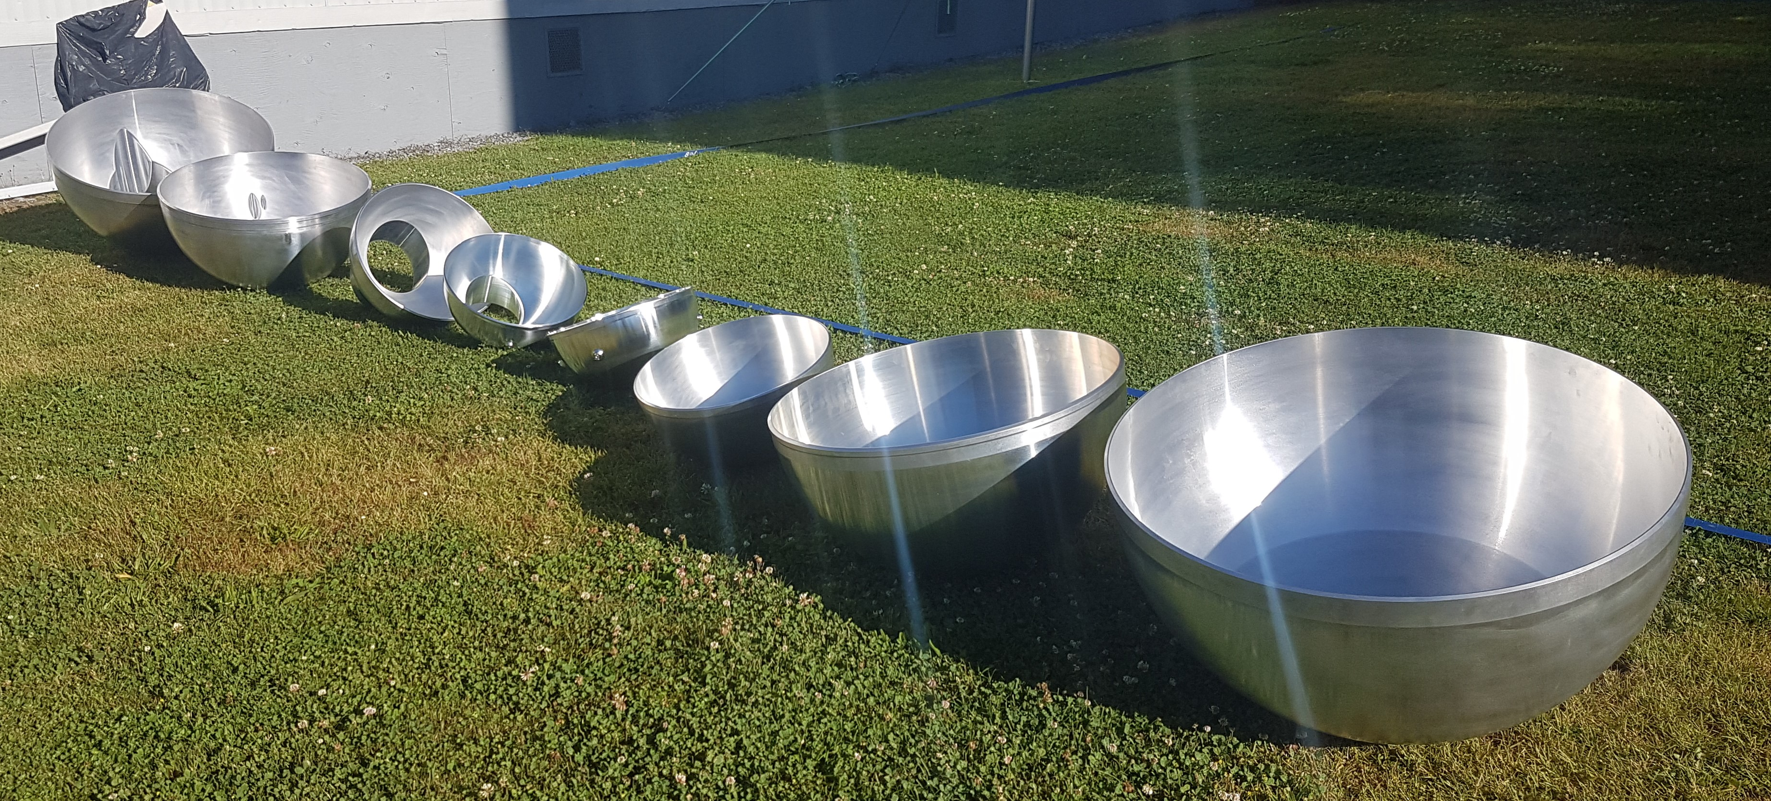
Moderator vessels
Machined, thin-walled Al domes to minimize neutron absorption
Withstand potential D₂ explosion pressures
Machining finished, preparing to start complicated assembly
0.8 m
D₂O
LD₂
He-II

Slide 14
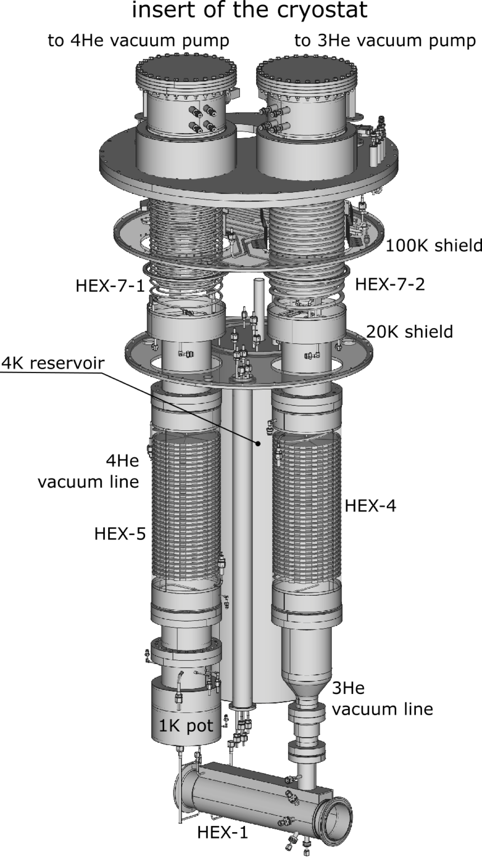
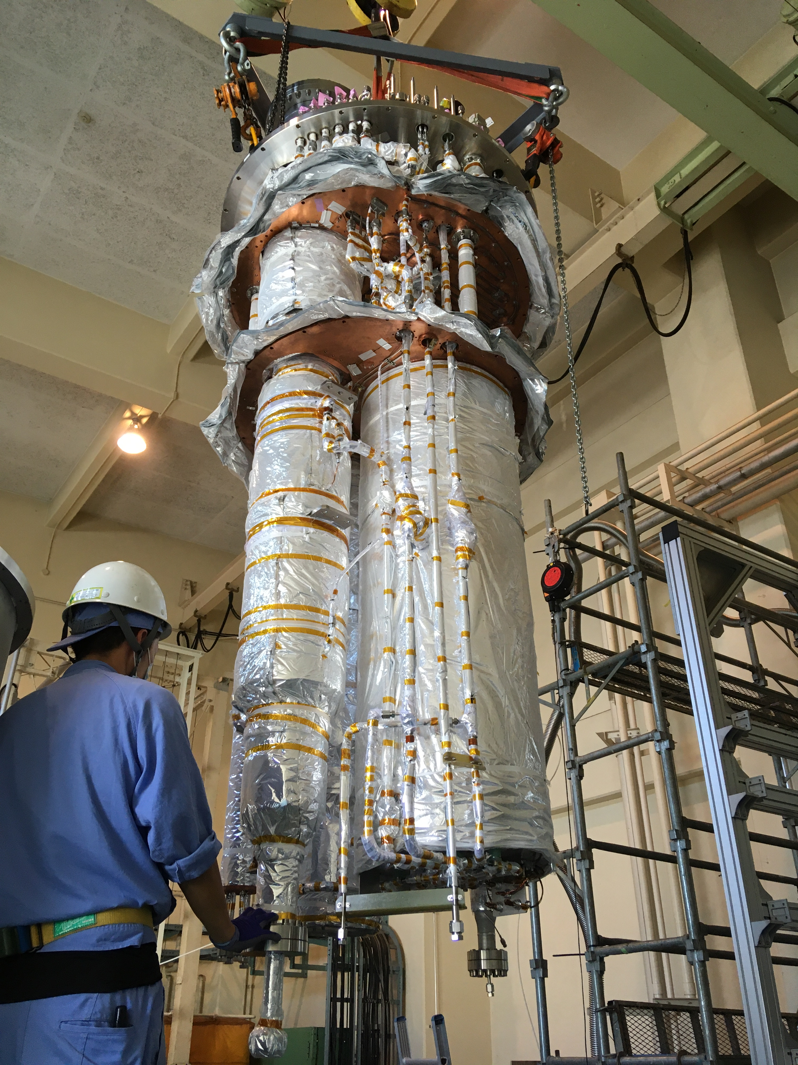
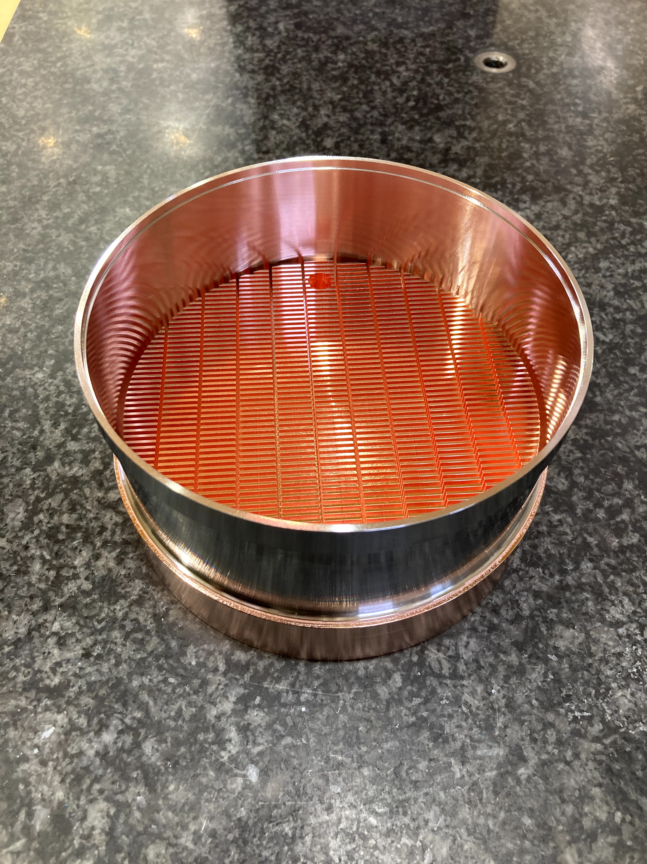
Cooling power: 10 W at 1K
3He fridge built & tested in Japan, shipped to TRIUMF in 2021
Pumps arrived 2021
Undergoing acceptance tests
⁴He
pumping
³He
pumping
³He pumping
³He-⁴He heat exchanger designs
UCN

Slide 15
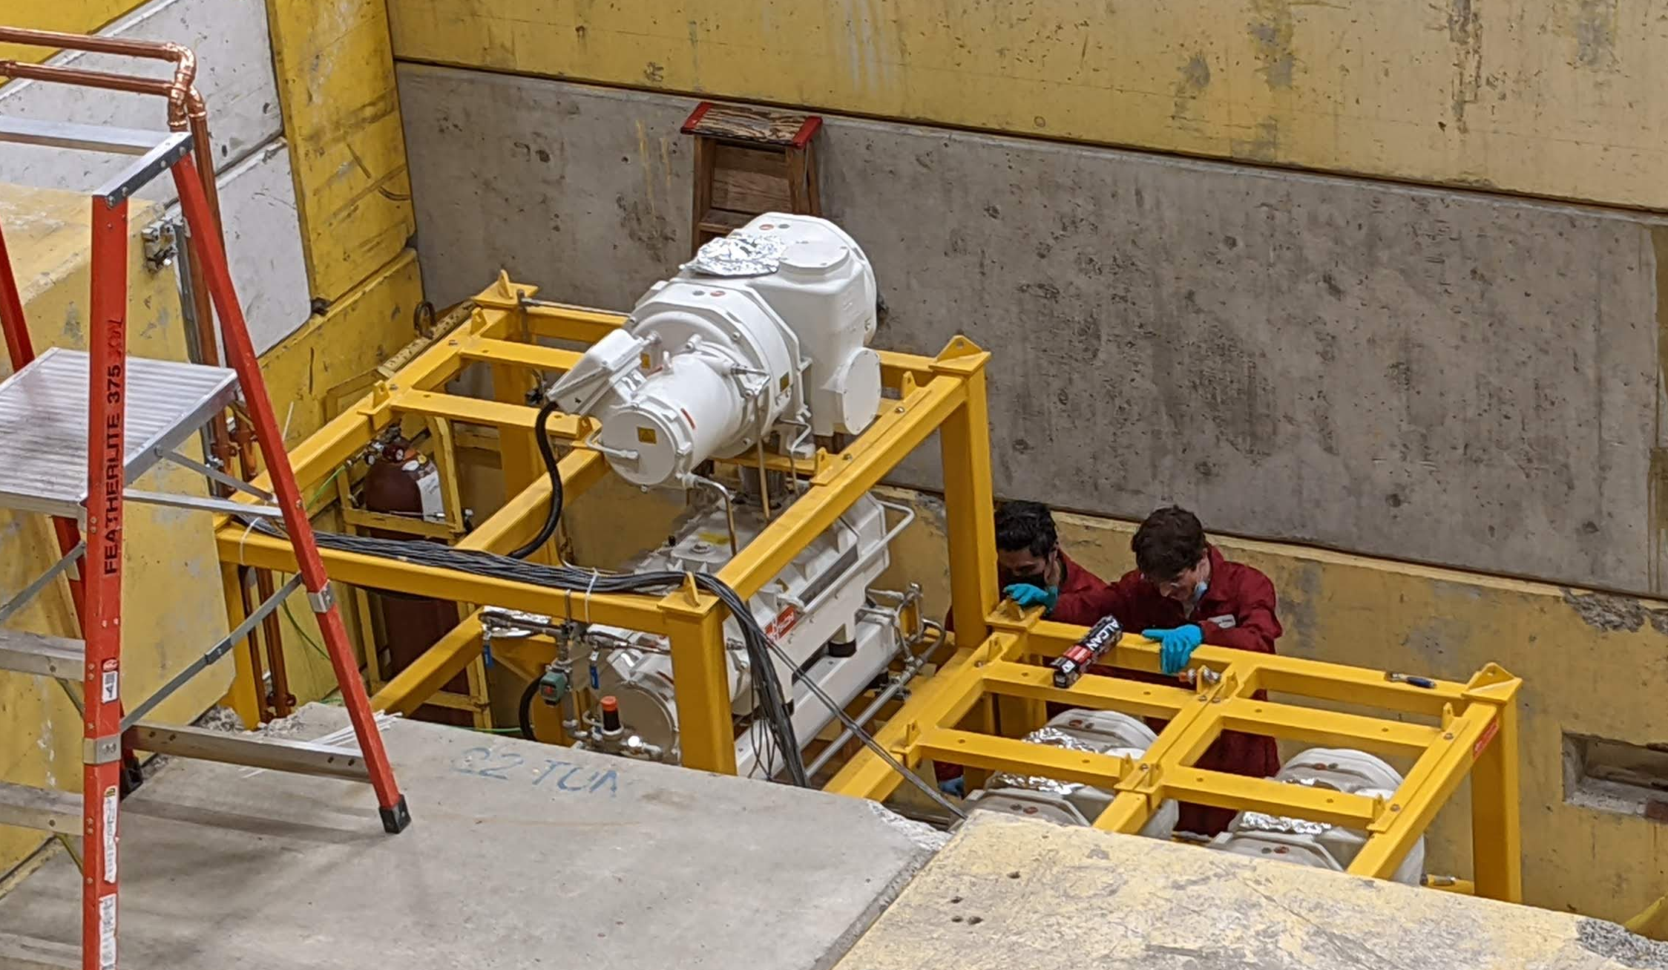
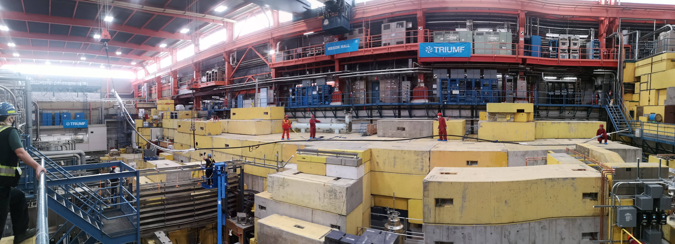
Lots of infrastructure
33 m-long liquid-helium transfer line
Large pumps to cool cryostat
Power
Cooling water
PLC
Pumping ducts
Piping for four
different gas systems

Slide 16
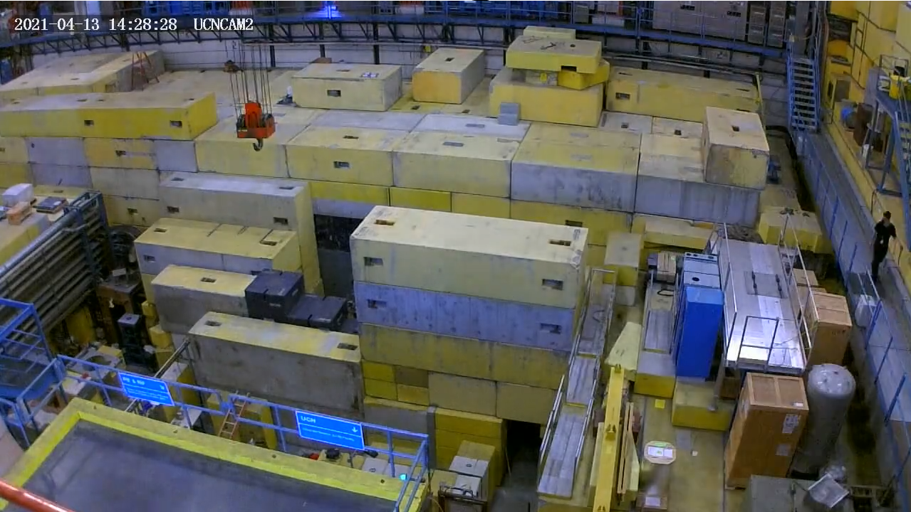
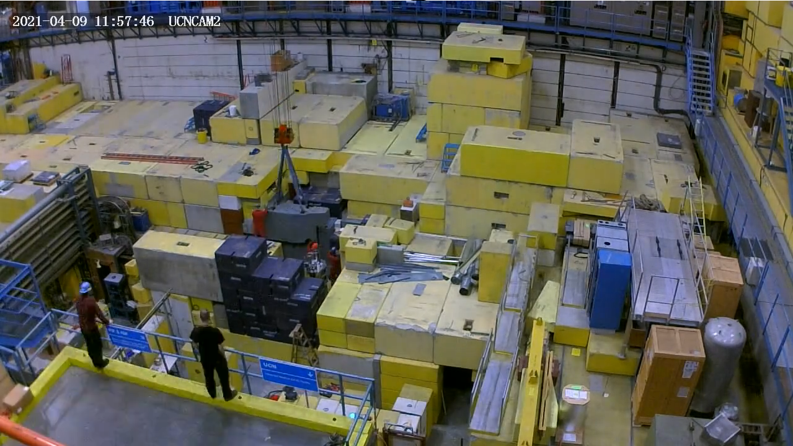
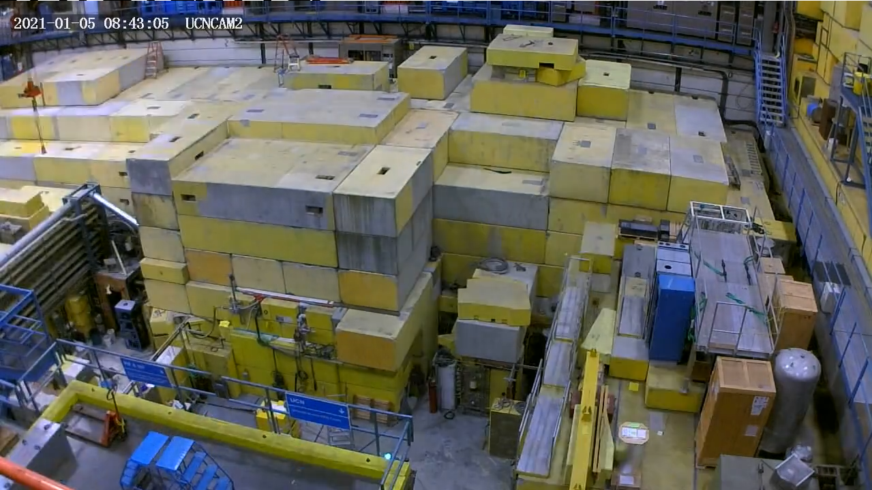
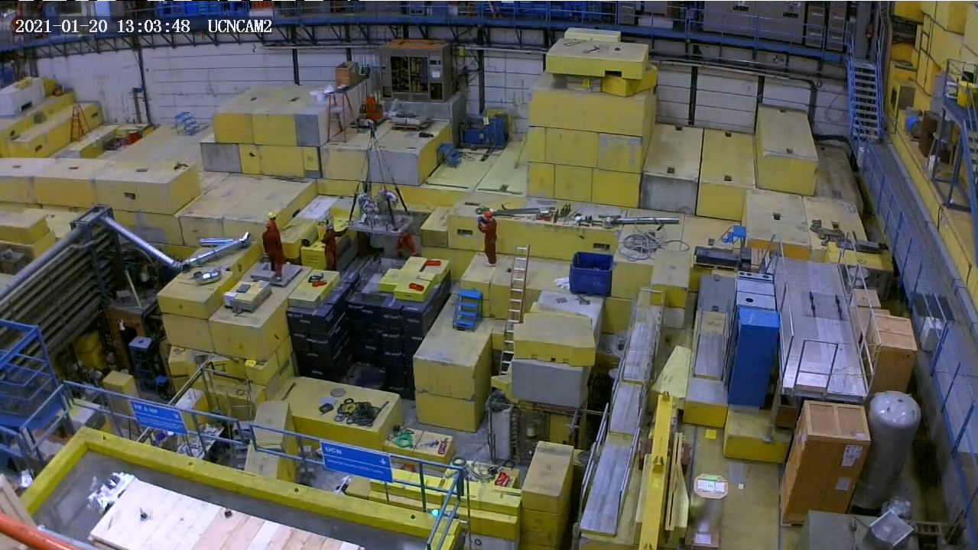
Radiation shielding
2021:
Reconfigured radiation shielding, foundation for moderator & cryostat installation
Removing prototype source
Service installation
Original shielding
Reconfiguration
Covering up

Slide 17
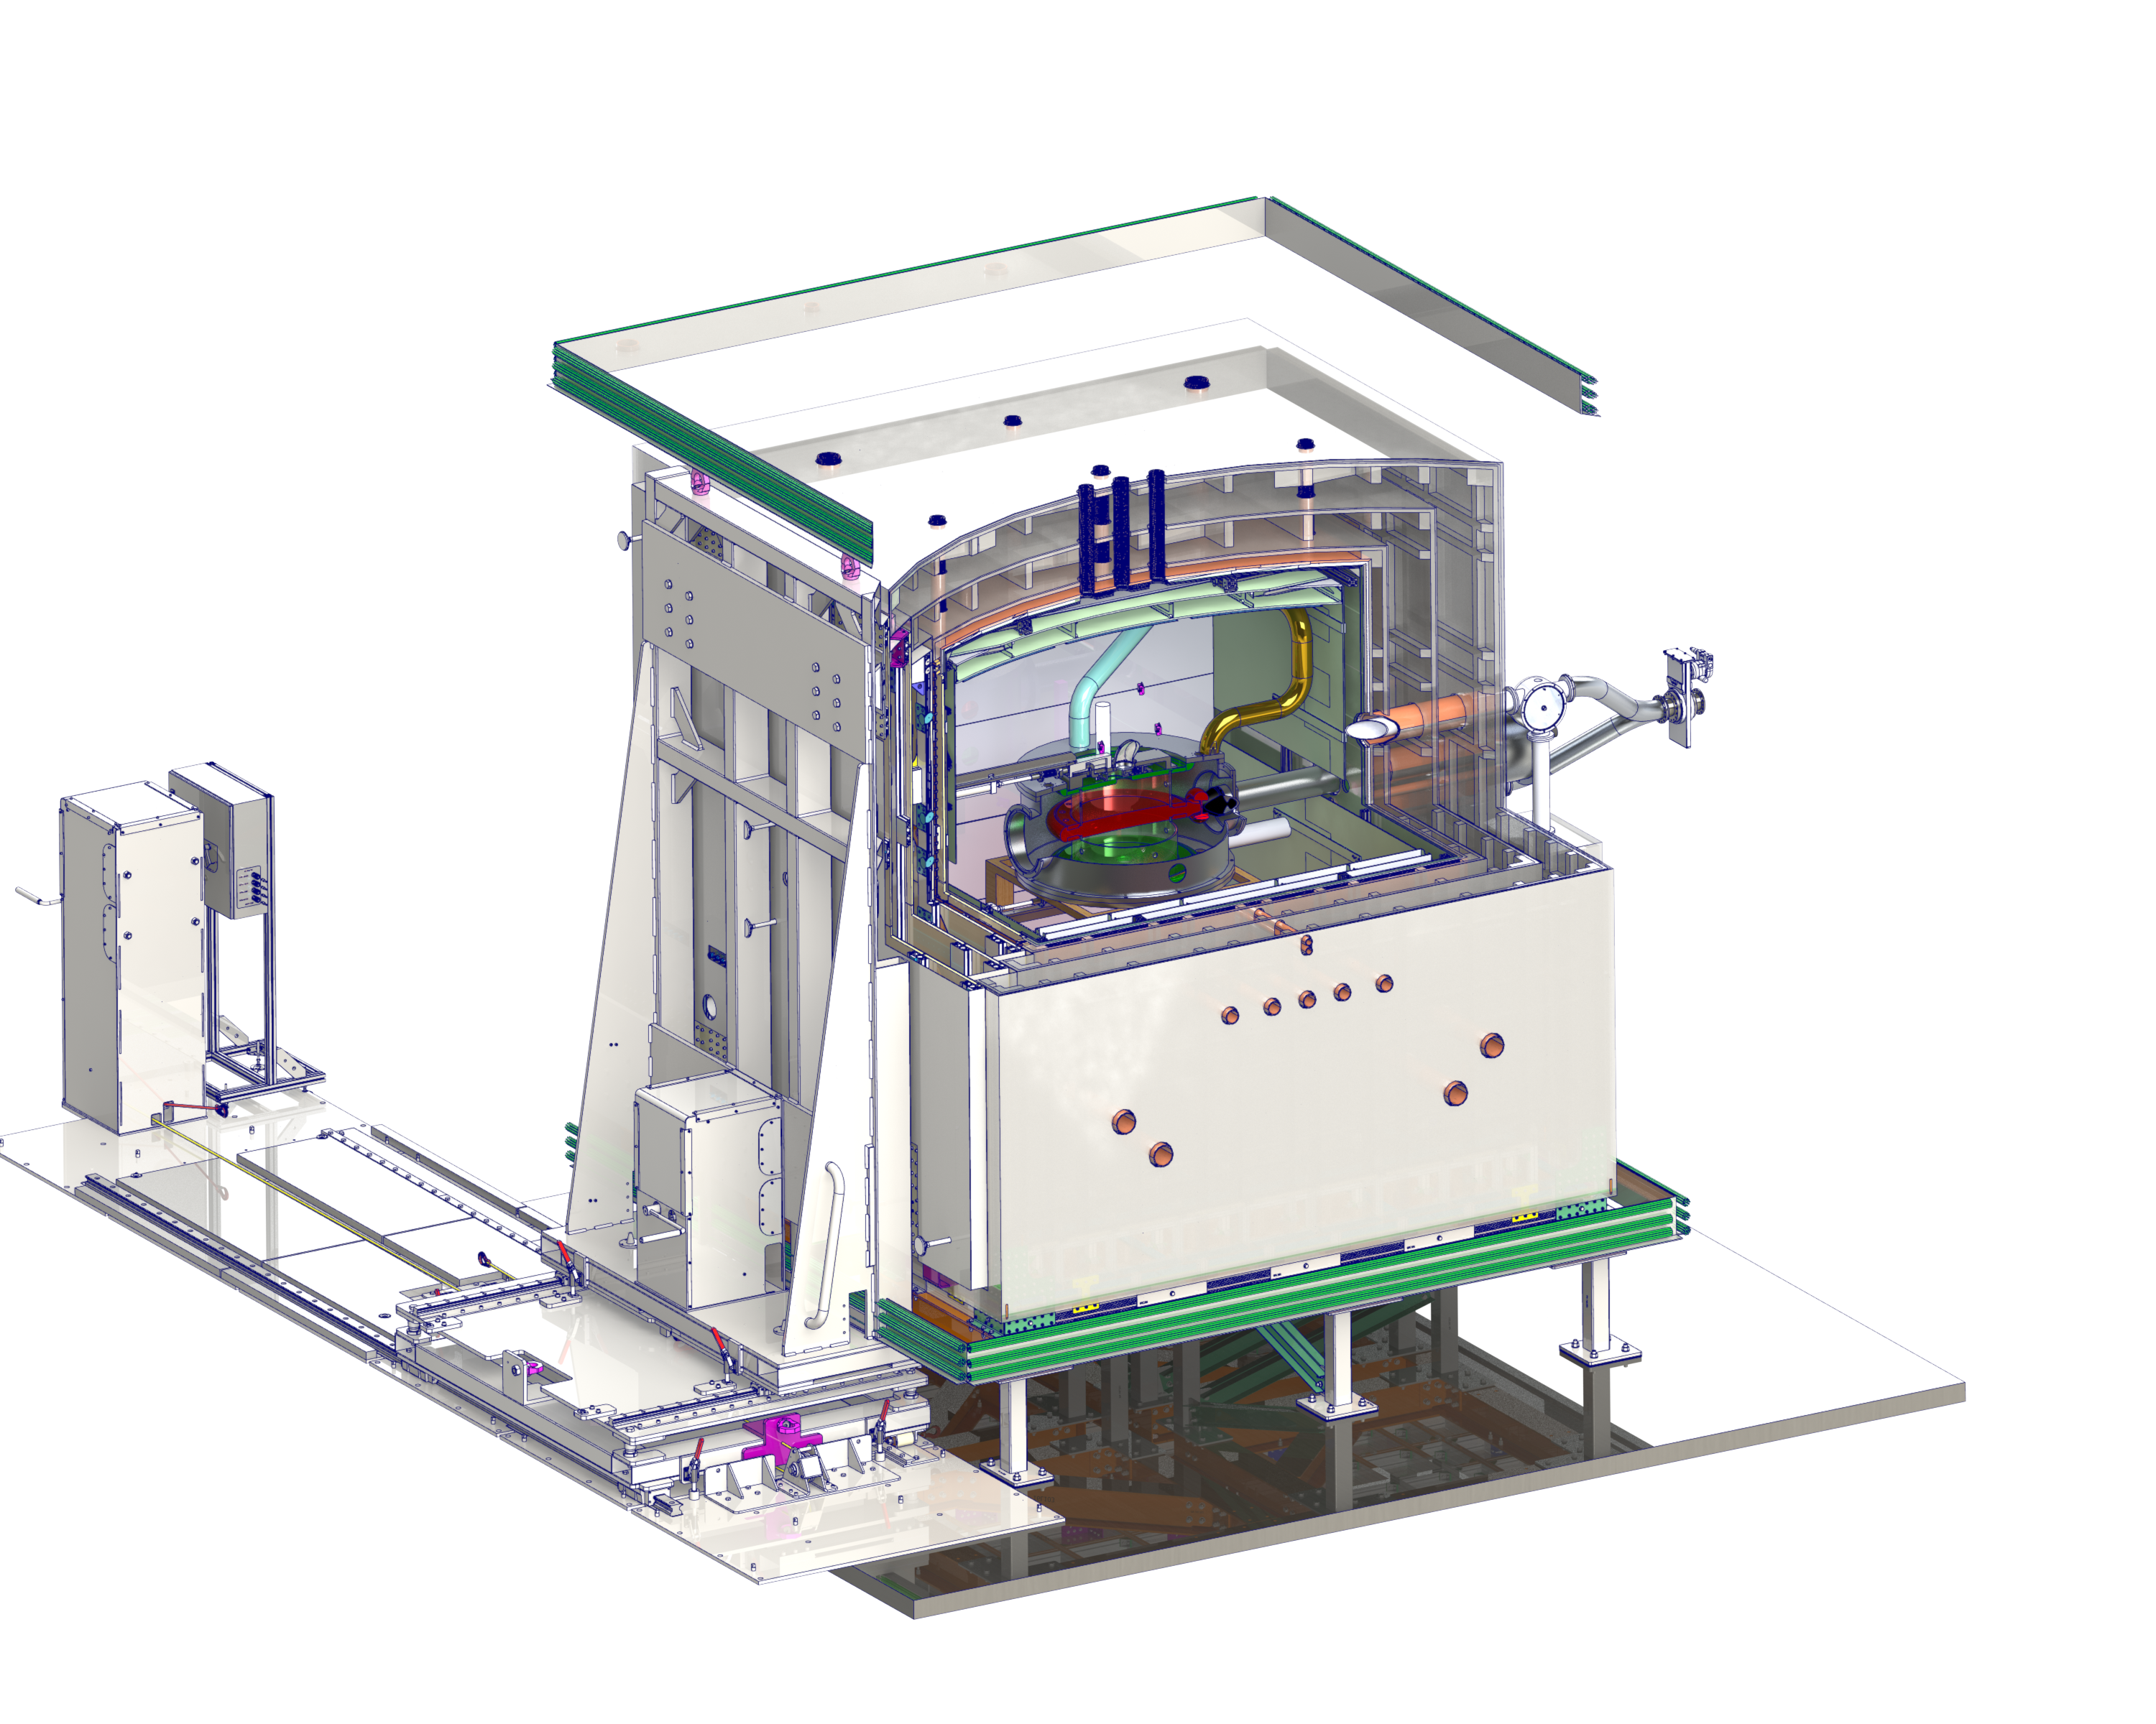
TUCAN EDM
Self shielded B₀ coil
(box cos theta)
UCN switch
Dual (top/bottom) measurement cells &
Hg comagnetometer
Polarized UCN
Spin analyzer, & detector x 4
3.5m
Magnetically
shielded room
with sliding door

Slide 18
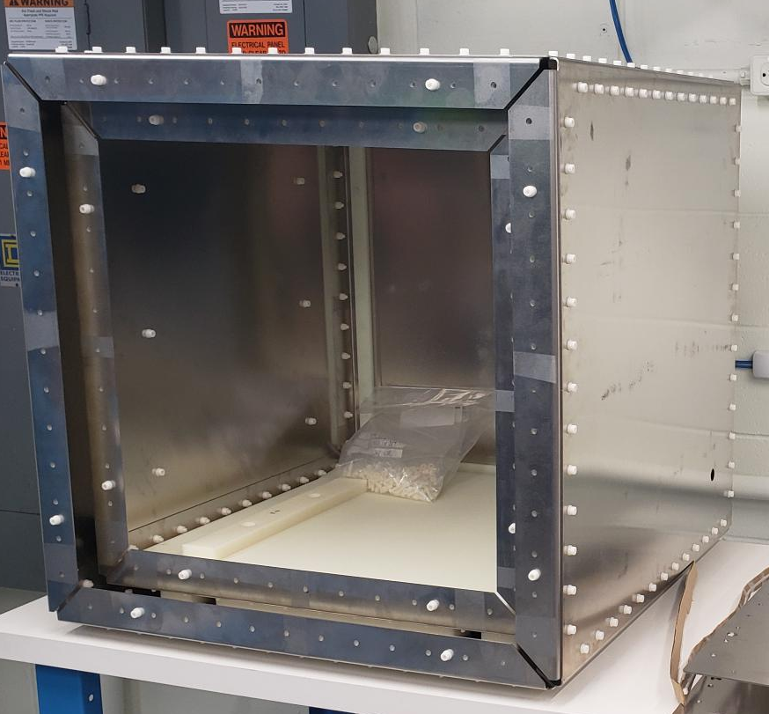
Magnetic shielding
3.5m
0.75m
Prototype shield
Shielded room installation starting this month
Internal coils nearing construction

Slide 19
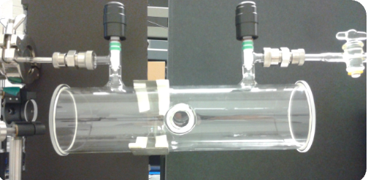
Magnetometry
Hg comagnetometer prototype achieved 10s free precession, 1 pT resolution
Goal: 10 fT
Operating 5 optical Cs magnetometers & 5 more on order

Slide 20
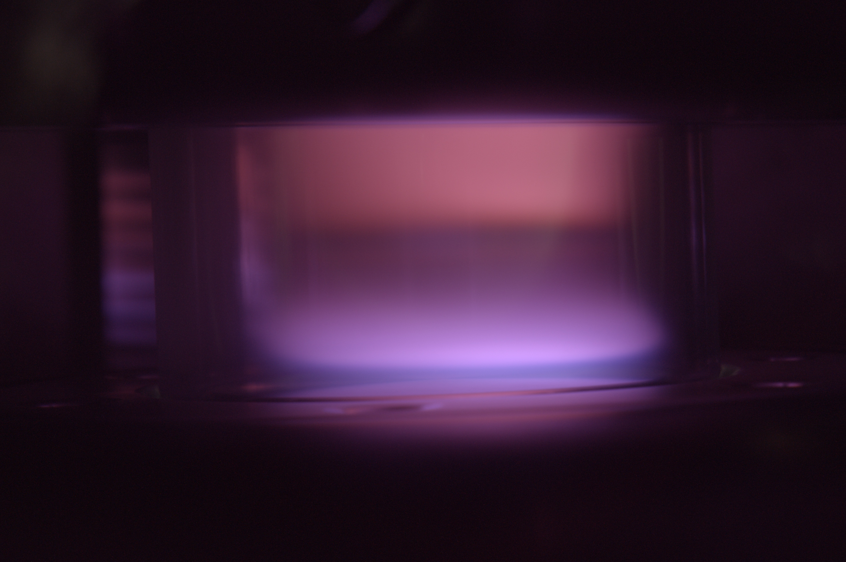
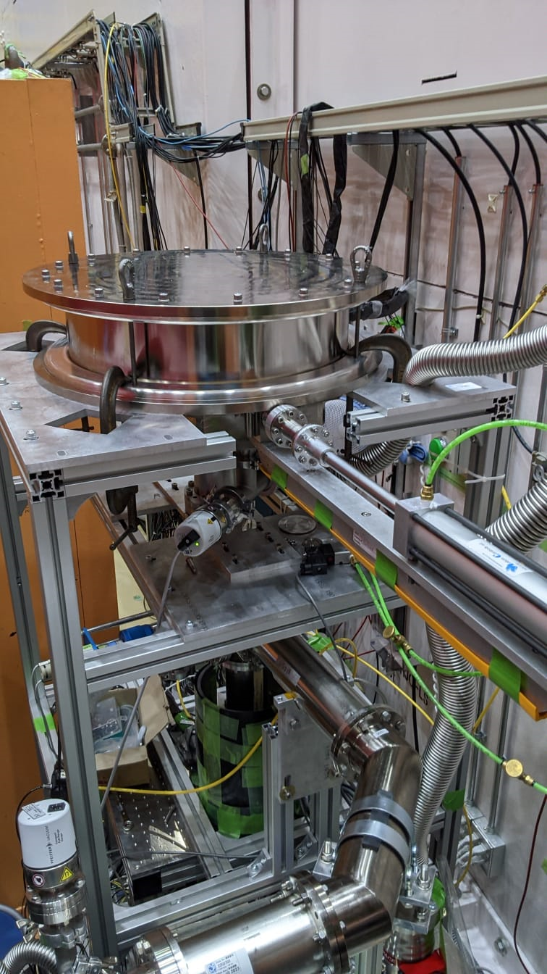
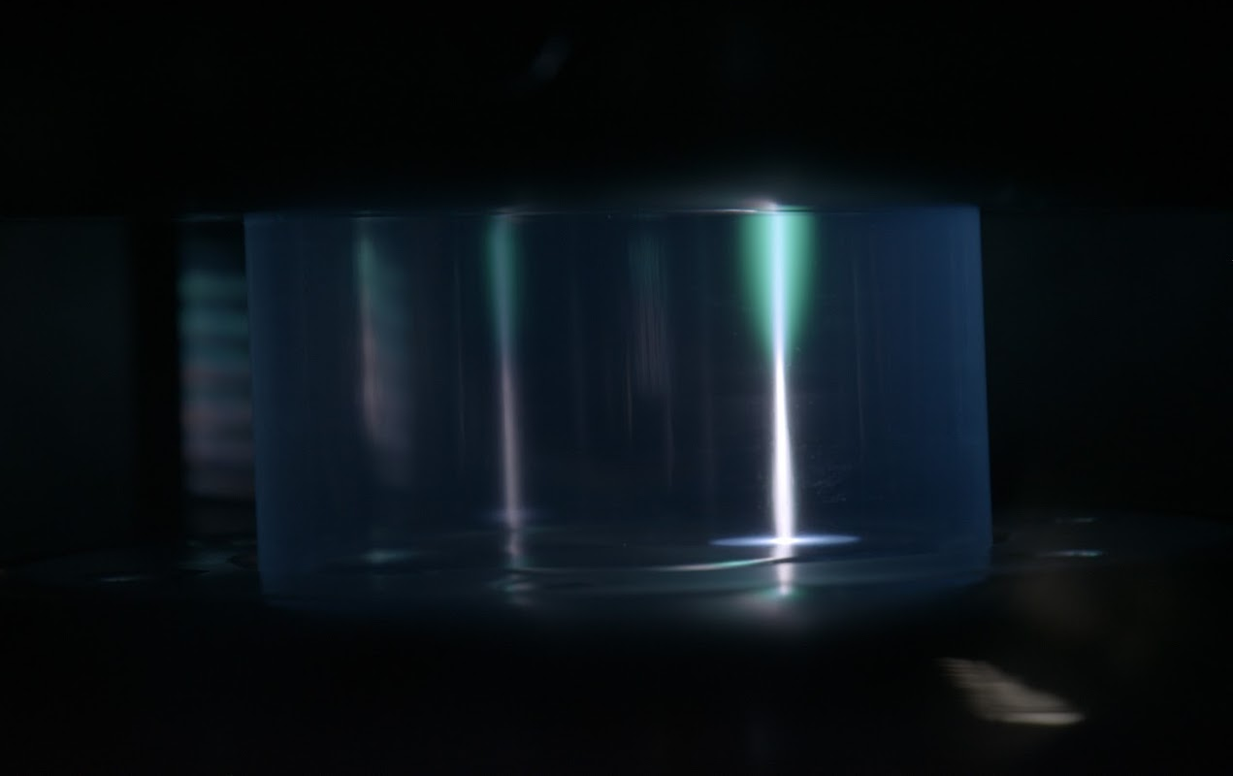
Precession cell
HV discharge testing
of electrodes, insulators, coatings, comag gases
Recently tested at J-PARC UCN source:
Prototype cell & valve, polarizers, detectors

Slide 21
Outlook
Q3 2022:
Cryostat installation
Start shielded room installation
Q4 2022:
First cryostat test
Q1 2023:
Moderator installation
Complete radiation shielding
Q2 2023:
Full cryostat commissioning
Shielded room installation complete
Q4 2023:
First UCN production
Goals
Search for the neutron electric dipole moment with a sensitivity of 10⁻²⁷ ecm
Build the world’s strongest ultracold-neutron source
Provide a UCN port for other users

Slide 22
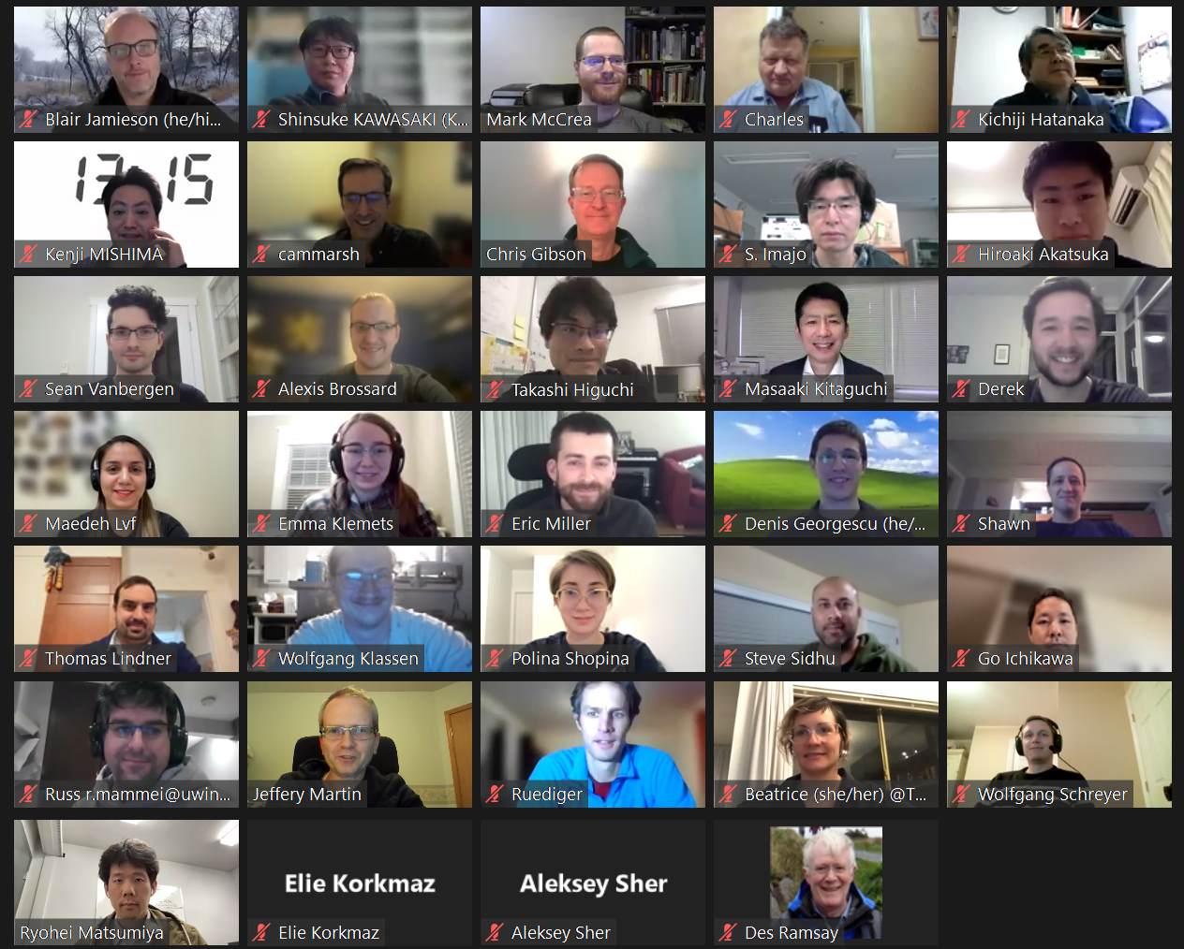
2022 virtual collaboration meeting
Thank you

