Slide 1
Studying LaNiO₃ and LaNiO₃/LaAlO₃ superlattices using ⁸Li β-detected NMR
Victoria Louise Karner

Slide 2
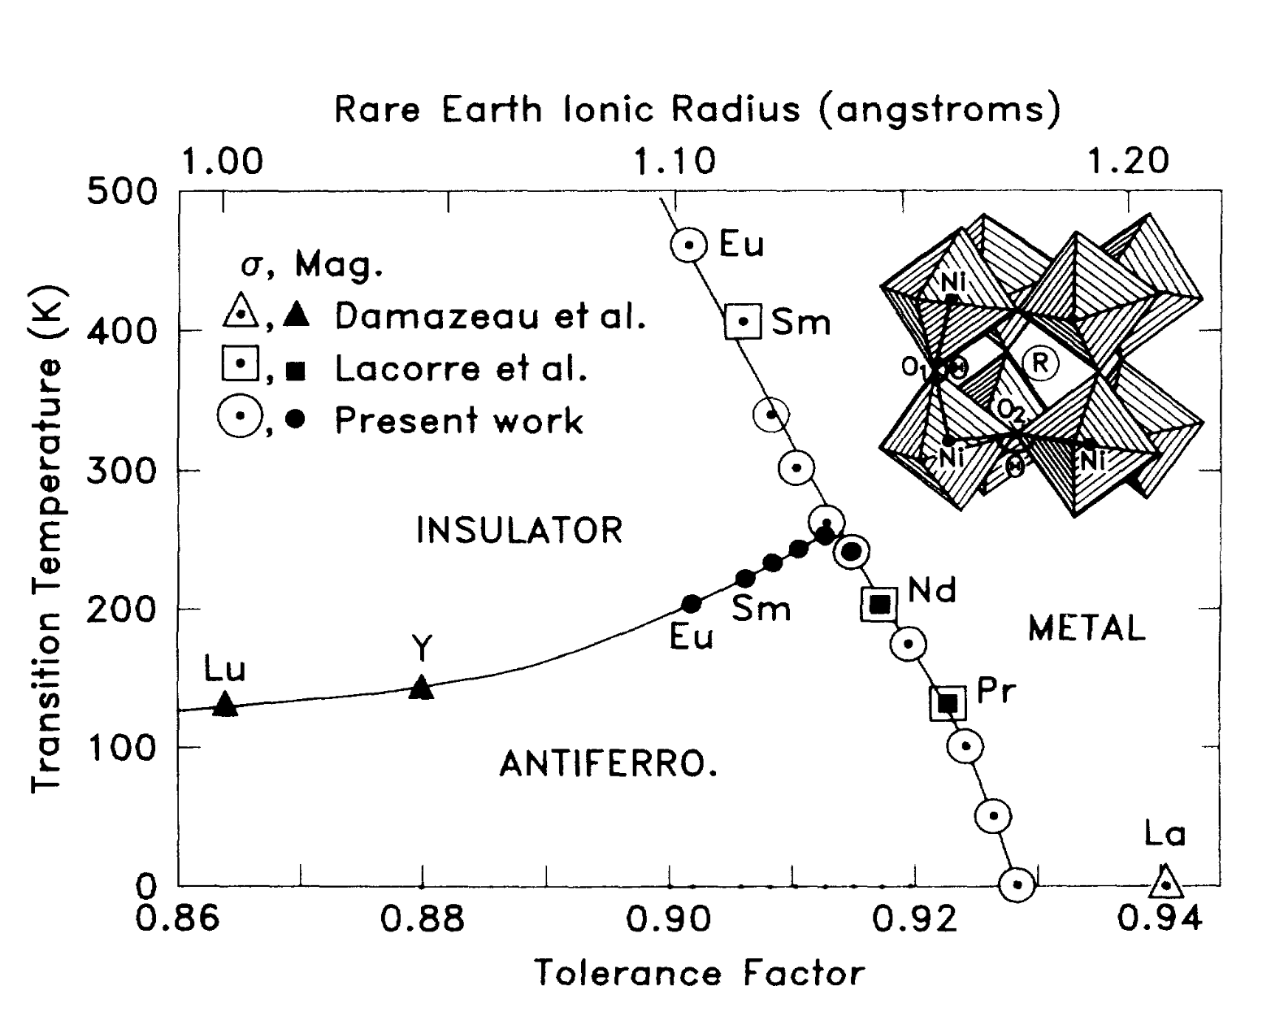
The metal-insulator transition in rare-earth nickelates (RNiO₃)
only metal!
2

Slide 3
Goal: Study the change in the metallic state of LaNiO₃ between the bulk and ultrathin layers in superlattices
3

Slide 4
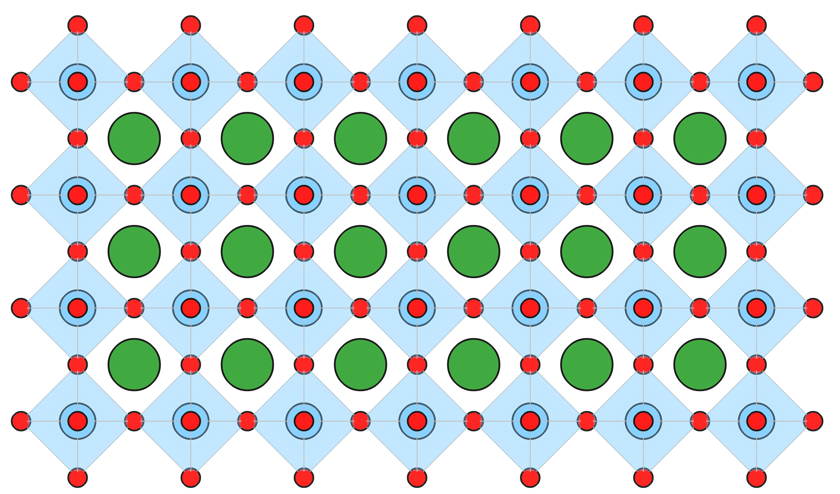
What is β-detected NMR?
UHV
B₀
Sample
$${}_{3}^{8}{Li → } {}_{4}^{8}{Be+ e^{−}+{\overline{ν}}_{e}}$$
$$t_{1/2} =848 ms$$
$$I =2$$
β-
4

Slide 5
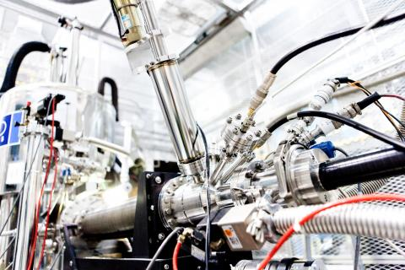
What is β-detected NMR?
Uses implanted β-decaying radioisotopes
The ions are spin polarized (magnetized) prior to implantation in sample
Detection is possible due to the anisotropy of β-decay
5

Slide 6
LaNiO₃ Samples
Single Crystal
38 nm PLD Film on LSAT
8 mm
J. Mitchell (ANL)
G. Cristiani (MPI-FKF)
A.V. Boris, et al. Science 332, 937 (2011)
6

Slide 7
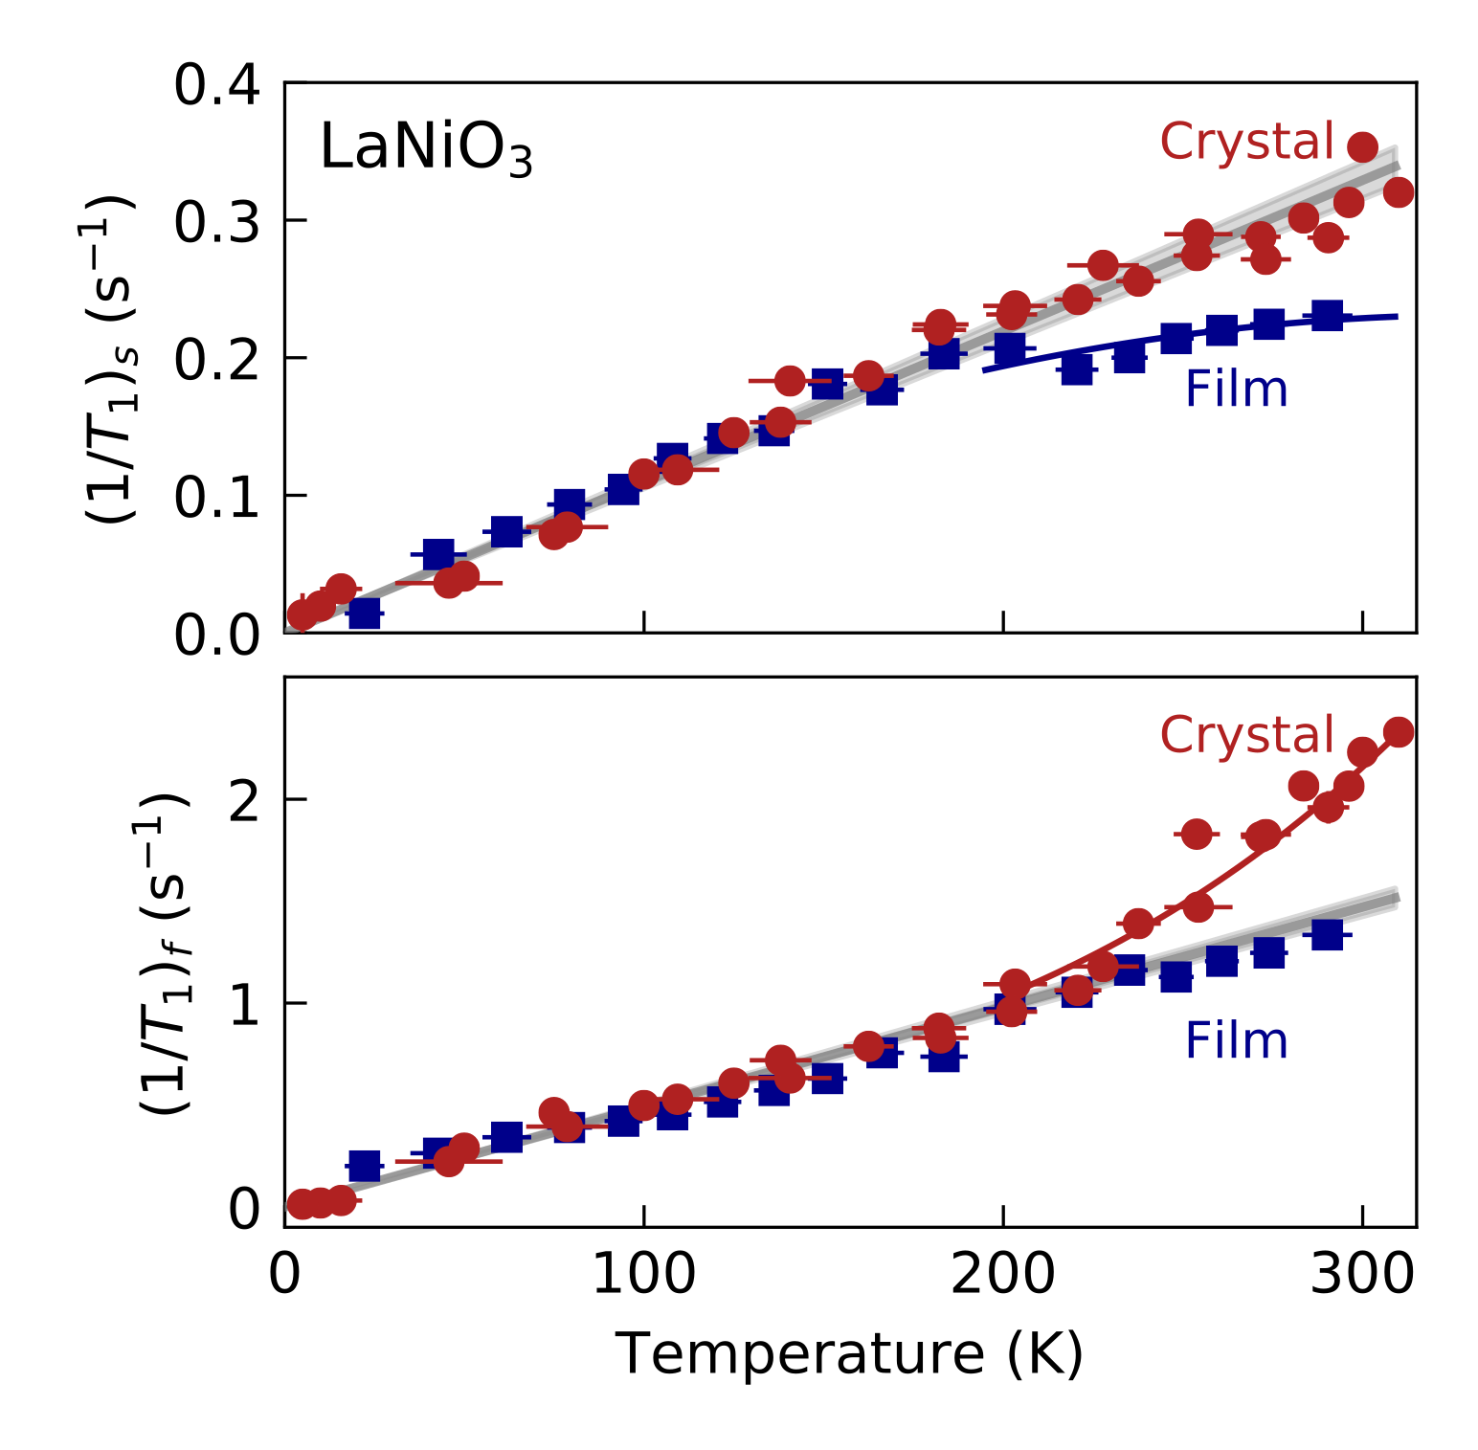
Excellent agreement between single crystal and film
Biexponential relaxation is surprising!
7

Slide 8
Summary of bulk LaNiO₃
Biexponential relaxation:
intrinsic to LaNiO₃
two different hyperfine couplings to ⁸Li
Linear SLR:
conventional metallic state
8

Slide 9
Structure of the LaNiO₃/LaAlO₃ superlattices
wide band gap insulator
LNO lattice constant ≈ 3.75 Å
9
Notes:
The goal of the experiments was to address the question: “How does the correlated metallic state in LaNiO3 become unstable as we approach the 2D limit?”
To this end, we studied a variety of LaNiO3/LaAlO3 superlattices with varying LaNiO3 thicknesses.

Slide 10
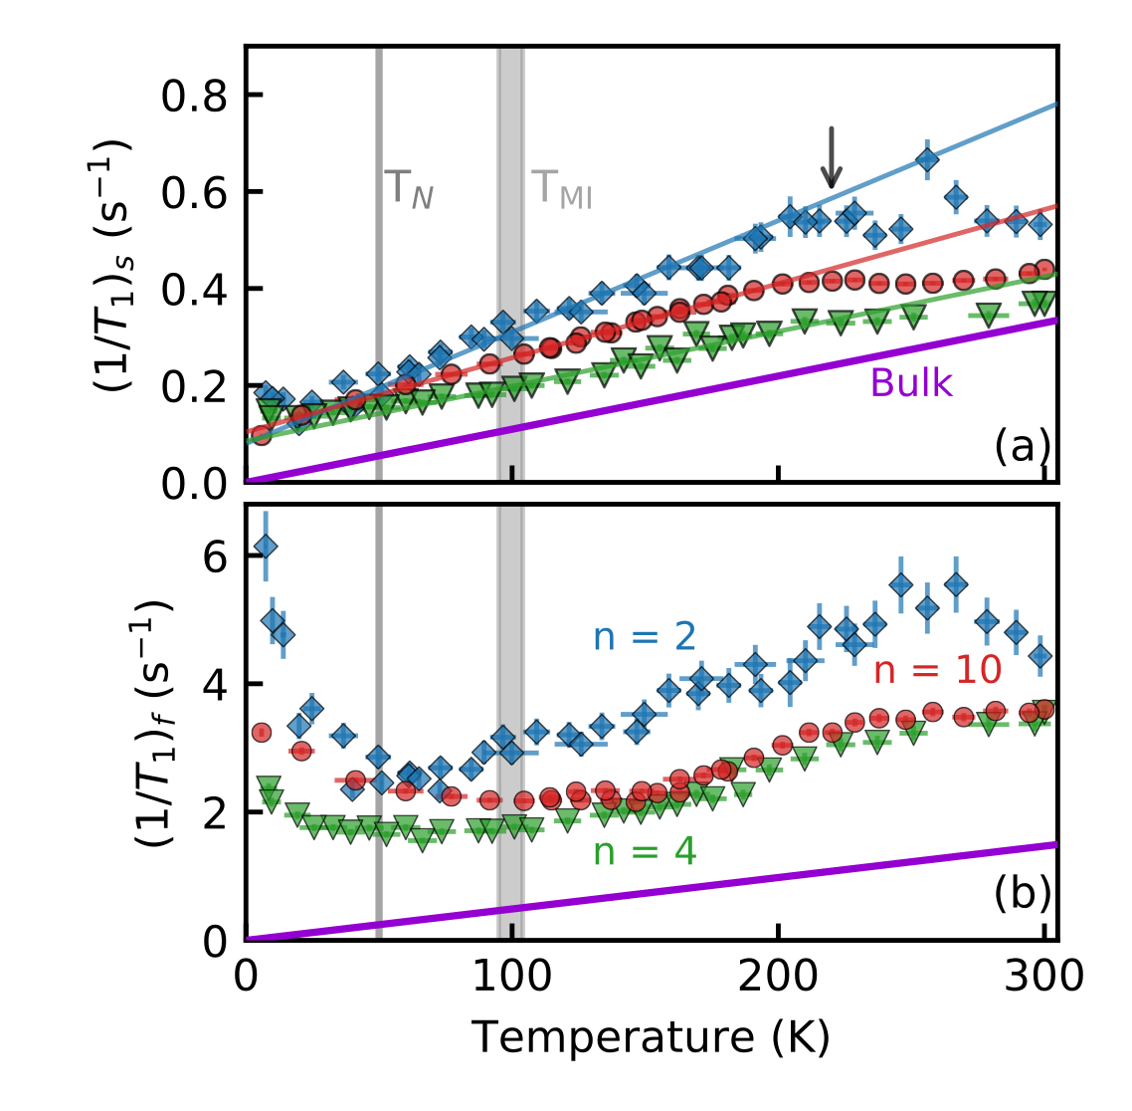
Where is the metal-insulator transition?
Different Temperature Dependences!
Suggests microscopic electronic phase separation
10
Notes:
Remember to start by addressing some basic trends in the data. Such as:
Slow:
Remains linear, i.e., metallic.
Not too different from the bulk.
Fast:
No longer linear
Strongly enhanced compared to the bulk

Slide 11
Biexponential relaxation suggests phase separation
Phase separation is unique:
Static on our timescale
Persists to 300 K
Observed in all samples, even bulk
11
Notes:
Our data therefore suggests that LaNiO3 must have microscopic electronic phase separation.
This phase separation is very unique.
1. It is static on our timescale.
2. It persists up to at least 300 K.
3. And we find it in all measured LaNiO3 samples.
Unfortunately, we cannot comment on its spatial structure since we are using a local probe; however, it is most likely nanoscopic.

Slide 12
Summary
In the bulk:
linear SLR indicates conventional metallic state
In the SLs:
slow component is linear even in the n = 2 SL
fast component is more complex
Biexponential relaxation:
intrinsic to LaNiO₃
suggests microscopic phase separation
12

Slide 13
Acknowledgements
β-NMR group at UBC/SBQMI:
A. Chatzichristos
M.H. Dehn
D. Fujimoto
R.F. Kiefl
W.A. MacFarlane
R.M.L. McFadden
J.O. Ticknor
TRIUMF:
C.P. Levy
R. Li
I. McKenzie
G.D. Morris
M.R. Pearson
M. Stachura
MPI-FKF:
E. Benckiser
A.V. Boris
G. Cristiani
B. Keimer
G. Logvenov
F. Wrobel
Argonne National Labs:
J. Zhang
J.F. Mitchell
13

Slide 14
Thank you!

