Slide 1


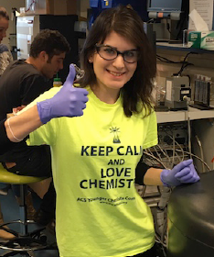




Finding New Materials – a chemical perspective.
Some examples.
R.J. Cava, Chemistry and Materials, Princeton U
With students and postdocs at PU.
Collaborators at BNL, ANL, Johns Hopkins U, Rutgers U, and Gdansk Poland

Slide 2
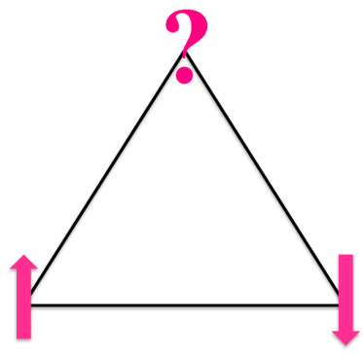
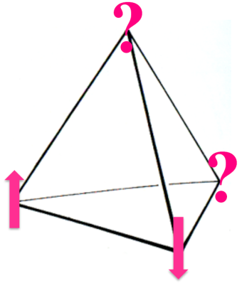

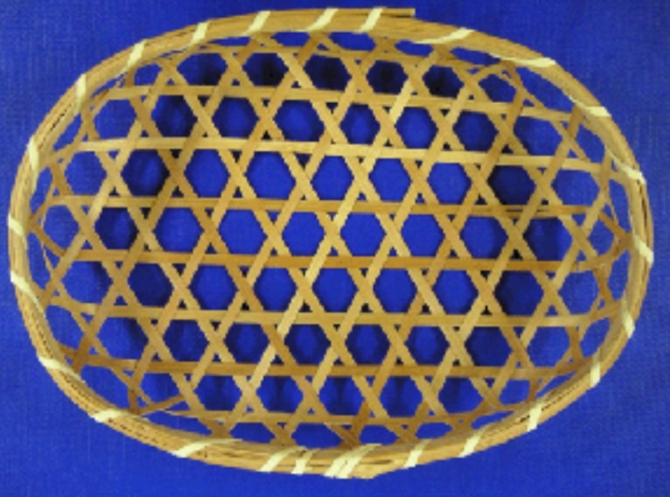
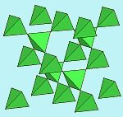
First, geometrically frustrated magnets
What happens at low temperatures when
atoms with magnetic moments that “want” to align opposite to their near neighbors
are placed on lattices based on triangles?
The low temperature spin ordering gets “frustrated”
To relate to something more familiar
Think of supercooled water
The Pyrochlore lattice.
Corner sharing tetrahedra.
It is three- dimensional.
The 4th point caps the Kagome.
The Kagome lattice of corner sharing triangles. It has a high number of energetically equivalent lowest energy states. It is planar.

Slide 3
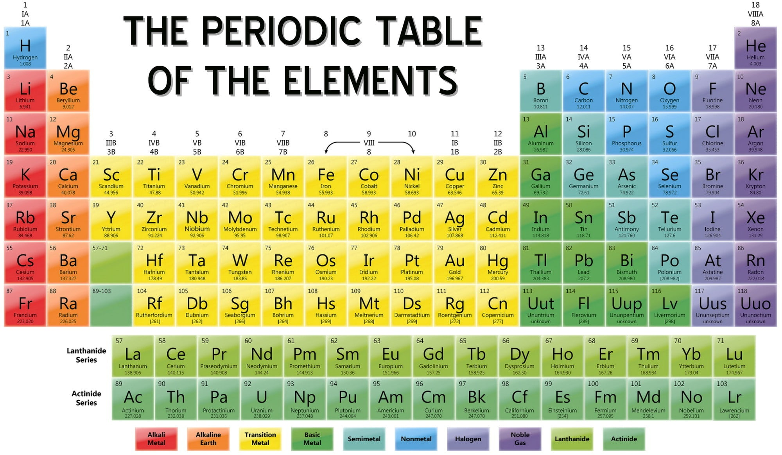


The periodic table, my happy place.
This time the elements of interest are near the top:

Slide 4

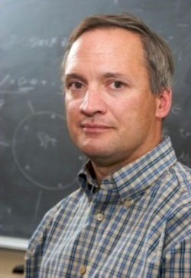
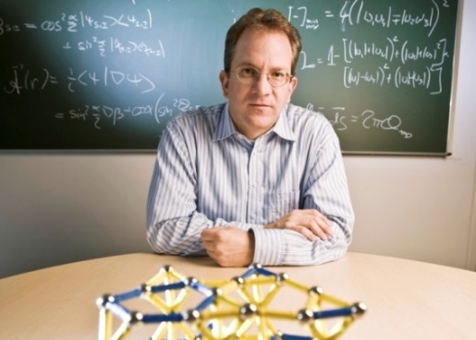
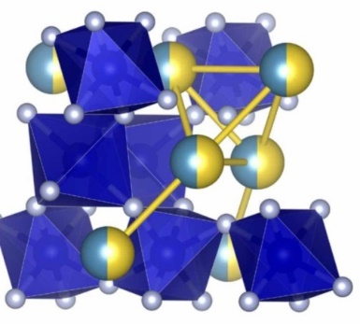
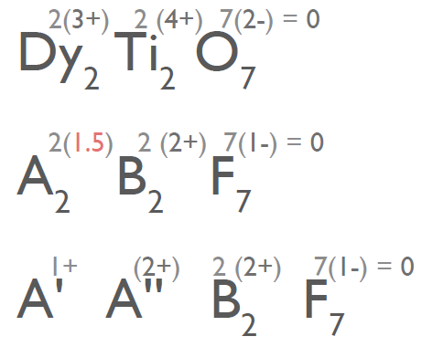
Transition metal fluoride pyrochlores
This work was motivated by
several theorists –
Michel Gingras
Leon Balents and
Roderich Moessner
Who independently asked me
“can you make a pyrochlore with stronger magnetic interactions than 1 K?”
The well studied ones are based on f electrons where the interactions are weak
Eventually, yes. But what are the materials requirements?
Because we need stronger interactions, we need to use magnetic transition elements. Divalent 3d transition elements are strongly magnetic but have to go on the B sites where the coordination is octahedral.
But the lower 3d element charge needs to be balanced.
On a normal rare earth pyrochlore
Only the A site is magnetic. f electrons
On a 3d-based pyrochlore
Only the B site is magnetic. d electrons
The magnetic lattice
geometries are the same

Slide 5
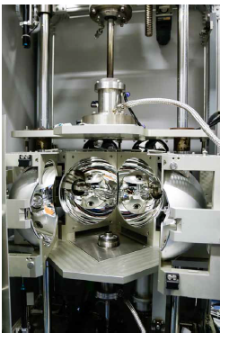
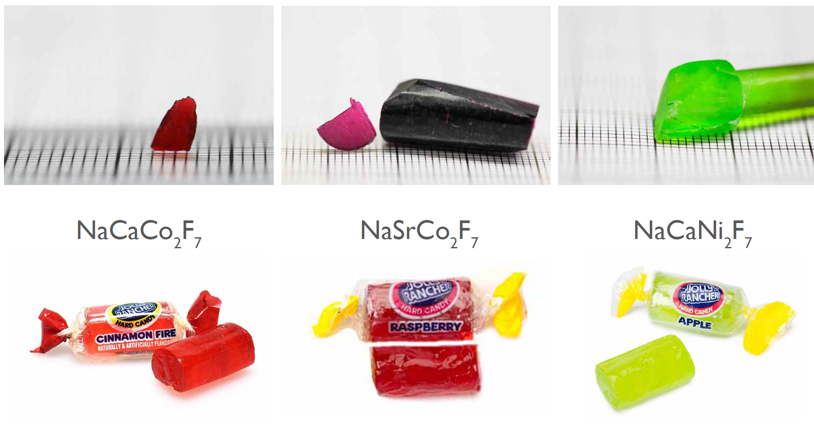
Grad student Jason Krizan grew very large single crystals in a Floating Zone furnace that he cut and oriented.

Slide 6
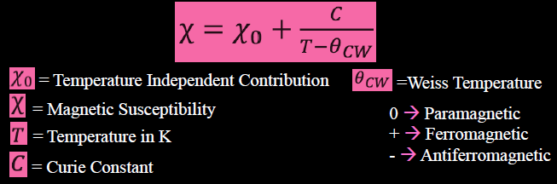
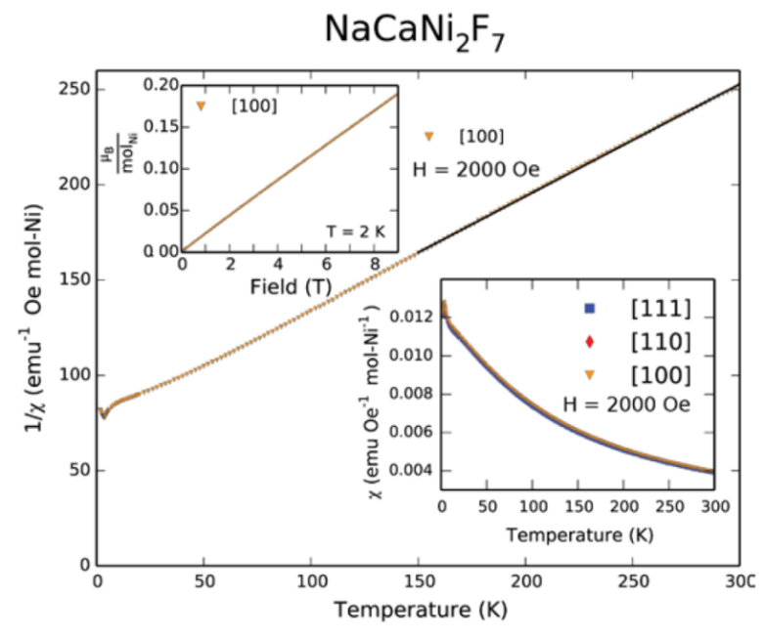
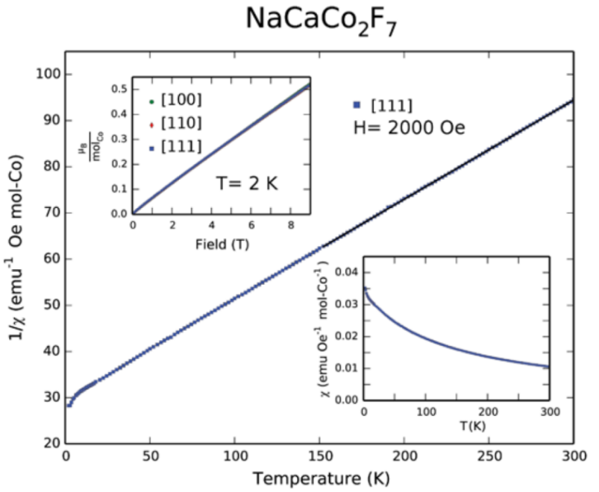
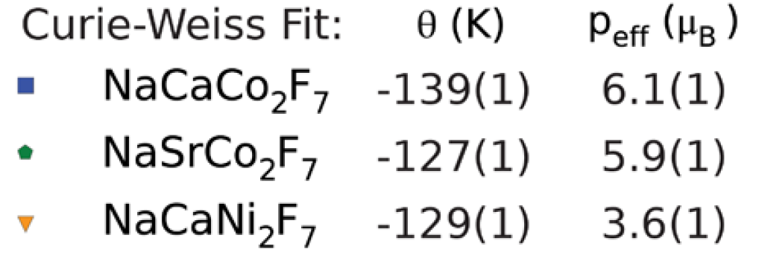
All display nice Curie Weiss law behavior
The magnetic interactions all larger than 100 K and the magnetic ordering transitions are 2-3 K so these are highly frustrated.

Slide 7
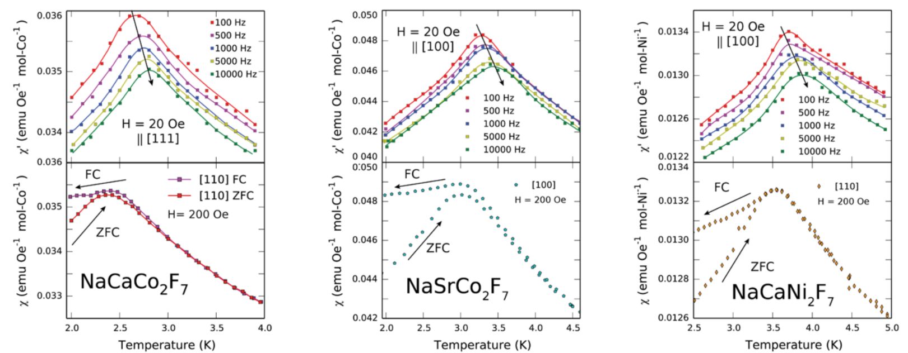
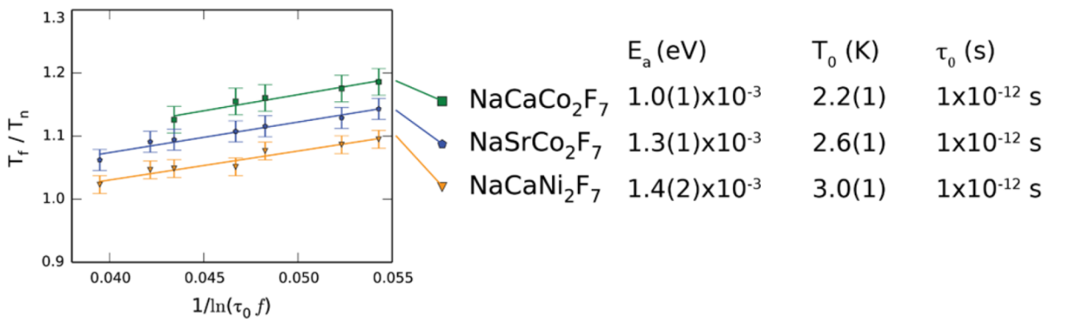
All the magnetic ordering transitions are “glassy” – ac susceptibility shows it.
We believe that it comes from the non-magnetic A site atom random mixing.
To satisfy their bond length and geometry requirements, the A site atoms move the Fluorines bonded to the Co and Ni,
introducing chemical disorder and therefore magnetic disorder.
All obey
reasonable
Vogel-Fulcher
behavior
for insulating
Spin glasses

Slide 8
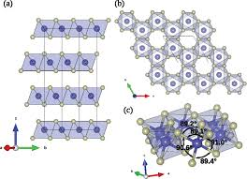
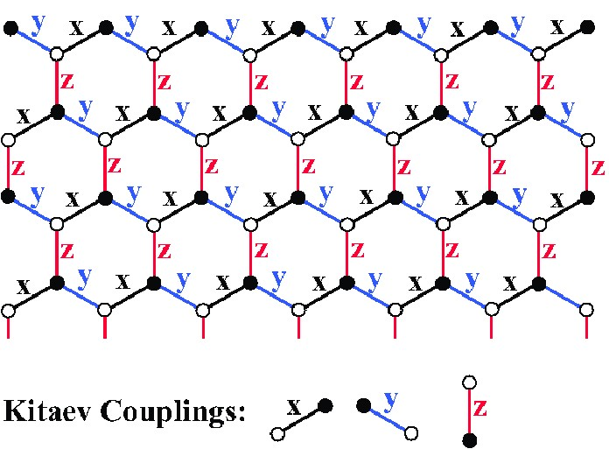
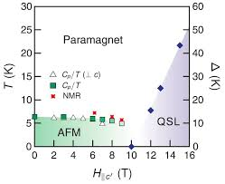
Second, Quantum Spin Liquids
Why do physicists like quantum spin liquids and honeycombs in particular?
Honeycombs are weird because of nn vs nnn interaction balance.
In a spin liquid magnetic moments don’t “ever” thermally freeze. In a quantum spin liquid (QSL) the state they get into at low T is quantum mechanical in character.
Na₂IrO₃ (actually Na₃(NaIr₂)O₆ structurally) is a prime candidate for a Kitaev Spin Liquid - a QSL state that has an “exact solution” and makes predictions that all believe.
RuCl₃ in a magnetic field seems to work. (ORNL) Field suppresses the “normal” magnetic interactions.
But Ir is insoluble in almost anything, so crystals of significant size are not possible to grow. This limits its study.
Significant spin orbit coupling is argued to be critical in this type of magnetic system, goes as m4
Crystals are accessible.
Field needed to get a potential QSL is almost too high but is OK. Limits its study.

Slide 9
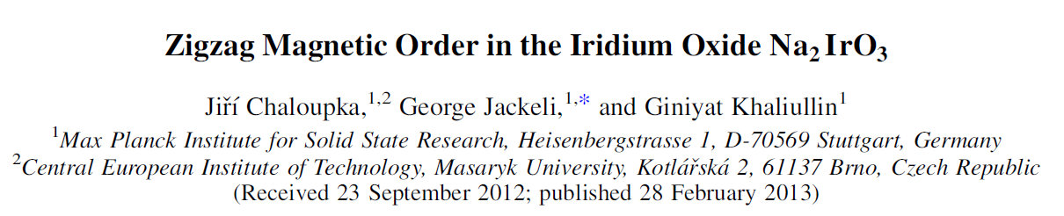
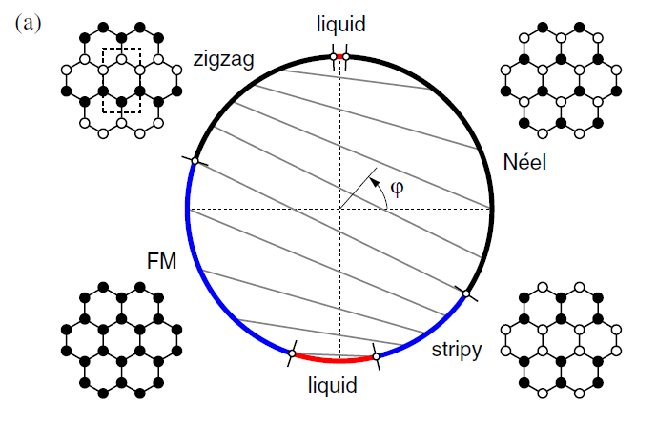
We start again with inspiration from theorists
Phi (φ) describes the ratio of near neighbor to next nearest neighbor coupling
What kind of magnetic state do you expect?

Slide 10

which eventually motivated us to work on BaCo₂(AsO₄)₂, an old material with a Co²⁺ honeycomb. Co²⁺ is weird if you ask me.
A magnetic material on a honeycomb lattice.
1. Directly relevant to the Kitaev model.
But does Co²⁺ have strong SOC?
2. Sometimes you plant a seed
that grows
slowly
3. and watch out
for arsenic
Postdoc Ruidan Zhong grew crystals and we got new data

Slide 11
Some of its properties
Lots of analogies to RuCl₃
Take the thermal conductivity
for example.
Heat is carried by lattice vibrations of course, and in this electrical insulator also by magnetic excitations.
There are dramatic magnetization steps
in a “weak” magnetic field

Slide 12
Our magnetic phase diagram for BaCo₂(AsO₄)₂
Is it a low spin Co²⁺ honeycomb with strong spin orbit coupling?
An AFM at low temperatures and low applied magnetic fields that enters a non-magnetic state in a field of 0.4 T.
Good size crystals grow, unlike the iridium oxides,
but like the RuCl₃ does.
But better than that one because the candidate QSL state appears at 0.5 Tesla rather than 8 Tesla, making it possible to probe by neutron scattering.
So Why isnt this it?
Are there too many trees in the forest to see this one?

Slide 13
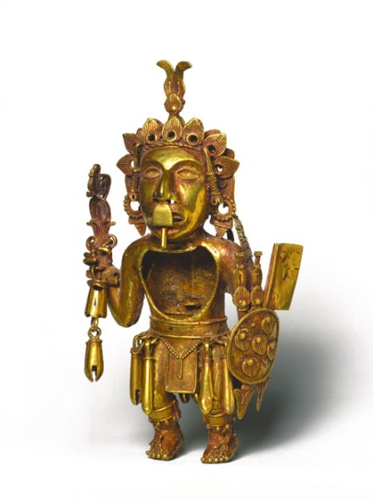
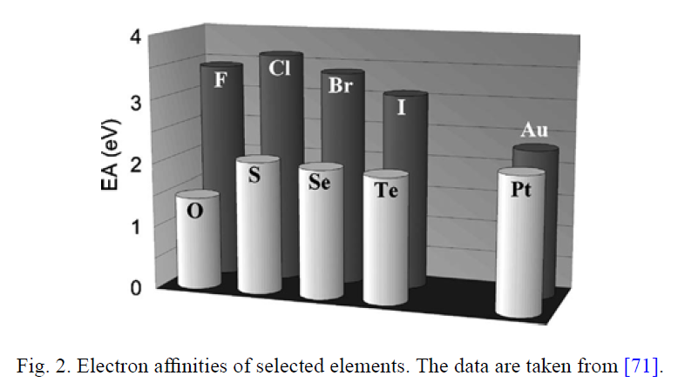
third. Gold! This time we start with a chemical question:
Why is gold interesting to some solid state chemists?
Gold is a “noble metal”, which means that normally it is uncharged.
It stays an element: Au⁰
3. Well, so far OK. but from a 2005 paper
by experimentalist Martin Jansen:
2. From its position in the periodic table it is a single electron donor in intermetallics, i.e. Au⁺¹
Co Ni Cu Zn
Rh Pd Ag Cd
Ir Pt Au Hg
(Y₃Au₃Sb₄ is a semiconductor )
So Au likes to accept an electron as much as S, Se, or Te do?
i.e. Au⁻¹ is stable! So what do you get? Au¹⁺, Au⁰ or Au⁻¹?

Slide 14
The periodic table, again. This time near the bottom:

Slide 15
Its interesting, so we started looking for new Au compounds
We used Au
plus
an electropositive element
plus
an electronegative element
To “confuse” the Au.
First, we found RAuBi₂

Slide 16
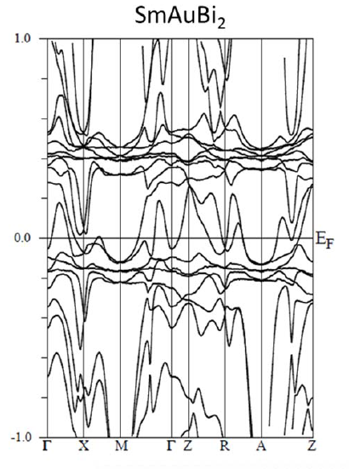
All show magnetic behavior
due to the rare earths present.
(Wien 2K, an electronic structure calculating program, is easily used,
even by chemists.)
The Bi layer dominates
the states at the Fermi energy
The materials can be thought of
as R³⁺ -(AuBi)²⁻ -Bi¹⁻ -
Leaving holes in the Bi layer.
Square planes of Bi, are interesting in topological materials
But chemically it is Au⁺¹ so its not the chemical crazyness we were after.

Slide 17
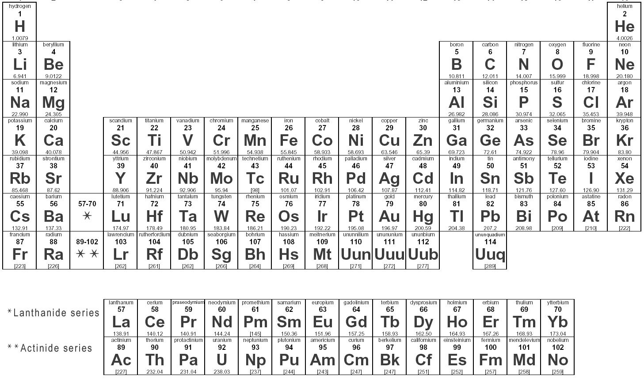

Consider 1:1:1 AYZ ternary compounds many semiconductors are found in this family
(even “complex” materials can follow simple chemical rules)
Stability and
semiconductivity
happen due
to the
“18 electron rule”
Its not “rocket science”
No DFT is needed.
Just count electrons.
e.g.
GdPtBi
ZrNiSn
Notes:
Change purple, change to squares

Slide 18
When we made 1:1:1 with Ln, Au, and Sb
something interesting happened.
Its crystal structure has very buckled layers
with the Au’s pulled together– why?
Is this an Au-Au bond in a solid?
A bond between inert atoms?

Slide 19



Counting the electrons
LaAuSn – a normal compound
with 18 electrons
LaAuSb - too many electrons
(19, not 18) What happens?
La
La
Au
Au
Sn
Sb
+ 1 e-
3e- + 11 e- + 4e- = 18e-
3e- + 11 e- + 5e- = 19e-
La³⁺ Au¹⁺ Sn⁴⁻ → La³⁺[AuSn]³⁻
2La³⁺ (Au⁰-Au⁰) 2Sb³⁻ →La₂Au₂Sb₂
Double the formula and “eat” the extra electrons
by forming an Au-Au bond between inert atoms. Our first JACS paper!

Slide 20

The result calculates to have almost a complete band gap.
Essentially a 19 electron semiconductor. but not quite – is it a Dirac Semimetal?
Bulk Dirac cone just below
calculated E_{F}
Possibly unusual electronic properties but no fancy measurements have been done
Weiwei Xie
Liz
Seibel
Notes:
Think about solids differently than molecules
Density of states (where an electron can be) varies not only by energy (bonding/antibonding) but also by direction in the crystal
Think of electrons as waves
K is the wavevector – direction and momentum of electrons
Dirac crossing – linear bands = electrons act like massless photons

Slide 21

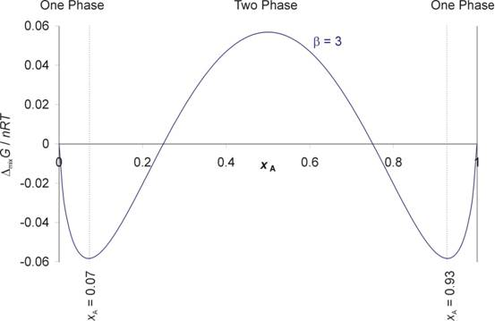

Finally, High Entropy Alloy (HEA) superconductors
ΔG = ΔH - TΔS
the golden rule of materials science
Usually one only thinks about (or calculates) ΔH not ΔS
when considering equilibrium between solid phases
(most solids have similar entropies)
But the entropy of mixing
is large in solid solutions with major fractions of mixed elements
Fabian von Rohr
Tomasz Klimczuk
This makes some surprising mixtures of elements stable in solid solution alloys.

Slide 22
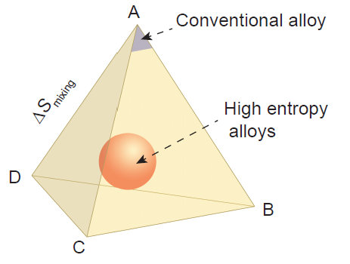
HEAs are not like most conventional alloys - where the properties of a dominant element are modified by small additions.
The properties of HEAs emerge as a property of the mixture of elements,
which are all present in significant proportion.
Example – a 4 element mixture
Metallurgists are interested in them due to their excellent mechanical properties.
Materials Scientists due to their microstructures and magnetism
I wondered, are there any HEA superconductors?
Yes. In Ta-Nb-Hf-Zr-Ti reported a few years ago.
Its existence was reported but not much information about it.

Slide 23
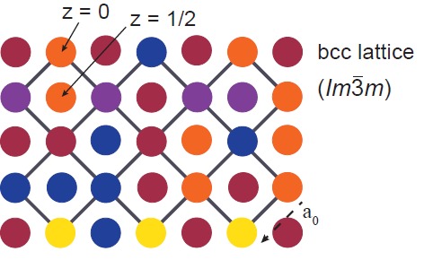
This HEA superconductor is BCC
Nb and Ta are BCC
Hf, Zr, are FCC
Ti is HCP
But the HEA is BCC
e.g.
schematically
for 4
elements
We tested the effects of electron count, alloy complexity
and the elements present
The alloy of interest is (TaNb)1-x(HfZrTi)x
For example x = 0.33 is ~ Ta33Nb33Hf11Zr11Ti11
x = 0.67 is ~ Ta16Nb16Hf22Zr22Ti22

Slide 24
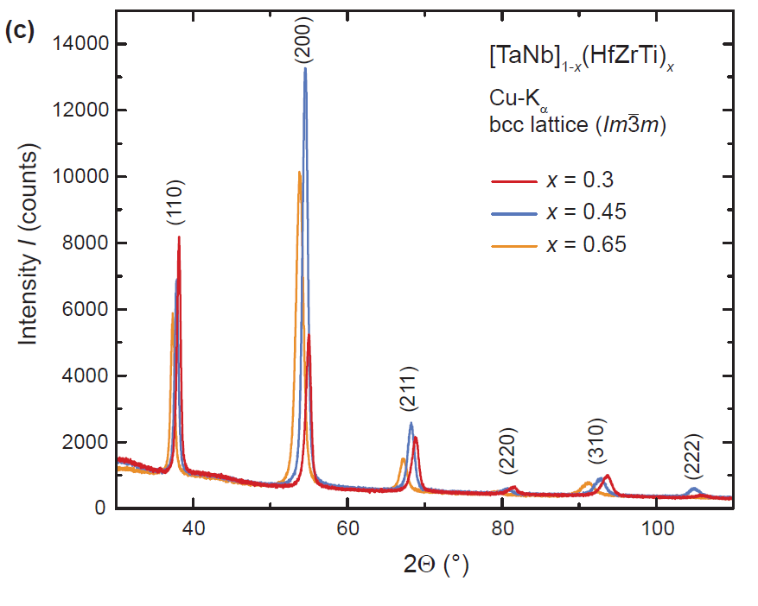
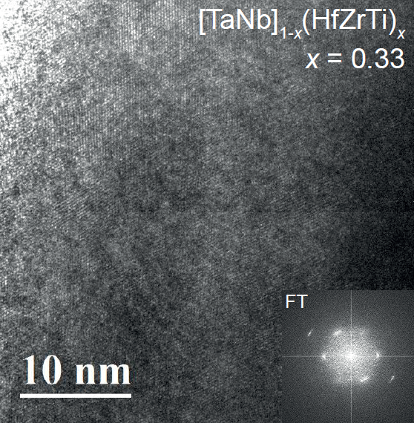
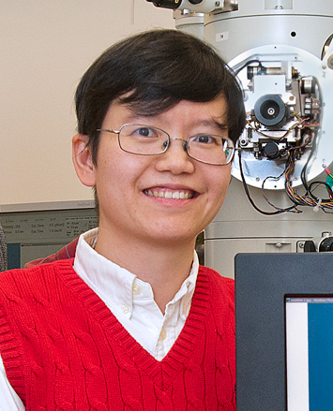
First, the average structure is BCC
The local level structure is important. Can it really be a random mix? Looking down the [111] direction of the HEA in the HRTEM.
It’s a random distribution of elements in a BCC lattice. No nanometer scale clusters.
(Jing Tao at BNL now IOP)

Slide 25
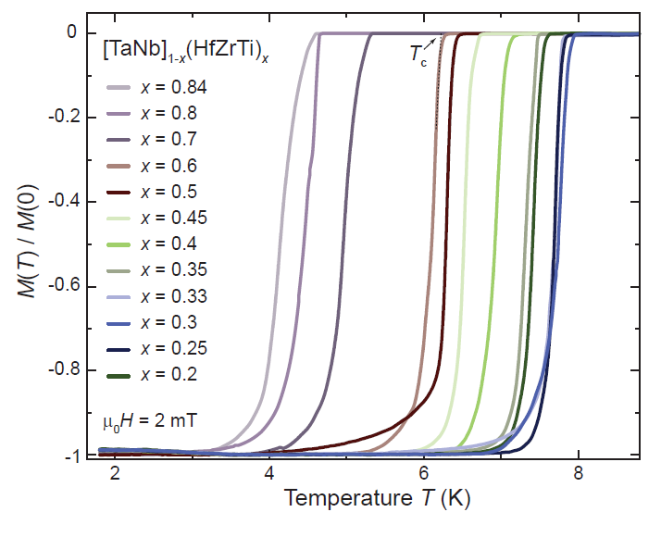
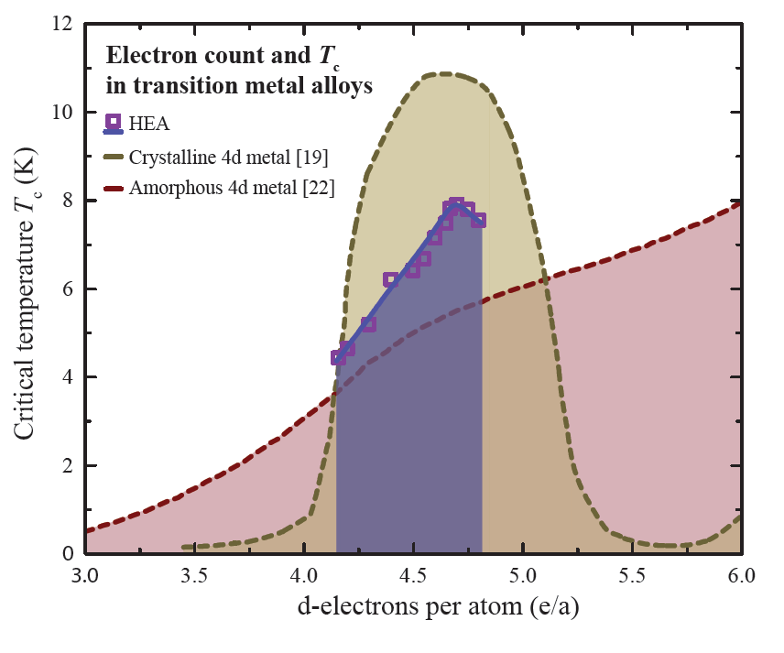
Changing x changes the electron count.
Nice, sharp Tc, full superconductors in all cases until the stability of the crystal structure breaks down.
Matthias
The electron count variation in Tc
is intermediate between amorphous alloys and binary crystalline metal alloys.
The range of stability is shown
HEA
amorphous

Slide 26
But are we done yet with the first HEA superconductor?
No!
We cant grind the samples!
We have to flatten the samples in a roller and then snip or file off pieces to get an X-ray pattern.
That suggests that the material is very hard.
How hard is it?
Will it mechanically survive to high pressures without failing?

Slide 27

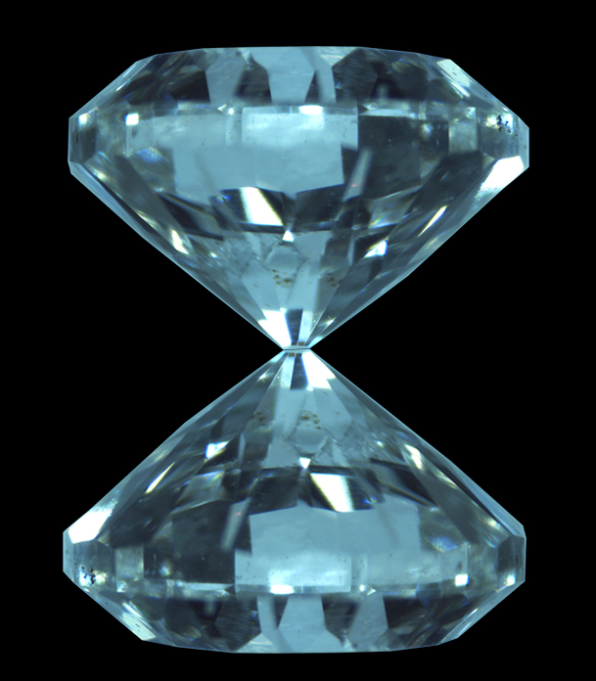

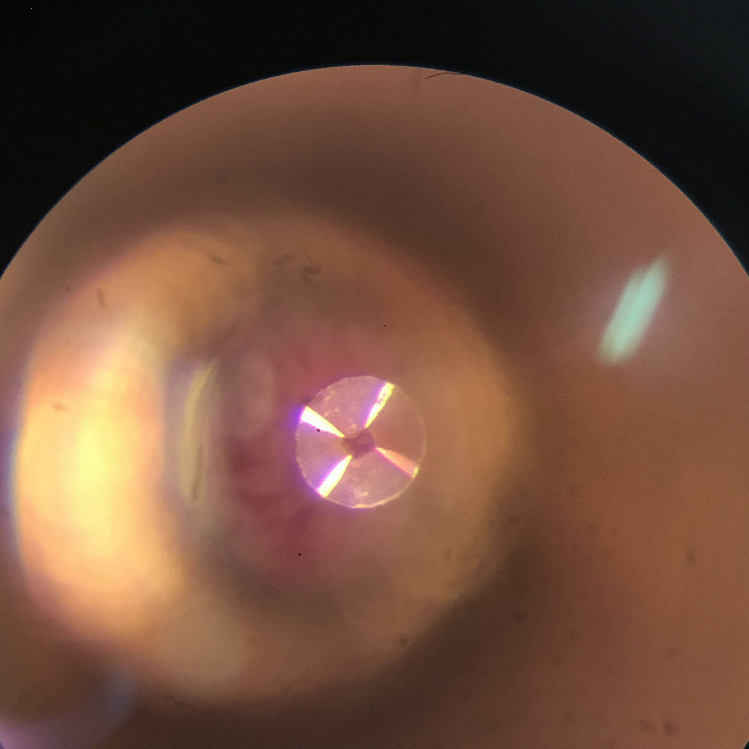
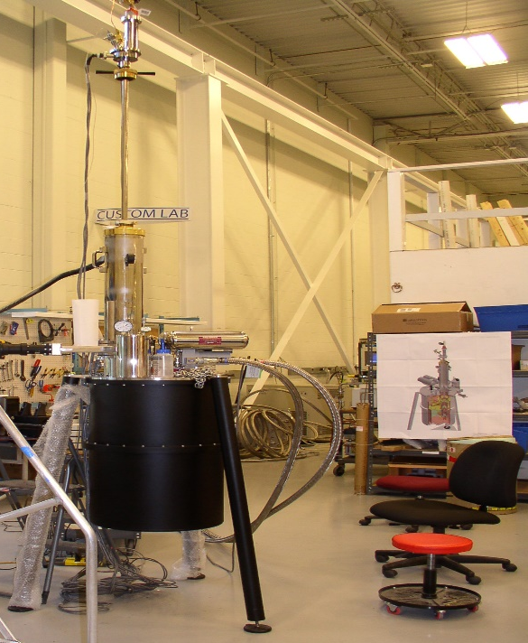
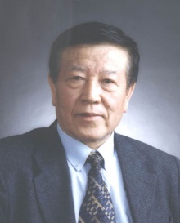
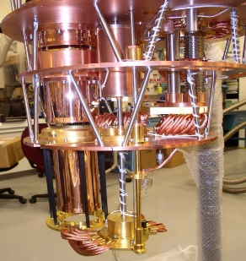
Taking the high entropy alloy superconductor
to very high pressures
Pt electrode
Flat circle anvil
Liling Sun IOP Beijing
80 μm
Pt electrode
V
b
a
sample
c
d
I
Insulating layer
10 μm
ZX Zhao
head of
superconductivity
At IOP and an old friend
Jing Guo IOP Beijing

Slide 28
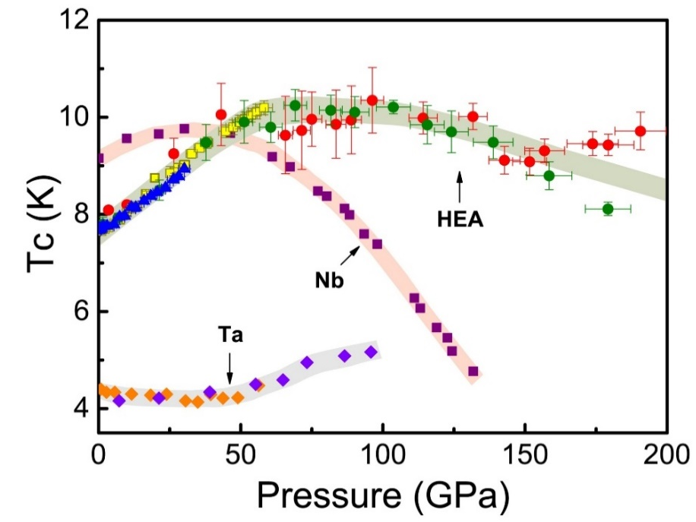
What did they find?
Tc vs. pressure.
Different colors are different
experiments
(they break the diamonds)
The material is continuously superconducting from 1 atmosphere to 200 GPa.

Slide 29
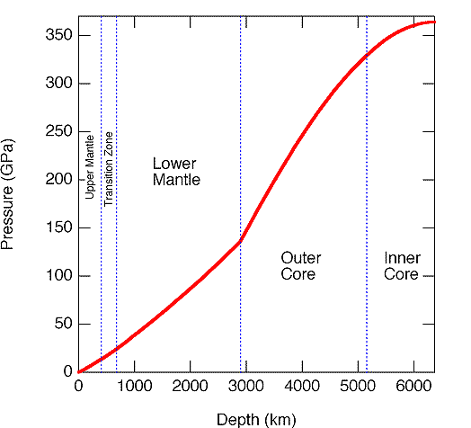
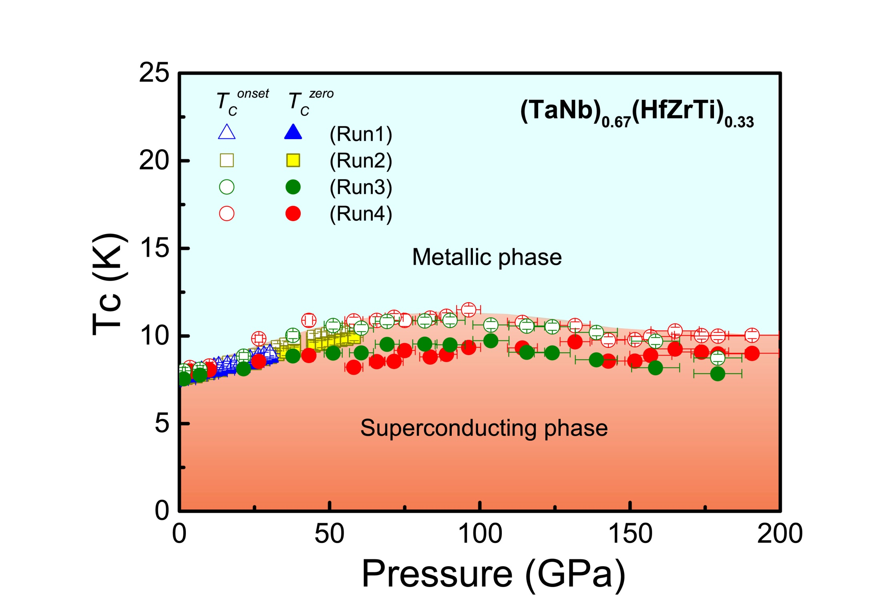
Really? Just how high is 200 Gpa in pressure?
Very high
Core of the earth high
The physicists can measure HC2 (the applied field needed to kill superconductivity) at those extreme pressures.
The material is still
superconducting.

Slide 30
Conclusion:
There are more opportunities in new materials research than you can
at first imagine.
In my opinion there are a lot of papers nowadays where people don’t
understand the role of theorists and “predictions”.
It’s the ideas that count for me.
You have to be willing to try some things that don’t work and
not be afraid to appear stupid for trying.
If one unexpected thing works, then you have done something special.
To close, In the words of my late uncle Conrad:
“Believe all religions. One of them may be right.”

Slide 32
More on the constituents - Lets maintain the electron count
and change the elements.
Is our superconductor
“the best that it can be?”
Nb and Ta are important. Hf, Sr, Ti are less so.

Slide 33
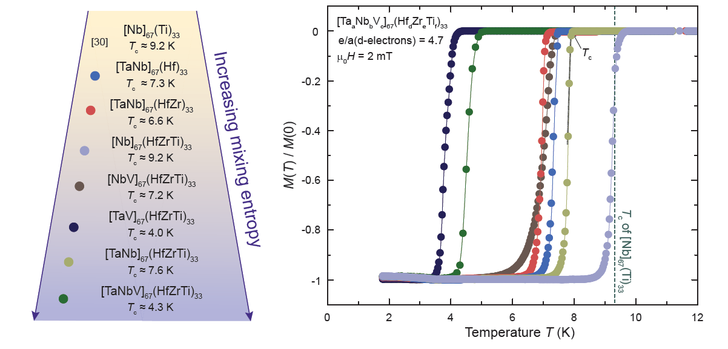
In a high entropy alloy superconductor
– do the elements present actually matter
Or is it only the electron count?
Nb is always good for Tc. V is always bad for Tc
Hf, Zr, Ti mixtures don’t hurt Tc.
So the elements do matter. But why?

Slide 34
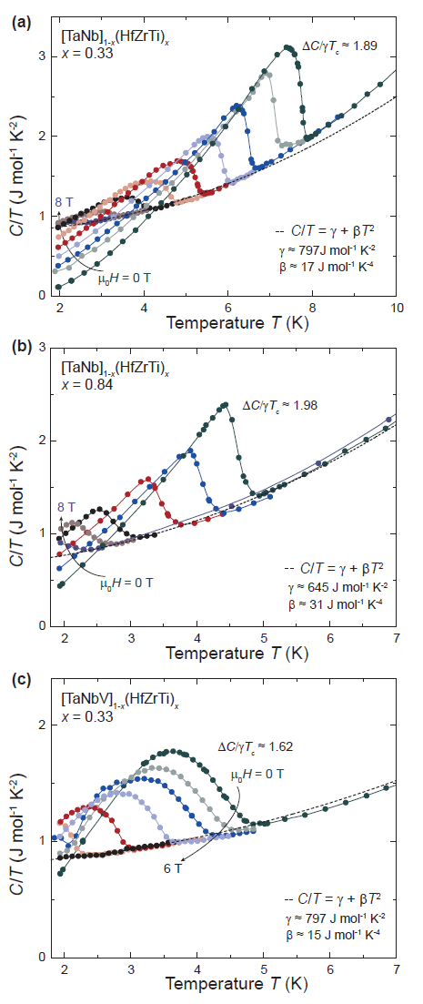
We looked at the specific heats.
The gamma values are comparable for the high and low Tc materials.
But for the V-containing HEA the electron phonon coupling is weaker.
We don’t really know why.
How can 33% Nb matter over 33% V?
(If you’re
thinking
percolation then
how can that change
Tc or E-ph coupling?
There are lots of interesting things to try in superconducting HEAs.
Here are some more…

Slide 35
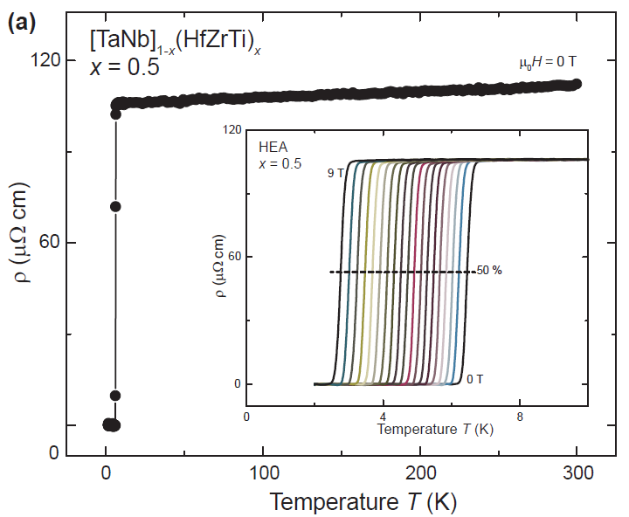
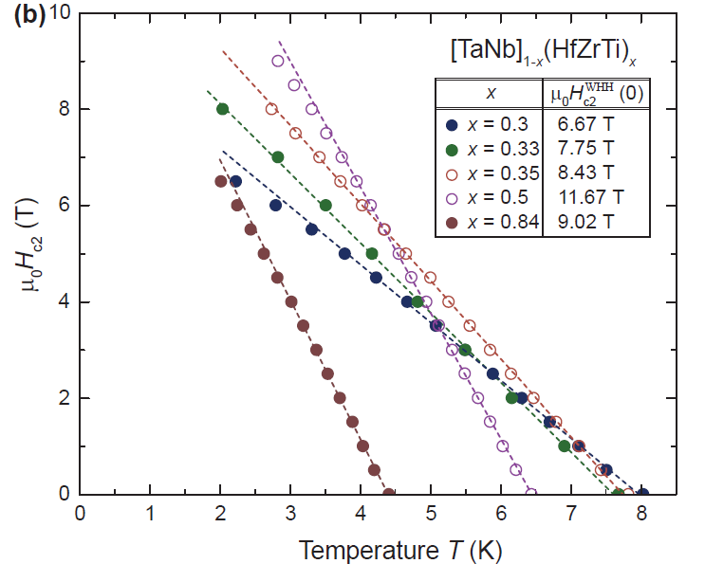
More: H_{C2}(T) for different x.
Nice behavior
The highest Tc material does not have the highest H_{C2}(0).
That one is
Ta25Nb25Hf16Zr16Ti16.
The alloy with the highest mixing entropy we studied.

Slide 36
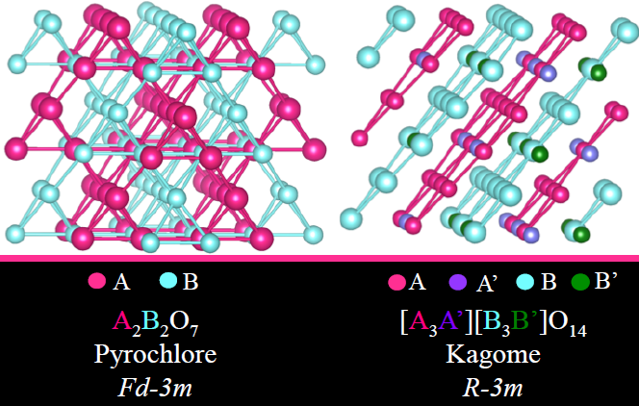
New rare earth
Kagome compounds
The most-well-known geometrically frustrated magnets
are the rare earth pyrochlores.
But no rare earth kagome’s were known.
(Kagome planes are the next-most-famous magnetically
frustrating geometry)
Can we compare Pyrochlores and Kagomes?
How can we make a rare earth Kagome
that has a pyrochlore equivalent?
Marisa Sanders
Yes. By separating one kagome plane from the others in a pyrochlore by chemical substitution
using non-magnetic elements.
A atoms are the only magnetic ones. Here they are rare earths.

Slide 37
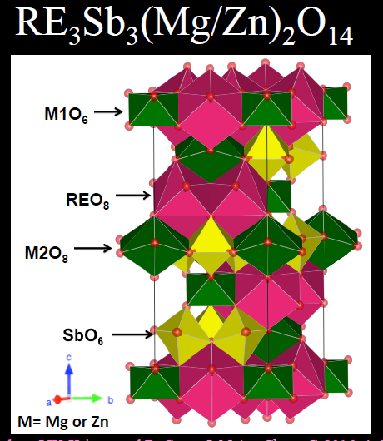
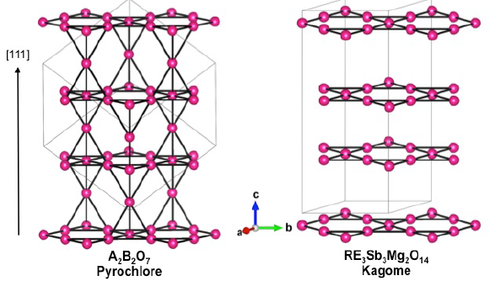
Different ways to look at the structure:
An unusual way –
extract the magnetic (A) RE atoms only
The usual way
MO_{n} coordination polyhedra
The trick, as usual, is to see the forest through the trees

Slide 38


For the large rare earths Marisa could make both the Kagome
and the Pyrochlore structures, i.e. the both 2D and 3D magnetic lattices.
So a direct comparison is possible.
Comparison of the magnetic properties of the Nd₂(ScNb)O₇ pyrochlore and the Nd₃Sb₂Mg₂O₁₄ kagome.
First comparison of its kind – no gross difference in behavior

Slide 39
The periodic table again again.

Slide 40

Final topic – 4. hexagonal perovskites
Hexagonal perovskites
Are materials based on ABO₃ formulas
with hexagonal symmetry
or minor distortions of it.
Rather than the usual cubic perovskites
In my opinion, at their heart is the structural stability of a close packed oxygen array where an A^{n+} ion is about the same size as an O²⁻ ion.
Ba²⁺ is the winner.
There are a large number of
variations.
A good chemical excuse for me to work on whether there are localized electrons or delocalized electrons on M_{n}X_{m} clusters.
Ba²⁺ (gray) in a close packed plane of O²⁻ (white)

Slide 41




The first of our work on hex perovskite oxides -a dimer compound
Ba₃TiRu₂O₉. Good news is that the dimers contain Ru⁴⁺ (4d⁴ spin 1)
Bad news is that it has structural disorder and so it is a spin glass.
Many dimer systems have been studied by physicists.
Nice but not so interesting for me
because they don’t directly address the issue of localized vs itinerant electrons on clusters.
Loi Nguyen
The first of our many insulators
In this family

Slide 42



Now the first of several trimer compounds.
First one is based on a 3d element (Mn).
I like trimers because “wheres the spin?”
Ba²⁺ and Nb⁵⁺ are not magnetic
So all magnetism is from Mn.
a 3d ion.
Two Mn⁴⁺ 3d³
One Mn³⁺ 3d⁴
As we progress from 3d to 4d to 5d magnetic elements
Does a local moment picture break down?
In this case a local picture works.
Russian theorists Komleva
Khomskii and Streltsov did it.

Slide 43
Now a second trimer compound Ba₄NbRu₃O₁₂.
Based on a 4d element that is often magnetic in oxides. (Ru)
Two Ru 4+ and one Ru3+
= 13 electrons per trimer = spin ½ per trimer
a nice spin.
Cigar-shaped spin ½ molecules on a triangular lattice.

Slide 44
Now things are looking interesting.
Magnetic moment is too low for a simple localized picture. Too high for a simple molecular picture.
Classic frustrated
Magnetism chi vs T
In a molecular picture, where are the electrons?
- on the Trimers, in hybridized Ru-O molecular orbitals.
In DFT with SOC and no U the material is a metal, but it is actually an insulator.
= the definition of a Mott insulator?
And its an electrical insulator

Slide 45


Two more: with Ir₃O₁₂ and Rh₃O₁₂ trimers in the new materials
Ba₄NbRh₃O₁₂ and Ba₄NbIr₃O₁₂.
Compares magnetism in Hex perovskites for 4d and 5d elements from the same column of the periodic table = same number of valence electrons.
Note its Co - Rh - Ir down the column.
The Co one makes an annoying disordered cubic perovskite.
Had the idea but then we actually made them and figured out their crystal structures.
They are 4d and 5d-based trimer compounds with no detectable structural disorder

Slide 46

Now lets look at their magnetism
To 1st order they seem very similar magnetically
Very small moments -
both effective moments are less than spin ½ per trimer. and the ϴ_{CW} are in the -15 to -25 K range
And there is no sign of magnetic ordering above 2 K
We have two 4+ ions and one 3+ ion
In these 4d-based (Rh) and 5d-based (Ir) trimer materials.
Rh ³⁺ and Ir³⁺ are d⁶ and possibly boring.
Rh⁴⁺ and Ir⁴⁺ are d⁵ and are not.
But where are the moments?
Localized on the atoms or in the trimer
Molecule orbitals?

Slide 47


Like the other hexagonal perovskites we looked at,
these are electrically insulating
And something is going on in the heat capacity
at low T
I suppose there must be some hexagonal
perovskites that aren’t insulating.
But what are they?
Ba₄NbIr₃O₁₂ is doing something strange. No magnetic phase transition, Cp/T continues to rise down to 0.35 K and does not extrapolate to 0 at T = 0.
Ba₄NbRh₃O₁₂ is losing entropy at around 2 K. and Cp/T extrapolates to 0 at T = 0. It behaves like its supposed to
I guess.
But the Rh is magnetic?
Very rare but not the first case.
Can the Ir one be a quantum spin liquid?
People are
working
on it.

Slide 48
Stable variations of the Hexagonal 1:1:1 crystal structures
Honeycomb rings in flat or buckled layers, differences in stacking

Slide 49
Conclusions
Our primary role is to introduce new materials whose electronic and magnetic properties may be interesting to experts.
Please ask me for crystals to do experiments on,
or for us to try to make a material to illustrate a theoretical concept that you have.
Thank you.
Fields are the most dynamic when theory, experiment, and new materials discovery develop in parallel.

