Slide 1
Nuclear Physics
Overview
TRIUMF Science Week 2022
Chris Ruiz
Nuclear Physics Dept | Physical Sciences Division

Slide 2
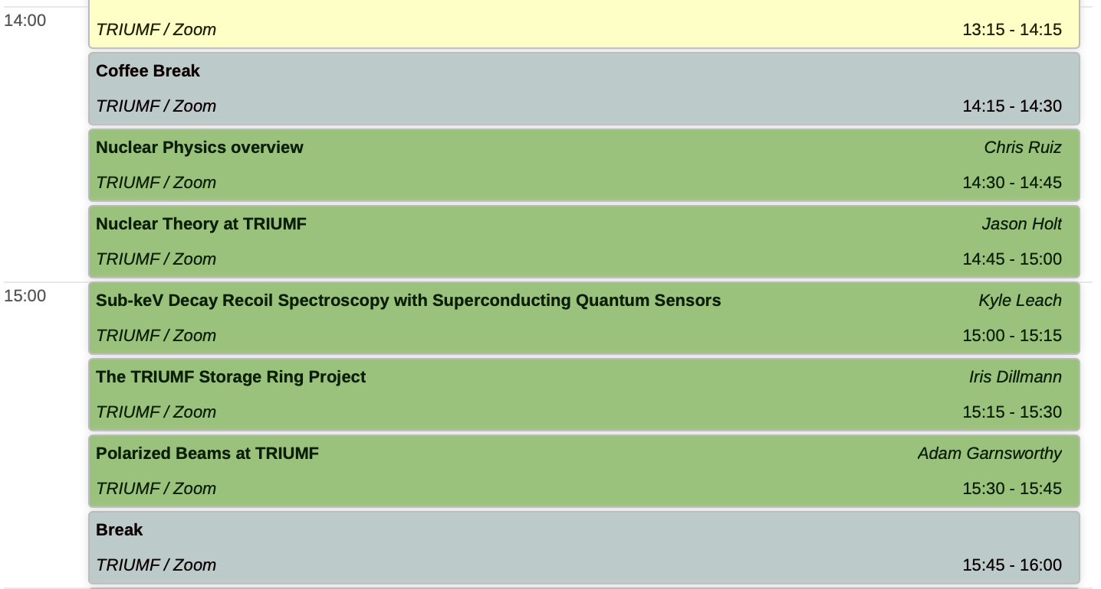
Session Intro

Slide 3
Outline
Nuclear Physics using ISAC now
Meeting the Challenge of ARIEL
  How ARIEL will change landscape & what we’ll need to get there
Staying on the cutting edge, New Directions

Slide 4
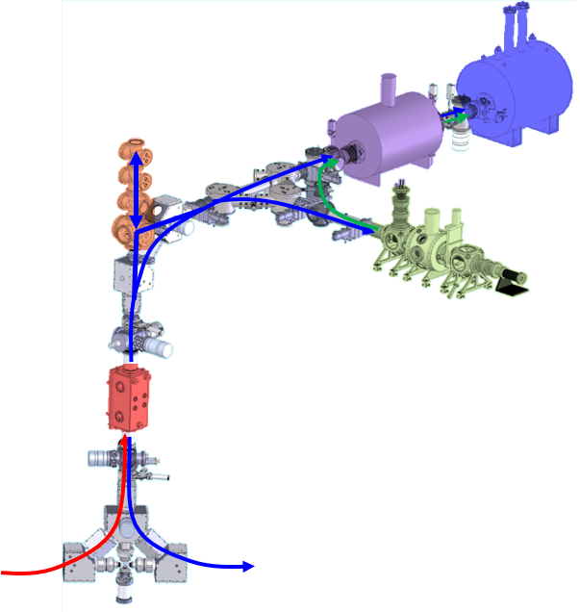
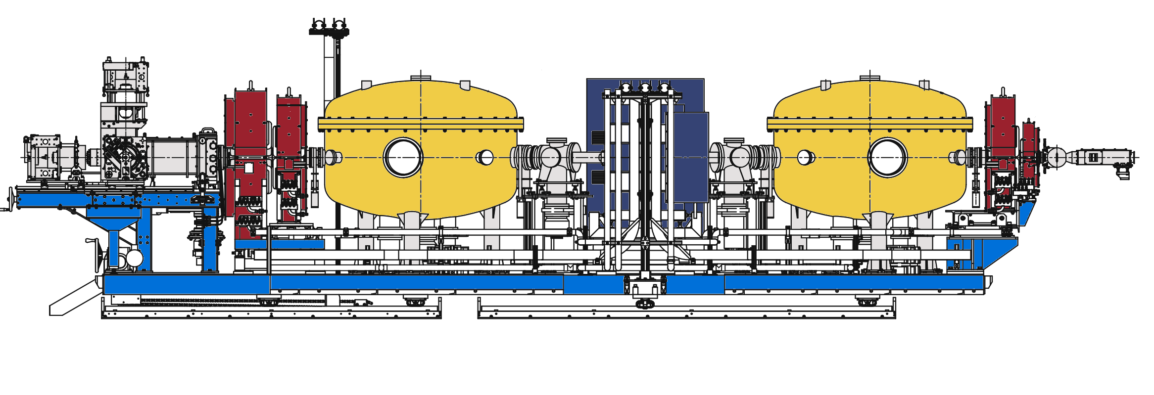

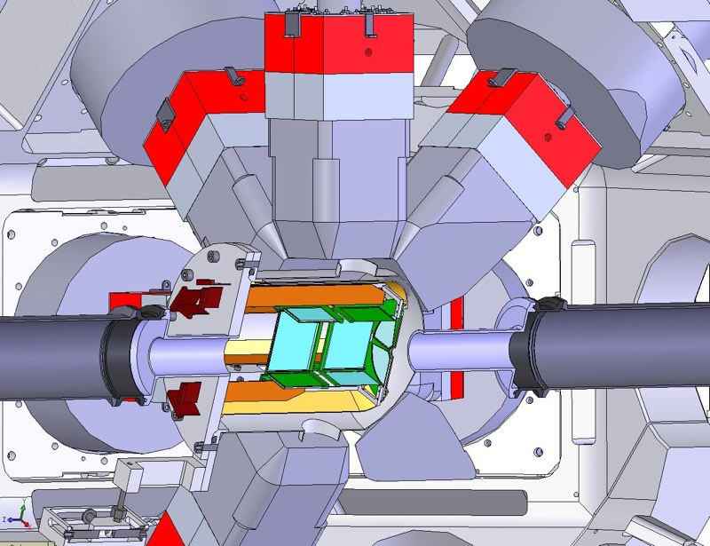
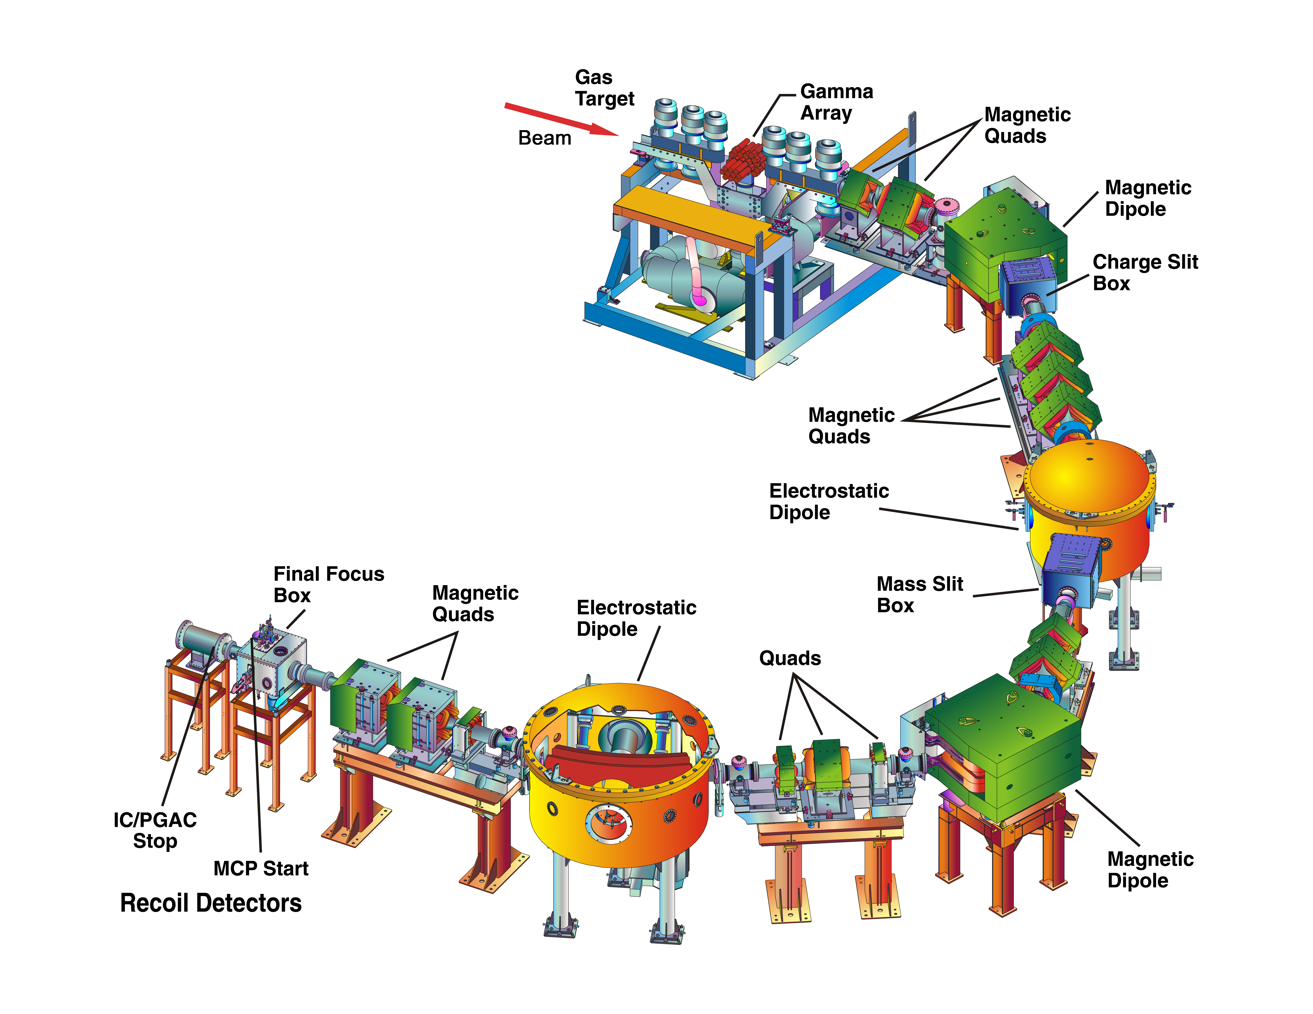
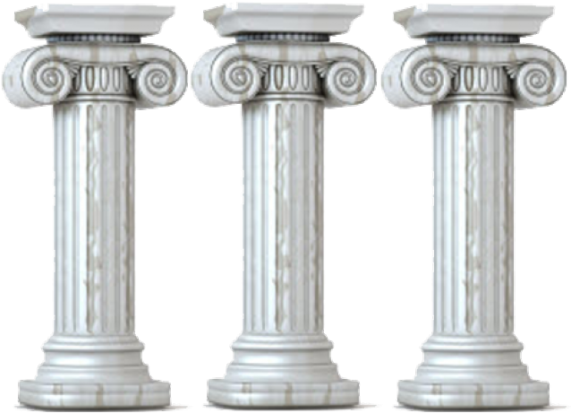
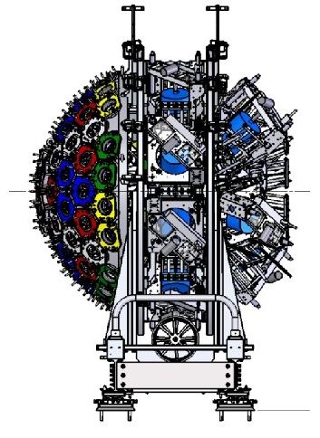
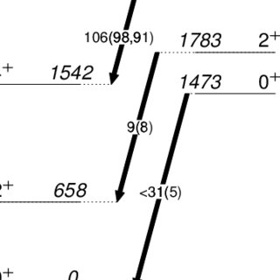
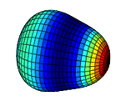
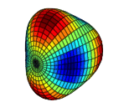
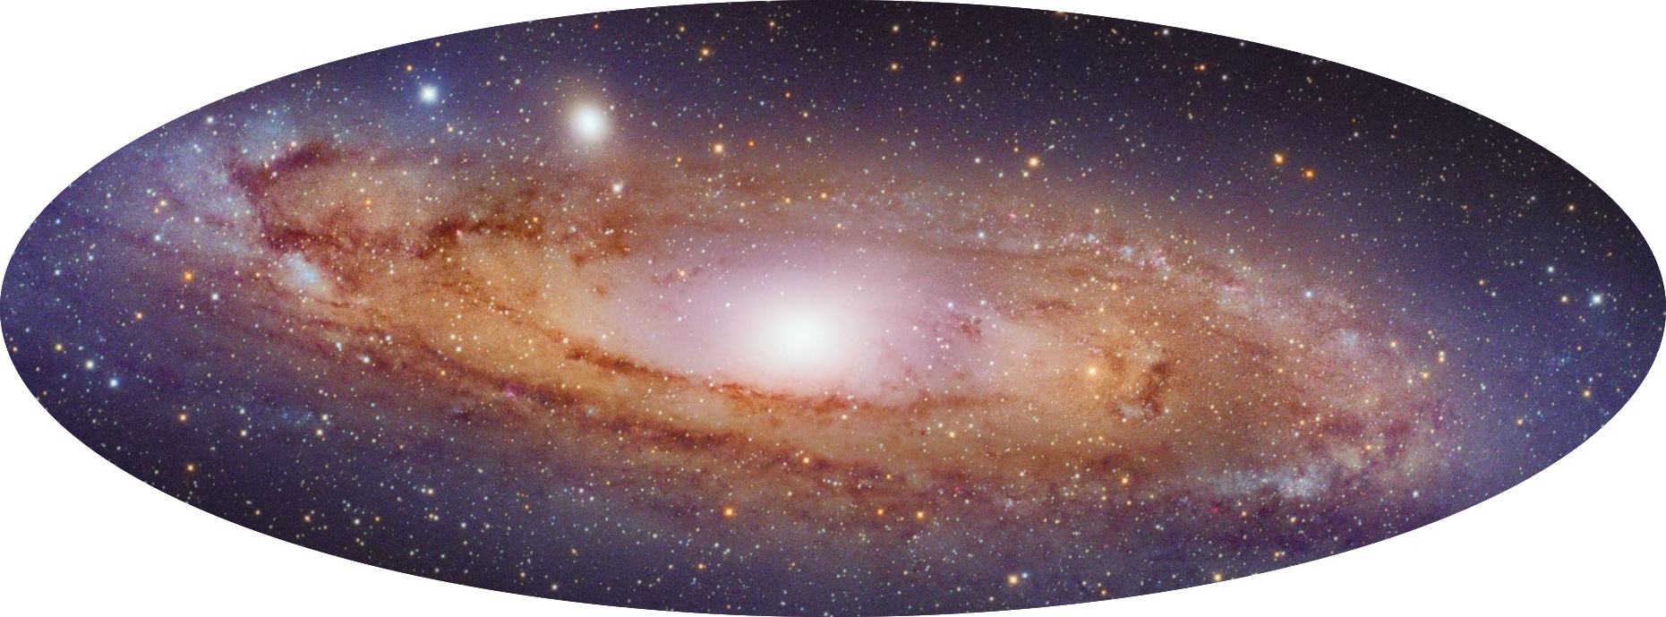

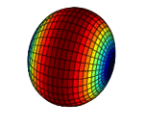
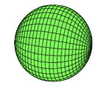
Nuclear Physics @ ISAC: World Leading Capabilities
Nuclear ground state & decay properties via decay spectroscopy
Charged-particle-induced reaction cross section measurement
Nuclear Structure
Nuclear Astrophysics
Precise Tests of Fundamental Interactions
Decay spectroscopy of reaction-induced excited states in exotic systems
Ground state mass measurement
Precise decay spectral shapes
Preparation & measurement of quantum states via lasers / traps
ISAC Facility “Toolbox”
Neutron-induced reaction cross section measurement
Orthogonality between most Facilities → Powerful Combinations Possible
Add new tools
Sharpen existing tools
Radioactive molecule production

Slide 5
Nuclear Physics @ ISAC: World Leading Capabilities
TRINAT | Precise, kinematically-complete measurements of beta-decay and associated parameters. Sensitive to time-reversal symmetry violation.
TITAN | Multi-instrument ion trap facility for masses & decay spectroscopy: MRTOF, MPET, EBIT: precision or coverage
FRANCIUM | Laser prepared Francium atoms probed towards Atomic Parity Violating signal
GRIFFIN / DESCANT | Decay spectrometer for gammas, betas, conversion electrons, neutrons
Polarizer / Laser-spec | Collinear probing of spin polarized isotopes for e.g. charge radii
DRAGON | Direct measurement of radiative proton & alpha capture reactions on exotic or stable isotopes
SONIK | Precision elastic scattering on radioactive nuclei → low energy scattering phase shifts
TUDA | Versatile direct & indirect charged particle reaction facility based around silicon arrays
DSL | Doppler-shift lifetime facility for determination of excited state lifetimes
IRIS | Solid hydrogen or deuterium target scattering facility using CsI & Silicon arrays → extracting structure information from reactions using weak exotic beams
TIGRESS | Gamma-ray spectroscopy of excited exotic reaction residues using escape-suppressed HPGe array
EMMA | Recoil Spectrometer for detection & analysis of exotic reaction residues
Nuclear ground state & decay properties via decay spectroscopy
Charged-particle-induced reaction cross section measurement
Nuclear Structure
Nuclear Astrophysics
Precise Tests of Fundamental Interactions
Decay spectroscopy of reaction-induced excited states in exotic systems
Ground state mass measurement
Precise decay spectral shapes
Preparation & measurement of quantum states via lasers / traps
Neutron-induced reaction cross section measurement
Orthogonality between most Facilities → Powerful Combinations Possible
Add new tools
Sharpen existing tools
Radioactive molecule production

Slide 6
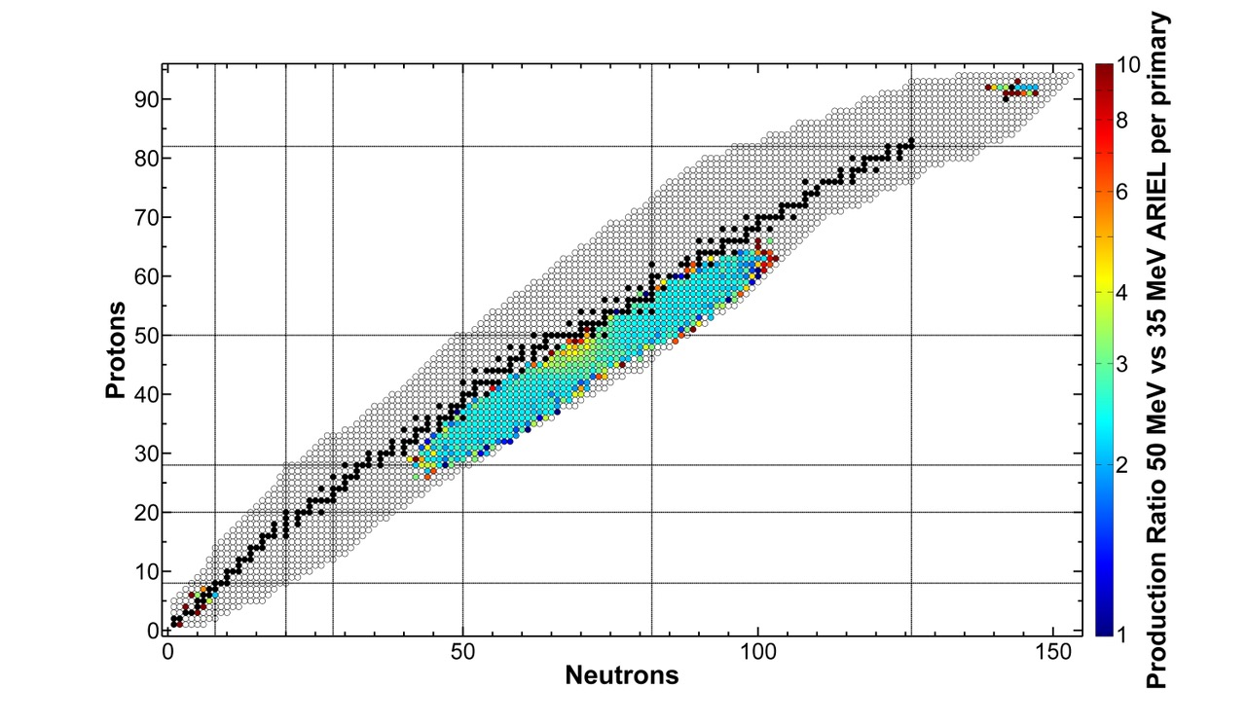
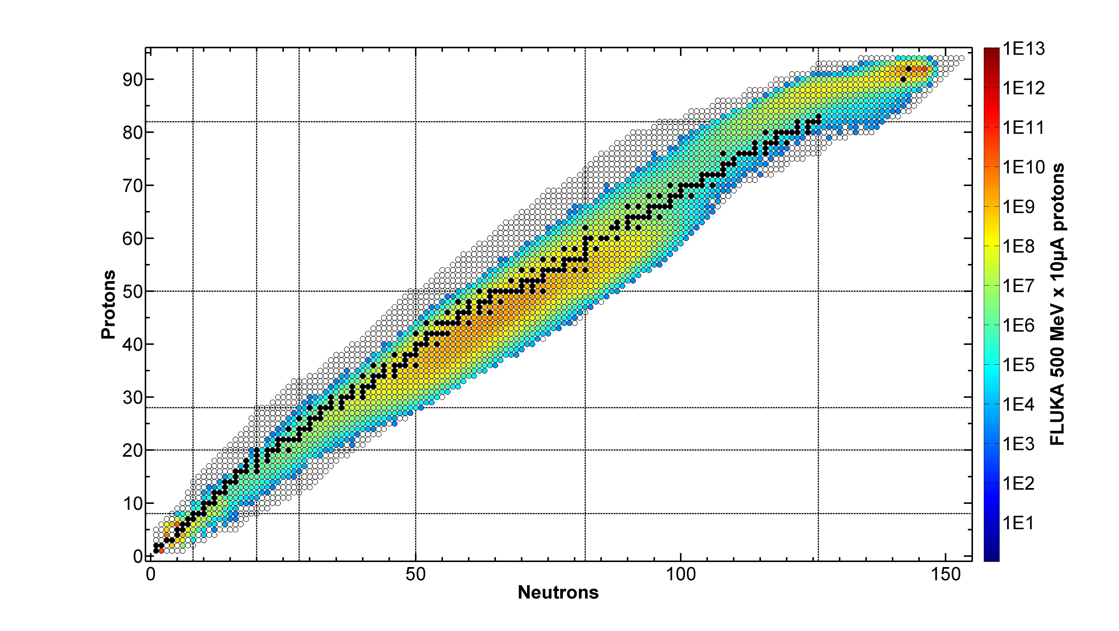
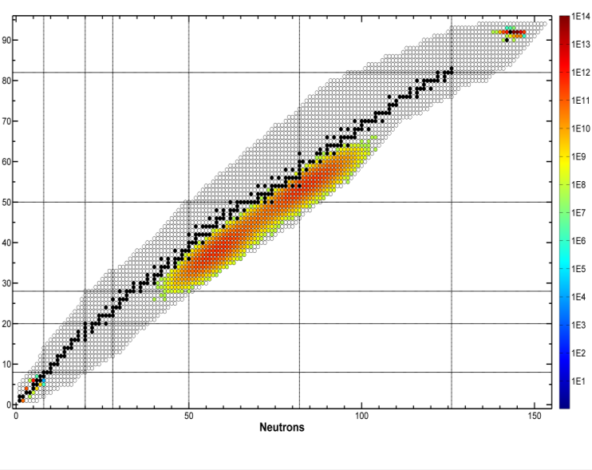
ARIEL: how it will affect the landscape
production intensity from ²³⁸UC_{x}
AETE
50 MeV x 10 mA electrons [1/s]
ISAC / APTW
500 MeV x 10 µA protons [1/s]
Pure n-rich products from photofission
Operational flexibility
High production intensities
New development opportunities in APTW design

Slide 7
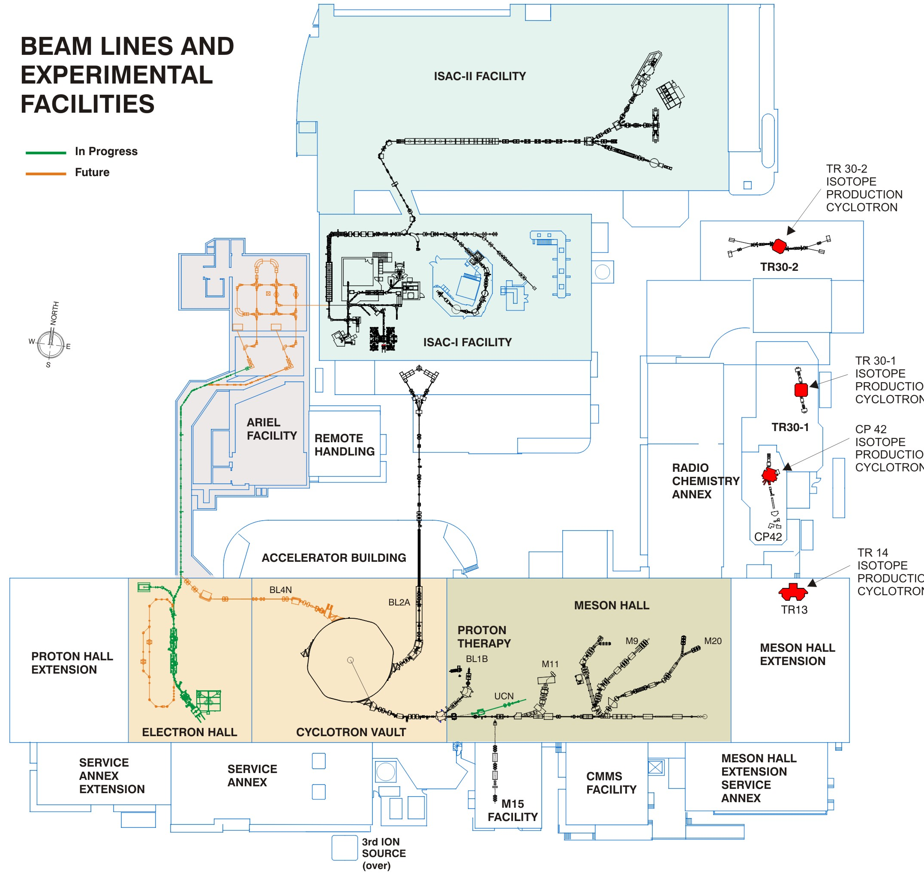
ARIEL Advantages (short term during ramp up starting 2026)
Second proton target station and parallel beam delivery capabilities
Significantly more targets, ion sources and beam development capabilities
Independent driver beams
  → (potentially longer RIB schedules from the e-linac, less downtime, physics program when cyclotron is down for longer repairs or refurbishments)
Possibilities of long beam times with “easy" n-rich isotopes while one or two exotic and demanding beams are delivered from the other two other stations.
ARIEL Beam Schedule will be : “Factory Mode” (more predictability, flexibility, opportunity)

Slide 8
ARIEL Advantages (ultimately)
More of intense, cleaner, neutron-rich beams
  Though not with same reach as FRIB (further towards drip-line), higher intensity a few isotopes lighter enables different class of experiments – less “first glimpse”, more precision and detail
3 independent RIB delivery paths – one accelerated, two low-energy
  In principle, 3x number of RIB shifts per year
    → With experimental community’s capacity, this will result in 1x<experiments<3x → publications
  Ability to de-couple beam development from delivery → more new species delivered on a shorter timescale → More flexible & impactful experiments
  Longer beamtimes (both n-rich, n-deficient) → greater sensitivity, e.g long precision measurements of small cross-section (e.g. astrophysics), more detailed surveys (multiple states probed in single run), long fundamental symmetries measurements
  Greater standard of measurement in terms of coverage and/or precision

Slide 9
What we’ll need to get there
Facilities maintained at a competitive cutting edge, with full coverage vis-à-vis capabilities & techniques
New directions to capture the ARIEL advantage
Greater collaboration between groups/facilities
More versatile, modular & portable ancillary equipment
Recall: by 2027, ramp up to 2-3x experiments running during year (+ New User Involvement!).
There will not necessarily be 2-3x postdocs & students
→ greater burden on local BAEs, techs & P&S physicists!
Need to keep our technical group adequately staffed & equipped

Slide 10
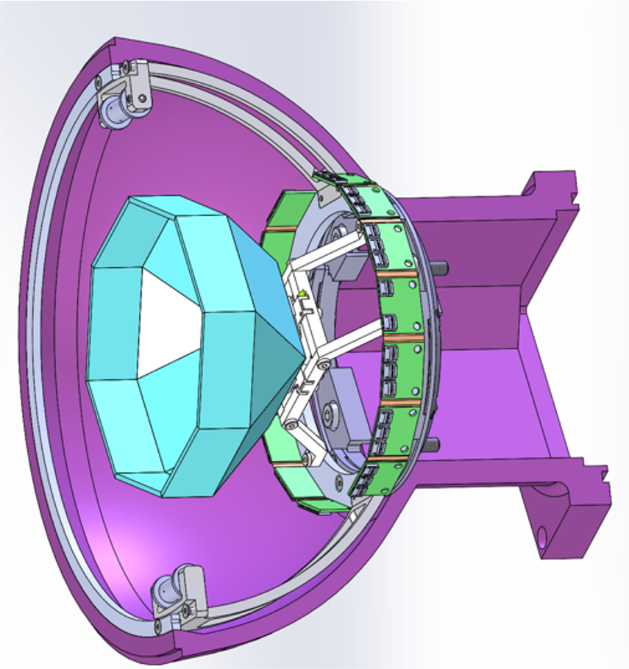
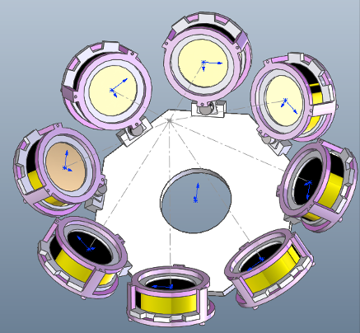
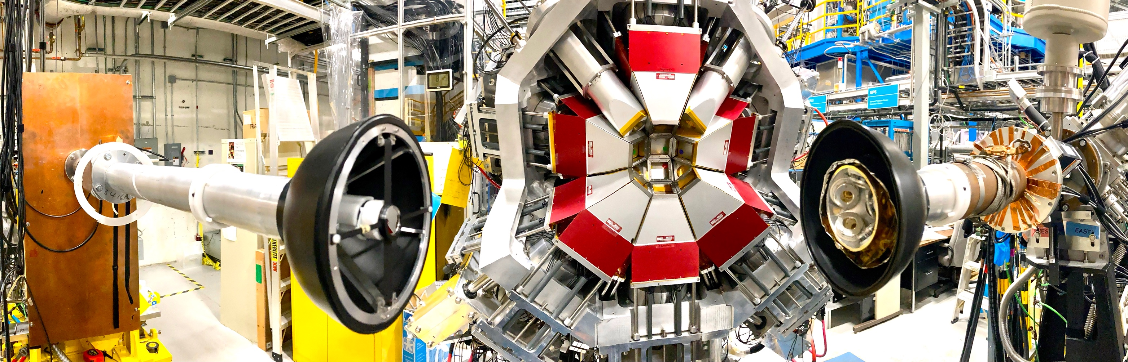
Sharpening the Tools: Decay Spectroscopy at GRIFFIN
Wide-ranging and active science program in nuclear structure, nuclear astrophysics and fundamental symmetries → New n-rich isotopes, higher yields, cleaner beams from ARIEL
New upgrades will ensure a competitive edge over worldwide competition + enable new science opportunities:
Upgrade SCEPTAR beta-tagging array to ARIES.
Upgrade PACES conversion electron spectrometer to CEDAR.
New “RCMP” detector → charged-particle spectroscopy (eg. 𝛽-delayed proton and alpha)
“Everything except the neutrino!”
ARIES
CEDAR
RCMP (U. Regina)
New Initiative: Couple GRIFFIN to the polarizer beamline (see talk by Adam Garnsworthy)

Slide 11
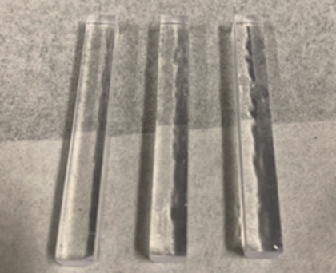
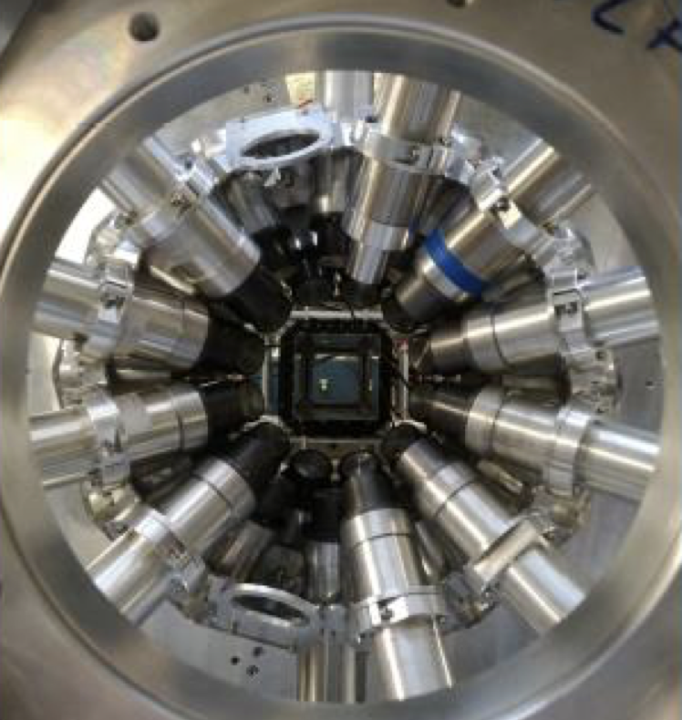
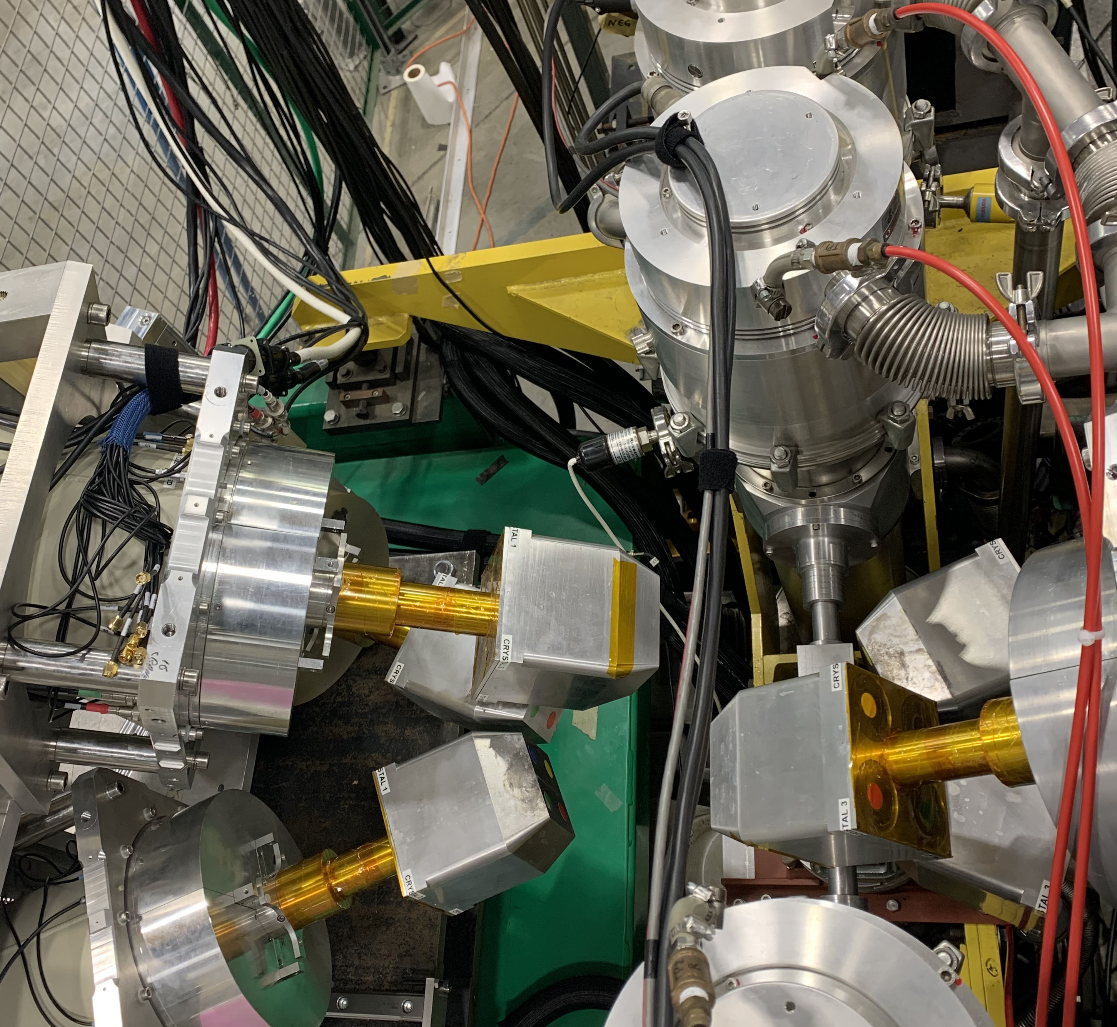
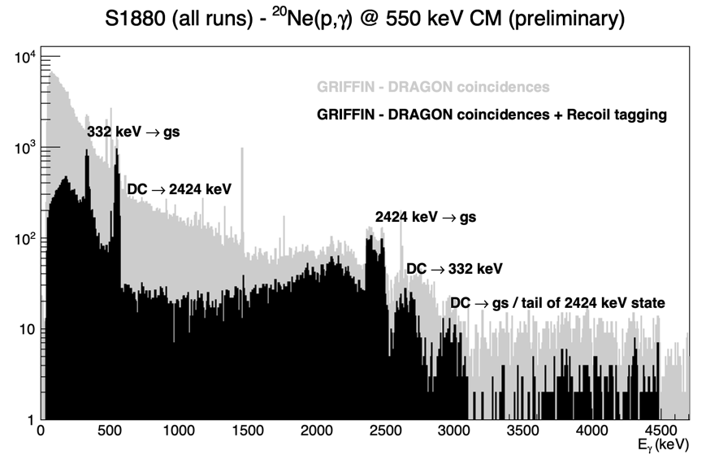
Sharpening the Tools:
Nuclear Astrophysics at medium energies (DRAGON, TUDA and ancillaries)
Melt-cast Organic Glass scintillators for neutron detection & (n/𝛾) pulse shape discrimination
Long RIB runs → statistics, systematics, coverage, completeness
  Many excited states measured in single run “Doing it right”
High intensity stable beam experiments with RF-booster cavity
  Direct capture, low cross-section → weakly bound halo states, astrophysics
New detectors: use of GRIFFIN HPGe, Surrey LaBr₃ array, neutron detection at target for (𝛼,n) (Organic Glass scintillators)
  Eventual development of replacement array for BGO (LYSO, Ce:GAGG) for high-efficiency + ultra-fast timing
Competitive or unique world-standard direct measurements of radiative capture, (p,𝛼), (𝛼,p) + elastic scattering, c.f. FRIB
LaBr₃ (Ce) example: FATIMA array (U. Surrey)
GRIFFIN Clovers @ DRAGON

Slide 12
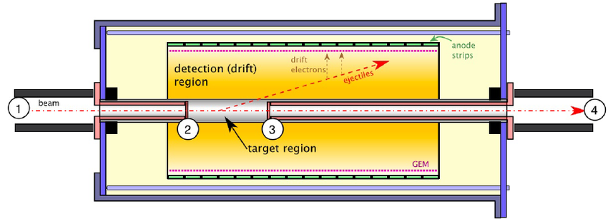
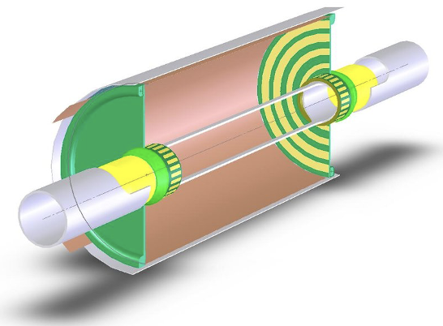
New Tools: Nuclear Astrophysics at medium energies
TPC for v. low cross section / high beam intensity
  → V. low energy astrophysics measurements e.g. (p,𝛼), (𝛼,p), (𝛼,n) for light nuclei e.g. Big Bang Nucleosynthesis, CNO etc
  Modified version for heavy mass
→ Co-axial separated design (beam doesn’t overwhelm particles of interest)
→ New flexible UrWELL GEM technology
→ Future flexible silicon detectors
→ Suitability of UrWELL GEMs with ³He gas, for neutron detection is also being explored
Combination with external neutron array (OGS)
Astro TPC (York/TRIUMF)
Added to existing facilities →
Complete “direct measurement toolkit section”

Slide 13
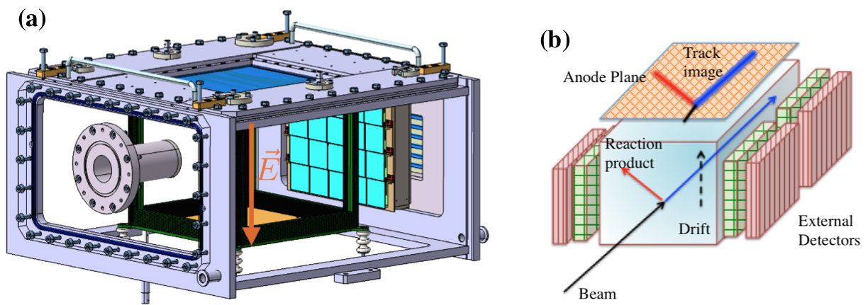
New Tools: Nuclear Reaction Spectroscopy with Active Target Time-Projection Chamber
Active target, allowing for ⁴He or ³He targets “EXACT TPC”
Designed to operate simultaneously with IRIS facility (in transmission mode)
Can be combined with ancillary detectors (e.g. neutron array)
  → With ARIEL, can measure ^{136,137}Sn(𝛼,𝛼’) to search for resonances just above n threshold
  Ideal tool to search for isoscalar giant monopole resonance as well
Complementary to IRIS facility transfer reactions (d,p) (p,d) (d,t) to get knowledge of neutron orbitals, EXACT e.g. allows for (³He,d) for proton orbitals to looks for changes in nuclear shells in heavy nuclei
Two nucleon transfer for pairing correlations using (³He,p) to study proton-neutron pairing in nuclei. e.g. ⁷⁶Sr(³He,p) to investigate T=0 pair vibration mode
Bonus astrophysics motivation: rp, r-process → Indirect measurements for proton capture in ²³Al;. ³⁵K, ⁵⁹Cu, ⁶¹Ga
→ Thick target to measure excitation spectrum across various energies for resonant capture reactions

Slide 14
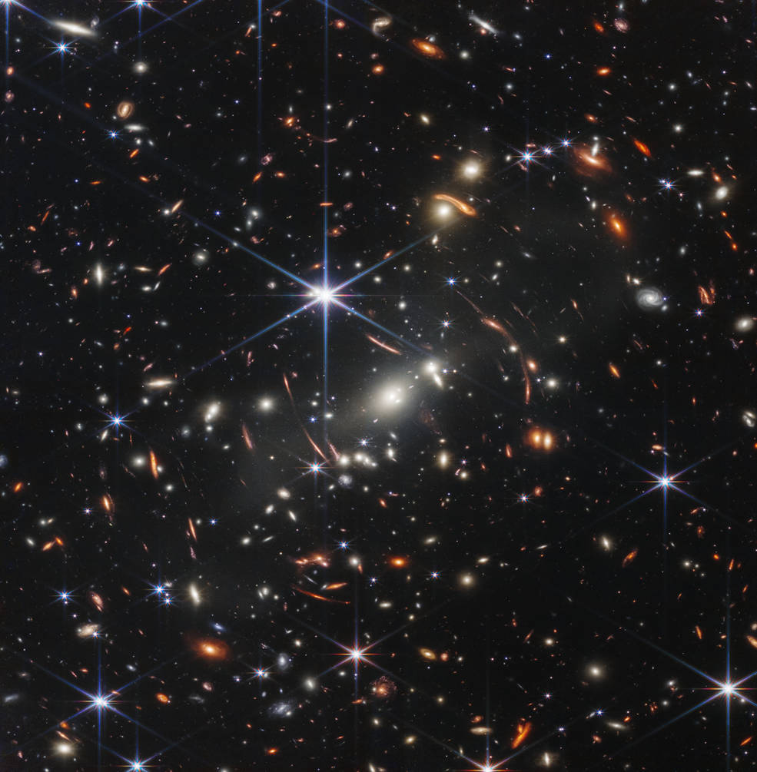
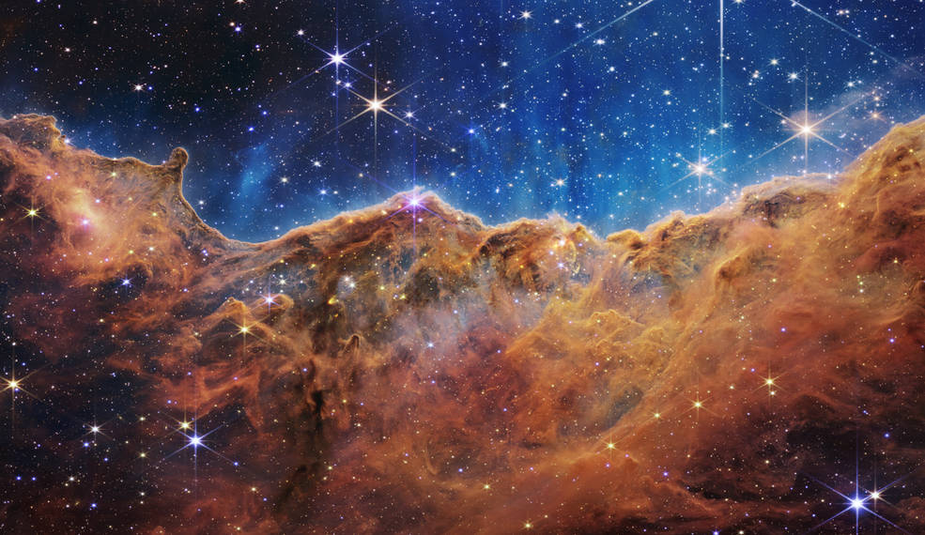
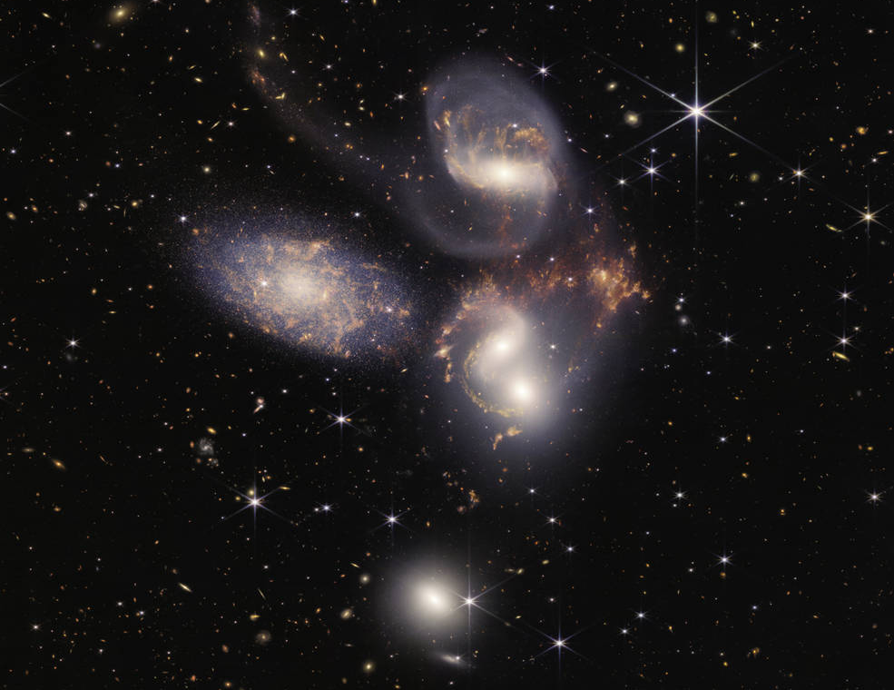




Generate stellar element yield sets covering entire mass and metallicity space
“How do stars evolve and release the heavy elements they produce back into space for recycling into new generations of stars and planets?”

Slide 15
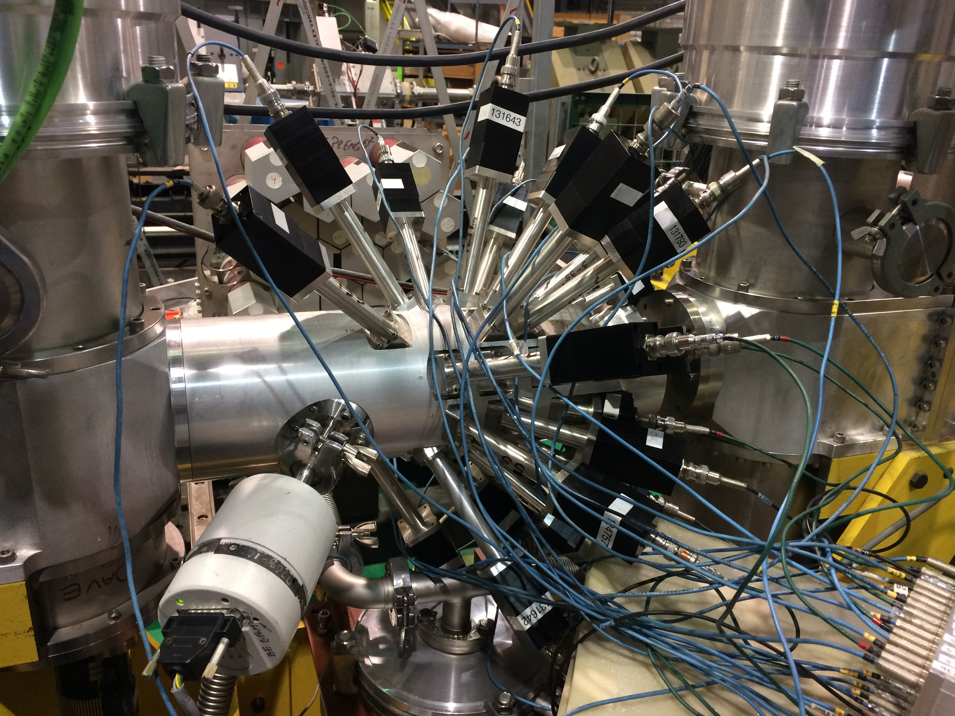
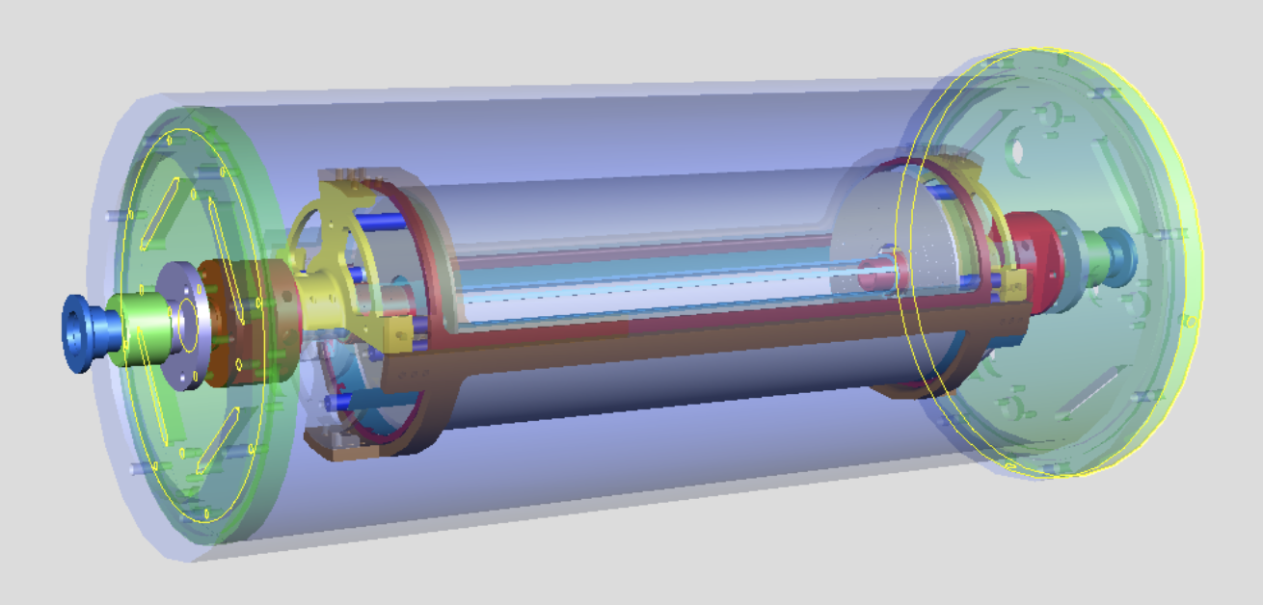
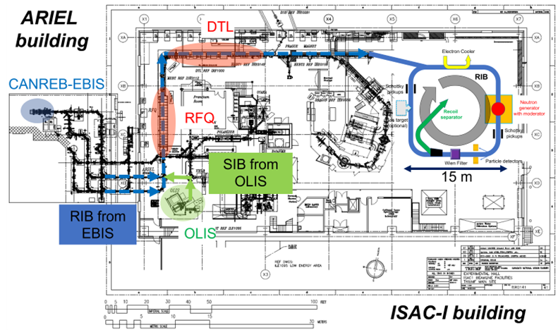
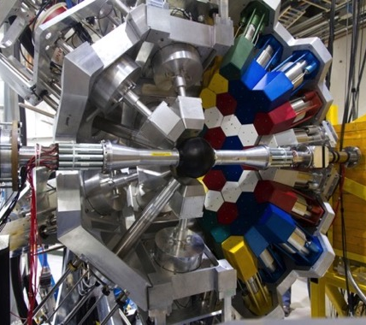
NUCLEAR ASTROPHYSICS Capabilities at ISAC (with exotic isotopes)
SONIK Array: elastic scattering phaseshifts (p,p), (𝛼,𝛼)
TUDA Array: direct measurement of (p,𝛼), (𝛼,p)
TIGRESS & Ancillary Detectors:
Fusion-evaporation, transfer reaction studies e.g. (d,p) etc
TITAN penning Trap & MR-TOF: ground-state masses (1st order parameter for r-process), in-trap decay spectroscopy
Neutron capture Storage Ring
“TRISR”
(See talk by Iris Dillmann)
Active Target: direct measurement of (𝛼,n), (𝛼,p)
Neutron-induced reaction cross section measurement
IRIS Solid H, D target
Indirect measurements (d,p), (p,n), (p,𝛼) etc
Indirect
Direct
GRIFFIN Spectrometer: total measurement of ground-state & decay properties: 𝛽+, 𝛽-, EC, e⁺e⁻, 𝛽-n, t_{1/2} etc
DRAGON Astrophysics Recoil Separator: direct measurement of (p,𝛾), (𝛼,𝛾)
Radiative neutron-capture on n-rich species, within i-process & r-process, is one of the biggest open fields of study in astrophysics: Binary neutron star mergers, core-collapse supernovae, CEMP stars → nucleosynthesis of the heaviest elements!
EMMA Spectrometer: couple with TIGRESS for transfer, direct (p,𝛾) etc
Medium Energy (0.15 – 1.8 A MeV)
High Energy (1.8 – 16 A MeV)
Low Energy (≤ 60 keV)

Slide 16




Thank you
Merci
www.triumf.ca
Follow us @TRIUMFLab

Slide 17
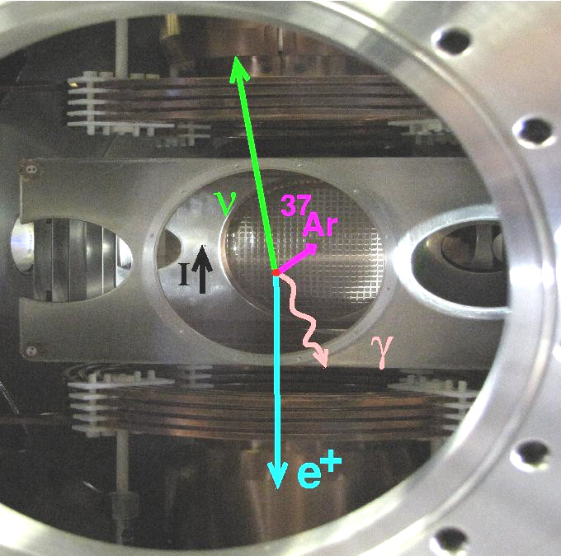
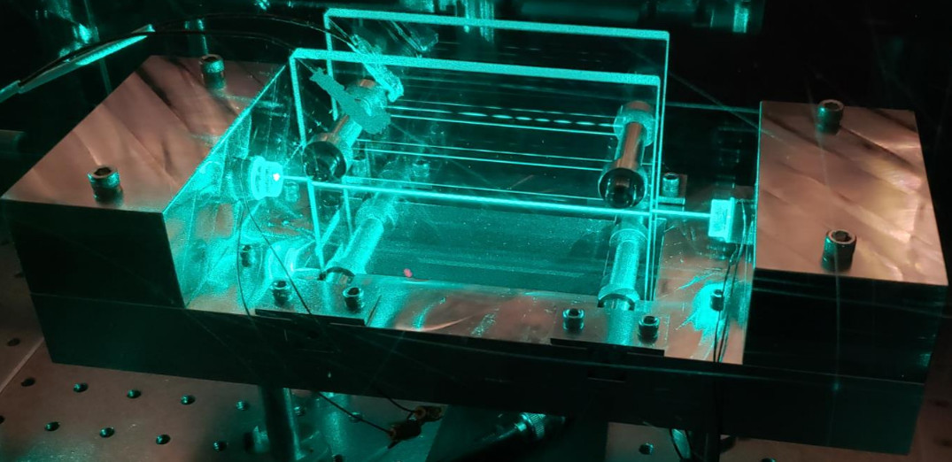
2023-2030 Strategy: Low Energy Experiments
→ Precision RIB Measurements / Fundamental Symmetries
Francium PNC Facility (Fr-PNC)
Currently at level of E1/M1 Stark transition measurement → Sensitivity & methodology proven
Atomic Parity-violating signal expected 2024
APV measurement competitive with others, 2025+ (into 5YP)
  Competitive electron-quark neutral weak coupling + nuclear anapole
These measurements need maximum yields of ²⁰⁸⁻²¹³Fr → n-dependent effects
D. DeMille et al. have S2139LOI which would look for Francium dimers at Fr-PNC, towards full ²²³FrAg EDM experiment ( see AMO discussion )
TRINAT (neutral atom trap) → TRINAT-𝛾
Extend 𝛽-𝜈-𝛾 from T-reversal symmetry breaking in ³⁷K (expected finished in current 5YP)
Consider isospin symmetry-breaking in isospin-suppressed Fermi-GT ^{36,45,47}K for V_{ud}
Develop case for time-reversal enhancement by isospin-suppressed F-GT → competitive search for Time-breaking, Parity-even isospin-breaking nucleon-nucleon interactions
TRINAT Needs:
Digitization of waveforms for ion & beta counters
Cryo vacuum upgrade
Gradually longer beam times towards long blocks for precision measurements (stat √N + systematic tests) in 5YP
TRINAT Trap
FRANCIUM UHV Power Buildup Cavity
(T. Hucko, ACOT 2021)

Slide 18
TITAN Ion Trap Facility
MR-TOF: 10 year + program of measuring r-process nuclei for astrophysics (masses), plus instrument of standard for measuring low intensities from ARIEL
MPET (Penning Trap): Precision mass measurements, v. high precision (1:1E+10) of heavy superallowed 𝛽-emitters → V_{ud}
  Long runs ~1 week/isotope
  More systematics controlled
EBIT (highly-charged ions) [5-10 year program]
  In-trap decay spectroscopy: nuclear structure & astro ~ 2-week runs
  Extreme UV spectroscopy → absolute charge radii of heavies (e.g. Fr, Ra) for EDMs
  Highly-charged radioactive molecules: establishing existence → RadMol facility

Slide 19
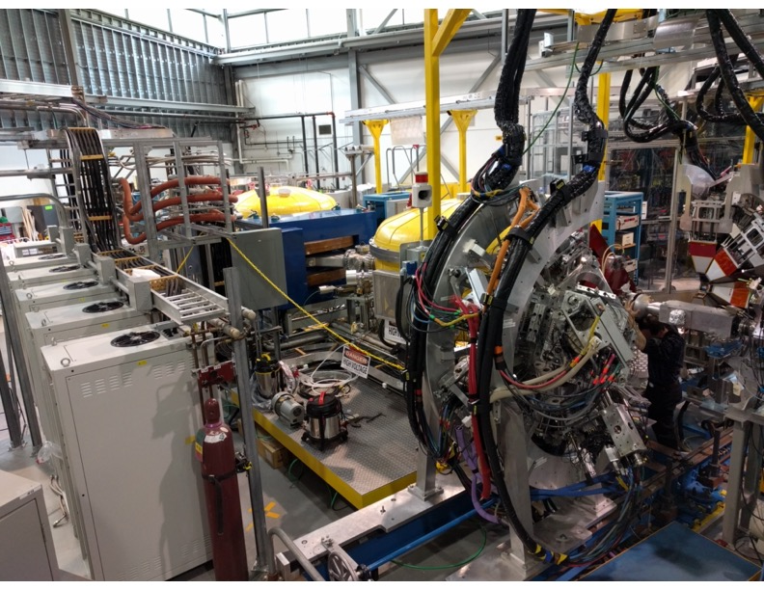
2023-2030 Strategy: High Energy Experiments
→ Pioneering & precision RIB Measurements / Nuclear Structure and Astrophysics
TIGRESS and EMMA
Nuclear structure frontiers with RIBs:
  Isospin: Exoticism, new magic numbers, indications of collectivity, ground states and small number of excited states
  Precision & Sensitivity: nature of shapes and shape coexistence, microscopic origin of magic numbers, collectivity, rich excited structures and transitions
Precision requires high efficiency and high RIB flux (intensity and time): highly efficient Ge detectors + recently upgraded GRIFFIN-style DAQ for ~30× the data throughput
CANREB and ARIEL will push the frontiers of precision and sensitivity:
  cleaner beams with lower isobaric contamination (esp. of fission products) & higher mass resolution lead to sensitivity; especially relevant for higher-mass fission peak largely unexplored by TIGRESS so far;
  longer beam times and higher intensities will permit precise measurements
Sensitivity requires a suite of auxiliary detectors and *clean* RIBs; coupling to EMMA greatly enhances sensitivity
EMMA enhancements: direct measurements of reaction cross sections at supernova energies: solid He targets and neutron detectors will enable (𝛼,n) in addition to (p,γ) and (𝛼,p)
Nuclear structure: 4 GRIFFIN HPGe detectors to be located near EMMA focal plane surrounding DSSD for decay spectroscopy of reaction products
Addition of annular Si in SHARC-II target chamber for ΔE-E measurements of light ejectiles to reduce fusion-evaporation background in α transfer reactions, enhance sensitivity for (³He,d) reactions
TIGRESS coupled to the EMMA recoil spectrometer target position

