Slide 1

Particle Physics at TRIUMF in next Five-Year Plan 2025-2030
Oliver Stelzer-Chilton (for the PP group)
Science Week 2022
July 18th–July 22nd, 2022

Slide 2

Particle Physics within the Physical Sciences Division
The departments of Particle Physics, Science & Technology and Scientific Computing address the areas:
High Energy Frontier
Neutrinos and Dark Matter
Precision Tests of Fundamental Interactions
Lead in Scientific Discovery through focus projects
Projects where we are involved in all areas
  detector design/construction, operations, data analysis
Ensure critical mass is established
Maintain leadership in all areas
Current experiments
  ATLAS, T2K/Hyper-K, ALPHA, TUCAN, SuperCDMS
New experiments expected to reach that point in the future
  DarkLight, nEXO, PIONEER
See talk by Jocelyn Monroe covering TRIUMF@SNOLAB

Slide 3
Enable Particle Physics in Canada and Abroad
TRIUMF is part of a network of laboratories and partner institutions
Leverage TRIUMF key expertise in accelerator, computing, detector and DAQ technologies
  Unique expertise in e.g. cryomodules, SiPM, TPC, gaseous detectors, DAQ, etc…
  Support for Accelerator and Engineering, Science Technology and Computing are crucial
SNOLAB: detector, facility and DAQ systems through Science and Technology involvement
-> SuperCDMS, nEXO, ARGO, DEAP, SNO+
CERN: In kind contributions to LHC and HL-LHC, share in detector upgrades -> ATLAS, ALPHA
KEK/J-PARC: beam monitoring accelerator contributions
share in detector upgrades -> T2K/Hyper-K
Gran Sasso: DAQ systems -> DarkSide
Future involvement
  Ocean Networks Canada: -> P-One
  Future Collider

Slide 4
Particle Physics Next 5YP Planning
Particle Physics Planning
  Dedicated meetings (mini-retreats) during March and April
  Presentations from all research groups + new future initiatives
  Contributions from: ATLAS, Hyper-K, ALPHA, HAICU, TUCAN, SuperCDMS, nEXO, PHAAR, DarkLight, PIONEER, P-ONE, Future Collider
  Hiring Priorities in short talks in dedicated meetings in May and June in preparation for PSD retreat
  New initiatives under discussion in dedicated task forces
    Center/platform/hub for detector development - joint with Nuclear Physics, SciTech
    Center/platform/hub for AMO/Quantum/Precision physics (HAICU, radioactive molecules, UCN, Francium…) - joint with Nuclear Physics and CMMS
  These are meant to 1) strengthen and refresh critical specialized technical expertise while 2) also fostering existing synergies and leveraging new as part of the next Five-Year Plan
See talks by Akira Konaka, Makoto Fujiwara and Stephan Malbrunot-Ettenauer

Slide 5
Next Five-Year Plan
Impact on Focus Projects

Slide 6
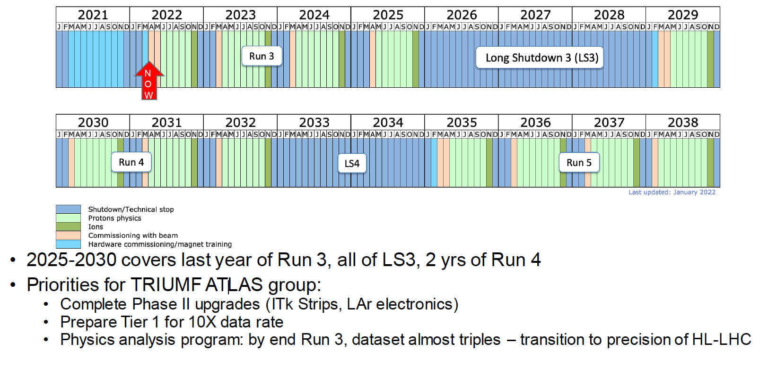
ATLAS

Slide 7
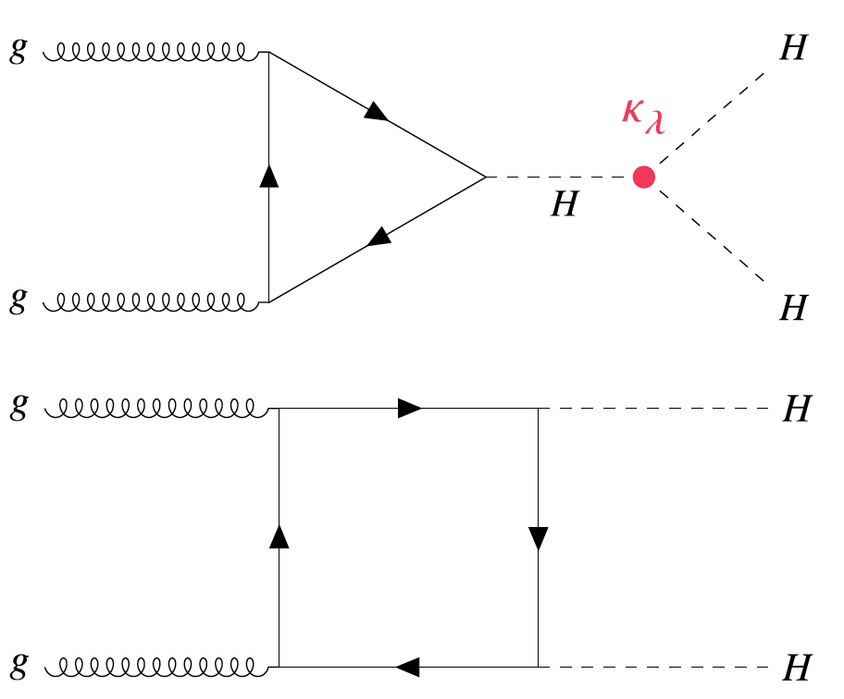
ATLAS
Physics with 3x the dataset: huge range of interesting physics options
  Higgs and Standard Model measurements become more precise
  Search program - higher energy, new signatures, new detector
A flagship analysis for future runs of the LHC
  Measuring κ_{λ} by measuring HH production
Κ_{λ} gives direct information on the Higgs potential
  Potentially evidence of HH before Run-4
  But clearly will be a HL-LHC legacy!

Slide 8
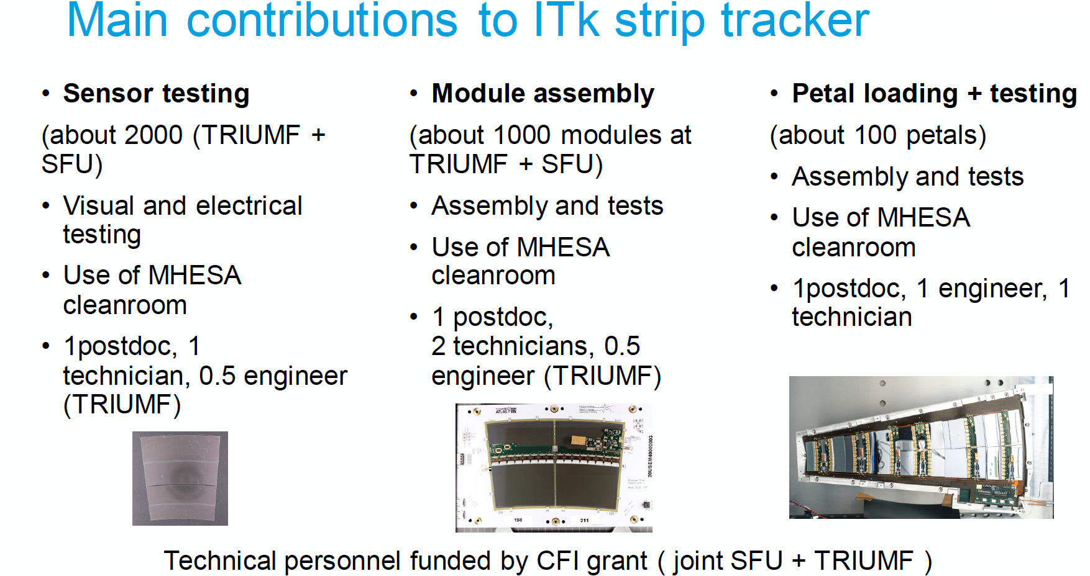
ATLAS

Slide 9
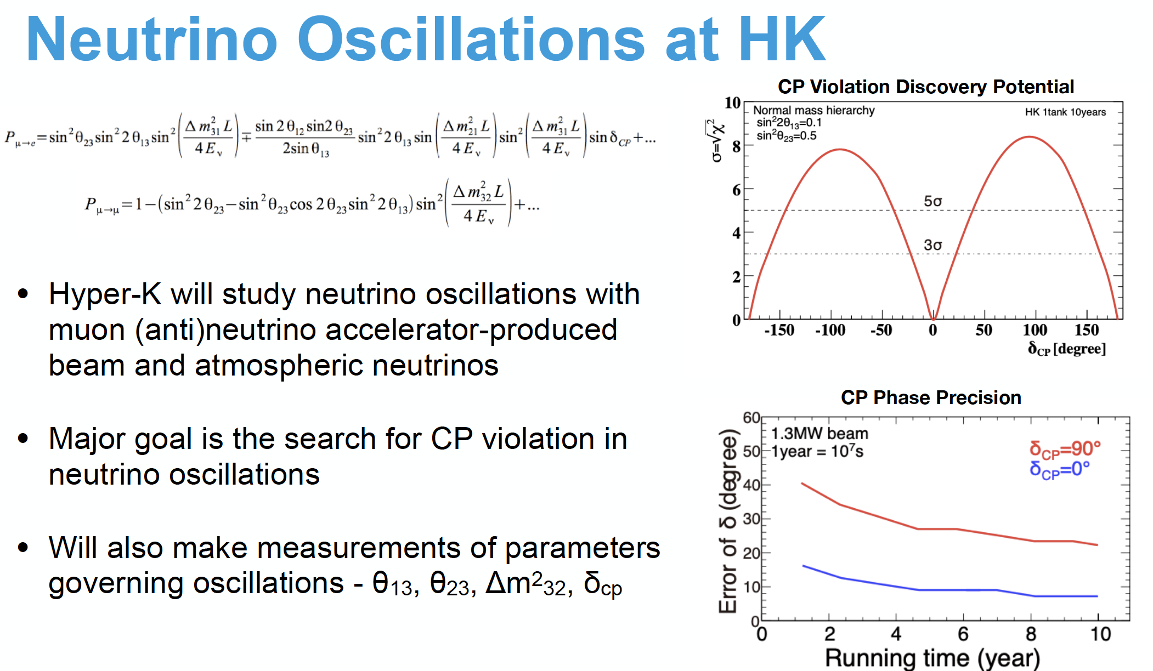
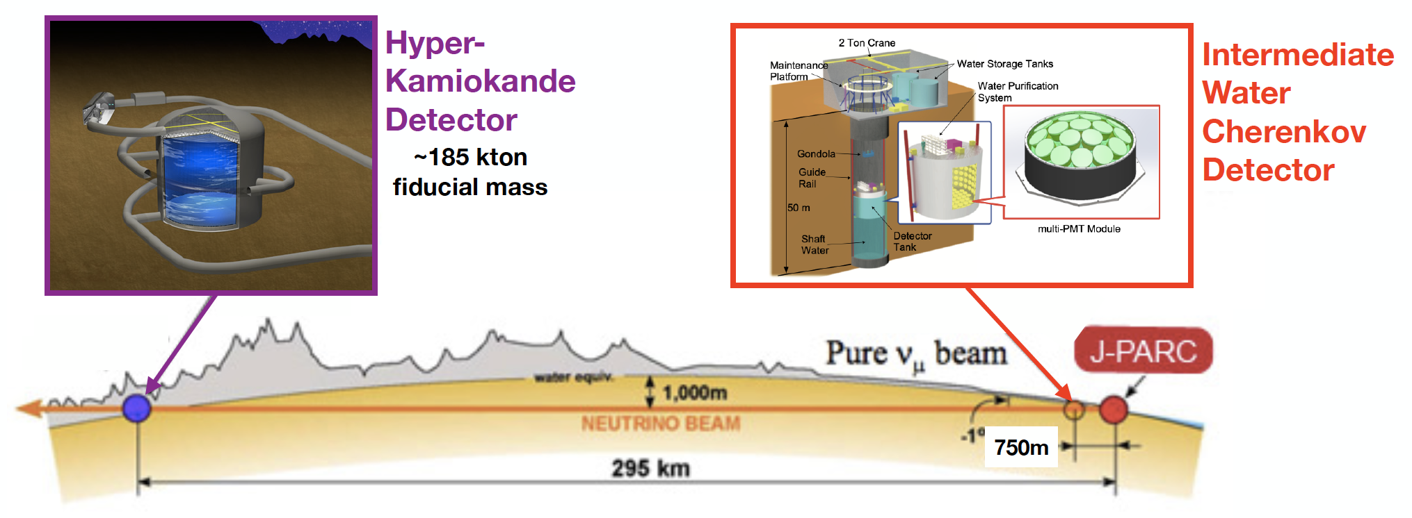

Slide 10
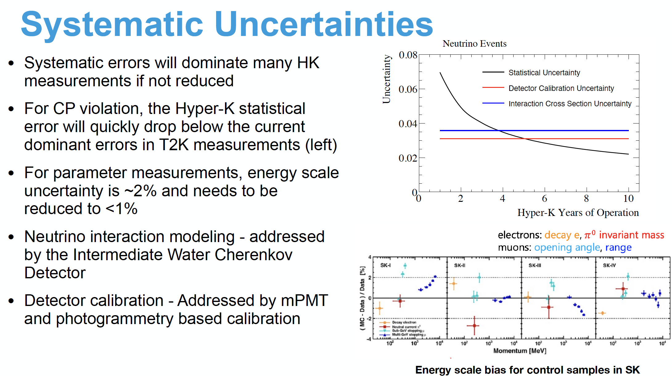
Hyper-K

Slide 11
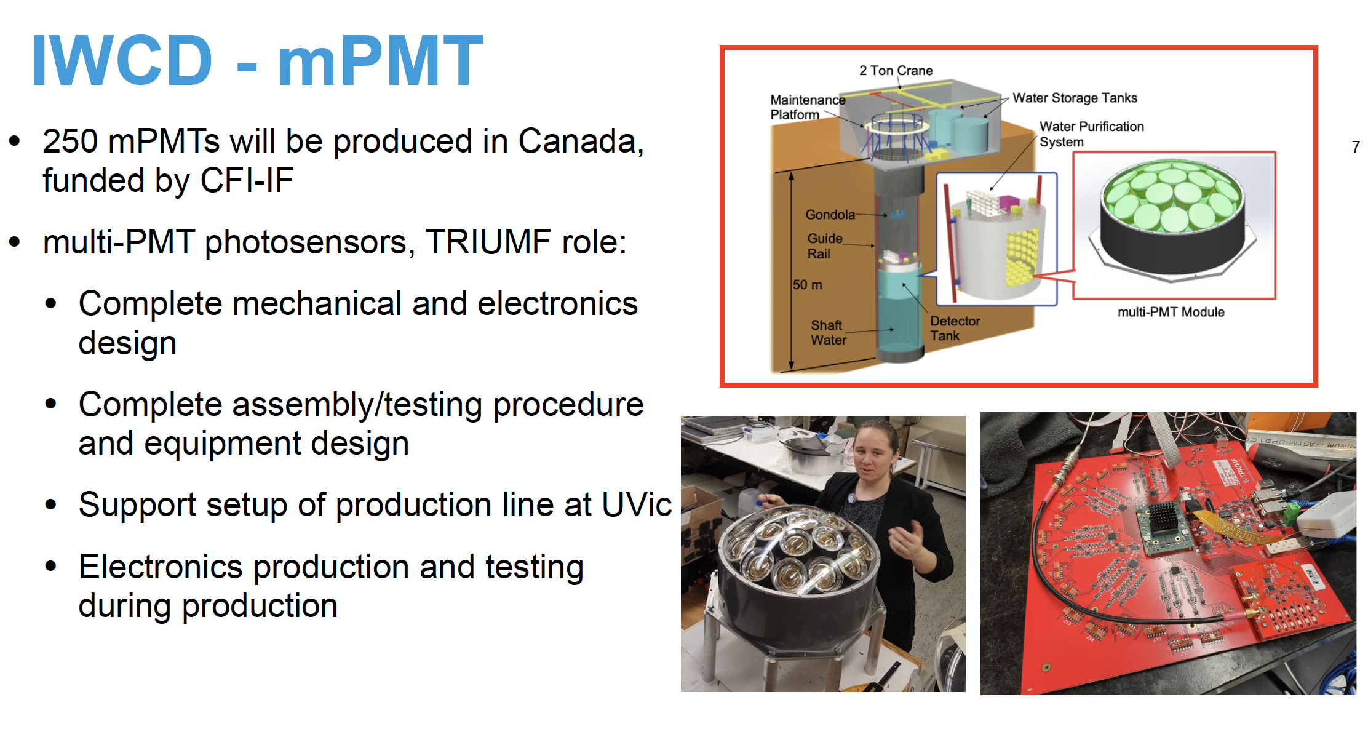
Hyper-K

Slide 12
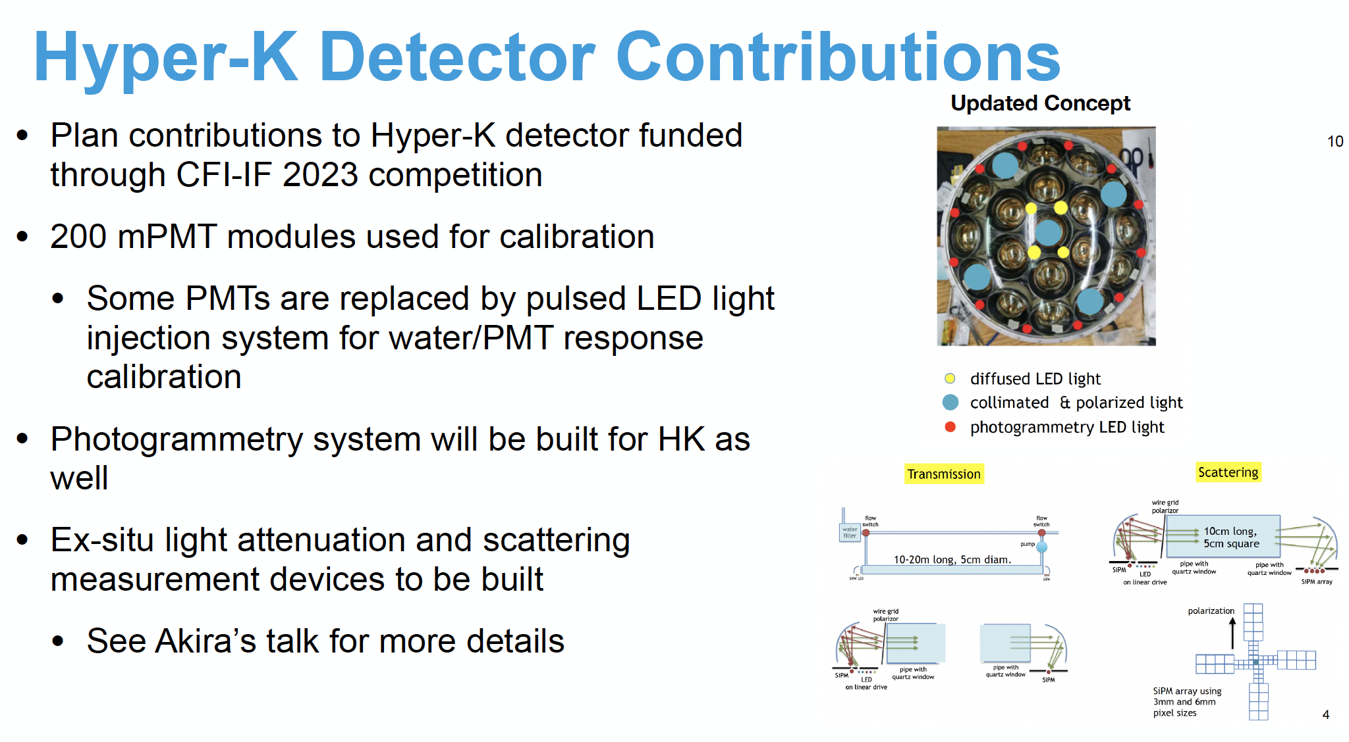
Hyper-K

Slide 13
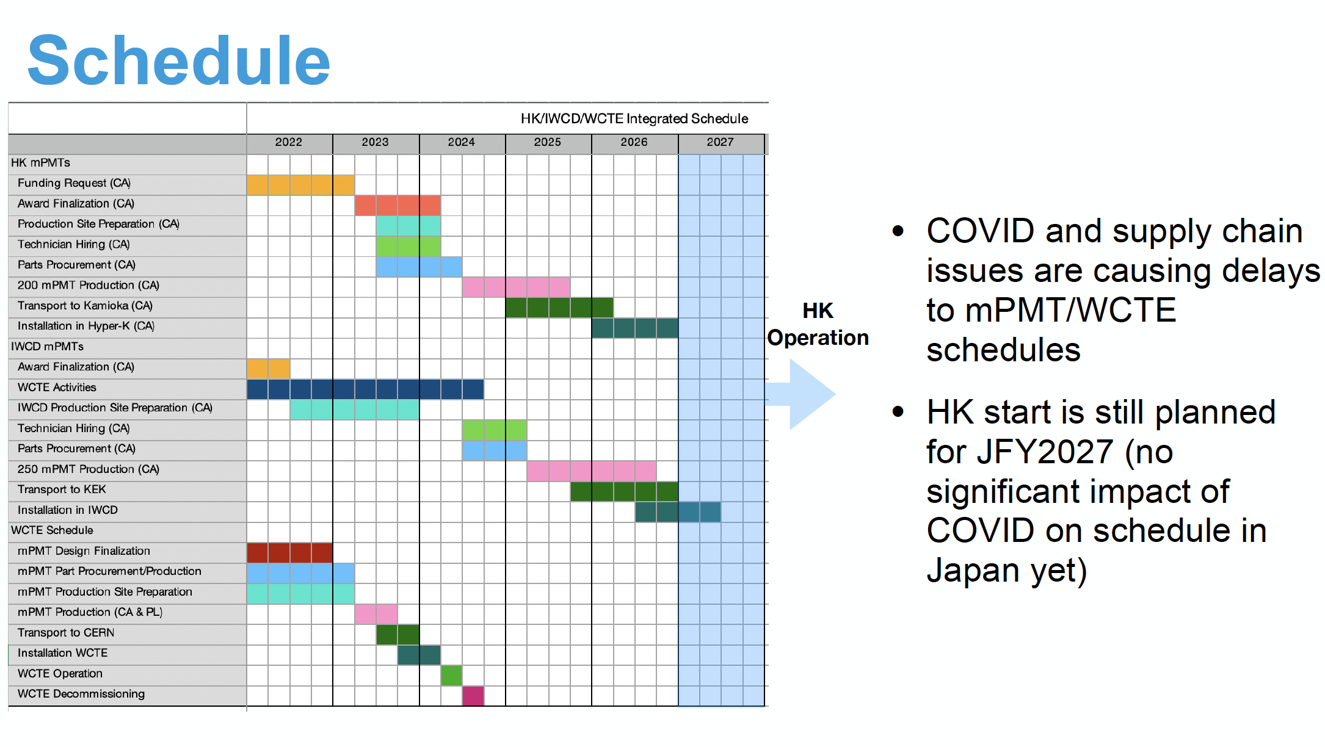
Hyper-K

Slide 14
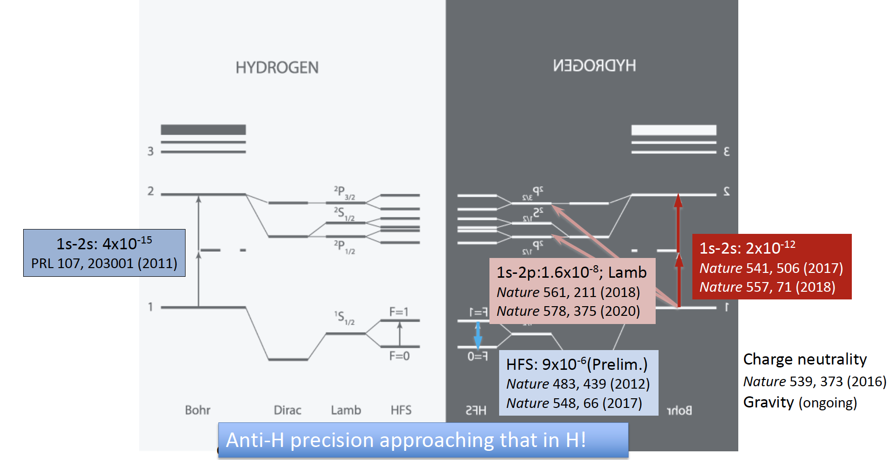
ALPHA

Slide 15
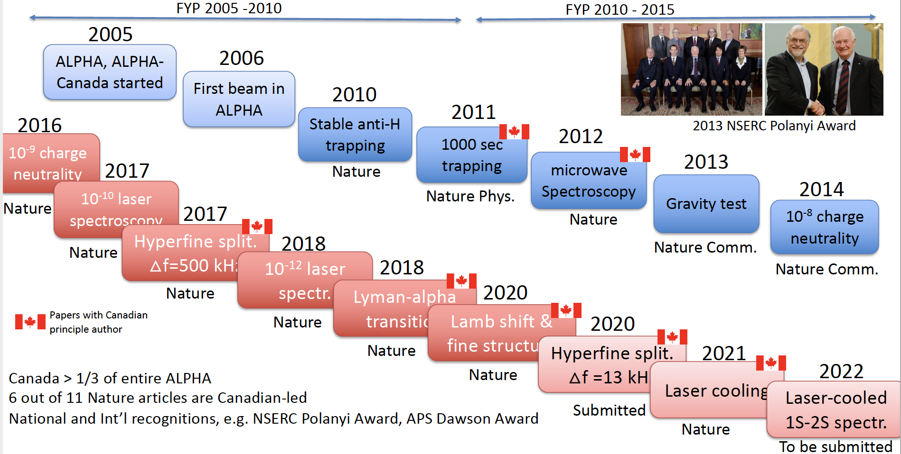
ALPHA

Slide 16
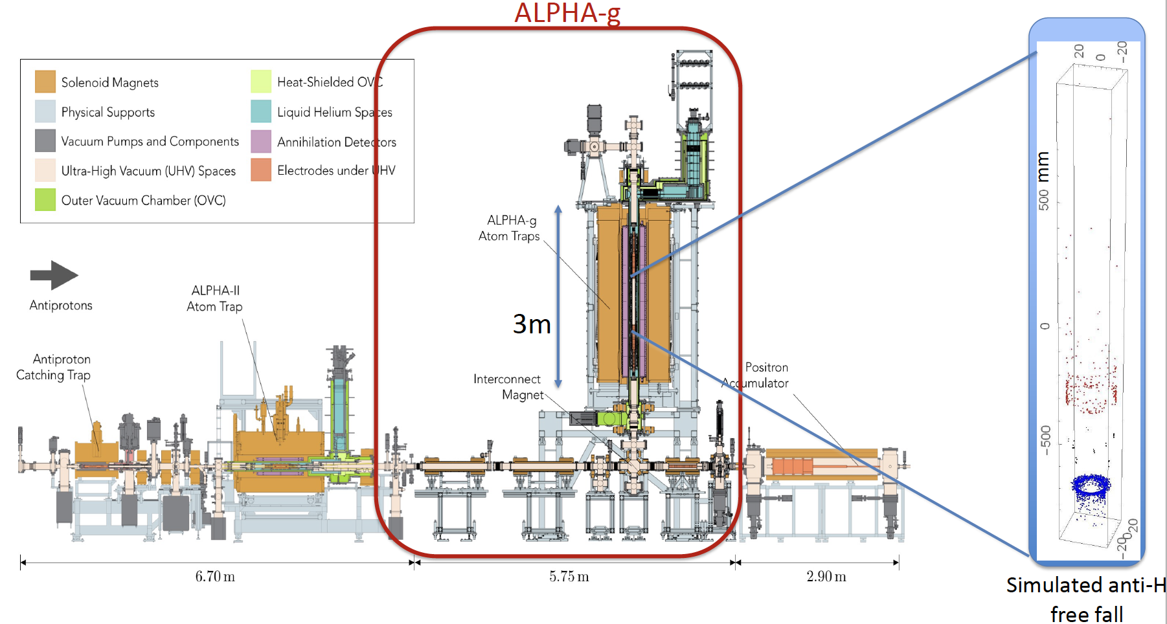
ALPHA

Slide 17
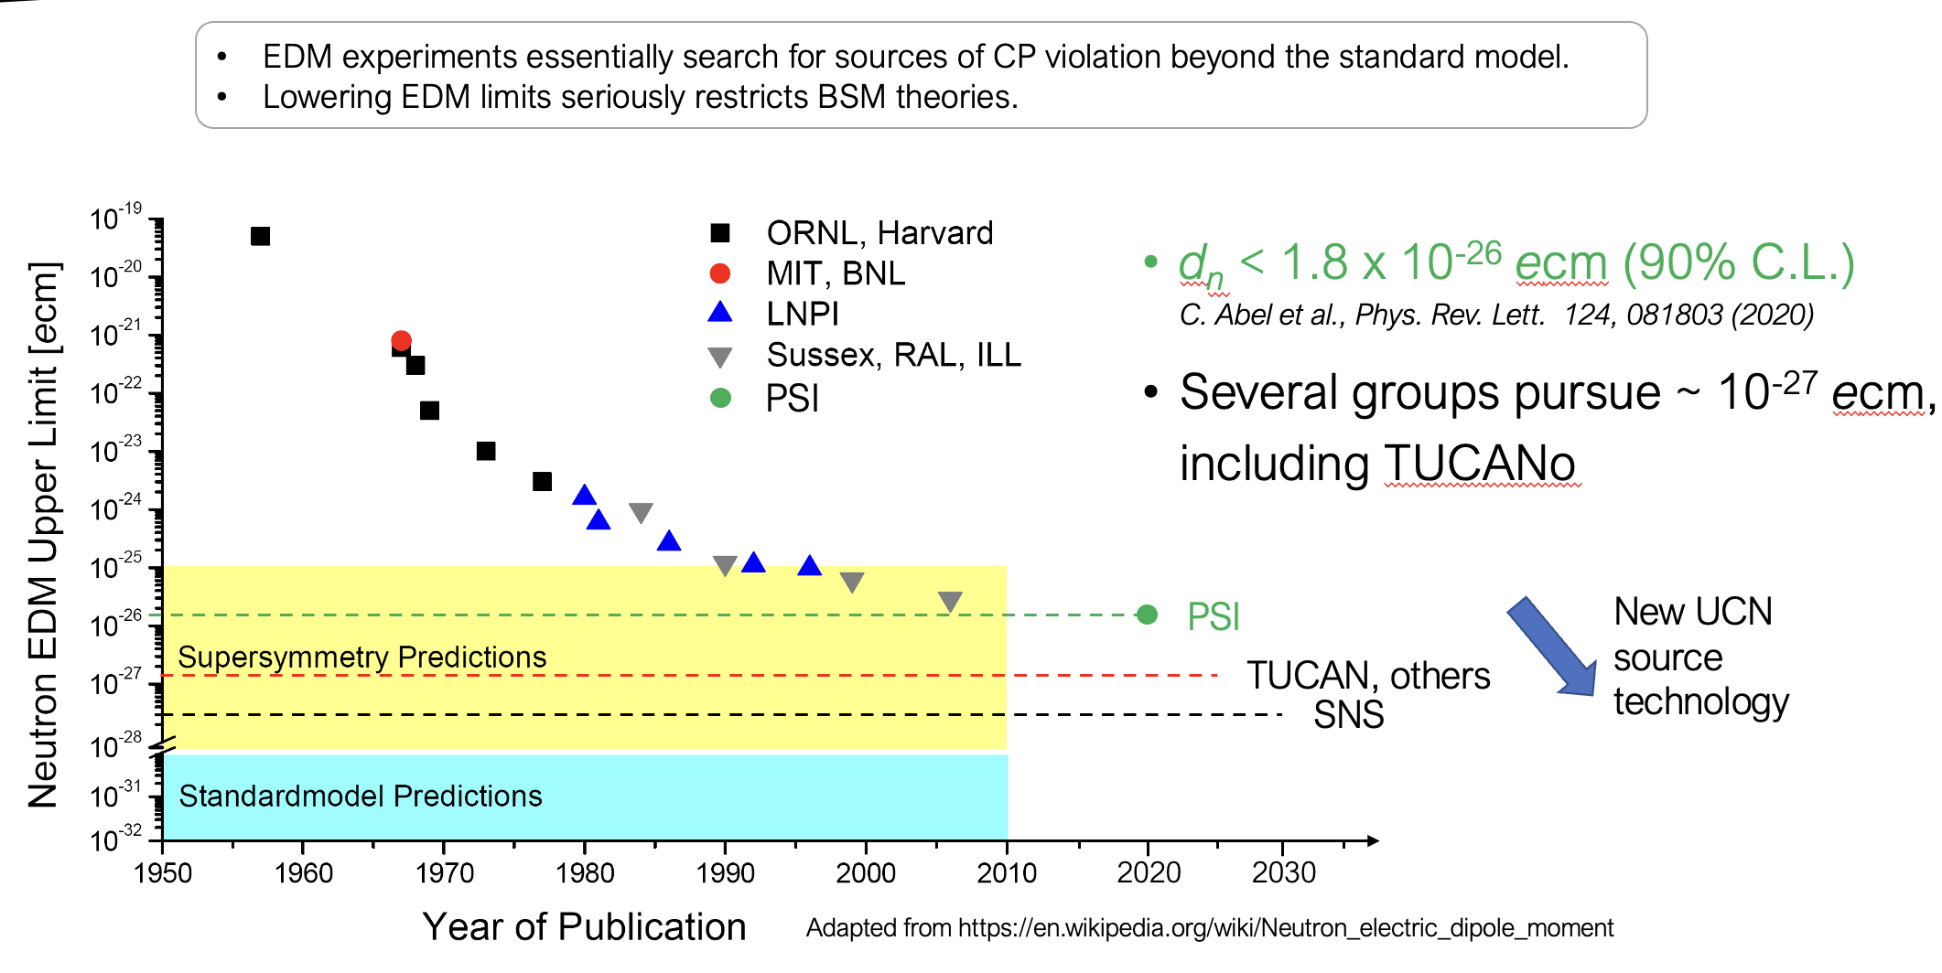
TUCAN

Slide 18
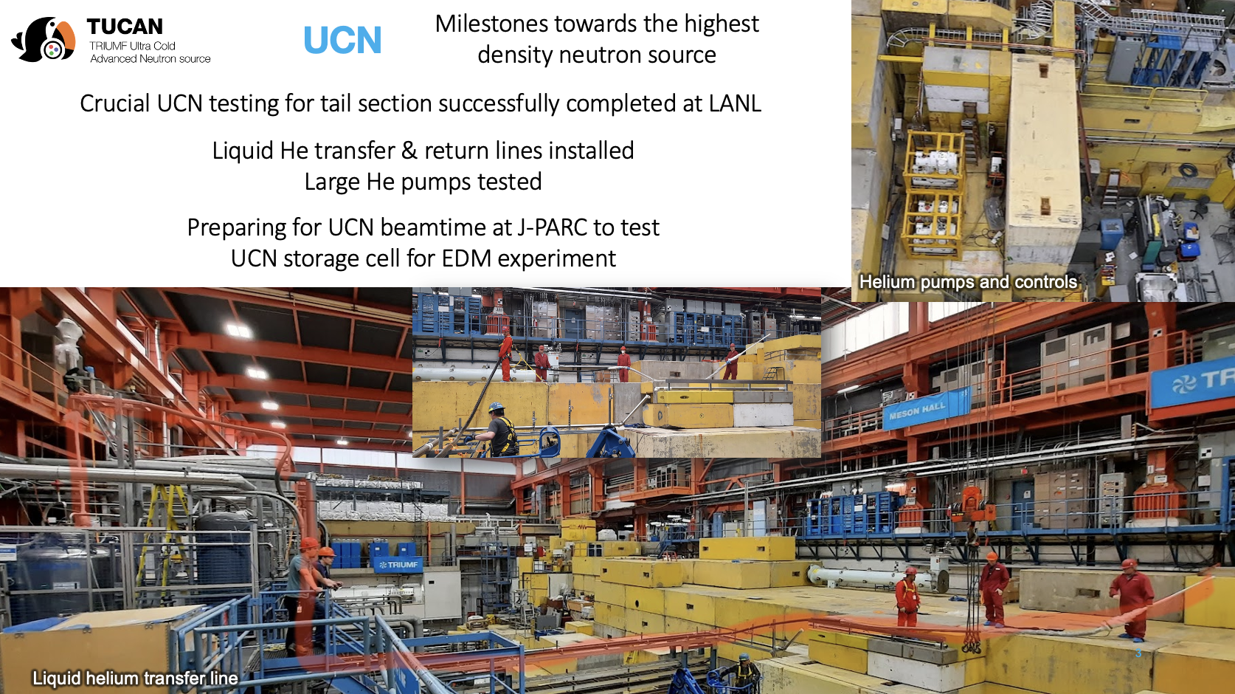
TUCAN

Slide 19
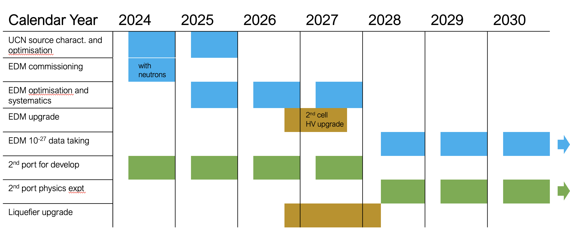
TUCAN

Slide 20
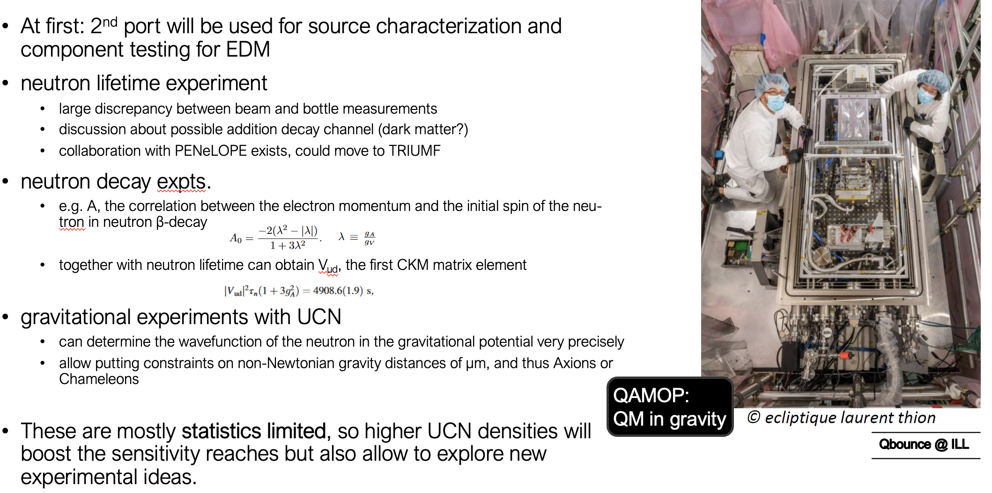
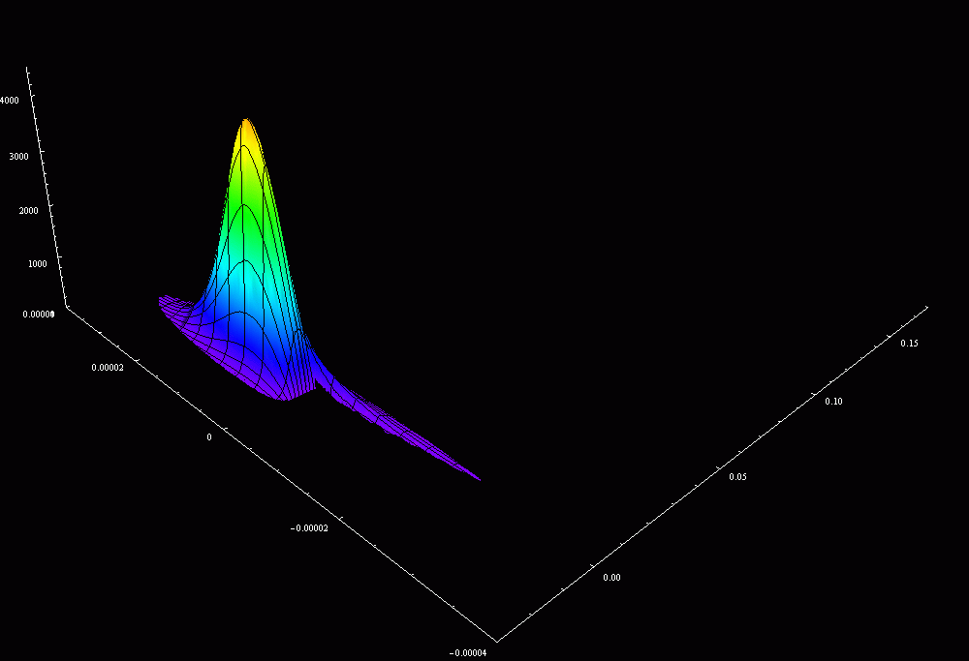
TUCAN

Slide 21
This Five-Year Plan
New Projects

Slide 22
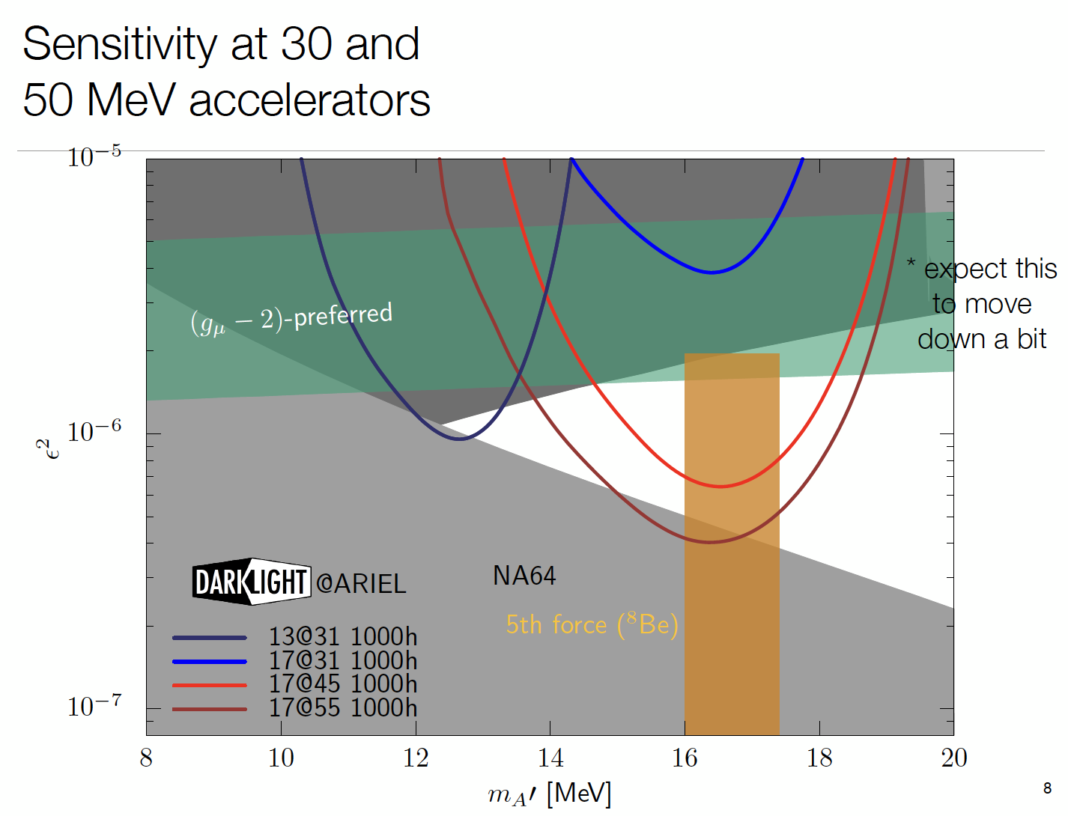
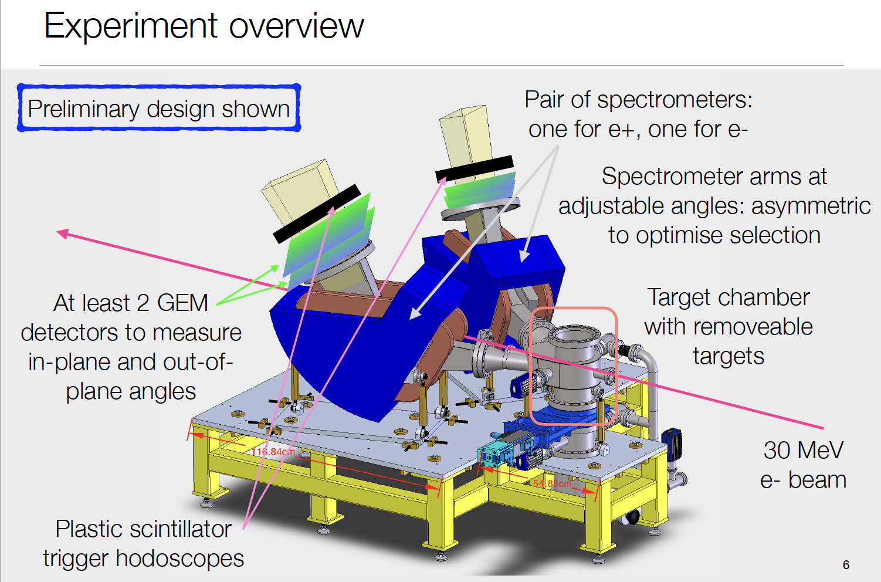
DarkLight
See talk by Kate Pachal

Slide 23
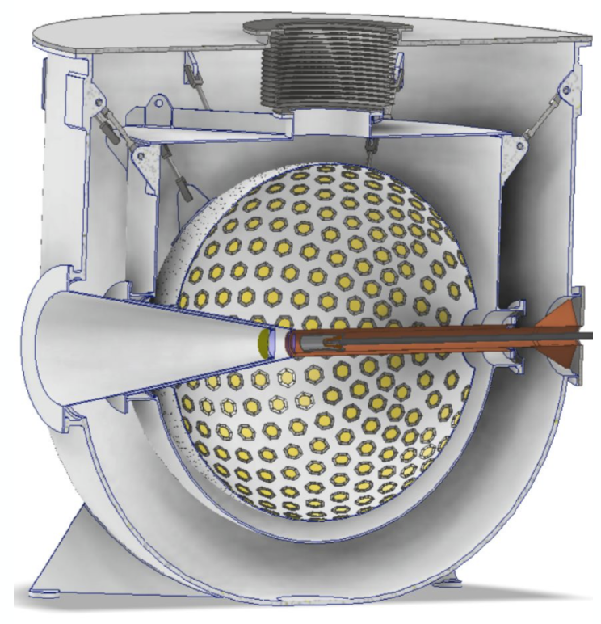
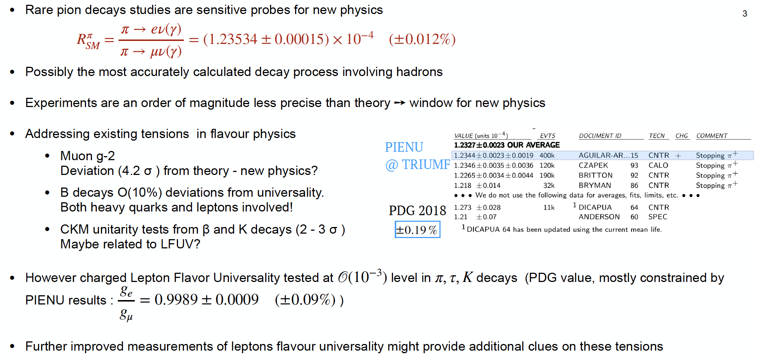
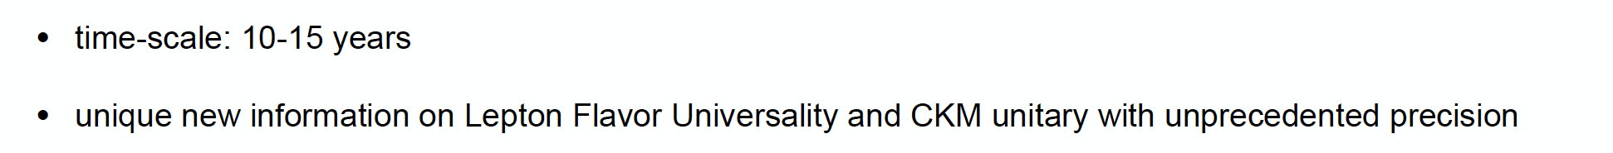
PIONEER@PSI

Slide 24
Next Five-Year Plan
Future Projects

Slide 25
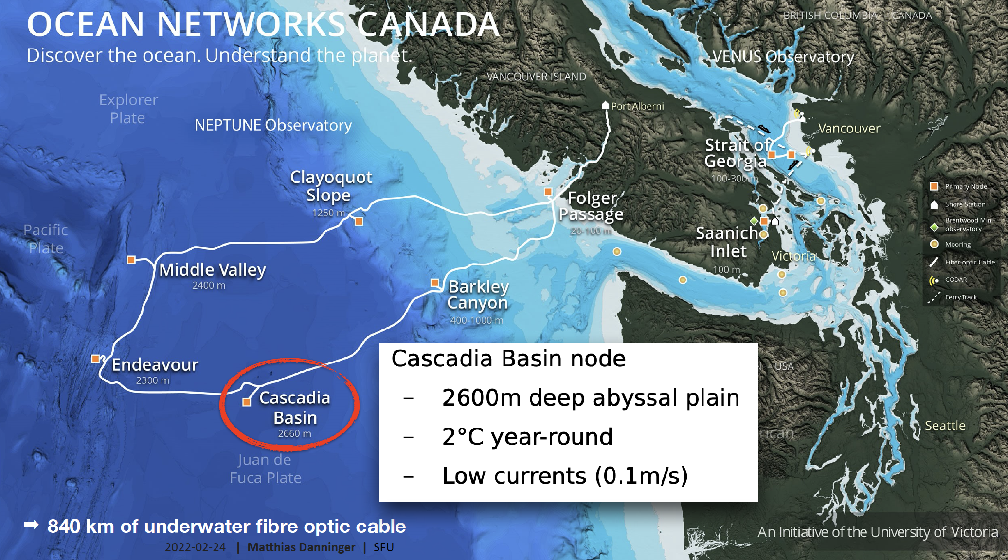
P-ONE
See talk by
Felix Henningsen

Slide 26
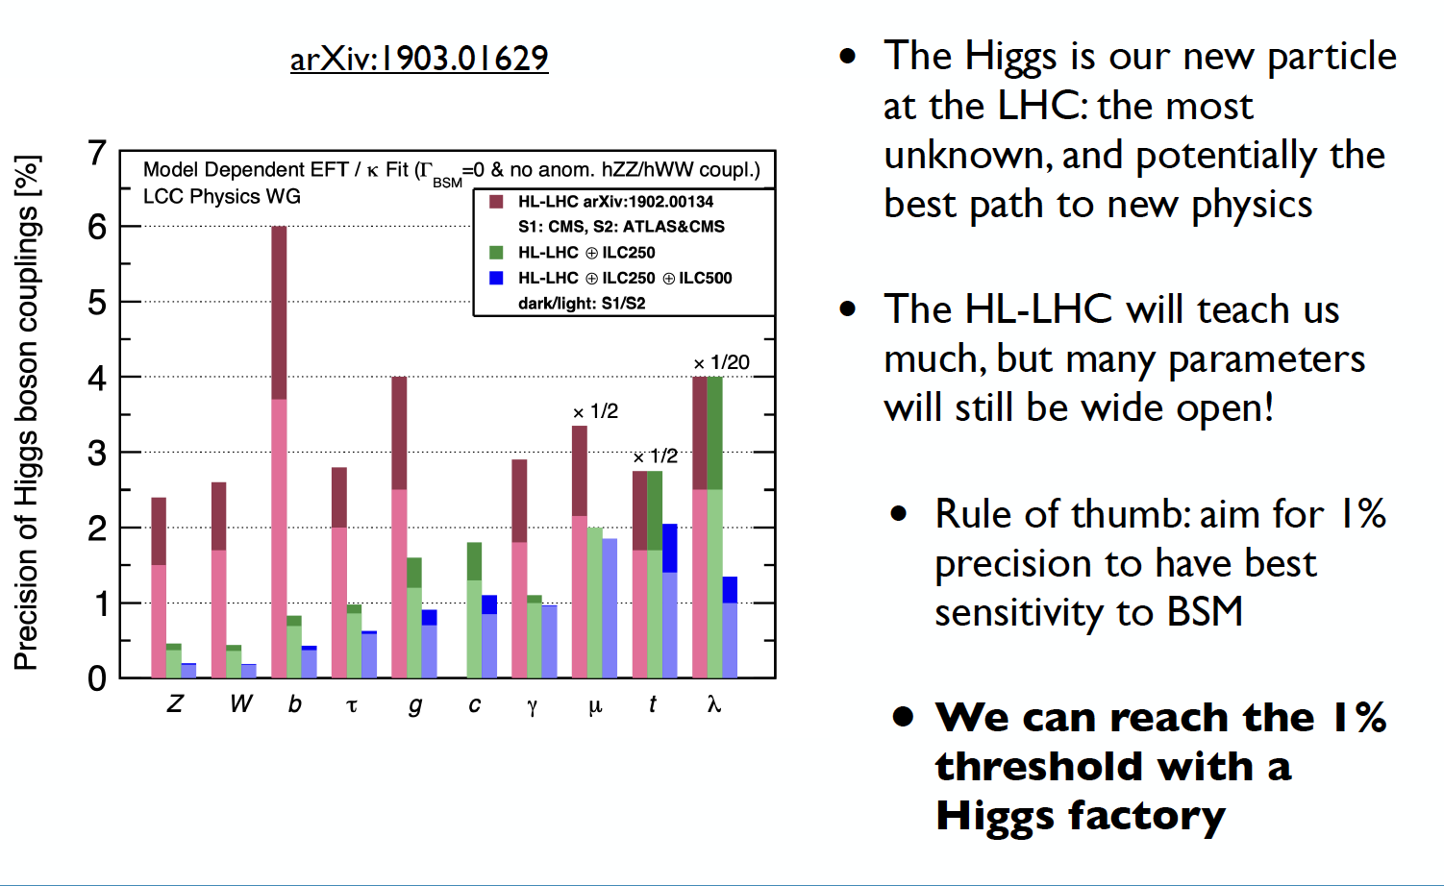
Future Collider
See talk by JoAnne Hewett from SNOWMASS

Slide 27
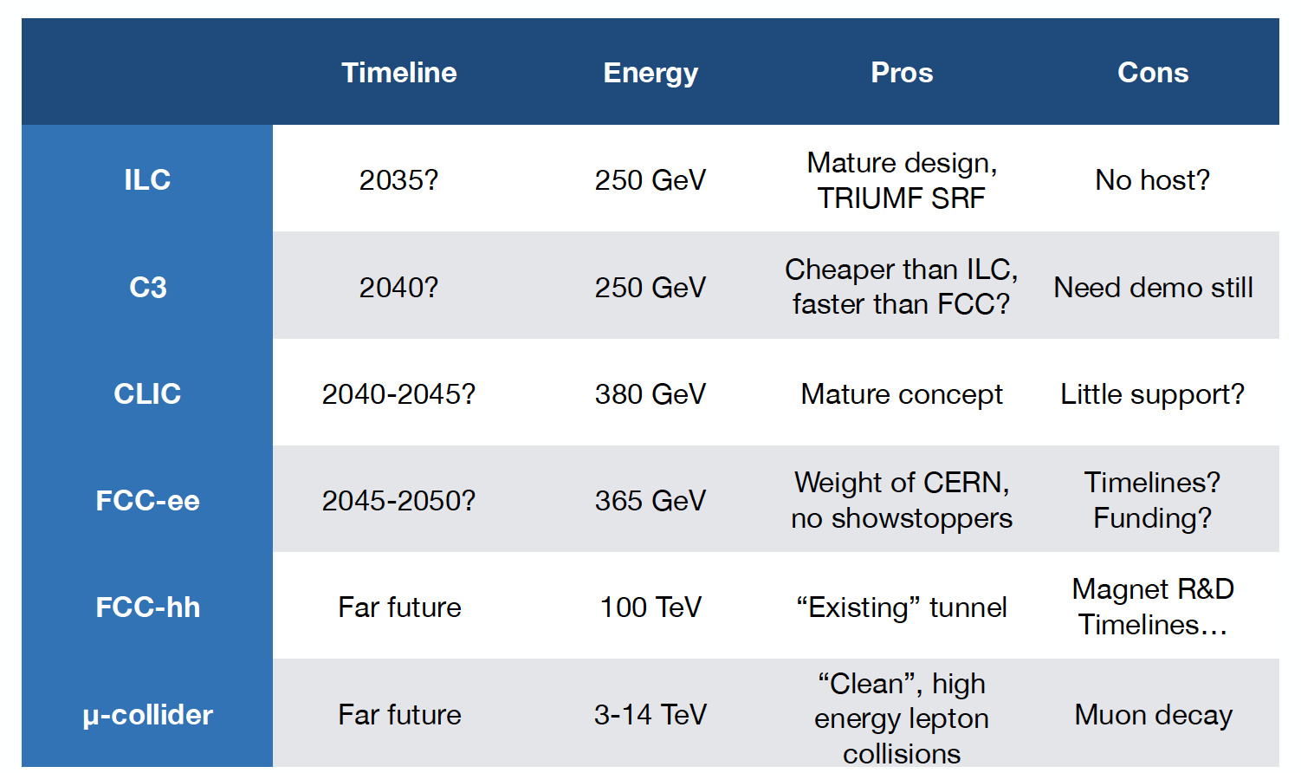
Future Collider

Slide 28
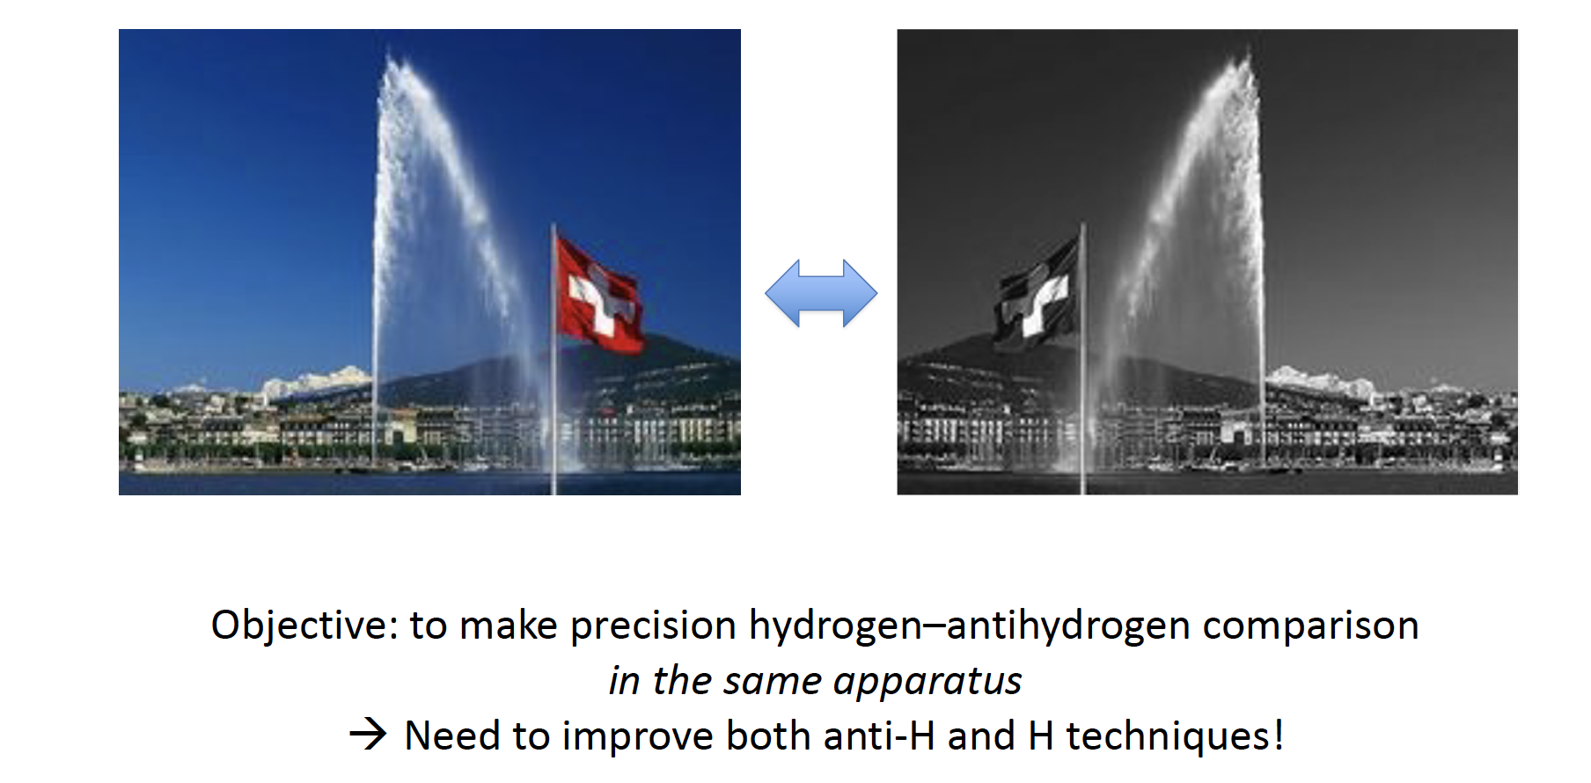
HAICU
See talk by Taka Momose

Slide 29
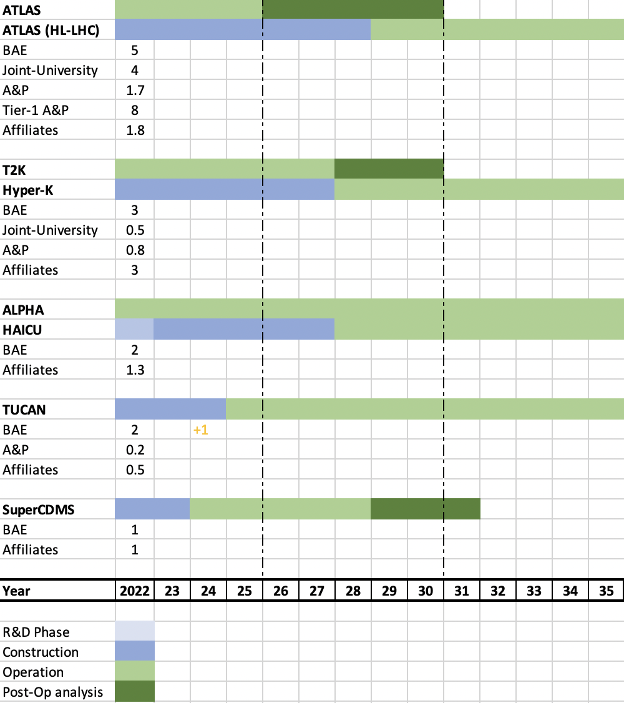
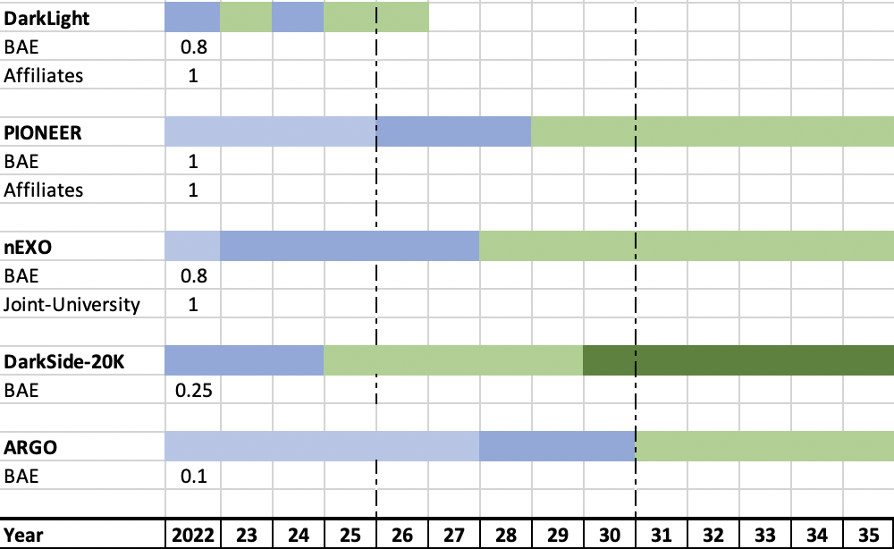
Chart of current and future projects in Particle Physics
Capture the TRIUMF supported local effort with focus on scientific and research contributions
  Additional technical support from Science and Technology department crucial
Each group has their complement of students, postdocs
List of future projects and associated personnel will move and grow as we develop the next 5-year plan
  E.g. Future Collider, new centers/platforms

Slide 30
Summary
Impact on Focus Projects in the Next Five-Year Plan
  TUCAN will move into user facility with the 2nd port – will need more scientific personnel
  Hyper-K program
    Significant requirements on technical and project management personnel from TRIUMF
  Upgrades to ATLAS will be mostly completed – except repairs and commissioning for ITK
    Likely will see the start of partial activities towards a future collider
New Projects
  DarkLight will have completed its physics run – discussions ongoing of future opportunities
  nEXO, PIONEER and HAICU will require more resources both technical and scientific
  Future collider and P-One involvement will become more concrete
New Initiatives
  All our experiments and their successes depend on facilities with key personnel and expertise, available resources in technical aspects + critically new space

Slide 31




Thank you
Merci
www.triumf.ca
Follow us @TRIUMFLab

