Slide 1
Scientific Computing Initiatives
Science Week 2022
Wojtek Fedorko, Reda Tafirout

Slide 2
Scientific Computing Department Organization
Recently created (fall of 2020), under Physical Sciences (formalized in spring of 2021)
Common umbrella for existing activities:
  Big data & Distributed Computing (ATLAS Tier-1) (R. Tafirout)
  Machine Learning & Quantum Information Systems (W. Fedorko)
Head / Deputy: R. Tafirout / W. Fedorko
A. De Silva X. Liu
R. Debhandari D. Qing
F. Fernandez Galindo Y. Shin
V. Kondratenko A. Wong
Affiliated Scientists:
C. Senko (Waterloo)
R. Islam (Waterloo)
P. Haljan (Simon Fraser)
J. Sirker (Manitoba)

Slide 3
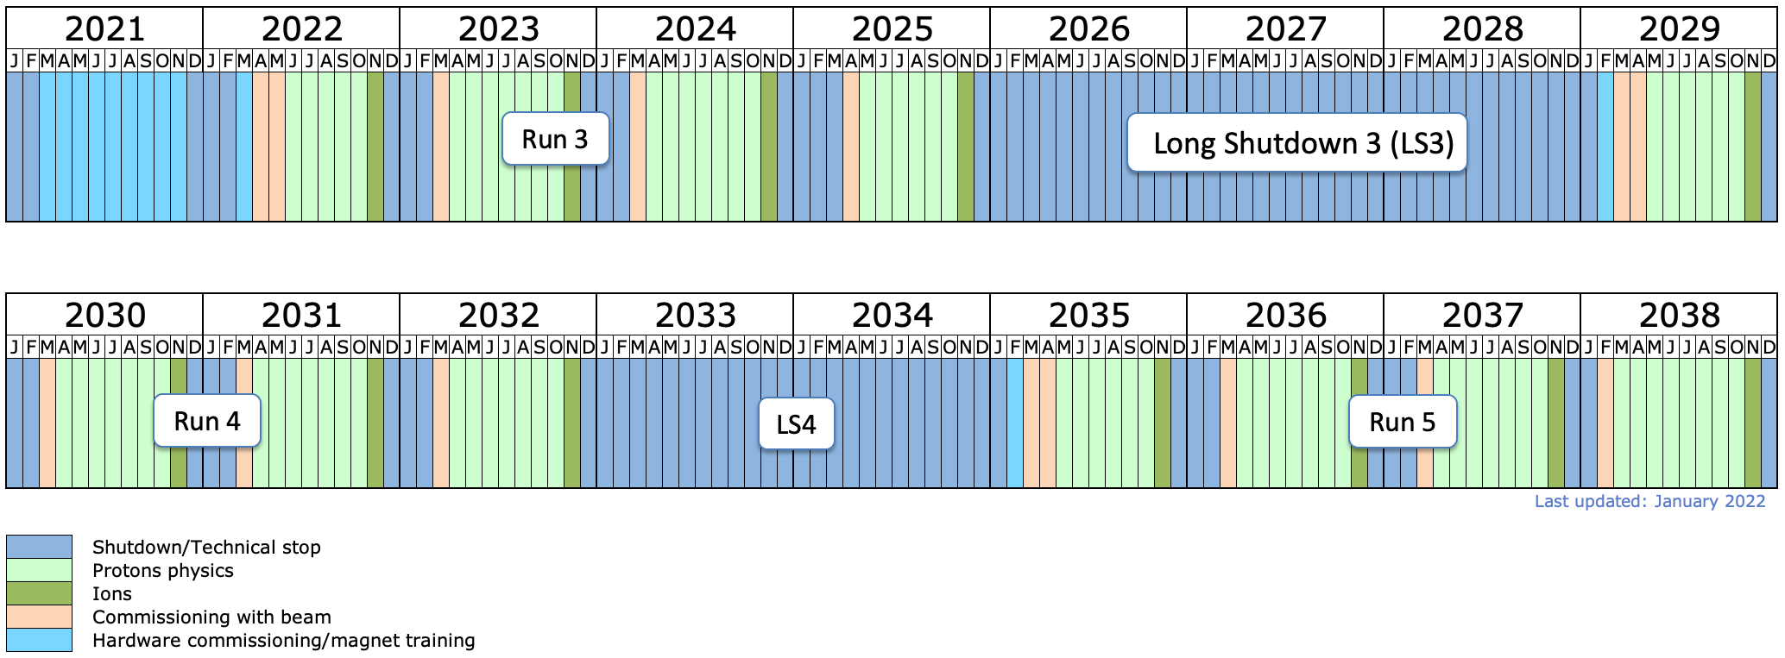
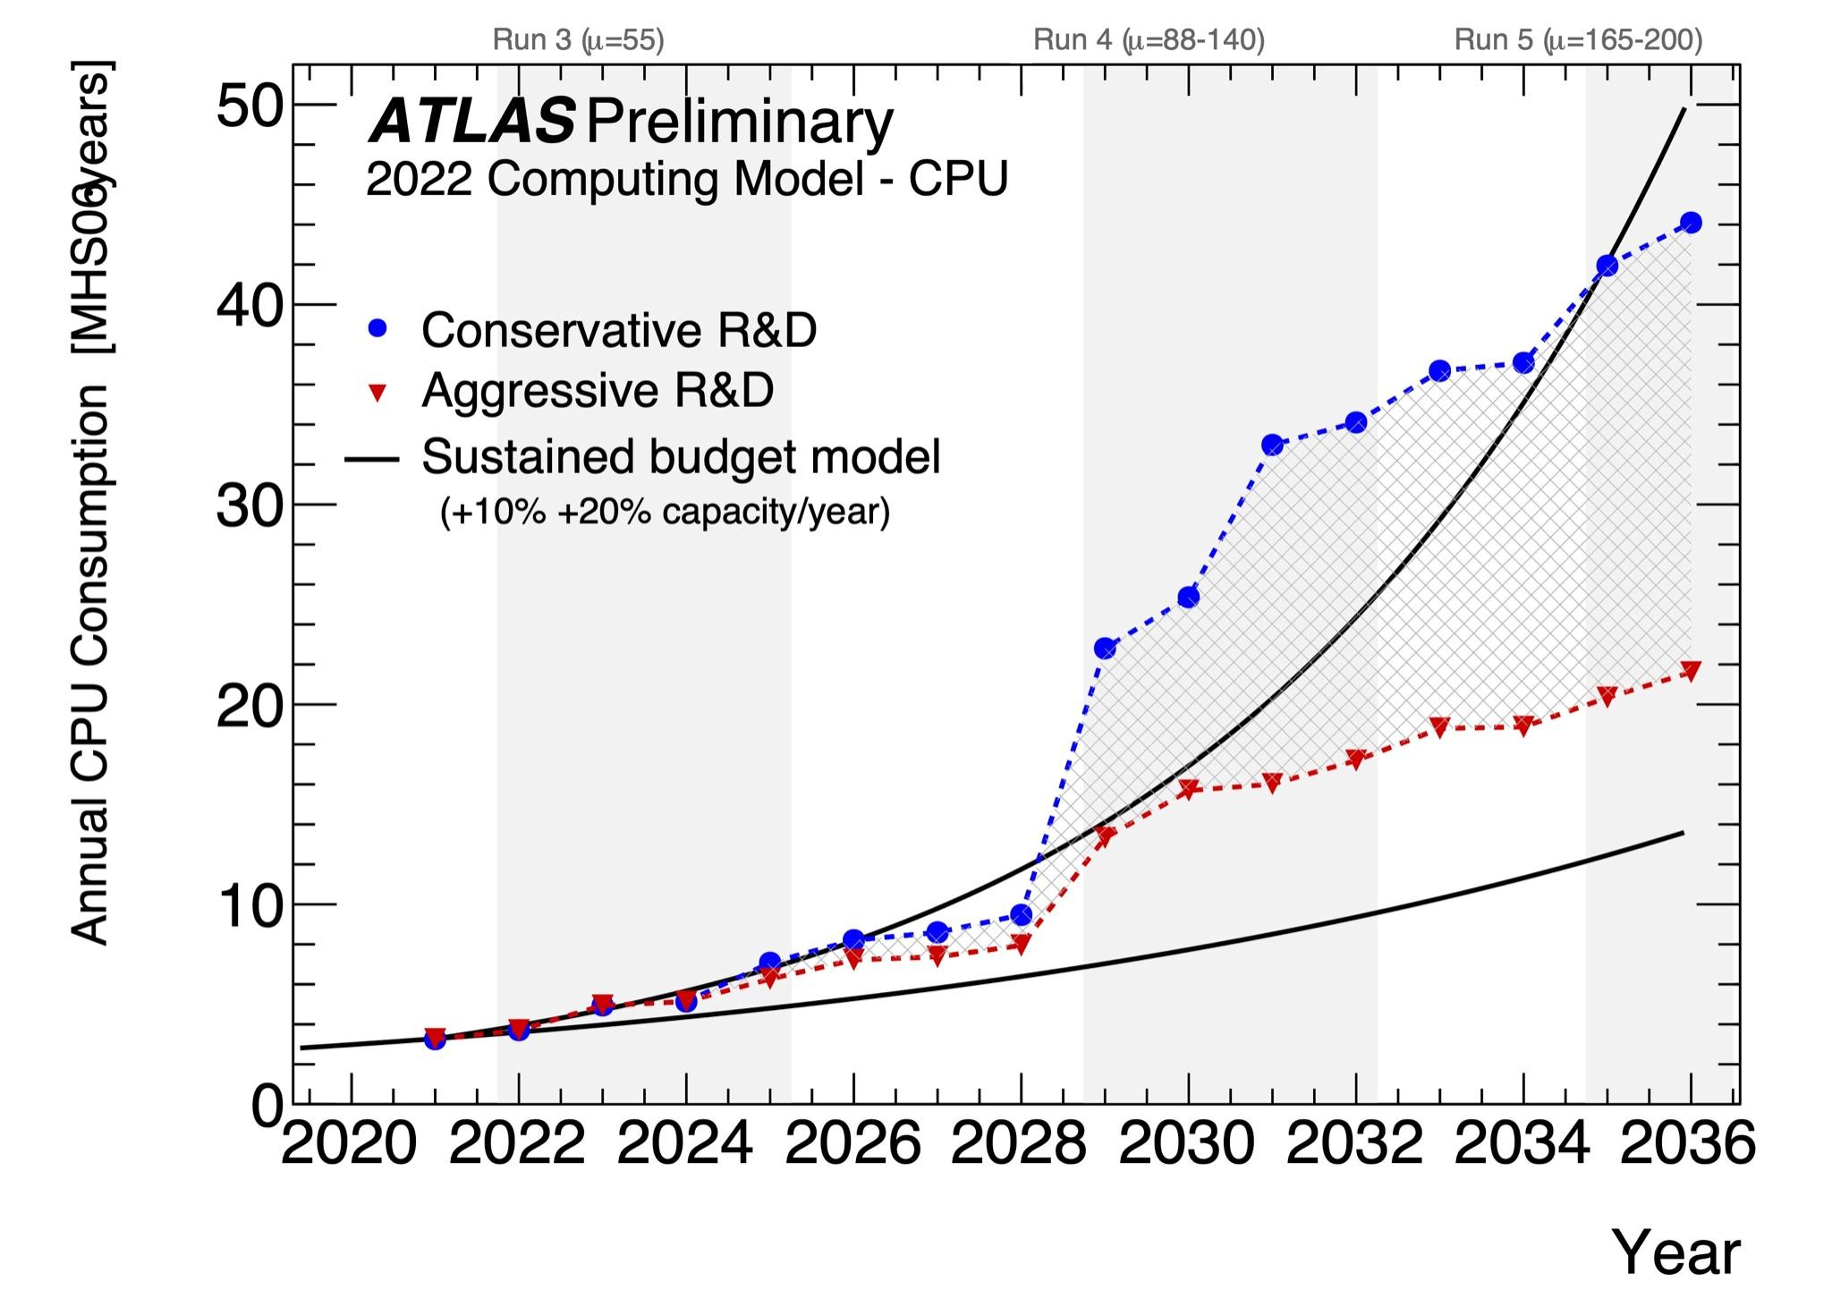
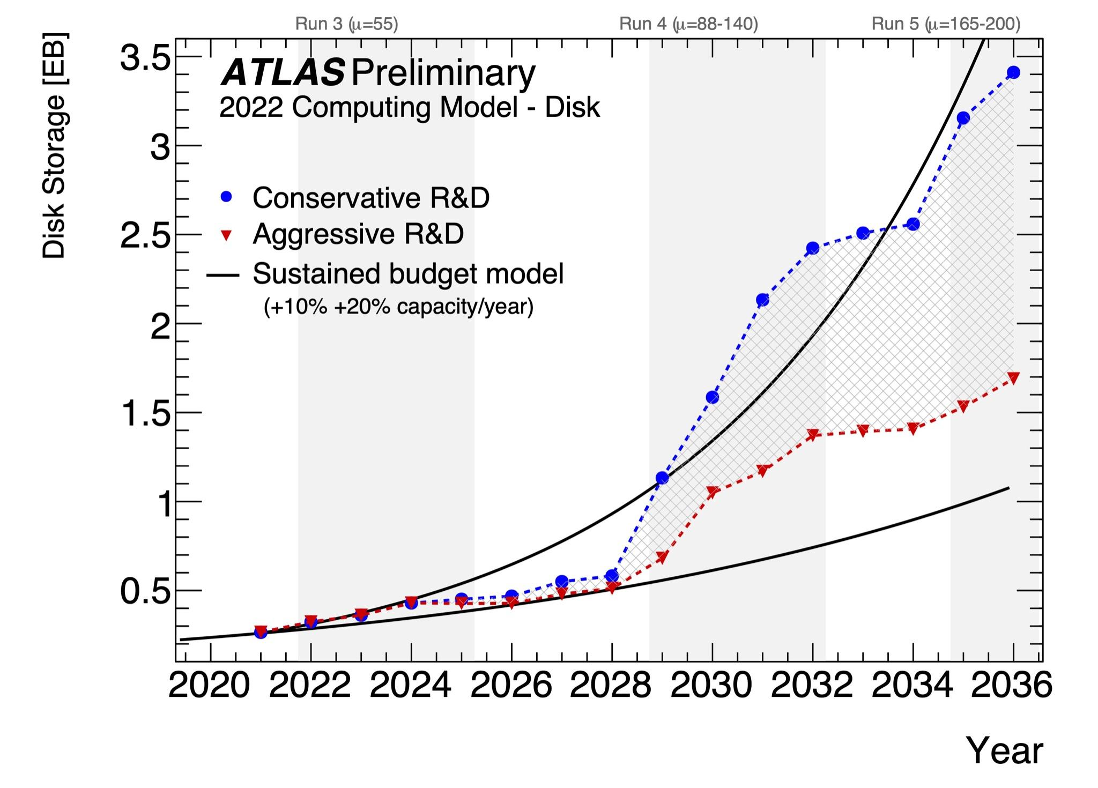
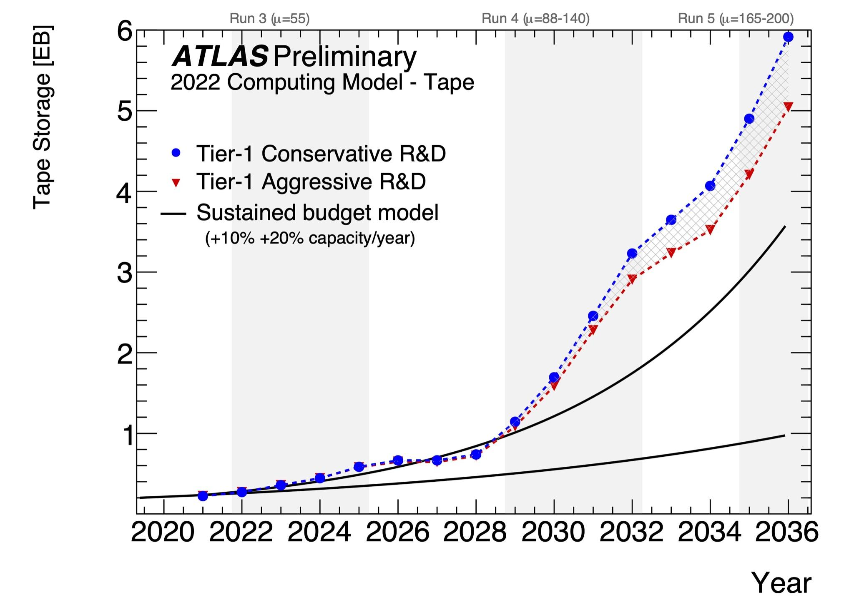
ATLAS Distributed Computing Needs
Large-scale resources crucial to the LHC scientific program
Tier-1 centres: providing 35-45% of required disk and CPU needs, and 100% of tape (computing model)
HL-LHC Software & Computing Roadmap document (various needed developments to meet data challenge)
LHC long term schedule

Slide 4
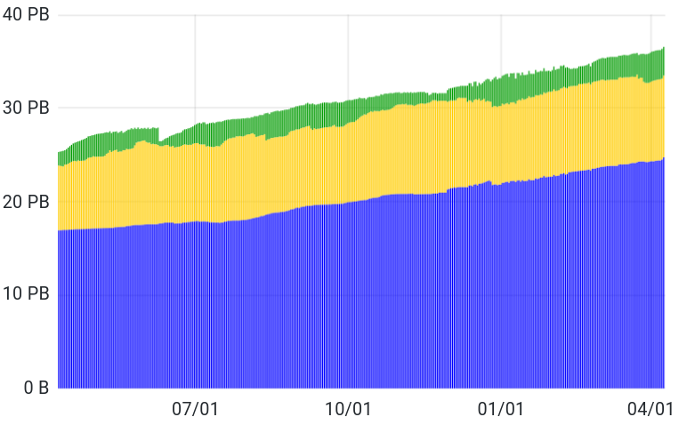
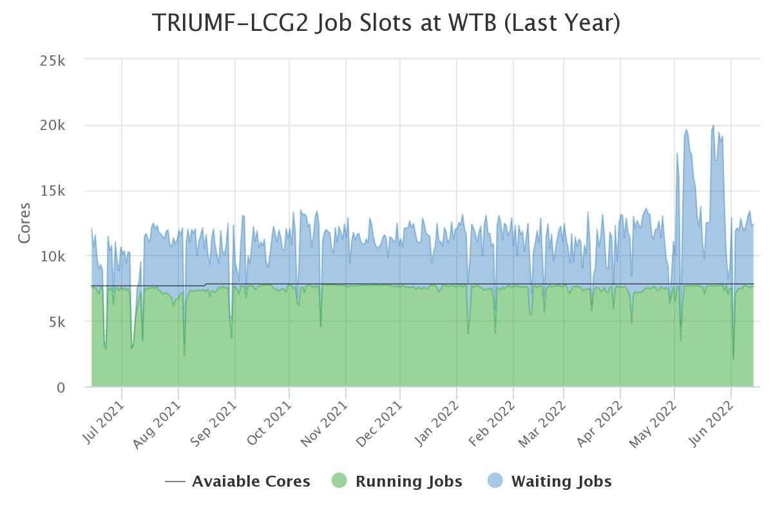
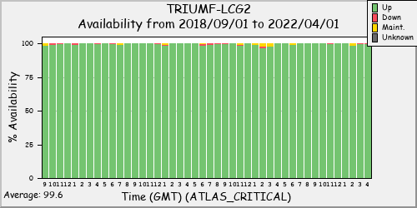
ATLAS Tier-1 plans
Providing 10% of worldwide Tier-1 resources
Relocated to SFU (since 2018), using CFI IF 2017
CFI IF 2020 award (current): cover needs for Run-3
  Capacity expansion
  Capital for new personnel (R&D for HL-LHC)
CFI IF 2023 proposal (cover LS3 and first two years of HL-LHC ($16.5M total project cost)
  Submitted last Friday
  Full refresh needed by end of 2025 / early 2026 (existing systems will be past 7 years) & capacity expansion
  Expansion phases in 2027 and 2029
  Need to follow closely technology developments / industry roadmap

Slide 5
Machine Learning / Quantum Computing: Present Activities
Enchancing science outcomes through the application of ML and QC
Technical and conceptual advisory on projects specified by TRIUMF PI’s
  Student / postdoc co-supervision
Initiative in identifying opportunities for new projects
Execution
Maintaining SW / container stack
Access to in-house ML computing – gateway to Digital Research Alliance of Canada (prev. Compute Canada)
Currently active projects:
  Particle physics: HyperK, NA62, ATLAS, Belle
  AD/Beam physics
HQP training:
  COOP, Capstone Programs, UBC Master of Data Science, MITACS GRA …
  Led organization of TSI “Cornerstone Models of Quantum Computing” 2020, 2021
Local and International collaboration: Helmholtz Association, QAI, QuantumBC…
New domain areas / will require expansion of manpower.

Slide 6
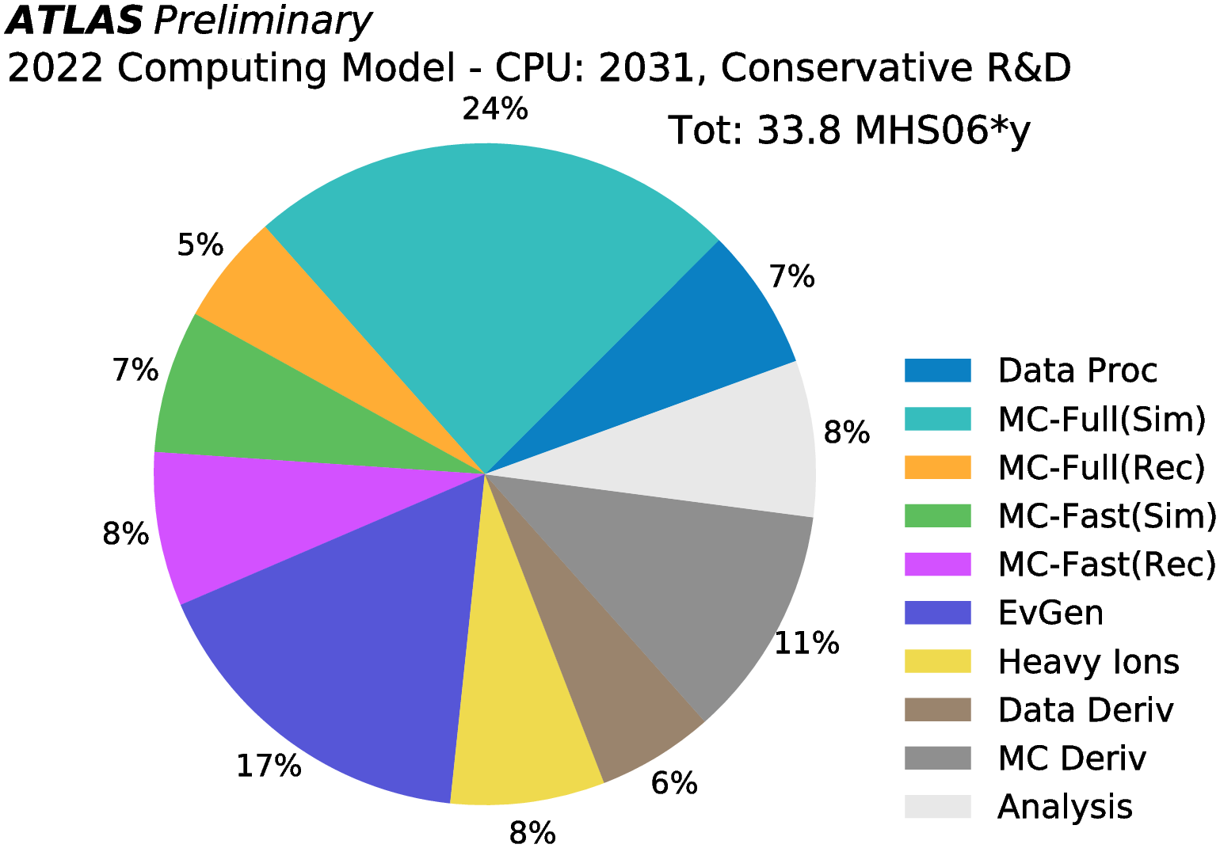
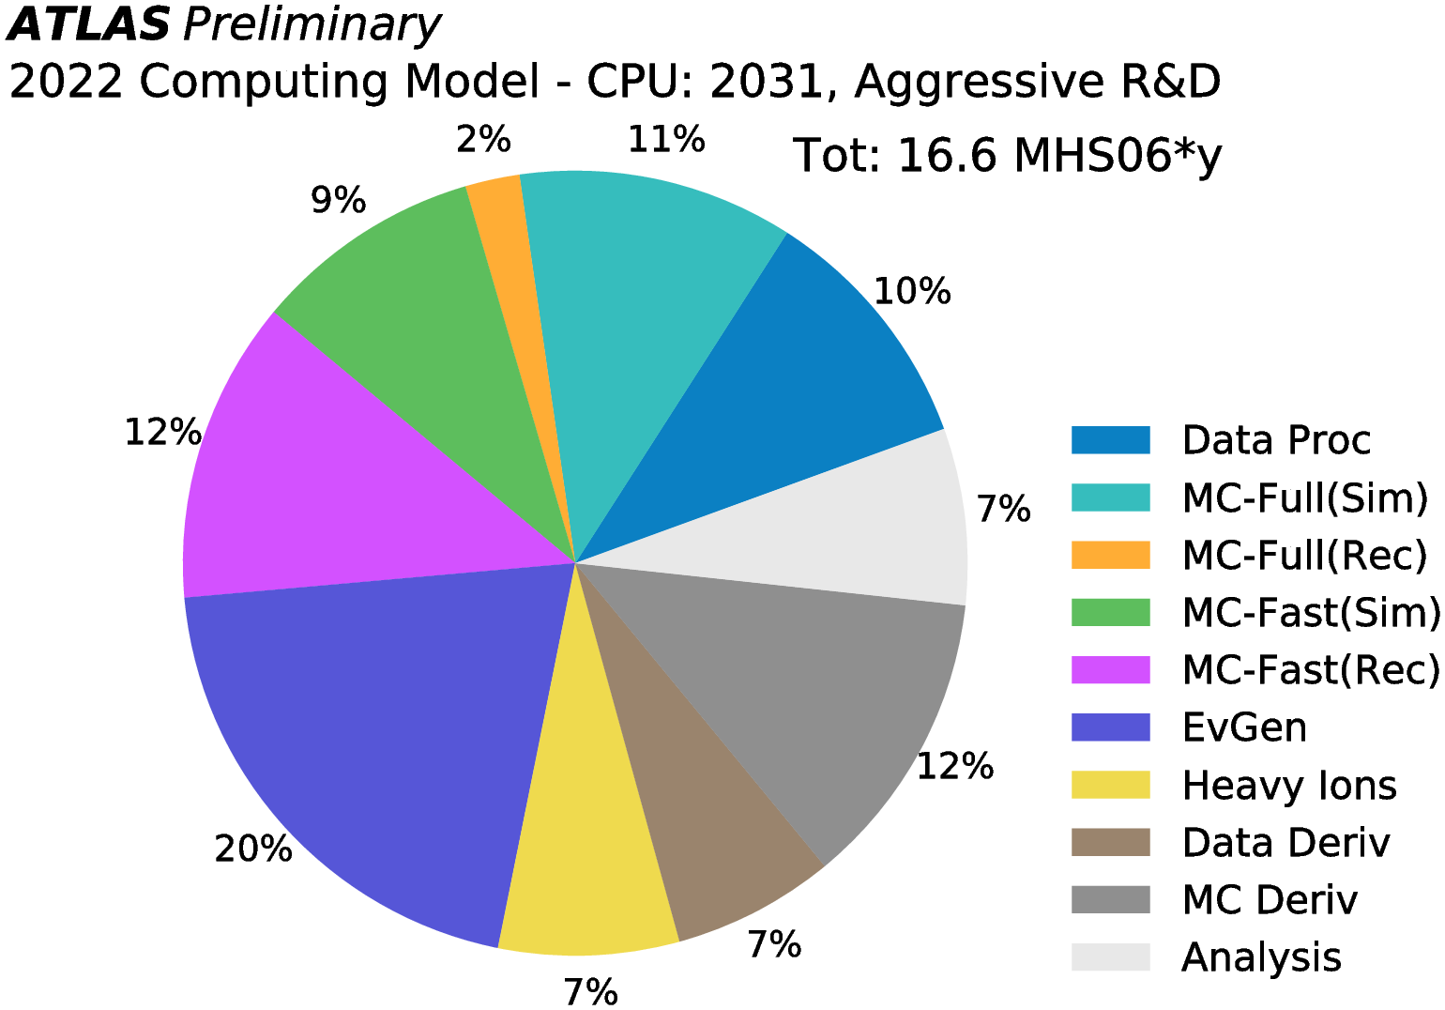
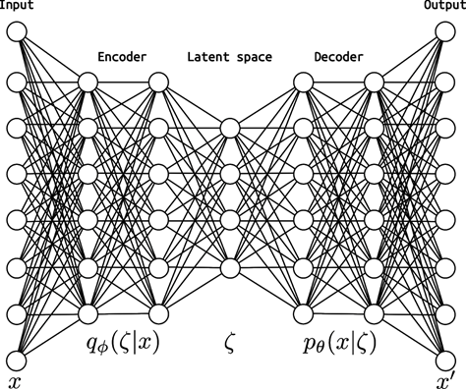
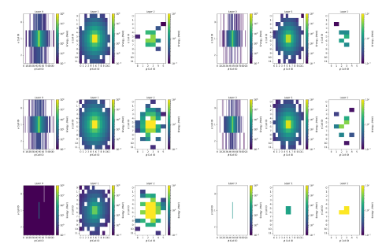
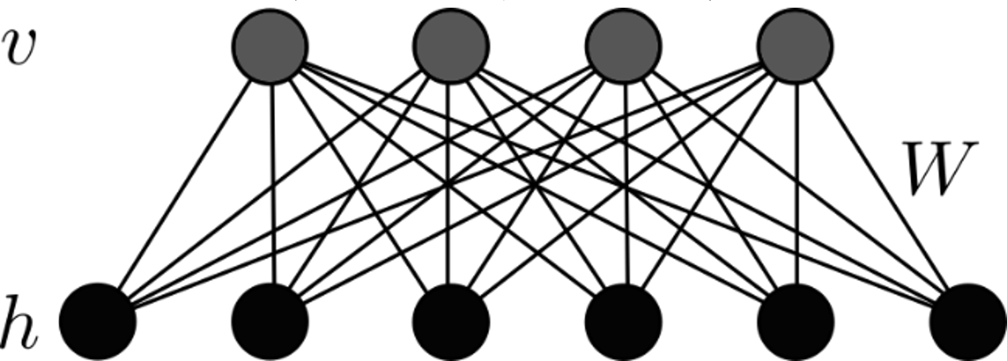
Examples of ML / QC projects I: Calorimetric Shower Generation for ATLAS
  Aim to replace First-principles (GEANT) or parametrized calorimeter simulation with a Quantum-Assisted Deep Learning Model
Cross-section ATLAS Detector
Prior
Prior:
Restricted / Quantum Boltzmann Machine
Showers generated by the model
  Using open GEANT4 particle-gun dataset resembling ATLAS LAr EM calo γ/e⁺/π⁺
  Performance demonstrated with classical analog of a quantum model
  Paper + poster ML4PS@NeurIPS2021; Talk at Helmholtz Association Physics at the Terascale; Poster at Quantum Days
  Development on-going aiming for sampling from D-Wave QPU:
  Intend to move to ATLAS datasets
e⁺
γ
  Variational Autoencoder
π⁺

Slide 7
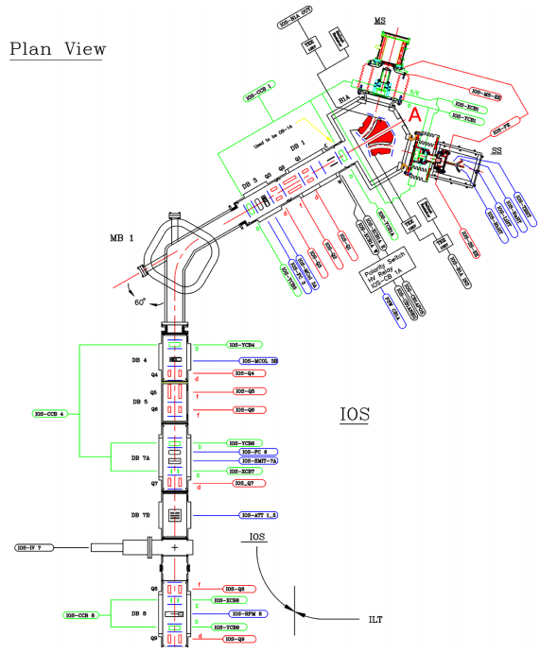
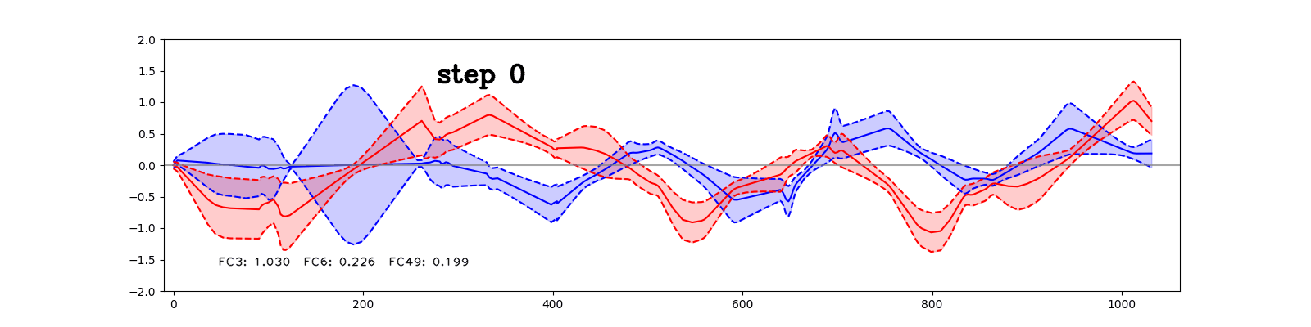
Examples of ML / QC projects II: Beamline tuning
  Augment/Automate beamline tuning
  OLIS: Starting point for AI-tuning
    Low current
    Non-radioactive
    Manual tuning by operators takes many hours, taking away from research beam time
  Goals for learning agent:
    Optimize beam transmission
    Mitigate unknown misalignments
    Improve speed and accuracy of tuning
Source: Beam Physics Note TRI-BN-20-13R, Olivier Shelbaya
  Reinforcement Learning:
  Actor-Critic method with state memory (Recurrent Deep Deterministic Policy Gradients -RDPG)
  Agent
Beam centroid and envelope [cm] x y
  Action:
  Steering parameters
  Environment:
  OLIS beamline
Length along nominal beam OLIS till RFQ [cm]

Slide 8
Scientific Computing: 20-Year vision and the 5-Year Plan
Scientific Computing Topical Group identified and discussed three themes:
  Scientific Computing Infrastructure: “Establish a focused and coherent approach to research computing”
  need to find suitable space/solution on-site to host additional ML platforms (currently at UBC with Theory)
  Research Software & Applications
    “Enhance science output through the application of modern scientific computing and Machine Learning technologies”
    ongoing discussions with PSD departments and across divisions needed to assess and justify additional manpower
  Quantum Computing User Facility
    “Establishment of Trapped Ion Quantum Computing user facility”
    review triggered by the director; panel formed in March; report delivered.
Ambition to take advantage of AI and QC articulated in individual topical group 20-year vision documents
20-year vision Advance Copy:
  “The ever-increasing amount of data produced in these experiments will require advances in high-performance computing, artificial intelligence, and quantum computing.”
  “TRIUMF will be seen as a strategic asset in the implementation of the National Quantum Strategy, specifically in the areas of quantum sensors, materials, and computing”
  “…we will support the Canadian quantum computing community in its ambitions by enabling access to relevant TRIUMF’s expertise and capabilities”

Slide 9
Translating vision into a plan
Are there more opportunities within Physical Sciences for ML/QC applications worth attacking in 2025-30?
  Initiated consultations with the PSD departments
Are there opportunities and need for support for ML and general Scientific computing applications in Life Sciences and Accelerator Division
  Automated beamline tuning
  Predictive maintenance
  Cyclotron simulation ↔ massively parallel GPU SW development
Are there opportunities to exploit synergies and consolidate SW development / model building in SW modeling passage of particles through matter (GEANT/FLUKA)
  target design (LS/AD)
  treatment design (LS)
  detector design (SciTech)
Are we not thinking about an aspect of Scientific Computing we should be?
What would it take to make it happen?
Let’s talk!

