Slide 1
Future Plans for IAMI
Esther Schirrmacher
With gratefully acknowledged help by the Life Sciences Division

Slide 2
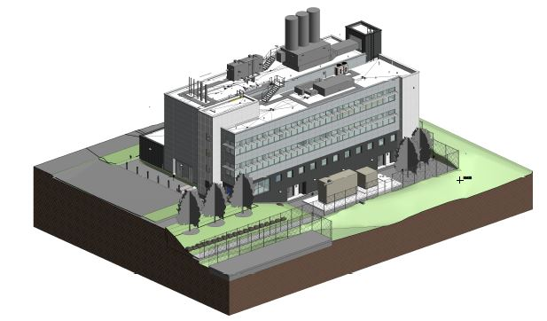
Institute for Advanced Medical Isotopes… is a building …
and also a LS program…

Slide 3
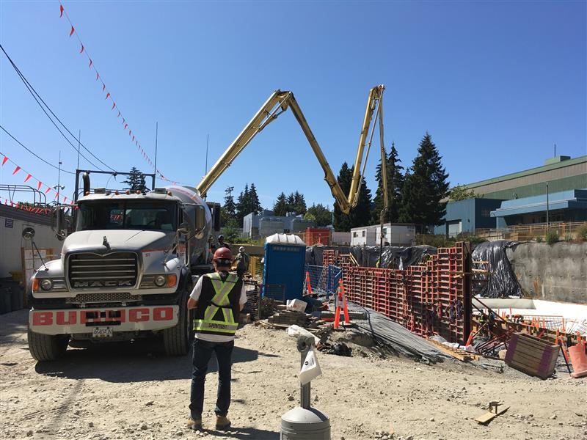
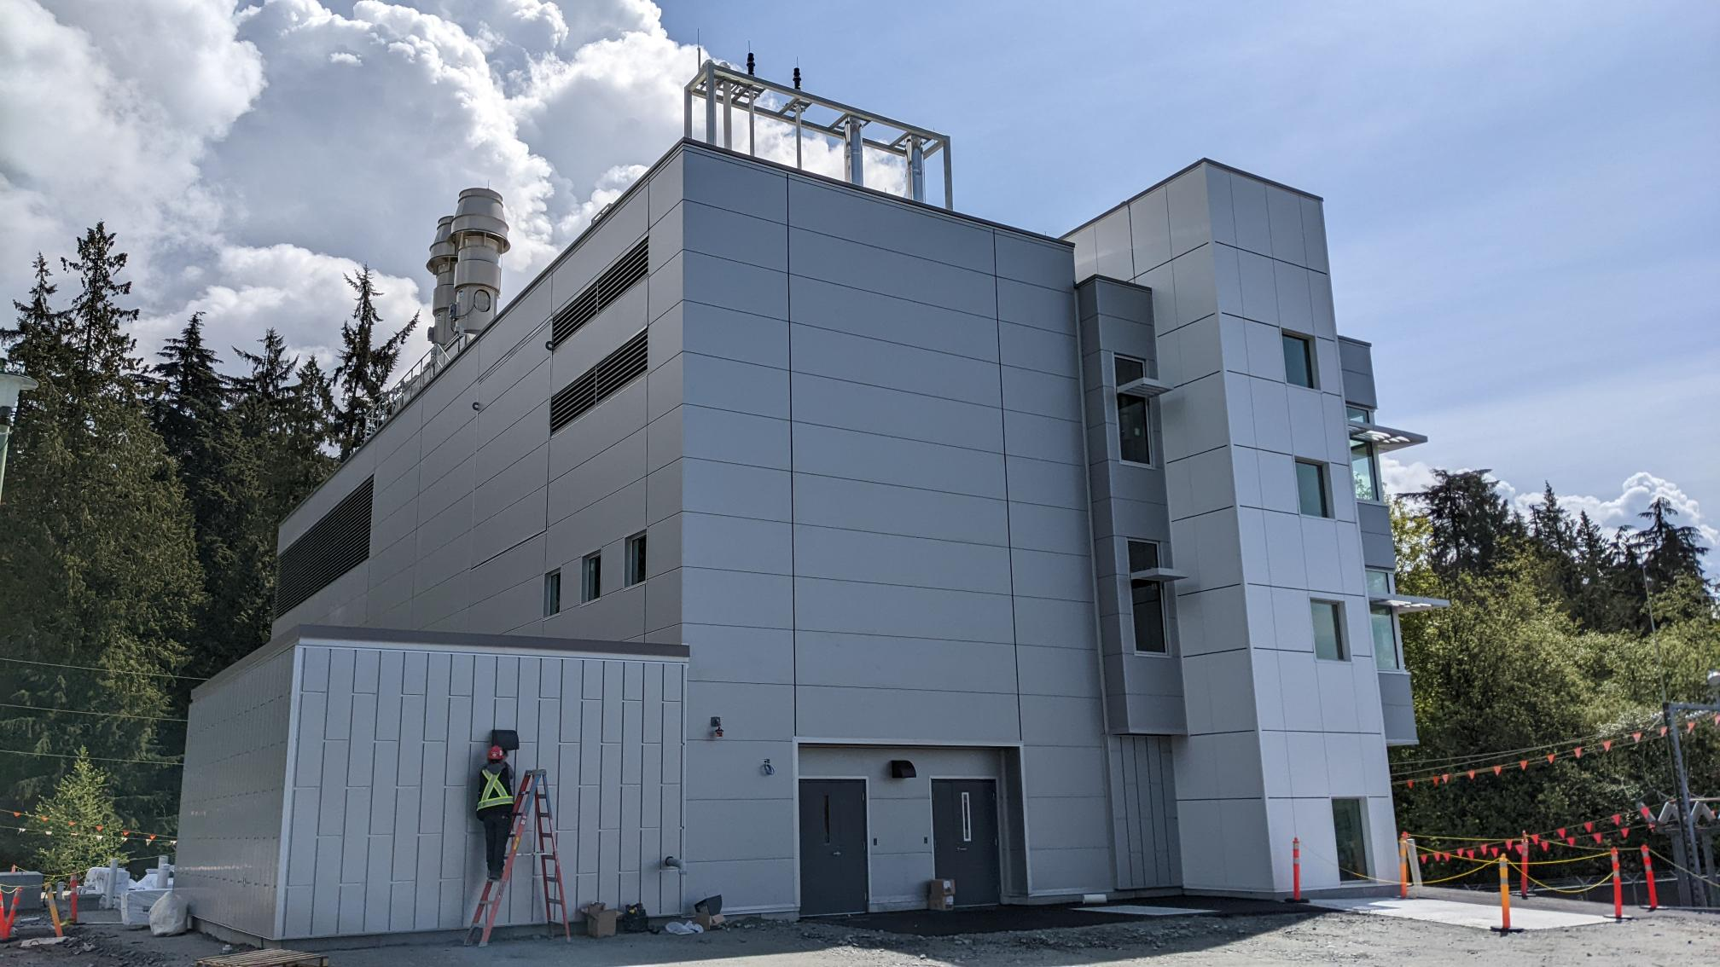
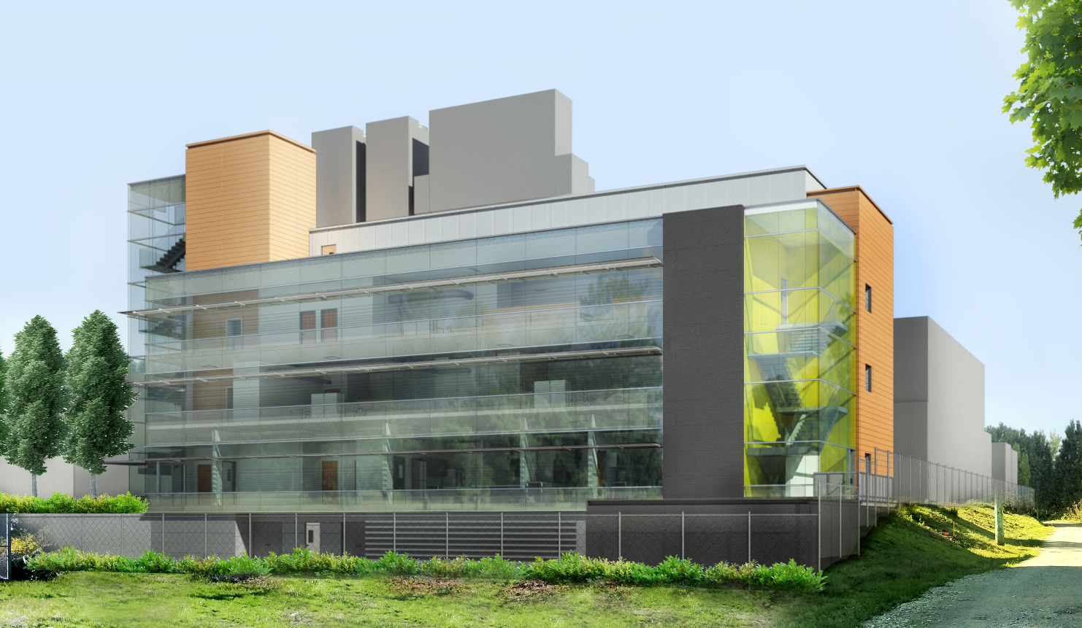
IAMI Timeline
2012:
The idea…
Spring 2019:
Finalized Design and tender
Spring 2020:
Redesign and contract signing
Summer 2020:
Construction begins
Summer 2022:
Construction completed
Winter 22/23(?):
Commissioning completed and operational start

Slide 4
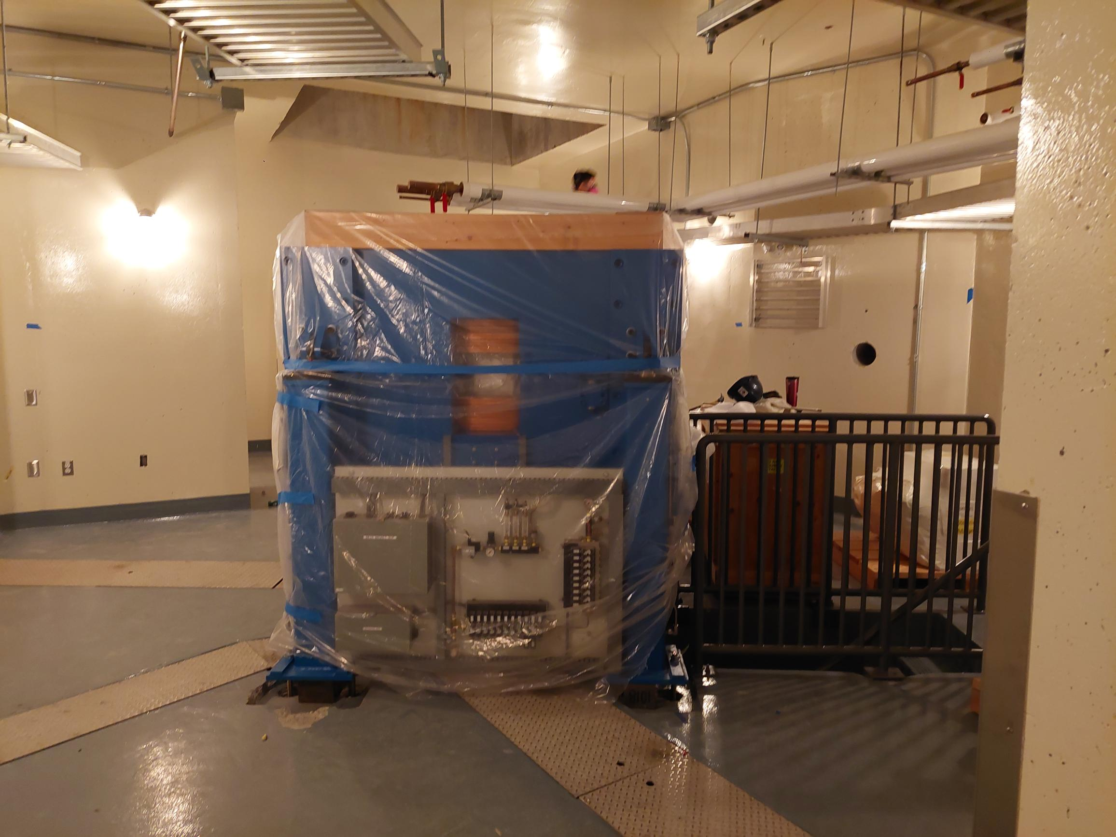
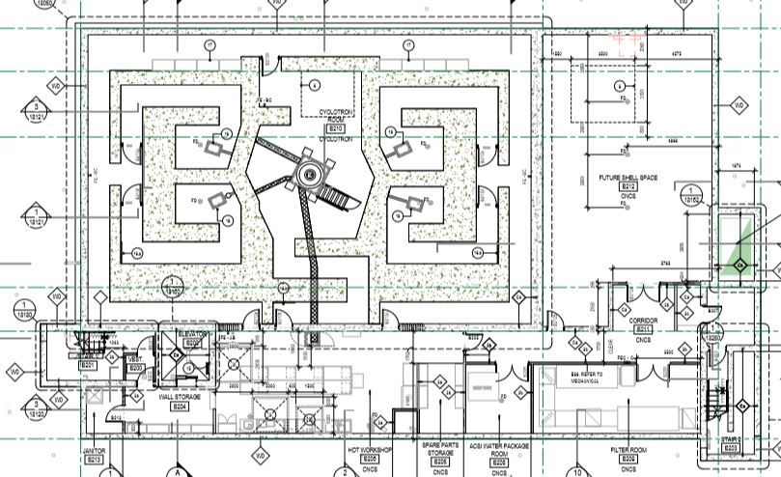
IAMI Building: Cyclotron
TR24
2 (1) solid target stations
2 target selectors with liquid targets

Slide 5
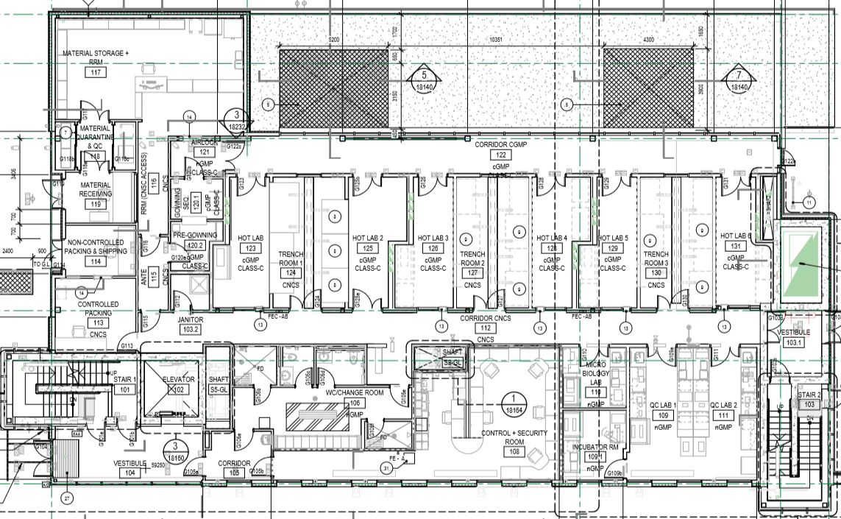
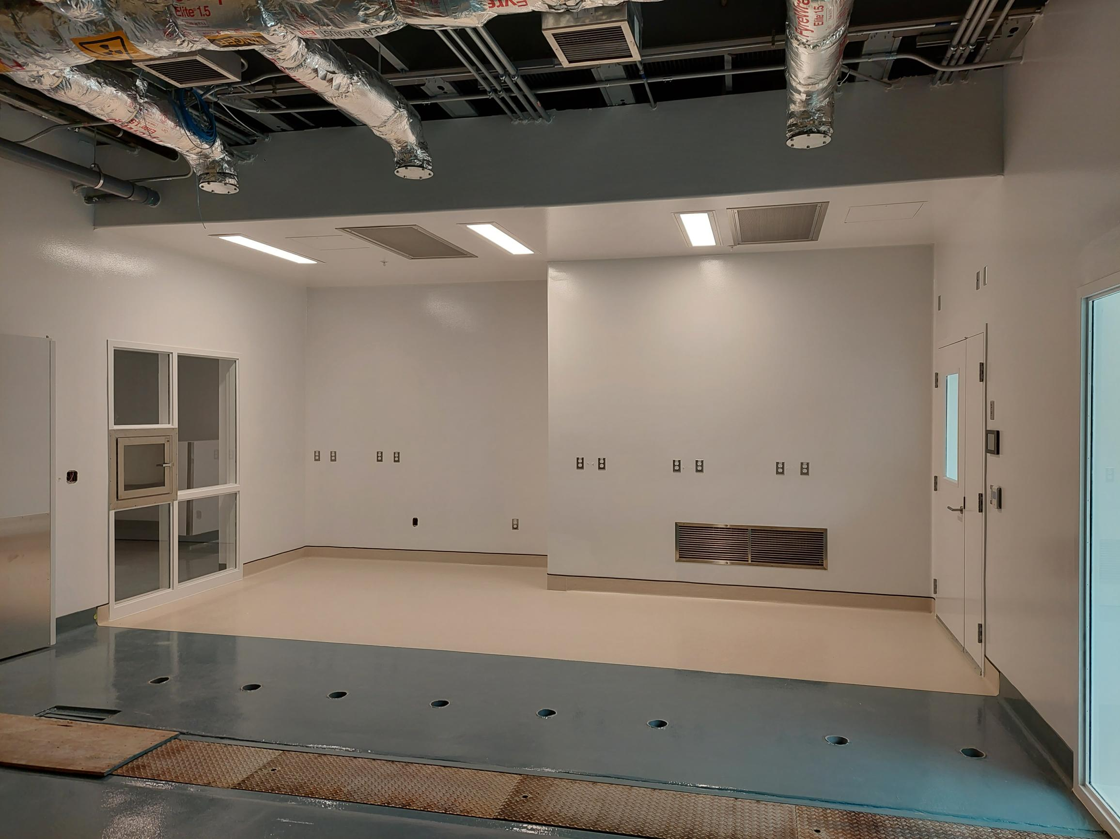
IAMI: Hotlab Space
2 hotlabs with hotcells
Remaining hotlabs will be fitted out once budget is available (2 will be leased to partners)

Slide 6
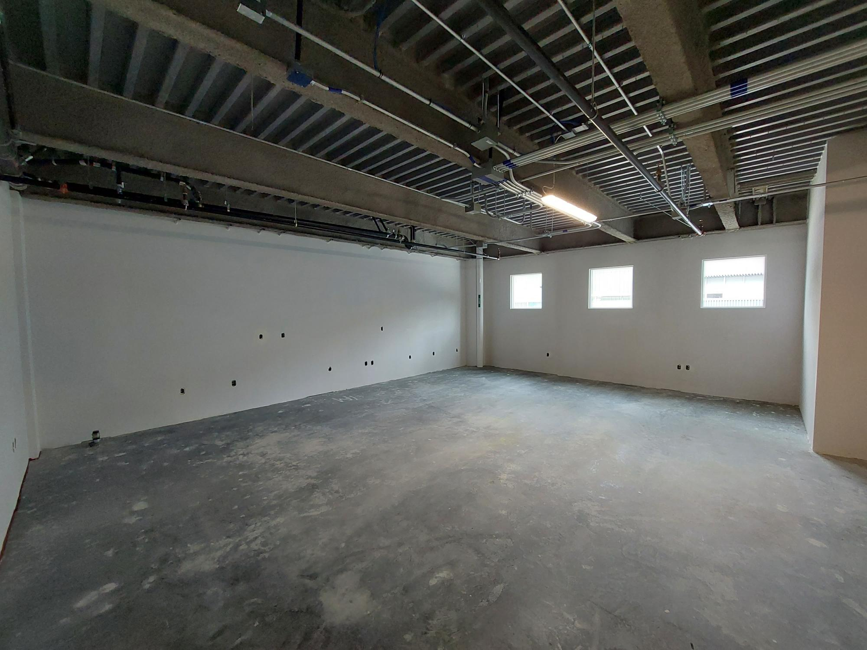
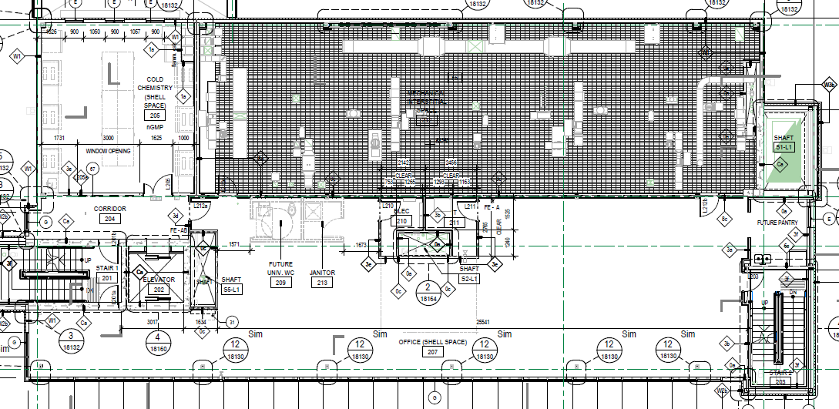
IAMI: Other spaces…
Cold chemistry lab
Office space
All of that to come when funding is available

Slide 7
What is IAMI to TRIUMF?
IAMI will be a multidisciplinary R&D and clinical translation facility working across five key areas
Medical isotope
production
Clinical imaging
Radiopharmaceutical
development
Cancer therapies
Accelerated drug
development

Slide 8
IAMI: What will we do?
^{99m}Tc production for the Province
¹⁸F production for BCC (back-up) and for UBC Tracer Program
Support existing and new partners to manufacture isotopes and/or tracers for R&D and clinical purposes (from equipment to lab space to knowledge to lab work by FTEs to regulatory expertise)
Use the space and the infrastructure to support LS research goals
By alleviating pressures on research infrastructure in other LS facilities
By introducing novel/intensifying existing programs

Slide 9
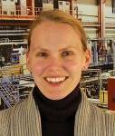
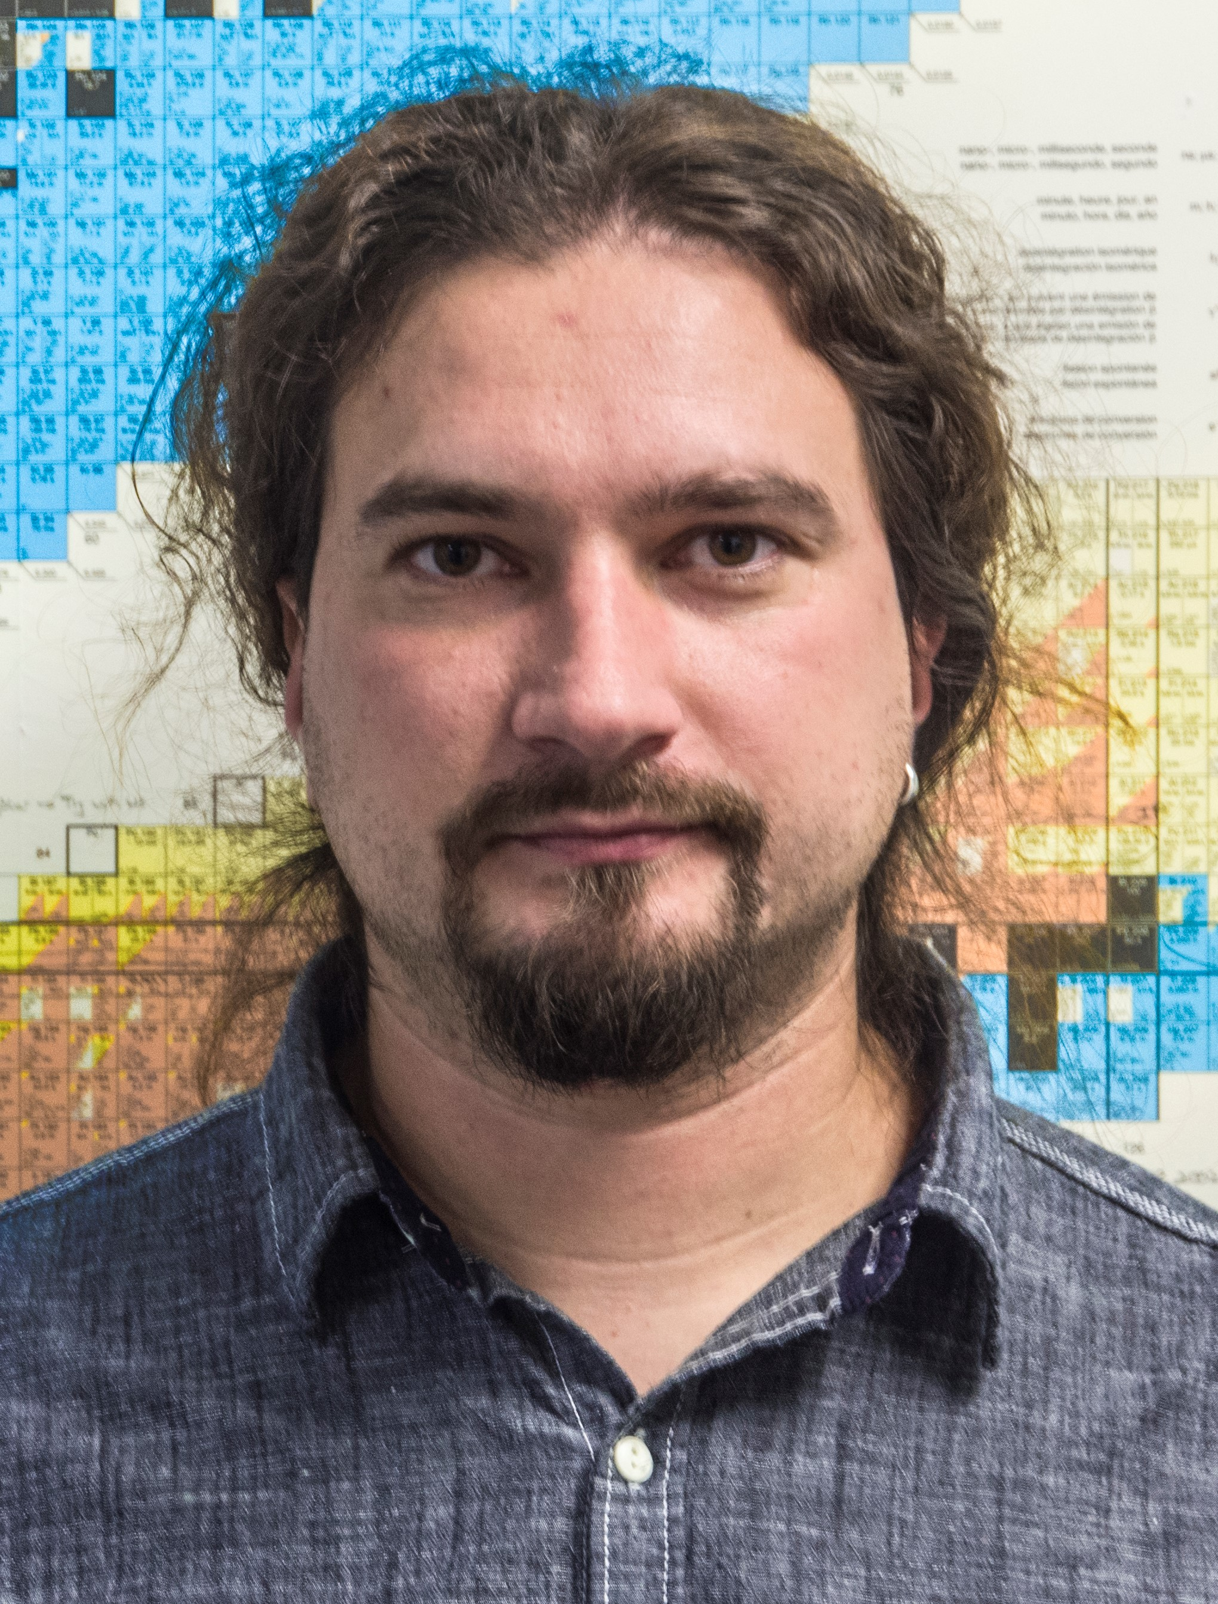
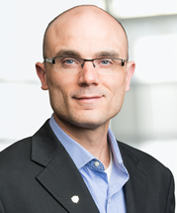
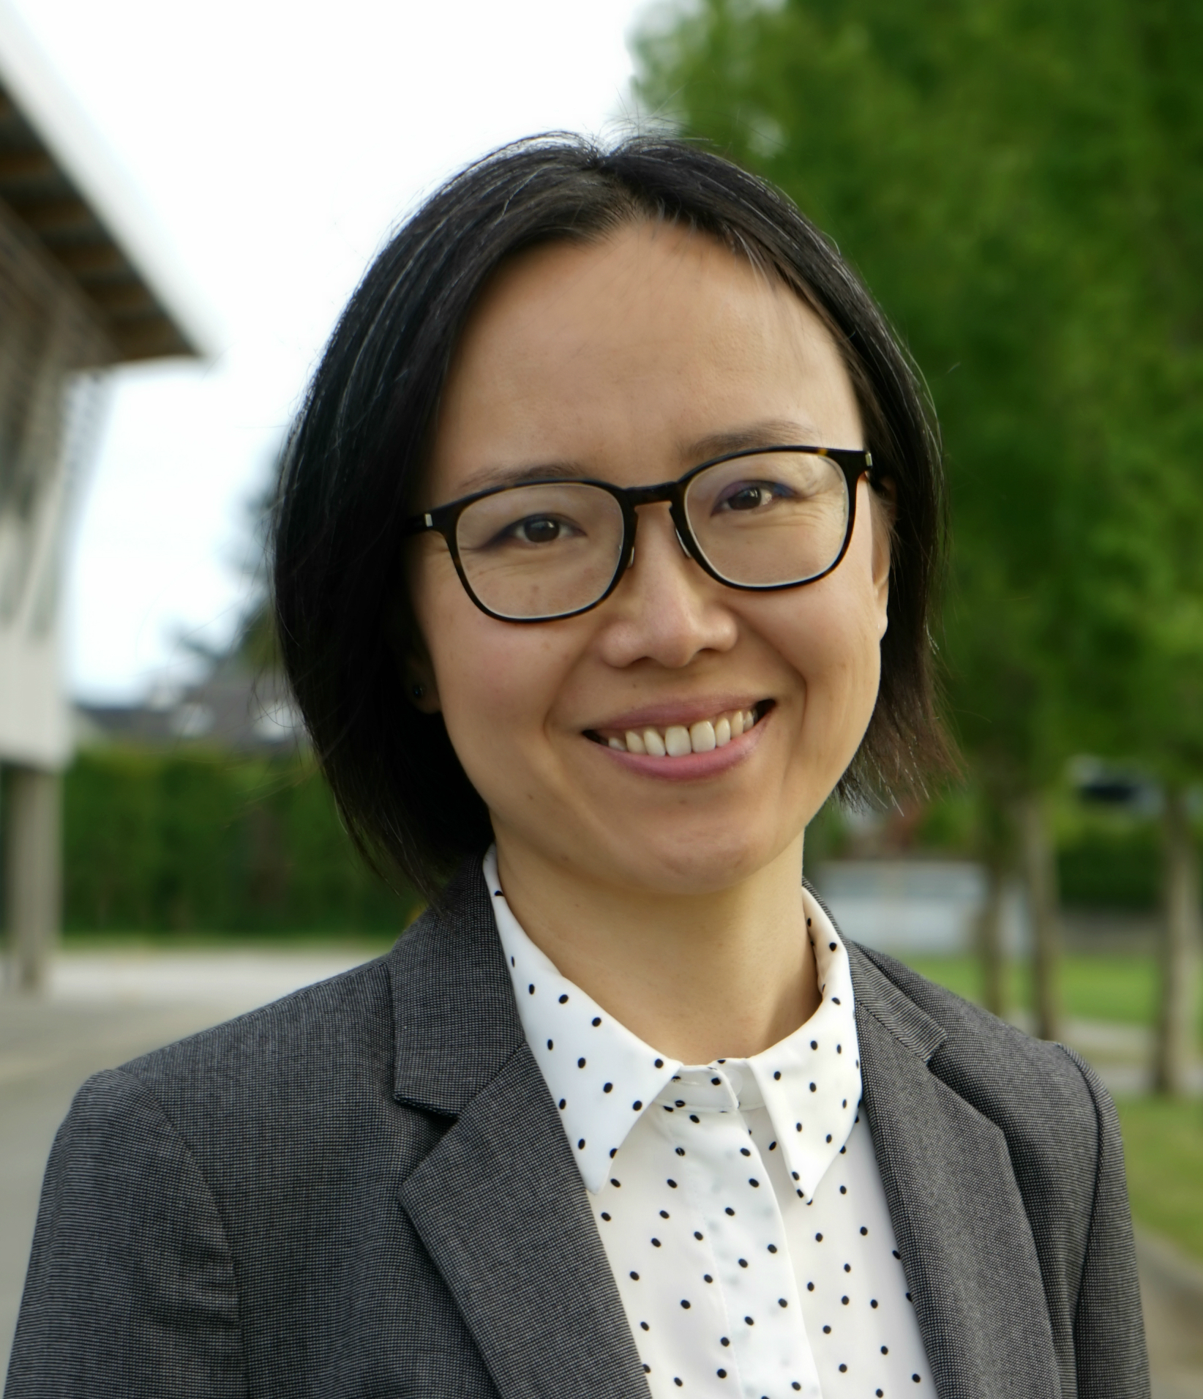
Life Sciences
at TRIUMF
Applied Ion Beams
Nuclear Chemistry
Applied Isotopes
Monika
Stachura
Cornelia
Hoehr
Valery
Radchenko
Paul
Schaffer
Hua
Yang
Caterina
Ramogida
(joint SFU)

Slide 10
IAMI: Enabling LS research
Provide access to TR24&targets for research into targetry
Produce a variety of radioisotopes, mainly radiometals, as well as perform the isolation/purification in hotcells
Possibility to scale up
Possibility to provide a GMP-quality for clinical translation
Re-build the expertise to make targets in-house
Attempting to free up valuable shielded fumehood space (for manual radiolabelling) in RCR2
Building and strengthening ties to clinical research to allow translation of LS research

Slide 11
IAMI: High-level Goals
Satisfy stakeholders, funders and partners by
Providing isotope security
Providing space for clinical translation
Train HQP
Create Life Sciences area jobs
Provide radiopharmaceuticals to partners to support research
Satisfy TRIUMF researchers in conjunction with TRIUMF and LS’s goals by
Provide access to cyclotron and targets
Provide isotopes for research purposes (incl. GMP-grade for clinical translation)
Alleviate space issues for researchers and students

Slide 12
IAMI: Potential bottle necks to achieve goals
Access to machine/irradiation (beam) time
Beam energy
Availability of a target station to accept beam
Laboratory space to perform post irradiation target processing
Radiopharmaceutical manufacturing space capacity
Manpower availability to operate equipment/spaces
Product | SOB | EOB | Tgt | CurrentµA | Dissolution Hotcell | Processing Hotcell | Dispensing Hotcell | QC | Package | Ship
^{99m}Tc | 20:05 | 02:05 | ¹⁰⁰Mo | 500 | 02:15 | 03:25 | 04:15 | 04:30 | 05:00 | 05:30
¹⁸F FDG | 04:00 | 06:00 | ¹⁸O-H₂0 | 125 | N/A | 06:10 | 06:45 | 06:50 | 07:00 | 07:30
¹⁸F FDG | 06:20 | 08:20 | ¹⁸O-H₂0 | 125 | N/A | 08:30 | 09:05 | 09:10 | 09:20 | 09:50
¹⁸F FDG | 08:25 | 10:25 | ¹⁸O-H₂0 | 125 | N/A | 10:35 | 11:10 | 11:15 | 11:25 | 11:55
Example of clinical runs (can be considered worst case for quite some time)

Slide 13
IAMI: Further Building Milestones
Cyclotron Installation
Hotcell Installation
Commissioning
Phase 2 of the Building for a potential partner (construction in the basement, on the Ground floor (for 2 hotlabs and a QC lab),a s well as L1 (office space)
Getting a second target station?
Phase 2 of the Building for TRIUMF (remaining hotlabs, QC space and office spaces)

Slide 14
Questions? Thank you Merci
www.triumf.ca
Follow us @TRIUMFLab

