Slide 1
Next 5YP within the 20-year vision
Summary
Accelerator Division
Oliver Kester
Director, Accelerator Division
TRIUMF Science week, July 22, 2022

Slide 2
TRIUMF accelerator complex
ISAC-II
High energy
ARIEL
Primary beam driver:
Cyclotron, 520 MeV, H⁻
Produces rare isotopes, neutrons and muons!
Isotope Separator and Accelerator facility - ISAC
Isotope Separator Online (ISOL) facility
ISAC-I: Normal conducting-linac, 0.15-1.8 MeV/u
ISAC-II: Superconducting-linac, 1.5-16.5 MeV/u
Advanced Rare Isotope Laboratory - ARIEL
Superconducting electron linac
30 MeV, 10 mA, cw
4 Cyclotrons for medical isotope production
ISAC-I
Low and
medium
energy
Cyclotrons
for medical
Isotope
production
520 MeV
Cyclotron

Slide 3
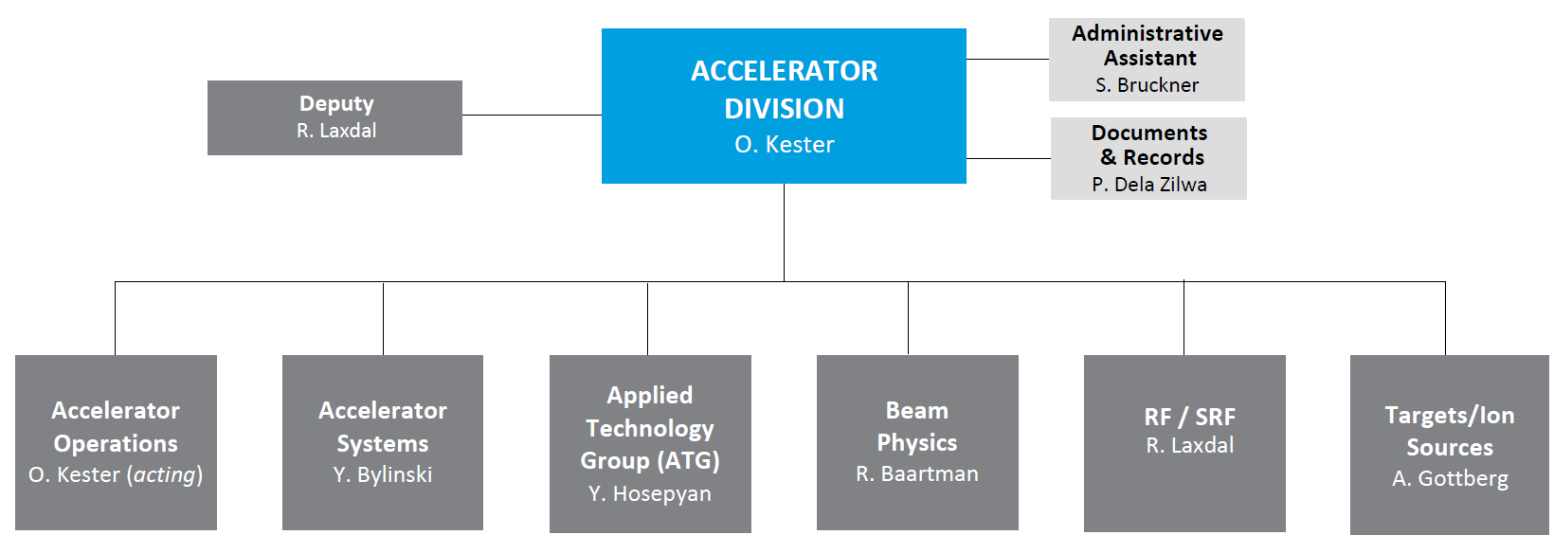
Structure of the ACC Division
Accelerator
Operations
J. Aoki (acting)
131 staff members (including post doctoral fellows) plus 30 staff from ATG
16 graduate students

Slide 4
TRIUMF Accelerator Development and Research
  Three main areas of activities:
  Operation, refurbishment and upgrade of the TRIUMF accelerator complex
  Domestic and international accelerator projects
  Accelerator research and development
  based on three pillars of excellence in
  beam physics and instrumentation
  secondary particle production
  SRF/RF technologies and research

Slide 5
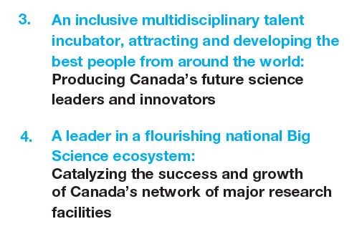
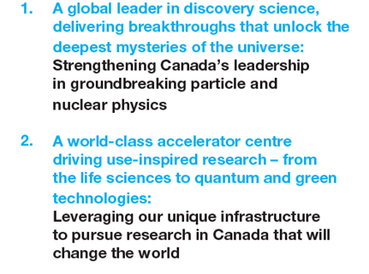
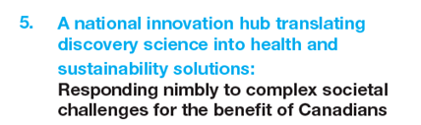
20-Year Vision
Five themes make up the foundation of the 20-Year Vision document. The Accelerator Division vision links to all themes:

Slide 6
Topics to be addressed in the next 5YP
The 5-year plan 2025-2030 must address
the operation and refurbishment / upgrade of the accelerator complex
the ARIEL completion and transition to standard operation
an engagement in domestic and international collaborations (CANS, HL-LHC etc.)
→ Prioritization ongoing
Driver accelerators (cyclotron, e-linac) and the according primary beam lines (BL1A and BL4N)
including improvements required for our business partners like BWXT
TCC – TRIUMF Control Center (combines Driver and RIB control room, exploiting modern beam tuning techniques and controls technologies)
Towards the operation of the Advanced Rare Isotope Laboratory (ARIEL completion and commissioning, ISAC target infrastructure, target module refurbishment, labs and ISAC accelerators)
External projects and collaboration (HL-LHC/CERN, SCK-CEN, VECC, CANS, DarkLight)
Research and education (Beam physics, high power accelerators – cyclotrons, linacs, colliders, SRF research and Targets and Ion Sources / Remote Handling

Slide 7
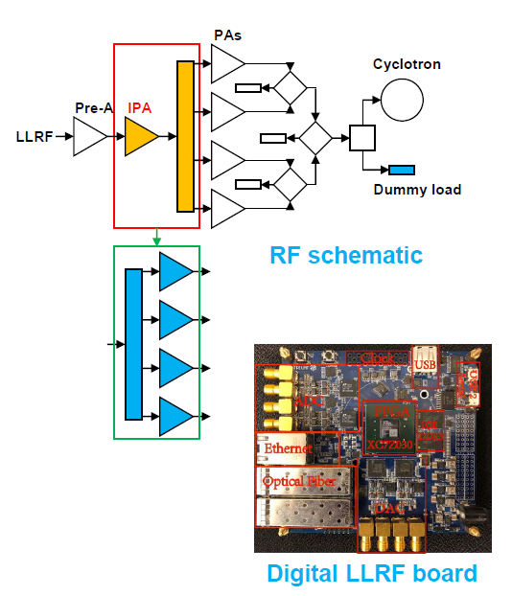
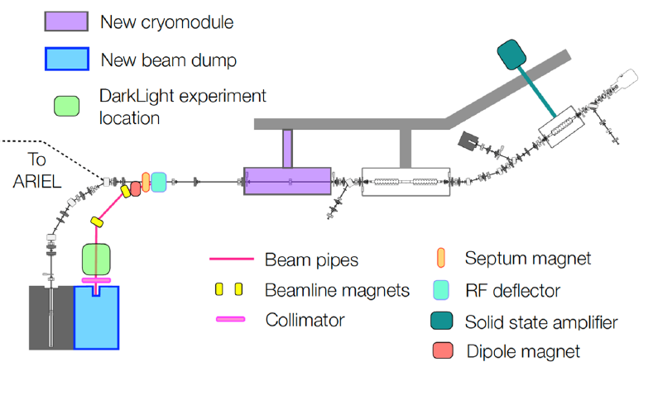
Driver accelerators
Continue cyclotron refurbishment RF system (SSA and digital LLRF)
Towards reduced cyclotron maintenance time (lid-up only every
second year)
E-linac towards high reliability and 100 kW beam power
→ for ARIEL operation
  R&D on particulate contamination, Plasma cleaning
  Support irradiation projects (FLASH, materials etc.)
  Search beyond the Standard Model – DarkLight
  (50 MeV, new beam dump, RF separator)
  Intense THz and IR radiation
Primary beam lines (BL1A and BL4N)
  Major BL1A refurbishments require RH priorities
  → Meson hall RH systems refurb, including hot cell,
  T1/T2 target transfer flask
  Continuation of RH controls refurbishment
  Develop and install RH waste management
  and reduction infrastructure

Slide 8
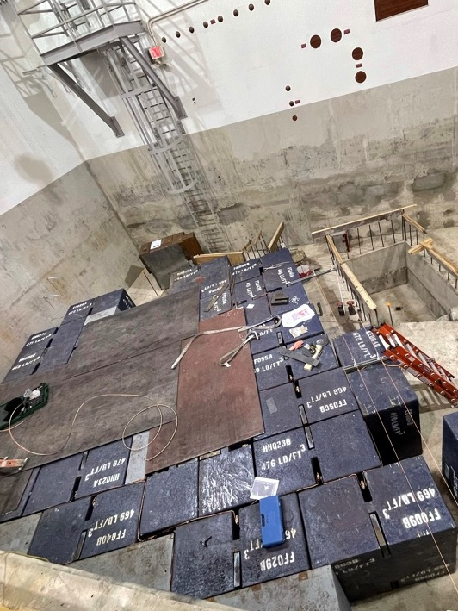
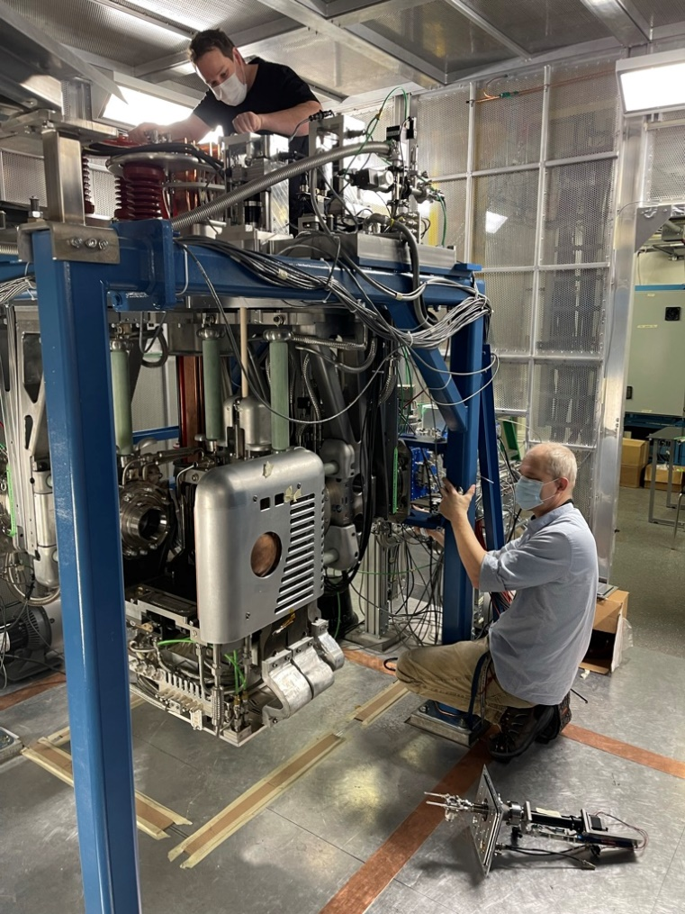
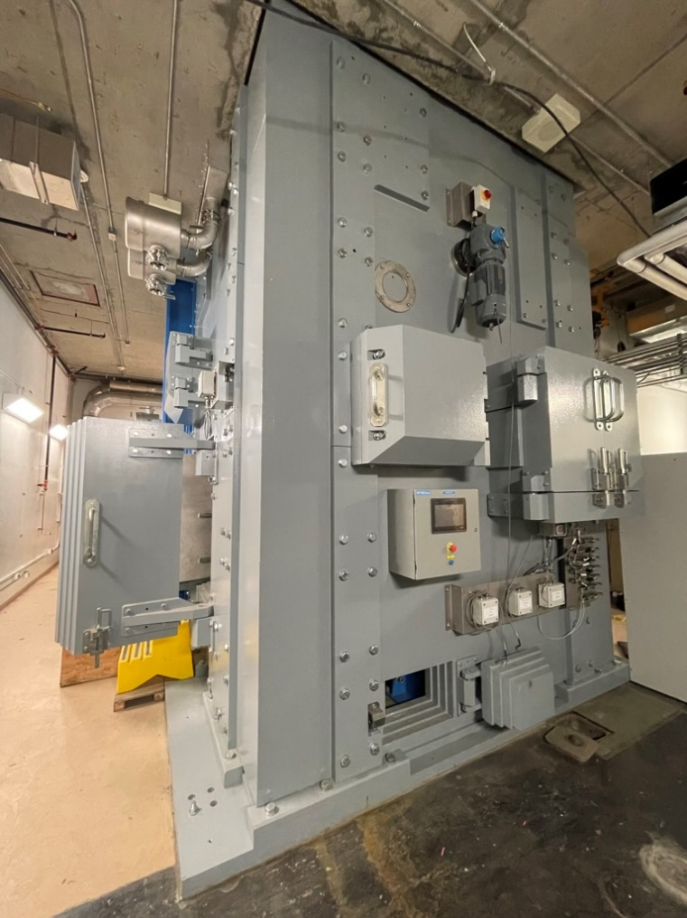
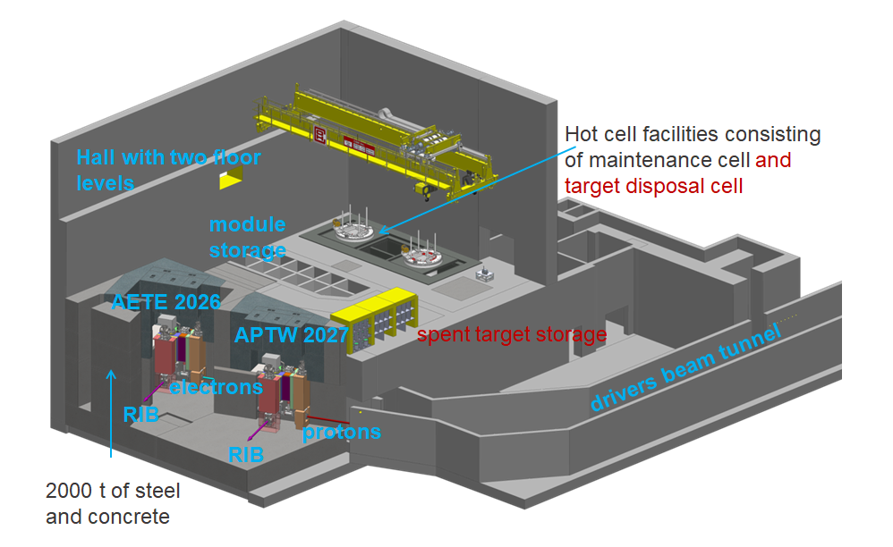
ARIEL completion and transition into Operation
Electron target station completion and online in 2026
Proton target station completion in 2027
→ BL4N completion
Will required a ramp up in operation to take full advantage of ARIEL over the next 5YP
→ 9000+ hours, 3 simultaneous exotic RIBs:
Offline target acceptance stand – TISA completion
Target production laboratories
Target decay storage vault
Resonant laser ion source for proton target station
APTW proton beam raster system
Target hall shielding
TISA

Slide 9
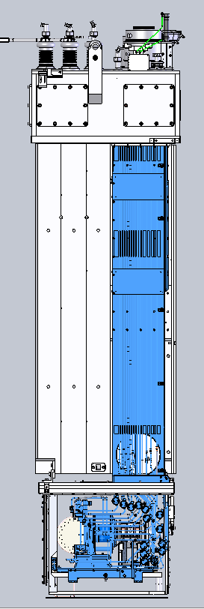
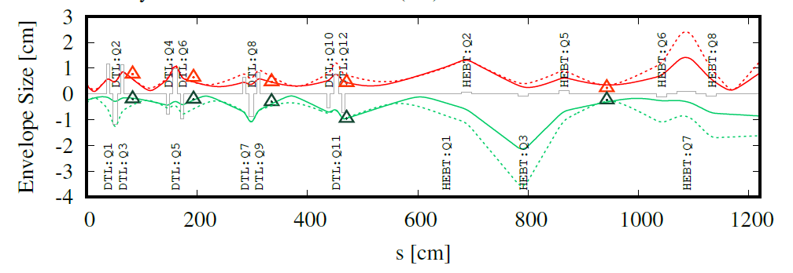
ISAC in the next 5YP
Full roll-out of regular target module refurbishment program (all major components except shielding)
Target production and conditioning systems renewal → labs
Electrical and mechanical systems
refurbishment and procurement of critical
spares
Laser Ion Source beam development:
2 elements/y (increasingly difficult)
Allow for more complex
setups and ALIS & TRILIS
parallel operation
From the ISAC Linacs
towards generalized usage
of model-based tunning
and machine learning
across TRIUMF.

Slide 10
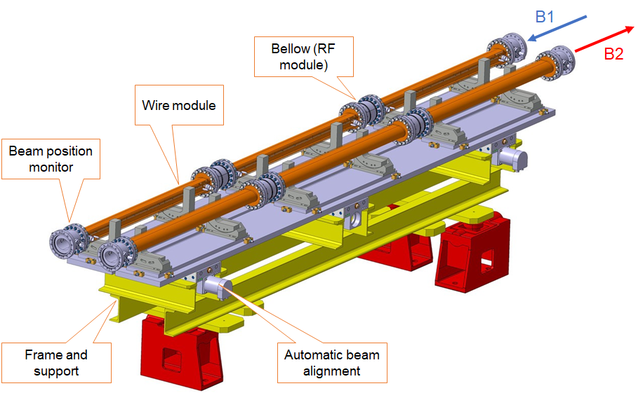
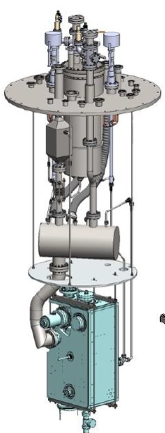
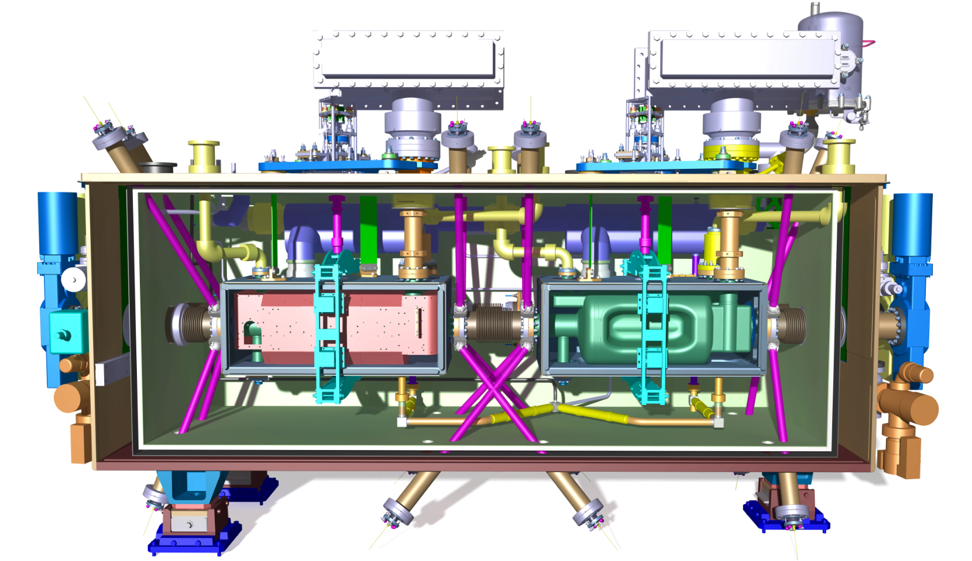
Example international: Collaboration with CERN
Beam simulation studies by beam physics group members on the theory for both long-range beam-beam (LRBB) and wire correctors in the HL-LHC
→ Effect on the closed orbit of the LHC coming from a misalignment
of wire correctors
Wire correctors are planned in locations on both
sides of the interaction point to compensate
LRBB effects
→ TRIUMF is asked to engage on wire corrector
for HL-LHC in the next 5YP – P530
TRIUMF will receive 10 dressed RF Dipole
resonators from US-AUP re-qualify and assemble
each pair of RFDs into five hermetic strings.
  TRIUMF to assemble hermetic strings
  into five cryomodules
  Cryomodule production and delivery will continue
  in the next 5YP period

Slide 11
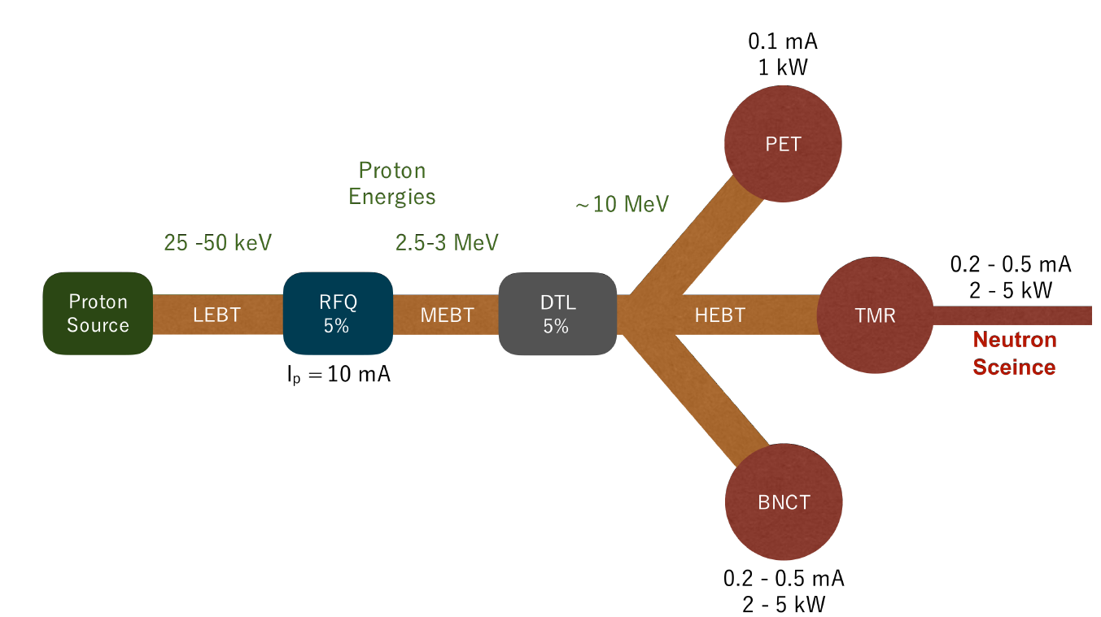
Example domestic: PC-CANS
TRIUMF is collaborating with the University of Windsor and the Canadian neutron scattering community towards an accelerator-based neutron facility
(D. Maharaj’s talk on Monday, CDR PC-CANS: PC-CANS CDR Circulated Proposal-v5.1.pdf)
Collaboration has conceptualized a stageable prototype CANS facility, PC-CANS, based on linac technology.
PC-CANS will allow competitive rates for neutron science, while
simultaneously producing F18 for PET and neutrons for a dedicated
BNCT research and development facility.
The PC-CANS prototype will be the
first CANS in Canada and the first
for BNCT in North America.
The project will augment and solidify
TRIUMF core competence in linac and target systems
and the proton accelerator technology is well aligned with applications

Slide 12
Staffing towards the ARIEL operation era
Basis for the staffing decision towards the ARIEL operation era is the Operational model for ARIEL (Document-129655).
→ Factory model, where the three RIB target areas are each scheduled in three-week cycles with each cycle starting on a subsequent week.
The operational model analysis includes an estimation of the extra effort required to commission, operate, develop and maintain a significantly expanded facility, over and above the present effort.
From this analysis we identified additional hires, taking the gain of efficiency into account
(TCC, advances beam tuning, IT tools, refurbished equipment)

Slide 13
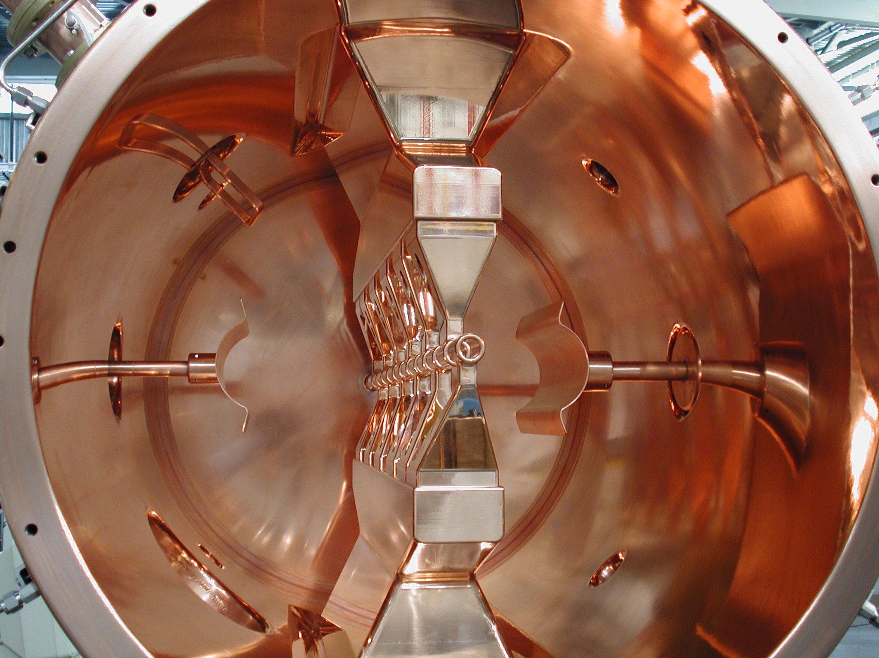




Thank you
www.triumf.ca
Follow us @TRIUMFLab

Slide 14
Additional slides

Slide 15
ACC division mission statement
The TRUMF accelerator division safely operates the TRIUMF accelerator complex with high performance and availability. We develop and implement new accelerator facilities and related technologies to support world class science nationally and internationally.
We lead accelerator physics research in Canada and foster TRIUMF’s position at the forefront of accelerator science. We advance our core competencies and transfer our knowledge to industry for the benefit of society.
We leverage infrastructure and expertise to provide world class training of HQP in accelerator physics and engineering.

Slide 16
Our 20-year Vision for TRIUMF Accelerator Science and Facilities
Isotope Valley
With ISAC+ARIEL+IAMI we will greatly expend our capabilities, and establish TRIUMF as a leading global center for isotope research.
Isotopes for physical science
Isotopes for life science
Isotopes to cure Canadians
Canadian Hub
We are Canada’s centre of excellence in accelerator-related science and technology.
We centralize knowledge, and diffuse it through training, counsel, and collaborations.
With our always evolving expertise we remain a leader in Canada’s transformation to a knowledge based economy.
Big Science — Big Tech
International collaborations are key to contribute to the most significant discoveries, attract talents, and maintain cutting-edge expertise.
We support international projects by leveraging our core knowledge and engaging Canadian industry.
We build on our strengths to serve science and invent life-changing technologies.
https://beamphys.triumf.ca/~tplanche/20-year-vision-acc.pdf

Slide 17
Summary of Accelerator topics in the next 5YP
Driver accelerators:
Cyclotron refurbishment and upgrades (RF, controls, etc.)
e-linac towards full performance
beam lines (BL1A – CFI project), BL4N completion for APTW
TCC – TRIUMF Control Center (combines Driver and RIB control room)
RIB facilities:
ARIEL completion and commissioning
ISAC target hall consolidation, target module refurbishment, labs, ISAC accelerators
Target ion sources, RILIS
Research and education:
HLA, model coupled beam tuning, machine learning
High power beams – e-linac, HL-LHC, EIC
Cyclotron technology (injection, beam loss reduction, SC cyclotron)
SRF research - plasma conditioning, degassing furnace, particulate migration
External projects:
  CERN HL-LHC and TIS
  SCK-CEN and Raon – TIS and post acceleration technologies
  CANS, DarkLight and FLASH irradiation

