Slide 1
Five year plan within the 20-year vision – Town Hall
Life Sciences Division
July 22nd, 2022
Paul Schaffer, PhD
Director, Life Sciences

Slide 2
Today’s presentation:
The Basics: LS Vision, Mission; The Team; Our Pillars
Research Summary
Current Priorities
Future Ambitions, Upcoming Priorities

Slide 3
Life Sciences Vision and Mission Statements
Vision Statement:
The Life Sciences Division will place TRIUMF as a global leader in the application of accelerator research toward the life sciences in a manner that derives maximum societal and economic benefit.
Mission Statement:
The Life Sciences Division at TRIUMF will innovate new accelerator technologies, isotopes and radiopharmaceuticals to better health, understand life and better the environment. The Division will leverage its core expertise to lead in our community as an interdisciplinary centre of excellence that enables ourselves, and our partners, with world-class people and state-of-the-art facilities.
3

Slide 4
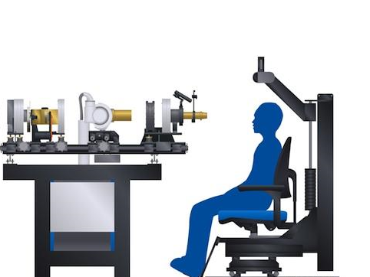
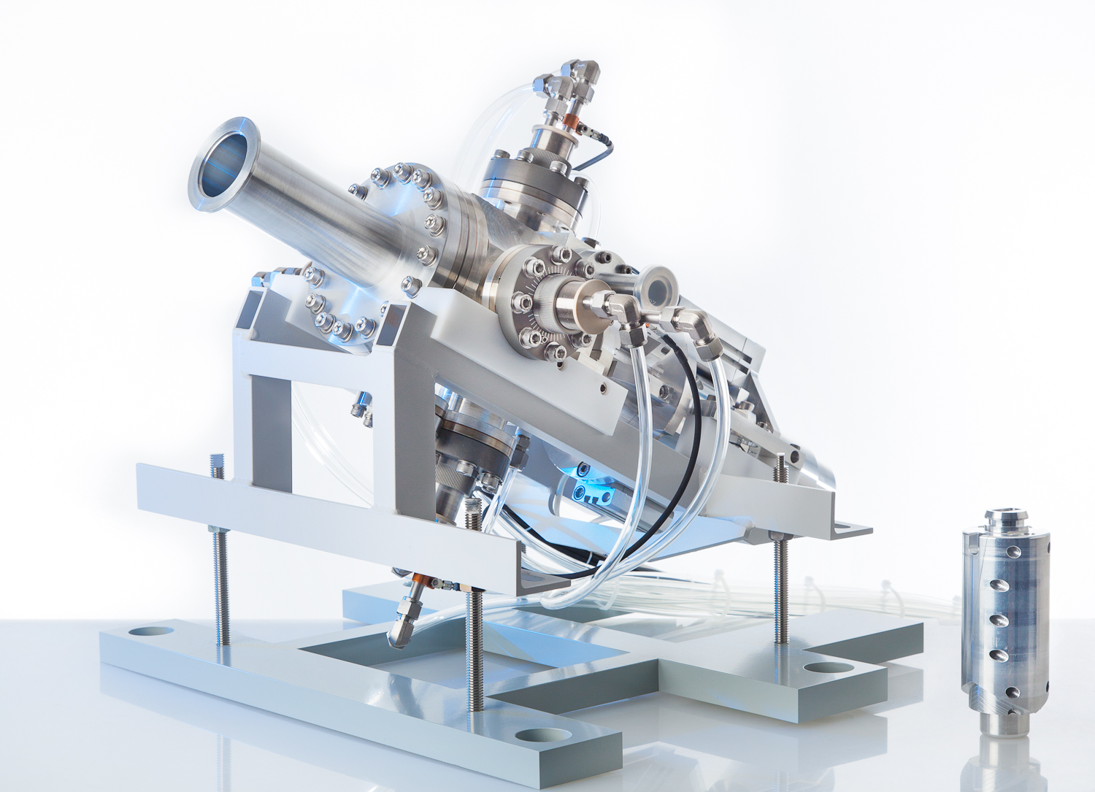
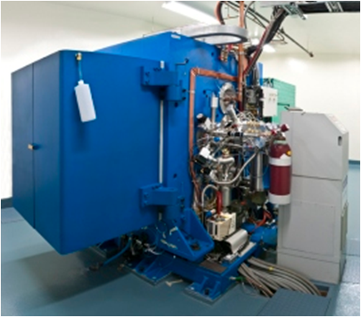
TRIUMF Life Sciences focuses on advancing accelerator-based technology for the development of isotopes that can improve life
Life Sciences
at TRIUMF
Applied Ion Beams
Nuclear Chemistry
Applied Isotopes

Slide 5
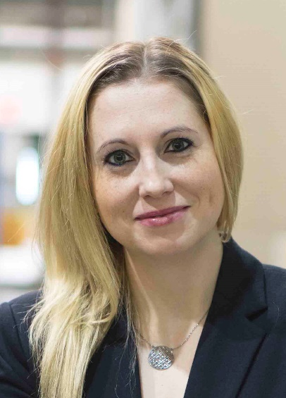
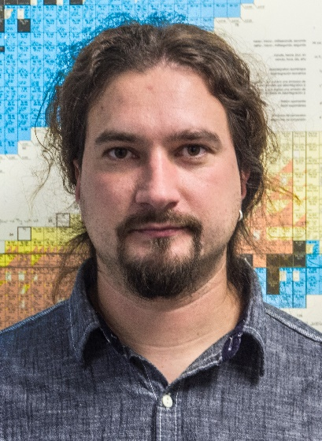
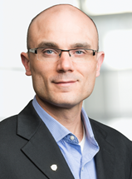
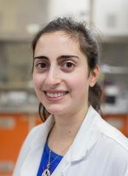
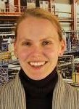
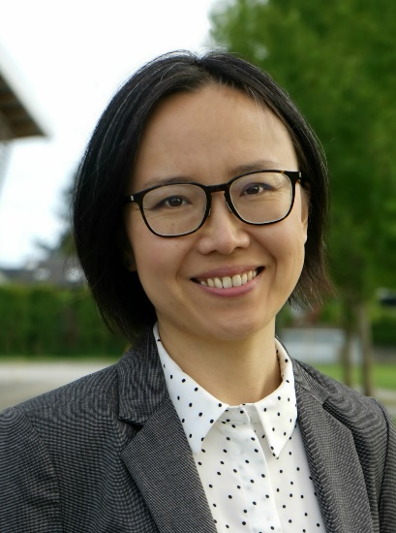
Life Sciences BAEs at TRIUMF
Applied Ion Beams
Nuclear Chemistry
Applied Isotopes
Monika
Stachura
Cornelia
Hoehr
Valery
Radchenko
Paul
Schaffer
Hua
Yang
Caterina
Ramogida
(joint SFU)
Research within TRIUMF Life Sciences focuses on advancing accelerator-based technology for the development of ion beams and isotopes that can improve life

Slide 6
Current Life Sciences Priorities
1) Build IAMI
2) Implement GMP capabilities – complete validation master plan
3) Grow/Enable Therapeutic Isotope Program
4) Deliver on our commitments (to our researchers and our partners)
These priorities are set via internal reviews, coupled with external peer evaluation (LSPEC)
Align with TRIUMF’s goals within:
Science and Technology
  Make ground-breaking discoveries across our multidisciplinary research portfolio
  Strengthen our position as a world-leading particle accelerator centre
People and Skills
  Become a hub for interdisciplinary education and training
  Inspire Canadians to discover and innovate
Innovation and Collaboration
  Translate science and technology into innovation
  Drive national and international collaboration in research, technology and innovation

Slide 7
Research Summary

Slide 8
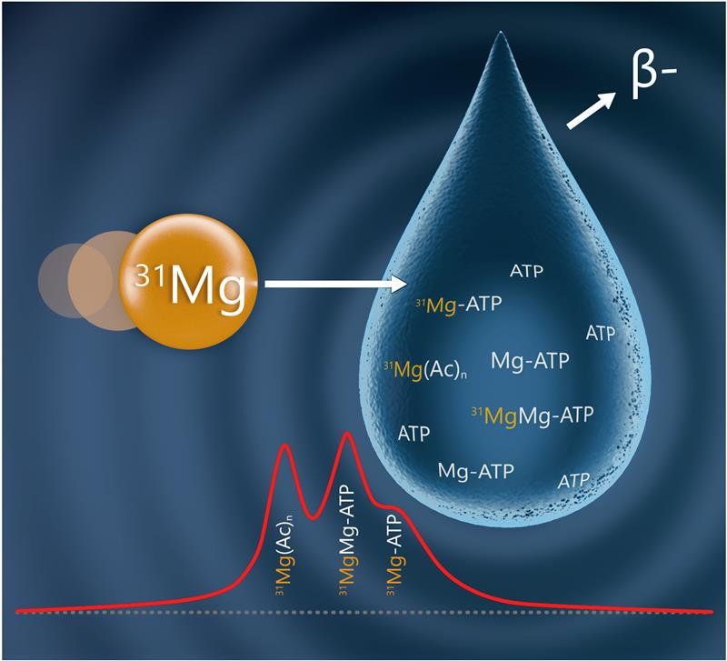
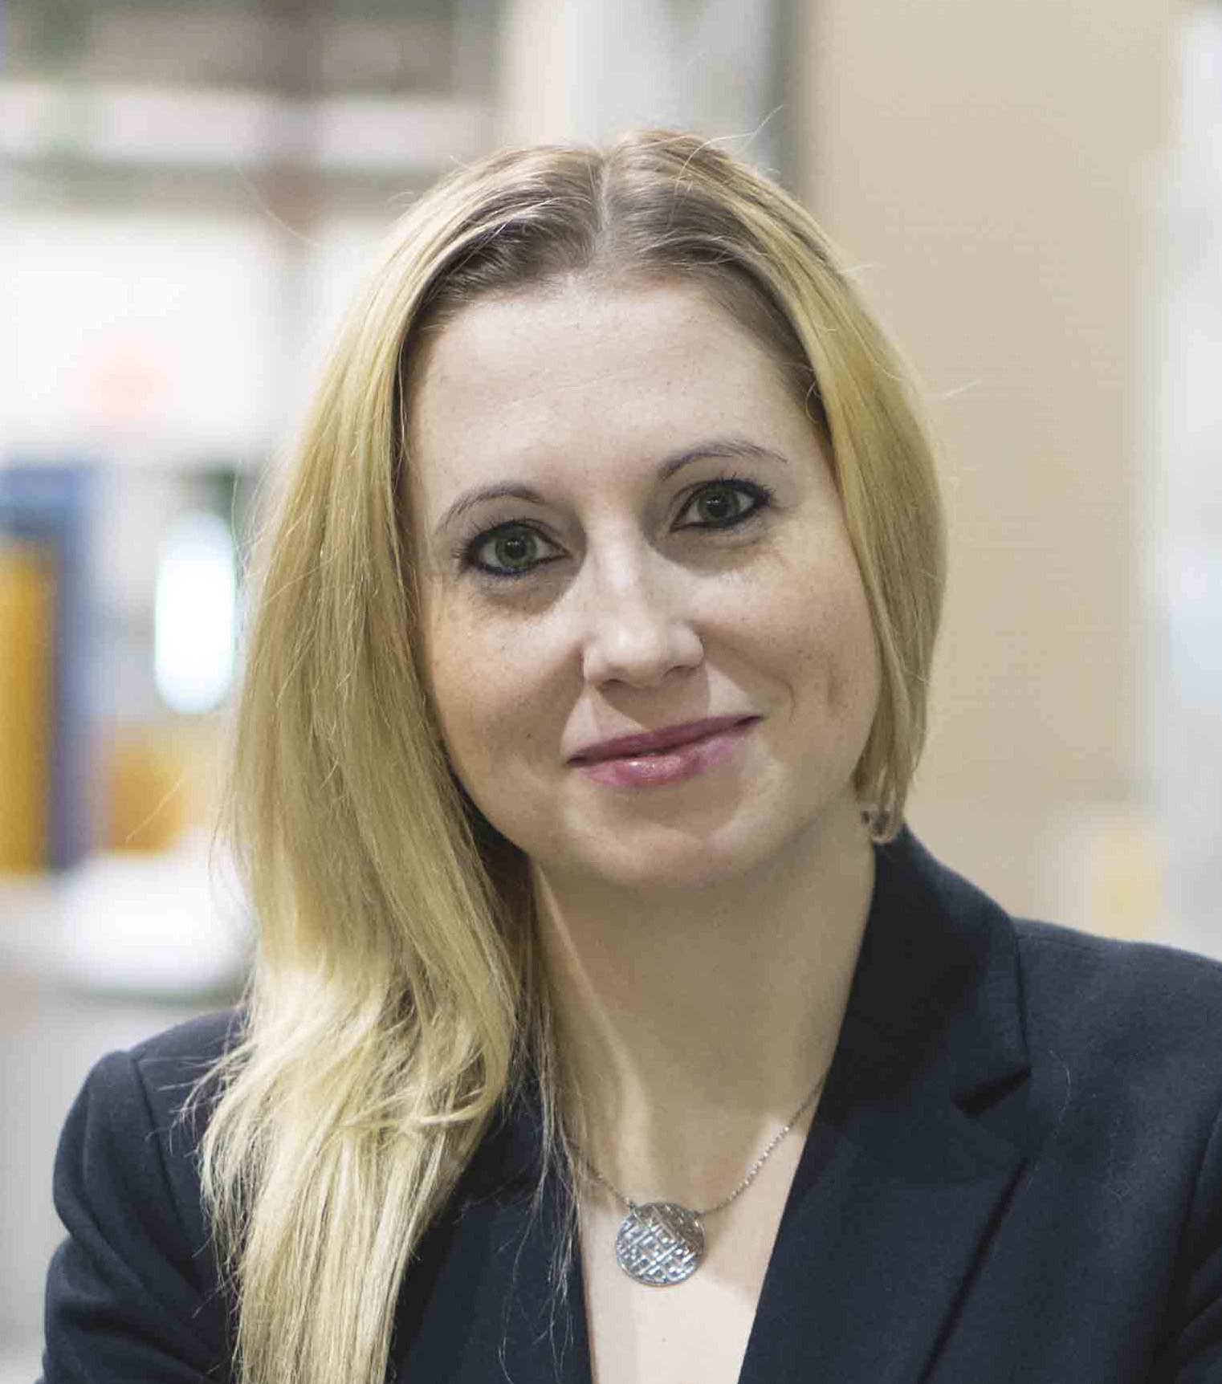
Bio-βNMR at TRIUMF
Current interests:
³¹Mg + ⁸Li (routine)
^{58/74}Cu (under development)
^{226,230}Ac (under development)
Attributes:
Unique, high-impact science;
International collaboration;
Private sector interest;
Threats: beam availability

Slide 9
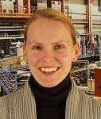
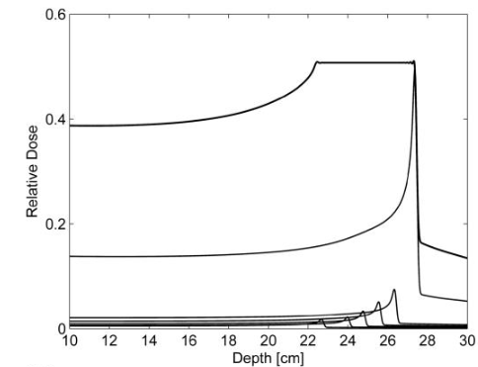
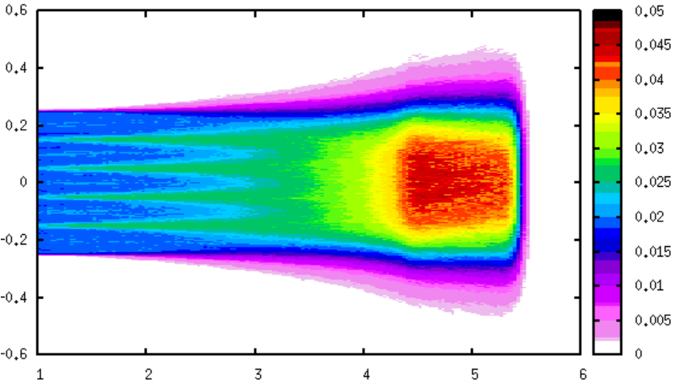
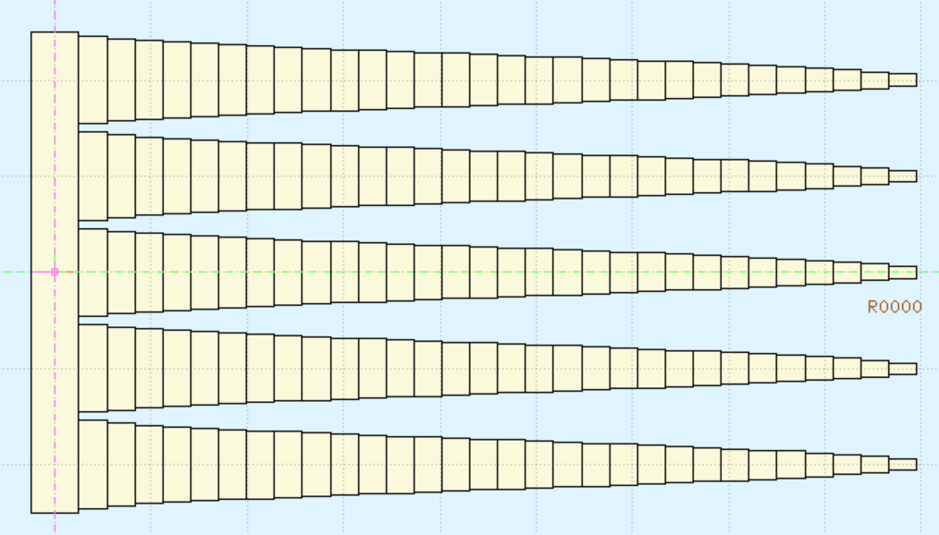
Proton (and photon) FLASH at TRIUMF
Current status:
Grant funding used to install prototype hardware; collect feasibility data
Attributes:
Builds on decades of PT experience at TRIUMF;
Threats: need for program/infrastructure investment
Generated Hedgehog design
Desired
SOBP
parameters
Dose (arbitrary units)
X coordinate (cm)
3D printing and physical
testing
Distance (cm)
Notes:
What I have now, and I’ll mention some of the next steps

Slide 10
Medical Isotopes: Metals offer many options
TR13 MeV
Legacy machine operating at
ideal energy for many isotopes
24 MeV
Modern, high-intensity machine
that expands on TRIUMF’s
isotope repertoire
520 MeV
Globally unique machine that
provides access to equally
unique isotopes, applications
T.I. Kostelnik and C. Orvig, Chem. Rev. 2019, 119, 902-956

Slide 11
Medical Isotopes: Metals offer many options
TR13 MeV
Legacy machine operating at
ideal energy for many isotopes
24 MeV
Modern, high-intensity machine
that expands on TRIUMF’s
isotope repertoire
520 MeV
Globally unique machine that
provides access to equally
unique isotopes, applications
T.I. Kostelnik and C. Orvig, Chem. Rev. 2019, 119, 902-956

Slide 12
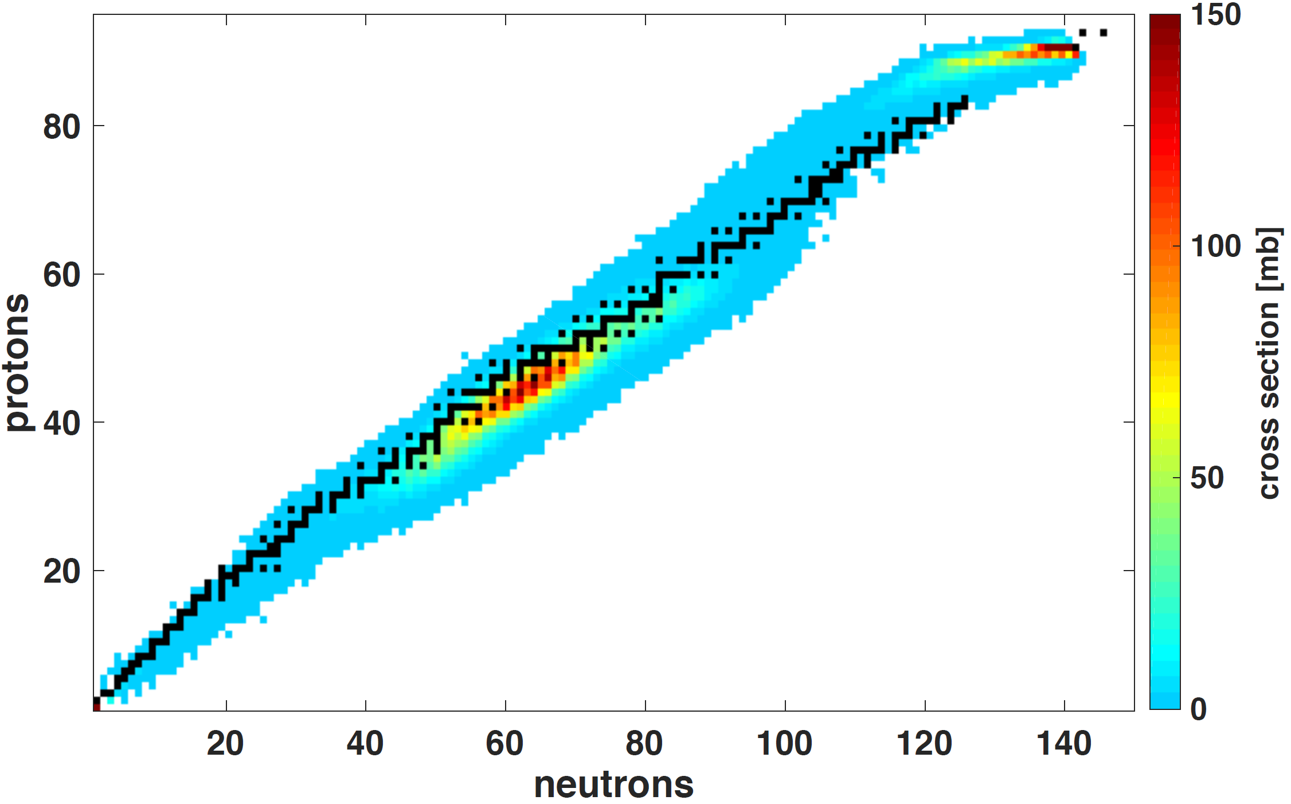
520 MeV Isotope Production
Generator assembly
Radioactive decay
…
²²⁸Th (1.92 y)
²²⁵Ra (14.9 d)
²³⁰Pa (17.4 d)
²²⁷Ac (21 y)
Chemical separation
²²⁴Ra (3.6 d)
²²⁵Ac (9.9 d)
²³⁰U (20.2 d)
²²⁷Th (18.7d)
²¹²Pb (10.6 h)
²¹³Bi (45.6 m)
²¹²Bi (60.6 m)
High-energy proton-induced spallation provides a virtual treasure trove of isotopes
Many isotopes produced have therapeutic/theragnostic potential
Threat: significant potential waste burden

Slide 13
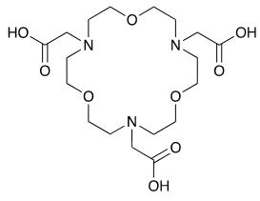
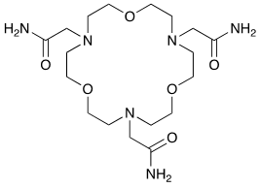
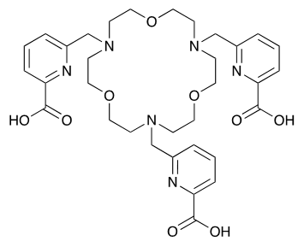
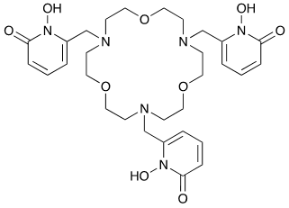
Radiopharmaceuticals Development

Slide 14
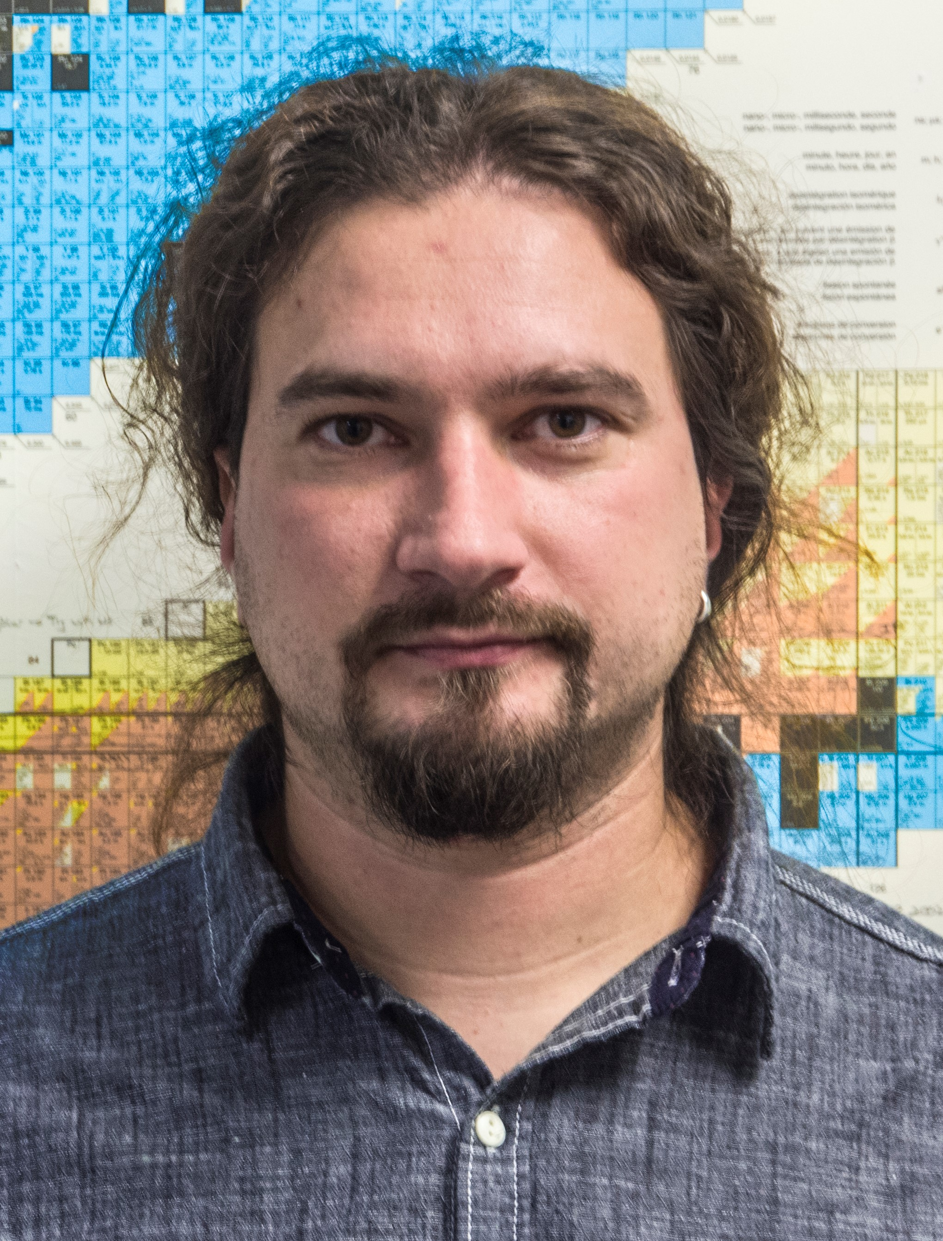
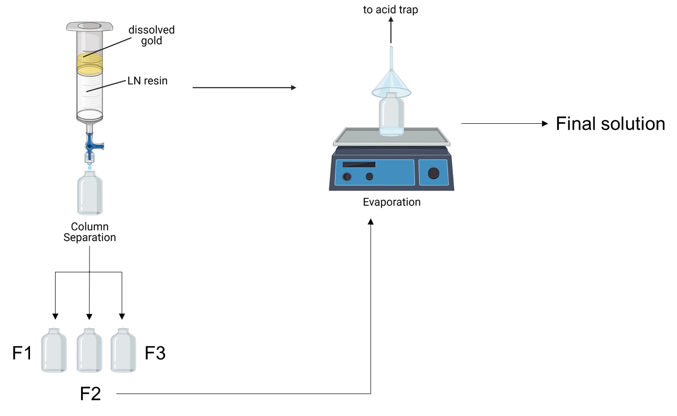
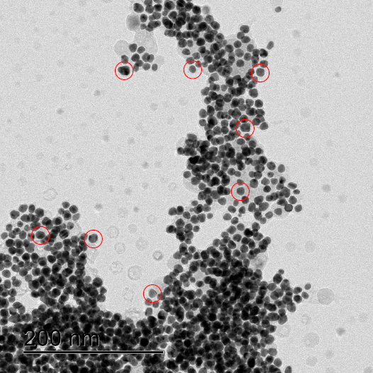
Radionuclide Therapy
is not limited to alpha-, beta- emitters
Production of ^{197m/g}Hg by irradiation of solid gold target
Production of nanoparticles from active gold/ ^{197m/g}Hg solution
Dissolving of gold/ ^{197m/g}Hg
197
Hg
mercury
119
230
Sb
U
antimony
uranium

Slide 15
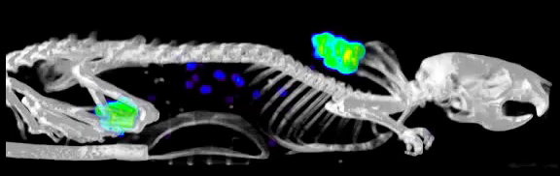
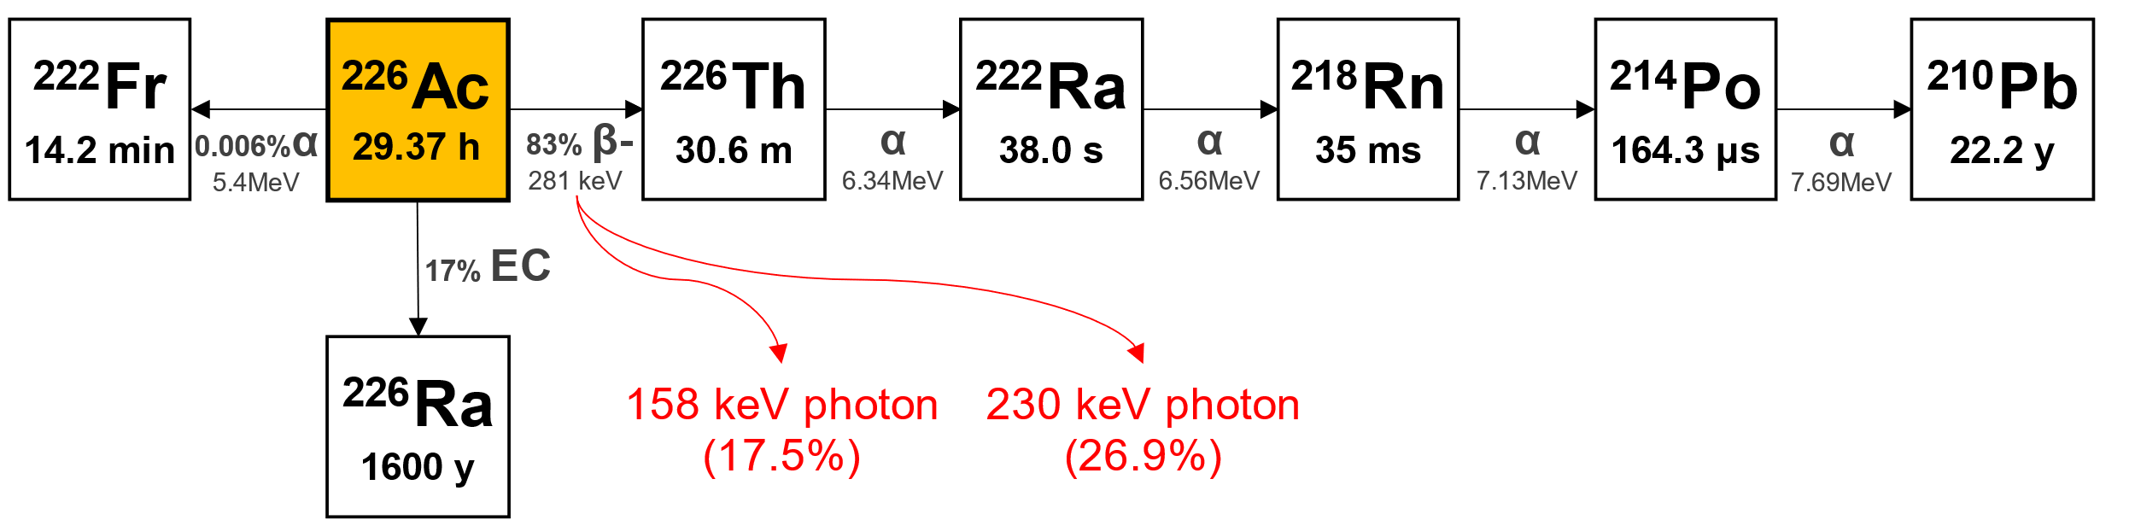
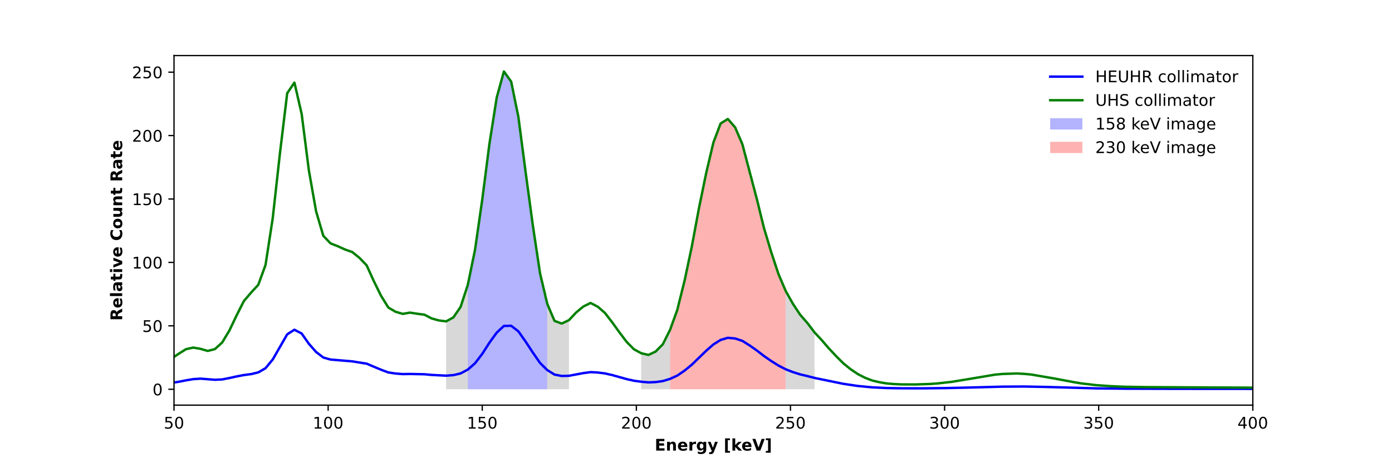
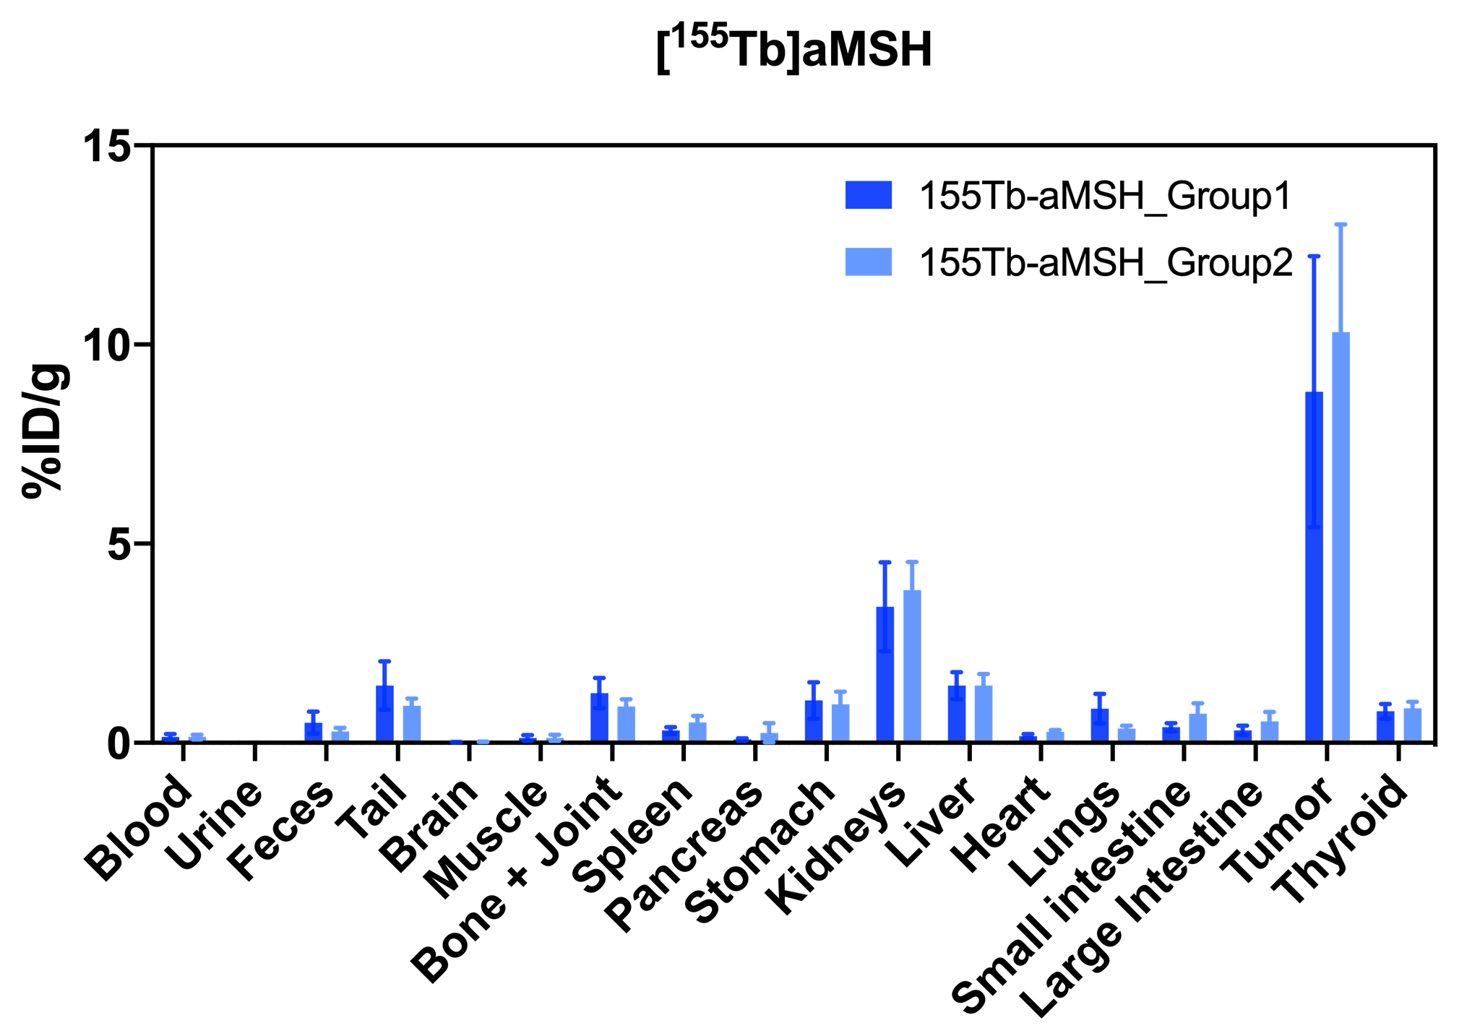
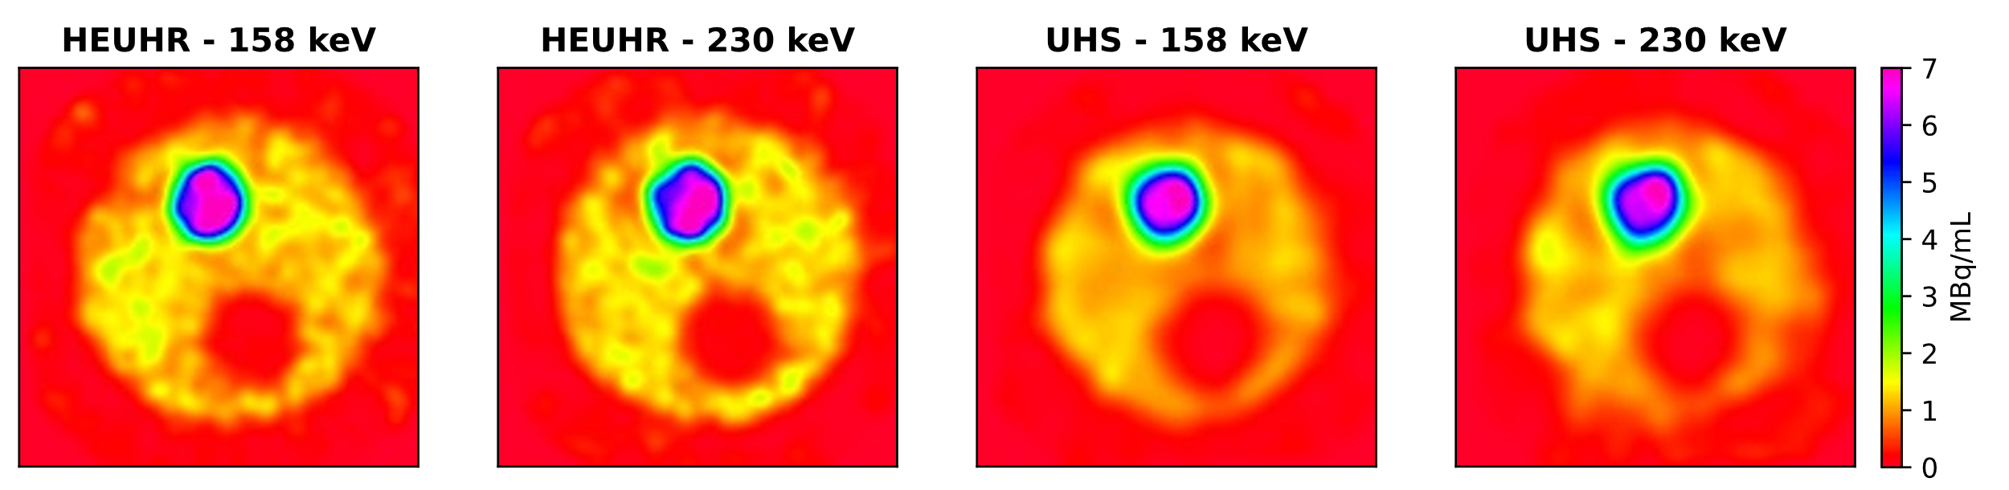
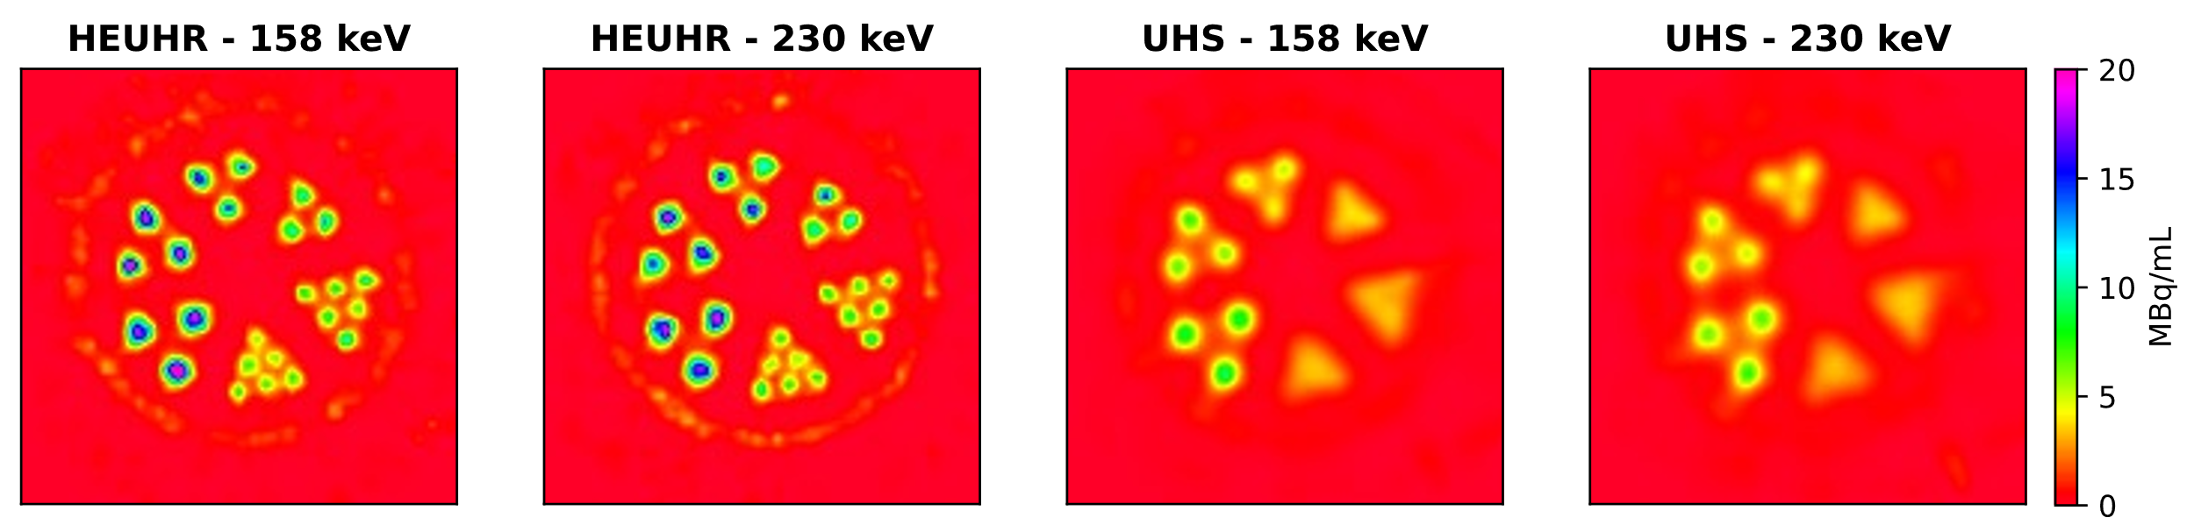
ISAC/ISOL
[¹⁵⁵Tb]Tb-crown-αMSH SPECT , 2h p.i.,
[¹⁵⁵Tb]Tb-crown-αMSH Biodistribution 2 h p.i.
High contrast images
Good tumour uptake

Slide 16
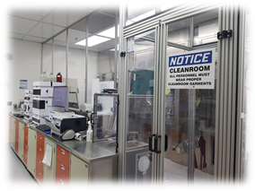
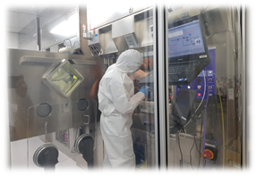
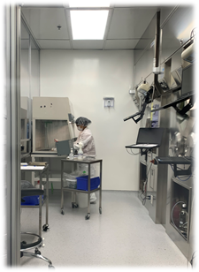
UBC; BC Cancer tracer supply (O22, O93)
Status on Tracer deliveries:
  Deliveries of [¹¹C] tracers to UBC resumed in January 2021
  Pandemic continues to challenge demand
  TRIUMF has met production reliability targets that mutually agreed upon between TRIUMF and UBC
  BC Cancer no longer utilizing F-DOPA as a clinical tracer
    Replaced with [⁶⁸Ga]DOTATOC
Status on advancing GMP compliance:
  250 GMP documents released so far (over 60 documents
  have gone through multiple releases)
  All tracer production is now performed under GMP conditions
  Continuous improvements have been made on the implementation of GMP processes.
    (61 Change Controls, 43 CAPAs have been filed and put into effect since 2021 Jan)
  New GMP Lab 007 coming online soon

Slide 17
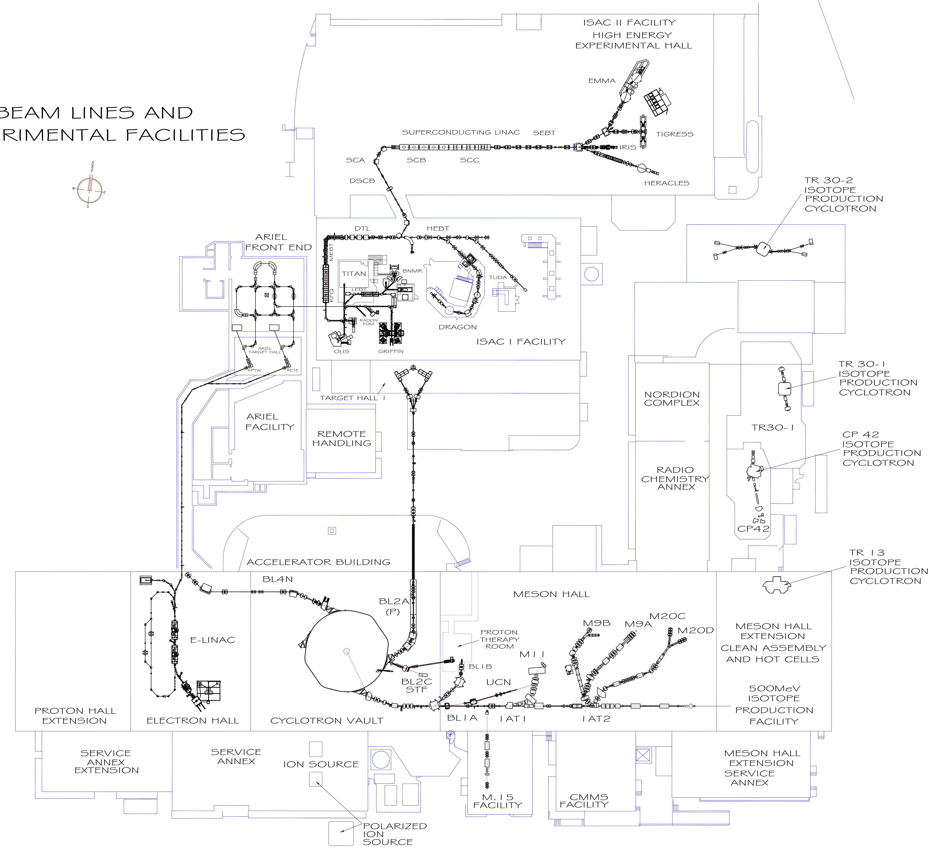
Life Sciences at TRIUMF
  Many applications derived from beams and isotopes obtained from 13 to 520 MeV machines
    Isotope production
    Radiochemistry
    Proton Therapy
    Bio-βNMR
  Other drivers: ARIEL, ISAC/ISOL
  Partnerships:
    UBC: Science, Pharmacy, Medicine, Engineering
    SFU: Science
    BC Cancer
    Fusion, BWXT
BWXT
ARIEL
ISAC
IPF
IAMI

Slide 18
Current Priorities

Slide 19



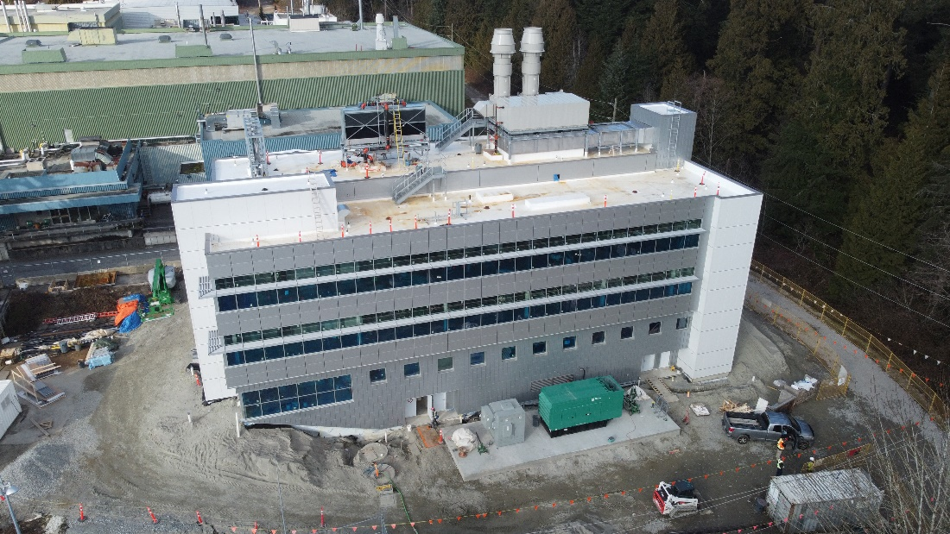
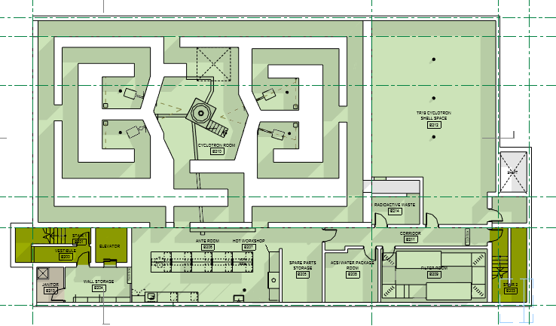
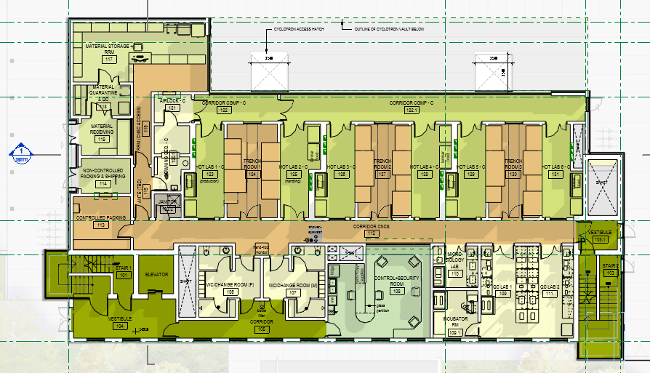
IAMI (P442)
includes P471, P550, P527
  Transitioned to TRIUMF
  Additional funding requests continue in discussion with provincial funding ministries for:
    Additional lab equipment
    Additional target capabilities
    Office space
Notes:
P471 notes: 2 liquid targets procured, installation by ACSI concurrent with TR24
procurement for components for1 solid target station underway; gate 3 passed March 2022 Target station installation by Dec 2022
;

Slide 20
IAMI (P442)
includes P471, P550, P527
  Transitioned to TRIUMF
  Additional funding requests continue in discussion with provincial funding ministries for:
    Additional lab equipment
    Additional target capabilities
    Office space
Notes:
P471 notes: 2 liquid targets procured, installation by ACSI concurrent with TR24
procurement for components for1 solid target station underway; gate 3 passed March 2022 Target station installation by Dec 2022
;

Slide 21
IAMI: Operations Model
Current proposal (pending full review, ratification by TRIUMF Board, Partners):
Operations and Governance will evolve through phases: Start-up through to Full Ops
Start-up operations occur in an integrated fashion within an existing, albeit modified Life Sciences organization. Operations supported by TRIUMF and partners;
Full operations are initiated once IAMI crosses a legal, financial or administrative threshold that has yet to be determined
Governance will be achieved through a Steering Committee that will recommend resource allocation to meet IAMI program objectives, including balance between R&D and revenue-generating activities
Next steps:
  Ratification of Operating and Governance Models
  Finalization of Business Plan – collaborate with TRIUMF Innovations

Slide 22
Proposed IAMI Start-up Governance
Science Advisory Committee (LSPEC?)
TRIUMF Executive Director
IAMI Steering Committee
Meets annually
Advises on new areas, global trends
Meets quarterly
Sets strategic direction/priorities
Ensures alignment of operations
Discusses/resolves issues from Ops
Director
Life Sciences
IAMI Operations Committee
IAMI Steering Committee composition (in principle):
  appointees (incl. chair) from TRIUMF, BCC and UBC
Director
IAMI Operations
Meets monthly
Manages/coordinates scheduling, operations
Facilities communications
Discusses and resolves issues
Status:
1) Phase 1 Lease and Operating Agreements are being finalized
2) LOU and LOI for expanded efforts are signed
3) Business and operating plans are being updated now that partner activities are becoming more well defined
4) Steering and Operating Committee Terms of References are being finalized
5) Services Agreement for expanded effort has been drafted and is under review
6) Sublease for expanded effort is being drafted

Slide 23
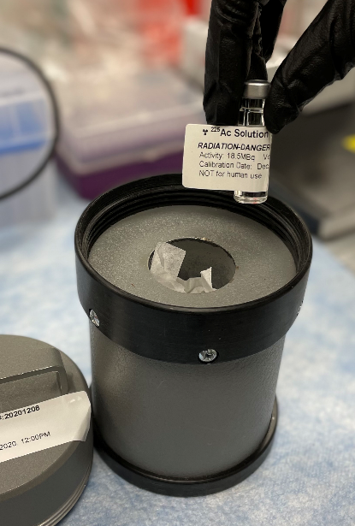
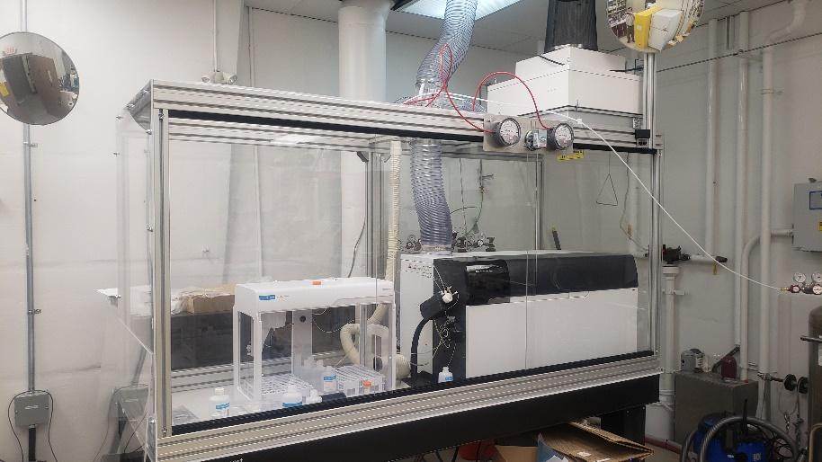
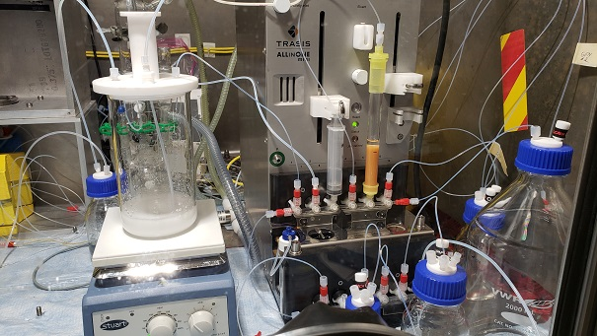
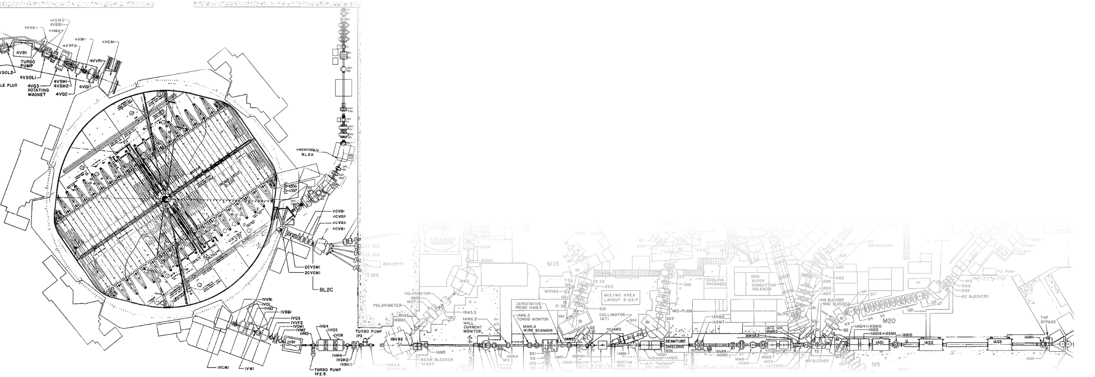
²²⁵Ac Production at TRIUMF (P476)
Objective: demonstrate the safe, routine, larger-scale production and quality control of ²²⁵Ac via high-energy proton irradiation of ²³²Th on BL1A
Current Status: 2021 campaign:
5 targets at IPF for a total of 28,900 µAh
Isolated up to 155 mCi of direct ²²⁵Ac (w/ ²²⁷Ac; corrected to EOB)
Isolated up to 14.7 mCi of ²²⁵Ra for generator assembly (corrected to EOB)
‘Milked’ ²²⁵Ra/²²⁵Ac generators 7 times for a total of 3.6 mCi of high purity ²²⁵Ac for distribution to collaborators and TRIUMF researchers
2022 campaign underway
Isotope Production Facility (IPF)

Slide 24
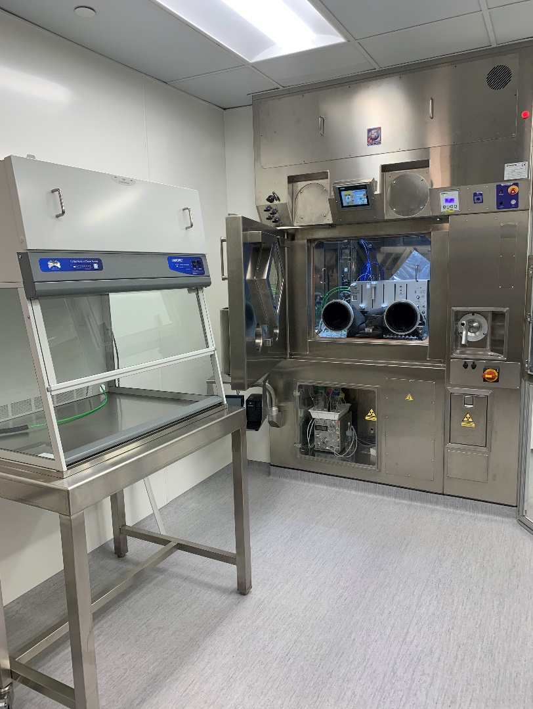
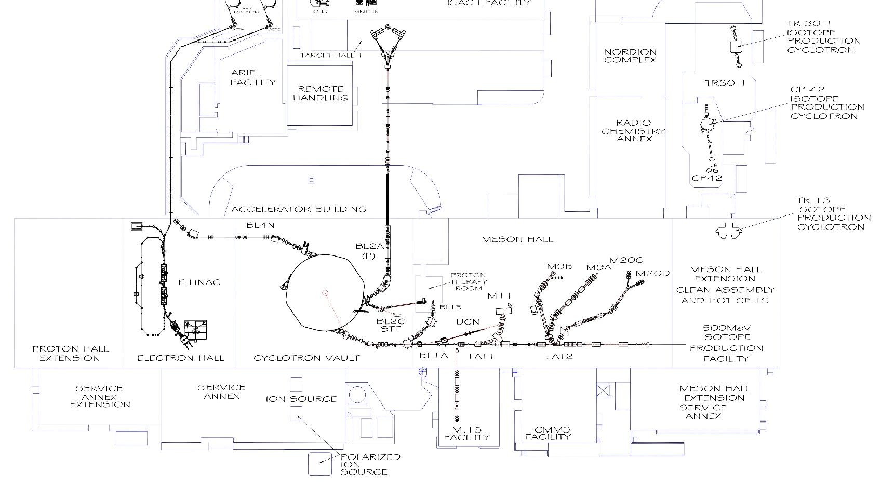
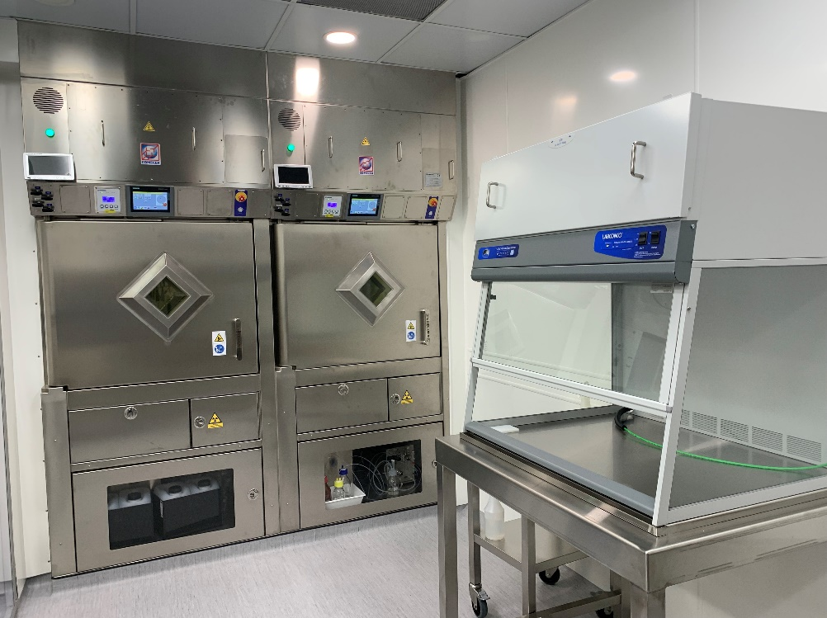
Complete Upgrade of RCA007
Objective: Expand ¹¹C- GMP neurotracer production capacity
Current Status: New hot cells, automated synthesis units and separate clean room
  HVAC commissioning for CNSC and GMP completed
Next step: Final lab commissioning (Gate 4A)

Slide 25
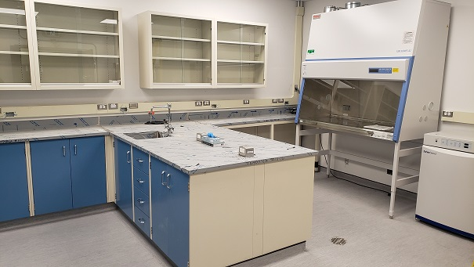


Commission TRIUMF Cell Biology Lab (P468)
Objective: Implement a basic cell culture facility in MHESA Lab 01A; leverage CFI JELF (Ramogida)
  Enable evaluation of radiopharmaceuticals in vitro
Current Status: PHAC approval of biohazard safety plan - Oct. 2021
  Construction complete
Next step: Lab commissioning (Gate 4A )

Slide 26
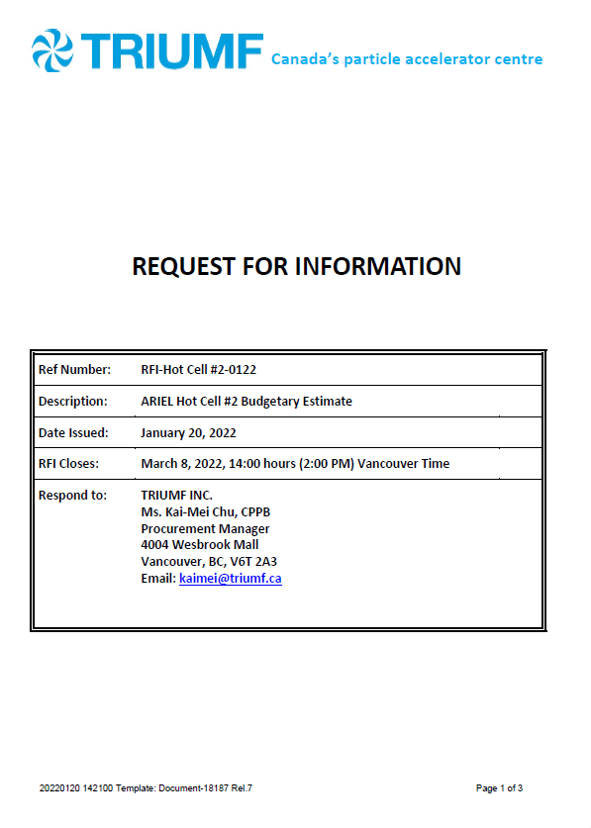

Complete ARIEL (P405 – Symbiotic Isotope Production)
Design efforts underway:
1. Target and transfer system design and prototyping
Transfer target prototype built and ready to be tested
Thermal target prototype built and ready to be tested
2. ARIEL Hot Cell 2 (HC2) technical specification development
Document review complete and sent out for RFI
Work underway to re-baseline within cost
Team:
Efforts underway to build depth in the project team
Evaluation of project schedule underway to ensure timely delivery

Slide 27
Future Ambitions, Upcoming Priorities

Slide 28

Replace BL1A (P540, P527)
Objective: replace, enhance functionality of BL1A
Next step: 2023 CFI Infrastructure Fund application submitted! Provincial applications underway
Title: TRIUMF High-Energy Accelerator Proton Irradiation Experiments (THErAPIE)
$28+M budget ($9.7M from CFI) involving 9 institutions across 4 provinces
  Two Research Programs:
    Radioisotopes & Radiopharmaceuticals
      Isotope production, radiochemistry,
      generators, radiopharmaceuticals
    Quantum Chemistry & Materials
      Quantum materials, green chemistry,
      new energy technologies

Slide 29
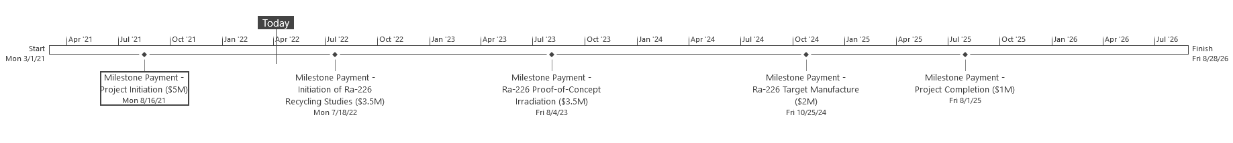
²²⁵Ac Production via ²²⁶Ra(p,2n) (P526)
Objective: Determine best path forward for production of ²²⁵Ac from ²²⁶Ra
Current Status:
Efforts underway to initiate radium handling, processing, recycling
Evaluate path forward for target design
Next Steps:
Project distillation into WBS structure

Slide 30
Expand bio-β-NMR (P382, P464)
Objective: enhance bio-βNMR infrastructure at TRIUMF
Next steps: prepare CFI application (2025)
7T bNMR
bio-β-NMR spectrometer
P464 (POLARIS)
P382 (bio-β-NMR)
3T bNMR
SMuRF spectrometer
0.2T bNMR spectrometer
(CMMS, PSD)
4e
4e
CMMS spectrometers
4e
9T bNMR spectrometer
(CMMS, PSD)
CFI 2025
Existing at ISAC-I
ISAC-I RIB
(Accelerator Div)
Polarizer
(Accelerator Div)
Notes:
Currently two bNMR spectrometers in the ISAC-I hall: high-field bNMR spectrometer (9T), and low-field bNQR spectrometer (230 G). Both of them are optimized for experiments in high vacuum (ultra clean environment for materials science applications). None of the existing spectrometers is is compatible with experiments in aqueous solutions. The pending CFI applications is for building a novel bNMR spectrometer dedicated to and optimized for biological, chemical and medicinal applications.
In meantime, we are using the existing infrastructure to run experiments with ionic liquids (salts that are molten at room temperature), like EMIM-Ac. Over the past 5 years we used bNMR to study different salts and biomolecules in EMIM-Ac. The above picture shows how we use the existing high-field spectrometer to carry out expeirments with liquids (very limited applications, but still doable).

Slide 31
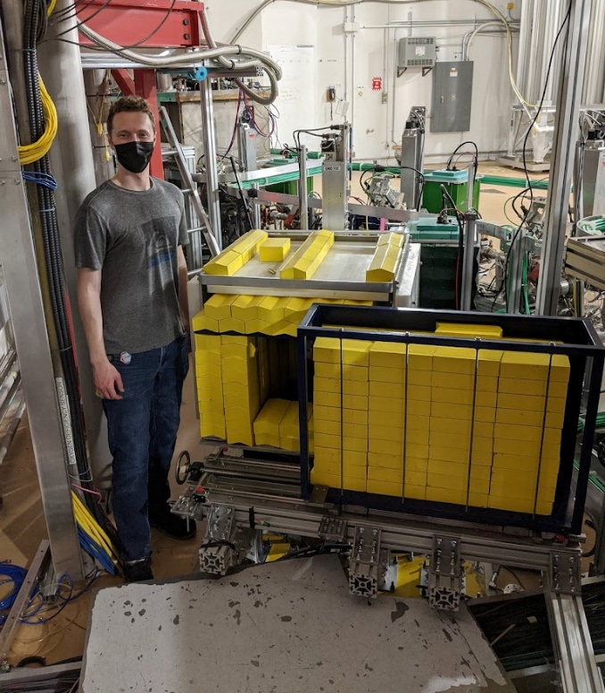
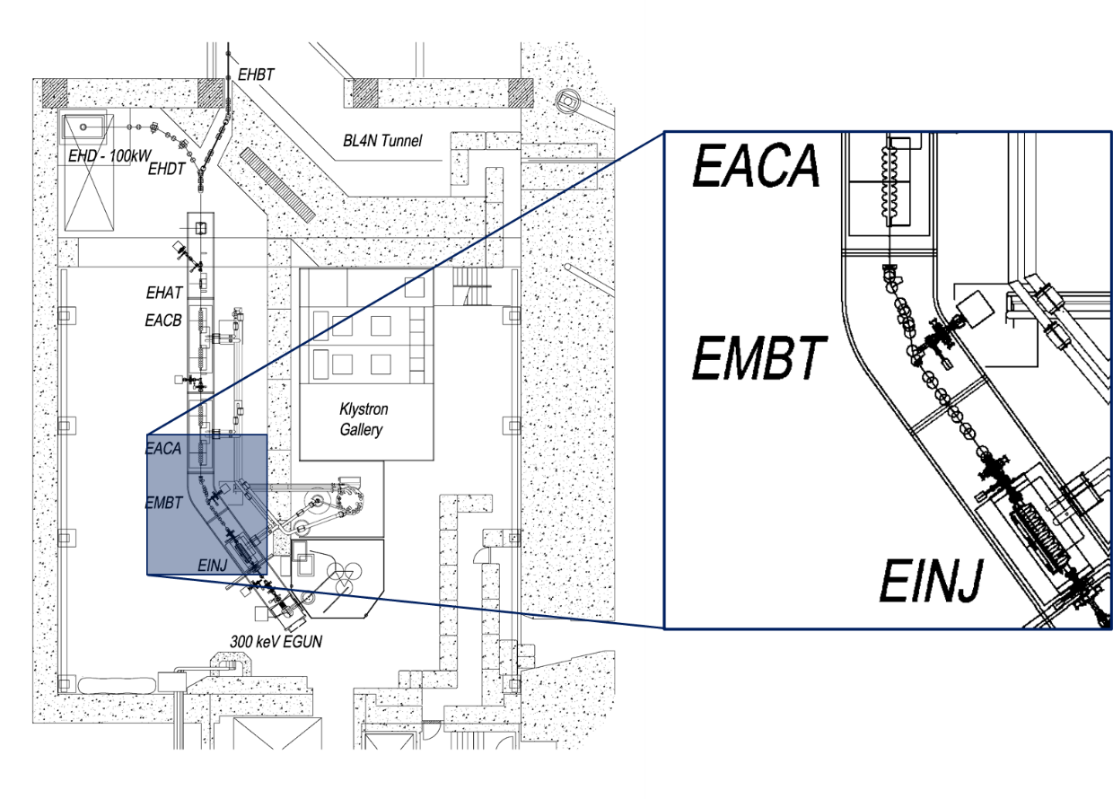
FLASH Proton and X-ray Therapy (P490)
Objective: establish go/no-go for larger-scale infrastructure investment at TRIUMF
Current Status: Feasibility (NFRF-Exploration grant) with animal studies underway
Next steps: prepare CFI application (2025)
Notes:
Currently two bNMR spectrometers in the ISAC-I hall: high-field bNMR spectrometer (9T), and low-field bNQR spectrometer (230 G). Both of them are optimized for experiments in high vacuum (ultra clean environment for materials science applications). None of the existing spectrometers is is compatible with experiments in aqueous solutions. The pending CFI applications is for building a novel bNMR spectrometer dedicated to and optimized for biological, chemical and medicinal applications.
In meantime, we are using the existing infrastructure to run experiments with ionic liquids (salts that are molten at room temperature), like EMIM-Ac. Over the past 5 years we used bNMR to study different salts and biomolecules in EMIM-Ac. The above picture shows how we use the existing high-field spectrometer to carry out expeirments with liquids (very limited applications, but still doable).

Slide 32
Summary
The Life Sciences Division continues to balance a significant project and operational workload in addition to research efforts
Current strategic priorities remain as IAMI, ARIEL, Ac-225
Future initiatives to continue focusing on building LS capabilities and infrastructure; leveraging both to foster strategic partnerships
  Includes operating IAMI, ARIEL
  investing in:
    BL1A
    bio-βNMR infrastructure
    Strategic decisions regarding FLASH
    Expansion of TRIUMF’s isotope, radiopharmaceutical portfolio

Slide 33
Our 20 Year Vision for Life Sciences
Think Big
Pursue Creative, Impactful Science
TRIUMF is inherently multidisciplinary and translational, brining together science, creativity, innovation and novel infrastructure; encouraging and inviting collaborators from around the world to answer some of life’s most difficult questions.
Be Different
Apply Physics to Life
TRIUMF Life Sciences will be an engine that applies accelerator science toward the study of life – in order to derive maximum societal benefit.
TRIUMF has globally unique infrastructure, rare talent, and an innovative mindset to better life for all.
Be Bold
Train and Send Forth World-Class Talent
Creative, impactful research will be woven into the cultural fabric of TRIUMF Life Sciences; training a generation of innovative thought and technology leaders to work collaboratively across disciplines to ask tough questions and derive elegant answers.

Slide 34
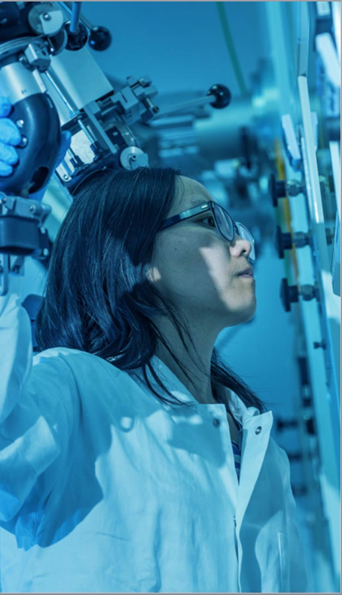




Thank you
www.triumf.ca
Follow us @TRIUMFLab

