Slide 1
Bifunctional Chelator Model as a Design of Radiopharmaceuticals and the Role of ¹⁹⁷Hg in it
Presenter: Shaohuang Chen (Life Sciences)
Supervised by Dr Valery Radchenko (TRIUMF/UBC) and Dr Caterina Ramogida (TRIUMF/SFU)
Shaohuang Chen
Notes:
Suggested to reorganize the timing distribution for the presentation: maybe devoting more time to introduction and current project, less time on future proposals
Suggested to add transitions between slides to make the entire logic flow more “naturally

Slide 2
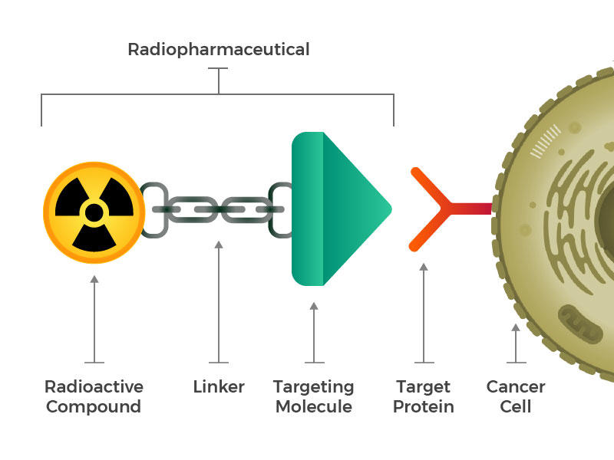
Bifunctional Chelator Model
F2
National Cancer Institute, National Institutes of Health, U.S. Department of Health and Human Services
Notes:
Mention the cited paper and transition to next slide → introduce motivation of my research
Optional: After saying solution was only evaporated to near dryness, explain in words orally: mercury chloride is volatile, evaporation to dryness poses a real risk of contaminating the surroundings.
Optional: After introducing the volatility of mercury chloride, also orally mention that the final solution was transferred into a smaller container for subsequent radiolabeling experiments.

