Slide 1
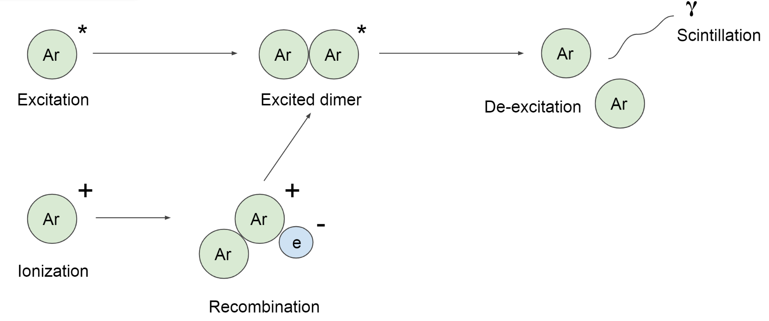
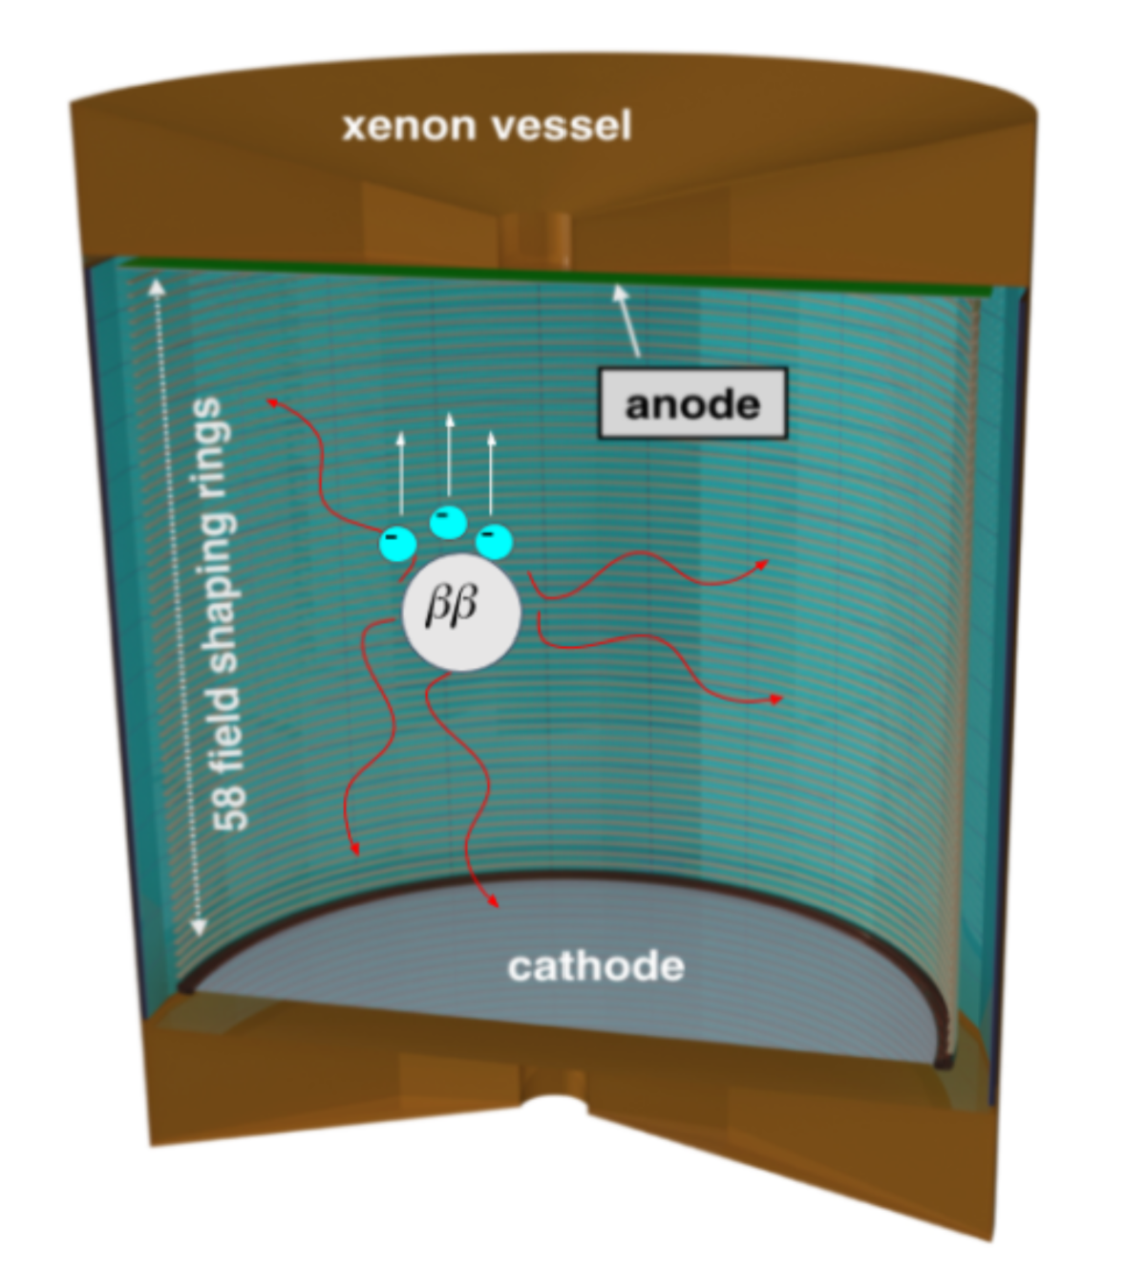
Scintillation Process in Liquid Xenon from Nuclear Recoils
Xe
Xe
Xe
Xe
Xe
Xe
Nuclear
Recoil
Xe
Xe
Xe
+
Xe
-
Xe
e
Electron Drift
The Light only Liquid Xenon Experiment, Austin de St Croix 2020

