Slide 1
Proton Therapy
By Mathias Roman
2022-07-15

Slide 2
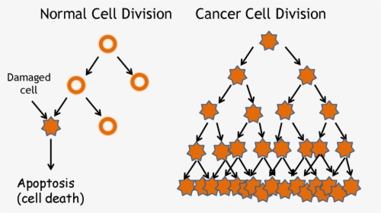
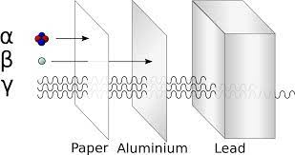
Cancer
Radiotherapy
Proton Therapy
Mutant Cells
Uncontrolable Growth
The ionization of DNA to damage cancerous cells while minimizing damage to healthy tissue.
The proton deposits most of its energy at a fixed penetration depth which is adjustable.
Internal:
Alpha Particles
External:
Electron
Neutron
Photons
Protons
https://www.kindpng.com/imgv/hhxiJiw_tumor-drawing-cancer-cell-cancer-cell-division-png/
Treatments:
Radiotherapy
Surgery
Chemotherapy
Hormone Therapy
Data from: https://www.bnl.gov/nsrl/userguide/bragg-curves-and-peaks.php
Further Readings:
Wilson RR. Radiological use of fast protons. Radiology. 1946;47:487–91.
https://www.triumf.ca/current-events/proton-therapy-celebrates-20th-anniversary
BLAKELY, Eleanor. Heavy-Ion Radiobiology: Cellular Studies, Advances in Radiation Biology, 1984;11:295-389.
Mathias Roman (mroma065@uottawa.ca)
https://en.wikipedia.org/wiki/Radiation

