Slide 1
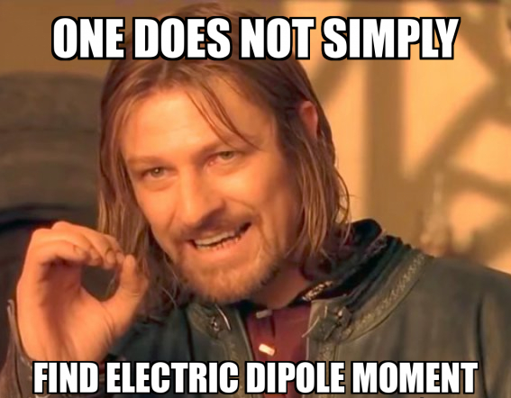
(without nuclear charge radius measurements!)
Yilin Wang | TRIUMF Science Week 2022 | UBC / TRIUMF

Slide 2
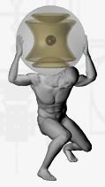
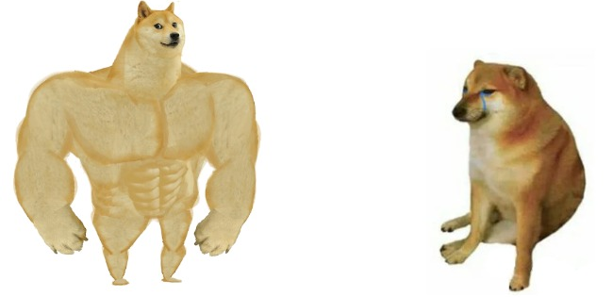
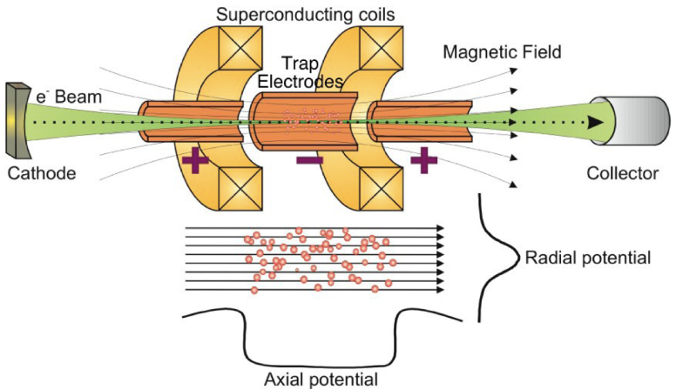
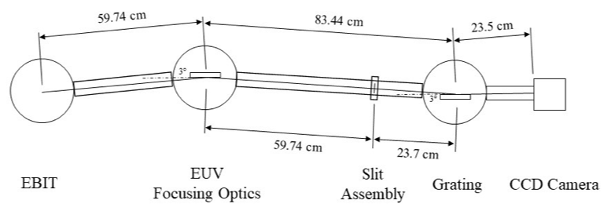
Violation of time- and parity-violation
Beyond Standard Model Physics
Searches for permanent Electric Dipole Moment (EDM)
TRIUMF’s Ion Trap for Atomic and Nuclear science (TITAN)
EXPECTATIONS REALITY
Charge breeding capabilities
Radioactive ion beam (RIB)
Extreme ultraviolet (EUV) spectrometer
Need absolute nuclear charge radius information
No experimental data for absolute charge radius beyond Bismuth (Z > 83) *
Optical access to stored ions
* Except U, Th

