Slide 1
TRIUMF Science Week 2022: LTS 3MT
Dark Matter: Knowing Something You Cannot See
Karishma M.
Master’s student in Particle Physics Phenomenology

Slide 2
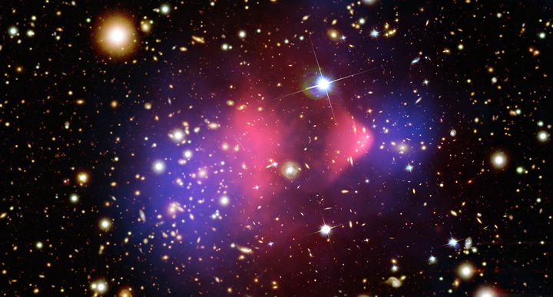
X-ray (pink): NASA/CXC/CfA/ M.Markevitch et al.; …… Lensing Map (blue): NASA/STScI ESO WFI; Magellan/U.Arizona/ D.Clowe et al.; …… Optical: NASA/STScI; Magellan/U.Arizona/D.Clowe et al.

