Slide 1
Tides: An Intriguing Physical Phenomenon
By: Lucas Backes
(Barium Tagging Group)

Slide 2
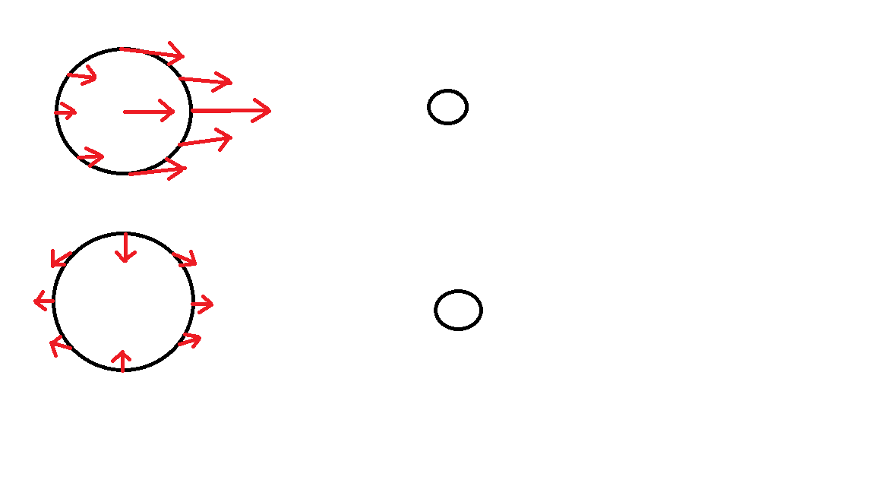
Tides: What are they and how do they work?
Tidal force is then defined as:
Not dependent on rotational motion!

