Slide 1
Expanding Science Capabilities of TITAN EBIT with a New Electron Gun
Jaime Cardona
TITAN, University of Manitoba

Slide 2
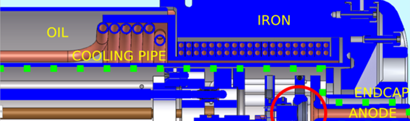
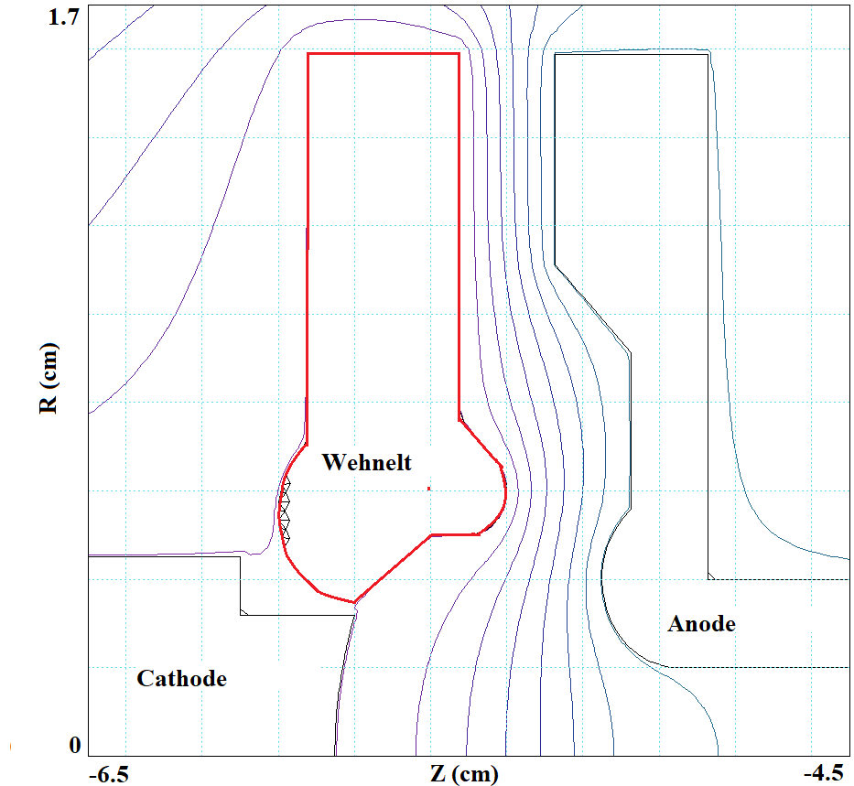
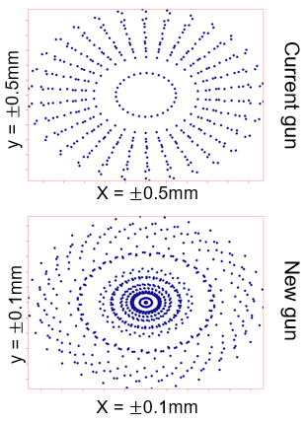
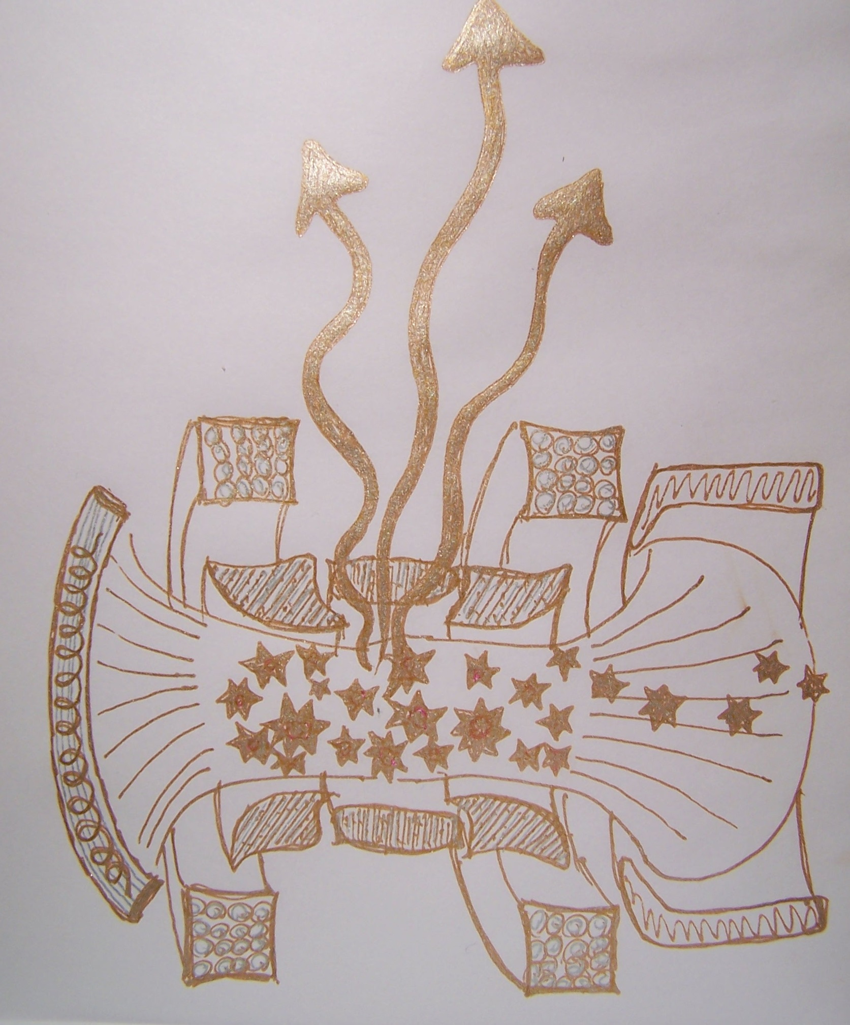
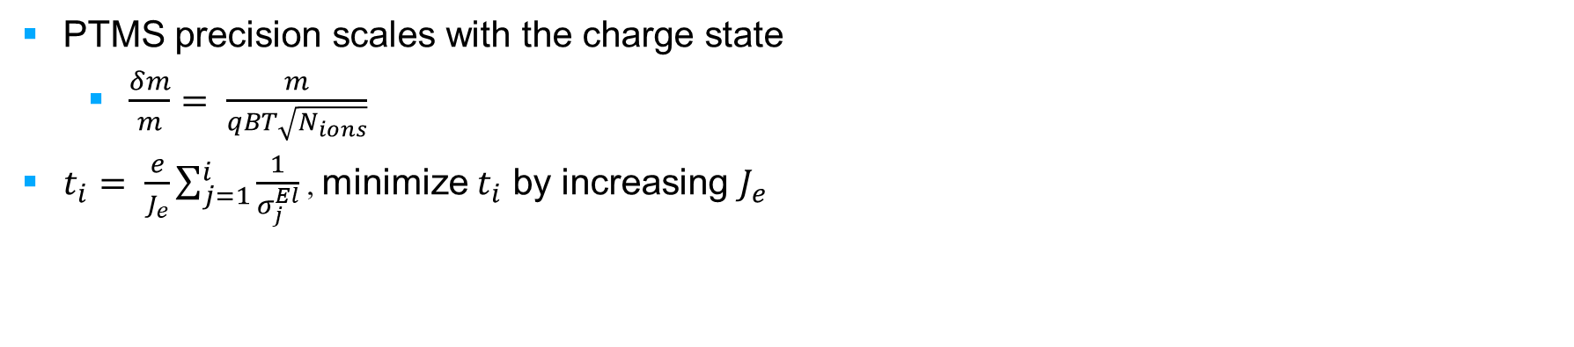
PTMS precision scales with the charge state
  $\frac{δm}{m}= \frac{m}{qBT\sqrt{N_{ions}}}$
$t_{i}= \frac{e}{J_{e}}\sum_{j=1}^{i}{\frac{1}{σ_{j}^{El}}}$ , minimize $t_{i}$ by increasing $J_{e}$

