Slide 1
Quantum Materials / Molecular and Materials Science
Presentation (G. Luke)
Current facility projects
Proposed developments
Discussion
Green technology (I. McKenzie, K. Ghandi, K. Kojima)
Discussion

Slide 2
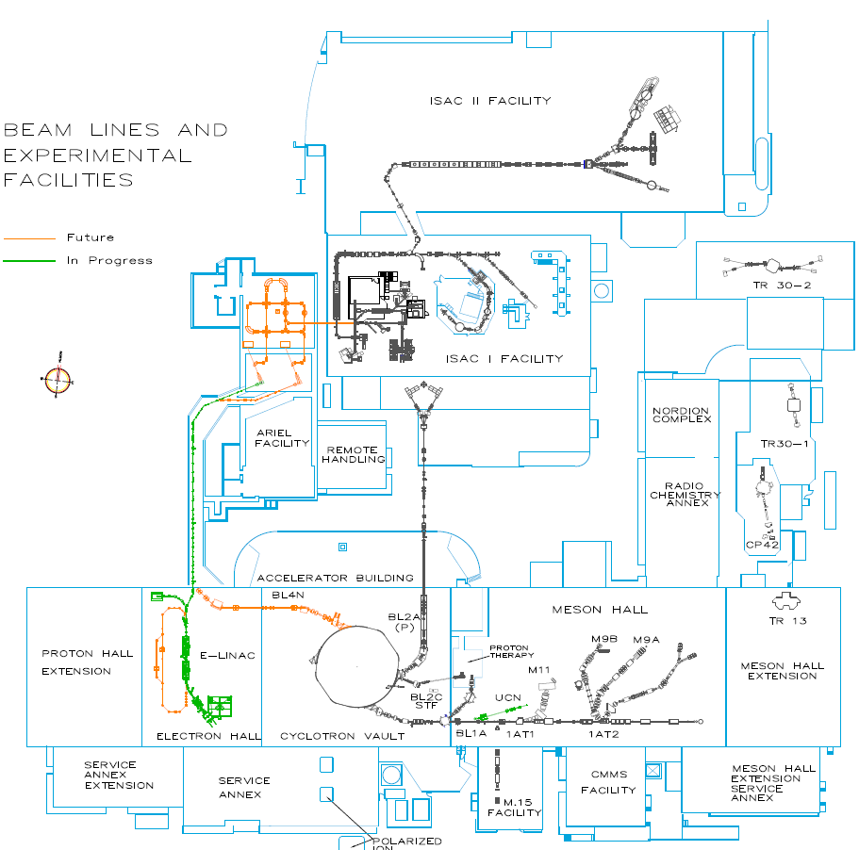
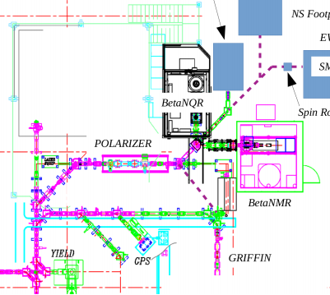
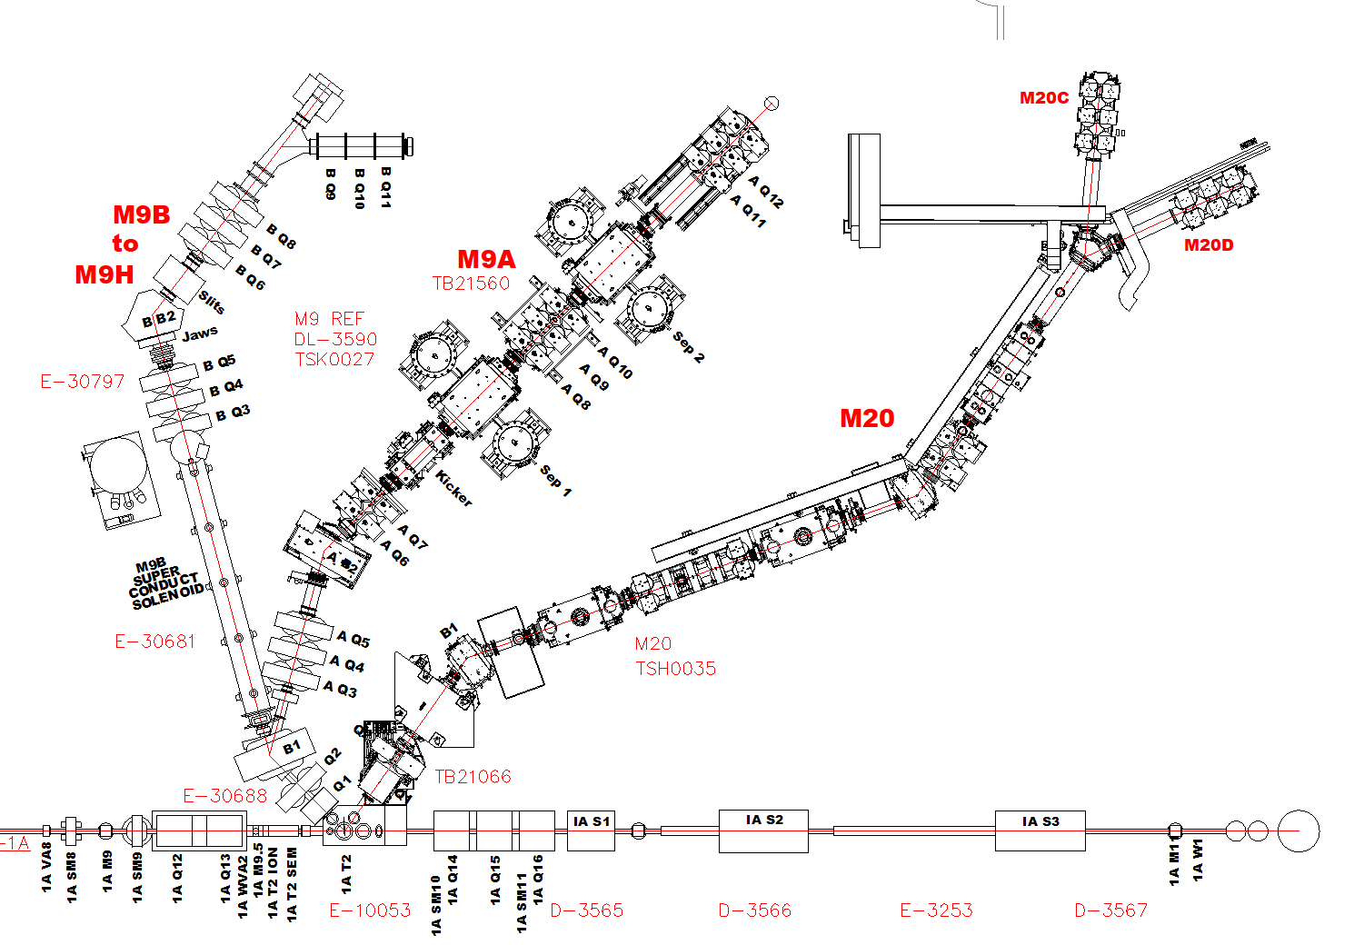
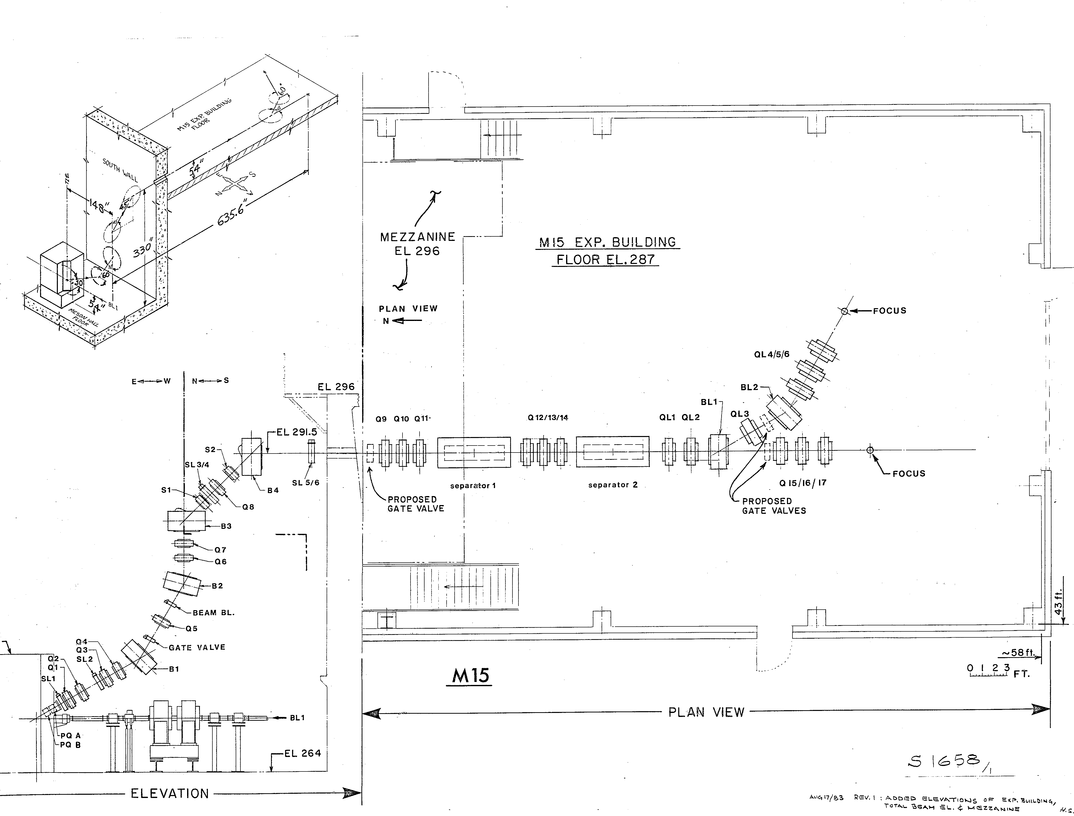
TRIUMF CMMS Current Beamlines
TRIUMF Beam Lines and Experimental Facilities
in progress
βNM/QR
M15

Slide 3
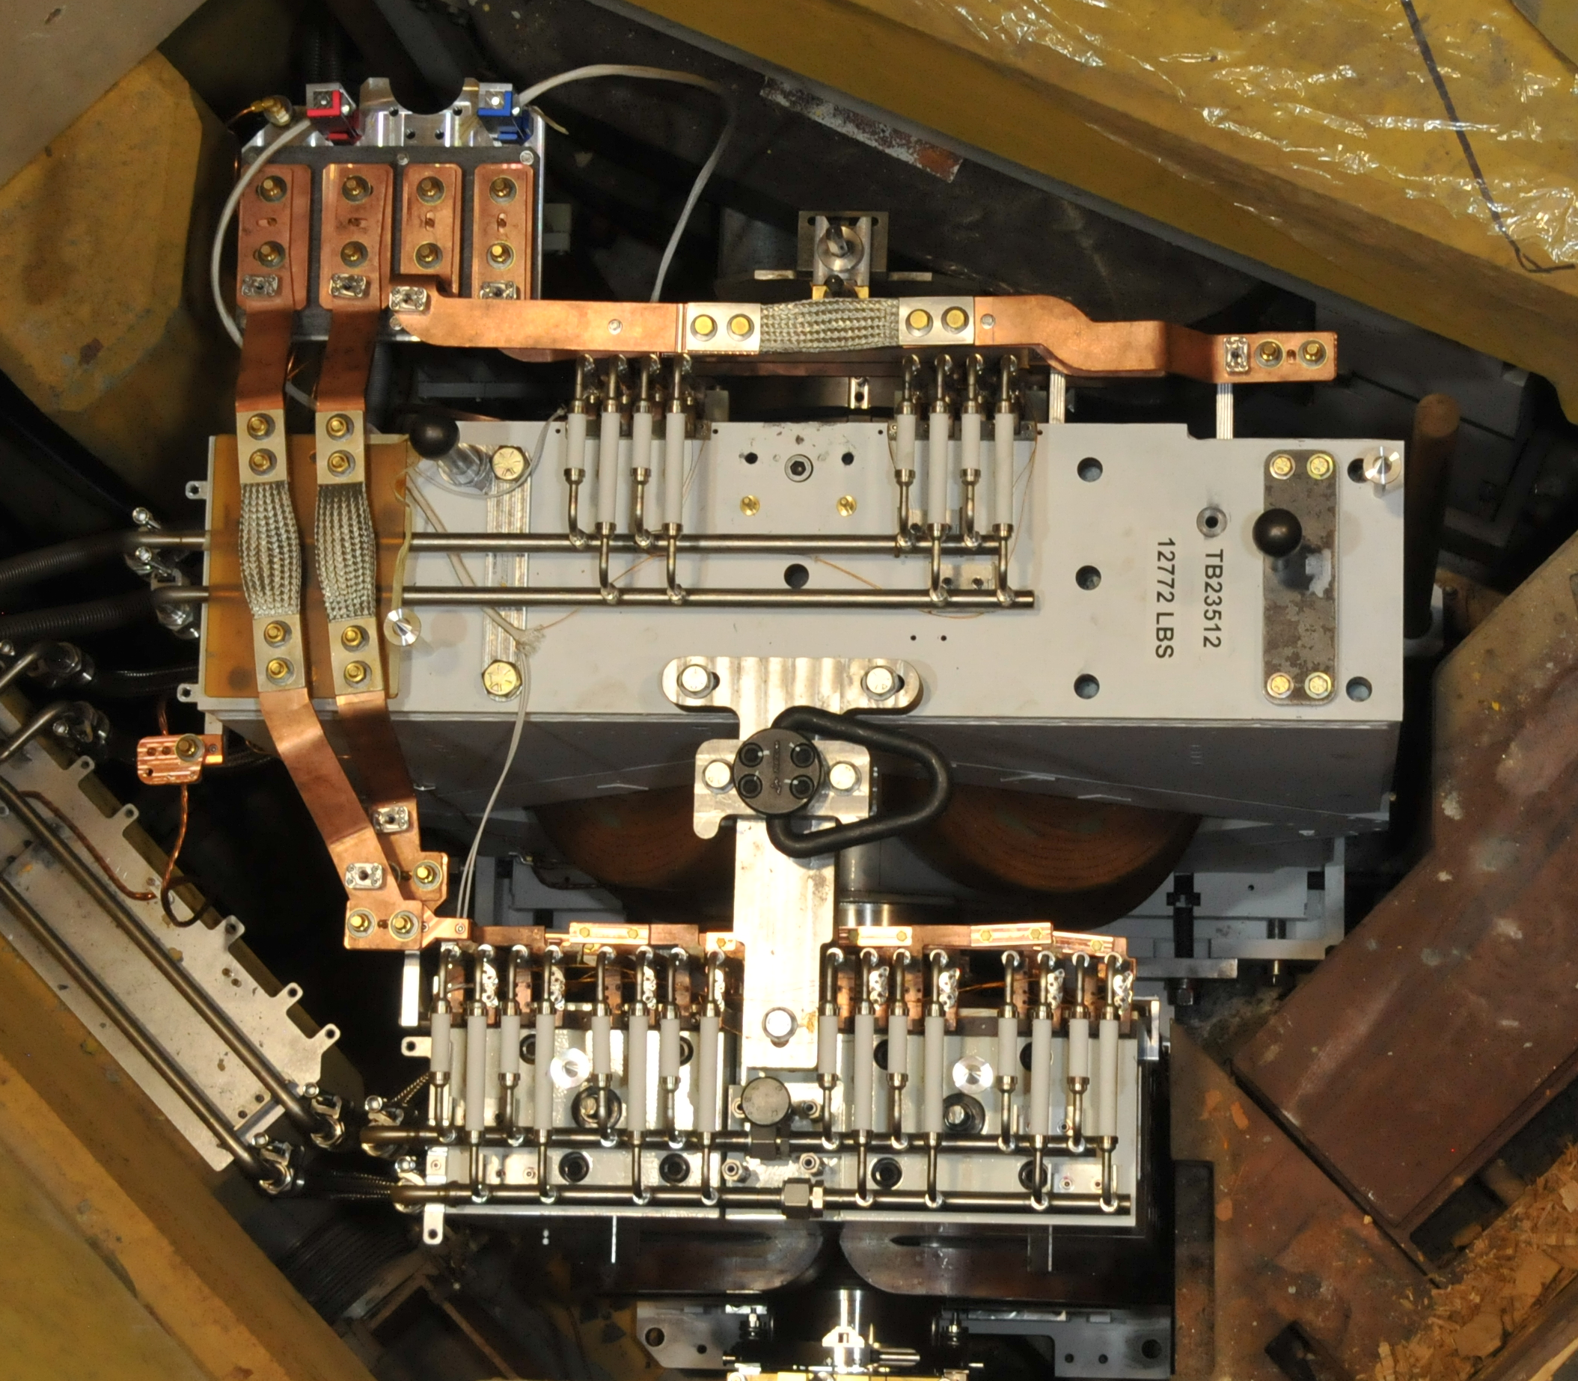
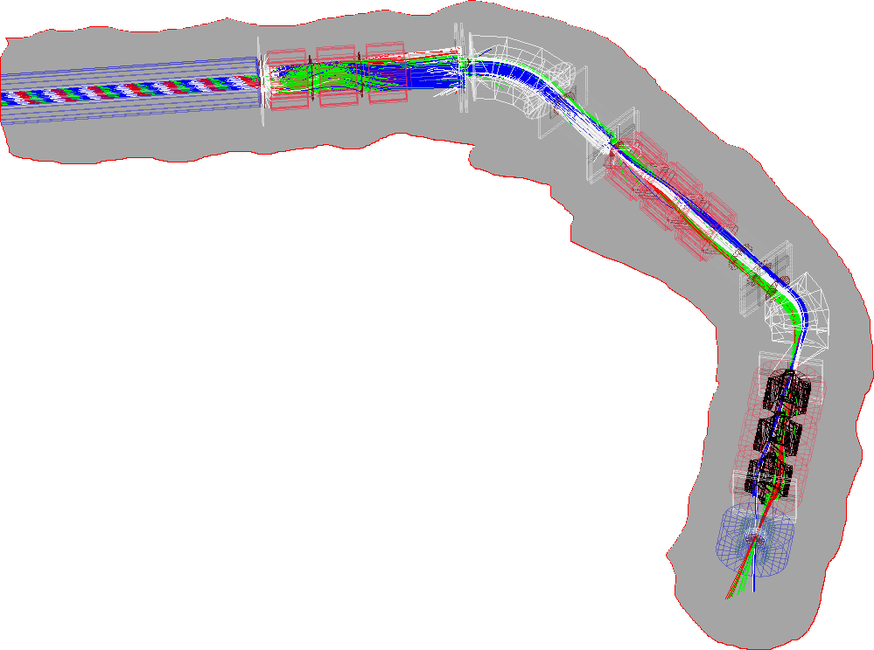
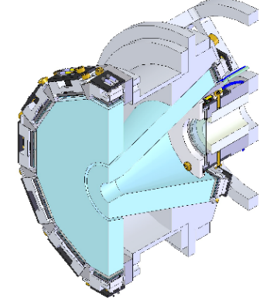
Status of Active CMMS Projects: Summary
  M9A: Beamline, optics and control systems complete.
  Testing of slit control elements in progress. Separator conditioning pending.
  Optics simulations indicate high luminosity small (5mm²) sample tunes.
  Expanding Muon Beam Lines at TRIUMF (i.e. M9H):
  CFI approved as of Nov. 2017 for the full $10.7M. Project well underway: Solenoid/DQ3 under construction. Gate 3 review competed. ITTs for remaining major components (DR, exp Magnet) due May 2022. Optical design indicates high luminosity tunes for transverse polarization.
  DQ3 slit design optimizations being evaluated.
  3T/M9H Spectrometer Developments:
  Mark III/IV of μ+/e+ SiPM front-end achieves 200ps timing resolution
  with beam -> a new generations of general purpose MuSR detectors.
  Evaluation of new configurations, i.e. summing amplifiers deployed in the magnet.
  7T NuTime Spectrometer:
  Unparalleled µSR Knight shift precision; ~3ppm @ 7T.
  New “fat pipe” ⁴He cryostat forSiPM based detectors tested to 2.5K
  “In beampipe” SiPM design of muon, veto and back counters, continue to advance.
vi. ³He cf/.5K cryostat: RTI funded. Delayed by fabricator, ETA mid 2022
vii. βNQR upgrade:. Completed. Initiates βNRM experimental capability for polarization
|| Sample face -> direct Meisner Effect sub-surface sensitivity in Nb cavity material.
Looking down onto the new M9 Q1-Q2 installed in the FE pit
Threads of
polarized
beam in
M9H.
NuTime μ, collimator & back SiPM detectors in magnet bore.

Slide 4
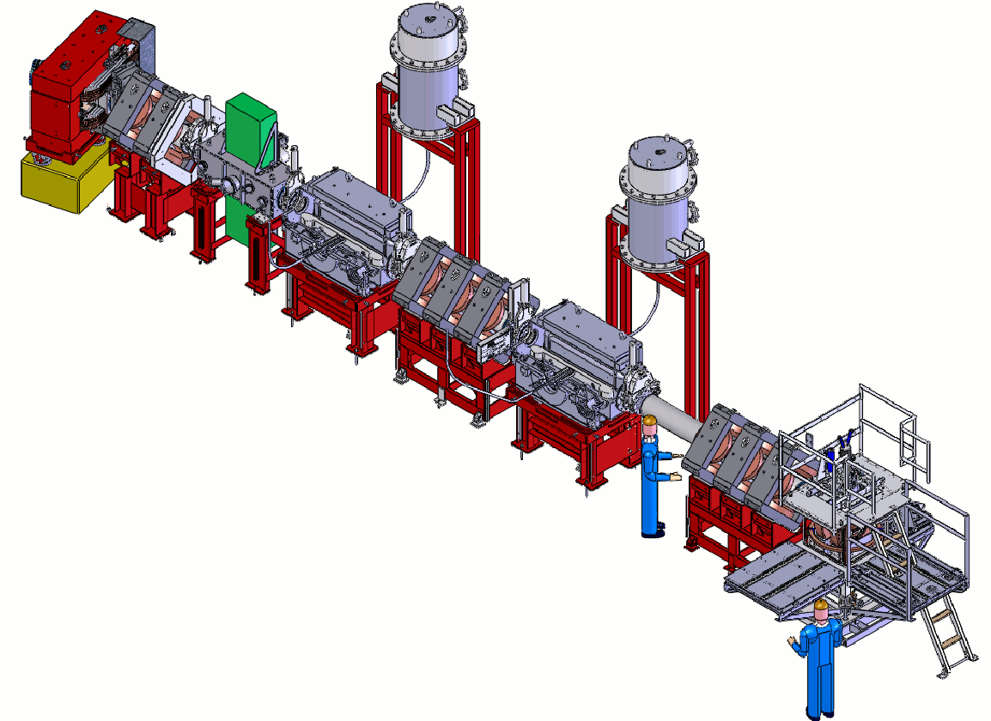
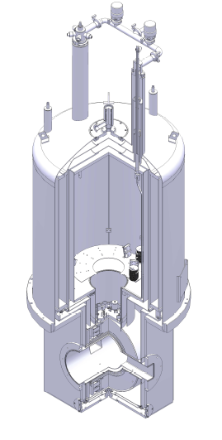
M9A almost ready to Roll, or rather Spin
3T Oxford dual bore access “M9“ superconducting magnet
Design well advanced but COVID slowed
Kicker
MORE capability
Achromatic Spin rotators
/ Wien filters
Forward Counter /Transverse
To do or done:
Final polarity check for quads, slits operational ✅
Publish a commissioning plan ✅ / safety docs ✅
Condition Spin Rotators/Separators
Establish low intensity tunes
Initiate safety surveys as beam intensity grows
Tune for high intensity … install existing DAQ system
Cryostat
Sample
Backward Counter
Muon Thin Counter
Active Collimator

Slide 5
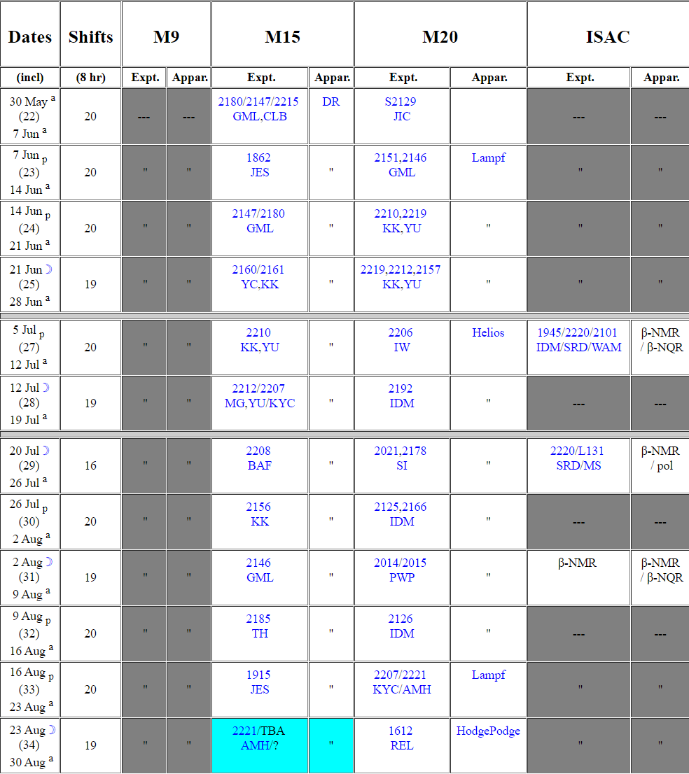
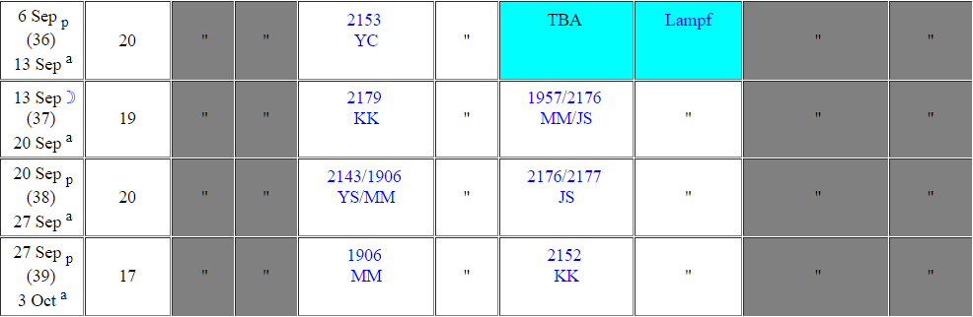
Scheduling of M9A
Tight beam schedule with only M15 and M20.
Maximize efficiency.
Proposal to schedule free blocks on M9A (~20% total) for short rapid access experiments (2 days max).
Support for remote experiments by TRIUMF staff.
Remainder (~80%) for longer experiments (5 days +) through MMS-EEC.
PIF
PIF

Slide 6
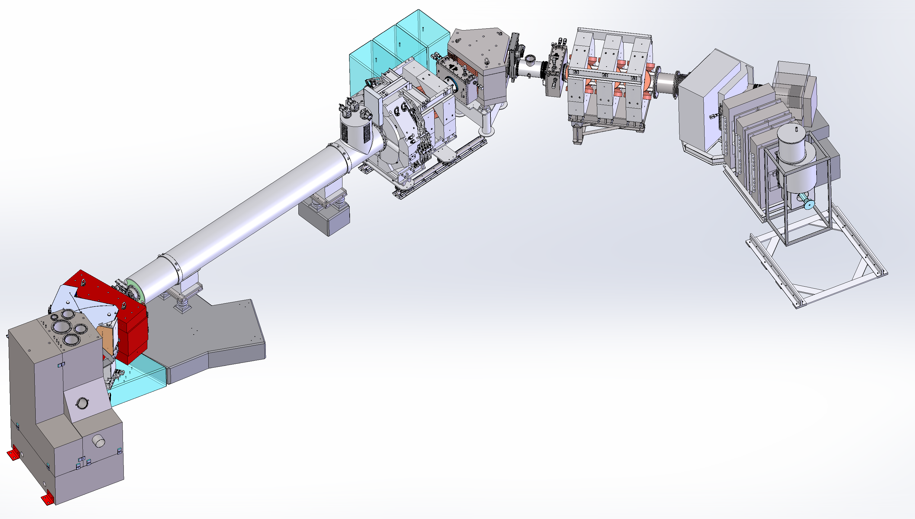
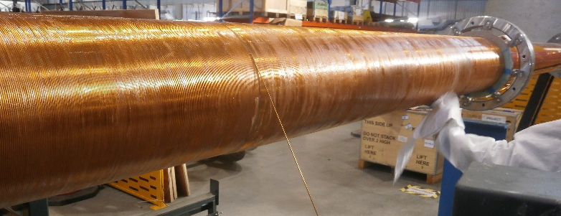
M9H: Reinventing the Muon Decay Beamline: CFI/etc funded
DQ345
Compact slits /w
beam profile detector
new Solenoid
T2-M9 front end repaired in 2020 !
Retractable/ rotating slit
(design by MK, JL)
SC 4T 6-port magnet
In bore SiPM spectrometer
100uW DR with large sample space
First muon decay channel explicitly designed for delivery of transversely spin polarized beams.
M9H Solenoid compared to previous M9B version:
  5T recondensing RT-bore solenoid, operates in persistent mode wit a robust 10hr hold time during total power loss or interruption
  Routine operations, semi-automated cool downs
  Awarded to Tesla Engineering, U.K
Post Solenoid Triplet:
Quad placement very tight to solenoid exit to capture beam “phase space”.
Triplet encompasses strong horizontal and vertical steering capabilities to collect off-axis spin polarized muons

Slide 7
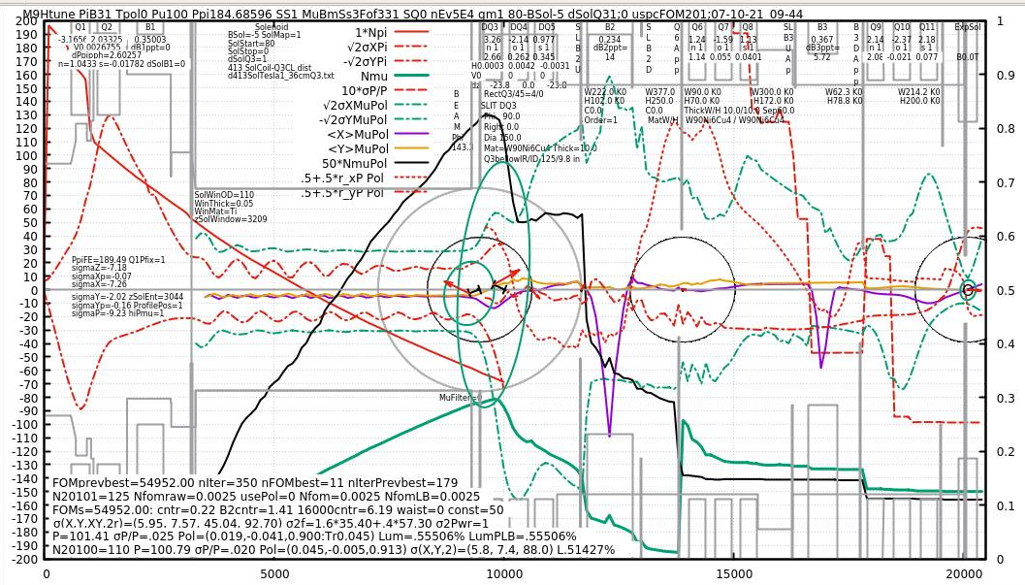

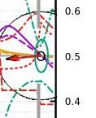
“Unconventional” Tuning Paradigm extended to M9H
Decay Muons: both LF (below) and TF polarizations benefit
Deploying slits on a previously “luminosity” simplex tuned beam, and reoptimizing ->
Ratio of beam stopping in the sample / cell walls increases by ~ order of magnitude.
LF polarized beam spot reduction factor = 4;
Luminosity loss ~ 0%
sigmaX =5.8mm
sigmaY =7.4mm
sigmaXY=43mm²
π beam injected into solenoid
μ beam profile exiting solenoid, sigmaXY=750
TF polarized beam spot reduction factor = 3;
Luminosity loss = 18%
Decays into μ beam in solenoid
Simplex tune paradigm utilizes the excess beam intensity loses during transport to reduce final beam spot area.
sigmaX =5.5mm
sigmaY =14.5mm
sigmaXY=82.6mm²

Slide 8
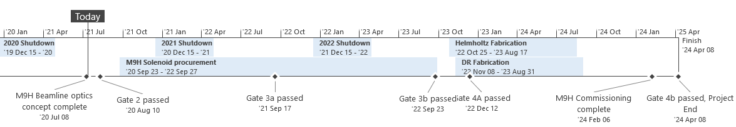
The M9H – Schedule
2021
2022
2023
2024
Shutdown 2020-2021 | Rest of 2020-2021 | 2022 | Shutdown 2022-2023
- Removal of: M9B Solenoid Q345 quad for upgrade Other Q345 section equip. Q678 section equip. Q91011 section equip. - Backfill void spaces - Survey area and services | - Beamline detailed design - Exp. station tenders - Commence beamline implementation AC upgrades Power supplies Controls (PLC/EPICS) DAQ | - Continue implementation of beamline sections - Exp. station detailed design | Install: M9H solenoid group Upgraded Q345 section Upgraded Q678 section Q91011 section Services Vacuum system

Slide 9
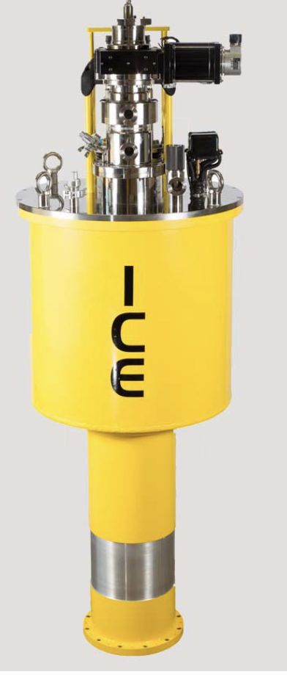
Short- and Long-Term Mitigation of LHe Supply Crisis
TRIUMF has committed to keep current programs intact with a short term policy of accepting spot-price purchasing LHe.
Increased demand for LHe from UCN.
The CMMS is about to place orders for a new 4T magnet and a DR for M9H. Equipment which can support He conservancy, i.e. dry and/or recondensing systems will look more attractive..
The value of beam time has always ”driven” considerations related to cryogenic equipment. i.e. a cryogenic technology that maximized “experimental beamtime”, i.e. fast sample changes, was considered the “best” choice.
The new (possibly recurring?) circumstances regarding He availability force us to change the choice paradigm from:
maximum beam time / per run → maximum beam time / per year
Fortunately, industry has recognized this with new products:
TRIUMF should strive to maximize on-site He storage capacity:
  Opportunistically fill the current high-pressure 3300L storage
  Consider increasing the storage infrastructure to 4400 L (i.e. an additional high pressure tank.)
i.e.
- Designed to take a large experimental heat-loads
- Provides fast sample exchange time: t<20 minutes RT to <2.0K.
- but: Initial cool down 15-24 hrs.

Slide 10
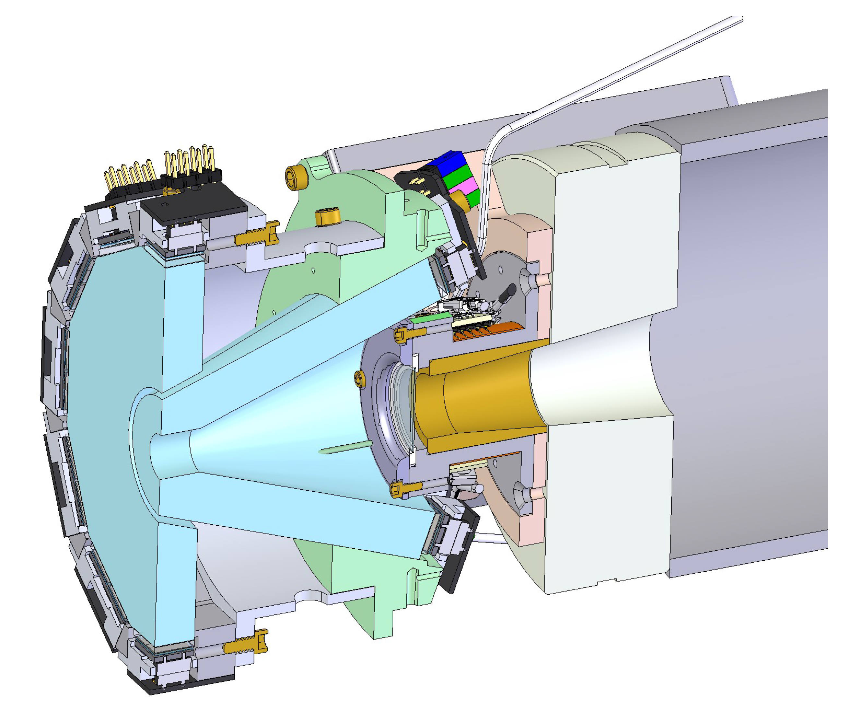
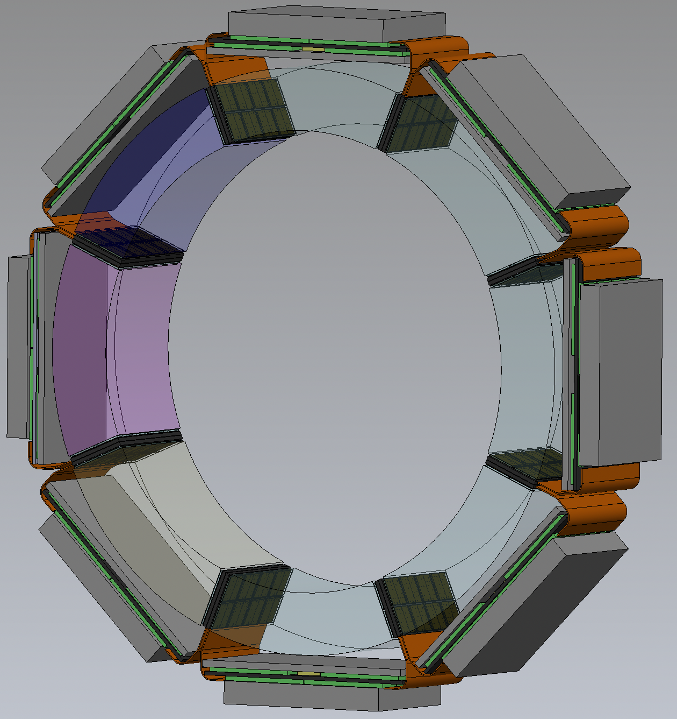
Status of Active CMMS Projects: Detector R&D
Progress with new generations of spectrometers with SiPM Detectors:
  Using compact avalanche diode “Silicon photo-multiplier detectors instead of the old standard PMTs off many advantaged
  - smaller
    - operate in high magnetic fields, i.e. > 9T
    -> no light guides needed
    -> superior timing
    -> more scientific impact
SiPM arrays
SiPM arrays
Fast summing amps front-end in 4T magnet bore
Back, Veto & Muon detectors
Transverse high timing resolution detector set for M9H spectrometer
Detector set for NuTime spectrometer, being built in the Scintillator Shop

Slide 11
THErAPIE: BL1A CFI Submission (July 15, 2022)
TRIUMF High-Energy Accelerator Proton Irradiation Experiments)
BL1A replacement to support isotope production and μSR
Total Project Costs: $28,254,267
CFI Request: $9,730,480
  Beamline elements: $9.4M
  Remote Handling & Shielding: $1.9M
  Isotope Production Facilities: $3.9M
  Muon Spectroscopy Endstations: $2.5M
  Distributed Radioisotopes for Theranostics: $2.4M
  Personnel: $7.9M

Slide 12
THErAPIE: Applicants and Matching Funds
University of British Columbia
McMaster University
University de Montreal
University of Guelph
University de Sherbrooke
TRIUMF
St. Joseph’s Healthcare (London)
University of Saskatchewan
Simon Fraser University
+ long list of other users
BKDF | $4.5M
Ontario Research Fund | $3.85M
Quebec Provincial | $0.55M
Innovation Saskatchewan | $0.33M
University of British Columbia | $1.5M
BWXT | $3.85M
TRIUMF | $5.07M

Slide 13
20 Year Vision and 5 Year Plan
20 Year Vision
A world-class accelerator centre driving use-inspired research—from the life sciences to quantum and green technologies
A national innovation hub translating discovery science into health and sustainability solutions
An inclusive multidisciplinary talent incubator, attracting and developing the best people from around the world
Advance Quantum Technologies:
Enable green technology solutions:
Engage with new complimentary initiatives:
i.e. THz, CANS (Accelerator based neutrons)
CMMS
  Realize the experimental capabilities of new muon and βNMR beamline infrastructure / beamtime.
  Establish new detector technologies, inclusive of increasing experimental automation.
  Proactively engage user groups: collaborations, outreach, new applications
5 Year Plan

Slide 14
Cohering with the TRIUMF 20 yr. Vision .. starting in this 5YP
New TRIUMF vision items … match new facility capabilities, i.e.
  M9H : ➔ new quantum materials / sustainability / battery research;
  M9A : ➔ hydrogen storage / new quantum materials;
  Increased βNMR beam-time (15 weeks vs 5) and/or experimental capacity :
  ➔ quantum materials / battery research
Manpower Requirements to turn TRIUMF Vision into Action
  New facility scientist with a specific “sustainability” and complimentary outreach mandate
  New facility scientist to enable and maintain a βNMR user facility.
  Additional technical staff:
    dedicated to supporting the experimental infrastructure (customized and specific sample prep & environments) required to sustain the additional technical loads expected
    Support for beamline and cryogenic maintenance … which increasingly is unavailable from historical TRIUMF resource groups
= 2 Scientists + 2 technicians ?

Slide 15
Materials Characterization and Computation Centre?
Central facility for quantum materials
Build on TRIUMF CMMS core competencies in μSR, βNMR and cryogenics and expand with new characterization tools
Support researchers across Canada to access specialized equipment (SQUID, PPMS with low-temperature capabilities, + ?)
DFT and related numerical calculations to support experiments (including muon and ⁸Li stopping sites)
Desirability?
Feasibility?
Personnel?
Space?

Slide 16

Nuclear
Hydroelectric
Solar
Wind
Energy Storage

Slide 17
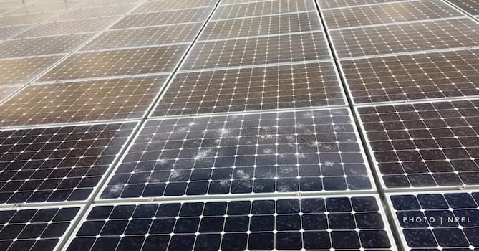
TRIUMF’s strength on Materials Science
Solar cell degradation:
water+heat+UV…
Muon provides
Hydrogen information
Si
More conventional usage of Muons:
Magnetic probes for Quantum Matters,
such as Superconductors, Quantum Magnet, …
S.F.J Cox, Rep. Prog. Phys. 72 (2009) 116501 (review)

Slide 18
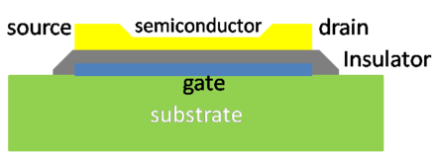
TRIUMF’s strength on Materials Science
Thin Film Transistor (TFT)
↓
20~500nm
↑
wikipedia.org/wiki/Organic_field-effect_transistor
K.M. Kojima et al. Appl. Phys. Lett. 115, 122104 (2019)
(PSI Low Energy Muon)
β-NMR provides film information
in-situ device characterization (in future?)

Slide 19
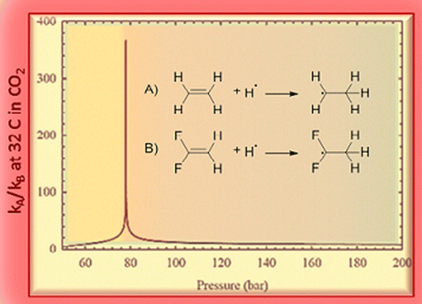
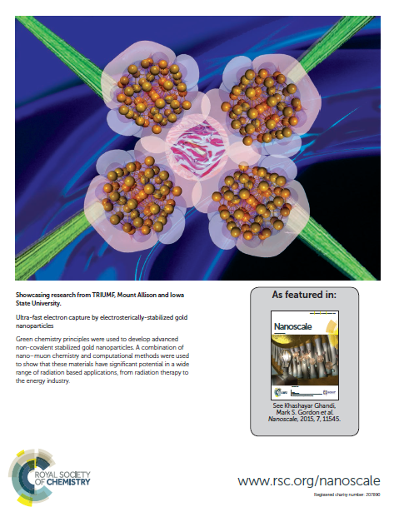
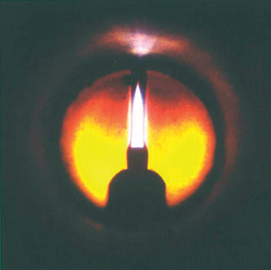
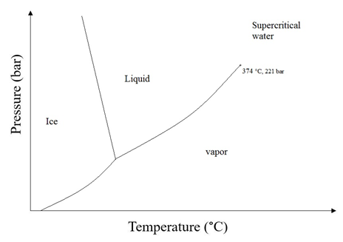
TRIUMF had a long history of contribution to green tech which dates to 2001: Experiment 943 Muonium and muoniated free radical formation and reactivity in sub- and supercritical carbon dioxide
Nanoscience
Green methods in polymerization
Polymerization in Supercritical Fluids
Recently moved to applications on Nanomaterials and Polymers
How to make nanocomposites for biosensing, agriculture & medical applications with minimal harm or ideally benefit to the environment?
J. Am. Chem. Soc., 2014, 136, 2200–2203
Synthetic Metals 2013, 175, 183– 191
The mechanisms of polymerization and using it to develop sustainable polymerization processes for health (Antimicrobial) & environmental industry
Nanoscale, 2015, 7, 11545-11551
Fundamental science nourished applications and innovations

Slide 20
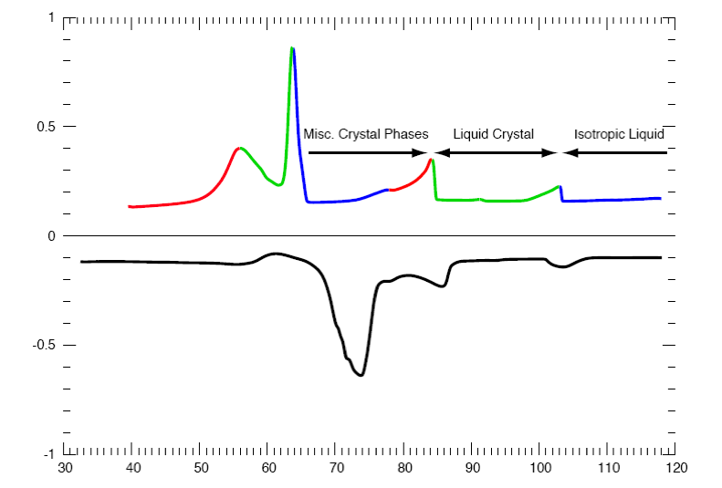
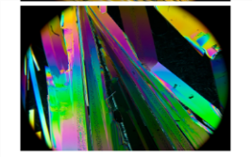
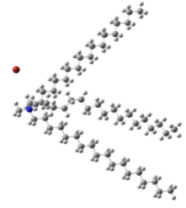
Fate of molten salts (ionic liquids) in Batteries and as Reagents for green technologies
Magnetic Ionic Liquids
IL crystals
Ionic Liquids (Ils)
New magnetic nanomaterial for medical and industrial applications
Magnetic Nanocomposite Material and Processes, US Patent, 06.12.2012, H01F 1/42, 13484898, Inventors: Khashayar Ghandi, P. Themens
J. Mater. Chem. A, 2013, 1, 11570
Polymeric Ionic liquid crystals
From 2006 my NSERC DG has been on beta decay probes of green tech: Effect of green solvents on chemical reactions and material formation: characterization of transient intermediates

Slide 21
Gen IV Nuclear Reactors: important source of clean electricity; a valuable supply towards net zero
 | Neutron Spectrum | Coolant | Temperature (ºC) | Pressure | Fuel Cycle | Size(s) (MWe) | Uses
GFR | Fast | He | 850 | High | Closed | 1200 | Electricity & Hydrogen
LFR | Fast | Pb or Pb-Bi | 480–800 | Low | Closed | 20–180 300–1200 600–1000 | Electricity & Hydrogen
MSR | Thermal or Fast | Liquid Salts | 750–1000 700–800 | Low | Open or Closed | 1000–1500 1000 or less | Electricity & Hydrogen
SFR | Fast | Na | 550 | Low | Closed | 300–1500 1000–2000 | Electricity
SCWR | Thermal or Fast | scH₂O | 510–650 | High | Open or Closed | 300–700 1000–1500 | Electricity & Hydrogen
VHTR | Thermal | He | 900–1000 | High | Open | 250–300 | Electricity & Hydrogen
GFR: Gas-Cooled Fast Reactor; Lead Fast Reactor; MSR: Molten Salt Reactor; SFR: Sodium Fast Reactor; SCWR: Supercritical Water-cooled Reactor; VHTR: Very High Temperature Reactor
The most important aspect is sustainability: multifaceted - efficiency, radiation; waste.
Notes:
GFR: Gas-Cooled Fast Reactor
LFR: Lead Cooled Fast Reactor
SFR: Sodium-Cooled Fast Reactor
SCWR: Supercritical Water Cooled Reactor
VHTR: Very-High-Temperature Reactor
MSR: Molten Salt Reactor
High Pressure: 7 -15 Mpa
+: Contains some U-235 or Pu-239
21

Slide 22
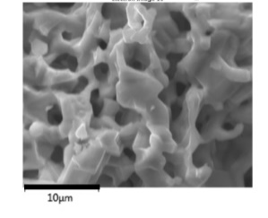
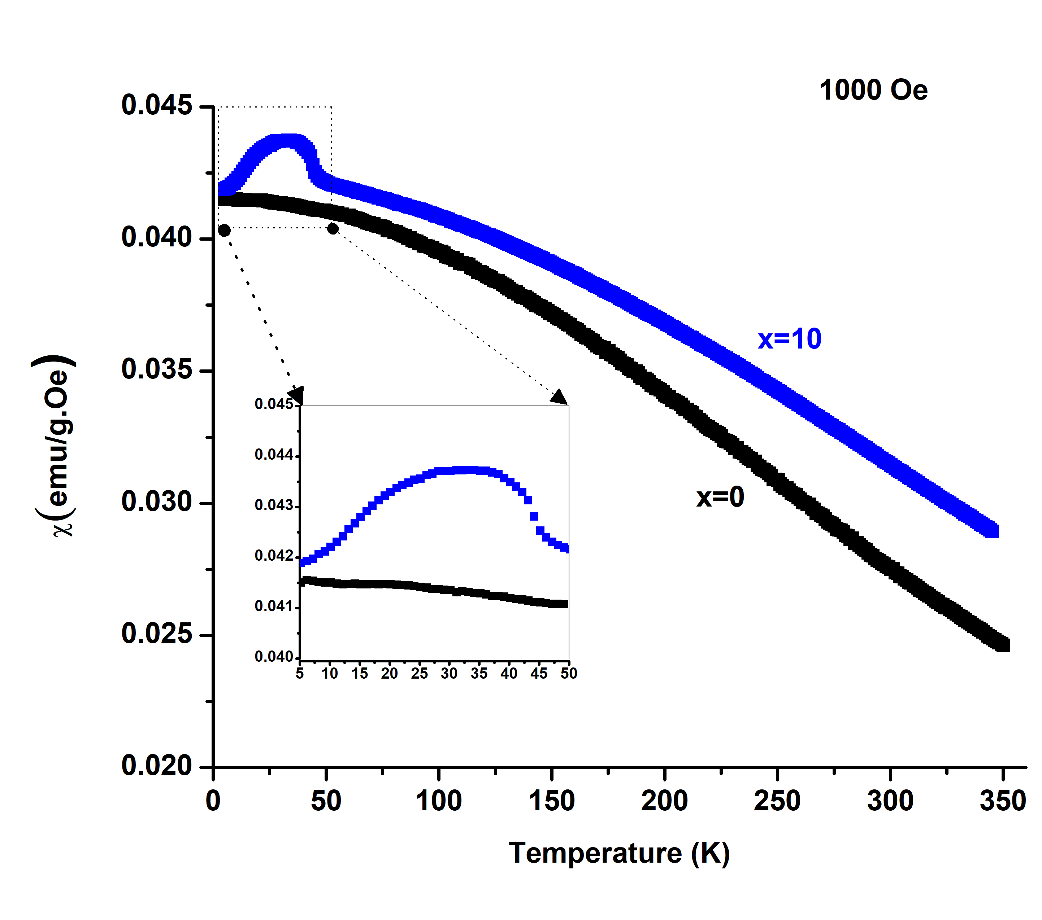
Design of new inorganic materials for health & green tech needs unique characterization techniques at TRIUMF
Ferrite Spinel with Microcages
Photochemistry
Magnetic catalysis
Electronics
Porous magnetic heterojunction semiconducting spinels as catalysts in clean technology
E&M radiation
Cap
Excellent properties in the areas of
10 µm
Active species
Porous Mn₃O₄
Spinel
High temperature electronics
Solar Power
Nuclear industry
Photocatalysts and chemical sensors in wastewater treatment
Formation on nuclear fuel rods during reactor operation
Semiconducting behavior (Wide band gap, p-n junction, fast carrier transport)
Batteries: High-capacity anodes
Environment
Applications in clean energy
& environment

Slide 23
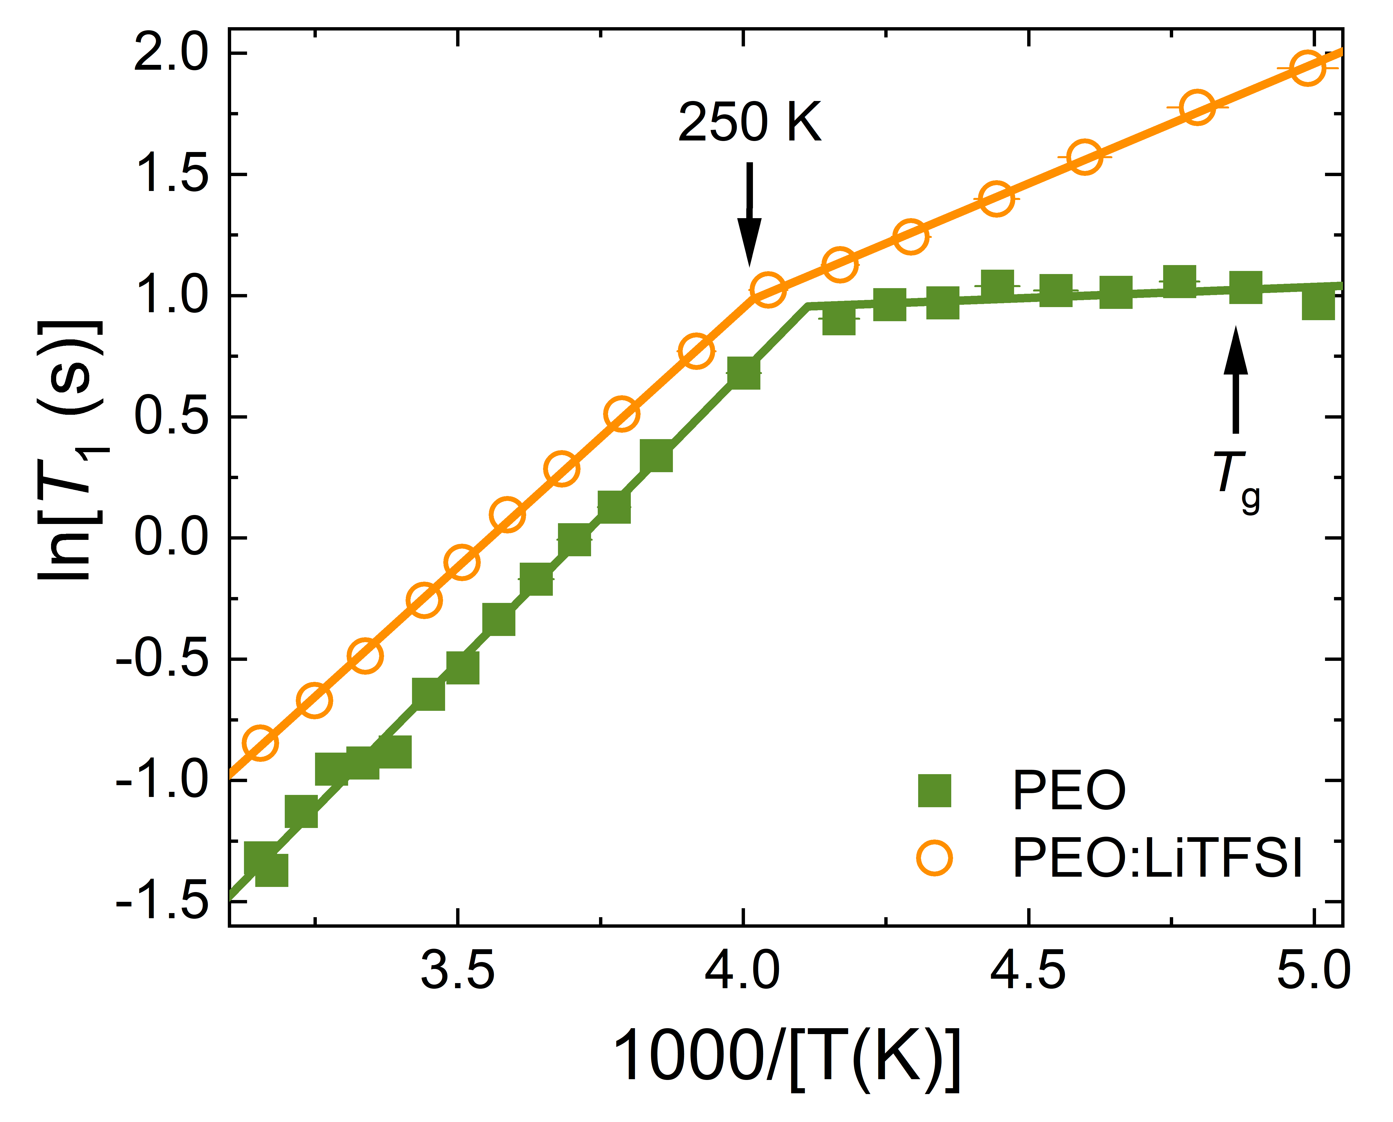
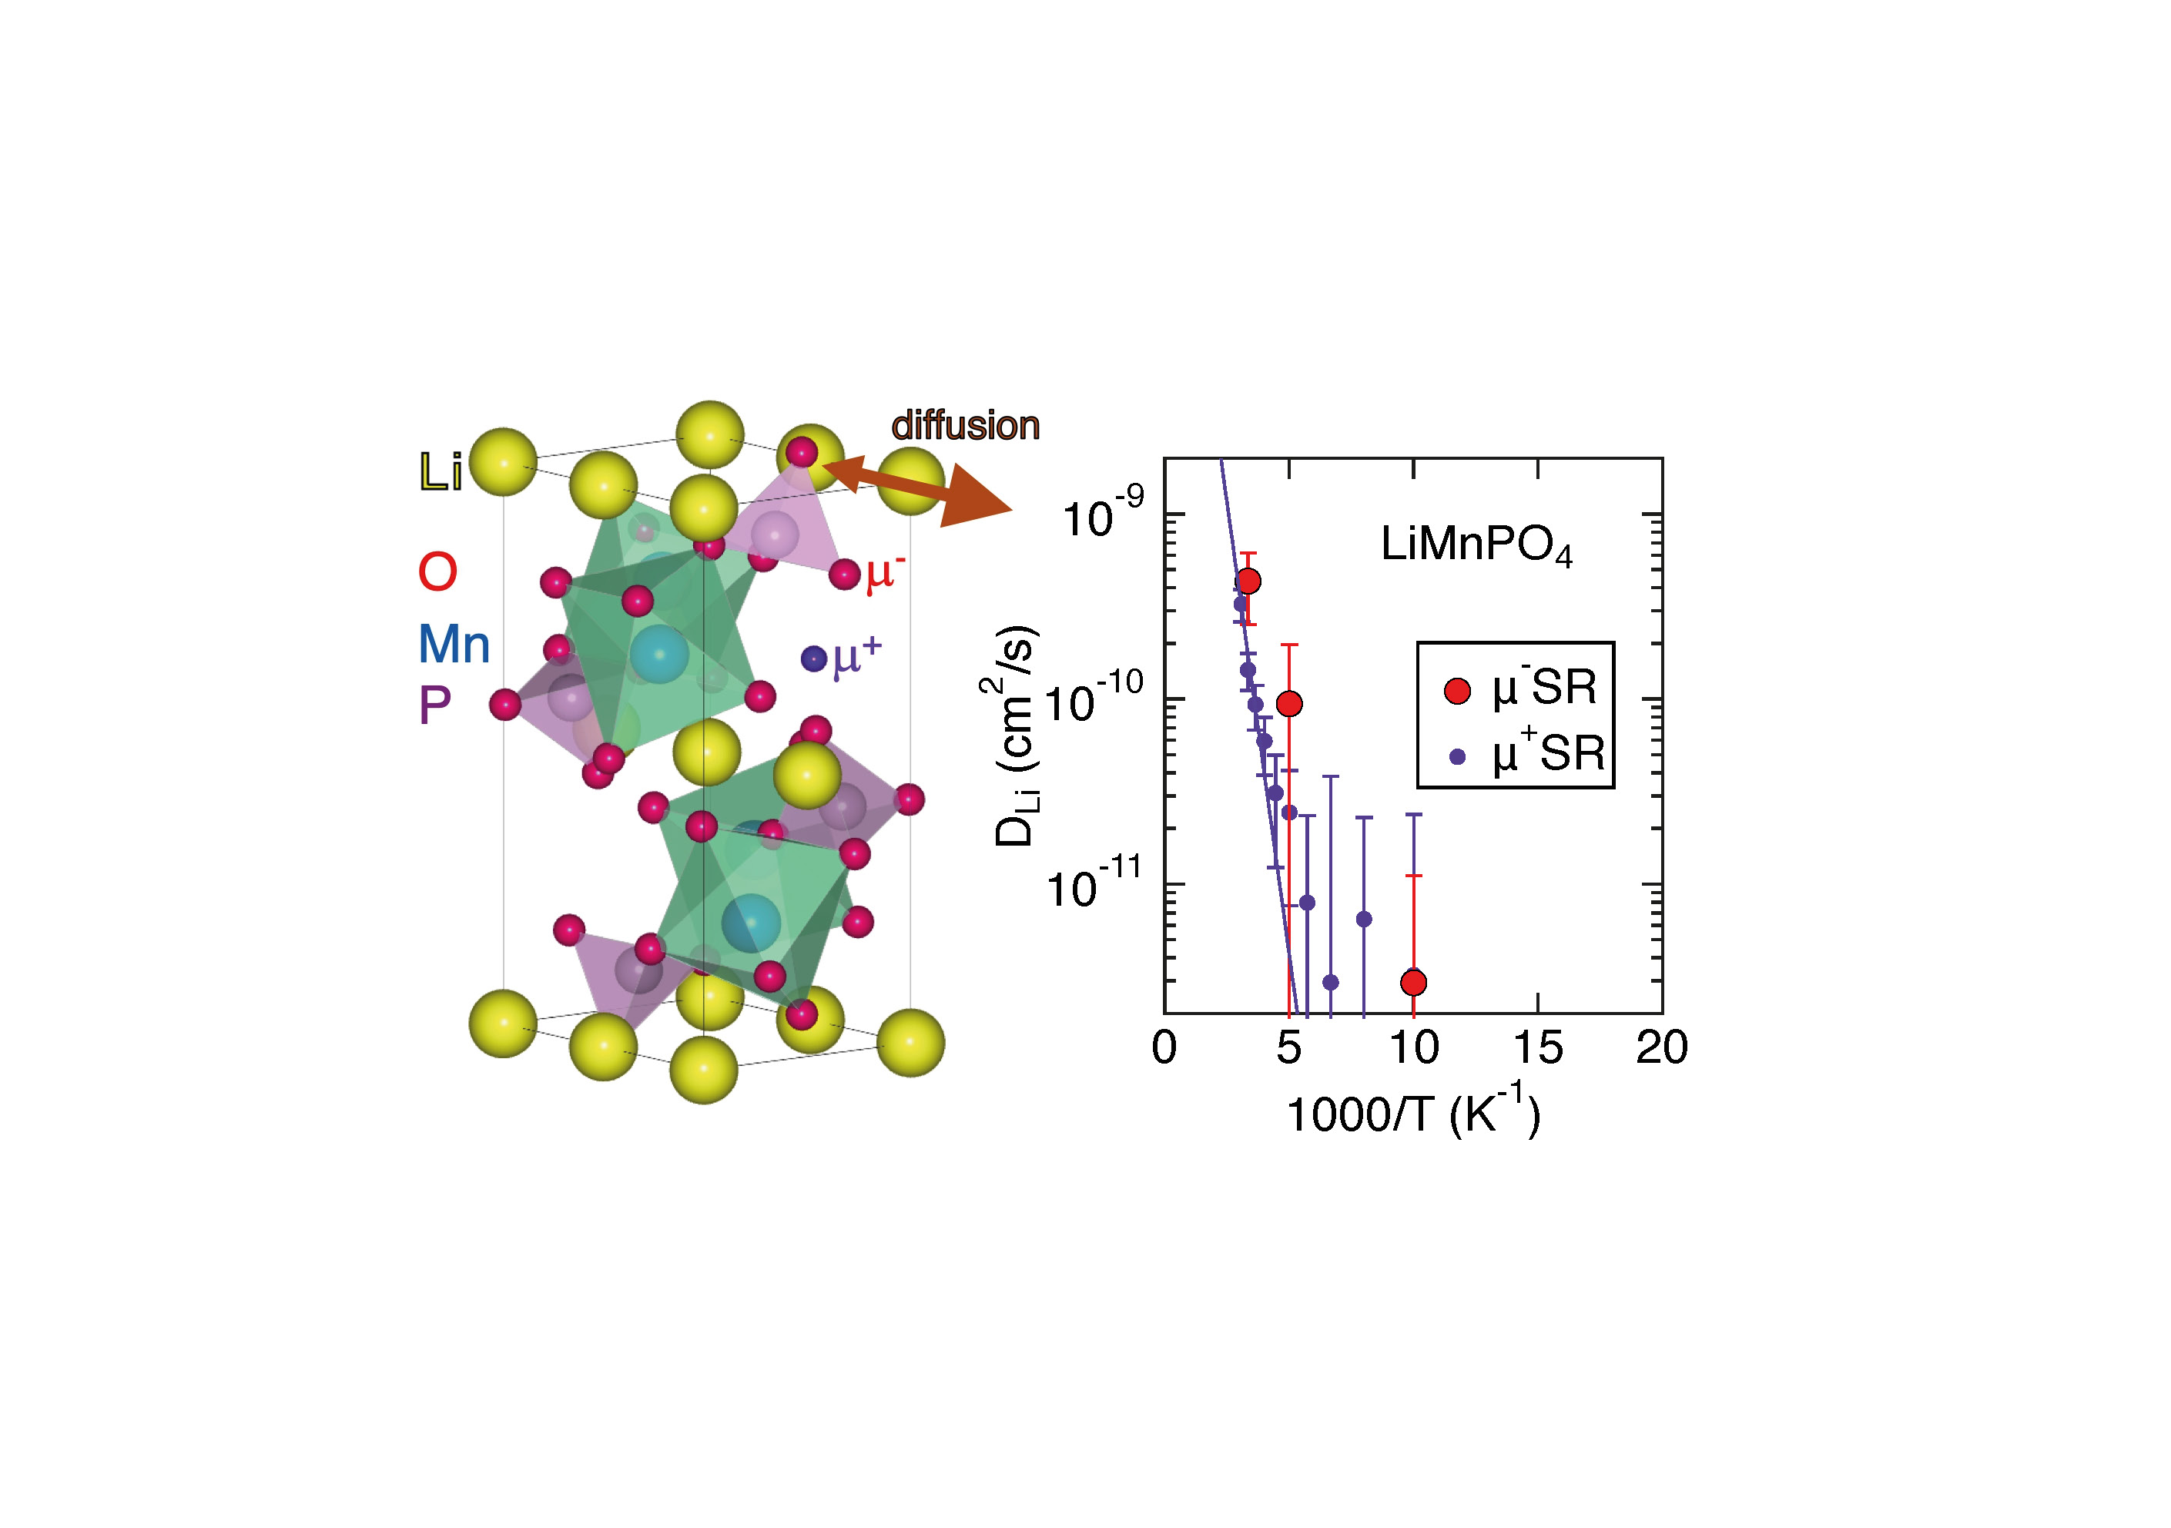
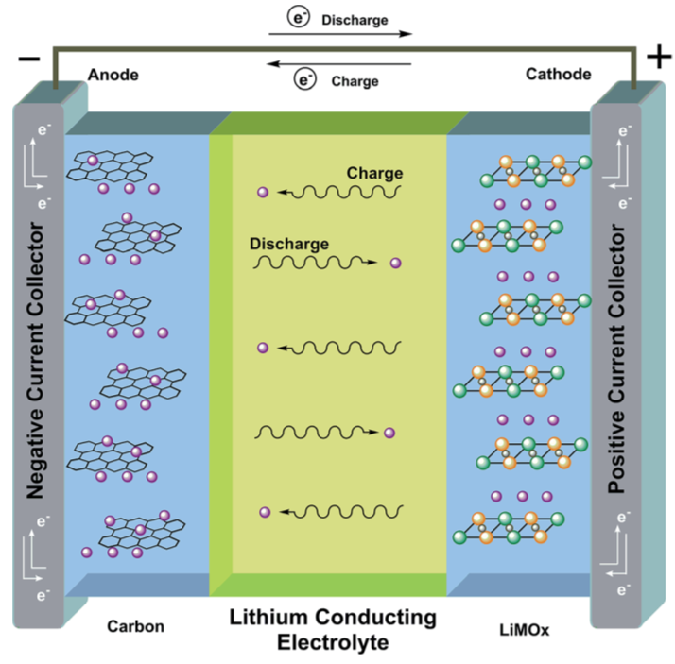
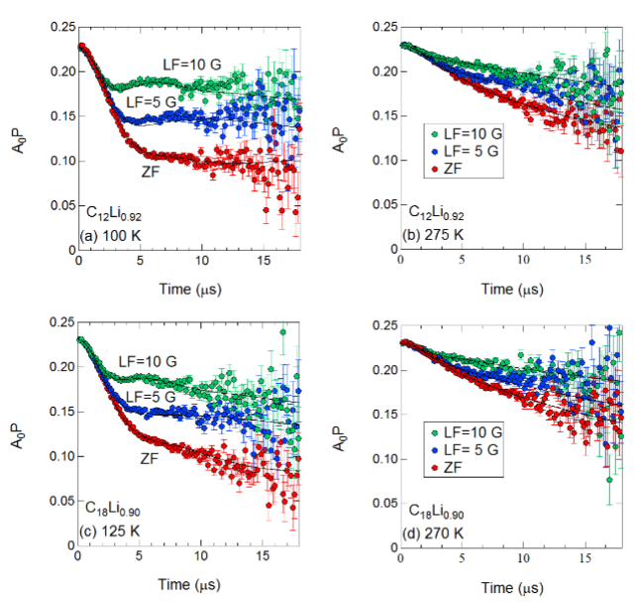
⁸Li⁺ β-NMR
Cathode
Electrolyte
μSR
Anode

Slide 24
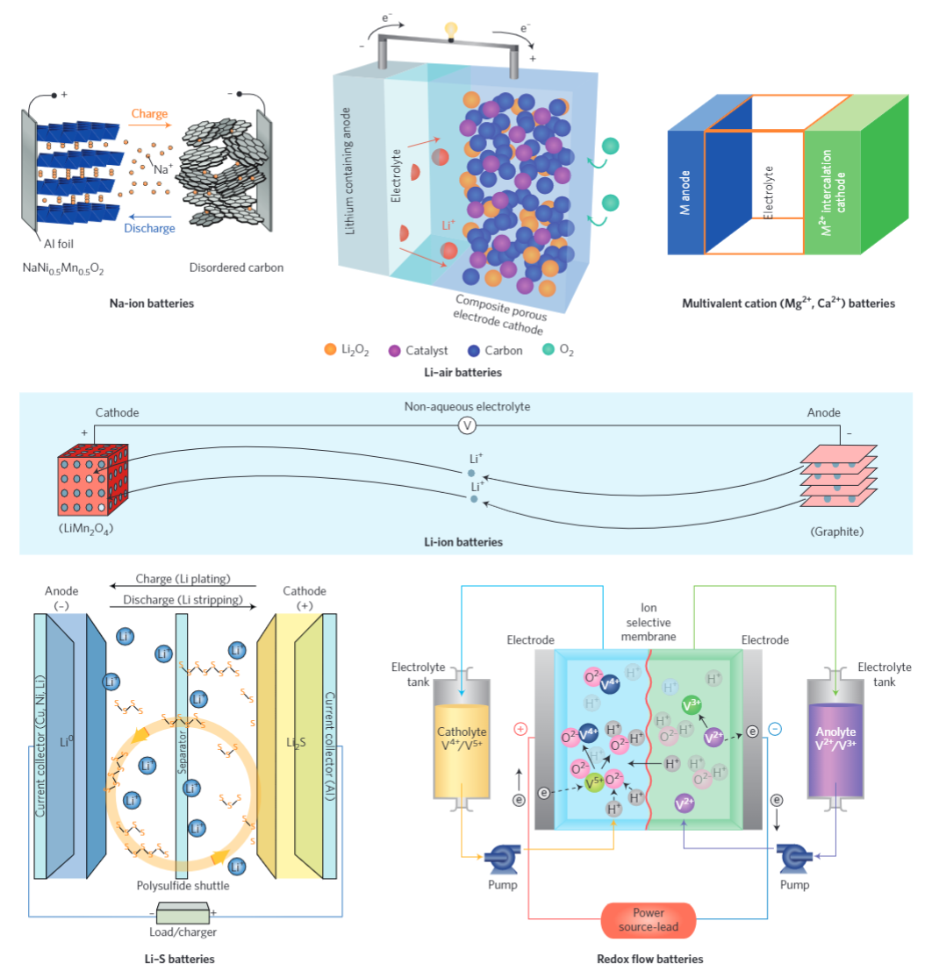
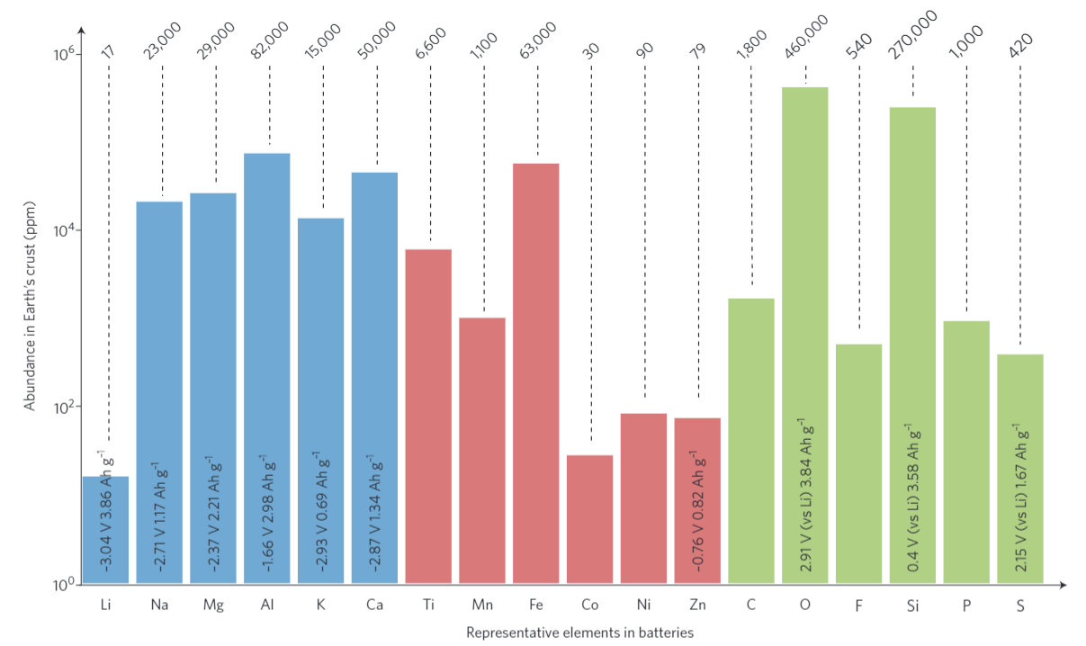
C. P. Grey and J. M. Tarascon
Nature Materials 16, 45–56 (2017)

Slide 25
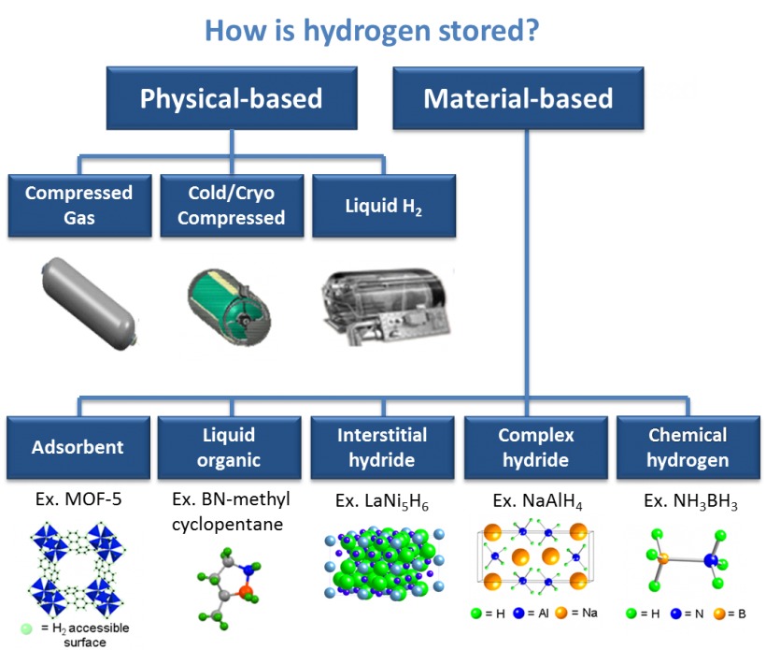
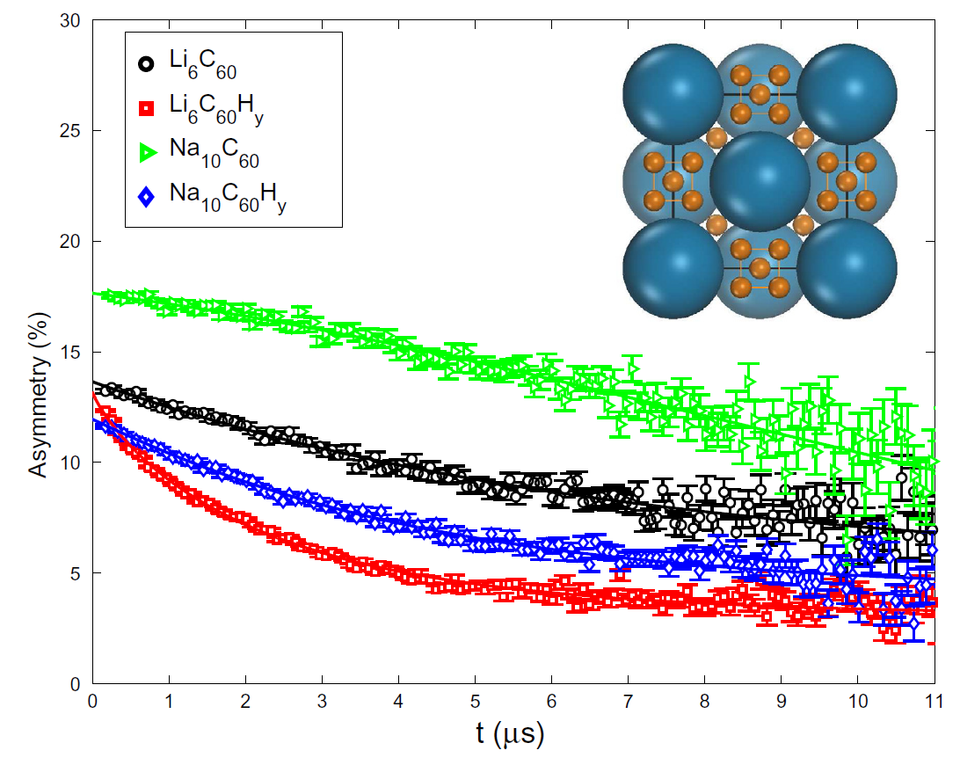
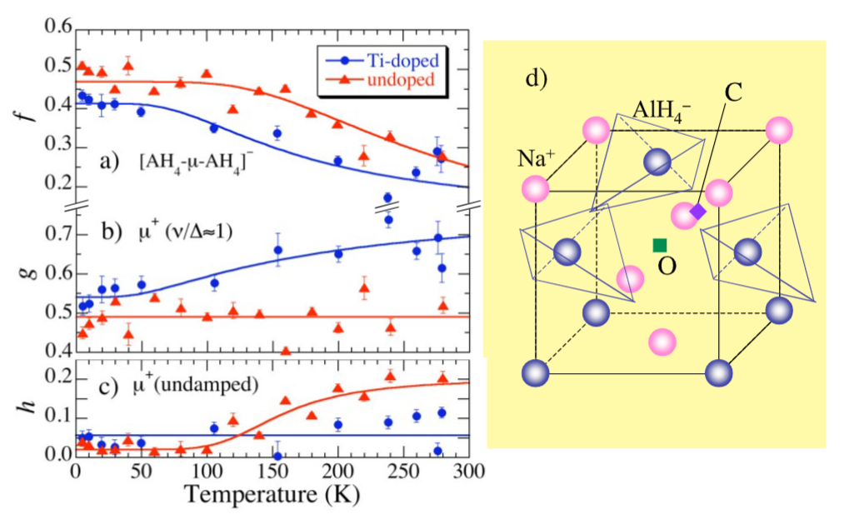
M. Aramani et al. Carbon 67, 92–97 (2014)
R. Kadono et al.
Phys. Rev. Lett. 100, 026401 (2008)

Slide 26
Enabling Green Technology Solutions
New climate and sustainability research program with dedicated support for internal and user-driven work in green technology development
Visitor program with rapid access to required facilities
Coordination with major research facilities (national and international), companies, and federal government

