Slide 1
Panel Discussion
“Basic Sciences and Sustainable Development”
TRIUMF Science Week 2022
Contribution of
Hamid AÏT ABDERRAHIM
DDG SCK CEN, Director of MYRRHA
SCK CEN, Boeretang 200, B-2400 Mol, Belgium
haitabde@sckcen.be or myrrha@sckcen.be

Slide 2
Demand of the organizers
What are the potential roles for basic science and in particular in the area of accelerator technology in supporting Agenda 2030 and sustainable development?
  What are the major challenges?
  What is the SCK CEN mission with respect to climate change and sustainable development?

Slide 3

SDGs 2030
In 2015, the United Nations defined 17 Sustainable Development Goals (SDGs) and 169 associated targets until 2030.
For many of the SDGs, the main challenge is linked to availability of massive quantities of sustainable & non-harmful energy for man & environment ➔ also nuclear
Among these goals, nuclear power can contribute in the areas of
  affordable and clean energy (SDG7),
  resilient infrastructure, inclusive and sustainable industrialization and innovation (SDG9),
  ensuring sustainable consumption and production patterns (SDG12)
  and combating climate change (SDG13).

Slide 4
Challenges for nuclear energy
Address high level waste by advanced options (P&T)
  Accelerator Driven System (appealing solution)
Improve use of natural resources for sustainability
  Uranium ➔ Closed fuel cycle + Fast Reactor technology
  Enlarge towards Thorium fuel cycle (Fast or Thermal or AcceleratorDTR)
Some figures to illustrate

Slide 5
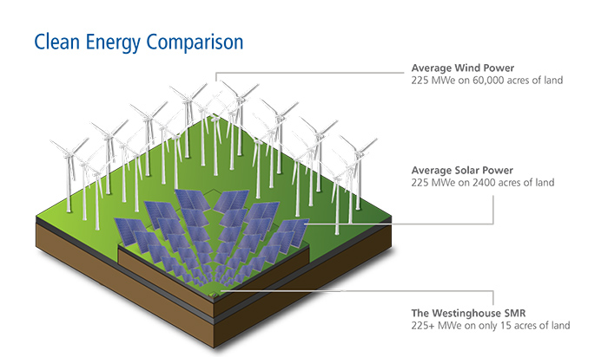
We need all clean energies ,,, but not forgetting SDG 12

Slide 6
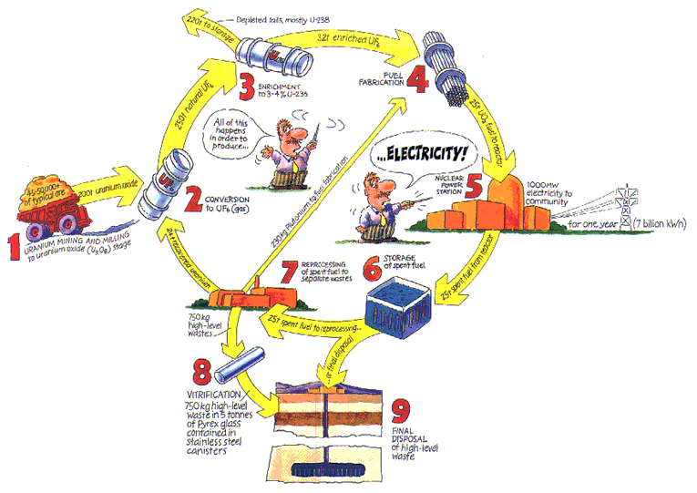
Quantities at different stages for 1GWe PWR
220 t depl. UF₆ + 32 t enrich. UF₆
25 t Fresh UO₂ (3 tot 4% ²³⁵U)
250 t nat. UF₆
25 t UO₂ in the reactor
45 to 50,000 t ore
24 t recover. UO₂ (1% ²³⁵U)
230 kg Pu for recycling
750 Vitrified HLW (FPs & MAs)
25 t Spent UO₂ Interim Storage
750 Vitrified HLW (FPs & MAs)
25 t Spent UO₂ Direct Disposed GD

Slide 8
Reducing the environmental footprint of NE
Reduce the Front End activities ➔ Partitioning

Slide 9
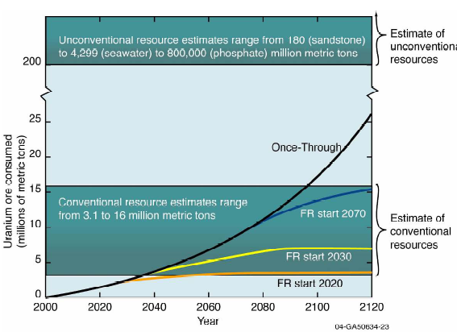
Better use of resources
Hypothesis: world nuclear energy demand growth:
1.8% per year
FR = Fast Reactors

Slide 10
Sustainability : Thorium vs Uranium in terms of resources
As shown in previous slide Thorium is very well distributed around the world limiting “Cartel” possibility
5 times more abundant than Uranium
  U + LWR technology ➔ Potential energy source for 100 to 200 y
  U + FBR technology ➔ (1)* (50 to 100) = 5.000 to 10.000 y
  Th + BR technology (Thermal or Fast) ➔ (2)* 5 = 25.000 to 50.000 y
Breeding with fast reactors for U-cycle will lead to a sustainable nuclear energy
Breeding both with thermal and fast reactors for Th-cycle will lead to nearly infinite source of energy

Slide 11
Sustainability : Thorium vs Uranium in terms of resources
Thorium 5 times more abundant than Uranium
  U + LWR technology ➔ Potential energy source for 100 to 200 y
  U + FBR technology ➔ (1)* (50 to 100) = 5.000 to 10.000 y
  Th + BR technology (Thermal or Fast or ADTR) ➔ (2)* 5 = 25.000 to 50.000 y
Breeding with fast reactors for U-cycle will lead to a sustainable nuclear energy
Breeding both with thermal and fast reactors for Th-cycle will lead to nearly infinite source of energy

