Slide 1
Opportunities for Nucleosynthesis Studies with TI-STAR and TIGRESS at ARIEL
Dennis Mücher, Leyla Atar, Tomer Rockman
University of Guelph + TRIUMF for the TIGRESS and TI-STAR collaborations

Slide 2
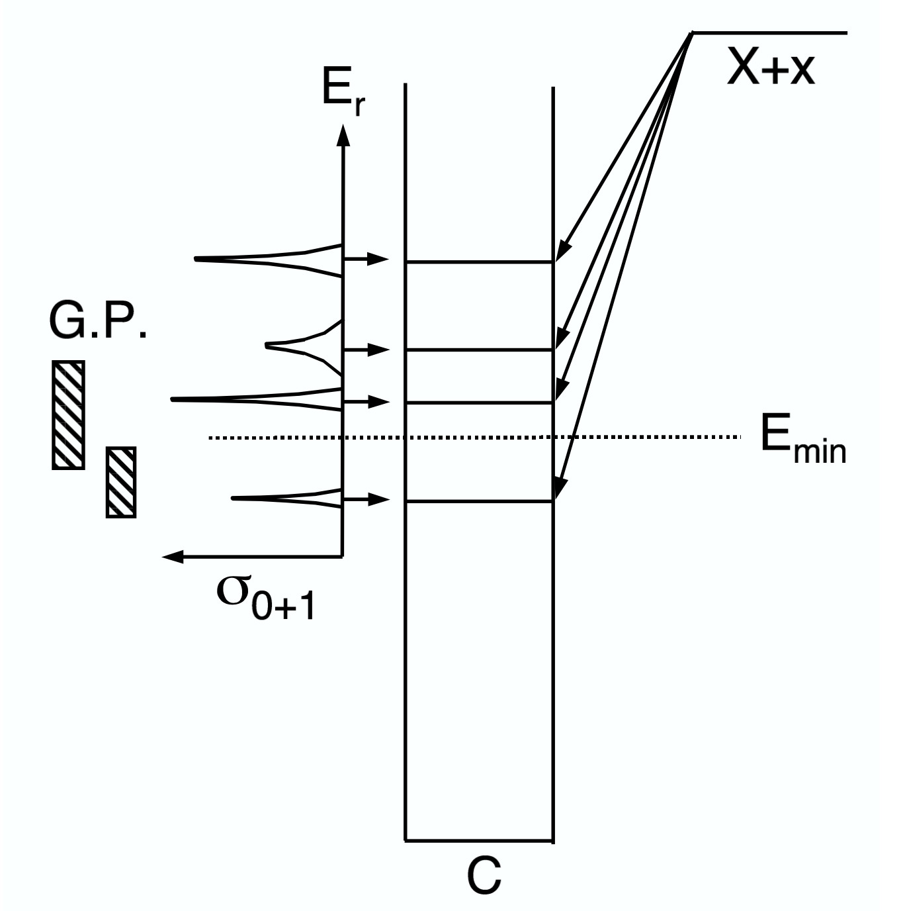
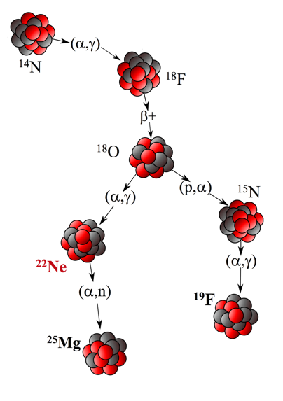
Intro: indirect approaches to nucleosynthesis studies
}
direct: DRAGON
}
indirect: TUDA, TACTIC, TIGRESS, IRIS, EMMA
Notes:
The goal of this experiment is to better constrain the reaction rate for the 18O(a.g)22Ne reaction rate. This reaction occurs in the helikum burning AGB and WR stars, and others, at temparatures beyond about 0.1 GK. The reaction chain presented here starts with the 14N nucleus, which is a small but significant remnant of the CNO cycle. The capture from 18O into 22Ne is interesting because of multiple reasons: first, 18O has a branch into either 22Ne or 15N, which determines the reaction flow and element production after 18O has been produced. This branching ratio direcntly depends on the 18O(a,g) rate, as well as on the well measured (p,alpha) rate into 15N.
The reaction of interest is furthermore a posiinig reaction for flurine production. The 18O(p,a) branch is considered a dominant contribution for florine production in the universe, but there is large inconsitencies between observation and calculation, e..g in Wolf-Rayet Stars.
Maybe most importantly, the subsequent 22Ne(alpha,n) reaction is considered a main souirce for neutrons for the s-process at high temperatures around 0.3GK. The amount of those s-process neutrons scales directly with the amount of 22Ne produced.

Slide 3
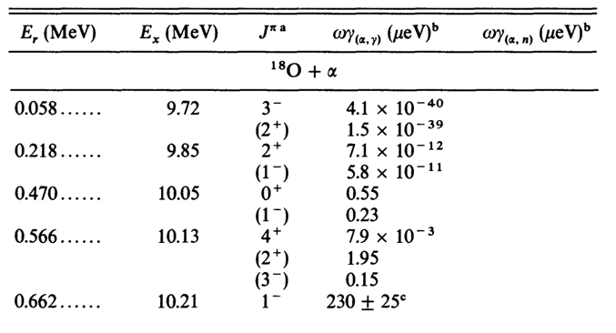
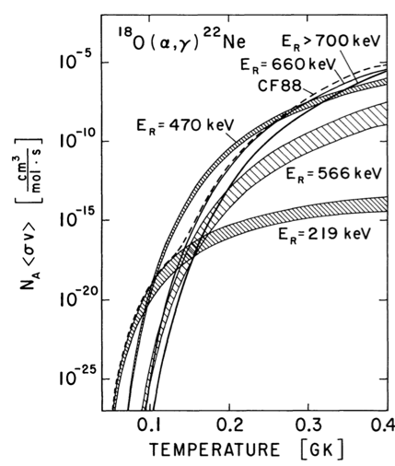
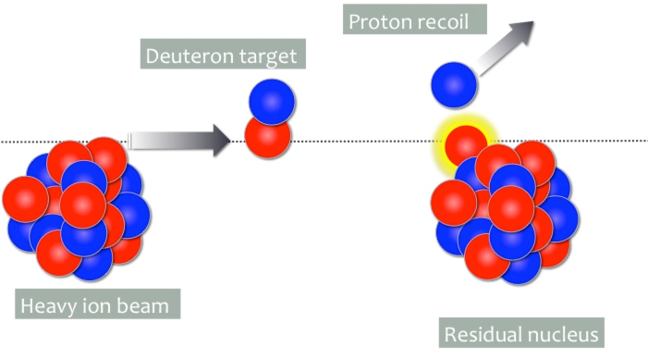
Example: spectroscopy of ²²Ne resonances at ISAC-II
Käppeler et al. 1994
²¹Ne
²²Ne

Slide 4
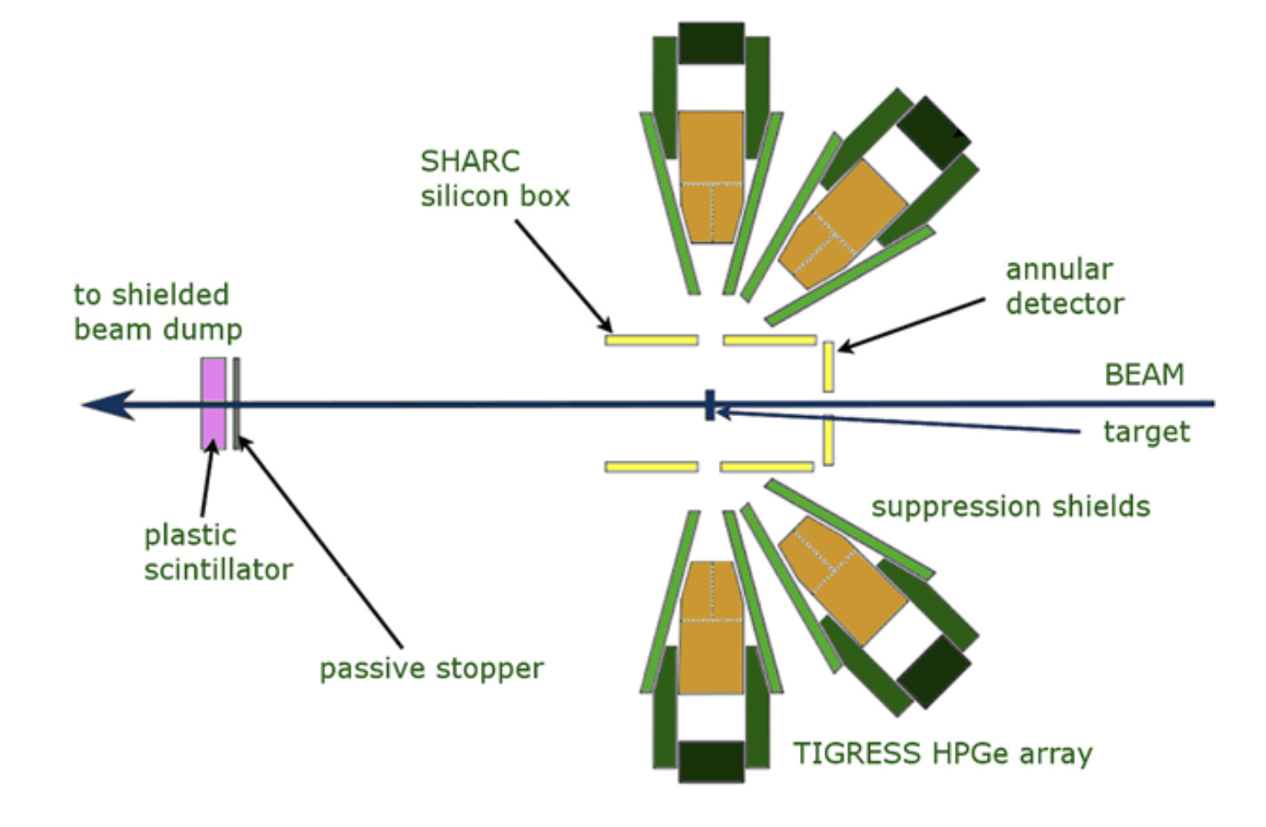
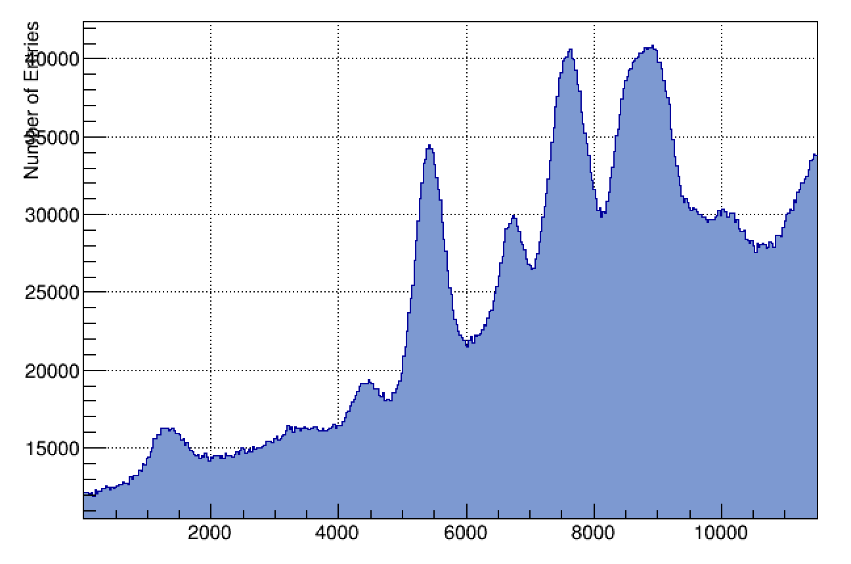
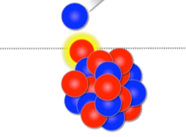

Particle-gamma spectroscopy with TIGRESS
²¹Ne(d,p), 7.9 MeV/u
August 2017
$E_{exc}$(MeV)

Slide 5
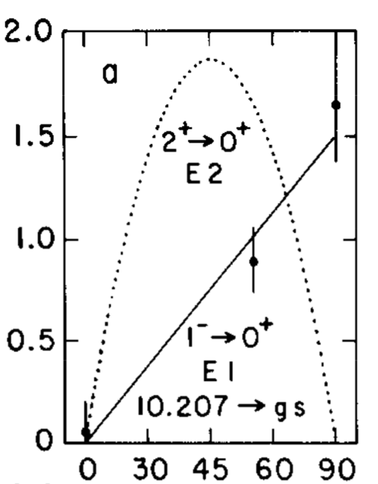
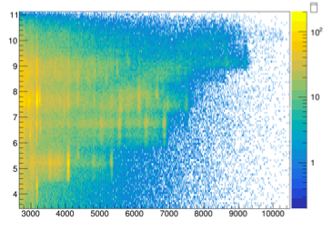
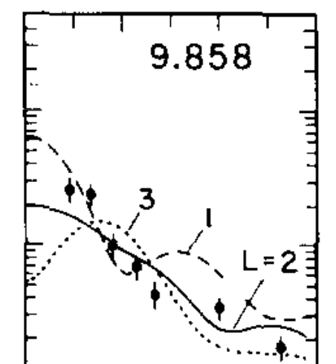

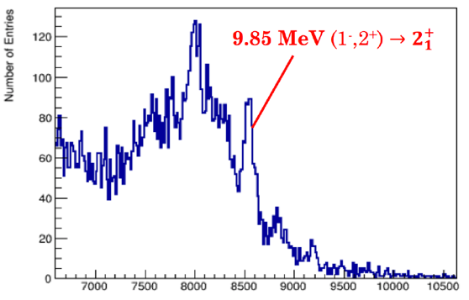





Example: spectroscopy of ²²Ne resonances at ISAC-II
$E_{exc}$(MeV)
$E_{γ}$(keV)
$θ_{γ}$(keV)
Analysis:
B. Greaves (UofG)
S. Gillespie (TRIUMF)
9.85 MeV
(1⁻,2⁺)
9.18 MeV
(4⁺)
8.56 MeV
(1,2)⁺
Single-escape peak
$E_{γ}$(keV)
$E_{exc}$(MeV)

Slide 6
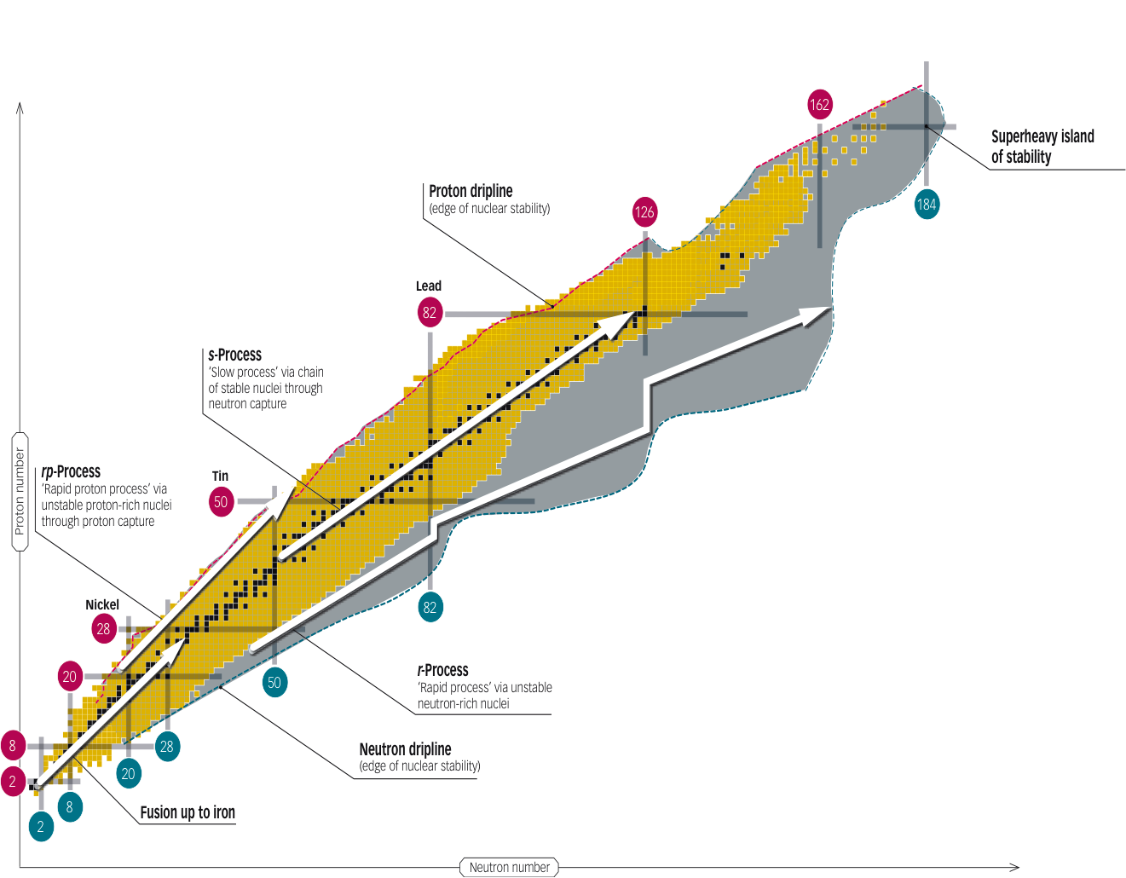
rp-process

Slide 7
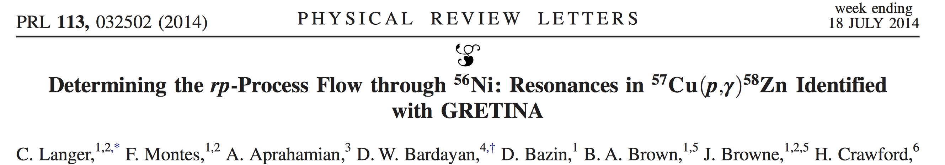
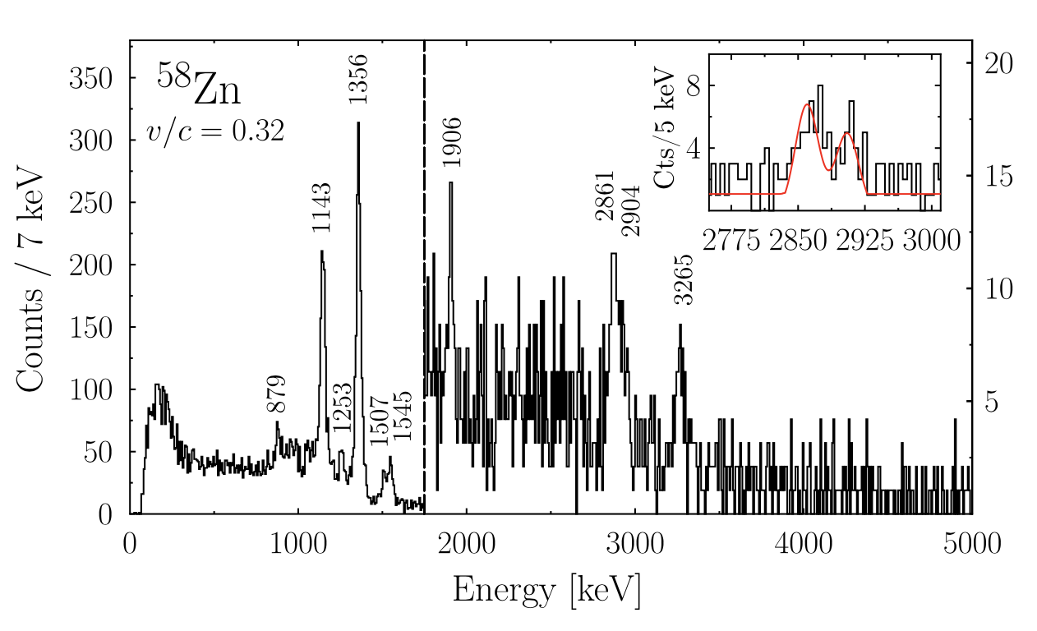
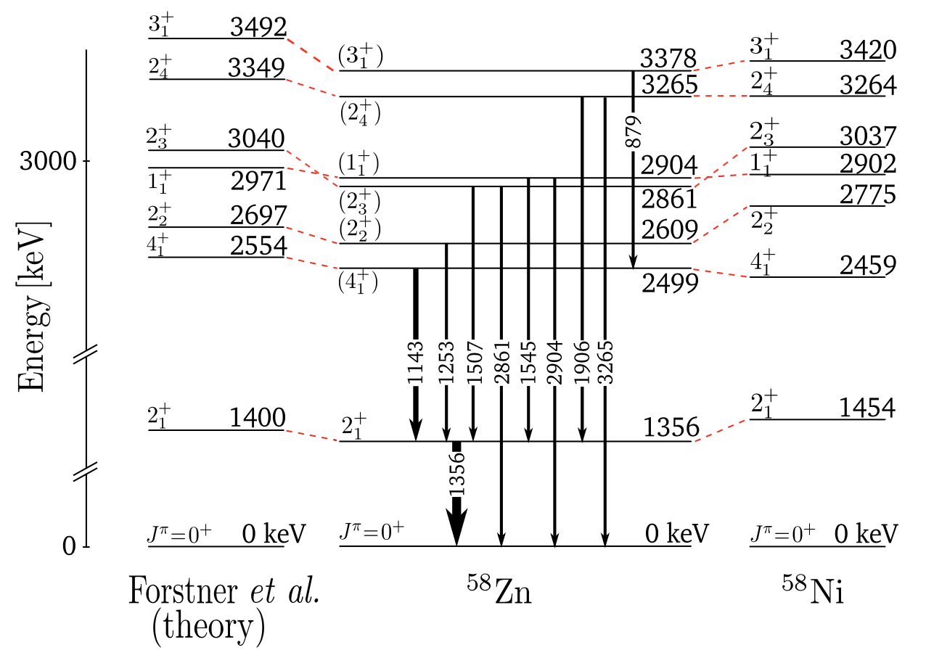
Indirect measurements for the rp-process
⁵⁷Cu(d,n)⁵⁸Zn
using GRETINA @ NSCL
resolution and statistics at the limit

Slide 8
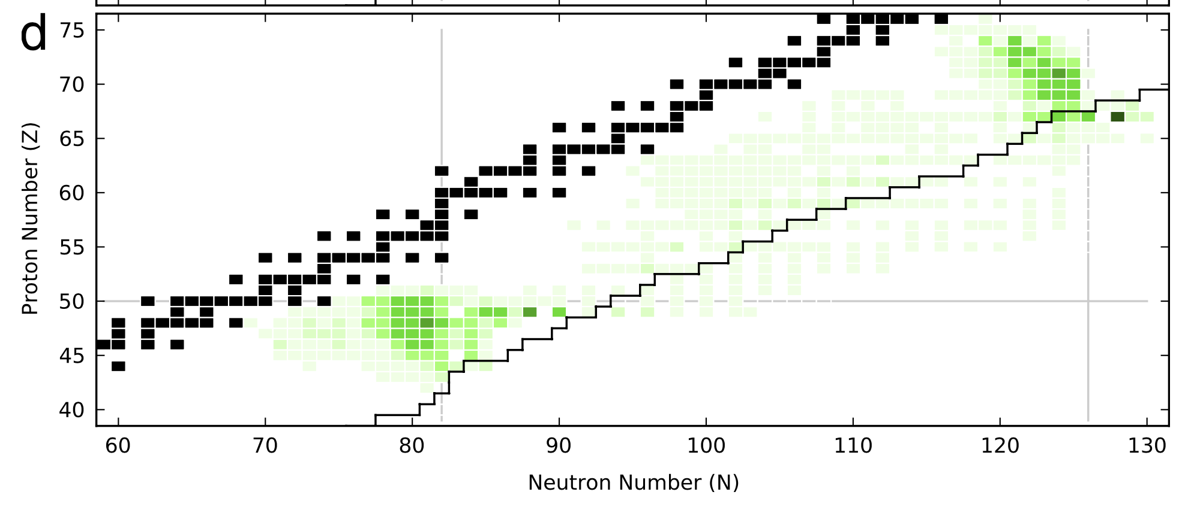
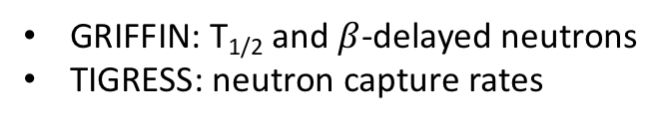
Constraining neutron capture rates
GRIFFIN: T_{1/2} and $β$-delayed neutrons
TIGRESS: neutron capture rates
Mumpower et al., Progress in Particle and Nuclear Physics 86 (2016) 86–126

Slide 9
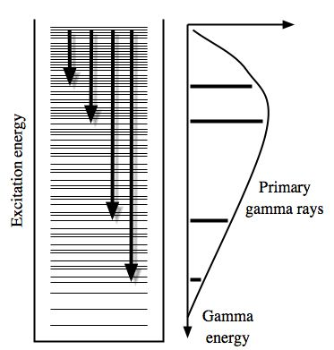
Constraining neutron capture rates
GRIFFIN: T_{1/2} and $β$-delayed neutrons
TIGRESS: neutron capture rates

Slide 10
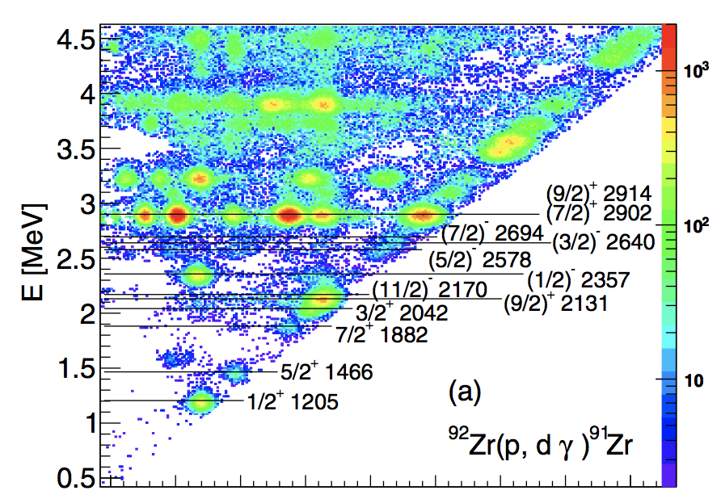
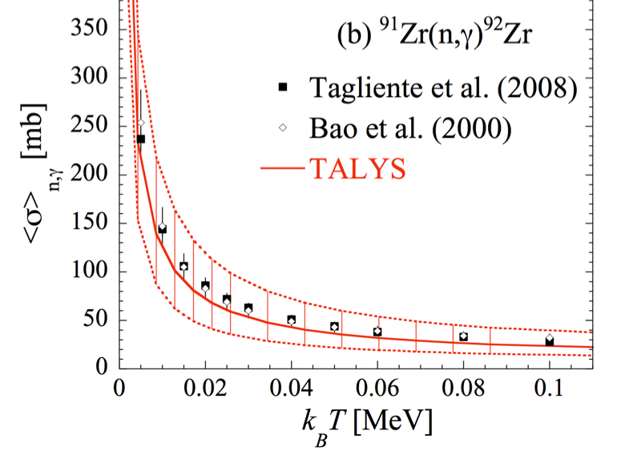
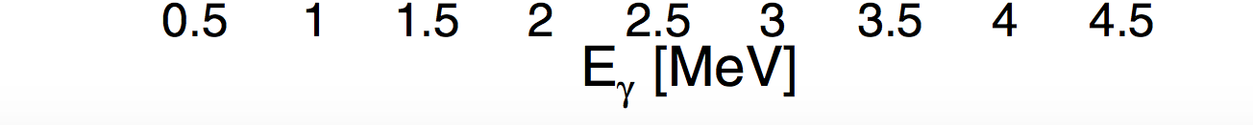
Validation of the “Oslo” method
M. Guttormsen et al., PRC 96, 024313 (2017)

Slide 11
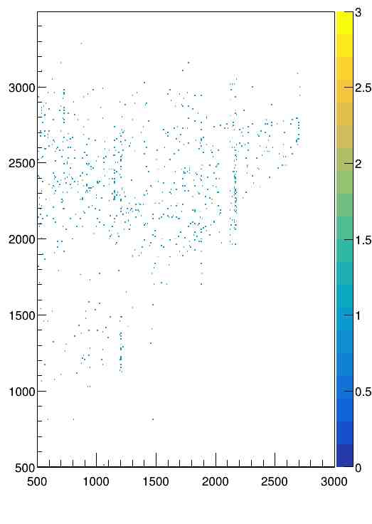
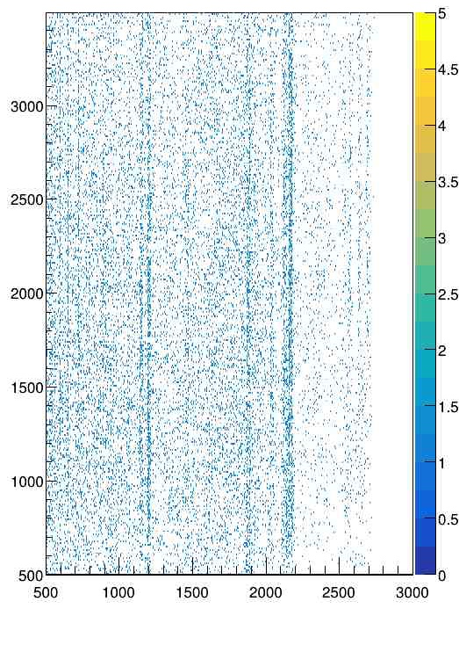
Oslo-method: doable for exotic beams at ARIEL?
0.16 mg/cm₂ CD₂ foil
5 mg/cm₂ CD₂ foil
excitation energy (keV)
⁹⁰Zr(d,p)⁹¹Zr
1000 pps
5 days beamtime
gamma energy (keV)

Slide 12
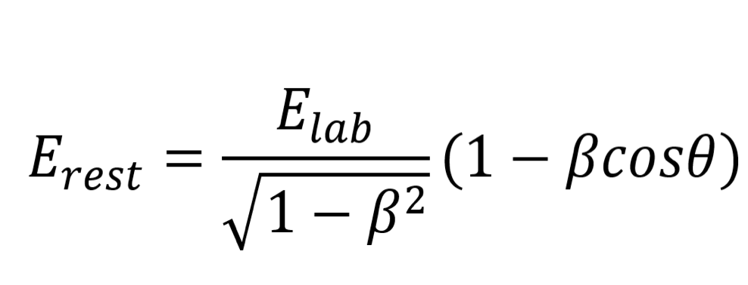
resolution vs. target thickness
silicon strip detector
p
p
heavy ion
CD₂

Slide 13
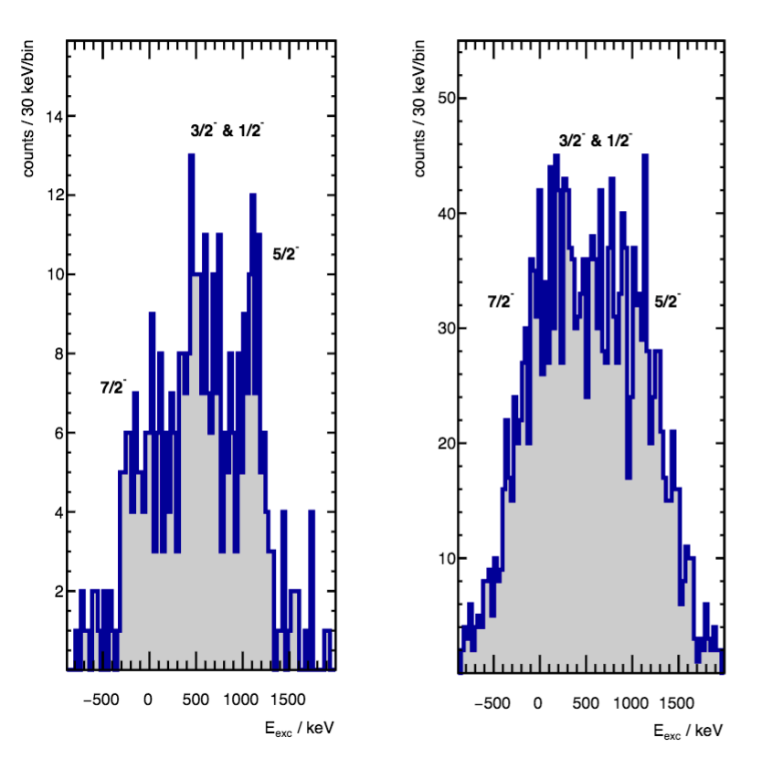
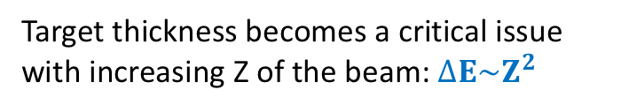
¹³⁶Sn(d,p) at ARIEL and CD₂ targets
foil: 0.1 mg/cm²
foil: 0.5 mg/cm²
Target thickness becomes a critical issue with increasing Z of the beam: $∆E\sim Z^{2}$

Slide 14
Idea:vertex tracking at ISOL energies using Si detectors
silicon strip detectors
(x_{2,}y₂)
p
p
(x_{1,}y₁)
¹³²Sn
10cm long D₂ gas target, 1bar

Slide 15
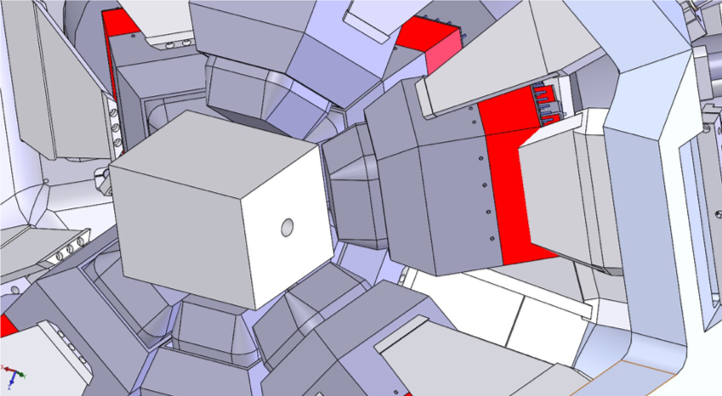
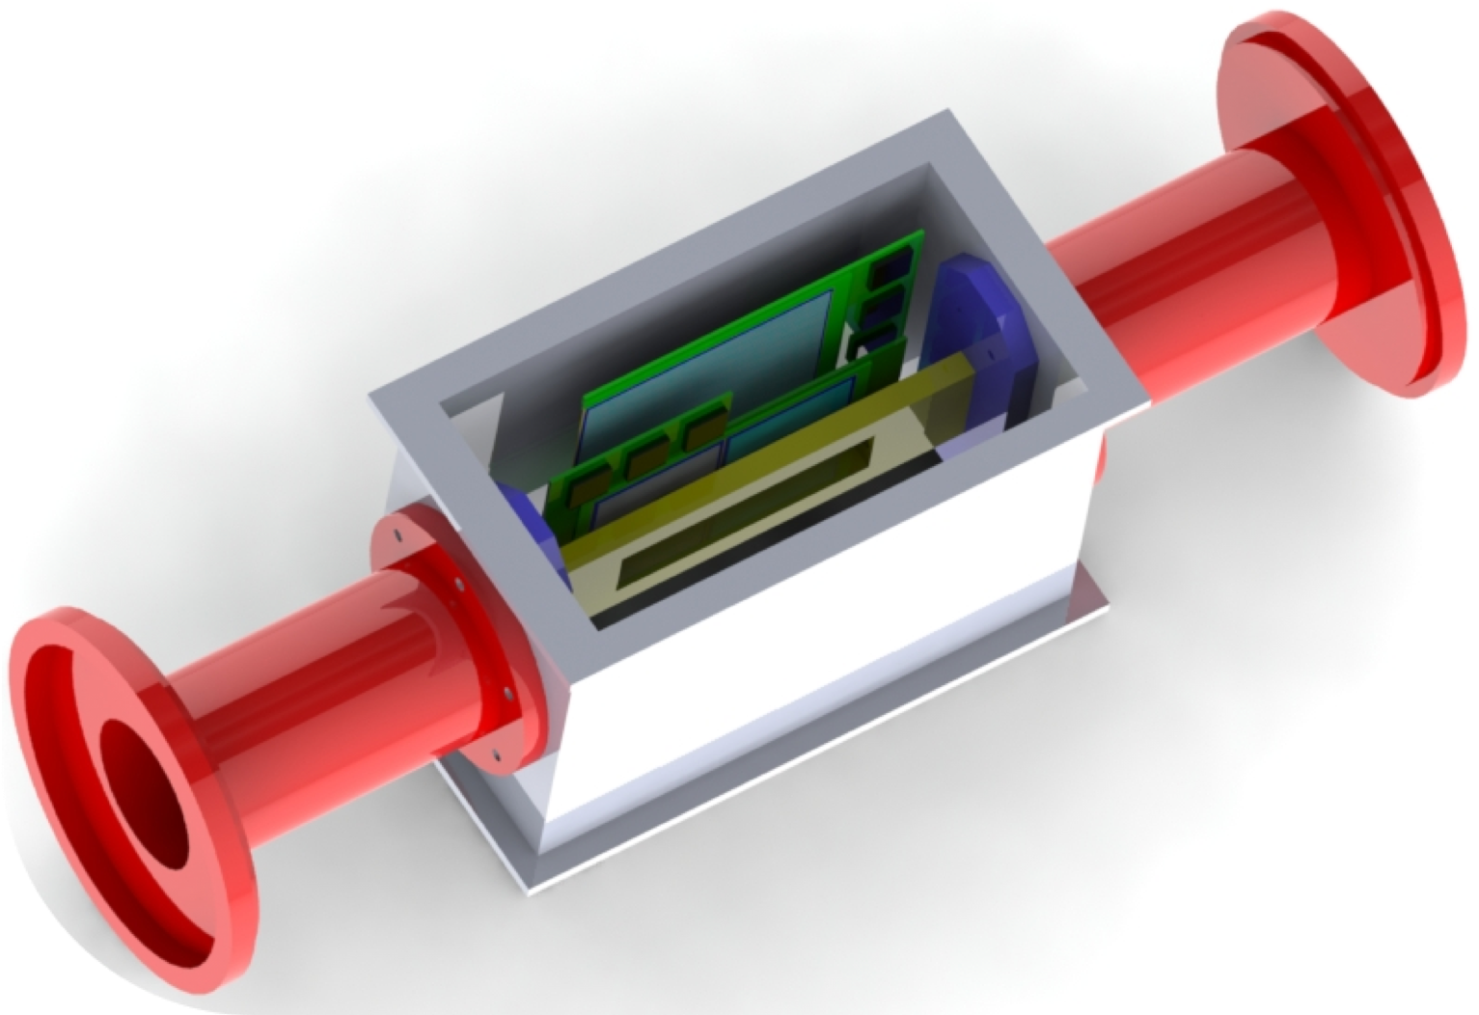
Layout of TI-STAR
Mechanical Design:
Fred Sarazin (Colorado School of Mines)
Robert Hendersson (TRIUMF)
TI-STAR =
TIGRESS Silicon Tracker ARray

Slide 16
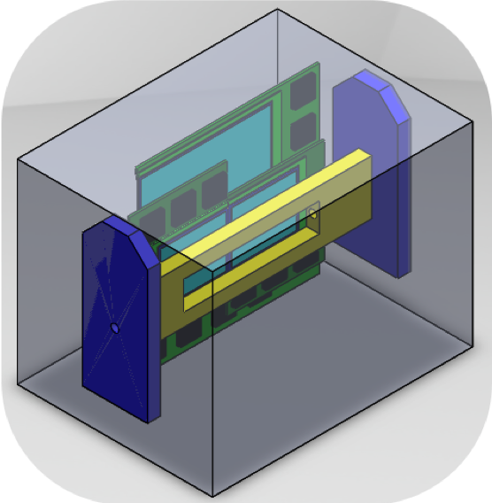
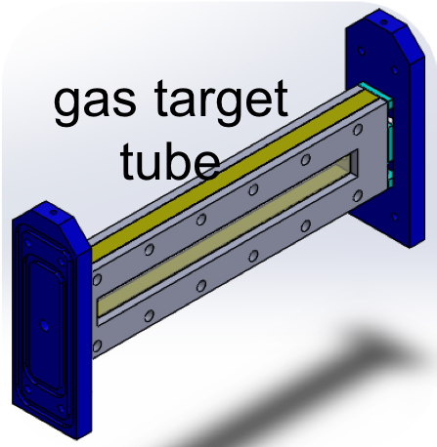
Layout of TI-STAR

Slide 17
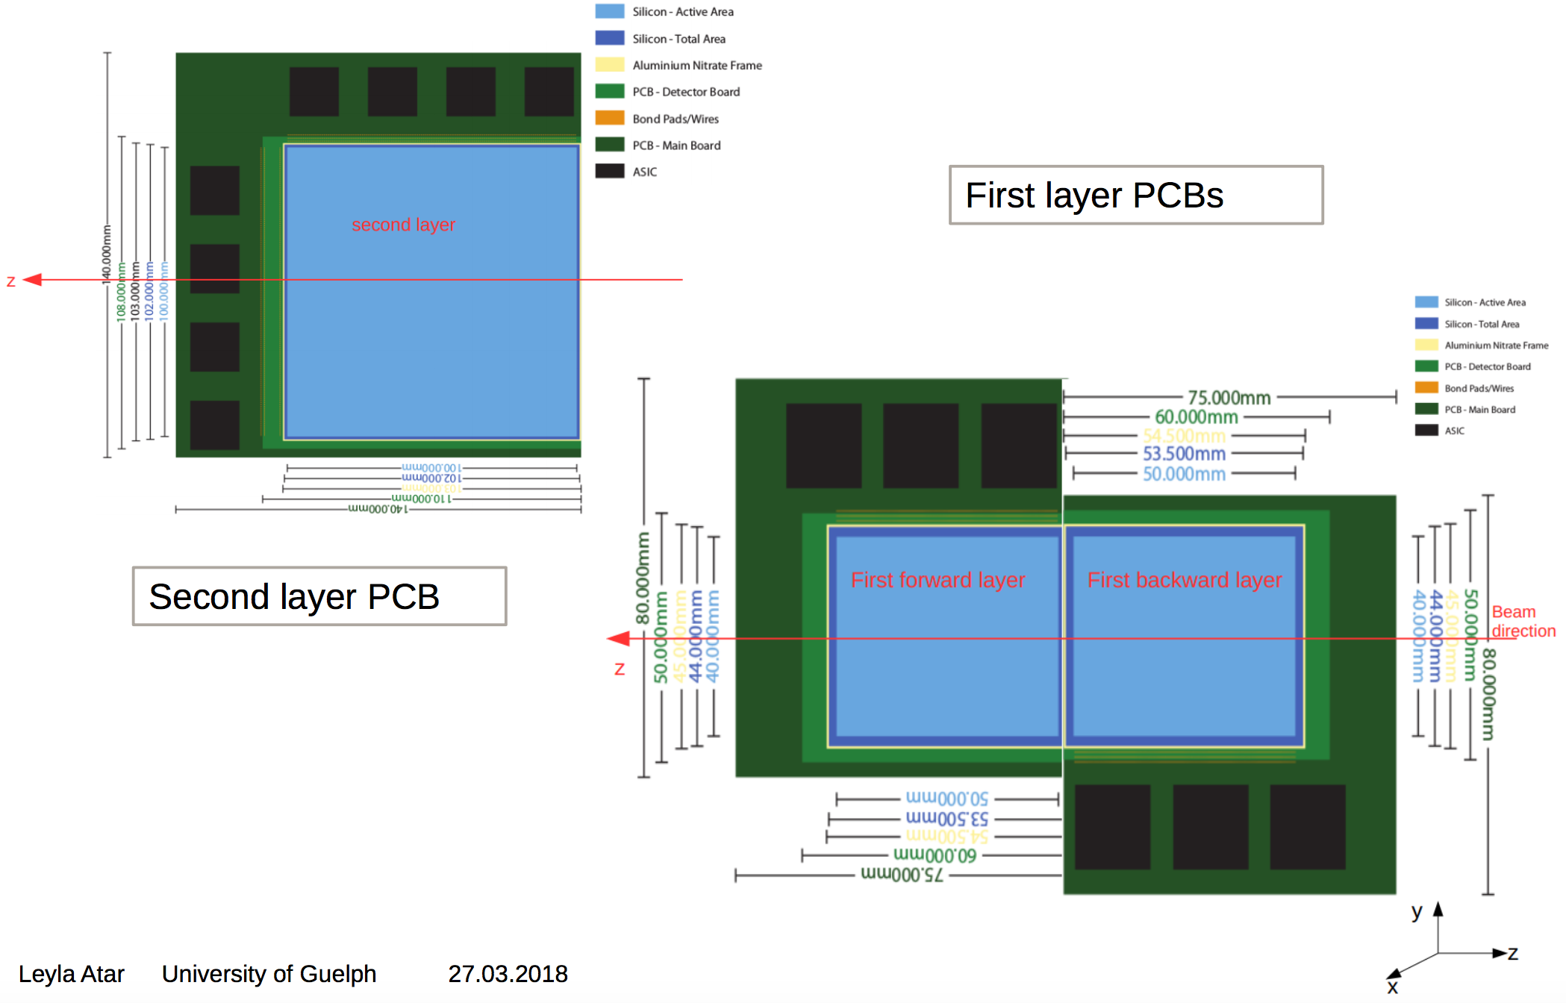
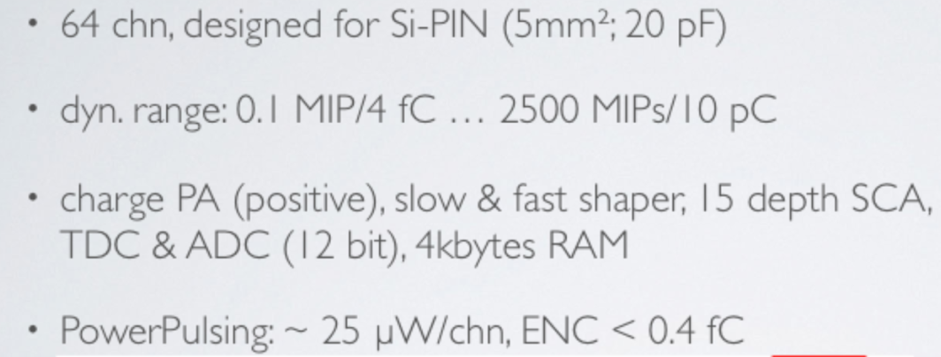
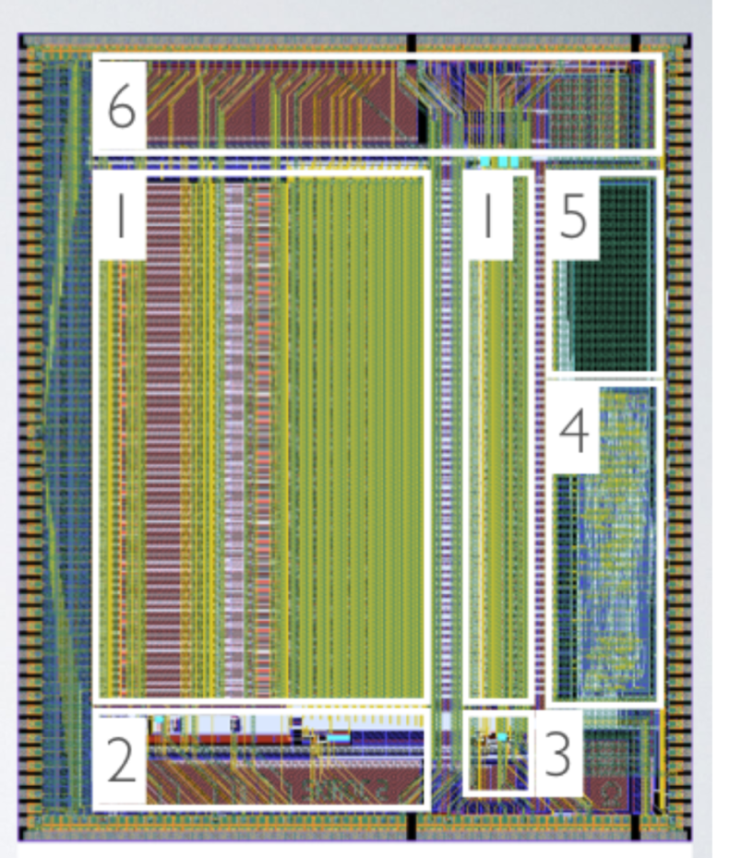
SKIROC-2 ASICs

Slide 18
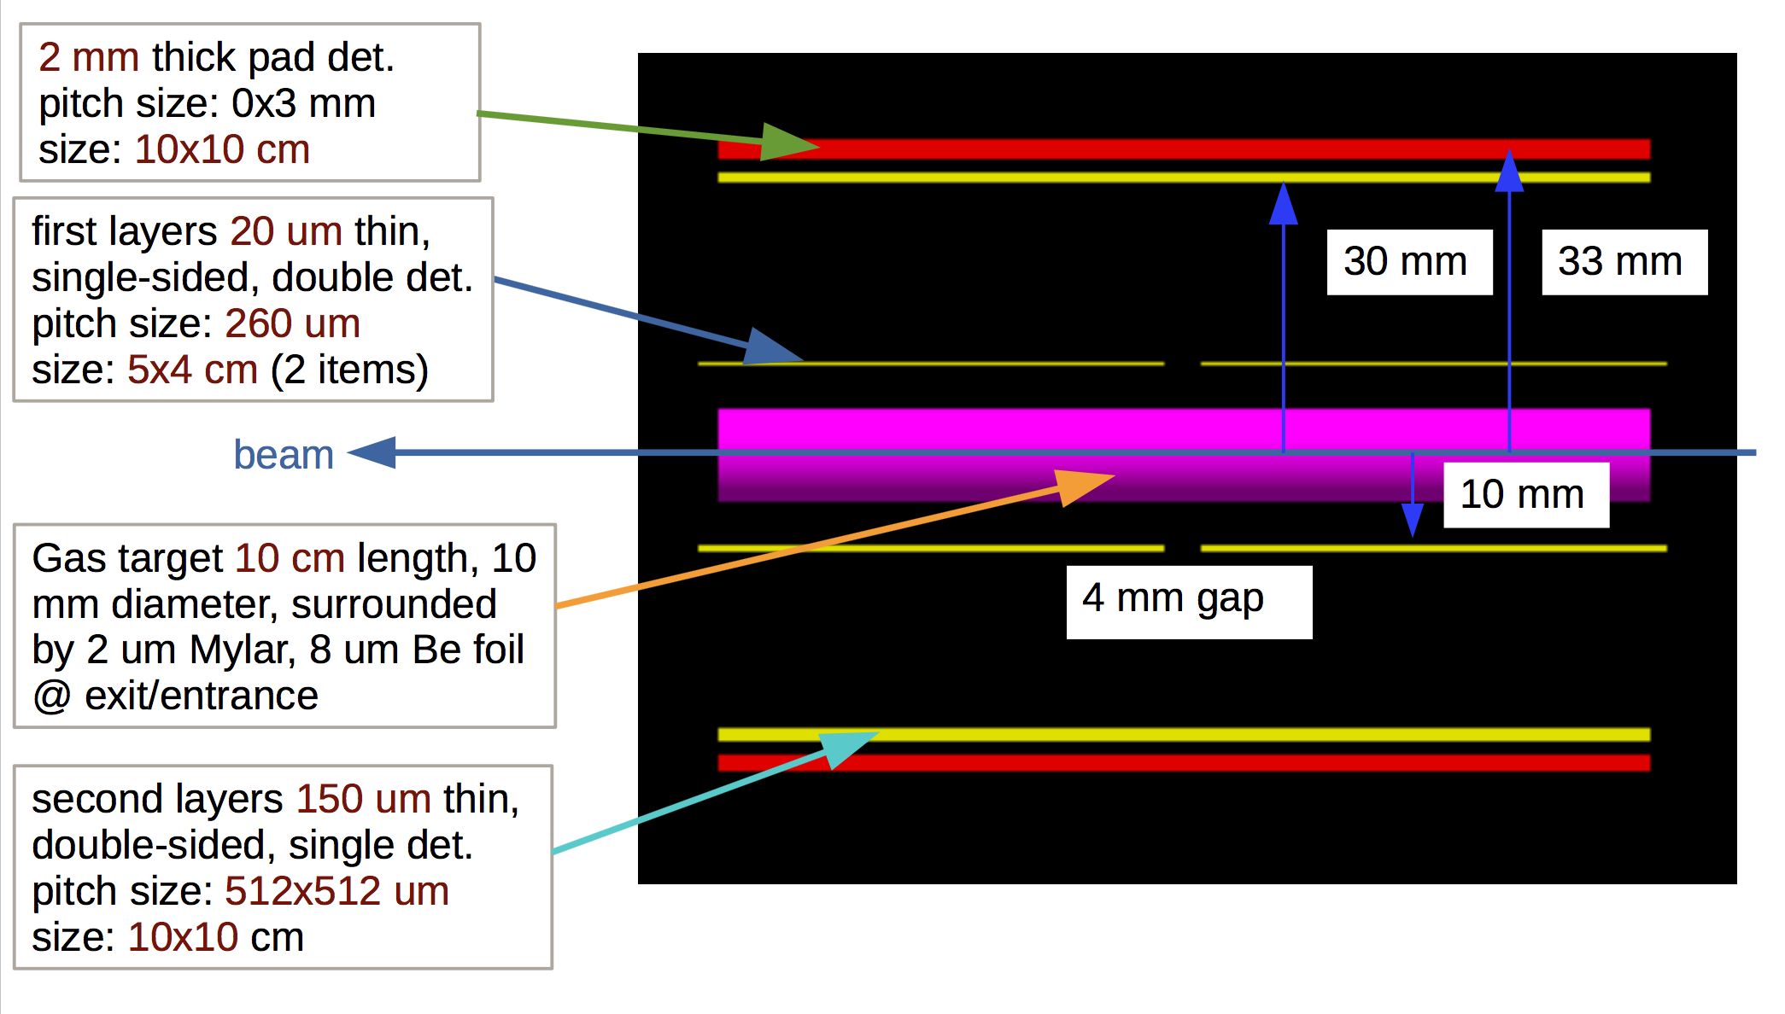
TI-STAR simulation

Slide 19
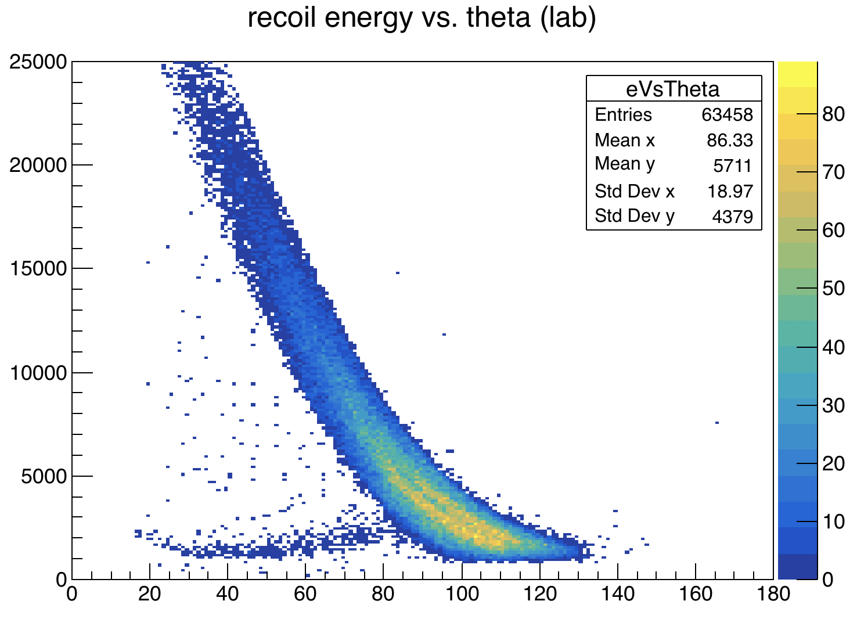
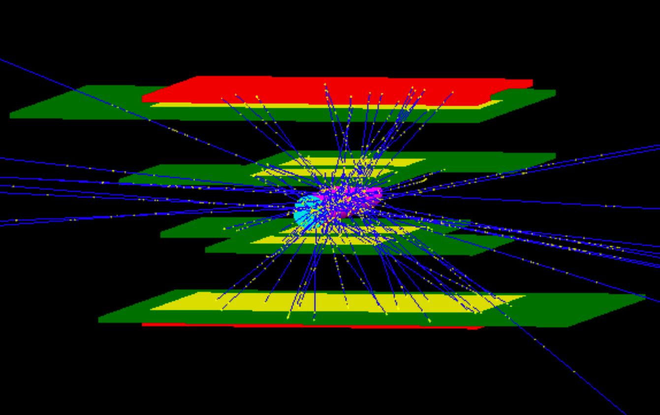
Silicon Tracker: Geant4 simulations

Slide 20
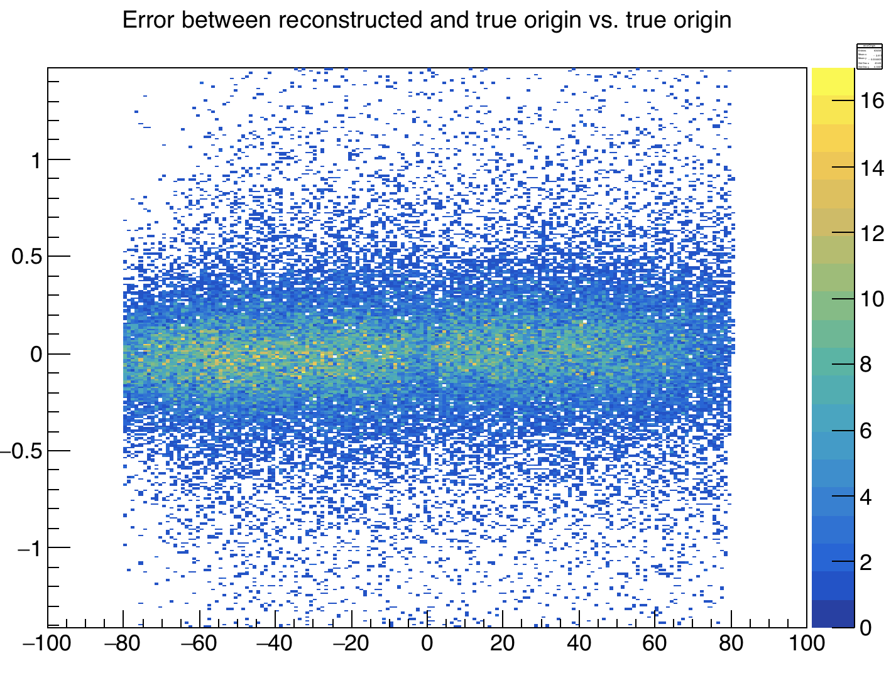
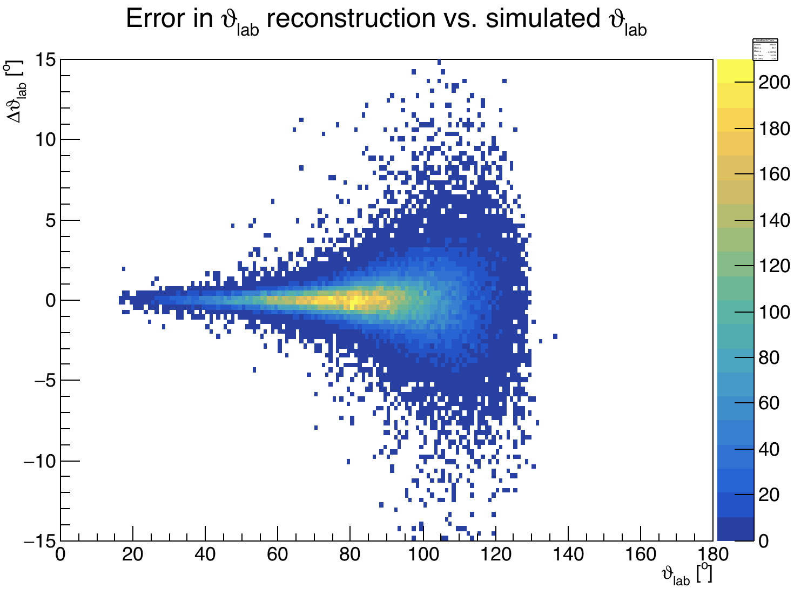
Silicon Tracker: Geant4 simulations

Slide 21
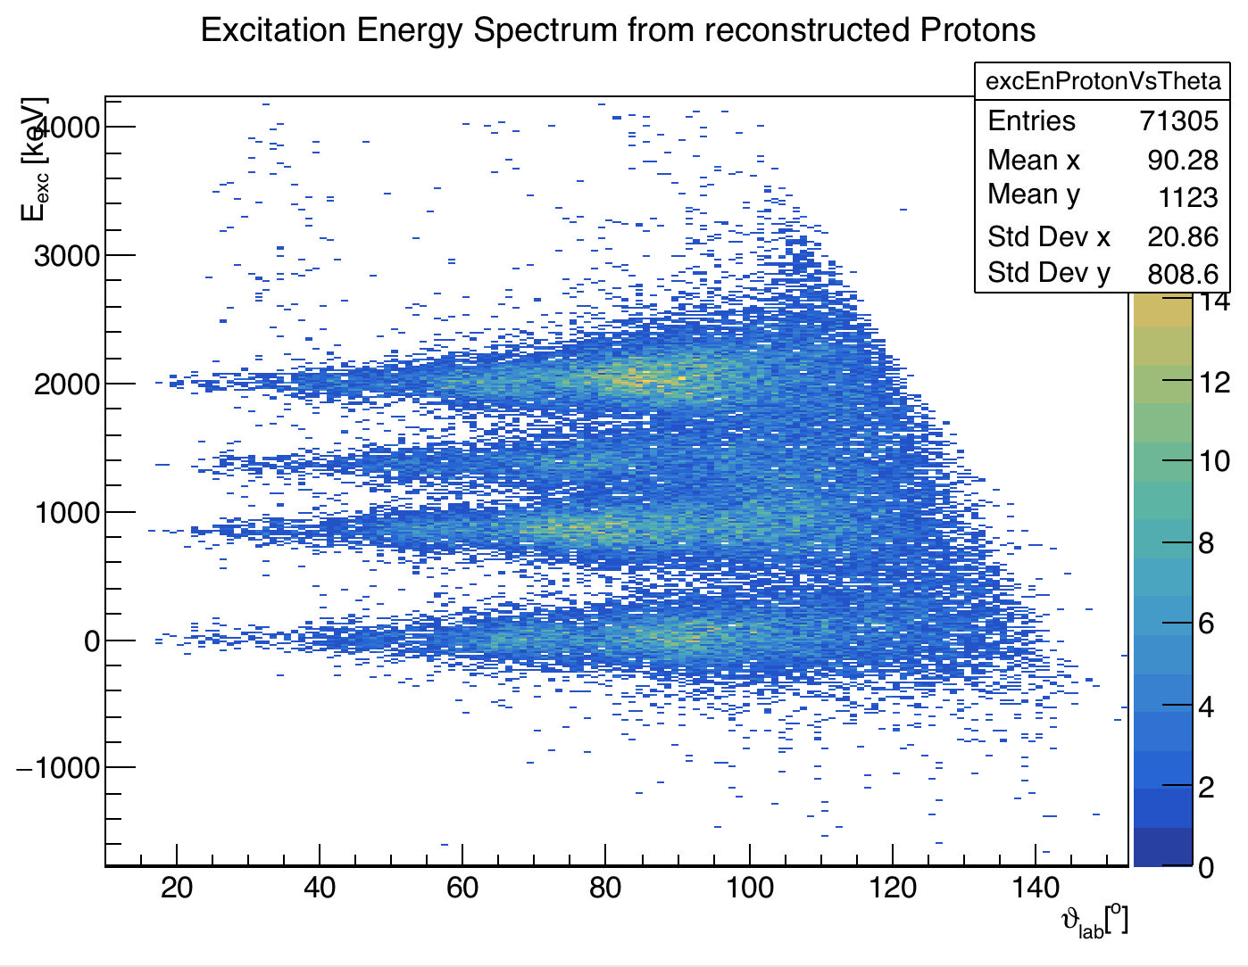
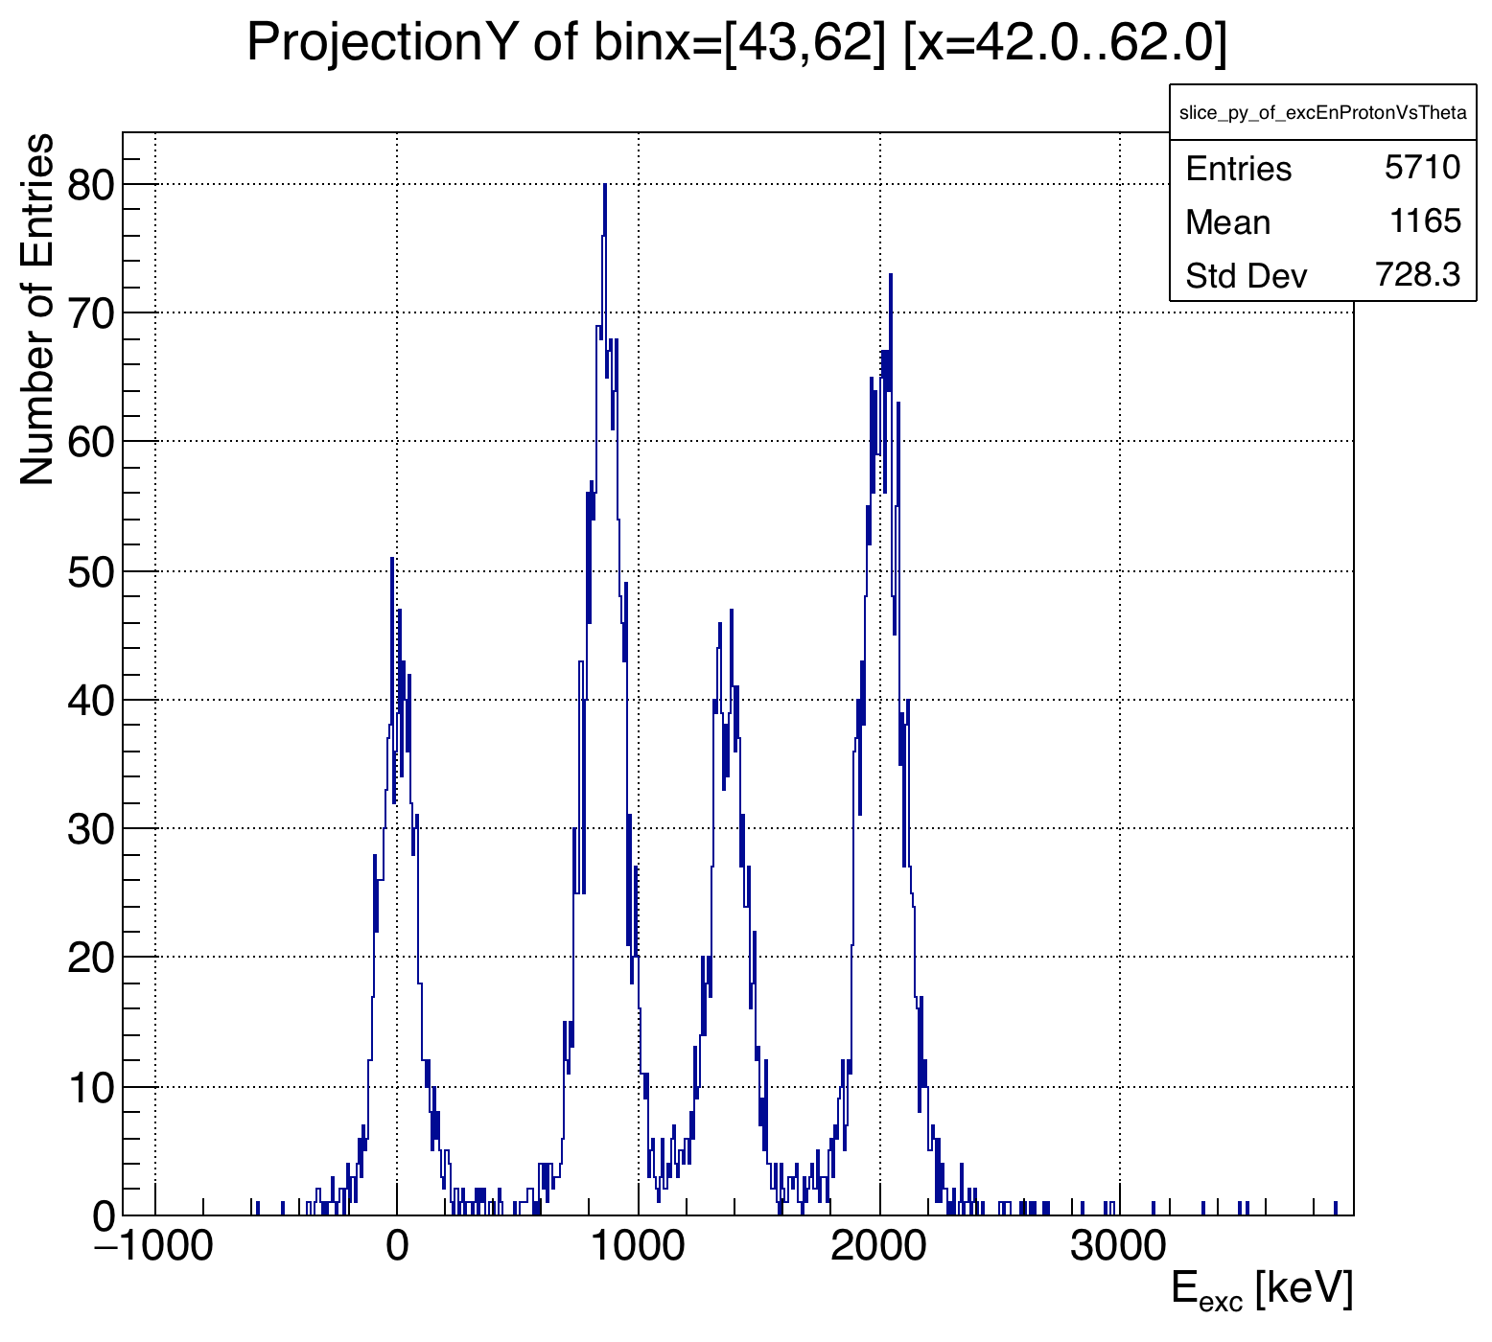
Silicon Tracker: Geant4 simulations
150 keV FWHM

Slide 22
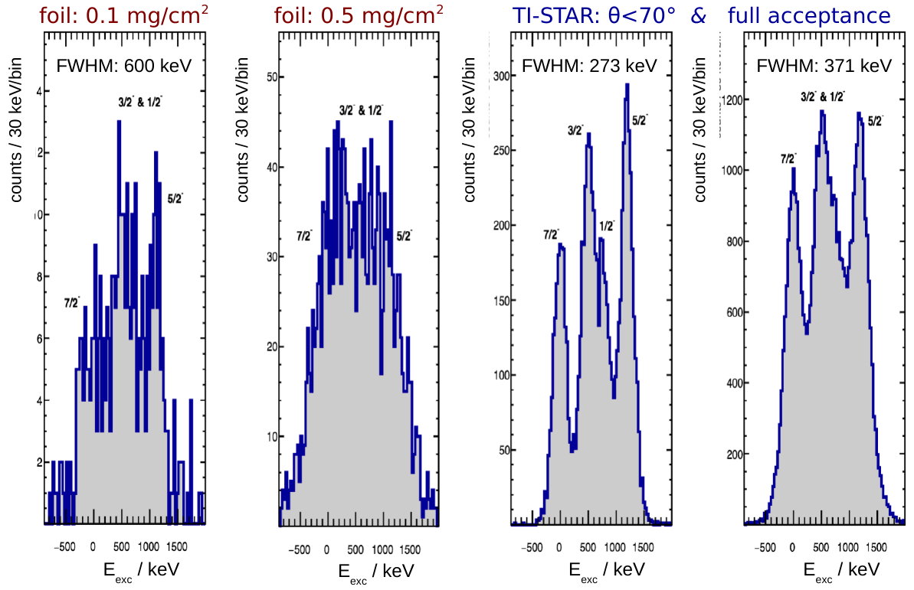
TI-STAR performance: ¹³⁶Sn(d,p)

Slide 23
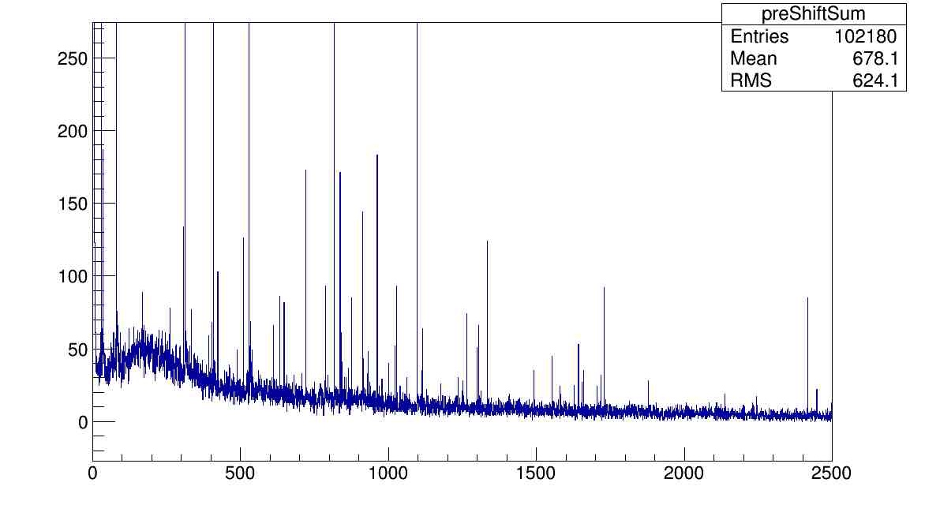
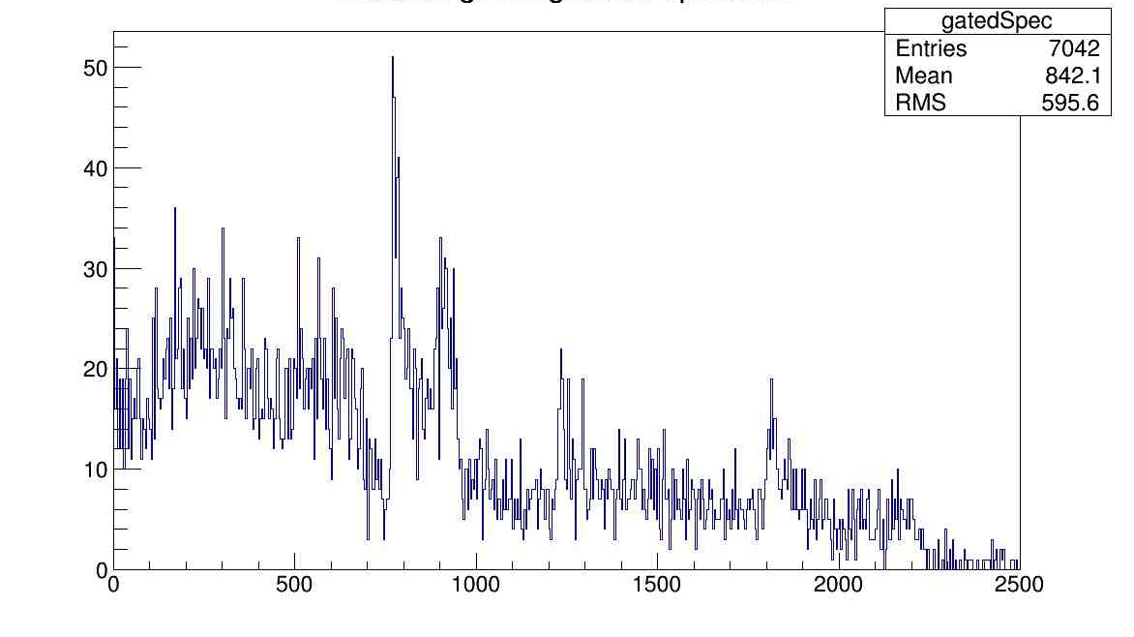
Implementing Realistic Beam Physics
¹³²Sn(d,p) @ 6 MeV/u
TI-STAR gas target (2.84 mg/cm² D2) with foils
Gate on TI-STAR
Counts
853 keV
1360 keV
2004 keV
Counts
Gamma energy (keV)
Gamma energy (keV)

Slide 24
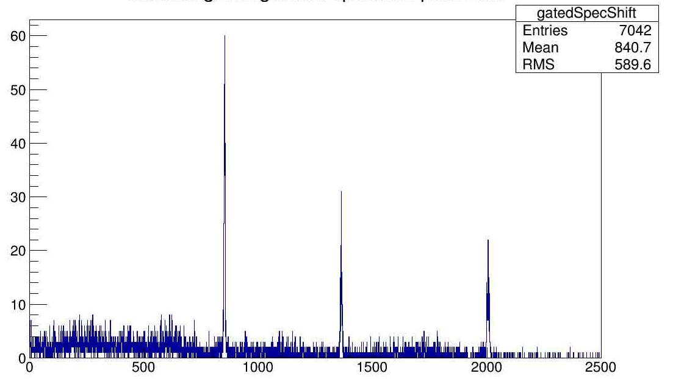
Implementing Realistic Beam Physics
¹³²Sn(d,p) @ 6 MeV/u
TI-STAR gas target (2.84 mg/cm² D2) with foils
853 keV
Counts
853 keV
1360 keV
2004 keV
Counts
1360 keV
2004 keV
σ = 1.3 keV
Gamma energy (keV)
Gamma energy (keV)

Slide 25
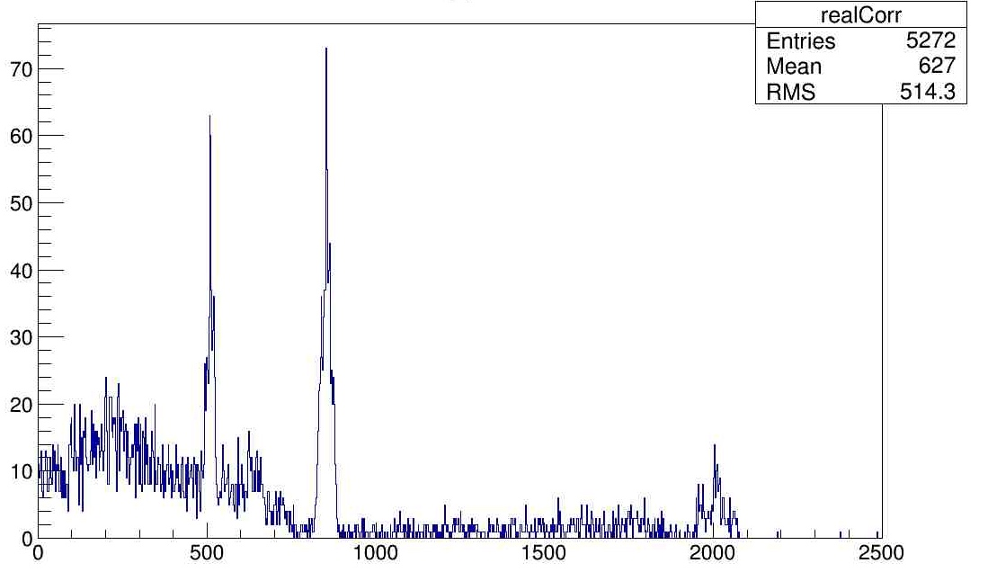
Implementing Realistic Beam Physics
¹³²Sn(d,p) @ 6 MeV/u
comparison: CD₂ foil; 10mg/cm²
853 keV
853 keV
1360 keV
Counts
Counts
1360 keV
2004 keV
2004 keV
σ = 1.3 keV
σ = 50.4 keV
Gamma energy (keV)
Gamma energy (keV)

Slide 26
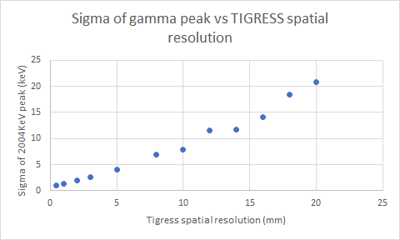
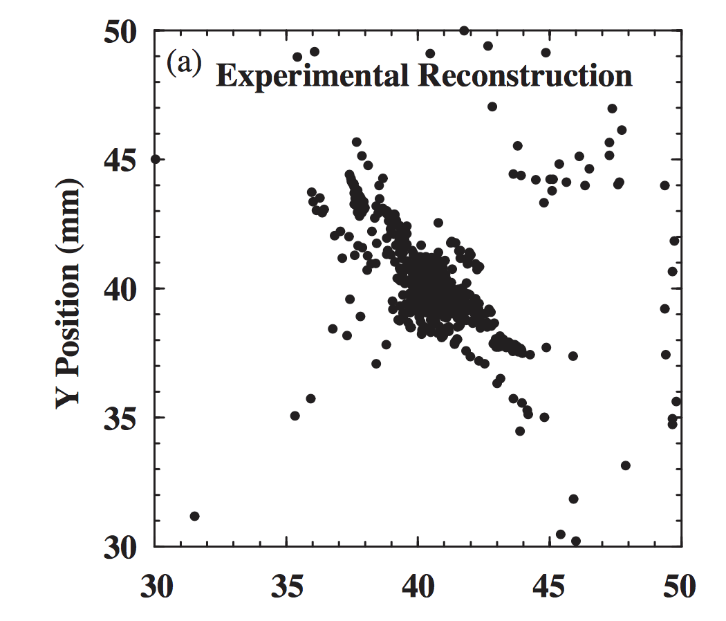

TIGRESS energy resolution using TI-STAR
Gamma ray resolution not limited by target thickness
PSA and gamma ray tracking limiting factors
limit for 2 mg/cm² CD₂
C.E. Svensson et al. / NIM A 540 (2005) 348–360

Slide 27
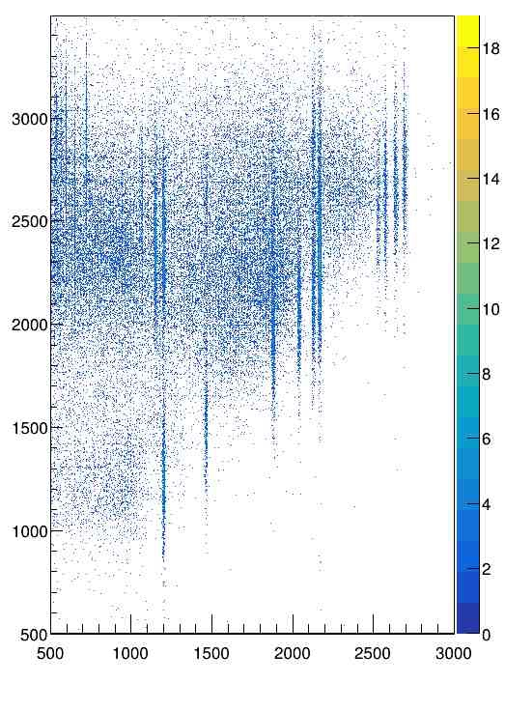
Oslo-method using TI-STAR and TIGRESS
0.16 mg/cm₂ CD₂ foil
5 mg/cm₂ CD₂ foil
1.9 mg/cm₂ D₂ gas
excitation energy (keV)
⁹⁰Zr(d,p)⁹¹Zr
1000 pps
5 days beamtime
gamma energy (keV)

Slide 28
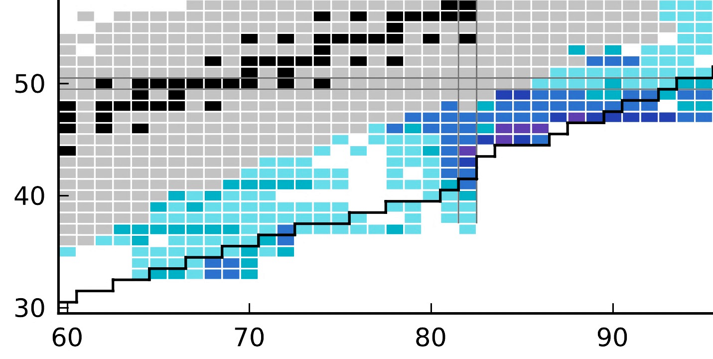

Neutron capture rates accessible using ARIEL beams
adabted from M. Mumpower et al., Prog. Part. Nucl. Phys. 86 (2016) 86-126
Z
foil experiment
TI-STAR
N
adapted from Prog. Part Nucl Phys 86 (2016) 86-126

Slide 29


A systematic physics program at ARIEL
reproduce known n-capture cross sections using stable beams
targeted towards future RIB experiments
possible first experiments: Sn,In, Lu, Yb stable beam
(d,p), (p, alpha) and other reactions
different beam energies
(d,p) for thin (0.5 mg/cm²) and thick target (5 mg/cm² ?)
understand role of EMMA
Step 1: establish $γ$-Oslo at TIGRESS

Slide 30
A systematic physics program at ARIEL
first new data a few steps away from stability
a few selected cases of largest interest, likely Yb – Lu region
gain experience for post-acceleration of such heavy, RIB at ISAC-II
probably using thick CD₂ target in SHARC
understand delta electrons in SHARC when using thick targets
beam impurities will be a challenge, maybe EMMA can help
Step 2: pre-CANREB beams

Slide 31
A systematic physics program at ARIEL
CANREB will allow to continue the systematic program:
Significant boost in intensity and purity of heavy beams
first r-process relevant data
comparison to beta-Oslo (e.g. SUN)
Step 3: experiments with CANREB and SHARC

Slide 32
A systematic physics program at ARIEL
CANREB will allow to continue the systematic program:
Significant boost in intensity and purity of heavy beams
first r-process relevant data
comparison to beta-Oslo (e.g. SUN)
Step 3: experiments with CANREB and SHARC

Slide 33

A systematic physics program at ARIEL
pushing towards the limits using TI-STAR
measure all accessible dominant n-capture cross sections
at the same time: studies on nuclear structure
also allows a systematic program on halo features of heavy nuclei
Step 4: experiments with ARIEL and TI-STAR

Slide 34
Silicon Tracker: Team
L. Atar, T. Rockman (both UofG): Geant4
Hadi Behnamian (Iranian lightsource facility): new postdoc to start in the fall: detector development, cooling
Vinzenz Bildstein, UofG: essential for this project
R. Gernhäuser, M. Böhmer (both TU Munich): ASICs, PCBs
F. Sarazin (Mines), R. Hendersson (TRIUMF): mechanical design, mechanics
F. Retiere (TRIUMF) + team: FPGA
R. Openshow, P. Lu (TRIUMF): gas system
gate-0 at TRIUMF: ✔
October 2016: meeting w. TRIUMF detector + electronics experts ✔
May 2017: CFI JELF envelope at U. of Guelph ($400k) ✔
January 2018: submission to CFI-JELF (total budget $750k) ✔
gate 1+2: in preparation
CFI results expected soon

