Slide 1
TRIUMF 50th Anniversary Science Symposium:
Early Cyclotron Days
David Axen

Slide 2
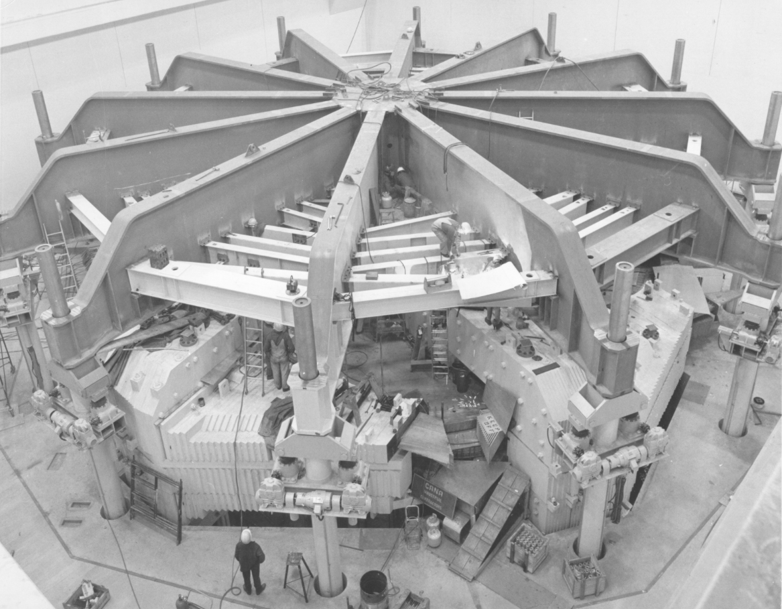

Slide 3
History of Nuclear Physics in Canada
Configuration of the TRIUMF laboratory
Proton Hall Experiments
Early Medical Program

Slide 4
By the spring of 1942, British scientists had made significant progress on determining the feasibility of an atomic bomb.
As researchers neared the production phase, British officials proposed that the secret Tube Alloys project at Cambridge’s Cavendish Laboratory be relocated to the United States.
Despite initial cooperation, American scientists on the S-1 Committee felt that collaboration with the British was no longer necessary.
With the United States hesitant to cooperate, the British government turned to Canada. In June 1942, Britain’s High Commissioner to Canada, Malcolm McDonald, met with Canada’s Minister of Munitions and Supply, Clarence Decatur “C.D.” Howe, to propose the establishment of a joint British-Canadian nuclear laboratory.
At first, Howe was wary. There were still many unanswered questions surrounding the development of a full-scale nuclear reactor and it seemed doubtful that one could be completed before the end of the war. In addition, the project would commit Canada to the expenditure of millions of dollars and divert scientists, equipment, and material from other vital war projects. Nonetheless, Howe believed that atomic energy would have a profound impact on society and the economy after the war, and the joint research effort would provide an opportunity for Canadian scientists to train in this field. In late August 1942, Howe gave the go ahead for the Montreal Laboratory with the simple words “Okay, let’s go.”
Canadian Atomic Heritage Foundation

Slide 5
The Montréal Laboratory in Quebec, Canada was established in late 1942 by the National Research Council of Canada (NRCC) to continue the nuclear research on the top-secret Tube Alloys project that was being conducted at Cavendish Laboratory in Cambridge, England. The first group of scientists arrived from England in December 1942
The laboratory’s staff quickly grew to include over three hundred scientists, technicians, and engineers, of whom about half were Canadian
On August 17, 1943, British Prime Minister Winston Churchill met with American President Roosevelt in Québec to discuss the unsatisfactory state of British-American collaboration in nuclear energy research, including the work of the Montréal Laboratory. After some prodding, Roosevelt agreed that arrangements should be made "to ensure full and effective collaboration between the two countries in bringing the project to fruition". A "Combined Policy Committee" under the chairmanship of Henry Stimson was established to work out the basis for implementing this agreement.
On April 13, 1944, the Combined Policy Committee decided to proceed with the design and construction of a heavy water moderated nuclear reactor in Canada. It was agreed that there would be a full exchange of information relevant to the design of the reactor and the extraction of the plutonium it produced. However, General Leslie Groves insisted that Halban and the other scientists who were not British subjects leave the project.
Notes:
Canadian accelerators

Slide 6
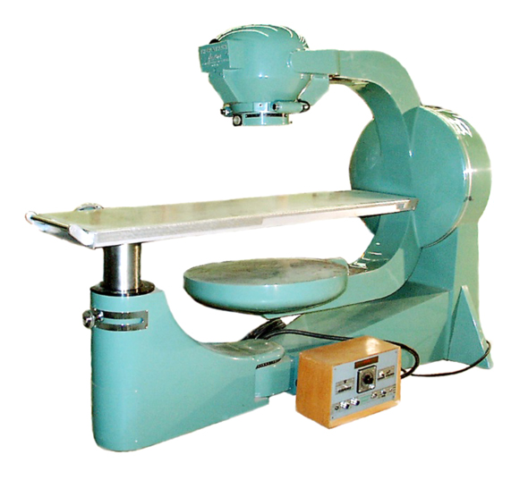
In 1951, University of Saskatchewan medical physicist Dr. Harold Johns and his graduate students became the first researchers in the world to successfully treat a cancer patient using cobalt-60 radiation therapy. This innovative technology—dubbed the “cobalt bomb” by the media - revolutionized cancer treatment
Notes:
culture
nuclear force

Slide 7
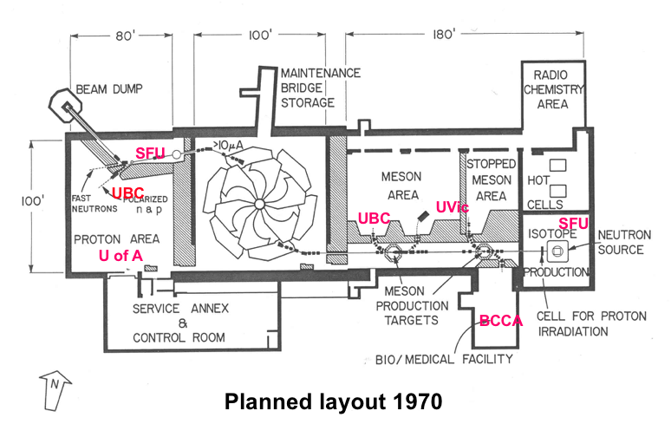

Slide 8
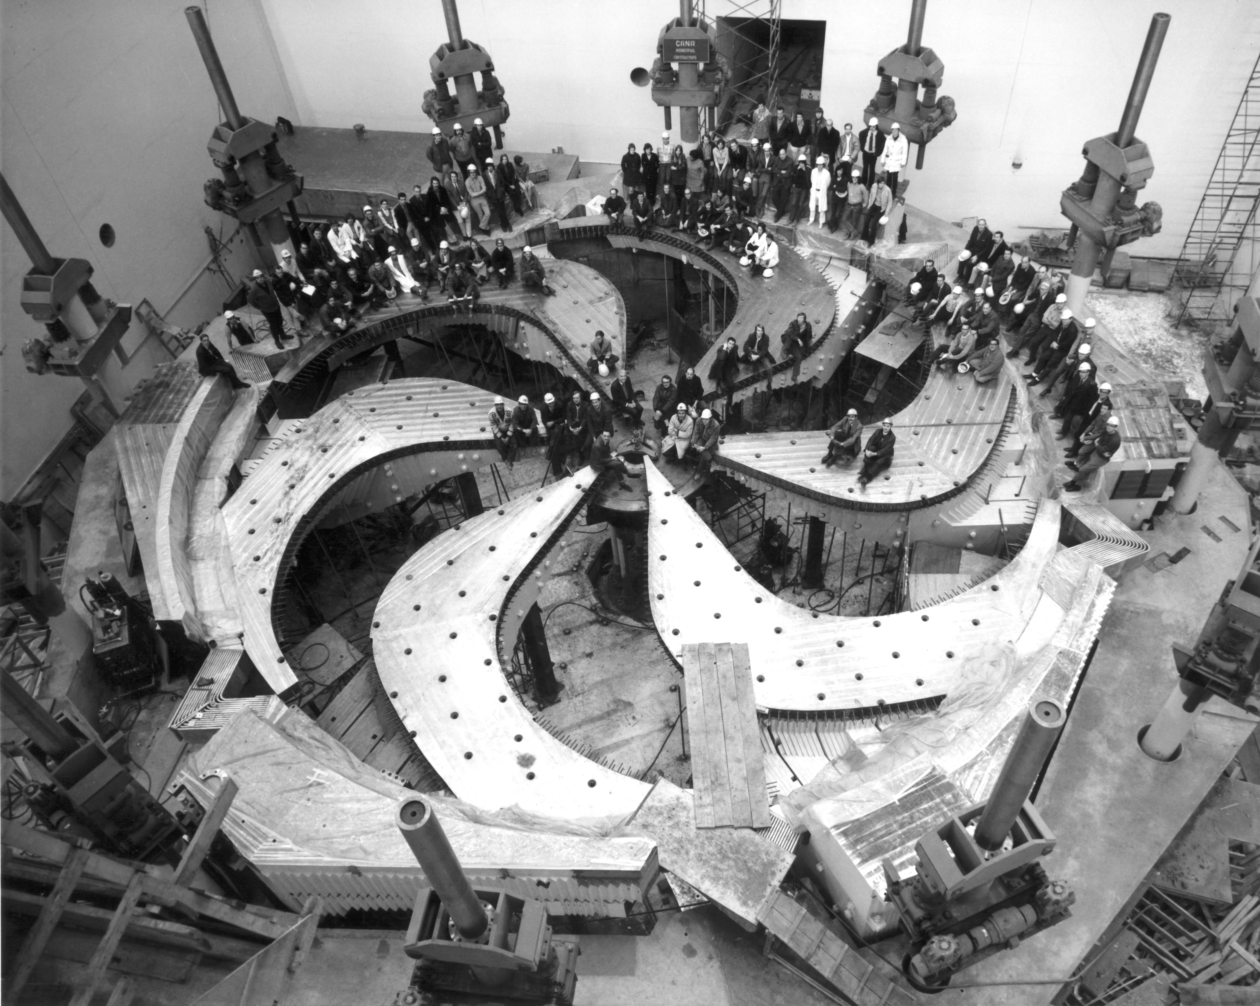
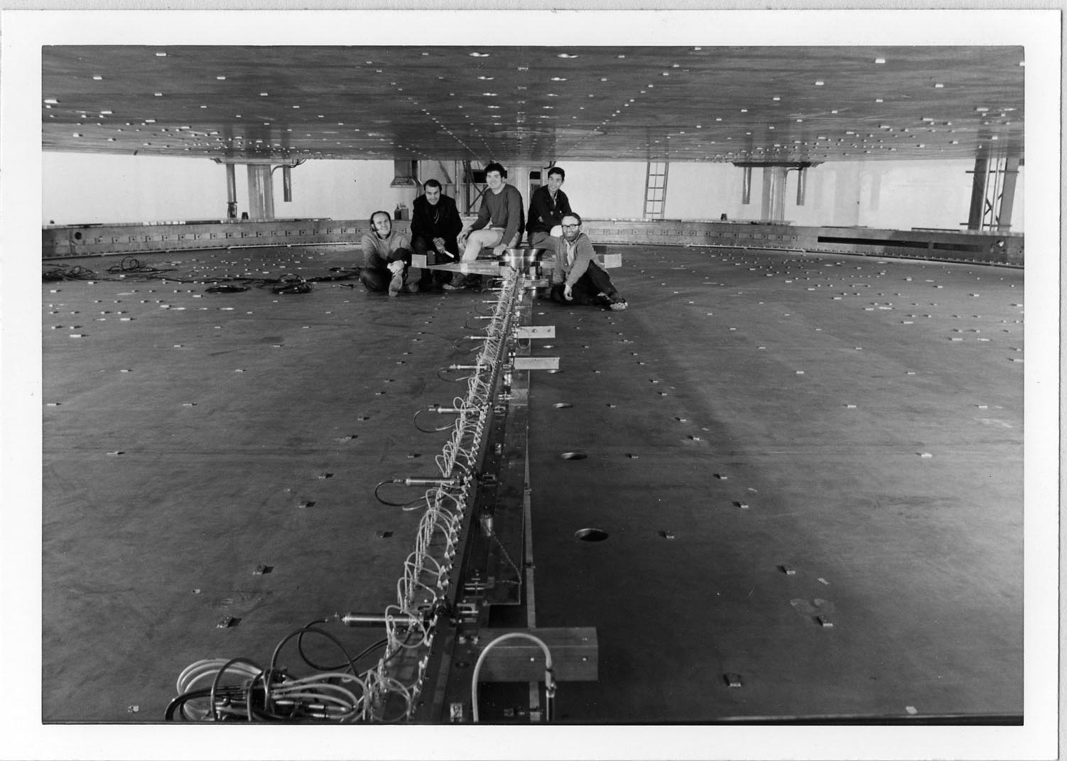
Cyclotron Systems and Challenges
Magnet
fabrication and assembly went well (1972)
4000 tons of steel in 50 ton shipments
first field maps-centre field too high by 100 g
difference in steel permeability 0.5” vs 5”
required gouging out 16 tons of steel
field tolerance of 1 g required ( 1 in 4000)
took ~ 9 months of shimming/measurements
delays gave other groups time to be ready
Field mapping using flip coils

Slide 9
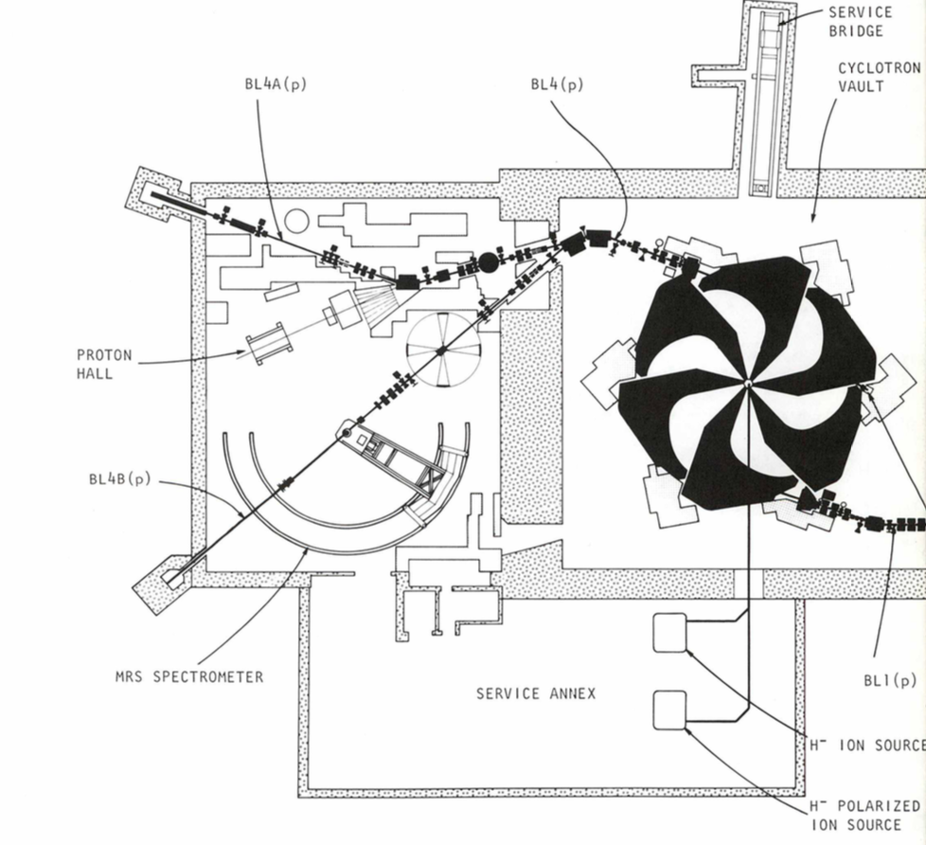

Slide 10
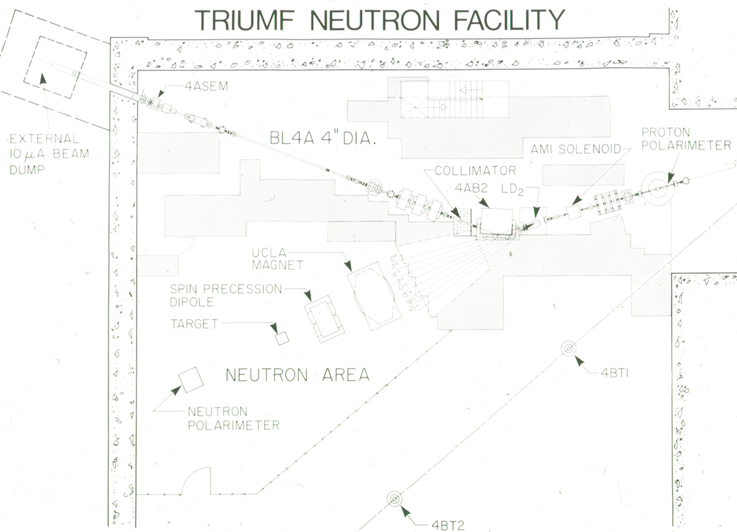

Slide 11
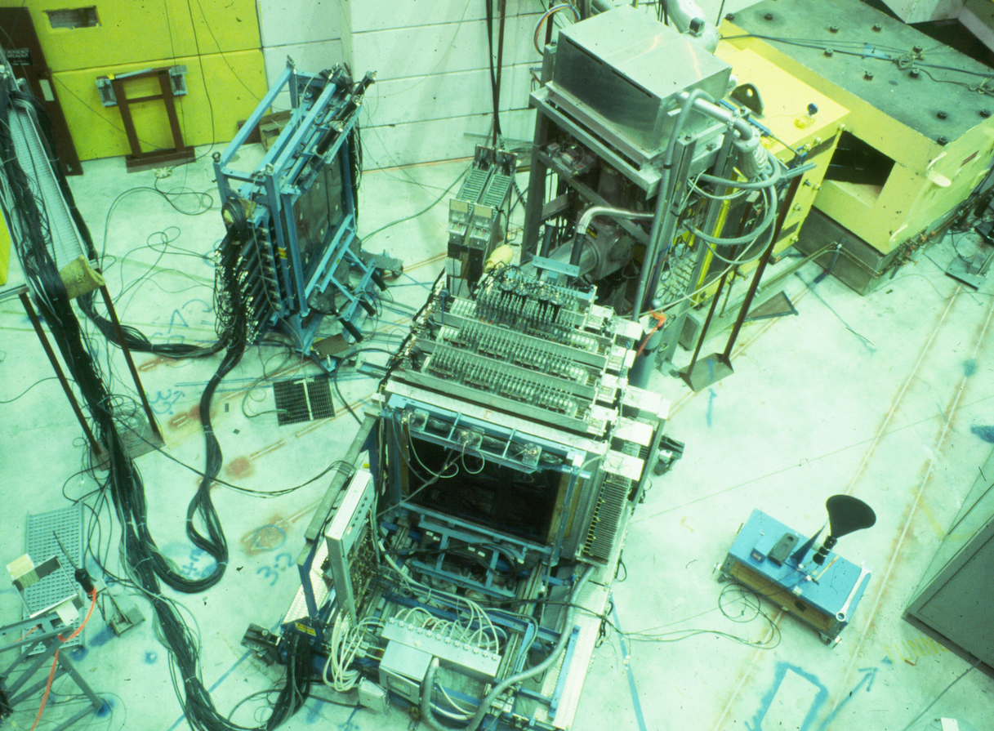

Slide 12
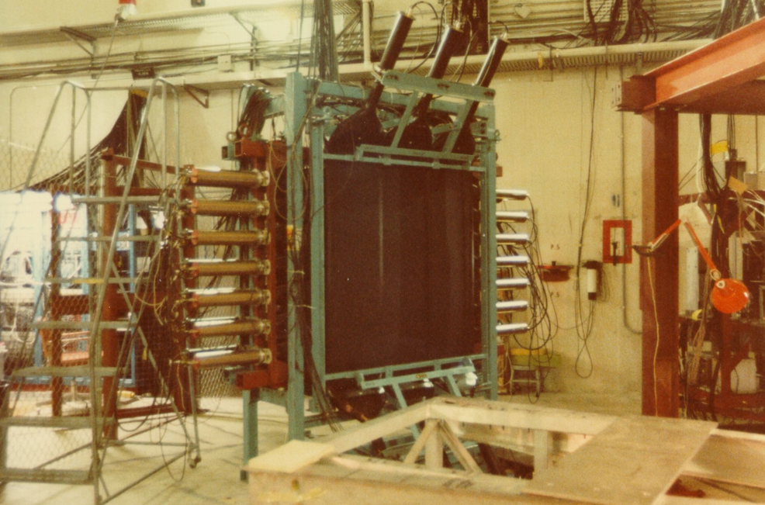

Slide 13
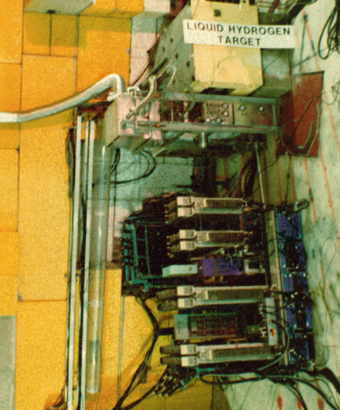

Slide 14
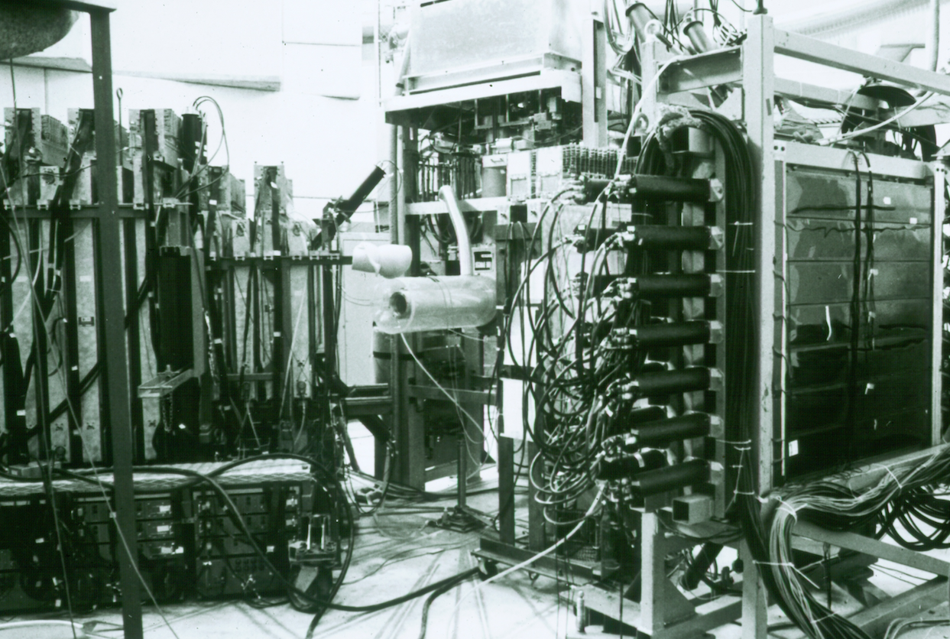

Slide 15
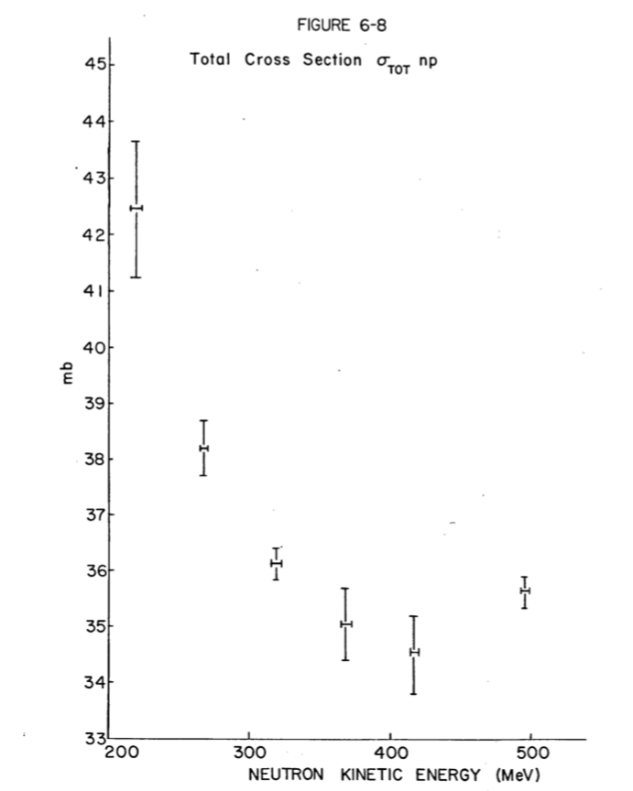
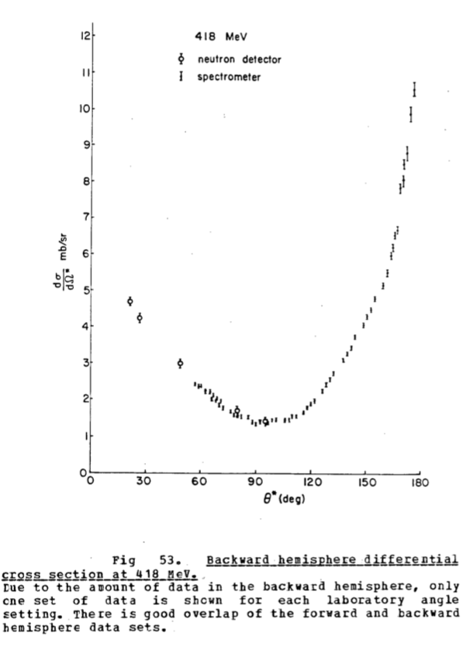

Slide 16
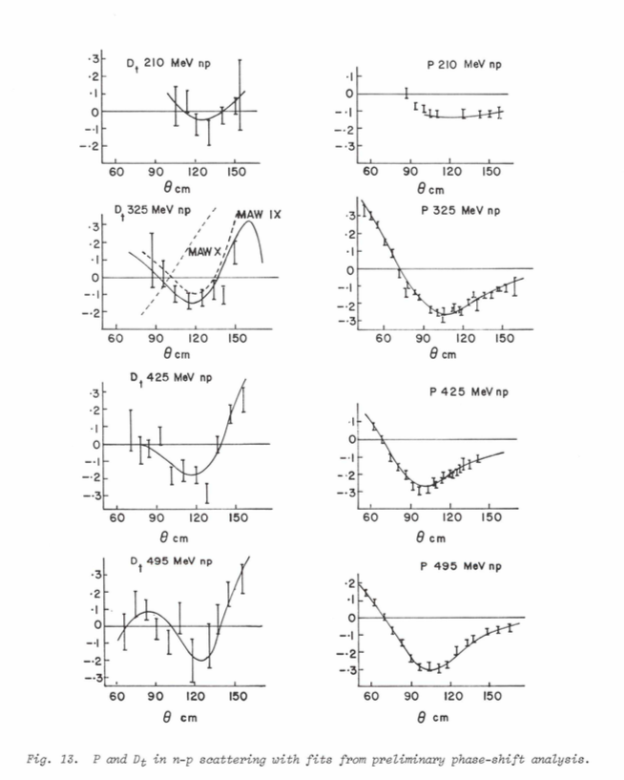

Slide 17
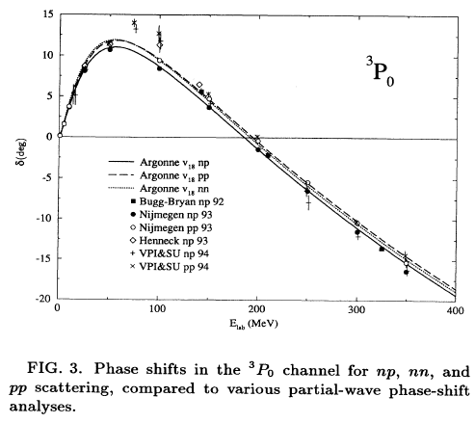

Slide 18
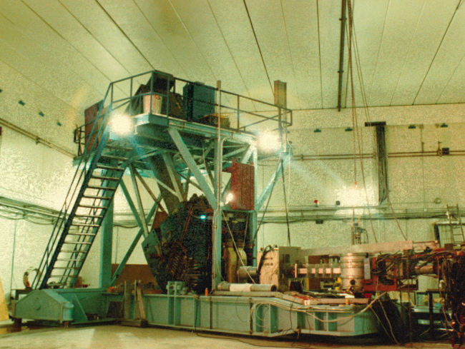

Slide 19
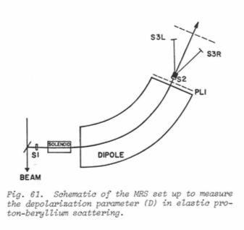

Slide 20
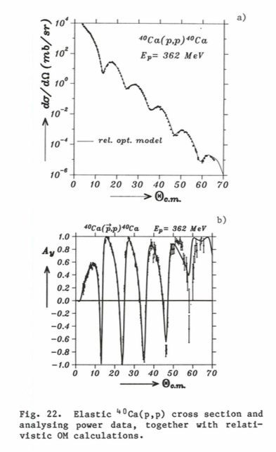

Slide 21
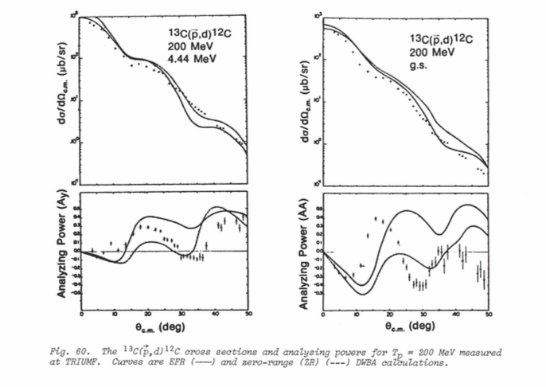

Slide 22
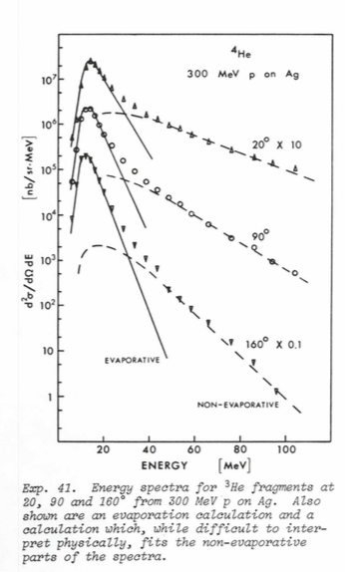

Slide 23
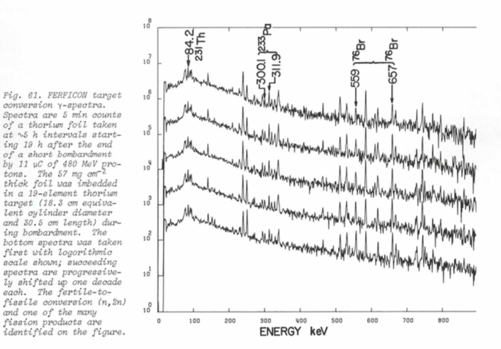

Slide 24
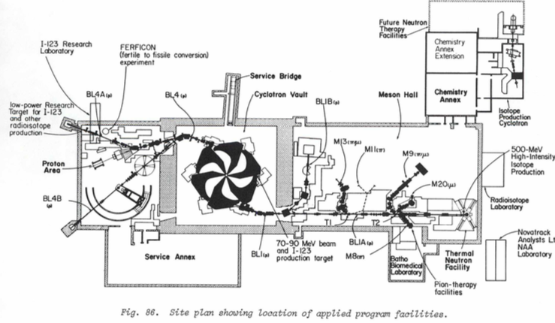

Slide 25
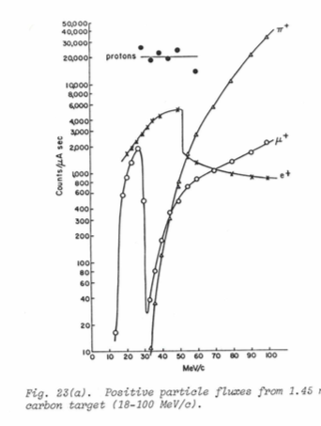
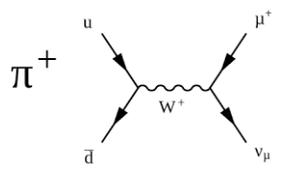

Slide 26
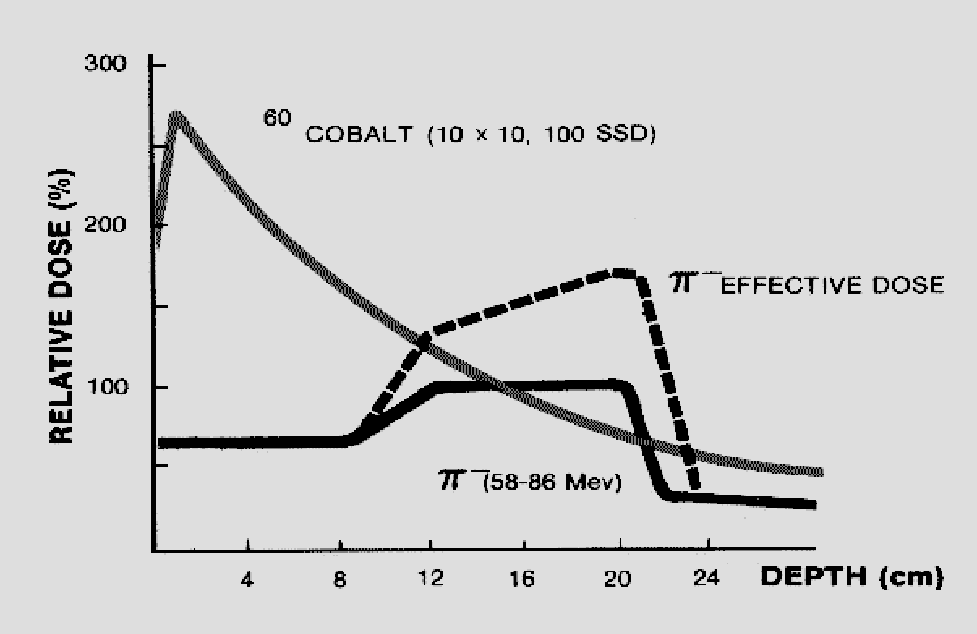

Slide 27
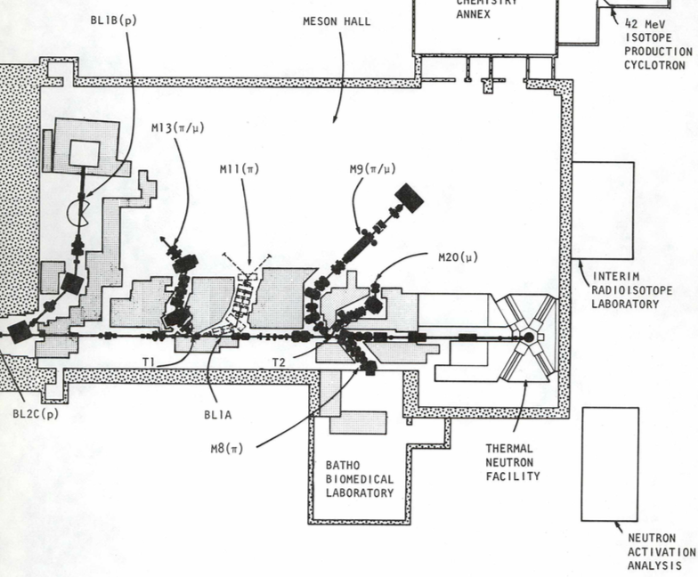

Slide 28
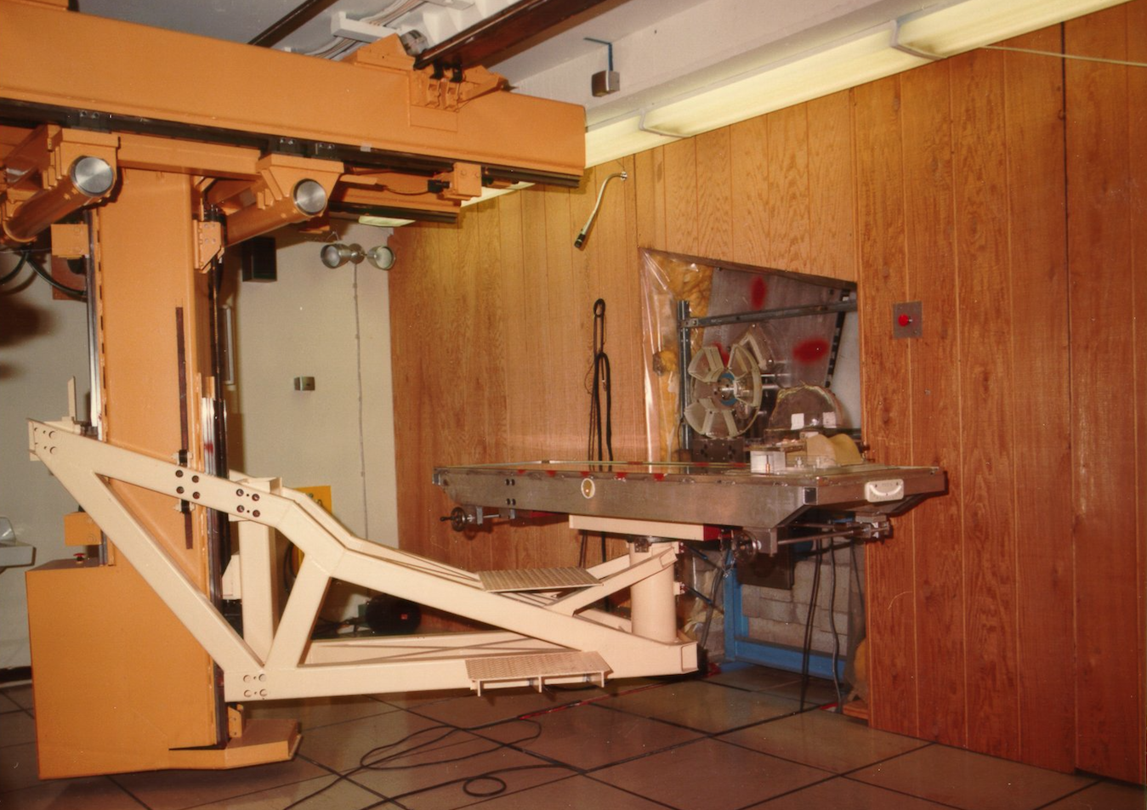

Slide 29
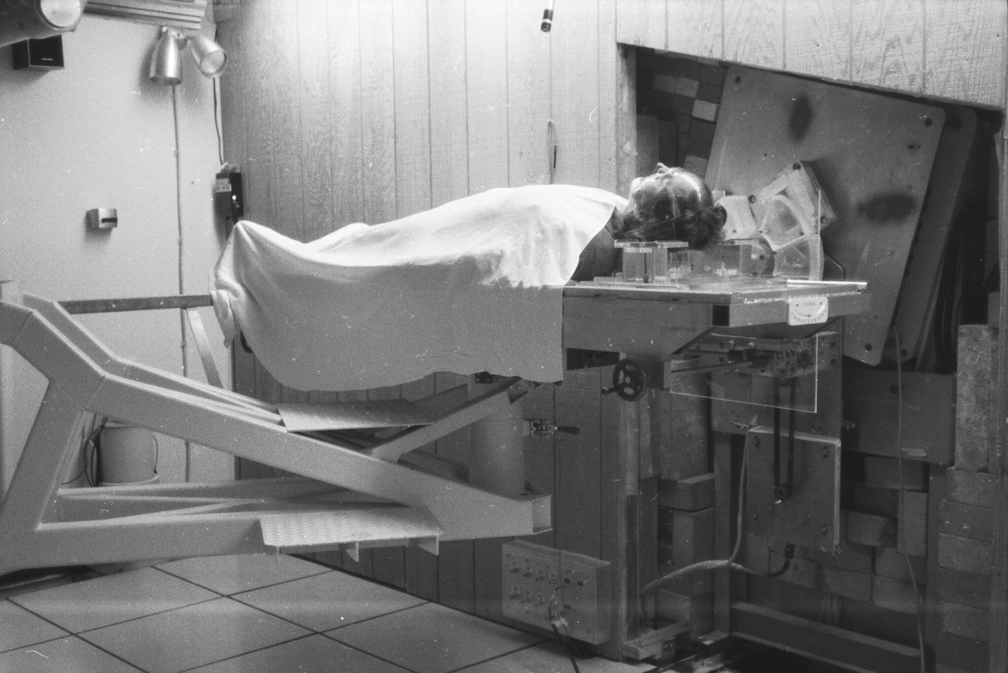

Slide 30
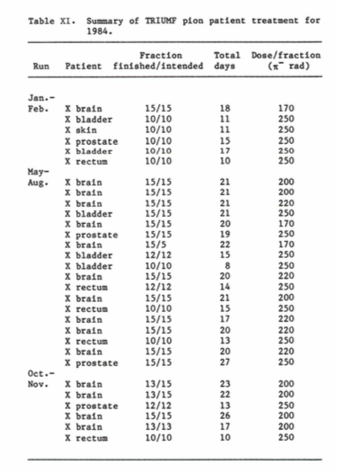

Slide 31
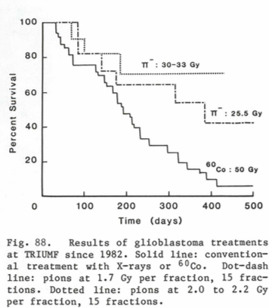
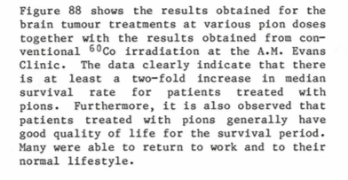

Slide 32
In 1978 a grant from the federal Department of Health and Welfare provided support for a pilot program supplying iodine-123 to several hospitals distributed across Canada with generally enthusiastic response concerning the prefera­bility of iodine-123 with a half life of 13 hours compared to the commonly used iodine-131 with a half life of 8 days.

Slide 33
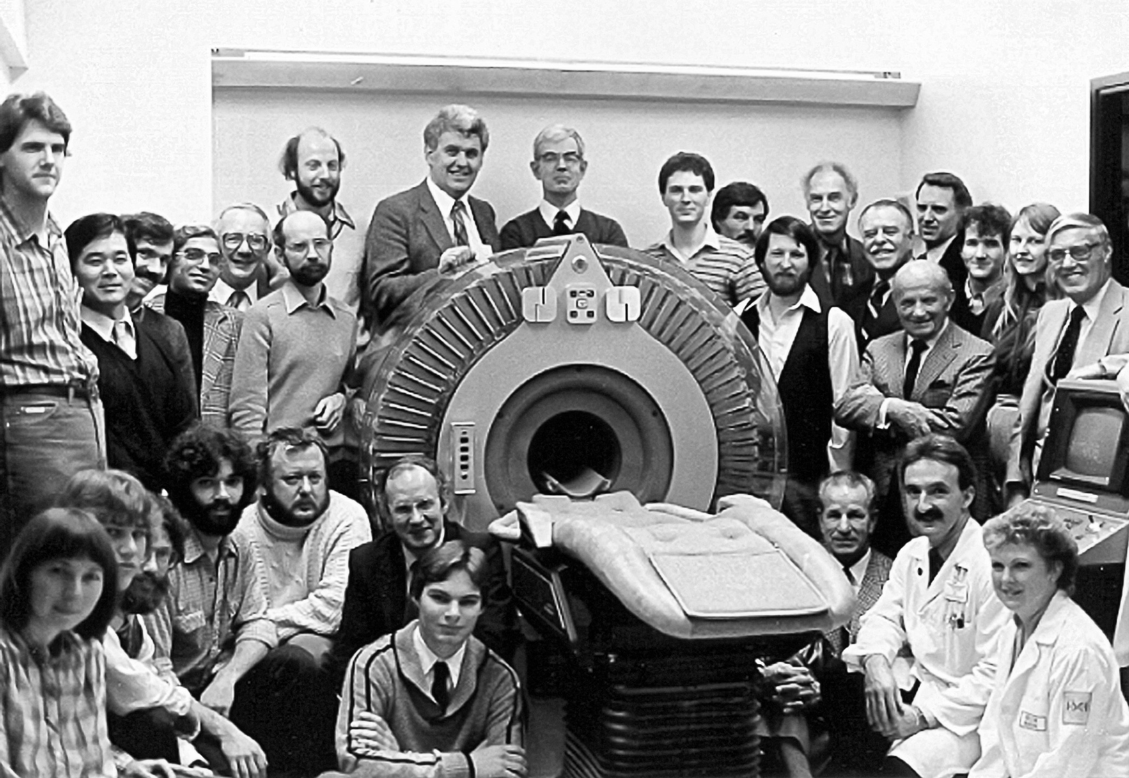

Slide 34
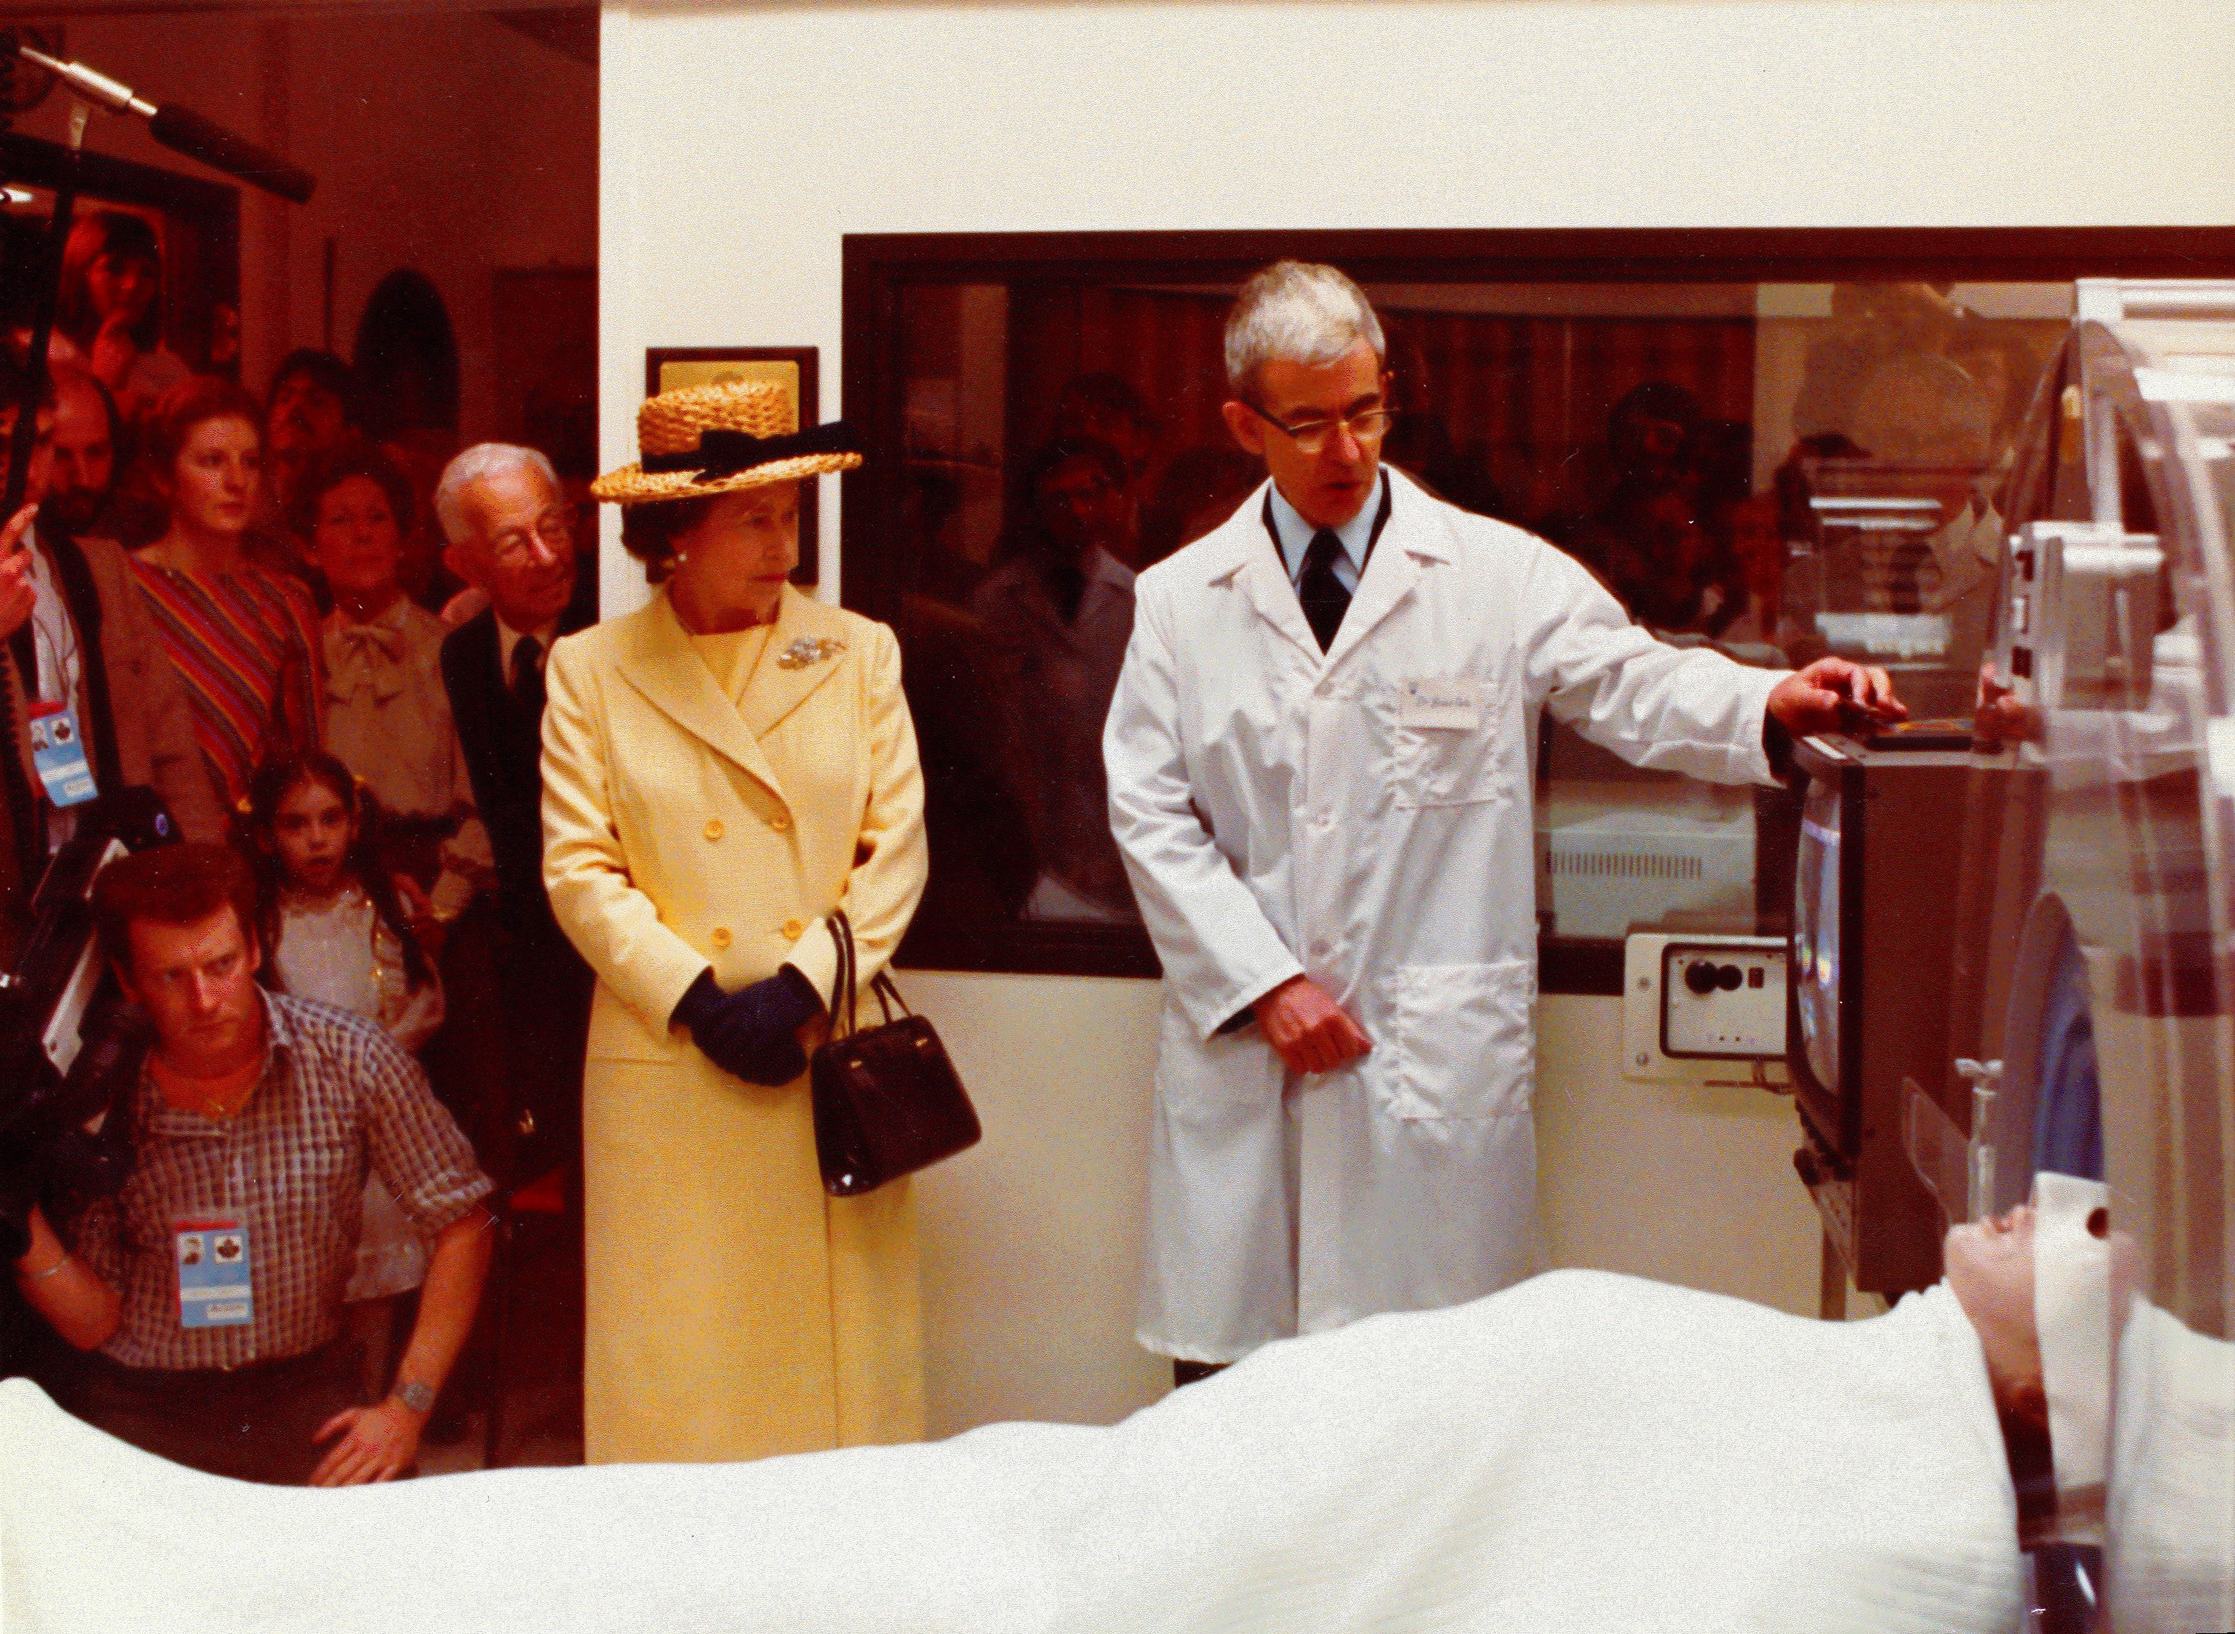

Slide 35
Thank you
Merci

Slide 36
