Slide 1

SRF at TRIUMF:
Accelerator Science and Achievements
Lia Merminga
TRIUMF Science Week 2018
July 16-19, 2018
Notes:
.

Slide 2
Outline
The beginning of SRF at TRIUMF
TRIUMF Masters SRF Technology
  ISAC-II Heavy Ion Linac
  ARIEL e-Linac
SRF: a core competency of TRIUMF
  R&D & HQP Training
  Global Partnerships
  New Developments
Final thoughts

Slide 3

The beginning of SRF at TRIUMF

Slide 4
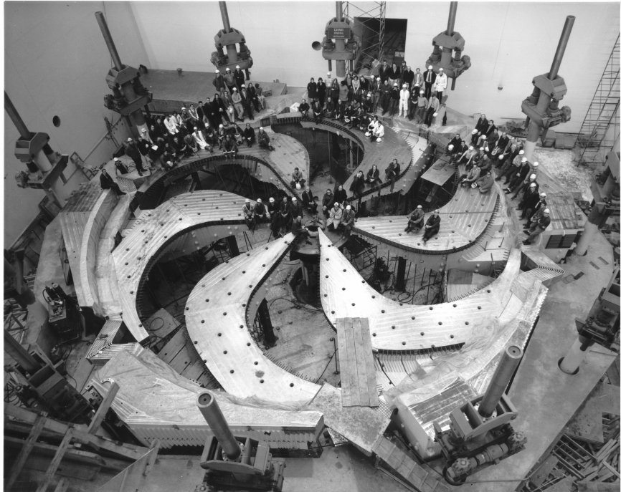
TRIUMF 1974-1994 – Cyclotron Laboratory
1972 TRIUMF, Vancouver, BC

Slide 5
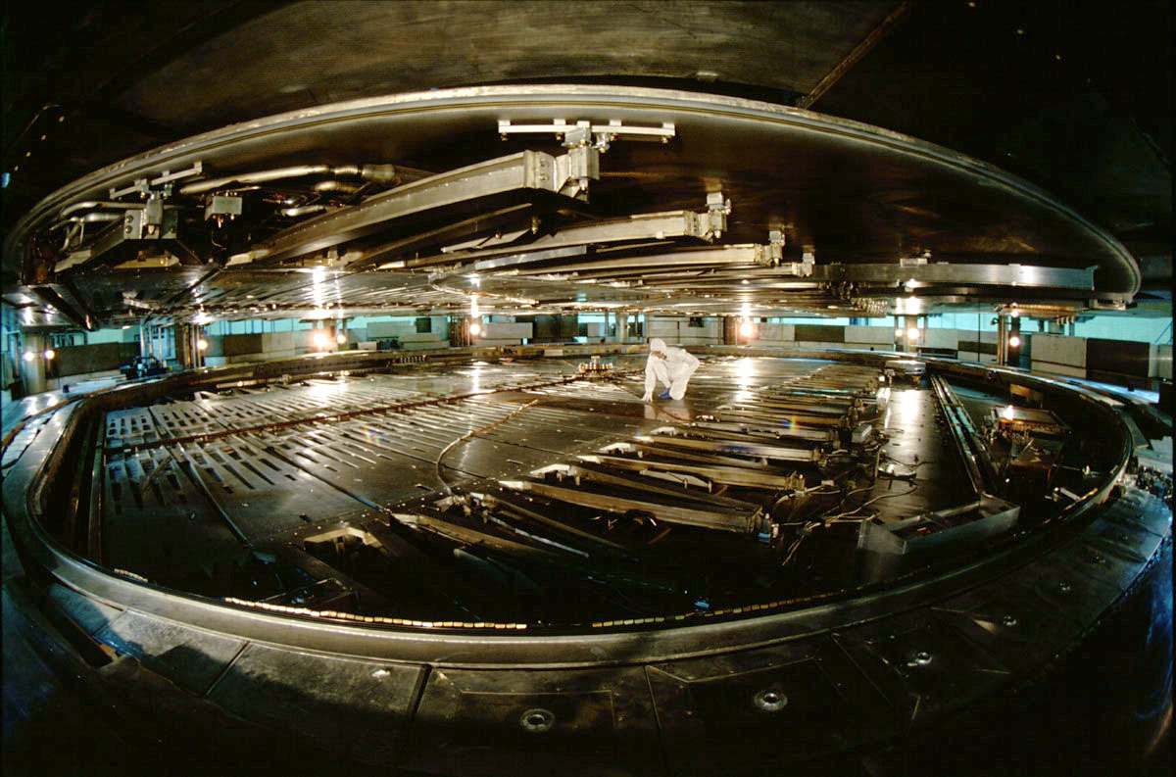

Slide 6
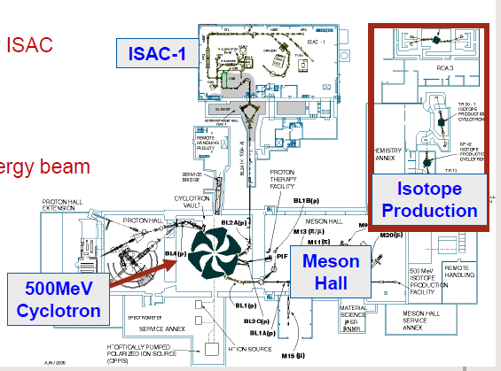
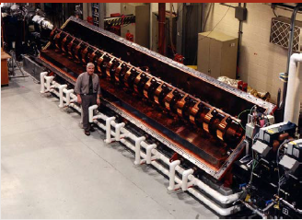
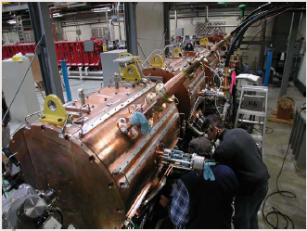
TRIUMF 1994-1998 – ISAC Era Begins
In 1994 TRIUMF was in need of a new direction
ISAC era begins
  Radioactive beams based on ISOL production using proton beams from 500MeV cyclotron
ISAC funding announced in 1995
1998 – first low energy beam
ISAC-I accelerators, RFQ, DTL designed and built at TRIUMF, have been delivering high quality radioactive and stable beams to experimenters since 2001

Slide 7
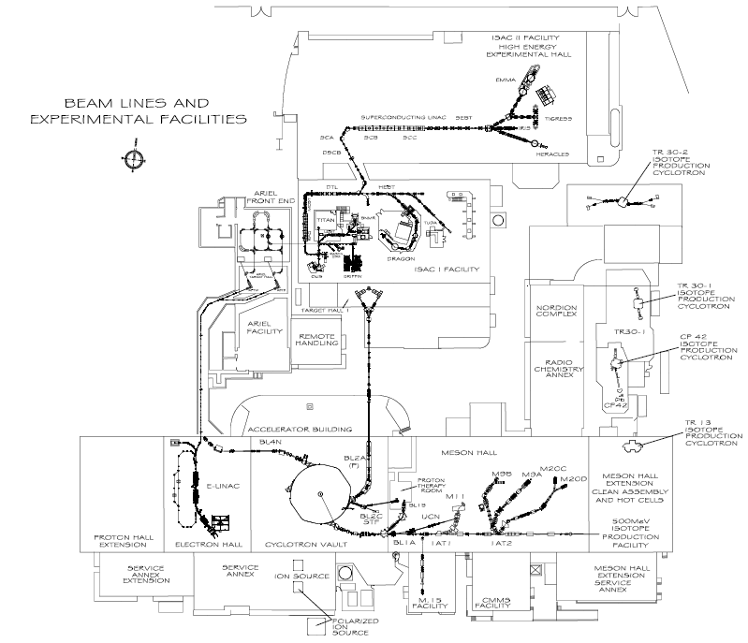
TRIUMF 2000 – SRF Era Begins
ISAC-II concept ~ 1998 to support higher energies at ISAC for Nuclear Physics studies at and above the Coulomb barrier
    Goal E ≥ 6.5MeV/u for A/q=6 with full energy variability
    Decision: develop a superconducting heavy ion linac of 40MV
SRF was a natural extension to the ISAC linac!
1999 - Initiated a collaboration with INFN-LNL
2000 - Cavity prototype tested at Legnaro

Slide 8
Why Superconducting for RIB post accelerator?
High gradient for cw operation
  CW room temperature accelerators limited by power and not field breakdown
Large apertures and longitudinal phase space
  High transmission, easy to tune
  Multi-charge acceleration possible
Flexible machine
  Suitable for a broad experimental program
  Energy fully variable from no acceleration to full acceleration
  Easy to manipulate longitudinal phase space
Superconducting cavities are ~100 times more efficient than room temperature in AC wall power
Superconducting linac with independently driven cavities supports flexible yet efficient acceleration

Slide 9
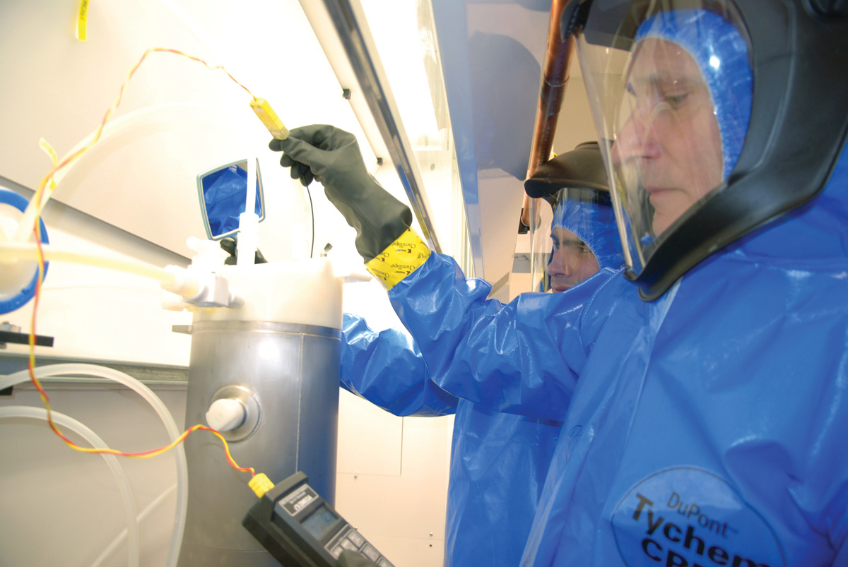
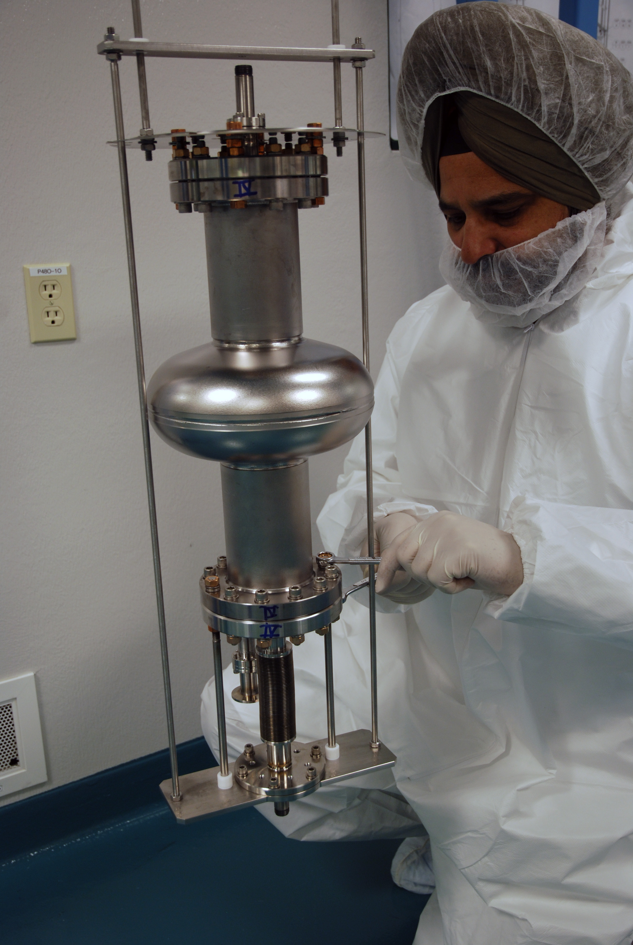
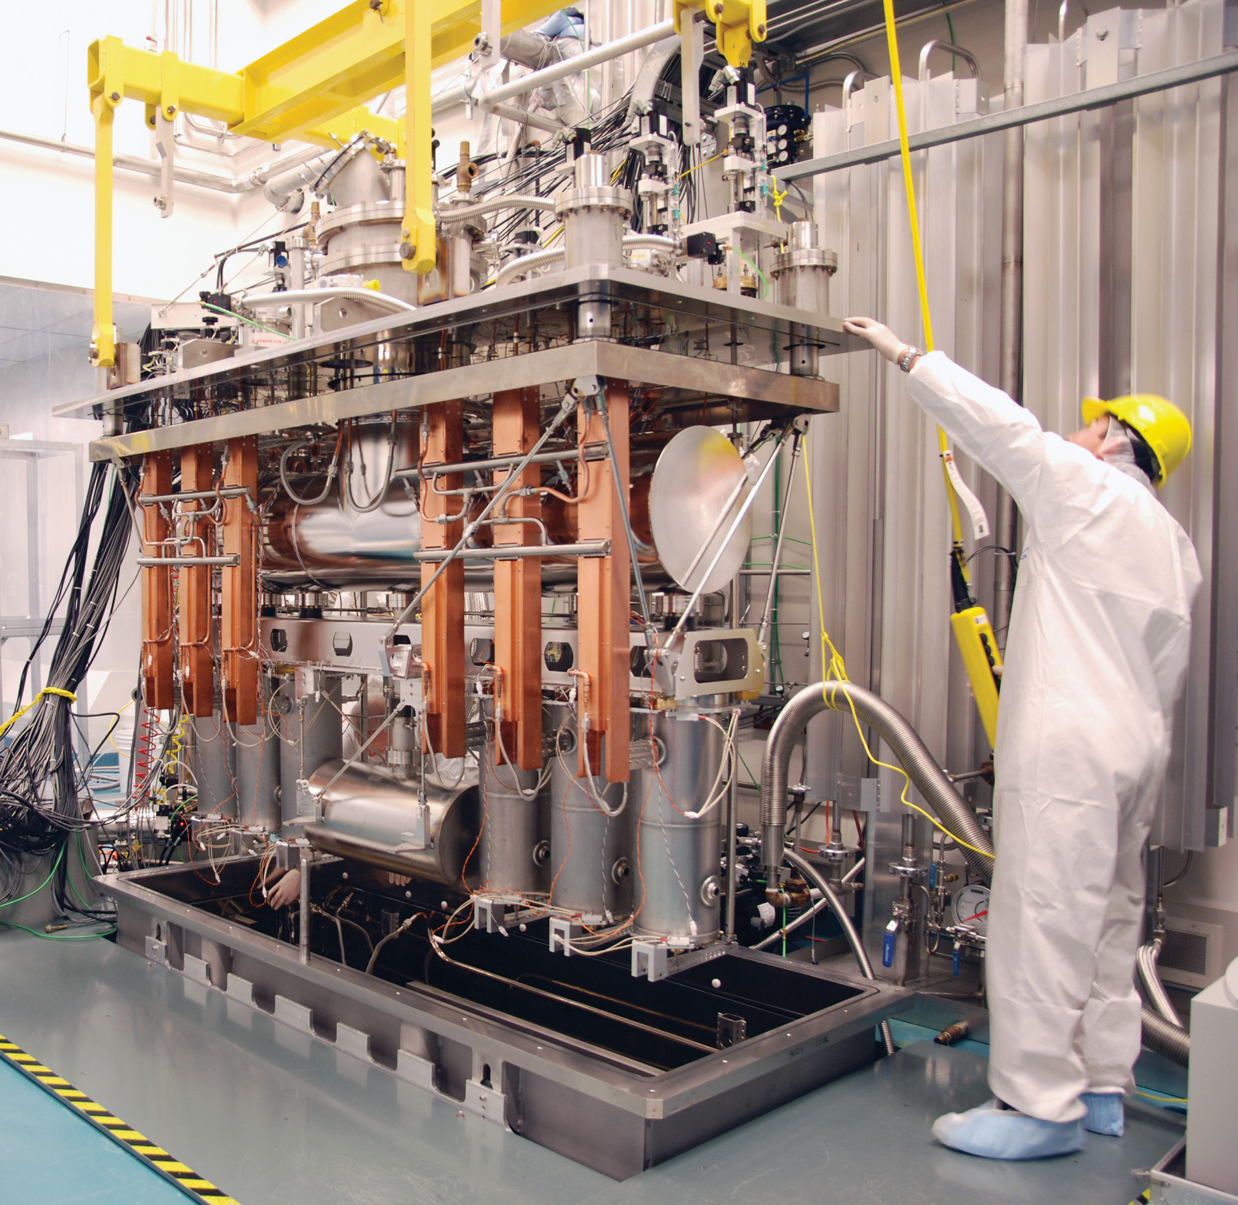
ISAC-II SRF Infrastructure - 2003
The ISAC-II building (2003) houses the SRF test and assembly areas
  500m² of floor space, overhead crane
  US cleaning tanks, HPWR area, rf test area, cryogenics on tap, cryomodule assembly area (clean room and larger dirty assembly space), chemical etching lab (BCP)
  Enabled the production and testing of 20 cavities and five cryomodules for the ISAC-II heavy ion linac
42m
ISAC-II SCRF Area
RF Controls Lab
Boot Area
RF Measurments
Water Rinse/Clean Area
17m
Boot-up
RF Meas
Preparation Area
SCRF Test Clean Area
Clean Assembly Area
Chemical Lab
Test Pit

Slide 10
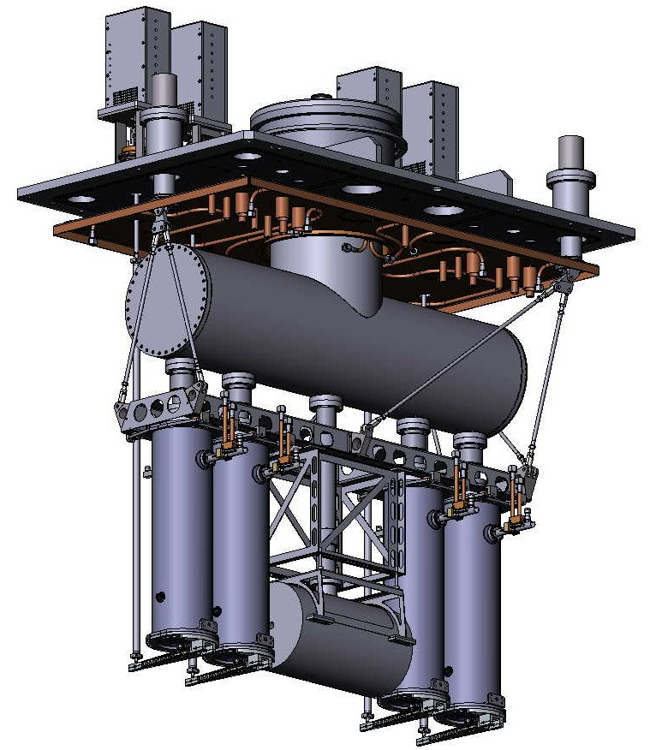
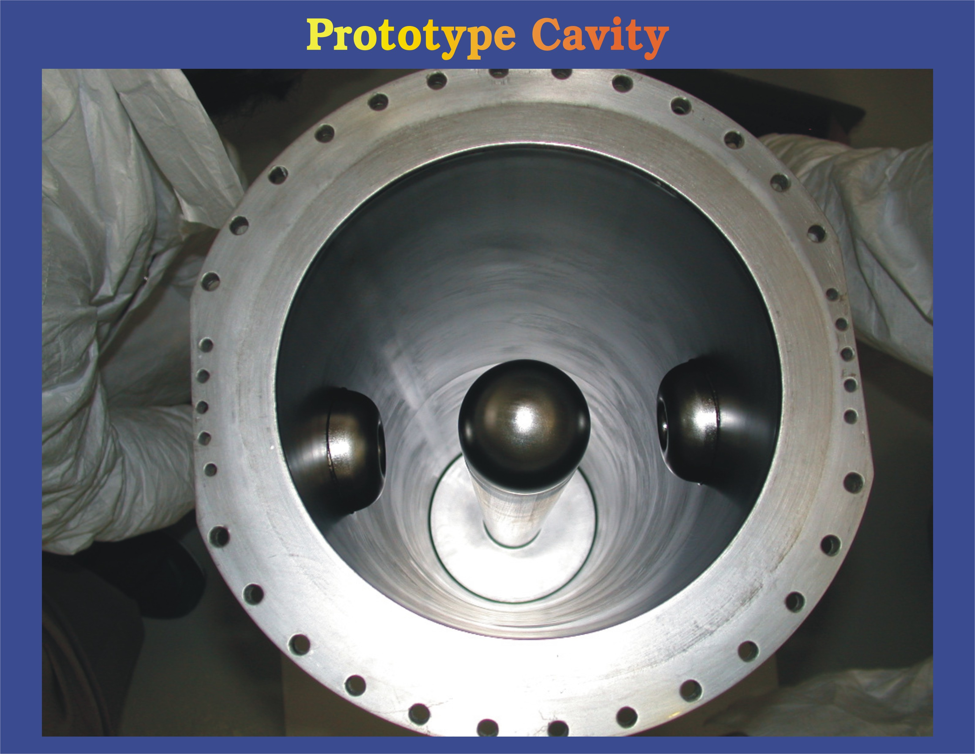
ISAC-II SC Linac Phase I – 2003-2006
Bulk niobium quarter wave cavities operating at 4.3K and 106MHz
Each cavity produces ~500kV on the ‘hot’ inner electrode with ~4 Watts of rf power
Two gaps give a total of 1 MV/cavity
Twenty bulk niobium quarter wave cavities (sourced from Italy) are housed in five cryomodules
Boosts ion energy by 20MV with low mass RIBs above the Coulomb barrier

Slide 11
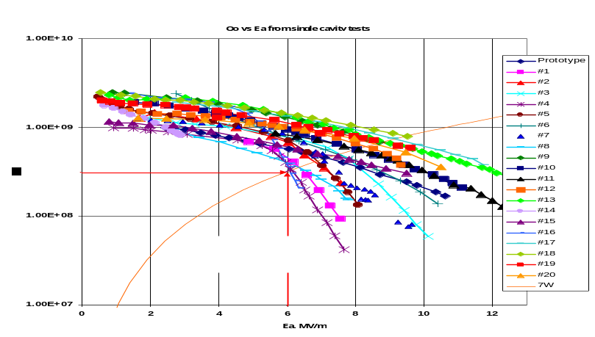
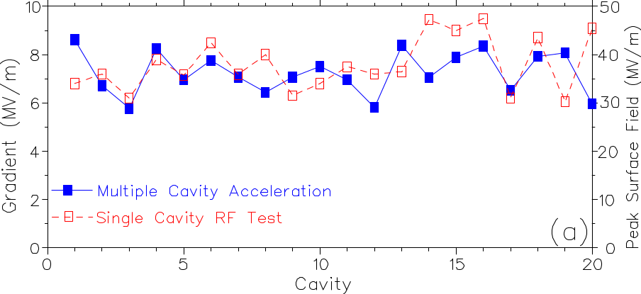
Performance exceeds expectation - 2006
The average gradient for the on-line cavities is 7.25MV/m corresponding to a peak surface field of 36MV/m
Off-line results give an average gradient at 7W/cavity of 7.6MV/m corresponding to Ep=38MV/m
=> CM clean assembly worked very well

Slide 12
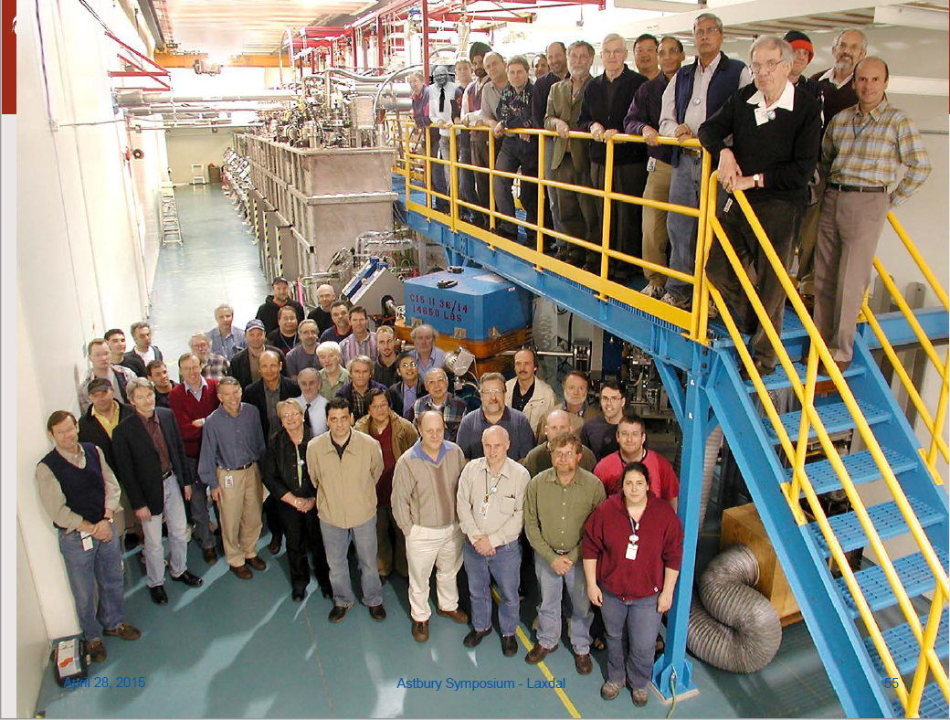

Slide 13
TRIUMF Masters SRF Technology

Slide 14
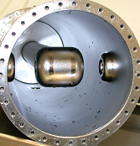
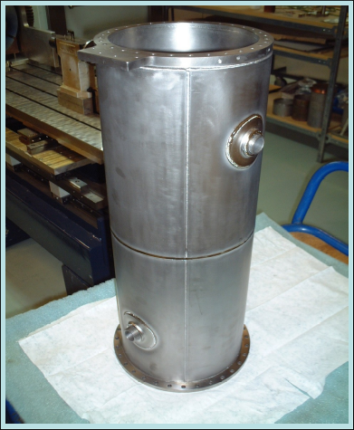
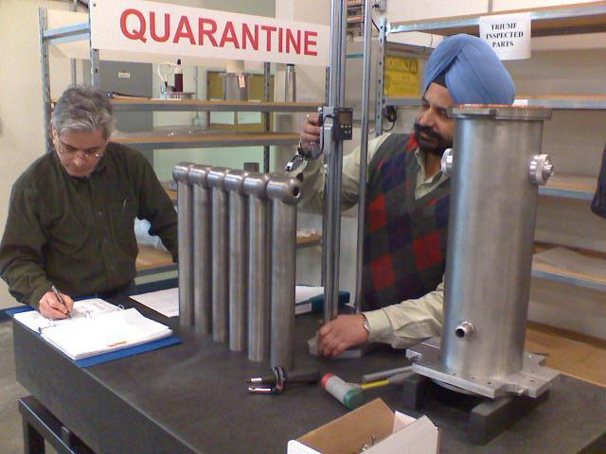
ISAC-II SC Linac Phase II – 2006-2010
Technical goal - Develop PAVAC Industries of Richmond BC for SRF cavity fabrication
  Prototypes in copper and Nb
  Twenty production cavities ordered – March 2008
  First niobium superconducting cavity fabrication in Canada
Adds 20MV of additional voltage gain for a total of 40MV in ISAC-II
Required 20 QWR’s at β=0.11

Slide 15
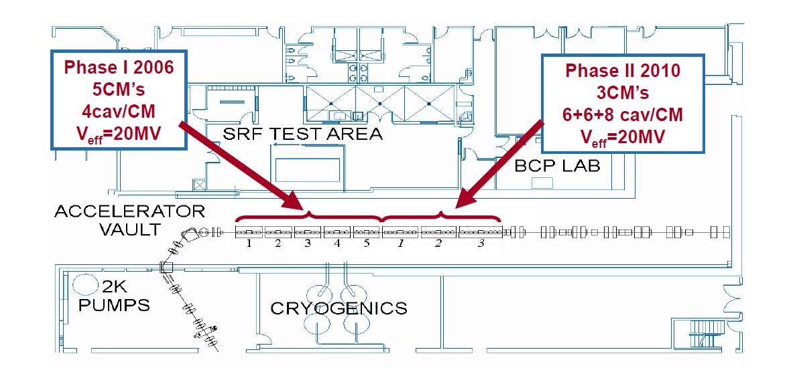
ISAC-II SC Linac – 2010

Slide 16
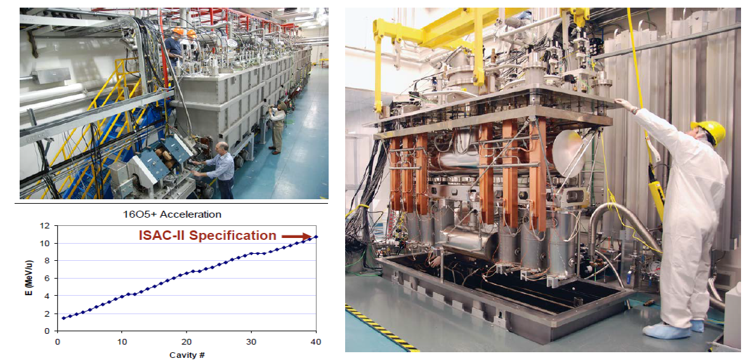
Success – April 2010

Slide 17
TRIUMF 2010 – The ARIEL Era Begins
Two new drivers: electron & proton
Two new target stations and front end
Substantially expand existing capabilities
  Three simultaneous beams
  RIBs via photofission
    high production of many neutron rich species
    relatively low isobaric contamination with respect to proton induced spallation
e-linac

Slide 18
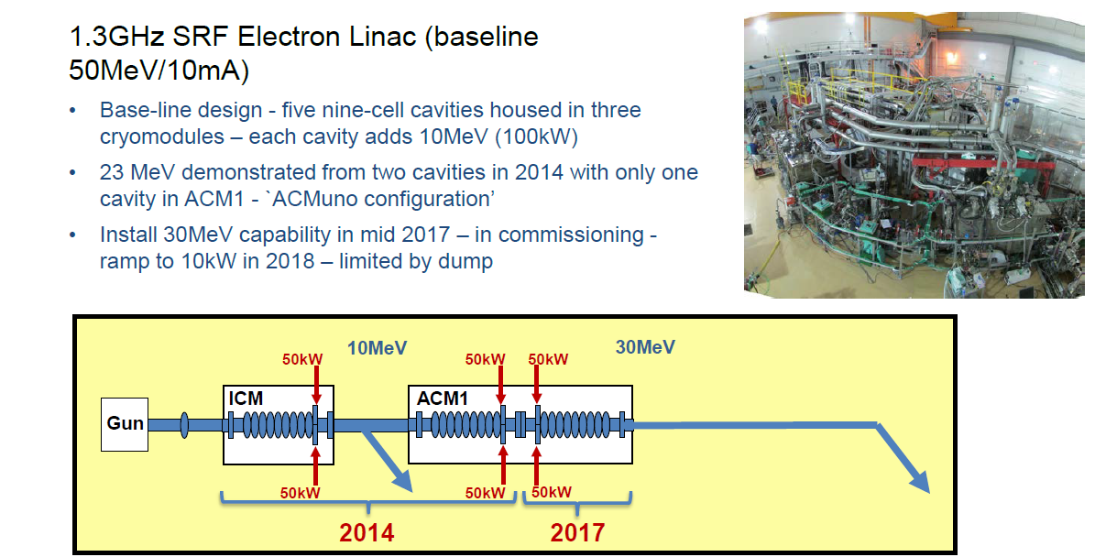
ARIEL 50MeV e-Linac

Slide 19
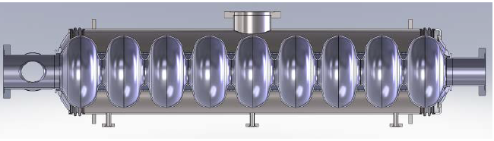
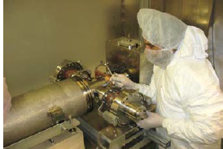
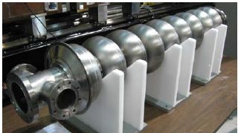
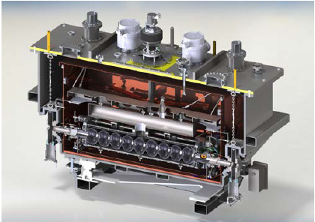
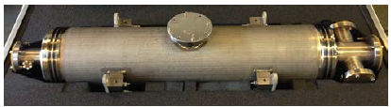
ARIEL SRF Systems – Made in Canada

Slide 20
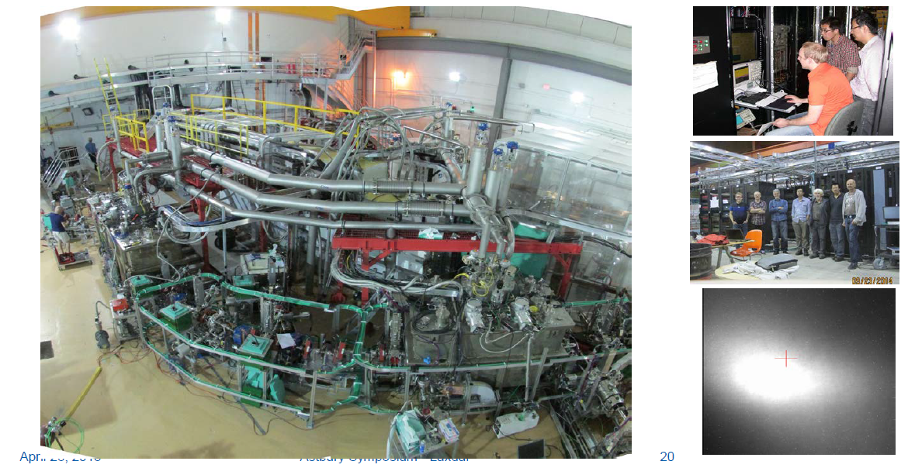
First Beam – September 30, 2014

Slide 21
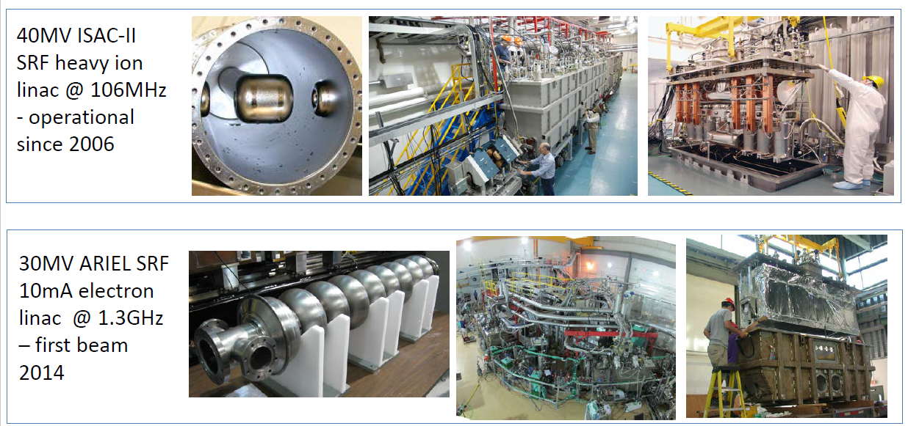
TRIUMF SRF Accelerators

Slide 22
SRF: a core competence of TRIUMF

Slide 23
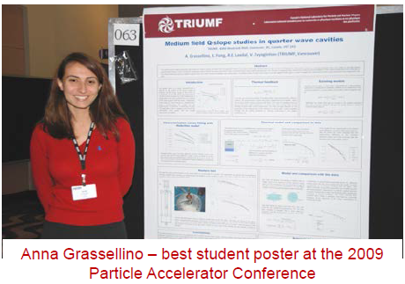
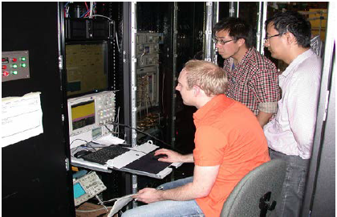
SRF HQP Training
TRIUMF offers a graduate students program in Accelerator Physics and Engineering
One course per year taught at UBC by TRIUMF research scientists
Five PhD students in SRF studies to date – highly successful:
  Anna Grassellino, Philipp Kolb, Ramona Leewe, Doug Storey, Sophia Yan

Slide 24
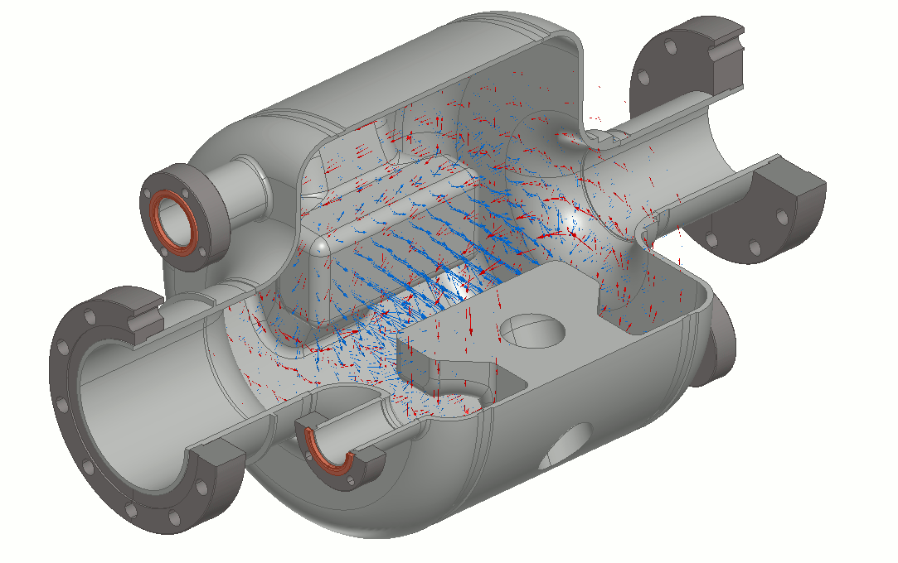
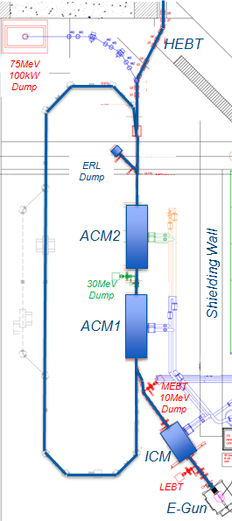
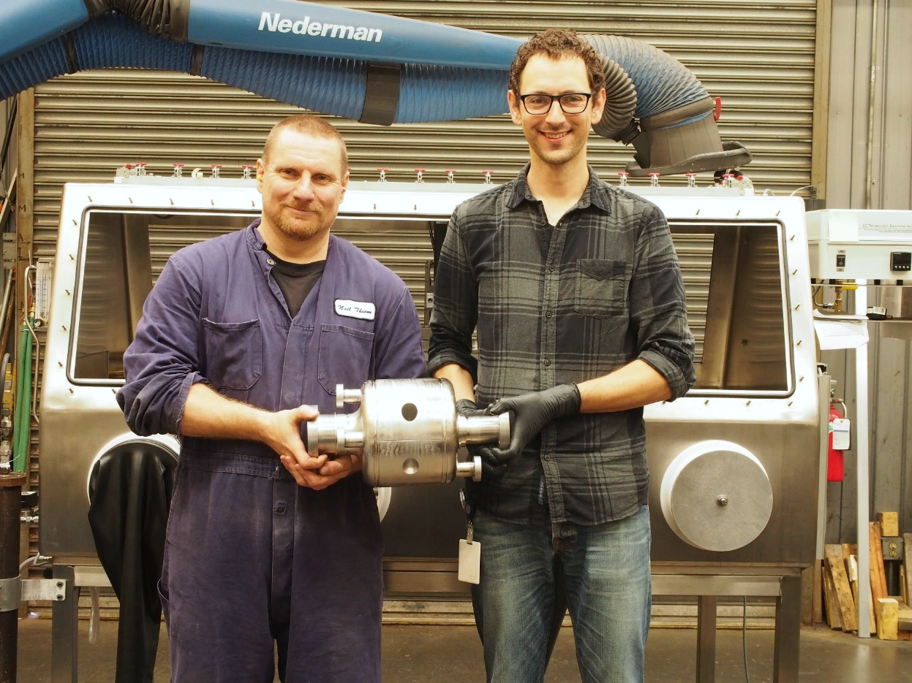
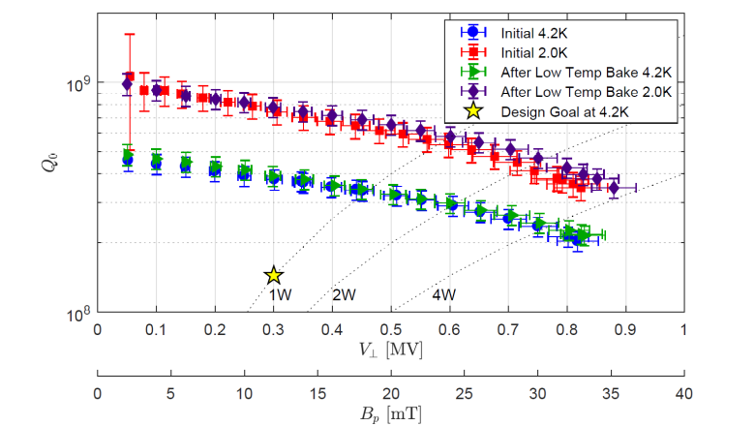
SRF HQP Training Example:
SRF Dipole Cavity – Doug Storey (UVic)
650MHz rf deflecting mode cavity has been designed and fabricated in Nb
SRF Cavity was fabricated in the TRIUMF machine shop from reactor grade Niobium with TIG welding
RF Dipole
First cavity fabricated in the TRIUMF Machine Shop

Slide 25
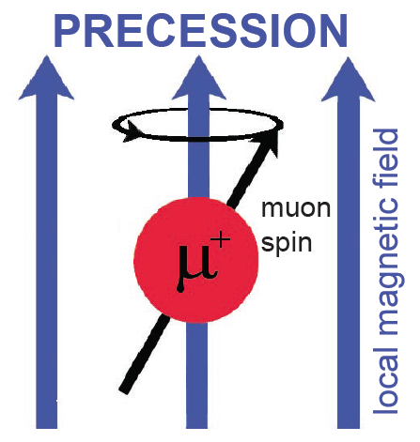
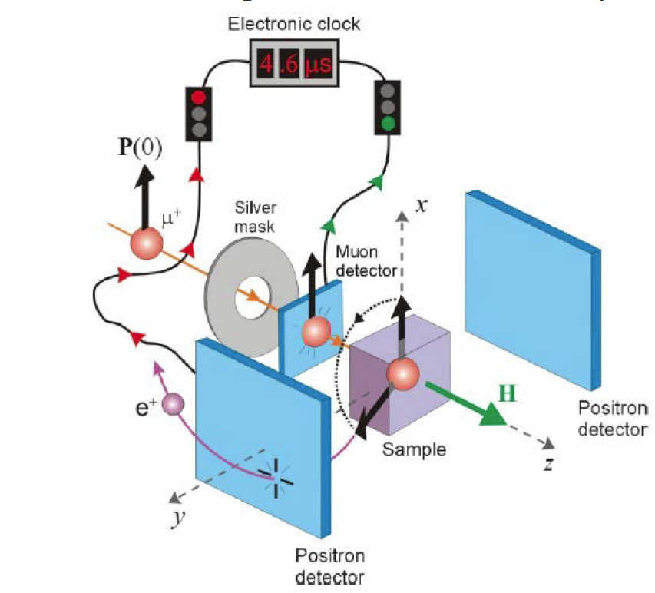
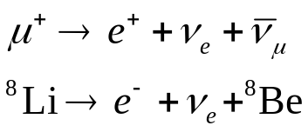
Material Science Probes at TRIUMF - μSR and β-NMR
TRIUMF has two world class material science probes in μSR and β-NMR – utilize the beta decay of a beam of polarized muons or 8Li ions respectively as probes of local magnetism
TRIUMF μSR samples near surface fields (100µm) and β-NMR samples surface fields (0->200nm)
Method
Imbedded probes decay with emitted positrons or electrons correlated with direction of spin. Spin precession dependent on the magnetic field of the imbedded probe
Superheating in coated niobium, T Junginger, W Wasserman and R E Laxdal, Superconductor Science and Technology, Volume 30, Number 12, Published 7 November 2017

Slide 26
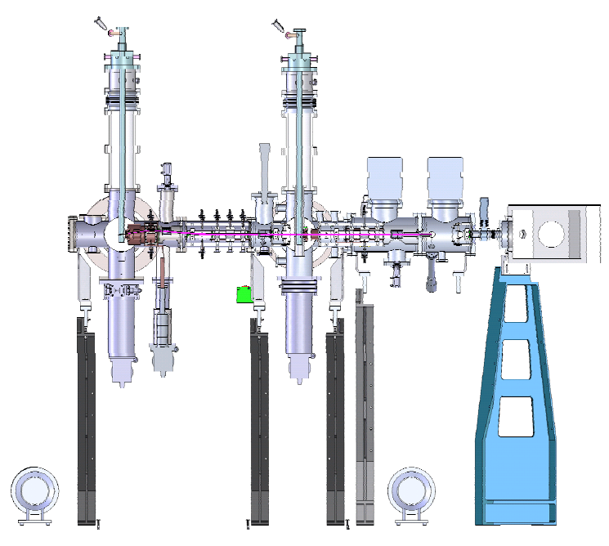
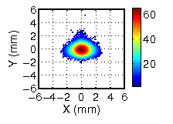
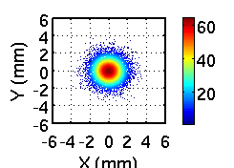
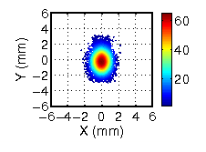
β-NQR High Field Upgrade
4 keV 8Li+
B = 0 G
Initial distribution
of 28 keV 8Li+ beam.
4 keV 8Li+ B = 2 kG
Motivation: Material studies in high transverse magnetic field (SRF material studies)

Slide 27
Global Partnerships

Slide 28
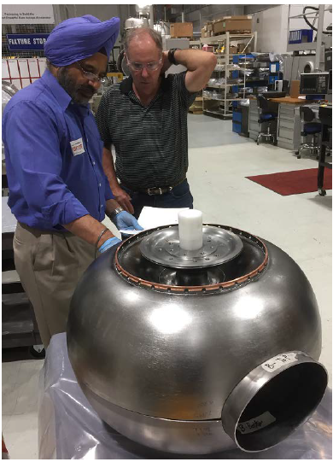
Single Spoke Resonator for RISP – Korea
TRIUMF designs/fabricates two SSRs – 325MHz β=0.3
Balloon variant is a new development designed to mitigate multipacting in SSR cavities
TRIUMF Machine Shop and SRF team successfully formed Nb parts for SSR1 – developing other local fabricators for brazing and spinning
New SSR variant prototype successfully completed by TRIUMF - RISP adopts balloon for SSR1 and SSR2

Slide 29
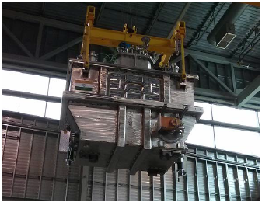
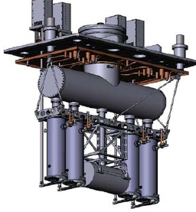
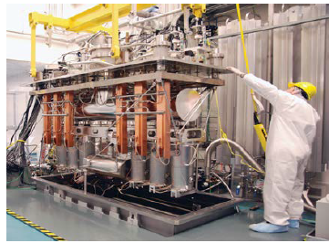
VECC Collaboration - India
Active and mutually beneficial collaboration since ~ 2010
Main deliverable: joint design and production of two e-Linac injector modules one for TRIUMF one for VECC (commissioned in 2016)
Latest deliverable: heavy ion cryomodule containing 4 QWR for VECC – started in 2017

Slide 30
New Developments

Slide 31
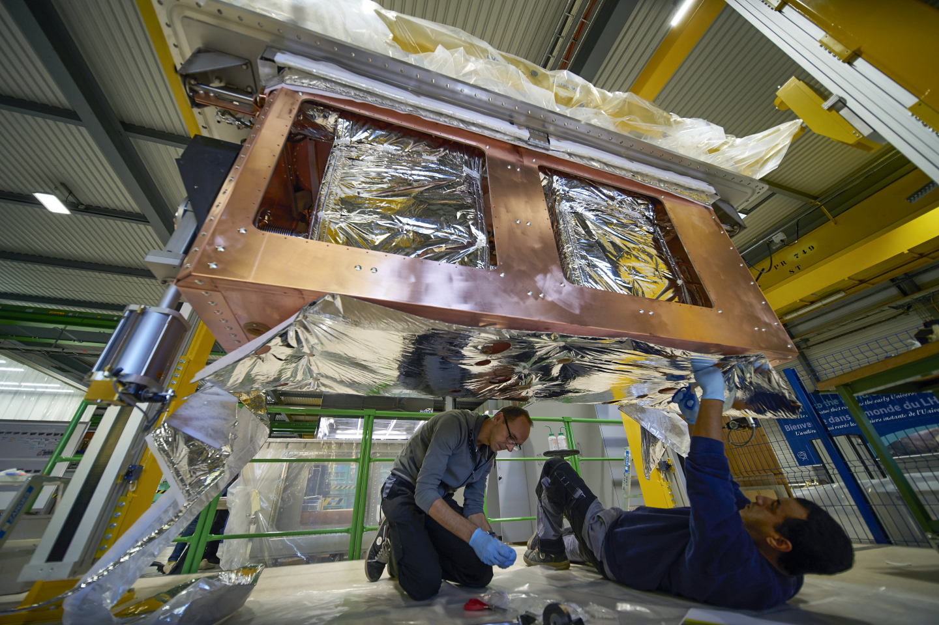
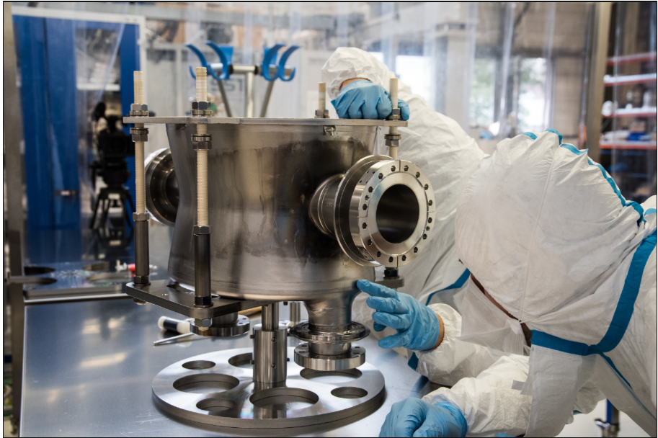
Canada to lead ‘coldbox’ technology for High-Luminosity LHC upgrade
Assembly of crab cavity housing

Slide 32
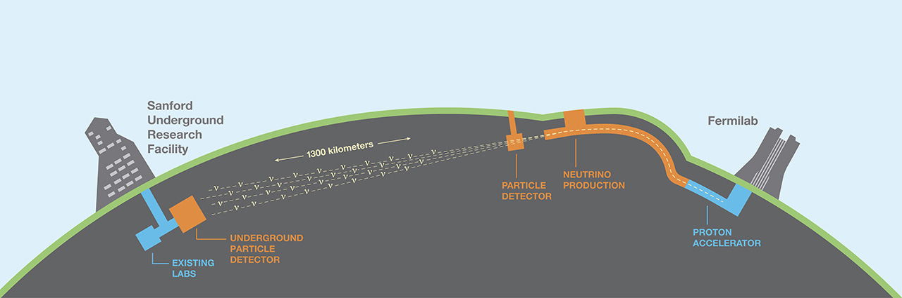
LBNF / DUNE / PIP-II
Long Baseline Neutrino Facility (LBNF) is the facility for the Deep Underground Neutrino Experiment (DUNE), a dual-site experiment for neutrino science and proton decay studies.
  Hosted at Fermilab (Batavia, IL) and SURF (Lead, SD)
The facility is an internationally designed, coordinated and funded program, a first of its kind for the US DOE.

Slide 33
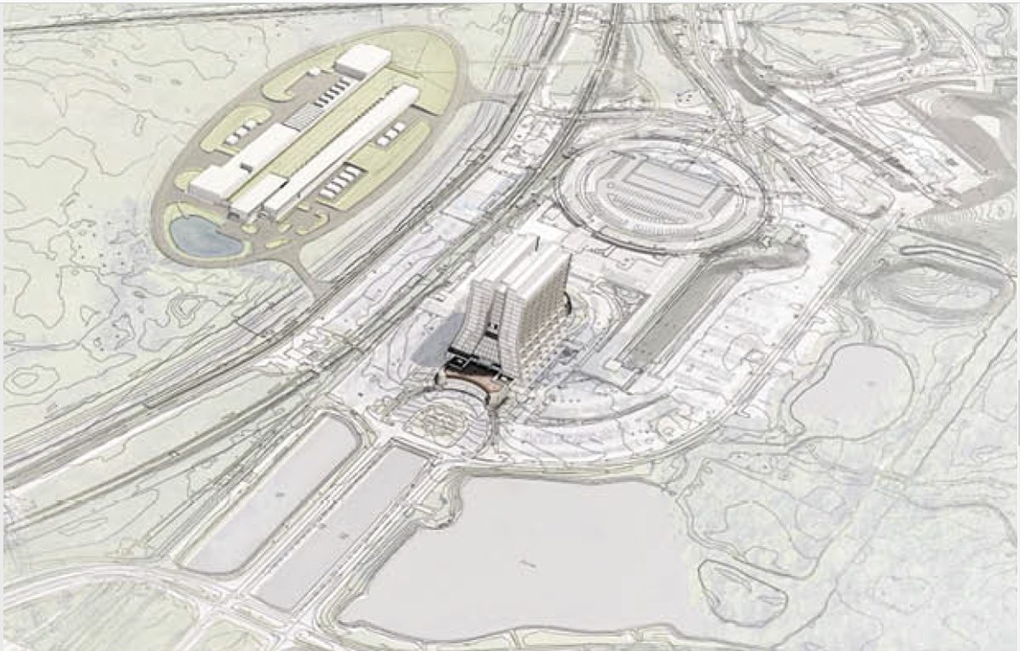
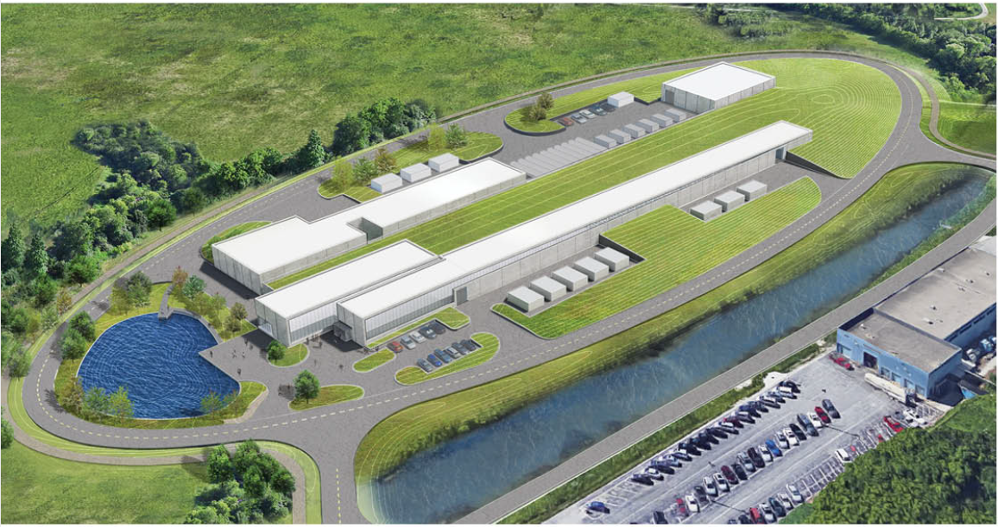
The PIP-II Project
Mission
PIP-II will deliver the world’s most intense beam of neutrinos to the international LBNF/DUNE project, and enable a broad physics research program, powering new discoveries for decades to come.
Goals
  Deliver 1.2 MW of proton beam power from the Main Injector over the energy range 60 – 120 GeV, at the start of LBNF ops
    Establish a platform for future upgrades to multi-MW capability
  Provide a platform for extension of capability to high duty factor/higher beam power, multiple users and reliable operations
    Support the ongoing 8 GeV program, including an upgrade path for Mu2e
Building the world’s most powerful neutrino beam

Slide 34


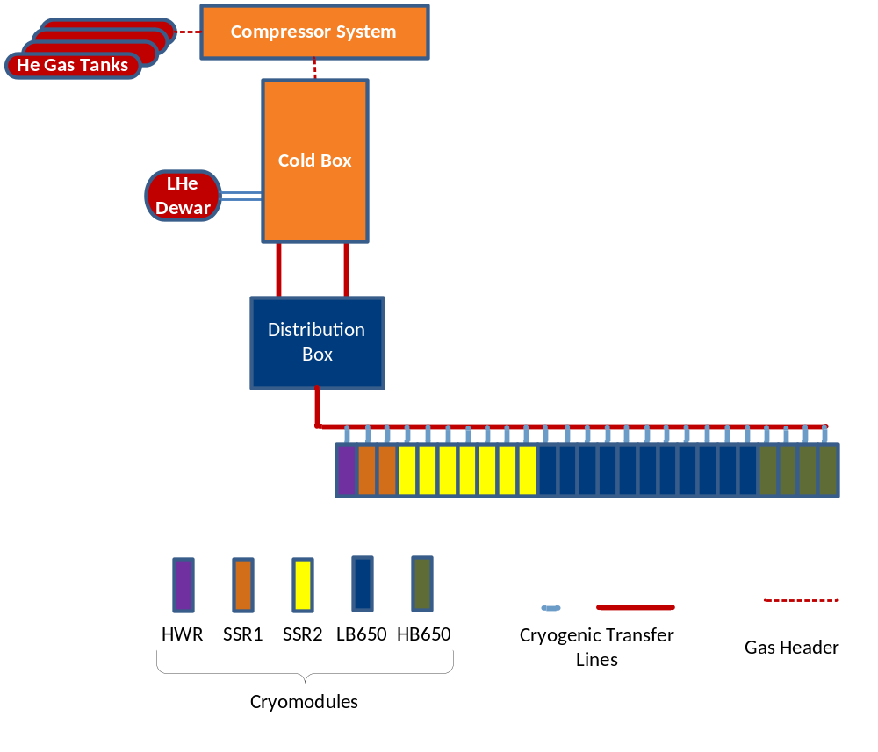










PIP-II SRF Linac & Areas of International Interest
HWR X 1
SSR1 X 2
SSR2 X 7
LB650 X 11
HB650 X 4
PIP-II is the first Accelerator Project in the U.S. with substantial International Contributions

Slide 35

Final thoughts
TRIUMF is Canada’s undisputed center for SRF physics and technology and a significant player in the international arena
TRIUMF SRF expertise are internationally recognized and sought out
TRIUMF SRF expertise, facilities and infrastructure enable to:
  Operate two world-class SRF accelerators
  Leverage world-leading materials science facilities for fundamental studies of RF superconductivity
  Run a highly successful HQP training program with Canadian and international universities
  Engage in global collaborations with a diverse portfolio of topics
This is a story of Canadian innovation, flexibility and resilience!
Congratulations TRIUMF!
Wishing you brilliant success for the next 50 years!

Slide 36

Special thanks to Bob Laxdal for providing material for this presentation!

