Slide 1
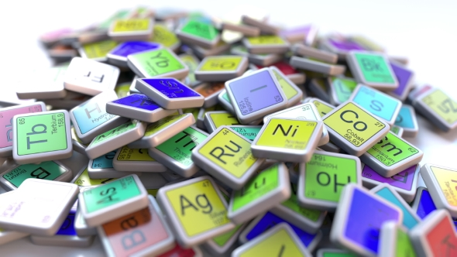
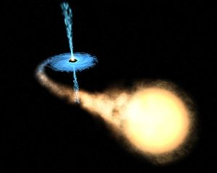
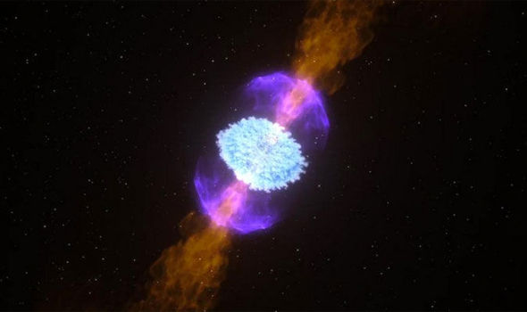
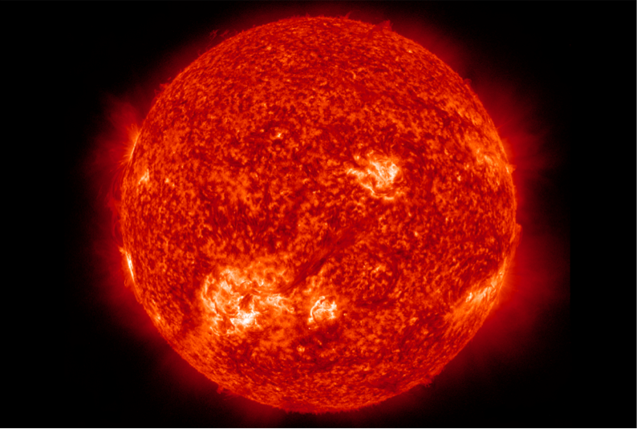
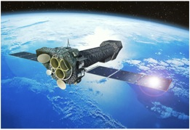
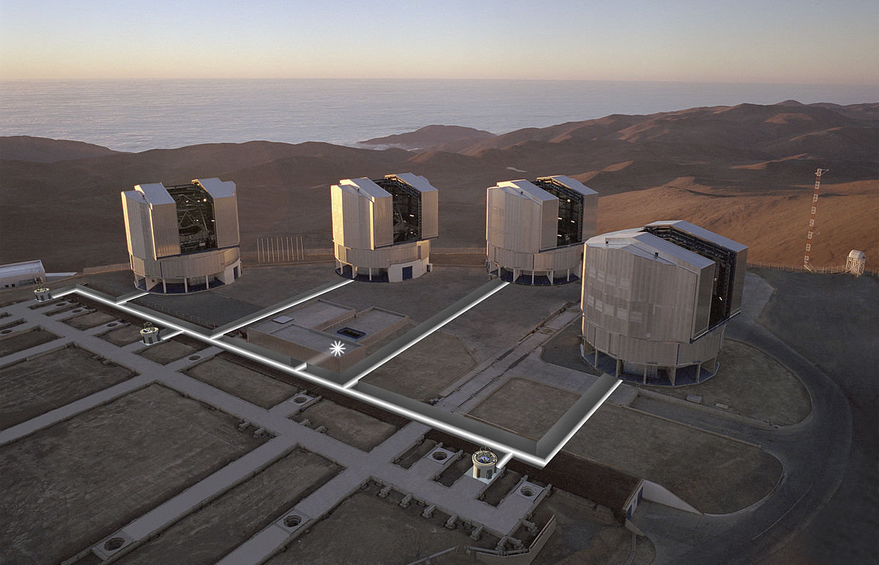
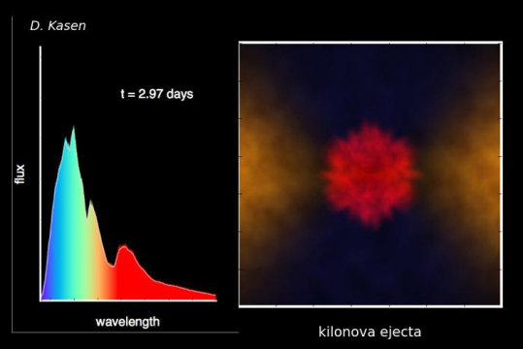
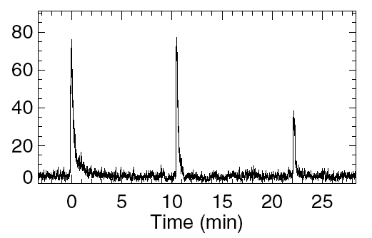
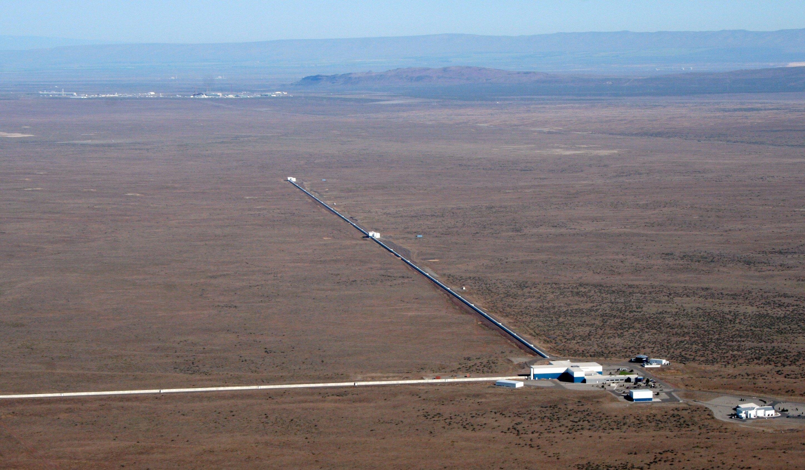
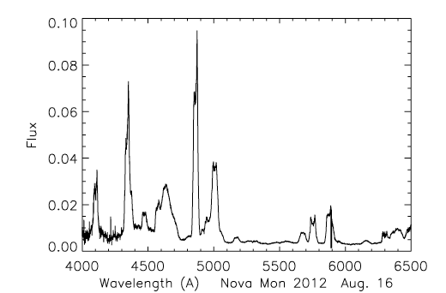
From Red Giants to Neutron Star Mergers
– Gavin Lotay

Slide 2
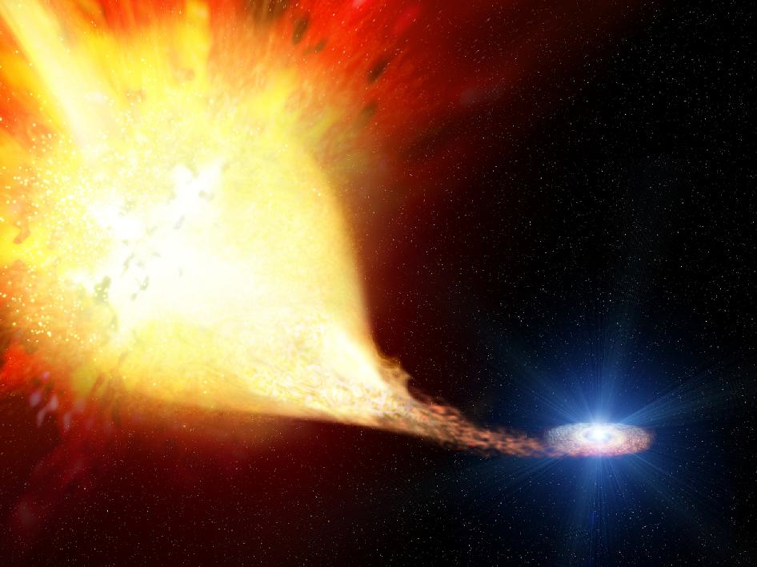
Microscopic to Macroscopic
²⁵Si
²⁶Si
²⁷Si
²⁸Si
Z
Reactions on RADIOACTIVE nuclei drive explosive astrophysical environments
²³Al
²⁴Al
²⁵Al
²⁶Al
²⁷Al
²²Mg
²³Mg
²⁴Mg
²⁵Mg
²⁶Mg
²¹Na
²²Na
²³Na
(p,γ)
(p,α)
^{A}X
(β⁺)
²⁰Ne
²¹Ne
²²Ne
N
NUCLEAR ASTROPHYSICS LINKS MICROSCOPIC TO MACROSCOPIC

Slide 3
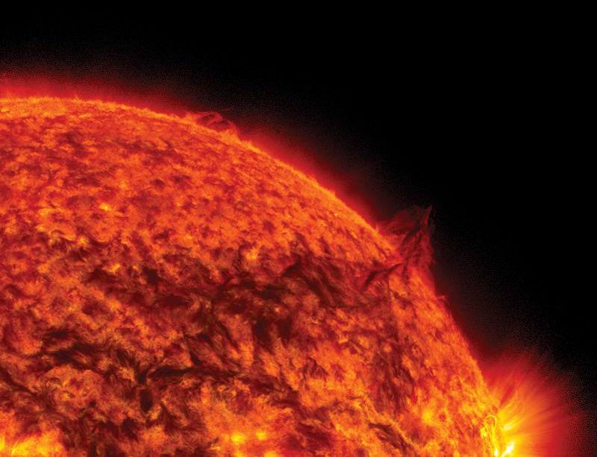
Red Giants

Slide 4

Red Giants

Slide 5
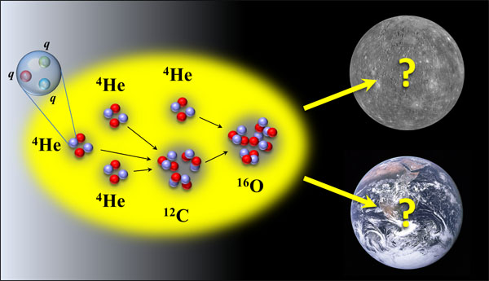
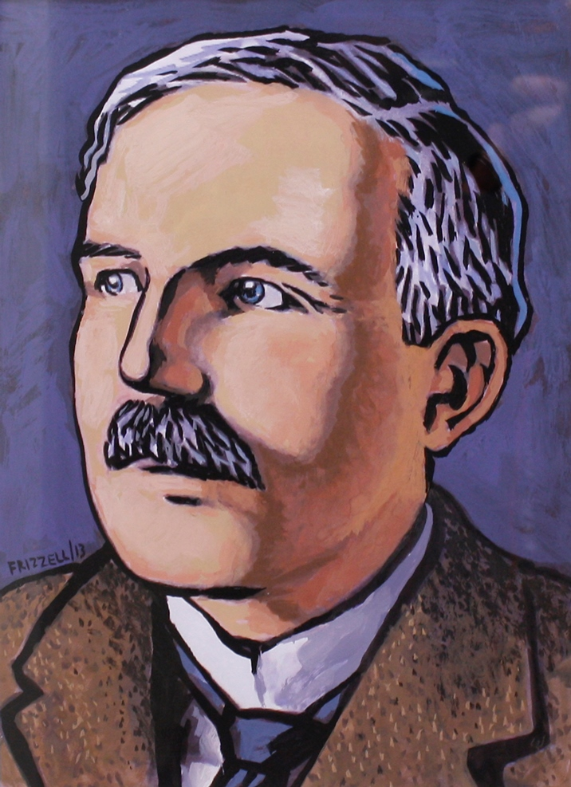
Red Giants
The ¹²C(α,γ)¹⁶O reaction
Even I could make a beam of α particles

Slide 6
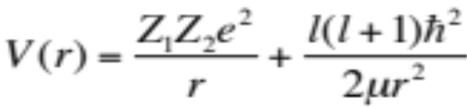
Red Giants
The ¹²C(α,γ)¹⁶O reaction
¹²C + ⁴He
Probability
¹⁶O
Interaction Energy, E

Slide 7
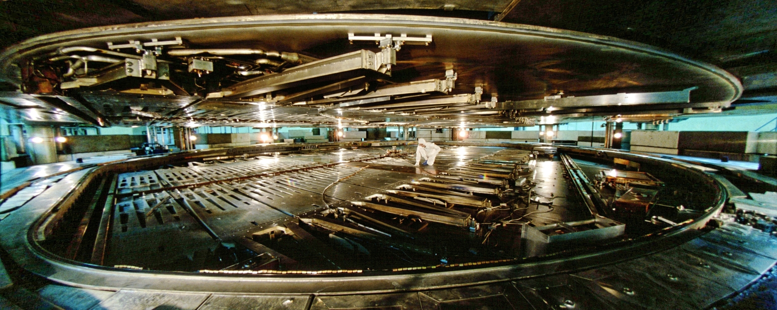
TISOL and innovative study of ¹²C(α,γ)¹⁶O
In the early 1990s, 2 μA protons from the TRIUMF cyclotron were used to bombard a zeolite target to produce ~10⁶ pps of ¹⁶N

Slide 8
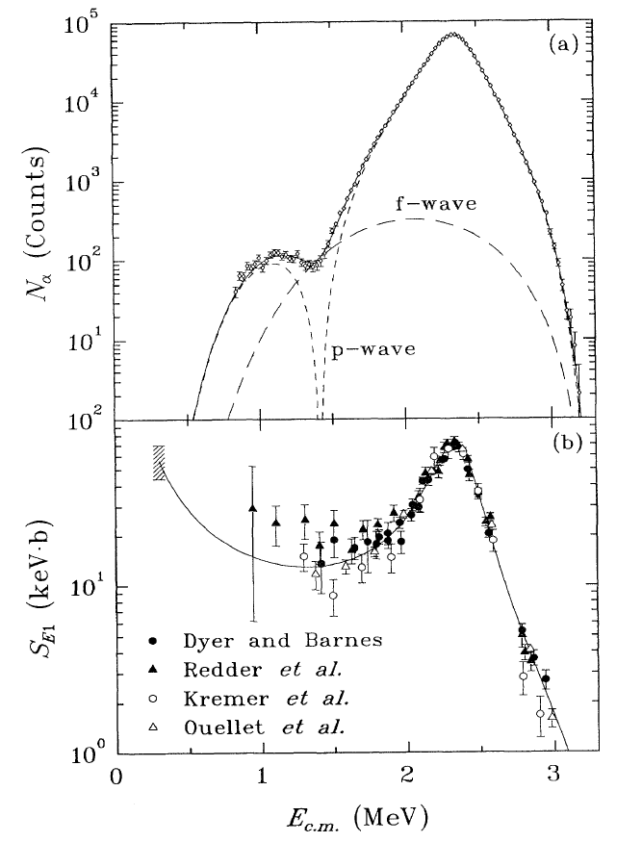
TISOL and innovative study of ¹²C(α,γ)¹⁶O
In the early 1990s, 2 μA protons from the TRIUMF cyclotron were used to bombard a zeolite target to produce ~10⁶ pps of ¹⁶N
That study provided the lowest energy data on the ¹²C(α,γ)¹⁶O reaction
⁴He
β ⁻
¹⁶N
¹⁶O*
¹²C
L. Buchmann et al., PRL 70, 6 (1993).

Slide 9
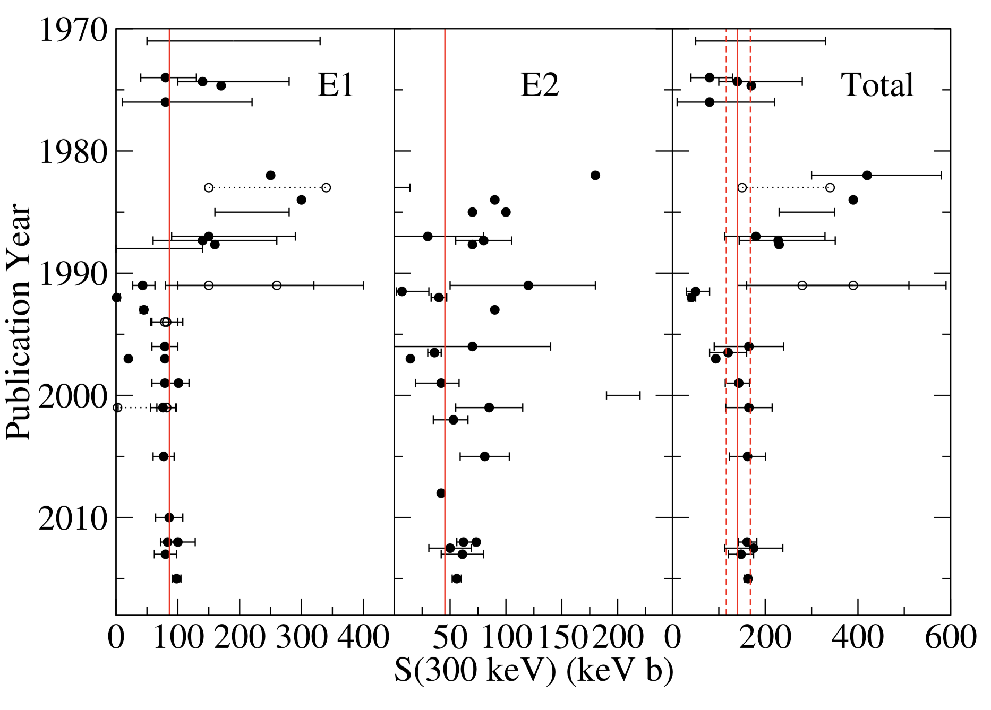
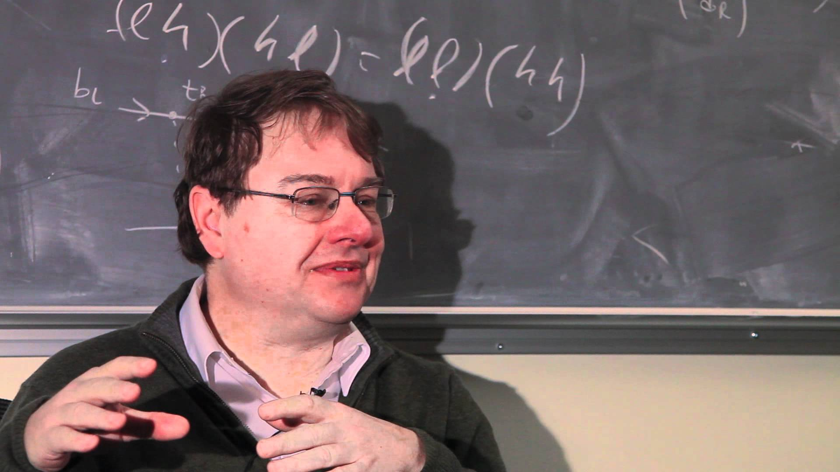
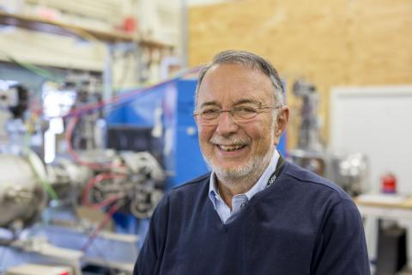
TISOL and innovative study of ¹²C(α,γ)¹⁶O
ISAC commissioned from 1998 to 1999
Now, up to 100μA protons are available to produce some of the most intense radioactive ion beams (RIBs) in the world
Proposal to study astrophysical reactions directly and indirectly using RIBs
TRIUMF measurements
This facility would be capable of producing some of the most intense radioactive beams available anywhere in the world
Birth of Nuclear Astrophysics at TRIUMF and paved the way for future studies of exploding stars at the then soon to be completed ISAC facility (1998)
JOHN D’AURIA
LOTHAR
BUCHMANN

Slide 10
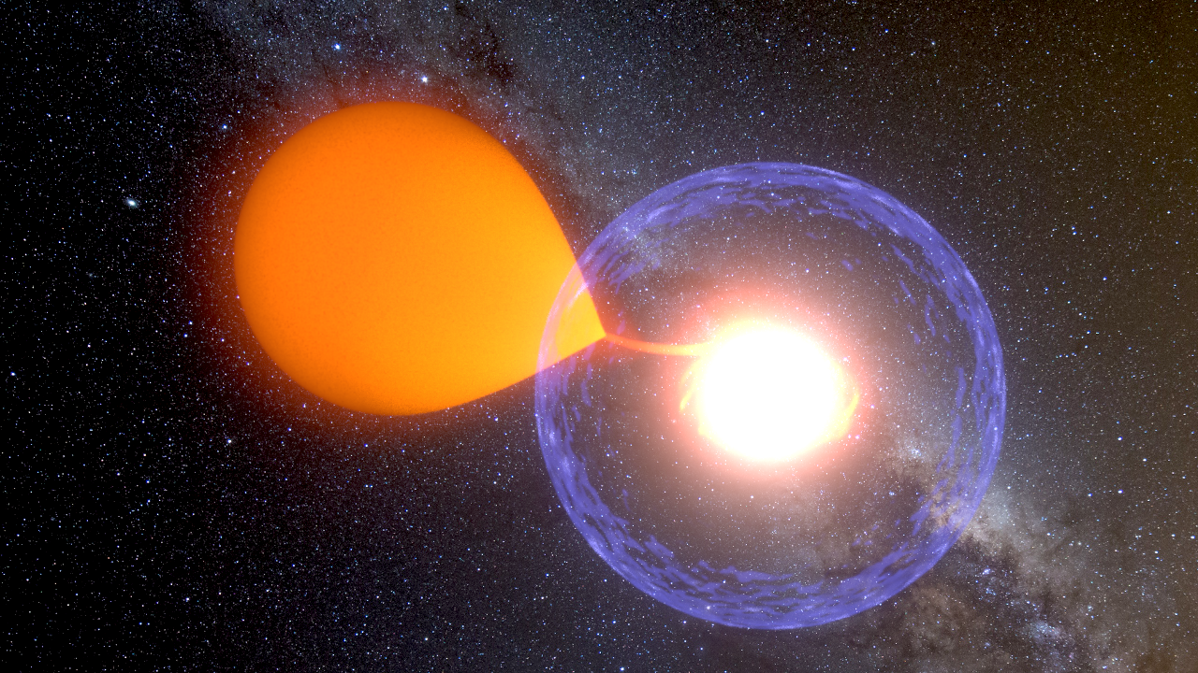
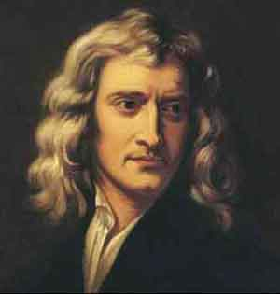
Studying Classical Novae at ISAC
(p,γ)
²⁶Si
²⁷Si
²⁸Si
^{A}X
³¹Cl
(β⁺)
²⁴Al
²⁵Al
²⁶Al
²⁷Al
³¹Cl
²²Mg
³⁰S
Among the most frequent and violent stellar explosions to occur in the Galaxy.
²³Mg
²⁴Mg
²⁵Mg
²⁶Mg
²¹Na
²²Na
²³Na
Principia Mathematica (1687): ‘from this fresh supply of new fuel those old stars, acquiring new splendour, may pass for new stars’
²⁰Ne
²¹Ne
²²Ne

Slide 11
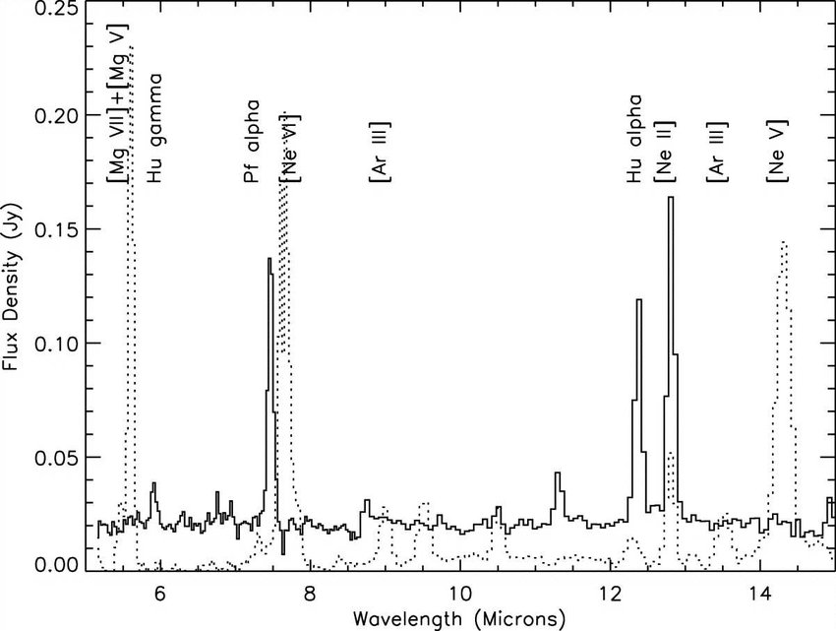
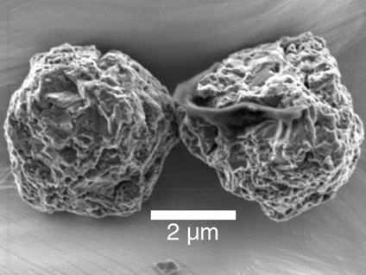
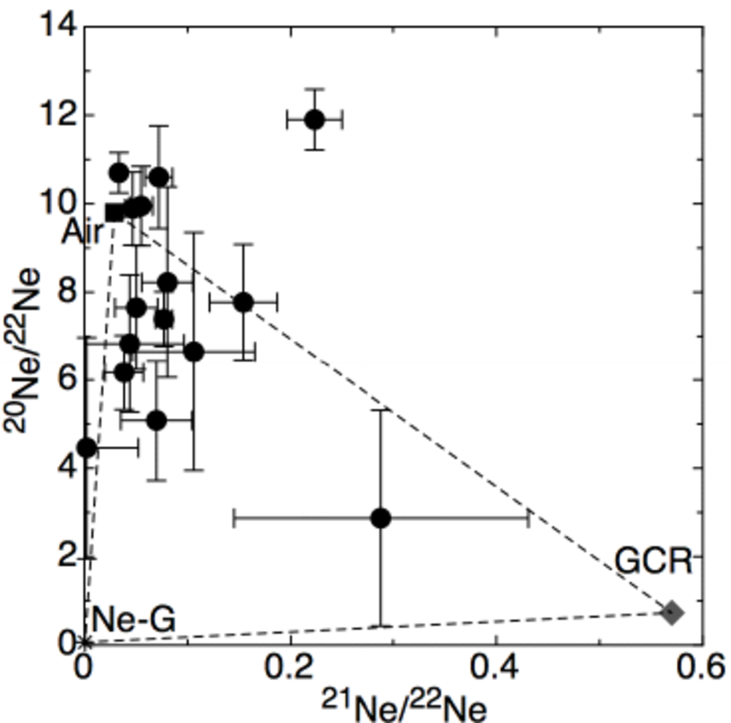
Studying Classical Novae at ISAC
(p,γ)
²⁶Si
²⁷Si
²⁸Si
^{A}X
³¹Cl
(β⁺)
²⁴Al
²⁵Al
²⁶Al
²⁷Al
³¹Cl
²²Mg
³⁰S
²³Mg
²⁴Mg
²⁵Mg
²⁶Mg
²¹Na
²²Na
²³Na
²⁰Ne
²¹Ne
²²Ne
The ²¹Na(p,γ)²²Mg reaction

Slide 12
Direct measurements of explosive reactions
²¹Na + p
γ
²²Mg
Probability
RESONANCES
Interaction Energy, E
²¹Na + p ➔ ²²Mg* ➔ ²²Mg + γ

Slide 13
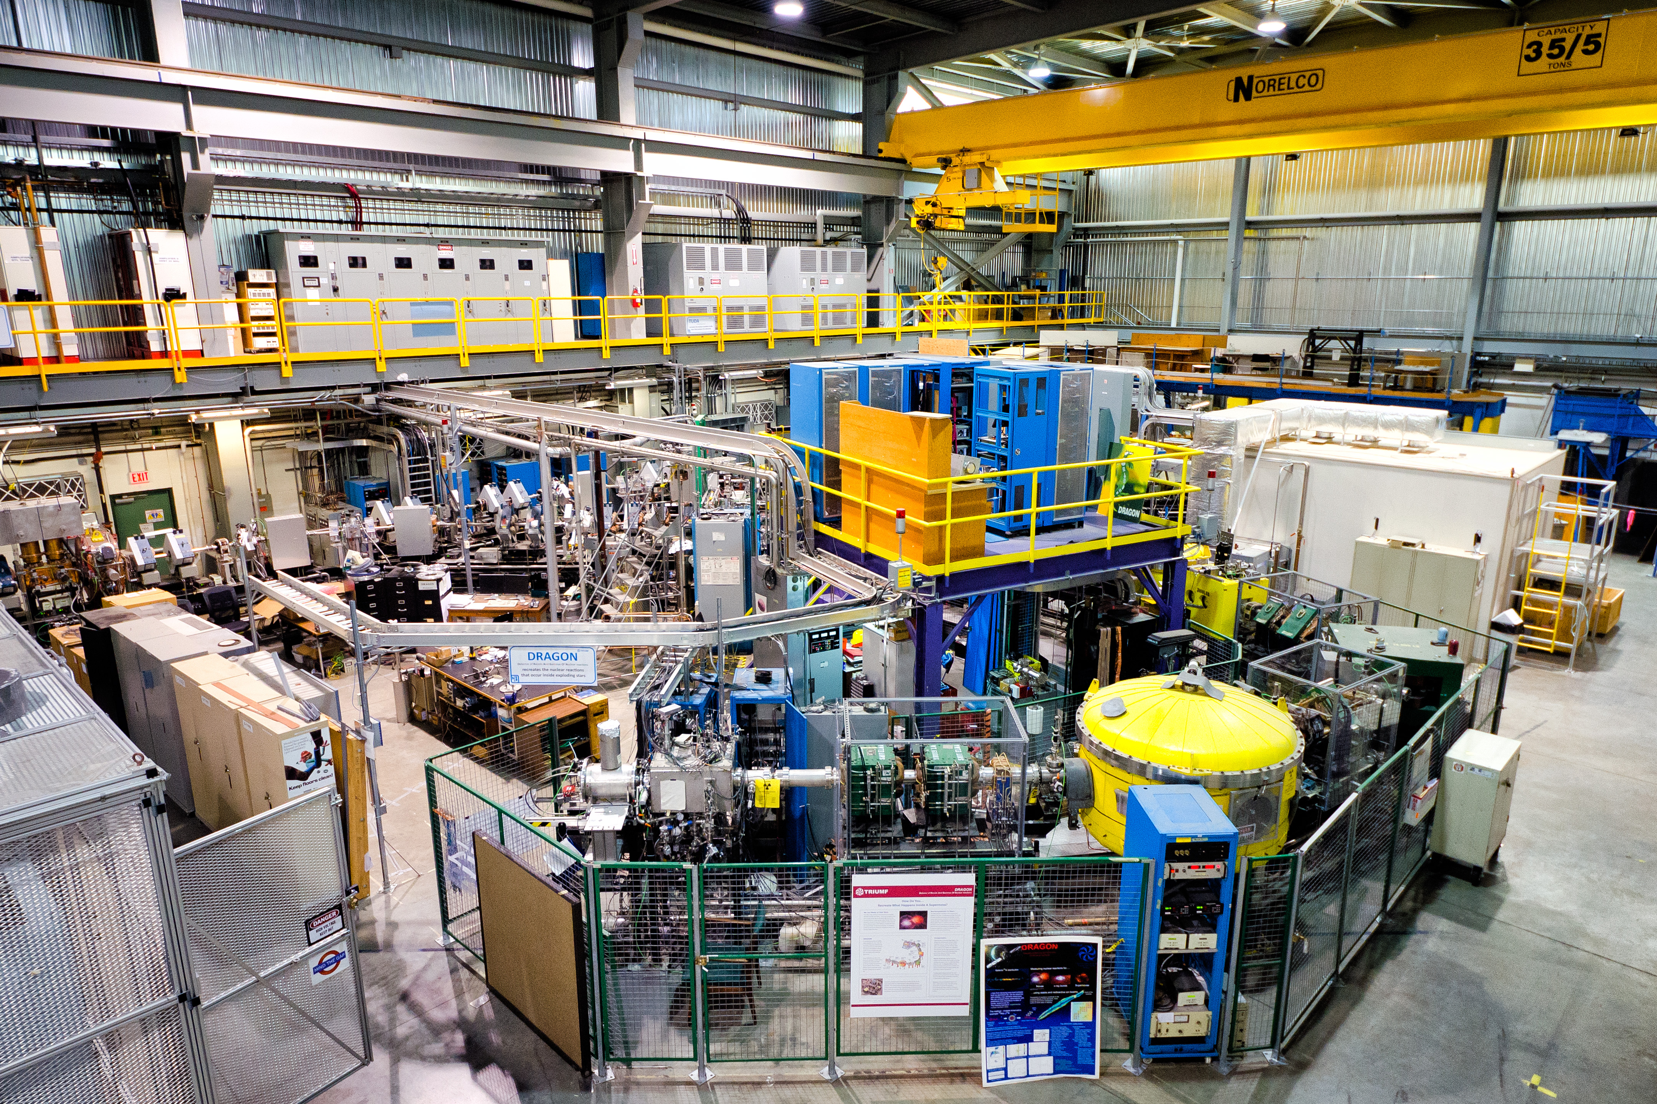
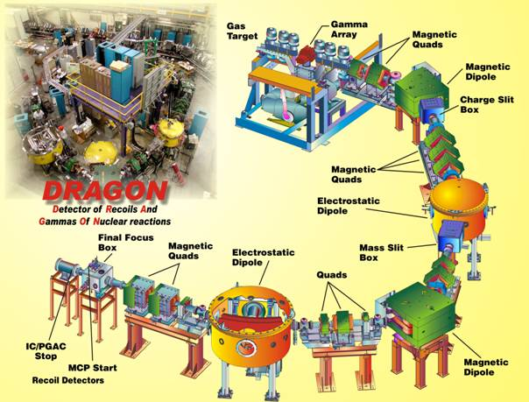
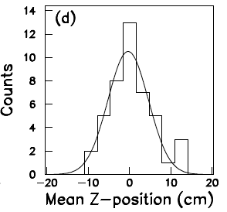
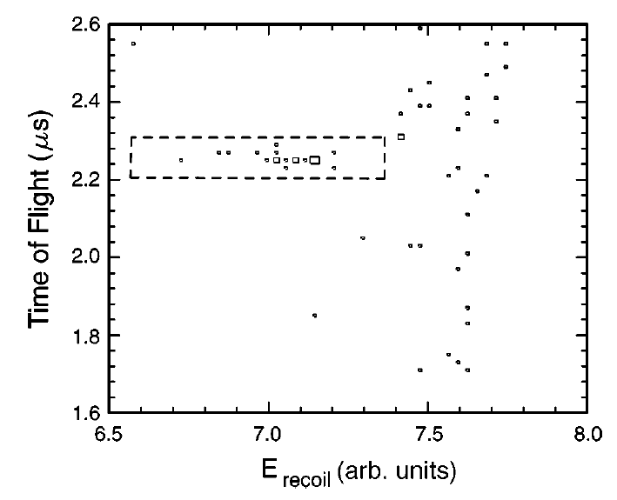
Detector of Recoils And Gammas Of Nuclear reactions
Beam of radioactive ²¹Na ~10⁹ pps
(p,γ)
Commissioned in 2001
DRAGON funding approved in 1998
State-of-the-art recoil spectrometer specifically designed for the direct measurement of astrophysical (p,γ) and (α,γ) reactions
DRAGON
The ²¹Na(p,γ)²²Mg reaction
Series of Electric and Magnetic dipoles act as a PRISM for different masses
²²Mg
A = 22

Slide 14
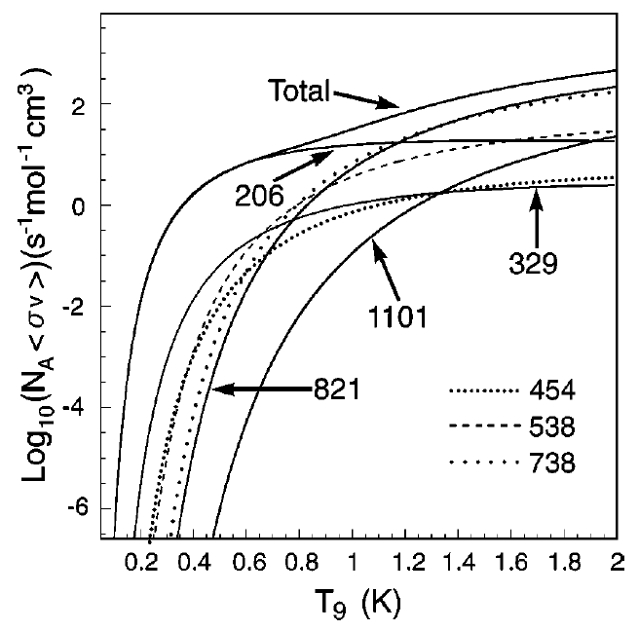
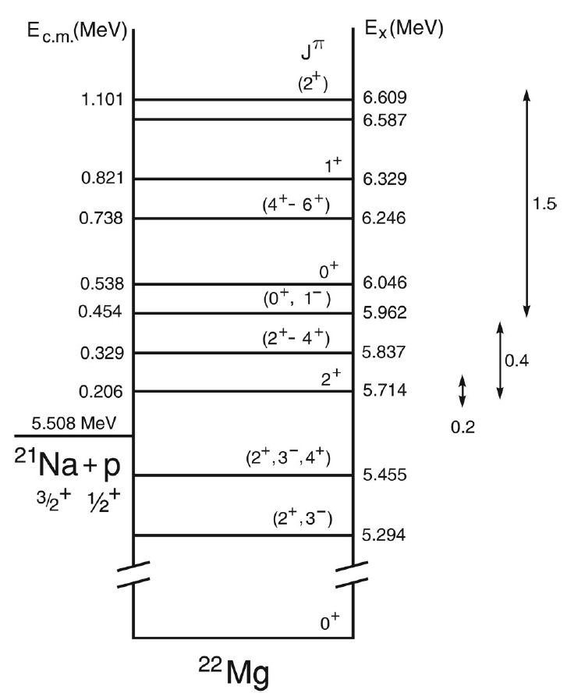
Direct measurement of ²¹Na(p,γ)²²Mg using DRAGON
S. Bishop et al., PRL 90, 16 (2003) and J.M. D’Auria et al., PRC 69, 065803 (2004)
First direct measurement performed using DRAGON at TRIUMF and remains the textbook example of how to perform a direct measurement of an astrophysical reaction using a radioactive beam

Slide 15
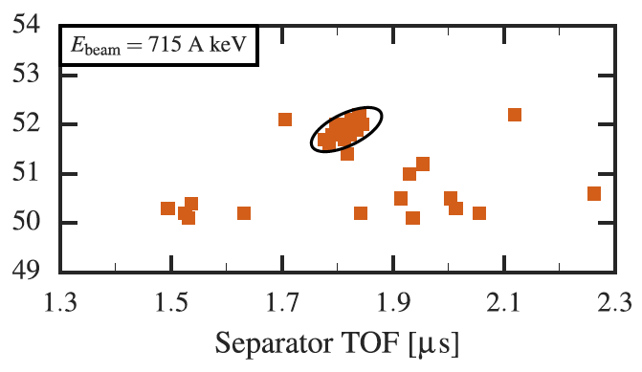
Since then…
Upgrades to DRAGON have allowed the collaboration to extend the programme of novae studies significantly
²³Mg(p,γ)²⁴Al – L. Erikson et al., PRC 81, 045808 (2010)
[Colorado School of Mines, USA]
with DRAGON to determine the endpoint of novae nucleosynthesis
¹⁸F(p,γ)¹⁹Ne – C. Akers et al., PRL 110, 262502 (2013)
[University of York, UK]
Most recently, an investigation of the ³⁸K(p,γ)³⁹Ca reaction was performed
Highest mass direct measurement to date, highlighted as an Editor’s suggestion and featured in Physics
G. Lotay, G. Christian et al. PRL 116, 132701 (2016) and G. Christian, G. Lotay et al. PRC 97, 025802 (2018)

Slide 16
Origin of Cosmic γ-ray Emitters
²⁵Si
²⁶Si
²⁷Si
²⁸Si
²³Al
²⁴Al
²⁵Al
²⁶Al
²⁷Al
²²Mg
²³Mg
²⁴Mg
²⁵Mg
²⁶Mg
²¹Na
²²Na
²³Na
²⁰Ne
²¹Ne
²²Ne

Slide 17
Origin of Cosmic γ-ray Emitters
Space-based γ-ray observatories
²⁵Si
²⁶Si
²⁷Si
²⁸Si
²³Al
²⁴Al
²⁵Al
²⁶Al
²⁷Al
1.809 MeV
γ
²²Mg
²³Mg
²⁴Mg
²⁵Mg
²⁶Mg
²¹Na
²²Na
²³Na
1.275 MeV
γ
²⁰Ne
²¹Ne
²²Ne

Slide 18
Origin of Cosmic γ-ray Emitters
Space-based γ-ray observatories
²⁵Si
²⁶Si
²⁷Si
²⁸Si
²³Al
²⁴Al
²⁵Al
²⁶Al
²⁷Al
1.809 MeV
First cosmic γ rays detected in Milky Way associated with decay of ²⁶Al
γ
²²Mg
²³Mg
²⁴Mg
²⁵Mg
²⁶Mg
²¹Na
²²Na
²³Na
²⁰Ne
²¹Ne
²²Ne
T_{1/2} of ²⁶Al ~ 0.5 Myr

Slide 19
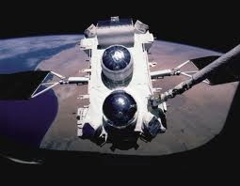
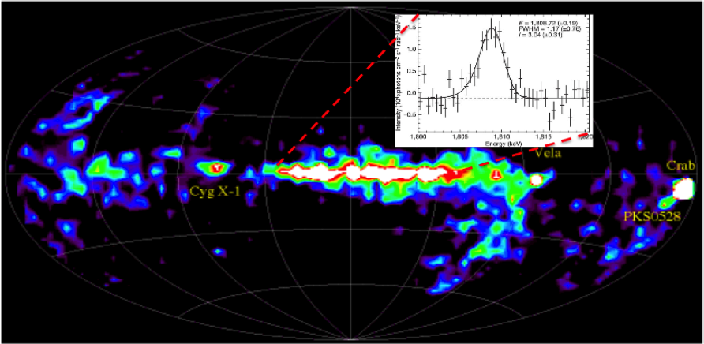
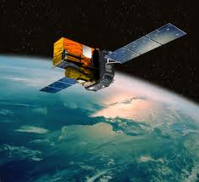
Origin of Cosmic γ-ray Emitters
Astrophysical Origin of ²⁶Al
Space-based γ-ray observatories
²⁵Si
²⁶Si
²⁷Si
²⁸Si
²³Al
²⁴Al
²⁵Al
²⁶Al
²⁷Al
1.809 MeV
First cosmic γ rays detected in Milky Way associated with decay of ²⁶Al
γ
²²Mg
²³Mg
²⁴Mg
²⁵Mg
²⁶Mg
²¹Na
²²Na
²³Na
²⁰Ne
²¹Ne
²²Ne
T_{1/2} of ²⁶Al ~ 0.5 Myr
Provided FIRST DIRECT evidence of ongoing nucleosynthesis in our Galaxy
INTEGRAL MISSION - R. Diehl et al., Nature 439, 45 (2006)

Slide 20
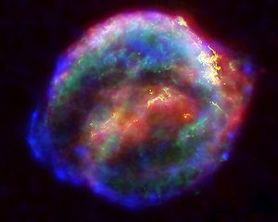
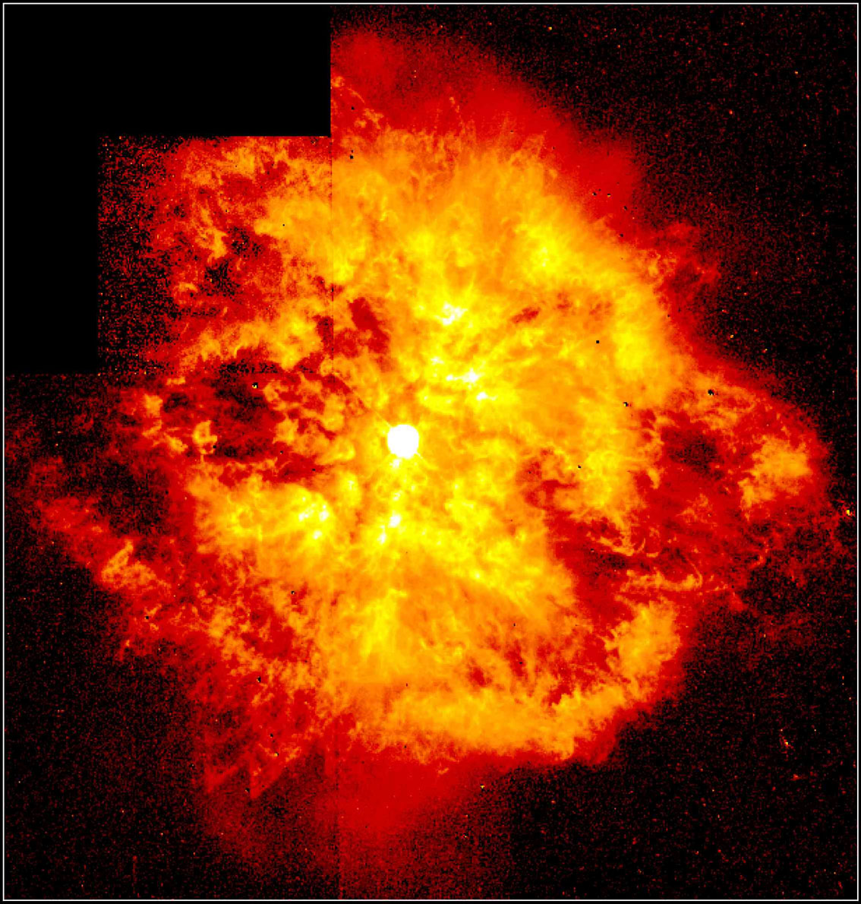
Astrophysical Origin of ²⁶Al
²⁶Si
²⁷Si
²⁸Si
SUPERNOVAE
²⁵Al
²⁶Al
²⁷Al
1.809 MeV γ ray
²⁴Mg
²⁵Mg
²⁶Mg
WOLF-RAYET STARS

Slide 21
Astrophysical Origin of ²⁶Al
²⁶Si
²⁷Si
²⁸Si
SUPERNOVAE
²⁵Al
²⁶Al
²⁷Al
1.809 MeV γ ray
²⁴Mg
²⁵Mg
²⁶Mg
²⁶Al(p,γ)²⁷Si REACTION
WOLF-RAYET STARS
Reaction dominated by resonances

Slide 22
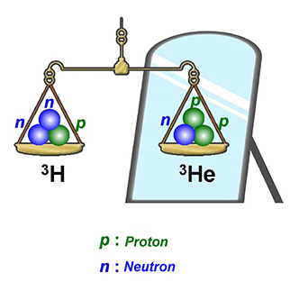
Charge Symmetry of the Nuclear Force (nn = pp = pn)
Nuclei with interchanged proton and neutron numbers (e.g. ²⁷Si₁₄ and ²⁷Al₁₃) are found to exhibit almost identical properties.
²⁷Si
²⁸Si
²⁶Al + p
²⁶Al
²⁷Al
Similarly, nuclear reactions that either add a proton to a nucleus or a neutron, should be the same
²⁶Al + n
Single-nucleon (d,p) transfer reactions offer experimental means of adding a neutron to a system

Slide 23
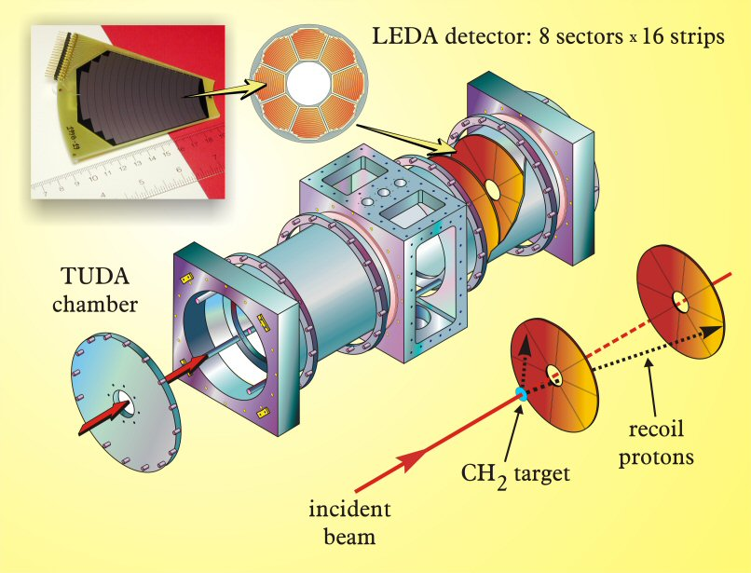
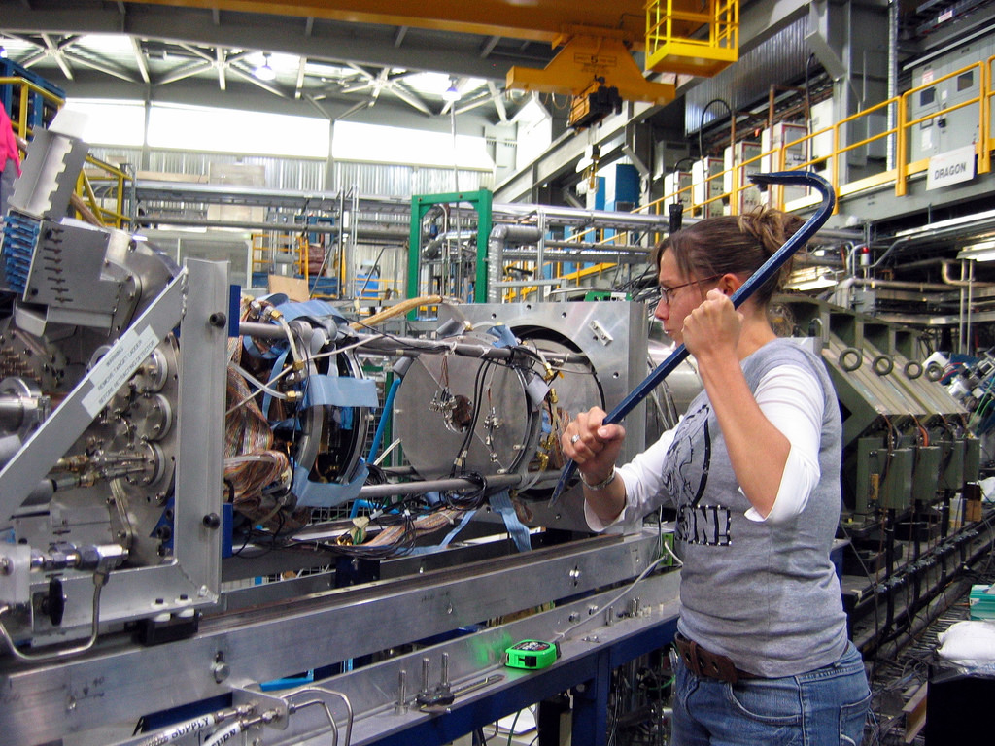
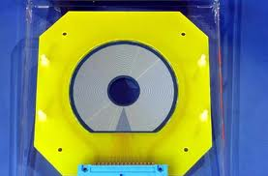
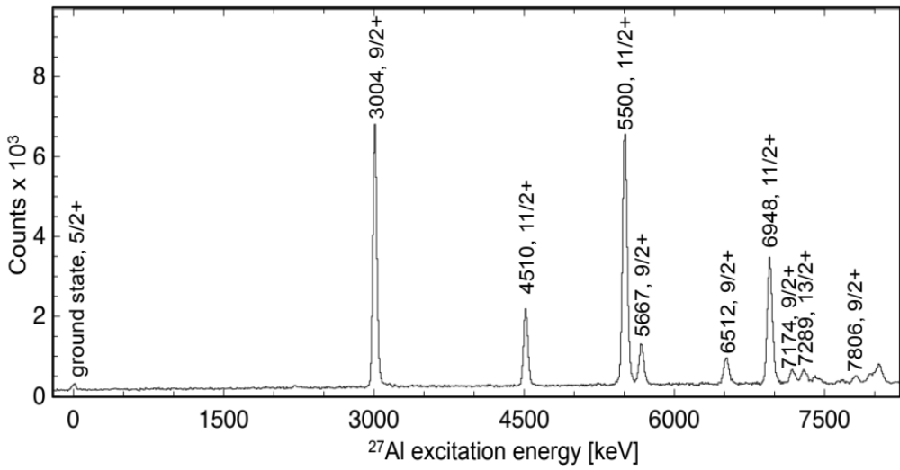
The ²⁶Al(d,p)²⁷Al reaction using TUDA at TRIUMF
²⁶Al beam at 10⁹ pps to bombard 50μg/cm² CD₂ target
Performed in ISAC-II at 6 MeV/u
State-of-the art in excitation energy resolution ~ 40 keV
Populated all Astrophysically important states

Slide 24
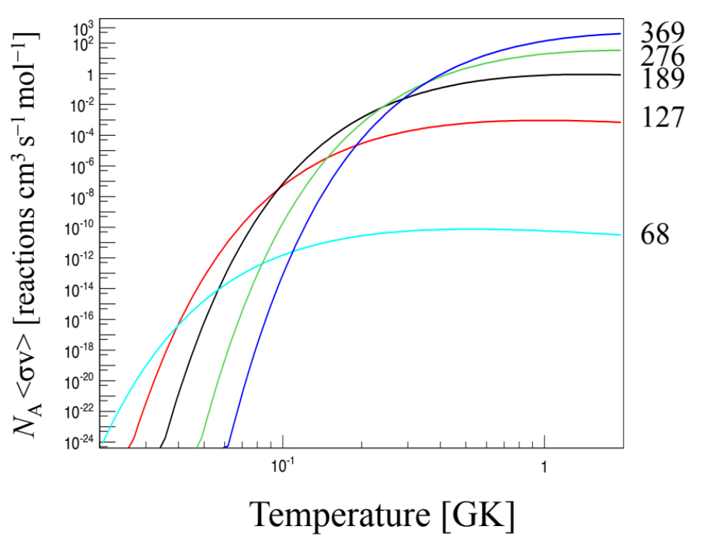
The Astrophysical ²⁶Al(p,γ)²⁷Si Reaction Rate
TUDA is a crucial device for indirect measurements of astrophysical reactions
V. Margerin, G. Lotay et al., PRL 115, 062701 (2015)

Slide 25
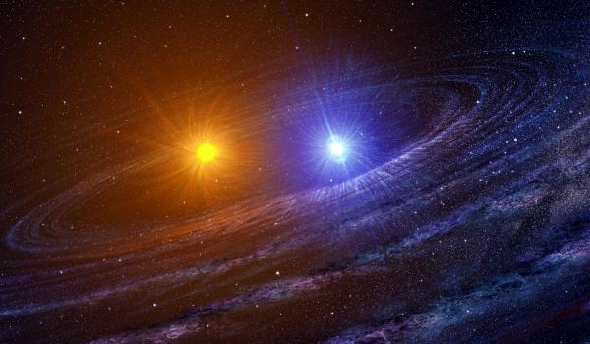
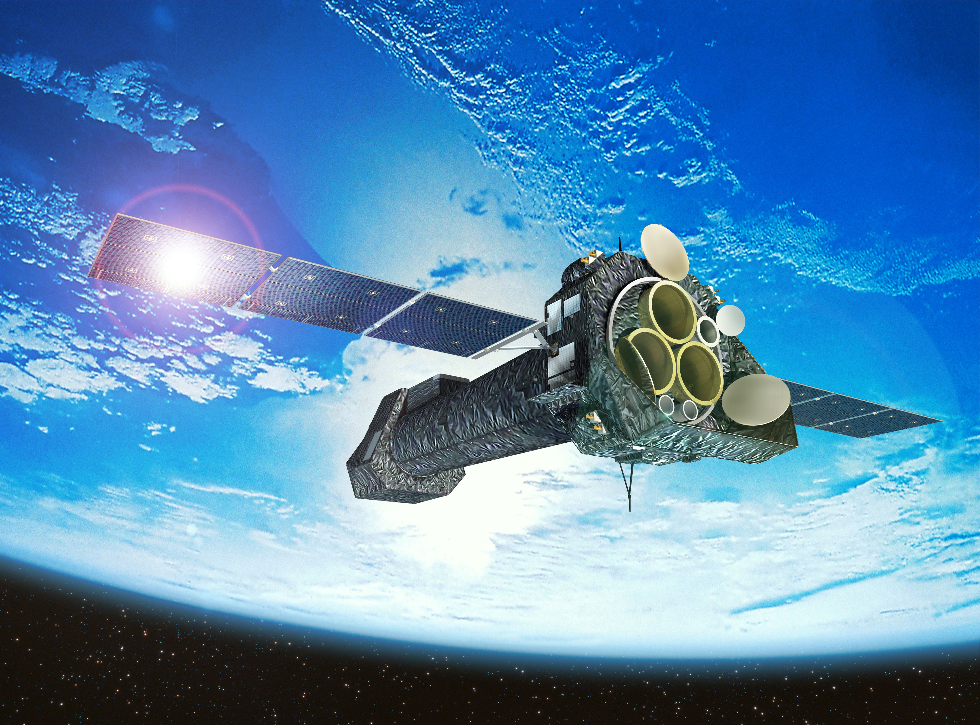
Astrophysical X-ray Bursts
rp process
²⁰Na
²¹Na
²²Na
²³Na
¹⁸Ne
¹⁹Ne
²⁰Ne
²¹Ne
²²Ne
HCNO Breakout
¹⁷F
¹⁸F
¹⁹F
¹⁴O
¹⁵O
¹⁶O
¹⁷O
¹⁸O
HCNO
¹³N
¹⁴N
¹⁵N
¹²C
¹³C
Requires simultaneous approach of DIRECT and INDIRECT measurements

Slide 26
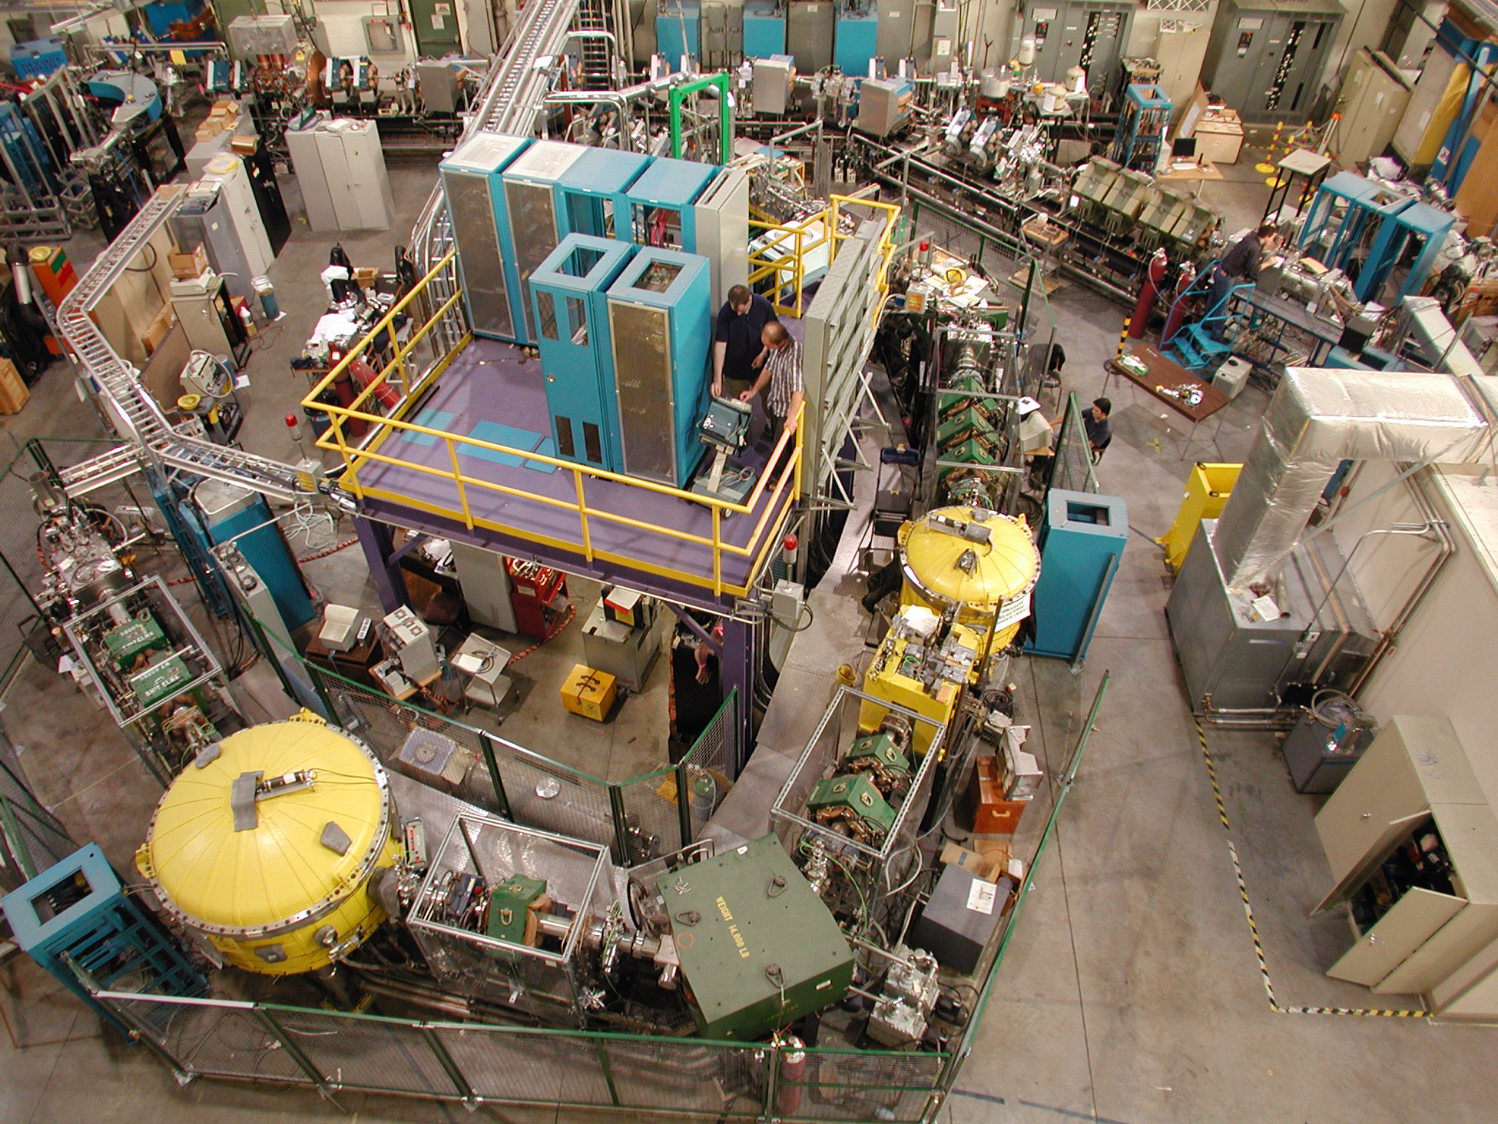
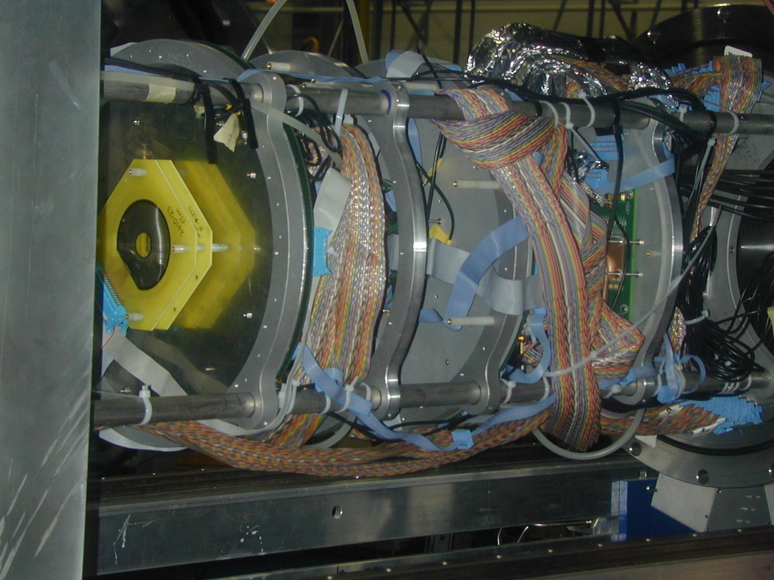
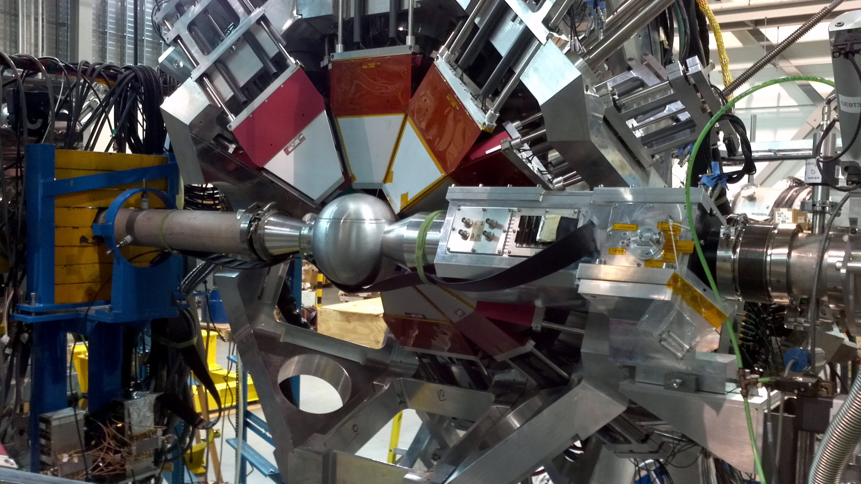
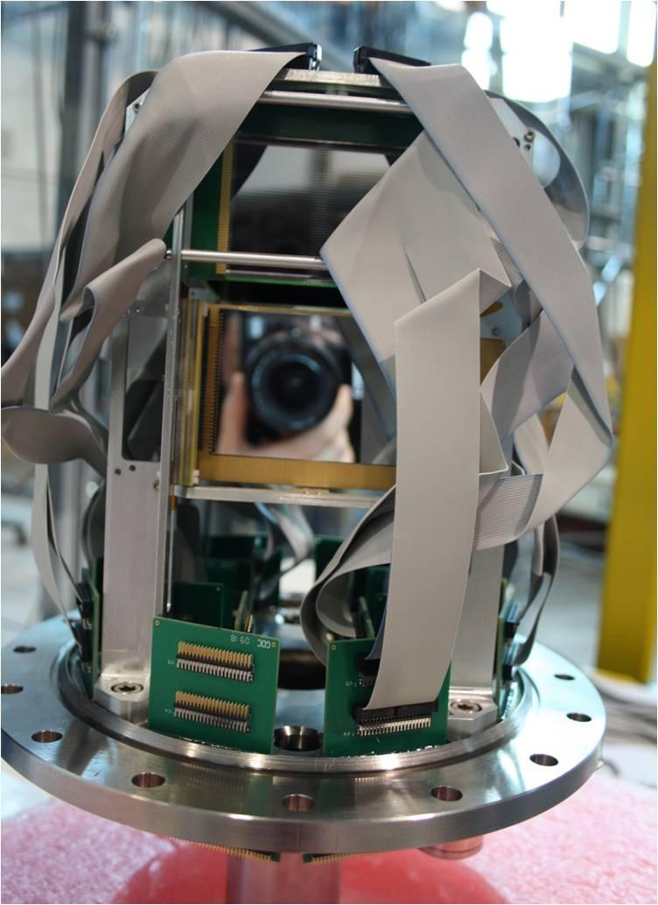
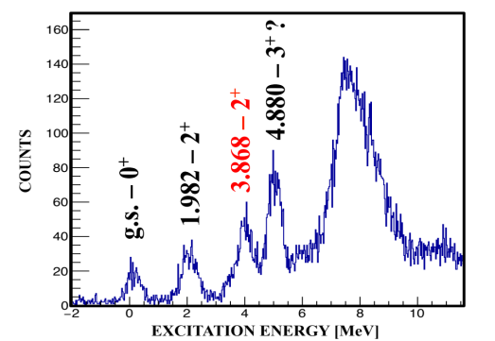
Investigating X-ray Bursts at TRIUMF
1. DRAGON solves 30-year old problem and measures ¹⁹Ne(p,γ)²⁰Na breakout reaction directly
R. Wilkinson, G. Lotay et al., PRL 119, 242701 (2017)
2. TUDA time-reversed ²¹Na(p,α)¹⁸Ne reaction to study ¹⁸Ne(α,p)²¹Na breakout reaction
FIRST EVER experimental study of resonance strengths in rp process
P.J. Salter et al., PRL 108, 242701 (2012)
TIGRESS
G. Lotay, M. Moukaddam et al., in progress
3. TIGRESS + SHARC used for ²³Ne(d,p)²⁴Ne transfer to study ²³Al(p,γ)²⁴Si rp process reaction.
SHARC

Slide 27



but identifying a stellar site in which this process can take place has been extremely challenging
Formation of Heavy Elements and Future Perspectives
Nearly half of all the elements we find on Earth heavier than Fe were formed in the astrophysical rapid neutron capture process (r process).
has finally provided the first direct evidence of a possible site of the r process
Correlated observation of gravitational waves, γ-ray bursts and a kilonova afterglow from a single stellar event

Slide 28

Formation of Heavy Elements and Future Perspectives
However, before gravitational waves can become a precision tool for analysing both the fundamental properties of matter and creation of chemical elements, nuclear physics must play a pivotal role.

Slide 29





Formation of Heavy Elements and Perspectives
ARIEL
Direct r process (n,γ) measurements are not feasible. However, indirect measurements using neutron rich RIBs (ARIEL) are possible
n
GRIFFIN + DESCANT
⁷⁷Cu
⁷⁸Cu
⁷⁹Cu
β–delayed neutron emission to investigate (n,γ) reactions
β
⁷⁶Ni
⁷⁷Ni
⁷⁸Ni
Mass measurements along the path of the r process
TITAN
EMMA
Perform (d,p) reactions as surrogates to (n,γ)

Slide 30



Formation of Heavy Elements and Perspectives
Nuclear astrophysics is an extremely vibrant area of research that is constantly evolving with the latest discoveries in astronomy
²²Ne(α,γ) using DRAGON – s process in red giant stars
²²Na(p,γ) using DRAGON and ²²Na(d,p) using TUDA – cosmic γ-ray emission
⁸³Rb(p,γ) using TIGRESS + EMMA – Nucleosynthesis in CCSN
but in order to continue that into the future there is a need for new radioactive ion beams and a necessity to perform measurements on the very edge of experimental feasibility
TRIUMF is currently at the forefront of nuclear astrophysics research but…
Beam development
Operate at the edge of feasibility
Current UK project bid to build custom heavy-ion storage ring for ISOL facility
Direct measurements with heavy-ion storage rings. Increase in reaction luminosity by ~10⁶ offers unique possibility.

