Slide 1
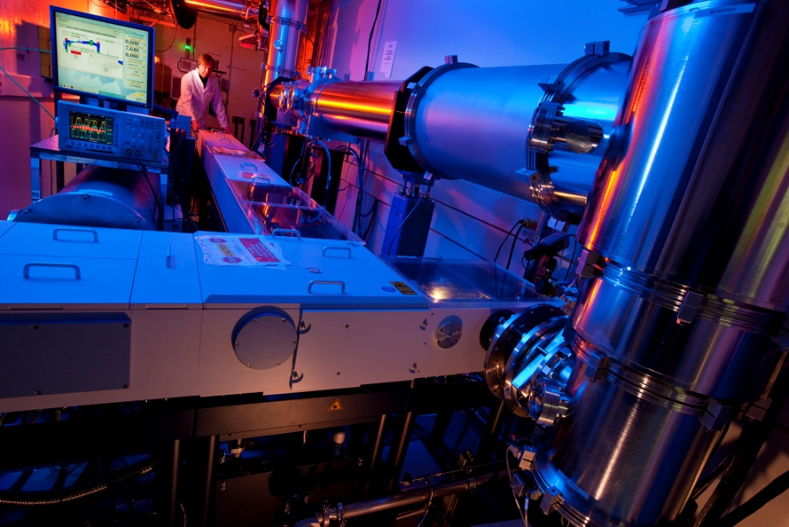
THz Spectroscopy at the Canadian Light Source
Brant Billinghurst

Slide 2
Outline
Introduction to Synchrotrons
The Synchrotron Advantage
The Far-Infrared Beamline
  Spectrometer
  High Resolution Gas Phase Spectroscopy
  Condensed Phase Spectroscopy
Coherent Synchrotron Radiation (CSR)
CSR Heterodyne Experiments

Slide 3
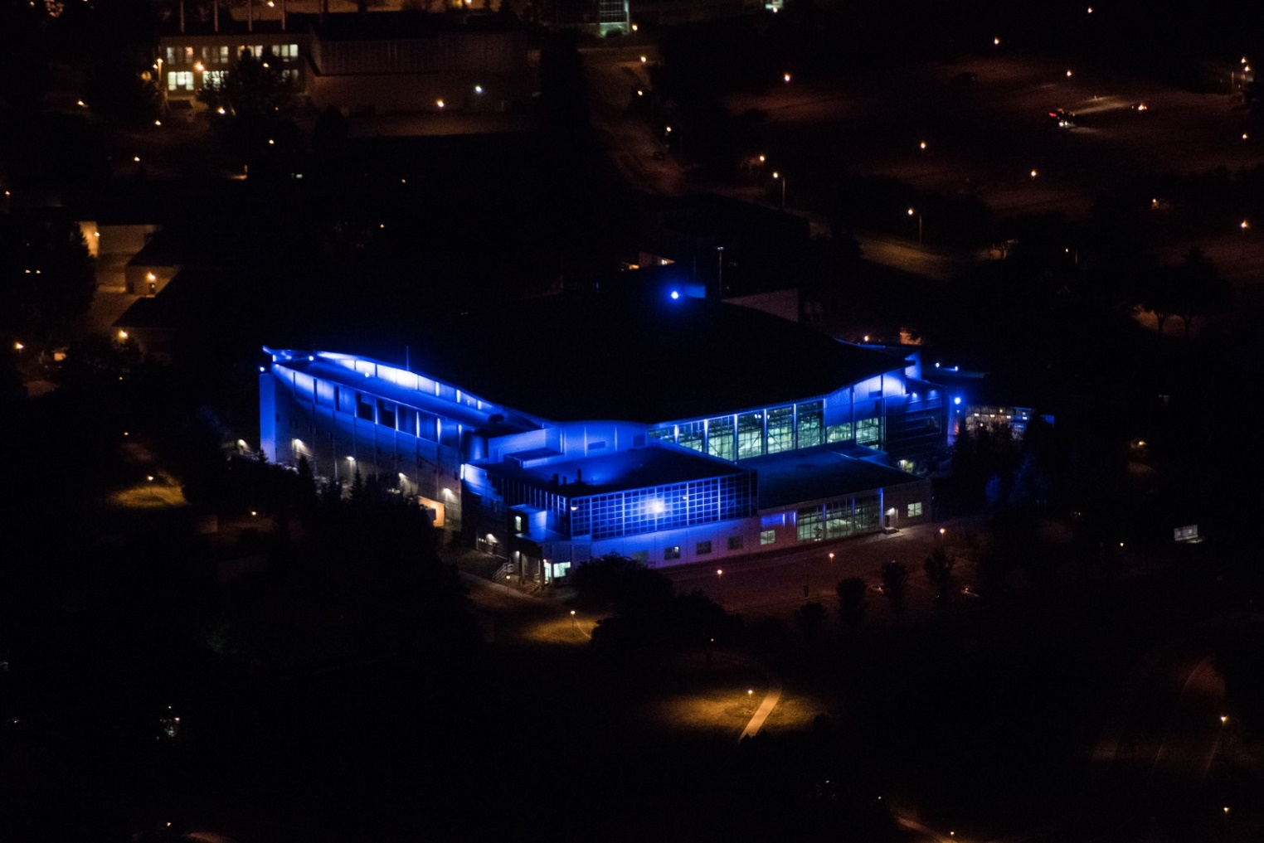
The Canadian Light Source
Located in Saskatoon
The only Synchrotron in Canada
3rd Generation storage ring
2.9 GeV
Maximum Current 220 mA
Circumference: 171 m

Slide 4
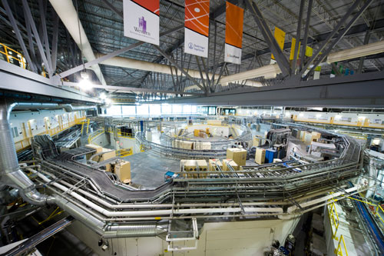
Beamlines
17 Beamlines
  Far-Infrared
  Mid-Infrared
  Soft X-ray
  Hard X-ray

Slide 5
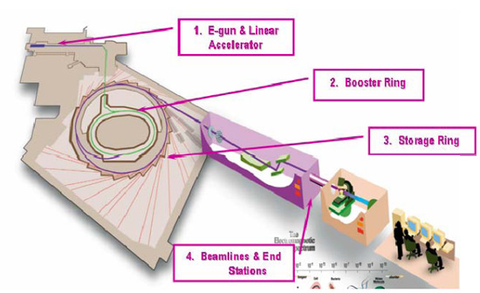
Basics of a Synchrotron

Slide 6
The Synchrotron Advantage
The electron beam is a very small source
Produces very high brightness
This allows experiments that would either be
  Impossible
  Impractical
This is true for all beamlines
Far-Infrared
  High Spectral Resolution
  High Spatial Resolution

Slide 7
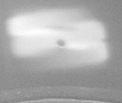
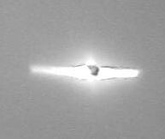
Brightness
Glow Bar
Synchrotron

Slide 8
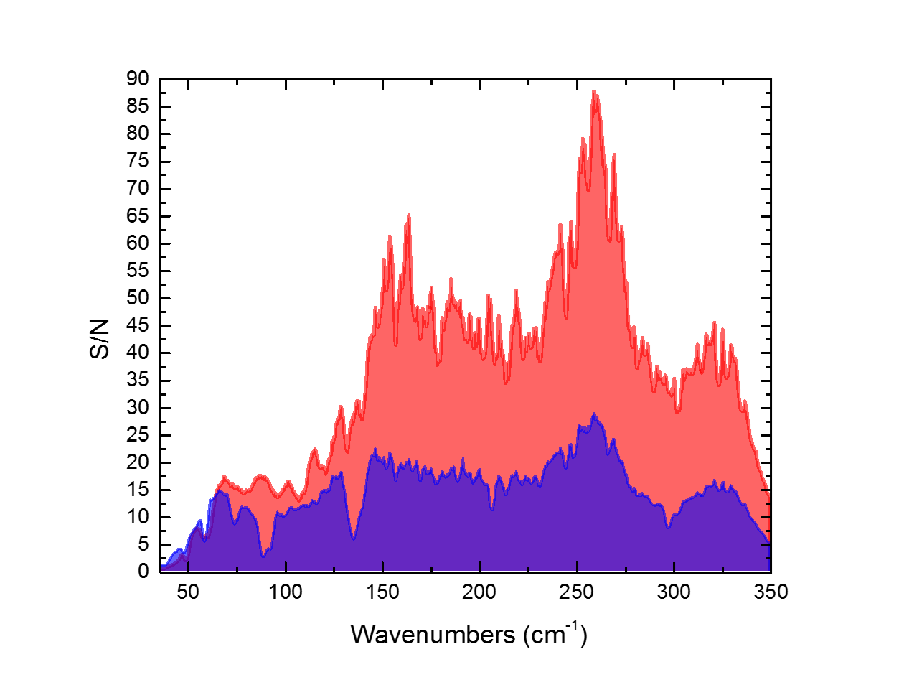
Synchrotron advantage: 30-335 cm⁻¹

Slide 9
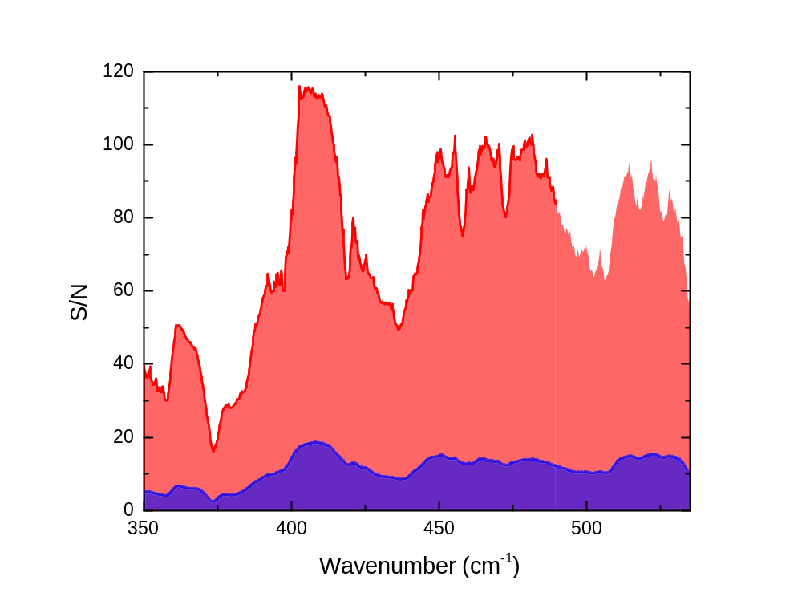
Synchrotron advantage: 335-535 cm⁻¹

Slide 10
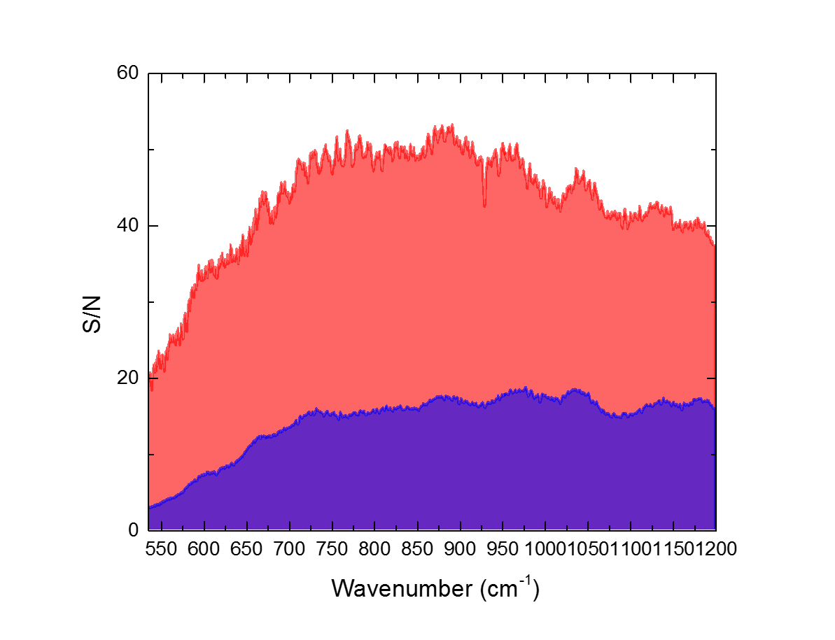
Synchrotron advantage: 500-1200 cm⁻¹

Slide 11
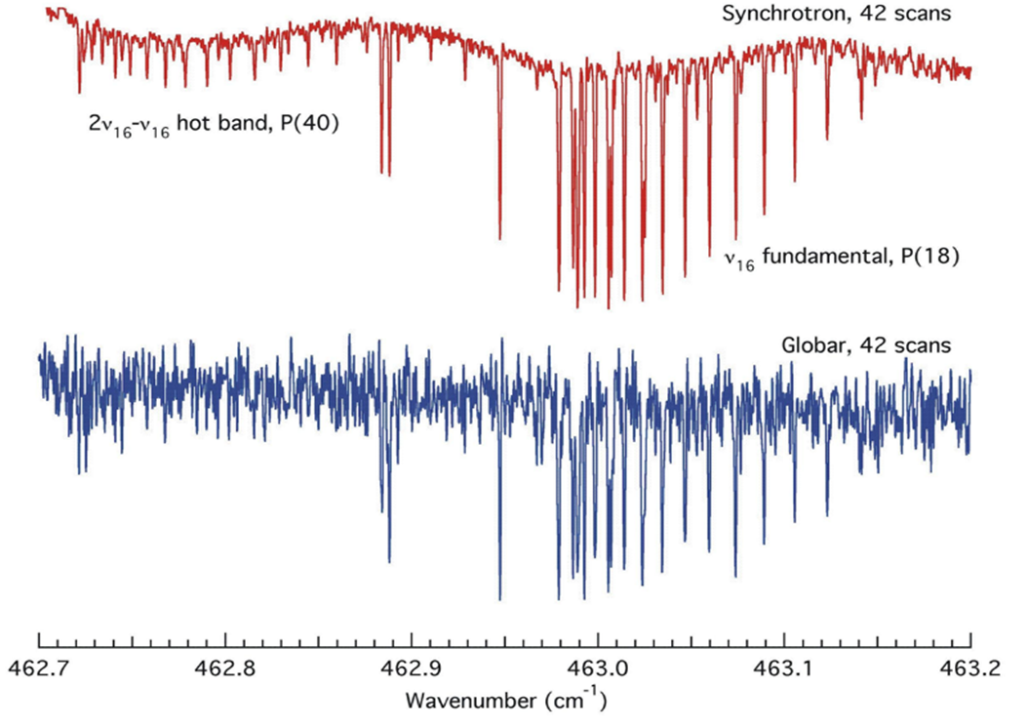
Example
High resolution spectra of pyrrole, collected using the synchrotron (top) compared to the same using the Globar (bottom). Reproduced from Tokaryk D.W. and van Wijngaarden J.A. "Fourier transform spectra of the ν₁₆ , 2ν₁₆ ,and 2ν₁₆- ν₁₆ bands of pyrrole taken with synchrotron radiation" Can. J. Phys. 87 (2009) 443-448. © Canadian Science Publishing or its licensors

Slide 12

The Far-Infrared Beamline : Spectrometer
Bruker IFS 125 HR Spectrometer
  9.4 M Pathlength Difference
  Nominal Resolution: 0.00096 cm⁻¹
  Beam splinters:
    75 micron Mylar (5-30 cm⁻¹)
    6 micron Mylar (30-535 cm⁻¹)
    KBr (400-4800 cm⁻¹)
    CaF (1850-20000 cm⁻¹)
  Sources
    Synchrotron
    Globar
    Tungsten Lamp
    Hg Arc

Slide 13
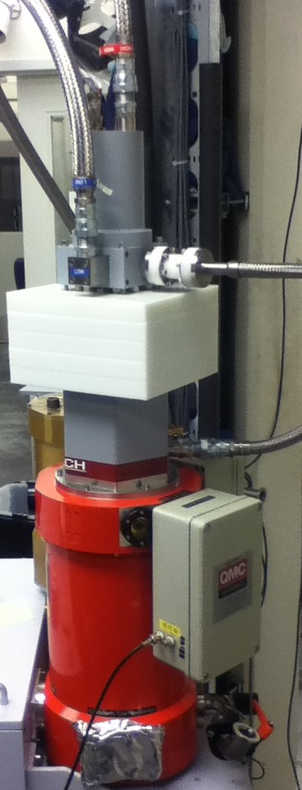
Detectors
QMC Detector
  Channel 1: Niobium TES Bolometer (5-600 cm⁻¹)
  Channel 2: Ge:Cu detector (200-1300 cm⁻¹)
Si Bolometer (5-335 cm⁻¹)
Si Bolometer (30-650 cm⁻¹)
Ge:Cu Detector (335-1900 cm⁻¹)
MCT NW (700-10000 cm⁻¹)
MCT WD (450-10000 cm⁻¹)
InSb (1850-10000 cm⁻¹)

Slide 14
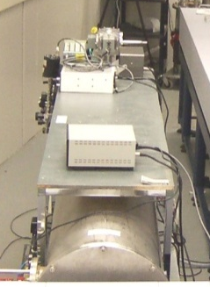
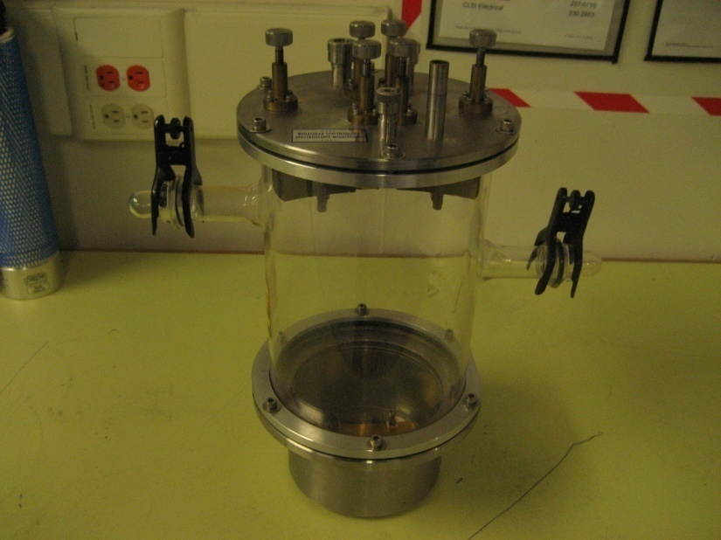
The Far-Infrared Beamline Gas Cells
2 Meter Gas Cell
  72 meter Maximum Pathlength
  Can be cooled to 200 K
  Can be warmed to 340 K
30 Meter Gas Cell
  12 meter Maximum Pathlength
  Ambient Temperature

Slide 15
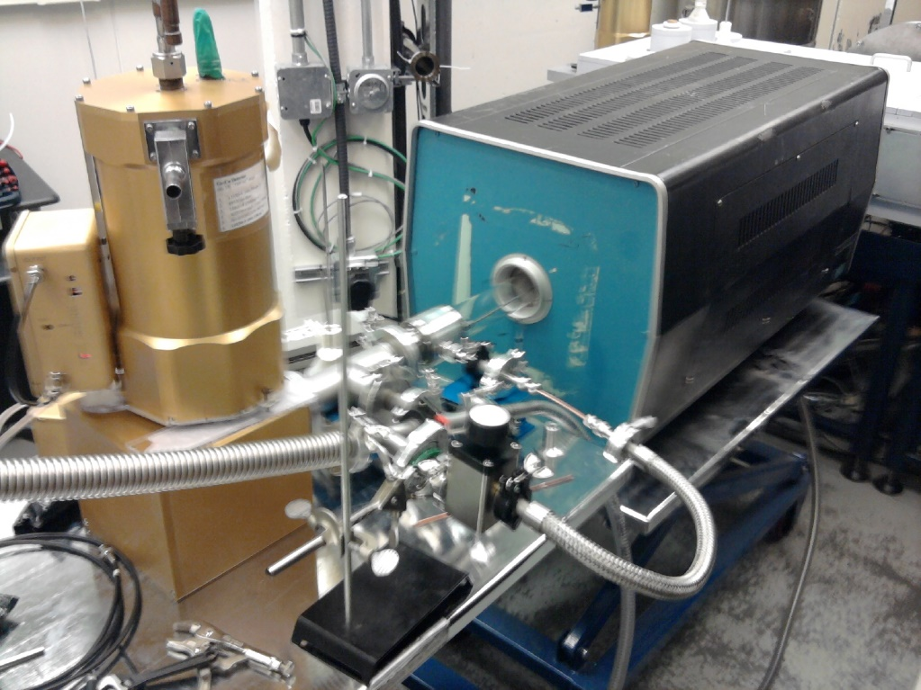
Furnace Cell
Maximum Temperature: 1500 °C
Pathlength 86 cm
Single Path
Flow capable

Slide 16
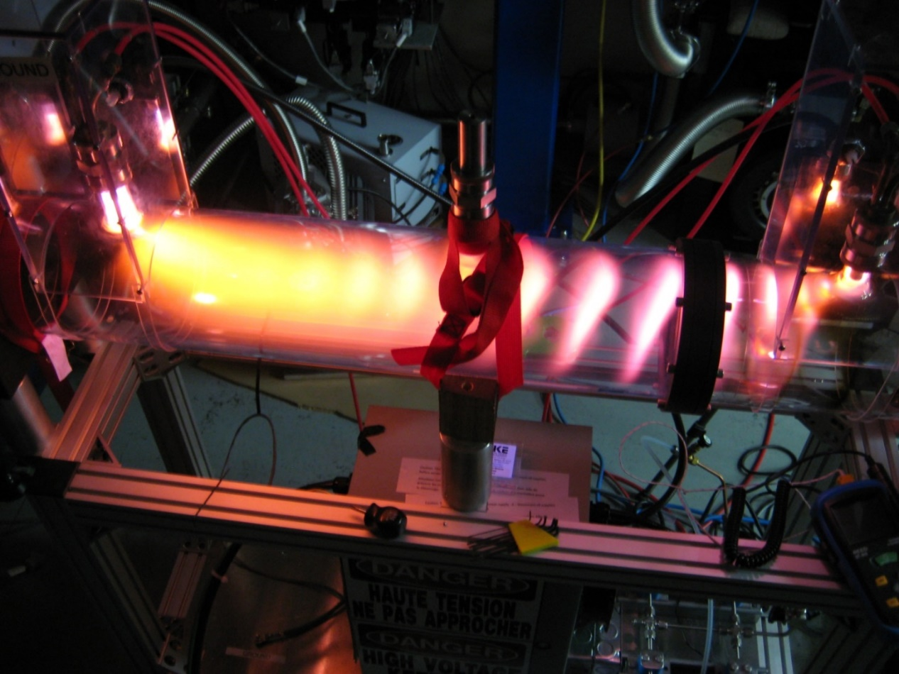
Glow Discharge Cell
1.5 M Base Pathlength
~50 Meter total Pathlength
High Voltage Supply
  Maximum Voltage: 3700 Volt
  Maximum Current: 180 mA

Slide 17
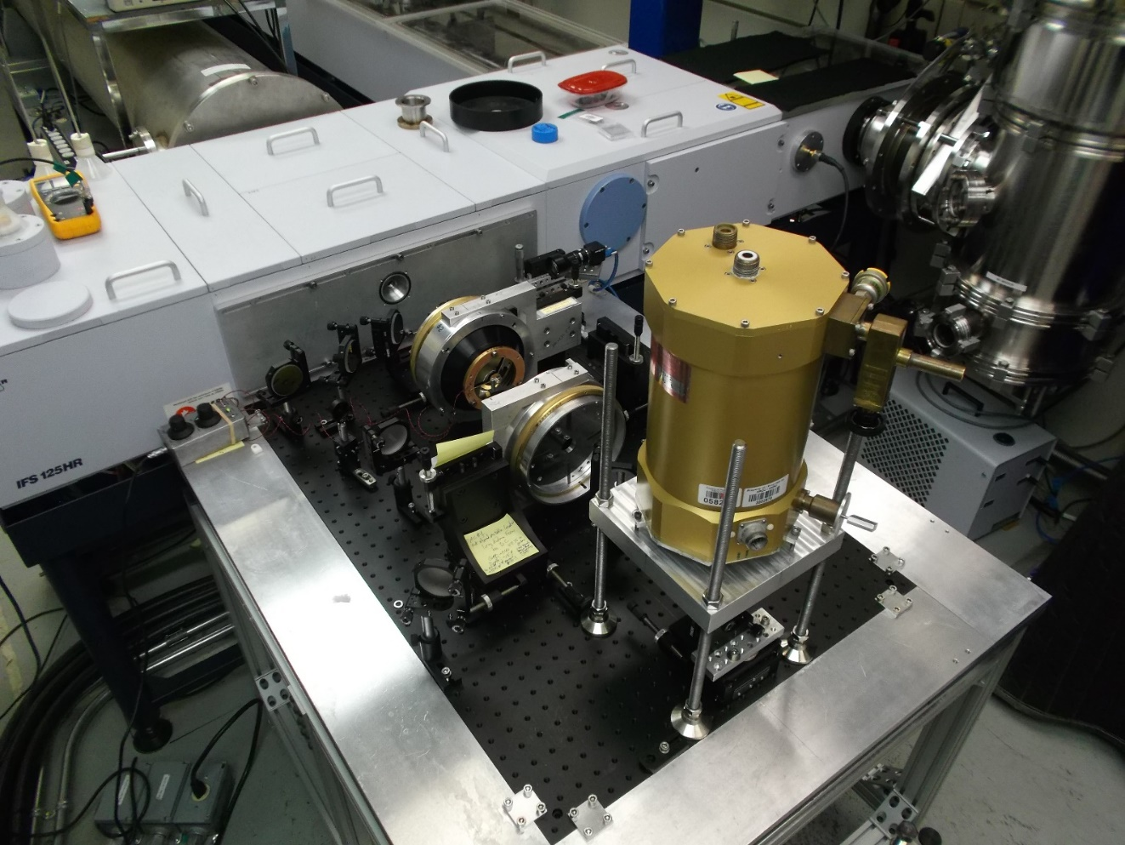
Horizontal Microscope
Design Based on SOLIEL System
Transmission or Reflectance
Designed for use with Diamond Anvil Cells
Numerical Aperture: 0.5
Working distance: 47 mm
Purged with Dry Nitrogen

Slide 18
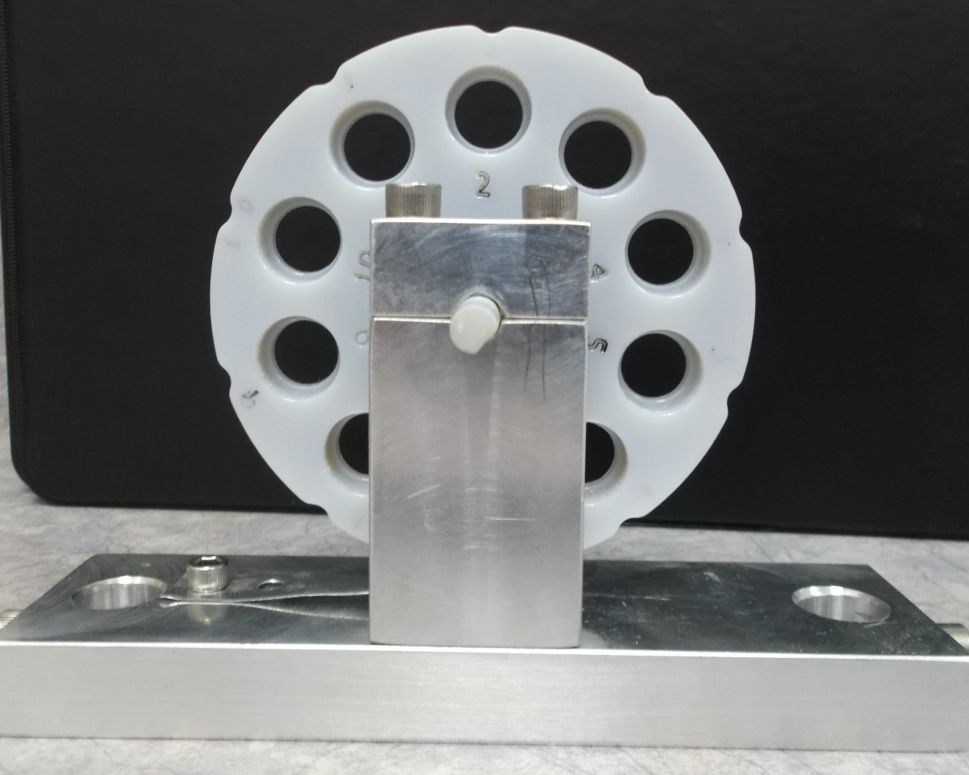
Pellet Wheel
Accepts 13 mm pellets
  KBr
  Polyethylene
Up to10 Pellets

Slide 19
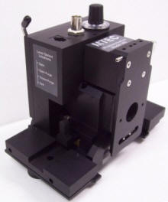
Photoacoustic Spectroscopy
MTEC Photoacoustic Cell
Excellent for Opaque samples
Capable of “depth profiling”
Little to no sample preparation
Works well with Coherent Synchrotron Radiation

Slide 20
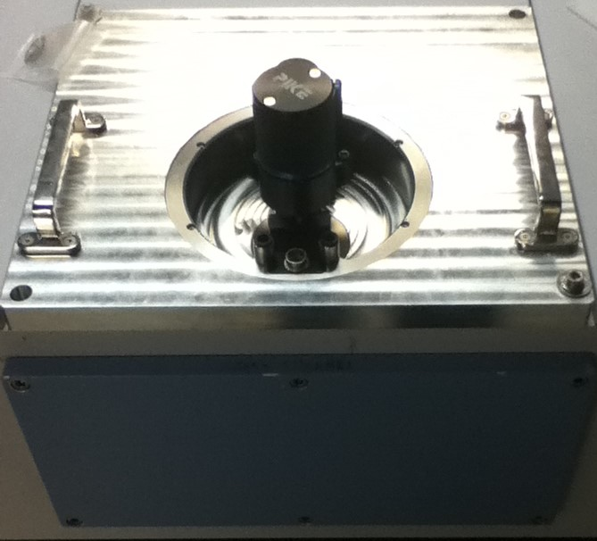
GladiATR

Slide 21
Coherent Synchrotron Radiation
Normal Synchrotron Radiation
Coherent Synchrotron Radiation

Slide 22
The CSR advantage
Bunch with N electrons undergoes acceleration a
Random radiation phases (incoherent)
Coherent Radiation Phases
2a²
(Ne)²
Ne²
Power =
3c²
P[coherent]
= N ≈ 10⁶ - 10¹⁰
P[incoherent]

Slide 23
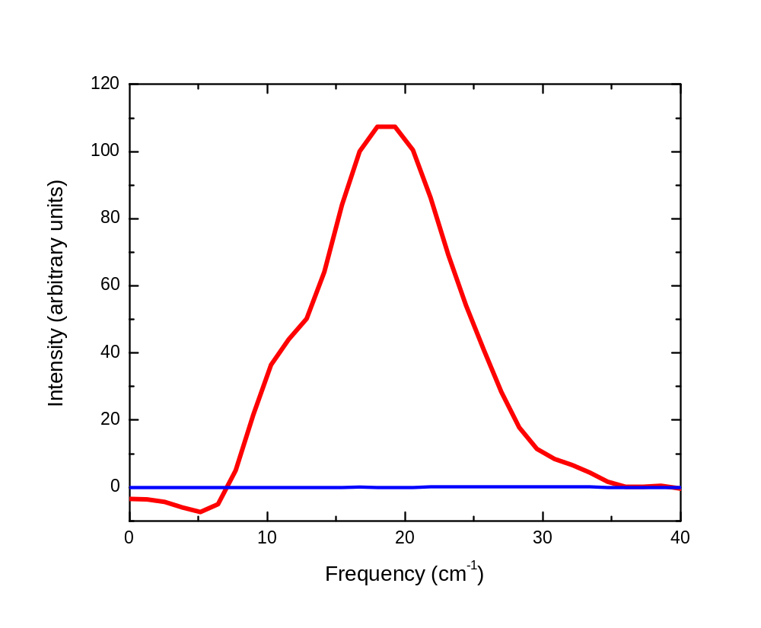
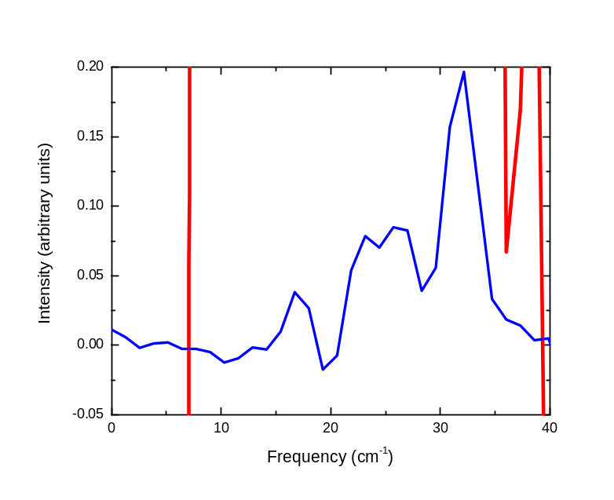
CSR: Spectrum

Slide 24
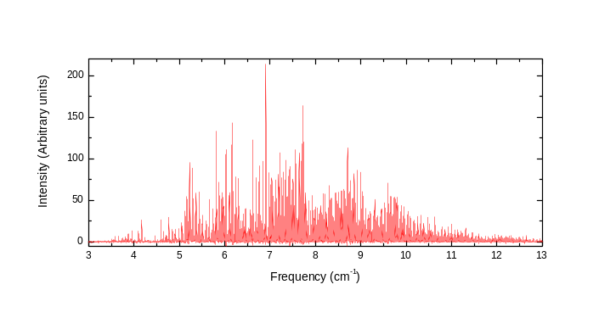
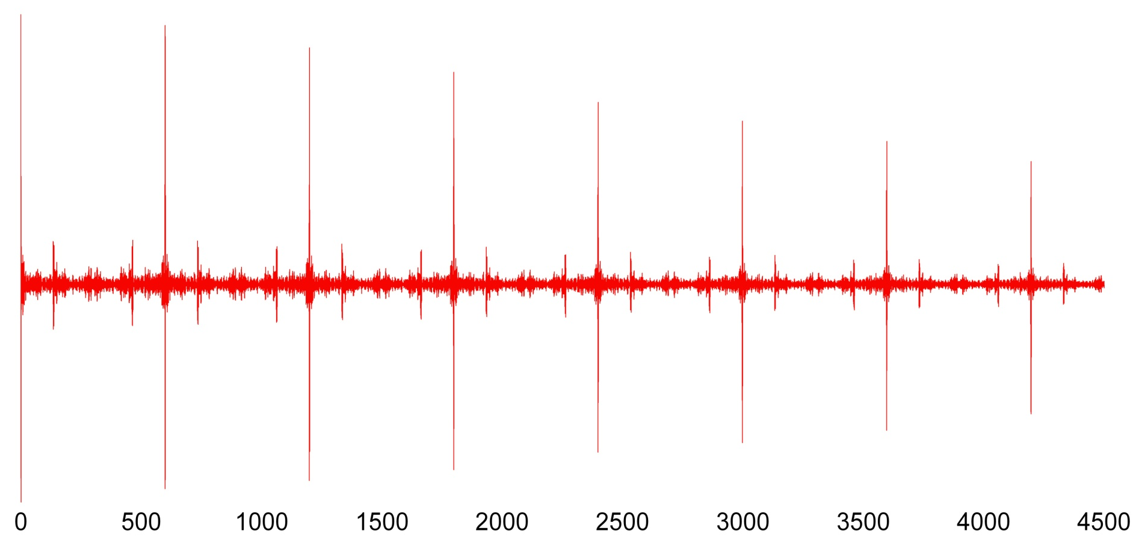
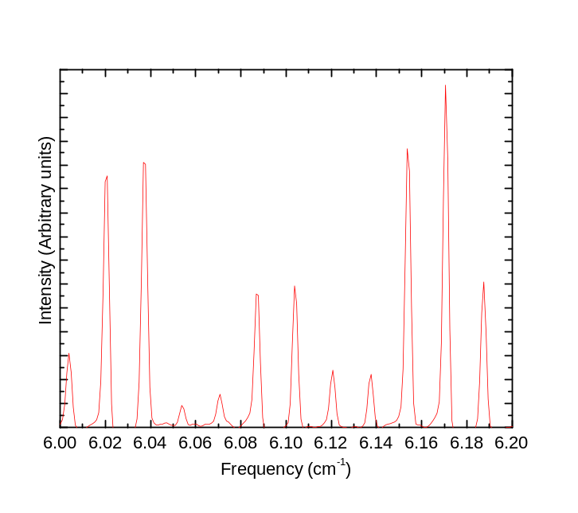
CSR: Superradiance
1↔1
1↔2
2↔2
2↔3
1↔3
...
...
2↔4
1↔4
...
2↔5
1↔5
...
2↔6
1↔6
...
2↔7
1↔7
...
2↔8
1↔8
...
2↔9
...

Slide 25
What is a Heterodyne ?
Frequency Multiplier
(24X)
CSR
(0-899 GHz)
Local Oscillator (LO)
Horn Antenna
(220-330 GHz)
Mixer
Signal Analyzer
LO-SIGNAL
LO+SIGNAL
Amplifier

Slide 26
Our Heterodyne
The equipment we have is
  A VDI WR3.4MixAMC-I Integrated Mixer/Amplifier/Mulitiplier Chain
    Range: 220-330 GHz
    Multiplication Factor: 24
    Gain: 10 dB
  A VDI WM570DHR3 Antenna Horn
    Range 220-330 GHz
  A VDI Synthesizer
    Output range 8-20 GHz
  Keysight N9020B Signal Analyzer
    Range: 10 Hz to 8.4 GHz

Slide 27
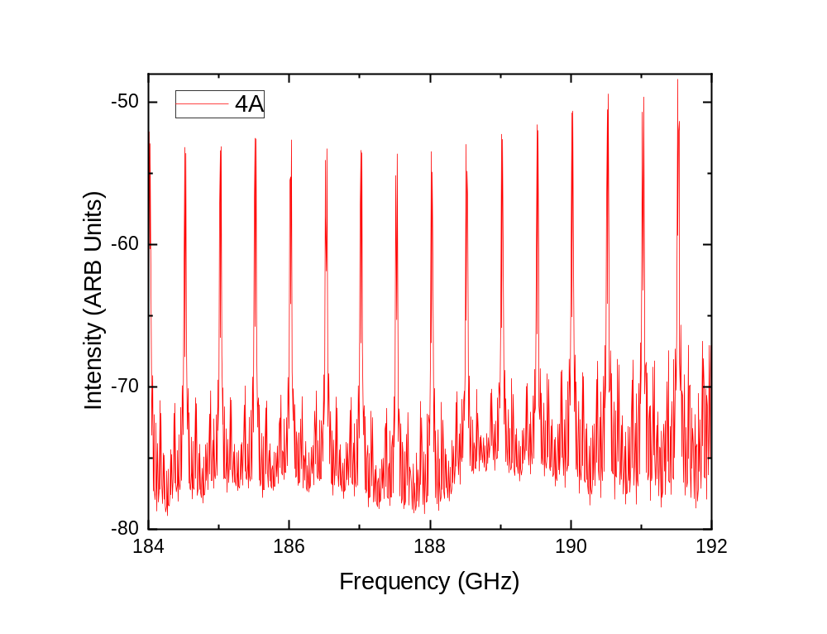
Success: LOW
Fill Pattern: 210 evenly spaced bunches
Synchrotron Frequency: 4.8 kHz
Current: 5.4 mA
Local Oscillator Frequency: 8 GHz
Spectrum Analyzer range: 10 MHz-8.4 GHz
Average: 100 Scans
Range: 6.13758-6.40443 cm⁻¹

Slide 28
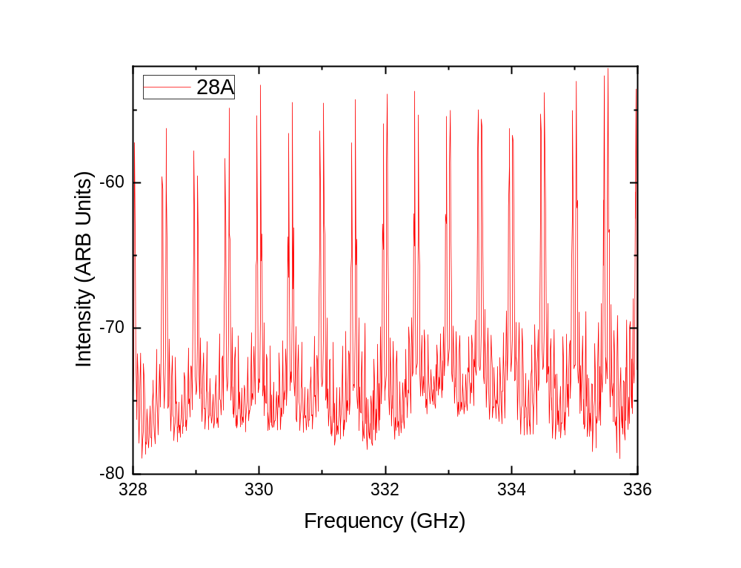
Success: HIGH
Fill Pattern: 210 evenly spaced bunches
Synchrotron Frequency: 4.8 kHz
Current: 4.6 mA
Local Oscillator Frequency: 14 GHz
Spectrum Analyzer range: 10 MHz-8.4 GHz
Average: 100 Scans
Range: 10.9490-11.20775 cm⁻¹

Slide 29
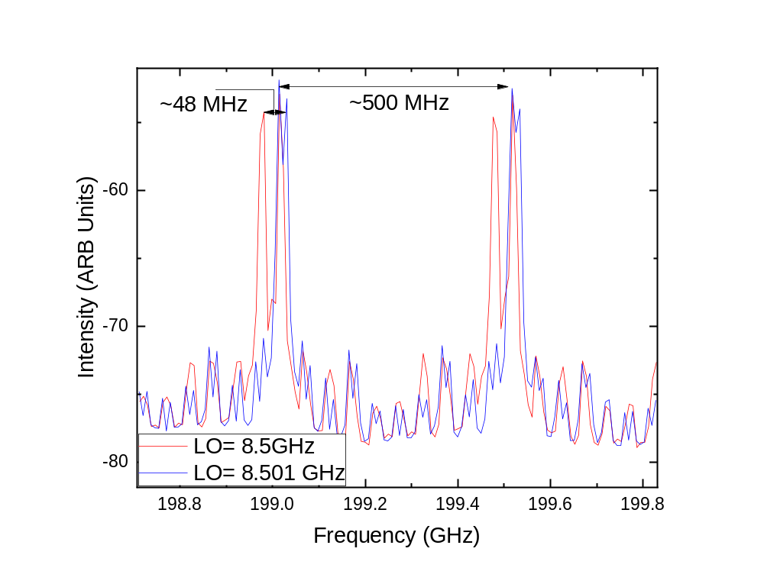
Results: 500 MHz
Note: Aliasing Between LO-SIG and LO+SIG
Here the X Axis is for LO-SIG
So the LO+SIG shifts by 2 X the ΔLO (after multiplication) or 48 MHz
500 MHz is the frequency that a bunch passes the port.
This is the same superradiant comb observed in our PR-STAB paper

Slide 30
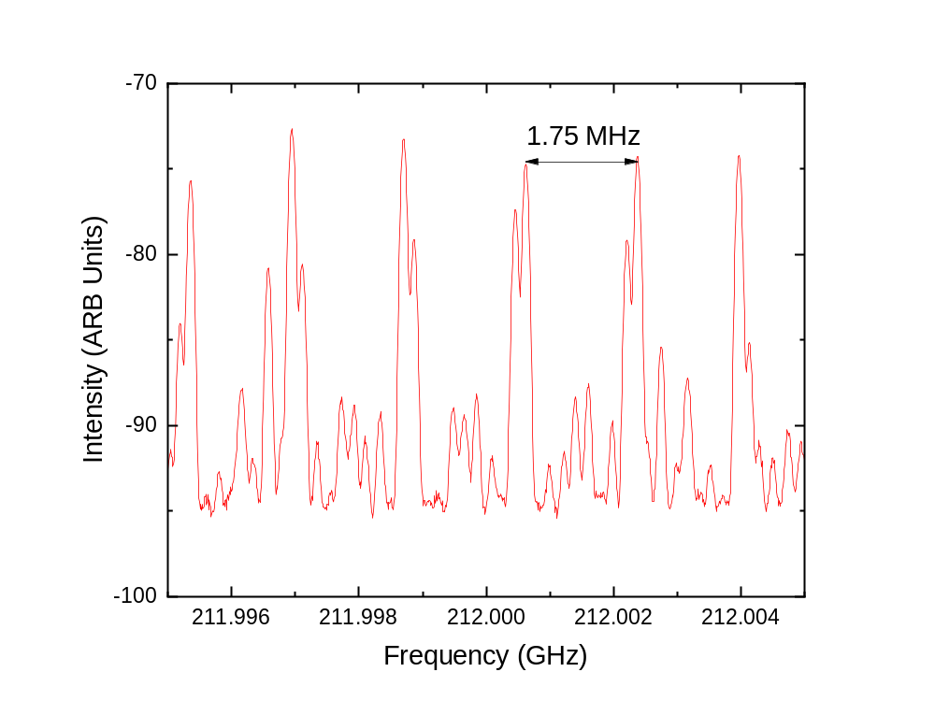
Results: 1.754 MHz
Zooming in more we can clearly see the 1.75 MHz
frequency comb which we associate with the revolution
frequency of the ring.

Slide 31
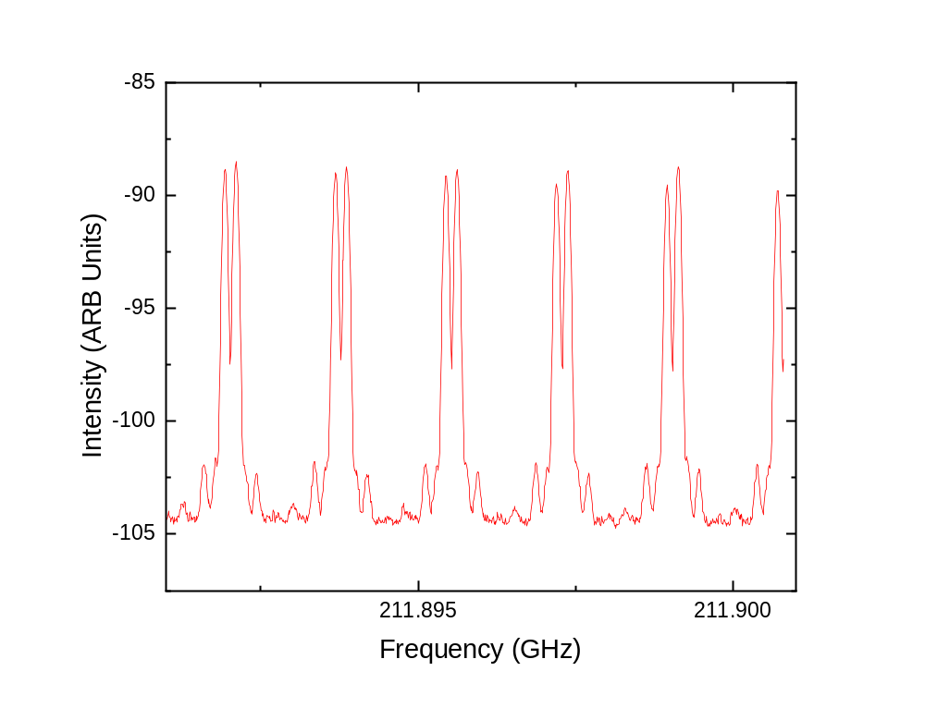
Results: Single Bunch – 1.754 MHz
Fill Pattern: 1 Bunch
Synchrotron Frequency: 4.8 kHz
Current: 0.08 mA
Local Oscillator Frequency: 9.00045 GHz
Spectrum Analyzer range: 10 MHz centered on 4.115 GHz
Average: 100 Scans
For spectroscopy this will allow 0.00006 cm⁻¹ resolution
16 times better than our spectrometer
The equivalent of an 83 meter interferometer

Slide 32
Thank you
Tim May
Dr. McKellar
Dr. van Wijngaarden
Dr. Tokaryk
Dr. Michaelian
Dr. Bergstrom
Dr. Wurtz
Dr Vogt
Tonia Batten
Dr. Dallin
Aimee Bell
Sylvestre Twagirayezu
Jianbao Zhao
Canadian Light Sources Staff
Far-Infrared Beamline
  Beamteam
  User community
Canada Foundation for Innovation
NSERC
University of Saskatchewan
Government of Saskatchewan
Western Economic Diversification Canada
National Research Council Canada
Canadian Institute of Health Research

Slide 33
Canadian Infrared Users Workshop
This workshop is intended to discuss the direction of Canadian infrared user facilities in the future.
Space is limited
Please contact us if you are interested in attending
  Brant.Billinghurst@lightsource.ca
  Scott.Rosendahl@lightsource.ca
  Ian.Burgess@usask.ca
Canadian IR Users Discussion Board
  http://canadian-ir-users.boards.net/

