Slide 1
Special Particle Physics Faculty Meeting
Agenda
Update
Discussion on Priorities

Slide 2
Training
From Petr:
Leadership Team Meeting conclusion
WD Q&A should be removed and everybody is welcome to remove it by themselves
Privacy training is mandatory and everybody must complete it
WD for everyone and WD for managers etc are recommended/optional
A revision of the privacy training will be done. However, the timeline has not been announced.
It should also be noted that there are job aides for various WD tasks available in pdf format that can be useful.

Slide 3
IPP 50th Anniversary (link to slides)

Slide 4
IPP 50th Anniversary

Slide 5
New Initiatives
Particle Physics Planning results in impact on existing and future experiments and
New initiatives under discussion
Center/platform/hub for detector development (with Science and Technology)
Center/platform/hub for AMO/Quantum/Precision/physics (HAICU, radioactive molecules, UCN…), across Particle & Nuclear Physics departments
Clearly in the ++ blue sky scenario
Imagine several BAE, engineers and techs for each innitiative
Two task forces created - kick off tomorrow (if interested let me know)
We also want to strengthen SciTech and infrastructure capabilities in a flat-flat scenario
How many hires for that?

Slide 6
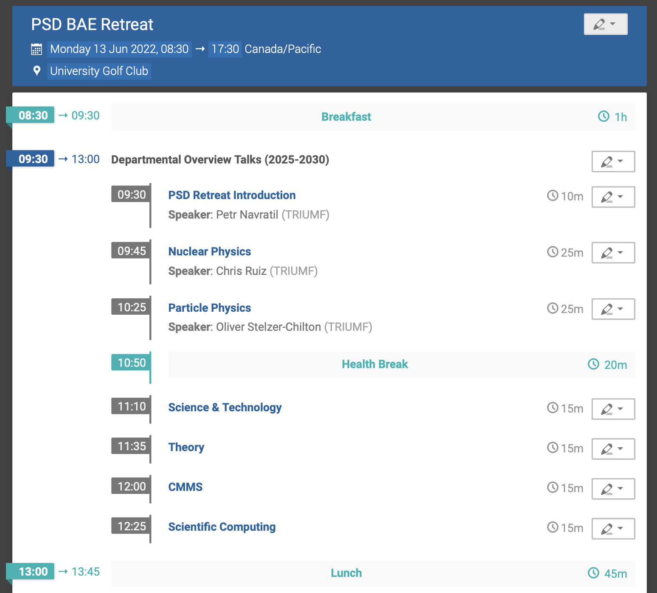
PSD Retreat
June 13th at the University Golf Club
BAE + invited P&S (A&P)
Agenda developing here

Slide 7
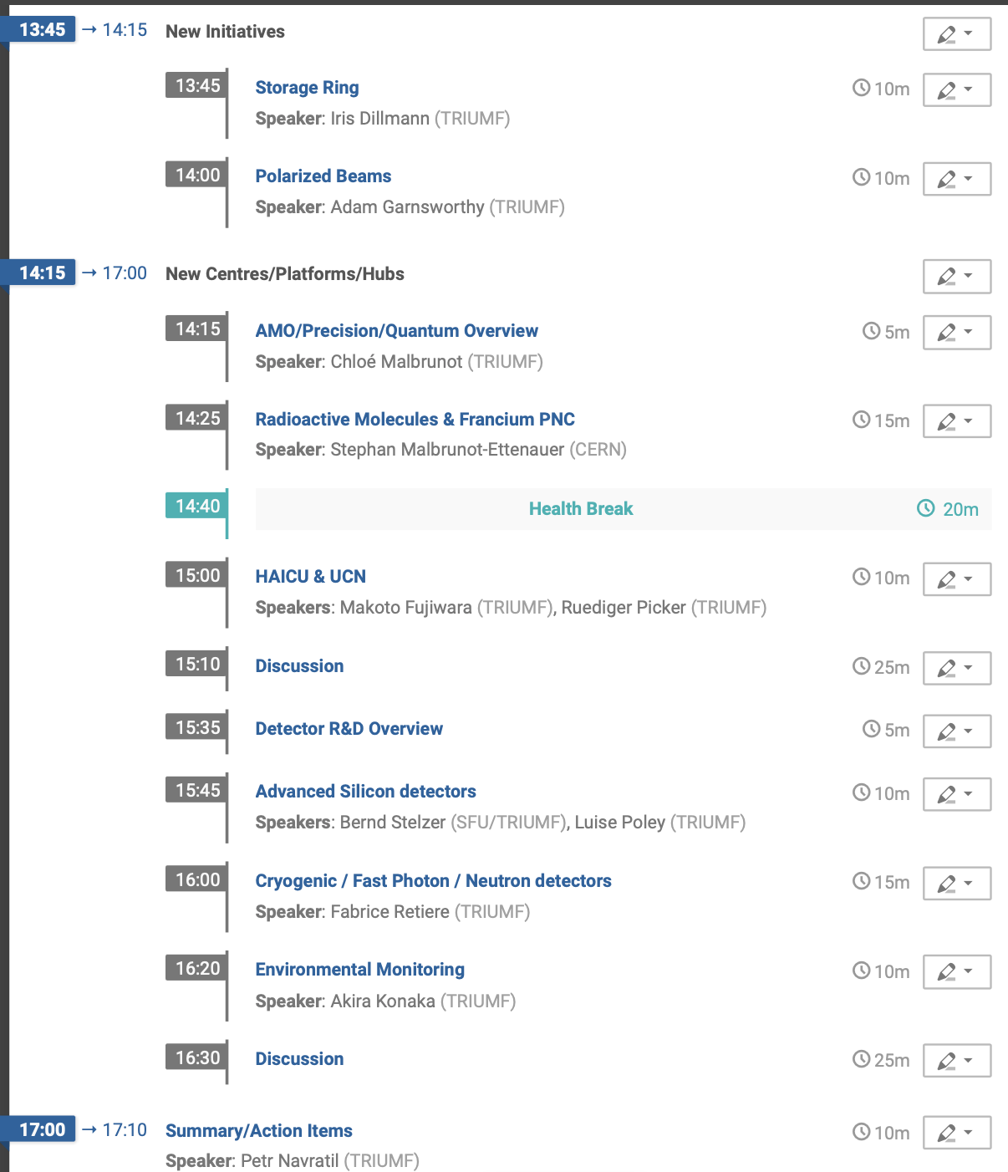
PSD Retreat

Slide 8
Science Week
Session on Wednesday and Thursday focuses on 5YP developments
Proposal for PP/SciTech/SciComp session
AMO session separately (with connection to ICAP)
Initiative on a Quantum&Precision Centre@TRIUMF | Amar Vutha (U of Toronto)
Spectroscopy of the highly forbidden 7s-8s transition in francium: Towards a measurement of atomic parity violation | Gerald Gwinner (Manitoba)
Radioactive Molecules for Nuclear Science | Ronald Garcia Ruiz (MIT)
Antihydrogen & hydrogen fountains | Taka Momose (UBC)
Theory Perspective (15+10)
Particle Physics at TRIUMF (Current focus projects + DarkLight + PIONEER + Future Collider (20+5))
TRIUMF @ SNOLAB Program (nEXO / DarkSide 20K / SuperCDMS (10+5))
PONE (5+5)
New CFREF proposal (10+5)
New Initiative Detector Development Platform (10+5)
Detectors for Environmental Monitoring (10+5)
Scientific Computing Initiatives (15+5)

Slide 9
Hiring Priorities
Over the last 2 meetings heard from
Future Collider (joint-position?)
TUCAN (1)
Astro-particle / DarkSide-20k / nEXO (encouraged by director?)
P-One (potentially big experiment nearby)
PIONEER (how large is critical mass?)
Hyper-K (replacement)
ALPHA/HAICU/Quantum (part of new initiative?)

Slide 10
AOB

