Slide 1





Global microscopic description of nucleon-nucleus scattering with quantified uncertainties
Jeremy Holt
Texas A&M University, College Station
*Collaborators: Taylor Whitehead (Michigan State University)
Yeunhwan Lim (Ewha Womans University, South Korea)
2nd Joint Canada-APCTP Meeting on Nuclear Theory, 8/9/2022

Slide 2
Motivation: Nuclear reactions with unstable isotopes
Interpretation of radioactive ion beam experiments
Neutron-capture rates in late-stage r-process nucleosynthesis
Ab initio nuclear reaction theory available for light systems at low energies
Needs:
  Optical potentials are a necessary ingredient in most reaction models
  Global optical potentials are needed to study reactions on a wide range of unstable isotopes
Challenges:
  Commonly used global optical potentials are phenomenological and fitted around nuclear stability → microscopic approaches may have greater predictive power away from stability
  Present global optical potentials do not allow for uncertainty quantification

Slide 3
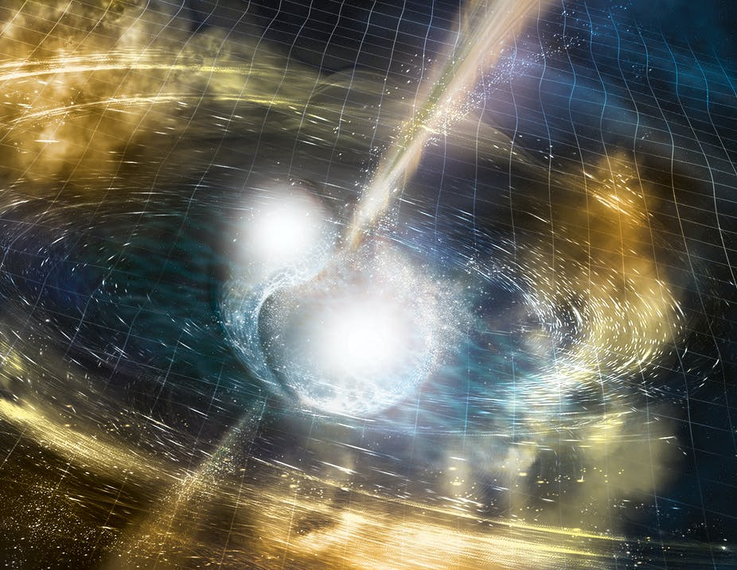
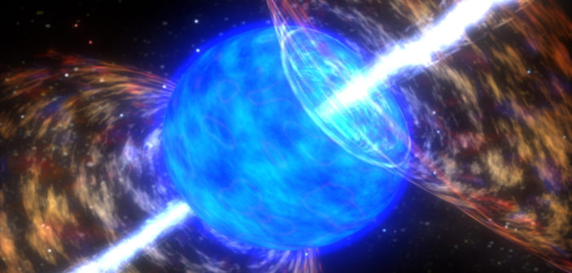
R-process nucleosynthesis
Neutron star mergers
Z. Meisel, J Phys Conf Ser (2016)
Astrophysical site?
Collapsars

Slide 4
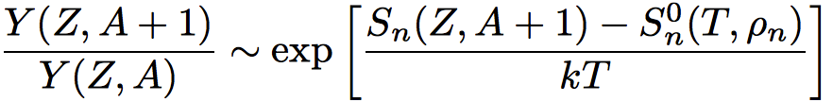
Nuclear physics inputs to r-process simulations
Masses of neutron-rich nuclei
Determine elemental abundance patterns along isotopic chains during equilibrium
Beta-decay lifetimes
Set timescale for formation of heavy elements from seed nuclei
Partly responsible for peaks at A = 130 and A = 195
Neutron-capture rates
Relevant during late-time freeze-out phase of the r-process
Sensitivity studies vary capture rates over orders of magnitude

Slide 5
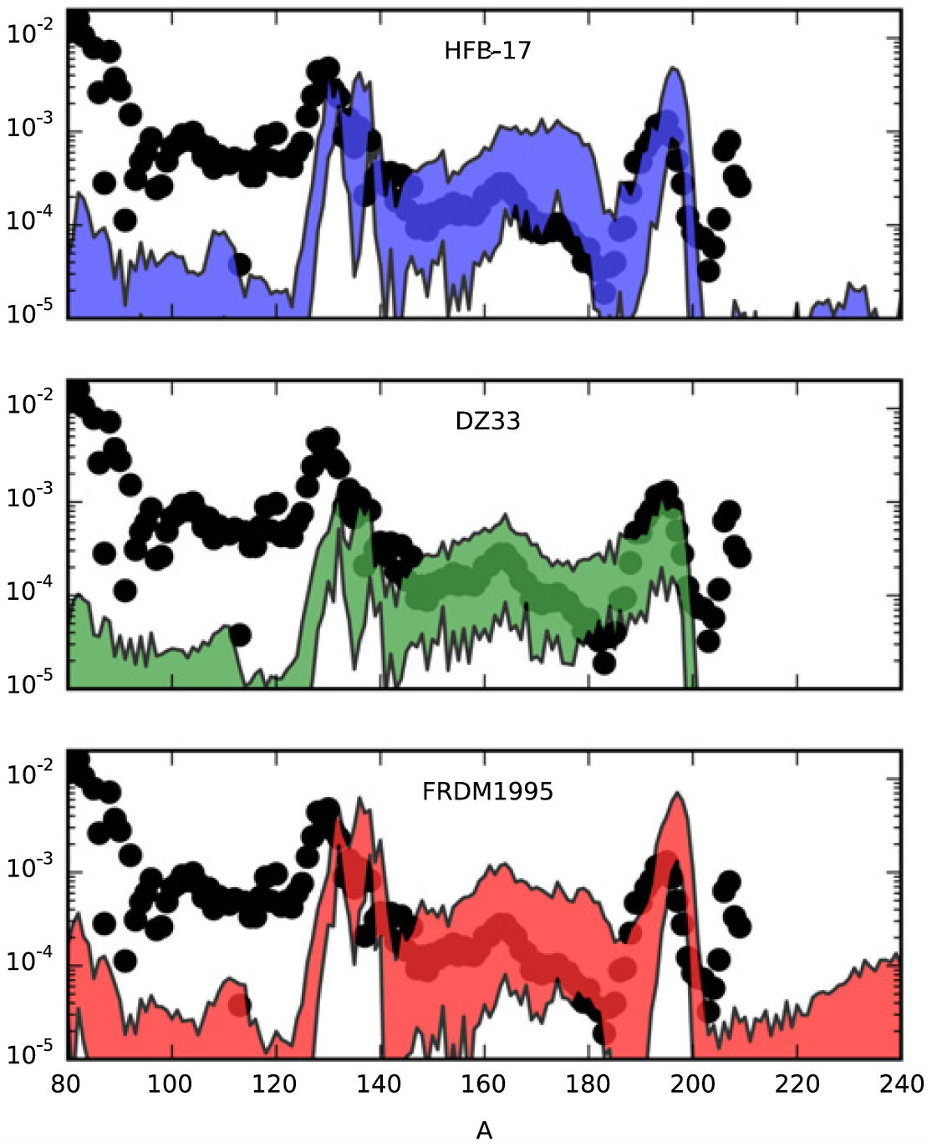
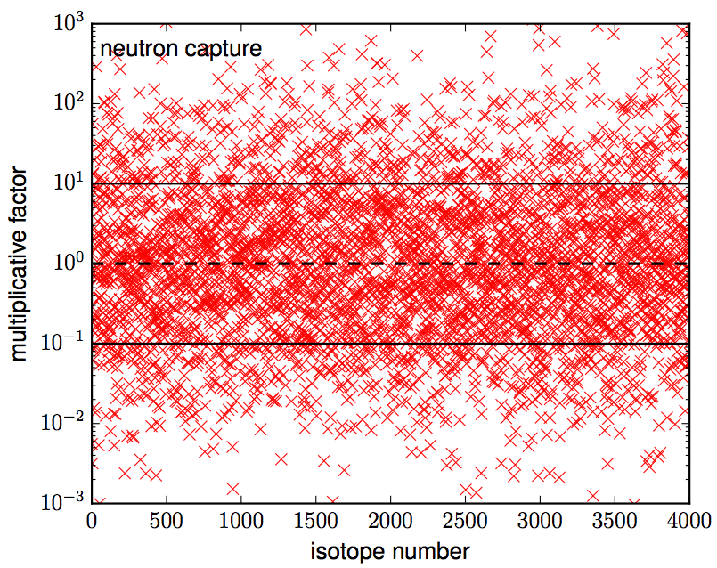
Neutron capture sensitivity studies
Uncertainties coming from:
Mumpower et al., PPNP (2016)
Nuclear level densities for Hauser-Feshbach
γ strength functions
Neutron-nucleus optical potentials
Mumpower et al., JPCF (2015)

Slide 6

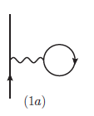

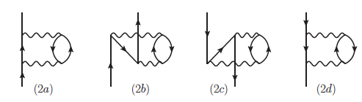
Global microscopic optical potential: start from nucleon optical potential in infinite nuclear matter
Identified with the on-shell nucleon self-energy
First-order (Hartree-Fock) contribution (real & energy independent):
Second-order perturbative contribution (complex & energy dependent):
Self consistency:
Derived from high-precision chiral two- and three-body forces

Slide 7
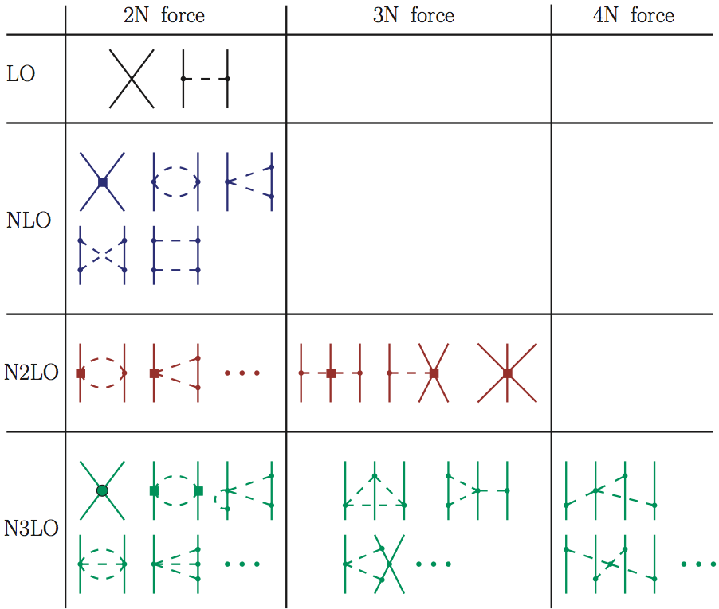
Chiral effective field theory (EFT) for nuclear forces
Nuclear forces from chiral EFT
1. Natural Separation of Scales
Energy
(q/Λ)⁰
π
Systematic expansion
~800 MeV
Heavy mesons (ρ, ω)
N
Fit to NN scattering, deuteron, ³H, ³He properties
(q/Λ)²
~270 MeV
Nucleon momenta
~140 MeV
Pion mass
(q/Λ)³
2. Goldstone bosons (pions) weakly-coupled at low momenta
(q/Λ)⁴
Enables uncertainty quantification

Slide 8
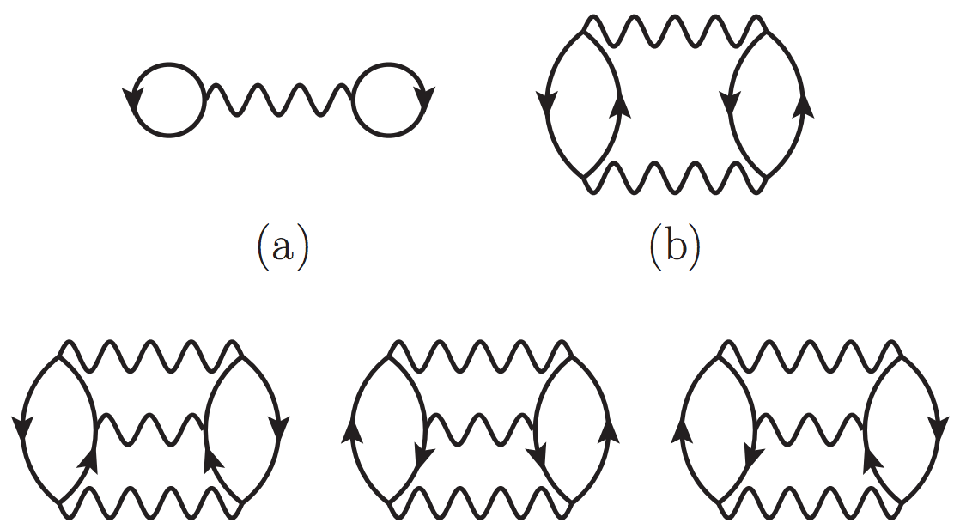
Nuclear matter uncertainties
Drischler, Holt & Wellenhofer,
ARNPS (2021)
Spinodal
instability
Holt, Kawaguchi & Kaiser, Front. Phys. (2020)
Saturation point is a fine-tuned quantity

Slide 9
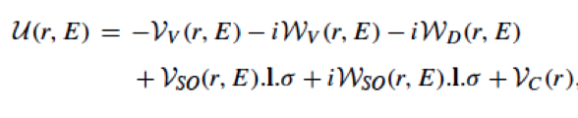
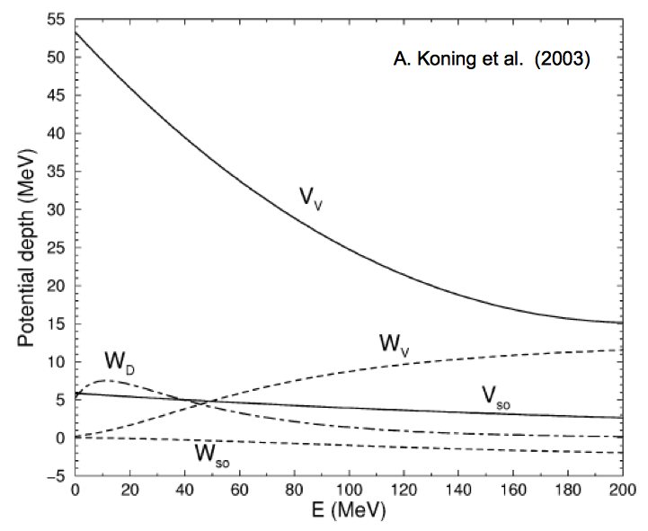

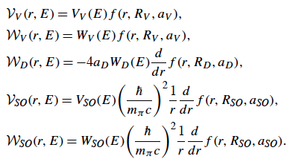
Global optical potential parameterization
Woods-Saxon shape:

Slide 10
Global optical potential parameterization: volume terms
Holt, Kaiser and Miller, PRC (2016)
Real volume strength function:
Very good agreement with phenomenology
Imaginary volume strength function: Too strongly absorptive

Slide 11
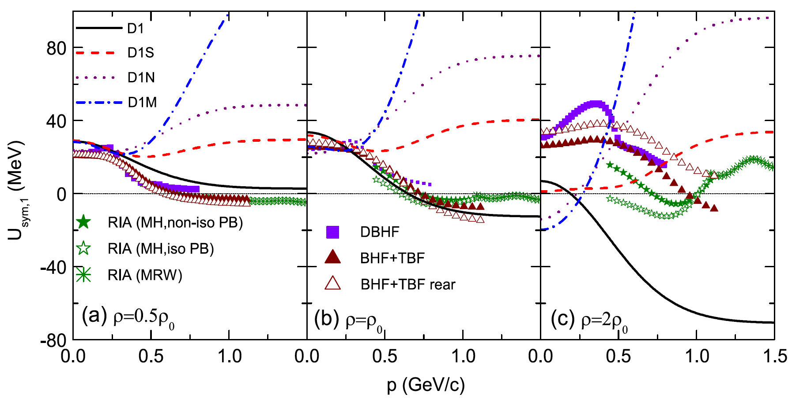

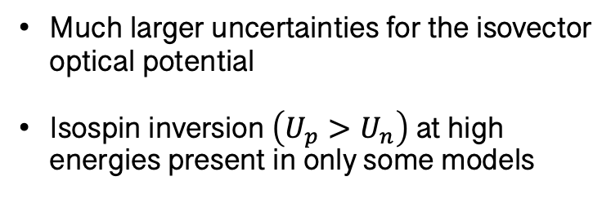
Optical potentials in neutron-rich infinite matter
B.-A. Li et al., PPNP (2018)
Isovector optical potential obeys “Lane form”:
$$U_{V}=U_{0}−U_{I}δ_{np}τ_{z}$$
Much larger uncertainties for the isovector optical potential
Isospin inversion$\left(U_{p}>U_{n}\right)$ at high energies present in only some models
Isovector Lane form above not obeyed at high energy in phenomenological Koning-Delaroche optical potential

Slide 12
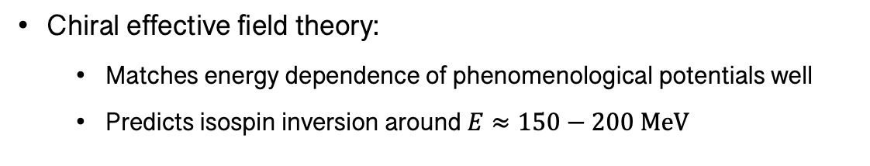
Optical potentials in neutron-rich infinite matter
Holt, Kaiser and Miller, PRC (2016)
Isovector optical potential obeys “Lane form”:
$$U_{V}=U_{0}−U_{I}δ_{np}τ_{z}$$
Much larger uncertainties for the isovector optical potential
Isospin inversion$\left(U_{p}>U_{n}\right)$ at high energies present in only some models
Chiral effective field theory:
  Matches energy dependence of phenomenological potentials well
  Predicts isospin inversion around $E≈150−200 \text{MeV}$

Slide 13
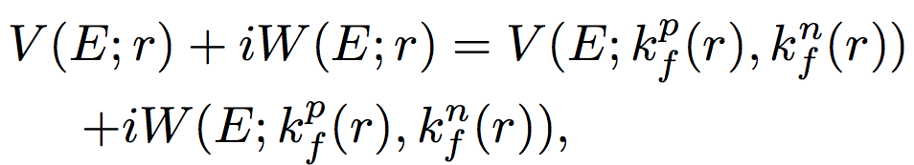
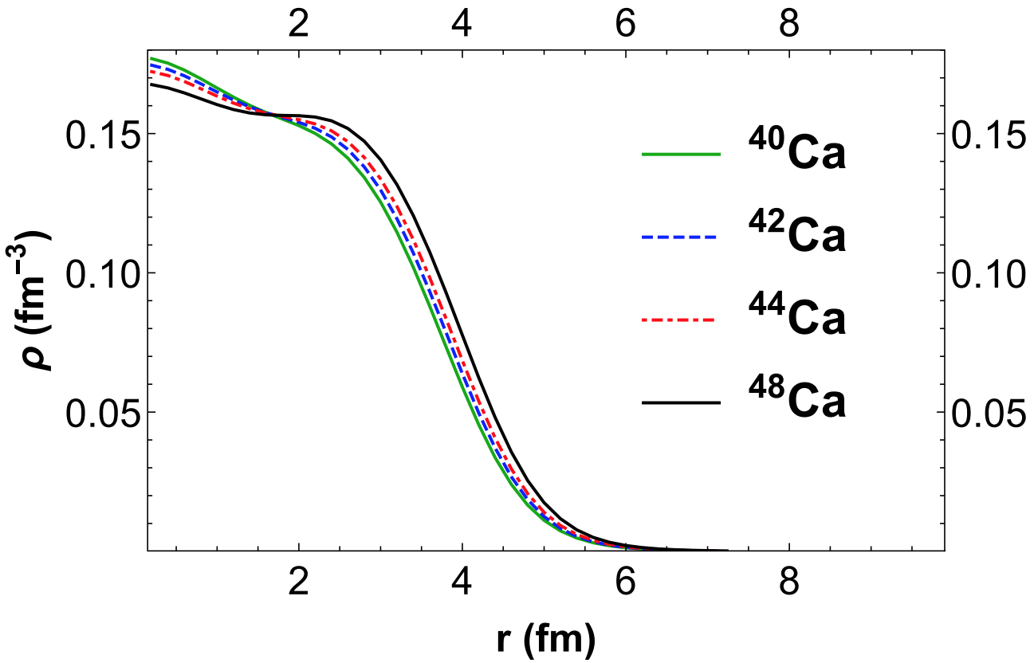
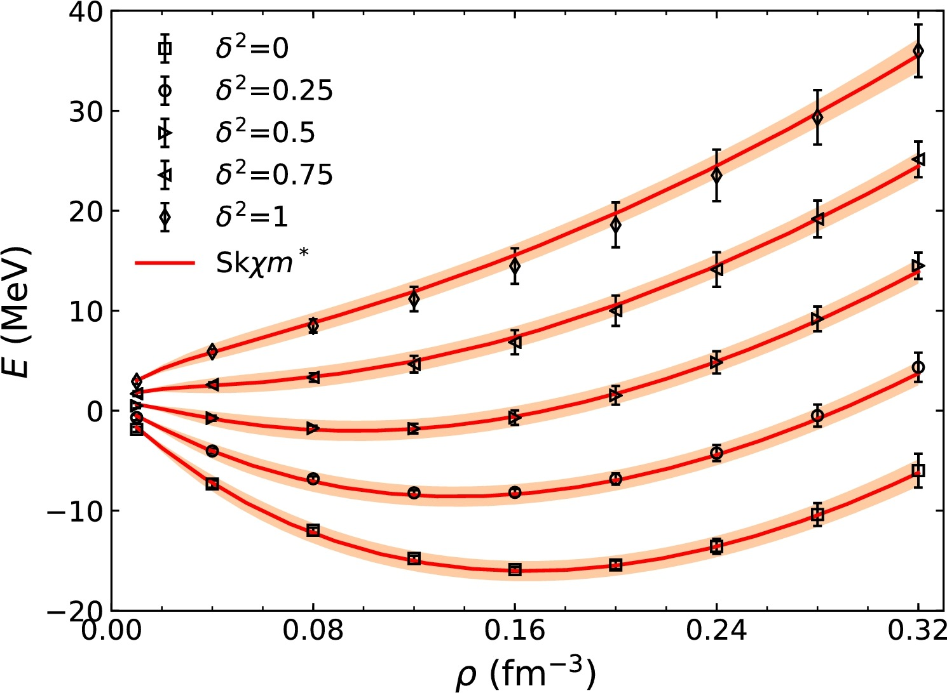
From nuclear matter to finite nuclei: Local density approximation (LDA)
Naïve local density approximation:
Optical potential in a finite nucleus matched to that of infinite matter at same isoscalar/isovector density
Density distributions from Skχ450 effective interaction
Skχ450 fitted to equation of state and effective mass
Zhang, Lim, Holt & Ko PLB (2018)
Whitehead, Lim & Holt, PRC (2019)

Slide 14
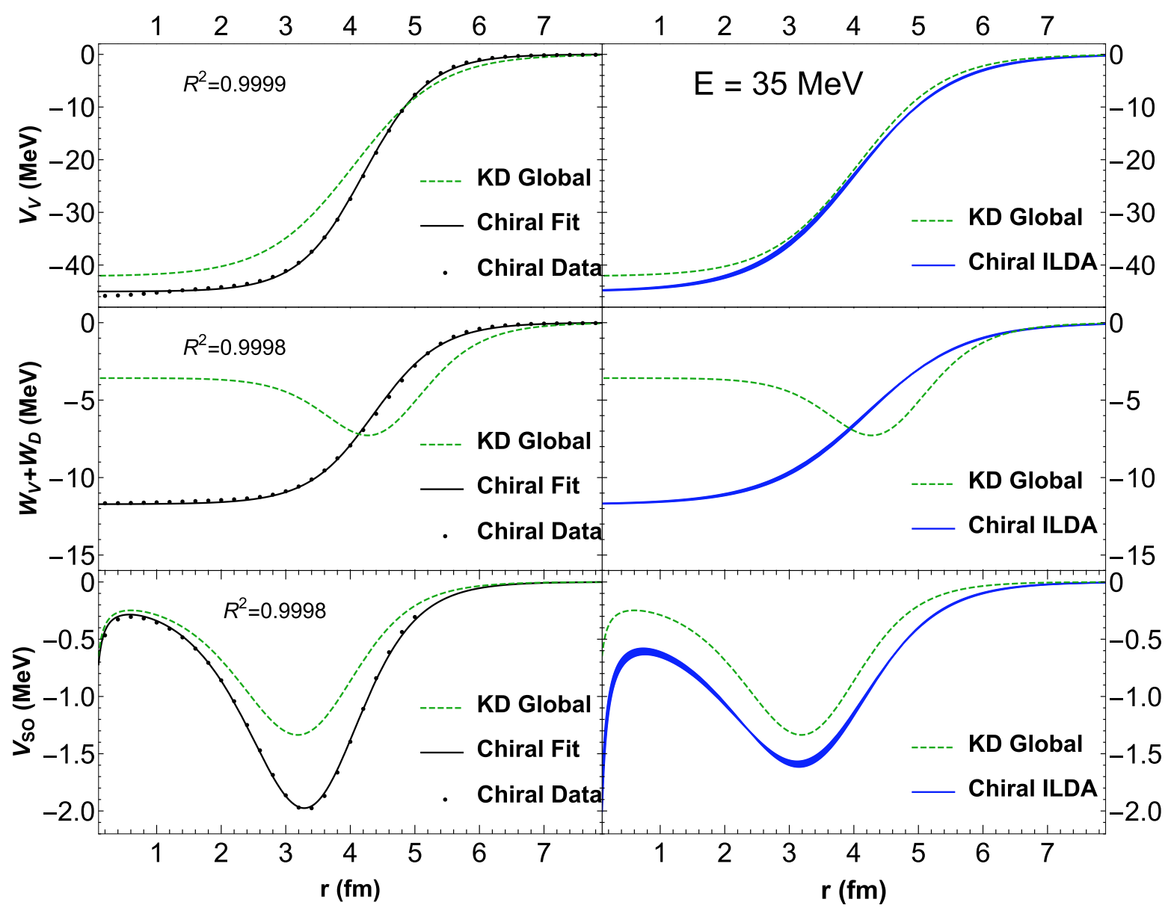
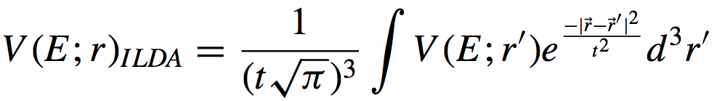
From nuclear matter to finite nuclei: Improved LDA
Local density approximation
Improved local density approximation
Whitehead, Lim & Holt, PRC (2019)
Real central
Finite range of nuclear force must be accounted for
Introduce Gaussian smearing function with range parameter t
Increases the Woods-Saxon diffuseness parameter in agreement with phenomenology
Imaginary central
Real spin-orbit

Slide 15
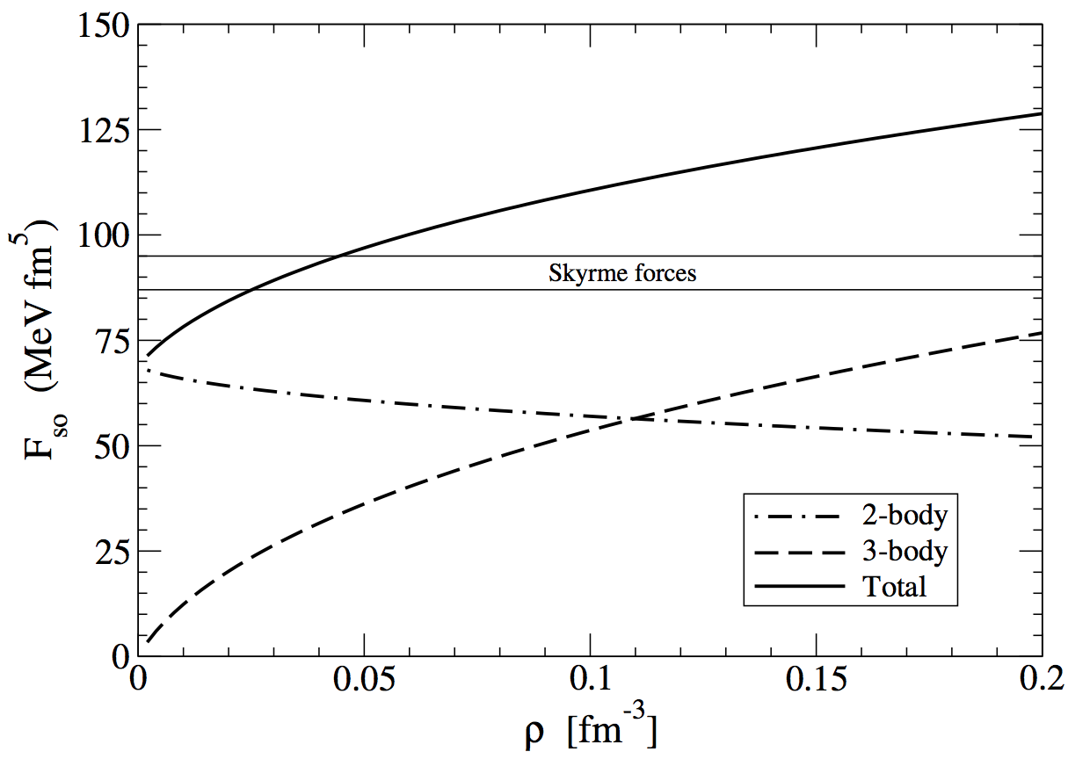
From nuclear matter to finite nuclei: spin-orbit interactions
Spin orbit interaction vanishes in infinite homogeneous nuclear matter
Density matrix expansion (Negele & Vautherin, PRC 1972)
Holt, Kaiser & Weise, EPJA (2011)
20% too large at density region of interest
Chiral EFT prediction
2nd-order perturbative contributions known to reduce spin-orbit strength

Slide 16
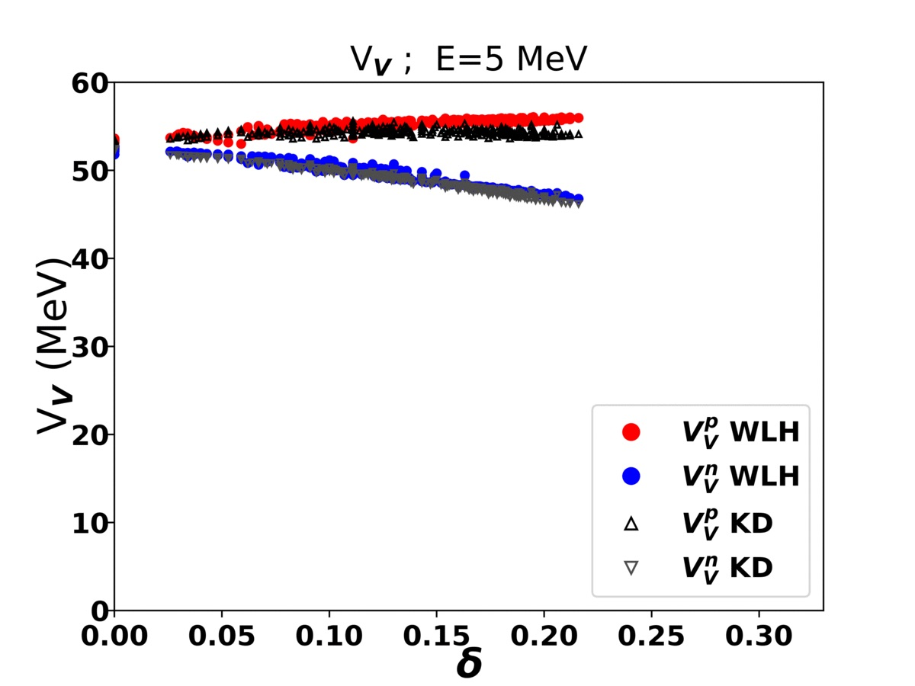
Comparison to phenomenology: isovector terms
Isovector optical potential obeys “Lane form”:
$$U_{V}=U_{0}−U_{I}δ_{np}τ_{z}$$
Much larger uncertainties for the isovector optical potential
Isospin inversion$\left(U_{p}>U_{n}\right)$ at high energies present in only some models
Whitehead, Lim & Holt, PRL (2021)
Isovector Lane form above not obeyed at high energy in phenomenological Koning-Delaroche optical potential

Slide 17
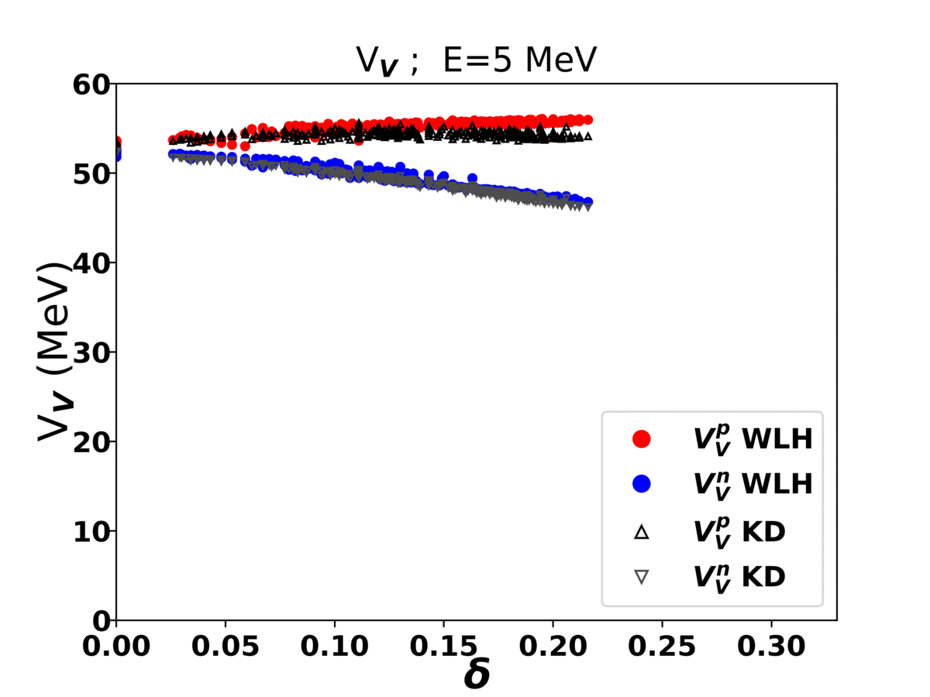
Comparison to phenomenology: isovector terms
Isovector optical potential obeys “Lane form”:
$$U_{V}=U_{0}−U_{I}δ_{np}τ_{z}$$
Much larger uncertainties for the isovector optical potential
Isospin inversion$\left(U_{p}>U_{n}\right)$ at high energies present in only some models
Whitehead, Lim & Holt, PRL (2021)
Isovector Lane form above not obeyed at high energy in phenomenological Koning-Delaroche optical potential

Slide 18
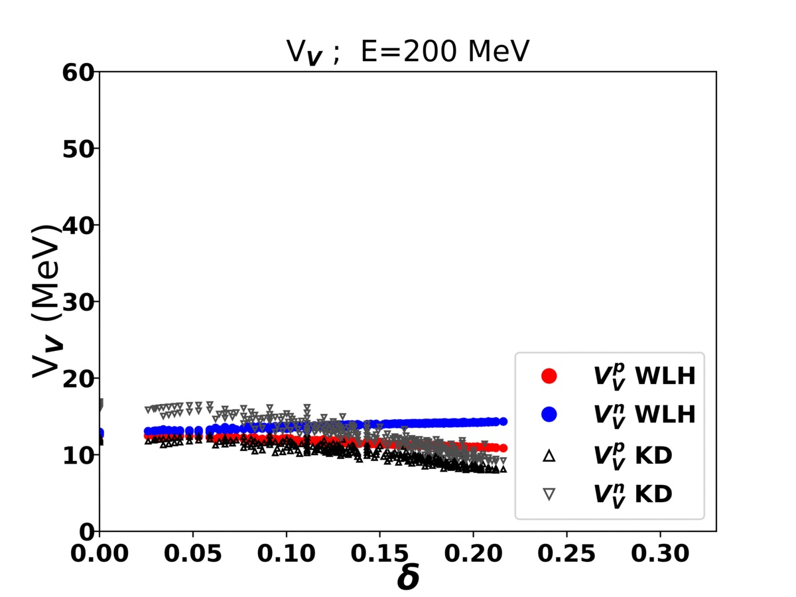
Comparison to phenomenology: isovector terms
Isovector optical potential obeys “Lane form”:
$$U_{V}=U_{0}−U_{I}δ_{np}τ_{z}$$
Much larger uncertainties for the isovector optical potential
Isospin inversion$\left(U_{p}>U_{n}\right)$ at high energies present in only some models
Whitehead, Lim & Holt, PRL (2021)
Isovector Lane form above not obeyed at high energy in phenomenological Koning-Delaroche optical potential

Slide 19
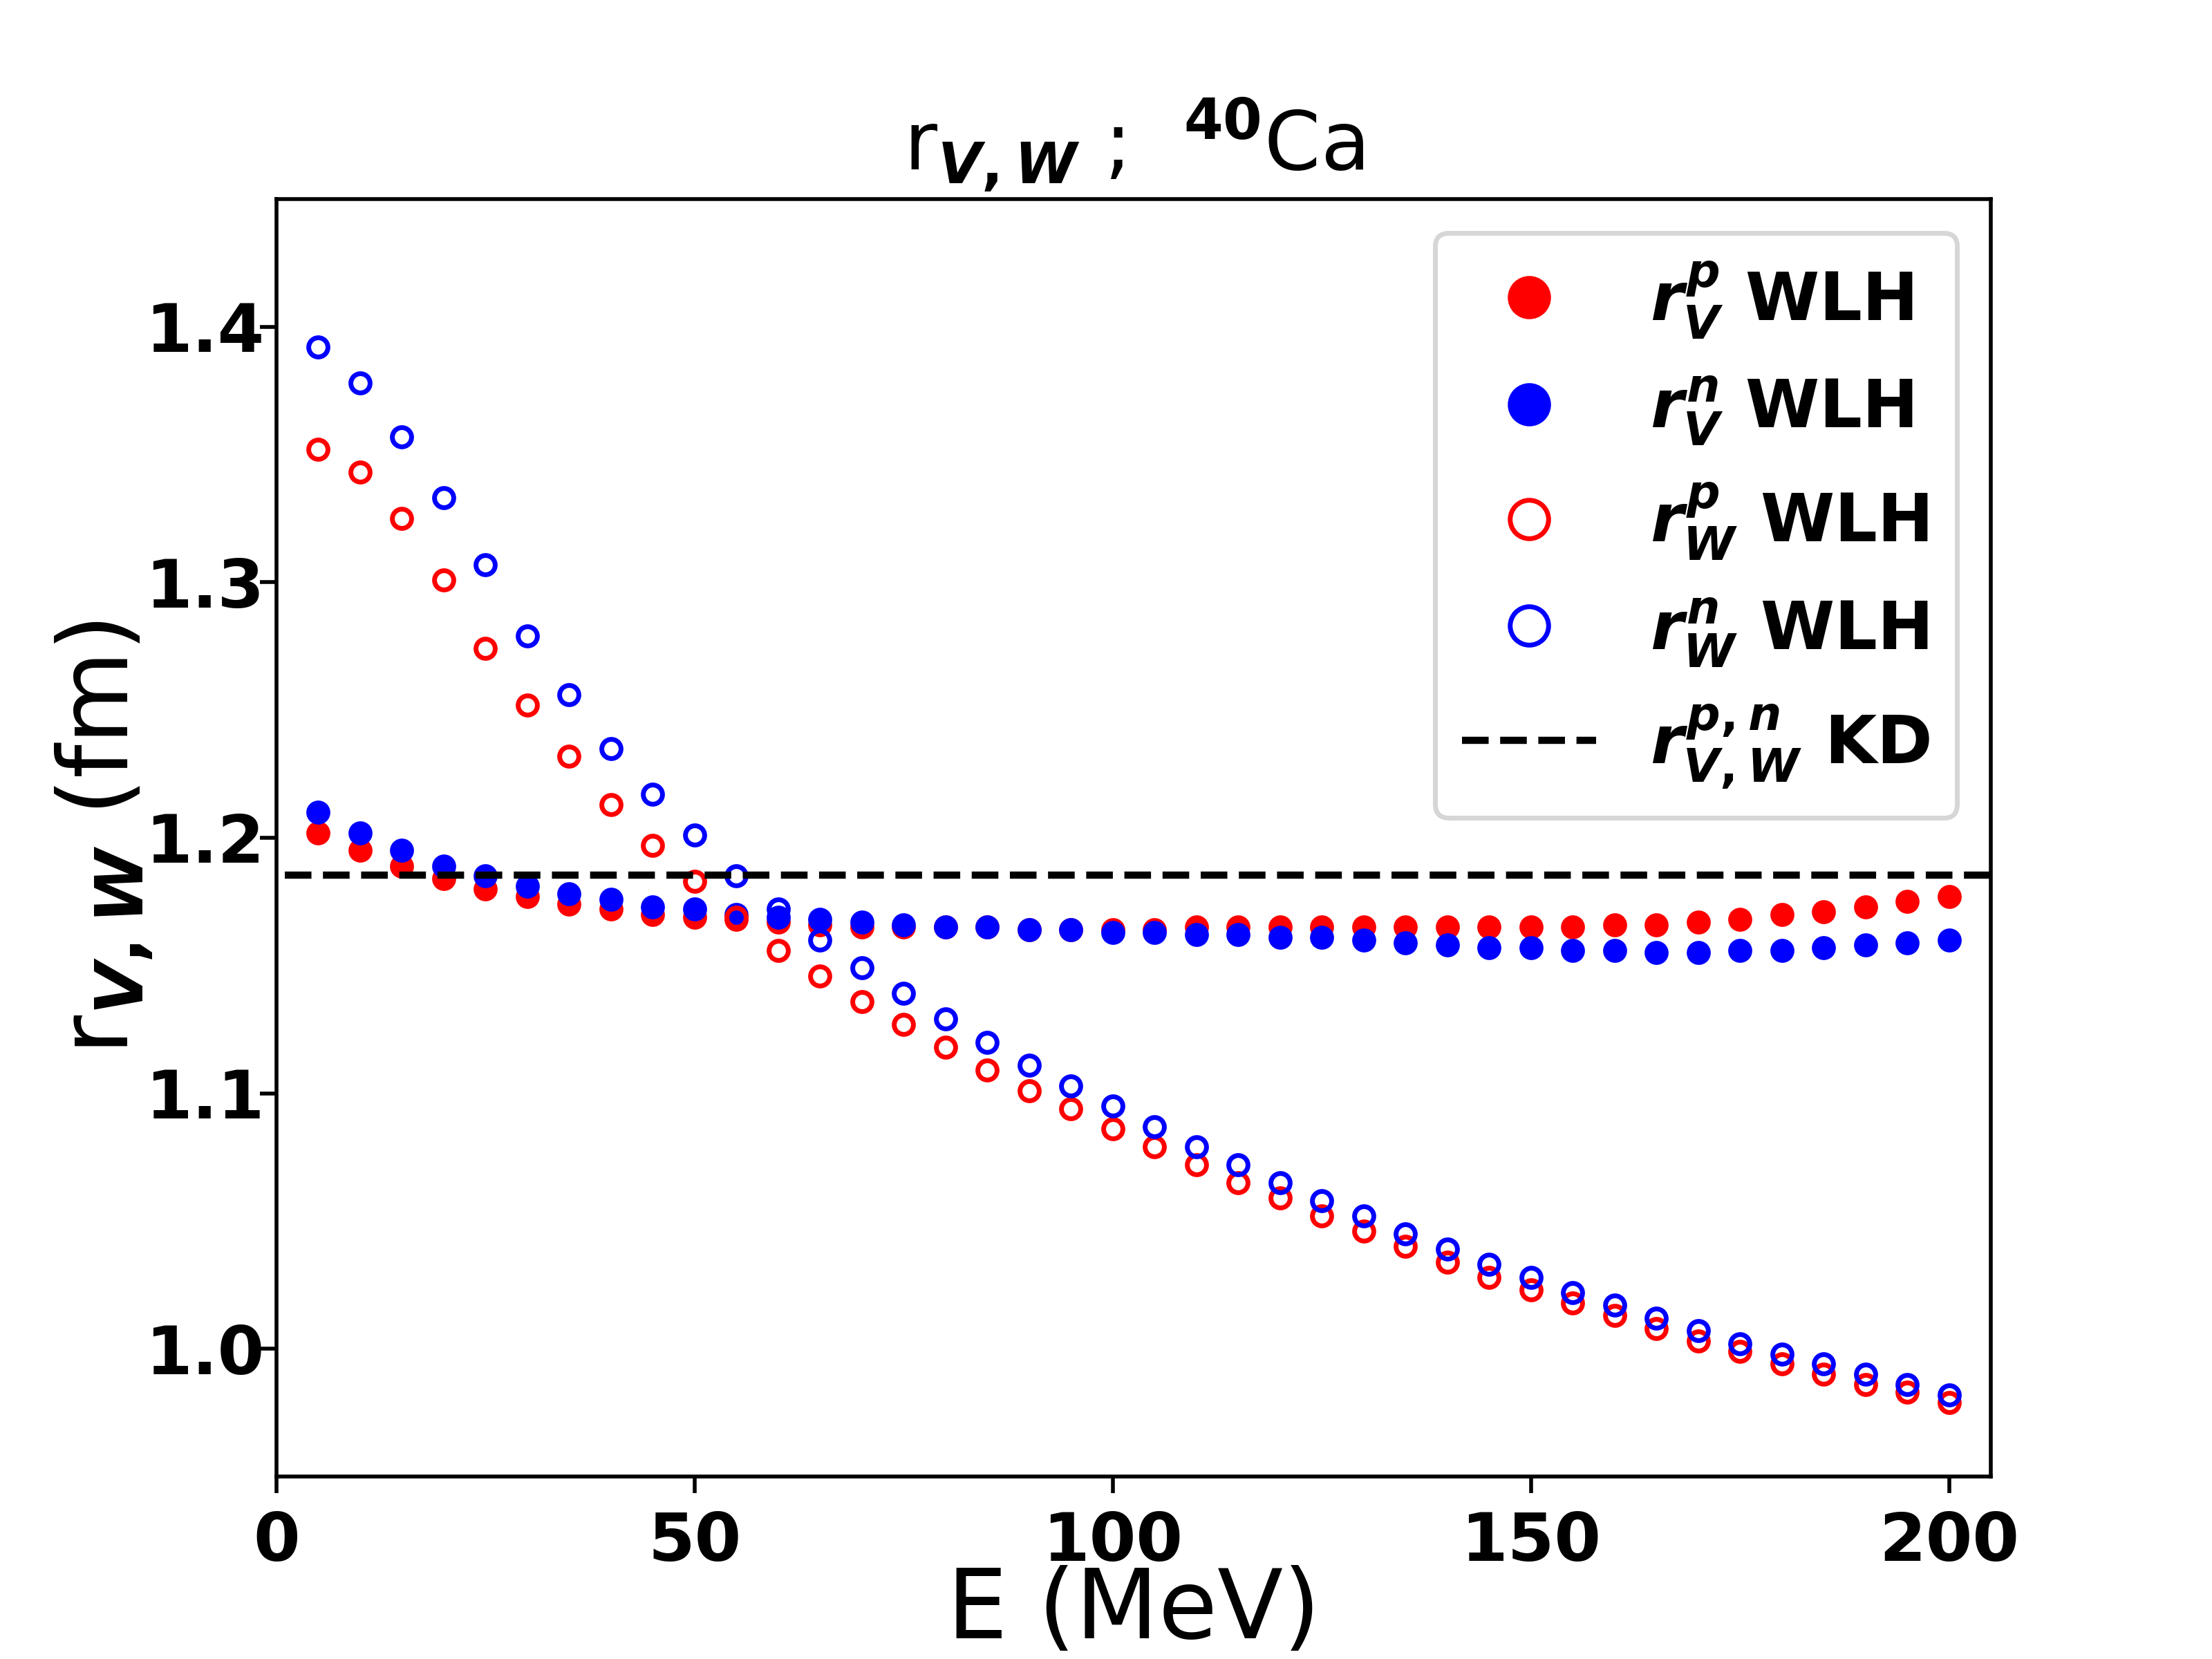
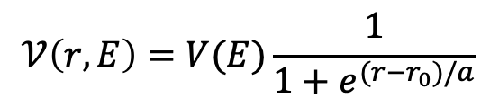
Comparison to phenomenology: radius parameter
New insights from microscopic calculations
Phenomenological optical potentials make (necessary) assumptions in the parameterization
Global analysis from microscopic calculations can inform phenomenological parameterizations
Example: Energy-dependent Woods-Saxon shape parameters
$$𝒱\left(r,E\right)=V(E)\frac{1}{1+e^{(r−r_{0})/a}}$$
Whitehead, Lim and Holt, in prep.
radius

Slide 20
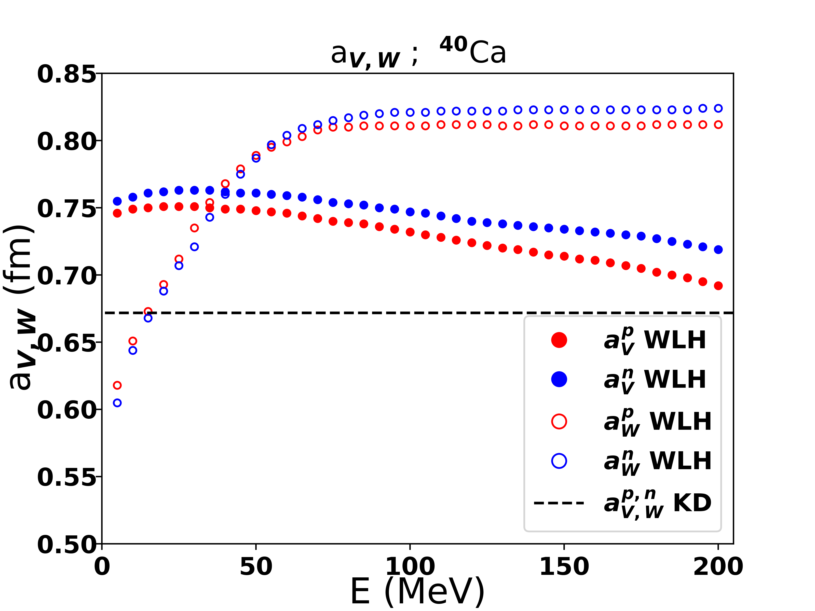
Comparison to phenomenology: diffuseness parameter
New insights from microscopic calculations
Phenomenological optical potentials make (necessary) assumptions in the parameterization
Global analysis from microscopic calculations can inform phenomenological parameterizations
Example: Energy-dependent Woods-Saxon shape parameters
$$𝒱\left(r,E\right)=V(E)\frac{1}{1+e^{(r−r_{0})/a}}$$
Whitehead, Lim and Holt, in prep.
diffuseness

Slide 21
Comparison to phenomenology and data: selected results

Slide 22
Uncertainty quantification: differential elastic scattering cross sections
Whitehead, Lim & Holt, PRL (2021)
New global “WLH” microscopic global optical potential with uncertainties
Proton/neutron optical potentials for 1800 target nuclei
Projectile energies
Microscopic results motivate new directions for phenomenology
  Different Woods-Saxon geometry parameters for real and imaginary parts
  Energy dependence of Woods-Saxon geometry parameters
Uncertainties obtained using 5000 sampled global optical potentials from covariance analysis of 5 chiral optical potentials

Slide 23
Uncertainty quantification: vector analyzing powers
New global “WLH” microscopic global optical potential with uncertainties
Whitehead, Lim & Holt, arXiv (2021)
Proton/neutron optical potentials for 1800 target nuclei
Projectile energies
Microscopic results motivate new directions for phenomenology
  Different Woods-Saxon geometry parameters for real and imaginary parts
  Energy dependence of Woods-Saxon geometry parameters
Uncertainties obtained using 5000 sampled global optical potentials from covariance analysis of 5 chiral optical potentials
Codes to generate optical potentials https://www.trwhitehead.com/WLH

Slide 24
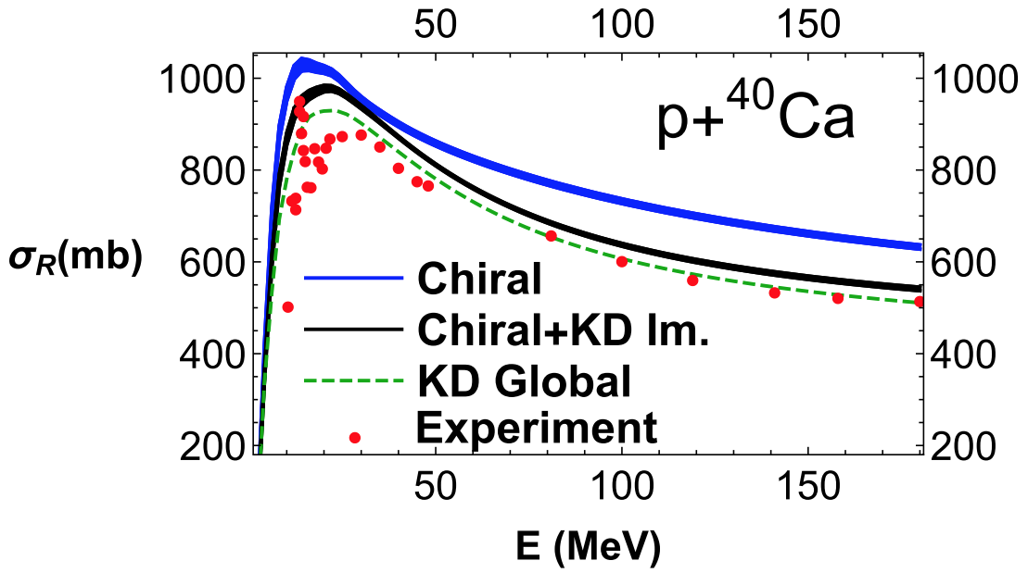
Total reaction cross section
Total reaction cross section:
Total cross section
Elastic cross section
Total reaction cross section accounts for all inelastic channels
Need for reduced imaginary OP
Whitehead, Lim & Holt, PRC (2019)

Slide 25
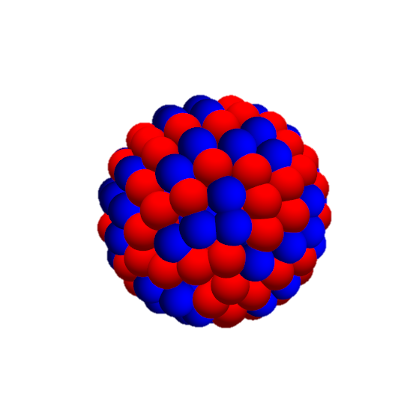



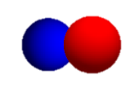
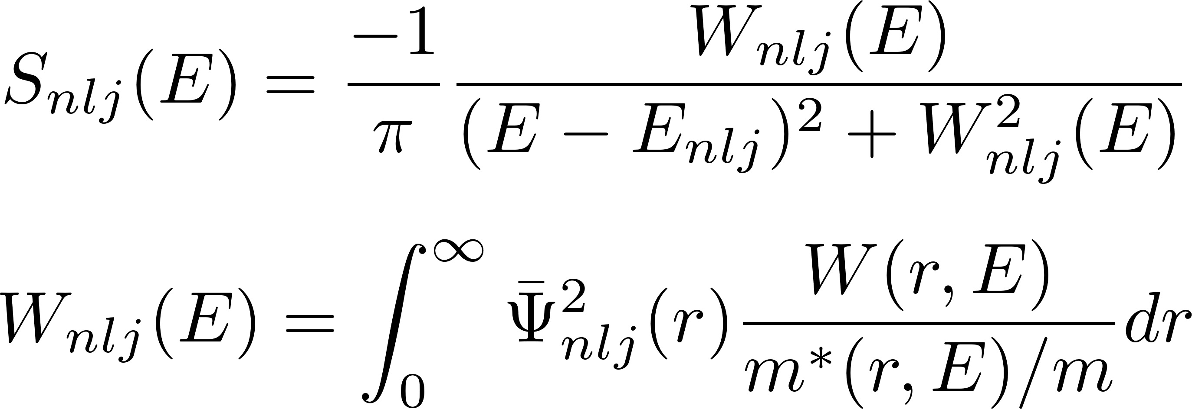
Nuclear mean field at negative energies: spectral functions
Knockout and capture cross sections
Whitehead, Escher & Holt, in prep.
Imaginary part of global optical potential
Effective mass from real part of global optical potential
Spectral functions for ⁴⁰Ca hole states calculated using a microscopic dispersive optical potential derived from chiral effective field theory
Compare to ⁴⁰Ca spectral functions from phenomenological optical potentials

Slide 26
Summary and future directions
First microscopic global optical potential with quantified uncertainties
  Good description of differential nucleon-nucleus elastic scattering cross sections within uncertainties
  Analyzing powers have larger uncertainties but also compare well to experiment
Improved uncertainty quantification possible: variations in chiral low-energy constants, more sophisticated treatments of EFT truncation errors and choice of resolution scale
Work in progress to interface new optical potentials with nuclear reaction codes for rare-isotope beam experiments

