Slide 1
nEDM
Analysis Framework
2018.08.08 Kenji MISHIMA

Slide 2
nEDM Analysis
We have to imagine how to obtain nEDM results before making experimental apparatus.
If we use Monte Carlo simulation for this analysis or uncertainty evaluation, it should be treated on the same framework.

Slide 3
Analysis Framework
Date/Time
nEDM
  UCN detectors
  Hg co-magnetmeters
  Other magnetmeter
  Electric field
  Magnetic field
  Surrounding field compensation coils
  Polarizer
  Spin flipper
  Temperature
  Vacuum
UCN source
  Proton current
  He-II temperature
  He-II pressure
  Monitor detector
  Valve open close

Slide 4
ROOT/C++ base
nEDM
UCN source
  UCN detectors data tree (time spectrum?)
  Proton current
  co-magnetometer time spectrum
  He-II Temperature
  Magnetometer time spectrum
  Coil currents
  UCN monitor
ROOT 1 batch tree raw
Analyzed tree
N-batch
tree
List data
count data

Slide 5
Simulation (Monte Carlo?)
nEDM
UCN source
Magnetic disturbance
  UCN detectors data tree (time spectrum?)
  Proton current
  co-magnetometer time spectrum
  He-II Temperature
  Magnetometer time spectrum
  Coil currents
  UCN monitor
ROOT 1 batch tree raw
Analyzed tree
N-batch
tree
List data
count data

Slide 6
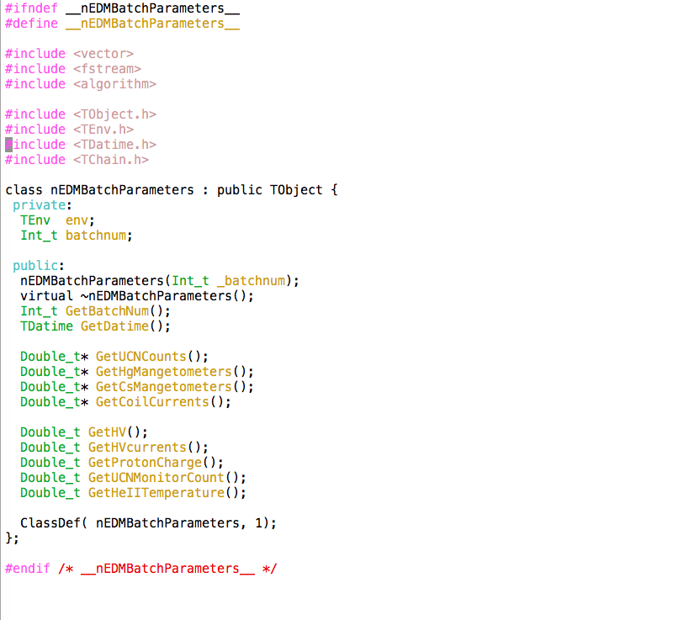
Example of ROOT class

Slide 7
Summary
We will measure nEDM.
The analysis framework for the measurement should be imaged before making experimental apparatus.
  How do we use data of devices? For what?
Monte Carlo simulation is useful to evaluate systematic uncertainties.

