Slide 1
BL1U update
R. Picker
Picture: ³He gas panel

Slide 2
General status of BL1U
These beamline elements have been commissioned (up to 10 muA)
  Vacuum system minus B1U:1V0 interlock with B1A – still need vacuum signal from 1A to make this interlock work
  Machine protect system (via beam blocker, septum, bender and kicker)
  Septum, bender, two quads (and their power supplies)
  HARPs (in DC only), BSMs
These beamline elements are ready for commissioning (or are partly commissioned)
  TNIM, kicker, target cooling system, UCN target air extraction system interlock
These beamline elements need work for full commissioning
  Target extraction system: extraction has been demonstrated, target storage cask has to be designed
  BPMs: readout is just getting ready
  TPM: readout ready, controls not
  Long term solution for kicker control: current one is working but should probably make dedicated TRIUMF board for kicker sequencing module – kicker timing module needs and EPICS interface
  Long term solution for notch monitor: see above
  Raster magnet: Really needed for 40 muA? Needs to be designed, built and commissioned.

Slide 3
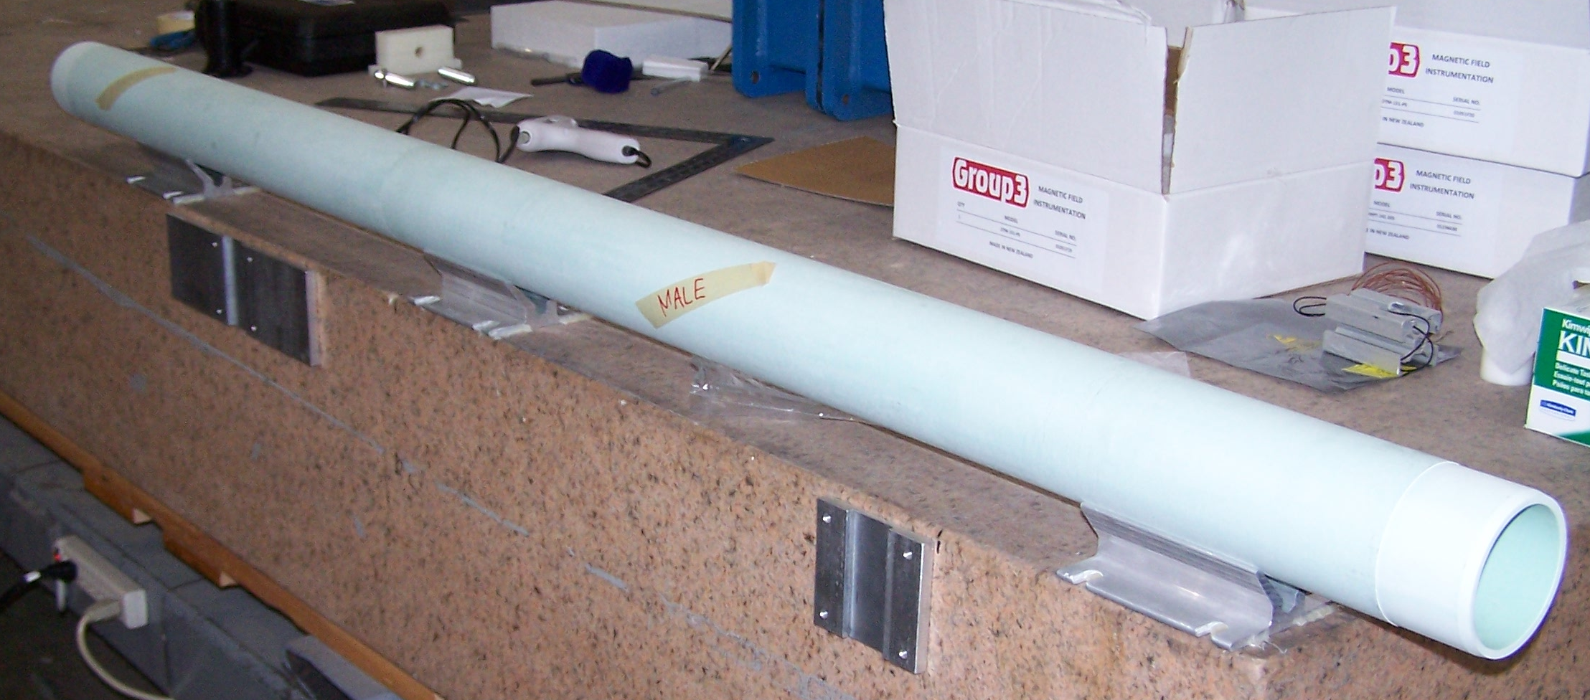
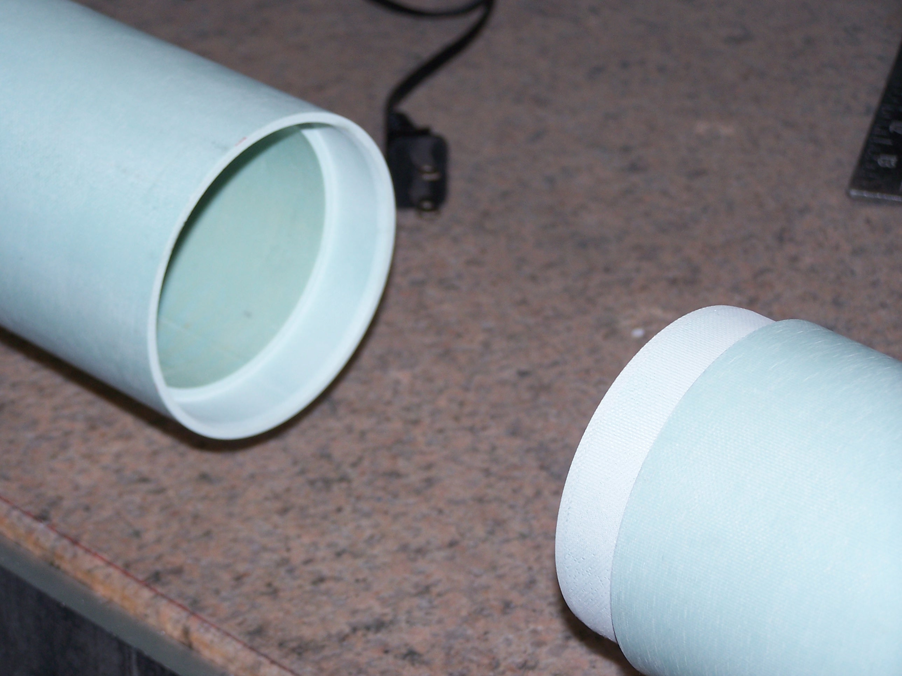
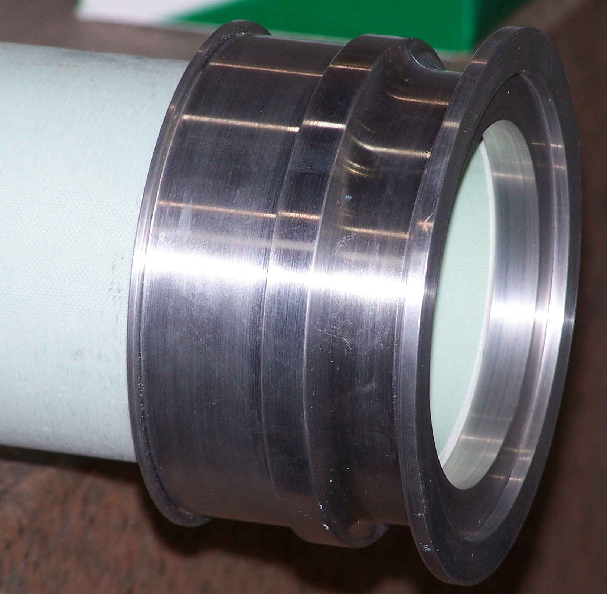
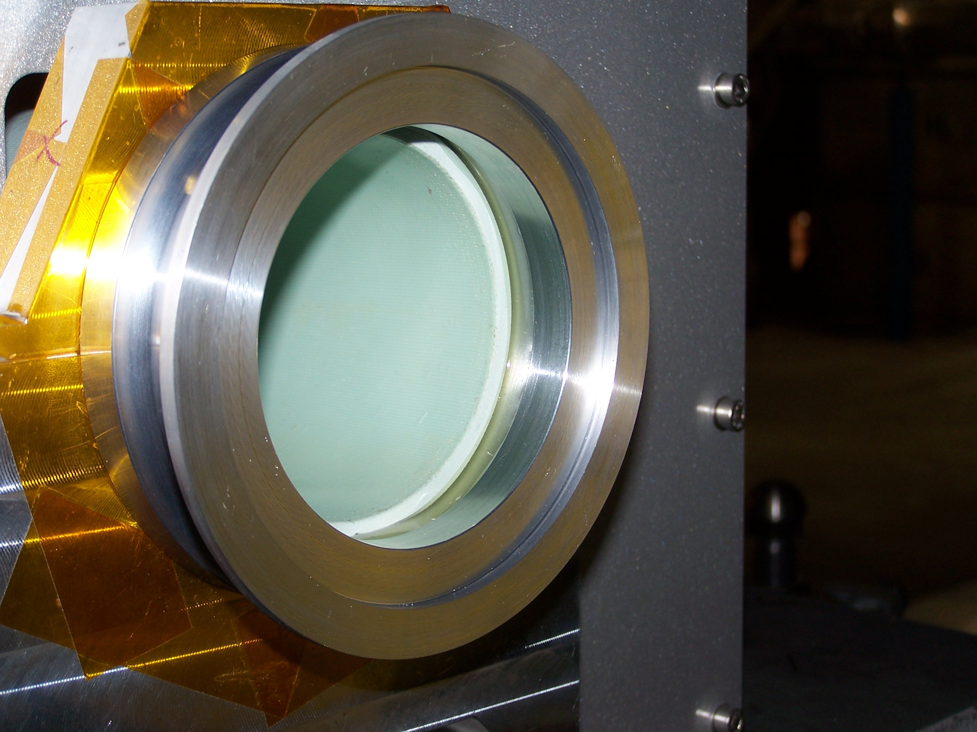
Kicker tube upgrade
The kicker tube puzzle
The original kicker tube was made from glass, with Wilson-type flanges to metal flanges.
Beginning of 2018, this was deemed unsafe for operation by TRIUMF management due to the risk of shattering and spreading pieces into beamlines.
Doug Preddy suggest a resin tube with glued on aluminum flanges.
This was installed almost towards the end of shutdown.
Thanks to Cam and Doug and Dimo from beamlines and vacuum group for taking care of this!

Slide 4
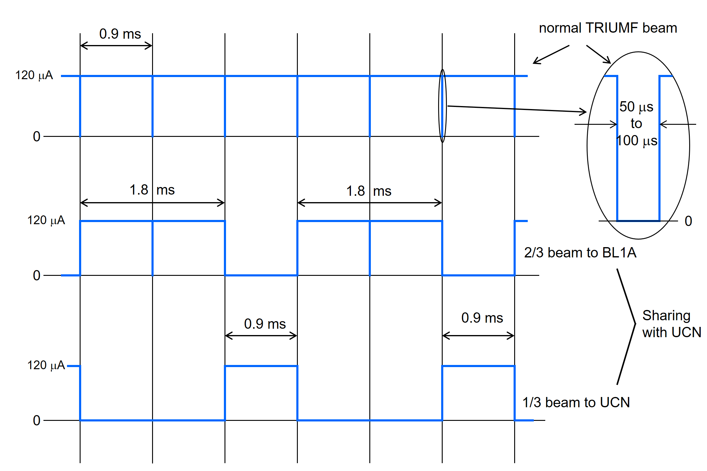
Kicker “upgrade”
The kicker conundrum
Kicker was ordered for 350 Hz rep rate
For 40 uA out of 120 we need 373 Hz
Pulser frequency is 1110 Hz
The power supply would have tripped at 370 Hz and this trip was hard coded.
Board was sent back to Danfysik and for only 9600 Euro, they did reprogram the board.
Kicker was tested at 375 Hz without problems.
Thanks to Thomas, Des and Art and Dan from the PS group for taking care of this!

Slide 5
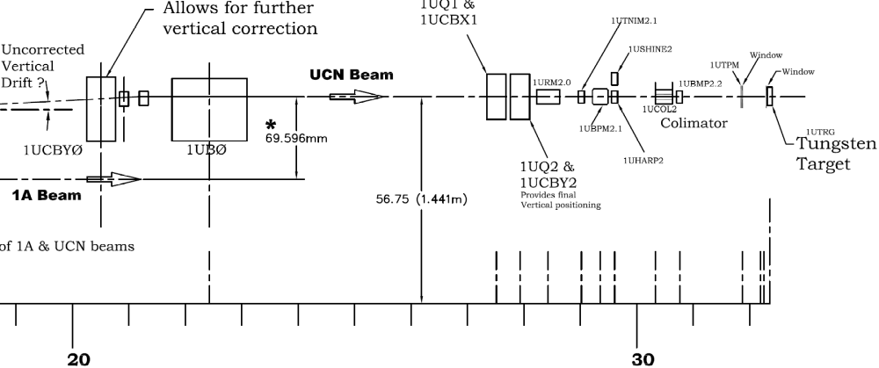
BL1U final leg, side view

Slide 6
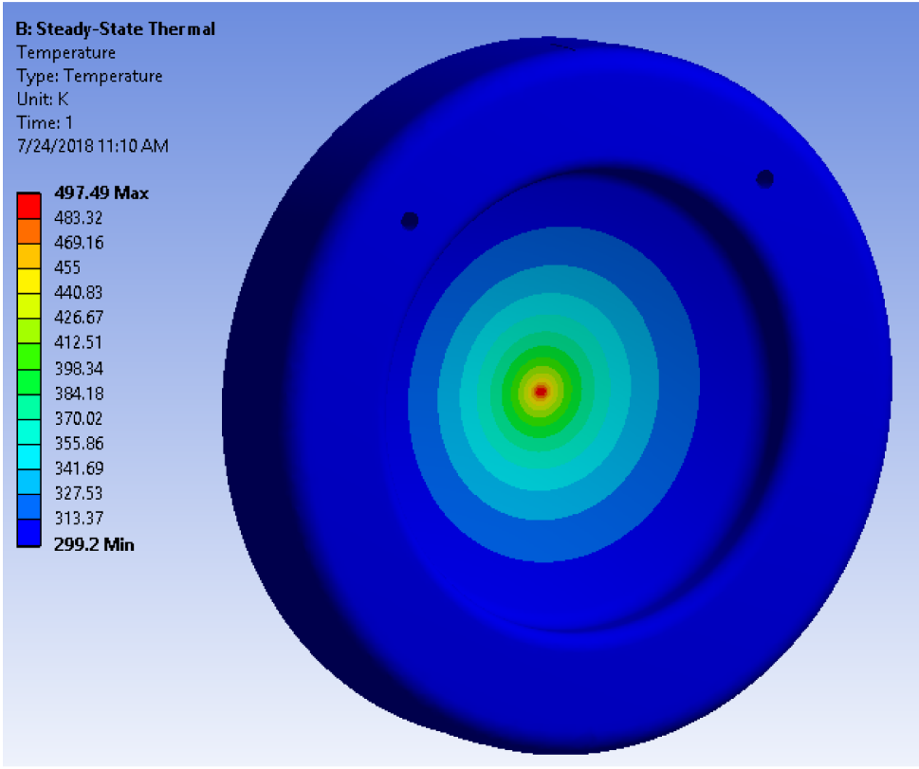
Beamline end window temperature
If the beam spot on the beamline end window is too small, it will creep or yield due to the differential pressure.
Right picture shows Ansys simulation of 1x1 mm beam spot (worst worst case) by Sean Vanbergen.
Need to make sure the beamspot is at least 5 x 7 mm ??? Sean is doing more calculations on this…

Slide 7
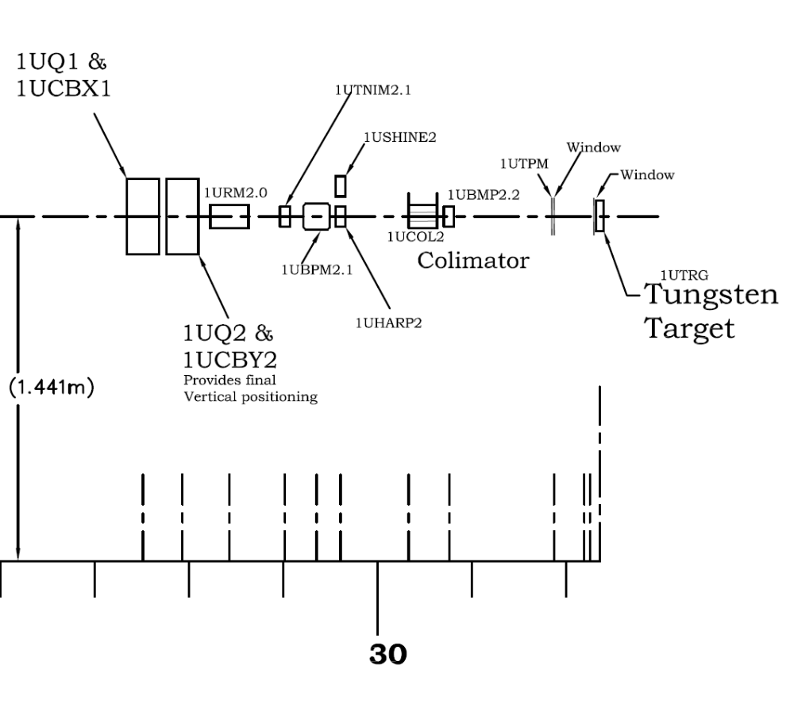
How to determine the beam profile
The challenge:
There is only one operational beam diagnostics element (HARP) downstream of the last optics element
The BL1V and 1U optics are not understood well enough (no full simulation of it, either)
We need to know the beam spot size in the beamline end window and target.
Possible solutions:
There is a TPM close to the target, which could be used to perform beam profile scans (Yi-Nong)
  Challenge 1: it only has 5 mm active area
  Challenge 2: controls are not.
We could install a second HARP instead of Q2 to extrapolate the beam shape to the target (Chuck)
  Challenge 1: it would only be ca 1.5 m before HARP 2 and the target is another 2.5 m away
  Challenge 2: 3 mm resolution is not ideal to extrapolate the beam spot on the target (Yi-Nong)
The challenge:
There is only one operational beam diagnostics element (HARP) downstream of the last optics element
The BL1V and 1U optics are not understood well enough (no full simulation of it, either)
We need to know the beam spot size in the beamline end window and target.
Possible solutions:
There is a TPM close to the target, which could be used to perform beam profile scans (Yi-Nong)
  Challenge 1: it only has 5 mm active area
  Challenge 2: controls are not.
We could install a second HARP instead of Q2 to extrapolate the beam shape to the target (Chuck)
  Challenge 1: it would only be ca 1.5 m before HARP 2 and the target is another 2.5 m away
  Challenge 2: 3 mm resolution is not ideal to extrapolate the beam spot on the target (Yi-Nong)

Slide 8
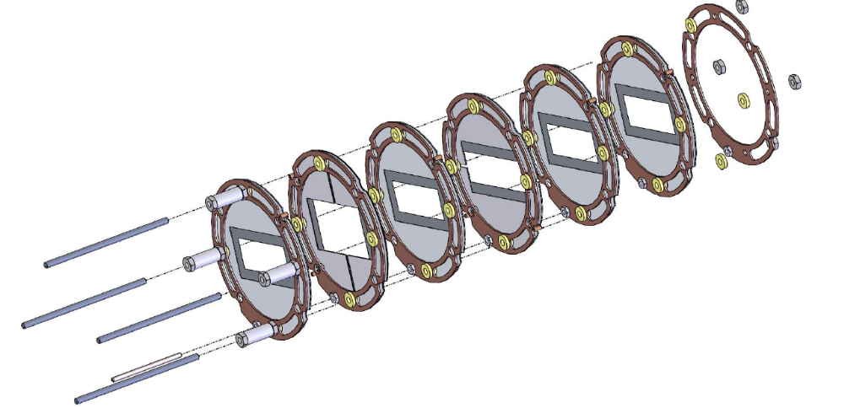
The BL1U TPM
Secondary-electron-emission-type target protect monitor
Opening 40 mm x 15 mm
Active width 5 mm
There was a rumor that the TPM cannot be seen well behind the collimator…

Slide 9
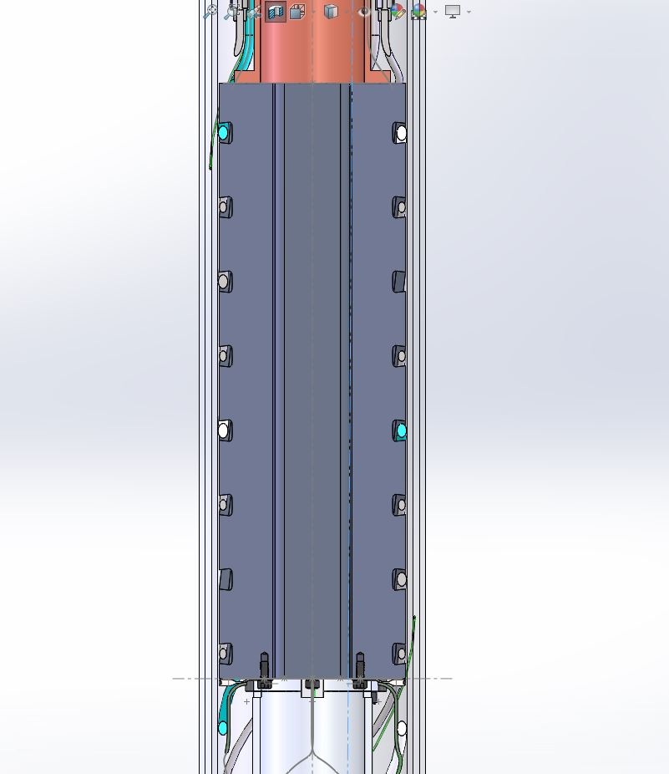
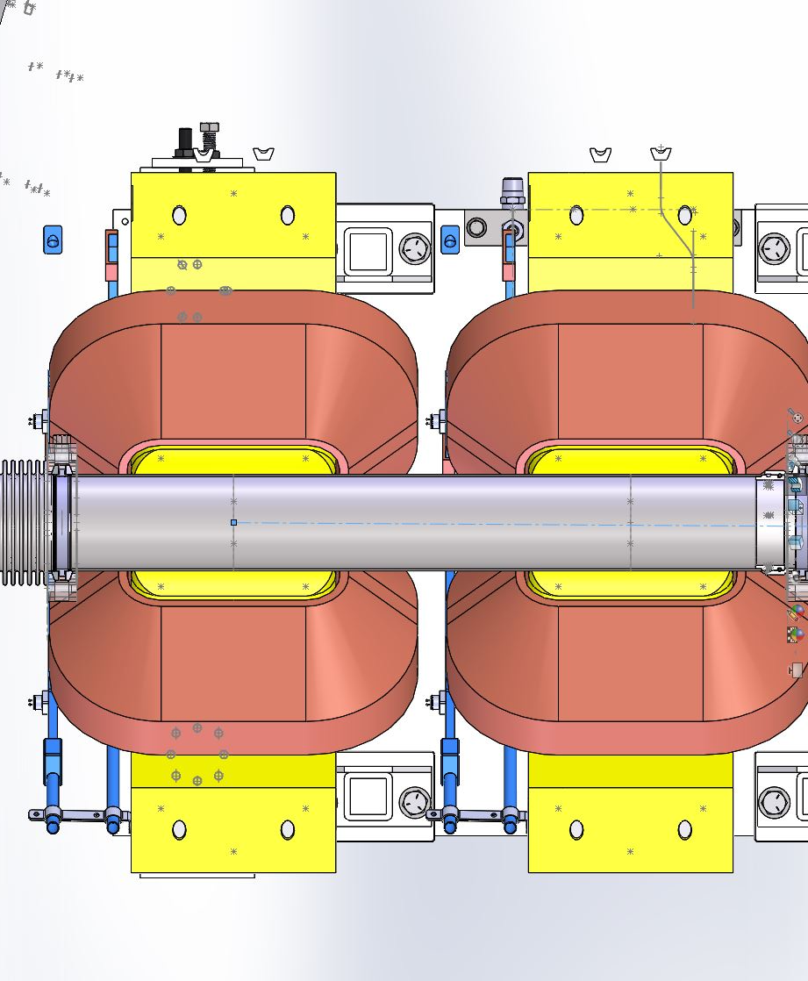
TPM optics
Horizontally deflected beam
Straight line starting in the center of Q1
(which doubles as a steering magnet)
Scraping the inside of the collimator

Slide 10
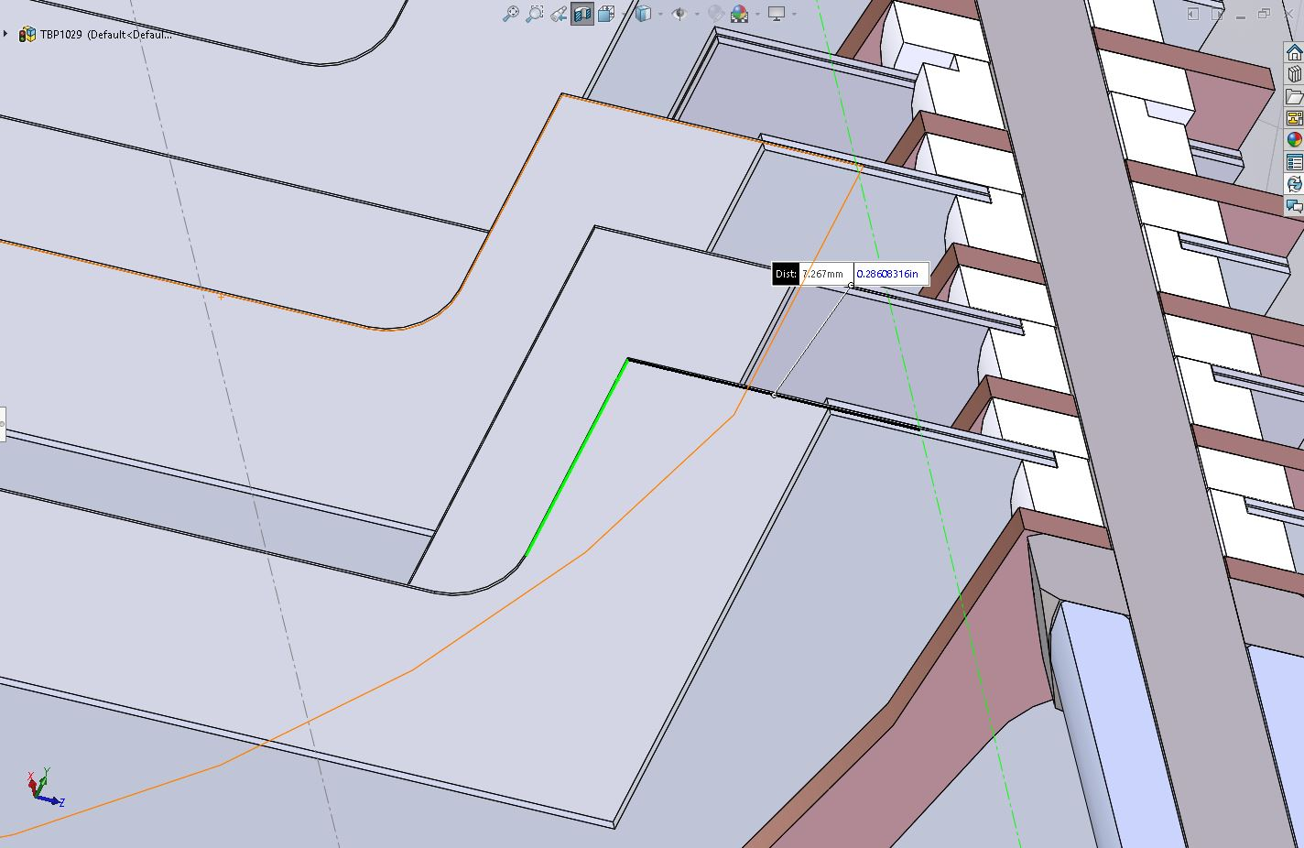
TPM optics
Horizontally deflected beam
x
TPM foil

Slide 11
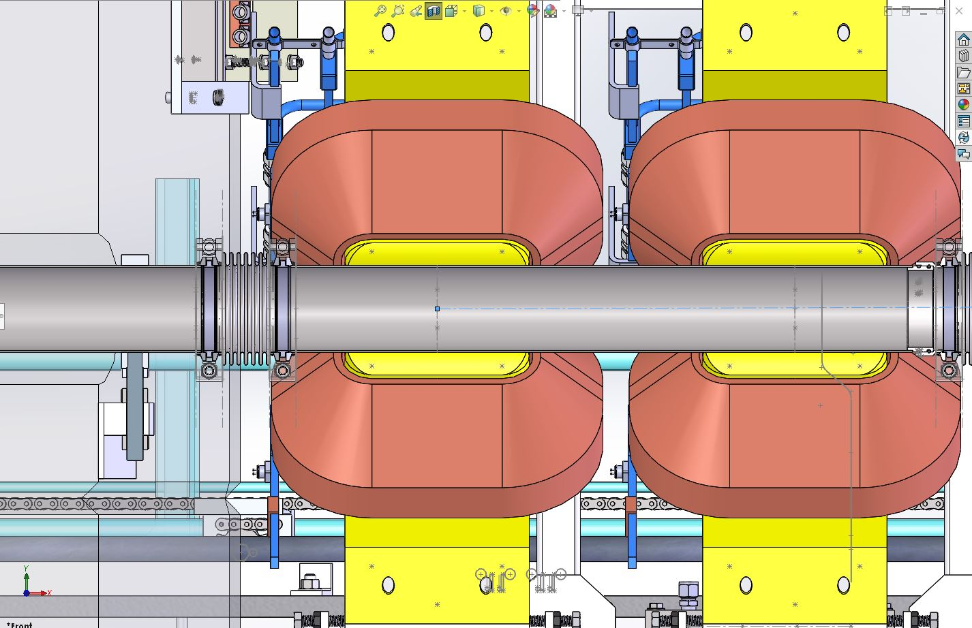
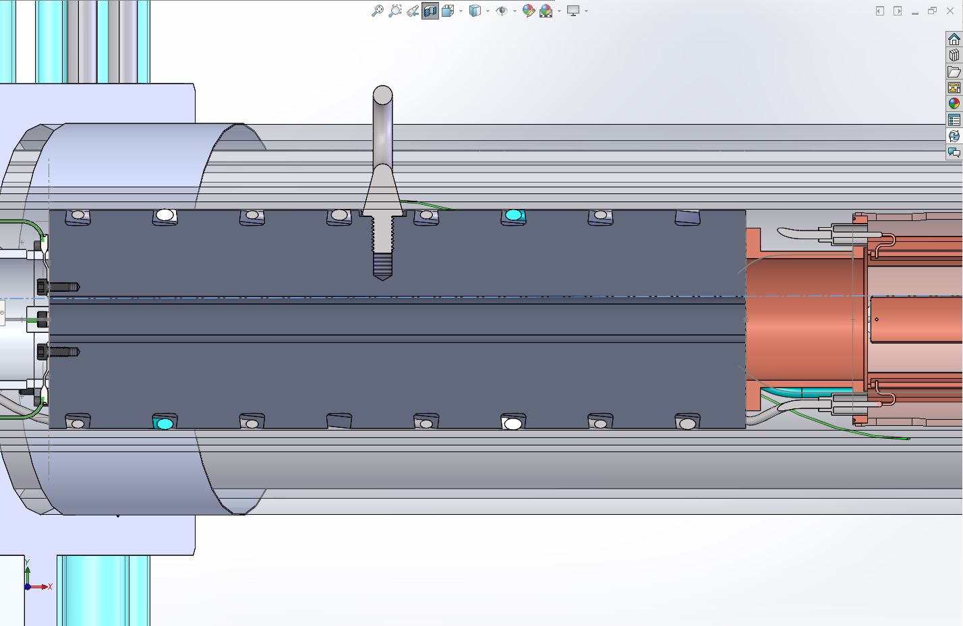
TPM optics
Vertically deflected beam
Straight line starting in the center of Q1
(which doubles as a steering magnet)
Scraping the inside of the collimator

Slide 12
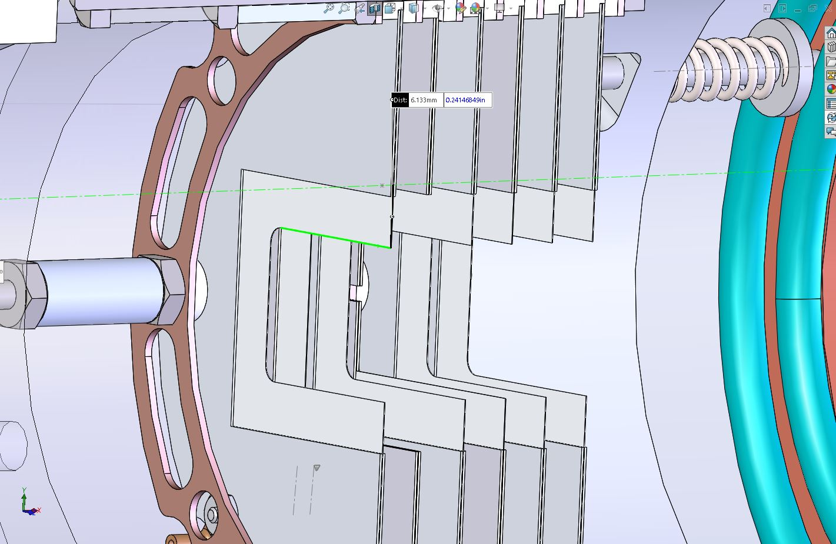
TPM optics
Horizontally deflected beam
x
TPM foil

Slide 13
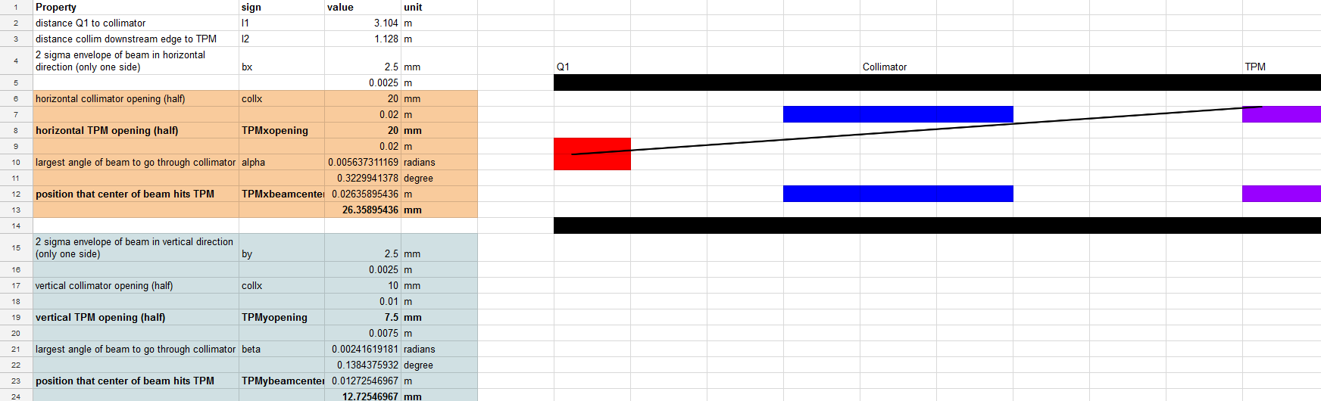
My calculation of this
https://docs.google.com/spreadsheets/d/1IDYH8c5B1zN4VDhGuKcZ-yDypj6c5ODS6oAaVklVkSE/edit?usp=sharing
I think the TPM should work just fine behind the collimator
Are 5 mm active width normal for TPMs?
Can we make the beam as small as 5 mm diameter?

Slide 14
Timeline working backwards
2021: installation of new UCN source ⇒ 40 μA operation of BL1U ⇒ installation of raster magnet (if required)
2020: design and construction of raster magnet (if required)
2019 BL1U runs: need to determine whether raster is necessary
2019 shutdown: need to install HARP1 (if required)
2018 BL1U runs: need to determine whether a HARP is necessary ⇒ need an operational TPM

Slide 15
Beamline profile next steps
TPM etc
Raster
We will get half a beam development shift in September for TPM test (Sep 11?)
TPM readout is ready, controls and display in EPICS is missing.
Could use a DVM or scope to display TPM output (voltage).
Oliver Kester has promised that he will to get controls group to get the TPM controls ready after the mini-shutdown.
Pietro is trying to get us a thesis student from UBC to do G4Beamline calculations of BL1U. Beam physicist Yi-Nong Rao would co-supervise.
See Chuck’s presentation
It looks like we will need a raster since it will be difficult to determine the beam spot size on the target with certainty and especially to diagnose it during full current running…

Slide 16
Other diagnostic items status
Beam profile monitors (BPMs): measure beam centroid in horizontal and vertical direction.
Important to diagnose beam during full current operation.
Readout boards are ready, controls should be ready by Fall running.
The challenge:
There is only one operational beam diagnostics element (HARP) downstream of the last optics element
The BL1V and 1U optics are not understood well enough (no full simulation of it, either)
We need to know the beam spot size in the beamline end window and target.
Possible solutions:
There is a TPM close to the target, which could be used to perform beam profile scans (Yi-Nong)
  Challenge 1: it only has 5 mm active area
  Challenge 2: controls are not.
We could install a second HARP instead of Q2 to extrapolate the beam shape to the target (Chuck)
  Challenge 1: it would only be ca 1.5 m before HARP 2 and the target is another 2.5 m away
  Challenge 2: 3 mm resolution is not ideal to extrapolate the beam spot on the target (Yi-Nong)

Slide 17
Handover of BL1U to Acc Div
What we want
BL1U and target are owned by the accelerator division
Physical sciences division (UCN group) own moderators around the target crypt and everything associated with UCN
UCN group requests beam properties from operations:
  Current and beam time structure on target (kicker parameters)
Certain beam properties are mandated by the beam end window and target
  Minimum beam spot size on the beam end window and target or rastering

Slide 18
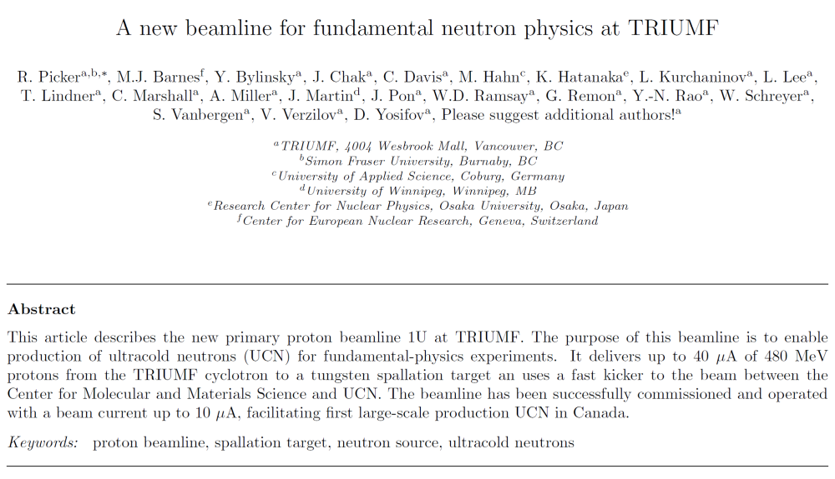
BL1U paper
Please let me know if you want to be on the author list!
Describes components of beamline, optics and some of the commissioning.
Paper is at 90%, will send draft around again in August…
https://www.overleaf.com/read/skhrxxntpjyv
Another paper on kicker is also in the pipelin

Slide 19
BL1U summary
Beam spot issues, diagnostics
Handover
We are getting closer to a solution.
We probably will need a raster magnet.
BPMs and TPMs are getting closer to being operational.
Handover has been agreed upon.
Oliver is definitely trying to help.
More involvement is seen already (kicker tube, kicker commissioning, beam spot discussions…)
Target and remote handling ownership are still debated in the Acc Div. Remote handling group is swamped with ARIEL…
We are getting the documents together for the handover: BL1U operations manual (thanks to Wolfgang), target water design note etc (Cam).

Slide 20
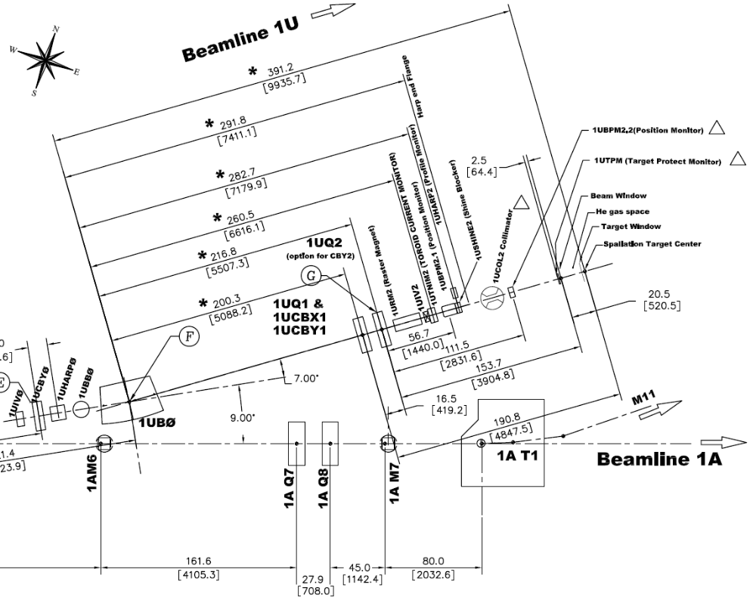
BL1U final leg
Top view
BL1U final leg, side view

