Slide 1
HTS Magnet to Polarize UltraCold Neutrons

Slide 2
We fabricated a HTS cylindrical to polarize ultracold neutrons (UCN). It consists of 10 double pancakes and the field strength at the center is larger than 3.5 T which is required to fully polarize 210 neV neutrons. Design and performance of the magnet are described.

Slide 3
Design parameters of the HTS cylindrical magnet.
Coil | Inner diameter | 131.5 mm
 | Outer diameter | 213 mm
 | Length | 105 mm
 | Number of DP | 10
 | Number of turns | 2800
 | Total length of wire | 1530 m
 | Inductance | 1 H
 | Weight | 30 kg
Magnet | Operating Temperature | 20 K
 | Rated current | 200 A
 | Field at the center | ≥ 3.5 T
Cryostat | Cooling power | 35 W at 45 K 0.9 W at 4 K
 | Temperature of the shield | 60 K

Slide 4
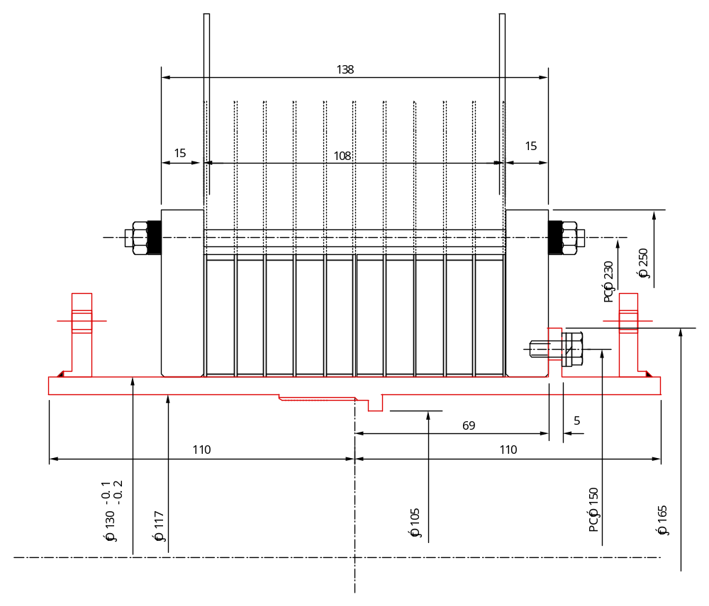
A cross sectional structure of the upper half of the cylindrical magnet. Each double pancake is sandwiched by 1 mm thick cooling plates made of cupper.

Slide 5
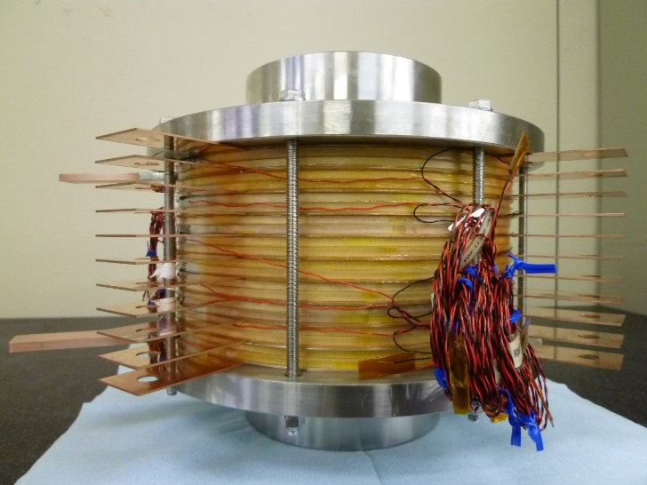
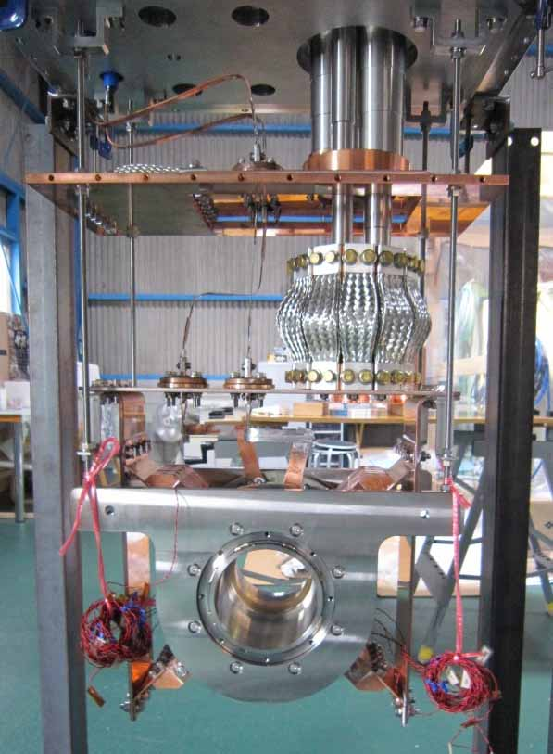
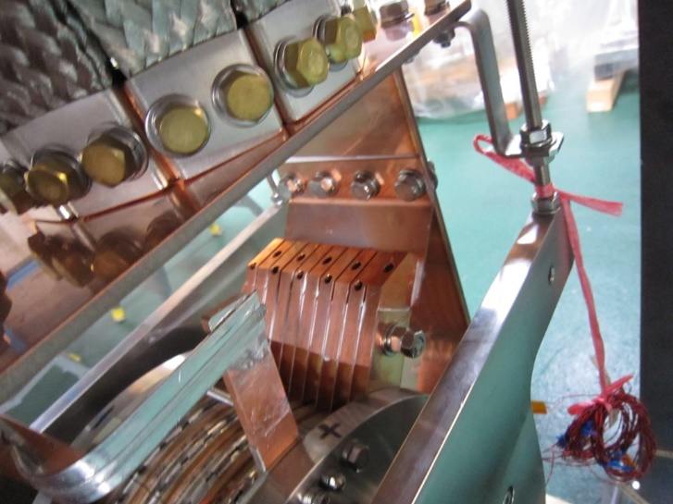
Coil and connection to current leads and cooling plates.
Connection to the 1st and 2nd stage of the pulse tube cryocooler.

Slide 6
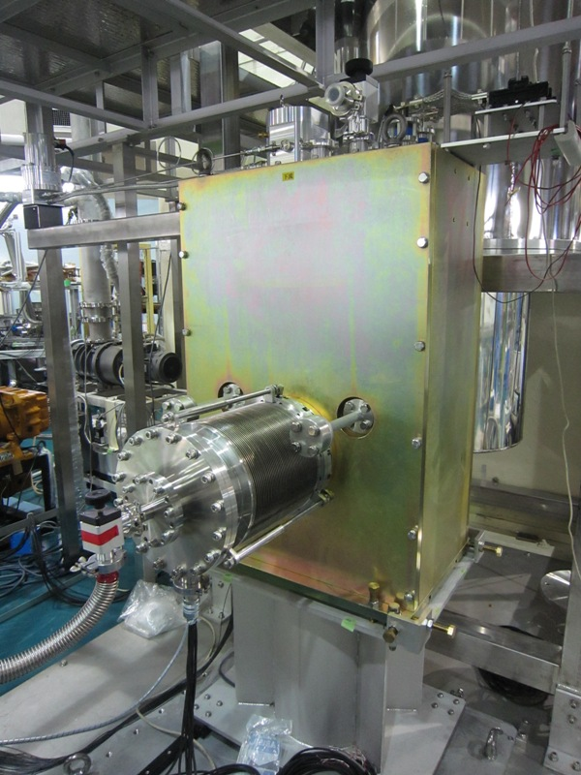
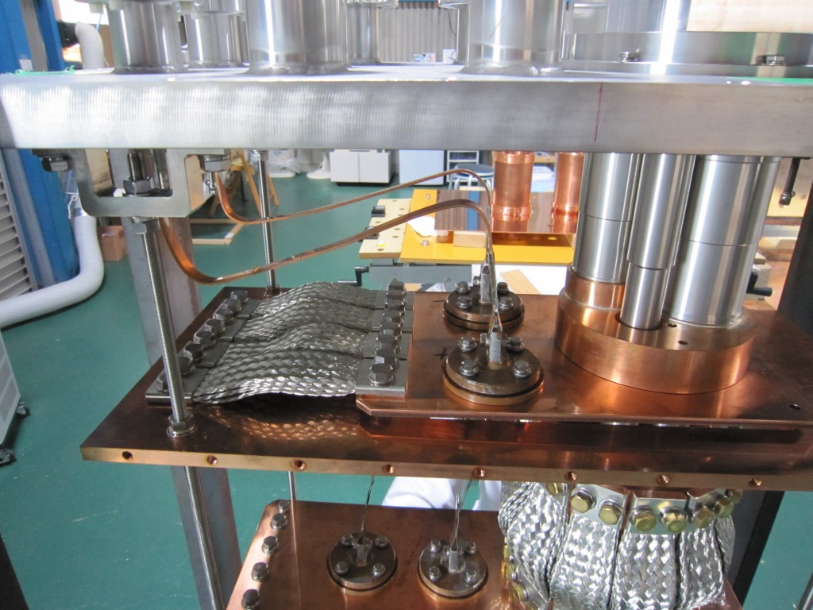
Current leads and thermal anchors on the 1st stage of the cryocooler.
Magnet installed downstream of the superthermal UCN source.

Slide 7
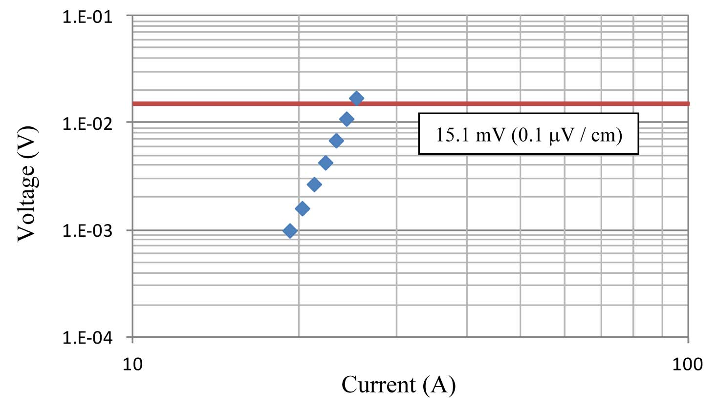
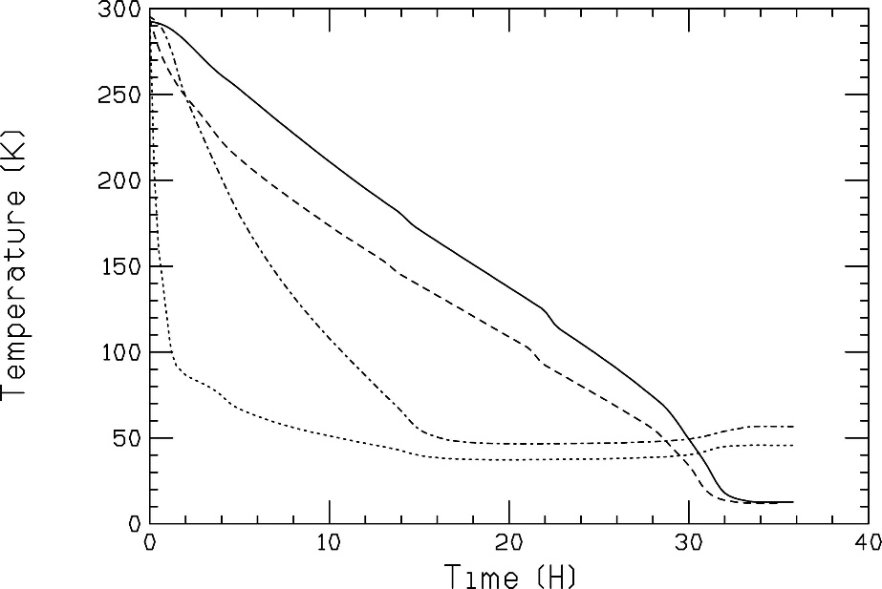
Results of Ic measurement at 77K. The total length of wire is 1530 m. The Ic value is 25 A which is better than the design value of 20 A.
Cooling performance of the system. Solid, dashed, dot-dashed and dotted lines show the temperature of the coil, the first stage of the cryocooler, the shield and the second stage of the cryocooler, respectively.

Slide 8
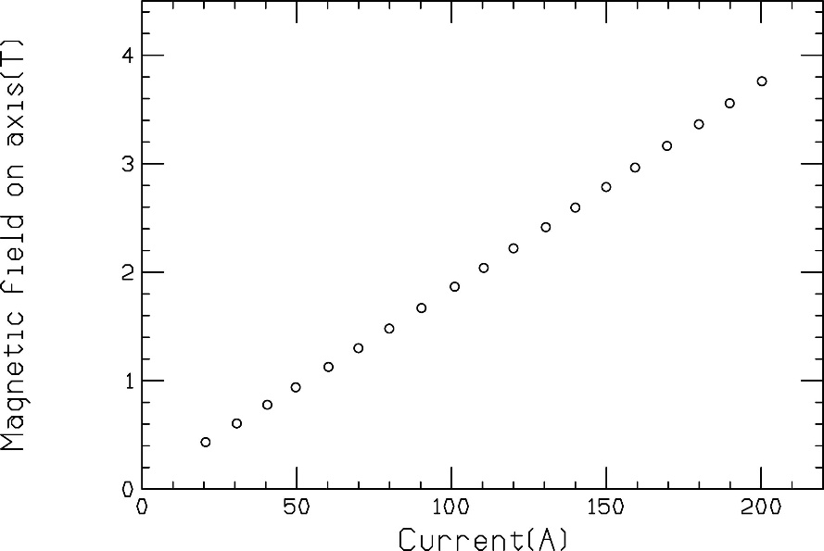
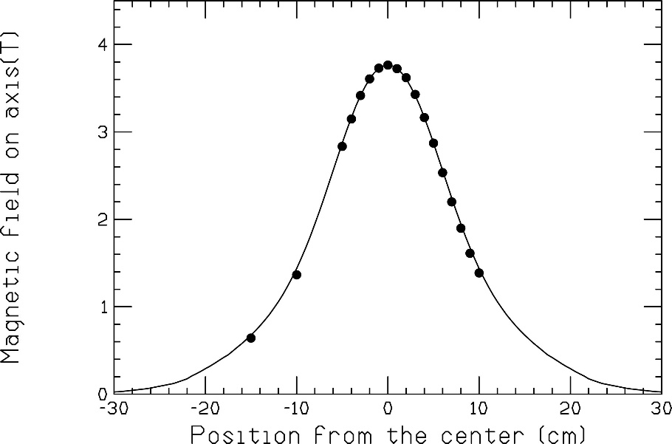
Excitation results of the fabricated magnet. At 200 A, the field strength is 3.75 T which is higher than required value 3.5 T to fully polarize 210 neV UCNs.
Field distribution along the axis. The solid line shows results of the numerical simulation by TOSCA.

Slide 9
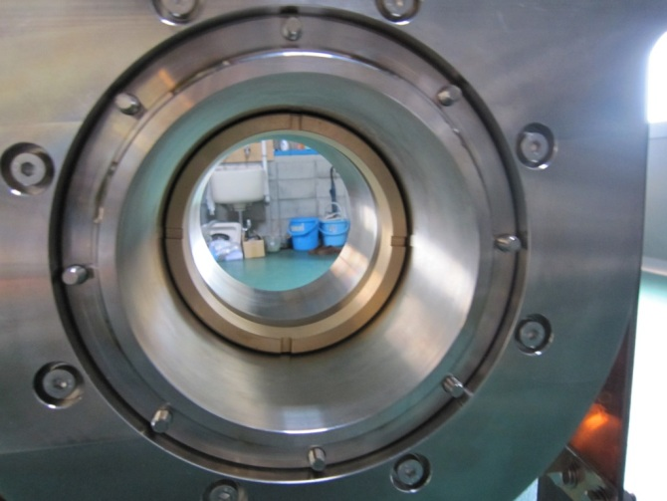
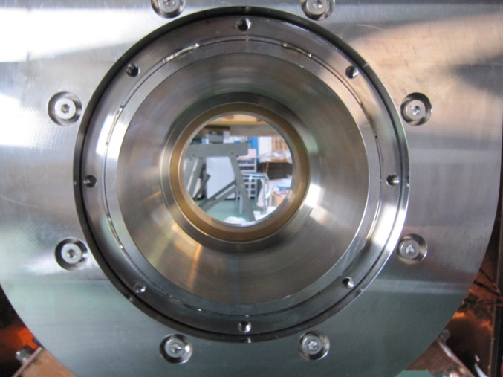
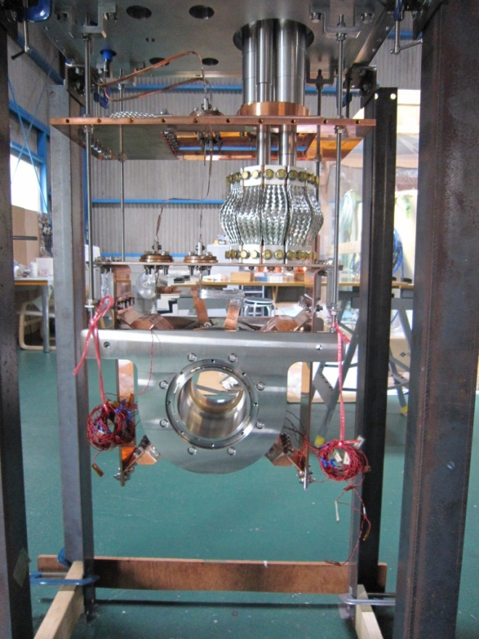
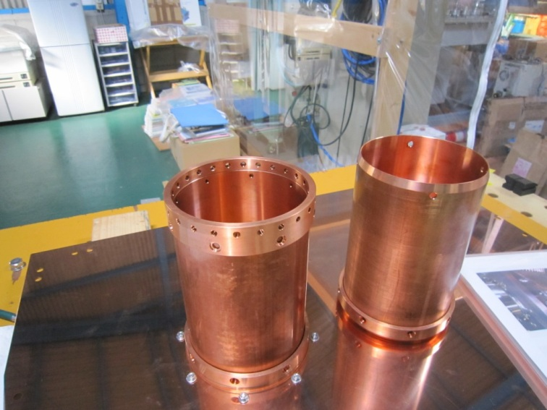

Fixing of an Al foil at the center
Downstream side
Upstream side: taper
Fixing: screw
Connections to thermal shields

Slide 10
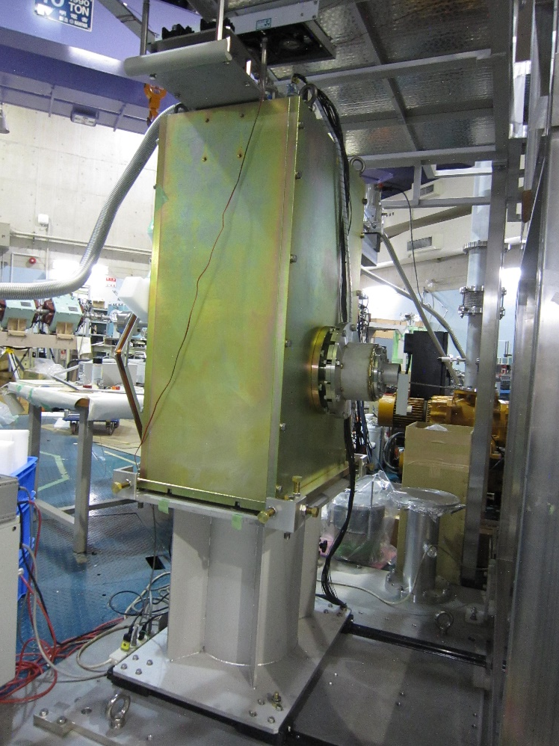
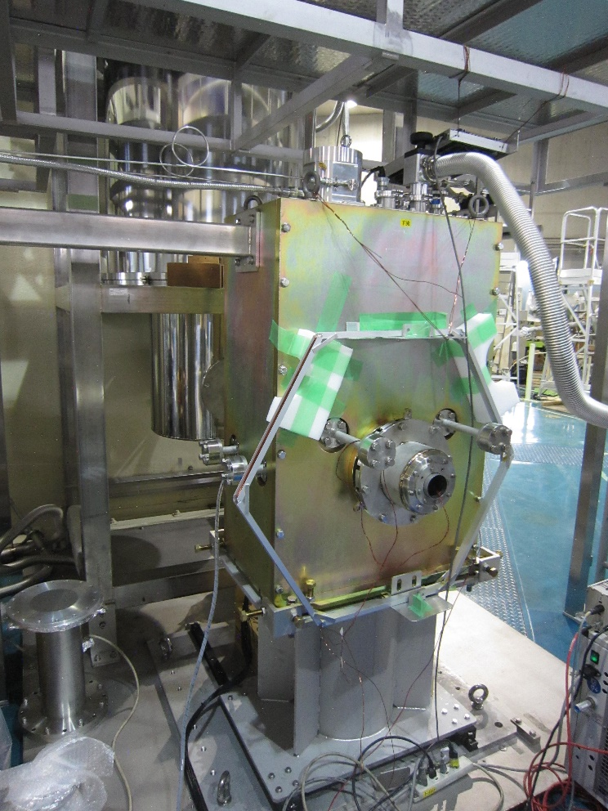

Slide 11
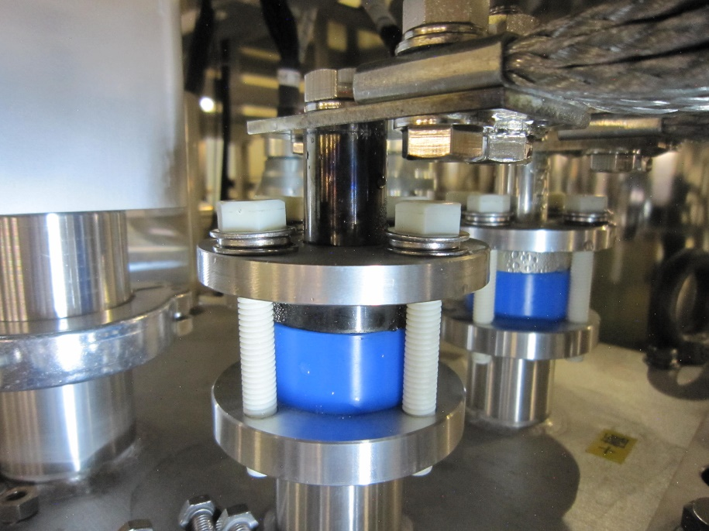
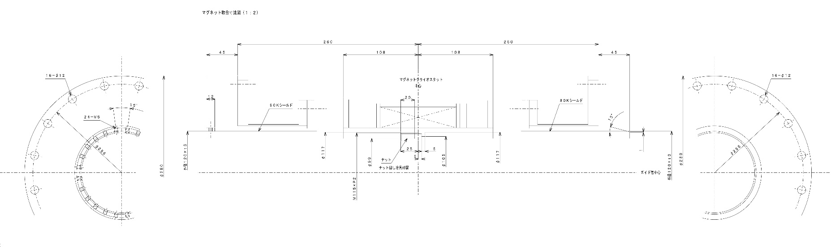
Current feedthroughs in air.

Slide 12
